Slide 1

Big Data Tutorial on
Mapping Big Data Applications to Clouds and HPC
Introduction
BigDat 2015: International Winter School on Big Data
Tarragona, Spain, January 26-30, 2015
January 26 2015
Geoffrey Fox
gcf@indiana.edu
http://www.infomall.org
School of Informatics and Computing
Digital Science Center
Indiana University Bloomington

Slide 2
Introduction
These lectures weave together
Data intensive applications and their key features
  Facets of Big Data Ogres
  Sports Analytics, Internet of Things and Image-based applications in detail
Parallelizing data mining algorithms (machine learning)
HPC-ABDS (High Performance Computing Enhanced Apache Big Data Stack)
  General discussion and specific examples
Hardware Architectures suitable for data intensive applications
Cloud Computing and use of dynamic deployment DevOps to integrate with HPC

Slide 3
Applications and Drivers
Commodity
Internet of Things
Research (Science and Engineering)

Slide 4
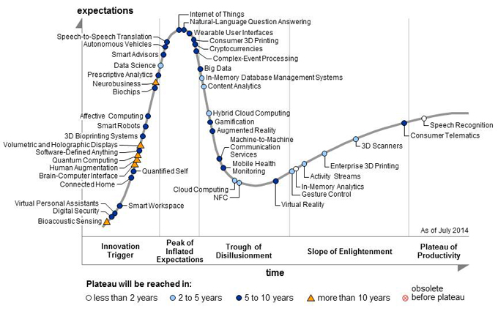
Gartner Emerging Technology Hype Cycle 2014

Slide 5
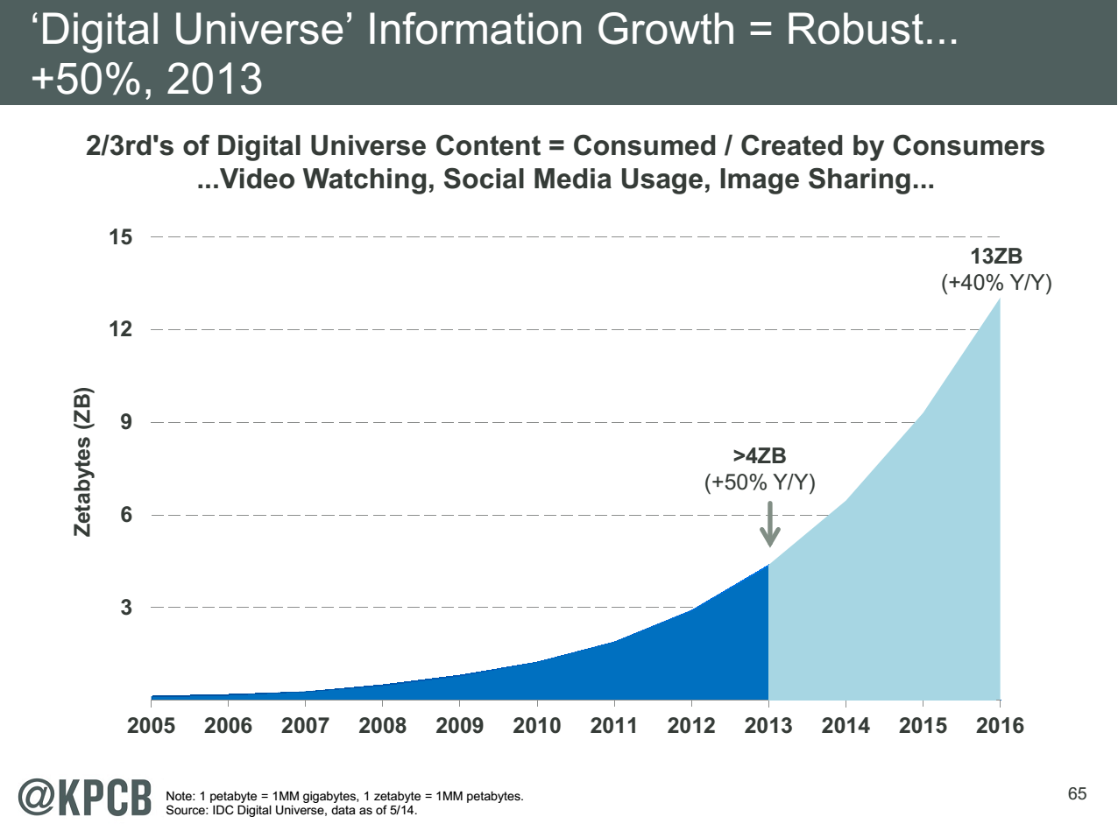
Zettabyte = 1000 Exabytes = 10⁶ Petabytes
Note largest science ~100 petabytes = 0.000025 total
Motivates leverage of commercial infrastructure
Note 7 ZB (7. 10²¹) is about a
terabyte (10¹²) for each person
in world
http://www.kpcb.com/internet-trends

Slide 6
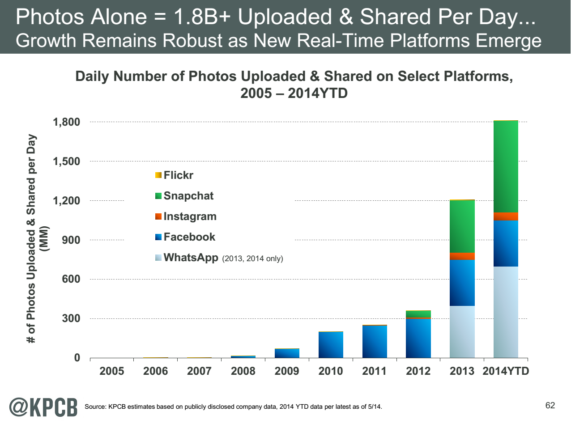
http://www.kpcb.com/internet-trends

Slide 7
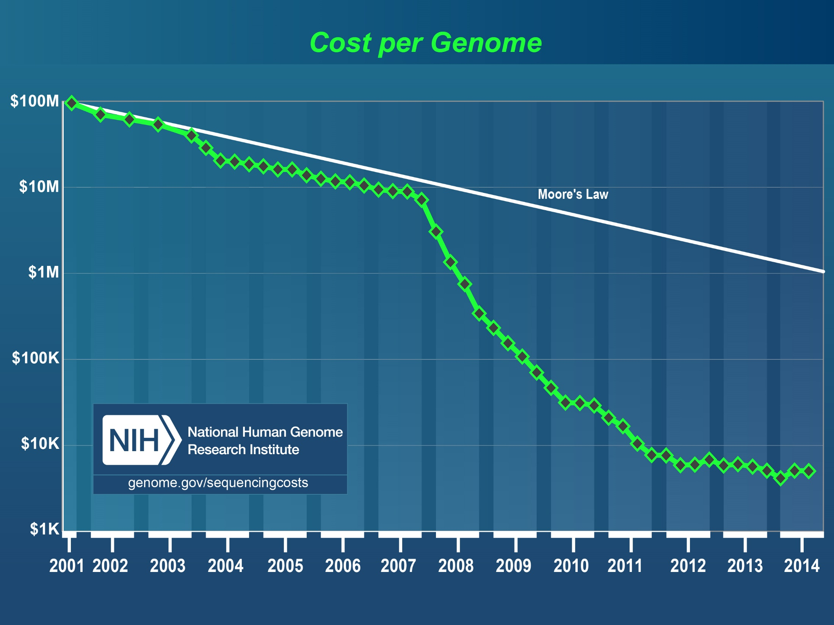
Why we need cost effective
Computing!
Full Personal Genomics: 3 petabytes per day
http://www.genome.gov/sequencingcosts/

Slide 8
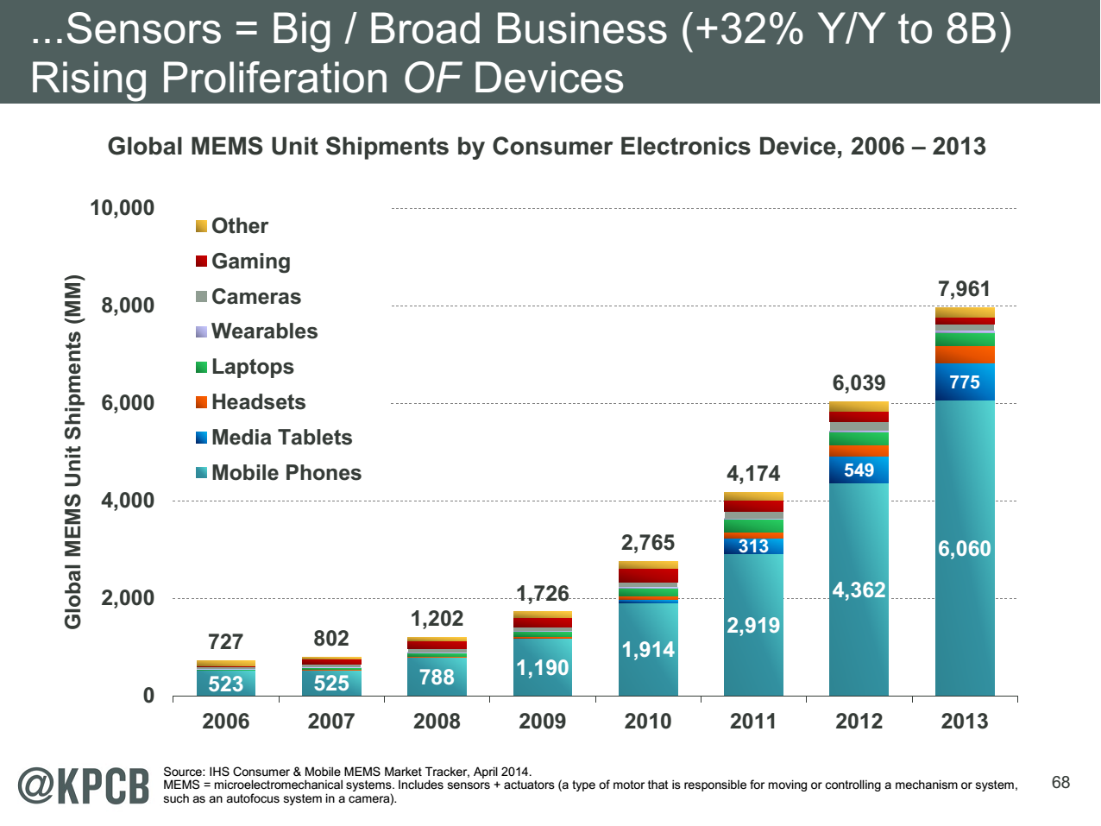
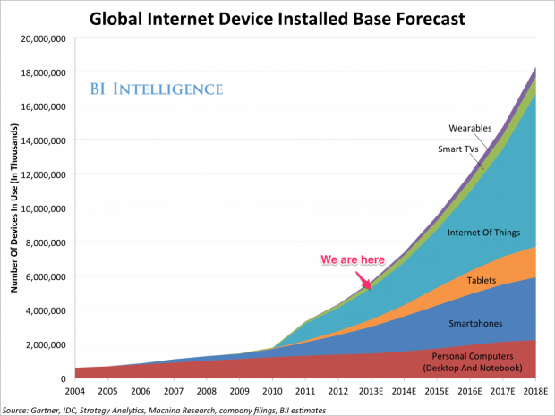
http://www.kpcb.com/internet-trends

Slide 9
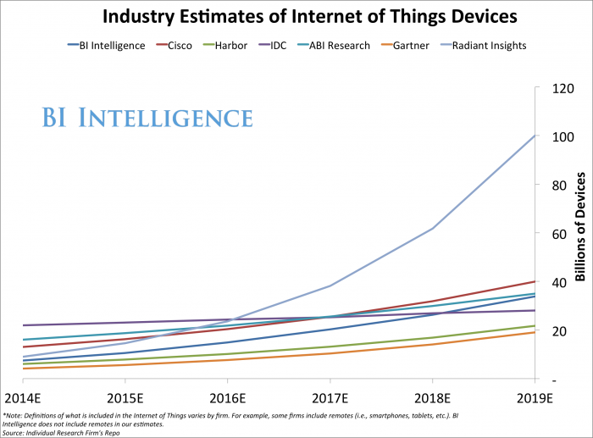

Slide 10
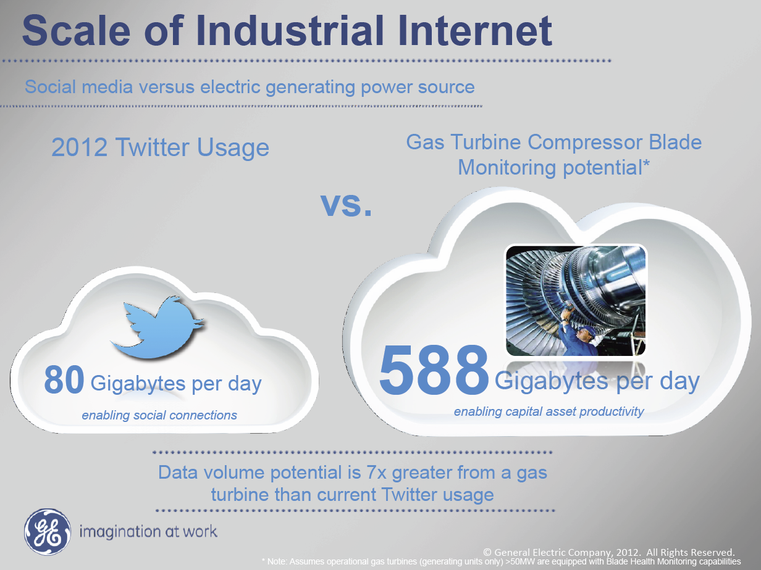
(of Things IIoT)
Ruh VP Software GE http://fisheritcenter.haas.berkeley.edu/Big_Data/index.html

Slide 11
Software defined machines with IIoT
https://www.gesoftware.com/sites/default/files/GE-Software-Modernizing-Machine-to-Machine-Interactions.pdf
Future

Slide 12

McKinsey Institute on Big Data Jobs
http://www.mckinsey.com/mgi/publications/big_data/index.asp.
There will be a shortage of talent necessary for organizations to take advantage of big data. By 2018, the United States alone could face a shortage of 140,000 to 190,000 people with deep analytical skills as well as 1.5 million managers and analysts with the know-how to use the analysis of big data to make effective decisions.
Informatics aimed at 1.5 million jobs. Computer Science covers the 140,000 to 190,000

Slide 13
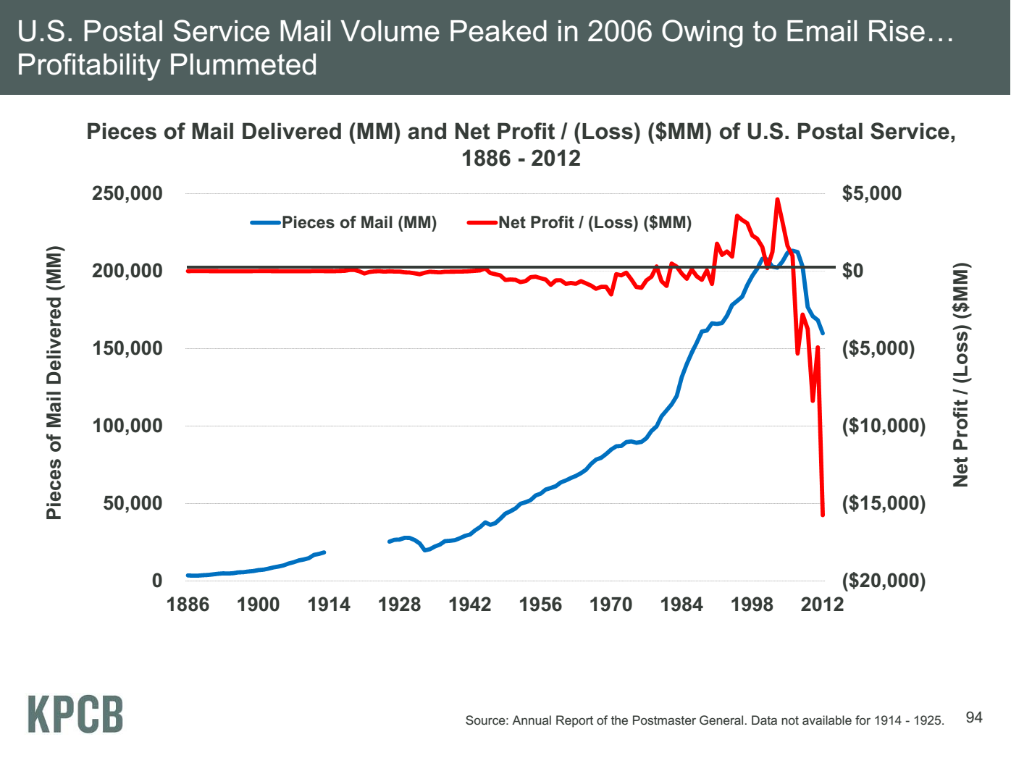
Meeker/Wu May 29 2013 Internet Trends D11 Conference

Slide 14
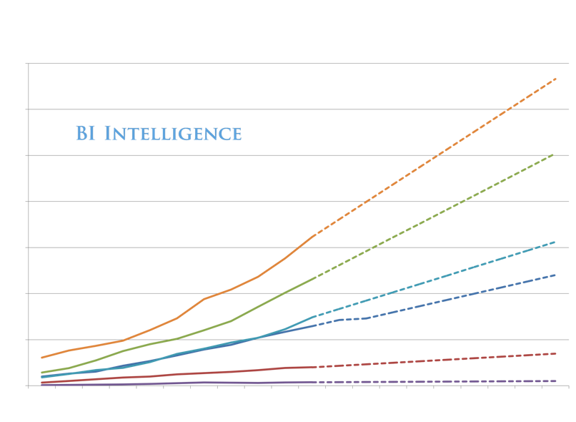
50%
50%
We Are Here 2014-2015

Slide 15

http://sephlawless.com/black-friday-2014
No more shopping malls?

Slide 16
51 Detailed Use Cases: Contributed July-September 2013
http://bigdatawg.nist.gov/usecases.php, 26 Features for each use case
Government Operation(4): National Archives and Records Administration, Census Bureau
Commercial(8): Finance in Cloud, Cloud Backup, Mendeley (Citations), Netflix, Web Search, Digital Materials, Cargo shipping (as in UPS)
Defense(3): Sensors, Image surveillance, Situation Assessment
Healthcare and Life Sciences(10): Medical records, Graph and Probabilistic analysis, Pathology, Bioimaging, Genomics, Epidemiology, People Activity models, Biodiversity
Deep Learning and Social Media(6): Driving Car, Geolocate images/cameras, Twitter, Crowd Sourcing, Network Science, NIST benchmark datasets
The Ecosystem for Research(4): Metadata, Collaboration, Translation, Light source data Astronomy and Physics(5): Sky Surveys including comparison to simulation, Large Hadron Collider at CERN, Belle II Accelerator in Japan
Earth, Environmental and Polar Science(10): Radar Scattering in Atmosphere, Earthquake, Ocean, Earth Observation, Ice sheet Radar scattering, Earth radar mapping, Climate simulation datasets, Atmospheric turbulence identification, Subsurface Biogeochemistry (microbes to watersheds), AmeriFlux and FLUXNET gas sensors
Energy(1): Smart grid
Largest open collection of Big Data Requirements?
Analyzed for common characteristics

Slide 17
What can we do with 51 Use Cases
Analyze use cases for commonalities and derive a set of key features
We do this along 4 different directions or views
  Problem Architecture View (overall structure of problem)
  Execution View (detailed structure of problem such as size, data abstraction)
  Data Style and Source View (such as database or data from a HPC simulation)
  Processing View (type of analytics performed such as graph or learning network)
Each has multiple features which we call facets
Combining facets gives categories of problems we call Ogres as previous work used dwarfs or giants
Ogres can be used to design machine architectures and benchmark sets with broad coverage

Slide 18
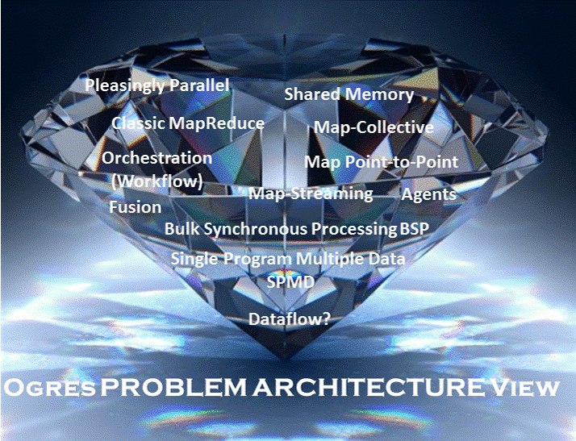

Slide 19
Software: HPC-ABDS
Integrating High Performance Computing with Apache Big Data Stack
Shantenu Jha, Judy Qiu, Andre Luckow
http://hpc-abds.org/kaleidoscope/

Slide 20
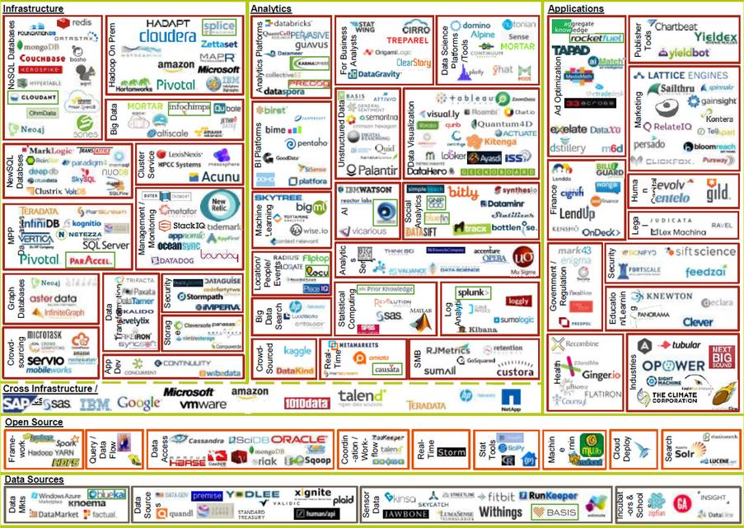
http://www.slideshare.net/mjft01/big-data-landscape-matt-turck-may-2014

Slide 21
There are a lot of Big Data and HPC Software systems
Challenge! Manage environment offering these different components

Slide 22
Functionality of 21 HPC-ABDS Layers
Message Protocols:
Distributed Coordination:
Security & Privacy:
Monitoring:
IaaS Management from HPC to hypervisors:
DevOps:
Interoperability:
File systems:
Cluster Resource Management:
Data Transport:
A) File management
B) NoSQL
C) SQL
In-memory databases&caches / Object-relational mapping / Extraction Tools
Inter process communication Collectives, point-to-point, publish-subscribe, MPI:
A) Basic Programming model and runtime, SPMD, MapReduce:
B) Streaming:
A) High level Programming:
B) Frameworks
Application and Analytics:
Workflow-Orchestration:
Here are 21 functionalities. (including 11, 14, 15 subparts)
Lets discuss how these are used in particular applications
4 Cross cutting at top
17 in order of layered diagram starting at bottom

Slide 23
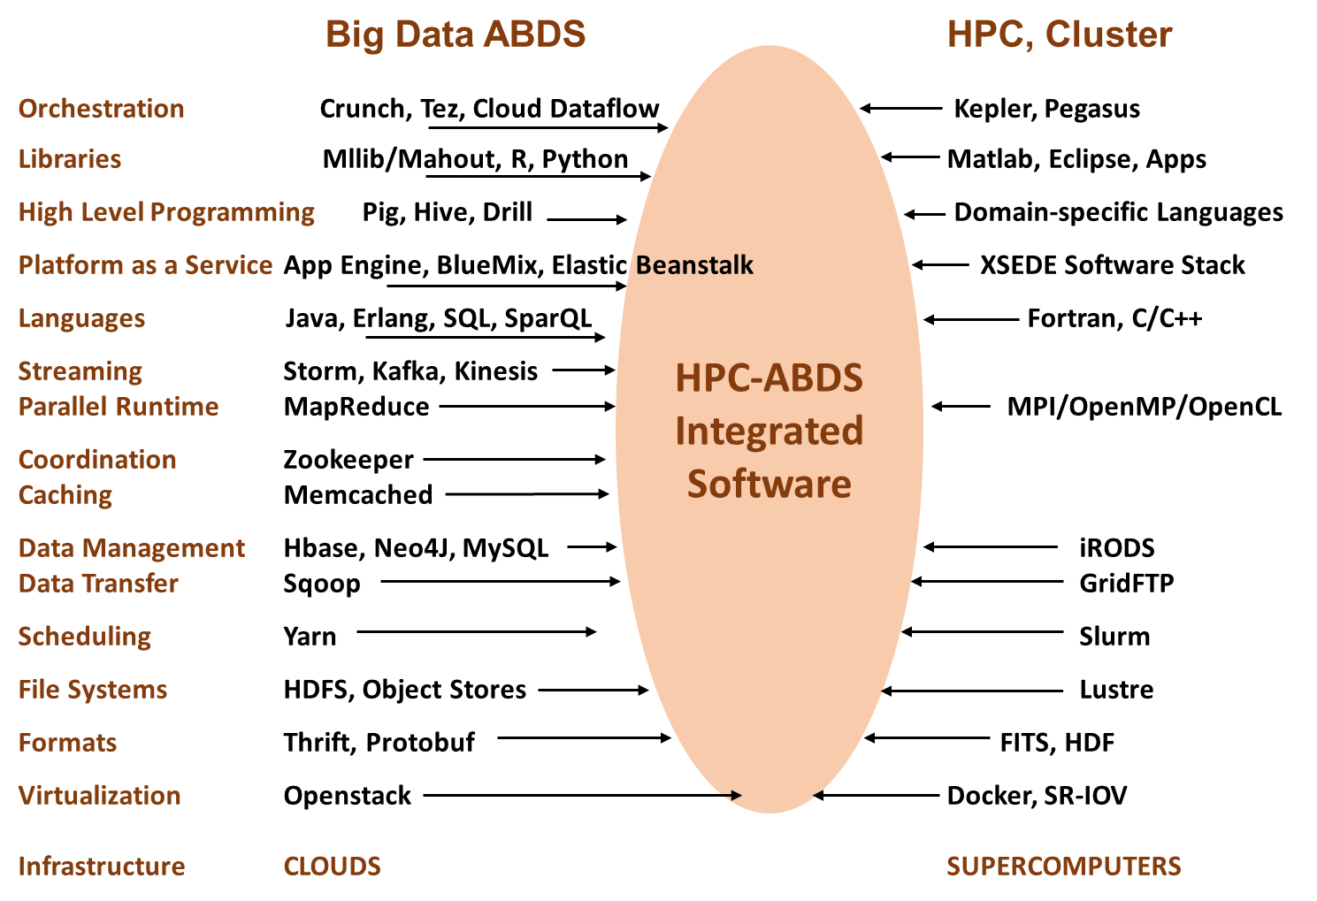

Slide 24
Software for a Big Data Initiative
Functionality of ABDS and Performance of HPC
Workflow: Apache Crunch, Python or Kepler
Data Analytics: Mahout, R, ImageJ, Scalapack
High level Programming: Hive, Pig
Batch Parallel Programming model: Hadoop, Spark, Giraph, Harp, MPI;
Streaming Programming model: Storm, Kafka or RabbitMQ
In-memory: Memcached
Data Management: Hbase, MongoDB, MySQL
Distributed Coordination: Zookeeper
Cluster Management: Yarn, Slurm
File Systems: HDFS, Object store (Swift),Lustre
DevOps: Cloudmesh, Chef, Puppet, Docker, Cobbler
IaaS: Amazon, Azure, OpenStack, Docker, SR-IOV
Monitoring: Inca, Ganglia, Nagios

Slide 25







HPC ABDS SYSTEM (Middleware)
289 Software Projects
System Abstraction/Standards
Data Format and Storage
HPC Yarn for Resource management
Horizontally scalable parallel
programming model
Collective and Point to Point Communication
Support for iteration (in memory processing)
HPC ABDS
Hourglass
Application Abstractions/Standards
Graphs, Networks, Images, Geospatial ..
Scalable Parallel Interoperable Data Analytics Library (SPIDAL)
High performance Mahout, R, Matlab …..
High Performance Applications

Slide 26
Getting High Performance on Data Analytics
On the systems side, we have two principles:
  The Apache Big Data Stack with ~290 projects has important
  broad functionality with a vital large support organization
  HPC including MPI has striking success in delivering high performance,
  however with a fragile sustainability model
There are key systems abstractions which are levels in HPC-ABDS software stack where Apache approach needs careful integration with HPC
  Resource management
  Storage
  Programming model -- horizontal scaling parallelism
  Collective and Point-to-Point communication
  Support of iteration
Data interface (not just key-value) but system also supports other important application abstractions
  Graphs/network
  Geospatial
  Genes
  Bags of words
  Images, etc.

Slide 27






MapReduce “File/Data Repository” Parallelism
Map = (data parallel) computation reading and writing data
Reduce = Collective/Consolidation phase e.g. forming multiple global sums as in histogram
Instruments
Iterative MapReduce
Map Map Map Map
Reduce Reduce Reduce
Communication
Portals
/Users
Disks
Map₁
Map₂
Map₃
Reduce

Slide 28
Hardware, Software, Applications
In my old papers (especially book Parallel Computing Works!), I discussed computing as multiple complex systems mapped into each other
Problem → Numerical formulation → Software → Hardware
Each of these 4 systems has an architecture that can be described in similar language
One gets an easy programming model if architecture of problem matches that of Software
One gets good performance if architecture of hardware matches that of software and problem
So “MapReduce” can be used as architecture of software (programming model) or “Numerical formulation of problem”

Slide 29
6 Data Analysis Architectures
Difficult to parallelize asynchronous
parallel
Graph Algorithms
Classic Hadoop in classes 1) 2)
BLAST Analysis Local Machine Learning Pleasingly Parallel | High Energy Physics (HEP) Histograms Web search Recommender Engines | Expectation maximization Clustering Linear Algebra, PageRank | Classic MPI PDE Solvers and Particle Dynamics Graph | Streaming images from Synchrotron sources, Telescopes, IoT
MapReduce and Iterative Extensions (Spark, Twister) |  |  | MPI, Giraph | Apache Storm
Harp – Enhanced Hadoop
Maps are Bolts

Slide 30
6 Forms of MapReduce

Slide 31
8 Data Analysis Problem Architectures
1) Pleasingly Parallel PP or “map-only” in MapReduce
  BLAST Analysis; Local Machine Learning
2A) Classic MapReduce MR, Map followed by reduction
  High Energy Physics (HEP) Histograms; Web search; Recommender Engines
2B) Simple version of classic MapReduce MRStat
  Final reduction is just simple statistics
3) Iterative MapReduce MRIter
  Expectation maximization Clustering Linear Algebra, PageRank
4A) Map Point to Point Communication
  Classic MPI; PDE Solvers and Particle Dynamics; Graph processing Graph
4B) GPU (Accelerator) enhanced 4A) – especially for deep learning
5) Map + Streaming + Communication
  Images from Synchrotron sources; Telescopes; Internet of Things IoT
  6) Shared memory allowing parallel threads which are tricky to program but lower latency
  Difficult to parallelize asynchronous parallel Graph Algorithms

Slide 32
Hardware Architectures

Slide 33
Clouds Offer From different points of view
Features from NIST:
  On-demand service (elastic);
  Broad network access;
  Resource pooling;
  Flexible resource allocation;
  Measured service
Economies of scale in performance and electrical power (Green IT)
Powerful new software models
  Platform as a Service is not an alternative to Infrastructure as a Service – it is instead an incredible valued added
  Amazon is as much PaaS as Azure
They are cheaper than classic clusters unless latter 100% utilized

Slide 34
Computer Cloud Assumptions I
Clouds will continue to grow in importance
Clouds consists of an “infinite” number of compute/storage/network nodes available on demand
Clouds can be public and/or private with similar architectures (but different security issues)
Clouds have some overheads but these are decreasing using SR-IOV and better hypervisors
Clouds are getting more powerful with better networks but
  Exascale Supercomputer will not be a cloud although most other systems will be!
Performance of clouds can be (easily) understood using standard (parallel computing) methods
Streaming and Internet of Things applications (80% NIST use cases) particularly well suited to clouds

Slide 35
Overhead of KVM between 0.8% and 0.5% compared to native Bare-metal

Slide 36
SR-IOV Enhanced Chemistry on Clouds
SR-IOV is single root I/O virtualization and cuts through virtualization overhead
VMs running LAMMPs achieve near-native performance at 32 cores & 4GPUs
  96.7% efficiency for LJ
  99.3% efficiency for Rhodo

Slide 37
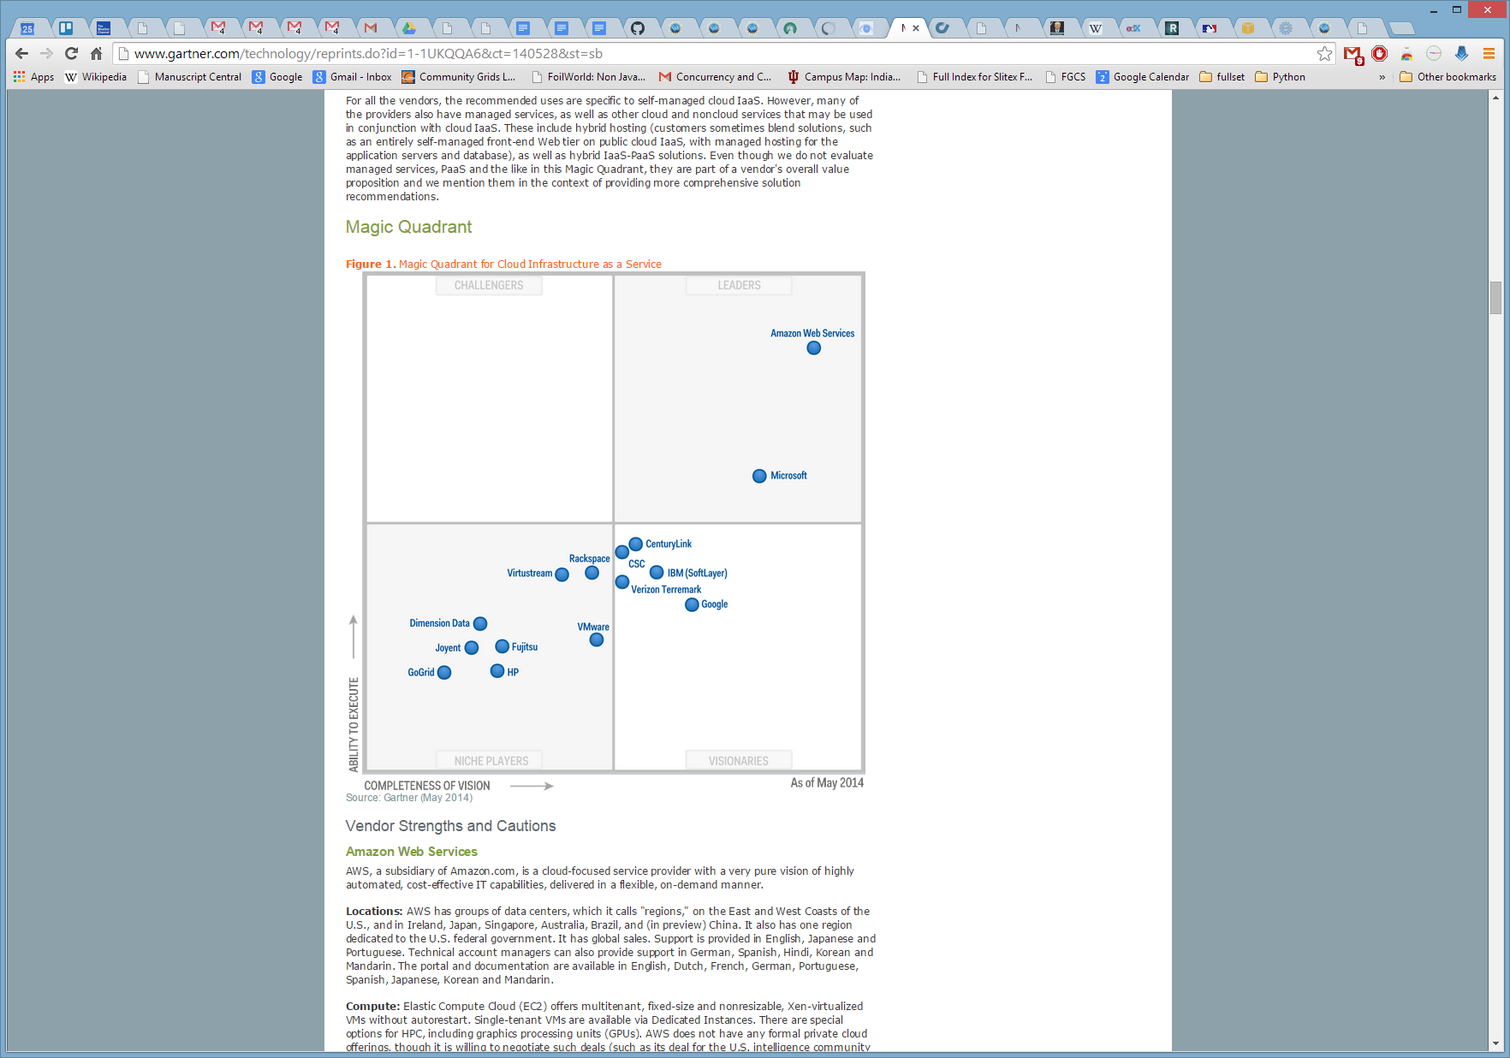
Gartner Magic Quadrant for Cloud Infrastructure as a Service
AWS in lead followed by Azure

Slide 38
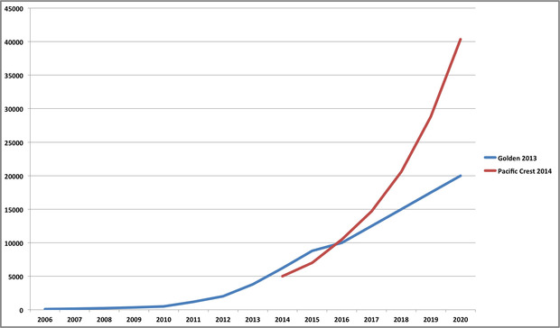
Estimated
Amazon Web Service Revenues
$40 Billion dollars

Slide 39
Computer Cloud Assumptions II
Big data revolution built around cloud processing
Incredibly powerful software ecosystem (the “Apache Big Data Stack” or ABDS) emerged to support Big Data
Much of this software is open-source and at all points in stack at least one good open source choice
DevOps (Chef, Cobbler ..) deploys dynamic virtual clusters
Research (science and engineering) similar big data needs to commercial but less search and recommender engines
  Both have large pleasingly parallel component (50%)
  Less classic MapReduce and more iterative algorithms
Streaming dominant (80%) and similar needs in research and commercial
HPC-ABDS links classic parallel computing and ABDS and runs on clouds or HPC systems

Slide 40
What Applications work in Clouds
Pleasingly (moving to modestly) parallel applications of all sorts with roughly independent data or spawning independent simulations
  Long tail of science and integration of distributed sensors
Commercial and Science Data analytics that can use MapReduce (some of such apps) or its iterative variants (most other data analytics apps)
Which science applications are using clouds?
  Venus-C (Azure in Europe): 27 applications not using Scheduler, Workflow or MapReduce (except roll your own)
  50% of applications on FutureGrid are from Life Science
  Lilly corporation is commercial cloud user (for drug discovery) but not IU Biology
Although overall very little science use of clouds
  Differences between clouds and HPC are decreasing with cloud overheads decreasing
  Software Defined Systems are making issues less important
  Platform as a Service and Framework (HPC-ABDS) are valuable independent of hypervisor

Slide 41
Parallelism over Users and Usages
“Long tail of science” can be an important usage mode of clouds.
In some areas like particle physics and astronomy, i.e. “big science”, there are just a few major instruments generating now petascale data driving discovery in a coordinated fashion.
In other areas such as genomics and environmental science, there are many “individual” researchers with distributed collection and analysis of data whose total data and processing needs can match the size of big science.
Clouds can provide scaling convenient resources for this important aspect of science.
Can be map only use of MapReduce if different usages naturally linked e.g. exploring docking of multiple chemicals or alignment of multiple DNA sequences
  Collecting together or summarizing multiple “maps” is a simple Reduction

Slide 42
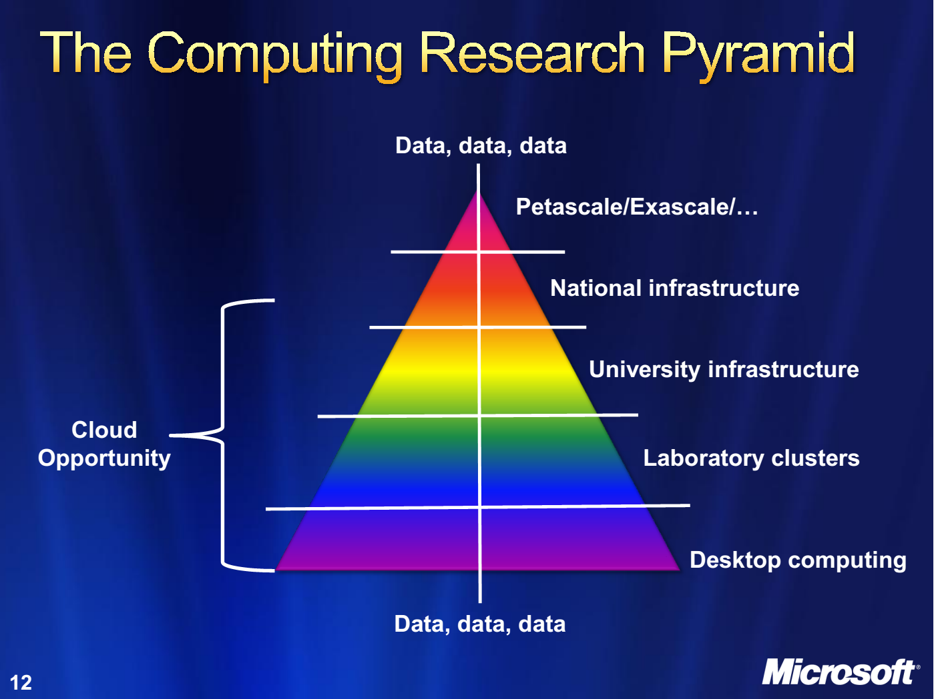
http://research.microsoft.com/en-us/people/barga/sc09_cloudcomp_tutorial.pdf

Slide 43
27 Venus-C Azure Applications
Chemistry (3)
• Lead Optimization in Drug Discovery
• Molecular Docking
Civil Protection (1)
• Fire Risk estimation and fire propagation
Biodiversity &
Biology (2)
• Biodiversity maps in marine species
• Gait simulation
Civil Eng. and Arch. (4)
• Structural Analysis
• Building information Management
• Energy Efficiency in Buildings
• Soil structure simulation
Physics (1)
• Simulation of Galaxies configuration
Earth Sciences (1)
• Seismic propagation
Mol, Cell. & Gen. Bio. (7)
• Genomic sequence analysis
• RNA prediction and analysis
• System Biology
• Loci Mapping
• Micro-arrays quality.
ICT (2)
• Logistics and vehicle routing
• Social networks analysis
Medicine (3)
• Intensive Care Units decision support.
• IM Radiotherapy planning.
• Brain Imaging
Mathematics (1)
• Computational Algebra
Mech, Naval & Aero. Eng. (2)
• Vessels monitoring
• Bevel gear manufacturing simulation
VENUS-C Final Review: The User Perspective 11-12/7 EBC Brussels http://www.venus-c.eu/Pages/Home.aspx

Slide 44
Clouds and HPC

Slide 45
2 Aspects of Cloud Computing:
Infrastructure and Runtimes
Cloud infrastructure: outsourcing of servers, computing, data, file space, utility computing, etc..
  Azure exemplifies
Cloud runtimes or Platform: tools to do data-parallel (and other) computations. Valid on Clouds and traditional clusters
  Apache Hadoop, Google MapReduce, Microsoft Dryad, Bigtable, Chubby and others
  MapReduce designed for information retrieval/e-commerce (search, recommender) but is excellent for a wide range of science data analysis applications
  Can also do much traditional parallel computing for data-mining if extended to support iterative operations
  Data Parallel File system as in HDFS and Bigtable
  Will come back to Apache Big Data Stack

Slide 46
Clouds have highlighted SaaS PaaS IaaS
But equally valid for classic clusters
Software
(Application
Or Usage) SaaS
Education
Applications
CS Research Use e.g. test new compiler or storage model
Software Services are building blocks of applications
The middleware or computing environment including HPC, Grids …
Nimbus, Eucalyptus, OpenStack, OpenNebula
CloudStack plus Bare-metal
OpenFlow – likely to grow in importance
Cloud e.g. MapReduce
HPC e.g. PETSc, SAGA
Computer Science e.g. Compiler tools, Sensor nets, Monitors
Platform
PaaS
Infra
structure
IaaS
Software Defined Computing (virtual Clusters)
Hypervisor, Bare Metal
Operating System
Network
NaaS
Software Defined Networks
OpenFlow GENI

Slide 47
(Old) Science Computing Environments
Large Scale Supercomputers – Multicore nodes linked by high performance low latency network
  Increasingly with GPU enhancement
  Suitable for highly parallel simulations
High Throughput Systems such as European Grid Initiative EGI or Open Science Grid OSG typically aimed at pleasingly parallel jobs
  Can use “cycle stealing”
  Classic example is LHC data analysis
Grids federate resources as in EGI/OSG or enable convenient access to multiple backend systems including supercomputers
Use Services (SaaS)
  Portals make access convenient and
  Workflow integrates multiple processes into a single job

Slide 48
Clouds HPC and Grids
Synchronization/communication Performance
Grids > Clouds > Classic HPC Systems
Clouds naturally execute effectively Grid workloads but are less clear for closely coupled HPC applications
Classic HPC machines as MPI engines offer highest possible performance on closely coupled problems
The 4 forms of MapReduce/MPI with increasing synchronization
  Map Only – pleasingly parallel
  Classic MapReduce as in Hadoop; single Map followed by reduction with fault tolerant use of disk
  Iterative MapReduce use for data mining such as Expectation Maximization in clustering etc.; Cache data in memory between iterations and support the large collective communication (Reduce, Scatter, Gather, Multicast) use in data mining
  Classic MPI! Support small point to point messaging efficiently as used in partial differential equation solvers. Also used for Graph algorithms
Use architecture with minimum required synchronization

Slide 49
Increasing Synchronization in Parallel Computing
Grids: least synchronization as distributed
Clouds: MapReduce has asynchronous maps typically processing data points with results saved to disk. Final reduce phase integrates results from different maps
  Fault tolerant and does not require map synchronization
  Dominant need for search and recommender engines
  Map only useful special case
HPC enhanced Clouds: Iterative MapReduce caches results between “MapReduce” steps and supports SPMD parallel computing with large messages as seen in parallel kernels (linear algebra) in clustering and other data mining
HPC: Typically SPMD (Single Program Multiple Data) “maps” typically processing particles or mesh points interspersed with multitude of low latency messages supported by specialized networks such as Infiniband and technologies like MPI
  Often run large capability jobs with 100K (going to 1.5M) cores on same job
  National DoE/NSF/NASA facilities run 100% utilization
  Fault fragile and cannot tolerate “outlier maps” taking longer than others
  Reborn on clouds as Giraph (Pregel) for graph Algorithms
  Often used in HPC unnecessarily when better to use looser synchronization

Slide 50
Where is HPC most important in HPC-ABDS
Especial Opportunities at
  Resource management – Yarn v Slurm
  File - iRODS
  Programming – HPC parallel computing experts
  Communication – integrate best of MPI into ABDS
  Monitoring – Inca, Ganglia from HPC
  Workflow – several from Grid computing
layers for HPC and ABDS integration

Slide 51
Comparing Data Intensive and Simulation Problems

Slide 52
Comparison of Data Analytics with Simulation I
Pleasingly parallel often important in both
Both are often SPMD and BSP
  Streaming event style important in Big Data; only see in simulations for “parameter sweep” simulations or in computational steering
  Non-iterative MapReduce is major big data paradigm
  not a common simulation paradigm except where “Reduce” summarizes pleasingly parallel execution
Big Data often has large collective communication
  Classic simulation has a lot of smallish point-to-point messages
Simulation dominantly sparse (nearest neighbor) data structures
  “Bag of words (users, rankings, images..)” algorithms are sparse, as is PageRank
  Important data analytics involves full matrix algorithms

Slide 53
Comparison of Data Analytics with Simulation II
There are similarities between some graph problems and particle simulations with a strange cutoff force.
  Both Map-Communication
Note many big data problems are “long range force” as all points are linked.
  Easiest to parallelize. Often full matrix algorithms
  e.g. in DNA sequence studies, distance δ(i, j) defined by BLAST, Smith-Waterman, etc., between all sequences i, j.
  Opportunity for “fast multipole” ideas in big data.
In image-based deep learning, neural network weights are block sparse (corresponding to links to pixel blocks) but can be formulated as full matrix operations on GPUs and MPI in blocks.
In HPC benchmarking, Linpack being challenged by a new sparse conjugate gradient benchmark HPCG, while I am diligently using non- sparse conjugate gradient solvers in clustering and Multi-dimensional scaling.

Slide 54


“Force Diagrams” for macromolecules and Facebook

Slide 55
Software Defined Systems

Slide 56
Software-Defined Distributed
System (SDDS) as a Service includes
FutureSystems uses
SDDS-aaS Tools
Provisioning
Image Management
IaaS Interoperability
NaaS, IaaS tools
Expt management
Dynamic IaaS NaaS
DevOps
Dynamic Orchestration and Dataflow
Software
(Application
Or Usage) SaaS
Use HPC-ABDS
Class Usages e.g. run GPU & multicore
Applications
Control Robot
CloudMesh is a SDDSaaS tool that uses Dynamic Provisioning and Image Management to provide custom environments for general target systems
Involves (1) creating,
(2) deploying, and
(3) provisioning
of one or more images in a set of machines on demand http://mycloudmesh.org/
Cloud e.g. MapReduce
HPC e.g. PETSc, SAGA
Computer Science e.g. Compiler tools, Sensor nets, Monitors
Platform
PaaS
Infra
structure
IaaS
Software Defined Computing (virtual Clusters)
Hypervisor, Bare Metal
Operating System
Network
NaaS
Software Defined Networks
OpenFlow GENI

Slide 57
SDDS: Software Defined Distributed Systems
This is roughly same as defining systems by configuration files and natural from DevOps approach
Typified by Chef, Puppet, Ansible, OpenStack Heat
Specifying desired system in software as opposed to explicit images, makes it easier to move programs between different hardware targets and between different hypervisors (including no hypervisor)
In SDDS both hardware and images are defined in software – Python popular

Slide 58
Using Lots of Services
To enable Big data processing, we need to support those processing data, those developing new tools and those managing big data infrastructure
Need Software, CPU’s, Storage, Networks delivered as Software-Defined Distributed System as a Service or SDDSaaS
  SDDSaaS integrates component services from lower levels of Kaleidoscope up to different Mahout or R components and the workflow services that integrate them
Given richness and rapid evolution of field, we need to enable easy use of the Kaleidoscope (and other) software.
Make a list of basic software services needed
Then define them as Puppet/Chef Puppies/recipes
Compose them with SDDSL Language
Specify infrastructures
Administrators, developers run Cloudmesh to deploy on demand
Application users directly access Data Analytics as Software as a Service created by Cloudmesh

Slide 59
Hardware Architectures corresponding to Problem Architectures
Grids Class 1)
Clouds – Class 1, 2A,) 2B) and some 3) and perhaps 5)
HPC Clusters – Class 3), 4A) and perhaps 5) but need to support data models such as Object stores and HDFS
  HPC Cloud Data Intensive Cluster
  Can support class 1) and 2) but overkill?
Specialized – class 4B), 6)
  HPC Cloud Data Intensive Cluster with accelerators (GPU, Mic) covers 1..5
  Large shared memory machines are “obviously” special
Do not know of study of what architectures are needed to support streaming 5)
  The cases – even with time synchronization – without complex parallel processing should run well on clouds

Slide 60
HPC-Cloud Data Intensive Cluster
C
C
C
C
C
C
C
C
C
C
C
C
C
C
C
C
S
Data
C
C
C
C
C
C
C
C
C
S
Data
C
C
C
C
C
C
C
C
C
C
C
C
C
C
C
C
S
Data
C
C
C
C
C
C
C
C
S
C
C
C
C
C
C
Data
C
C
C
C
C
C
C
C
Lustre, GPFS, Object Store
C
C
Traditional Compute Cluster with virtual clusters superimposed. These are either isolated or share nodes
SR-IOV support ensures that maintain high performance communication with Infiniband interconnect

Slide 61
HPC Cloud Cluster supporting HDFS
S
C
C
C
C
Data
Data
Data
Data
Data
S
C
C
C
C
Data
Data
Data
Data
Data
S
C
C
C
C
Data
Data
Data
Data
Data
S
C
C
C
C
Data
Data
Data
Data
Data
Object Store
This cluster has large disk on each node; Infiniband interconnect
Data copied from Object store to HDFS at start of session
Supports architectures 1-5

Slide 62
Online Resources

Slide 63
Online Classes
Big Data Applications & Analytics
  ~40 hours of video mainly discussing applications (The X in X-Informatics or X-Analytics) in context of big data and clouds https://bigdatacoursespring2015.appspot.com/preview
Big Data Open Source Software and Projects http://bigdataopensourceprojects.soic.indiana.edu/
  ~15 Hours of video discussing HPC-ABDS and use on FutureSystems in Big Data software
Both divided into sections (coherent topics), units (~lectures) and lessons (5-20 minutes where student is meant to stay awake

Slide 64
Big Data Applications & Analytics Topics
1 Unit: Organizational Introduction
1 Unit: Motivation: Big Data and the Cloud; Centerpieces of the Future Economy
3 Units: Pedagogical Introduction: What is Big Data, Data Analytics and X-Informatics
SideMOOC: Python for Big Data Applications and Analytics: NumPy, SciPy, MatPlotlib
SideMOOC: Using FutureSystems for Java and Python
4 Units: X-Informatics with X= LHC Analysis and Discovery of Higgs particle
  Integrated Technology: Explore Events; histograms and models; basic statistics (Python and some in Java)
3 Units on a Big Data Use Cases Survey
SideMOOC: Using Plotviz Software for Displaying Point Distributions in 3D
3 Units: X-Informatics with X= e-Commerce and Lifestyle
Technology (Python or Java): Recommender Systems - K-Nearest Neighbors
Technology: Clustering and heuristic methods
1 Unit: Parallel Computing Overview and familiar examples
4 Units: Cloud Computing Technology for Big Data Applications & Analytics
2 Units: X-Informatics with X = Web Search and Text Mining and their technologies
Technology for Big Data Applications & Analytics : Kmeans (Python/Java)
Technology for Big Data Applications & Analytics: MapReduce
Technology for Big Data Applications & Analytics : Kmeans and MapReduce Parallelism (Python/Java)
Technology for Big Data Applications & Analytics : PageRank (Python/Java)
3 Units: X-Informatics with X = Sports
1 Unit: X-Informatics with X = Health
1 Unit: X-Informatics with X = Internet of Things & Sensors
1 Unit: X-Informatics with X = Radar for Remote Sensing
Red = Software

Slide 65
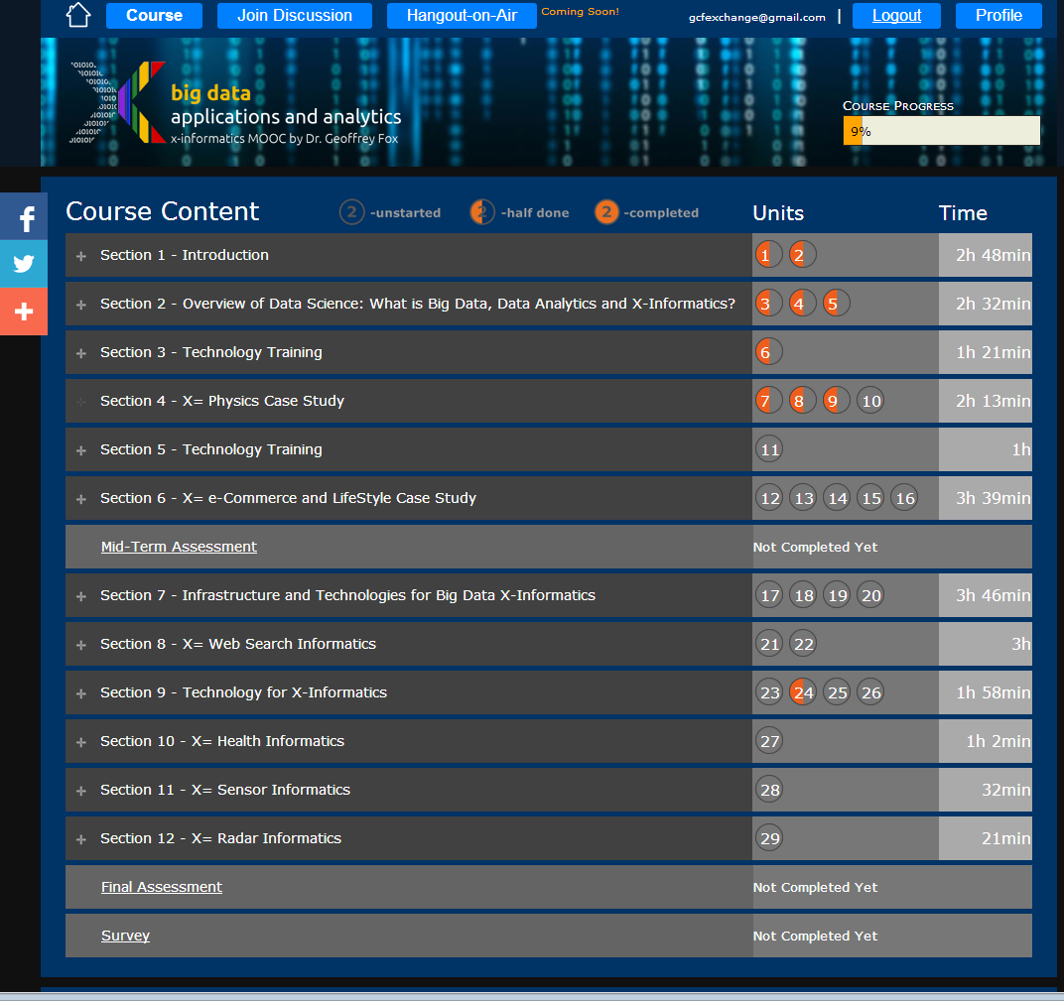
Example
Google
Course Builder MOOC
4 levels
Course
Section (12)
Units(29)
Lessons(~150)
Units are roughly traditional lecture
Lessons are ~10 minute segments
http://x-informatics.appspot.com/course

Slide 66
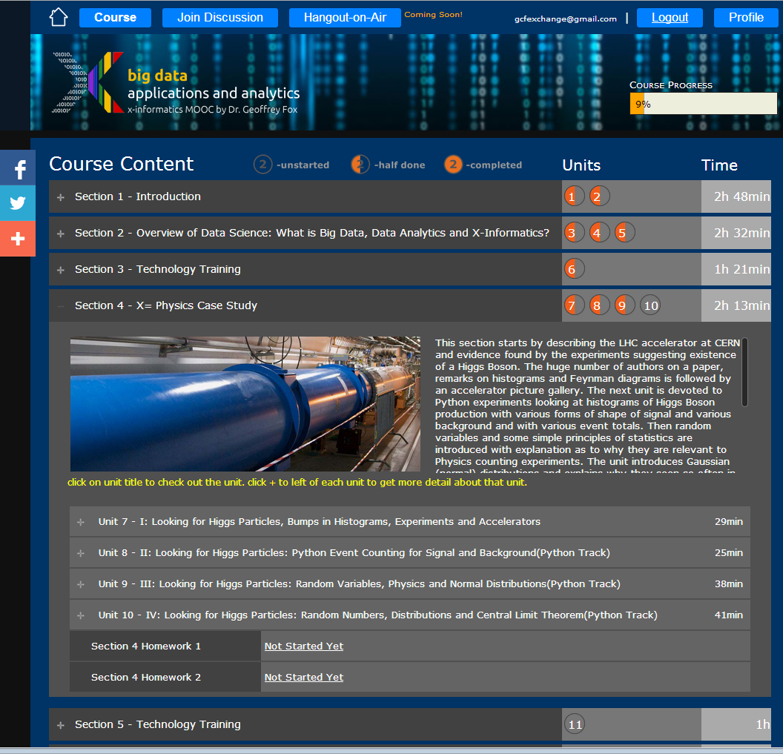
Example
Google
Course Builder
MOOC
The Physics Section expands to 4 units and 2 Homeworks
Unit 9 expands to 5 lessons
Lessons played on YouTube
“talking head video + PowerPoint”
http://x-informatics.appspot.com/course

Slide 67
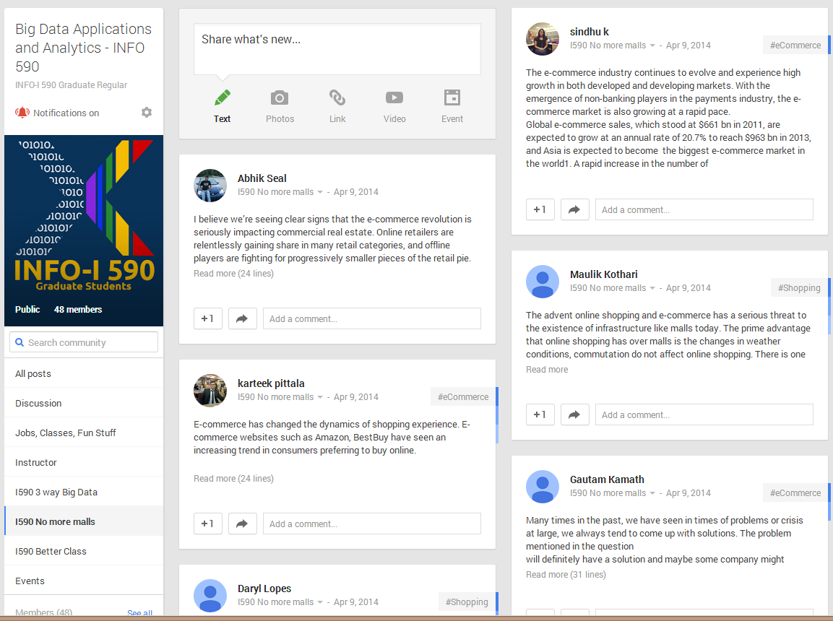
The community group for one of classes and one forum (“No more malls”)

Slide 68
Big Data Open Source Software and Projects Syllabus
The course covers the following material
  The cloud computing architecture underlying ABDS and contrast of this with HPC.
  The software architecture with its different layers at http://hpc-abds.org/kaleidoscope/ covering broad functionality and rationale for each layer. Nearly all of 289 software packages are covered in one slide each
  We will give application examples
  Then we will go through selected software systems – about 10% of those in the Kaleidoscope which have been already deployed on FutureGrid systems using OpenStack and Chef recipes.
  Students will chose one other open source member of Kaleidoscope each and deploy as in d).
  The main activity of the course will be building a significant project using multiple HPC-ABDS subsystems combined with user code and data.
  Teams of up to 3 students can be formed with corresponding increase in scope in activities e), f)
Grading will be based on participation (10%), ABDS deployment (30%) and Project (60%). The class will interact with postings on a Google community group. The online section will also interact with Google Hangout or equivalent.
We will use FutureSystems (FutureGrid) facilities and cloud computing experience is helpful but not essential.
Good working experience with Java is required and Python will be used

Slide 69
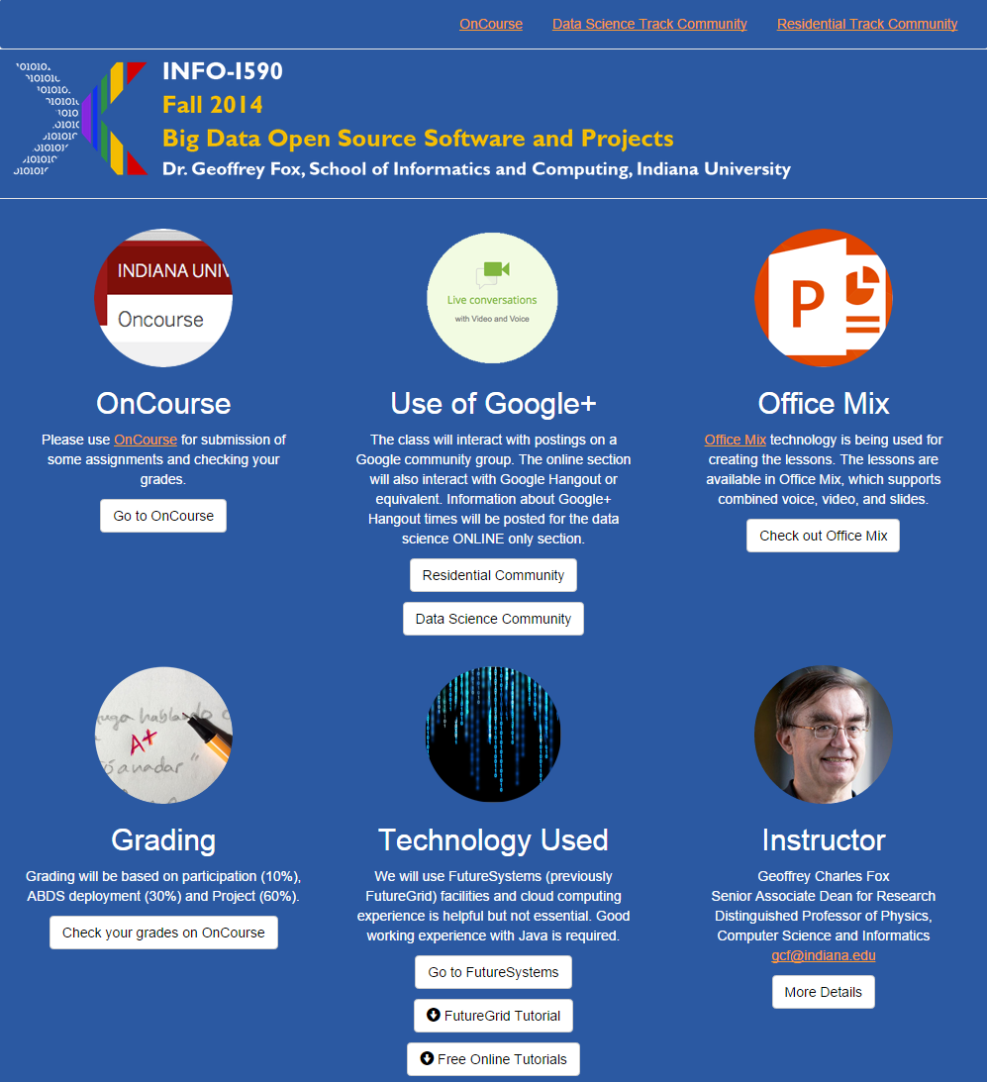
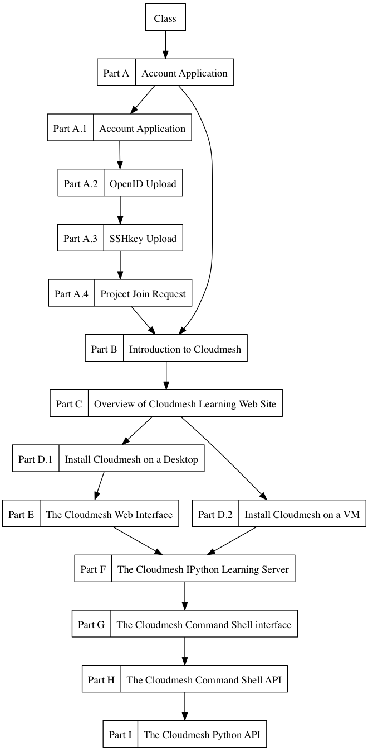
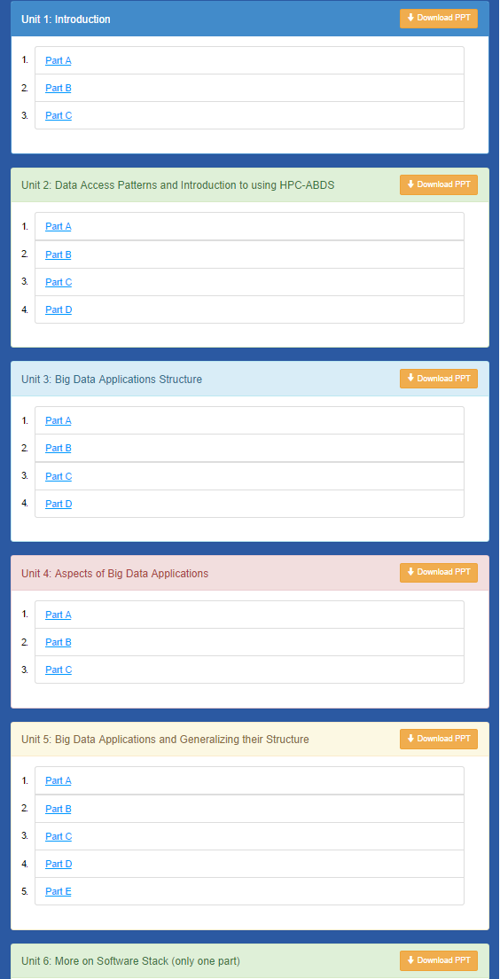
Cloudmesh MOOC Videos
http://bigdataopensourceprojects.soic.indiana.edu/

Slide 70
Overview of Cloudmesh on FutureSystems Tutorial
Getting Started – FutureSystems
  Account Creation
  OpenStack (india.futuresystems.org)
  Cloudmesh installation (management software)
Tutorials
  Tutorial I: Deploying Virtual Cluster
  Tutorial II: Deploying Hadoop Cluster
  Tutorial III: Deploying MongoDB Cluster
Resources
  Source code
  Documentation (manuals and tutorials)

Slide 71
Cloudmesh Resources
Tutorials
  Main Home: http://introduction-to-cloud-computing-on-futuresystems.readthedocs.org/en/latest/index.html
  Videos: http://introduction-to-cloud-computing-on-futuresystems.readthedocs.org/en/latest/resources.html
Cloudmesh
  Documentation with video clips: http://cloudmesh.github.io/introduction_to_cloud_computing/class/i590.html
  Source code: https://github.com/cloudmesh/cloudmesh

Slide 72
Lessons / Insights
Enhanced Apache Big Data Stack HPC-ABDS has ~290 members
Integrate (don’t compete) HPC with “Commodity Big data” (Azure to Amazon to Enterprise Data Analytics)
  i.e. improve Mahout; don’t compete with it
  Use Hadoop plug-ins rather than replacing Hadoop
Use Software defined Distributed Systems
Iterative algorithms in machine learning
Can analyze data intensive applications to identify common features

