Slide 1
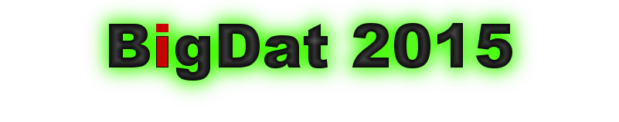
Big Data Tutorial on
Mapping Big Data Applications to Clouds and HPC
Keynote
BigDat 2015: International Winter School on Big Data
Tarragona, Spain, January 26-30, 2015
January 26 2015
Geoffrey Fox
gcf@indiana.edu
http://www.infomall.org
School of Informatics and Computing
Digital Science Center
Indiana University Bloomington

Slide 2
Introduction
These lectures weave together
Data intensive applications and their key features
  Facets of Big Data Ogres
  Sports Analytics, Internet of Things and Image-based applications in detail
Parallelizing data mining algorithms (machine learning)
HPC-ABDS (High Performance Computing Enhanced Apache Big Data Stack)
  General discussion and specific examples
Hardware Architectures suitable for data intensive applications
Cloud Computing and use of dynamic deployment DevOps to integrate with HPC

Slide 3
Online Classes
Big Data Applications & Analytics
  ~40 hours of video mainly discussing applications (The X in X-Informatics or X-Analytics) in context of big data and clouds https://bigdatacoursespring2015.appspot.com/preview
Big Data Open Source Software and Projects http://bigdataopensourceprojects.soic.indiana.edu/
  ~15 Hours of video discussing HPC-ABDS and use on FutureSystems in Big Data software
Both divided into sections (coherent topics), units (~lectures) and lessons (5-20 minutes where student is meant to stay awake

Slide 4
Cloudmesh Resources
Tutorials
  Main Home: http://introduction-to-cloud-computing-on-futuresystems.readthedocs.org/en/latest/index.html
  Videos: http://introduction-to-cloud-computing-on-futuresystems.readthedocs.org/en/latest/resources.html
Cloudmesh
  Documentation with video clips: http://cloudmesh.github.io/introduction_to_cloud_computing/class/i590.html
  Source code: https://github.com/cloudmesh/cloudmesh

Slide 5
There are a lot of Big Data and HPC Software systems in 17 (21) layers
Build on – do not compete with the 289 HPC-ABDS systems

Slide 6
HPC and Data Analytics
Identify/develop parallel large scale data analytics data analytics library SPIDAL (Scalable Parallel Interoperable Data Analytics Library ) of similar quality to PETSc and ScaLAPACK which have been very influential in success of HPC for simulations
Analyze Big Data applications to identify analytics needed and generate benchmark applications and characteristics (Ogres with facets)
Analyze existing analytics libraries (in practice limit to some application domains and some general libraries) – catalog library members available and performance
  Apache Mahout low performance and not many entries;
  R largely sequential and missing key algorithms;
  Apache MLlib just starting
Identify range of big data computer architectures
Analyze Big Data Software and identify software model HPC-ABDS (HPC – Apache Big Data Stack) to allow interoperability (Cloud/HPC) and high performance merging HPC and commodity cloud software
Design or identify new or existing algorithms including and assuming parallel implementation
Many more data scientists than computational scientists so HPC implications of data analytics could be influential on simulation software and hardware

Slide 7
Analytics and the DIKW Pipeline
Data goes through a pipeline
Raw data → Data → Information → Knowledge → Wisdom → Decisions
Each link enabled by a filter which is “business logic” or “analytics”
  All filters are Analytics
However I am most interested in filters that involve “sophisticated analytics” which require non trivial parallel algorithms
  Improve state of art in both algorithm quality and (parallel) performance
See Apache Crunch or Google Cloud Dataflow supporting pipelined analytics
  And Pegasus, Taverna, Kepler from Grid community
Data
Information
Analytics
Information
Knowledge
More Analytics

Slide 8
NIST Big Data Initiative
Led by Chaitin Baru, Bob Marcus, Wo Chang

Slide 9
NBD-PWG (NIST Big Data Public Working Group) Subgroups & Co-Chairs
There were 5 Subgroups
  Note mainly industry
Requirements and Use Cases Sub Group
  Geoffrey Fox, Indiana U.; Joe Paiva, VA; Tsegereda Beyene, Cisco
Definitions and Taxonomies SG
  Nancy Grady, SAIC; Natasha Balac, SDSC; Eugene Luster, R2AD
Reference Architecture Sub Group
  Orit Levin, Microsoft; James Ketner, AT&T; Don Krapohl, Augmented Intelligence
Security and Privacy Sub Group
  Arnab Roy, CSA/Fujitsu Nancy Landreville, U. MD Akhil Manchanda, GE
Technology Roadmap Sub Group
  Carl Buffington, Vistronix; Dan McClary, Oracle; David Boyd, Data Tactics
See http://bigdatawg.nist.gov/usecases.php
And http://bigdatawg.nist.gov/V1_output_docs.php

Slide 10

Use Case Template
26 fields completed for 51 areas
Government Operation: 4
Commercial: 8
Defense: 3
Healthcare and Life Sciences: 10
Deep Learning and Social Media: 6
The Ecosystem for Research: 4
Astronomy and Physics: 5
Earth, Environmental and Polar Science: 10
Energy: 1

Slide 11
51 Detailed Use Cases: Contributed July-September 2013
Covers goals, data features such as 3 V’s, software, hardware
26 Features for each use case
Biased to science
http://bigdatawg.nist.gov/usecases.php
https://bigdatacoursespring2014.appspot.com/course (Section 5)
Government Operation(4): National Archives and Records Administration, Census Bureau
Commercial(8): Finance in Cloud, Cloud Backup, Mendeley (Citations), Netflix, Web Search, Digital Materials, Cargo shipping (as in UPS)
Defense(3): Sensors, Image surveillance, Situation Assessment
Healthcare and Life Sciences(10): Medical records, Graph and Probabilistic analysis, Pathology, Bioimaging, Genomics, Epidemiology, People Activity models, Biodiversity
Deep Learning and Social Media(6): Driving Car, Geolocate images/cameras, Twitter, Crowd Sourcing, Network Science, NIST benchmark datasets
The Ecosystem for Research(4): Metadata, Collaboration, Language Translation, Light source experiments
Astronomy and Physics(5): Sky Surveys including comparison to simulation, Large Hadron Collider at CERN, Belle Accelerator II in Japan
Earth, Environmental and Polar Science(10): Radar Scattering in Atmosphere, Earthquake, Ocean, Earth Observation, Ice sheet Radar scattering, Earth radar mapping, Climate simulation datasets, Atmospheric turbulence identification, Subsurface Biogeochemistry (microbes to watersheds), AmeriFlux and FLUXNET gas sensors
Energy(1): Smart grid

Slide 12

Table 4: Characteristics of 6 Distributed Applications
Application Example | Execution Unit | Communication | Coordination | Execution Environment
Montage | Multiple sequential and parallel executable | Files | Dataflow (DAG) | Dynamic process creation, execution
NEKTAR | Multiple concurrent parallel executables | Stream based | Dataflow | Co-scheduling, data streaming, async. I/O
Replica-Exchange | Multiple seq. and parallel executables | Pub/sub | Dataflow and events | Decoupled coordination and messaging
Climate Prediction (generation) | Multiple seq. & parallel executables | Files and messages | Master-Worker, events | @Home (BOINC)
Climate Prediction (analysis) | Multiple seq. & parallel executables | Files and messages | Dataflow | Dynamics process creation, workflow execution
SCOOP | Multiple Executable | Files and messages | Dataflow | Preemptive scheduling, reservations
Coupled Fusion | Multiple executable | Stream-based | Dataflow | Co-scheduling, data streaming, async I/O
Part of Property Summary Table

Slide 13
51 Use Cases: What is Parallelism Over?
People: either the users (but see below) or subjects of application and often both
Decision makers like researchers or doctors (users of application)
Items such as Images, EMR, Sequences below; observations or contents of online store
  Images or “Electronic Information nuggets”
  EMR: Electronic Medical Records (often similar to people parallelism)
  Protein or Gene Sequences;
  Material properties, Manufactured Object specifications, etc., in custom dataset
  Modelled entities like vehicles and people
Sensors – Internet of Things
Events such as detected anomalies in telescope or credit card data or atmosphere
(Complex) Nodes in RDF Graph
Simple nodes as in a learning network
Tweets, Blogs, Documents, Web Pages, etc.
  And characters/words in them
Files or data to be backed up, moved or assigned metadata
Particles/cells/mesh points as in parallel simulations

Slide 14
Features of 51 Use Cases I
PP (26) “All” Pleasingly Parallel or Map Only
MR (18) Classic MapReduce MR (add MRStat below for full count)
MRStat (7) Simple version of MR where key computations are simple reduction as found in statistical averages such as histograms and averages
MRIter (23) Iterative MapReduce or MPI (Spark, Twister)
Graph (9) Complex graph data structure needed in analysis
Fusion (11) Integrate diverse data to aid discovery/decision making; could involve sophisticated algorithms or could just be a portal
Streaming (41) Some data comes in incrementally and is processed this way
Classify (30) Classification: divide data into categories
S/Q (12) Index, Search and Query

Slide 15
Features of 51 Use Cases II
CF (4) Collaborative Filtering for recommender engines
LML (36) Local Machine Learning (Independent for each parallel entity) – application could have GML as well
GML (23) Global Machine Learning: Deep Learning, Clustering, LDA, PLSI, MDS,
  Large Scale Optimizations as in Variational Bayes, MCMC, Lifted Belief Propagation, Stochastic Gradient Descent, L-BFGS, Levenberg-Marquardt . Can call EGO or Exascale Global Optimization with scalable parallel algorithm
Workflow (51) Universal
GIS (16) Geotagged data and often displayed in ESRI, Microsoft Virtual Earth, Google Earth, GeoServer etc.
HPC (5) Classic large-scale simulation of cosmos, materials, etc. generating (visualization) data
Agent (2) Simulations of models of data-defined macroscopic entities represented as agents

Slide 16
6 Data Analysis Architectures
Difficult to parallelize asynchronous
parallel
Graph Algorithms
Classic Hadoop in classes 1) 2) but not clearly best in class 1)
Many Task)
PP
MR MRStat
MRIter
Graph, HPC
Streaming
BLAST Analysis Local Machine Learning Pleasingly Parallel | High Energy Physics (HEP) Histograms Web search Recommender Engines | Expectation maximization Clustering Linear Algebra, PageRank | Classic MPI PDE Solvers and Particle Dynamics Graph | Streaming images from Synchrotron sources, Telescopes, IoT
MapReduce and Iterative Extensions (Spark, Twister) |  |  | MPI, Giraph | Apache Storm
Harp – Enhanced Hadoop
Maps are Bolts

Slide 17
13 Image-based Use Cases
13-15 Military Sensor Data Analysis/ Intelligence PP, LML, GIS, MR
7:Pathology Imaging/ Digital Pathology: PP, LML, MR for search becoming terabyte 3D images, Global Classification
18&35: Computational Bioimaging (Light Sources): PP, LML Also materials
26: Large-scale Deep Learning: GML Stanford ran 10 million images and 11 billion parameters on a 64 GPU HPC; vision (drive car), speech, and Natural Language Processing
27: Organizing large-scale, unstructured collections of photos: GML Fit position and camera direction to assemble 3D photo ensemble
36: Catalina Real-Time Transient Synoptic Sky Survey (CRTS): PP, LML followed by classification of events (GML)
43: Radar Data Analysis for CReSIS Remote Sensing of Ice Sheets: PP, LML to identify glacier beds; GML for full ice-sheet
44: UAVSAR Data Processing, Data Product Delivery, and Data Services: PP to find slippage from radar images
45, 46: Analysis of Simulation visualizations: PP LML ?GML find paths, classify orbits, classify patterns that signal earthquakes, instabilities, climate, turbulence

Slide 18
Internet of Things and Streaming Apps
It is projected that there will be 24 (Mobile Industry Group) to 50 (Cisco) billion devices on the Internet by 2020.
The cloud natural controller of and resource provider for the Internet of Things.
Smart phones/watches, Wearable devices (Smart People), “Intelligent River” “Smart Homes and Grid” and “Ubiquitous Cities”, Robotics.
Majority of use cases are streaming – experimental science gathers data in a stream – sometimes batched as in a field trip. Below is sample
10: Cargo Shipping Tracking as in UPS, Fedex PP GIS LML
13: Large Scale Geospatial Analysis and Visualization PP GIS LML
28: Truthy: Information diffusion research from Twitter Data PP MR for Search, GML for community determination
39: Particle Physics: Analysis of LHC Large Hadron Collider Data: Discovery of Higgs particle PP Local Processing Global statistics
50: DOE-BER AmeriFlux and FLUXNET Networks PP GIS LML
51: Consumption forecasting in Smart Grids PP GIS LML

Slide 19
Global Machine Learning aka EGO – Exascale Global Optimization
Typically maximum likelihood or χ² with a sum over the N data items – documents, sequences, items to be sold, images etc. and often links (point-pairs).
  Usually it’s a sum of positive numbers as in least squares
Covering clustering/community detection, mixture models, topic determination, Multidimensional scaling, (Deep) Learning Networks
PageRank is “just” parallel linear algebra
Note many Mahout algorithms are sequential – partly as MapReduce limited; partly because parallelism unclear
  MLLib (Spark based) better
SVM and Hidden Markov Models do not use large scale parallelization in practice?
Some overlap/confusion with with graph analytics

Slide 20
Data Gathering, Storage, Use

Slide 21
10 Bob Marcus Data Processing Use Cases
Multiple users performing interactive queries and updates on a database with basic availability and eventual consistency (BASE = (Basically Available, Soft state, Eventual consistency) as opposed to ACID = (Atomicity, Consistency, Isolation, Durability) )
Perform real time analytics on data source streams and notify users when specified events occur
Move data from external data sources into a highly horizontally scalable data store, transform it using highly horizontally scalable processing (e.g. Map-Reduce), and return it to the horizontally scalable data store (ELT Extract Load Transform)
Perform batch analytics on the data in a highly horizontally scalable data store using highly horizontally scalable processing (e.g MapReduce) with a user-friendly interface (e.g. SQL like)
Perform interactive analytics on data in analytics-optimized database
Visualize data extracted from horizontally scalable Big Data store
Move data from a highly horizontally scalable data store into a traditional Enterprise Data Warehouse (EDW)
Extract, process, and move data from data stores to archives
Combine data from Cloud databases and on premise data stores for analytics, data mining, and/or machine learning
Orchestrate multiple sequential and parallel data transformations and/or analytic processing using a workflow manager

Slide 22
2. Perform real time analytics on data source streams and notify users when specified events occur
Specify filter
Filter Identifying Events
Fetch streamed Data
Post Selected Events
Streaming Data
Posted Data
Identified Events
Streaming Data
Streaming Data
Archive
Repository
Storm, Kafka, Hbase, Zookeeper

Slide 23



5. Perform interactive analytics on data in analytics-optimized database
Mahout, R
Hadoop, Spark, Giraph, Pig …
Data Storage: HDFS, Hbase
Data, Streaming, Batch …..

Slide 24
5A. Perform interactive analytics on observational scientific data
Science Analysis Code, Mahout, R
Grid or Many Task Software, Hadoop, Spark, Giraph, Pig …
Data Storage: HDFS, Hbase, File Collection
Direct Transfer
Transport batch of data to primary analysis data system
Streaming Twitter data for Social Networking
Local Accumulate and initial computing
NIST examples include LHC, Remote Sensing, Astronomy and Bioinformatics
Record Scientific Data in “field”

Slide 25
Big Data Patterns – the Ogres

Slide 26
Distributed Computing Practice for Large-Scale Science & Engineering
S. Jha, M. Cole, D. Katz, O. Rana, M. Parashar, and J. Weissman,
Characteristics of 6 Distributed Applications – NOTE DATAFLOW
Application Example | Execution Unit | Communication | Coordination | Execution Environment
Montage | Multiple sequential and parallel executable | Files | Dataflow (DAG) | Dynamic process creation, execution
NEKTAR | Multiple concurrent parallel executables | Stream based | Dataflow | Co-scheduling, data streaming, async. I/O
Replica-Exchange | Multiple seq. and parallel executables | Pub/sub | Dataflow and events | Decoupled coordination and messaging
Climate Prediction (generation) | Multiple seq. & parallel executables | Files and messages | Master-Worker, events | @Home (BOINC)
Climate Prediction (analysis) | Multiple seq. & parallel executables | Files and messages | Dataflow | Dynamics process creation, workflow execution
SCOOP | Multiple Executable | Files and messages | Dataflow | Preemptive scheduling, reservations
Coupled Fusion | Multiple executable | Stream-based | Dataflow | Co-scheduling, data streaming, async I/O
Work of

Slide 27
10 Security & Privacy Use Cases
Consumer Digital Media Usage
Nielsen Homescan
Web Traffic Analytics
Health Information Exchange
Personal Genetic Privacy
Pharma Clinic Trial Data Sharing
Cyber-security
Aviation Industry
Military - Unmanned Vehicle sensor data
Education - “Common Core” Student Performance Reporting

Slide 28
7 Computational Giants of
NRC Massive Data Analysis Report
http://www.nap.edu/catalog.php?record_id=18374
G1: Basic Statistics e.g. MRStat
G2: Generalized N-Body Problems
G3: Graph-Theoretic Computations
G4: Linear Algebraic Computations
G5: Optimizations e.g. Linear Programming
G6: Integration e.g. LDA and other GML
G7: Alignment Problems e.g. BLAST

Slide 29
Would like to capture
“essence of these use cases”
“small” kernels, mini-apps
Or Classify applications into patterns
Section 5 of my class https://bigdatacoursespring2014.appspot.com/preview classifies 51 use cases with ogre facets

Slide 30
HPC Benchmark Classics
Linpack or HPL: Parallel LU factorization
for solution of linear equations
NPB version 1: Mainly classic HPC solver kernels
  MG: Multigrid
  CG: Conjugate Gradient
  FT: Fast Fourier Transform
  IS: Integer sort
  EP: Embarrassingly Parallel
  BT: Block Tridiagonal
  SP: Scalar Pentadiagonal
  LU: Lower-Upper symmetric Gauss Seidel

Slide 31
13 Berkeley Dwarfs
Dense Linear Algebra
Sparse Linear Algebra
Spectral Methods
N-Body Methods
Structured Grids
Unstructured Grids
MapReduce
Combinational Logic
Graph Traversal
Dynamic Programming
Backtrack and
Branch-and-Bound
Graphical Models
Finite State Machines
First 6 of these correspond to Colella’s original.
Monte Carlo dropped.
N-body methods are a subset of Particle in Colella.
Note a little inconsistent in that MapReduce is a programming model and spectral method is a numerical method.
Need multiple facets!

Slide 32
Facets of the Ogres

Slide 33
Introducing Big Data Ogres and their Facets I
Big Data Ogres provide a systematic approach to understanding applications, and as such they have facets which represent key characteristics defined both from our experience and from a bottom-up study of features from several individual applications.
The facets capture common characteristics (shared by several problems)which are inevitably multi-dimensional and often overlapping.
Ogres characteristics are cataloged in four distinct dimensions or views.
Each view consists of facets; when multiple facets are linked together, they describe classes of big data problems represented as an Ogre.
Instances of Ogres are particular big data problems
A set of Ogre instances that cover a rich set of facets could form a benchmark set
Ogres and their instances can be atomic or composite

Slide 34
Introducing Big Data Ogres and their Facets II
Ogres characteristics are cataloged in four distinct dimensions or views.
Each view consists of facets; when multiple facets are linked together, they describe classes of big data problems represented as an Ogre.
One view of an Ogre is the overall problem architecture which is naturally related to the machine architecture needed to support data intensive application while still being different.
Then there is the execution (computational) features view, describing issues such as I/O versus compute rates, iterative nature of computation and the classic V’s of Big Data: defining problem size, rate of change, etc.
The data source & style view includes facets specifying how the data is collected, stored and accessed.
The final processing view has facets which describe classes of processing steps including algorithms and kernels. Ogres are specified by the particular value of a set of facets linked from the different views.

Slide 35
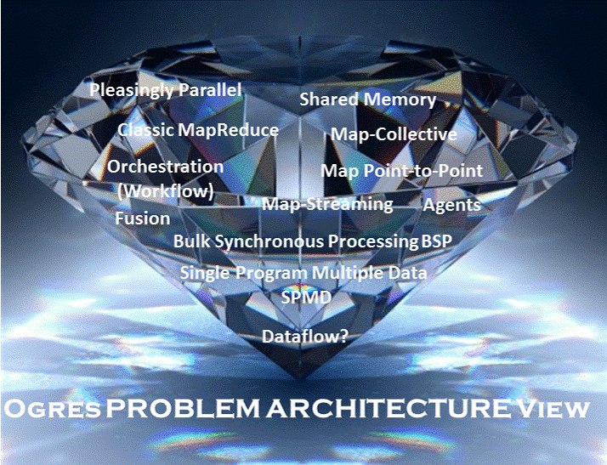

Slide 36
Facets of the Ogres
Meta or Macro Aspects:
Problem Architecture

Slide 37
Problem Architecture View of Ogres (Meta or MacroPatterns)
Pleasingly Parallel – as in BLAST, Protein docking, some (bio-)imagery including Local Analytics or Machine Learning – ML or filtering pleasingly parallel, as in bio-imagery, radar images (pleasingly parallel but sophisticated local analytics)
Classic MapReduce: Search, Index and Query and Classification algorithms like collaborative filtering (G1 for MRStat in Features, G7)
Map-Collective: Iterative maps + communication dominated by “collective” operations as in reduction, broadcast, gather, scatter. Common datamining pattern
Map-Point to Point: Iterative maps + communication dominated by many small point to point messages as in graph algorithms
Map-Streaming: Describes streaming, steering and assimilation problems
Shared Memory: Some problems are asynchronous and are easier to parallelize on shared rather than distributed memory – see some graph algorithms
SPMD: Single Program Multiple Data, common parallel programming feature
BSP or Bulk Synchronous Processing: well-defined compute-communication phases
Fusion: Knowledge discovery often involves fusion of multiple methods.
Dataflow: Important application features often occurring in composite Ogres
Use Agents: as in epidemiology (swarm approaches)
Workflow: All applications often involve orchestration (workflow) of multiple components
Note problem and machine architectures are related
Notes:
Big dwarfs are Ogres
Implement Ogres in ABDS+

Slide 38
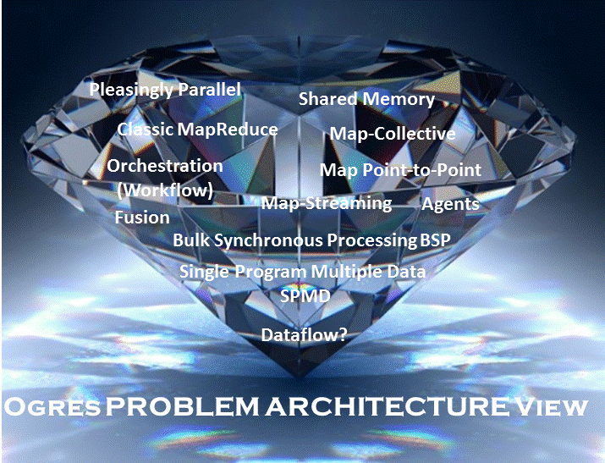

Slide 39
Facets in the Execution Features Views

Slide 40
One View of Ogres has Facets that are micropatterns or Execution Features
Performance Metrics; property found by benchmarking Ogre
Flops per byte; memory or I/O
Execution Environment; Core libraries needed: matrix-matrix/vector algebra, conjugate gradient, reduction, broadcast; Cloud, HPC etc.
Volume: property of an Ogre instance
Velocity: qualitative property of Ogre with value associated with instance
Variety: important property especially of composite Ogres
Veracity: important property of “mini-applications” but not kernels
Communication Structure; Interconnect requirements; Is communication BSP, Asynchronous, Pub-Sub, Collective, Point to Point?
Is application (graph) static or dynamic?
Most applications consist of a set of interconnected entities; is this regular as a set of pixels or is it a complicated irregular graph?
Are algorithms Iterative or not?
Data Abstraction: key-value, pixel, graph(G3), vector, bags of words or items
Are data points in metric or non-metric spaces?
Is algorithm O(N²) or O(N) (up to logs) for N points per iteration (G2)

Slide 41
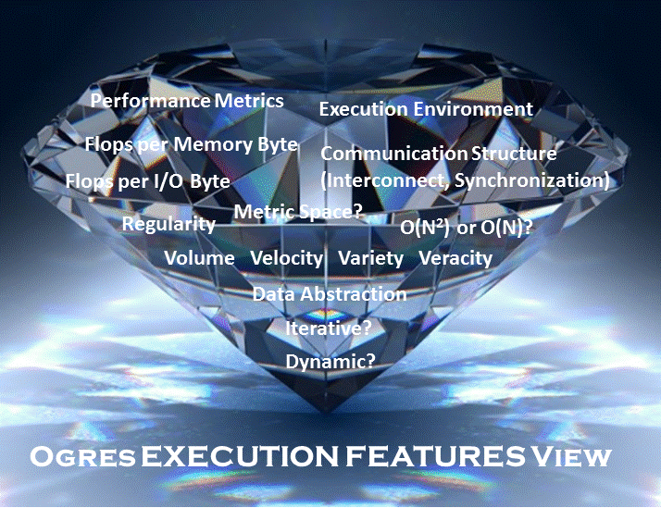

Slide 42
Facets of the Ogres
Data Source and Style Aspects

Slide 43
Data Source and Style View of Ogres I
SQL NewSQL or NoSQL: NoSQL includes Document,
Column, Key-value, Graph, Triple store; NewSQL is SQL redone to exploit NoSQL performance
Other Enterprise data systems: 10 examples from NIST integrate SQL/NoSQL
Set of Files or Objects: as managed in iRODS and extremely common in scientific research
File systems, Object, Blob and Data-parallel (HDFS) raw storage: Separated from computing or colocated? HDFS v Lustre v. Openstack Swift v. GPFS
Archive/Batched/Streaming: Streaming is incremental update of datasets with new algorithms to achieve real-time response (G7); Before data gets to compute system, there is often an initial data gathering phase which is characterized by a block size and timing. Block size varies from month (Remote Sensing, Seismic) to day (genomic) to seconds or lower (Real time control, streaming)
Notes:
Big dwarfs are Ogres
Implement Ogres in ABDS+

Slide 44
Data Source and Style View of Ogres II
Shared/Dedicated/Transient/Permanent: qualitative property of data; Other characteristics are needed for permanent auxiliary/comparison datasets and these could be interdisciplinary, implying nontrivial data movement/replication
Metadata/Provenance: Clear qualitative property but not for kernels as important aspect of data collection process
Internet of Things: 24 to 50 Billion devices on Internet by 2020
HPC simulations: generate major (visualization) output that often needs to be mined
Using GIS: Geographical Information Systems provide attractive access to geospatial data
Note 10 Bob Marcus (lead NIST effort) Use cases
Notes:
Big dwarfs are Ogres
Implement Ogres in ABDS+

Slide 45
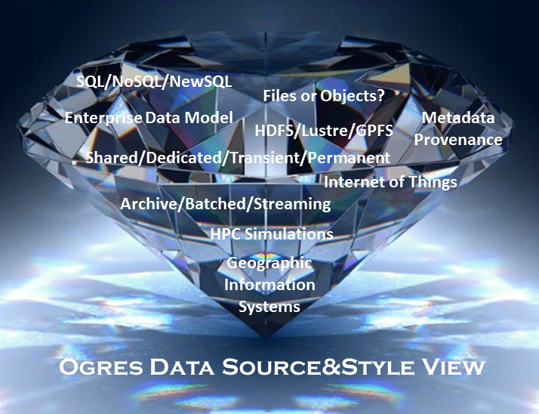

Slide 46
Facets of the Ogres Processing View

Slide 47
Facets in Processing (run time) View of Ogres I
Micro-benchmarks ogres that exercise simple features of hardware such as communication, disk I/O, CPU, memory performance
Local Analytics executed on a single core or perhaps node
Global Analytics requiring iterative programming models (G5,G6) across multiple nodes of a parallel system
Optimization Methodology: overlapping categories
  Nonlinear Optimization (G6)
  Machine Learning
  Maximum Likelihood or χ² minimizations
  Expectation Maximization (often Steepest descent)
  Combinatorial Optimization
  Linear/Quadratic Programming (G5)
  Dynamic Programming
Visualization is key application capability with algorithms like MDS useful but it itself part of “mini-app” or composite Ogre
Alignment (G7) as in BLAST compares samples with repository
Notes:
Big dwarfs are Ogres
Implement Ogres in ABDS+

Slide 48
Facets in Processing (run time) View of Ogres II
Streaming divided into 5 categories depending on event size and synchronization and integration
  Set of independent events where precise time sequencing unimportant.
  Time series of connected small events where time ordering important.
  Set of independent large events where each event needs parallel processing with time sequencing not critical
  Set of connected large events where each event needs parallel processing with time sequencing critical.
  Stream of connected small or large events to be integrated in a complex way.
Basic Statistics (G1): MRStat in NIST problem features
Search/Query/Index: Classic database which is well studied (Baru, Rabl tutorial)
Recommender Engine: core to many e-commerce, media businesses; collaborative filtering key technology
Classification: assigning items to categories based on many methods
  MapReduce good in Alignment, Basic statistics, S/Q/I, Recommender, Calssification
Deep Learning of growing importance due to success in speech recognition etc.
Problem set up as a graph (G3) as opposed to vector, grid, bag of words etc.
Using Linear Algebra Kernels: much machine learning uses linear algebra kernels
Notes:
Big dwarfs are Ogres
Implement Ogres in ABDS+

Slide 49
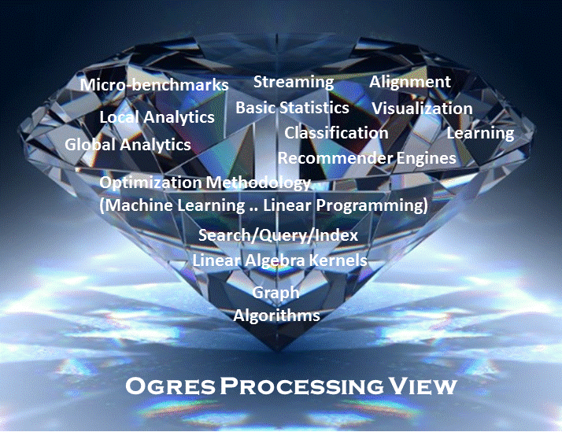

Slide 51

14
$O\left(N^{2}\right)$ = NN / $O(N)$ = N
Shared / Dedicated / Transient / Permanent
13
Metric = M / Non-Metric = N
12
Data Abstraction
11
Iterative / Simple
Execution View
Regular = R / Irregular = I
10
Geospatial Information System
Archived/Batched/Streaming
9
Dynamic = D / Static = S
8
Communication Structure
Metadata/Provenance
Enterprise Data Model
SQL/NoSQL/NewSQL
7
Veracity
HDFS/Lustre/GPFS
6
Variety
HPC Simulations
5
Velocity
Internet of Things
4
Volume
Files/Objects
3
Execution Environment; Core libraries
Flops per Byte; Memory I/O
2
Flops/Byte
1
Performance Metrics
4 Ogre Views and 50 Facets
8
10
11
12
1
2
3
4
5
6
7
9
10
9
8
7
6
5
4
3
2
1
Single Program Multiple Data
Bulk Synchronous Parallel
Micro-benchmarks
Problem
Architecture
View
1
Local Analytics
2
Classic MapReduce
Map Point-to-Point
Global Analytics
Pleasingly Parallel
3
Map-Collective
Map Streaming
Shared Memory
Optimization Methodology
4
Visualization
5
Dataflow
Workflow
Data Source and Style View
Alignment
6
Fusion
Agents
Streaming
7
Basic Statistics
8
Search / Query / Index
9
Recommender Engine
10
Classification
11
Deep Learning
12
Processing View
Graph Algorithms
13
Linear Algebra Kernels
14

Slide 52
Benchmarks based on Ogres
Analytics

Slide 53
Core Analytics Ogre Instances
(microPattern) I
Map-Only
  Pleasingly parallel - Local Machine Learning
MapReduce: Search/Query/Index
  Summarizing statistics as in LHC Data analysis (histograms) (G1)
  Recommender Systems (Collaborative Filtering)
  Linear Classifiers (Bayes, Random Forests)
Alignment and Streaming (G7)
  Genomic Alignment, Incremental Classifiers
Global Analytics
Nonlinear Solvers (structure depends on objective function) (G5,G6)
  Stochastic Gradient Descent SGD
  (L-)BFGS approximation to Newton’s Method
  Levenberg-Marquardt solver

Slide 54
Core Analytics Ogre Instances
(microPattern) II
Map-Collective (See Mahout, MLlib)
(G2,G4,G6)
  Often use matrix-matrix,-vector operations, solvers (conjugate gradient)
  Outlier Detection, Clustering (many methods),
  Mixture Models, LDA (Latent Dirichlet Allocation), PLSI (Probabilistic Latent Semantic Indexing)
  SVM and Logistic Regression
  PageRank, (find leading eigenvector of sparse matrix)
  SVD (Singular Value Decomposition)
  MDS (Multidimensional Scaling)
  Learning Neural Networks (Deep Learning)
  Hidden Markov Models

Slide 55
Core Analytics Ogre Instances
(microPattern) III
Global Analytics – Map-Communication (targets for Giraph) (G3)
  Graph Structure (Communities, subgraphs/motifs, diameter, maximal cliques, connected components)
  Network Dynamics - Graph simulation Algorithms (epidemiology)
Global Analytics – Asynchronous Shared Memory (may be distributed algorithms)
  Graph Structure (Betweenness centrality, shortest path) (G3)
  Linear/Quadratic Programming, Combinatorial Optimization, Branch and Bound (G5)

Slide 56
Benchmarks across Facets
Micro Benchmarks: SPEC, EnhancedDFSIO (HDFS), Terasort, Wordcount, Grep, MPI, Basic Pub-Sub ….
SQL and NoSQL Data systems, Search, Recommenders: TPC (-C to x–HS for Hadoop), BigBench, Yahoo Cloud Serving, Berkeley Big Data, HiBench, BigDataBench, Cloudsuite, Linkbench
Spatial Query: select from image or earth data
Streaming: Gather in Pub-Sub(Kafka) + Process (Apache Storm) solution (e.g. gather tweets, Internet of Things); ? BGBenchmark; need examples of 5 subclasses
Pleasingly parallel (Local Analytics): as in initial steps of LHC, Astronomy, Pathology, Bioimaging (differ in type of data analysis)
Analytics: Select from those Ogres given earlier including Graph 500 entries
Workflow and Composite (analytics on xSQL) linking above

Slide 57
Facets
We can associate facets (numbered 1… for each view) with each potential benchmark. Then select benchmarks with unique facets.

Slide 58
Parallel Data Analytics Issues and examples

Slide 59
Remarks on Parallelism I
Most use parallelism over items in data set
  Entities to cluster or map to Euclidean space
Except deep learning (for image data sets)which has parallelism over pixel plane in neurons not over items in training set
  as need to look at small numbers of data items at a time in Stochastic Gradient Descent SGD
  Need experiments to really test SGD – as no easy to use parallel implementations tests at scale NOT done
  Maybe got where they are as most work sequential
Maximum Likelihood or χ² both lead to structure like
Minimize sum ∑_{items=1}^{N} (Positive nonlinear function of unknown parameters for item i)
All solved iteratively with (clever) first or second order approximation to shift in objective function
  Sometimes steepest descent direction; sometimes Newton
  11 billion deep learning parameters; Newton impossible
  Have classic Expectation Maximization structure
  Steepest descent shift is sum over shift calculated from each point
SGD – take randomly a few hundred of items in data set and calculate shifts over these and move a tiny distance
  Classic method – take all (millions) of items in data set and move full distance

Slide 60
Remarks on Parallelism II
Need to cover non vector semimetric and vector spaces for clustering and dimension reduction (N points in space)
MDS Minimizes Stress
σ(X) = Σ_{i<j=1}^{N} weight(i,j) (δ(i, j) - d(X_{i} , X_{j}))²
Semimetric spaces just have pairwise distances defined between points in space δ(i, j)
Vector spaces have Euclidean distance and scalar products
  Algorithms can be O(N) and these are best for clustering but for MDS O(N) methods may not be best as obvious objective function O(N²)
  Important new algorithms needed to define O(N) versions of current O(N²) – “must” work intuitively and shown in principle
Note matrix solvers all use conjugate gradient – converges in 5-100 iterations – a big gain for matrix with a million rows. This removes factor of N in time complexity
Ratio of #clusters to #points important; new ideas if ratio >~ 0.1

Slide 61
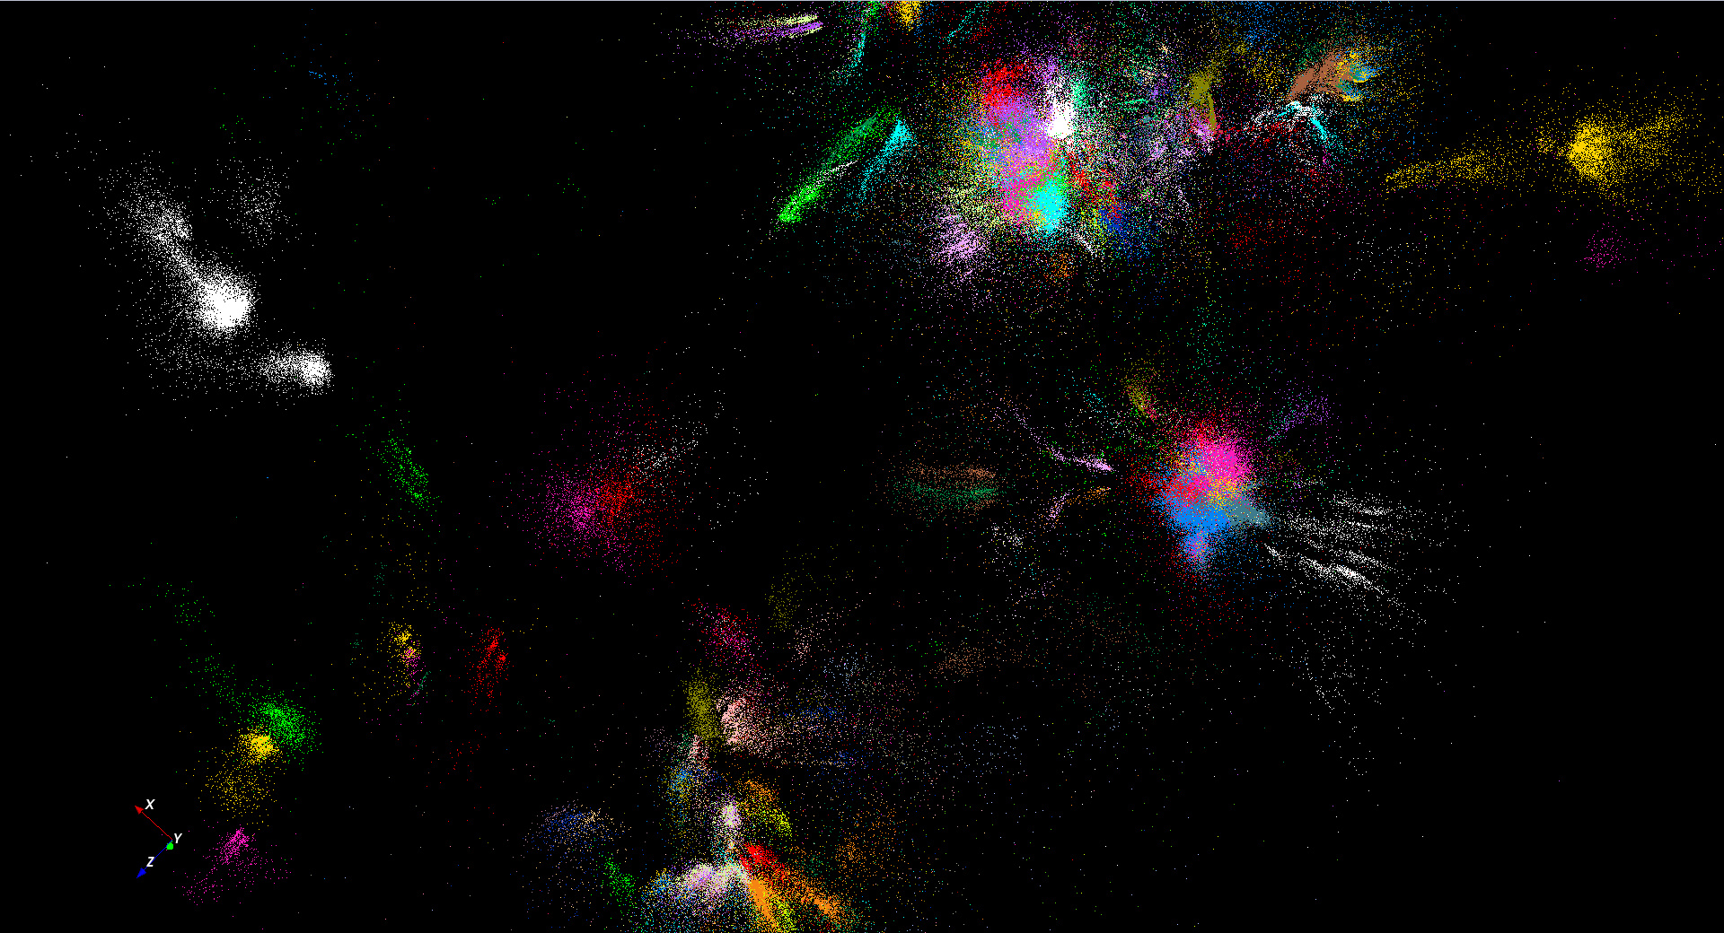
446K sequences
~100 clusters

Slide 62
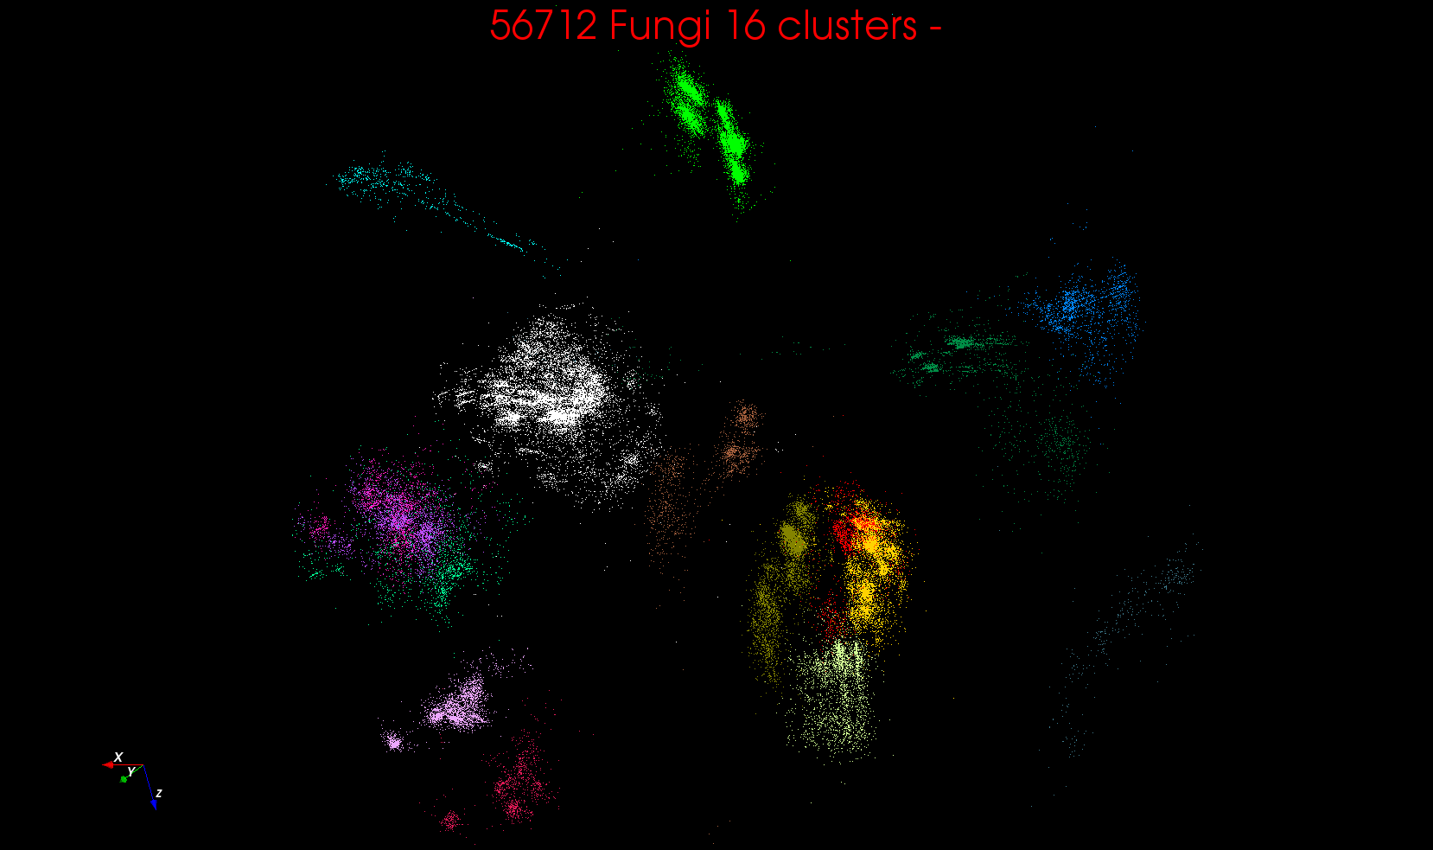
“clean” sample of 446K
O(N²) green-green and purple-purple interactions have value but green-purple are “wasted”
O(N²) interactions between green and purple clusters should be able to represent by centroids as in Barnes-Hut.
Hard as no Gauss theorem; no multipole expansion and points really in 1000 dimension space as clustered before 3D projection

Slide 63
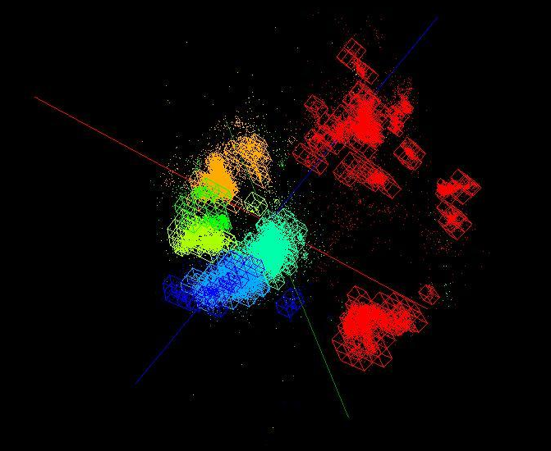
OctTree for 100K sample of Fungi
We use OctTree for logarithmic interpolation (streaming data)

Slide 64
“clean” sample of 446K
O(N²) green-green and purple-purple interactions have value but green-purple are “wasted”
O(N²) interactions between green and purple clusters should be able to represent by centroids as in Barnes-Hut.
Hard as no Gauss theorem; no multipole expansion and points really in 1000 dimension space as clustered before 3D projection

Slide 65
OctTree for 100K sample of Fungi
We use OctTree for logarithmic interpolation (streaming data)

Slide 66

Protein Universe Browser (map big data to 3D to use “GIS”) for COG Sequences with a few illustrative biologically identified clusters

Slide 67
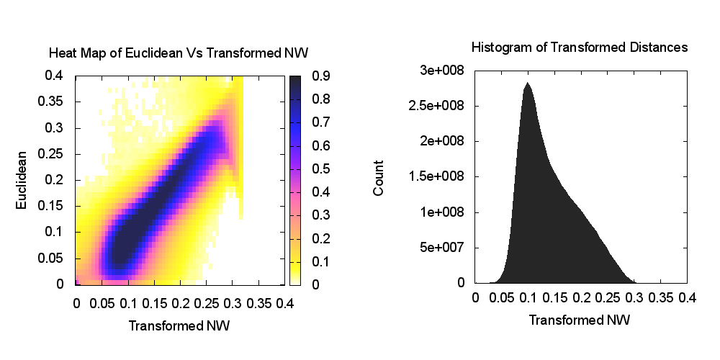
Heatmap of biology distance (Needleman-Wunsch) vs 3D Euclidean Distances
If d a distance, so is f(d) for any monotonic f. Optimize choice of f

Slide 68
Algorithm Challenges
See NRC Massive Data Analysis report
O(N) algorithms for O(N²) problems
Parallelizing Stochastic Gradient Descent
Streaming data algorithms – balance and interplay between batch methods (most time consuming) and interpolative streaming methods
Graph algorithms
Machine Learning Community uses parameter servers; Parallel Computing (MPI) would not recommend this?
  Is classic distributed model for “parameter service” better?
Apply best of parallel computing – communication and load balancing – to Giraph/Hadoop/Spark
Are data analytics sparse?; many cases are full matrices
BTW Need Java Grande – Some C++ but Java most popular in ABDS, with Python, Erlang, Go, Scala (compiles to JVM) …..

Slide 69
Lessons / Insights
Proposed classification of Big Data applications with features generalized as facets and kernels for analytics
Data intensive algorithms do not have the well developed high performance libraries familiar from HPC
Challenges with O(N²) problems
Global Machine Learning or (Exascale Global Optimization) particularly challenging
Develop SPIDAL (Scalable Parallel Interoperable Data Analytics Library)
  New algorithms and new high performance parallel implementations
Integrate (don’t compete) HPC with “Commodity Big data” (Google to Amazon to Enterprise/Startup Data Analytics)
  i.e. improve Mahout; don’t compete with it
  Use Hadoop plug-ins rather than replacing Hadoop
Enhanced Apache Big Data Stack HPC-ABDS has ~290 members with HPC opportunities at Resource management, Storage/Data, Streaming, Programming, monitoring, workflow layers.

