Slide 1
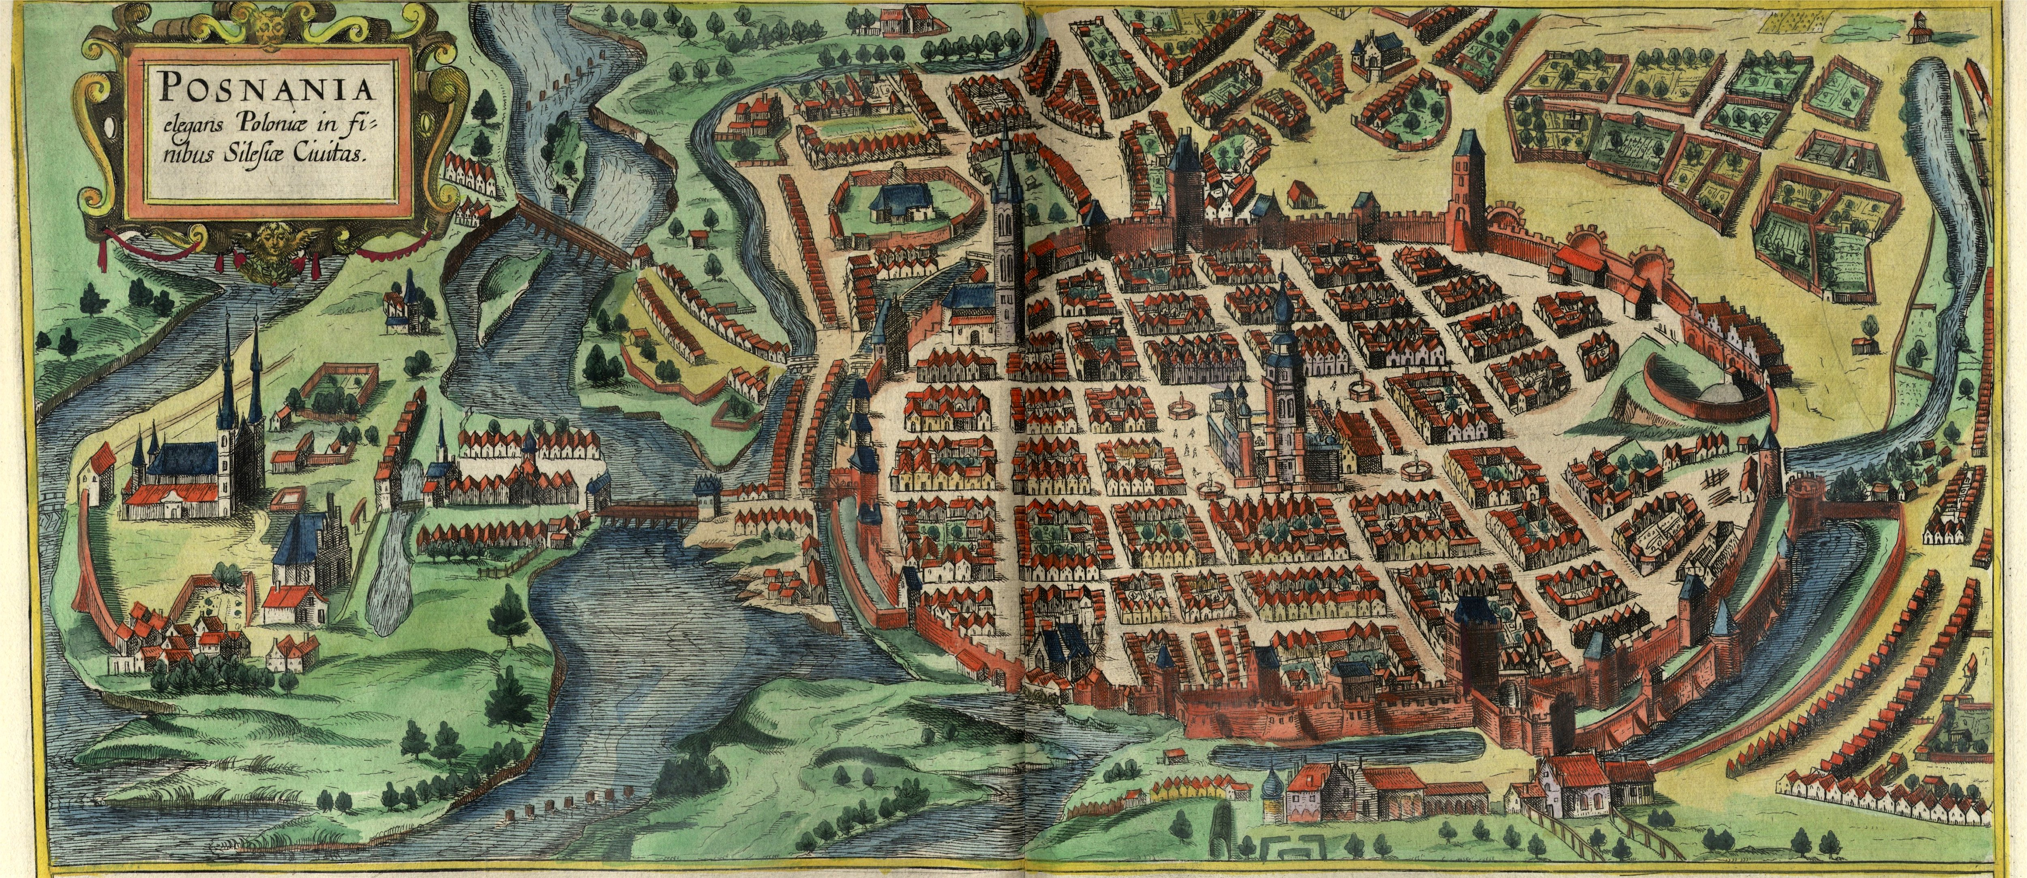
MLforHPC/CI BDEC2 Working Group Learning Everywhere https://www.exascale.org/bdec/agenda/poznan
Poznan, Poland Geoffrey Fox, May 16, 2019 gcf@indiana.edu, http://www.dsc.soic.indiana.edu/, http://spidal.org/
Digital Science Center

Slide 2
MLforHPC and HPCforML
We tried to distinguish between different interfaces for ML/DL and HPC.
HPCforML: Using HPC to execute and enhance ML performance, or using HPC simulations to train ML algorithms (theory guided machine learning), which are then used to understand experimental data or simulations.
MLforHPC: Using ML to enhance HPC applications and systems; Big Data comes from the computation
A special case of Dean at NIPS 2017 – "Machine Learning for Systems and Systems for Machine Learning",
Microsoft 2018 meeting focus on MLforBigDataComputations

Slide 3
HPCforML in detail
HPCforML can be further subdivided
HPCrunsML: Using HPC to execute ML with high performance
SimulationTrainedML: Using HPC simulations to train ML algorithms, which are then used to understand experimental data or simulations. (Return to this as similar to MLaroundHPC)
Twister2 supports HPCrunsML by using high performance technology everywhere and this has been my major emphasis over last 5 years

Slide 4
MLforHPC in detail
MLforHPC can be further subdivided into several categories:
MLautotuning: Using ML to configure (autotune) ML or HPC simulations.
MLafterHPC: ML analyzing results of HPC as in trajectory analysis and structure identification in biomolecular simulations
MLaroundHPC: Using ML to learn from simulations and produce learned surrogates for the simulations or parts of simulations. The same ML wrapper can also learn configurations as well as results. Most Important
MLControl: Using simulations (with HPC) in control of experiments and in objective driven computational campaigns. Here the simulation surrogates are very valuable to allow real-time predictions.
Twister2 supports MLforHPC by allowing nodes of HPC dataflow representation to be wrapped with ML

Slide 5
MLforHPC Details I
MLAutoTuningHPC: Learning Configurations This is classic Autotuning and one optimizes some mix of performance and quality of results with the learning network inputting the configuration parameters of the computation. This includes initial values and also dynamic choices such as block sizes for cache use, variable step sizes in space and time. It can also include discrete choices as to the type of solver to be used.
MLAutoTuningHPC: Smart Ensembles Here we choose the best set of computation defining parameters to achieve some goal such as providing the most efficient training set with defining parameters spread well over the relevant phase space.
MLAutoTuningHPC: Learning Model Setups from Observational Data Seen when simulation set up as a set of agents.Tuning agent (model) parameters to optimize agent outputs to available empirical data presents one of the greatest challenges in model construction.

Slide 6
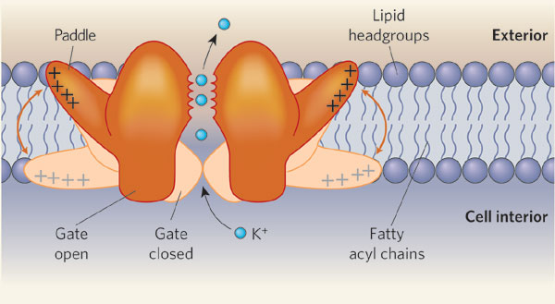
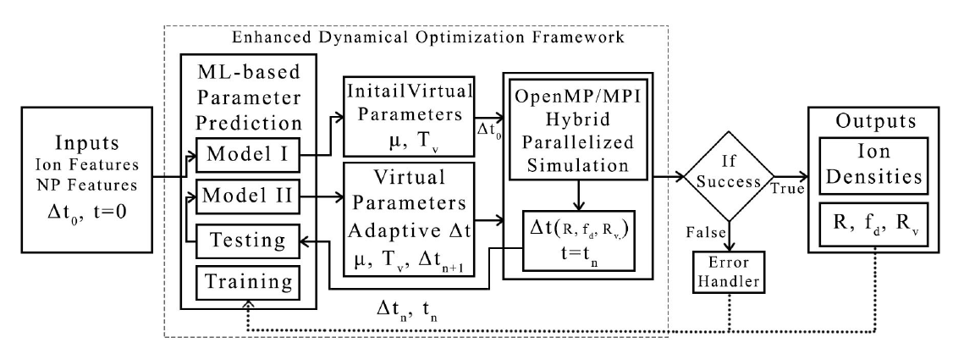
MLAutotunedHPC. Machine Learning for Parameter Auto-tuning in Molecular Dynamics Simulations: Efficient Dynamics of Ions near Polarizable Nanoparticles
Integration of machine learning (ML) methods for parameter prediction for MD simulations by demonstrating how they were realized in MD simulations of ions near polarizable NPs.
Note ML used at start and end of simulation blocks
JCS Kadupitiya, Geoffrey Fox, Vikram Jadhao
ML-Based Simulation Configuration
Inference I
Inference I
Inference II
Inference II
Testing
Testing
Training
Training

Slide 7
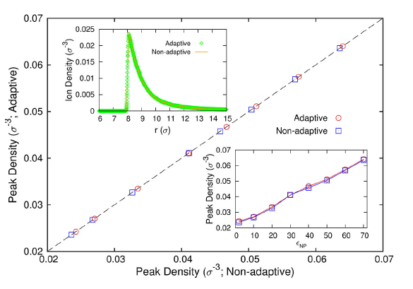
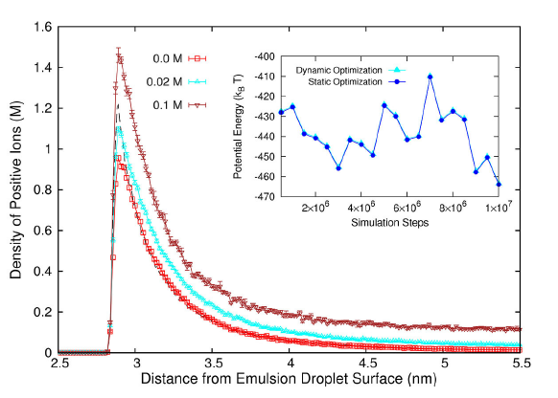
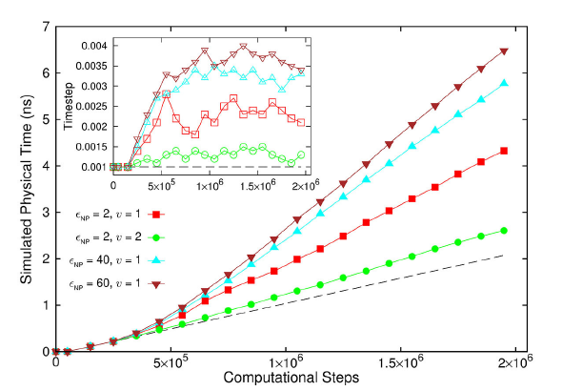
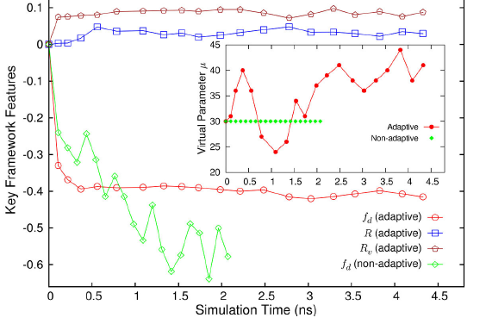
Results for MLAutotuning
Comparison of results for peak densities of counterions between adaptive (ML) and original non-adaptive cases (they look identical)
Ionic densities from MLAutotuned system. Inset compares ML system results with those of slower original system
Key characteristics of simulated system showing greater stability for ML enabled adaptive approach.
Quality of simulation measured by time simulated per step with increasing use of ML enhancements. (Larger is better). Inset is timestep used
An ANN based regression model was integrated with MD simulation and predicted excellent simulation environment 94:3% of the time; human operation is more like 20(student)-50(faculty)% and runs simulation slower to be safe.
Auto-tuning of parameters generated accurate dynamics of ions for 10 million steps while improving the stability.
The integration of ML-enhanced framework with hybrid OpenMP/MPI parallelization techniques reduced the computational time of simulating systems with 1000 of ions and induced charges from 1000 of hours to 10 of hours, yielding a maximum speedup of 3 from MLAutoTuning and a maximum speedup of 600 from the combination of ML and parallel computing.
The approach can be generalized to select optimal parameters in other MD applications & energy minimization problems.

Slide 8
MLforHPC Details II
MLaroundHPC: Learning Outputs from Inputs: This has a wide spectrum of use cases with two extreme cases given below. It includes SimulationTrainedML where the simulations are performed to directly train an AI system rather than the AI system being added to learn a simulation.
Fields from Fields Here one feeds in initial conditions and the neural network learns the result where initial and final results are fields
Computation Results from Computation defining Parameters Here one just feeds in a modest number of metaparameters that the define the problem and learn a modest number of calculated answers. This presumably requires fewer training samples than a)

Slide 9
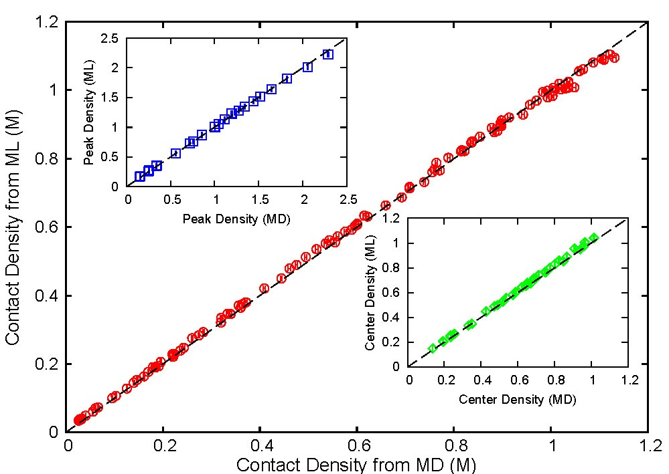
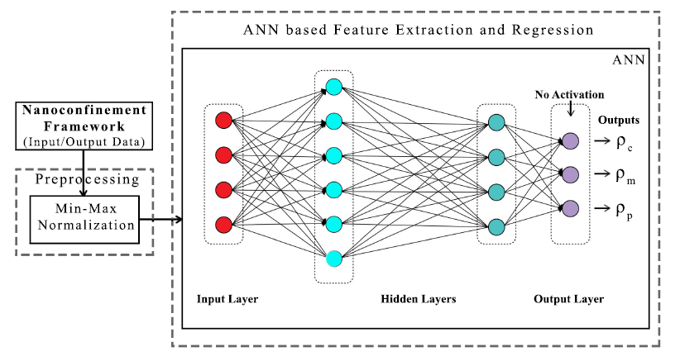
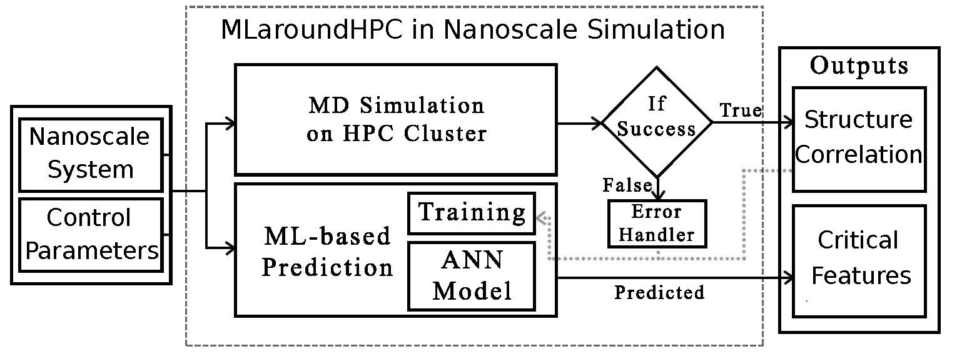
MLaroundCI: Machine learning for performance enhancement with Surrogates of molecular dynamics simulations
We find that an artificial neural network based regression model successfully learns desired features associated with the output ionic density profiles (the contact, mid-point and peak densities) generating predictions for these quantities that are in excellent agreement with the results from explicit molecular dynamics simulations.
The integration of an ML layer enables real-time and anytime engagement with the simulation framework, thus enhancing the applicability for both research and educational use.
Will be deployed on nanoHUB for education
ML-Based Simulation Prediction ANN Model
Training
Inference
ML used during simulation

Slide 10
Speedup of MLaroundCI
T_{seq} is sequential time
T_{train} time for a (parallel) simulation used in training ML
T_{learn} is time per point to run machine learning
T_{lookup} is time to run inference per instance
N_{train} number of training samples
N_{lookup} number of results looked up
Becomes T_{seq}/T_{train} if ML not used
Becomes T_{seq}/T_{lookup} (10⁵ faster in our case) if inference dominates (will overcome end of Moore’s law and win the race to zettascale)
This application to be deployed on nanoHub for high performance education use
N_{train} is 7K to 16K in our work

Slide 11
MLaroundHPC: Learning Model Details I
a) Learning Agent Behavior One has a model such as a set of cells modeling a virtual tissue. One can use ML to learn dynamics of cells replacing detailed computations by ML surrogates. As can be millions to billions of such agents the performance gain can be huge. Note for parallel computing that one has the same computation cost of full model but much smaller calculation. So parallel overheads go up
b) Learning Special Cases of Agent Behavior A few or lots of the cells are special such as those reflecting cancer for virtual tissue case
c) Learning Effective Potentials or Interaction Graphs An effective potential is an analytic, quasi-emperical or quasi-phenomological potential that combines multiple, perhaps opposing, effects into a single potential. Effective potential are typically defined using physical intuition. For example, we have a model specified at a microscopic scale and we define a coarse graining to a different scale with macroscopic entities defined to interact with effective dynamics specified in some fashion such as an effective potential or effective interaction graph. This is classic coarse graining strategy

Slide 12
MLaroundHPC: Learning Model Details II
(d) Learning Agent Behavior – a Predictor-Corrector approach Here one time steps models and at each step optimize the parameters to minimize divergence between simulation and ground truth data. The ground truth here may be in the form of experimental data, or from highly detailed (and expensive) quantum or micro-scale calculations. The time series of parameter adjustments define information missing from the model.. This is an extended data assimilation approach.
Example: produce a generic model organism such as an embryo. Take this generic model as a template and learn the different adjustments for particular individual organisms.
(e) Inference of Missing Model Structure In this case we aggregate the Learned Predictor Corrector MLs, there is substantial evidence that in some signifiant cases, we can infer unknown model structure from the aggregation of individual learned predictor corrector models. In these cases we can then add these inferred mechanisms to the base model structure and repeat the basic predictor-corrector steps. In addition, this aggregation means that every completed data set and simulation increases the expressiveness of the base model

Slide 13
MLControl
(a) Experiment Control Using simulations (possibly with HPC) in control of experiments and in objective driven computational campaigns . Here the simulation surrogates are very valuable to allow real-time predictions. Applied in Material Science and Fusion
(b) Experiment Design One of the biggest challenges of models is the uncertainty in the precise model structures and parameters. Model-based design of experiments (MBDOE) assists in the planning of highly effective and efficient experiments – it capitalizes on the uncertainty in the models to investigate how to perturb the real system to maximize the information obtained from experiments. MBDOE with new ML assistance identifies the optimal conditions for stimuli and measurements that yield the most information about the system given practical limitations on realistic experiments

