Slide 1
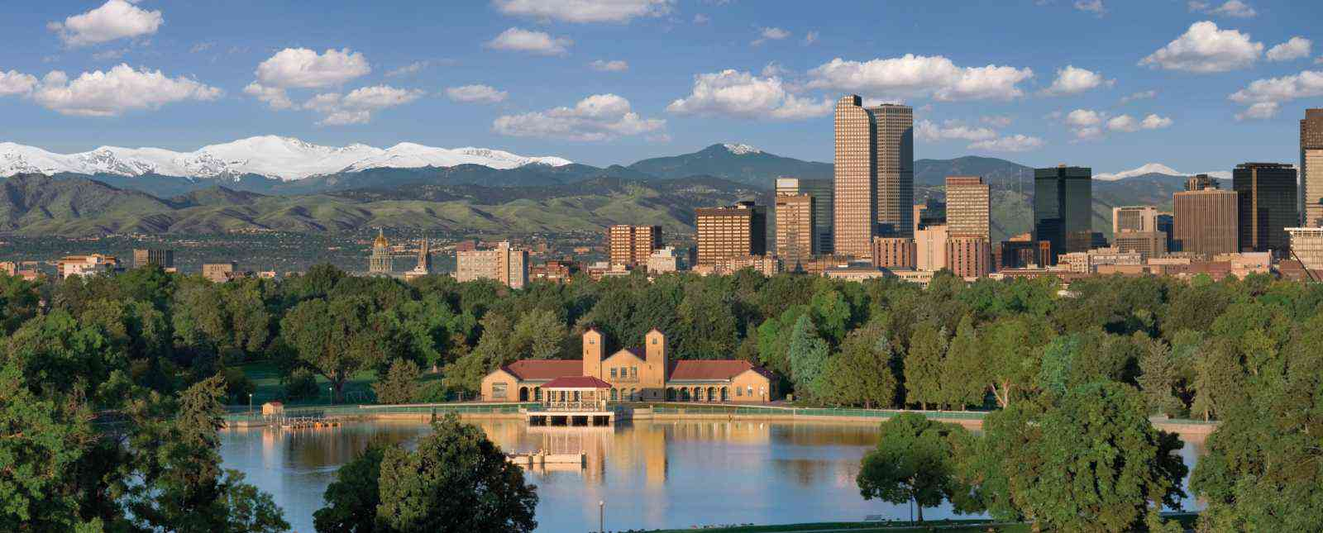
Implications of Integration of Deep Learning and HPC for Benchmarking
Geoffrey Fox, Shantenu Jha, November 16, 2019 2019 BenchCouncil International Symposium on Benchmarking, Measuring and Optimizing (Bench’19) Denver, Colorado, USA
gcf@indiana.edu, http://www.dsc.soic.indiana.edu/, http://spidal.org/

Slide 2
Next Generation of Cyberinfrastructure: BDEC2 Overarching Principles
We want to discover a very small number of classes of Hardware-Software systems that together will support all major Cyberinfrastructure (CI) needs for researchers in the next 5 years. It is unlikely to be a single class but a small number of shared major system classes will be attractive as it
Implies not many distinct software stacks and hardware types to support
The size of resources in any area goes like Fixed Total Budget/Number of distinct types and so will be larger if we just have a few key types.
Note projects like BDEC2 are aiming at new systems and possibly constraints from continuity to the past may be less important than for production systems deployed today.
Almost by definition, any big data computing must involve HPC technologies but not necessarily classic HPC systems.
The growing demand from Big Data and from the use of ML with simulations (MLAutotuning, MLaroundHPC) implies new demands for new algorithms and new ideas for hardware/software of the supporting cyberinfrastructure CI.
The AI for science initiative from DoE will certainly need new CI
We will term the systems as HPC if they involve an HPC edge such as Google edge TPU. Both Cloud and Edge are Intelligent

Slide 3
Next Generation of Cyberinfrastructure: Application Requirements
Four classes of applications are
Classic Big Data Analytics as in the analysis of LHC data, SKA, Light sources, health, NASA and environmental data. HPCforML
Cloud-Edge applications which certainly overlap with 1) as data in many fields comes from the edge
Integration of ML and Data analytics with simulations. “learning everywhere”, MLforHPC
Classic simulations which are addressed excellently by DoE exascale program and although our focus is Big Data, one should consider this application area as we need to integrate simulations with data analytics and ML (Machine Learning) -- item 3) above

Slide 4
What Benchmarks are meaningful?
Benchmarks should correspond to types of problems that are important or at least commonly used
Local Machine Learning running on single cores or nodes (many pleasing parallel instances)
Global machine learning running parallelized codes
This is Capability v Capacity (HTC) classification
a) is perhaps most common commercially and corresponds to a framework OpenWhisk/Spark launching ML as in R or Scikit-Learn instances. This benchmark depends on
Function as a Service capability of launcher (OpenWhisk/Spark)
Performance of R or Scikit-Learn instance
Suitable for cloud-native implementation
b) is perhaps most interesting to me as a parallel computing researcher. This benchmark depends on
Ability of launching environment to support parallel computing with communication performance etc.
Quality and nature of parallelization (Model parallelism or Data parallelism)

Slide 5
Global machine learning running parallelized codes
Today 2) seems to be becoming dominated by deep learning which seems most effective and innovative Big Data approach.
PyTorch, Tensorflow, MXNET and not R or Spark+Mllib are favorite systems
But Spark, Flink etc. are still used to “wrap” or prepare data for DL systems.
MLPerf has a large set of “commercially interesting” deep learning training and inference benchmarks
Tony Hey adding scientific benchmarks
MLPerf shows importance of data parallelism versus model parallelism
What are the best benchmarks for “to wrap or prepare data for parallel DL systems”
System wide benchmarks
“Operators” in Spark
Edge applications
Dataflow / workflow applications
Plus non-DL examples of importance such as Terasort

Slide 6
Next Generation of Cyberinfrastructure: Remarks on Deep Learning
We expect growing use of deep learning (DL) replacing older machine learning methods and DL will appear in many different forms such as Perceptrons, Convolutional NN's, Recurrent NN's, Graph Representational NN's, Autoencoders, Variational Autoencoder, Transformers, Generative Adversarial Networks, and Deep Reinforcement Learning.
For industry, growth in reinforcement learning is increasing the computational requirements of systems. However, it is hard to predict the computational complexity, parallelizability, and algorithm structure for DL even just 3 years out.
Note we always have the training and inference phases for DL and these have very different system needs.
Training will give large often parallel jobs; Inference will need a lot of small tasks.
Note in parallel DL, one MUST change both batch size and # training epochs as one scales to larger systems (in fixed problem size case) and this is implicit in MLPerf results; this may change with more model parallelism
Parallel Computing Failed again!!

Slide 7
Implications of Specialized AI Hardware
Currently GPU’s (and TPU’s) can be used to speedup both Deep Learning and Simulations
However we are likely to see specialized AI hardware which is
Only useful for machine learning
In fact only useful for deep learning and particular variants thereof
That impacts significance of benchmark in a machine used for DL and other computing
And will be very important when you need to run ML as an integrated part of a job which is doing simulations or other significant computing
MLforHPC shows this

Slide 8
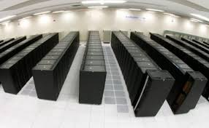
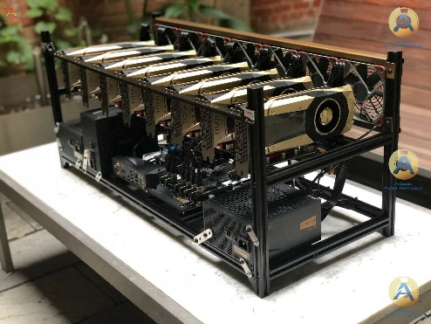
AI as a Service
Need to shield computer architectures and users from changes in AI implementations
One approach is to offer AI as a service implemented as Function as a Service
Event-based FaaS offers attractive computing model and low latency
Mix of NVMe and fast communication channels to minimize data transfer and other overheads in accessing AI Service
Can change to new hardware/software/algorithm transparently
AI as a service
Broker
Simulation as a service
NVMe as a service

Slide 9
HPCforML and MLforHPC
Technical aspects of converging HPC and Machine Learning
HPCforML
Parallel high performance ML algorithms
High Performance Spark, Hadoop, Storm
8 scenarios for MLforHPC
Illustrate a few scenarios
Research Issues

Slide 10
Dean at NeurIPS
DECEMBER 2017
ML for optimizing parallel computing (load balancing)
Learned Index Structure
ML for Data-center Efficiency
ML to replace heuristics and user choices (Autotuning)

Slide 11
Implications of Machine Deep Learning for Systems and Systems for Machine Deep Learning
We could replace “Systems” by “HPC”
I use HPC as we are aiming at systems that support big data or big simulations and almost by (my) definition should naturally involve HPC.
So we get ML for HPC and HPC for ML
HPC for ML is very important but has been quite well studied and understood
It makes data analytics run much faster
ML for HPC is transformative both as a technology and for application progress enabled
If it is ML for HPC running ML, then we have the creepy situation of the AI supercomputer improving itself
ML operationally DL at the moment!

Slide 12
MLforHPC (ML for Systems) in detail
MLforHPC can be further subdivided into several categories:
MLafterHPC: ML analyzing results of HPC as in trajectory analysis and structure identification in biomolecular simulations. Well established and successful
MLControl: Using simulations (with HPC) and ML in control of experiments and in objective driven computational campaigns. Here simulation surrogates are very valuable to allow real-time predictions. Very Promising
MLAutotuning: Using ML to configure (autotune) ML or HPC simulations.
MLaroundHPC: Using ML to learn from simulations and produce learned surrogates for the simulations or parts of simulations. The same ML wrapper can also learn configurations as well as results. Most Important.
Note ML impacts science/theory/algorithms not just the cyberinfrastructure

Slide 13
MLaroundHPC and MLAutotuningHPC
Use Computation to represent Simulation or Big Data
Improving Computations with Configurations and Integration of Data
Autotuning of initial and running configuration; data assimilation
Learn Structure, Theory and Model for Computations
Learn potentials, support cross-scale integration; learn microscale structure; derive fundamental theories
Generate smart ensembles and collective coordinates
Learn Surrogates for Simulations
Can be input specifications mapped into output features
Can be combined with experimental observation over same input specifications
Or input field values mapped to output field values
ML gives speedup factors from 2 (static Autotuning) to 10^{N} (N=5 in one example) from surrogates with strong speedup (fixed problem speedup)

Slide 14
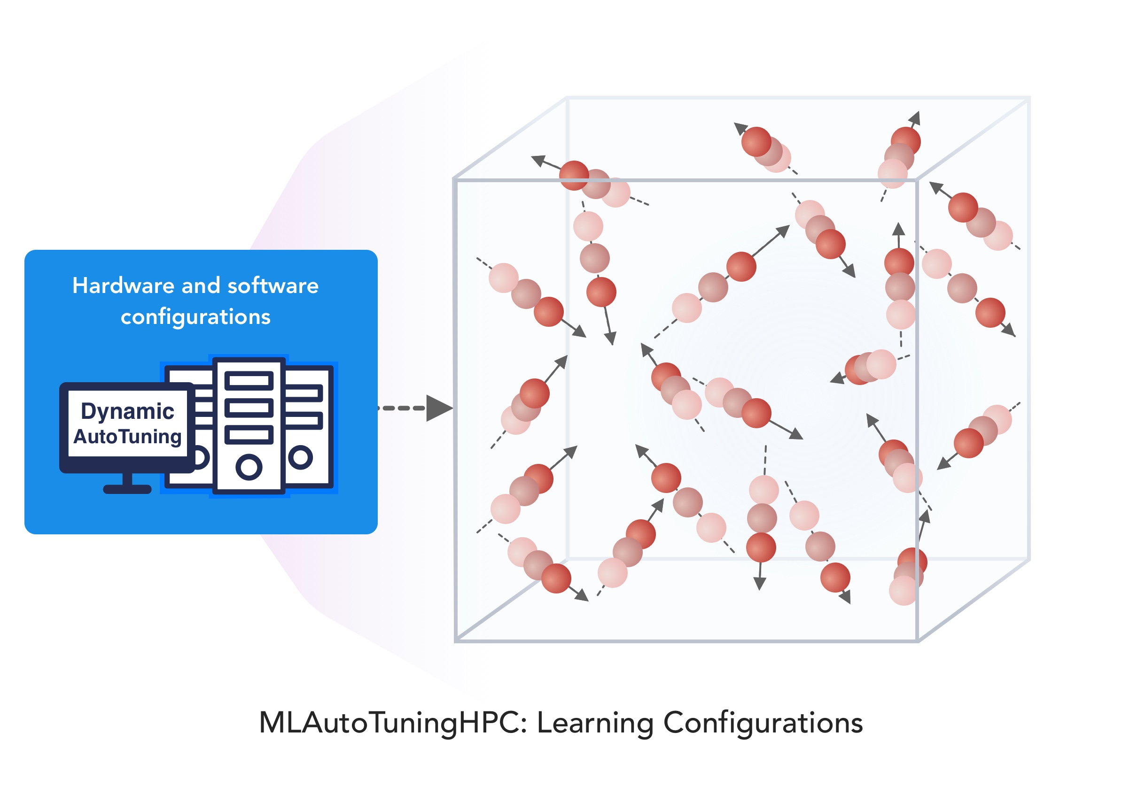
1. Improving Simulation with Configurations and Integration of Data 1.1 MLAutoTuningHPC: Learning Configurations
This is classic Autotuning and one optimizes some mix of performance and quality of results with the learning network inputting the configuration parameters of the computation.
This includes initial values and also dynamic choices such as block sizes for cache use, variable step sizes in space and time.
It can also include discrete choices as to the type of solver to be used.

Slide 15
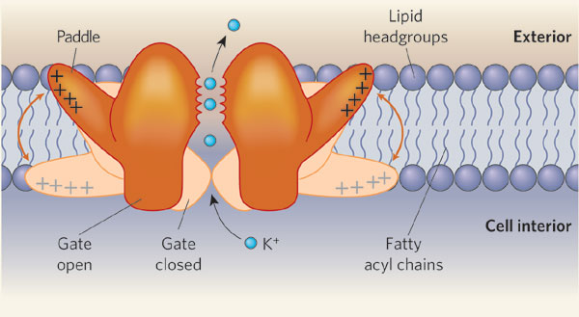
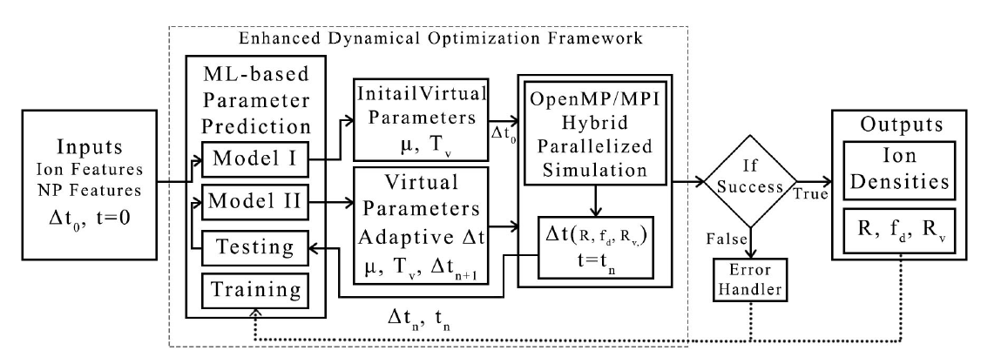
MLAutoTuningHPC: Learning Configurations by Parameter Auto-tuning in Molecular Dynamics Simulations: Efficient Dynamics of Ions near Polarizable Nanoparticles (NPs)
Integration of machine learning (ML) methods for parameter prediction for MD simulations by demonstrating how they were realized in MD simulations of ions near polarizable NPs.
Note ML used at start and end of simulation blocks
JCS Kadupitiya,
Geoffrey Fox,
Vikram Jadhao
ML-Based Simulation Configuration
Inference I
Inference I
Inference II
Inference II
Testing
Testing
Training
Training

Slide 16
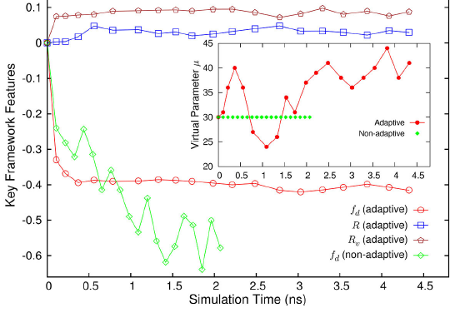
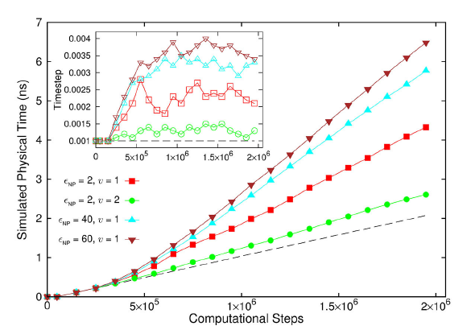
Results for Nanosimulation MLAutotuning
Key characteristics of simulated system showing greater stability for ML enabled adaptive approach.
Auto-tuning of parameters generated accurate dynamics of ions for 10 million steps while improving the stability.
Integrated with ML-enhanced framework with hybrid OpenMP/MPI
Maximum speedup of 3 from MLAutoTuning and a maximum speedup of 600 from the combination of ML and parallel computing.
Quality of simulation measured by time simulated per step with increasing use of ML enhancements. (Larger is better).
Inset is timestep used

Slide 17
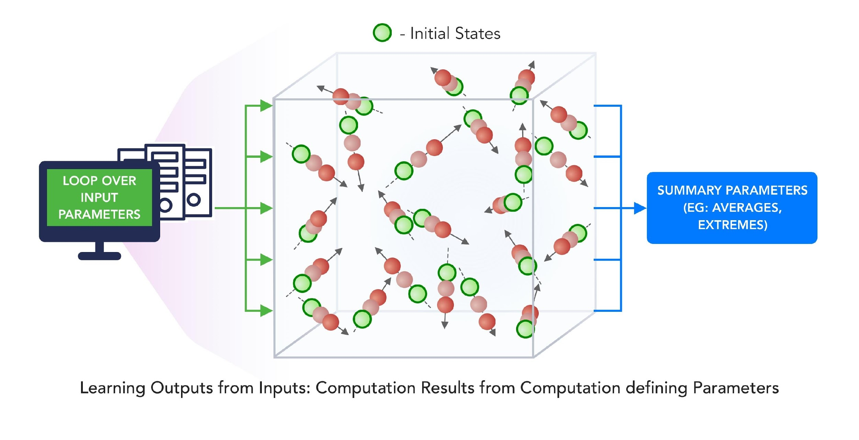
3. MLforHPC Learn Surrogates for Simulation 3.1 MLaroundHPC: Learning Outputs from Inputs:
a) Computation Results from Computation defining Parameters
Here one just feeds in a modest number of meta-parameters that the define the problem and learn a modest number of calculated answers.
This presumably requires fewer training samples than “fields from fields” and is main use of MLaroundHPC so far
Can mix simulations and observations
Operationally same as SimulationTrainedML but with a different goal: In SimulationTrainedML the simulations are performed to directly train an AI system rather than the AI system being added to learn a simulation.

Slide 18
MLaroundHPC: Learning Outputs from Inputs (parameters) High Performance Surrogates of nanosimulations
JCS Kadupitiya,
Geoffrey Fox,
Vikram Jadhao
An example of Learning Outputs from Inputs: Computation Results from Computation defining Parameters
Employed to extract the ionic structure in electrolyte solutions confined by planar and spherical surfaces.
Written with C++ and accelerated with hybrid MPI-OpenMP.
MLaroundHPC successfully learns desired features associated with the output ionic density that are in excellent agreement with the results from explicit molecular dynamics simulations.
Will be deployed on nanoHUB for education (an attractive use of surrogates)

Slide 19
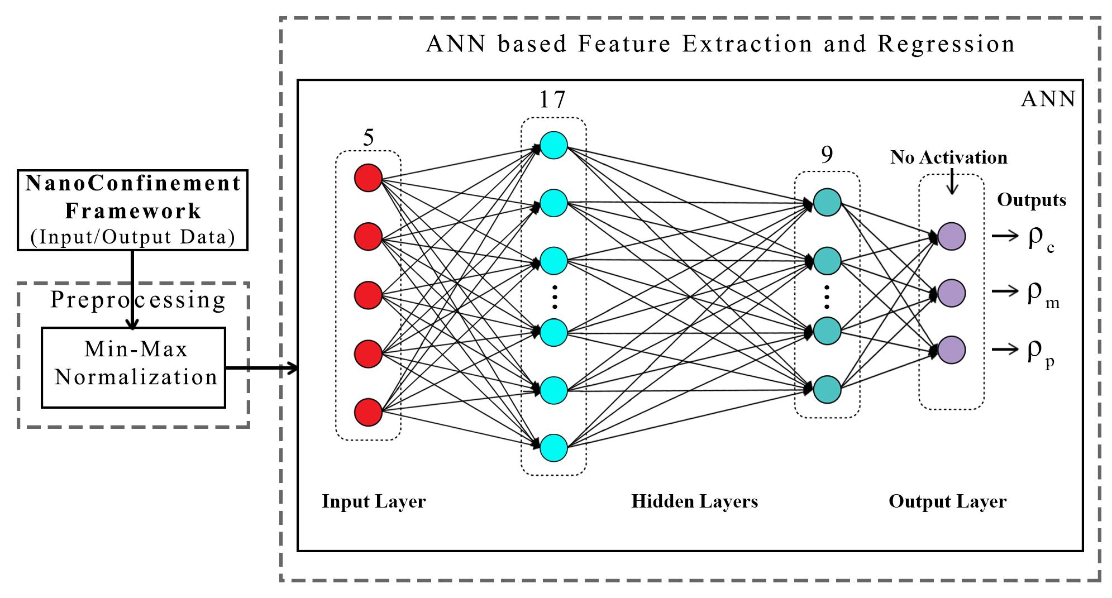
ANN for Regression
Dataset having 6,864 simulation configurations was created for training and testing (0.7:0.3) the ML model.
Note learning network quite small
ANN was trained to predict three continuous variables; Contact density ρ_{c} , mid-point (center of the slit) density ρ_{m} , and peak density ρ_{p}
TensorFlow, Keras and Sklearn libraries were used in the implementation
Adam optimizer, xavier normal distribution, mean square loss function, dropout regularization.
JCS Kadupitiya,
Geoffrey Fox,
Vikram Jadhao

Slide 20
Parameter Prediction in Nanosimulation
ANN based regression model predicted Contact density ρ_{c} , mid-point (center of the slit) density ρ_{m} , and peak density ρ_{p} accurately with a success rate of 95:52% (MSE ~ 0:0000718), 92:07% (MSE ~ 0:0002293), and 94:78% (MSE ~ 0:0002306) respectively, easily outperforming other non-linear regression models
Success means within error bars (2 sigma) of Molecular Dynamics Simulations

Slide 21
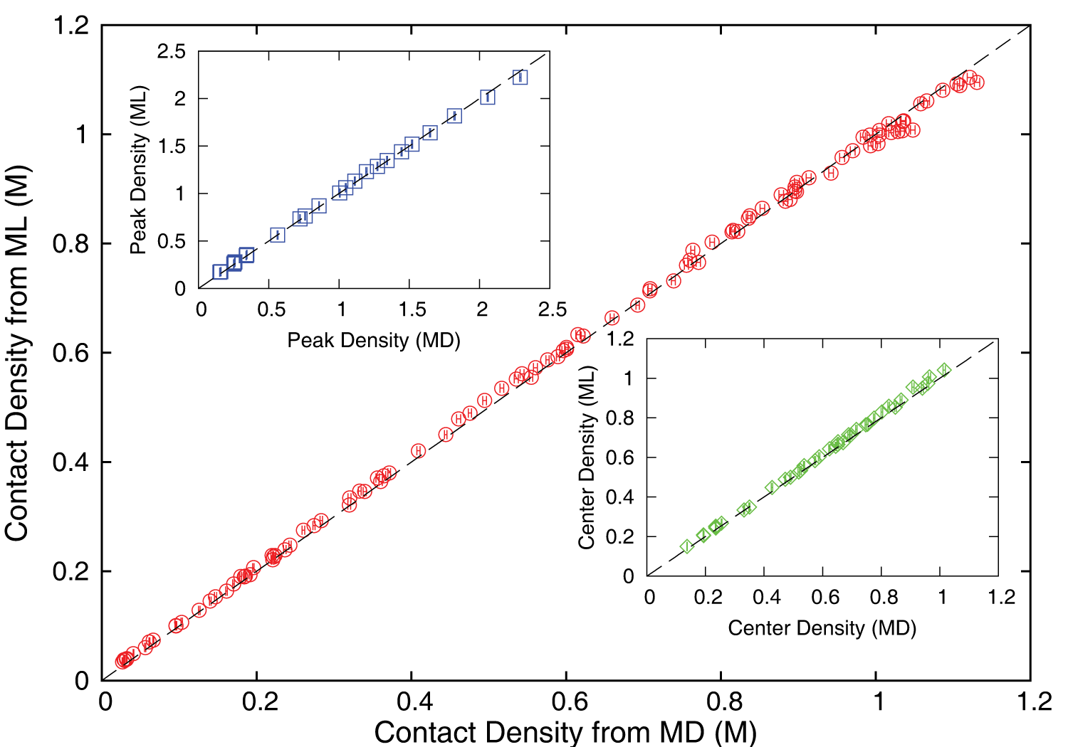
Accuracy comparison between ML predictions and MD simulation results
JCS Kadupitiya,
Geoffrey Fox,
Vikram Jadhao
ρ_{c ,} ρ_{m} and ρ_{p} predicted by the ML model were found to be in excellent agreement with those calculated using the MD method; correlated data from both approaches fall on the dashed lines which indicate perfect correlation.

Slide 22
Speedup of MLaroundHPC
T_{seq} is sequential time
T_{train} time for a (parallel) simulation used in training ML
T_{learn} is time per point to run machine learning
T_{lookup} is time to run inference per instance
N_{train} number of training samples
N_{lookup} number of results looked up
Becomes T_{seq}/T_{train} if ML not used
Becomes T_{seq}/T_{lookup} (10⁵ in our case) if inference dominates (will overcome end of Moore’s law and win the race to zettascale)
Another factor as inferences uses one core; parallel simulation 128 cores
Speedup is strong (not weak with problem size increasing to improve performance) scaling as size fixed
N_{train} is 7K to 16K in our work

Slide 23
INSILICO MEDICINE USED CREATIVE AI TO DESIGN POTENTIAL DRUGS IN JUST 21 DAYS
September 4 2019 News Item
Map Drug (Material) Structure to Drug (Material) Properties
Hong Kong-based Insilico Medicine sent shockwaves through the pharma industry after publishing research in Nature Biotechnology that proves its AI-powered drug discovery system was capable of producing at least one potential treatment for fibrosis in less than a month's time.
The system uses a Deep Reinforcement Learning algorithm that can imagine potential protein structures based on existing research and certain preprogrammed design criteria.
Insilico's system initially produced 30,000 possible designs, which the research team whittled down to six that were synthesized in the lab, with one design eventually tested on mice to promising results.
Insilico's AI-powered research process could offer a massive push forward for the pharmaceutical industry, which faces increasingly high drug development costs. In just a handful of weeks and for approximately $150,000, Insilico delivered what typically takes pharmaceutical companies $2.6 billion over seven years.

Slide 24
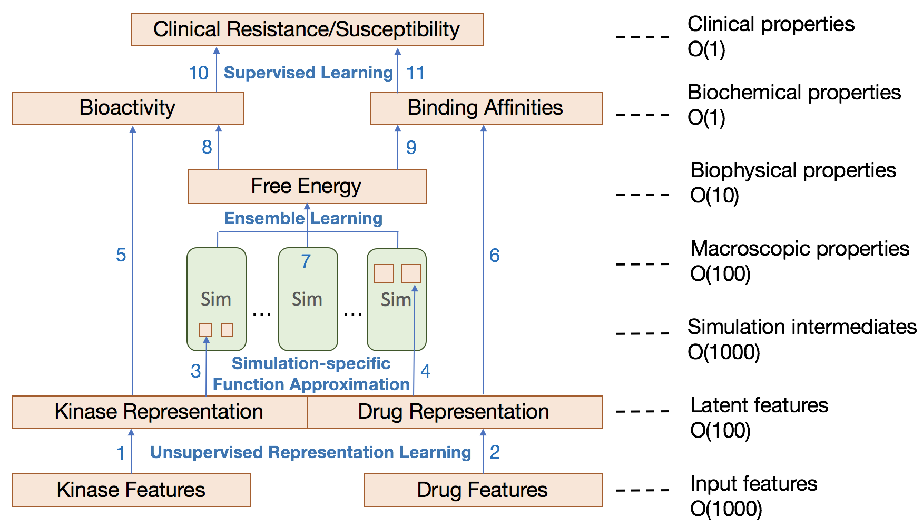
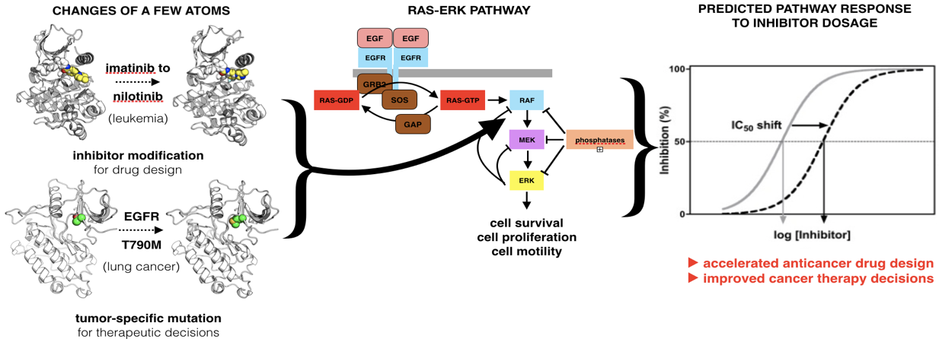
Examination of the therapeutic effectiveness of Kinase ML at multiple levels and points in the discovery process
CANDLE-INSPIRE
Kinase effectiveness workflow with number of features of relevance at each stage
Ensemble simulations and DL training samples

Slide 25
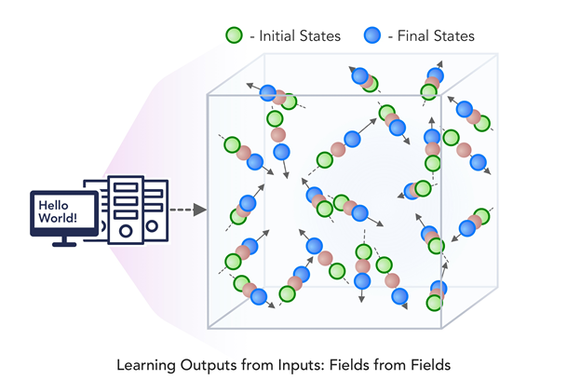
3. MLforHPC Learn Surrogates for Simulation 3.2 MLaroundHPC: Learning Outputs from Inputs:
b) Fields from Fields
Here one feeds in initial conditions and the neural network learns the result where initial and final results are fields
In simple cases, it is shown that you can learn Newton’s laws and their numerical approximation
Unclear how far but probably generalizes

Slide 26
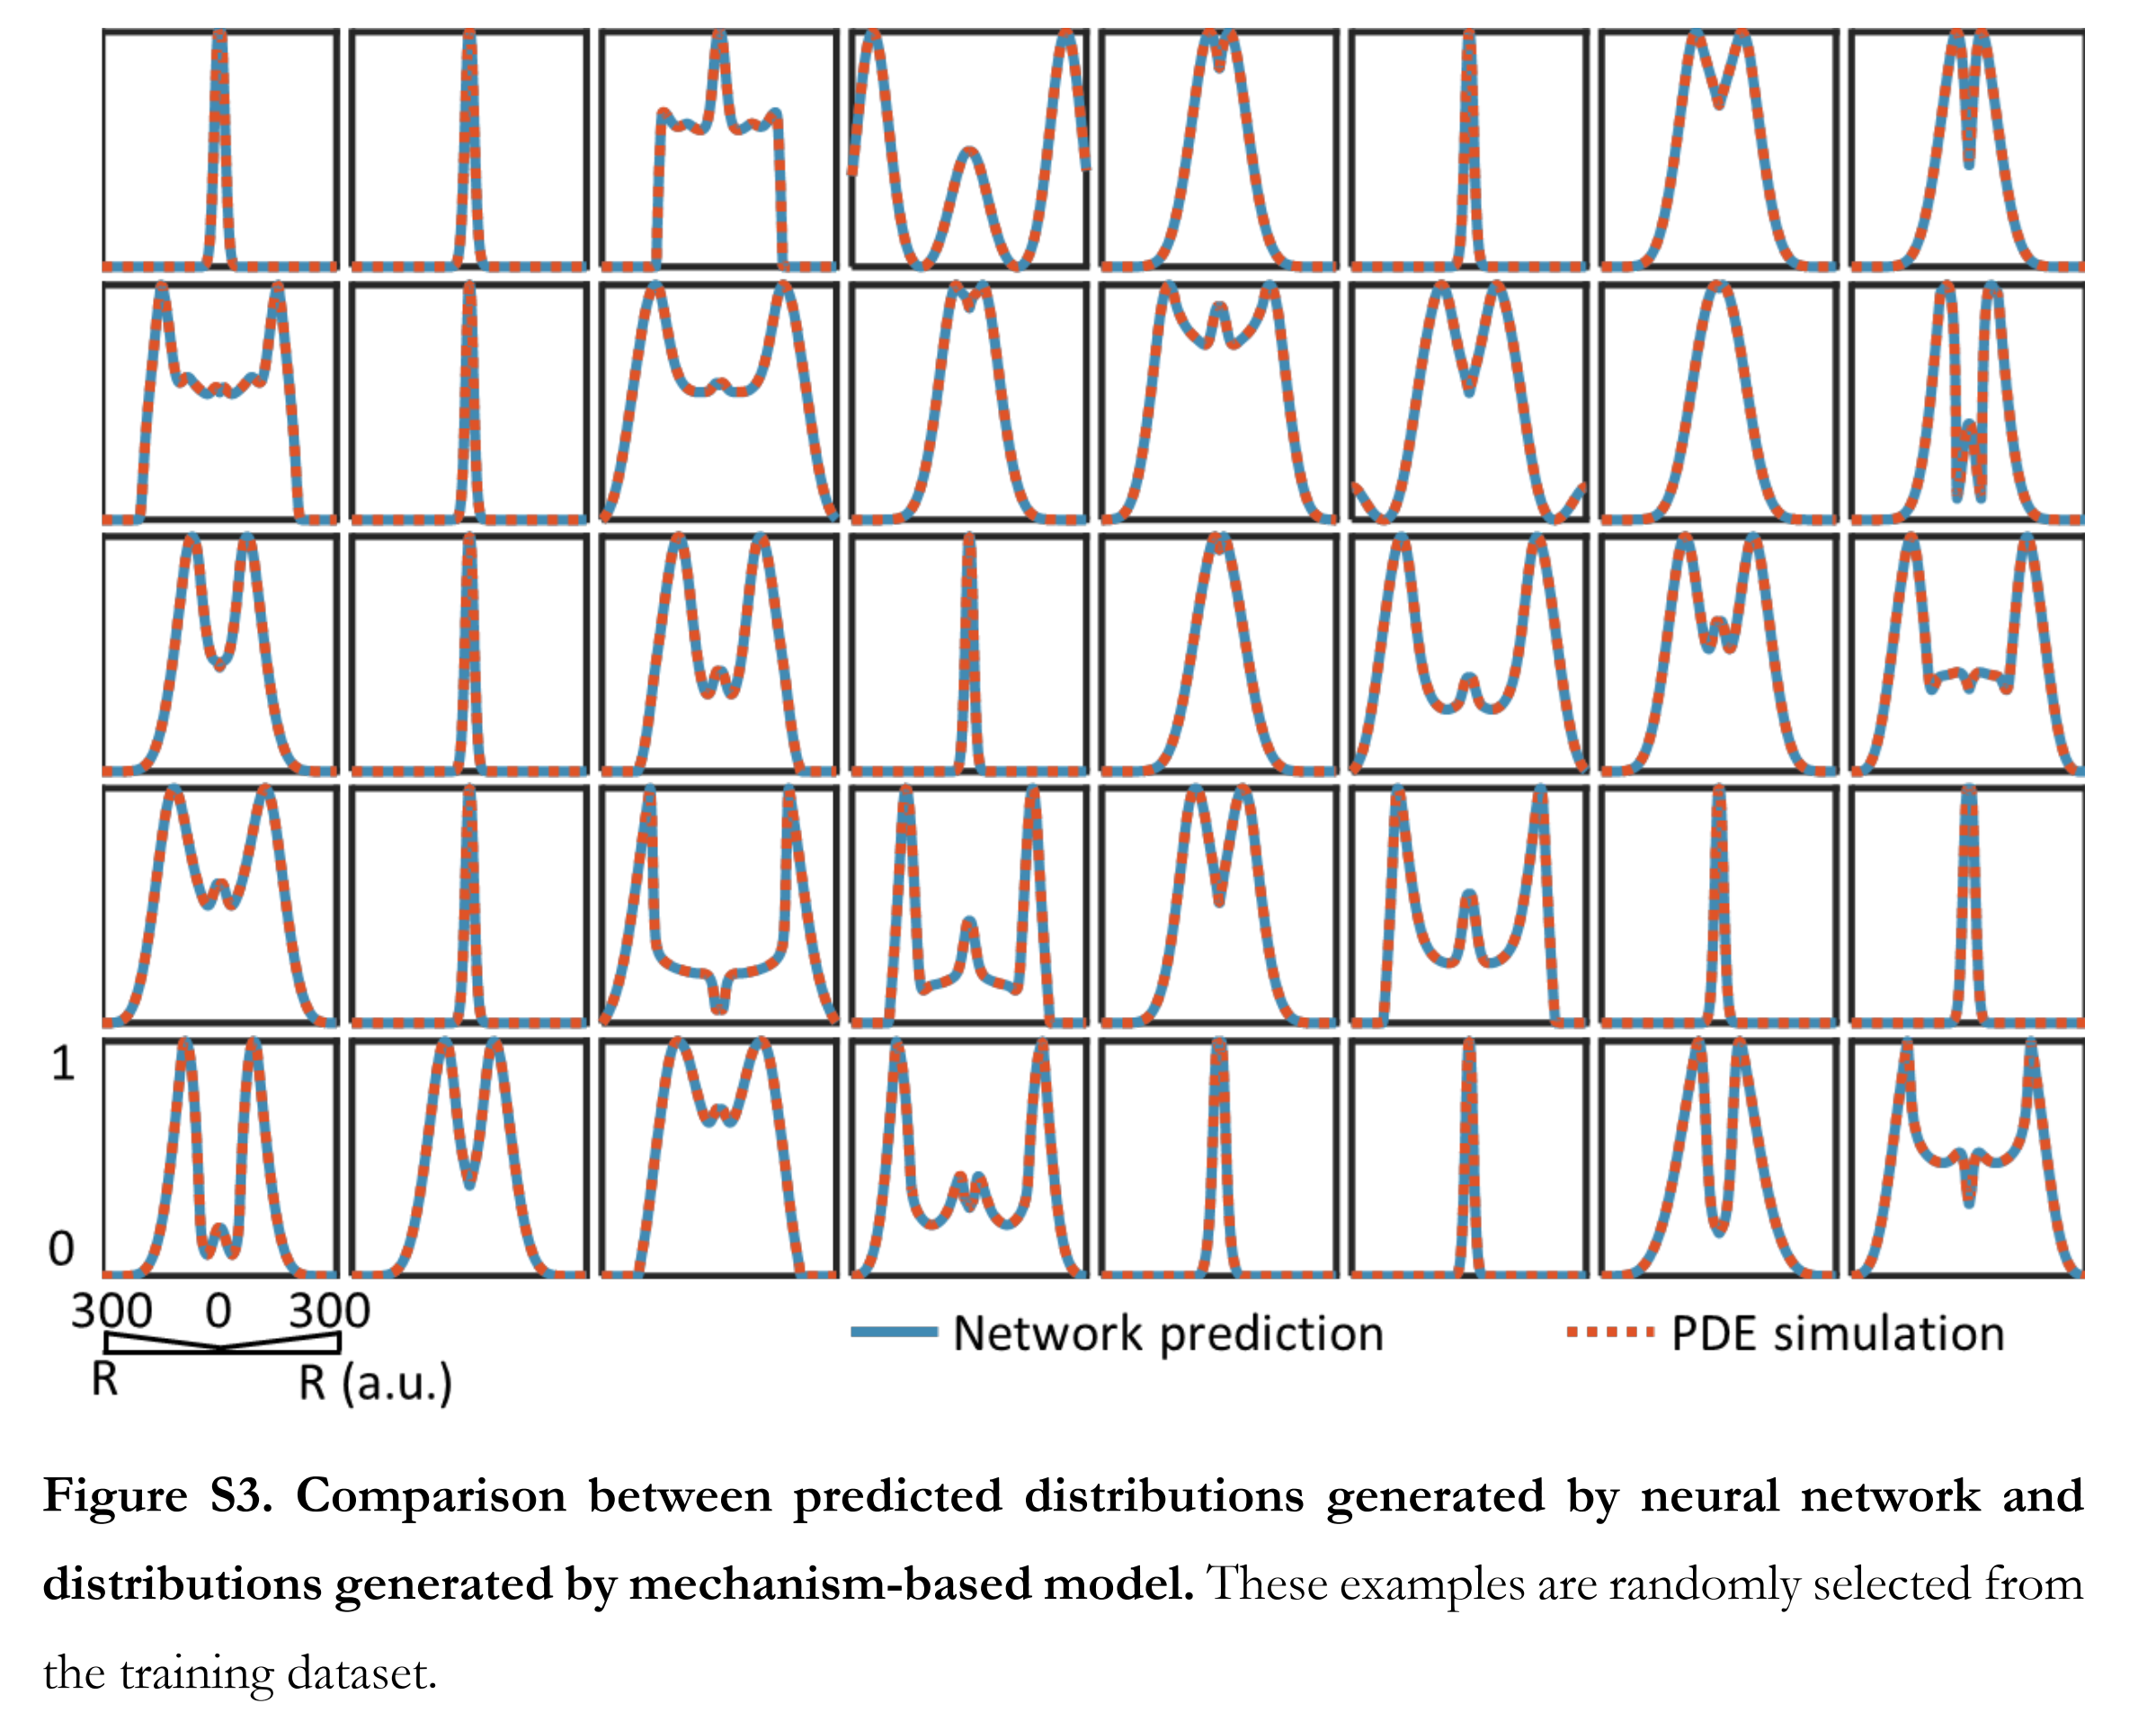
Fields from Parameters Recent paper “Massive computational acceleration by using neural networks to emulate mechanism based biological models” uses 501 LSTM units to represent a one-dimensional grid of values which is output of a two-dimensional gene circuit simulation which only depends on radius.

Slide 27
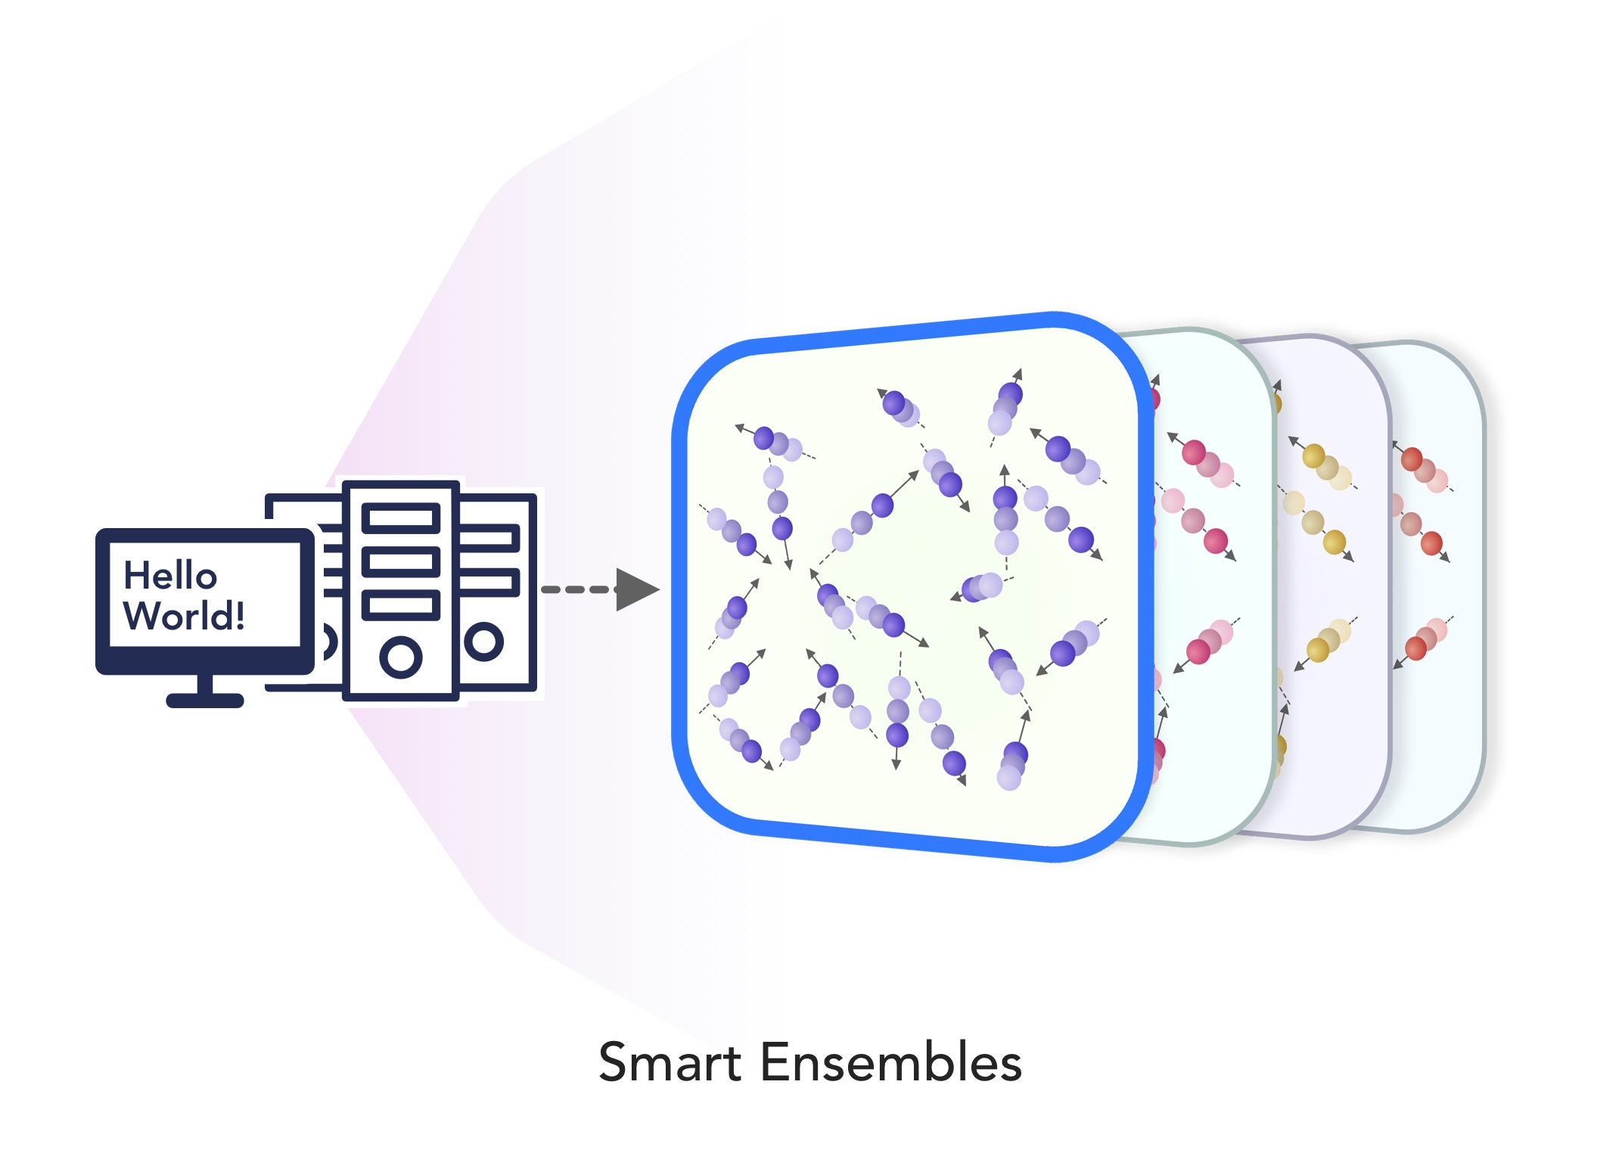
2. Learn Structure, Theory and Model for Simulation 2.1 MLAutoTuningHPC: Smart Ensembles
Here we choose the best set of collective coordinates to achieve some computation goal
Such as exploring special states – proteins are folding
Or providing the most efficient training set with defining parameters spread well over the relevant phase space.
Deep Learning (e.g. autoencoders) replacing other machine learning approaches to find collective coordinates

Slide 28
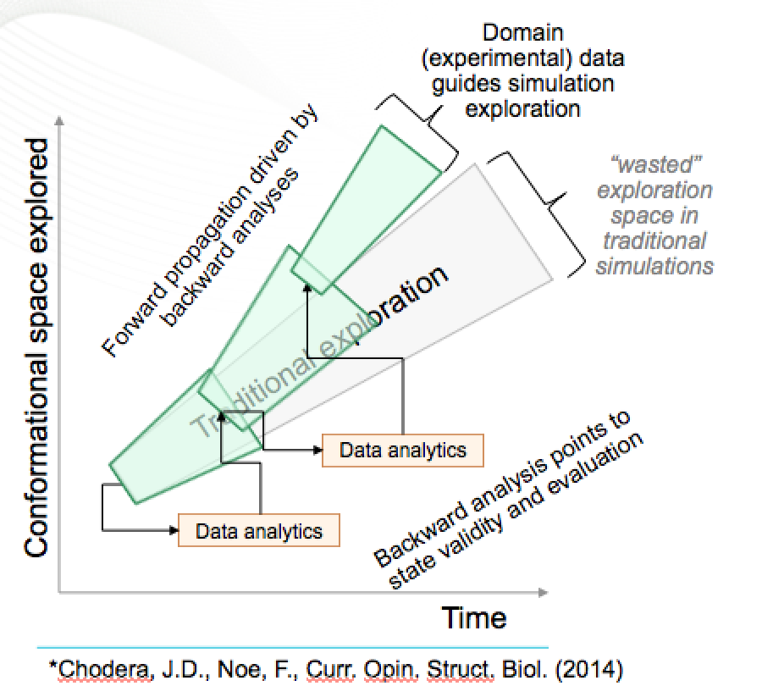
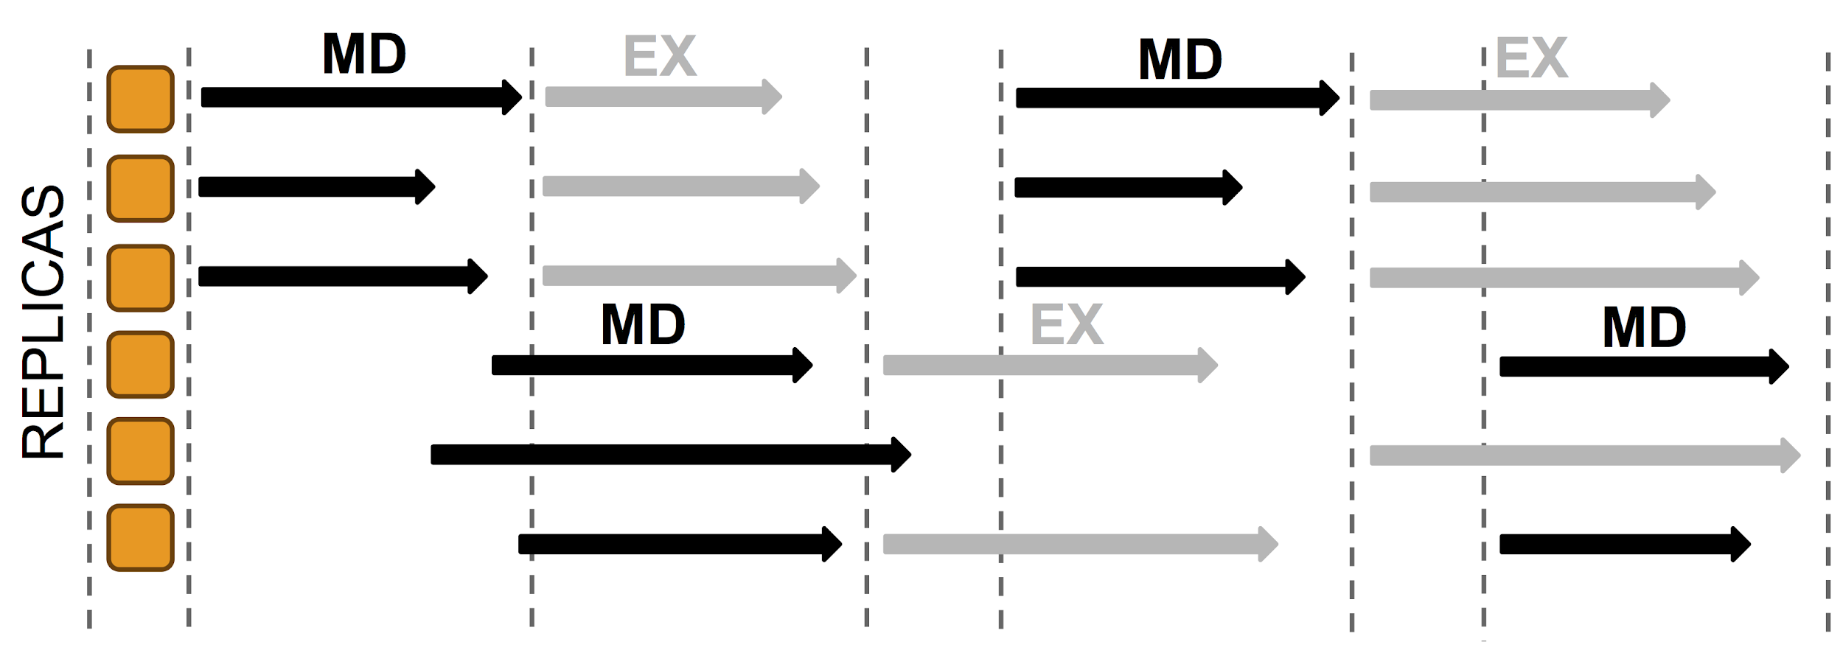
ML based enhanced sampling of Phase Space
Run ensembles of shortish runs rather than one long run
Traditional approach uses replica exchanges
In Markov State Model for biomolecular simulations , phase space is determined by clustering trajectories (not deep learning) and mapping space with these clusters and their transition
Most recent method uses deep learning autoencoders to find collective coordinates to map out space and move quickly. (DL replaces ML)

Slide 29
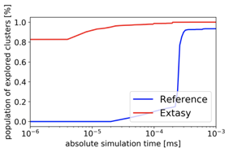
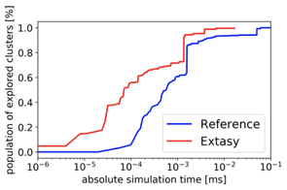
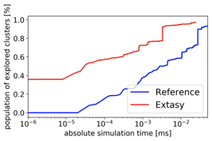
Adaptive Sampling Using non-DL ML (Clustering)
Red line % phase space with clustering
Blue is % with hard core MD
Below phase space explored in top two collective coordinates; ML finds new regions

Slide 30
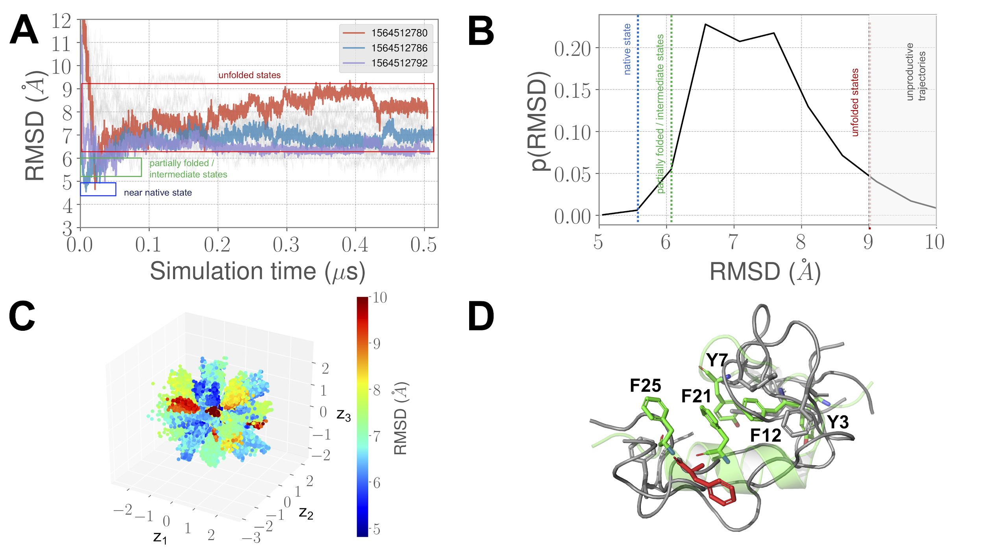
CVAE Convolutional Variational Autoencoder driven Ensemble-MD
For BBA: 20X improvement
Shantenu Jha Collaboration with ANL: see https://arxiv.org/pdf/1908.00496.pdf

Slide 31
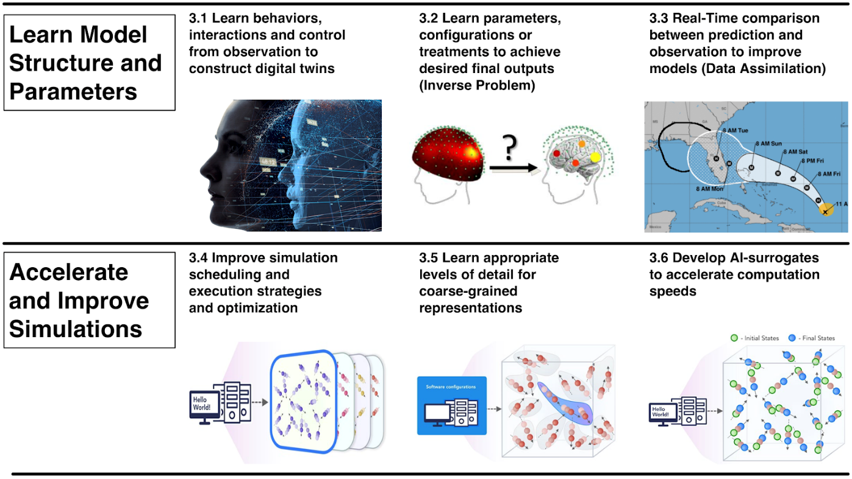
Engineering Health: Digital twin based Personalized Medicine
Uses 6 distinct MLforHPC categories
Data Assimilation can customize generic models for each patient
Surrogates for cell models can give huge performance increase (as inference used so often so training amortized) as in other agent-based models
Initial Applications
AI-Assisted Development of digital twins for immunotherapies (using the body’s own immune cells to kill cancers rather than chemotherapies) using data generated from organoid cultures of patient-derived cancer cells.
AI-Assisted Deployment of Digital Twins for Diagnosis, Prognosis and Treatment Optimization of Diabetic Retinopathy (DR):

Slide 32
Putting it all Together Simulating Biological Organisms (with James Glazier @IU)
Learning Model (Agent) Behavior Replace components by learned surrogates (Reaction Kinetics Coupled ODE’s)
All steps use MLAutotuning
Smart Ensembles
Dynamic Data Assimilation

Slide 33
Operator Formulation of Deep Learning Inference
Suppose we are solving PDE’s or sets of coupled ODE’s
Typically we solve iteratively New Values = (Differential Operator) Previous Values
Classic applied math tells you nifty difference equations and spectral methods to represent Operator numerically
Deep Learning learns the operator from classic numerics or observational data or their combination
Inference is New Values = (DL Operator) Previous Values
This new nonlinear trained DL operator can allow much larger time steps, incorporate variations in parameters etc.
DL Operator is the new theory (Newton’s laws) of science
High order approximations are traditionally very sensitive to noise and one was taught to avoid but ANN are the opposite – both verbose and robust
See DL operator for Lennard Jones Potential in two LSTM layers!
Newton’s laws for this have 2-4 parameters

Slide 34
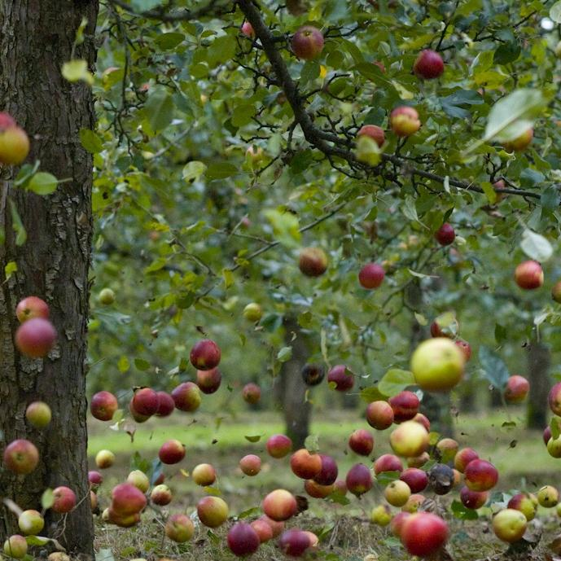
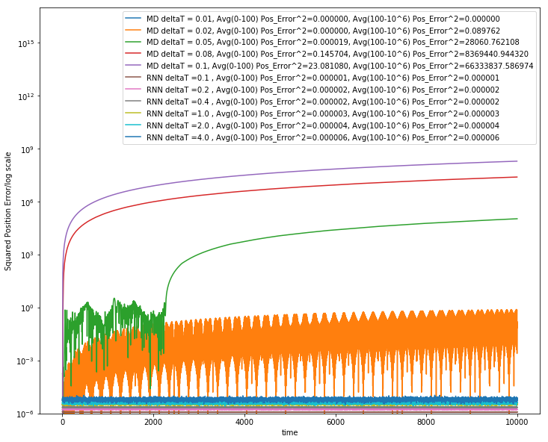
Learning how Apples Fall ?
Work with JCS Kadupitiya and Vikram Jadhao
We could use F=ma with 1D ODE solved by Verlet
Or use Recurrent Neural Network (LSTM) and Tensorflow (the new Newton)
Error Squared
MD dt > 0.01
MD dt = 0.01, LSTM

Slide 35
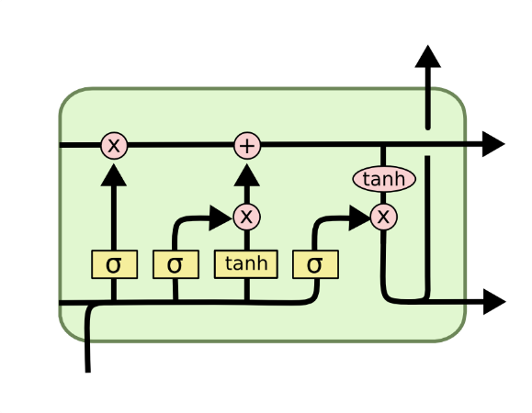
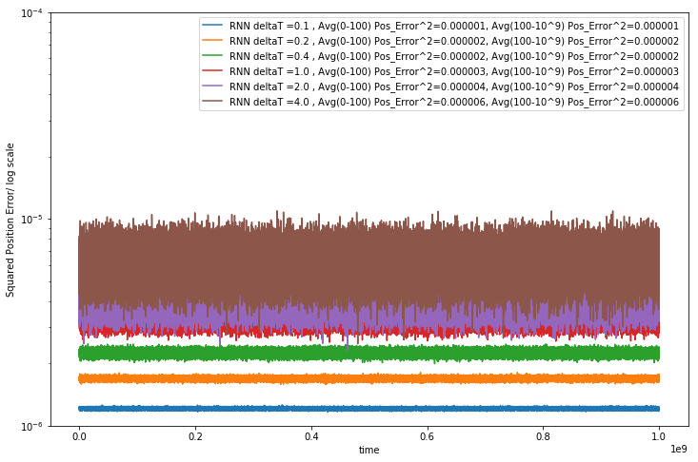
Extending to longer times
LSTM Cell
System trained up to t=100; network used up to t=10,000 or 10,000,000
Plots show error for MD and LSTM for different time steps. LSTM upto t=4
LSTM allows reliable large time steps; learns potential and differential operator
Compared to classic numerics has LOTS of parameters, statistical averaging (e.g. 32 initial LSTM’s only differing in randomized initial conditions) and nonlinear activation nodes
Looking at multiparticle systems learning O(N^2) potentia
Simple Harmonic Oscillator used upto 10⁹ dt
Error Squared
Timesteps

Slide 36
Computational Performance comparison
LJ is Lennard Jones potential
MD (Molecular Dynamics) simulations are performed with dt=0.01 using Velocity Verlet
All results are the full time up to T=100 and using unseen data
LSTM is fastest due to large step size allowed and retains accuracy
10x is dt=0.1
100x is dt=1
400x is dt=4 steps
RNN Type | Simple harmonic oscillator | Double well results | LJ potential single particle results
MD | MD time = 0.18sec | MD time = 0.19sec | MD time = 0.27sec
Vanilla RNN | 2 layers of 64 units each timeframes=5 MSE~0.01 RNN10x= 2.5sec Trainable parameters=12609 | 2 layers of 128 units each timeframes=10 MSE~0.95 RNN10x= 5.29sec Trainable parameters=49793 | 3 layers of 128 units each timeframes=10 MSE~0.84 RNN10x= 7.24sec Trainable parameters=82689
GRU | 2 layers of 16 units each timeframes=4 MSE~0.005 GRU10x= 4.69sec Trainable parameters=2513 | 2 layers, of 32 units each timeframes=5 MSE~0.005 GRU10x= 6.5sec Trainable parameters=9633 | 2 layers of 64 units each timeframes=5 MSE~0.01 GRU10x= 8.54sec Trainable parameters=37697
LSTM | 2 layers of 8 units each timeframes=4 MSE~0.005 LSTM 10x= 3.07sec LSTM100x= 0.21sec LSTM400x= 0.04sec Trainable parameters=905 | 2 layers of 16 units each timeframes=4 MSE~0.005 LSTM10x= 3.12sec LSTM100x= 0.22sec LSTM400x= 0.05sec Trainable parameters=3345 | 2 layers of 32 units each timeframes=4 MSE~0.01 LSTM10x= 3.27sec LSTM100x= 0.21sec LSTM400x= 0.06sec Trainable parameters=12833

Slide 37
Implications of MLforHPC for Benchmarking
Hyperparameter choice and impact on performance
Dynamic integration of ML and Simulation needs to be optimized and benchmarked
Important if nodes can do simulation and DL like CPU’s and GPU’s
Not much experience/consensus
Need to benchmark both the effort spent running ML to support HPC but also the performance increase gotten
This performance is raw speed for surrogates but is more subtle for use of collective coordinates and smart ensembles
Need to verify accuracy of surrogates and quality of learnt structure
When can we get to Zettascale remembering our first example achieved a speedup of 10⁵?

