Slide 1
AI-Driven Science and Engineering with the Global AI and Modeling Supercomputer GAIMSC
Workshop on Clusters, Clouds, and Data for Scientific Computing CCDSC 2018
Châteauform’, La Maison des Contes, 427 Chemin de Chanzé, (near Lyon) France September 4-7 2018
http://www.netlib.org/utk/people/JackDongarra/CCDSC-2018/
Geoffrey Fox, September 5, 2018
Digital Science Center
Department of Intelligent Systems Engineering
Indiana University Bloomington
gcf@indiana.edu, http://www.dsc.soic.indiana.edu/, http://spidal.org/

Slide 2
Let’s learn from Microsoft Research what they think are hot areas
Industry’s role in research much larger today than 20-40 years ago
Microsoft Research has about 1000 researchers and has 800 interns per year
One of the largest computer science research organizations (INRIA larger)
They just held a faculty summit August 2018 largely focused on systems for AI
https://www.microsoft.com/en-us/research/event/faculty-summit-2018/
With an interesting overview at the end positioning their work as building designing and using the "Global AI Supercomputer" concept linking the Intelligent Cloud to the Intelligent Edge https://www.youtube.com/watch?v=jsv7EWhCqIQ&feature=youtu.be

Slide 3
aa
aa

Slide 4
aa
aa

Slide 5
Adding Modeling?
Microsoft is very optimistic and excited
I added “Modeling” to get the Global AI and Modeling Supercomputer GAIMSC
Modeling was meant to
Include classic simulation oriented supercomputers
Even just in Big Data, one needs to build a model for the machine learning to use
Note many talks discussed autotuning i.e. using GAIMSC to optimize GAIMSC

Slide 6
Possible Slogans for Research in Global AI and Modeling Supercomputer arena
AI First Science and Engineering
Global AI and Modeling Supercomputer (Grid)
Linking Intelligent Cloud to Intelligent Edge
Linking Digital Twins to Deep Learning
High-Performance Big-Data Computing
Big Data and Extreme-scale Computing (BDEC)
Common Digital Continuum Platform for Big Data and Extreme Scale Computing (BDEC2)
Using High Performance Computing ideas/technologies to give higher functionality and performance “cloud” and “edge” systems
Software 2.0 – replace Python by Training Data
Industry 4.0 – Software defined machines or Industrial Internet of Things

Slide 7
Big Data and Extreme-scale Computing http://www.exascale.org/bdec/
BDEC Pathways to Convergence Report
New series BDEC2 “Common Digital Continuum Platform for Big Data and Extreme Scale Computing” with first meeting November 28-30, 2018 Bloomington Indiana USA.
First day is evening reception with meeting focus “Defining application requirements for a Common Digital Continuum Platform for Big Data and Extreme Scale Computing”
Next meetings: February 19-21 Kobe, Japan (National infrastructure visions) followed by two in Europe, one in USA and one in China.
http://www.exascale.org/bdec/sites/www.exascale.org.bdec/files/whitepapers/bdec2017pathways.pdf

Slide 8
AI First Research for AI-Driven Science and Engineering
Artificial Intelligence is a dominant disruptive technology affecting all our activities including business, education, research, and society.
Further, several companies have proposed AI first strategies.
They used to be mobile first
The AI disruption is typically associated with big data coming from edge, repositories or sophisticated scientific instruments such as telescopes, light sources and gene sequencers.
AI First requires mammoth computing resources such as clouds, supercomputers, hyperscale systems and their distributed integration.
AI First strategy is using the Global AI and Modeling Supercomputer GAIMSC
Indiana University is examining a Masters in AI-Driven Engineering

Slide 9
AI First Publicity: 2017 Headlines
The Race For AI: Google, Twitter, Intel, Apple In A Rush To Grab Artificial Intelligence Startups
Google, Facebook, And Microsoft Are Remaking Themselves Around AI
Google: The Full Stack AI Company
Bezos Says Artificial Intelligence to Fuel Amazon's Success
Microsoft CEO says artificial intelligence is the 'ultimate breakthrough'
Tesla’s New AI Guru Could Help Its Cars Teach Themselves
Netflix Is Using AI to Conquer the World... and Bandwidth Issues
How Google Is Remaking Itself As A “Machine Learning First” Company
If You Love Machine Learning, You Should Check Out General Electric
Notes:
until ISE came along

Slide 10
Requirements for Global AI (and Modeling) Supercomputer
Application Requirements: The structure of application clearly impacts needed hardware and software
Pleasingly parallel
Workflow
Global Machine Learning
Data model: SQL, NoSQL; File Systems, Object store; Lustre, HDFS
Distributed data from distributed sensors and instruments (Internet of Things) requires Edge computing model
Device – Fog – Cloud model and streaming data software and algorithms
Hardware: node (accelerators such as GPU or KNL for deep learning) and multi-node architecture configured as AI First HPC Cloud;
Disks speed and location
Software requirements: Programming model for GAIMSC
Analytics
Data management
Streaming or Repository access or both

Slide 11
Distinctive Features of Applications
Ratio of data to model sizes: vertical axis on next slide
Importance of Synchronization – ratio of inter-node communication to node computing: horizontal axis on next slide
Sparsity of Data or Model; impacts value of GPU’s or vector computing
Irregularity of Data or Model
Geographic distribution of Data as in edge computing; use of streaming (dynamic data) versus batch paradigms
Dynamic model structure as in some iterative algorithms

Slide 12
Big Data and Simulation Difficulty in Parallelism Size of Synchronization constraints
Loosely Coupled
Tightly Coupled
HPC Clouds: Accelerators
High Performance Interconnect
HPC Clouds/Supercomputers
Memory access also critical
Commodity Clouds
Size of Disk I/O
MapReduce as in scalable databases
Global Machine Learning
e.g. parallel clustering
Deep Learning
Graph Analytics e.g. subgraph mining
LDA
Pleasingly Parallel
Often independent events
Unstructured Adaptive Sparse
Current major Big Data category
Linear Algebra at core (often not sparse)
Structured Adaptive Sparse
Parameter sweep simulations
Largest scale simulations
Just two problem characteristics
There is also data/compute distribution seen in grid/edge computing
Exascale Supercomputers

Slide 13
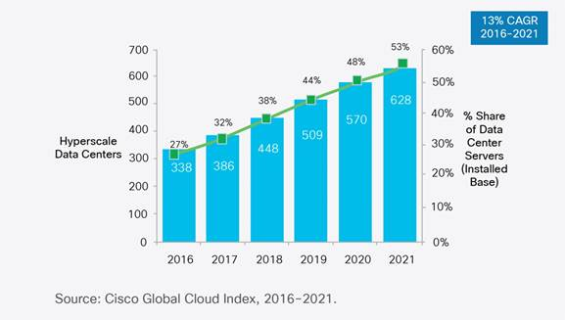
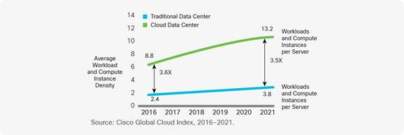
Remembering Grid Computing: IoT and Distributed Center I
Hyperscale data centers will grow from 338 in number at the end of 2016 to 628 by 2021. They will represent 53 percent of all installed data center servers by 2021.
They form a distributed Compute (on data) grid with some 50 million servers
94 percent of workloads and compute instances will be processed by cloud data centers by 2021-- only six percent will be processed by traditional data centers.
Analysis from CISCO https://www.cisco.com/c/en/us/solutions/collateral/service-provider/global-cloud-index-gci/white-paper-c11-738085.html
Number of Public or Private Cloud Data Center Instances
Number of Cloud Data Centers
Number of instances per server

Slide 14
Remembering Grid Computing: IoT and Distributed Center II
By 2021, Cisco expects IoT connections to reach 13.7 billion, up from 5.8 billion in 2016, according to its Global Cloud Index.
Globally, the data stored in data centers will nearly quintuple by 2021 to reach 1.3ZB by 2021, up 4.6-fold (a CAGR of 36 percent) from 286 exabytes (EB) in 2016.
Big data will reach 403 EB by 2021, up almost eight-fold from 25EB in 2016. Big data will represent 30 percent of data stored in data centers by 2021, up from 18 percent in 2016.
The amount of data stored on devices will be 4.5-times higher than data stored in data centers, at 5.9ZB by 2021.
Driven largely by IoT, the total amount of data created (and not necessarily stored) by any device will reach 847ZB per year by 2021, up from 218ZB per year in 2016.
The Intelligent Edge or IoT is a distributed Data Grid

Slide 15
Mary Meeker identifies even more digital data

Slide 16
Overall Global AI and Modeling Supercomputer GAIMSC Architecture
There is only a cloud at the logical center but it’s physically distributed and owned by a few major players
There is a very distributed set of devices surrounded by local Fog computing; this forms the logically and physically distributed edge
The edge is structured and largely data
These are two differences from the Grid of the past
e.g. self driving car will have its own fog and will not share fog with truck that it is about to collide with
The cloud and edge will both be very heterogeneous with varying accelerators, memory size and disk structure.

Slide 17
Its is challenging these days to compete with Berkeley, Stanford, Google, Facebook, Amazon, Microsoft, IBM.
Zaharia from Stanford (earlier Berkeley and Spark)

Slide 18
Collaborating on the Global AI and Modeling Supercomputer GAIMSC
Microsoft says:
We can only “play together” and link functionalities from Google, Amazon, Facebook, Microsoft, Academia if we have open API’s and open code to customize
We must collaborate
Open source Apache software
Academia needs to use and define their own Apache projects
We want to use AI supercomputer for AI-Driven science studying the early universe and the Higgs boson and not just producing annoying advertisements (goal of most elite CS researchers)

Slide 19
Should we train data scientists or data engineers?
Gartner says that 3 times as many jobs for data engineers as data scientists.
There is more to life (jobs) than Machine Learning!
ML Code
NIPS 2015 http://papers.nips.cc/paper/5656-hidden-technical-debt-in-machine-learning-systems.pdf

Slide 20
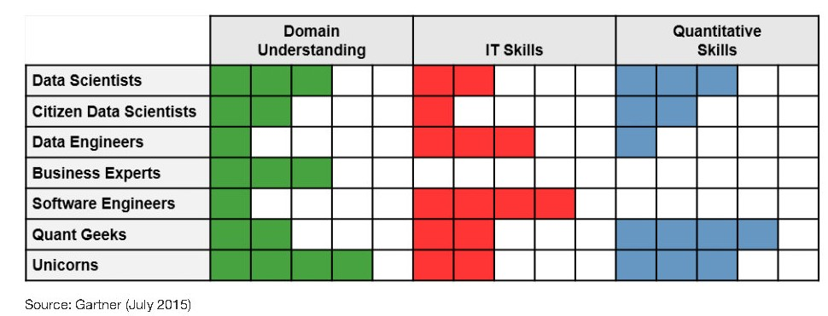
Gartner on Data Engineering
Gartner says that job numbers in data science teams are
10% - Data Scientists
20% - Citizen Data Scientists ("decision makers")
30% - Data Engineers
20% - Business experts
15% - Software engineers
5% - Quant geeks
~0% - Unicorns (very few exist!)

Slide 21
Ways of adding High Performance to Global AI (and Modeling) Supercomputer
Fix performance issues in Spark, Heron, Hadoop, Flink etc.
Messy as some features of these big data systems intrinsically slow in some (not all) cases
All these systems are “monolithic” and difficult to deal with individual components
Execute HPBDC from classic big data system with custom communication environment – approach of Harp for the relatively simple Hadoop environment
Provide a native Mesos/Yarn/Kubernetes/HDFS high performance execution environment with all capabilities of Spark, Hadoop and Heron – goal of Twister2
Execute with MPI in classic (Slurm, Lustre) HPC environment
Add modules to existing frameworks like Scikit-Learn or Tensorflow either as new capability or as a higher performance version of existing module.

Slide 22
Working with Industry?
Many academic areas today have been turned upside down by the increased role of industry as there is so much overlap between major University research issues and problems where the large technology companies are battling it out for commercial leadership.
Correspondingly we have seen -- especially with top-ranked departments --- increasing numbers and styles of industry-university collaboration. Probably most departments must join this trend and increase their Industry links if they are to thrive.
Sometimes faculty are 20% University and 80% Industry
These links can have the student internship opportunity needed for ABET and traditional in the field.
However, this is a double-edged sword as the increased access to internships for our best Ph.D. students is one reason for the decrease in University research contribution.
We should try to make such internships part of joint University-Industry research and not just an Industry only activity
Relationship can be jointly run centers such as NSF I/UCRC and Industry oriented University centers such as Intel parallel Computing centers

Slide 23
GAIMSC Global AI & Modeling Supercomputer Questions
What do gain from the concept? e.g. Ability to work with Big Data community
What do we lose from the concept? e.g. everything runs as slow as Spark
Is GAIMSC useful for BDEC2 initiative? For NSF? For DoE? For Universities? For Industry? For users?
Does adding modeling to concept add value?
What are the research issues for GAIMSC? e.g. how to program?
What can we do with GAIMSC that we couldn’t do with classic Big Data technologies?
What can we do with GAIMSC that we couldn’t do with classic HPC technologies?
Are there deep or important issues associated with the “Global” in GAIMSC?
Is the concept of an auto-tuned Global AI Supercomputer scary?

