Slide 1
AI-Driven Science and Engineering with the Global AI and Modeling Supercomputer GAIMSC: Extra Slides
Workshop on Clusters, Clouds, and Data for Scientific Computing CCDSC 2018
Châteauform’, La Maison des Contes, 427 Chemin de Chanzé, (near Lyon) France, September 4-7 2018
http://www.netlib.org/utk/people/JackDongarra/CCDSC-2018/
Geoffrey Fox, September 5, 2018
Digital Science Center
Department of Intelligent Systems Engineering
Indiana University Bloomington
gcf@indiana.edu, http://www.dsc.soic.indiana.edu/, http://spidal.org/

Slide 2
aa
aa

Slide 3
What are GAIMSC Researchers looking at? Topics in Microsoft Faculty Summit I
Systems Research | Fueling Future Disruptions Overall Vision
Welcome: https://youtu.be/_IF9esNec3E
Introduction: https://youtu.be/RnzjxXOqovc
Summary: Global AI Supercomputer: Intelligent Cloud and Intelligent Edge: https://youtu.be/jsv7EWhCqIQ
Entrepreneurship and Systems Research https://youtu.be/vszcATWtr2U
Azure and Intelligent Cloud
Inside Microsoft Azure Datacenter Architecture:
The Art of Building a Reliable Cloud Network https://youtu.be/Iiwb7ysxyck
Fundamentals of Artificial Intelligence AI and Intelligent Systems
Free Inference and Instant Training: Breakthroughs and Implications https://youtu.be/Tkl6ERLWAbA. 3 slidesets
Knowledge Systems and AI
AI Infrastructure and Tools. 1 slideset

Slide 4
Topics in Microsoft Faculty Summit II
AI to Control (AI) Systems. GAIMSC is autotuned by itself
Database and Data Analytic Systems https://youtu.be/nxEIfluXQ_A 3 slidesets
AI for AI Systems https://youtu.be/MqBOuoLflpU. 2 slidesets
The Good, the Bad, and the Ugly of ML for Networked Systems. 3 slidesets
Edge Computing
Intelligent Edge. 4 slidesets
Security and Privacy
Verification and Secure Systems https://youtu.be/J9977DaNAlc 2 slidesets
Confidential Computing. 4 slidesets
CPU & DRAM Bugs: Attacks & Defenses. 3 slidesets
Current Trends in Blockchain Technology https://youtu.be/QcRQRUlk5Xs. 3 slidesets

Slide 5
Topics in Microsoft Faculty Summit III
Physical Systems
Hardware-accelerated Networked Systems. 2 slidesets
Programmable Hardware for Distributed Systems. 1 slideset
Future of Cloud Storage Systems. 2 slidesets
Quantum Computers: Software and Hardware Architecture. 2 slidesets
Software Engineering
Continuous Deployment: Current and Future Challenges. 2 slidesets

Slide 6
aa
aa

Slide 7
aa
aa

Slide 8
aa
aa

Slide 9
aa
aa

Slide 10
Zaharia discussed ML Platforms. This is goal of BDEC2 and many in this room

Slide 11
Zaharia discussed MLflow. He ignores HPC workflow systems

Slide 12
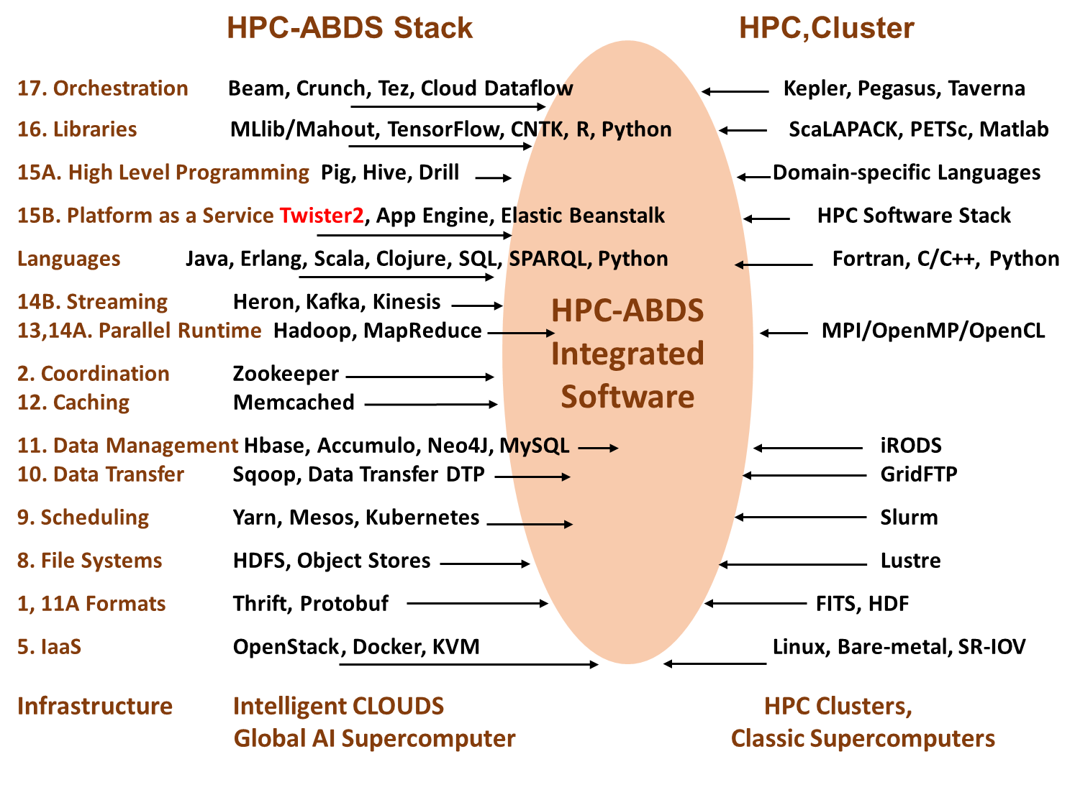
Different choices in software systems for Global AI Supercomputer and for simulation supercomputers

Slide 13
GAIMSC Programming Environment Components I
Area | Component | Implementation | Comments: User API
Architecture Specification | Coordination Points | State and Configuration Management; Program, Data and Message Level | Change execution mode; save and reset state
 | Execution Semantics | Mapping of Resources to Bolts/Maps in Containers, Processes, Threads | Different systems make different choices - why?
 | Parallel Computing | Spark Flink Hadoop Pregel MPI modes | Owner Computes Rule
Job Submission | (Dynamic/Static) Resource Allocation | Plugins for Slurm, Yarn, Mesos, Marathon, Aurora | Client API (e.g. Python) for Job Management
Task System | Task migration | Monitoring of tasks and migrating tasks for better resource utilization | Task-based programming with Dynamic or Static Graph API; FaaS API; Support accelerators (CUDA,FPGA, KNL)
 | Elasticity | OpenWhisk
 | Streaming and FaaS Events | Heron, OpenWhisk, Kafka/RabbitMQ
 | Task Execution | Process, Threads, Queues
 | Task Scheduling | Dynamic Scheduling, Static Scheduling, Pluggable Scheduling Algorithms
 | Task Graph | Static Graph, Dynamic Graph Generation

Slide 14
GAIMSC Programming Environment Components II
Area | Component | Implementation | Comments
Communication API | Messages | Heron | This is user level and could map to multiple communication systems
 | Dataflow Communication | Fine-Grain Twister2 Dataflow communications: MPI,TCP and RMA Coarse grain Dataflow from NiFi, Kepler? | Streaming, ETL data pipelines; Define new Dataflow communication API and library
 | BSP Communication Map-Collective | Conventional MPI, Harp | MPI Point to Point and Collective API
Data Access | Static (Batch) Data | File Systems, NoSQL, SQL | Data API
 | Streaming Data | Message Brokers, Spouts
Data Management | Distributed Data Set | Relaxed Distributed Shared Memory(immutable data), Mutable Distributed Data | Data Transformation API; Spark RDD, Heron Streamlet
Fault Tolerance | Check Pointing | Upstream (streaming) backup; Lightweight; Coordination Points; Spark/Flink, MPI and Heron models | Streaming and batch cases distinct; Crosses all components
Security | Storage, Messaging, execution | Research needed | Crosses all Components

Slide 15
Abstract
Most things are dominated by Artificial Intelligence (AI). Technology Companies like Amazon, Google, Facebook, and Microsoft are AI First organizations.
Engineering achievement today is highlighted by the AI buried in a vehicle or machine. Industry (Manufacturing) 4.0 focusses on the AI-Driven future of the Industrial Internet of Things.
Software is eating the world.
We can describe much computer systems work as designing, building and using the Global AI and Modelling supercomputer which itself is autonomously tuned by AI. We suggest that this is not just a bunch of buzzwords but has profound significance and examine consequences of this for education and research.
Naively high-performance computing should be relevant for the AI supercomputer but somehow the corporate juggernaut is not making so much use of it. We discuss how to change this.

