Slide 1
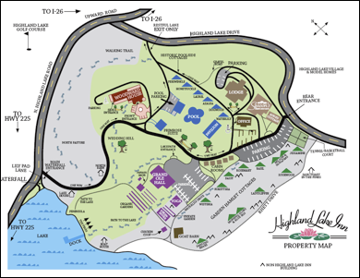
MPI and MapReduce
CCGSC 2010 Flat Rock NC
September 8 2010
Geoffrey Fox
gcf@indiana.edu
http://www.infomall.org http://www.futuregrid.org
Director, Digital Science Center, Pervasive Technology Institute
Associate Dean for Research and Graduate Studies, School of Informatics and Computing
Indiana University Bloomington

Slide 2
MapReduce
Data Partitions
Map(Key, Value)
A hash function maps the results of the map tasks to reduce tasks
Reduce(Key, List<Value>)
Reduce Outputs
Implementations (Hadoop – Java; Dryad – Windows) support:
Splitting of data with customized file systems
Passing the output of map functions to reduce functions
Sorting the inputs to the reduce function based on the intermediate keys
Quality of service
20 petabytes per day (on an average of 400 machines) processed by Google using MapReduce September 2007

Slide 3
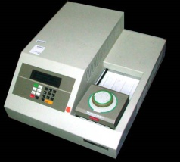
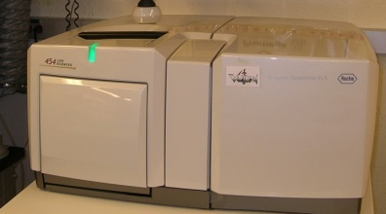
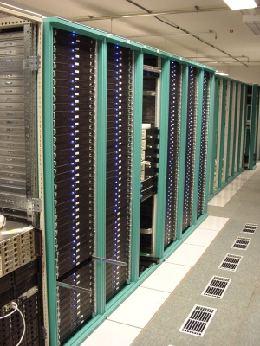
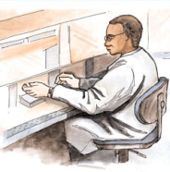
MapReduce “File/Data Repository” Parallelism
Map = (data parallel) computation reading and writing data
Reduce = Collective/Consolidation phase e.g. forming multiple global sums as in histogram
Instruments
MPI or Iterative MapReduce
Map Reduce Map Reduce Map
Communication
Reduce
Portals /Users
Disks
Map₁
Map₂
Map₃

Slide 4
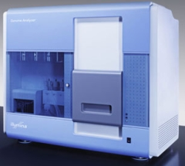
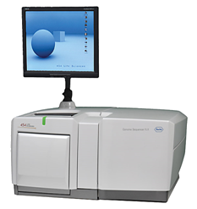
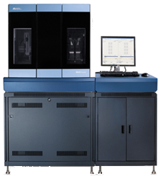
Typical Application Challenge: DNA Sequencing Pipeline
MapReduce
Pairwise
clustering
FASTA File N Sequences
block
Pairings
Sequence
Alignment/
Assembly
Dissimilarity
Matrix
N(N-1)/2 values
MPI
Visualization
Blocking
MDS
Read Alignment
Illumina/Solexa Roche/454 Life Sciences Applied Biosystems/SOLiD
Internet
Modern Commercial Gene Sequencers
Linear Algebra or Expectation Maximization based data mining poor on MapReduce – equivalent to using MPI writing messages to disk and restarting processes each step/iteration of algorithm

Slide 5
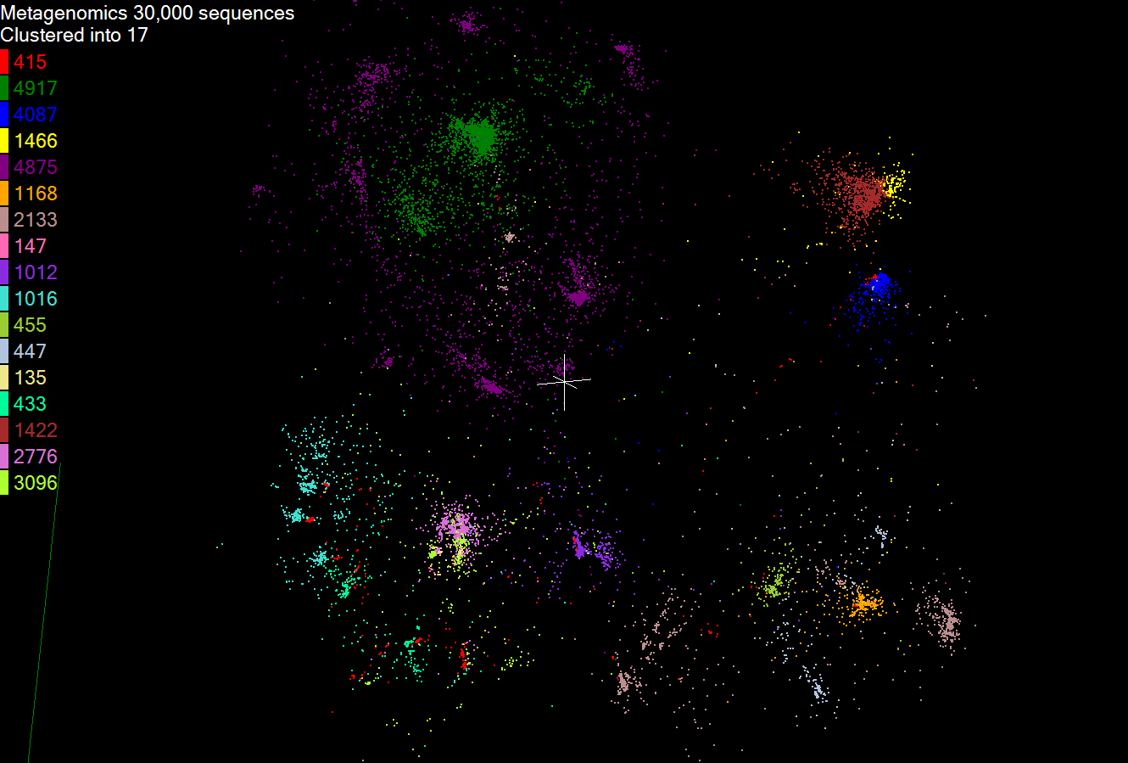
Metagenomics
This visualizes results of dimension reduction to 3D of 30000 gene sequences from an environmental sample. The many different genes are classified by clustering algorithm and visualized by MDS dimension reduction

Slide 6
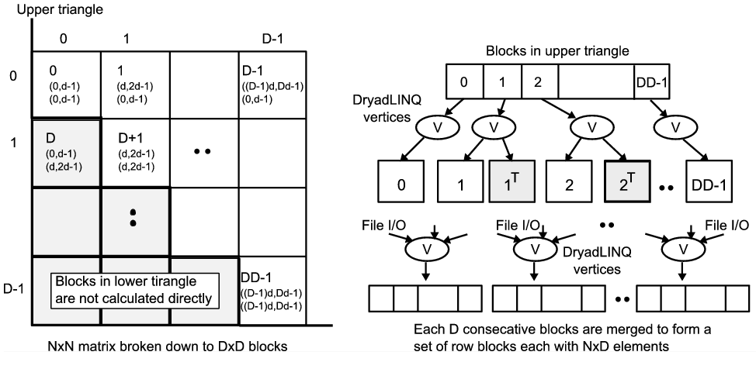
All-Pairs Using MPI or DryadLINQ
125 million distances
4 hours & 46 minutes
Calculate Pairwise Distances (Smith Waterman Gotoh)
Calculate pairwise distances for a collection of genes (used for clustering, MDS)
Fine grained tasks in MPI
Coarse grained tasks in DryadLINQ
Performed on 768 cores (Tempest Cluster)
Moretti, C., Bui, H., Hollingsworth, K., Rich, B., Flynn, P., & Thain, D. (2009). All-Pairs: An Abstraction for Data Intensive Computing on Campus Grids. IEEE Transactions on Parallel and Distributed Systems , 21, 21-36.

Slide 7
Smith Waterman MPI DryadLINQ Hadoop
Hadoop is Java; MPI and Dryad are C#

Slide 8
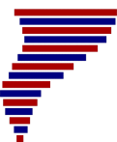
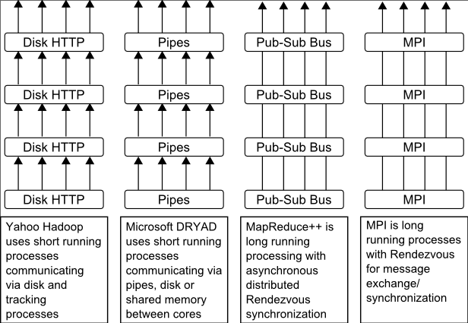
Twister(MapReduce++)
Pub/Sub Broker Network
Map Worker
M
Worker Nodes
R
Reduce Worker
Streaming based communication
Intermediate results are directly transferred from the map tasks to the reduce tasks – eliminates local files
Cacheable map/reduce tasks
Static data remains in memory
Combine phase to combine reductions
User Program is the composer of MapReduce computations
Extends the MapReduce model to iterative computations
D
D
MR
Driver
User
Program
M
M
M
M
D
MRDeamon
R
R
R
R
Data Read/Write
Communication
Data Split
File System
Iterate
Static
data
Configure()
User Program
Map(Key, Value)
δ flow
Reduce (Key, List<Value>)
Combine (Key, List<Value>)
Different synchronization and intercommunication mechanisms used by the parallel runtimes
Close()

Slide 9
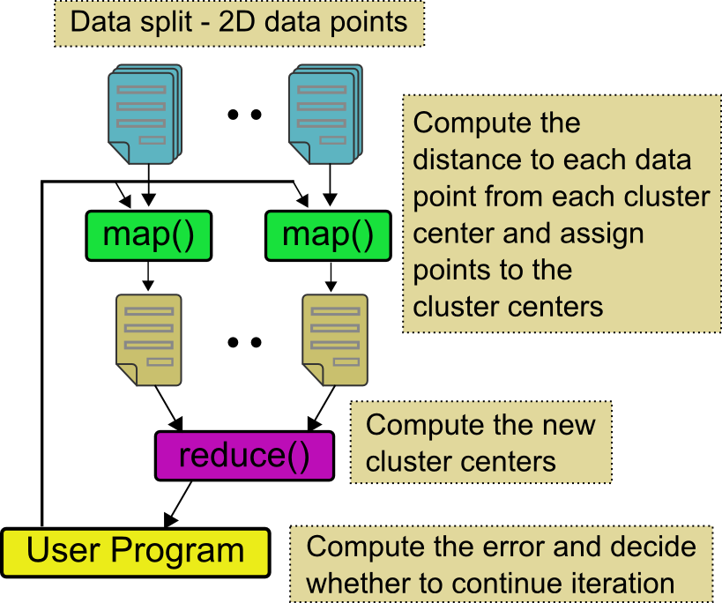
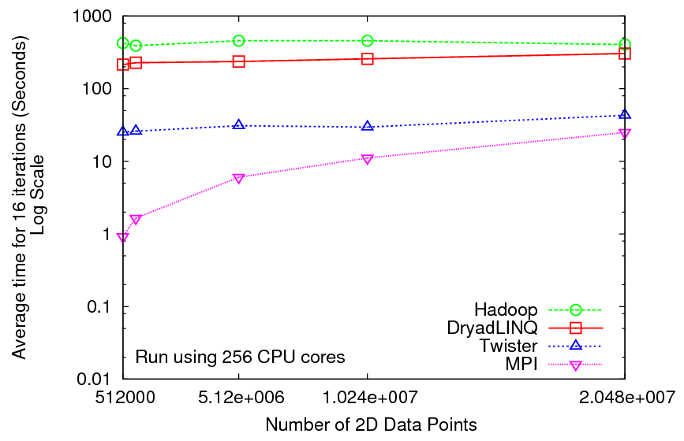
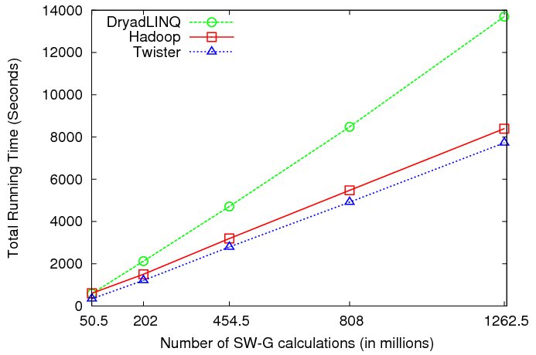
Iterative and non-Iterative Computations
K-means
Smith Waterman is a non iterative case and of course runs fine
Performance of K-Means

Slide 10
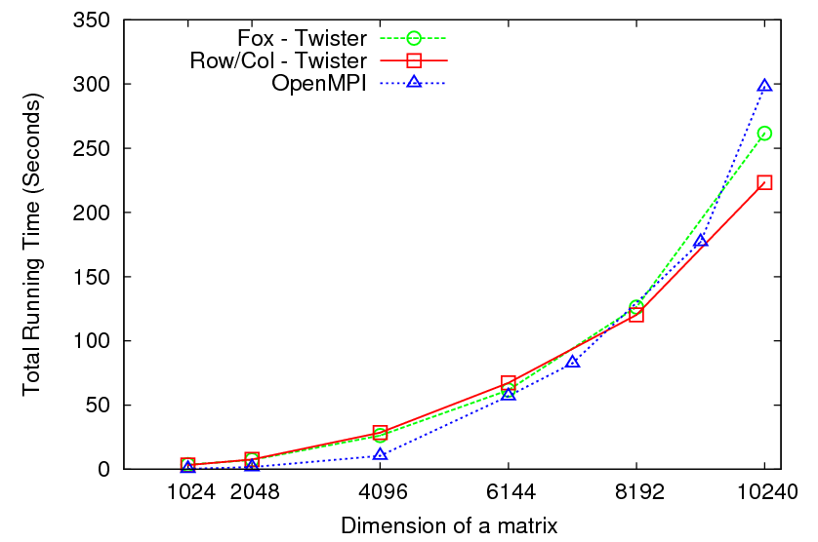
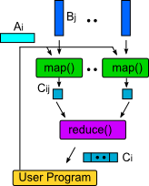
Matrix Multiplication 64 cores
Square blocks Twister
Row/Col decomp Twister
Square blocks OpenMPI

Slide 11
Overhead OpenMPI v Twister negative overhead due to cache

Slide 12
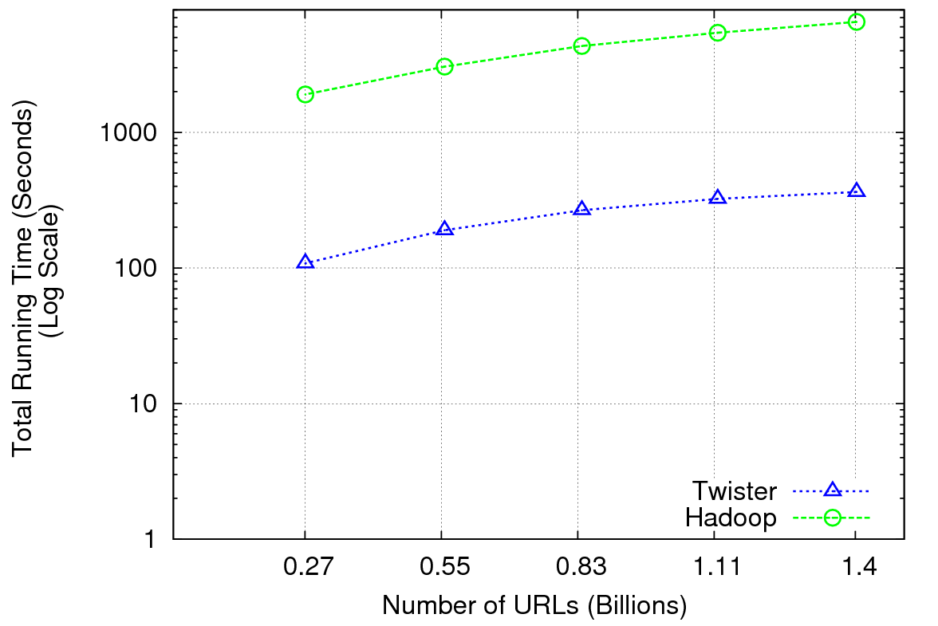
Performance of Pagerank using ClueWeb Data (Time for 20 iterations) using 32 nodes (256 CPU cores) of Crevasse

Slide 13
Fault Tolerance and MapReduce
MPI does “maps” followed by “communication” including “reduce” but does this iteratively
There must (for most communication patterns of interest) be a strict synchronization at end of each communication phase
Thus if a process fails then everything grinds to a halt
In MapReduce, all Map processes and all reduce processes are independent and stateless and read and write to disks
As 1 or 2 (reduce+map) iterations, no difficult synchronization issues
Thus failures can easily be recovered by rerunning process without other jobs hanging around waiting
Re-examine MPI fault tolerance in light of MapReduce
Relevant for Exascale?
Re-examine MapReduce in light of MPI experience …..

Slide 14
MPI & Iterative MapReduce papers
MapReduce on MPI Torsten Hoefler, Andrew Lumsdaine and Jack Dongarra, Towards Efficient MapReduce Using MPI, Recent Advances in Parallel Virtual Machine and Message Passing Interface Lecture Notes in Computer Science, 2009, Volume 5759/2009, 240-249
MPI with generalized MapReduce
Jaliya Ekanayake, Hui Li, Bingjing Zhang, Thilina Gunarathne, Seung-Hee Bae, Judy Qiu, Geoffrey Fox Twister: A Runtime for Iterative MapReduce, Proceedings of the First International Workshop on MapReduce and its Applications of ACM HPDC 2010 conference, Chicago, Illinois, June 20-25, 2010 http://grids.ucs.indiana.edu/ptliupages/publications/twister__hpdc_mapreduce.pdf http://www.iterativemapreduce.org/
Grzegorz Malewicz, Matthew H. Austern, Aart J. C. Bik, James C. Dehnert, Ilan Horn, Naty Leiser, and Grzegorz Czajkowski Pregel: A System for Large-Scale Graph Processing, Proceedings of the 2010 international conference on Management of data Indianapolis, Indiana, USA Pages: 135-146 2010
Yingyi Bu, Bill Howe, Magdalena Balazinska, Michael D. Ernst HaLoop: Efficient Iterative Data Processing on Large Clusters, Proceedings of the VLDB Endowment, Vol. 3, No. 1, The 36th International Conference on Very Large Data Bases, September 1317, 2010, Singapore.
Matei Zaharia, Mosharaf Chowdhury, Michael J. Franklin, Scott Shenker, Ion Stoica Spark: Cluster Computing with Working Sets poster at http://radlab.cs.berkeley.edu/w/upload/9/9c/Spark-retreat-poster-s10.pdf

Slide 15
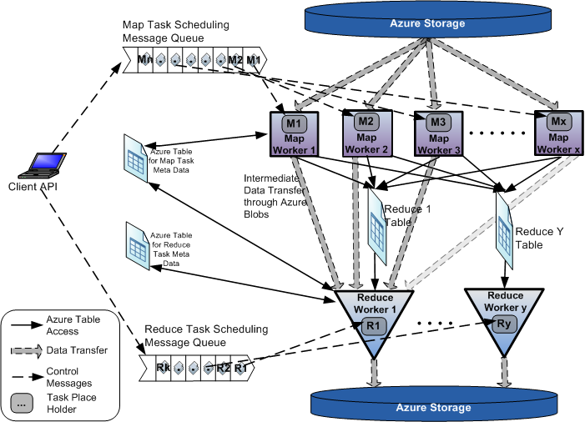
AzureMapReduce

Slide 16
Scaled Timing with Azure/Amazon MapReduce

Slide 17
Cap3 Cost
Notes:
This is just the cost for the compute instances. In addition to this, there will be minor charges for the data storage for EMR & AzureMR. Also there will be additional minor charges for the queue service and table service for AzureMR.
Cost presented here are amortized for the actual time (time/3600 * num_instances * instance_price_per_hour), assuming the remaining time of the instance hour have been put to useful work.
Note: EMR & Hadoop-EC2 requires one extra node to act as the master node (included in the cost calculation)

Slide 18
Smith Waterman: “Scaled Speedup” Timing

Slide 19
Smith Waterman: daily effect

Slide 20
SWG Cost
Notes:
This is just the cost for the compute instances. In addition to this, there will be minor charges for the data storage for EMR & AzureMR. Also there will be additional minor charges for the queue service and table service for AzureMR.
Cost presented here are amortized for the actual time (time/3600 * num_instances * instance_price_per_hour), assuming the remaining time of the instance hour have been put to useful work.
Note: EMR & Hadoop-EC2 requires one extra node to act as the master node (included in the cost calculation)

Slide 21
TwisterMPIReduce
PairwiseClustering MPI
Multi Dimensional Scaling MPI
Generative Topographic Mapping MPI
Other …
TwisterMPIReduce
Azure Twister (C# C++)
Java Twister
Microsoft Azure
FutureGrid
Local Cluster
Amazon EC2
Runtime package supporting subset of MPI mapped to Twister
Set-up, Barrier, Broadcast, Reduce

Slide 22
Some Issues with AzureTwister and AzureMapReduce
Transporting data to Azure: Blobs (HTTP), Drives (GridFTP etc.), Fedex disks
Intermediate data Transfer: Blobs (current choice) versus Drives (should be faster but don’t seem to be)
Azure Table v Azure SQL: Handle all metadata
Messaging Queues: Use real publish-subscribe system in place of Azure Queues to get scaling (?) with multiple brokers – especially AzureTwister
Azure Affinity Groups: Could allow better data-compute and compute-compute affinity

Slide 23
Research Issues
Clouds are suitable for “Loosely coupled” data parallel applications
“Map Only” (really pleasingly parallel) certainly run well on clouds (subject to data affinity) with many programming paradigms
Parallel FFT and adaptive mesh PDE solver very bad on MapReduce but suitable for classic MPI engines.
MapReduce is more dynamic and fault tolerant than MPI; it is simpler and easier to use
Is there an intermediate class of problems for which Iterative MapReduce useful?
Long running processes?
Mutable data small in size compared to fixed data(base)?
Only support reductions?
Is it really different from a fault tolerant MPI?
Multicore implementation
Link to HDFS or equivalent data parallel file system
Will AzureTwister run satisfactorily?

Slide 24
FutureGrid in a Nutshell
FutureGrid provides a testbed with a wide variety of computing services to its users
Supporting users developing new applications and new middleware using Cloud, Grid and Parallel computing (Hypervisors – Xen, KVM, ScaleMP, Linux, Windows, Nimbus, Eucalyptus, Hadoop, Globus, Unicore, MPI, OpenMP …)
Software supported by FutureGrid or users
~5000 dedicated cores distributed across country
The FutureGrid testbed provides to its users:
A rich development and testing platform for middleware and application users looking at interoperability, functionality and performance
A rich education and teaching platform for advanced cyberinfrastructure classes
Each use of FutureGrid is an experiment that is reproducible
Cloud infrastructure supports loading of general images on Hypervisors like Xen; FutureGrid dynamically provisions software as needed onto “bare-metal” using Moab/xCAT based environment

Slide 25
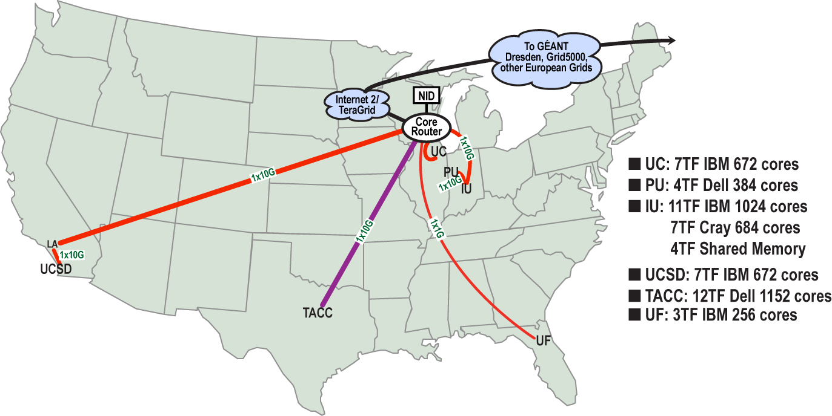
FutureGrid: a Grid/Cloud Testbed
Operational: IU Cray operational; IU , UCSD, UF & UC IBM iDataPlex operational
Network, NID operational
TACC Dell running acceptance tests – ready ~September 15
Private Public
NID: Network Impairment Device
FG Network

Slide 26
FutureGrid Dynamic Provisioning Results
Time minutes
Number of nodes
Time elapsed between requesting a job and the jobs reported start time on the provisioned node. The numbers here are an average of 2 sets of experiments.

Slide 27
200 papers submitted to main track; 4 days of tutorials

