Slide 1
Data Analytics: Clouds, Algorithms, and Curricula
CDAC Pune India
December 20 2012 (postponed from December 19)
Geoffrey Fox
gcf@indiana.edu
http://www.infomall.org http://www.futuregrid.org
School of Informatics and Computing
Digital Science Center
Indiana University Bloomington

Slide 2
Abstract
We suggest that big data implies robust data-mining algorithms that must run in parallel to achieve needed performance. Further we need appropriate data science training to support the different X-Informatics fields that are emerging and expanding.
Further the ability to use Cloud computing allows us to tap cheap commercial resources and several important data and programming advances. Nevertheless we also need to exploit traditional HPC environments.
Both cloud computing and data science are expected to have many millions of new jobs for our students.
We discuss an approach to the technical challenges which involves Iterative MapReduce as an interoperable Cloud-HPC runtime. We stress that the communication structure of data analytics is very different from classic parallel algorithms as one uses large collective operations (reductions or broadcasts) rather than the many small messages familiar from parallel particle dynamics and partial differential equation solvers.
Data science needs different runtime optimizations from those familiar from simulations. We discuss sample algorithms for clustering and visualization by dimension reduction
We suggest that a coordinated effort is needed to enable big data analytics across many fields. We need data science curricula, quality scalable robust data mining libraries and system architectures that support data intensive applications.
We mention FutureGrid and a software defined Computing Testbed as a Service

Slide 3
Broad Overview:
Data Deluge to Clouds

Slide 4

Some Trends
  The Data Deluge is clear trend from Commercial (Amazon, e-commerce) , Community (Facebook, Search) and Scientific applications
  Light weight clients from smartphones, tablets to sensors
  Multicore reawakening parallel computing
  Exascale initiatives will continue drive to high end with a simulation orientation
  Clouds with cheaper, greener, easier to use IT for (some) applications
  New jobs associated with new curricula
    Clouds as a distributed system (classic CS courses)
    Data Analytics (Important theme in academia and industry)
    Network/Web Science

Slide 5
Some Data sizes
  ~40 10⁹ Web pages at ~300 kilobytes each = 10 Petabytes
  Youtube 48 hours video uploaded per minute;
    in 2 months in 2010, uploaded more than total NBC ABC CBS
    ~2.5 petabytes per year uploaded?
  LHC 15 petabytes per year
  Radiology 69 petabytes per year
  Square Kilometer Array Telescope will be 100 terabits/second
  Earth Observation becoming ~4 petabytes per year
  Earthquake Science – few terabytes total today
  PolarGrid – 100’s terabytes/year
  Exascale simulation data dumps – terabytes/second

Slide 6
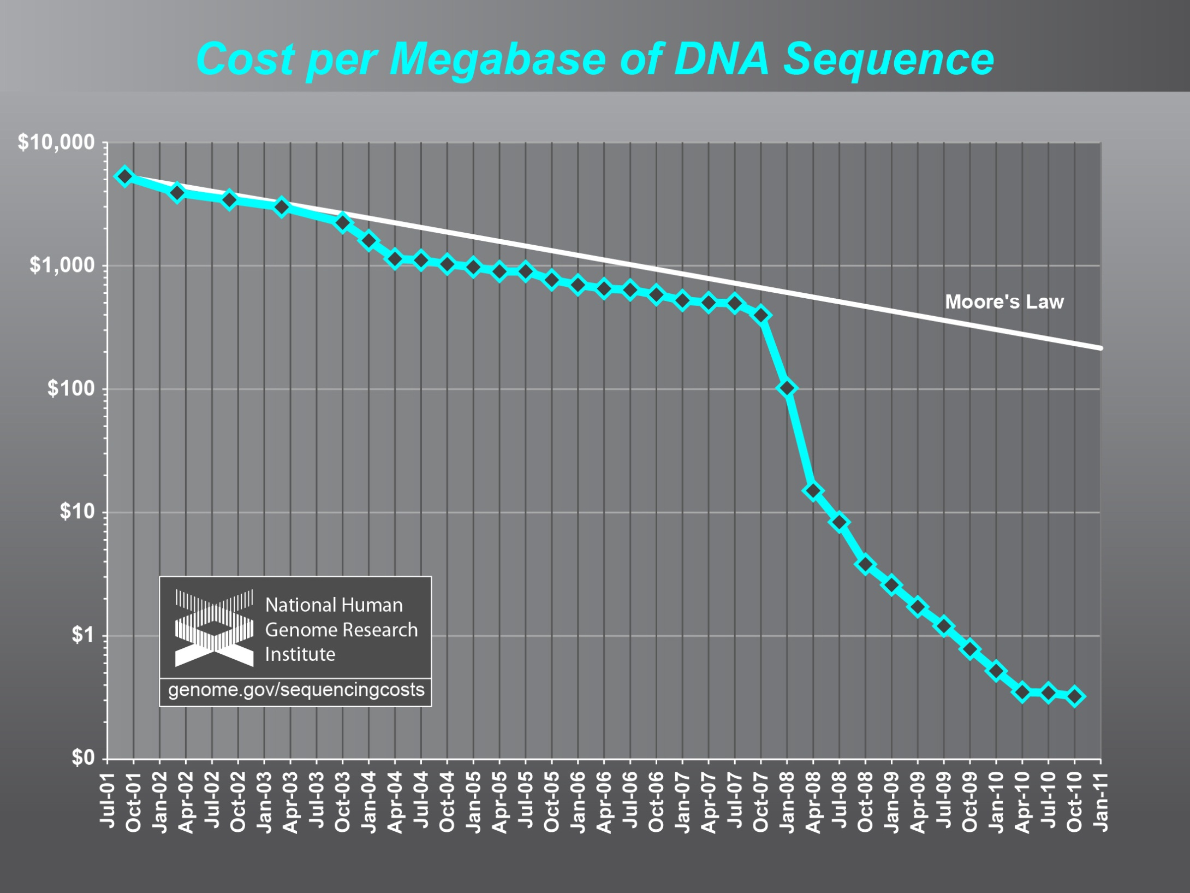
Why need cost effective
Computing!
Full Personal Genomics: 3 petabytes per day

Slide 7
Clouds Offer From different points of view
Features from NIST:
  On-demand service (elastic);
  Broad network access;
  Resource pooling;
  Flexible resource allocation;
  Measured service
Economies of scale in performance and electrical power (Green IT)
Powerful new software models
  Platform as a Service is not an alternative to Infrastructure as a Service – it is instead an incredible valued added
  Amazon is as much PaaS as Azure

Slide 8
Some Sizes in 2010
http://www.mediafire.com/file/zzqna34282frr2f/koomeydatacenterelectuse2011finalversion.pdf
30 million servers worldwide
Google had 900,000 servers (3% total world wide)
Google total power ~200 Megawatts
  < 1% of total power used in data centers (Google more efficient than average – Clouds are Green!)
  ~ 0.01% of total power used on anything world wide
Maybe total clouds are 20% total world server count (a growing fraction)

Slide 9
Some Sizes Cloud v HPC
Top Supercomputer Sequoia Blue Gene Q at LLNL
  16.32 Petaflop/s on the Linpack benchmark using 98,304 CPU compute chips with 1.6 million processor cores and 1.6 Petabyte of memory in 96 racks covering an area of about 3,000 square feet
  7.9 Megawatts power
Largest (cloud) computing data centers
  100,000 servers at ~200 watts per CPU chip
  Up to 30 Megawatts power
So largest supercomputer is around 1-2% performance of total cloud computing systems with Google ~20% total

Slide 10
Clouds in Science

Slide 11
2 Aspects of Cloud Computing:
Infrastructure and Runtimes
Cloud infrastructure: outsourcing of servers, computing, data, file space, utility computing, etc..
Cloud runtimes or Platform: tools to do data-parallel (and other) computations. Valid on Clouds and traditional clusters
  Apache Hadoop, Google MapReduce, Microsoft Dryad, Bigtable, Chubby and others
  MapReduce designed for information retrieval but is excellent for a wide range of science data analysis applications
  Can also do much traditional parallel computing for data-mining if extended to support iterative operations
  Data Parallel File system as in HDFS and Bigtable

Slide 12
Infrastructure, Platforms, Software as a Service
Software
(Application
Or Usage) SaaS
Education
Applications
CS Research Use e.g. test new compiler or storage model
Software Services are building blocks of applications
The middleware or computing environment
Nimbus, Eucalyptus, OpenStack, OpenNebula
CloudStack
OpenFlow
Cloud e.g. MapReduce
HPC e.g. PETSc, SAGA
Computer Science e.g. Compiler tools, Sensor nets, Monitors
Platform
PaaS
Infra
structure
IaaS
Software Defined Computing (virtual Clusters)
Hypervisor, Bare Metal
Operating System
Network
NaaS
Software Defined Networks
OpenFlow GENI

Slide 13
Science Computing Environments
Large Scale Supercomputers – Multicore nodes linked by high performance low latency network
  Increasingly with GPU enhancement
  Suitable for highly parallel simulations
High Throughput Systems such as European Grid Initiative EGI or Open Science Grid OSG typically aimed at pleasingly parallel jobs
  Can use “cycle stealing”
  Classic example is LHC data analysis
Grids federate resources as in EGI/OSG or enable convenient access to multiple backend systems including supercomputers
  Portals make access convenient and
  Workflow integrates multiple processes into a single job
Specialized visualization, shared memory parallelization etc. machines

Slide 14
Clouds HPC and Grids
Synchronization/communication Performance
Grids > Clouds > Classic HPC Systems
Clouds naturally execute effectively Grid workloads but are less clear for closely coupled HPC applications
Classic HPC machines as MPI engines offer highest possible performance on closely coupled problems
    Likely to remain in spite of Amazon cluster offering
Service Oriented Architectures portals and workflow appear to work similarly in both grids and clouds
May be for immediate future, science supported by a mixture of
  Clouds – some practical differences between private and public clouds – size and software
  High Throughput Systems (moving to clouds as convenient)
  Grids for distributed data and access
  Supercomputers (“MPI Engines”) going to exascale

Slide 15
Cloud Applications

Slide 16
What Applications work in Clouds
Pleasingly (moving to modestly) parallel applications of all sorts with roughly independent data or spawning independent simulations
  Long tail of science and integration of distributed sensors
Commercial and Science Data analytics that can use MapReduce (some of such apps) or its iterative variants (most other data analytics apps)
Which science applications are using clouds?
  Venus-C (Azure in Europe): 27 applications not using Scheduler, Workflow or MapReduce (except roll your own)
  50% of applications on FutureGrid are from Life Science
  Locally Lilly corporation is commercial cloud user (for drug discovery) but not IU Biolohy
But overall very little science use of clouds

Slide 17
27 Venus-C Azure Applications
Chemistry (3)
• Lead Optimization in Drug Discovery
• Molecular Docking
Civil Protection (1)
• Fire Risk estimation and fire propagation
Biodiversity &
Biology (2)
• Biodiversity maps in marine species
• Gait simulation
Civil Eng. and Arch. (4)
• Structural Analysis
• Building information Management
• Energy Efficiency in Buildings
• Soil structure simulation
Physics (1)
• Simulation of Galaxies configuration
Earth Sciences (1)
• Seismic propagation
Mol, Cell. & Gen. Bio. (7)
• Genomic sequence analysis
• RNA prediction and analysis
• System Biology
• Loci Mapping
• Micro-arrays quality.
ICT (2)
• Logistics and vehicle routing
• Social networks analysis
Medicine (3)
• Intensive Care Units decision support.
• IM Radiotherapy planning.
• Brain Imaging
Mathematics (1)
• Computational Algebra
Mech, Naval & Aero. Eng. (2)
• Vessels monitoring
• Bevel gear manufacturing simulation

Slide 18
Parallelism over Users and Usages
“Long tail of science” can be an important usage mode of clouds.
In some areas like particle physics and astronomy, i.e. “big science”, there are just a few major instruments generating now petascale data driving discovery in a coordinated fashion.
In other areas such as genomics and environmental science, there are many “individual” researchers with distributed collection and analysis of data whose total data and processing needs can match the size of big science.
Clouds can provide scaling convenient resources for this important aspect of science.
Can be map only use of MapReduce if different usages naturally linked e.g. exploring docking of multiple chemicals or alignment of multiple DNA sequences
  Collecting together or summarizing multiple “maps” is a simple Reduction

Slide 19
Internet of Things and the Cloud
It is projected that there will be 24 billion devices on the Internet by 2020. Most will be small sensors that send streams of information into the cloud where it will be processed and integrated with other streams and turned into knowledge that will help our lives in a multitude of small and big ways.
The cloud will become increasing important as a controller of and resource provider for the Internet of Things.
As well as today’s use for smart phone and gaming console support, “Intelligent River” “smart homes” and “ubiquitous cities” build on this vision and we could expect a growth in cloud supported/controlled robotics.
Some of these “things” will be supporting science
Natural parallelism over “things”
“Things” are distributed and so form a Grid

Slide 20
Classic Parallel Computing
HPC: Typically SPMD (Single Program Multiple Data) “maps” typically processing particles or mesh points interspersed with multitude of low latency messages supported by specialized networks such as Infiniband and technologies like MPI
  Often run large capability jobs with 100K (going to 1.5M) cores on same job
  National DoE/NSF/NASA facilities run 100% utilization
  Fault fragile and cannot tolerate “outlier maps” taking longer than others
Clouds: MapReduce has asynchronous maps typically processing data points with results saved to disk. Final reduce phase integrates results from different maps
  Fault tolerant and does not require map synchronization
  Map only useful special case
HPC + Clouds: Iterative MapReduce caches results between “MapReduce” steps and supports SPMD parallel computing with large messages as seen in parallel kernels (linear algebra) in clustering and other data mining

Slide 21
4 Forms of MapReduce
(a) Map Only
(b) Classic MapReduce
(c) Iterative MapReduce
(d) Loosely Synchronous
Input
Input
Iterations
Input
map
map
map
P_{ij}
reduce
reduce
Output
BLAST Analysis
Parametric sweep
Pleasingly Parallel
High Energy Physics (HEP) Histograms
Distributed search
Expectation maximization Clustering e.g. Kmeans
Linear Algebra, Page Rank
Classic MPI
PDE Solvers and particle dynamics
Domain of MapReduce and Iterative Extensions
Science Clouds
MPI
Exascale
MPI is Map followed by Point to Point Communication – as in style d)

Slide 22
Data Intensive Applications
Applications tend to be new and so can consider emerging technologies such as clouds
Do not have lots of small messages but rather large reduction (aka Collective) operations
  New optimizations e.g. for huge messages
EM (expectation maximization) tends to be good for clouds and Iterative MapReduce
  Quite complicated computations (so compute largish compared to communicate)
  Communication is Reduction operations (global sums or linear algebra in our case)
We looked at Clustering and Multidimensional Scaling using deterministic annealing which are both EM
  See also Latent Dirichlet Allocation and related Information Retrieval algorithms with similar EM structure

Slide 23
Map Collective Model (Judy Qiu)
Combine MPI and MapReduce ideas
Implement collectives optimally on Infiniband, Azure, Amazon ……
Iterate
Input
map
Initial Collective Step
Generalized Reduce
Final Collective Step

Slide 24
Twister for Data Intensive
Iterative Applications
Generalize to arbitrary Collective
Broadcast
Compute
Communication
Reduce/ barrier
New Iteration
Smaller Loop-Variant Data
Larger Loop-Invariant Data
(Iterative) MapReduce structure with Map-Collective is framework
Twister runs on Linux or Azure
Twister4Azure is built on top of Azure tables, queues, storage
Qiu, Gunarathne
Notes:
Most of these applications consists of iterative computation and communication steps where single iterations can easily be specified as MapReduce computations.
Large input data sizes which are loop-invariant and can be reused across iterations.
Loop-variant results.. Orders of magnitude smaller…
While these can be performed using traditional MapReduce frameworks, Traditional is not efficient for these types of computations. MR leaves lot of room for improvements in terms of iterative applications.

Slide 25
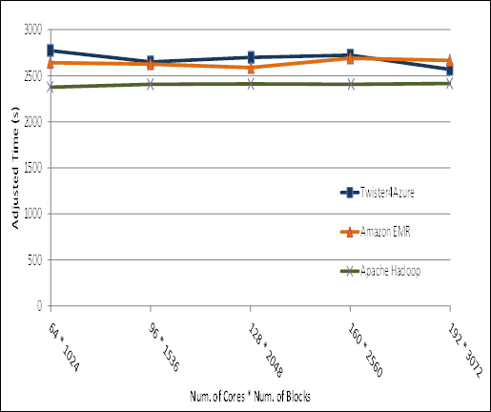

Pleasingly Parallel
Performance Comparisons
Smith Waterman
Sequence Alignment
BLAST Sequence Search
Cap3 Sequence Assembly

Slide 26

Performance – Kmeans Clustering
Overhead between iterations
First iteration performs the initial data fetch
Twister4Azure
Task Execution Time Histogram
Number of Executing Map Task Histogram
Hadoop
Twister
Hadoop on bare metal scales worst
Twister4Azure(adjusted for C#/Java)
Strong Scaling with 128M Data Points
Weak Scaling
Qiu, Gunarathne

Slide 27
Recent results on 512 cores Azure
20 Dimensions
500 Centers
Data sizes 128 million
Qiu, Gunarathne

Slide 28
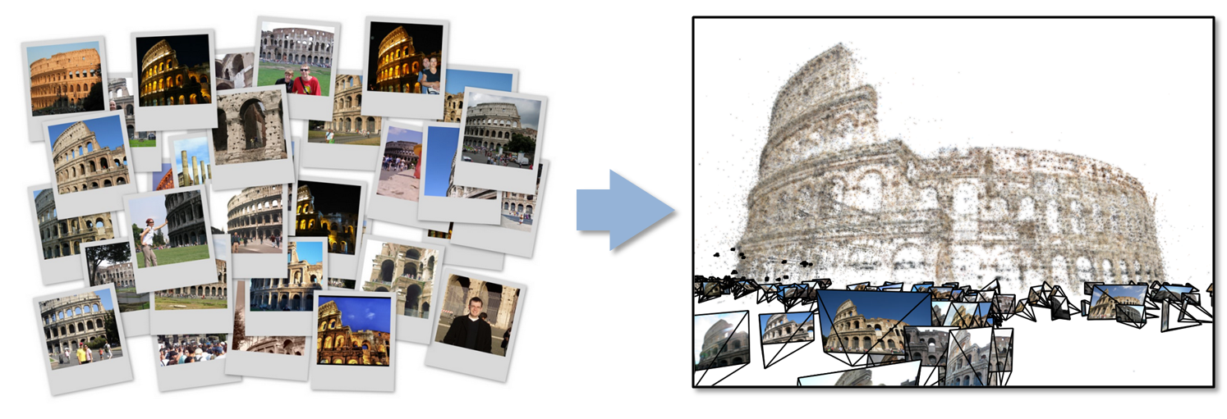
Data Intensive Kmeans Clustering
  ─ Image Classification: 1.5 TB; 500 features per image;10k clusters
  1000 Map tasks; 1GB data transfer per Map task
Work of Qiu and Zhang

Slide 29
Twister Communication Steps
Broadcast
Broadcasting
  Data could be large
  Chain & MST
Map Collectives
  Local merge
Reduce Collectives
  Collect but no merge
Combine
  Direct download or Gather
Map Tasks
Map Tasks
Map Tasks
Map Collective
Map Collective
Map Collective
Reduce Tasks
Reduce Tasks
Reduce Tasks
Reduce Collective
Reduce Collective
Reduce Collective
Work of Qiu and Zhang
Gather

Slide 30
Polymorphic Scatter-Allgather in Twister i.e. have collective primitives and find optimal implementation on each system
Work of Qiu and Zhang

Slide 31
Twister Performance on Kmeans Clustering
Work of Qiu and Zhang

Slide 32
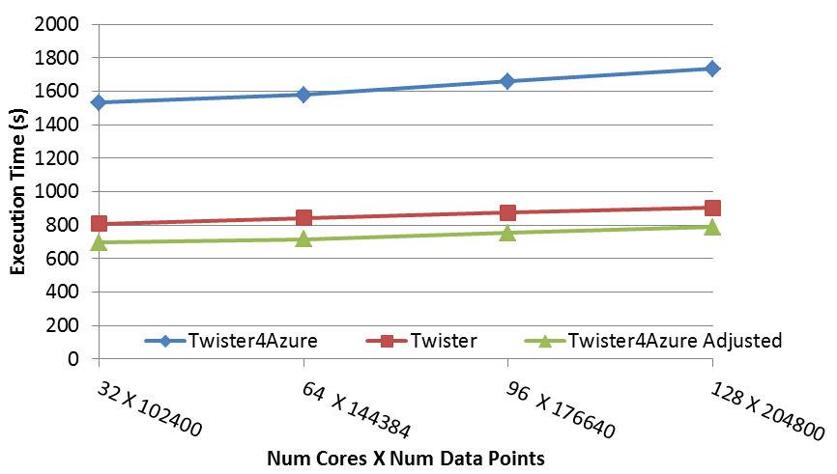
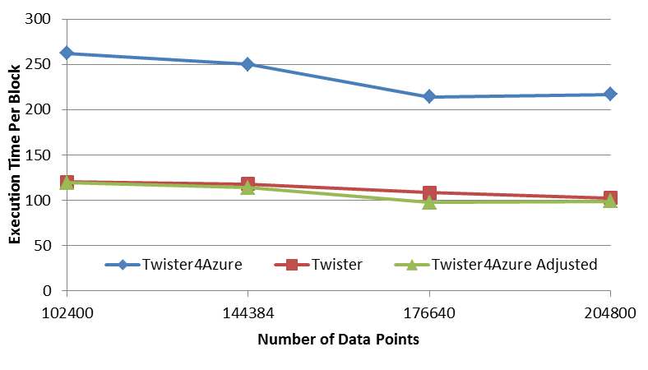
Multi Dimensional Scaling
BC: Calculate BX
X: Calculate invV (BX)
Calculate Stress
Map
Reduce
Merge
Map
Reduce
Merge
Map
Reduce
Merge
New Iteration
Performance adjusted for sequential performance difference
Weak Scaling
Data Size Scaling
Scalable Parallel Scientific Computing Using Twister4Azure. Thilina Gunarathne, BingJing Zang, Tak-Lon Wu and Judy Qiu. Submitted to Journal of Future Generation Computer Systems. (Invited as one of the best 6 papers of UCC 2011)
Notes:
The Java HPC Twister experiment was performed in a dedicated large-memory cluster of Intel(R) Xeon(R) CPU E5620 (2.4GHz) x 8 cores with 192GB memory per compute node and with Gigabit Ethernet on Linux. Java HPC Twister results do not include the initial data distribution time.
Azure large instances with 4 workers per instances is used. Memory mapped based caching and AllGather primitive are used.
Left: Weak scaling where workload per core is ~constant. Ideal is a straight horizontal line. X axis is
Right: Data size scaling with 128 Azure small instances/cores, 20 iterations.
The Twister4Azure adjusted (t_{a}) depicts the performance of Twister4Azure normalized according to the sequential MDS BC calculation and Stress calculation performance ratio between the Azure(t_{sa}) and Cluster(t_{sc}) environments used for Java HPC Twister. It is calculated using t_{a} x (t_{sc}/t_{sa}). This estimation however does not account for the overheads that remain constant irrespective of the computation time. Hence Twister4Azure seems to perform better, but in reality when the task execution times become smaller, twister4Azure overheads will become relatively larger and the performance would not be as good as shown in the adjusted curve.

Slide 33
Multi Dimensional Scaling on Azure
Qiu, Gunarathne

Slide 34
Data Analytics

Slide 35
General Remarks I
An immature (exciting) field: No agreement as to what is data analytics and what tools/computers needed
  Databases or NOSQL?
  Shared repositories or bring computing to data
  What is repository architecture?
Sources: Data from observation or simulation
Different terms: Data analysis, Datamining, Data analytics., machine learning, Information visualization
Fields: Computer Science, Informatics, Library and Information Science, Statistics, Application Fields including Business
Approaches: Big data (cell phone interactions) v. Little data (Ethnography, surveys, interviews)
Topics: Security, Provenance, Metadata, Data Management, Curation

Slide 36
General Remarks II
Tools: Regression analysis; biostatistics; neural nets; bayesian nets; support vector machines; classification; clustering; dimension reduction; artificial intelligence; semantic web
One driving force: Patient records growing fast
Another: Abstract graphs from net leads to community detection
Some data in metric spaces; others very high dimension or none
Large Hadron Collider analysis mainly histogramming – all can be done with MapReduce (larger use than MPI)
Commercial: Google, Bing largest data analytics in world
Time Series: Earthquakes, Tweets, Stock Market (Pattern Informatics)
Image Processing from climate simulations to NASA to DoD to Radiology (Radar and Pathology Informatics – same library)
Financial decision support; marketing; fraud detection; automatic preference detection (map users to books, films)

Slide 37
Data Analytics and Algorithms

Slide 38
Algorithms for Data Analytics
In simulation area, it is observed that equal contributions to improved performance come from increased computer power and better algorithms
http://cra.org/ccc/docs/nitrdsymposium/pdfs/keyes.pdf
In data intensive area, we haven’t seen this effect so clearly
  Information retrieval revolutionized but
  Still using Blast in Bioinformatics (although Smith Waterman etc. better)
  Still using R library which has many non optimal algorithms
  Parallelism and use of GPU’s often ignored

Slide 39
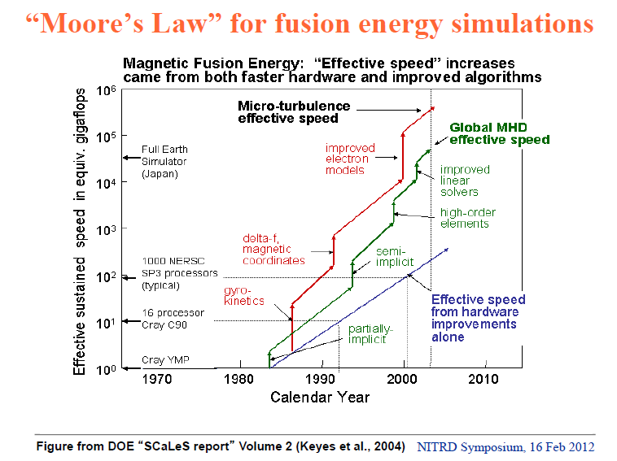

Slide 40
Data Analytics Futures?
PETSc and ScaLAPACK and similar libraries very important in supporting parallel simulations
Need equivalent Data Analytics libraries
Include datamining (Clustering, SVM, HMM, Bayesian Nets …), image processing, information retrieval including hidden factor analysis (LDA), global inference, dimension reduction
  Many libraries/toolkits (R, Matlab) and web sites (BLAST) but typically not aimed at scalable high performance algorithms
Should support clouds and HPC; MPI and MapReduce
  Iterative MapReduce an interesting runtime; Hadoop has many limitations
Need a coordinated Academic Business Government Collaboration to build robust algorithms that scale well
  Crosses Science, Business Network Science, Social Science
Propose to build community to define & implement
SPIDAL or Scalable Parallel Interoperable Data Analytics Library

Slide 41
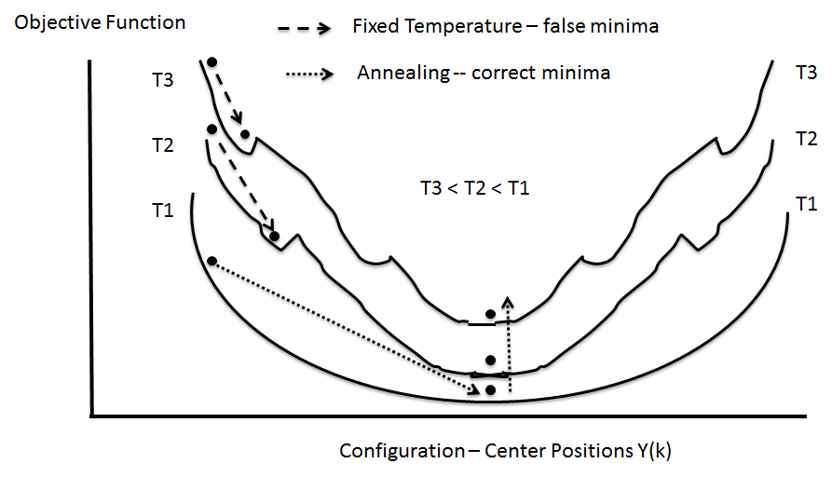
Deterministic Annealing
Deterministic Annealing works in many areas including clustering, latent factor analysis, dimension reduction for both metric and non metric spaces
  ~Always gets better answers than K-means and R?
  But can be parallelized and put on GPU

Slide 42
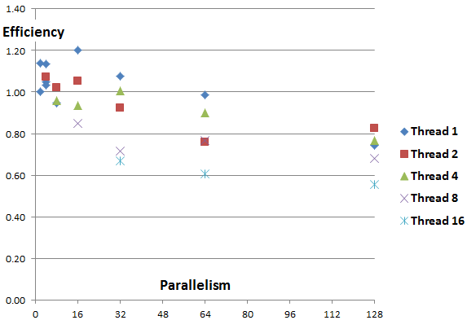
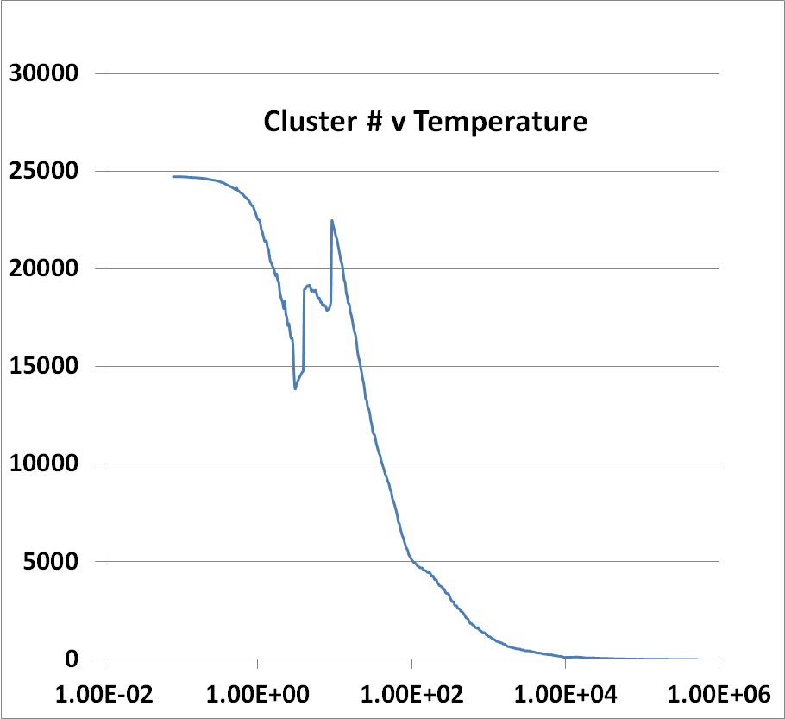
DA is Multiscale and Parallel
200K 74D 138 Clusters
241K 2D LC-MS 25000 Clusters
Start at high temperature with one cluster and keep splitting
Parallelism over points (easy) and centers
Improve using triangle inequality test in high dimensions

Slide 43
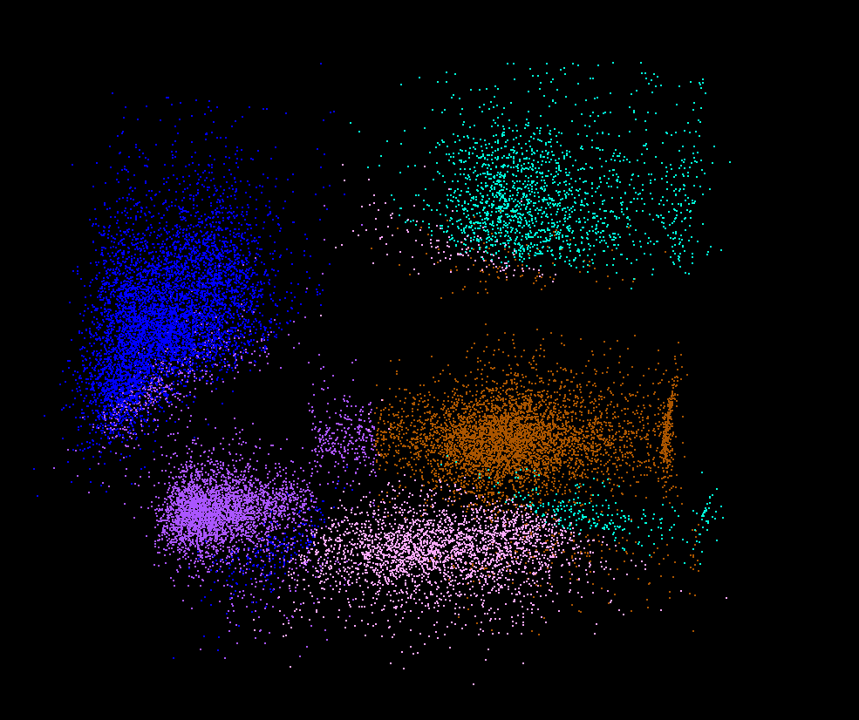
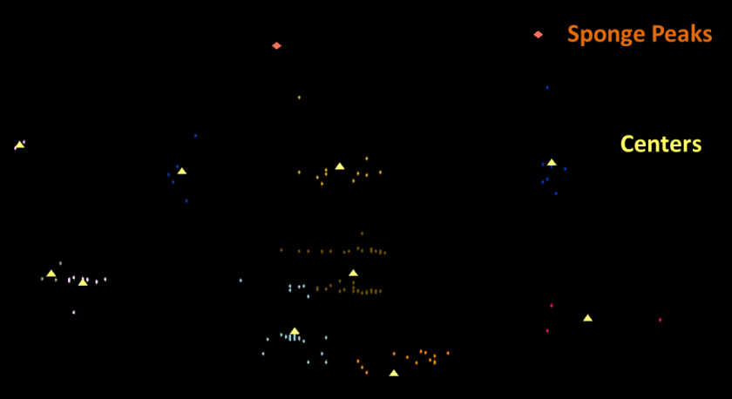
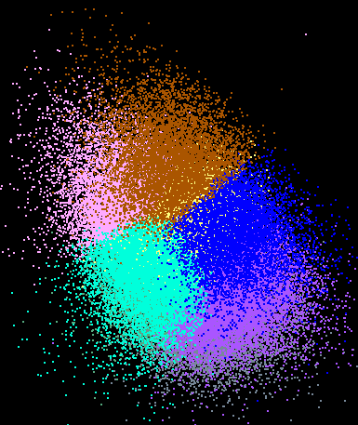
Dimension Reduction/MDS
You can get answers but do you believe them!
Need to visualize
H_{MDS} = Σ_{x<y=1}^{N} weight(x,y) (δ(x, y) – d_{3D}(x, y))²
Here x and y separately run over all points in the system, δ(x, y) is distance between x and y in original space while d_{3D}(x, y) is distance between them after mapping to 3 dimensions. One needs to minimize H_{MDS} for optimal choices of mapped positions X_{3D}(x).
LC-MS 2D
Pathology 54D
Lymphocytes 4D

Slide 44

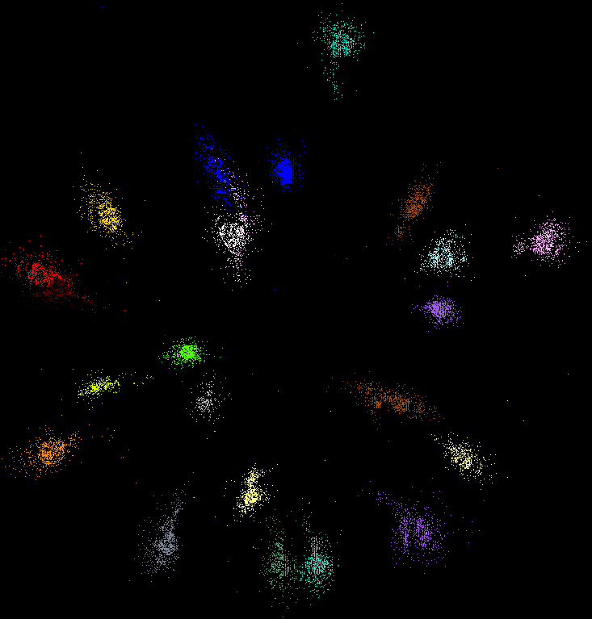
MDS runs as well in Metric and non Metric Cases
DA Clustering also runs in non metric with rather different formalism
COG Database with biology clusters
Metagenomics with DA clusters

Slide 45
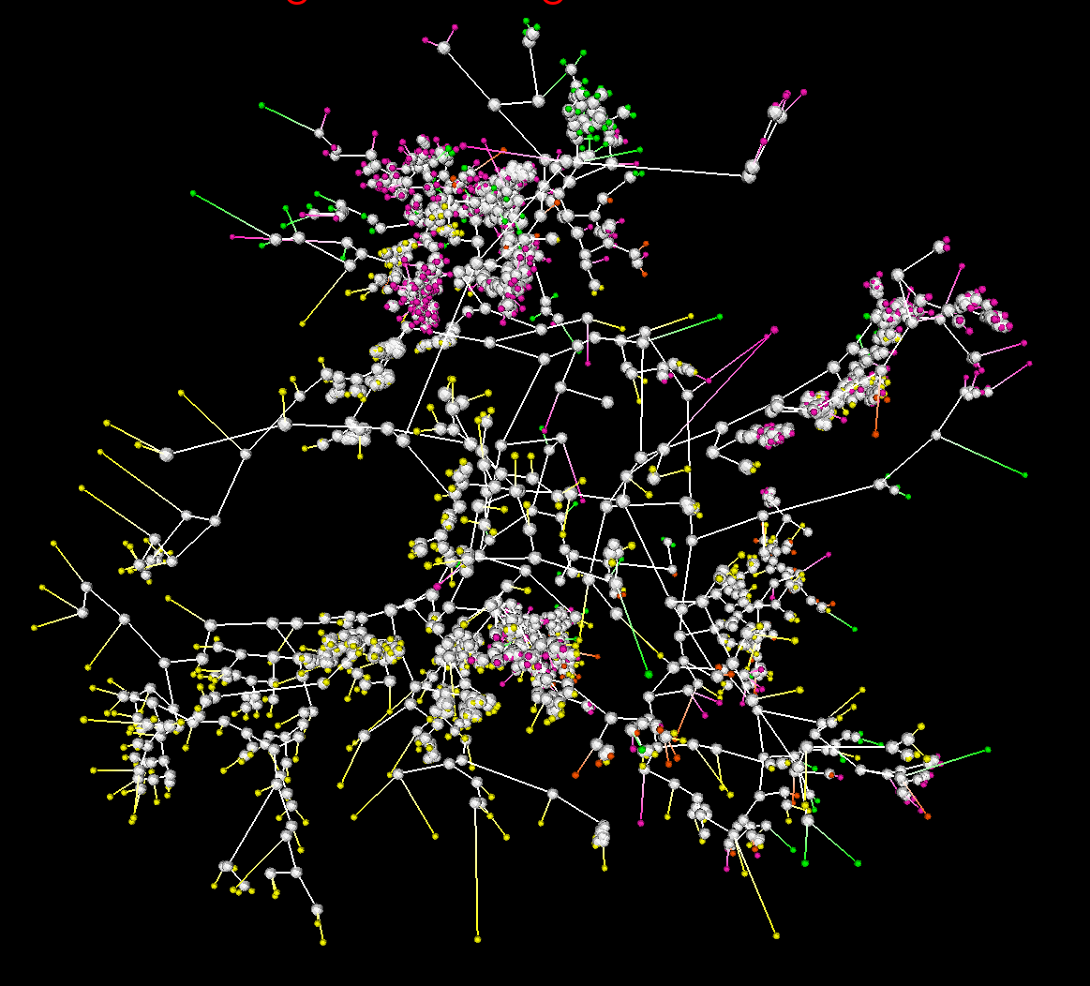
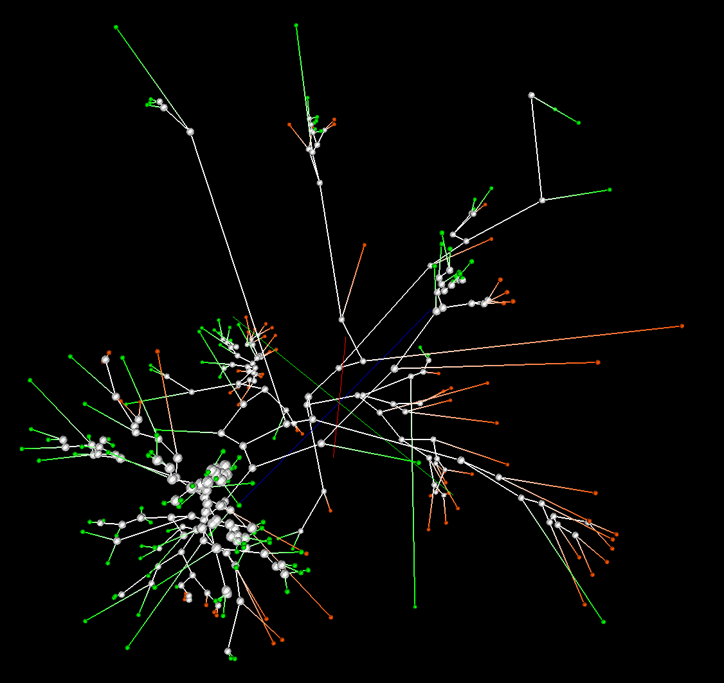
Phylogenetic tree using MDS
200 Sequences
(126 centers of clusters found from 446K)
Tree found from mapping sequences to 10D using Neighbor Joining
Whole collection mapped to 3D
2133 Sequences
Extended from set of 200
Trees by Neighbor Joining in 3D map
Silver Spheres Internal Nodes

Slide 46
Data Analytics (and Informatics) Field and its Education and Training

Slide 47

Jobs v. Countries

Slide 48

McKinsey Institute on Big Data Jobs
There will be a shortage of talent necessary for organizations to take advantage of big data. By 2018, the United States alone could face a shortage of 140,000 to 190,000 people with deep analytical skills as well as 1.5 million managers and analysts with the know-how to use the analysis of big data to make effective decisions.

Slide 49
Data Analytics Education
Broad Range of Topics from Policy to new algorithms
Enables X-Informatics where several X’s defined especially in Life Sciences
  Medical, Bio, Chem, Health, Pathology, Astro, Social, Business, Security, Crisis, Intelligence Informatics defined (more or less)
  Could invent Life Style (e.g. IT for Facebook), Radar …. Informatics
  Physics Informatics ought to exist but doesn’t
Plenty of Jobs and broader range of possibilities than computational science but similar issues
  What type of degree (Certificate, track, “real” degree)
  What type of program (department, interdisciplinary group supporting education and research program)

Slide 50
Computational Science
Interdisciplinary field between computer science and applications with primary focus on simulation areas
Very successful as a research area
  XSEDE and Exascale systems enable
Several academic programs but these have been less successful as
  No consensus as to curricula and jobs (don’t appoint faculty in computational science; do appoint to DoE labs)
  Field relatively small
Started around 1990
Note Computational Chemistry is typical part of Computational Science (and chemistry) whereas Cheminformatics is part of Informatics and data science
  Here Computational Chemistry much larger than Cheminformatics but
  Typically data side larger than simulations

Slide 51
Informatics at Indiana University

Slide 52
Informatics at Indiana University
School of Informatics and Computing
  Computer Science
  Informatics
  Information and Library Science (new DILS was SLIS)
Undergraduates: Informatics ~3x Computer Science
  Mean UG Hiring Salaries
  Informatics $54K; CS $56.25K
  Masters hiring $70K
  125 different employers 2011-2012
Graduates: CS ~2x Informatics
DILS Graduate only, MLS main degree

Slide 53
Largely Informatics at IU
Security largely moved to Computer Science
Bioinformatics moved to Computer Science
Cheminformatics
Health Informatics
Music Informatics moved to Computer Science
Complex Networks and Systems
Human Computer Interaction Design
Social Informatics
Only last topic definitely not part of CS

Slide 54
Largely Applied Computer Science
Cyberinfrastructure and High Performance Computing largely in Computer Science
Data, Databases and Search in Computer Science
Image Processing/ Computer Vision in Informatics
Ubiquitous Computing Need to add
Robotics in Informatics
Visualization and Computer Graphics Retired in CS
These are fields you will find in many computer science departments but are focused on using computers

Slide 55
Largely Core Computer Science
Computer Architecture
Computer Networking
Programming Languages and Compilers
Artificial Intelligence, Artificial Life and Cognitive Science
Computation Theory and Logic
Quantum Computing
These are traditional important fields of Computer Science providing ideas and tools used in Informatics and Applied Computer Science

Slide 56
MOOC’s

Slide 57
Massive Open Online Courses (MOOC)
MOOC’s are very “hot” these days with Udacity and Coursera as start-ups
Over 100,000 participants but concept valid at smaller sizes
Relevant to Data Science as this is a new field with few courses at most universities
Technology to make MOOC’s: Google Open Source Course Builder is lightweight LMS (learning management system) released September 12 2012
Supports MOOC model as a collection of short prerecorded segments (talking head over PowerPoint) termed lessons
Compose playlists of lessons into sessions, modules, courses
  Session is an “Album” and lessons are “songs” in an iTunes analogy

Slide 58
MOOC’s on a) Cloud b) X-Informatics
Cloud MOOC based on one week Summer School on “Clouds for Science” held on FutureGrid end of July 2012
X-Informatics class next semester is general overview of “use of IT” (data analysis) in “all fields” starting with data deluge and pipeline
Observation→Data→Information→Knowledge→Wisdom
Go through many applications from life/medical science to “finding Higgs” and business informatics
Describe cyberinfrastructure needed with visualization, security, provenance, portals, services and workflow
Lab sessions built on virtualized infrastructure (appliances)
Describe and illustrate key algorithms histograms, clustering, Support Vector Machines, Dimension Reduction, Hidden Markov Models and Image processing

Slide 59
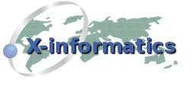





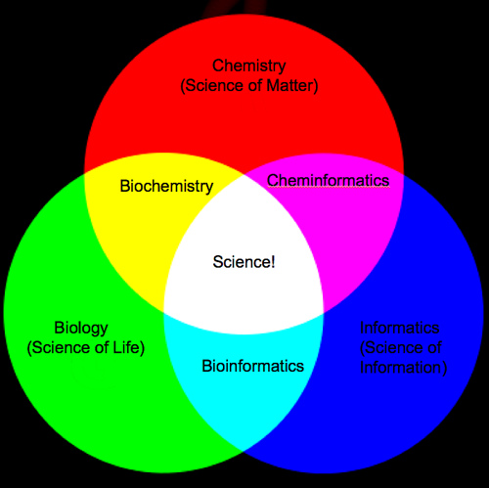

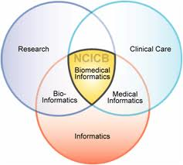
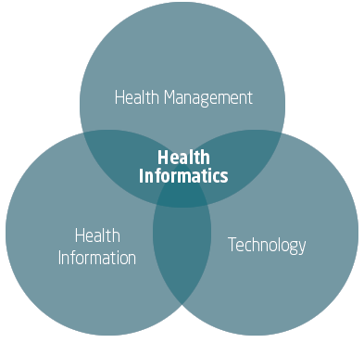
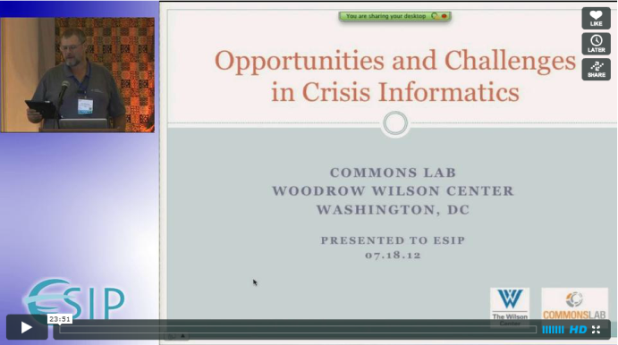
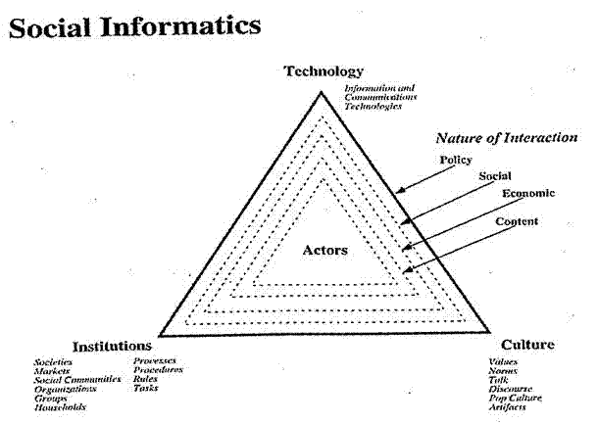
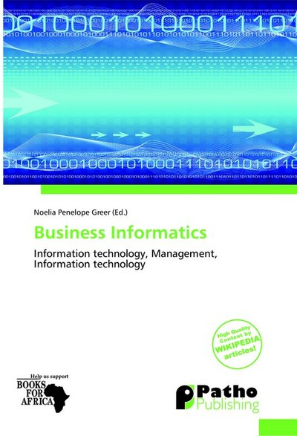
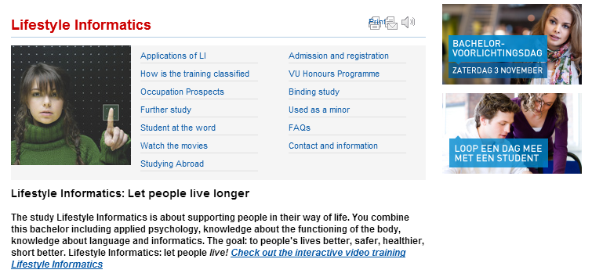

Slide 60
FutureGrid

Slide 61
Some Existing Testbeds
Grid5000
Emulab (and PRObE Parallel Reconfigurable Observational Environment)
OpenCirrus
Planetlab
ExoGENI and ProtoGENI
FutureGrid
Production systems used in testing mode!
  Production emphasizes stability; long jobs
  Testbeds emphasize flexibility, interactivity and short(er) jobs

Slide 62
FutureGrid key Concepts
FutureGrid is an international testbed modeled on Grid5000
Supporting international Computer Science and Computational Science research in cloud, grid and parallel computing (HPC)
The FutureGrid testbed provides to its users:
  A flexible development and testing platform for middleware and application users looking at interoperability, functionality, performance or evaluation
  FutureGrid is user-customizable, accessed interactively and supports Grid, Cloud and HPC software with and without VM’s
  A rich education and teaching platform for classes
See G. Fox, G. von Laszewski, J. Diaz, K. Keahey, J. Fortes, R. Figueiredo, S. Smallen, W. Smith, A. Grimshaw, FutureGrid - a reconfigurable testbed for Cloud, HPC and Grid Computing, Bookchapter – draft

Slide 63
FutureGrid Offers
Common Clouds:
  OpenStack, Eucalyptus, Nimbus, (OpenNebula)
HPC
  MPI, …
Dynamic Provisioning
  Replace OS on a Node
RAIN
  Place Templated Images on HPC, Eucalyptus, and OpenStack
  Demonstrated Feasibility and Usefulness of
  Cloud-shifting
  e.g. Assign resources (servers) to a cloud on demand
  Demonstrated during the Cloud Summer School July 2012 at Indiana University on the cluster India

Slide 64

FutureGrid Grid supports Cloud Grid HPC Computing Testbed as a Service (aaS)
12TF Disk rich + GPU 512 cores
NID: Network Impairment Device
Private
Public
FG Network
64

Slide 65
4 Use Types for FutureGrid TestbedaaS
275 approved projects (1400 users) November 13 2012
  USA, China, India, Pakistan, lots of European countries
  Industry, Government, Academia
Training Education and Outreach (10%)
  Semester and short events; interesting outreach to HBCU
Computer science and Middleware (59%)
  Core CS and Cyberinfrastructure; Interoperability (2%) for Grids and Clouds; Open Grid Forum OGF Standards
Computer Systems Evaluation (29%)
  XSEDE (TIS, TAS), OSG, EGI; Campuses
New Domain Science applications (26%)
  Life science highlighted (14%), Non Life Science (12%)
  Generalize to building Research Computing-aaS
Fractions are as of July 15 2012 add to > 100%

Slide 66
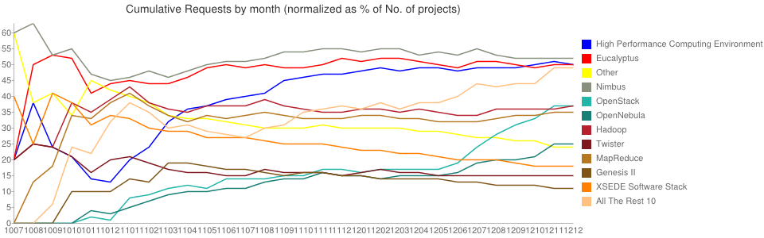
What Users want on FutureGrid
OpenStack

Slide 67
Recent Trends
FutureGrid(Project Trends)
  All IaaS same interest volume
  OpenStack ⬆⬆⬆
  OpenNebula ⬆⬆
  Nimbus 
  Eucalyptus ⬇
  Eucalyptus (Class) ➔
Google (User Trends)
  OpenStack ⬆⬆⬆
  CloudStack ⬆⬆
  Eucalyptus ⬇⬇
  Nimbus 

Slide 68
FutureGrid offers
Computing Testbed as a Service
FutureGrid Uses
Testbed-aaS Tools
Provisioning
Image Management
IaaS Interoperability
NaaS, IaaS tools
Expt management
Dynamic IaaS NaaS
Devops
CS Research Use e.g. test new compiler or storage model
Class Usages e.g. run GPU & multicore
Applications
Software
(Application
Or Usage) SaaS
Cloud e.g. MapReduce
HPC e.g. PETSc, SAGA
Computer Science e.g. Compiler tools, Sensor nets, Monitors
FutureGrid Usages
Computer Science
Applications and understanding Science Clouds
Technology Evaluation including XSEDE testing
Education & Training
Platform
PaaS
Infra
structure
IaaS
Software Defined Computing (virtual Clusters)
Hypervisor, Bare Metal
Operating System
Network
NaaS
Software Defined Networks
OpenFlow GENI

Slide 69
Learning from FutureGrid
Architecture of TestbedaaS
Extend current IaaS dynamic provisioning to IaaS+NaaS
Generate a cross-continent distributed system on demand with
  Desired O/S, hypervisor or not
  Optimized networking
  All software defined without systems admins
  Form a group of interested researchers/developers
Need broader choice in hardware
  Form an international collaboration
Use most appropriate solution
  Commercial clouds could be best solution for some users

Slide 70
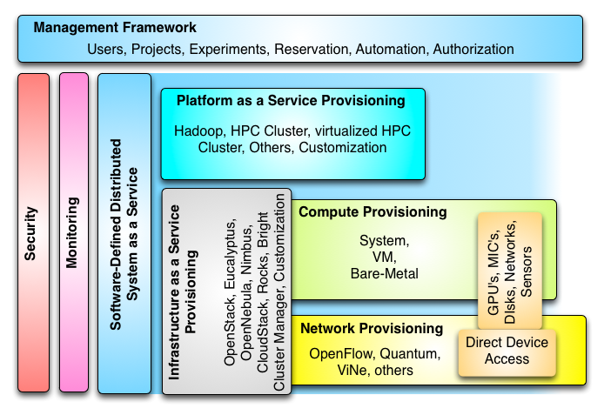
Technical Architecture of TestbedaaS

Slide 71
Conclusions

Slide 72
Conclusions
Clouds and HPC are here to stay and one should plan on using both
Data Intensive programs are not like simulations as they have large “reductions” (“collectives”) and do not have many small messages
Iterative MapReduce an interesting approach; need to optimize collectives for new applications (Data analytics) and resources (clouds, GPU’s …)
Need an initiative to build scalable high performance data analytics library on top of interoperable cloud-HPC platform
  Consortium from Physical/Biological/Social/Network Science, Image Processing, Business
Many promising algorithms such as deterministic annealing not used as implementations not available in R/Matlab etc.
  More sophisticated software and runs longer but can be efficiently parallelized so runtime not a big issue

Slide 73
Conclusions II
CTaaS (Computing Testbed as a Service) and software defined computing
More employment opportunities in clouds than HPC and Grids and in data than simulation; so cloud and data related activities popular with students
International activity to discuss data science education
  Agree on curricula; is such a degree attractive?
Role of MOOC’s as either
  Disseminating new curricula
  Managing course fragments that can be assembled into custom courses for particular interdisciplinary students

