Slide 1
Characteristics of Big Data Applications and
Scalable Software Systems
Chesapeake Large-Scale Analytics Conference
Loews Annapolis Hotel
Annapolis
October 16 2014
Geoffrey Fox
gcf@indiana.edu
http://www.infomall.org
School of Informatics and Computing
Digital Science Center
Indiana University Bloomington

Slide 2
HPC and Data Analytics
Identify/develop parallel large scale data analytics data analytics library SPIDAL (Scalable Parallel Interoperable Data Analytics Library ) of similar quality to PETSc and ScaLAPACK which have been very influential in success of HPC for simulations
Analyze Big Data applications to identify analytics needed and generate benchmark applications and characteristics (Ogres with facets)
Analyze existing analytics libraries (in practice limit to some application domains and some general libraries) – catalog library members available and performance
  Apache Mahout low performance and not many entries;
  R largely sequential and missing key algorithms;
  Apache MLlib just starting
Identify range of big data computer architectures
Analyze Big Data Software and identify software model HPC-ABDS (HPC – Apache Big Data Stack) to allow interoperability (Cloud/HPC) and high performance merging HPC and commodity cloud software
Design or identify new or existing algorithms including and assuming parallel implementation
Many more data scientists than computational scientists so HPC implications of data analytics could be influential on simulation software and hardware

Slide 3
Analytics and the DIKW Pipeline
Data goes through a pipeline
Raw data → Data → Information → Knowledge → Wisdom → Decisions
Each link enabled by a filter which is “business logic” or “analytics”
We are interested in filters that involve “sophisticated analytics” which require non trivial parallel algorithms
  Improve state of art in both algorithm quality and (parallel) performance
See Google Cloud Dataflow supporting pipelined analytics
Data
Information
Analytics
Information
Knowledge
More Analytics

Slide 4
NIST Big Data Initiative
Led by Chaitin Baru, Bob Marcus, Wo Chang

Slide 5
NBD-PWG (NIST Big Data Public Working Group) Subgroups & Co-Chairs
There were 5 Subgroups
  Note mainly industry
Requirements and Use Cases Sub Group
  Geoffrey Fox, Indiana U.; Joe Paiva, VA; Tsegereda Beyene, Cisco
Definitions and Taxonomies SG
  Nancy Grady, SAIC; Natasha Balac, SDSC; Eugene Luster, R2AD
Reference Architecture Sub Group
  Orit Levin, Microsoft; James Ketner, AT&T; Don Krapohl, Augmented Intelligence
Security and Privacy Sub Group
  Arnab Roy, CSA/Fujitsu Nancy Landreville, U. MD Akhil Manchanda, GE
Technology Roadmap Sub Group
  Carl Buffington, Vistronix; Dan McClary, Oracle; David Boyd, Data Tactics
See http://bigdatawg.nist.gov/usecases.php
And http://bigdatawg.nist.gov/V1_output_docs.php

Slide 6
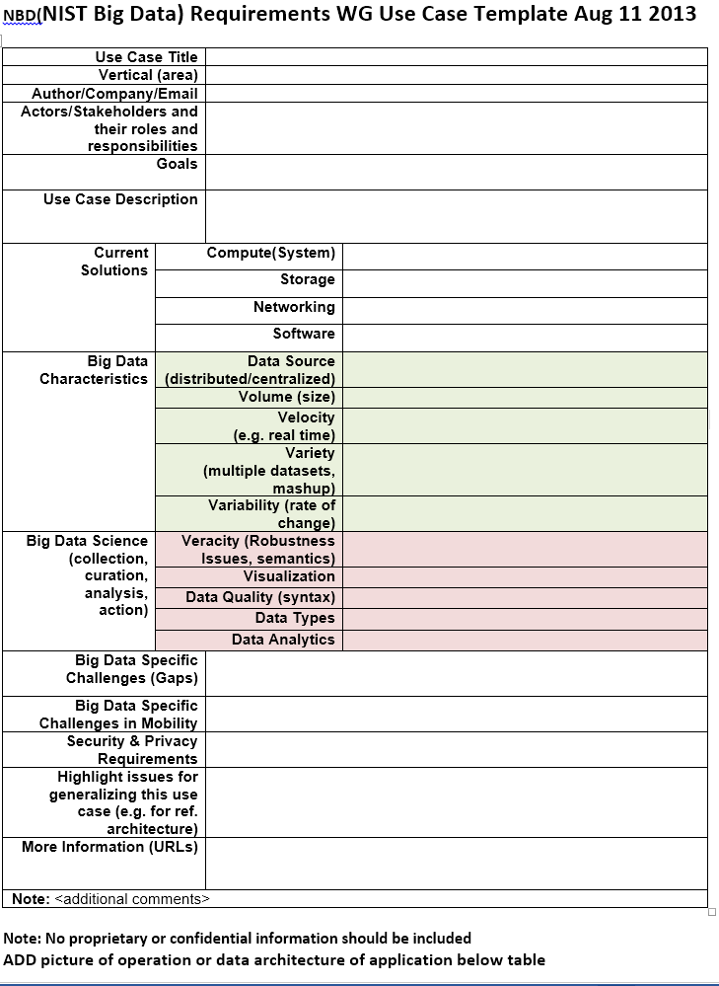
Use Case Template
26 fields completed for 51 areas
Government Operation: 4
Commercial: 8
Defense: 3
Healthcare and Life Sciences: 10
Deep Learning and Social Media: 6
The Ecosystem for Research: 4
Astronomy and Physics: 5
Earth, Environmental and Polar Science: 10
Energy: 1

Slide 7
51 Detailed Use Cases: Contributed July-September 2013
Covers goals, data features such as 3 V’s, software, hardware
26 Features for each use case
Biased to science
http://bigdatawg.nist.gov/usecases.php
https://bigdatacoursespring2014.appspot.com/course (Section 5)
Government Operation(4): National Archives and Records Administration, Census Bureau
Commercial(8): Finance in Cloud, Cloud Backup, Mendeley (Citations), Netflix, Web Search, Digital Materials, Cargo shipping (as in UPS)
Defense(3): Sensors, Image surveillance, Situation Assessment
Healthcare and Life Sciences(10): Medical records, Graph and Probabilistic analysis, Pathology, Bioimaging, Genomics, Epidemiology, People Activity models, Biodiversity
Deep Learning and Social Media(6): Driving Car, Geolocate images/cameras, Twitter, Crowd Sourcing, Network Science, NIST benchmark datasets
The Ecosystem for Research(4): Metadata, Collaboration, Language Translation, Light source experiments
Astronomy and Physics(5): Sky Surveys including comparison to simulation, Large Hadron Collider at CERN, Belle Accelerator II in Japan
Earth, Environmental and Polar Science(10): Radar Scattering in Atmosphere, Earthquake, Ocean, Earth Observation, Ice sheet Radar scattering, Earth radar mapping, Climate simulation datasets, Atmospheric turbulence identification, Subsurface Biogeochemistry (microbes to watersheds), AmeriFlux and FLUXNET gas sensors
Energy(1): Smart grid

Slide 8
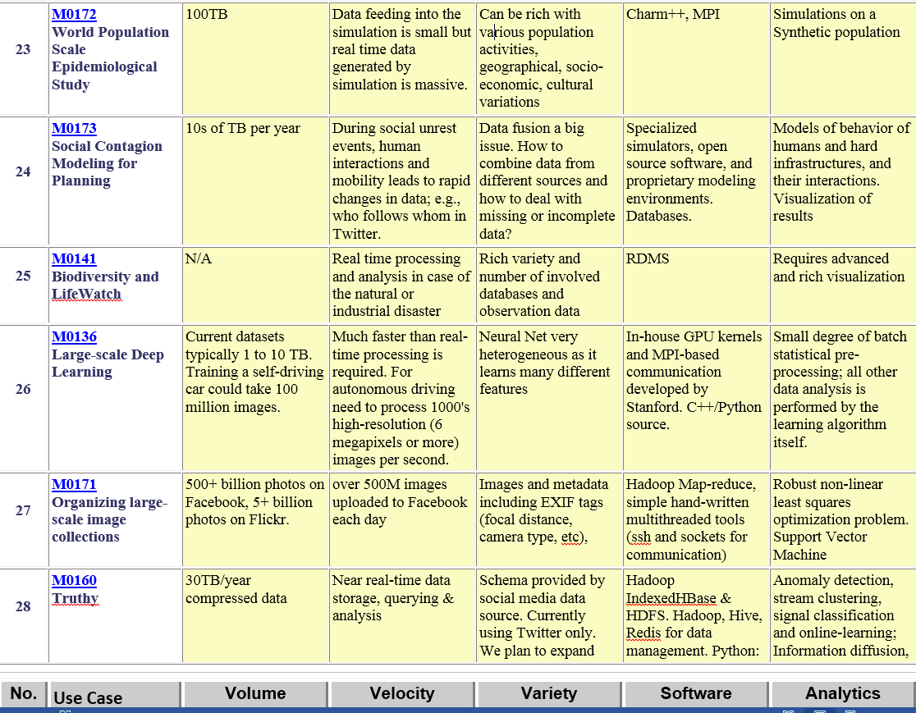
Table 4: Characteristics of 6 Distributed Applications
Application Example | Execution Unit | Communication | Coordination | Execution Environment
Montage | Multiple sequential and parallel executable | Files | Dataflow (DAG) | Dynamic process creation, execution
NEKTAR | Multiple concurrent parallel executables | Stream based | Dataflow | Co-scheduling, data streaming, async. I/O
Replica-Exchange | Multiple seq. and parallel executables | Pub/sub | Dataflow and events | Decoupled coordination and messaging
Climate Prediction (generation) | Multiple seq. & parallel executables | Files and messages | Master-Worker, events | @Home (BOINC)
Climate Prediction (analysis) | Multiple seq. & parallel executables | Files and messages | Dataflow | Dynamics process creation, workflow execution
SCOOP | Multiple Executable | Files and messages | Dataflow | Preemptive scheduling, reservations
Coupled Fusion | Multiple executable | Stream-based | Dataflow | Co-scheduling, data streaming, async I/O
Part of Property Summary Table

Slide 9
Big Data Patterns – the Ogres

Slide 10
HPC Benchmark Classics
Linpack or HPL: Parallel LU factorization for solution of linear equations
NPB version 1: Mainly classic HPC solver kernels
  MG: Multigrid
  CG: Conjugate Gradient
  FT: Fast Fourier Transform
  IS: Integer sort
  EP: Embarrassingly Parallel
  BT: Block Tridiagonal
  SP: Scalar Pentadiagonal
  LU: Lower-Upper symmetric Gauss Seidel

Slide 11
13 Berkeley Dwarfs
Dense Linear Algebra
Sparse Linear Algebra
Spectral Methods
N-Body Methods
Structured Grids
Unstructured Grids
MapReduce
Combinational Logic
Graph Traversal
Dynamic Programming
Backtrack and Branch-and-Bound
Graphical Models
Finite State Machines
First 6 of these correspond to Colella’s original.
Monte Carlo dropped.
N-body methods are a subset of Particle in Colella.
Note a little inconsistent in that MapReduce is a programming model and spectral method is a numerical method.
Need multiple facets!

Slide 12
7 Computational Giants of
NRC Massive Data Analysis Report
G1: Basic Statistics (see MRStat later)
G2: Generalized N-Body Problems
G3: Graph-Theoretic Computations
G4: Linear Algebraic Computations
G5: Optimizations e.g. Linear Programming
G6: Integration e.g. LDA and other GML
G7: Alignment Problems e.g. BLAST

Slide 13
51 Use Cases: What is Parallelism Over?
People: either the users (but see below) or subjects of application and often both
Decision makers like researchers or doctors (users of application)
Items such as Images, EMR, Sequences below; observations or contents of online store
  Images or “Electronic Information nuggets”
  EMR: Electronic Medical Records (often similar to people parallelism)
  Protein or Gene Sequences;
  Material properties, Manufactured Object specifications, etc., in custom dataset
  Modelled entities like vehicles and people
Sensors – Internet of Things
Events such as detected anomalies in telescope or credit card data or atmosphere
(Complex) Nodes in RDF Graph
Simple nodes as in a learning network
Tweets, Blogs, Documents, Web Pages, etc.
  And characters/words in them
Files or data to be backed up, moved or assigned metadata
Particles/cells/mesh points as in parallel simulations

Slide 14
Features of 51 Use Cases I
PP (26) “All” Pleasingly Parallel or Map Only
MR (18) Classic MapReduce MR (add MRStat below for full count)
MRStat (7) Simple version of MR where key computations are simple reduction as found in statistical averages such as histograms and averages
MRIter (23) Iterative MapReduce or MPI (Spark, Twister)
Graph (9) Complex graph data structure needed in analysis
Fusion (11) Integrate diverse data to aid discovery/decision making; could involve sophisticated algorithms or could just be a portal
Streaming (41) Some data comes in incrementally and is processed this way
Classify (30) Classification: divide data into categories
S/Q (12) Index, Search and Query

Slide 15
Features of 51 Use Cases II
CF (4) Collaborative Filtering for recommender engines
LML (36) Local Machine Learning (Independent for each parallel entity) – application could have GML as well
GML (23) Global Machine Learning: Deep Learning, Clustering, LDA, PLSI, MDS,
  Large Scale Optimizations as in Variational Bayes, MCMC, Lifted Belief Propagation, Stochastic Gradient Descent, L-BFGS, Levenberg-Marquardt . Can call EGO or Exascale Global Optimization with scalable parallel algorithm
Workflow (51) Universal
GIS (16) Geotagged data and often displayed in ESRI, Microsoft Virtual Earth, Google Earth, GeoServer etc.
HPC (5) Classic large-scale simulation of cosmos, materials, etc. generating (visualization) data
Agent (2) Simulations of models of data-defined macroscopic entities represented as agents

Slide 16
Global Machine Learning aka EGO – Exascale Global Optimization
Typically maximum likelihood or χ² with a sum over the N data items – documents, sequences, items to be sold, images etc. and often links (point-pairs).
  Usually it’s a sum of positive numbers as in least squares
Covering clustering/community detection, mixture models, topic determination, Multidimensional scaling, (Deep) Learning Networks
PageRank is “just” parallel linear algebra
Note many Mahout algorithms are sequential – partly as MapReduce limited; partly because parallelism unclear
  MLLib (Spark based) better
SVM and Hidden Markov Models do not use large scale parallelization in practice?
Some overlap/confusion with with graph analytics

Slide 17
13 Image-based Use Cases
13-15 Military Sensor Data Analysis/ Intelligence PP, LML, GIS, MR
7:Pathology Imaging/ Digital Pathology: PP, LML, MR for search becoming terabyte 3D images, Global Classification
18&35: Computational Bioimaging (Light Sources): PP, LML Also materials
26: Large-scale Deep Learning: GML Stanford ran 10 million images and 11 billion parameters on a 64 GPU HPC; vision (drive car), speech, and Natural Language Processing
27: Organizing large-scale, unstructured collections of photos: GML Fit position and camera direction to assemble 3D photo ensemble
36: Catalina Real-Time Transient Synoptic Sky Survey (CRTS): PP, LML followed by classification of events (GML)
43: Radar Data Analysis for CReSIS Remote Sensing of Ice Sheets: PP, LML to identify glacier beds; GML for full ice-sheet
44: UAVSAR Data Processing, Data Product Delivery, and Data Services: PP to find slippage from radar images
45, 46: Analysis of Simulation visualizations: PP LML ?GML find paths, classify orbits, classify patterns that signal earthquakes, instabilities, climate, turbulence

Slide 18
Internet of Things and Streaming Apps
It is projected that there will be 24 (Mobile Industry Group) to 50 (Cisco) billion devices on the Internet by 2020.
The cloud natural controller of and resource provider for the Internet of Things.
Smart phones/watches, Wearable devices (Smart People), “Intelligent River” “Smart Homes and Grid” and “Ubiquitous Cities”, Robotics.
Majority of use cases are streaming – experimental science gathers data in a stream – sometimes batched as in a field trip. Below is sample
10: Cargo Shipping Tracking as in UPS, Fedex PP GIS LML
13: Large Scale Geospatial Analysis and Visualization PP GIS LML
28: Truthy: Information diffusion research from Twitter Data PP MR for Search, GML for community determination
39: Particle Physics: Analysis of LHC Large Hadron Collider Data: Discovery of Higgs particle PP Local Processing Global statistics
50: DOE-BER AmeriFlux and FLUXNET Networks PP GIS LML
51: Consumption forecasting in Smart Grids PP GIS LML

Slide 19
Big Data Ogres
Facets I: These features (PP, MR, MRStat, MRIter, Graph, Fusion, Streaming, Classify, S/Q, CF, LML, GML, Workflow, GIS, HPC, Agents) plus some broad features familiar from past like BSP? (Bulk Synchronous Processing), SPMD?, iterative?, irregular?, dynamic?, communication/compute, I-O/compute, Data abstraction (array, key-value…)
Facets II: Data source and access (see later)
Kernels (generalized analytics): see later

Slide 20
System Architecture

Slide 21
4 Forms of MapReduce
(1) Map Only
(2) Classic MapReduce
(3) Iterative Map Reduce or Map-Collective
(4) Point to Point or Map-Communication
Input
Input
Iterations
Input
map
map
map
Local
reduce
reduce
Output
Graph
PP | MR MRStat | MRIter | Graph, HPC
BLAST Analysis Local Machine Learning Pleasingly Parallel | High Energy Physics (HEP) Histograms Distributed search Recommender Engines | Expectation maximization Clustering e.g. K-means Linear Algebra, PageRank | Classic MPI PDE Solvers and Particle Dynamics Graph Problems
MapReduce and Iterative Extensions (Spark, Twister) |  |  | MPI, Giraph
Integrated Systems such as Hadoop + Harp with Compute and Communication model separated
Correspond to First 4 Big Data Architectures

Slide 22
Useful Set of Analytics Architectures
Pleasingly Parallel: including local machine learning as in parallel over images and apply image processing to each image
- Hadoop could be used but many other HTC, Many task tools
Classic MapReduce including search, collaborative filtering and motif finding implemented using Hadoop etc.
Map-Collective or Iterative MapReduce using Collective Communication (clustering) – Hadoop with Harp, Spark …..
Map-Communication or Iterative Giraph: (MapReduce) with point-to-point communication (most graph algorithms such as maximum clique, connected component, finding diameter, community detection)
  Vary in difficulty of finding partitioning (classic parallel load balancing)
Large and Shared memory: thread-based (event driven) graph algorithms (shortest path, Betweenness centrality) and Large memory applications
Ideas like workflow are “orthogonal” to this

Slide 23
HPC-ABDS
Integrating High Performance Computing with Apache Big Data Stack
Shantenu Jha, Judy Qiu, Andre Luckow

Slide 25
HPC-ABDS Layers
Message Protocols
Distributed Coordination:
Security & Privacy:
Monitoring:
IaaS Management from HPC to hypervisors:
DevOps:
Interoperability:
File systems:
Cluster Resource Management:
Data Transport:
SQL / NoSQL / File management:
In-memory databases&caches / Object-relational mapping / Extraction Tools
Inter process communication Collectives, point-to-point, publish-subscribe
Basic Programming model and runtime, SPMD, Streaming, MapReduce, MPI:
High level Programming:
Application and Analytics:
Workflow-Orchestration:
Here are 17 functionalities.
4 Cross cutting at top
13 in order of layered diagram starting at bottom

Slide 26







HPC ABDS SYSTEM (Middleware)
200 Software Projects
System Abstraction/Standards
Data Format and Storage
HPC ABDS
Hourglass
HPC Yarn for Resource management
Horizontally scalable parallel programming model
Collective and Point to Point Communication
Support for iteration (in memory processing)
Application Abstractions/Standards
Graphs, Networks, Images, Geospatial ..
Scalable Parallel Interoperable Data Analytics Library (SPIDAL)
High performance Mahout, R, Matlab …..
High Performance Applications

Slide 27
Maybe a Big Data Initiative would include
We don’t need 200 software packages so can choose e.g.
Workflow: Python or Kepler or Apache Crunch
Data Analytics: Mahout, R, ImageJ, Scalapack
High level Programming: Hive, Pig
Parallel Programming model: Hadoop, Spark, Giraph (Twister4Azure, Harp), MPI; Storm, Kapfka or RabbitMQ (Sensors)
In-memory: Memcached
Data Management: Hbase, MongoDB, MySQL or Derby
Distributed Coordination: Zookeeper
Cluster Management: Yarn, Slurm
File Systems: HDFS, Lustre
DevOps: Cloudmesh, Chef, Puppet, Docker, Cobbler
IaaS: Amazon, Azure, OpenStack, Libcloud
Monitoring: Inca, Ganglia, Nagios

Slide 28
Harp Design
Parallelism Model
Architecture
MapReduce Model
Map-Collective or Map-Communication Model
M
M
M
M
MapReduce Applications
Map-Collective
or Map-Communication Applications
M
M
M
M
Application
Shuffle
Harp
Optimal Communication
MapReduce V2
R
R
Framework
Resource Manager
YARN

Slide 29
Features of Harp Hadoop Plugin
Hadoop Plugin (on Hadoop 1.2.1 and Hadoop 2.2.0)
Hierarchical data abstraction on arrays, key-values and graphs for easy programming expressiveness.
Collective communication model to support various communication operations on the data abstractions (will extend to Point to Point)
Caching with buffer management for memory allocation required from computation and communication
BSP style parallelism
Fault tolerance with checkpointing

Slide 30
WDA SMACOF MDS (Multidimensional Scaling) using Harp on IU Big Red 2
Parallel Efficiency: on 100-300K sequences
Best available MDS (much better than that in R)
Java
Harp (Hadoop plugin)
Cores =32 #nodes
Conjugate Gradient (dominant time) and Matrix Multiplication

Slide 31
Increasing Communication
Identical Computation
Mahout and Hadoop MR – Slow due to MapReduce
Python slow as Scripting; MPI fastest
Spark Iterative MapReduce, non optimal communication
Harp Hadoop plug in with ~MPI collectives

Slide 32
Data Gathering, Storage, Use

Slide 33
Data Source and Style Facet I
(i) SQL or NoSQL: NoSQL includes Document, Column, Key-value, Graph, Triple store
(ii) Other Enterprise data systems: e.g. Warehouses
(iii) Set of Files: as managed in iRODS and extremely common in scientific research
(iv) File, Object, Block and Data-parallel (HDFS) raw storage: Separated from computing?
(v) Internet of Things: 24 to 50 Billion devices on Internet by 2020
(vi) Streaming: Incremental update of datasets with new algorithms to achieve real-time response (G7)
(vii) HPC simulations: generate major (visualization) output that often needs to be mined
(viii) Involve GIS: Geographical Information Systems provide attractive access to geospatial data
Notes:
Big dwarfs are Ogres
Implement Ogres in ABDS+

Slide 34
2. Perform real time analytics on data source streams and notify users when specified events occur
Specify filter
Filter Identifying Events
Fetch streamed Data
Post Selected Events
Streaming Data
Posted Data
Identified Events
Streaming Data
Streaming Data
Archive
Repository
Storm, Kafka, Hbase, Zookeeper

Slide 35



5. Perform interactive analytics on data in analytics-optimized data system
Mahout, R
Hadoop, Spark, Giraph, Pig …
Data Storage: HDFS, Hbase
Data, Streaming, Batch …..

Slide 36
Data Source and Style Facet II
Before data gets to compute system, there is often an initial data gathering phase which is characterized by a block size and timing. Block size varies from month (Remote Sensing, Seismic) to day (genomic) to seconds or lower (Real time control, streaming)
There are storage/compute system styles: Shared, Dedicated, Permanent, Transient
Other characteristics are needed for permanent auxiliary/comparison datasets and these could be interdisciplinary, implying nontrivial data movement/replication
10 Data Access/Use Styles from Bob Marcus at NIST (you have seen his patterns 2 and 5 and my extension for science 5A follows)
Notes:
Big dwarfs are Ogres
Implement Ogres in ABDS+

Slide 37
5A. Perform interactive analytics on observational scientific data
Science Analysis Code, Mahout, R
Grid or Many Task Software, Hadoop, Spark, Giraph, Pig …
Data Storage: HDFS, Hbase, File Collection (Lustre)
Direct Transfer
Transport batch of data to primary analysis data system
Streaming Twitter data for Social Networking
Local Accumulate and initial computing
NIST Examples include LHC, Remote Sensing, Astronomy and Bioinformatics
Record Scientific Data in “field”

Slide 38
Analytics Facet (kernels) of the Ogres

Slide 39
Core Analytics I
Map-Only
  Pleasingly parallel - Local Machine Learning
MapReduce: Search/Query/Index
  Summarizing statistics as in LHC Data analysis (histograms) (G1)
  Recommender Systems (Collaborative Filtering)
  Linear Classifiers (Bayes, Random Forests)
Alignment and Streaming (G7)
  Genomic Alignment, Incremental Classifiers
Global Analytics: Nonlinear Solvers (structure depends on objective function) (G5,G6)
  Stochastic Gradient Descent SGD
  (L-)BFGS approximation to Newton’s Method
  Levenberg-Marquardt solver
Notes:
BFGS Broyden–Fletcher–Goldfarb–Shanno algorithm
L = limited memory

Slide 40
Core Analytics II
Global Analytics: Map-Collective (See Mahout, MLlib) (G2,G4,G6)
  Often use matrix-matrix,-vector operations, solvers (conjugate gradient)
  Clustering (many methods), Mixture Models, LDA (Latent Dirichlet Allocation), PLSI (Probabilistic Latent Semantic Indexing)
  SVM and Logistic Regression
  Outlier Detection (several approaches)
  PageRank, (find leading eigenvector of sparse matrix)
  SVD (Singular Value Decomposition)
  MDS (Multidimensional Scaling)
  Learning Neural Networks (Deep Learning)
  Hidden Markov Models

Slide 41
Core Analytics III
Global Analytics – Map-Communication (targets for Giraph) (G3)
  Graph Structure (Communities, subgraphs/motifs, diameter, maximal cliques, connected components)
  Network Dynamics - Graph simulation Algorithms (epidemiology)
Global Analytics – Asynchronous Shared Memory (may be distributed algorithms)
  Graph Structure (Betweenness centrality, shortest path) (G3)
  Linear/Quadratic Programming, Combinatorial Optimization, Branch and Bound (G5)

Slide 42
Benchmark Suite in spirit of NAS Parallel Benchmarks or Berkeley Dwarfs

Slide 43
Benchmarks across Facets
Classic Database: TPC benchmarks
NoSQL Data systems: store, index, query (e.g. on Tweets)
Hard core commercial: Web Search, Collaborative Filtering (different structure and defer to Google!)
Streaming: Gather in Pub-Sub(Kafka) + Process (Apache Storm) solution (e.g. gather tweets, Internet of Things)
Pleasingly parallel (Local Analytics): as in initial steps of LHC, Astronomy, Pathology, Bioimaging (differ in type of data analysis)
“Global” Analytics: Deep Learning, SVM, Clustering, Multidimensional Scaling, Graph Community finding (~Clustering) to Shortest Path (? Shared memory)
Workflow linking above

Slide 44
Parallel Data Analytics Issues

Slide 45
Remarks on Parallelism I
Most use parallelism over items in data set
  Entities to cluster or map to Euclidean space
Except deep learning (for image data sets)which has parallelism over pixel plane in neurons not over items in training set
  as need to look at small numbers of data items at a time in Stochastic Gradient Descent SGD
  Need experiments to really test SGD – as no easy to use parallel implementations tests at scale NOT done
  Maybe got where they are as most work sequential
Maximum Likelihood or χ² both lead to structure like
Minimize sum ∑_{items=1}^{N} (Positive nonlinear function of unknown parameters for item i)
All solved iteratively with (clever) first or second order approximation to shift in objective function
  Sometimes steepest descent direction; sometimes Newton
  11 billion deep learning parameters; Newton impossible
  Have classic Expectation Maximization structure
  Steepest descent shift is sum over shift calculated from each point
SGD – take randomly a few hundred of items in data set and calculate shifts over these and move a tiny distance
  Classic method – take all (millions) of items in data set and move full distance

Slide 46
Remarks on Parallelism II
Need to cover non vector semimetric and vector spaces for clustering and dimension reduction (N points in space)
MDS Minimizes Stress
σ(X) = Σ_{i<j=1}^{N} weight(i,j) (δ(i, j) - d(X_{i} , X_{j}))²
Semimetric spaces just have pairwise distances defined between points in space δ(i, j)
Vector spaces have Euclidean distance and scalar products
  Algorithms can be O(N) and these are best for clustering but for MDS O(N) methods may not be best as obvious objective function O(N²)
  Important new algorithms needed to define O(N) versions of current O(N²) – “must” work intuitively and shown in principle
Note matrix solvers all use conjugate gradient – converges in 5-100 iterations – a big gain for matrix with a million rows. This removes factor of N in time complexity
Ratio of #clusters to #points important; new ideas if ratio >~ 0.1

Slide 47
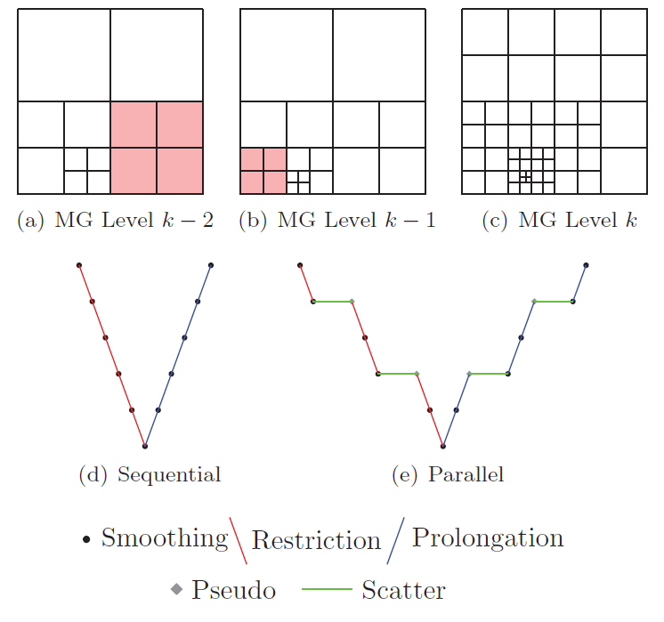
When is a Graph “just” a Sparse Matrix?
Most systems are built of connected entities which can be considered a graph
  See multigrid meshes
  Particle dynamics
PageRank is a graph
algorithm or “just”
sparse matrix
multiplication
to implement power
method of finding
leading eigenvector

Slide 48
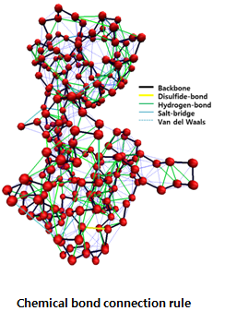
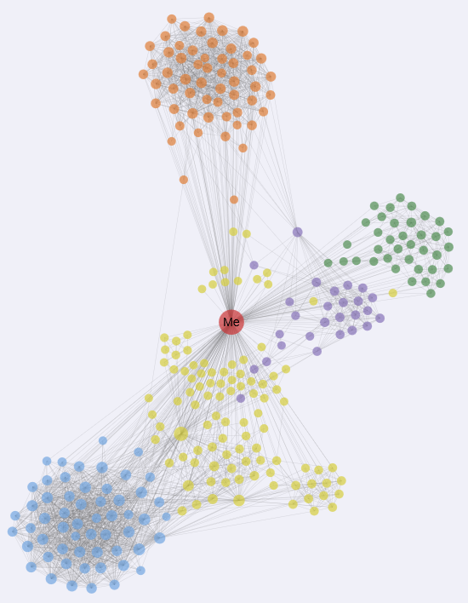
“Force Diagrams” for macromolecules and Facebook

Slide 49
Parallel Data Analytics Examples

Slide 50
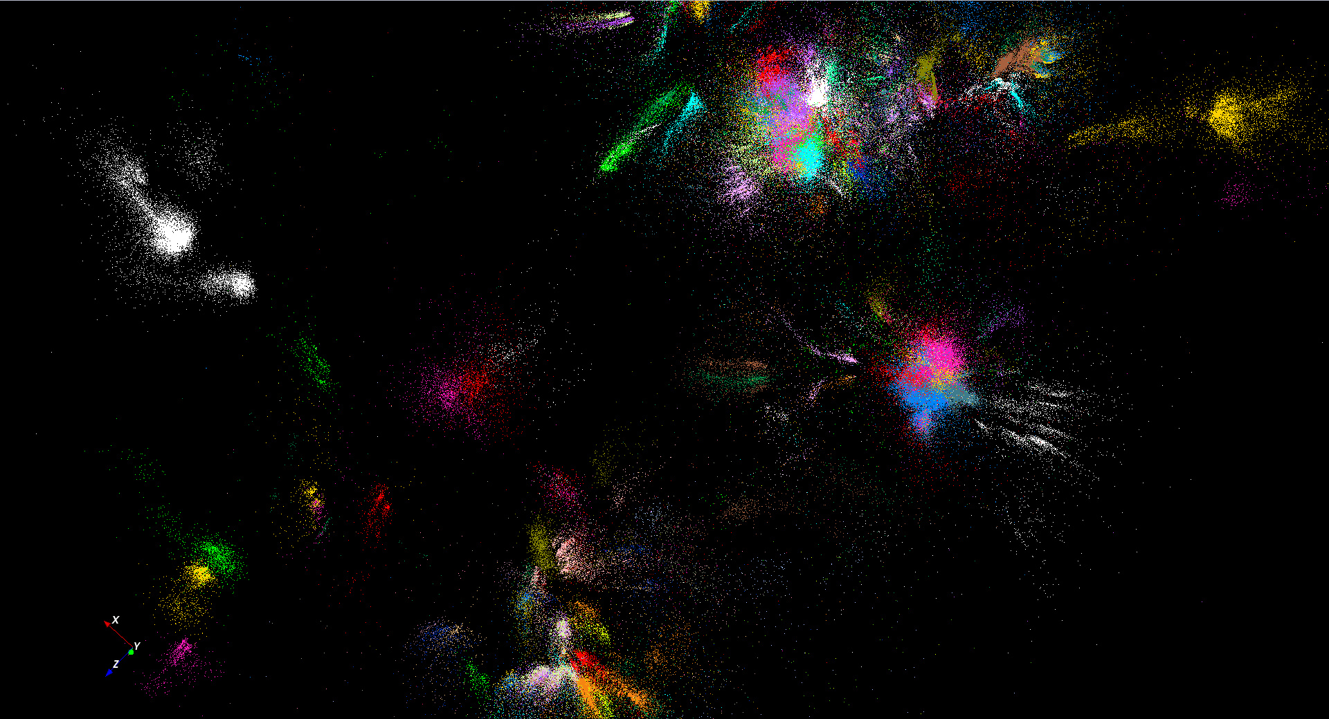
446K sequences
~100 clusters

Slide 51
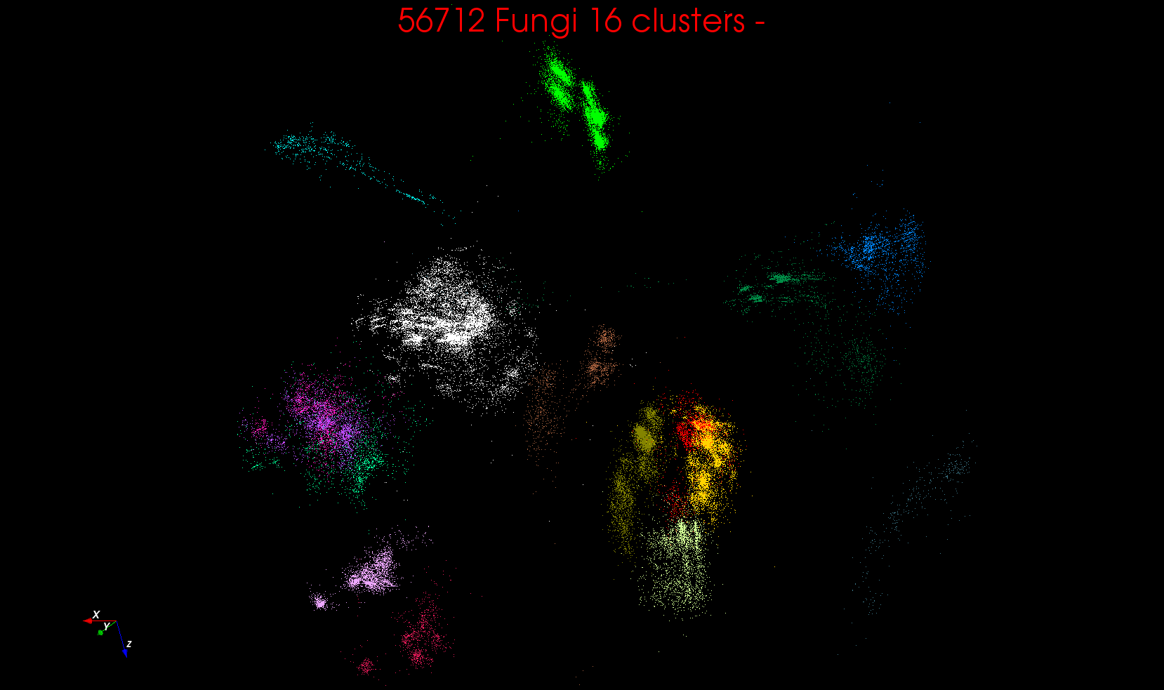
“clean” sample of 446K
O(N²) green-green and purple-purple interactions have value but green-purple are “wasted”
O(N²) interactions between green and purple clusters should be able to represent by centroids as in Barnes-Hut.
Hard as no Gauss theorem; no multipole expansion and points really in 1000 dimension space as clustered before 3D projection

Slide 52
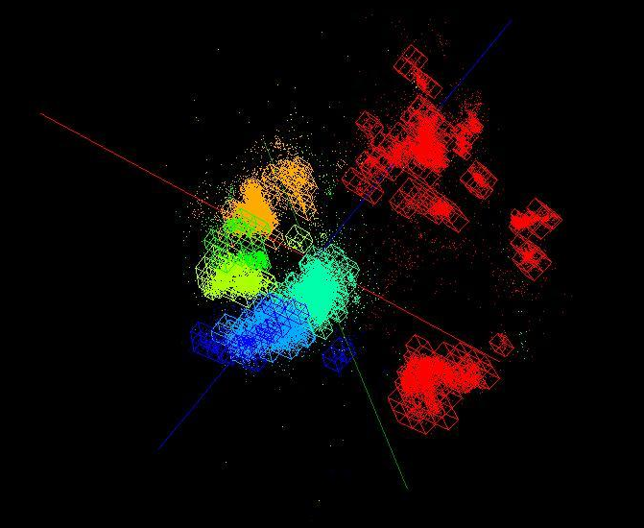
OctTree for 100K sample of Fungi
We use OctTree for logarithmic interpolation (streaming data)

Slide 53
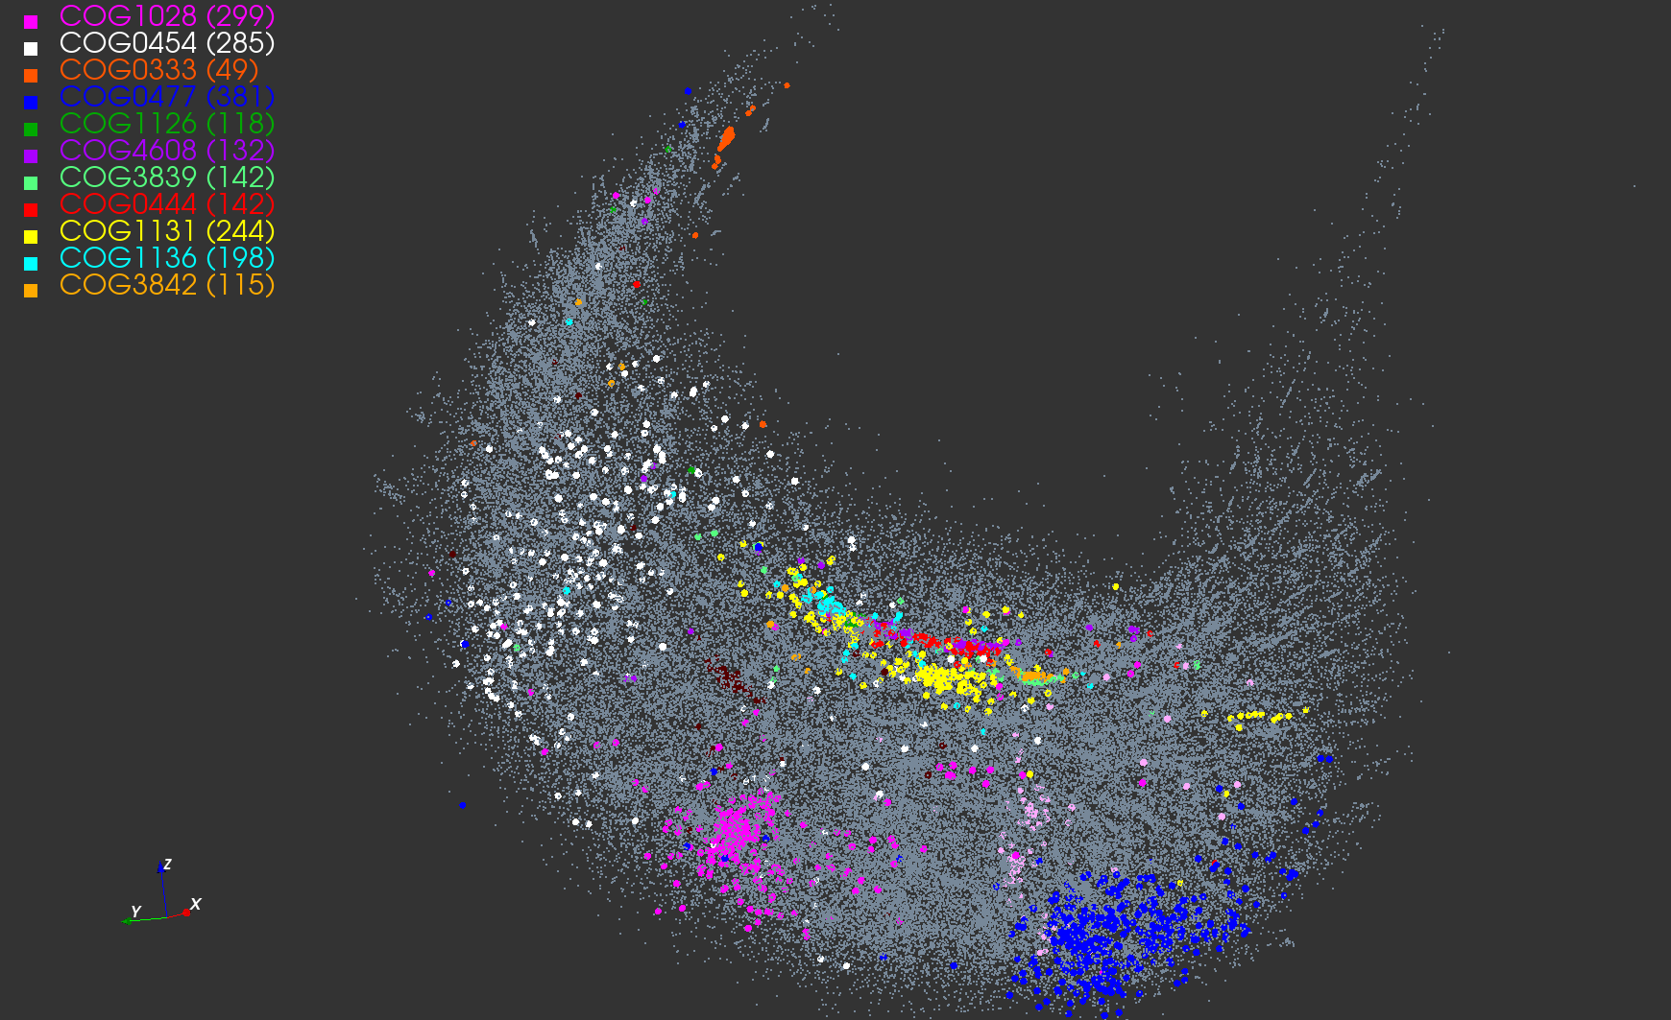
Protein Universe Browser (map big data to 3D to use “GIS”) for COG Sequences with a few illustrative biologically identified clusters

Slide 54
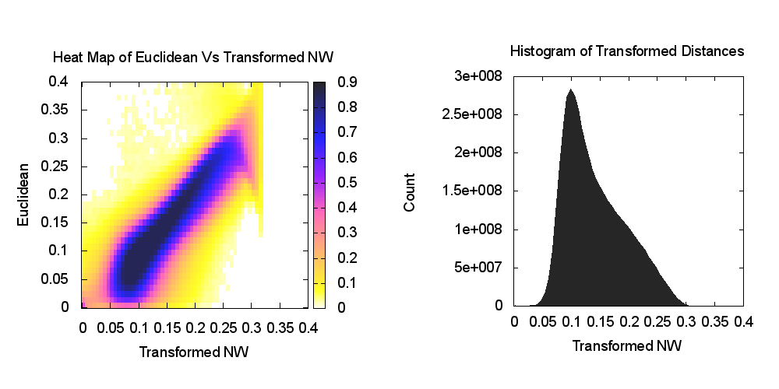
Heatmap of biology distance (Needleman-Wunsch) vs 3D Euclidean Distances
If d a distance, so is f(d) for any monotonic f. Optimize choice of f

Slide 55
Algorithm Challenges
See NRC Massive Data Analysis report
O(N) algorithms for O(N²) problems
Parallelizing Stochastic Gradient Descent
Streaming data algorithms – balance and interplay between batch methods (most time consuming) and interpolative streaming methods
Graph algorithms
Machine Learning Community uses parameter servers; Parallel Computing (MPI) would not recommend this?
  Is classic distributed model for “parameter service” better?
Apply best of parallel computing – communication and load balancing – to Giraph/Hadoop/Spark
Are data analytics sparse?; many cases are full matrices
BTW Need Java Grande – Some C++ but Java most popular in ABDS, with Python, Erlang, Go, Scala (compiles to JVM) …..

Slide 56
Data Science at Indiana University

Slide 57
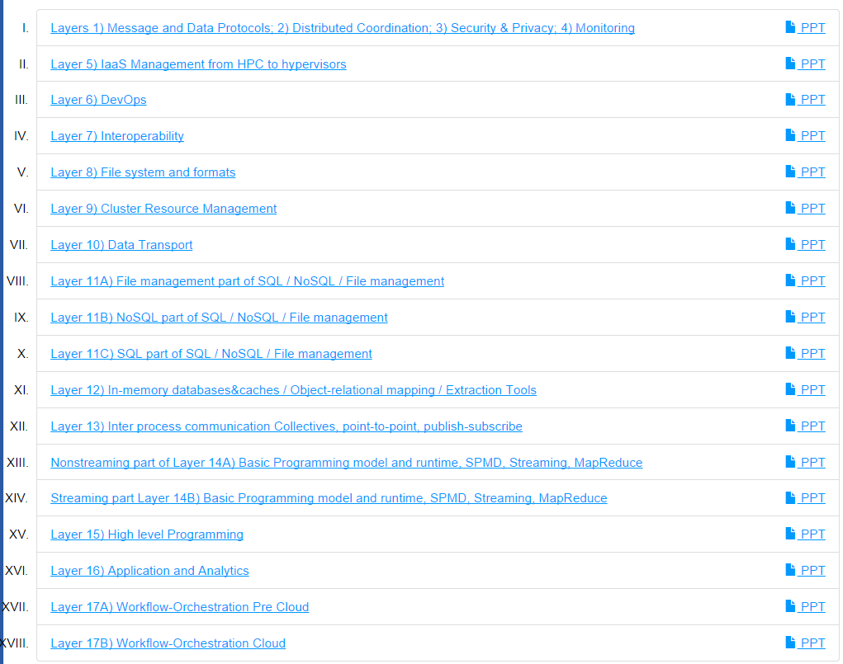
6 hours of Video describing 200 technologies from online class

Slide 58
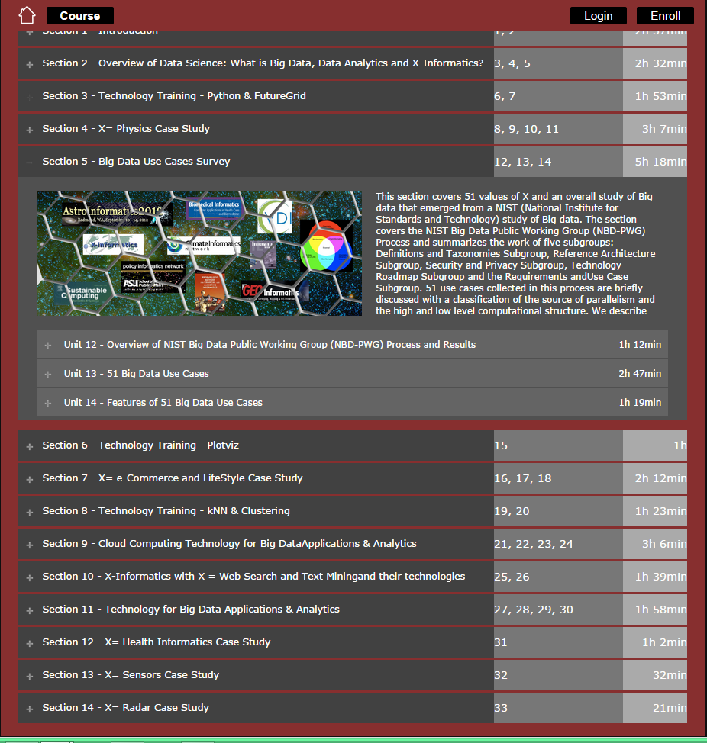
5 hours of video on 51 use cases
Online classes in Data Science Certificate /Masters
Prettier as Google Course Builder

Slide 59
IU Data Science Masters Features
Fully approved by University and State October 14 2014
Blended online and residential
Department of Information and Library Science, Division of Informatics and Division of Computer Science in the Department of Informatics and Computer Science, School of Informatics and Computing and the Department of Statistics, College of Arts and Science, IUB
30 credits (10 conventional courses)
Basic (general) Masters degree plus tracks
  Currently only track is “Computational and Analytic Data Science ”
  Other tracks expected
A purely online 4-course Certificate in Data Science has been running since January 2014 (Technical and Decision Maker paths)
A Ph.D. Minor in Data Science has been proposed.

Slide 60
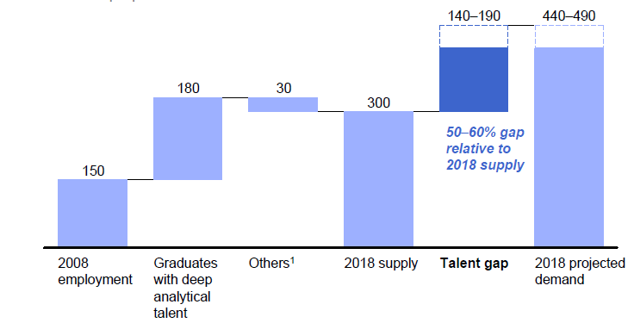
McKinsey Institute on Big Data Jobs
Decision maker and Technical paths
There will be a shortage of talent necessary for organizations to take advantage of big data. By 2018, the United States alone could face a shortage of 140,000 to 190,000 people with deep analytical skills as well as 1.5 million managers and analysts with the know-how to use the analysis of big data to make effective decisions.
At SOIC@IU, Informatics/ILS aimed at 1.5 million jobs. Computer Science covers the 140,000 to 190,000
http://www.mckinsey.com/mgi/publications/big_data/index.asp.

Slide 61
Lessons / Insights
Proposed classification of Big Data applications with features and kernels for analytics
Data intensive algorithms do not have the well developed high performance libraries familiar from HPC
Global Machine Learning or (Exascale Global Optimization) particularly challenging
Develop SPIDAL (Scalable Parallel Interoperable Data Analytics Library)
  New algorithms and new high performance parallel implementations
Integrate (don’t compete) HPC with “Commodity Big data” (Google to Amazon to Enterprise Data Analytics)
  i.e. improve Mahout; don’t compete with it
  Use Hadoop plug-ins rather than replacing Hadoop
Enhanced Apache Big Data Stack HPC-ABDS has ~200 members with HPC opportunities at Resource management, Storage/Data, Streaming, Programming, monitoring, workflow layers.

Slide 62
Thank you NSF
3 yr. XPS: FULL: DSD: Collaborative Research: Rapid Prototyping HPC Environment for Deep Learning IU, Tennessee (Dongarra), Stanford (Ng)
“Rapid Python Deep Learning Infrastructure” (RaPyDLI) Builds optimized Multicore/GPU/Xeon Phi kernels (best exascale dataflow) with Python front end for general deep learning problems with ImageNet exemplar. Leverage Caffe from UCB.
5 yr. Datanet: CIF21 DIBBs: Middleware and High Performance Analytics Libraries for Scalable Data Science IU, Rutgers (Jha), Virginia Tech (Marathe), Kansas (CReSIS), Emory (Wang), Arizona(Cheatham), Utah(Beckstein)
HPC-ABDS: Cloud-HPC interoperable software performance of HPC (High Performance Computing) and the rich functionality of the commodity Apache Big Data Stack.
SPIDAL (Scalable Parallel Interoperable Data Analytics Library): Scalable Analytics for Biomolecular Simulations, Network and Computational Social Science, Epidemiology, Computer Vision, Spatial Geographical Information Systems, Remote Sensing for Polar Science and Pathology Informatics.

Slide 63
Machine Learning in Network Science, Imaging in Computer Vision, Pathology, Polar Science, Biomolecular Simulations
Algorithm | Applications | Features | Status | Parallelism
Graph Analytics
Community detection | Social networks, webgraph | Graph . | P-DM | GML-GrC
Subgraph/motif finding | Webgraph, biological/social networks |  | P-DM | GML-GrB
Finding diameter | Social networks, webgraph |  | P-DM | GML-GrB
Clustering coefficient | Social networks |  | P-DM | GML-GrC
Page rank | Webgraph |  | P-DM | GML-GrC
Maximal cliques | Social networks, webgraph |  | P-DM | GML-GrB
Connected component | Social networks, webgraph |  | P-DM | GML-GrB
Betweenness centrality | Social networks | Graph, Non-metric, static | P-Shm | GML-GRA
Shortest path | Social networks, webgraph |  | P-Shm
Spatial Queries and Analytics
Spatial relationship based queries | GIS/social networks/pathology informatics | Geometric | P-DM | PP
Distance based queries |  |  | P-DM | PP
Spatial clustering |  |  | Seq | GML
Spatial modeling |  |  | Seq | PP
GML Global (parallel) ML
GrA Static GrB Runtime partitioning

Slide 64
Some specialized data analytics in SPIDAL
Algorithm | Applications | Features | Status | Parallelism
Core Image Processing
Image preprocessing | Computer vision/pathology informatics | Metric Space Point Sets, Neighborhood sets & Image features | P-DM | PP
Object detection & segmentation |  |  | P-DM | PP
Image/object feature computation |  |  | P-DM | PP
3D image registration |  |  | Seq | PP
Object matching |  | Geometric | Todo | PP
3D feature extraction |  |  | Todo | PP
Deep Learning
Learning Network, Stochastic Gradient Descent | Image Understanding, Language Translation, Voice Recognition, Car driving | Connections in artificial neural net | P-DM | GML
aa
PP Pleasingly Parallel (Local ML)
Seq Sequential Available
GRA Good distributed algorithm needed
Todo No prototype Available
P-DM Distributed memory Available
P-Shm Shared memory Available

Slide 65
Some Core Machine Learning Building Blocks
Algorithm | Applications | Features | Status | //ism
DA Vector Clustering | Accurate Clusters | Vectors | P-DM | GML
DA Non metric Clustering | Accurate Clusters, Biology, Web | Non metric, O(N²) | P-DM | GML
Kmeans; Basic, Fuzzy and Elkan | Fast Clustering | Vectors | P-DM | GML
Levenberg-Marquardt Optimization | Non-linear Gauss-Newton, use in MDS | Least Squares | P-DM | GML
SMACOF Dimension Reduction | DA- MDS with general weights | Least Squares, O(N²) | P-DM | GML
Vector Dimension Reduction | DA-GTM and Others | Vectors | P-DM | GML
TFIDF Search | Find nearest neighbors in document corpus | Bag of “words” (image features) | P-DM | PP
All-pairs similarity search | Find pairs of documents with TFIDF distance below a threshold
 |  |  | Todo | GML
Support Vector Machine SVM | Learn and Classify | Vectors | Seq | GML
Random Forest | Learn and Classify | Vectors | P-DM | PP
Gibbs sampling (MCMC) | Solve global inference problems | Graph | Todo | GML
Latent Dirichlet Allocation LDA with Gibbs sampling or Var. Bayes | Topic models (Latent factors) | Bag of “words” | P-DM | GML
Singular Value Decomposition SVD | Dimension Reduction and PCA | Vectors | Seq | GML
Hidden Markov Models (HMM) | Global inference on sequence models | Vectors | Seq | PP & GML

