Slide 1
Clouds Cyberinfrastructure and Collaboration
CTS2010 Chicago IL
May 20 2010
http://cisedu.us/cis/cts/10/main/callForPapers.jsp
Geoffrey Fox
gcf@indiana.edu
http://www.infomall.org http://www.futuregrid.org
Director, Digital Science Center, Pervasive Technology Institute
Associate Dean for Research and Graduate Studies, School of Informatics and Computing
Indiana University Bloomington

Slide 2
Important Trends
Data Deluge in all fields of science
  Also throughout life e.g. web!
Multicore implies parallel computing important again
  Performance from extra cores – not extra clock speed
Clouds – new commercially supported data center model replacing compute grids
Smartphones and Tablets increasingly important

Slide 3

Gartner 2009 Hype Curve
Clouds, Web2.0, Tablet PC
Service Oriented Architectures

Slide 4


Clouds as Cost Effective Data Centers
Builds giant data centers with 100,000’s of computers; ~ 200
-1000 to a shipping container with Internet access
“Microsoft will cram between 150 and 220 shipping containers filled with data center gear into a new 500,000 square foot Chicago facility. This move marks the most significant, public use of the shipping container systems popularized by the likes of Sun Microsystems and Rackable Systems to date.”

Slide 5


The Data Center Landscape
Range in size from “edge” facilities to megascale.
Economies of scale
  Approximate costs for a small size center (1K servers) and a larger, 50K server center.
Technology | Cost in small-sized Data Center | Cost in Large Data Center | Ratio
Network | $95 per Mbps/ month | $13 per Mbps/ month | 7.1
Storage | $2.20 per GB/ month | $0.40 per GB/ month | 5.7
Administration | ~140 servers/ Administrator | >1000 Servers/ Administrator | 7.1
Each data center is
11.5 times
the size of a football field

Slide 6
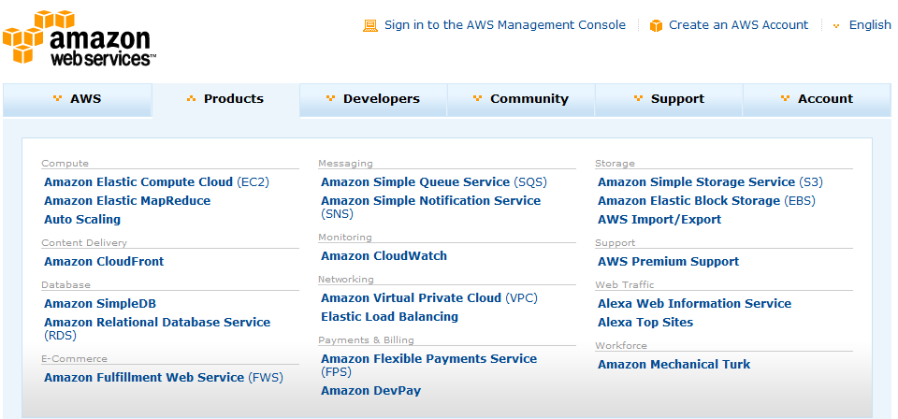








Commercial Cloud Systems
Software
Google App Engine

Slide 7






Sensors as a Service
Cell phones are important sensor/Collaborative device
Sensors as a Service
Sensor Processing as a Service (MapReduce)

Slide 9
Clouds hide Complexity
Cyberinfrastructure
Is “Research as a Service”
SaaS: Software as a Service
(e.g. CFD or Search documents/web are services)
PaaS: Platform as a Service
IaaS plus core software capabilities on which you build SaaS
(e.g. Azure is a PaaS; MapReduce is a Platform)
IaaS (HaaS): Infrastructure as a Service
(get computer time with a credit card and with a Web interface like EC2)

Slide 10
Philosophy of Clouds and Grids
Clouds are (by definition) commercially supported approach to large scale computing
  So we should expect Clouds to replace Compute Grids
  Current Grid technology involves “non-commercial” software solutions which are hard to evolve/sustain
  Maybe Clouds ~4% IT expenditure 2008 growing to 14% in 2012 (IDC Estimate)
  Many government clouds
Public Clouds are broadly accessible resources like Amazon and Microsoft Azure – powerful but not easy to customize and perhaps data trust/privacy issues
Private Clouds run similar software and mechanisms but on “your own computers” (not clear if still elastic)
Services still are correct architecture with either REST (Web 2.0) or Web Services

Slide 11
Collaboration as a Service
Describes use of clouds to host the various services needed for collaboration, crisis management, command and control etc.
  Manage exchange of information between collaborating people and sensors
  Support the shared databases and information processing defining common knowledge
  Support filtering of information from sensors and databases
  Simulations might be managed from clouds but run on “MPI engines” outside Clouds if needed parallel implementation
Data sources, users and simulations outside cloud

Slide 12
Cyberinfrastructure and Collaboration I
Grids support Virtual Organizations VO’s which are the groups of scientists involved in a particular eScience (distributed global science research) project
These grids involve a distributed set of compute, data and instruments with an expected tendency towards use of clouds
VO’s allow the teams of scientists a common authentication and authorization framework to link to resources on grids
Support of such heterogeneous systems likely to grow in importance but currently not well integrated with Web 2.0 / Commercial systems

Slide 13
Cyberinfrastructure and Collaboration II
Grids are front-ended by Portals which are important for Collaboration
HUBzero (initially developed for nanotechnology as nanoHUB) from Purdue is best known portal environment but one can use any container for Gadgets or Portlets which are modular user interface components to user-facing services
In 2009, nanoHUB served 274,000 visitors from 172 countries worldwide. Of these, a core audience of more than 100,000 users watched seminars, downloaded podcasts and other educational materials, and accessed more than 160 nanotechnology simulation tools. While accessing the tools, users launched a total of 369,000 simulation runs via their web browser and spent 7,286 days collectively interacting with tools and plotting results.
nanoHUB essentially back-ended by a Cloud

Slide 14
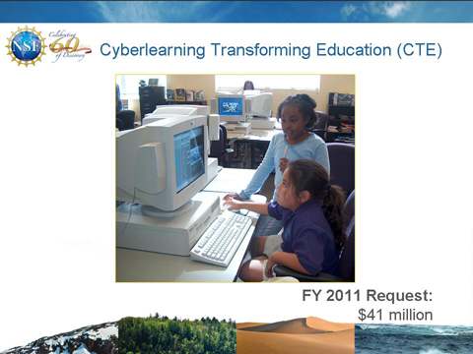
Cyberlearning
The use of Cyberinfrastructure to support (collaborative) education is (by definition) Cyberlearning and is top request in using Cyberinfrastructure by small colleges in US
Major new NSF Initiative CTE
Appliances are an important development supporting online interactive learning
Appliances are complete image of a computing environment that can be instantiated on a virtual machine and bring up
  Grids
  Parallel MPI
  MapReduce
  environments for students

Slide 15
Broad Architecture Components
Traditional Supercomputers (TeraGrid and DEISA) for large scale parallel computing – mainly simulations
  Likely to offer major GPU enhanced systems
Traditional Grids for handling distributed data – especially instruments and sensors
Clouds for multitude of modest activities such as services hosting sensors
  Especially where “elastic” on-demand processing needed as in crises
Clouds for “high throughput computing” including much data analysis using loosely coupled parallel computations
  e.g. for large activities that can be broken up into many loosely coupled processes such as those involved in information retrieval
  e.g. for large “parameter searches” – running same application with different defining parameters
MapReduce important data processing technology

Slide 16
Cloud Issues
Security, Privacy
  Private clouds can address but cannot offer same degree of “elasticity” as smaller
Performance
  Software network interfaces
  Virtualization hurts locality (compute node to compute node for parallel computing; compute node to data for data analysis)
  Poor and costly transfer of data into cloud
Confusion in field with 3 different major offerings – Amazon, Google, Microsoft and no academic (private) software stacks with a rich feature set

Slide 17
Cloud Computing: Infrastructure and Runtimes
Cloud infrastructure: outsourcing of servers, computing, data, file space, utility computing, etc.
  Handled through Web services that control virtual machine lifecycles.
Cloud runtimes: tools (for using clouds) to do data-parallel computations.
  Apache Hadoop, Google MapReduce, Microsoft Dryad, Bigtable, Chubby and others
  MapReduce designed for information retrieval but is excellent for a wide range of science data analysis applications
  Can also do much traditional parallel computing for data-mining if extended to support iterative operations
  Not usually on Virtual Machines

Slide 18






MapReduce “File/Data Repository” Parallelism
Map = (data parallel) computation reading and writing data
Reduce = Collective/Consolidation phase e.g. forming multiple global sums as in histogram
Instruments
Iterative MapReduce
Map Map Map Map
Reduce Reduce Reduce
Communication
Reduce
Portals
/Users
Disks
Map₁
Map₂
Map₃

Slide 19
MapReduce
Data Partitions
Map(Key, Value)
A hash function maps the results of the map tasks to reduce tasks
Reduce(Key, List<Value>)
Reduce Outputs
Implementations support:
  Splitting of data
  Passing the output of map functions to reduce functions
  Sorting the inputs to the reduce function based on the intermediate keys
  Quality of service

Slide 20
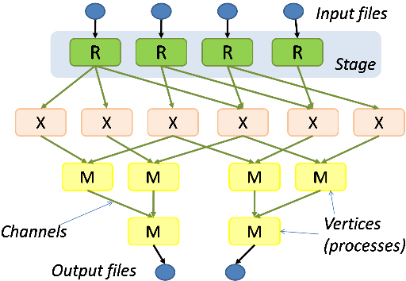
Hadoop & Dryad
Apache Hadoop
Microsoft Dryad
Master Node
Data/Compute Nodes
Job
Tracker
M
M
M
M
R
R
R
R
Name
Node
Data blocks
1
2
2
4
HDFS
3
3
Apache Implementation of Google’s MapReduce
Uses Hadoop Distributed File System (HDFS) manage data
Map/Reduce tasks are scheduled based on data locality in HDFS
Hadoop handles:
  Job Creation
  Resource management
  Fault tolerance & re-execution of failed map/reduce tasks
The computation is structured as a directed acyclic graph (DAG)
  Superset of MapReduce
Vertices – computation tasks
Edges – Communication channels
Dryad process the DAG executing vertices on compute clusters
Dryad handles:
  Job creation, Resource management
  Fault tolerance & re-execution of vertices

Slide 21


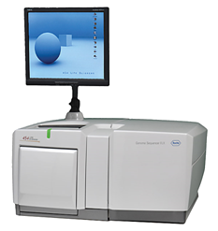
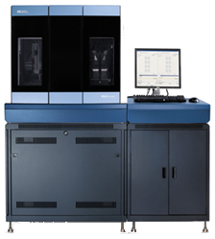
DNA Sequencing Pipeline
MapReduce
Pairwise
clustering
Sequence
alignment
Dissimilarity
Matrix
N(N-1)/2 values
Visualization
Plotviz
FASTA File
N Sequences
Blocking
block
Pairings
MPI
MDS
Read Alignment
Illumina/Solexa Roche/454 Life Sciences Applied Biosystems/SOLiD
Internet
Modern Commercial Gene Sequencers
This chart illustrate our research of a pipeline mode to provide services on demand (Software as a Service SaaS)
User submit their jobs to the pipeline. The components are services and so is the whole pipeline.

Slide 22


Biology MDS and Clustering Results
Alu Families
This visualizes results of Alu repeats from Chimpanzee and Human Genomes. Young families (green, yellow) are seen as tight clusters. This is projection of MDS dimension reduction to 3D of 35399 repeats – each with about 400 base pairs
Metagenomics
This visualizes results of dimension reduction to 3D of 30000 gene sequences from an environmental sample. The many different genes are classified by clustering algorithm and visualized by MDS dimension reduction

Slide 23


Twister(MapReduce++)
Pub/Sub Broker Network
Map Worker
M
Streaming based communication
Intermediate results are directly transferred from the map tasks to the reduce tasks – eliminates local files
Cacheable map/reduce tasks
  Static data remains in memory
Combine phase to combine reductions
User Program is the composer of MapReduce computations
Extends the MapReduce model to iterative computations
Worker Nodes
R
Reduce Worker
D
D
MR
Driver
User
Program
M
M
M
M
D
MRDeamon
R
R
R
R
Data Read/Write
Communication
Data Split
File System
Iterate
Static
data
Configure()
User Program
Map(Key, Value)
δ flow
Reduce (Key, List<Value>)
Combine (Key, List<Value>)
Different synchronization and intercommunication mechanisms used by the parallel runtimes
Close()

Slide 26
Fault Tolerance and MapReduce
MPI does “maps” followed by “communication” including “reduce” but does this iteratively
There must (for most communication patterns of interest) be a strict synchronization at end of each communication phase
  Thus if a process fails then everything grinds to a halt
In MapReduce, all Map processes and all reduce processes are independent and stateless and read and write to disks
Thus failures can easily be recovered by rerunning process without other jobs hanging around waiting

Slide 27
 | AWS/ Azure | Hadoop | DryadLINQ
Programming patterns | Independent job execution | MapReduce | DAG execution, MapReduce + Other patterns
Fault Tolerance | Task re-execution based on a time out | Re-execution of failed and slow tasks. | Re-execution of failed and slow tasks.
Data Storage | S3/Azure Storage. | HDFS parallel file system. | Local files
Environments | EC2/Azure, local compute resources | Linux cluster, Amazon Elastic MapReduce | Windows HPCS cluster
Ease of Programming | EC2 : ** Azure: *** | **** | ****
Ease of use | EC2 : *** Azure: ** | *** | ****
Scheduling & Load Balancing | Dynamic scheduling through a global queue, Good natural load balancing | Data locality, rack aware dynamic task scheduling through a global queue, Good natural load balancing | Data locality, network topology aware scheduling. Static task partitions at the node level, suboptimal load balancing
Notes:
Hi Professor,Yes. More * are better. This table was done mainly to compare EC2 & Azure with the Dryad & Hadoop based on a reviewer comment and it's bit subjective.
I gave similar ratings for the ease of programming of DryadLINQ & Hadoop. There is a jumpstart cost in learning DryadLINQ if somebody is not familiar with LINQ. But when he knows DryadLINQ, it's easier to program.
I also mention DryadLINQ is easier to use than Hadoop. What I meant by "ease of use" is the level of difficulty in managing the framework and to run the tasks. Given the availability of a Windows HPCS cluster, it's easier to install and run DryadLINQ than setting up a Hadoop cluster. But on the other hand with DryadLINQ users have to do the data distribution manually or through programatically, I don't think I'm capturing that in my rating.

Slide 28


Sequence Assembly in the Clouds
Cap3 parallel efficiency
Cap3 – Per core per file (458 reads in each file) time to process sequences

Slide 29
Cost to assemble to process 4096 FASTA files
~ 1 GB / 1875968 reads (458 readsX4096)
Amazon AWS total :11.19 $
    Compute 1 hour X 16 HCXL (0.68$ * 16) = 10.88 $
    10000 SQS messages = 0.01 $
    Storage per 1GB per month = 0.15 $
    Data transfer out per 1 GB = 0.15 $
Azure total : 15.77 $
    Compute 1 hour X 128 small (0.12 $ * 128) = 15.36 $
    10000 Queue messages = 0.01 $
    Storage per 1GB per month = 0.15 $
    Data transfer in/out per 1 GB = 0.10 $ + 0.15 $
Tempest (amortized) : 9.43 $
  24 core X 32 nodes, 48 GB per node
  Assumptions : 70% utilization, write off over 3 years, include support

Slide 30
FutureGrid Concepts
Support development of new applications and new middleware using Cloud, Grid and Parallel computing (Nimbus, Eucalyptus, Hadoop, Globus, Unicore, MPI, OpenMP. Linux, Windows …) looking at functionality, interoperability, performance
Put the “science” back in the computer science of grid computing by enabling replicable experiments
Open source software built around Moab/xCAT to support dynamic provisioning from Cloud to HPC environment, Linux to Windows ….. with monitoring, benchmarks and support of important existing middleware
June 2010 Initial users; September 2010 All hardware (except IU shared memory system) accepted and major use starts; October 2011 FutureGrid allocatable via TeraGrid process

Slide 31

FutureGrid: a Grid Testbed
IU Cray operational, IU IBM (iDataPlex) completed stability test May 6
UCSD IBM operational, UF IBM stability test completes ~ May 12
Network, NID and PU HTC system operational
UC IBM stability test completes ~ May 27; TACC Dell awaiting delivery of components
NID: Network Impairment Device
Private
Public
FG Network

Slide 32
FutureGrid Partners
Indiana University (Architecture, core software, Support)
Purdue University (HTC Hardware)
San Diego Supercomputer Center at University of California San Diego (INCA, Monitoring)
University of Chicago/Argonne National Labs (Nimbus)
University of Florida (ViNE, Education and Outreach)
University of Southern California Information Sciences (Pegasus to manage experiments)
University of Tennessee Knoxville (Benchmarking)
University of Texas at Austin/Texas Advanced Computing Center (Portal)
University of Virginia (OGF, Advisory Board and allocation)
Center for Information Services and GWT-TUD from Technische Universtität Dresden. (VAMPIR)
Blue institutions have FutureGrid hardware

Slide 33
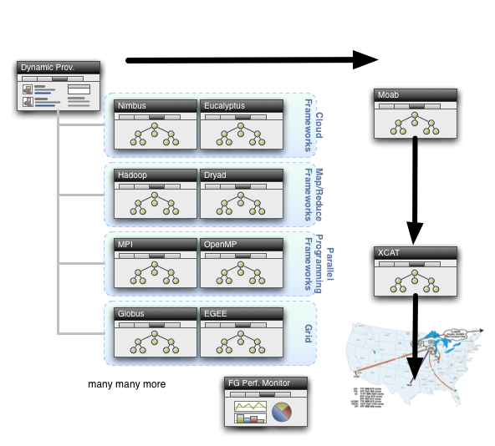
Dynamic Provisioning

Slide 34
Clouds and Collaboration I
Clouds are the largest scale computer centers ever constructed and so they have the capacity to be important to large scale collaboration problems as well as those at small scale.
Commercial clouds were born from computer systems to support Web 2.0 (collaboration) systems – Search, Youtube, Flickr ….
Clouds exploit the economies of this scale and so can be expected to be a cost effective approach to computing. Their architecture explicitly addresses the important fault tolerance issue.
Clouds are commercially supported and so one can expect reasonably robust software without the sustainability difficulties seen from the academic software systems critical to much current Cyberinfrastructure.
There are 3 major vendors of clouds (Amazon, Google, Microsoft) and many other infrastructure and software cloud technology vendors. This competition should ensure that clouds should develop in a healthy innovative fashion.
Further attention is already being given to cloud standards
There are many Cloud research projects, conferences (Indianapolis December 2010) and other activities with research cloud infrastructure efforts including Nimbus, OpenNebula, Sector/Sphere and Eucalyptus.

Slide 35
Clouds and Collaboration II
There are a growing number of academic /research cloud systems supporting users through NSF Programs for Google/IBM and Microsoft Azure systems. In NSF, FutureGrid will offer a Cloud testbed and Magellan is a major DoE experimental cloud system. The EU framework 7 project VENUS-C is just starting.
Clouds offer "on-demand" and interactive computing that is more attractive than batch systems to many users.
MapReduce attractive computing model supporting data intensive applications
Cyberinfrastructure and Grids builds systems including clouds
BUT
The centralized computing model for clouds runs counter to the concept of "bringing the computing to the data" and bringing the "data to a commercial cloud facility" may be slow and expensive.
There are many security, legal and privacy issues that often mimic those Internet which are especially problematic in areas such health informatics and where proprietary information could be exposed.
The virtualized networking currently used in the virtual machines in today’s commercial clouds and jitter from complex operating system functions increases synchronization/communication costs.
  This is especially serious in large scale parallel computing and leads to significant overheads in many MPI applications. Indeed the usual (and attractive) fault tolerance model for clouds runs counter to the tight synchronization needed in most MPI applications.

Slide 36
The term SALSA or Service Aggregated Linked Sequential Activities, is derived from Hoare’s Concurrent Sequential Processes (CSP)
SALSA Group
http://salsahpc.indiana.edu
Group Leader: Judy Qiu
Staff : Adam Hughes
CS PhD: Jaliya Ekanayake, Thilina Gunarathne, Jong Youl Choi, Seung-Hee Bae,
Yang Ruan, Hui Li, Bingjing Zhang, Saliya Ekanayake,
CS Masters: Stephen Wu
Undergraduates: Zachary Adda, Jeremy Kasting, William Bowman
http://salsahpc.indiana.edu/content/cloud-materials Cloud Tutorial Material
Notes:
describes our approach to multicore computing where we used services as modules to capture key functionalities implemented with multicore threading.
This will be expanded as a proposed approach to parallel computing where one produces libraries of parallelized components and combines them with a generalized service integration (workflow) model

