Slide 1
Clouds and Web2.0
Introduction
CTS08 Tutorial
Hyatt Regency Irvine California
May 19 2008
Geoffrey Fox, Marlon Pierce
Community Grids Laboratory, School of informatics
Indiana University
http://www.infomall.org/multicore
gcf@indiana.edu, http://www.infomall.org
1
Notes:
1

Slide 2
e-moreorlessanything
‘e-Science is about global collaboration in key areas of science, and the next generation of infrastructure that will enable it.’ from its inventor John Taylor Director General of Research Councils UK, Office of Science and Technology
e-Science is about developing tools and technologies that allow scientists to do ‘faster, better or different’ research
Similarly e-Business captures an emerging view of corporations as dynamic virtual organizations linking employees, customers and stakeholders across the world.
This generalizes to e-moreorlessanything including presumably e-Collaboration and e-DefenseSystems ….
A deluge of data of unprecedented and inevitable size must be managed and understood.
People (see Web 2.0), computers, data (including sensors and instruments) must be linked.
On demand assignment of experts, computers, networks and storage resources must be supported
2
Notes:
2

Slide 3
Applications, Infrastructure, Technologies
This field is confused by inconsistent use of terminology; I define
Web Services, Grids and (aspects of) Web 2.0 (Enterprise 2.0) are technologies
Grids could be everything (Broad Grids implementing some sort of managed web) or reserved for specific architectures like OGSA or Web Services (Narrow Grids)
These technologies combine and compete to build electronic infrastructures termed e-infrastructure or Cyberinfrastructure and possibly implemented as Clouds
e-moreorlessanything is an emerging application area of broad importance that is hosted on the infrastructures e-infrastructure or Cyberinfrastructure
e-Science or perhaps better e-Research is a special case of e-moreorlessanything

Slide 4
Relevance of Web 2.0
Web 2.0 can help e-moreorlessanything in many ways
Its tools (web sites) can enhance collaboration, i.e. effectively support virtual organizations, in different ways from grids (See VOaaS later)
The popularity of Web 2.0 can provide high quality technologies and software that (due to large commercial investment) can be very useful in e-moreorlessanything and preferable to Grid or Web Service solutions
Web 2.0 through Clouds is bringing largest most scalable infrastructure (IaaS, HaaS)
The usability and participatory nature of Web 2.0 can bring science and its informatics to a broader audience
Web 2.0 can even help the emerging challenge of using multicore chips i.e. in improving parallel computing programming and runtime environments

Slide 5
Gartner 2006 Technology Hype Curve

Slide 6


















“Best Web 2.0 Sites” -- 2006
Extracted from http://web2.wsj2.com/
All important capabilities for e-Science
Social Networking
Start Pages
Social Bookmarking
Peer Production News
Social Media Sharing
Online Storage
(Computing)
See http://www.seomoz.org/web2.0 for May 2007 List
6
Notes:
6

Slide 7
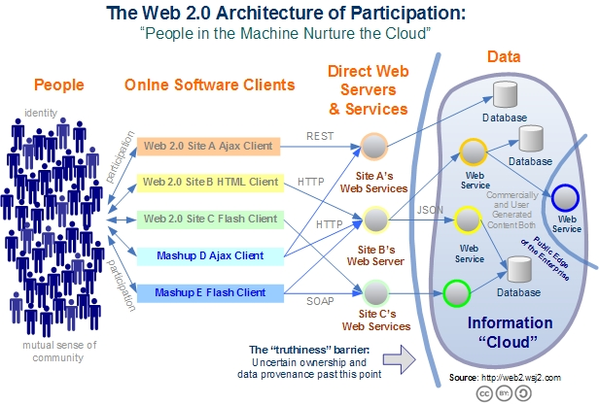
Web 2.0 Systems like Grids have Portals, Services, Resources
Captures the incredible development of interactive Web sites enabling people to create and collaborate

Slide 8
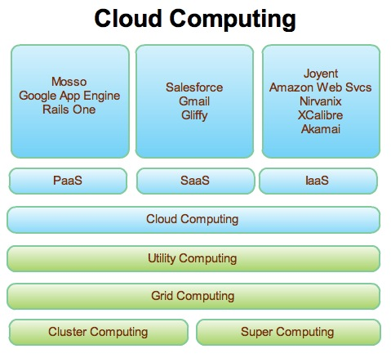
Web 2.0 and Clouds
Grids are less popular but most of what we did is reusable
Clouds are designed heterogeneous (for functionality) scalable distributed systems whereas Grids integrate a priori heterogeneous (for politics) systems
Clouds should be easier to use,
cheaper, faster and scale to larger
sizes than Grids
Grids assume you can’t design
system but rather must accept
results of N independent
supercomputer funding calls
SaaS: Software as a Service
IaaS: Infrastructure as a Service
or HaaS: Hardware as a Service
PaaS: Platform as a Service
delivers SaaS on IaaS

Slide 9
In more detail Web2.0 Offers
Technologies such as Mashups, Gadgets, JSON, Ajax, RSS
S/P/H/IaaS “as a Service” deployment
Some special services implementing VOaaS Virtual Organizations as a Service
  Tagging user generated comments/labels
  Facebook, LinkedIn …..implementing collegiality
  Shared files (electronic resources) by P2P or Flickr/YouTube approach
  OaaS (Office as a Service) as in Google documents
  Blogs, Wikis including Wikipedia itself
  SciVee and myExperiment are some eScience examples

Slide 10
User Interface Layer
Browser +
JavaScript Libraries
Browser + JavaScript Libraries
Browser +
JavaScript Libraries
AJAX, JSON, REST, RSS
User Cloud Layer
Server-Side
Gdata Apps
Facebook Apps
Gadgets, Gadget Aggregators
SOAP, REST, RSS
System Cloud Layer
Blogs, Calendars, Docs, etc
Facebook
Social Gadget
Containers

Slide 11
Map Key
Red blocks represent browsers and things that run in them (JavaScript).
  This is the “user” level.
  Client side mashups
Green blocks represent Web servers and their applications.
  This is the “developer” level.
  Server-side mashups.
  These can run on any hosting environment: your web server, Amazon EC2, Google GAE, etc.
Blue blocks represent third party services.
  This is the “system cloud” layer.
Arrows represent network communications.
  Everything goes over HTTP
  REST, AJAX: communication patterns.
  RSS, ATOM, JSON, SOAP: message format.

Slide 12
Web 2.0 and Web Services
I once thought Web Services were inevitable but this is no longer clear to me
They achieved interoperability by exposing everything )in SOAP headers)
  Alternative (REST) exposes the minimum needed
Web services are complicated, slow and non functional
  WS-Security is unnecessarily slow and pedantic (canonicalization of XML)
  WS-RM (Reliable Messaging) seems to have poor adoption and doesn’t work well in collaboration
  WSDM (distributed management) specifies a lot
There are de facto Web 2.0 standards like Google Maps and powerful suppliers like Google/Microsoft which “define the architectures/interfaces

Slide 13
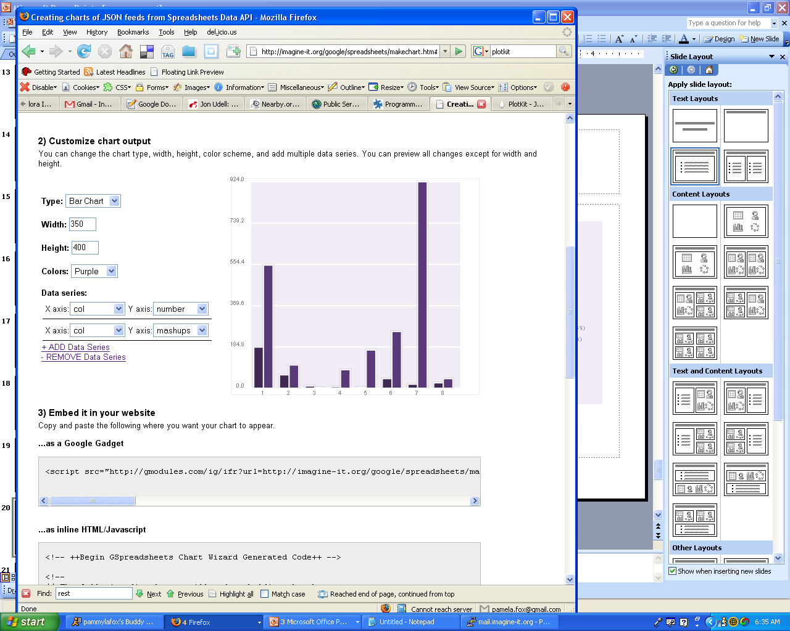
Distribution of APIs and Mashups per Protocol
google maps
Number of
APIs
Number of
Mashups
del.icio.us
SOAP is quite a small fraction
virtual earth
411sync
yahoo! search
yahoo! geocoding
technorati
netvibes
yahoo! images
trynt
amazon ECS
yahoo! local
live.com
google search
flickr
youtube
ebay
amazon S3
REST
SOAP
XML-RPC
REST,
XML-RPC
REST,
XML-RPC, SOAP
REST,
SOAP
JS
Other

Slide 14
Too much Computing?
Historically both grids and parallel computing have tried to increase computing capabilities by
  Optimizing performance of codes at cost of re-usability
  Exploiting all possible CPU’s such as Graphics co-processors and “idle cycles” (across administrative domains)
  Linking central computers together such as NSF/DoE/DoD supercomputer networks without clear user requirements
Next Crisis in technology area will be the opposite problem – commodity chips will be 32-128way parallel in 5 years time and we currently have no idea how to use them on commodity systems – especially on clients
  Only 2 releases of standard software (e.g. Office) in this time span so need solutions that can be implemented in next 3-5 years
Intel RMS analysis: Gaming and Generalized decision support (data mining) are ways of using these cycles

Slide 15
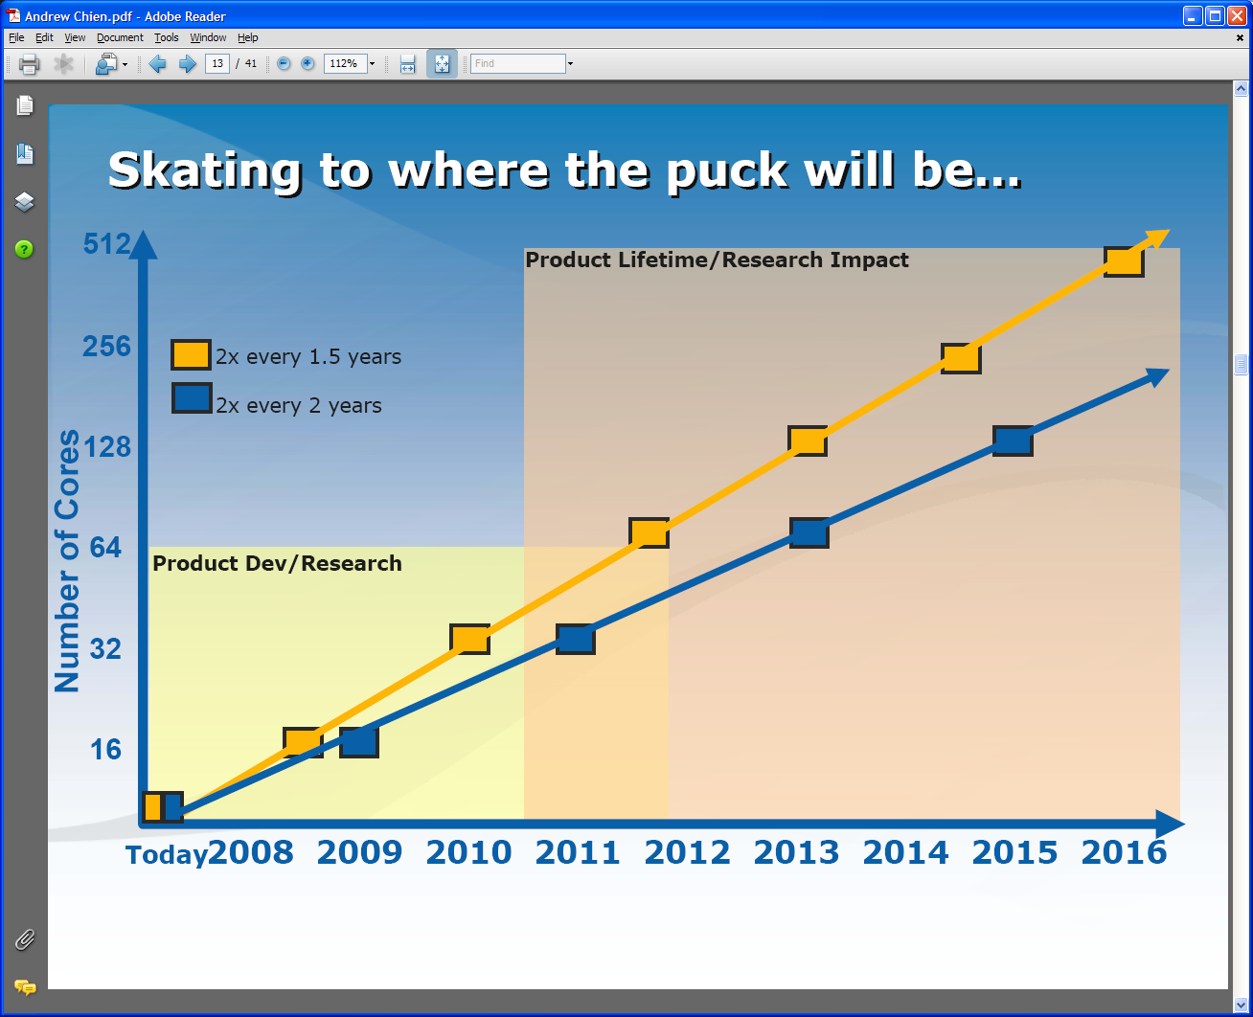
Intel’s Projection

Slide 16
Intel’s Application Stack

Slide 17
Too much Data to the Rescue?
Multicore servers have clear “universal parallelism” as many users can access and use machines simultaneously
Maybe also need application parallelism (e.g. datamining) as needed on client machines
Over next years, we will be submerged of course in data deluge
  Scientific observations for e-Science
  Local (video, environmental) sensors
  Data fetched from Internet defining users interests
Maybe data-mining of this “too much data” will use up the “too much computing” both for science and commodity PC’s
  PC will use this data(-mining) to be intelligent user assistant?
  Must have highly parallel algorithms

Slide 18
What are Clouds?
Clouds are “Virtual Clusters” (maybe “Virtual Grids”) of usually “Virtual Machines”
  They may cross administrative domains or may “just be a single cluster”; the user cannot and does not want to know
  VMware, Xen .. virtualize a single machine and service (grid) architectures virtualize across machines
Clouds support access to (lease of) computer instances
  Instances accept data and job descriptions (code) and return results that are data and status flags
Clouds can be built from Grids but will hide this from user
Clouds designed to build 100 times larger data centers
Clouds support green computing by supporting remote location where operations including power cheaper

Slide 19

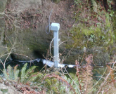
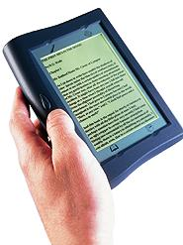





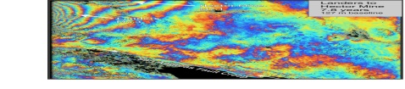
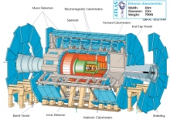
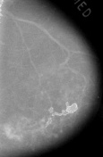



Information and Cyberinfrastructure
Raw Data → Data → Information → Knowledge → Wisdom → Decisions
Another
Grid
Another
Grid
SS
SS
SS
SS
SS
SS
fs
fs
Discovery
Cloud
Filter
Service
Portal
Filter
Cloud
fs
fs
SS
fs
fs
Filter
Cloud
Inter-Service Messages
Another
Service
fs
fs
SS
Filter
Cloud
fs
Filter
Service
fs
fs
fs
SS
fs
fs
fs
Filter
Service
fs
Discovery
Cloud
fs
fs
fs
fs
SS
Traditional Grid with exposed services
Filter
Cloud
fs
Filter
Service
fs
Filter
Cloud
Filter
Cloud
SS
fs
fs
Another
Grid
SS
SS
SS
SS
SS
SS
Sensor or Data
Interchange
Service
SS
SS
SS
SS
SS
SS
Compute
Cloud
Storage
Cloud
Database

Slide 20
Clouds and Grids
Clouds are meant to help user by simplifying interface to computing
Clouds are meant to help CIO and CFO by simplifying system architecture enabling larger (factor of 100) more cost effective data centers
Clouds support green computing by supporting remote location where operations including power cheaper
Clouds are like Grids in many ways but a cloud is built as a “ab initio” system whereas Grids are built from existing heterogeneous systems (with heterogeneity exposed)
The low level interoperability architecture of services has failed – the WS-* do not work. However only need these if linking heterogeneous systems. Clouds do not need low level interoperability but rather expose high level interfaces
Clouds very very loosely coupled; services loosely coupled

Slide 21
Technical Questions about Clouds I
What is performance overhead?
  On individual CPU
  On system including data and program transfer
What is cost gain
  From size efficiency; “green” location
Is Cloud Security adequate: can clouds be trusted?
Can one can do parallel computing on clouds?
  Looking at “capacity” not “capability” i.e. lots of modest sized jobs
  Marine corps will use Petaflop machines – they just need ssh and a.out

Slide 22
Technical Questions about Clouds II
How is data-compute affinity tackled in clouds?
  Co-locate data and compute clouds?
  Lots of optical fiber i.e. “just” move the data?
What happens in clouds when demand for resources exceeds capacity – is there a multi-day job input queue?
  Are there novel cloud scheduling issues?
Do we want to link clouds (or ensembles defined as atomic clouds); if so how and with what protocols
Is there an intranet cloud e.g. “cloud in a box” software to manage personal (cores on my future 128 core laptop) department or enterprise cloud?

Slide 23
MSI Challenge Problem
There are > 330 MSI’s – Minority Serving Institutions
  2 examples
ECSU (Elizabeth City State University) is a small state university in North Carolina
  HBCU with 4000 students
  Working on PolarGrid (Sensors in Arctic/Antarctic linked to “TeraGrid”)
Navajo Tech in Crown Point NM is community college with technology leadership for Navajo Nation
  “Internet to the Hogan and Dine Grid” links Navajo communities by wireless
  Wish to integrate TeraGrid science into Navajo Nation education curriculum
Current Grid technology too complicated; especially if you are not an R1 institution
Hard to deploy campus grids broadly into MSI’s
Clouds could provide virtual campus resources?

Slide 24
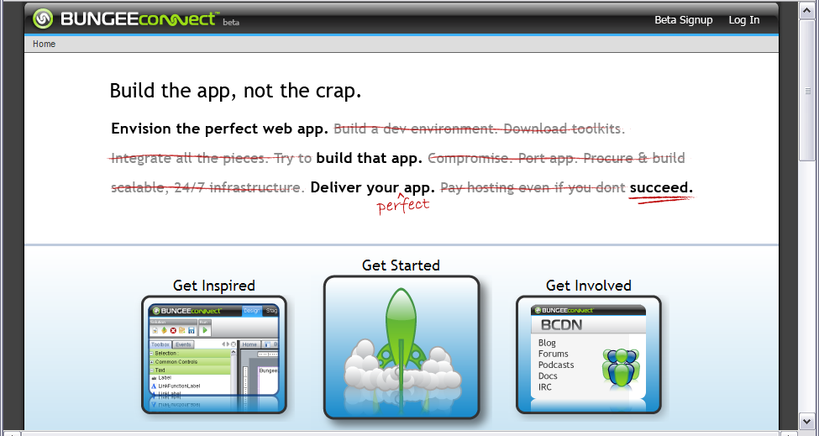
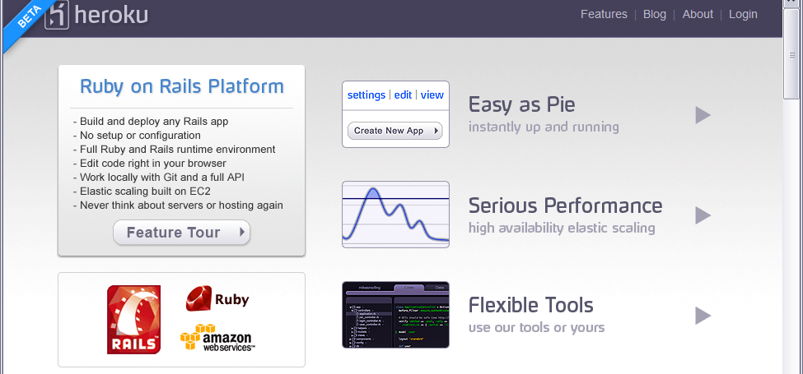
Some Small Cloud Companies
http://www.bungeelabs.com/
http://heroku.com/
http://heroku.com/

Slide 25
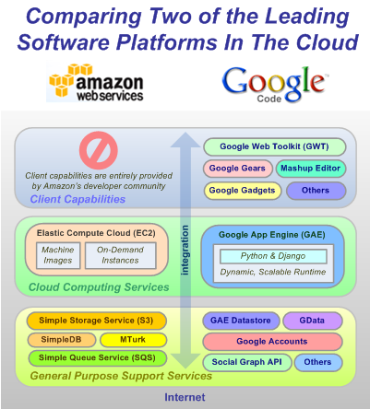
The Big Players!
Amazon and Google
IBM, Dell, Microsoft, Sun ….
are not far behind

Slide 26
Cloud References
http://en.wikipedia.org/wiki/Cloud_computing
  Includes references to Amazon, Apple, Dell, Enomalism, Globus, Google, IBM, KnowledgeTreeLive, Nature, New York Times, Zimdesk
  Others like Microsoft Windows Live Skydrive important
http://en.wikipedia.org/wiki/Amazon_Elastic_Compute_Cloud
http://uc.princeton.edu/main/index.php?option=com_content&task=view&id=2589&Itemid=1 Policy Issues
http://www.cra.org/ccc/home.article.bigdata.html
  Hadoop (MapReduce) and “Data Intensive Computing”
http://ianfoster.typepad.com/blog/2008/01/theres-grid-in.html
Dion Hinchcliffe http://blogs.zdnet.com/Hinchcliffe/?p=166
http://www.productionscale.com/home/2008/4/24/cloud-computing-get-your-head-in-the-clouds.html
http://www.readwriteweb.com/archives/windows_collapsing_2011_tipping_point.php

Slide 27
Superior (from broad usage) technologies of Web 2.0
Mash-ups can replace Workflow
Gadgets can replace Portlets
UDDI replaced by user generated registries

Slide 28
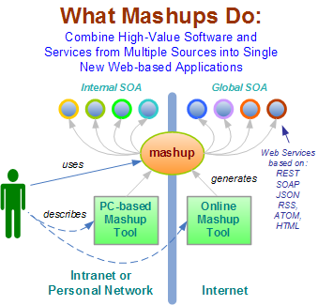
Mashups v Workflow?
Mashup Tools are reviewed at http://blogs.zdnet.com/Hinchcliffe/?p=63
Workflow Tools are reviewed by Gannon and Fox http://grids.ucs.indiana.edu/ptliupages/publications/Workflow-overview.pdf
Both include scripting in PHP, Python, ssh etc. as both implement distributed programming at level of services
Mashups use all types of service interfaces and perhaps do not have the potential robustness (security) of Grid service approach
Mashups typically “pure” HTTP (REST)
28
Notes:
28

Slide 29
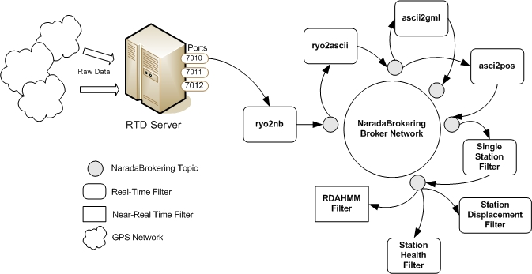
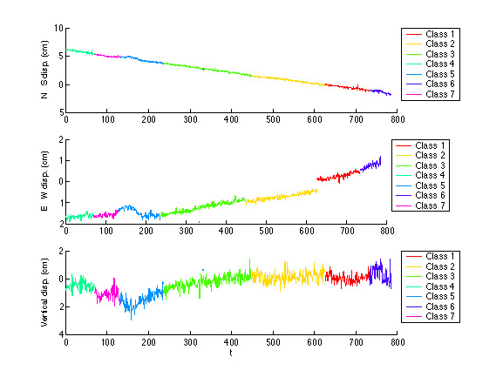
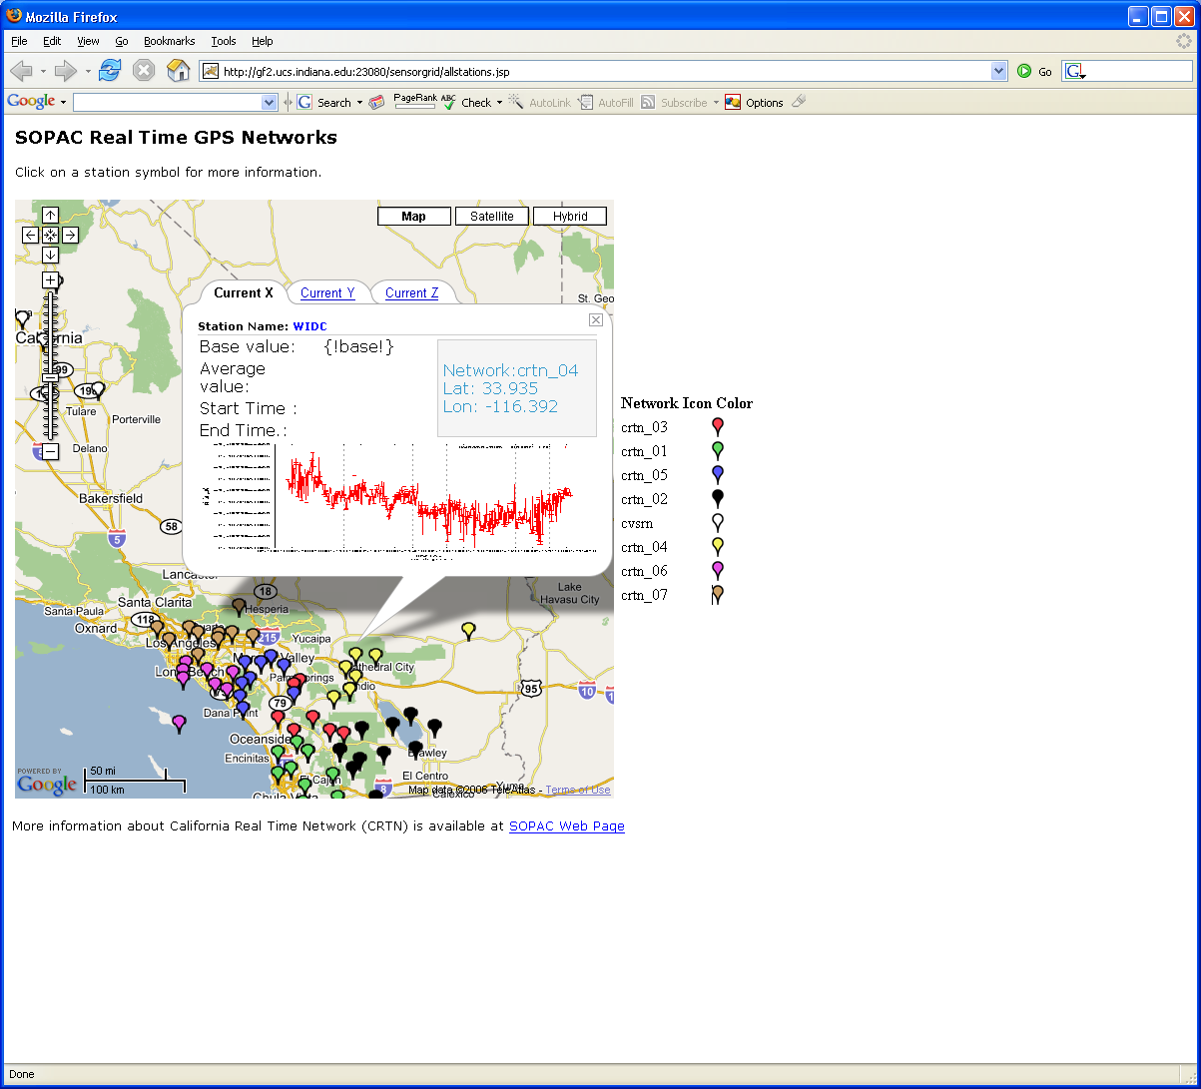
Grid Workflow Datamining in Earth Science
NASA GPS
Work with Scripps Institute
Grid services controlled by scripting workflow process real time data from ~70 GPS Sensors in Southern California
Earthquake
Streaming Data
Support
Transformations
Data Checking
Archival
Hidden Markov
Datamining (JPL)
Real Time
Display (GIS)
29
Notes:
29

Slide 30
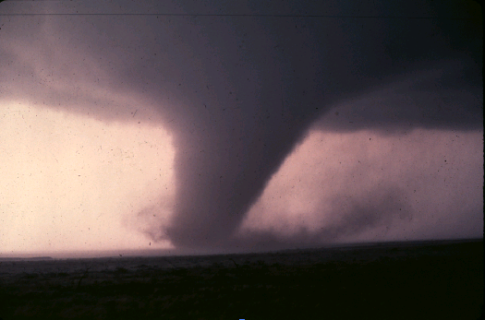
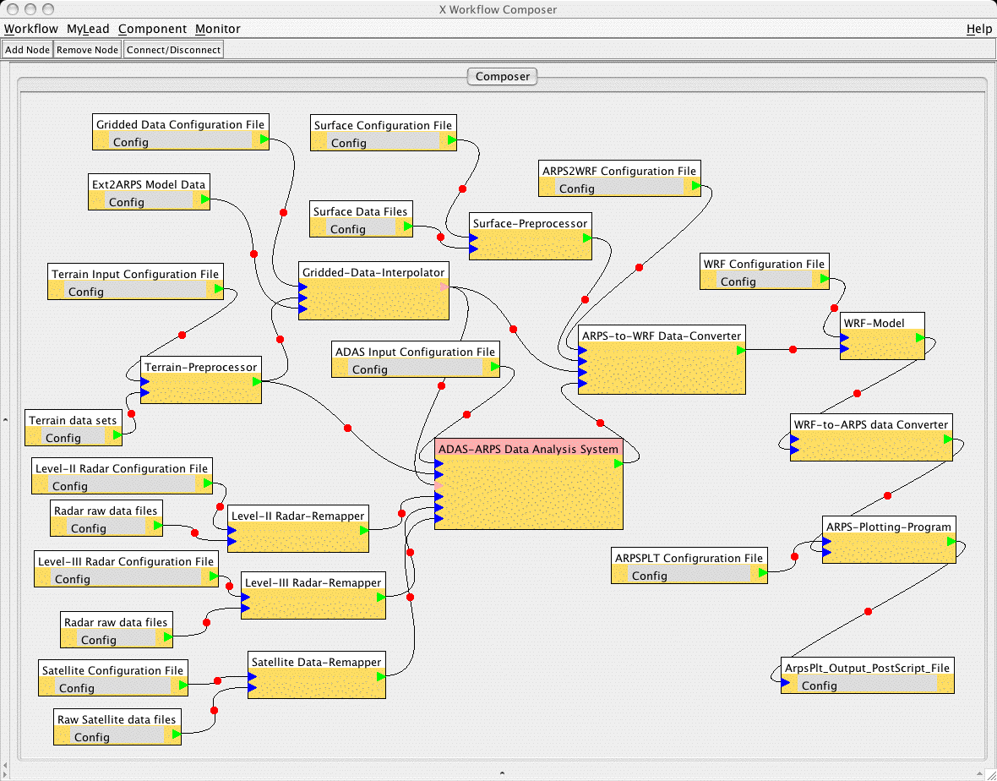
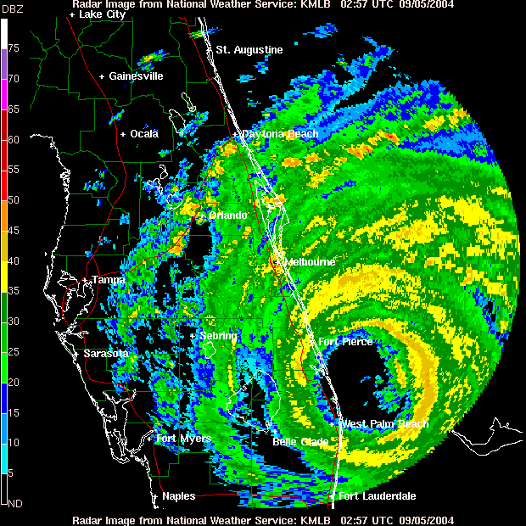
Grid Workflow Data Assimilation in Earth Science
Grid services triggered by abnormal events and controlled by workflow process real time data from radar and high resolution simulations for tornado forecasts
Typical graphical interface to service composition
Taverna another well known Grid/Web Service workflow tool
Recent Web 2.0 visual Mashup tools include Yahoo Pipes and Microsoft Popfly

Slide 31
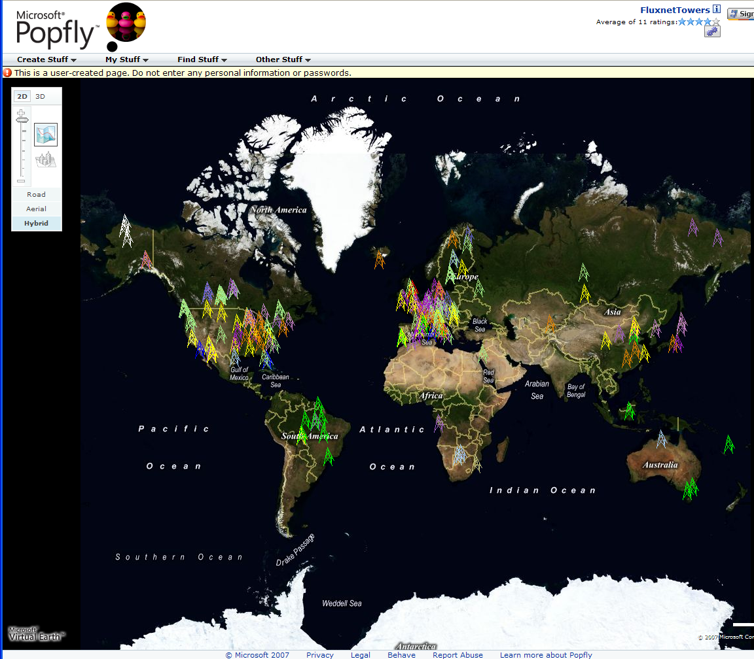
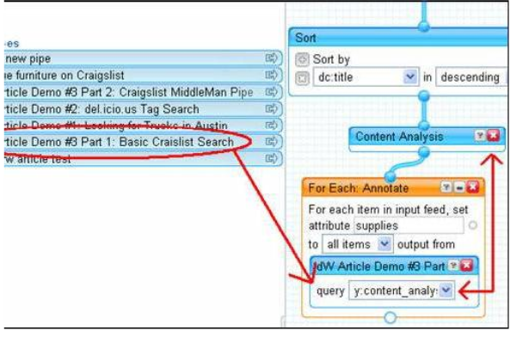
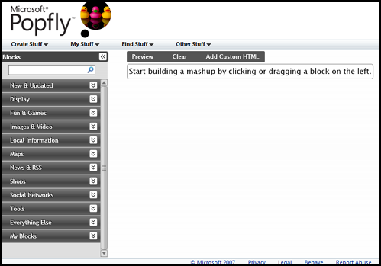
Major Companies entering mashup area
Web 2.0 Mashups (by definition the largest market) are likely to drive composition tools for Grid and web
Recently we see Mashup tools like Yahoo Pipes and Microsoft Popfly which have familiar graphical interfaces
Currently only simple examples but tools could become powerful
Yahoo Pipes

Slide 32
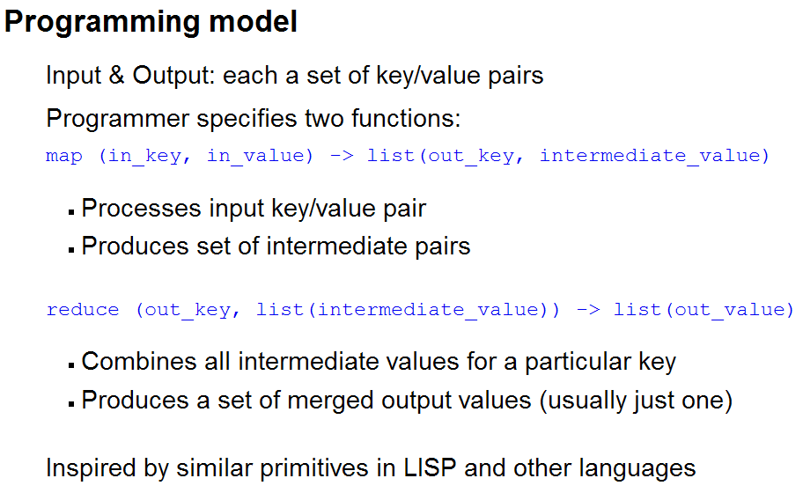
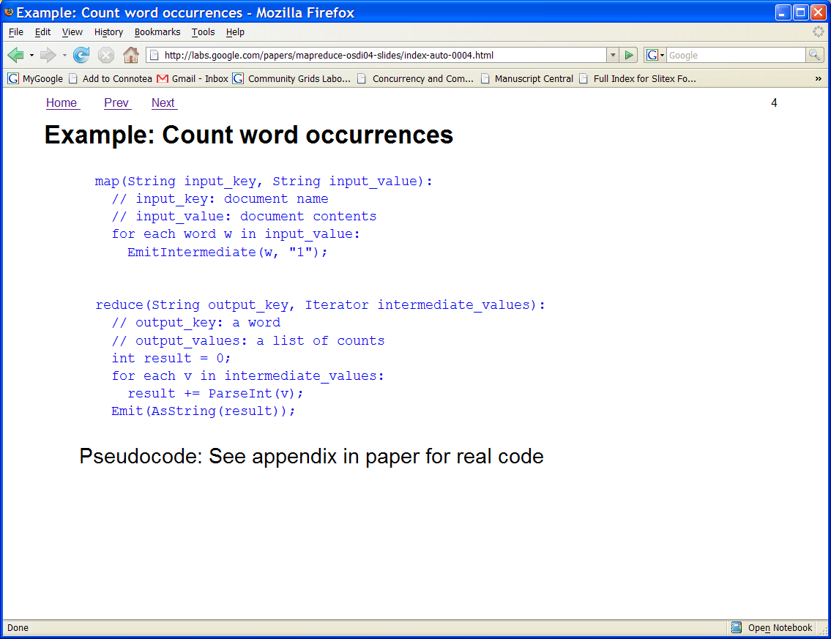
Google MapReduce
Simplified Data Processing on Clusters/Clouds
http://labs.google.com/papers/mapreduce.html
This is a dataflow model between services where services can do useful document oriented data parallel applications including reductions
The decomposition of services onto cluster engines (clouds) is automated
The large I/O requirements of datasets changes efficiency analysis in favor of dataflow
Services (count words in example) can obviously be extended to general parallel applications
There are many alternatives to language expressing either dataflow and/or parallel operations and/or workflow

Slide 33
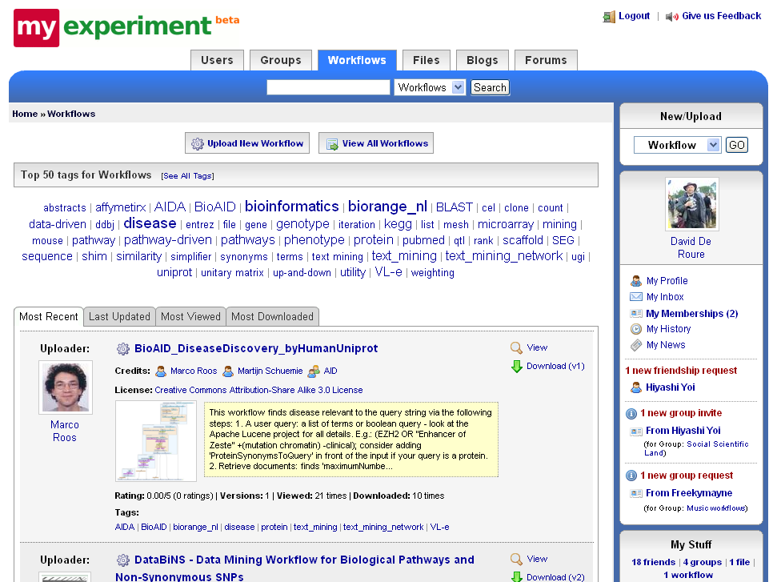

Slide 34
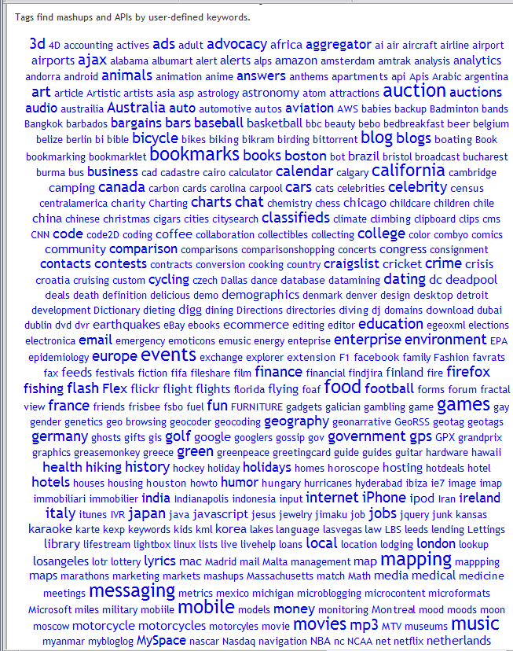
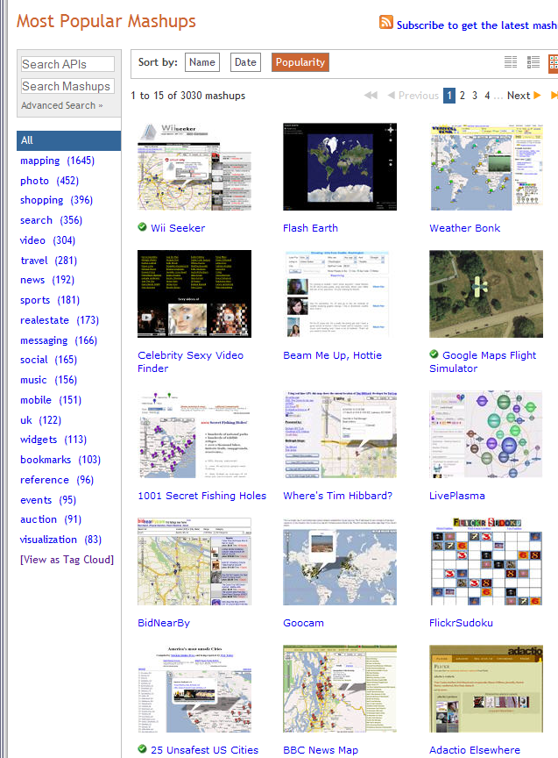
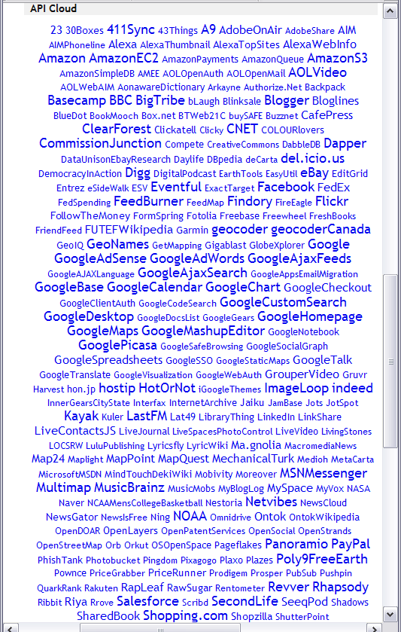
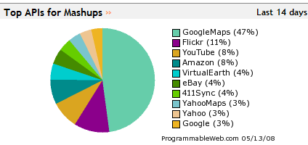
Web 2.0 Mashups and APIs
http://www.programmableweb.com/ has (May 14 2008) 3030 Mashups and 748 Web 2.0 APIs
and with GoogleMaps the most often used in Mashups
This is the Web 2.0 UDDI (service registry)

Slide 35
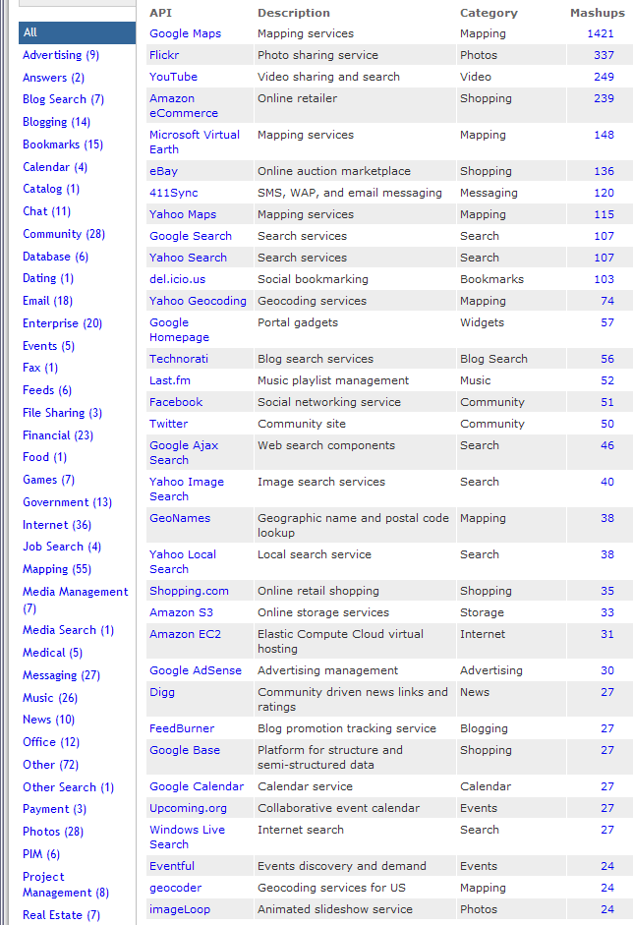
The List of Web 2.0 API’s
Each site has API and its features
Divided into broad categories
Only a few used a lot
(64 API’s used in 10 or
more mashups)
RSS feed of new APIs
Google maps dominates
but Amazon EC2/S3
growing in popularity
Interesting that no such eScience site; we are not building interoperable
(re-usable) services?

Slide 36
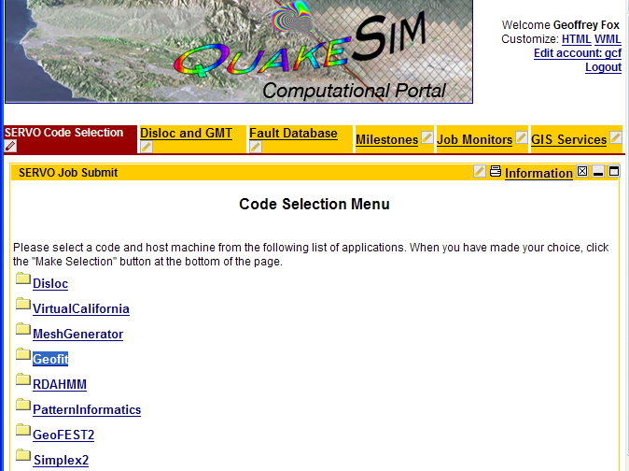
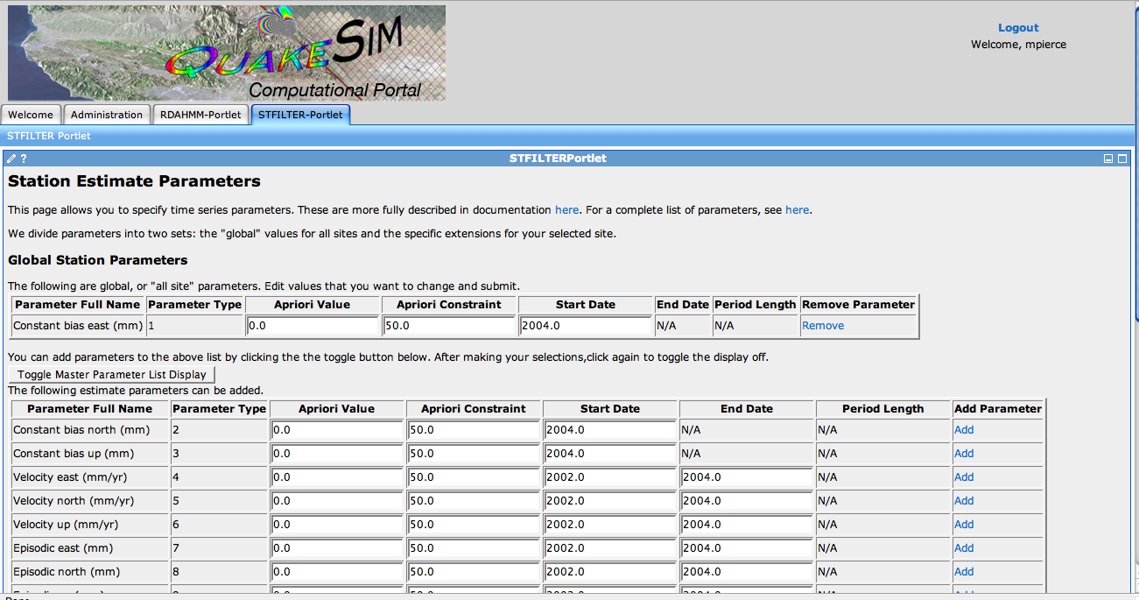
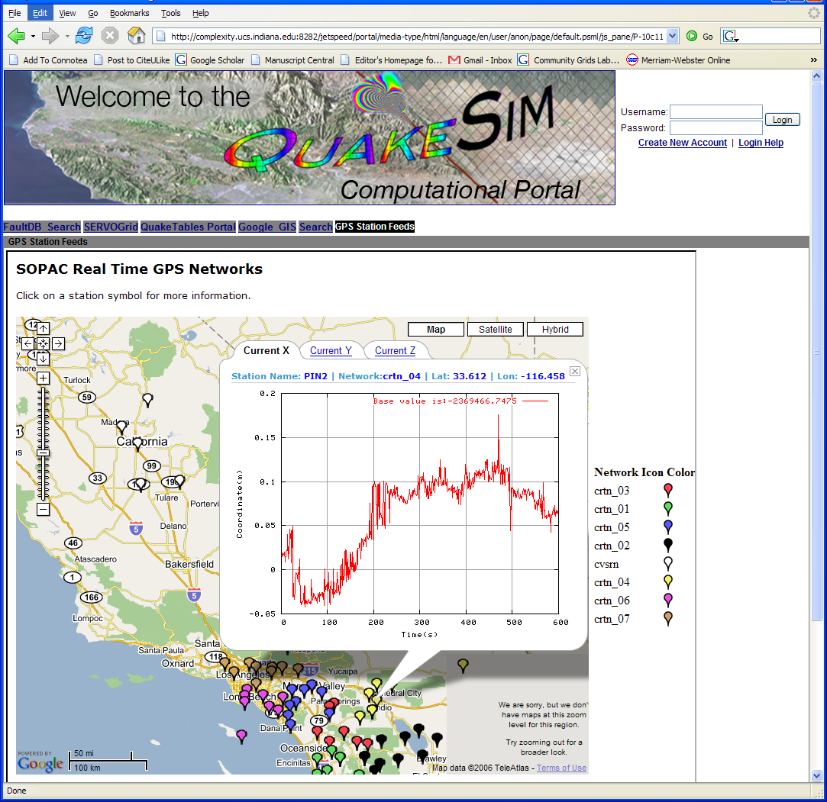
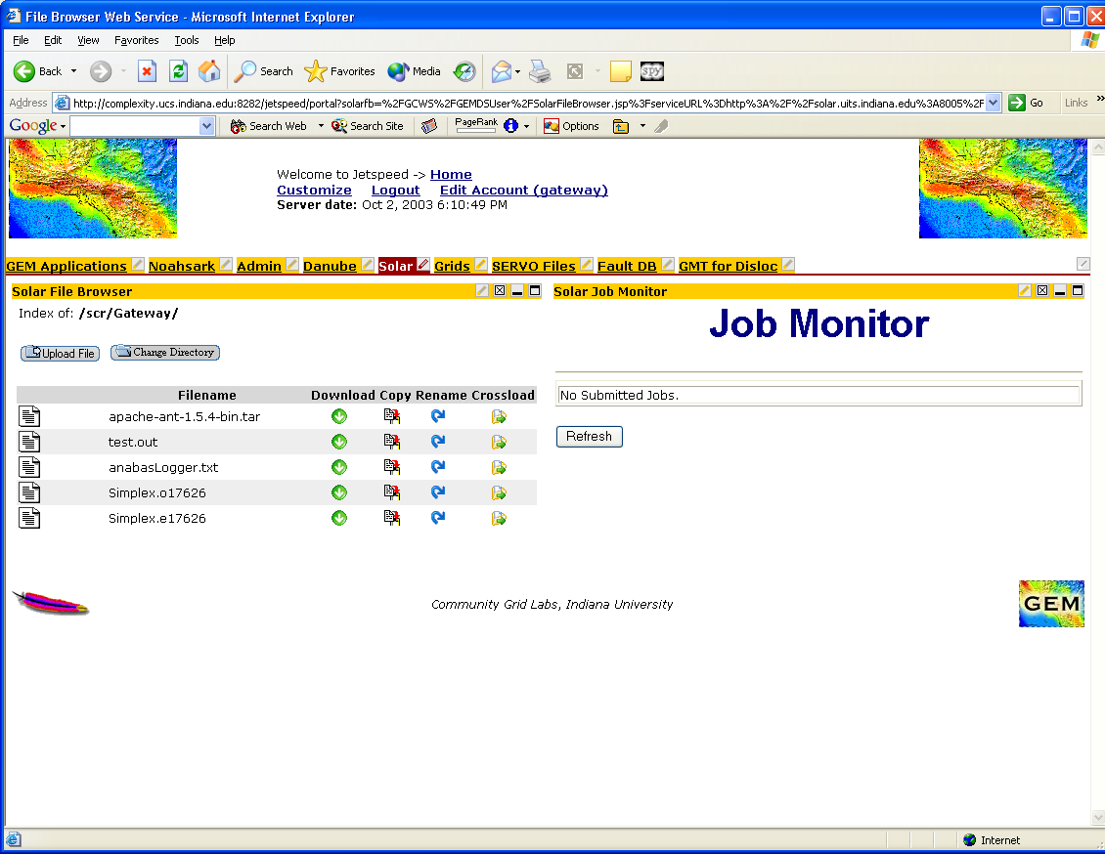
Grid-style portal as used in Earthquake Grid
The Portal is built from portlets – providing user interface fragments for each service that are composed into the full interface – uses OGCE technology as does planetary science VLAB portal with University of Minnesota
QuakeSim has a typical Grid technology portal
Such Server side Portlet-based approaches to portals are being challenged by client side gadgets from Web 2.0
36
Notes:
36

Slide 37
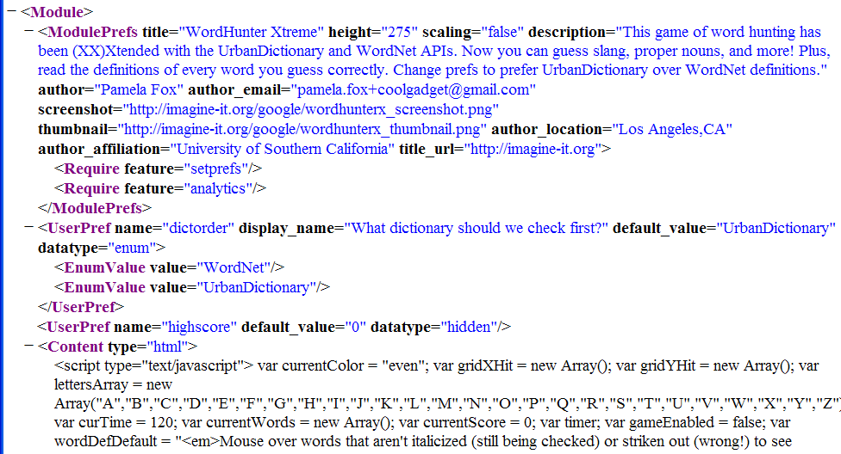
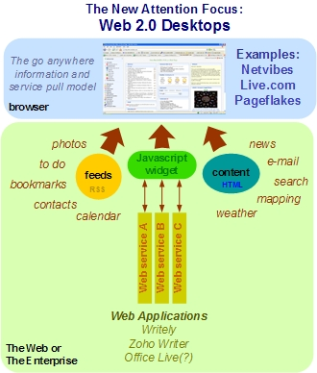
Typical Google Gadget Structure
Google Gadgets are an example of
Start Page (Web 2.0 term for portals) technology
See http://blogs.zdnet.com/Hinchcliffe/?p=8
… Lots of HTML and JavaScript </Content> </Module>
Portlets build User Interfaces by combining fragments in a standalone Java Server
Google Gadgets build User Interfaces by combining fragments with JavaScript on the client
Notes:
37

Slide 38
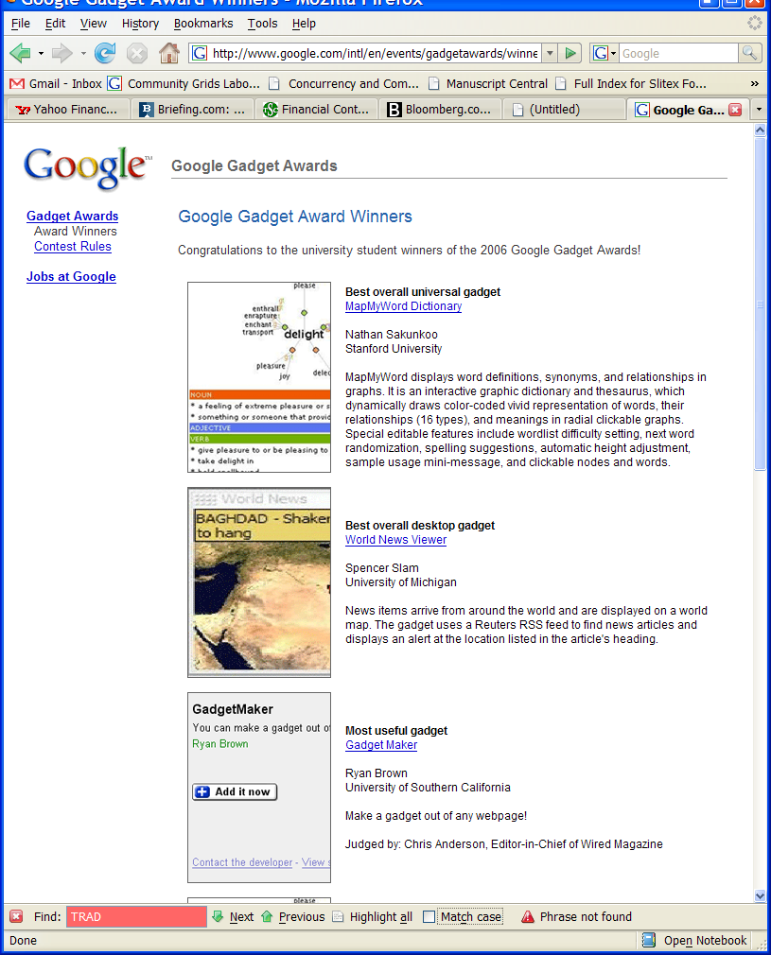
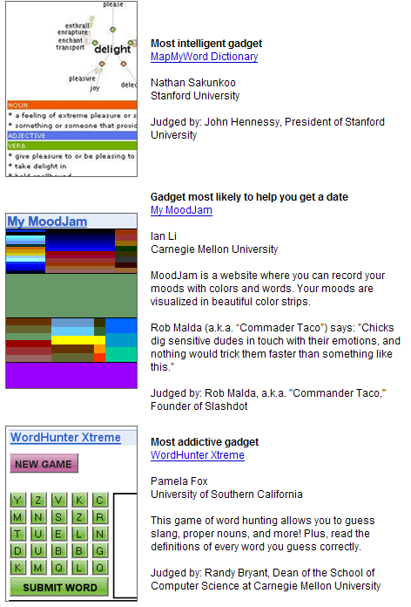
Portlets v. Google Gadgets
Note the many competitions powering Web 2.0
Mashup and Gadget Development
38
Portals for Grid Systems are built using portlets with software like GridSphere integrating these on the server-side into a single web-page
Google (at least) offers the Google sidebar and Google home page which support Web 2.0 services and do not use a server side aggregator
Google is more user friendly!
The many Web 2.0 competitions is an interesting model for promoting development in the world-wide distributed collection of Web 2.0 developers
I guess Web 2.0 model will win!
Notes:
38

Slide 39
Some Web 2.0 Activities at IU
Use of Blogs, RSS feeds, Wikis etc.
Use of Mashups for Cheminformatics Grid workflows
Moving from Portlets to Gadgets in portals (or at least supporting both)
Use of Connotea to produce tagged document collections such as http://www.connotea.org/user/crmc for parallel computing
IDIOM integrates multiple tagging and search systems and copes with overlapping inconsistent annotations (Talk-Fatih)
MSI-CIEC portal augments Connotea to tag both URL and URI’s e.g. TeraGrid use, PI’s and Proposals (Talk-Marlon)
Use of MapReduce style system for collaborative data analysis (Talk by Jaliya)
Multicore SALSA project using for Parallel Programming 2.0

Slide 40
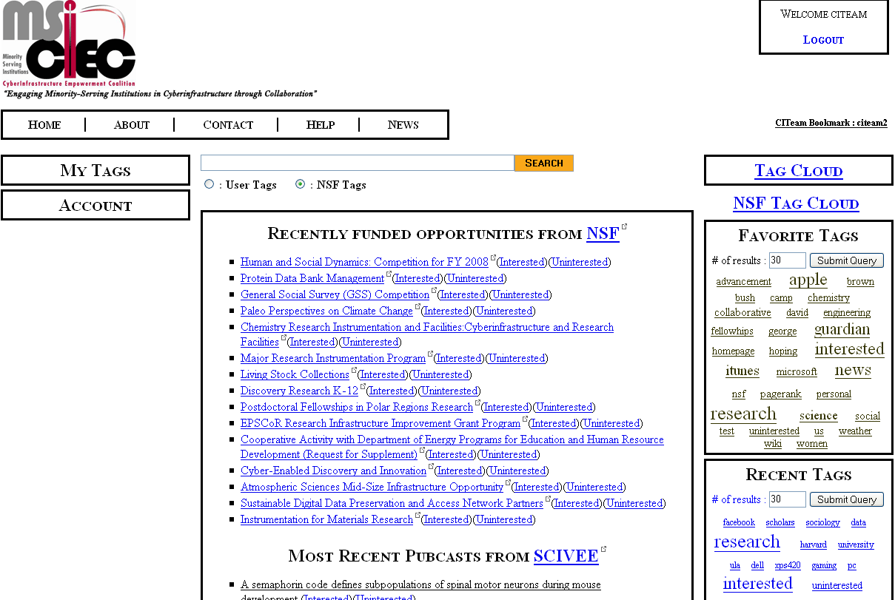
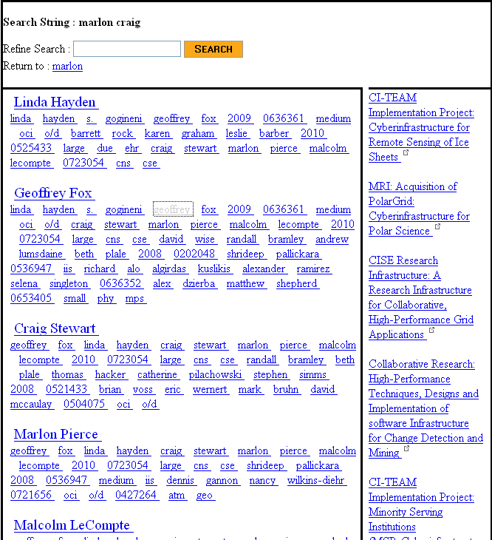
MSI-CIEC Web 2.0 Research Matching Portal
Portal supporting tagging and linkage of Cyberinfrastructure Resources
NSF (and other agencies via grants.gov) Solicitations and Awards
MSI-CIEC Portal Homepage
Feeds such as SciVee and NSF
Researchers on NSF Awards
User and Friends
TeraGrid Allocations
Search Results
Search for linked people, grants etc.
Could also be used to support matching of students and faculty for REUs etc.
MSI-CIEC Portal Homepage
Search Results

Slide 41
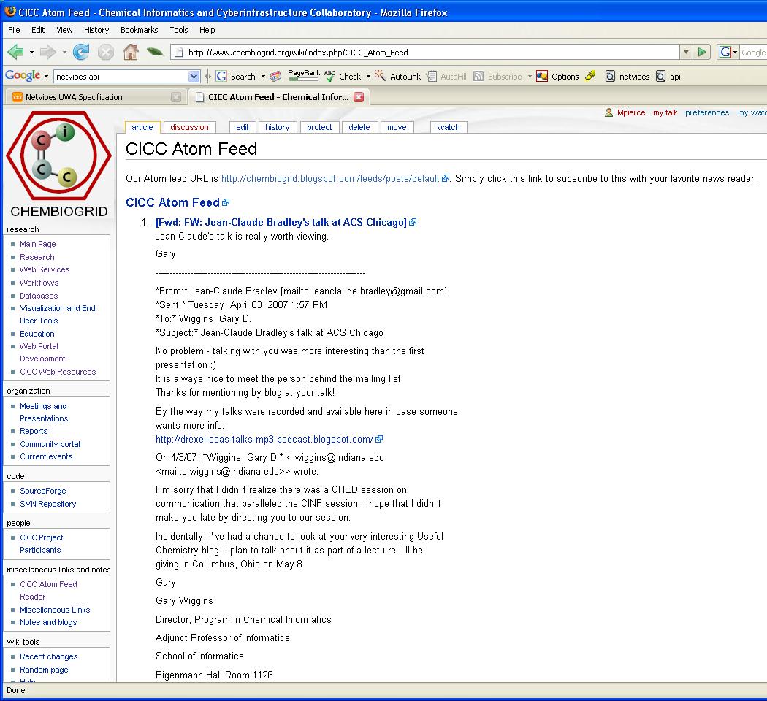
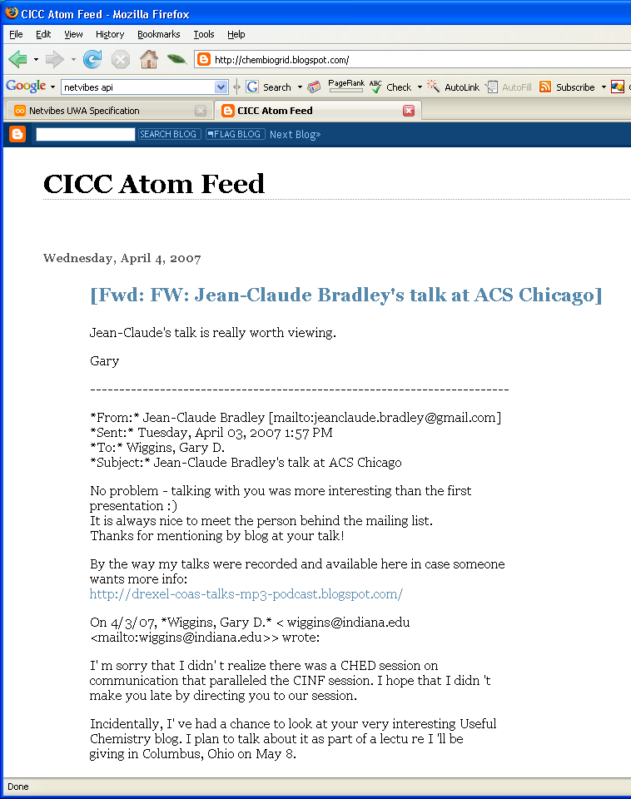
Use blog to create posts.
Display blog RSS feed in MediaWiki.
Notes:
41

Slide 42
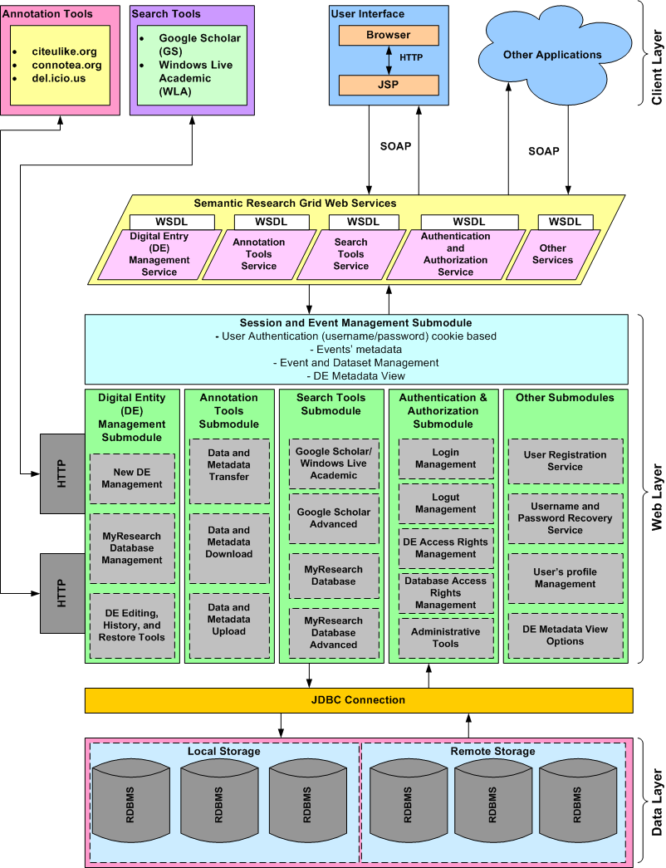
Semantic Research Grid (SRG)
Integrates tagging and search system that allows users to use multiple sites and consistently integrate them with traditional citation databases
We built a mashup linking to del.icio.us, CiteULike, Connotea allowing exchange of tags between sites and between local repositories
Repositories also link to local sources (PubsOnline) and Google Scholar (GS) and Windows Academic Live (WLA)
  GS has number of cited publications.
  WLA has Digital Object Identifier (DOI)
We implement a rather more powerful access control mechanism
We build heuristic tools to mine “web lists” for citations
We have an “event” based architecture (consistency model) allowing change actions to be preserved and selectively changed
  Supports integrating different inconsistent views of a given document and its updates on different tagging systems
IDIOM
5/19/2008
42

Slide 43
Parallel Programming 2.0
Web 2.0 Mashups (by definition the largest market) will drive composition tools for Grid, web and parallel programming
Parallel Programming 2.0 can build on same Mashup tools like Yahoo Pipes and Microsoft Popfly for workflow.
Alternatively can use “cloud” tools like MapReduce
We are using workflow technology DSS developed by Microsoft for Robotics
Classic parallel programming for core image and sensor programming
MapReduce/”DSS” integrates data processing/decision support together

Slide 44
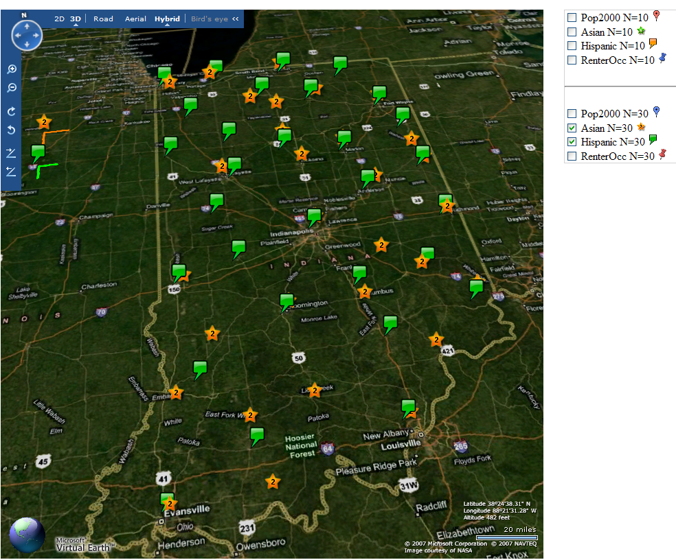

Slide 45
Services v. micro-parallelism
Micro-parallelism uses low latency CCR threads or MPI processes
Services can be used where loose coupling natural
  Input data
  Algorithms
    PCA
    DAC GTM GM DAGM DAGTM – both for complete algorithm and for each iteration
    Linear Algebra used inside or outside above
    Metric embedding MDS, Bourgain, Quadratic Programming ….
    HMM, SVM ….
  User interface: GIS (Web map Service) or equivalent
SALSA

Slide 46
Timing of HP Opteron Multicore as a function of number of simultaneous two-way service messages processed (November 2006 DSS Release)
DSS Service Measurements
Measurements of Axis 2 shows about 500 microseconds – DSS is 10 times better
46
Notes:
46

Slide 47
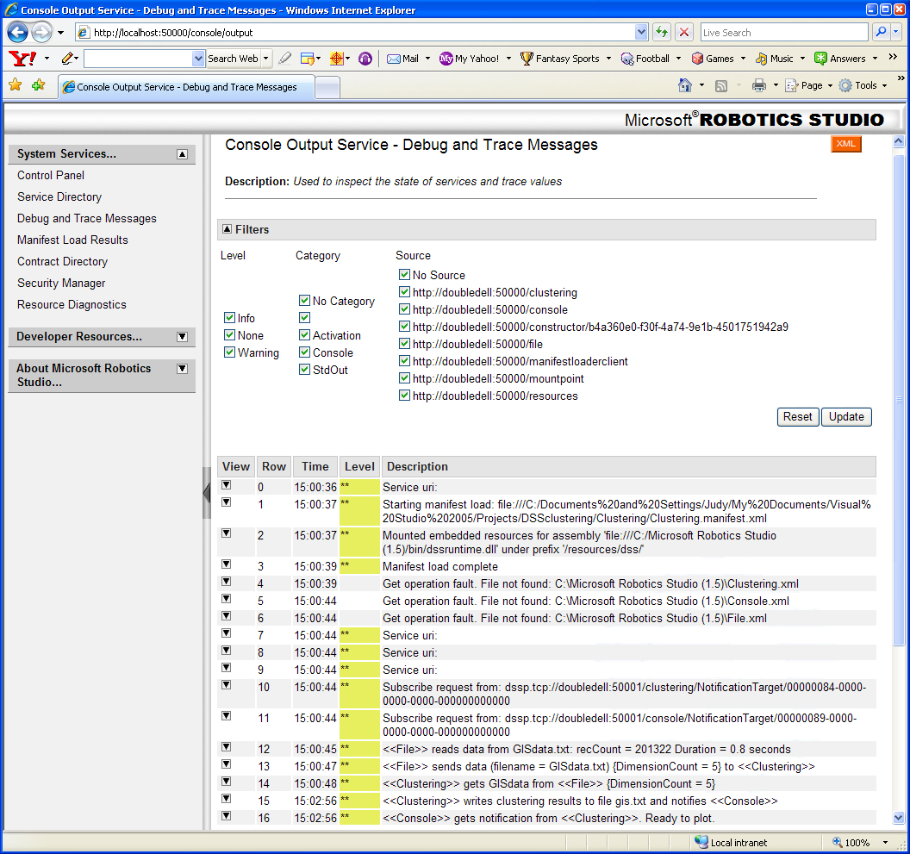

Slide 48
Where did Narrow Grids and Web Services go wrong?
Interoperability Interfaces will be for data not for infrastructure
  Google, Amazon, TeraGrid, European Grids will not interoperate at the resource or compute (processing) level but rather at the data streams flowing in and out of independent Grid clouds
  Data focus is consistent with Semantic Grid/Web but not clear if latter has learnt the usability message of Web 2.0
Lack of detailed standards in Web 2.0 preferable to industry who can get proprietary advantage inside their clouds
One needs to share computing, data, people in e-moreorlessanything, Grids initially focused on computing but data and people are more important
eScience is healthy as is e-moreorlessanything
Most Grids are solving wrong problem at wrong point in stack with a complexity that makes friendly usability difficult

Slide 49
The Ten areas covered by the 60 core WS-* Specifications
WS-* Specification Area | Typical Grid/Web Service Examples
1: Core Service Model | XML, WSDL, SOAP
2: Service Internet | WS-Addressing, WS-MessageDelivery; Reliable Messaging WSRM; Efficient Messaging MOTM
3: Notification | WS-Notification, WS-Eventing (Publish-Subscribe)
4: Workflow and Transactions | BPEL, WS-Choreography, WS-Coordination
5: Security | WS-Security, WS-Trust, WS-Federation, SAML, WS-SecureConversation
6: Service Discovery | UDDI, WS-Discovery
7: System Metadata and State | WSRF, WS-MetadataExchange, WS-Context
8: Management | WSDM, WS-Management, WS-Transfer
9: Policy and Agreements | WS-Policy, WS-Agreement
10: Portals and User Interfaces | WSRP (Remote Portlets)

Slide 50
WS-* Areas and Web 2.0
WS-* Specification Area | Web 2.0 Approach
1: Core Service Model | XML becomes optional but still useful SOAP becomes JSON RSS ATOM WSDL becomes REST with API as GET PUT etc. Axis becomes XmlHttpRequest
2: Service Internet | No special QoS. Use JMS or equivalent?
3: Notification | Hard with HTTP without polling– JMS perhaps?
4: Workflow and Transactions (no Transactions in Web 2.0) | Mashups, Google MapReduce Scripting with PHP JavaScript ….
5: Security | SSL, HTTP Authentication/Authorization, OpenID is Web 2.0 Single Sign on
6: Service Discovery | http://www.programmableweb.com
7: System Metadata and State | Processed by application – no system state – Microformats are a universal metadata approach
8: Management==Interaction | WS-Transfer style Protocols GET PUT etc.
9: Policy and Agreements | Service dependent. Processed by application
10: Portals and User Interfaces | Start Pages, AJAX and Widgets(Netvibes) Gadgets

