Slide 1
Scientific Computing Supported by Clouds, Grids and HPC(Exascale) Systems
June 24 2012
HPC 2012 Cetraro, Italy
Geoffrey Fox
gcf@indiana.edu
Informatics, Computing and Physics
Indiana University Bloomington

Slide 2
Science Computing Environments
Large Scale Supercomputers – Multicore nodes linked by high performance low latency network
  Increasingly with GPU enhancement
  Suitable for highly parallel simulations
High Throughput Systems such as European Grid Initiative EGI or Open Science Grid OSG typically aimed at pleasingly parallel jobs
  Can use “cycle stealing”
  Classic example is LHC data analysis
Grids federate resources as in EGI/OSG or enable convenient access to multiple backend systems including supercomputers
  Portals make access convenient and
  Workflow integrates multiple processes into a single job
Specialized visualization, shared memory parallelization etc. machines

Slide 3
Some Observations
Classic HPC machines as MPI engines offer highest possible performance on closely coupled problems
  Not going to change soon (maybe delivered by Amazon)
Clouds offer from different points of view
    On-demand service (elastic)
    Economies of scale from sharing
    Powerful new software models such as MapReduce, which have advantages over classic HPC environments
    Plenty of jobs making it attractive for students & curricula
    Security challenges
HPC problems running well on clouds have above advantages
Note 100% utilization of Supercomputers makes elasticity moot for capability (very large) jobs and makes capacity (many modest) use not be on-demand
Need Cloud-HPC Interoperability

Slide 4

14 million Cloud Jobs by 2015

Slide 5
Clouds and Grids/HPC
Synchronization/communication Performance
Grids > Clouds > Classic HPC Systems
Clouds naturally execute effectively Grid workloads but are less clear for closely coupled HPC applications
Service Oriented Architectures portals and workflow appear to work similarly in both grids and clouds
May be for immediate future, science supported by a mixture of
  Clouds – some practical differences between private and public clouds – size and software
  High Throughput Systems (moving to clouds as convenient)
  Grids for distributed data and access
  Supercomputers (“MPI Engines”) going to exascale

Slide 6
What Applications work in Clouds
Pleasingly parallel applications of all sorts with roughly independent data or spawning independent simulations
  Long tail of science and integration of distributed sensors
Commercial and Science Data analytics that can use MapReduce (some of such apps) or its iterative variants (most other data analytics apps)
Which science applications are using clouds?
  Many demonstrations –Conferences, OOI, HEP ….
  Venus-C (Azure in Europe): 27 applications not using Scheduler, Workflow or MapReduce (except roll your own)
  50% of applications on FutureGrid are from Life Science but there is more computer science than total applications
  Locally Lilly corporation is major commercial cloud user (for drug discovery) but Biology department is not

Slide 7
Parallelism over Users and Usages
“Long tail of science” can be an important usage mode of clouds.
In some areas like particle physics and astronomy, i.e. “big science”, there are just a few major instruments generating now petascale data driving discovery in a coordinated fashion.
In other areas such as genomics and environmental science, there are many “individual” researchers with distributed collection and analysis of data whose total data and processing needs can match the size of big science.
Clouds can provide scaling convenient resources for this important aspect of science.
Can be map only use of MapReduce if different usages naturally linked e.g. exploring docking of multiple chemicals or alignment of multiple DNA sequences
  Collecting together or summarizing multiple “maps” is a simple Reduction

Slide 8
Internet of Things and the Cloud
It is projected that there will be 24 billion devices on the Internet by 2020. Most will be small sensors that send streams of information into the cloud where it will be processed and integrated with other streams and turned into knowledge that will help our lives in a multitude of small and big ways.
It is not unreasonable for us to believe that we will each have our own cloud-based personal agent that monitors all of the data about our life and anticipates our needs 24x7.
The cloud will become increasing important as a controller of and resource provider for the Internet of Things.
As well as today’s use for smart phone and gaming console support, “smart homes” and “ubiquitous cities” build on this vision and we could expect a growth in cloud supported/controlled robotics.
Natural parallelism over “things”

Slide 9
Internet of Things: Sensor Grids
A pleasingly parallel example on Clouds
A sensor (“Thing”) is any source or sink of time series
  In the thin client era, smart phones, Kindles, tablets, Kinects, web-cams are sensors
  Robots, distributed instruments such as environmental measures are sensors
  Web pages, Googledocs, Office 365, WebEx are sensors
  Ubiquitous Cities/Homes are full of sensors
They have IP address on Internet
Sensors – being intrinsically distributed are Grids
However natural implementation uses clouds to consolidate and control and collaborate with sensors
Sensors are typically “small” and have pleasingly parallel cloud implementations

Slide 10
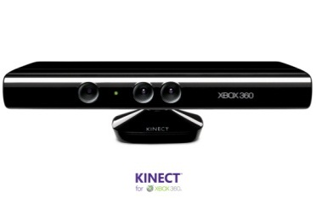








Sensors as a Service
Output Sensor
Sensors as a Service
Sensor Processing as a Service (could use
MapReduce)
A larger sensor ………
https://sites.google.com/site/opensourceiotcloud/ Open Source Sensor (IoT) Cloud

Slide 11
Classic Parallel Computing
HPC: Typically SPMD (Single Program Multiple Data) “maps” typically processing particles or mesh points interspersed with multitude of low latency messages supported by specialized networks such as Infiniband and technologies like MPI
  Often run large capability jobs with 100K (going to 1.5M) cores on same job
  National DoE/NSF/NASA facilities run 100% utilization
  Fault fragile and cannot tolerate “outlier maps” taking longer than others
Clouds: MapReduce has asynchronous maps typically processing data points with results saved to disk. Final reduce phase integrates results from different maps
  Fault tolerant and does not require map synchronization
  Map only useful special case
HPC + Clouds: Iterative MapReduce caches results between “MapReduce” steps and supports SPMD parallel computing with large messages as seen in parallel kernels (linear algebra) in clustering and other data mining

Slide 12
4 Forms of MapReduce
(a) Map Only
(b) Classic MapReduce
(c) Iterative MapReduce
(d) Loosely Synchronous
Input
Input
Iterations
Input
map
map
map
P_{ij}
reduce
reduce
Output
BLAST Analysis
Parametric sweep
Pleasingly Parallel
High Energy Physics (HEP) Histograms
Distributed search
Expectation maximization Clustering e.g. Kmeans
Linear Algebra, Page Rank
Classic MPI
PDE Solvers and particle dynamics
Domain of MapReduce and Iterative Extensions
MPI

Slide 13
Commercial “Web 2.0” Cloud Applications
Internet search, Social networking, e-commerce, cloud storage
These are larger systems than used in HPC with huge levels of parallelism coming from
  Processing of lots of users or
  An intrinsically parallel Tweet or Web search
Classic MapReduce is suitable (although Page Rank component of search is parallel linear algebra)
Data Intensive
Do not need microsecond messaging latency

Slide 14
Data Intensive Applications
Applications tend to be new and so can consider emerging technologies such as clouds
Do not have lots of small messages but rather large reduction (aka Collective) operations
  New optimizations e.g. for huge messages
  e.g. Expectation Maximization (EM) has a few broadcasts but dominated by reductions
Not clearly a single exascale job but rather many smaller (but not sequential) jobs e.g. to analyze groups of sequences
Algorithms not clearly robust enough to analyze lots of data
  Current standard algorithms such as R not designed for big data
Multidimensional Scaling MDS is iterative rectangular matrix-matrix multiplication controlled by EM
Look in detail at Deterministically Annealed Pairwise Clustering as an EM example

Slide 15
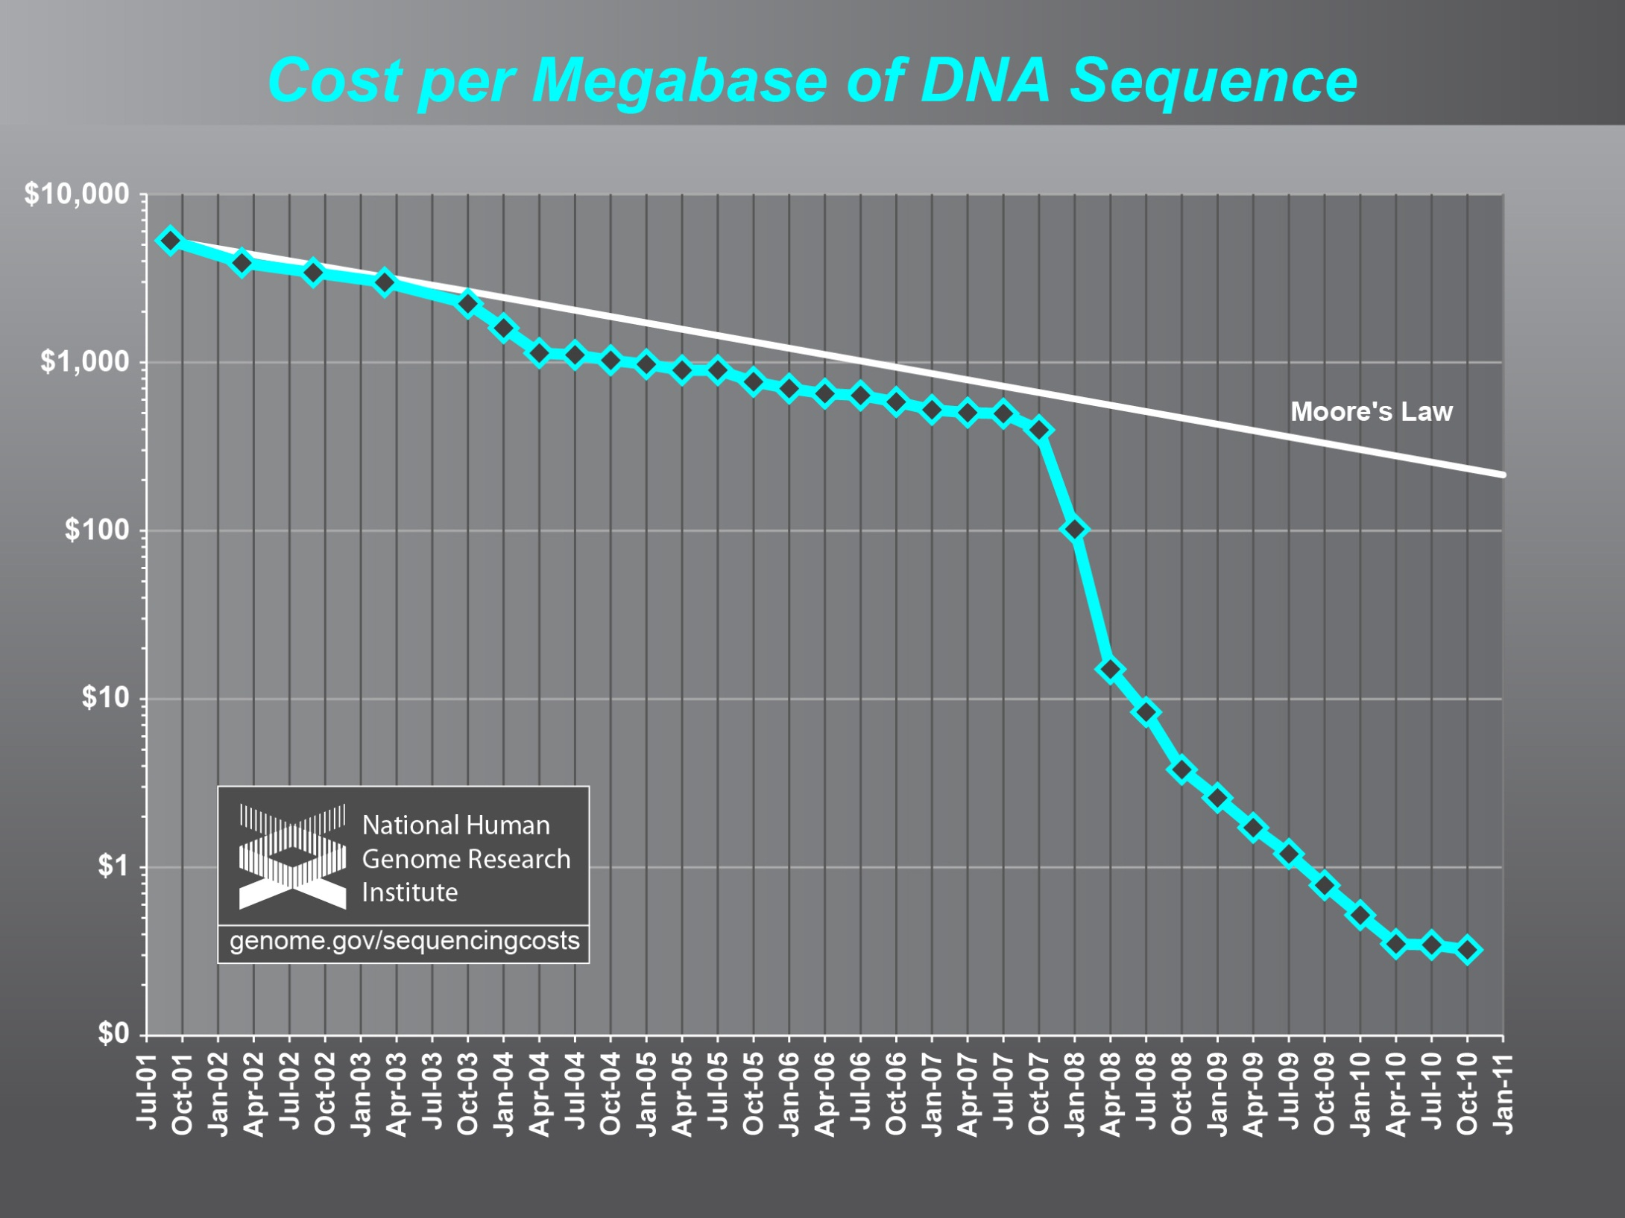
Full Personal Genomics: 3 petabytes per day

Slide 16
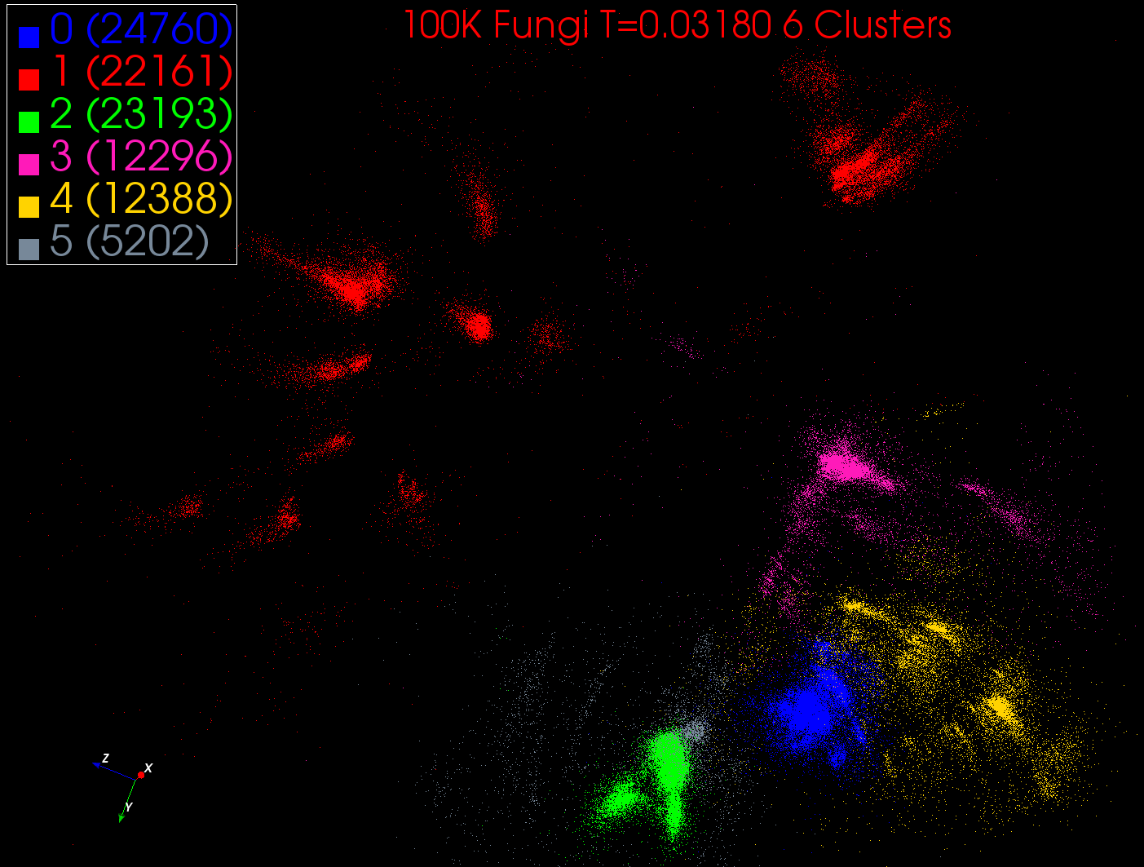
Intermediate step in DA-PWC
With 6 clusters
MDS used to project from high dimensional to 3D space
Each of 100K points is a sequence. Clusters are Fungi families. 140 Clusters at end of iteration
N=100K points is 10^5 core hours
Scales between O(N) and O(N²)

Slide 17
DA-PWC EM Steps (Expectation E is red, Maximization M Black) k runs over clusters; i,j points
A(k) = - 0.5 ∑_{i=1}^{N} ∑_{j=1}^{N} δ(i, j) <M_{i}(k)> <M_{j}(k)> / <C(k)>²
B_{i}(k) = ∑_{j=1}^{N} δ(i, j) <M_{j}(k)> / <C(k)>
ε_{i}(k) = (B_{i}(k) + A(k))
<M_{i}(k)> = exp( -ε_{i}(k)/T )/∑_{k=1}^{K} exp(-ε_{i}(k)/T)
C(k) = ∑_{i=1}^{N} <M_{i}(k)>
δ(i, j) distance between points I and j
Parallelize by distributing points i across processes
Clusters k in simplest case are parameters held by all tasks – fails when k reaches ~10,000. Real challenge to automatic parallelizer!
Either Broadcasts of <M_{i}(k)> and/or reductions

Slide 18
Twister for Data Intensive
Iterative Applications
Generalize to arbitrary Collective
Broadcast
Compute
Communication
Reduce/ barrier
New Iteration
Smaller Loop-Variant Data
Larger Loop-Invariant Data
(Iterative) MapReduce structure with Map-Collective is framework
Twister runs on Linux or Azure
Twister4Azure is built on top of Azure tables, queues, storage
Judy Qiu IU will talk Thursday
Notes:
Most of these applications consists of iterative computation and communication steps where single iterations can easily be specified as MapReduce computations.
Large input data sizes which are loop-invariant and can be reused across iterations.
Loop-variant results.. Orders of magnitude smaller…
While these can be performed using traditional MapReduce frameworks, Traditional is not efficient for these types of computations. MR leaves lot of room for improvements in terms of iterative applications.

Slide 19
MDS Azure 128 cores
Note fluctuations limit performance
Each step is two (blue followed by red) rectangular matrix multiplications

Slide 20
MDS Azure 128 cores
Top is weak scaling
Bottom 128 cores, vary data size
Twister is on non virtualized Linux
“Adjusted” takes out sequential performance difference

Slide 21
What to use in Clouds: Cloud PaaS
HDFS style file system to collocate data and computing
Queues to manage multiple tasks
Tables to track job information
MapReduce and Iterative MapReduce to support parallelism
Services for everything
Portals as User Interface
Appliances and Roles as customized images
Software tools like Google App Engine, memcached
Workflow to link multiple services (functions)
Data Parallel Languages like Pig; more successful than HPF?

Slide 22
What to use in Grids and Supercomputers?
HPC PaaS
Services Portals and Workflow as in clouds
MPI and GPU/multicore threaded parallelism
GridFTP and high speed networking
Wonderful libraries supporting parallel linear algebra, particle evolution, partial differential equation solution
Globus, Condor, SAGA, Unicore, Genesis for Grids
Parallel I/O for high performance in an application
Wide area File System (e.g. Lustre) supporting file sharing
This is a rather different style of PaaS from clouds –
should we unify?

Slide 23
Is PaaS a good idea?
If you have existing code, PaaS may not be very relevant immediately
  Just need IaaS to put code on clouds
But surely it must be good to offer high level tools?
For example, Twister4Azure is built on top of Azure tables, queues, storage
Historically HPCC 1990-2000 built MPI, libraries, (parallel) compilers ..
Grids 2000-2010 built federation, scheduling, portals and workflow
Clouds 2010-…. have a fresh interest in powerful programming models

Slide 24
How to use Clouds I
Build the application as a service. Because you are deploying one or more full virtual machines and because clouds are designed to host web services, you want your application to support multiple users or, at least, a sequence of multiple executions.
  If you are not using the application, scale down the number of servers and scale up with demand.
  Attempting to deploy 100 VMs to run a program that executes for 10 minutes is a waste of resources because the deployment may take more than 10 minutes.
  To minimize start up time one needs to have services running continuously ready to process the incoming demand.
Build on existing cloud deployments. For example use an existing MapReduce deployment such as Hadoop or existing Roles and Appliances (Images)

Slide 25
How to use Clouds II
Use PaaS if possible. For platform-as-a-service clouds like Azure use the tools that are provided such as queues, web and worker roles and blob, table and SQL storage.
  Note HPC systems don’t offer much in PaaS area
Design for failure. Applications that are services that run forever will experience failures. The cloud has mechanisms that automatically recover lost resources, but the application needs to be designed to be fault tolerant.
  In particular, environments like MapReduce (Hadoop, Daytona, Twister4Azure) will automatically recover many explicit failures and adopt scheduling strategies that recover performance "failures" from for example delayed tasks.
  One expects an increasing number of such Platform features to be offered by clouds and users will still need to program in a fashion that allows task failures but be rewarded by environments that transparently cope with these failures. (Need to build more such robust environments)

Slide 26
How to use Clouds III
Use as a Service where possible. Capabilities such as SQLaaS (database as a service or a database appliance) provide a friendlier approach than the traditional non-cloud approach exemplified by installing MySQL on the local disk.
  Suggest that many prepackaged aaS capabilities such as Workflow as a Service for eScience will be developed and simplify the development of sophisticated applications.
Moving Data is a challenge. The general rule is that one should move computation to the data, but if the only computational resource available is a the cloud, you are stuck if the data is not also there.
  Persuade Cloud Vendor to host your data free in cloud
  Persuade Internet2 to provide good link to Cloud
  Decide on Object Store v. HDFS style (or v. Lustre WAFS on HPC)

Slide 27
aaS versus Roles/Appliances
If you package a capability X as XaaS, it runs on a separate VM and you interact with messages
  SQLaaS offers databases via messages similar to old JDBC model
If you build a role or appliance with X, then X built into VM and you just need to add your own code and run
  Generalized worker role builds in I/O and scheduling
Lets take all capabilities – MPI, MapReduce, Workflow .. – and offer as roles or aaS (or both)
Perhaps workflow has a controller aaS with graphical design tool while runtime packaged in a role?
Need to think through packaging of parallelism

Slide 28
Private Clouds
Define as non commercial cloud used to support science
What does it take to make private cloud platforms competitive with commercial systems?
Plenty of work at VM management level with Eucalyptus, Nimbus, OpenNebula, OpenStack
  Only now maturing
  Nimbus and OpenNebula pretty solid but not widely adopted in USA
  OpenStack and Eucalyptus recent major improvements
Open source PaaS tools like Hadoop, Hbase, Cassandra, Zookeeper but not integrated into platform
Need dynamic resource management in a “not really elastic” environment as limited size
Federation of distributed components (as in grids) to make a decent size system

Slide 29
Architecture of Data Repositories?
Traditionally governments set up repositories for data associated with particular missions
  For example EOSDIS (Earth Observation), GenBank (Genomics), NSIDC (Polar science), IPAC (Infrared astronomy)
  LHC/OSG computing grids for particle physics
This is complicated by volume of data deluge, distributed instruments as in gene sequencers (maybe centralize?) and need for intense computing like Blast
  i.e. repositories need lots of computing?

Slide 30
Clouds as Support for Data Repositories?
The data deluge needs cost effective computing
  Clouds are by definition cheapest
  Need data and computing co-located
Shared resources essential (to be cost effective and large)
  Can’t have every scientists downloading petabytes to personal cluster
Need to reconcile distributed (initial source of ) data with shared analysis
  Can move data to (discipline specific) clouds
  How do you deal with multi-disciplinary studies
Data repositories of future will have cheap data and elastic cloud analysis support?
  Hosted free if data can be used commercially?

Slide 31
Using Science Clouds in a Nutshell
High Throughput Computing; pleasingly parallel; grid applications
Multiple users (long tail of science) and usages (parameter searches)
Internet of Things (Sensor nets) as in cloud support of smart phones
(Iterative) MapReduce including “most” data analysis
Exploiting elasticity and platforms (HDFS, Object Stores, Queues ..)
Use worker roles, services, portals (gateways) and workflow
Good Strategies:
  Build the application as a service;
  Build on existing cloud deployments such as Hadoop;
  Use PaaS if possible;
  Design for failure;
  Use as a Service (e.g. SQLaaS) where possible;
  Address Challenge of Moving Data

Slide 32
Cosmic Comments I
Does Cloud + MPI Engine for computing + grids for data cover all?
  Will current high throughput computing and cloud concepts merge?
Need interoperable data analytics libraries for HPC and Clouds
Can we characterize data analytics applications?
  I said modest size and kernels need reduction operations and are often full matrix linear algebra (true?)
Does a “modest-size private science cloud” make sense
  Too small to be elastic?
Should governments fund use of commercial clouds (or build their own)
  Most science doesn’t have privacy issues motivating private clouds
Most interest in clouds from “new” applications such as life sciences

Slide 33
Cosmic Comments II
Recent private cloud infrastructure (Eucalyptus 3, OpenStack Essex in USA) much improved
  Nimbus, OpenNebula still good
But are they really competitive with commercial cloud fabric runtime?
Should we integrate HPC and Cloud Platforms?
More employment opportunities in clouds than HPC and Grids; so cloud related activities popular with students
Science Cloud Summer School July 30-August 3
  Part of virtual summer school in computational science and engineering and expect over 200 participants spread over 9 sites
Science Cloud and MapReduce XSEDE Community groups

