Slide 1
Overview of Cyberinfrastructure and The Breadth of Its Application
Cyberinfrastructure Day
Claflin University Orangeburg SC
April 12 2013
Geoffrey Fox
gcf@indiana.edu
http://www.infomall.org http://www.futuregrid.org
Director, Digital Science Center
Associate Dean for Research and Graduate Studies, School of Informatics and Computing
Indiana University Bloomington
Notes:
SALSA is
Service Aggregated Linked Sequential Activities

Slide 2

Some Trends
  The Data Deluge is clear trend from Commercial (Amazon, e-commerce) , Community (Facebook, Search) and Scientific applications
  Light weight clients from smartphones, tablets to sensors
  Multicore reawakening parallel computing
  Exascale initiatives will continue drive to high end with a simulation orientation on fastest computers
  Clouds with cheaper, greener, easier to use IT for (some) applications
  New jobs associated with new curricula
    Clouds as a distributed system (classic CS courses)
    Data Science and Data Analytics (Important theme in academia and industry)
    Network/Web Science

Slide 3
What is Cyberinfrastructure
Cyberinfrastructure is (from NSF) infrastructure that supports distributed research and learning (e-Science, e-Research, e-Education)
  Links data, people, computers
Exploits Internet technology (Web2.0 and Clouds) adding (via Grid technology) management, security, supercomputers etc.
It has three aspects: parallel – low latency (microseconds) between nodes and distributed – highish latency (milliseconds) between nodes with clouds in between
Parallel needed to get high performance on individual large simulations, data analysis etc.; must decompose problem
Distributed aspect integrates already distinct components – especially natural for data (as in biology databases etc.)
3
Notes:
3

Slide 4
e-moreorlessanything or X-Informatics
‘e-Science is about global collaboration in key areas of science, and the next generation of infrastructure that will enable it.’ from inventor of term John Taylor Director General of Research Councils UK, Office of Science and Technology
e-Science is about developing tools and technologies that allow scientists to do ‘faster, better or different’ research
Similarly e-Business captures the emerging view of corporations as dynamic virtual organizations linking employees, customers and stakeholders across the world.
This generalizes to e-moreorlessanything including e-DigitalLibrary, e-FineArts, e-HavingFun and e-Education
A deluge of data of unprecedented and inevitable size must be managed and understood.
People (virtual organizations), computers, data (including sensors and instruments) must be linked via hardware and software networks
4
Notes:
4

Slide 5
Big Data Ecosystem in One Sentence
Use Clouds running Data Analytics processing Big Data to solve problems in X-Informatics ( or e-X)
X = Astronomy, Biology, Biomedicine, Business, Chemistry, Crisis, Energy, Environment, Finance, Health, Intelligence, Lifestyle, Marketing, Medicine, Pathology, Policy, Radar, Security, Sensor, Social, Sustainability, Wealth and Wellness with more fields (physics) defined implicitly
Spans Industry and Science (research)
Education: Data Science
http://www.nytimes.com/2013/04/14/education/edlife/universities-offer-courses-in-a-hot-new-field-data-science.html?pagewanted=all&_r=0

Slide 6
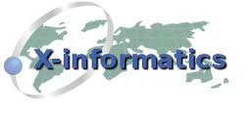



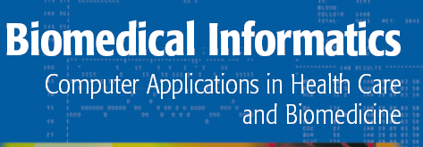


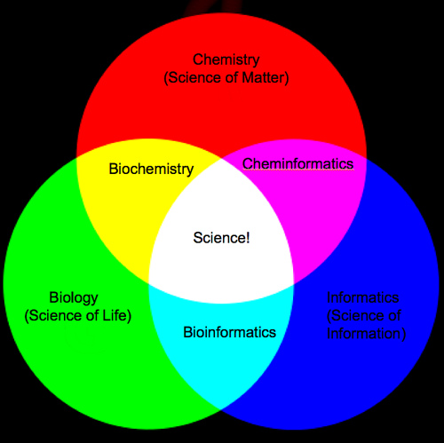
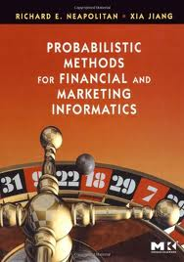
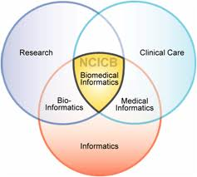
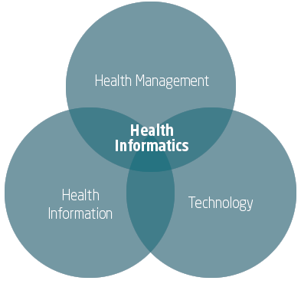
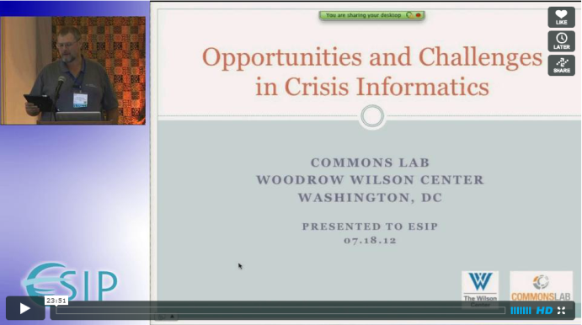

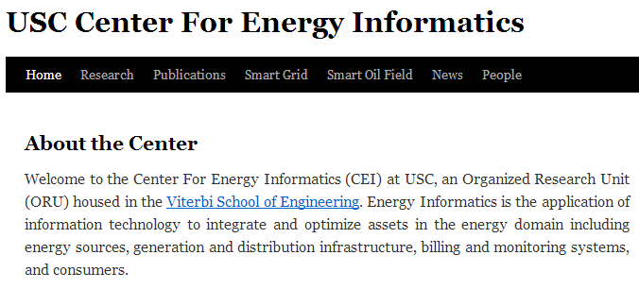
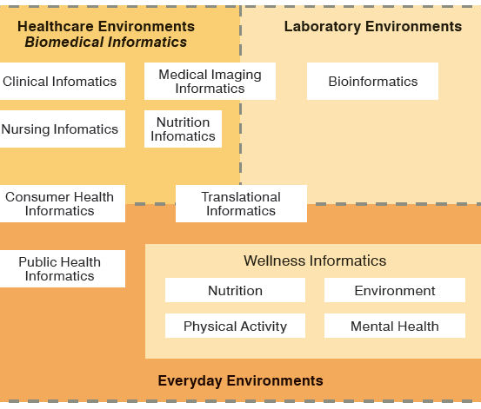
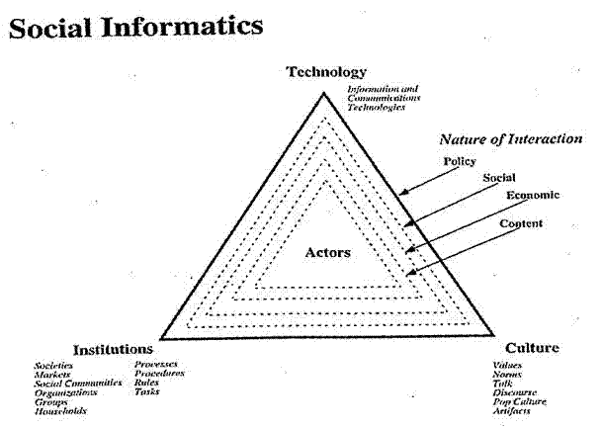

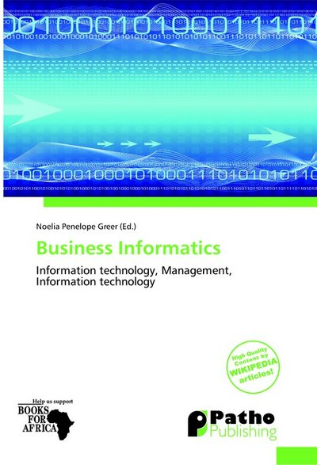
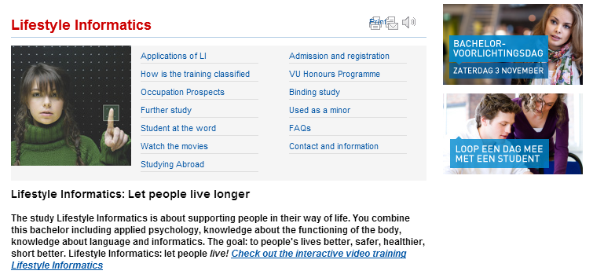
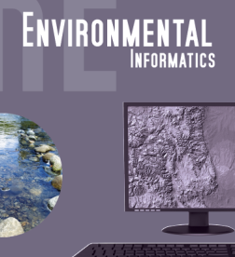

Social Informatics

Slide 7
The Span of Cyberinfrastructure
High definition videoconferencing linking people across the globe
Digital Library of music, curriculum, scientific papers
Flickr, YouTube, Netflix, Google, Facebook, Amazon ...
Simulating a new battery design (exascale problem)
Sharing data from world’s telescopes
Using cloud to analyze your personal genome
Enabling all to be equal partners in creating knowledge and converting it to wisdom
Analyzing Tweets…documents to discover which stocks will crash; how disease is spreading; linguistic inference; ranking of institutions

Slide 8
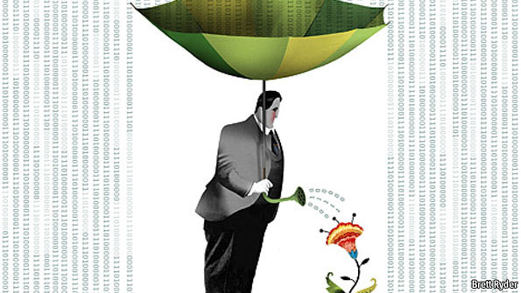
The data deluge: The Economist Feb 25 2010 http://www.economist.com/node/15579717
According to one estimate, mankind created 150 exabytes (billion gigabytes) of data in 2005. This year(2010), it will create 1,200 exabytes. Merely keeping up with this flood, and storing the bits that might be useful, is difficult enough. Analysing it, to spot patterns and extract useful information, is harder still. Even so, the data deluge is already starting to transform business, government, science and everyday life
20120117berkeley1.pdf
Jeff Hammerbacher

Slide 9
Some Data sizes
  ~40 10⁹ Web pages at ~300 kilobytes each = 10 Petabytes
  Youtube 48 hours video uploaded per minute;
    in 2 months in 2010, uploaded more than total NBC ABC CBS
    ~2.5 petabytes per year uploaded?
  LHC 15 petabytes per year
  Radiology 69 petabytes per year
  Square Kilometer Array Telescope will be 100 terabits/second
  Earth Observation becoming ~4 petabytes per year
  Earthquake Science – few terabytes total today
  PolarGrid – 100’s terabytes/year
  Exascale simulation data dumps – terabytes/second

Slide 10
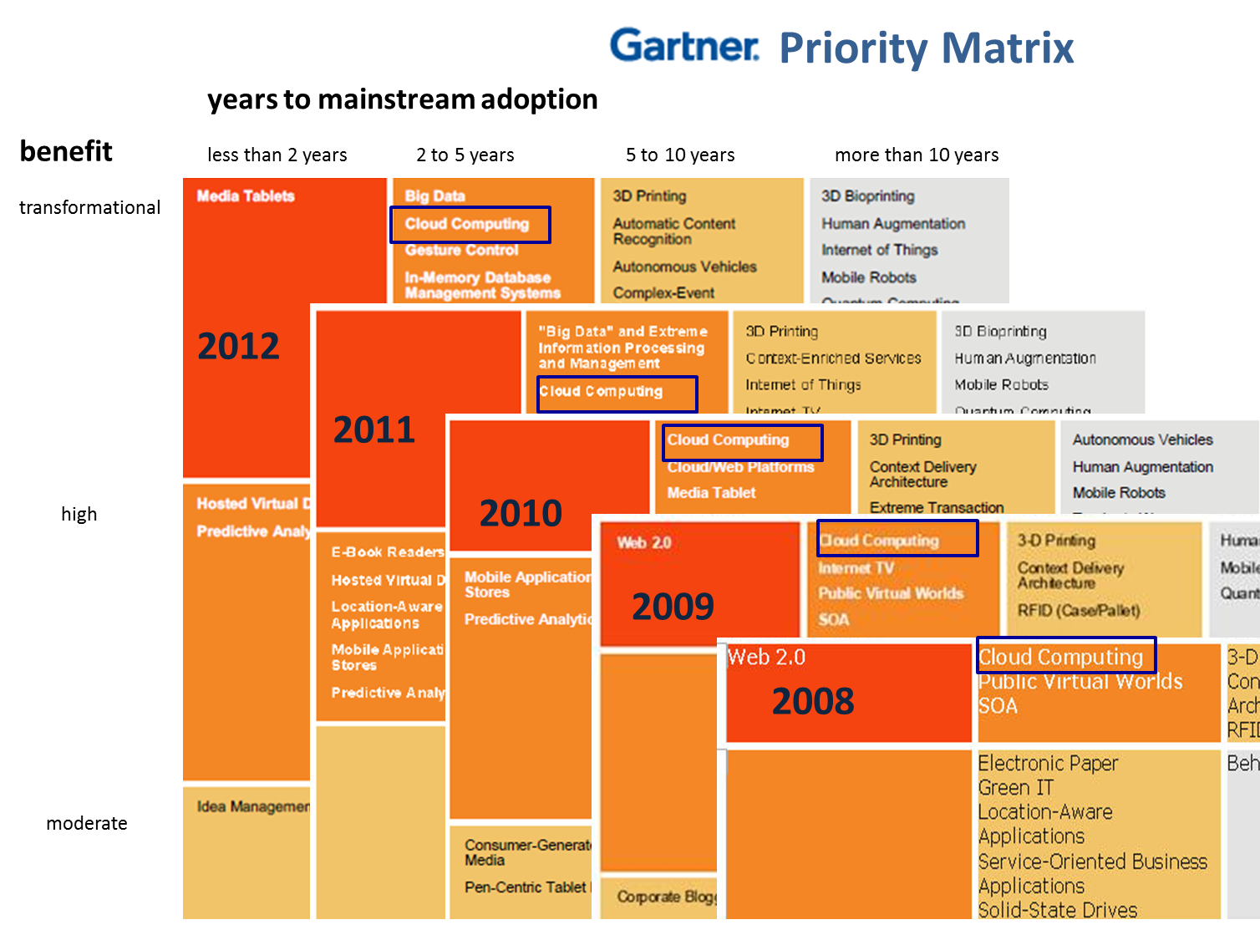

Slide 11
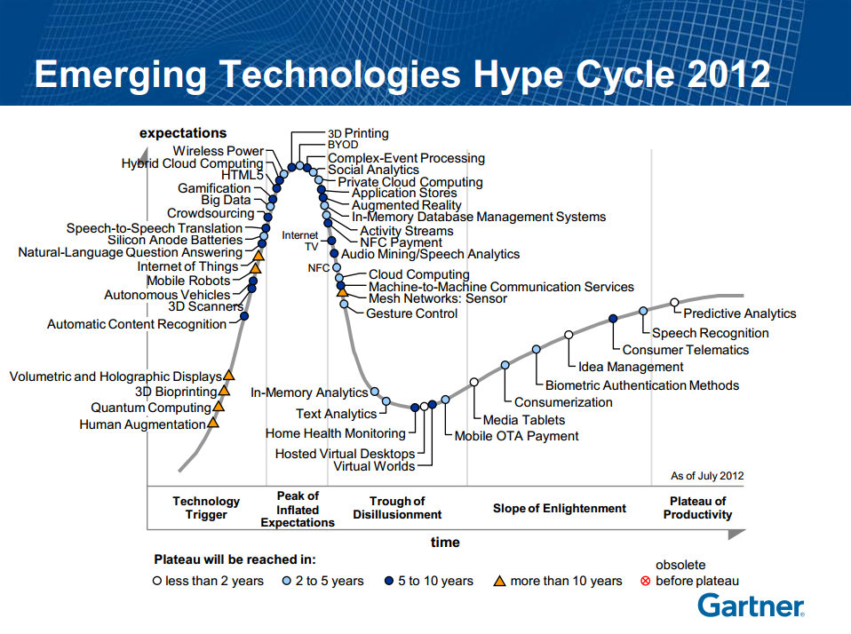

Slide 12
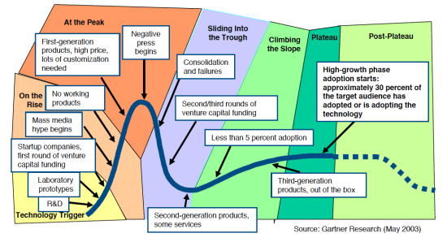
Hype Cycle
Also describes Stock Prices, Popularity of artists etc.?

Slide 13
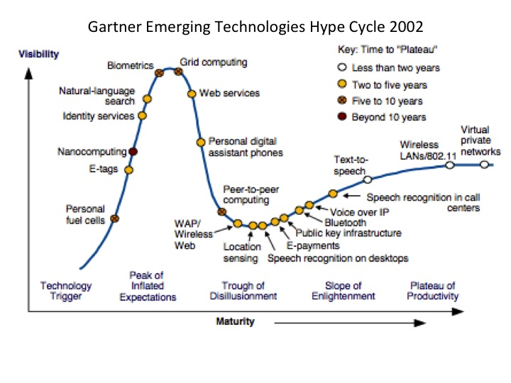

Slide 14
Jobs

Slide 15

Jobs v. Countries
http://www.microsoft.com/en-us/news/features/2012/mar12/03-05CloudComputingJobs.aspx

Slide 16

McKinsey Institute on Big Data Jobs
There will be a shortage of talent necessary for organizations to take advantage of big data. By 2018, the United States alone could face a shortage of 140,000 to 190,000 people with deep analytical skills as well as 1.5 million managers and analysts with the know-how to use the analysis of big data to make effective decisions.
This course aimed at 1.5 million jobs. Computer Science covers the 140,000 to 190,000
http://www.mckinsey.com/mgi/publications/big_data/index.asp.

Slide 17
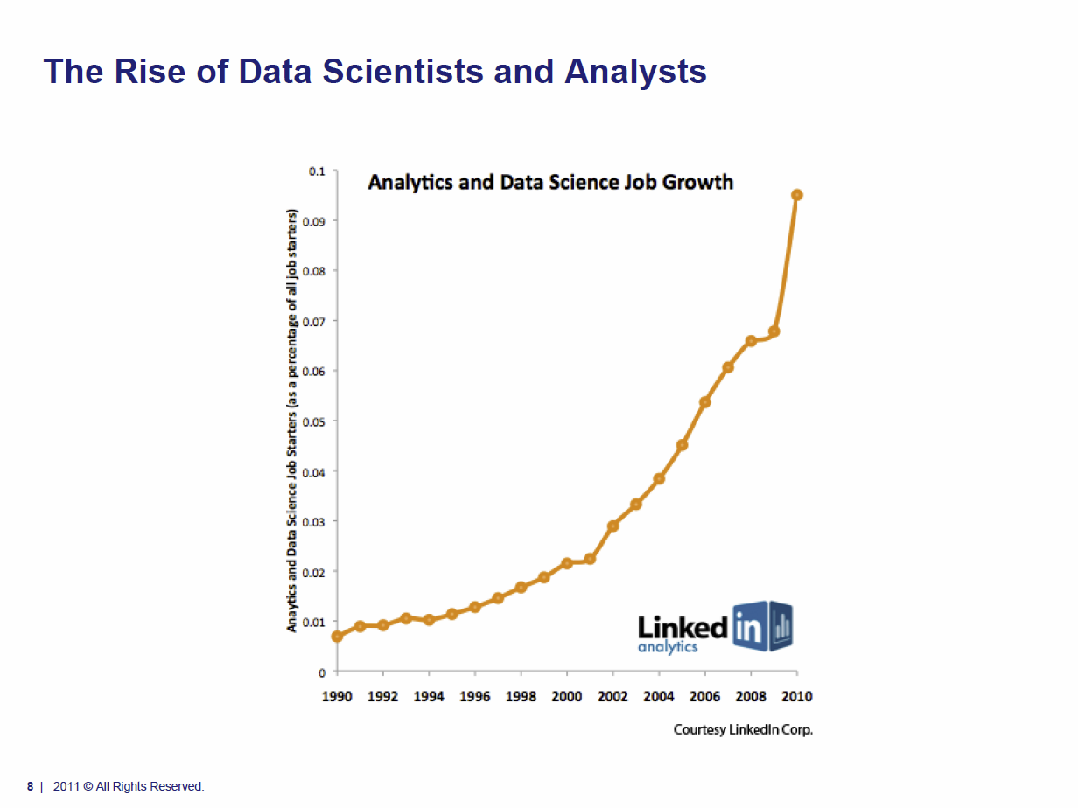
Tom Davenport Harvard Business School http://fisheritcenter.haas.berkeley.edu/Big_Data/index.html Nov 2012

Slide 18
Applications

Slide 19
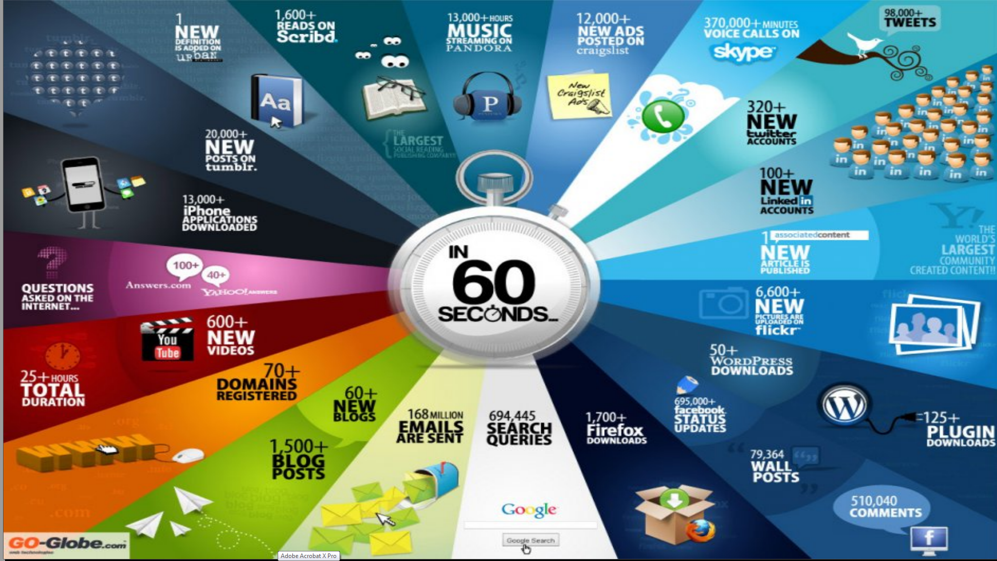
http://cs.metrostate.edu/~sbd/ Oracle

Slide 20
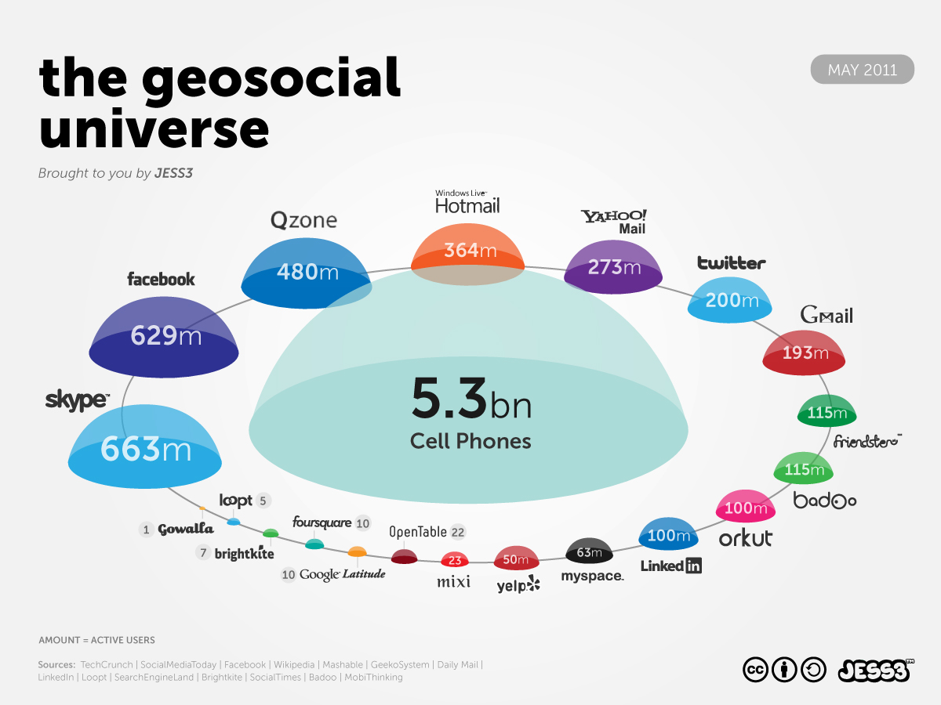
http://jess3.com/geosocial-universe-2/

Slide 21
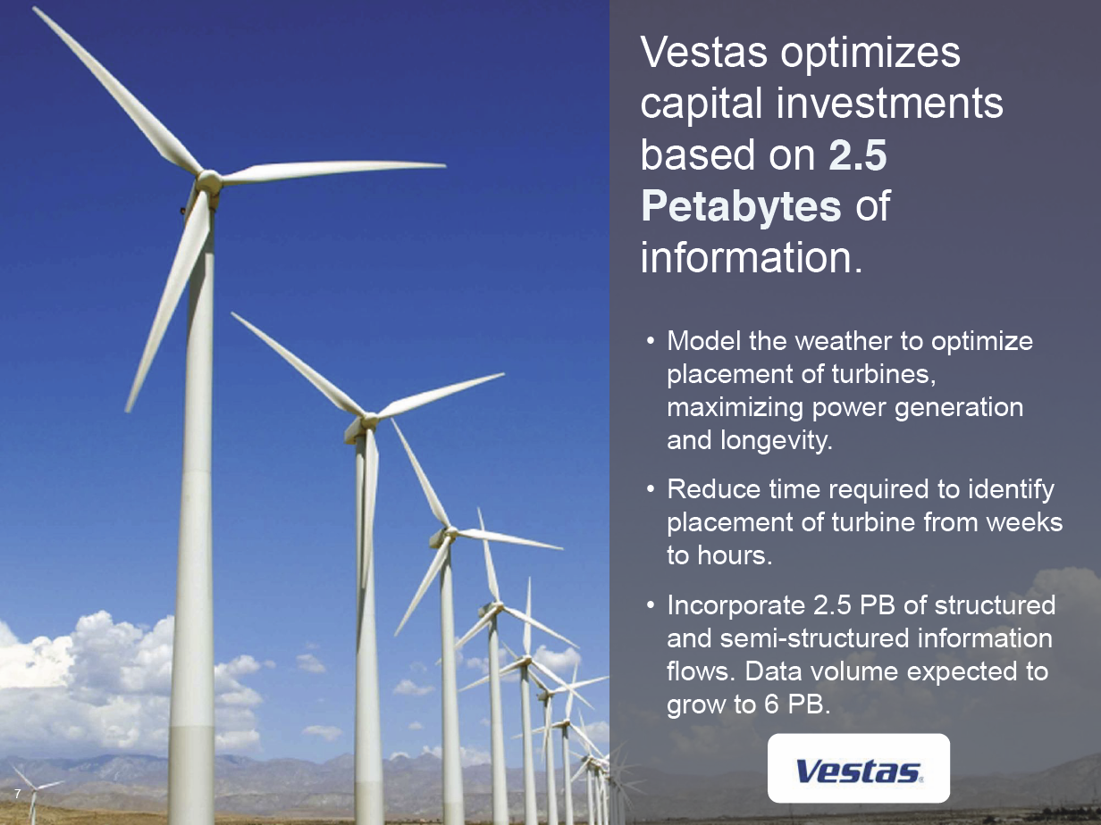
Anjul Bhambhri, VP of Big Data, IBM http://fisheritcenter.haas.berkeley.edu/Big_Data/index.html

Slide 22
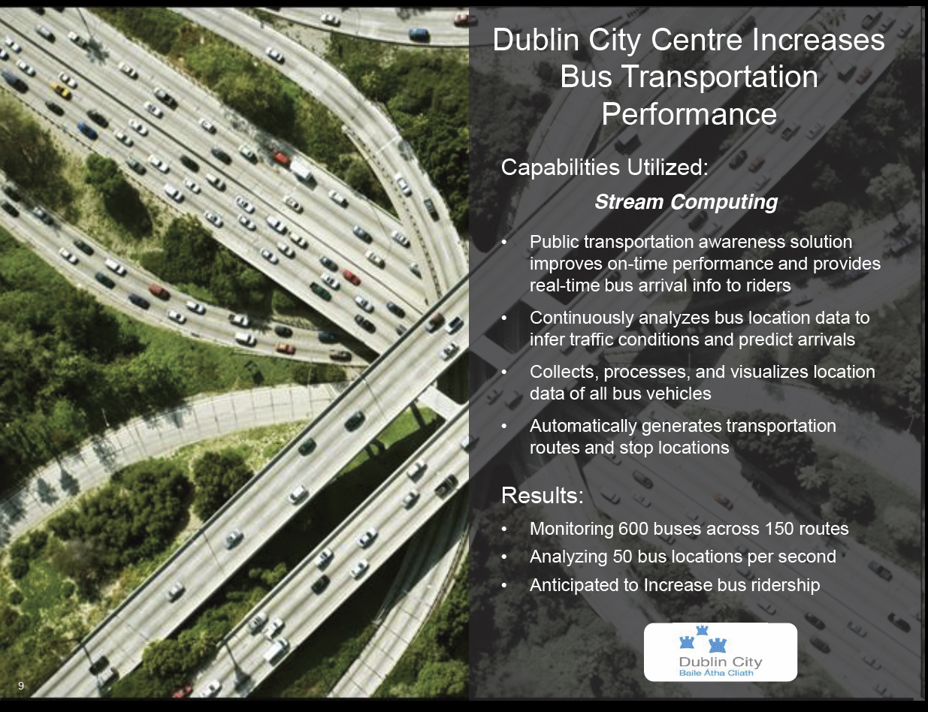
Anjul Bhambhri, VP of Big Data, IBM http://fisheritcenter.haas.berkeley.edu/Big_Data/index.html

Slide 23
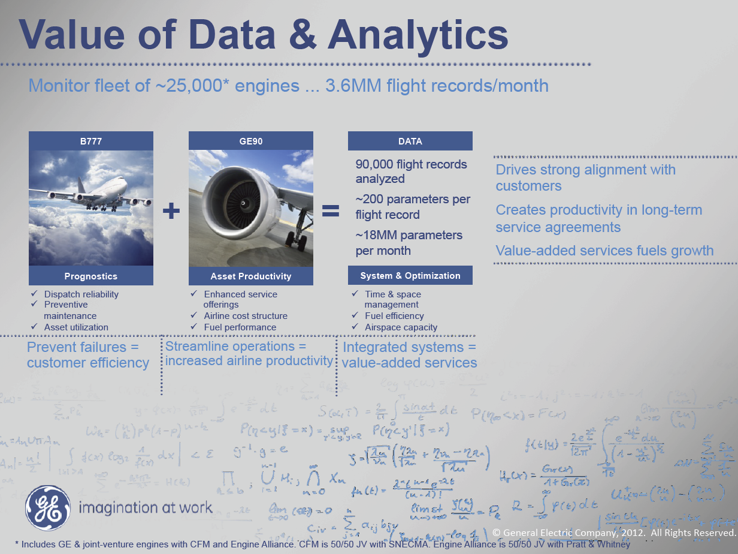
MM = Million
Ruh VP Software GE http://fisheritcenter.haas.berkeley.edu/Big_Data/index.html

Slide 24
“Taming the Big Data Tidal Wave” 2012
(Bill Franks, Chief Analytics Officer Teradata)
Web Data (“the original big data”)
  Analyze customer web browsing of e-commerce site to see topics looked at etc.
Auto Insurance (telematics monitoring driving)
  Equip cars with sensors
Text data in multiple industries
  Sentiment analysis, identify common issues (as in eBay lamp example), Natural Language processing
Time and location (GPS) data
  Track trucks (delivery), vehicles(track), people(tell them nearby goodies)
Retail and manufacturing: RFID
  Asset and inventory management,
Utility industry: Smart Grid
  Sensors allow dynamic optimization of power
Gaming industry: Casino Chip tracking (RFID)
  Track individual players, detect fraud, identify patterns
Industrial engines and equipment: sensor data
  See GE engine
Video games: telemetry
  This is like monitoring web browsing but rather monitor actions in a game
Telecommunication and other industries: Social Network data
  Connections make this big data.
  Use connections to find new customers with similar interests

Slide 25
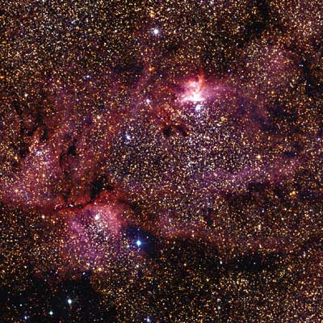
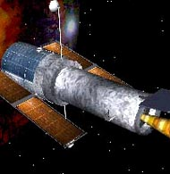
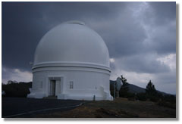
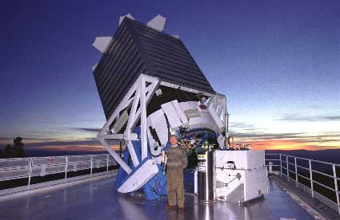
Tracking the Heavens
“The Universe is now being explored systematically, in a panchromatic way, over a range of spatial and temporal scales that lead to a more complete, and less biased understanding of its constituents, their evolution, their origins, and the physical processes governing them.”
Towards a National Virtual Observatory
Hubble Telescope
Palomar Telescope
Sloan Telescope

Slide 26
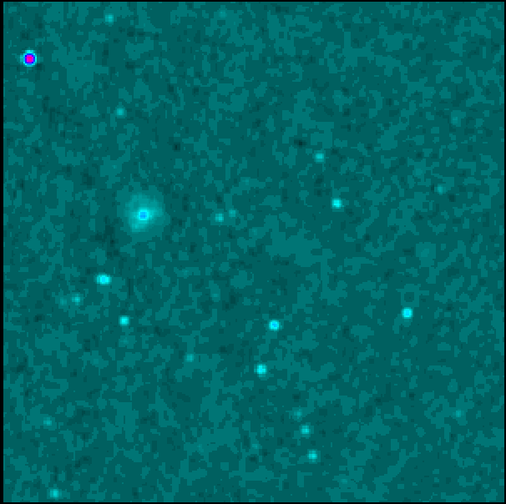

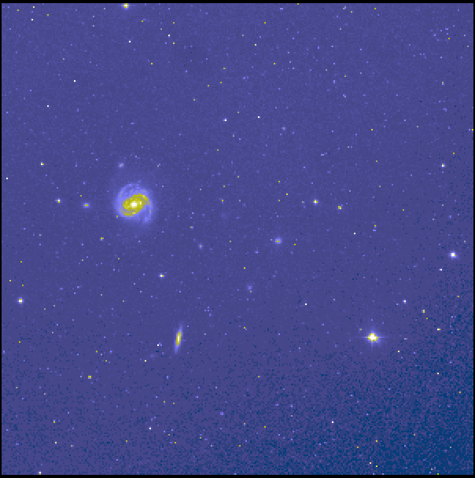
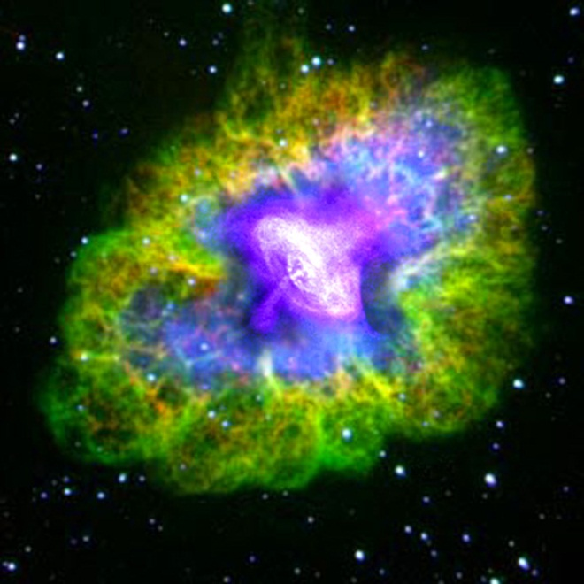
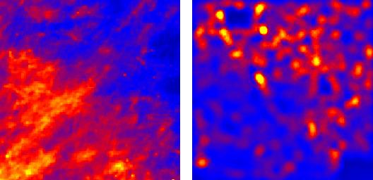
Virtual Observatory Astronomy Grid
Integrate Experiments
Radio
Far-Infrared
Visible
Dust Map
Visible + X-ray
Galaxy Density Map

Slide 27
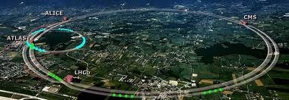
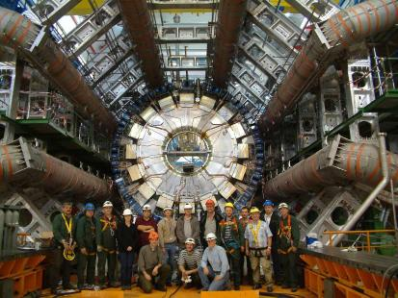
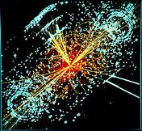
http://grids.ucs.indiana.edu/ptliupages/publications/Where%20does%20all%20the%20data%20come%20from%20v7.pd
ATLAS Expt
Note LHC lies in a tunnel 27 kilometres (17 mi) in circumference
The LHC produces some 15 petabytes of data per year of all varieties and with the exact value depending on duty factor of accelerator (which is reduced simply to cut electricity cost but also due to malfunction of one or more of the many complex systems) and experiments. The raw data produced by experiments is processed on the LHC Computing Grid, which has some 200,000 Cores arranged in a three level structure. Tier-0 is CERN itself, Tier 1 are national facilities and Tier 2 are regional systems. For example one LHC experiment (CMS) has 7 Tier-1 and 50 Tier-2 facilities.
Higgs Event

Slide 28
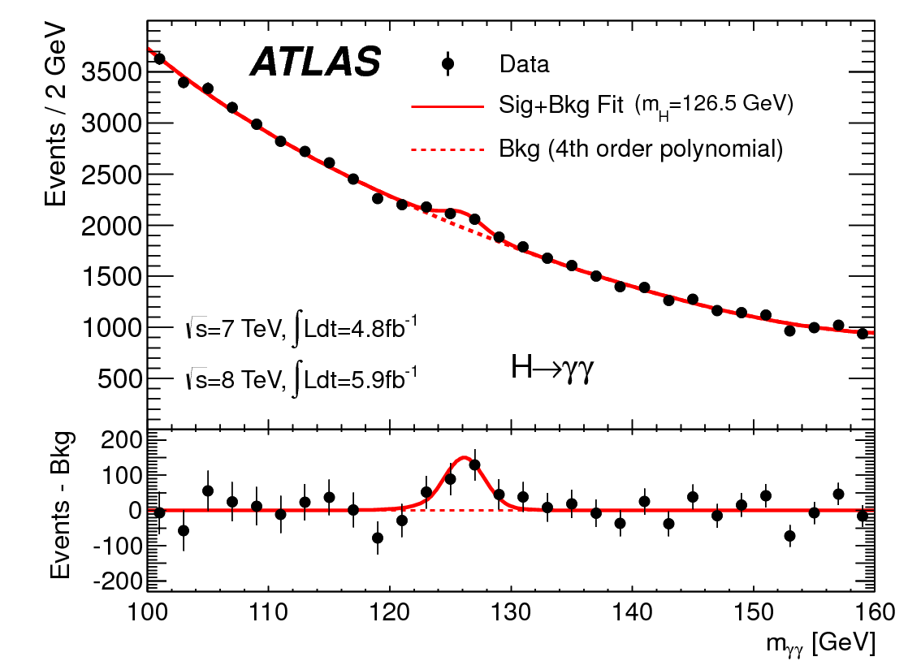
http://www.quantumdiaries.org/2012/09/07/why-particle-detectors-need-a-trigger/atlasmgg/
Model

Slide 29
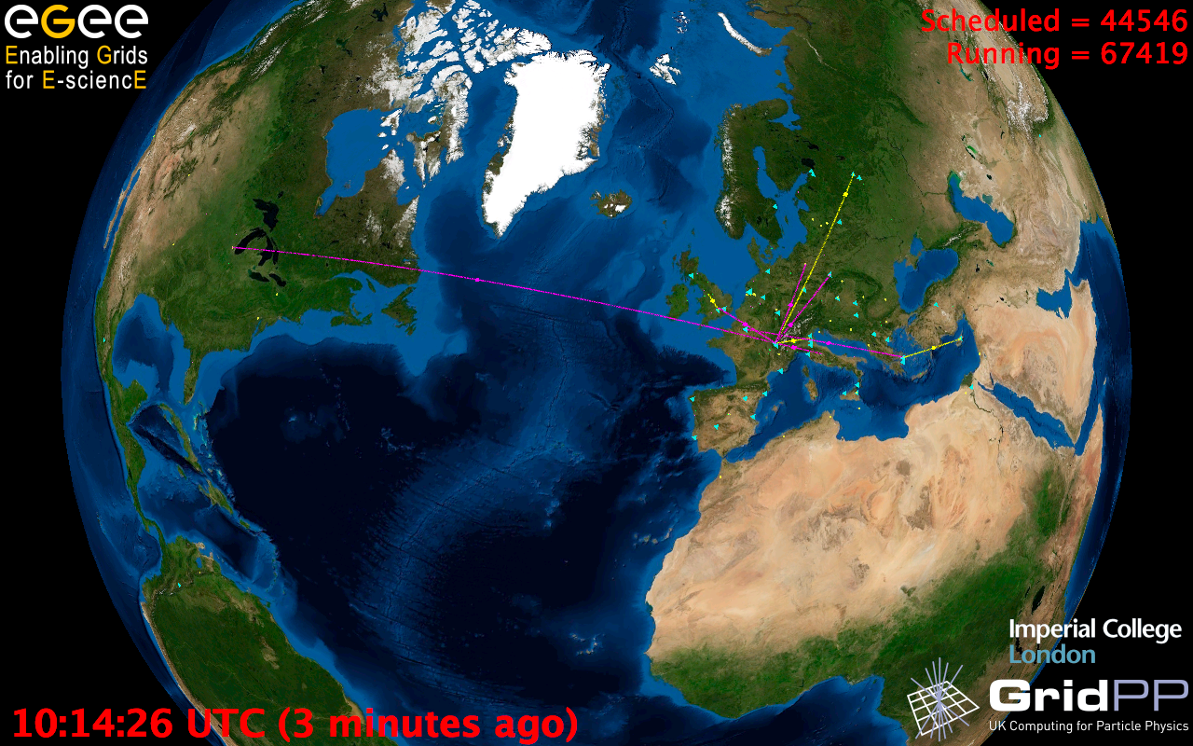
European Grid Infrastructure
Status April 2010 (yearly increase)
10000 users: +5%
243020 LCPUs (cores): +75%
40PB disk: +60%
61PB tape: +56%
15 million jobs/month: +10%
317 sites: +18%
52 countries: +8%
175 VOs: +8%
29 active VOs: +32%

Slide 30
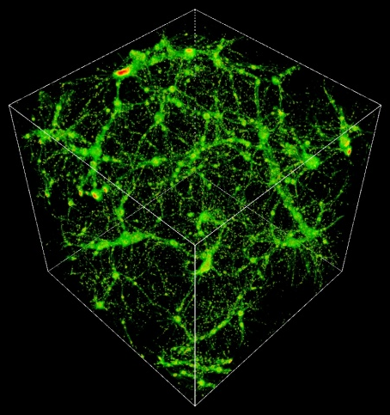
TeraGrid Example: Astrophysics
Science: MHD and star formation; cosmology at galactic scales (6-1500 Mpc) with various components: star formation, radiation diffusion, dark matter
Application: Enzo (loosely similar to: GASOLINE, etc.)
Science Users: Norman, Kritsuk (UCSD), Cen, Ostriker, Wise (Princeton), Abel (Stanford), Burns (Colorado), Bryan (Columbia), O’Shea (Michigan State), Kentucky, Germany, UK, Denmark, etc.
Notes:
The StarGate demo at SC09 combined steps 5 and 6, using 10 Gbps ESnet connection and 10 Gbps Dynamic Circuit Network (DCN) – 150 TB was moved from NICS to ANL for rendering on GPU cluster, results were streamed to OptiPortal at SC – our network tradeoffs include similar options.
The full simulation takes 3 months real time at NICS, moving data to ANL takes 3 nights – moving the data is practical, if it can be made simple and reliable.
http://www.lbl.gov/cs/Archive/news112009.html

Slide 32
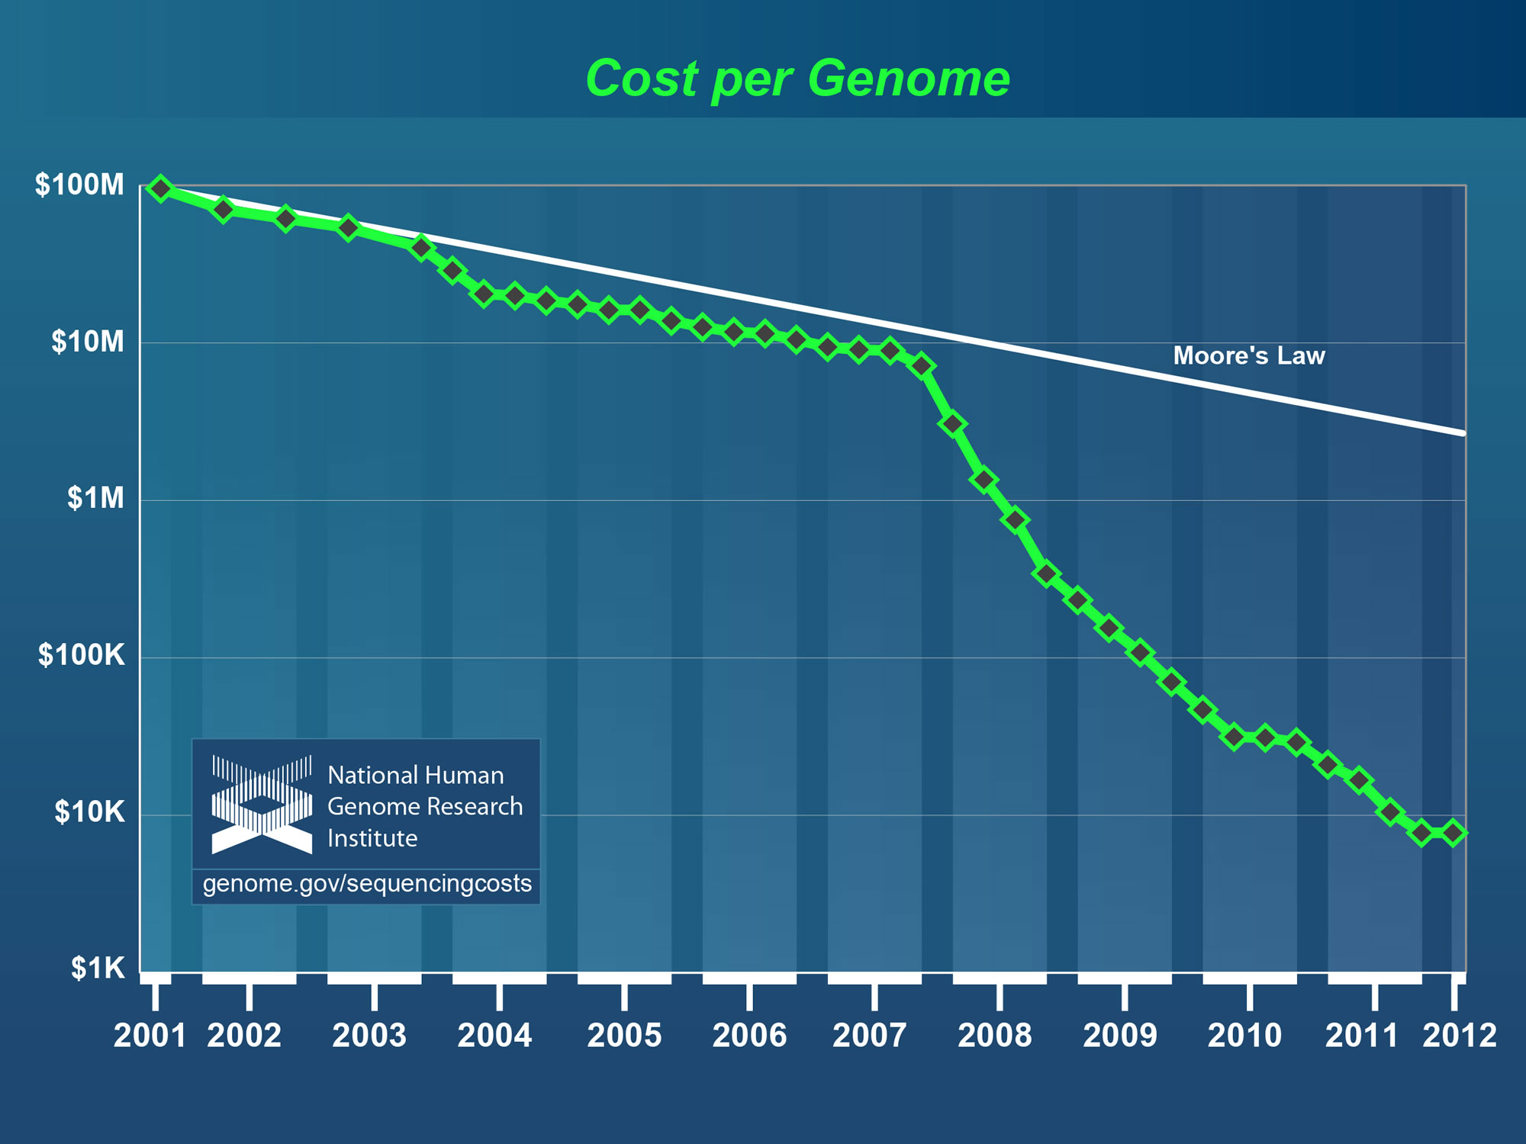
Why need cost effective
Computing!
Full Personal Genomics: 3 petabytes per day
http://www.genome.gov/sequencingcosts/

Slide 33

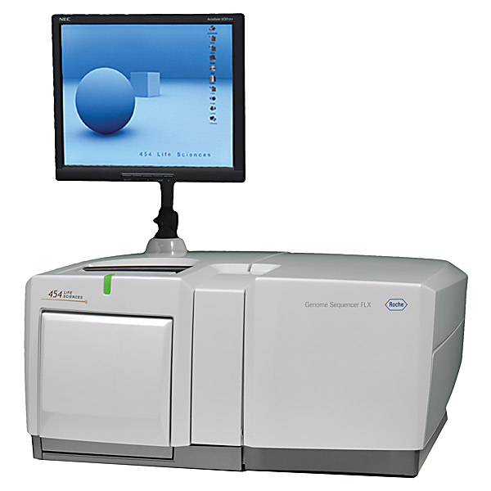
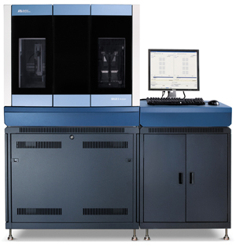
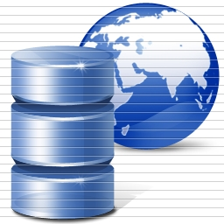
DNA Sequencing Pipeline
Illumina/Solexa Roche/454 Life Sciences Applied Biosystems/SOLiD
Internet
~300 million base pairs per day leading to
~3000 sequences per day per instrument
? 500 instruments at ~0.5M$ each
Read Alignment
Pairwise
clustering
Form block
Pairings
Sequence
alignment
Dissimilarity
Matrix
N(N-1)/2 values
Visualization
Plotviz
FASTA File
N Sequences
Blocking
MPI
MDS
MapReduce

Slide 34
Ninety-six percent of radiology practices in the USA are filmless and Table below illustrates the annual volume of data across the types of diagnostic imaging; this does not include cardiology which would take the total to over 10⁹ GB (an Exabyte).
http://grids.ucs.indiana.edu/ptliupages/publications/Where%20does%20all%20the%20data%20come%20from%20v7.pd
Modality | Part B non HMO | All Medicare | All Population | Per 1000 persons | Ave study size (GB) | Total annual data generated in GB
CT | 22 million | 29 million | 87 million | 287 | 0.25 | 21,750,000
MR | 7 million | 9 million | 26 million | 86 | 0.2 | 5,200,000
Ultrasound | 40 million | 53 million | 159 million | 522 | 0.1 | 15,900,000
Interventional | 10 million | 13 million | 40 million | 131 | 0.2 | 8,000,000
Nuclear Medicine | 10 million | 14 million | 41 million | 135 | 0.1 | 4,100,000
PET | 1 million | 1 million | 2 million | 8 | 0.1 | 200,000
Xray, total incl. mammography | 84 million | 111 million | 332 million | 1,091 | 0.04 | 13,280,000
All Diagnostic Radiology | 174 million | 229 million | 687 million | 2,259 | 0.1 | 68,700,000 68.7 PETAbytes

Slide 35
Lightweight Cyberinfrastructure to support mobile Data gathering expeditions plus classic central resources (as a cloud)

Slide 36
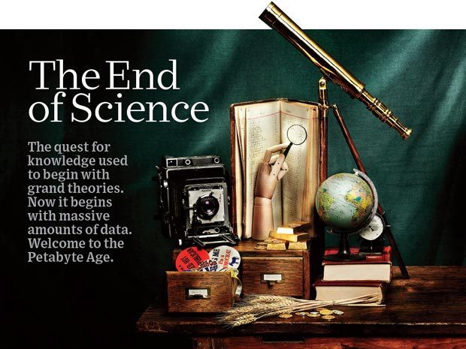
http://www.wired.com/wired/issue/16-07 September 2008

Slide 37
The 4 paradigms of Scientific Research
Theory
Experiment or Observation
  E.g. Newton observed apples falling to design his theory of mechanics
Simulation of theory or model
Data-driven (Big Data) or The Fourth Paradigm: Data-Intensive Scientific Discovery (aka Data Science)
  http://research.microsoft.com/en-us/collaboration/fourthparadigm/
  A free book
  More data; less models

Slide 38
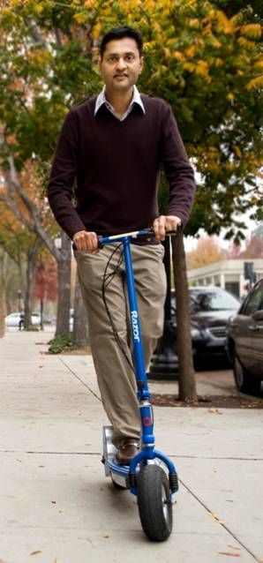
More data usually beats better algorithms
Here's how the competition works. Netflix has provided a large data set that tells you how nearly half a million people have rated about 18,000 movies. Based on these ratings, you are asked to predict the ratings of these users for movies in the set that they have not rated. The first team to beat the accuracy of Netflix's proprietary algorithm by a certain margin wins a prize of $1 million!
Different student teams in my class adopted different approaches to the problem, using both published algorithms and novel ideas. Of these, the results from two of the teams illustrate a broader point. Team A came up with a very sophisticated algorithm using the Netflix data. Team B used a very simple algorithm, but they added in additional data beyond the Netflix set: information about movie genres from the Internet Movie Database(IMDB). Guess which team did better?
Anand Rajaraman is Senior Vice President at Walmart Global eCommerce, where he heads up the newly created @WalmartLabs,
http://anand.typepad.com/datawocky/2008/03/more-data-usual.html
20120117berkeley1.pdf Jeff Hammerbacher

Slide 39
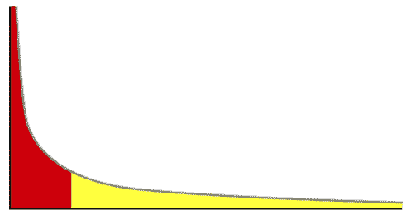
The Long Tail of Science
High energy physics, astronomy
genomics
The long tail: economics, social science, ….
Collectively “long tail” science is generating a lot of data
  Estimated at over 1PB per year and it is growing fast.
80-20 rule: 20% users generate 80% data but not necessarily 80% knowledge
Gannon Talk

Slide 40
Internet of Things and the Cloud
It is projected that there will be 24 billion devices on the Internet by 2020. Most will be small sensors that send streams of information into the cloud where it will be processed and integrated with other streams and turned into knowledge that will help our lives in a multitude of small and big ways.
The cloud will become increasing important as a controller of and resource provider for the Internet of Things.
As well as today’s use for smart phone and gaming console support, “Intelligent River” “smart homes and grid” and “ubiquitous cities” build on this vision and we could expect a growth in cloud supported/controlled robotics.
Some of these “things” will be supporting science
Natural parallelism over “things”
“Things” are distributed and so form a Grid

Slide 41
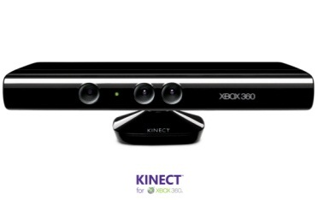








Sensors (Things) as a Service
Output Sensor
Sensors as a Service
Sensor Processing as a Service (could use
MapReduce)
A larger sensor ………
https://sites.google.com/site/opensourceiotcloud/ Open Source Sensor (IoT) Cloud

Slide 42
Clouds

Slide 43
Amazon making money
It took Amazon Web Services (AWS) eight years to hit $650 million in revenue, according to Citigroup in 2010.
Just three years later, Macquarie Capital analyst Ben Schachter estimates that AWS will top $3.8 billion in 2013 revenue, up from $2.1 billion in 2012 (estimated), valuing the AWS business at $19 billion.
It's a lot of money, and it underlines Amazon's increasingly dominant role in cloud computing, and the rising risks associated with enterprises putting all their eggs in the AWS basket.

Slide 44
Physically Clouds are Clear
A bunch of computers in an efficient data center with an excellent Internet connection
They were produced to meet need of public-facing Web 2.0 e-Commerce/Social Networking sites
They can be considered as “optimal giant data center” plus internet connection
Note enterprises use private clouds that are giant data centers but not optimized for Internet access

Slide 45
Virtualization made several things more convenient
Virtualization = abstraction; run a job – you know not where
Virtualization = use hypervisor to support “images”
  Allows you to define complete job as an “image” – OS + application
Efficient packing of multiple applications into one server as they don’t interfere (much) with each other if in different virtual machines;
They interfere if put as two jobs in same machine as for example must have same OS and same OS services
Also security model between VM’s more robust than between processes

Slide 46
Next Step is Renting out Idle Clouds
Amazon noted it could rent out its idle machines
Use virtualization for maximum efficiency and security
If cloud bigger enough, one gets elasticity – namely you can rent as much as you want except perhaps at peak times
This assumes machine hardware quite cheap and can keep some in reserve
  10% of 100,000 servers is 10,000 servers
I don’t know if Amazon switches off spare computers and powers up on “mothers day”
  Illustrates difficulties in studying field – proprietary secrets

Slide 47
Different aaS (as aService)’s
IaaS: Infrastructure is “renting” service for hardware
PaaS: Convenient service interface to Systems capabilities
SaaS: Convenient service interface to applications
NaaS: Summarizes modern “Software Defined Networks”

Slide 48
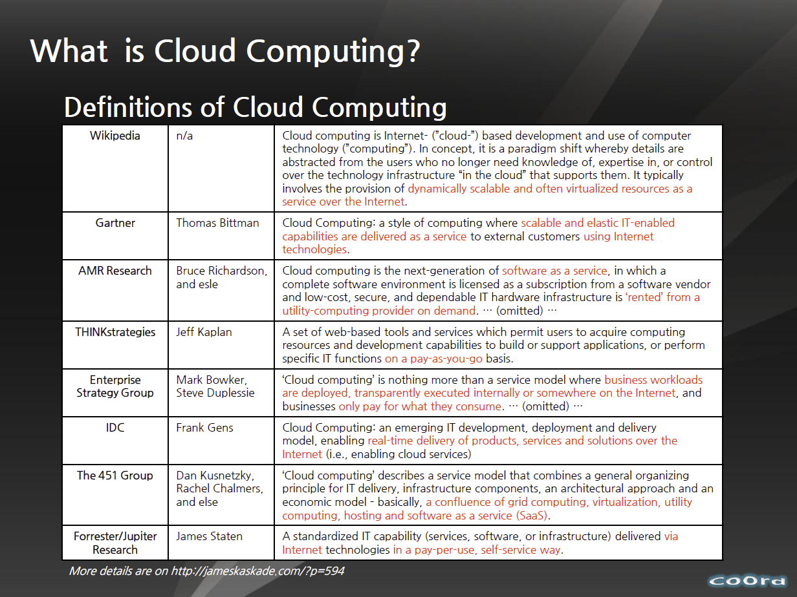
http://www.slideshare.net/woorung/trend-and-future-of-cloud-computing

Slide 49
The Google gmail example
http://www.google.com/green/pdfs/google-green-computing.pdf
Clouds win by efficient resource use and efficient data centers
Business Type | Number of users | # servers | IT Power per user | PUE (Power Usage effectiveness) | Total Power per user | Annual Energy per user
Small | 50 | 2 | 8W | 2.5 | 20W | 175 kWh
Medium | 500 | 2 | 1.8W | 1.8 | 3.2W | 28.4 kWh
Large | 10000 | 12 | 0.54W | 1.6 | 0.9W | 7.6 kWh
Gmail (Cloud) | ∞ | ∞ | < 0.22W | 1.16 | < 0.25W | < 2.2 kWh

Slide 50
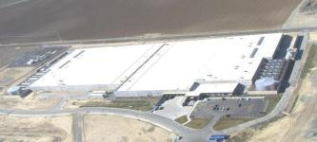

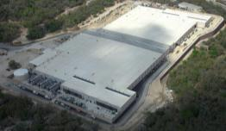
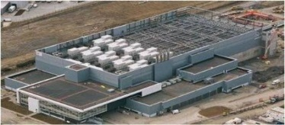




The Microsoft Cloud is Built on Data Centers
~100 Globally Distributed Data Centers
Range in size from “edge” facilities to megascale (100K to 1M servers)
Quincy, WA
Chicago, IL
San Antonio, TX
Dublin, Ireland
Generation 4 DCs
Gannon Talk

Slide 51



Data Centers Clouds &
Economies of Scale
Range in size from “edge” facilities to megascale.
Economies of scale
  Approximate costs for a small size center (1K servers) and a larger, 50K server center.
2 Google warehouses of computers on the banks of the Columbia River, in The Dalles, Oregon
Such centers use 20MW-200MW
(Future) each with 150 watts per CPU
Save money from large size, positioning with cheap power and access with Internet
Technology | Cost in small-sized Data Center | Cost in Large Data Center | Ratio
Network | $95 per Mbps/ month | $13 per Mbps/ month | 7.1
Storage | $2.20 per GB/ month | $0.40 per GB/ month | 5.7
Administration | ~140 servers/ Administrator | >1000 Servers/ Administrator | 7.1
Each data center is
11.5 times
the size of a football field

Slide 52


Containers: Separating Concerns
MICROSOFT

Slide 53
Education and Clouds

Slide 54
3-way Clouds and/or
Cyberinfrastructure
Use it in faculty, graduate student and undergraduate research
  ~10 students each summer at IU from ADMI
Teach it as it involves areas of Information Technology with lots of job opportunities
Use it to support distributed learning environment
  A cloud backend for course materials and collaboration
  Green computing infrastructure

Slide 55
C4 = Continuous Collaborative
Computational Cloud
C4 EMERGING VISION
While the internet has changed the way we communicate and get entertainment, we need to empower the next generation of engineers and scientists with technology that enables interdisciplinary collaboration for lifelong learning.
Today, the cloud is a set of services that people explicitly have to access (from laptops, desktops, etc.). In 2020 the C4 will be part of our lives, as a larger, pervasive, continuous experience. The measure of success will be how “invisible” it becomes.
C4 Society Vision
We are no prophets and can’t anticipate what exactly will work, but we expect to have high bandwidth and ubiquitous connectivity for everyone everywhere, even in rural areas (using power-efficient micro data centers the size of shoe boxes). Here the cloud will enable business, fun, destruction and creation of regimes (societies)
Wandering through life with a tablet/smartphone hooked to cloud
Education should embrace C4 just as students do
Notes:
C4 Continuous Collaborative Computational Cloud

Slide 56
Higher Education 2020
Computational Thinking
Modeling
& Simulation
C⁴
Continuous
Collaborative
Computational
Cloud
C⁴
I
C⁴ Intelligent Society
N
T
E
C⁴ Intelligent Economy
C(DE)SE
L
L
C⁴ Intelligent People
Internet &
Cyberinfrastructure
I
G
E
Motivating
Issues
job / education mismatch
Higher Ed rigidity
Interdisciplinary work
Engineering v Science, Little v. Big science
N
C
E
NSF
Educate “Net Generation”
Re-educate pre “Net Generation”
in Science and Engineering
Exploiting and developing C⁴
C⁴ Curricula, programs
C⁴ Experiences (delivery mechanism)
C⁴ REUs, Internships, Fellowships
CDESE is Computational and Data-enabled Science and Engineering

Slide 57
Implementing C4 in a Cloud Computing Curriculum
Generate curricula that will allow students to enter cloud computing workforce
Teach workshops explaining cloud computing to MSI faculty
Write a basic textbook
Design courses at Indiana University
Design modules and modifications suitable to be taught at MSI’s
Help teach initial MSI courses

Slide 58


ADMI Cloudy View on
Computing Workshop
June 2011
Concept and Delivery by
Jerome Mitchell:
Undergraduate ECSU,
Masters Kansas, PhD Indiana
Jerome took two courses from IU in this area Fall 2010 and Spring 2011
ADMI: Association of Computer and Information Science/Engineering Departments at Minority Institutions
Offered on FutureGrid (see later)
10 Faculty and Graduate Students from ADMI Universities
The workshop provided information from cloud programming models to case studies of scientific applications on FutureGrid.
At the conclusion of the workshop, the participants indicated that they would incorporate cloud computing into their courses and/or research.

Slide 59


