Slide 1
High Performance Parallel Computing with Clouds and Cloud Technologies
CloudComp 09
Munich, Germany
1
1,2
Jaliya Ekanayake, Geoffrey Fox
{jekanaya,gcf}@indiana.edu
School of Informatics and Computing
Pervasive Technology Institute
Indiana University Bloomington
1
2

Slide 2
Acknowledgements to:
Joe Rinkovsky and Jenett Tillotson at IU UITS
SALSA Team - Pervasive Technology Institution, Indiana University
Scott Beason
Xiaohong Qiu
Thilina Gunarathne

Slide 3
Computing in Clouds
Eucalyptus
(Open source)
Commercial Clouds
Amazon EC2
3Tera
Private Clouds
Nimbus
GoGrid
Xen
Some Benefits:
On demand allocation of resources (pay per use)
Customizable Virtual Machine (VM)s
Any software configuration
Root/administrative privileges
Provisioning happens in minutes
Compared to hours in traditional job queues
Better resource utilization
No need to allocated a whole 24 core machine to perform a single threaded R analysis
Accessibility to a computation power is no longer a barrier.

Slide 4
Cloud Technologies/Parallel Runtimes
Cloud technologies
E.g.
Apache Hadoop (MapReduce)
Microsoft DryadLINQ
MapReduce++ (earlier known as CGL-MapReduce)
Moving computation to data
Distributed file systems (HDFS, GFS)
Better quality of service (QoS) support
Simple communication topologies
Most HPC applications use MPI
Variety of communication topologies
Typically use fast (or dedicated) network settings

Slide 5
Applications & Different Interconnection Patterns
Map Only (Embarrassingly Parallel) | Classic MapReduce | Iterative Reductions MapReduce++ | Loosely Synchronous
CAP3 Analysis Document conversion (PDF -> HTML) Brute force searches in cryptography Parametric sweeps | High Energy Physics (HEP) Histograms SWG gene alignment Distributed search Distributed sorting Information retrieval | Expectation maximization algorithms Clustering Linear Algebra | Many MPI scientific applications utilizing wide variety of communication constructs including local interactions
- CAP3 Gene Assembly - PolarGrid Matlab data analysis | - Information Retrieval - HEP Data Analysis - Calculation of Pairwise Distances for ALU Sequences | K-means Deterministic Annealing Clustering - Multidimensional Scaling MDS | - Solving Differential Equations and - particle dynamics with short range forces
Input
iterations
Input
Input
map
map
map
Pij
reduce
Output
reduce
Domain of MapReduce and Iterative Extensions
MPI

Slide 6
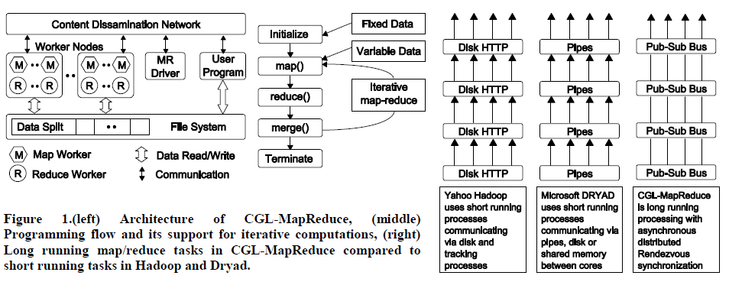
MapReduce++ (earlier known as CGL-MapReduce)
In memory MapReduce
Streaming based communication
Avoids file based communication mechanisms
Cacheable map/reduce tasks
Static data remains in memory
Combine phase to combine reductions
Extends the MapReduce programming model to iterative MapReduce applications

Slide 7
What I will present next
Our experience in applying cloud technologies to:
EST (Expressed Sequence Tag) sequence assembly program -CAP3.
HEP Processing large columns of physics data using ROOT
K-means Clustering
Matrix Multiplication
Performance analysis of MPI applications using a private cloud environment

Slide 8
Cluster Configurations
Feature | Windows Cluster | iDataplex @ IU
CPU | Intel Xeon CPU L5420 2.50GHz | Intel Xeon CPU L5420 2.50GHz
# CPU /# Cores | 2 / 8 | 2 / 8
Memory | 16 GB | 32GB
# Disks | 2 | 1
Network | Giga bit Ethernet | Giga bit Ethernet
Operating System | Windows Server 2008 Enterprise - 64 bit | Red Hat Enterprise Linux Server -64 bit
# Nodes Used | 32 | 32
Total CPU Cores Used | 256 | 256
DryadLINQ
Hadoop / MPI/ Eucalyptus

Slide 9
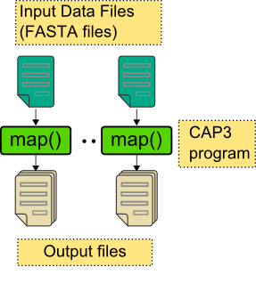
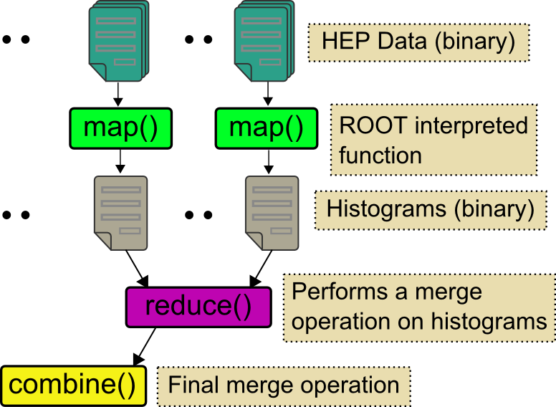
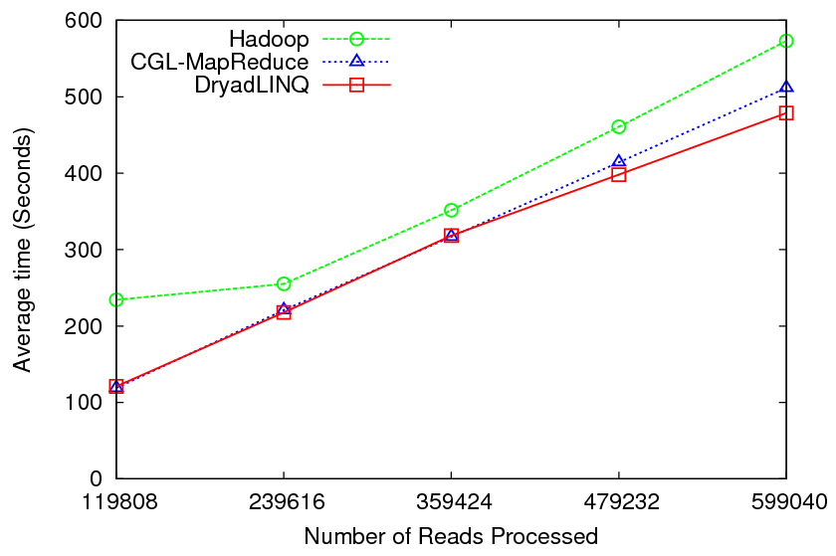
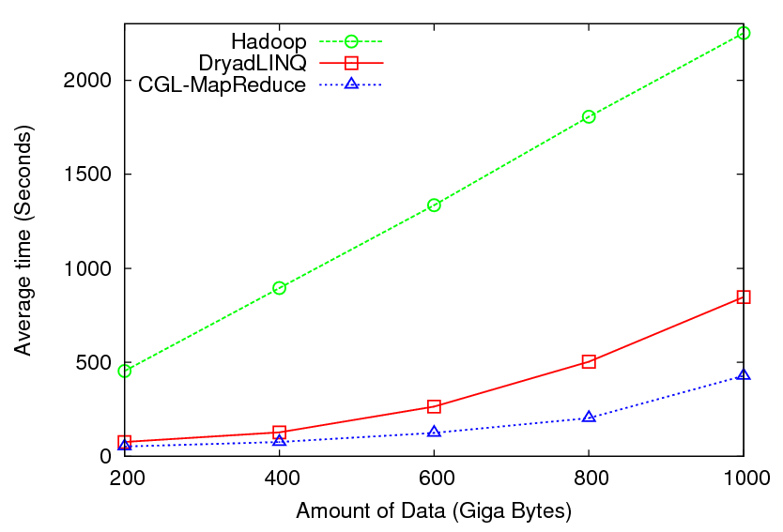
Pleasingly Parallel Applications
CAP3
High Energy
Physics
Performance of CAP3
Performance of HEP

Slide 10
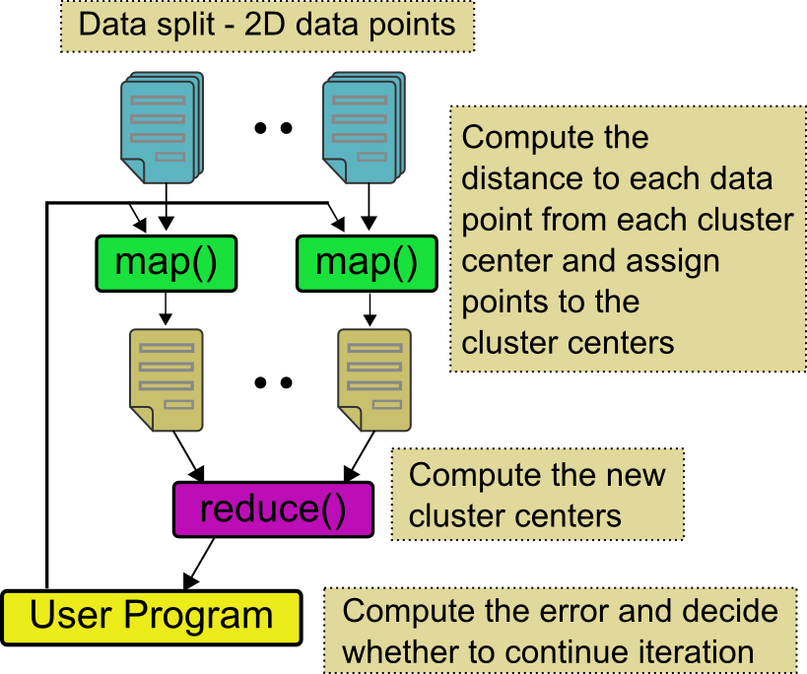
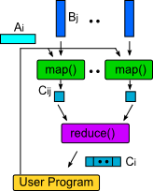
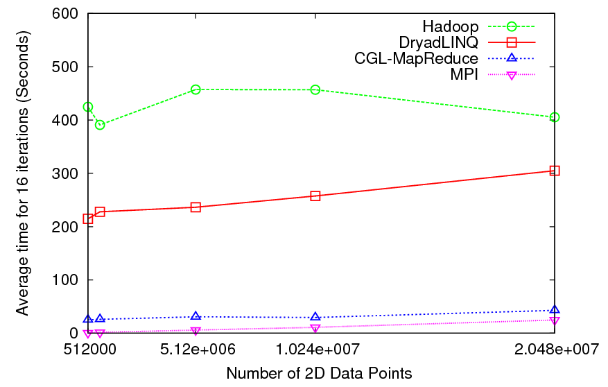
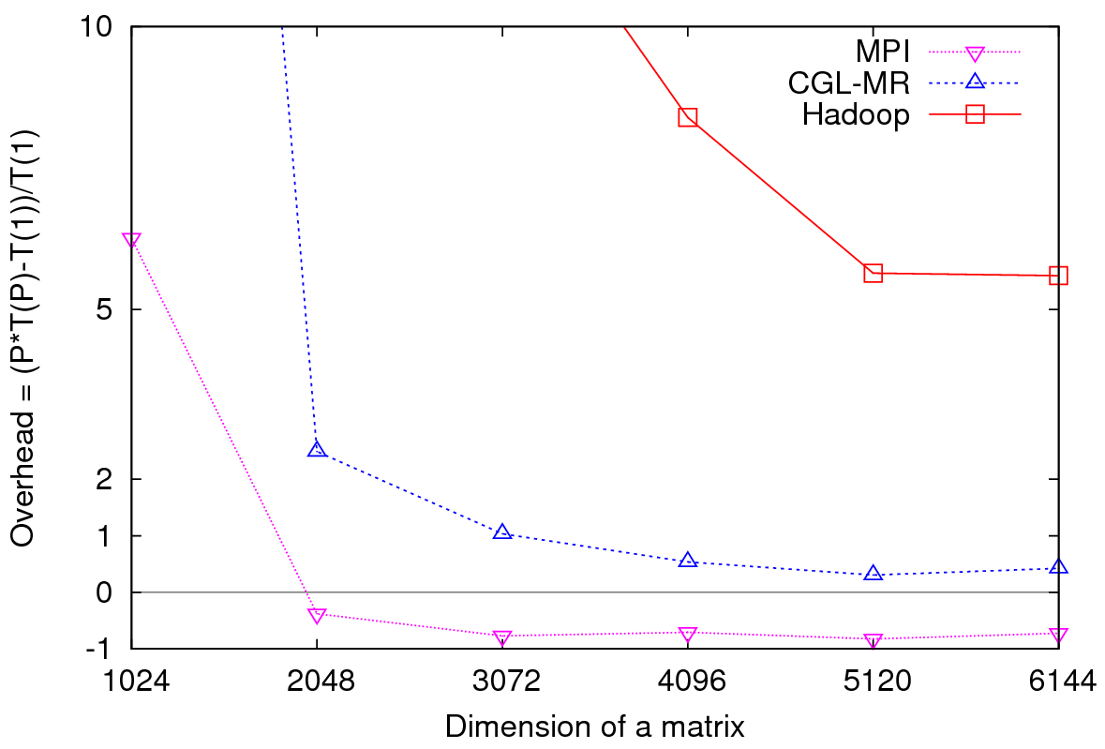
Iterative Computations
K-means
Matrix Multiplication
Performance of K-Means
Parallel Overhead Matrix Multiplication

Slide 11
Performance analysis of MPI applications using a private cloud environment
Eucalyptus and Xen based private cloud infrastructure
Eucalyptus version 1.4 and Xen version 3.0.3
Deployed on 16 nodes each with 2 Quad Core Intel Xeon processors and 32 GB of memory
All nodes are connected via a 1 giga-bit connections
Bare-metal and VMs use exactly the same software configurations
Red Hat Enterprise Linux Server release 5.2 (Tikanga) operating system. OpenMPI version 1.3.2 with gcc version 4.1.2.

Slide 12
Different Hardware/VM configurations
Ref | Description | Number of CPU cores per virtual or bare-metal node | Amount of memory (GB) per virtual or bare-metal node | Number of virtual or bare-metal nodes
BM | Bare-metal node | 8 | 32 | 16
1-VM-8-core (High-CPU Extra Large Instance) | 1 VM instance per bare-metal node | 8 | 30 (2GB is reserved for Dom0) | 16
2-VM-4- core | 2 VM instances per bare-metal node | 4 | 15 | 32
4-VM-2-core | 4 VM instances per bare-metal node | 2 | 7.5 | 64
8-VM-1-core | 8 VM instances per bare-metal node | 1 | 3.75 | 128
Invariant used in selecting the number of MPI processes
Number of MPI processes = Number of CPU cores used

Slide 13
MPI Applications
Feature | Matrix multiplication | K-means clustering | Concurrent Wave Equation
Description | Cannon’s Algorithm square process grid | K-means Clustering Fixed number of iterations | A vibrating string is (split) into points Each MPI process updates the amplitude over time
Grain Size
Computation Complexity | O (n^3) | O(n) | O(n)
Message Size
Communication Complexity | O(n^2) | O(1) | O(1)
Communication/Computation
n
n
1
n
n
d
n
C
1
d
1
n

Slide 14
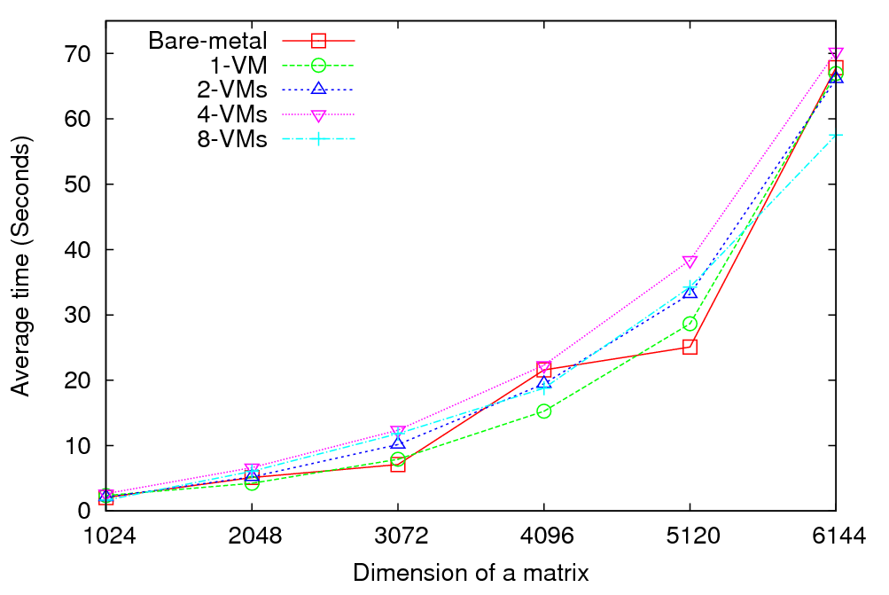
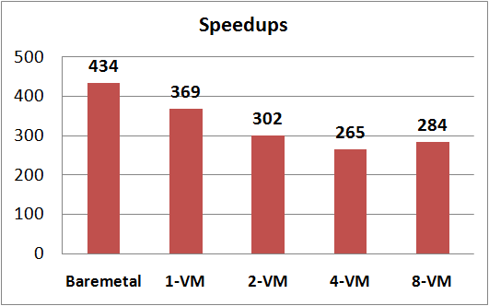
Matrix Multiplication
Performance - 64 CPU cores
Speedup – Fixed matrix size (5184x5184)
Implements Cannon’s Algorithm [1]
Exchange large messages
More susceptible to bandwidth than latency
At least 14% reduction in speedup between bare-metal and 1-VM per node
[1] S. Johnsson, T. Harris, and K. Mathur, “Matrix multiplication on the connection machine,” In Proceedings of the 1989 ACM/IEEE Conference on Supercomputing (Reno, Nevada, United States, November 12 - 17, 1989). Supercomputing '89. ACM, New York, NY, 326-332. DOI= http://doi.acm.org/10.1145/76263.76298

Slide 15
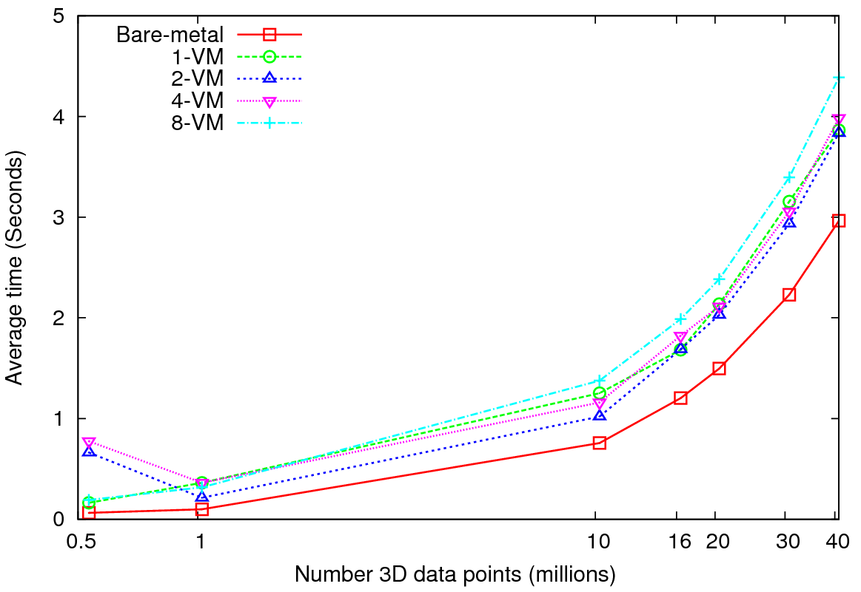
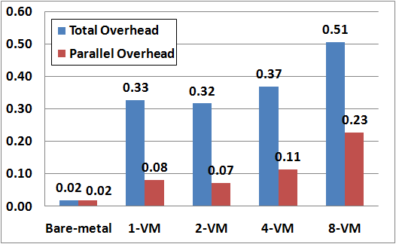
Kmeans Clustering
Performance – 128 CPU cores
Overhead = (P * T(P) –T(1))/T(1)
Up to 40 million 3D data points
Amount of communication depends only on the number of cluster centers
Amount of communication << Computation and the amount of data processed
At the highest granularity VMs show at least ~33% of total overhead
Extremely large overheads for smaller grain sizes

Slide 16
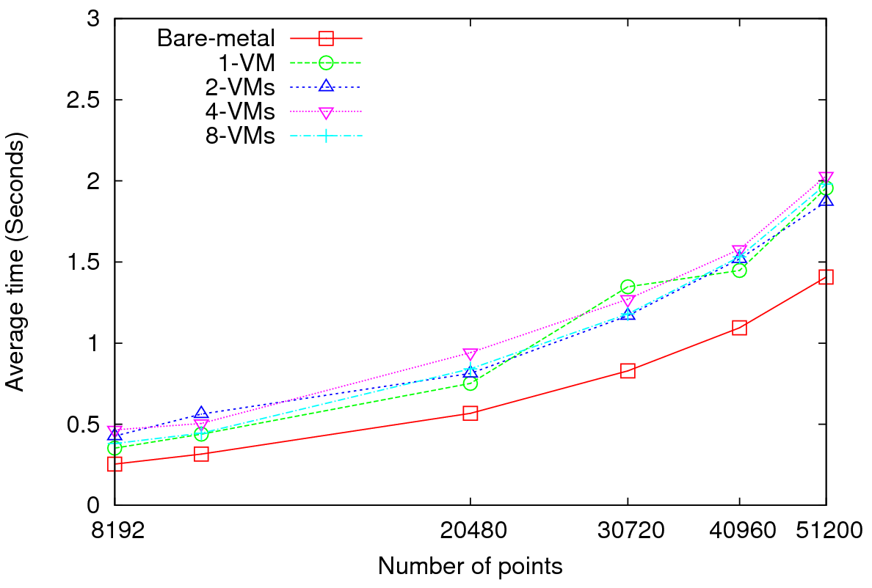
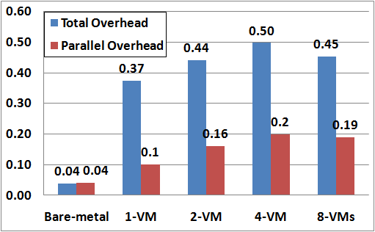
Concurrent Wave Equation Solver
Performance - 64 CPU cores
Overhead = (P * T(P) –T(1))/T(1)
Clear difference in performance and overheads between VMs and bare-metal
Very small messages (the message size in each MPI_Sendrecv() call is only 8 bytes)
More susceptible to latency
At 40560 data points, at least ~37% of total overhead in VMs

Slide 17
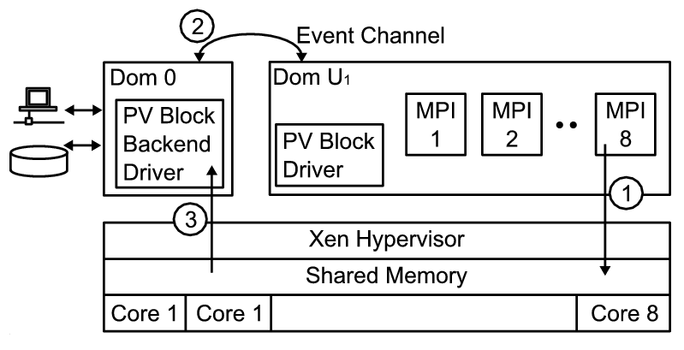
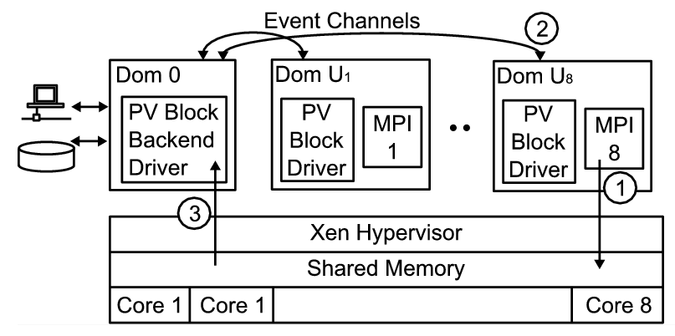
Higher latencies -1
1-VM per node
8 MPI processes inside the VM
8-VMs per node
1 MPI process inside each VM
domUs (VMs that run on top of Xen para-virtualization) are not capable of performing I/O operations
dom0 (privileged OS) schedules and execute I/O operations on behalf of domUs
More VMs per node => more scheduling => higher latencies

Slide 18
Higher latencies -2
Kmeans Clustering
Lack of support for in-node communication => “Sequentializing” parallel communication
Better support for in-node communication in OpenMPI
sm BTL (shared memory byte transfer layer)
Both OpenMPI and LAM-MPI perform equally well in 8-VMs per node configuration

Slide 19
Conclusions and Future Works
Cloud technologies works for most pleasingly parallel applications
Runtimes such as MapReduce++ extends MapReduce to iterative MapReduce domain
MPI applications experience moderate to high performance degradation (10% ~ 40%) in private cloud
Dr. Edward walker noticed (40% ~ 1000%) performance degradations in commercial clouds [1]
Applications sensitive to latencies experience higher overheads
Bandwidth does not seem to be an issue in private clouds
More VMs per node => Higher overheads
In-node communication support is crucial
Applications such as MapReduce may perform well on VMs ?
[1] Walker, E.: benchmarking Amazon EC2 for high-performance scientific computing, http://www.usenix.org/publications/login/2008-10/openpdfs/walker.pdf

Slide 20
Questions?
Notes:
Transition to Atilla

Slide 21
Thank You!

