Slide 1
Large Scale Data Analytics on Clouds
CloudDB 2012
4th International Conference on Data Management in the Cloud
CIKM 2012 Maui
October 29 2012
Geoffrey Fox
gcf@indiana.edu
http://www.infomall.org http://www.futuregrid.org
School of Informatics and Computing
Digital Science Center
Indiana University Bloomington

Slide 2
Abstract
We summarize important overall issues affecting use of clouds to support Data Science. We describe the mapping of different applications to HPCC and Cloud systems and the architecture that support data analytics that is interoperable between these architectures
We posit that big data implies robust data-mining algorithms that must run in parallel to achieve needed performance.
Ability to use Cloud computing allows us to tap cheap commercial resources and several important data and programming advances. Nevertheless we also need to exploit traditional HPC environments. We discuss our approach to this challenge which involves Iterative MapReduce as an interoperable Cloud-HPC runtime.
We stress that the communication structure of data analytics is different from classic parallel algorithms as one uses large collective operations (reductions or broadcasts) rather than the many small messages familiar from parallel particle dynamics and partial differential equation solvers.
We suggest that a coordinated effort is needed to build quality scalable robust data mining libraries to enable big data analysis across many fields.
We discuss FutureGrid

Slide 3
2 Aspects of Cloud Computing:
Infrastructure and Runtimes
Cloud infrastructure: outsourcing of servers, computing, data, file space, utility computing, etc..
Cloud runtimes or Platform: tools to do data-parallel (and other) computations. Valid on Clouds and traditional clusters
  Apache Hadoop, Google MapReduce, Microsoft Dryad, Bigtable, Chubby and others
  MapReduce designed for information retrieval but is excellent for a wide range of science data analysis applications
  Can also do much traditional parallel computing for data-mining if extended to support iterative operations
  Data Parallel File system as in HDFS and Bigtable

Slide 4
Infrastructure, Platforms, Software as a Service
System e.g. SQL, GlobusOnline
Applications e.g.
Amber, Blast, MDS
Software Services are building blocks of applications
The middleware or computing environment
Nimbus, Eucalyptus, OpenStack, OpenNebula
CloudStack
OpenFlow
Applications
SaaS
Platform
PaaS
Cloud e.g. MapReduce
HPC e.g. PETSc, SAGA
Computer Science e.g. Compiler tools, Sensor nets, Monitors
Hypervisor
Bare Metal
Operating System
Virtual Clusters
Virtual Networks
Infrastructure
IaaS

Slide 5
Science Computing Environments
Large Scale Supercomputers – Multicore nodes linked by high performance low latency network
  Increasingly with GPU enhancement
  Suitable for highly parallel simulations
High Throughput Systems such as European Grid Initiative EGI or Open Science Grid OSG typically aimed at pleasingly parallel jobs
  Can use “cycle stealing”
  Classic example is LHC data analysis
Grids federate resources as in EGI/OSG or enable convenient access to multiple backend systems including supercomputers
  Portals make access convenient and
  Workflow integrates multiple processes into a single job
Specialized visualization, shared memory parallelization etc. machines

Slide 6
Clouds HPC and Grids
Synchronization/communication Performance
Grids > Clouds > Classic HPC Systems
Clouds naturally execute effectively Grid workloads but are less clear for closely coupled HPC applications
Classic HPC machines as MPI engines offer highest possible performance on closely coupled problems
    Likely to remain in spite of Amazon cluster offering
Service Oriented Architectures portals and workflow appear to work similarly in both grids and clouds
May be for immediate future, science supported by a mixture of
  Clouds – some practical differences between private and public clouds – size and software
  High Throughput Systems (moving to clouds as convenient)
  Grids for distributed data and access
  Supercomputers (“MPI Engines”) going to exascale

Slide 7
Cloud Applications

Slide 8
What Applications work in Clouds
Pleasingly (moving to modestly) parallel applications of all sorts with roughly independent data or spawning independent simulations
  Long tail of science and integration of distributed sensors
Commercial and Science Data analytics that can use MapReduce (some of such apps) or its iterative variants (most other data analytics apps)
Which science applications are using clouds?
  Venus-C (Azure in Europe): 27 applications not using Scheduler, Workflow or MapReduce (except roll your own)
  50% of applications on FutureGrid are from Life Science
  Locally Lilly corporation is commercial cloud user (for drug discovery) but not IU Biolohy
But overall very little science use of clouds

Slide 9
Parallelism over Users and Usages
“Long tail of science” can be an important usage mode of clouds.
In some areas like particle physics and astronomy, i.e. “big science”, there are just a few major instruments generating now petascale data driving discovery in a coordinated fashion.
In other areas such as genomics and environmental science, there are many “individual” researchers with distributed collection and analysis of data whose total data and processing needs can match the size of big science.
Clouds can provide scaling convenient resources for this important aspect of science.
Can be map only use of MapReduce if different usages naturally linked e.g. exploring docking of multiple chemicals or alignment of multiple DNA sequences
  Collecting together or summarizing multiple “maps” is a simple Reduction

Slide 10
Internet of Things and the Cloud
It is projected that there will be 24 billion devices on the Internet by 2020. Most will be small sensors that send streams of information into the cloud where it will be processed and integrated with other streams and turned into knowledge that will help our lives in a multitude of small and big ways.
The cloud will become increasing important as a controller of and resource provider for the Internet of Things.
As well as today’s use for smart phone and gaming console support, “Intelligent River” “smart homes” and “ubiquitous cities” build on this vision and we could expect a growth in cloud supported/controlled robotics.
Some of these “things” will be supporting science
Natural parallelism over “things”
“Things” are distributed and so form a Grid

Slide 11
Classic Parallel Computing
HPC: Typically SPMD (Single Program Multiple Data) “maps” typically processing particles or mesh points interspersed with multitude of low latency messages supported by specialized networks such as Infiniband and technologies like MPI
  Often run large capability jobs with 100K (going to 1.5M) cores on same job
  National DoE/NSF/NASA facilities run 100% utilization
  Fault fragile and cannot tolerate “outlier maps” taking longer than others
Clouds: MapReduce has asynchronous maps typically processing data points with results saved to disk. Final reduce phase integrates results from different maps
  Fault tolerant and does not require map synchronization
  Map only useful special case
HPC + Clouds: Iterative MapReduce caches results between “MapReduce” steps and supports SPMD parallel computing with large messages as seen in parallel kernels (linear algebra) in clustering and other data mining

Slide 12
4 Forms of MapReduce
(a) Map Only
(b) Classic MapReduce
(c) Iterative MapReduce
(d) Loosely Synchronous
Input
Input
Iterations
Input
map
map
map
P_{ij}
reduce
reduce
Output
BLAST Analysis
Parametric sweep
Pleasingly Parallel
High Energy Physics (HEP) Histograms
Distributed search
Expectation maximization Clustering e.g. Kmeans
Linear Algebra, Page Rank
Classic MPI
PDE Solvers and particle dynamics
Domain of MapReduce and Iterative Extensions
Science Clouds
MPI
Exascale
MPI is Map followed by Point to Point Communication – as in style d)

Slide 13
Data Intensive Applications
Applications tend to be new and so can consider emerging technologies such as clouds
Do not have lots of small messages but rather large reduction (aka Collective) operations
  New optimizations e.g. for huge messages
EM (expectation maximization) tends to be good for clouds and Iterative MapReduce
  Quite complicated computations (so compute largish compared to communicate)
  Communication is Reduction operations (global sums or linear algebra in our case)
We looked at Clustering and Multidimensional Scaling using deterministic annealing which are both EM
  See also Latent Dirichlet Allocation and related Information Retrieval algorithms with similar EM structure

Slide 14
Map Collective Model (Judy Qiu)
Combine MPI and MapReduce ideas
Implement collectives optimally on Infiniband, Azure, Amazon ……
Iterate
Input
map
Initial Collective Step
Generalized Reduce
Final Collective Step

Slide 15
Twister for Data Intensive
Iterative Applications
Generalize to arbitrary Collective
Broadcast
Compute
Communication
Reduce/ barrier
New Iteration
Smaller Loop-Variant Data
Larger Loop-Invariant Data
(Iterative) MapReduce structure with Map-Collective is framework
Twister runs on Linux or Azure
Twister4Azure is built on top of Azure tables, queues, storage
Qiu, Gunarathne
Notes:
Most of these applications consists of iterative computation and communication steps where single iterations can easily be specified as MapReduce computations.
Large input data sizes which are loop-invariant and can be reused across iterations.
Loop-variant results.. Orders of magnitude smaller…
While these can be performed using traditional MapReduce frameworks, Traditional is not efficient for these types of computations. MR leaves lot of room for improvements in terms of iterative applications.

Slide 16
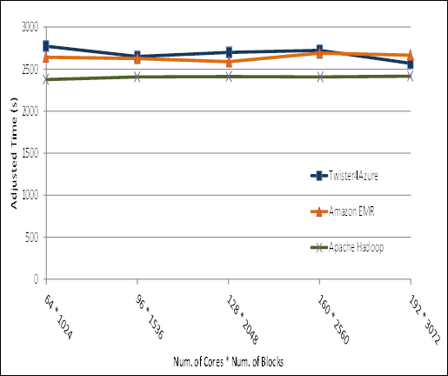
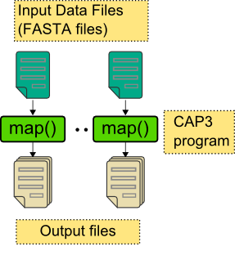
Pleasingly Parallel
Performance Comparisons
Smith Waterman
Sequence Alignment
BLAST Sequence Search
Cap3 Sequence Assembly

Slide 17
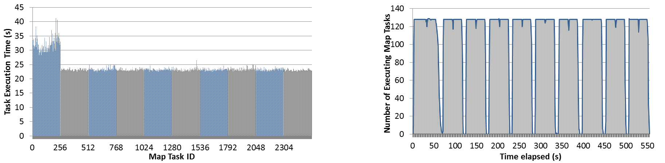
Performance – Kmeans Clustering
Overhead between iterations
First iteration performs the initial data fetch
Twister4Azure
Task Execution Time Histogram
Number of Executing Map Task Histogram
Hadoop
Twister
Hadoop on bare metal scales worst
Twister4Azure(adjusted for C#/Java)
Strong Scaling with 128M Data Points
Weak Scaling
Qiu, Gunarathne

Slide 18
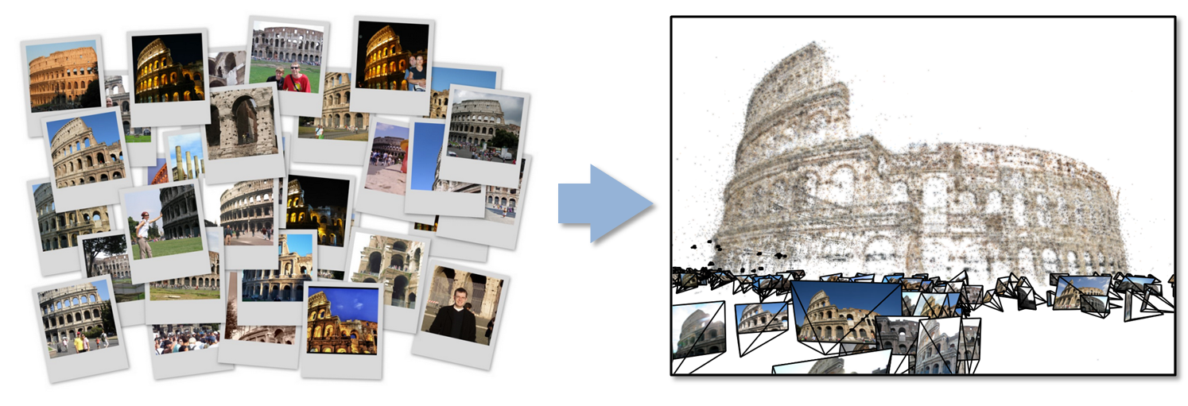
Data Intensive Kmeans Clustering
  ─ Image Classification: 1.5 TB; 500 features per image;10k clusters
  1000 Map tasks; 1GB data transfer per Map task
Work of Qiu and Zhang

Slide 19
Twister Communication Steps
Broadcast
Broadcasting
  Data could be large
  Chain & MST
Map Collectives
  Local merge
Reduce Collectives
  Collect but no merge
Combine
  Direct download or Gather
Map Tasks
Map Tasks
Map Tasks
Map Collective
Map Collective
Map Collective
Reduce Tasks
Reduce Tasks
Reduce Tasks
Reduce Collective
Reduce Collective
Reduce Collective
Work of Qiu and Zhang
Gather

Slide 20
Polymorphic Scatter-Allgather in Twister i.e. have collective primitives and find optimal implementation on each system
Work of Qiu and Zhang

Slide 21
Twister Performance on Kmeans Clustering
Work of Qiu and Zhang

Slide 22
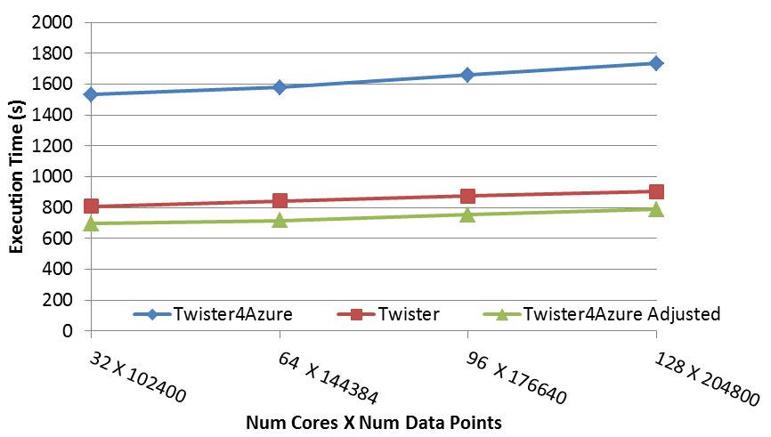
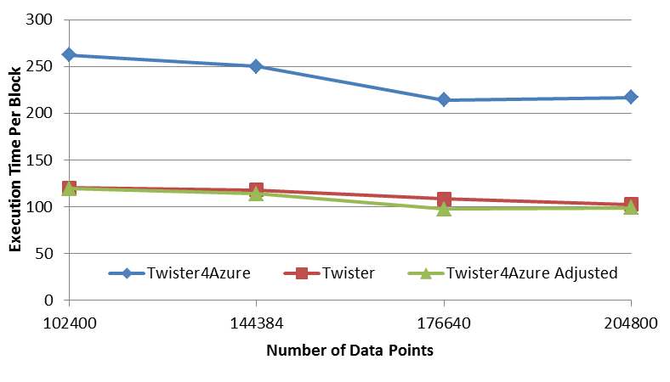
Multi Dimensional Scaling
BC: Calculate BX
X: Calculate invV (BX)
Calculate Stress
Map
Reduce
Merge
Map
Reduce
Merge
Map
Reduce
Merge
New Iteration
Performance adjusted for sequential performance difference
Weak Scaling
Data Size Scaling
Scalable Parallel Scientific Computing Using Twister4Azure. Thilina Gunarathne, BingJing Zang, Tak-Lon Wu and Judy Qiu. Submitted to Journal of Future Generation Computer Systems. (Invited as one of the best 6 papers of UCC 2011)
Notes:
The Java HPC Twister experiment was performed in a dedicated large-memory cluster of Intel(R) Xeon(R) CPU E5620 (2.4GHz) x 8 cores with 192GB memory per compute node and with Gigabit Ethernet on Linux. Java HPC Twister results do not include the initial data distribution time.
Azure large instances with 4 workers per instances is used. Memory mapped based caching and AllGather primitive are used.
Left: Weak scaling where workload per core is ~constant. Ideal is a straight horizontal line. X axis is
Right: Data size scaling with 128 Azure small instances/cores, 20 iterations.
The Twister4Azure adjusted (t_{a}) depicts the performance of Twister4Azure normalized according to the sequential MDS BC calculation and Stress calculation performance ratio between the Azure(t_{sa}) and Cluster(t_{sc}) environments used for Java HPC Twister. It is calculated using t_{a} x (t_{sc}/t_{sa}). This estimation however does not account for the overheads that remain constant irrespective of the computation time. Hence Twister4Azure seems to perform better, but in reality when the task execution times become smaller, twister4Azure overheads will become relatively larger and the performance would not be as good as shown in the adjusted curve.

Slide 23
Multi Dimensional Scaling on Azure
Qiu, Gunarathne

Slide 24
Data Analytics

Slide 25
Data Intensive Futures?
PETSc and ScaLAPACK and similar libraries very important in supporting parallel simulations
Need equivalent Data Analytics libraries
Include datamining (Clustering, SVM, HMM, Bayesian Nets …), image processing, information retrieval including hidden factor analysis (LDA), global inference, dimension reduction
  Many libraries/toolkits (R, Matlab) and web sites (BLAST) but typically not aimed at scalable high performance algorithms
Should support clouds and HPC; MPI and MapReduce
  Iterative MapReduce an interesting runtime; Hadoop has many limitations
Need a coordinated Academic Business Government Collaboration to build robust algorithms that scale well
  Crosses Science, Business Network Science, Social Science
Propose to build community to define & implement
SPIDAL or Scalable Parallel Interoperable Data Analytics Library

Slide 26
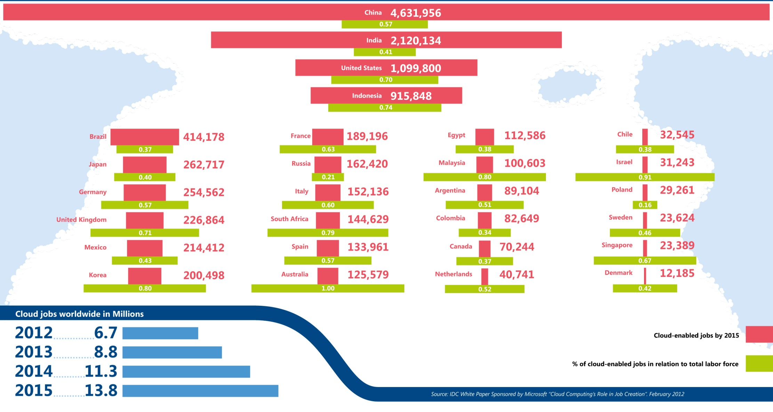
Jobs v. Countries

Slide 27
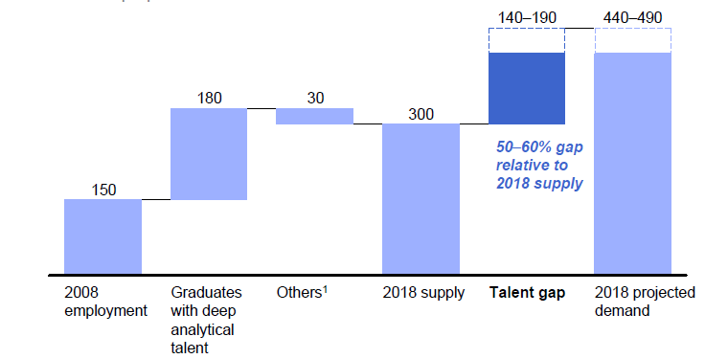
McKinsey Institute on Big Data Jobs
There will be a shortage of talent necessary for organizations to take advantage of big data. By 2018, the United States alone could face a shortage of 140,000 to 190,000 people with deep analytical skills as well as 1.5 million managers and analysts with the know-how to use the analysis of big data to make effective decisions.

Slide 28
Massive Open Online Courses (MOOC)
MOOC’s are very “hot” these days with Udacity and Coursera as start-ups
Over 100,000 participants but concept valid at smaller sizes
Relevant to Data Science as this is a new field with few courses at most universities
Technology to make MOOC’s
  Drupal mooc (unclear it’s real)
  Google Open Source Course Builder is lightweight LMS (learning management system) released September 12 rescuing us from Sakai
At least one MOOC model is collection of short prerecorded segments (talking head over PowerPoint)

Slide 29
MOOC’s on a) Cloud b) X-Informatics
Cloud MOOC based on one week Summer School on “Clouds for Science” held on FutureGrid end of July 2012
X-Informatics class next semester is general overview of “use of IT” (data analysis) in “all fields” starting with data deluge and pipeline
Observation→Data→Information→Knowledge→Wisdom
Go through many applications from life/medical science to “finding Higgs” and business informatics
Describe cyberinfrastructure needed with visualization, security, provenance, portals, services and workflow
Lab sessions built on virtualized infrastructure (appliances)
Describe and illustrate key algorithms histograms, clustering, Support Vector Machines, Dimension Reduction, Hidden Markov Models and Image processing

Slide 30
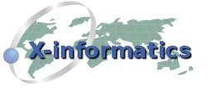





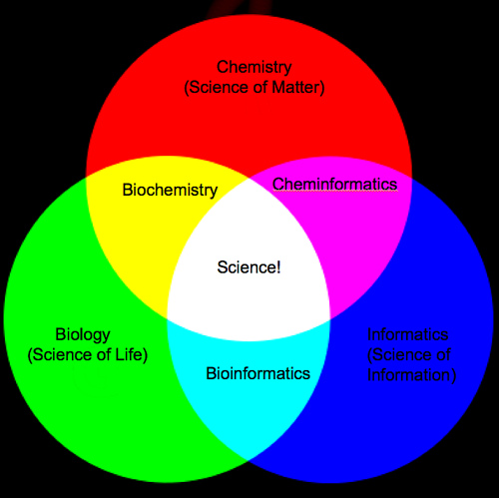

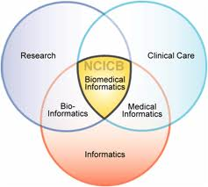
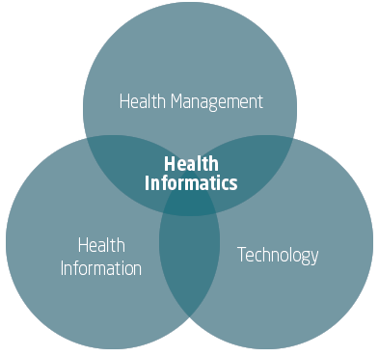
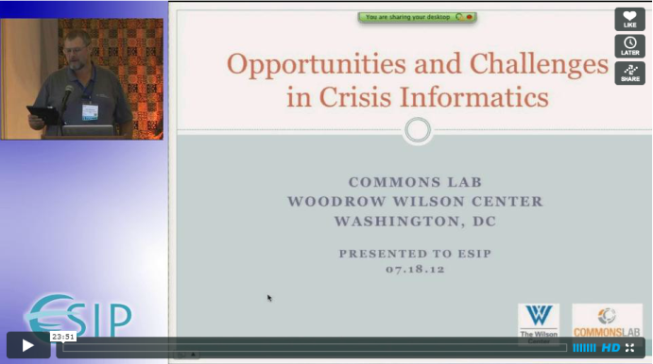
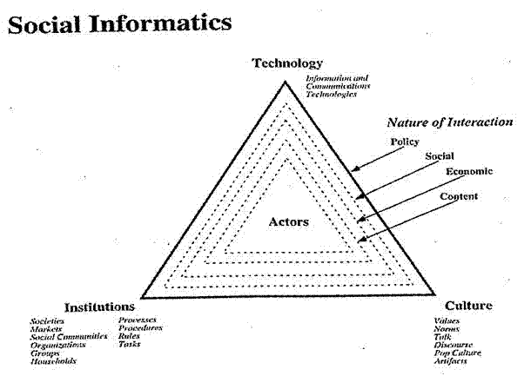
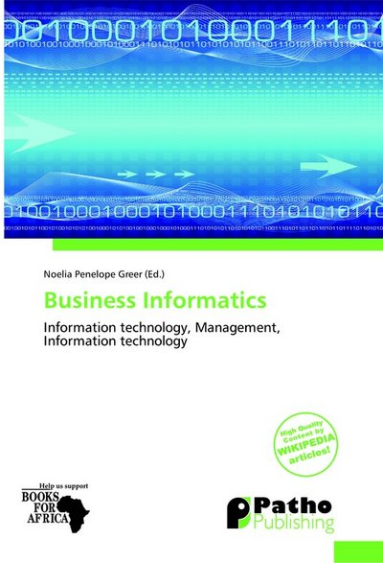
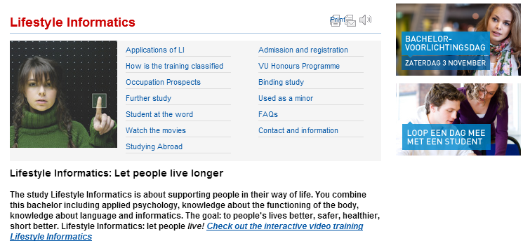

Slide 31
FutureGrid

Slide 32
FutureGrid key Concepts I
FutureGrid is an international testbed modeled on Grid5000
  October 22 2012: 270 Projects, >1350 users
Supporting international Computer Science and Computational Science research in cloud, grid and parallel computing (HPC)
The FutureGrid testbed provides to its users:
  A flexible development and testing platform for middleware and application users looking at interoperability, functionality, performance or evaluation
  FutureGrid is user-customizable, accessed interactively and supports Grid, Cloud and HPC software with and without VM’s
  A rich education and teaching platform for classes
See G. Fox, G. von Laszewski, J. Diaz, K. Keahey, J. Fortes, R. Figueiredo, S. Smallen, W. Smith, A. Grimshaw, FutureGrid - a reconfigurable testbed for Cloud, HPC and Grid Computing, Bookchapter – draft

Slide 33
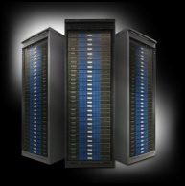
FutureGrid key Concepts II
Rather than loading images onto VM’s, FutureGrid supports Cloud, Grid and Parallel computing environments by provisioning software as needed i.e. provides “Software Defined Computing Environment”
  Image library for MPI, OpenMP, MapReduce (Hadoop, (Dryad), Twister), gLite, Unicore, Globus, Xen, ScaleMP (distributed Shared Memory),
  Templated so can use on multiple environments from OpenStack to Eucalyptus to bare-metal to Amazon
Aims at reproducible experiments
FutureGrid has ~4400 distributed cores with a dedicated network and a Spirent XGEM network fault and delay generator
Image1
Image2
…
ImageN
Choose
Load
Run

Slide 34
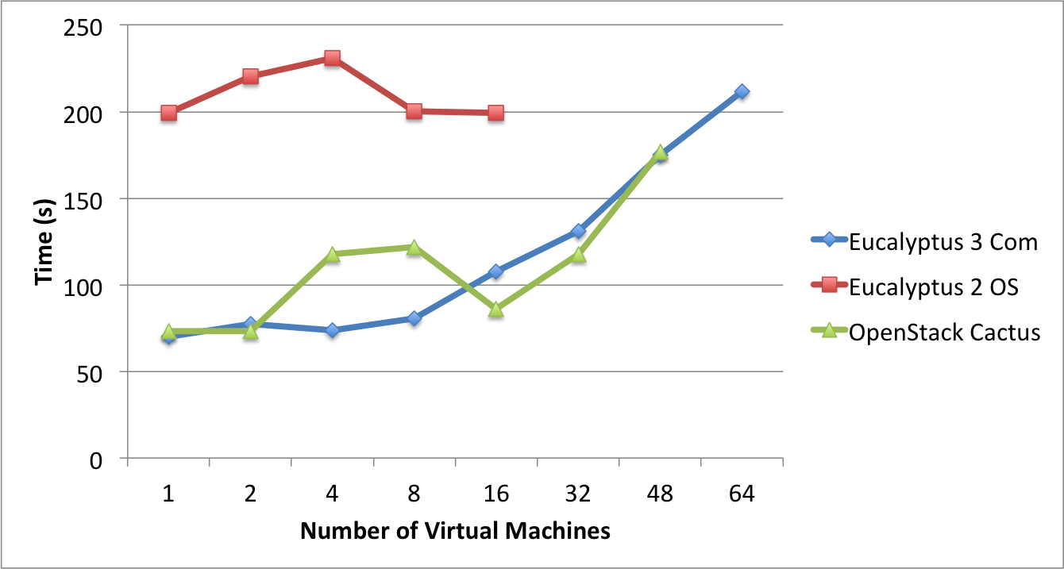
Results Eucalyptus 3, Eucalyptus 2 and OpenStack Cactus

Slide 35
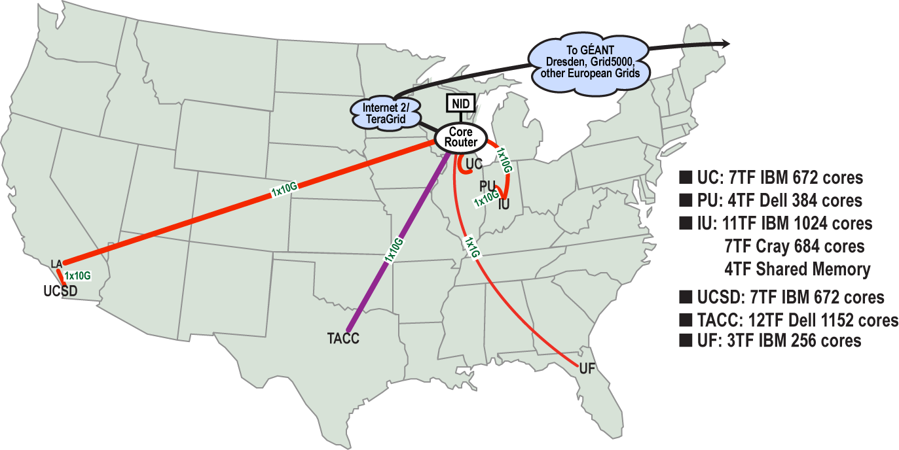
FutureGrid Grid supports Cloud Grid HPC Computing Testbed as a Service (aaS)
12TF Disk rich + GPU 512 cores
NID: Network Impairment Device
Private
Public
FG Network
35

Slide 36
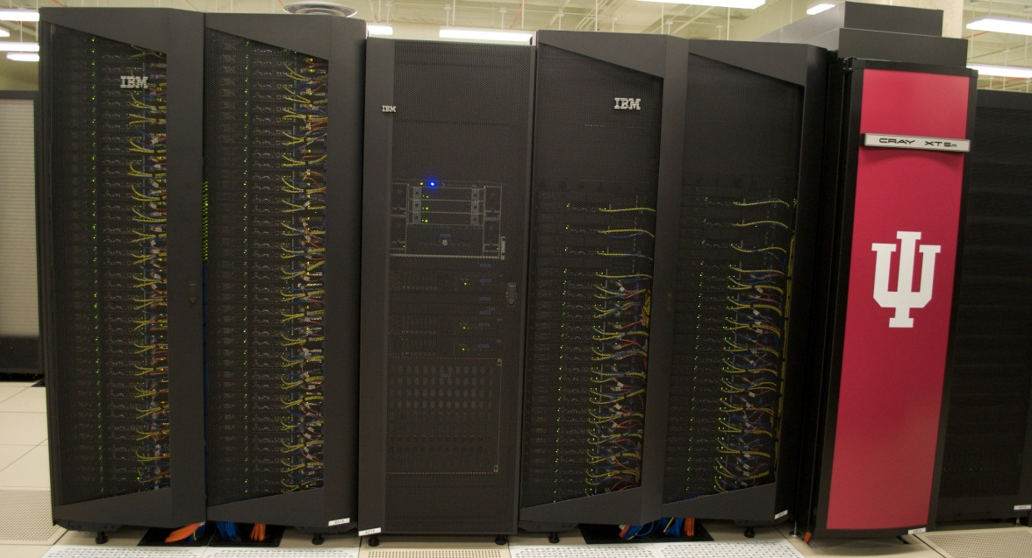
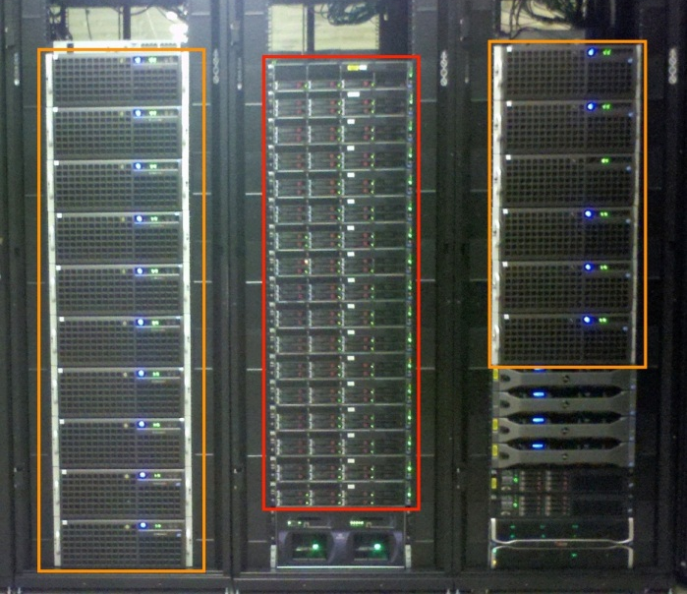
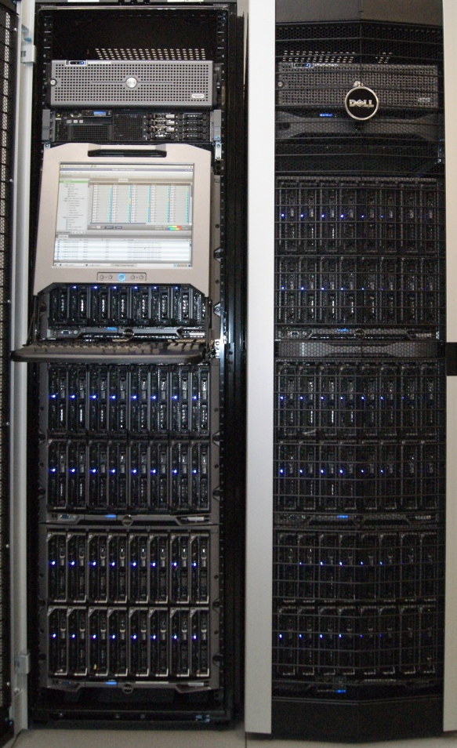
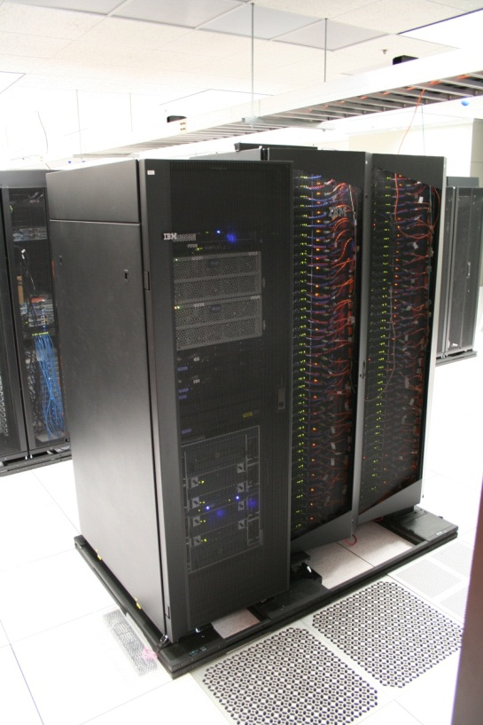
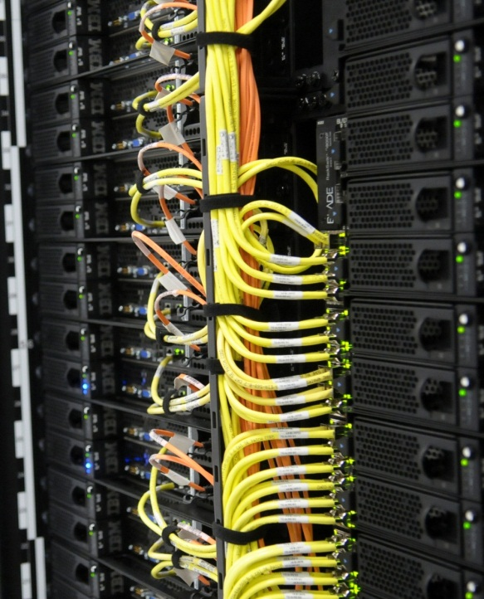
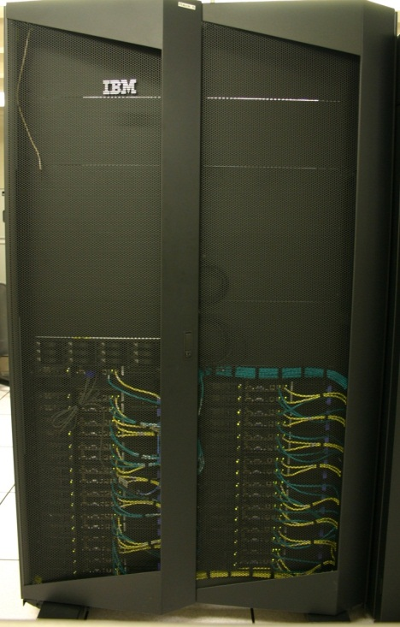
FutureGrid Distributed Testbed-aaS
Bravo Delta (IU)
India (IBM) and Xray (Cray) (IU)
Hotel (Chicago)
Foxtrot (UF)
Sierra (SDSC)
Alamo (TACC)

Slide 37
Compute Hardware
Name | System type | # CPUs | # Cores | TFLOPS | Total RAM (GB) | Secondary Storage (TB) | Site | Status
india | IBM iDataPlex | 256 | 1024 | 11 | 3072 | 180 | IU | Operational
alamo | Dell PowerEdge | 192 | 768 | 8 | 1152 | 30 | TACC | Operational
hotel | IBM iDataPlex | 168 | 672 | 7 | 2016 | 120 | UC | Operational
sierra | IBM iDataPlex | 168 | 672 | 7 | 2688 | 96 | SDSC | Operational
xray | Cray XT5m | 168 | 672 | 6 | 1344 | 180 | IU | Operational
foxtrot | IBM iDataPlex | 64 | 256 | 2 | 768 | 24 | UF | Operational
Bravo | Large Disk & memory | 32 | 128 | 1.5 | 3072 (192GB per node) | 192 (12 TB per Server) | IU | Operational
Delta | Large Disk & memory With Tesla GPU’s | 32 CPU 32 GPU’s | 192+ 14336 GPU | ? 9 | 1536 (192GB per node) | 192 (12 TB per Server) | IU | Operational
Echo (ScaleMP) | Large Disk & Memory | 32 CPU | 192 | 2 | 6144 | 192 | IU | On Order
Lima | SSD | 16 | 128 | 1.3 | 512 | 3.8 (SSD) 8 (disk) | SDSC | On Order

Slide 38
FutureGrid Partners
Indiana University (Architecture, core software, Support)
San Diego Supercomputer Center at University of California San Diego (INCA, Monitoring)
University of Chicago/Argonne National Labs (Nimbus)
University of Florida (ViNE, Education and Outreach)
University of Southern California Information Sciences (Pegasus to manage experiments)
University of Tennessee Knoxville (Benchmarking)
University of Texas at Austin/Texas Advanced Computing Center (Portal)
University of Virginia (OGF, XSEDE Software stack)
Center for Information Services and GWT-TUD from Technische Universtität Dresden. (VAMPIR)
Red institutions have FutureGrid hardware

Slide 39
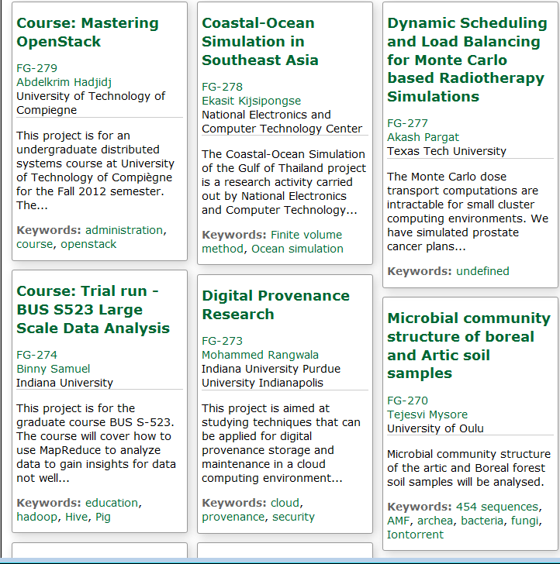
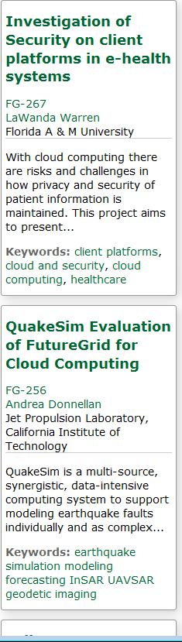
Recent Projects

Slide 40
4 Use Types for FutureGrid TestbedaaS
270 approved projects (>1350 users) October 22 2012
  USA, China, India, Pakistan, lots of European countries
  Industry, Government, Academia
Training Education and Outreach (10%)
  Semester and short events; interesting outreach to HBCU
Computer science and Middleware (59%)
  Core CS and Cyberinfrastructure; Interoperability (2%) for Grids and Clouds; Open Grid Forum OGF Standards
Computer Systems Evaluation (29%)
  XSEDE (TIS, TAS), OSG, EGI; Campuses
New Domain Science applications (26%)
  Life science highlighted (14%), Non Life Science (12%)
  Generalize to building Research Computing-aaS
Fractions are as of July 15 2012 add to > 100%

Slide 41
Computing
Testbed as a Service

Slide 42
FutureGrid Computing Testbed as a Service
“Software Defined Computing Systems”
FutureGrid Uses
Testbed-aaS Tools
Provisioning
Image Management
IaaS Interoperability
NaaS, IaaS tools
Expt management
Dynamic Network
Devops
System e.g. SQL
Class Usages e.g. run GPU & multicore
Research Use e.g. test new compiler or storage model
Software
(Application
Or Usage) SaaS
Cloud e.g. MapReduce
HPC e.g. PETSc, SAGA
Computer Science e.g. Compiler tools, Sensor nets, Monitors
FutureGrid Usages
Computer Science
Applications and understanding Science Clouds
Technology Evaluation including XSEDE testing
Education and Training
Platform
PaaS
Infra
structure
IaaS
Software Defined Computing (virtual Clusters)
Hypervisor, Bare Metal
Operating System
Network
NaaS
Software Defined Networks
OpenFlow GENI

Slide 43
Expanding Resources in FutureGrid
We have a core set of resources but need to keep up to date and expand in size
Natural is to build large systems and support large experiments by federating hardware from several sources
  Requirement is that partners in federation agree on and develop together TestbedaaS
Infrastructure includes networks, devices, edge (client) equipment

Slide 44
Conclusions

Slide 45
Conclusions
Clouds and HPC are here to stay and one should plan on using both
Data Intensive programs are not like simulations as they have large “reductions” (“collectives”) and do not have many small messages
Iterative MapReduce an interesting approach; need to optimize collectives for new applications (Data analytics) and resources (clouds, GPU’s …)
Need an initiative to build scalable high performance data analytics library on top of interoperable cloud-HPC platform
  Consortium from Physical/Biological/Social/Network Science, Image Processing, Business
Many promising algorithms such as deterministic annealing not used as implementations not available in R/Matlab etc.
  More software and runs longer but can be efficiently parallelized so runtime not a big issue

