Slide 1
Status of Clouds and their applications
Ball Aerospace
Dayton
July 26 2011
Geoffrey Fox
gcf@indiana.edu
http://www.infomall.org http://www.futuregrid.org
Director, Digital Science Center, Pervasive Technology Institute
Associate Dean for Research and Graduate Studies, School of Informatics and Computing
Indiana University Bloomington

Slide 2
Important Trends
Data Deluge in all fields of science
Multicore implies parallel computing important again
  Performance from extra cores – not extra clock speed
  GPU enhanced systems can give big power boost
Clouds – new commercially supported data center model replacing compute grids (and your general purpose computer center)
Light weight clients: Sensors, Smartphones and tablets accessing and supported by backend services in cloud
Commercial efforts moving much faster than academia in both innovation and deployment

Slide 3



Data Centers Clouds &
Economies of Scale I
Range in size from “edge” facilities to megascale.
Economies of scale
  Approximate costs for a small size center (1K servers) and a larger, 50K server center.
2 Google warehouses of computers on the banks of the Columbia River, in The Dalles, Oregon
Such centers use 20MW-200MW
(Future) each with 150 watts per CPU
Save money from large size, positioning with cheap power and access with Internet
Technology | Cost in small-sized Data Center | Cost in Large Data Center | Ratio
Network | $95 per Mbps/ month | $13 per Mbps/ month | 7.1
Storage | $2.20 per GB/ month | $0.40 per GB/ month | 5.7
Administration | ~140 servers/ Administrator | >1000 Servers/ Administrator | 7.1
Each data center is
11.5 times
the size of a football field

Slide 4


Data Centers, Clouds
& Economies of Scale II
Builds giant data centers with 100,000’s of computers;
~ 200-1000 to a shipping container with Internet access
“Microsoft will cram between 150 and 220 shipping containers filled with data center gear into a new 500,000 square foot Chicago facility. This move marks the most significant, public use of the shipping container systems popularized by the likes of Sun Microsystems and Rackable Systems to date.”

Slide 5
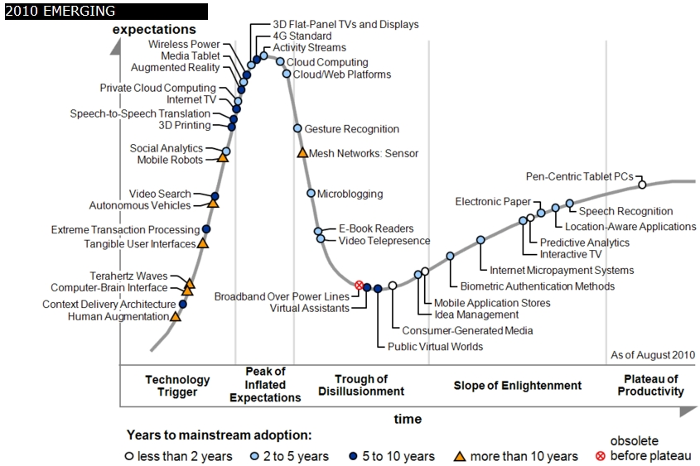
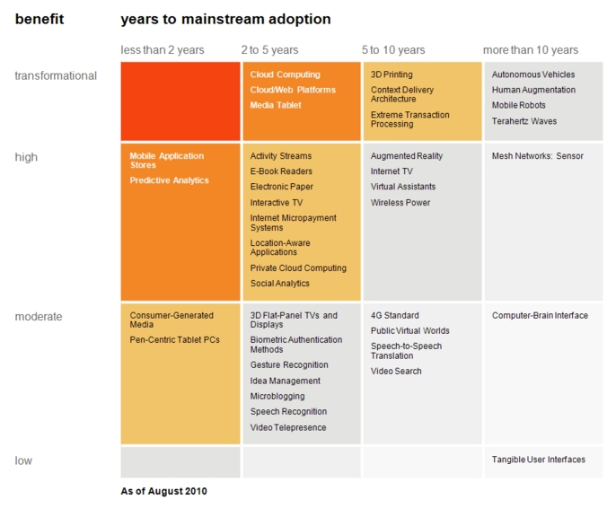

Transformational
High
Moderate
Low
Gartner 2009 Hype Curve
Clouds, Web2.0
Service Oriented Architectures
Cloud Computing
Cloud Web Platforms
Media Tablet

Slide 6
Clouds and Jobs
Clouds are a major industry thrust with a growing fraction of IT expenditure that IDC estimates will grow to $44.2 billion direct investment in 2013 while 15% of IT investment in 2011 will be related to cloud systems with a 30% growth in public sector.
Gartner also rates cloud computing high on list of critical emerging technologies with for example “Cloud Computing” and “Cloud Web Platforms” rated as transformational (their highest rating for impact) in the next 2-5 years.
Correspondingly there is and will continue to be major opportunities for new jobs in cloud computing with a recent European study estimating there will be 2.4 million new cloud computing jobs in Europe alone by 2015.
Cloud computing is an attractive for projects focusing on workforce development. Note that the recently signed “America Competes Act” calls out the importance of economic development in broader impact of NSF projects

Slide 7








Sensors as a Service
Cell phones are important sensor
Sensors as a Service
Sensor Processing as a Service (MapReduce)

Slide 8
Grids MPI and Clouds
Grids are useful for managing distributed systems
  Pioneered service model for Science
  Developed importance of Workflow
  Performance issues – communication latency – intrinsic to distributed systems
  Can never run large differential equation based simulations or datamining
Clouds can execute any job class that was good for Grids plus
  More attractive due to platform plus elastic on-demand model
  MapReduce easier to use than MPI for appropriate parallel jobs
  Currently have performance limitations due to poor affinity (locality) for compute-compute (MPI) and Compute-data
  These limitations are not “inevitable” and should gradually improve as in July 13 2010 Amazon Cluster announcement
  Will probably never be best for most sophisticated parallel differential equation based simulations
Classic Supercomputers (MPI Engines) run communication demanding differential equation based simulations
  MapReduce and Clouds replaces MPI for other problems
  Much more data processed today by MapReduce than MPI (Industry Informational Retrieval ~50 Petabytes per day)

Slide 9
Important Platform Capability
MapReduce
Data Partitions
Map(Key, Value)
A hash function maps the results of the map tasks to reduce tasks
Reduce(Key, List<Value>)
Reduce Outputs
Implementations (Hadoop – Java; Dryad – Windows) support:
  Splitting of data
  Passing the output of map functions to reduce functions
  Sorting the inputs to the reduce function based on the intermediate keys
  Quality of service

Slide 10
Why MapReduce?
Largest (in data processed) parallel computing platform today as runs information retrieval engines at Google, Yahoo and Bing.
Portable to Clouds and HPC systems
Has been shown to support much data analysis
It is “disk” (basic MapReduce) or “database” (DrayadLINQ) NOT “memory” oriented like MPI; supports “Data-enabled Science”
Fault Tolerant and Flexible
Interesting extensions like Pregel and Twister (Iterative MapReduce)
Spans Pleasingly Parallel, Simple Analysis (make histograms) to main stream parallel data analysis as in parallel linear algebra
  Not so good at solving PDE’s

Slide 11

Typical FutureGrid Performance Study
Linux, Linux on VM, Windows, Azure, Amazon Bioinformatics

Slide 12
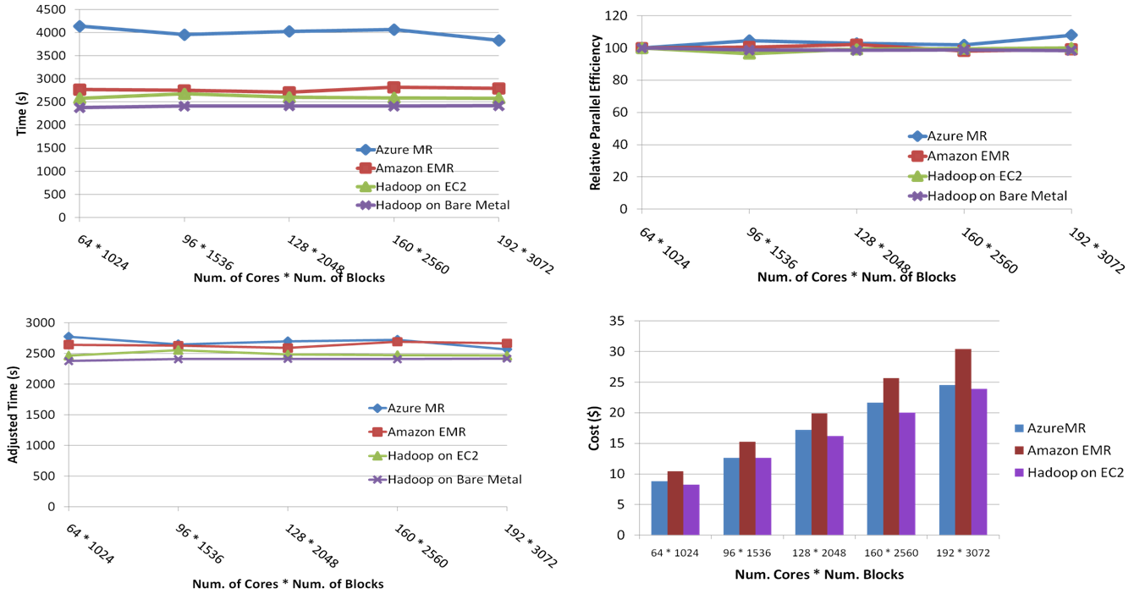
SWG Sequence Alignment Performance
Smith-Waterman-GOTOH to calculate all-pairs dissimilarity
Notes:
~123 million sequence alignments, for under 30$ with zero up front hardware cost,

Slide 13
Application Classification:
MapReduce and MPI
(a) Map Only
(b) Classic MapReduce
(c) Iterative MapReduce
(d) Loosely Synchronous
Input
Input
Iterations
Input
map
map
map
P_{ij}
reduce
reduce
Output
BLAST Analysis
Smith-Waterman Distances
Parametric sweeps
PolarGrid Matlab data analysis
High Energy Physics (HEP) Histograms
Distributed search
Distributed sorting
Information retrieval
Expectation maximization clustering e.g. Kmeans
Linear Algebra
Multimensional Scaling
Page Rank
Many MPI scientific applications such as solving differential equations and particle dynamics
Domain of MapReduce and Iterative Extensions
MPI

Slide 14
Fault Tolerance and MapReduce
MPI does “maps” followed by “communication” including “reduce” but does this iteratively
There must (for most communication patterns of interest) be a strict synchronization at end of each communication phase
  Thus if a process fails then everything grinds to a halt
In MapReduce, all Map processes and all reduce processes are independent and stateless and read and write to disks
  As 1 or 2 (reduce+map) iterations, no difficult synchronization issues
Thus failures can easily be recovered by rerunning process without other jobs hanging around waiting
Re-examine MPI fault tolerance in light of MapReduce
  Twister will interpolate between MPI and MapReduce

Slide 15






MapReduce “File/Data Repository” Parallelism
Map = (data parallel) computation reading and writing data
Reduce = Collective/Consolidation phase e.g. forming multiple global sums as in histogram
Instruments
Iterative MapReduce
Map Map Map Map
Reduce Reduce Reduce
Communication
Reduce
Portals
/Users
Disks
Map₁
Map₂
Map₃

Slide 16

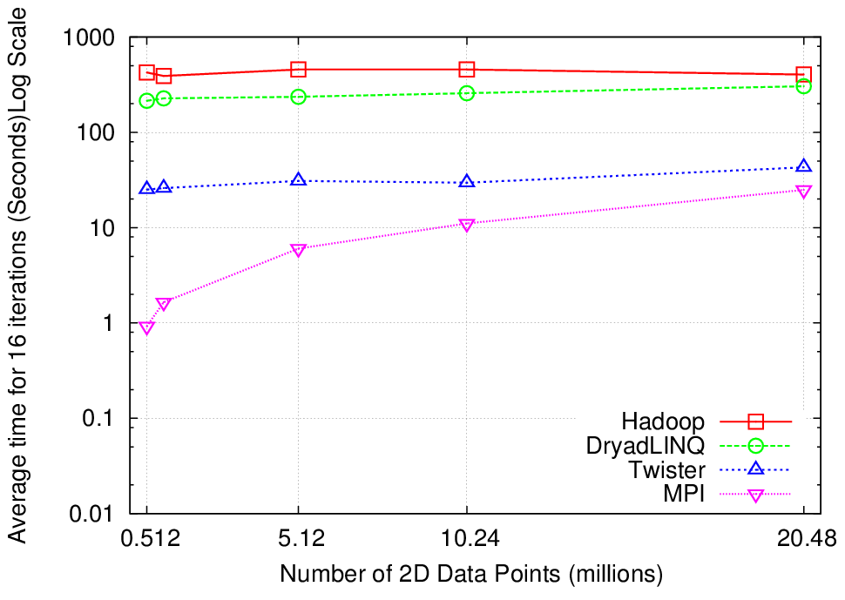
Why Iterative MapReduce? K-means
http://www.iterativemapreduce.org/
Compute the distance to each data point from each cluster center and assign points to cluster centers
map
map
Time for 20 iterations
reduce
Compute new cluster
centers
User program
Compute new cluster centers
Typical iterative data analysis
Typical MapReduce runtimes incur extremely high overheads
  New maps/reducers/vertices in every iteration
  File system based communication
Long running tasks and faster communication in Twister (Iterative MapReduce) enables it to perform close to MPI

Slide 17




Twister4Azure Performance
Kmeans Clustering
Performance with/without
data caching
Speedup gained using data cache
Scaling speedup
Increasing number of iterations
Notes:
KMeans iterative MapReduce performance. 16 Azure Small instances, 6 iterations, 8 to 48 million 20-D data points.
Left: Performance with and without data caching.
Right: Speedup obtained from using the data cache
Left: Scaling speedup with increasing number of instances (Azure Small) & data for 10 iterations.
Right: Increasing number of iterations using 16 million data points with caching using 16 Azure Small instances.

Slide 18
Simple Concusions
Clouds may not be suitable for everything but they are suitable for majority of data intensive applications
  Solving partial differential equations on 100,000 cores probably needs classic MPI engines
Cost effectiveness, elasticity and quality programming model will drive use of clouds in many areas
Need to solve issues of
  Security-privacy-trust for sensitive data
  How to store data – “data parallel file systems” (HDFS) or classic HPC approach with shared file systems with Lustre etc.
Iterative MapReduce natural Cluster – HPC – Cloud cross-platform programming model
Sensors well suited to clouds in basic management and parallel processing

Slide 19
FutureGrid key Concepts I
FutureGrid supports Computer Science and Computational Science research in cloud, grid and parallel computing (HPC)
The FutureGrid testbed provides to its users:
  An interactive development and testing platform for middleware and application users looking at interoperability, functionality, performance or evaluation with or without virtualization
  A rich education and teaching platform for advanced cyberinfrastructure (computer science) classes
FutureGrid has a complementary focus to both the Open Science Grid and the other parts of XSEDE.
Note that significant current use in Education, Computer Science Systems and Biology/Bioinformatics

Slide 20

FutureGrid key Concepts II
Rather than loading images onto VM’s, FutureGrid supports Cloud, Grid and Parallel computing environments by dynamically provisioning software as needed onto “bare-metal” using Moab/xCAT
  Image library for MPI, OpenMP, MapReduce (Hadoop, Dryad, Twister), gLite, Unicore, Xen, Genesis II, ScaleMP (distributed Shared Memory), Nimbus, Eucalyptus, OpenNebula, OpenStack, KVM, Windows …..
Growth comes from users depositing novel images in library
FutureGrid has ~4300 (will grow to ~5000) distributed cores with a dedicated network and a Spirent XGEM network fault and delay generator
Image1
Image2
…
ImageN
Choose
Load
Run

Slide 21

FutureGrid: a Grid/Cloud/HPC Testbed
NID: Network Impairment Device
Private
Public
FG Network

Slide 22
Compute Hardware
Name | System type | # CPUs | # Cores | TFLOPS | Total RAM (GB) | Secondary Storage (TB) | Site | Status
india | IBM iDataPlex | 256 | 1024 | 11 | 3072 | 339 + 16 | IU | Operational
alamo | Dell PowerEdge | 192 | 768 | 8 | 1152 | 30 | TACC | Operational
hotel | IBM iDataPlex | 168 | 672 | 7 | 2016 | 120 | UC | Operational
sierra | IBM iDataPlex | 168 | 672 | 7 | 2688 | 96 | SDSC | Operational
xray | Cray XT5m | 168 | 672 | 6 | 1344 | 339 | IU | Operational
foxtrot | IBM iDataPlex | 64 | 256 | 2 | 768 | 24 | UF | Operational
Bravo* | Large Disk & memory | 32 | 128 | 1.5 | 3072 (192GB per node) | 144 (12 TB per Server) | IU | Early user Aug. 1 general
Delta* | Large Disk & memory With Tesla GPU’s | 16 16 GPU’s | 96 | ? 3 | 1536 (192GB per node) | 96 (12 TB per Server) | IU | ~Sept 15
Total |  | 1064 | 4288 | 45 | 16TB
* Teasers for next machine

Slide 23
5 Use Types for FutureGrid
122 approved projects July 17 2011
  https://portal.futuregrid.org/projects
Training Education and Outreach (13)
  Semester and short events; promising for small universities
Interoperability test-beds (4)
  Grids and Clouds; Standards; from Open Grid Forum OGF
Domain Science applications (42)
  Life science highlighted (21)
Computer science (50)
  Largest current category
Computer Systems Evaluation (35)
  TeraGrid (TIS, TAS, XSEDE), OSG, EGI
Clouds are meant to need less support than other models; FutureGrid needs more user support …….

Slide 24
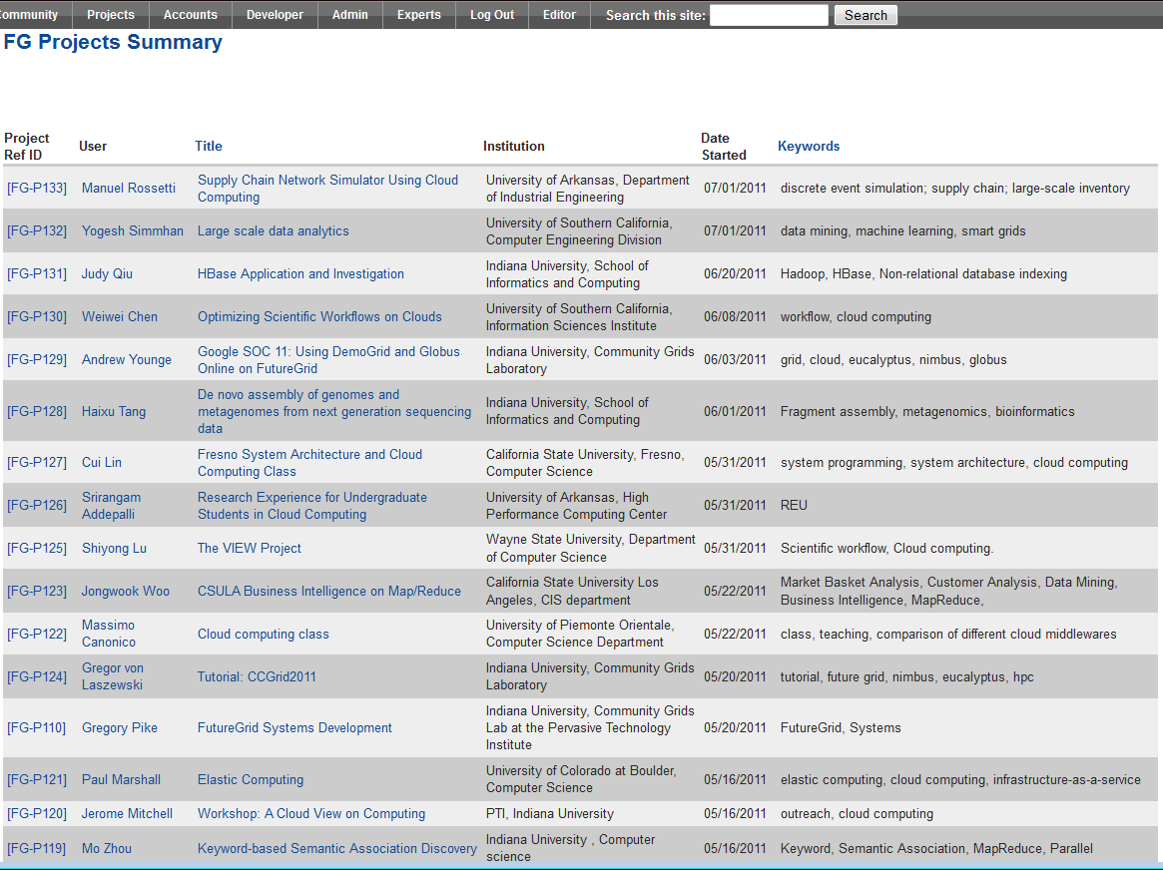
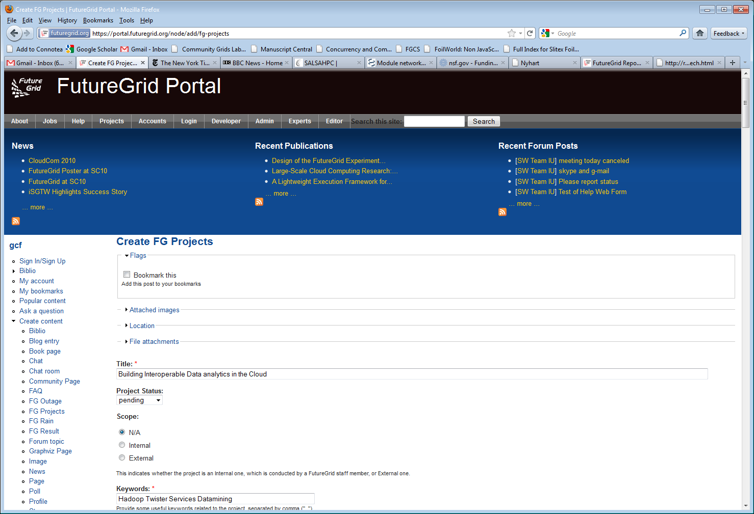
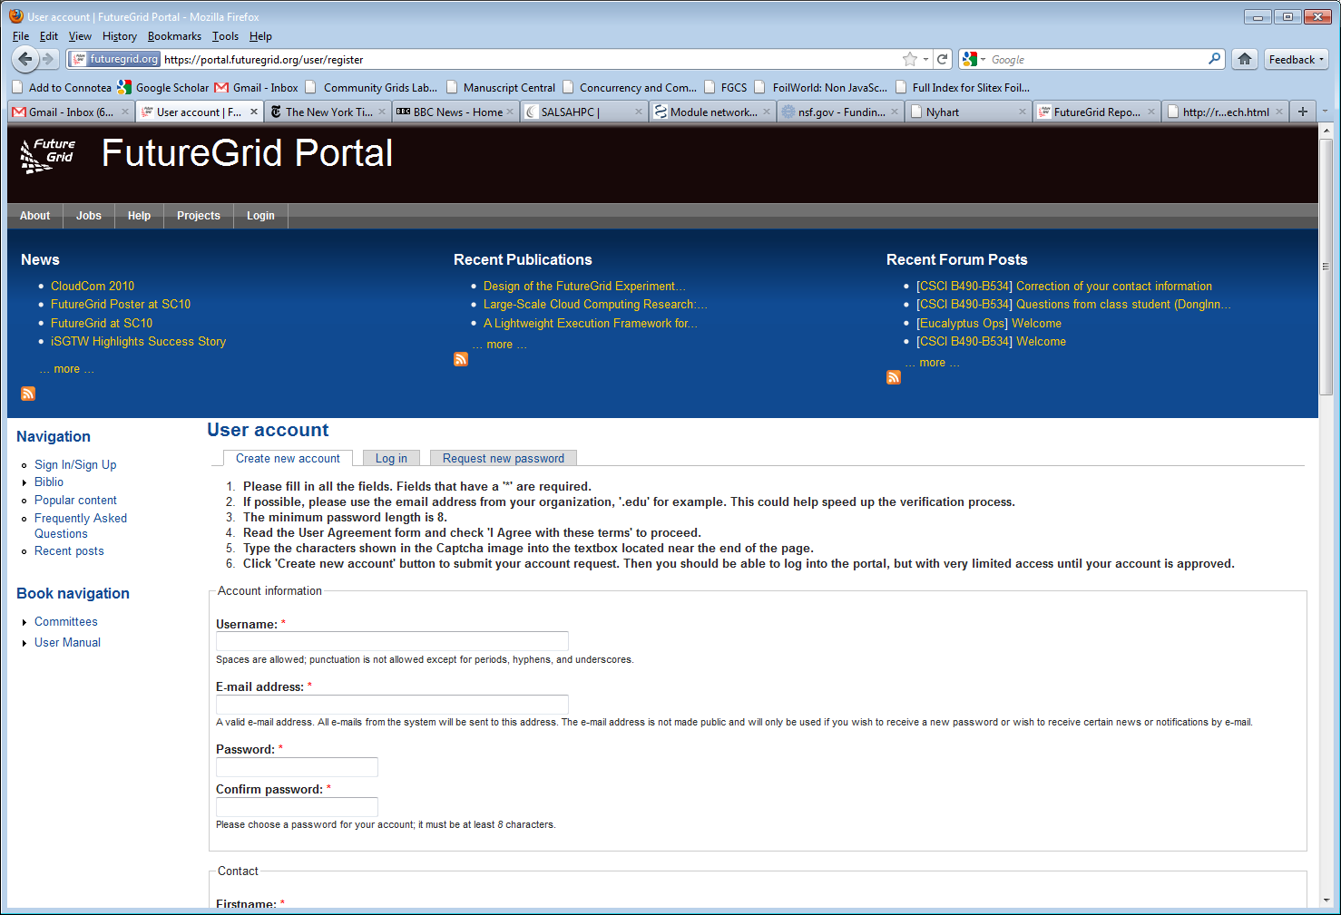
Create a Portal Account and apply for a Project

Slide 25
Selected Current Education projects
System Programming and Cloud Computing, Fresno State, Teaches system programming and cloud computing in different computing environments
REU: Cloud Computing, Arkansas, Offers hands-on experience with FutureGrid tools and technologies
Workshop: A Cloud View on Computing, Indiana School of Informatics and Computing (SOIC), Boot camp on MapReduce for faculty and graduate students from underserved ADMI institutions
Topics on Systems: Distributed Systems, Indiana SOIC, Covers core computer science distributed system curricula (for 60 students)

