Slide 1
Deterministic Annealing Dimension Reduction and Biology
Indiana University
Environmental Genomics
April 20 2012
Geoffrey Fox
gcf@indiana.edu
http://www.infomall.org http://www.futuregrid.org
Director, Digital Science Center, Pervasive Technology Institute
Associate Dean for Research and Graduate Studies, School of Informatics and Computing
Indiana University Bloomington

Slide 2
Some Motivation
Big Data requires high performance – achieve with parallel computing
Big Data requires robust algorithms as more opportunity to make mistakes
Deterministic annealing (DA) is one of better approaches to optimization
Tends to remove local optima
Addresses overfitting
Faster than simulated annealing
Return to my heritage (physics) with an approach I called Physical Computation (cf. also genetic algs) -- methods based on analogies to nature
Physics systems find true lowest energy state if you anneal i.e. you equilibrate at each temperature as you cool

Slide 3
Some Ideas
Deterministic annealing is better than many well-used optimization problems
Started as “Elastic Net” by Durbin for Travelling Salesman Problem TSP
Basic idea behind deterministic annealing is mean field approximation, which is also used in “Variational Bayes” and many “neural network approaches”
Markov chain Monte Carlo (MCMC) methods are roughly single temperature simulated annealing
Less sensitive to initial conditions
Avoid local optima
Not equivalent to trying random initial starts

Slide 4
Uses of Deterministic Annealing
Clustering
Vectors: Rose (Gurewitz and Fox)
Clusters with fixed sizes and no tails (Proteomics team at Broad)
No Vectors: Hofmann and Buhmann (Just use pairwise distances)
Dimension Reduction for visualization and analysis
Vectors: GTM
No vectors: MDS (Just use pairwise distances)
Can apply to general mixture models (but less study)
Gaussian Mixture Models
Probabilistic Latent Semantic Analysis with Deterministic Annealing DA-PLSA as alternative to Latent Dirichlet Allocation (typical informational retrieval/global inference topic model)

Slide 5
Deterministic Annealing
Gibbs Distribution at Temperature T P(χ) = exp( - H(χ)/T) / ∫ dχ exp( - H(χ)/T)
Or P(χ) = exp( - H(χ)/T + F/T )
Minimize Free Energy combining Objective Function and Entropy F = < H - T S(P) > = ∫ dχ {P(χ)H + T P(χ) lnP(χ)}
H is objective function to be minimized as a function of parameters χ
Simulated annealing corresponds to doing these integrals by Monte Carlo
Deterministic annealing corresponds to doing integrals analytically (by mean field approximation) and is much faster than Monte Carlo
In each case temperature is lowered slowly – say by a factor 0.95 to 0.99 at each iteration

Slide 6
Implementation of DA Central Clustering
Clustering variables are M_{i}(k) where this is probability point i belongs to cluster k and ∑_{k=1}^{K} M_{i}(k) = 1
In Central or PW Clustering, take H₀ = ∑_{i=1}^{N} ∑_{k=1}^{K} M_{i}(k) ε_{i}(k)
Linear form allows DA integrals to be done analytically
Central clustering has ε_{i}(k) = (X(i)- Y(k))² and M_{i}(k) determined by Expectation step
H_{Central} = ∑_{i=1}^{N} ∑_{k=1}^{K} M_{i}(k) (X(i)- Y(k))²
<M_{i}(k)> = exp( -ε_{i}(k)/T ) / ∑_{k=1}^{K} exp( -ε_{i}(k)/T )
Centers Y(k) are determined in M step of EM method

Slide 7
Deterministic Annealing
F({y}, T)
Solve Linear Equations for each temperature
Nonlinear effects mitigated by initializing with solution at previous higher temperature
Configuration {y}
Minimum evolving as temperature decreases
Movement at fixed temperature going to local minima if not initialized “correctly

Slide 8
Rose, K., Gurewitz, E., and Fox, G. C. ``Statistical mechanics and phase transitions in clustering,'' Physical Review Letters, 65(8):945-948, August 1990.
My #6 most cited article (415 cites including 8 in 2012)
System becomes unstable as Temperature lowered and there is a phase transition and one splits cluster into two and continues EM iteration
One can start with just one cluster

Slide 9
Some non-DA Ideas
Dimension reduction gives Low dimension mappings of data to both visualize and apply geometric hashing
No-vector (can’t define metric space) problems are O(N²)
Genes are no-vector unless multiply aligned
For no-vector case, one can develop O(N) or O(NlogN) methods as in “Fast Multipole and OctTree methods”
Map high dimensional data to 3D and use classic methods developed originally to speed up O(N²) 3D particle dynamics problems

Slide 10
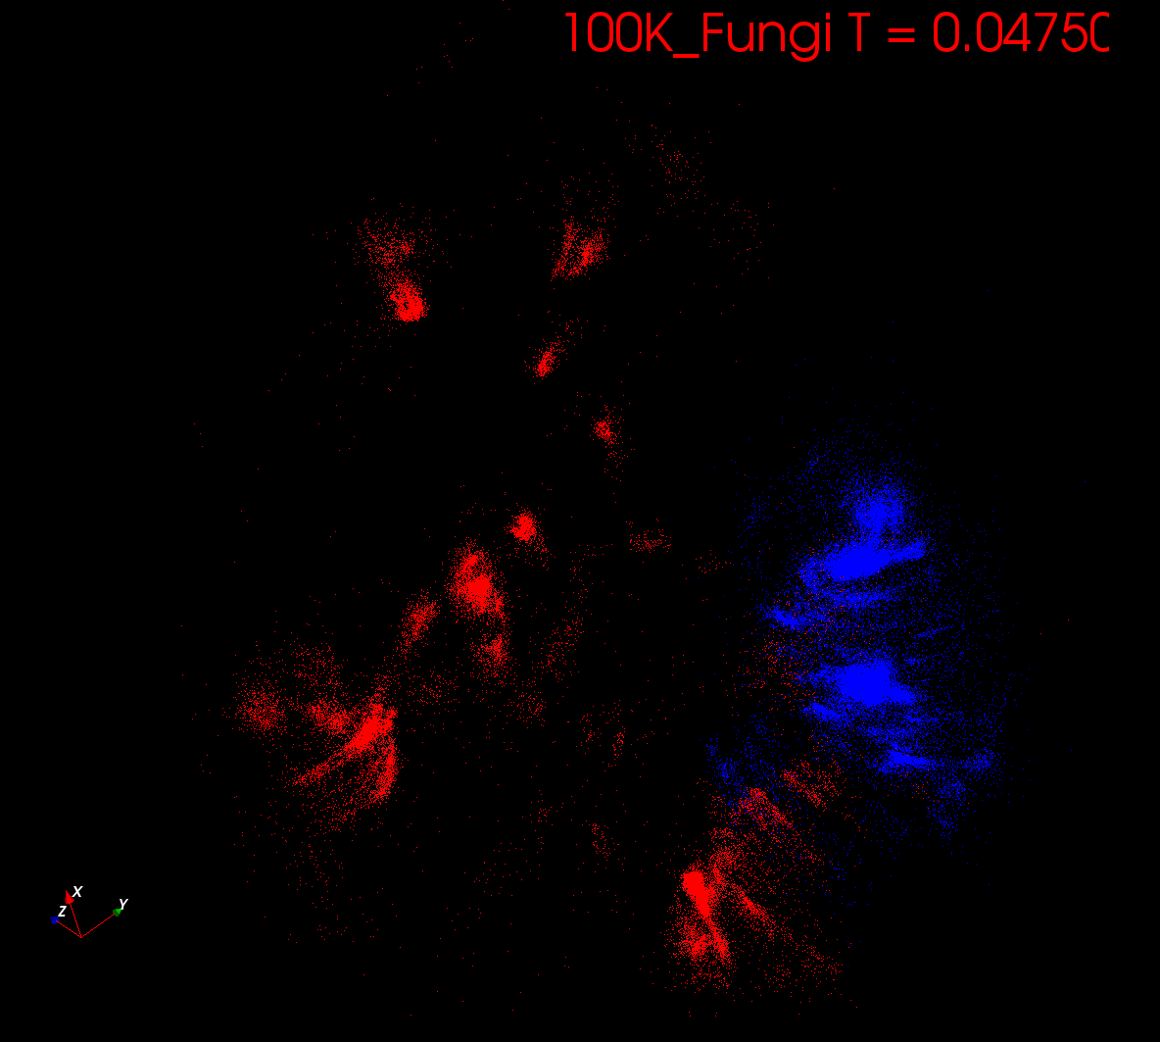
Start at T= “∞” with 1 Cluster
Decrease T, Clusters emerge at instabilities

Slide 11
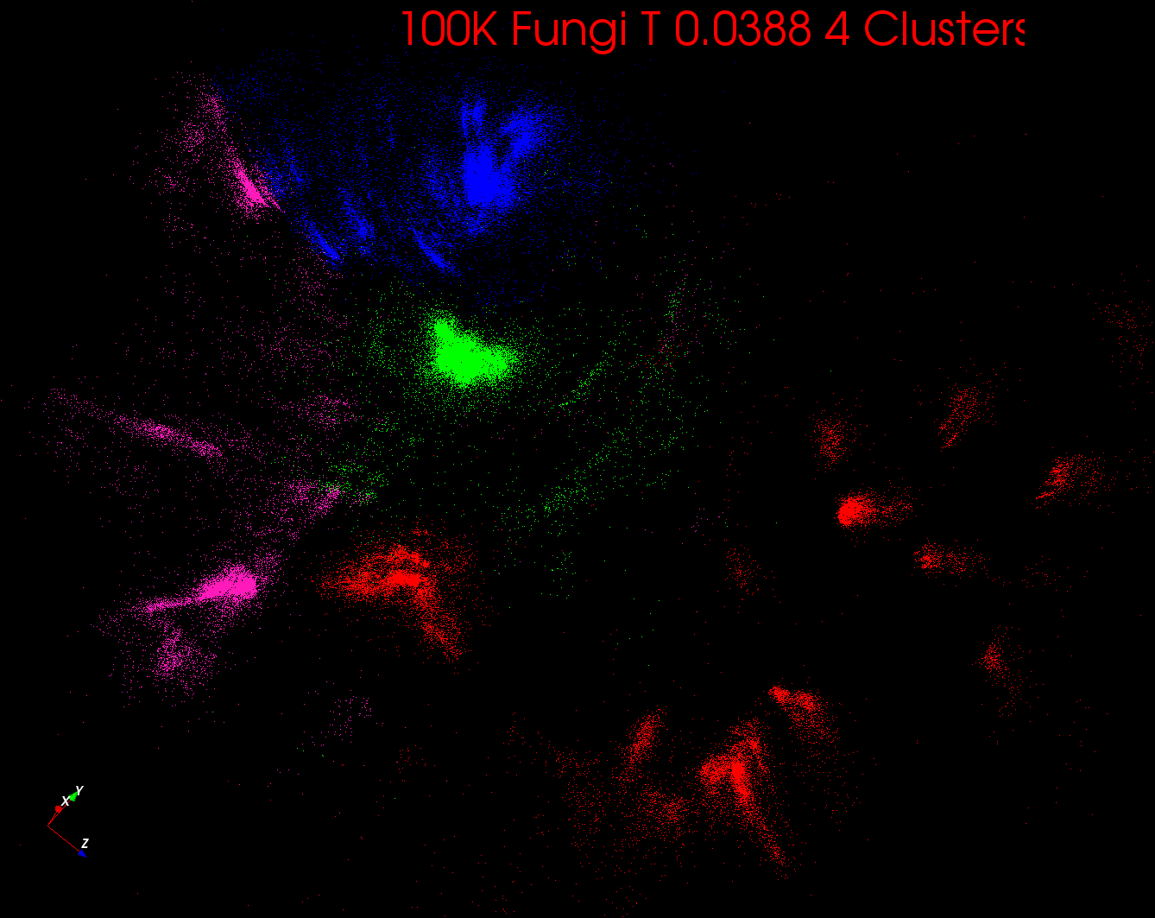

Slide 12
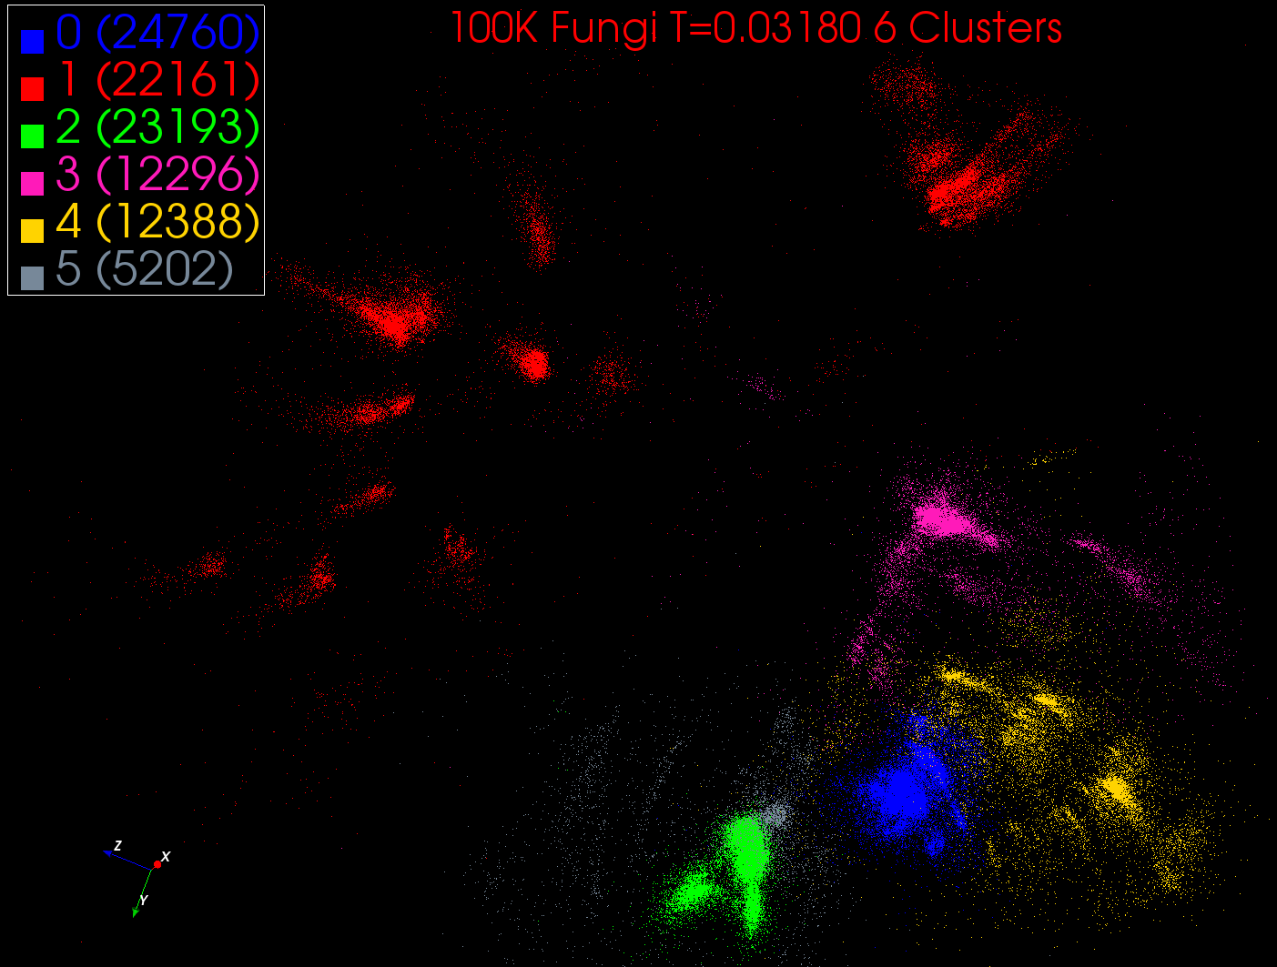

Slide 13
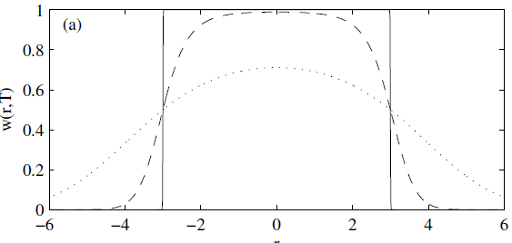
Trimmed Clustering
Clustering with position-specific constraints on variance: Applying redescending M-estimators to label-free LC-MS data analysis (Rudolf Frühwirth , D R Mani and Saumyadipta Pyne) BMC Bioinformatics 2011, 12:358
H_{TCC} = ∑_{k=0}^{K} ∑_{i=1}^{N} M_{i}(k) f(i,k)
f(i,k) = (X(i) - Y(k))²/2σ(k)² k > 0
f(i,0) = c² / 2 k = 0
The 0’th cluster captures (at zero temperature) all points outside clusters (background)
Clusters are trimmed (X(i) - Y(k))²/2σ(k)² < c² / 2
Applied to Proteomics Mass Spectrometry
T = 1
T ~ 0
T = 5
Distance from cluster center

Slide 14
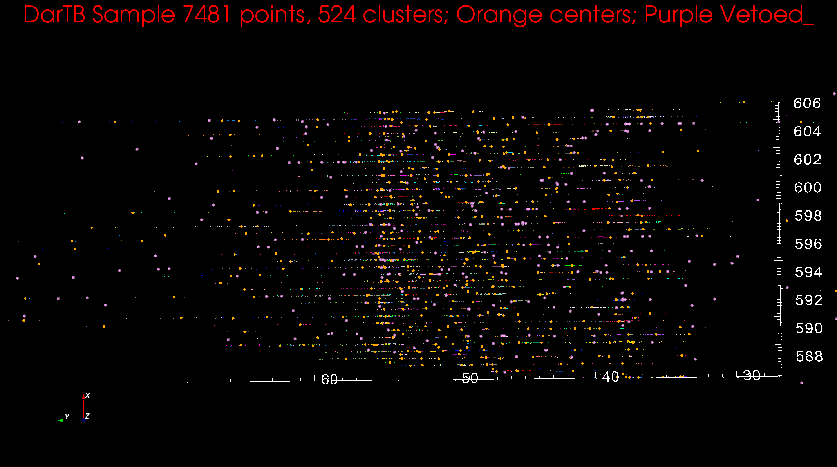
Proteomics 2D DA Clustering

Slide 15
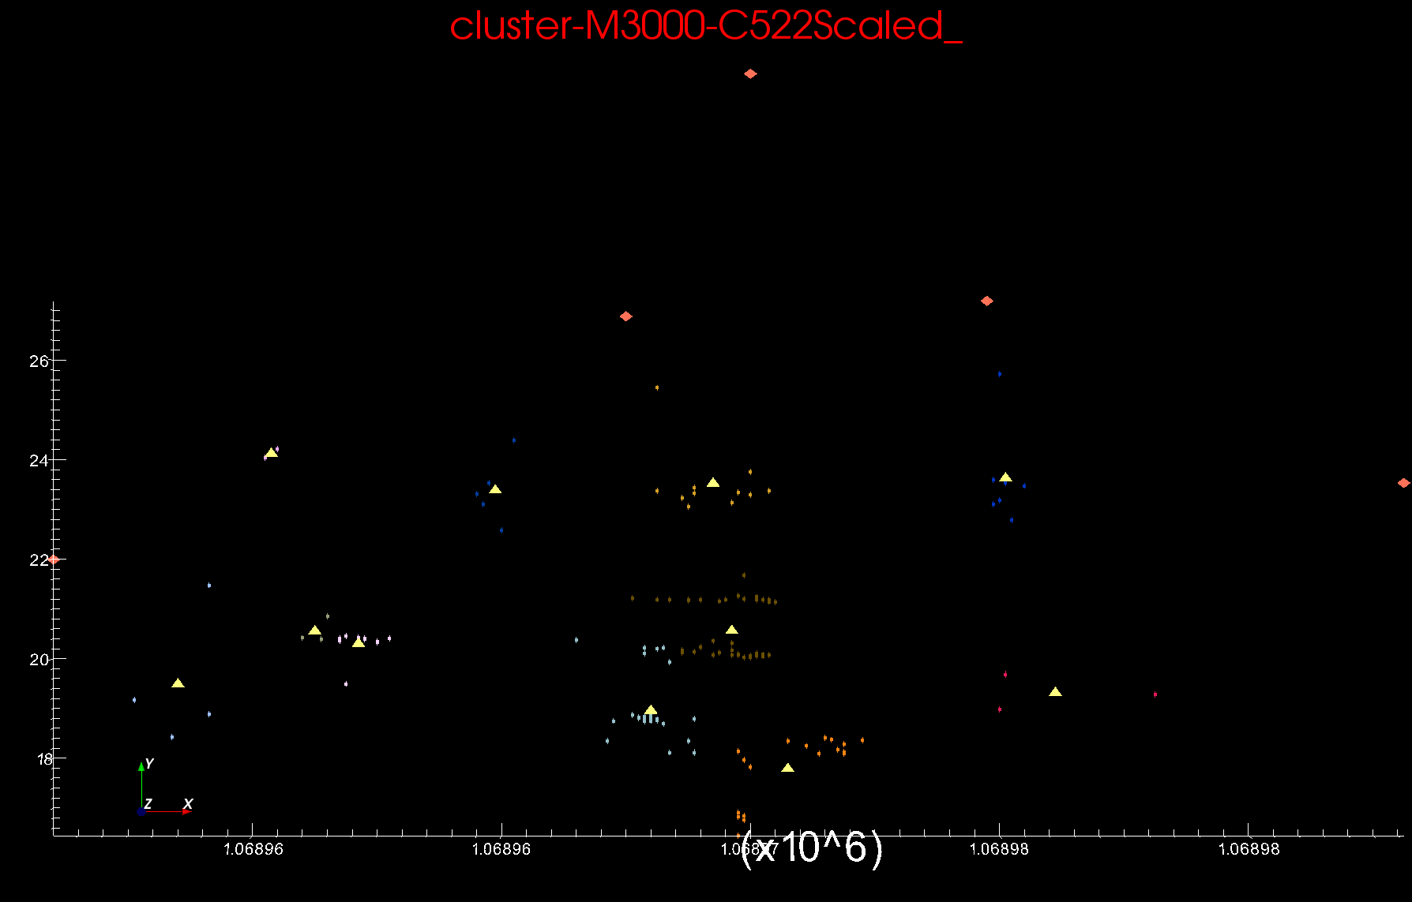
Proteomics 2D DA Clustering -- Scaled

Slide 16
High Performance Dimension Reduction and Visualization
Need is pervasive
Large and high dimensional data are everywhere: biology, physics, Internet, …
Visualization can help data analysis
Visualization of large datasets with high performance
Map high-dimensional data into low dimensions (2D or 3D).
Need Parallel programming for processing large data sets
Developing high performance dimension reduction algorithms:
MDS(Multi-dimensional Scaling)
GTM(Generative Topographic Mapping)
DA-MDS(Deterministic Annealing MDS)
DA-GTM(Deterministic Annealing GTM)
Interactive visualization tool PlotViz
Notes:
With David Wild

Slide 17
Multidimensional Scaling MDS
Map points in high dimension to lower dimensions
Many such dimension reduction algorithms (PCA Principal component analysis easiest); simplest but perhaps best at times is MDS
Minimize Stress σ(X) = Σ_{i<j=1}^{n} weight(i,j) (δ(i, j) - d(X_{i} , X_{j}))²
δ(i, j) are input dissimilarities and d(X_{i} , X_{j}) the Euclidean distance squared in embedding space (3D usually)
SMACOF or Scaling by minimizing a complicated function is clever steepest descent (expectation maximization EM) algorithm
Computational complexity goes like N² * Reduced Dimension
We developed a Deterministic annealed version of it which is much better
Could just view as non linear χ² problem (Tapia et al. Rice)
Slower but more general
All parallelize with high efficiency

Slide 18
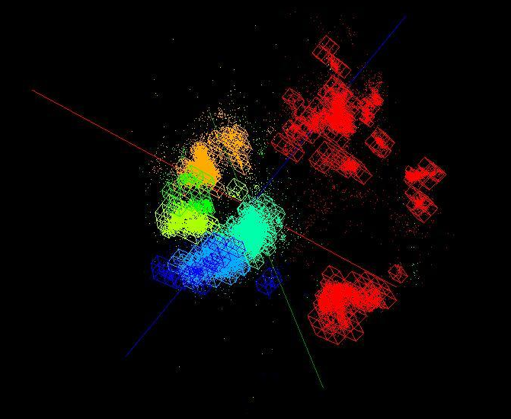
OctTree for 100K sample of Fungi
We use OctTree for logarithmic interpolation

Slide 19
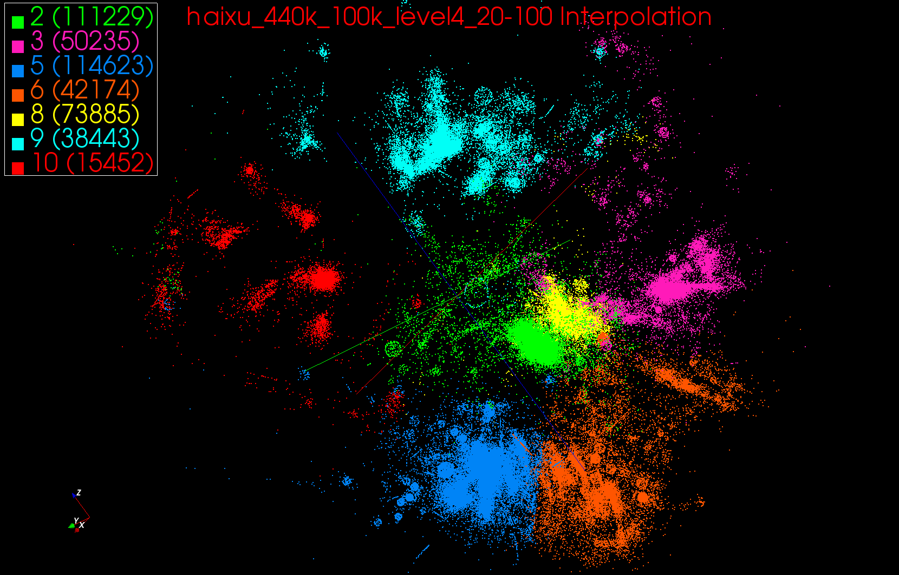
440K Interpolated

Slide 20
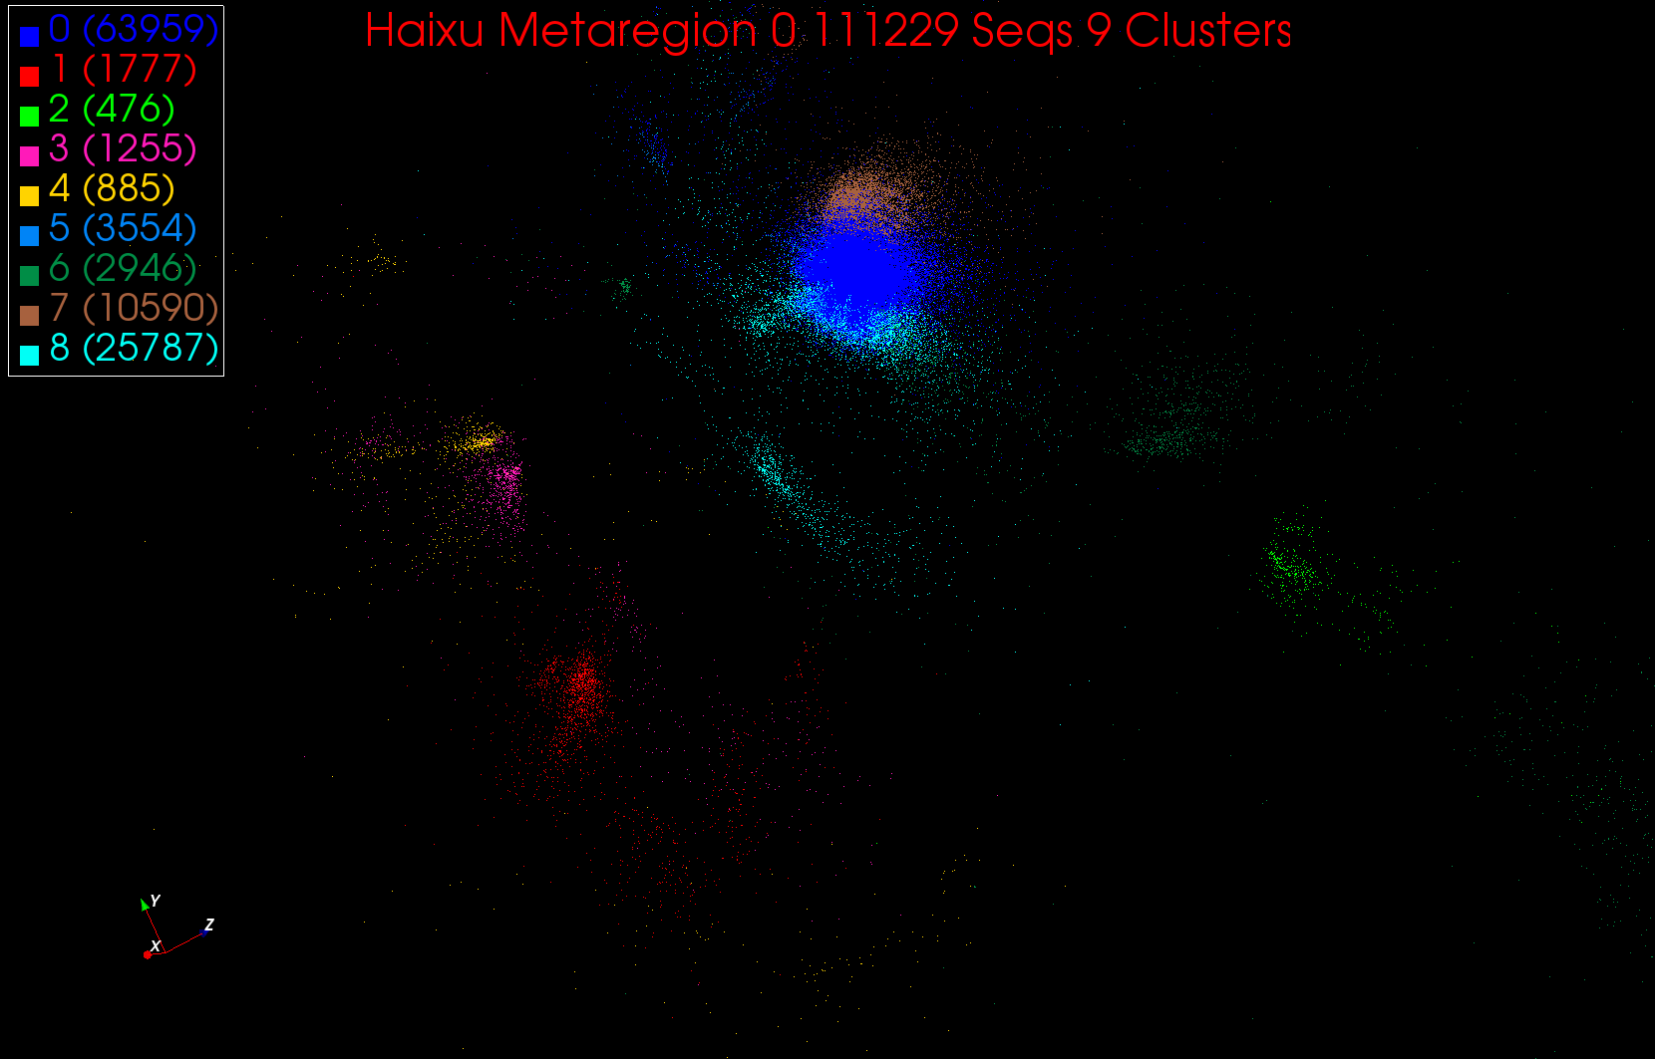
A large cluster in Region 0

Slide 21
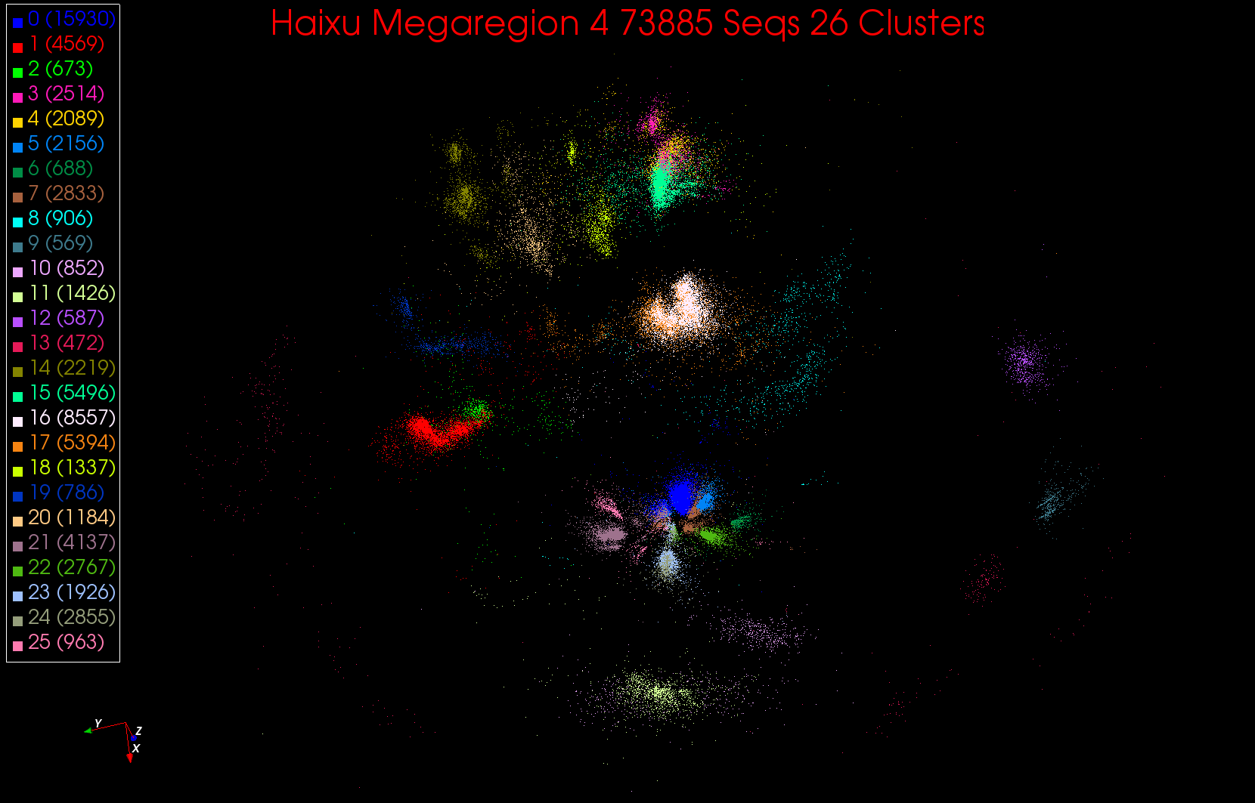
26 Clusters in Region 4

Slide 22
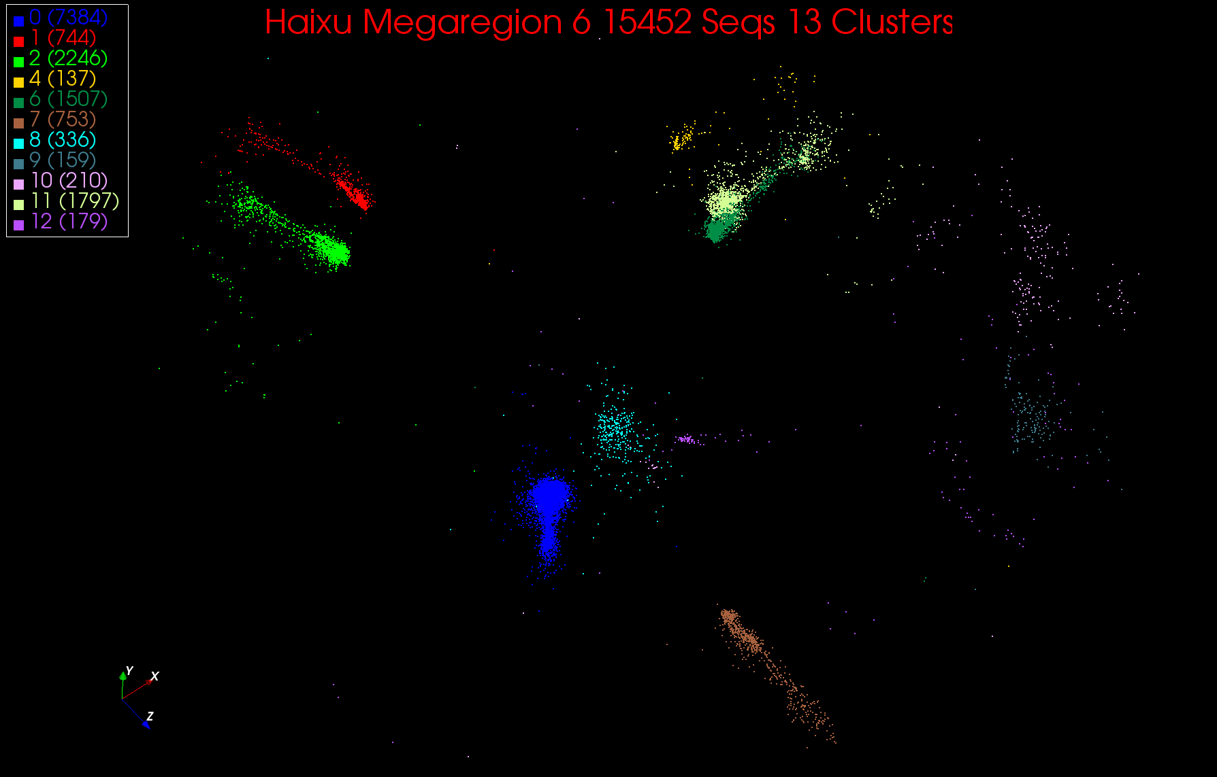
13 Clusters in Region 6

Slide 23
Phylogenetic Tree with Centers of Clusters at bottom

Slide 24
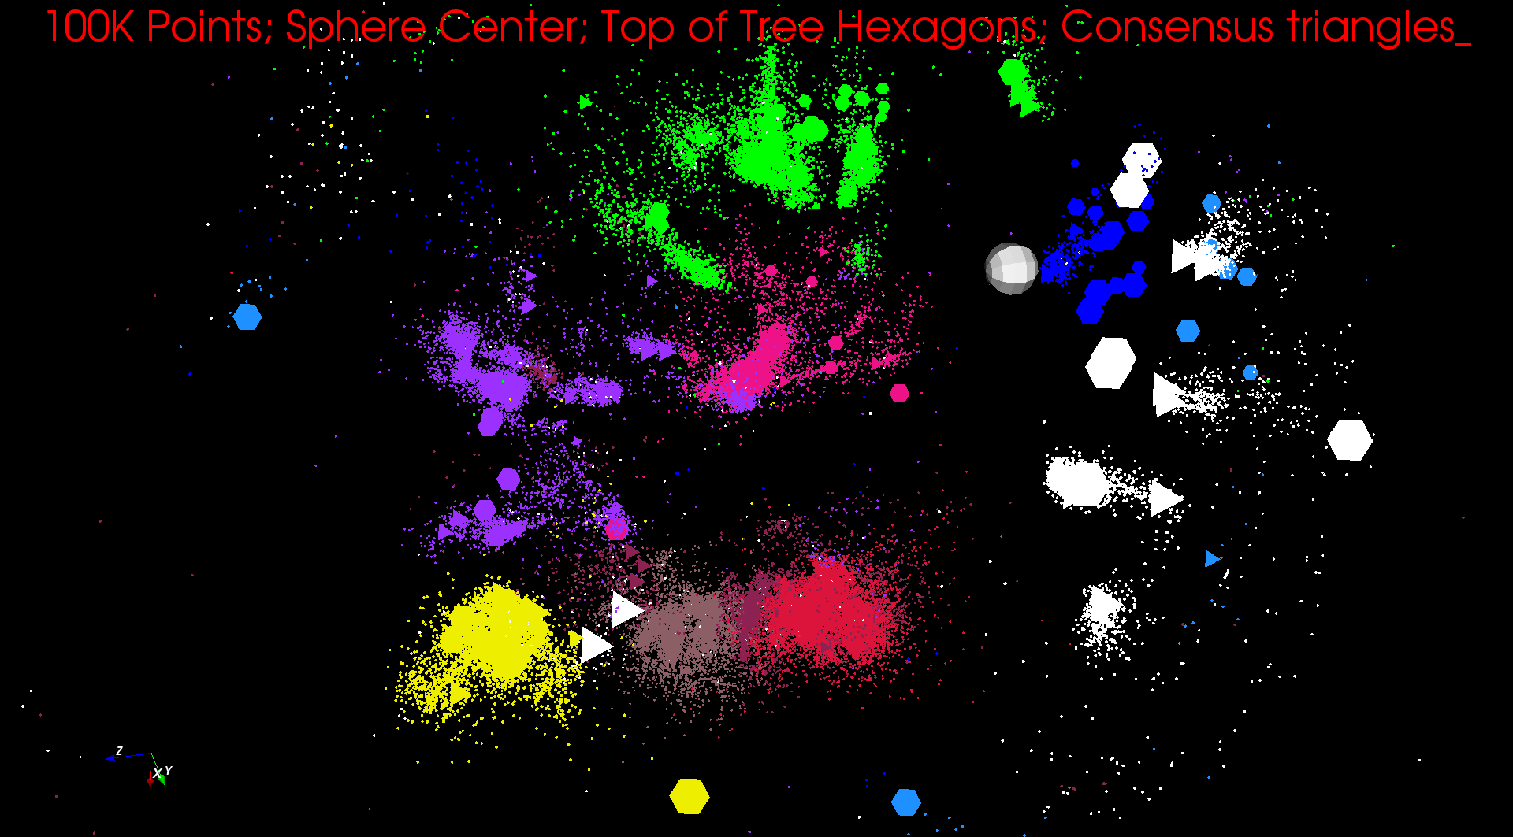
Phylogenetic Tree I

Slide 25
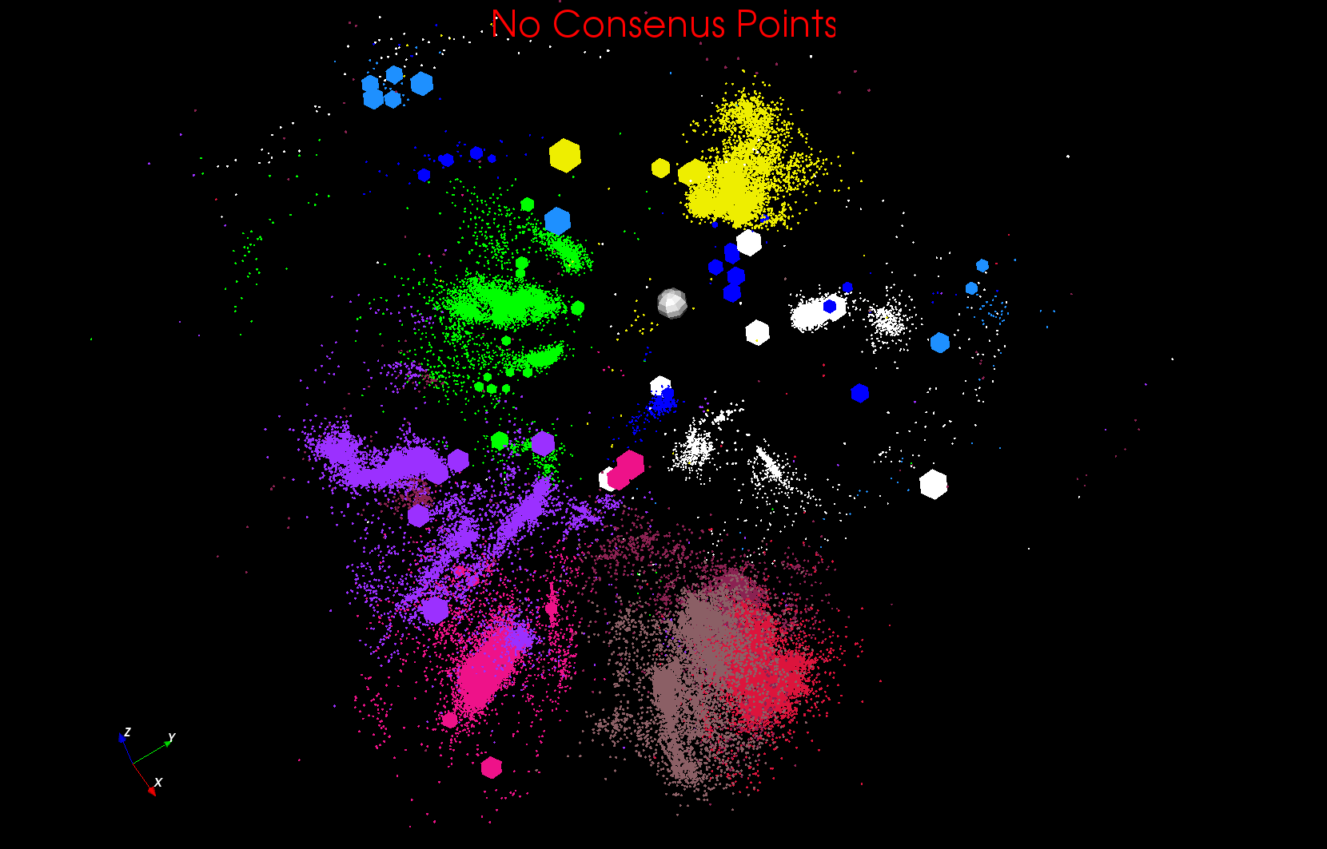
Phylogenetic Tree II

Slide 26
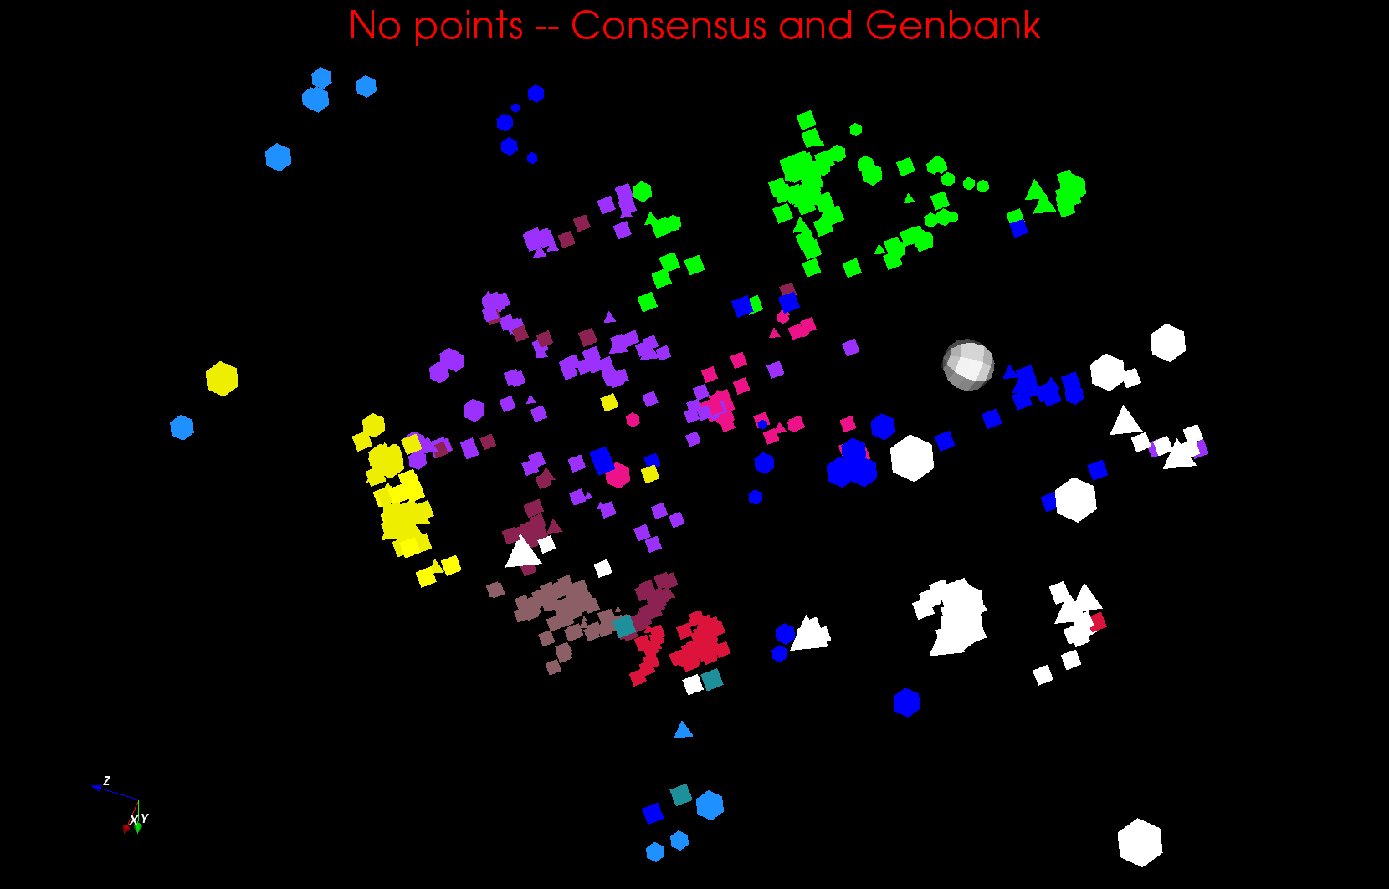
Phylogenetic Tree III

Slide 27
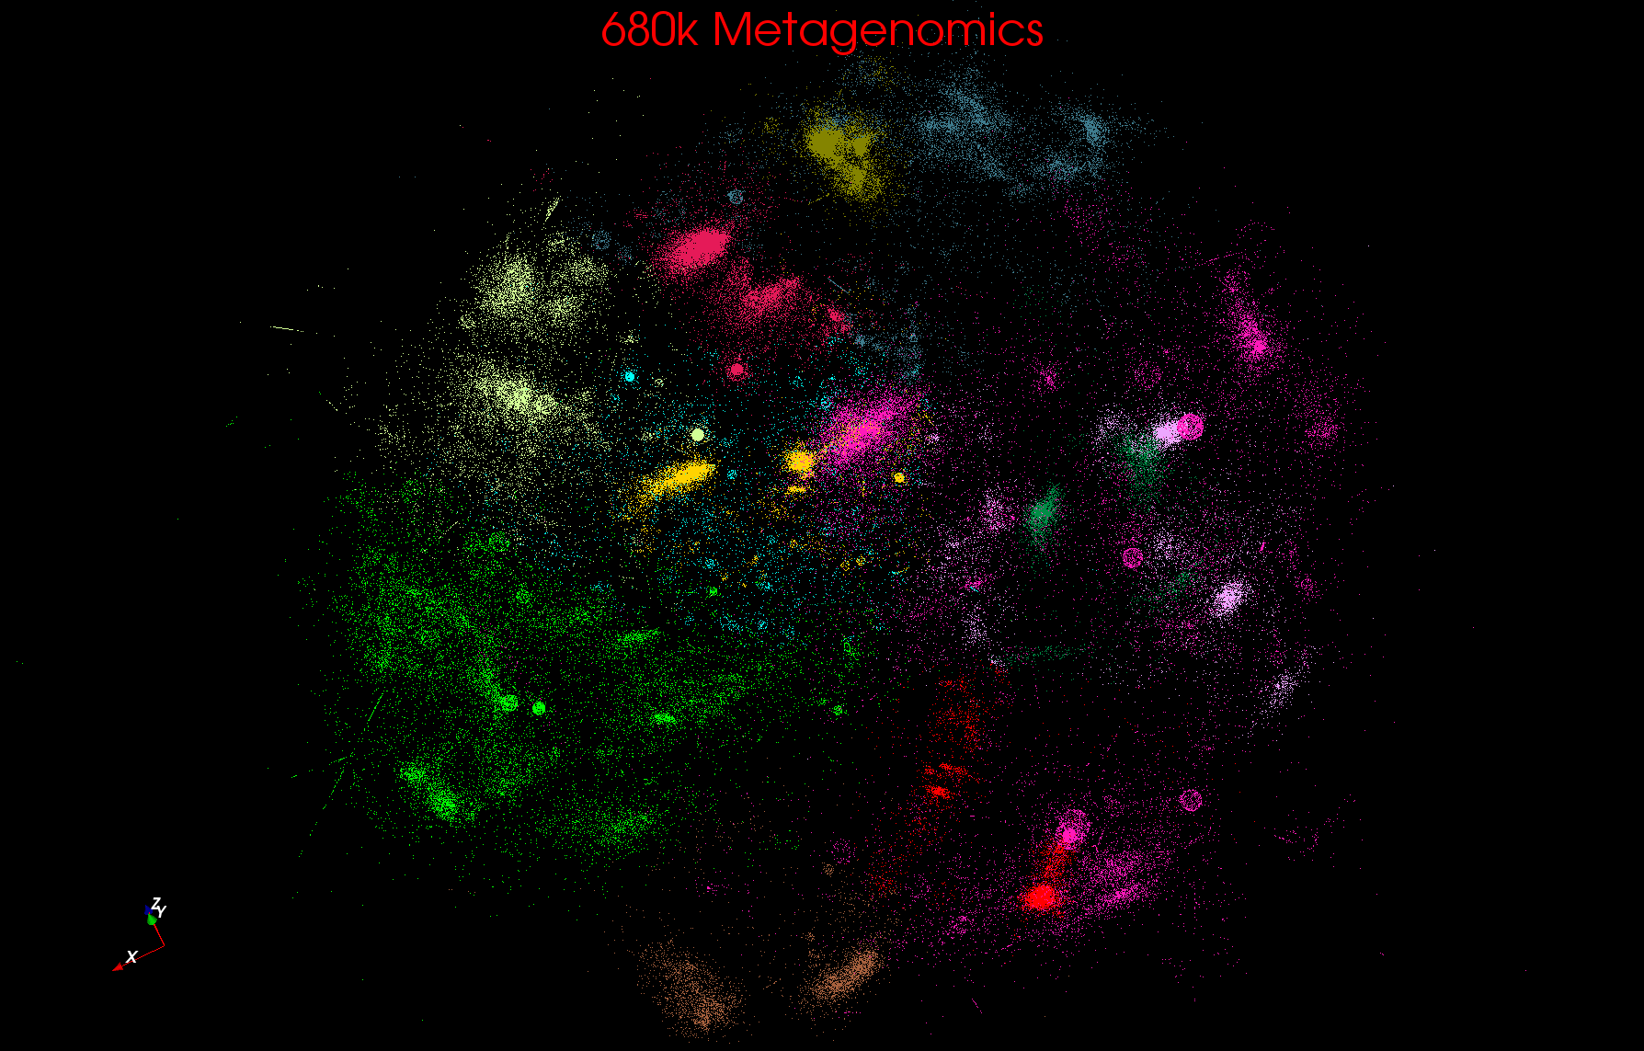
Metagenomics

Slide 28
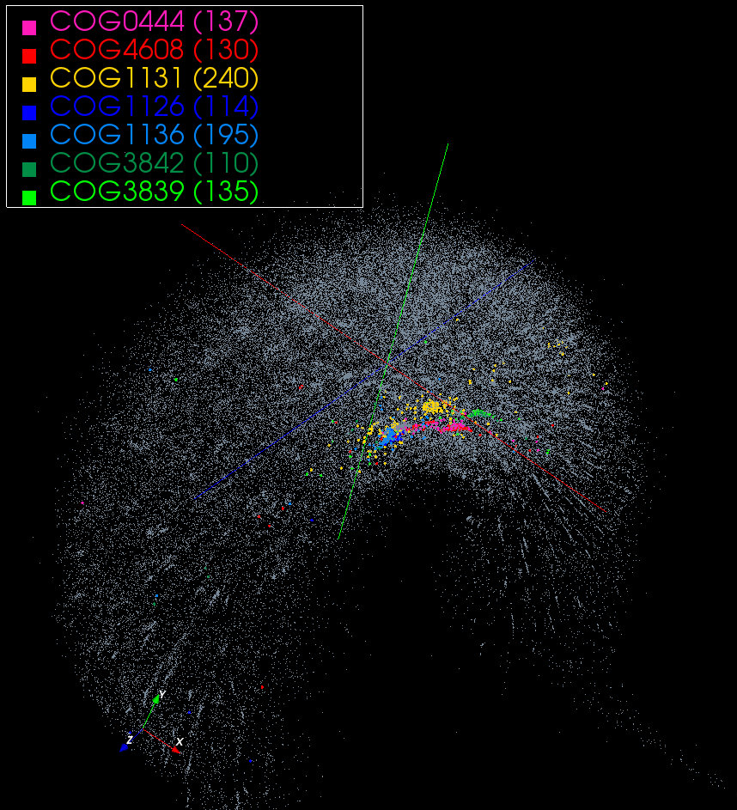
~100K COG with 7 clusters from database

Slide 29
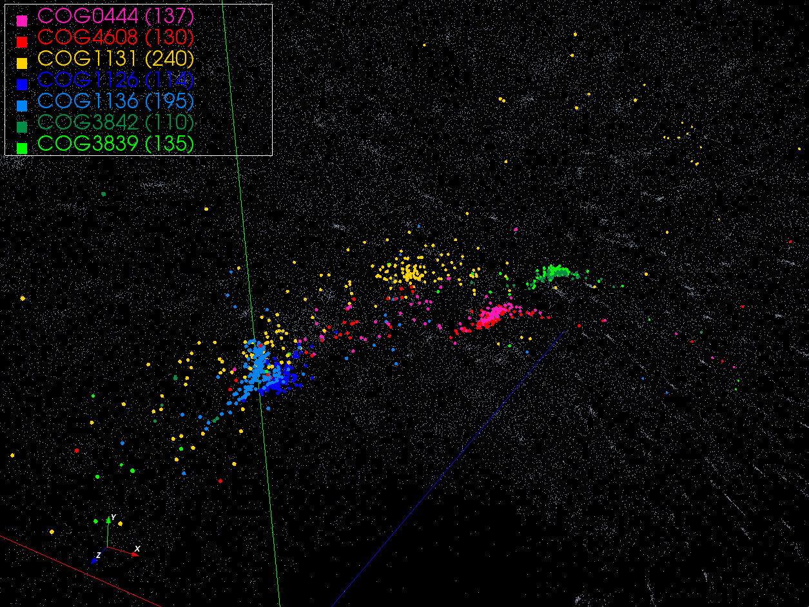

Slide 30
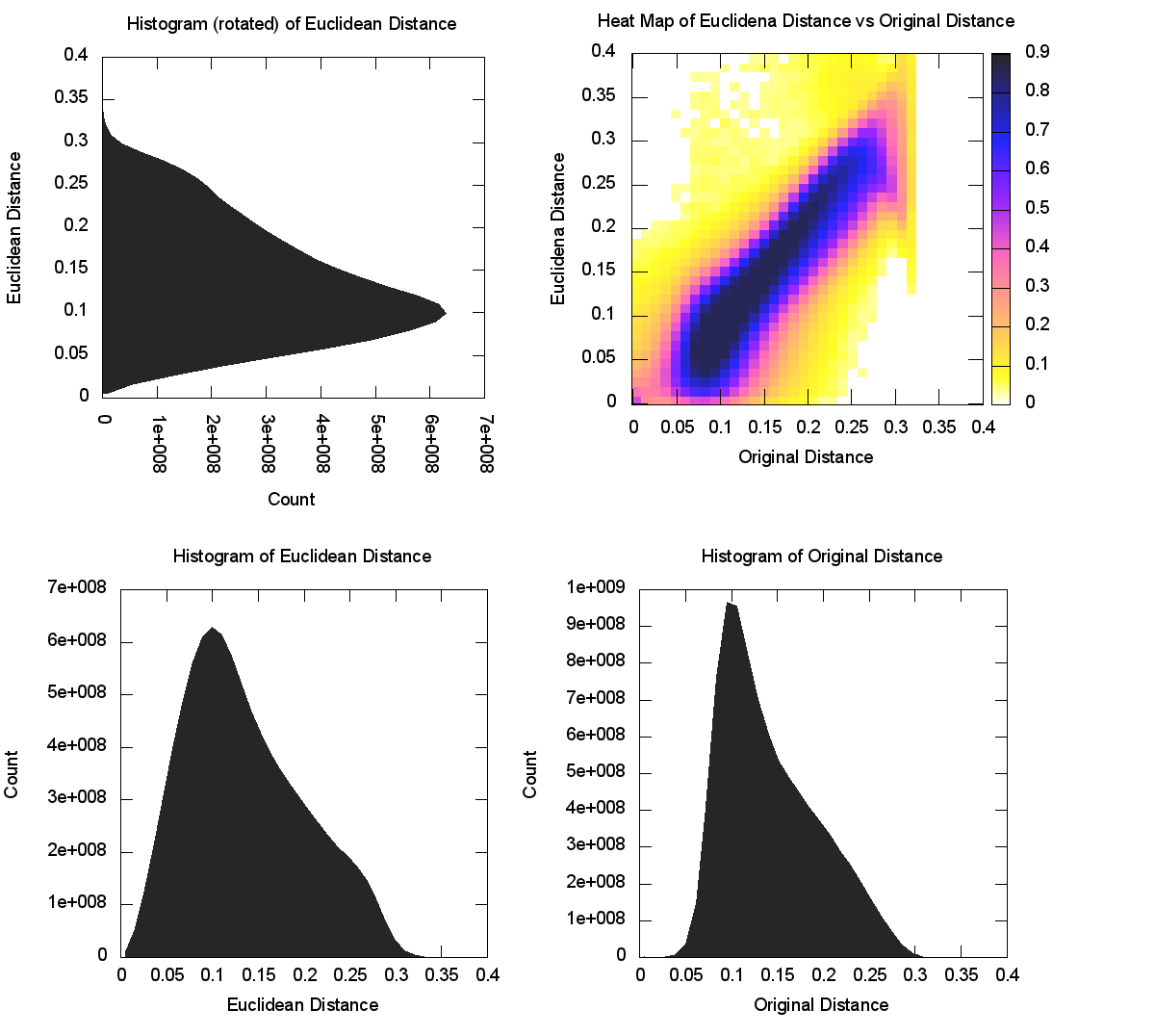
CoG NW Sqrt (4D)

Slide 31
References
Ken Rose, Deterministic Annealing for Clustering, Compression, Classification, Regression, and Related Optimization Problems. Proceedings of the IEEE, 1998. 86: p. 2210--2239.
References earlier papers including his Caltech Elec. Eng. PhD 1990
T Hofmann, JM Buhmann, “Pairwise data clustering by deterministic annealing”, IEEE Transactions on Pattern Analysis and Machine Intelligence 19, pp1-13 1997.
Hansjörg Klock and Joachim M. Buhmann, “Data visualization by multidimensional scaling: a deterministic annealing approach”, Pattern Recognition, Volume 33, Issue 4, April 2000, Pages 651-669.
Frühwirth R, Waltenberger W: Redescending M-estimators and Deterministic Annealing, with Applications to Robust Regression and Tail Index Estimation. http://www.stat.tugraz.at/AJS/ausg083+4/08306Fruehwirth.pdf Austrian Journal of Statistics 2008, 37(3&4):301-317.
Review http://grids.ucs.indiana.edu/ptliupages/publications/pdac24g-fox.pdf
Recent algorithm work by Seung-Hee Bae, Jong Youl Choi (Indiana CS PhD’s)
http://grids.ucs.indiana.edu/ptliupages/publications/CetraroWriteupJune11-09.pdf
http://grids.ucs.indiana.edu/ptliupages/publications/hpdc2010_submission_57.pdf

Slide 32
Web Links
1.) Metagenomics http://salsahpc.indiana.edu/millionseq/mina/16SrRNA_index.html
parent page at http://salsahpc.indiana.edu/millionseq/
2.) Proteomics: The COG Project http://manxcatcogblog.blogspot.com/
3.) Fungi http://salsahpc.indiana.edu/millionseq/haixu/fungi_index.html
parent page http://salsahpc.indiana.edu/millionseq/
4.) Region Clustering http://salsahpc.indiana.edu/nih/index.php/Region_Clustering
5.) Fungi Phylogenetic http://salsafungiphy.blogspot.com/
6.) The Metagenomics Qiime http://salsametagenomicsqiime.blogspot.com/
7.) Also http://salsahpc.indiana.edu/nih

