Slide 1
Cyberinfrastructure/Grids/Clouds
IU has several relevant distributed system activities including
  TeraGrid NSF Grid Portals and Participation
  PolarGrid support of CReSIS project with Cyberinfrastructure to support remote experiments and data analysis
  QuakeSim Grid to support Earthquake Science including sensors
  NetCentric Sensor Grid for AFRL
Active in Open Grid Forum and eScience Community including chair of current eScience IEEE conference

Slide 2
Current Status
Dominant interest of IU is Data driven Cyberinfrastructure linking from large scale systems to new multicore parallel algorithms
Grids have evolved to clouds with substantial new commercial software supporting dynamic service deployment and user friendly Web 2.0 Interfaces
New data driven programming models (Hadoop, Dryad ..)

Slide 3
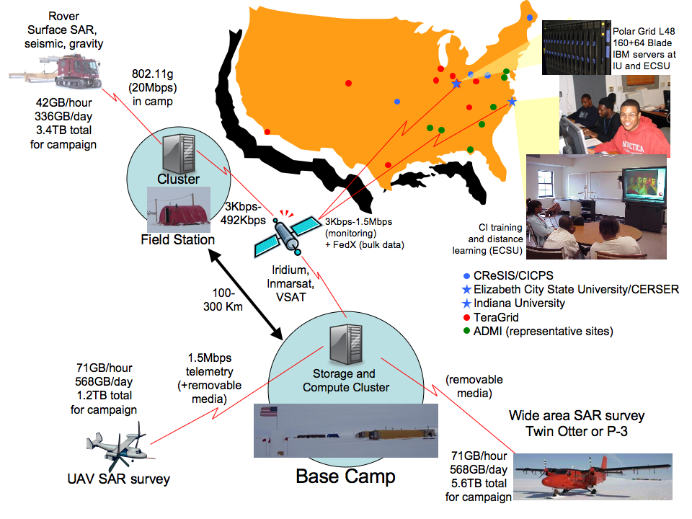

Slide 4
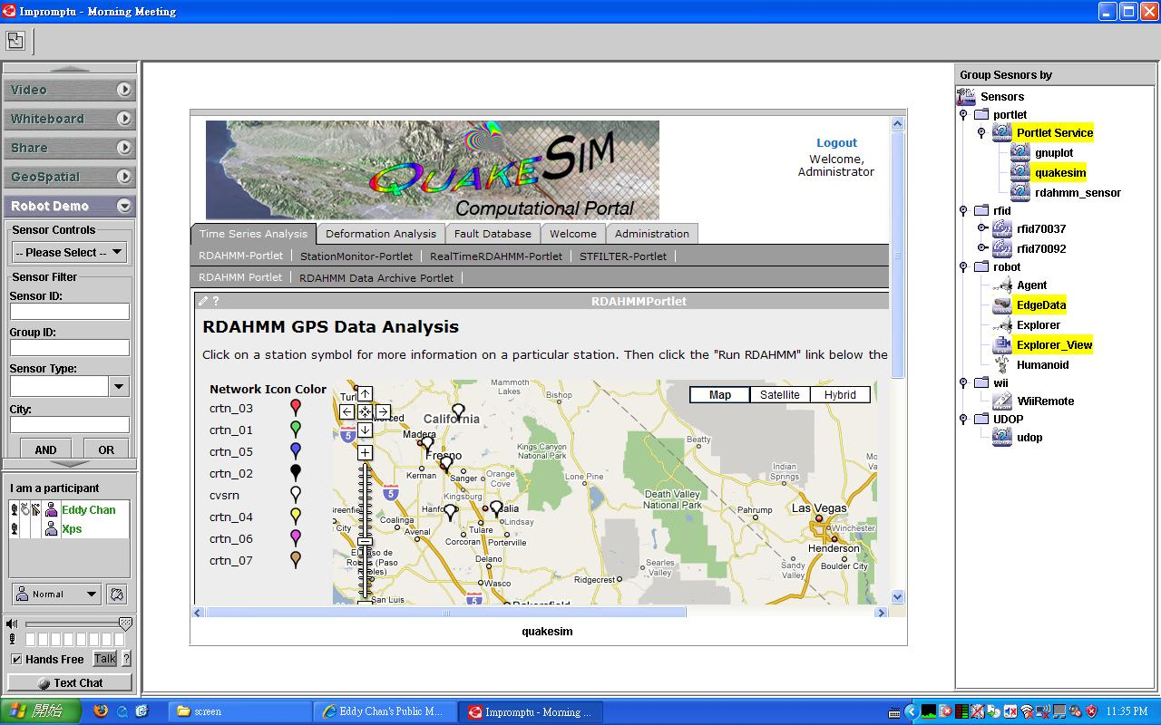
QuakeSim Grid of Grids with RDAHMM Filter (Compute) Grid

Slide 5

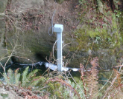
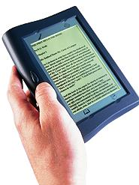





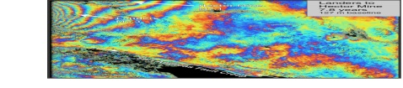
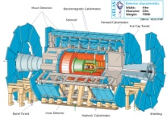
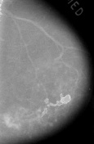



Grid of Grids and Clouds
Raw Data → Data → Information → Knowledge → Wisdom → Decisions
Another
Grid
Another
Grid
SS
SS
SS
SS
SS
SS
fs
fs
Discovery
Cloud
Filter
Service
Portal
Filter
Cloud
fs
fs
SS
fs
fs
Filter
Cloud
Inter-Service Messages
Another
Service
fs
fs
SS
Filter
Cloud
fs
Filter
Service
fs
fs
fs
SS
fs
fs
fs
Filter
Service
fs
Discovery
Cloud
fs
fs
fs
fs
SS
Traditional Grid with exposed services
Filter
Cloud
fs
Filter
Service
fs
Filter
Cloud
Filter
Cloud
SS
fs
fs
Another
Grid
SS
SS
SS
SS
SS
SS
Sensor or Data
Interchange
Service
SS
SS
SS
SS
SS
SS
Compute
Cloud
Storage
Cloud
Database

Slide 6

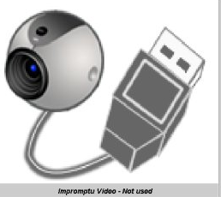
Demonstration Sensor Grid
Sensors geolocated
by attached GPS
Laptop for PowerPoint (just a sensor)
2 Robots used
Webcams
Lego Robot GPS Nokia N800 RFID Tag RFID Reader

Slide 7
Typical Sensor Grid Interface

Slide 8
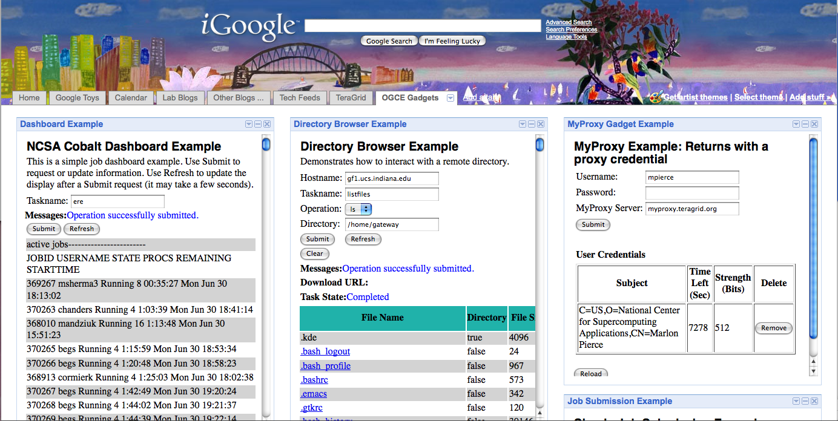
Grid Portals as Google Gadgets:
MOAB dashboard, remote directory browser, and proxy management.

Slide 9
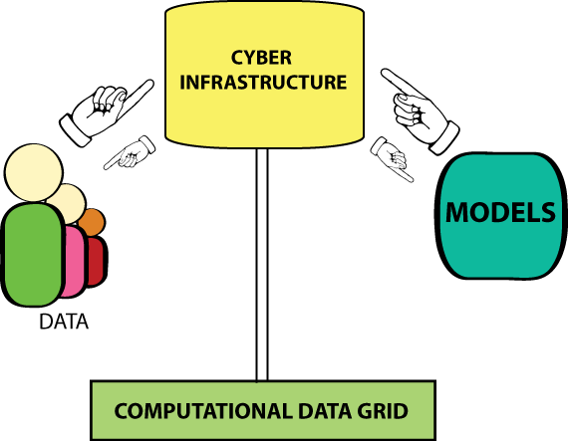
Modeling and Analytics Grid
We architect as Grid of Grids and Clouds (Systems of Systems)
Change classic compute grid to cloud
Notes:
NDSSL is providing Models and Data to the Cyberinfrastructure,
Within what is called the Modeling Grid

Slide 10
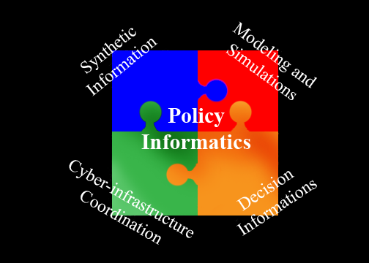
Overall Vision
Change ways in which HPC-based models and analytical tools are delivered to analysts
  Make HPC resources seamless, invisible for routine analytical efforts
  Organize HPC resources as an evolving commodity
Analyst can focus on delivering results rather than becoming computing expert
Each component built as a subgrid with defined messaging interfaces
Notes:
NDSSL is leading Policy Informatics at Virginia Tech
CNIMS is being developed by NDSSL, VT in partnership with DTRA

Slide 11
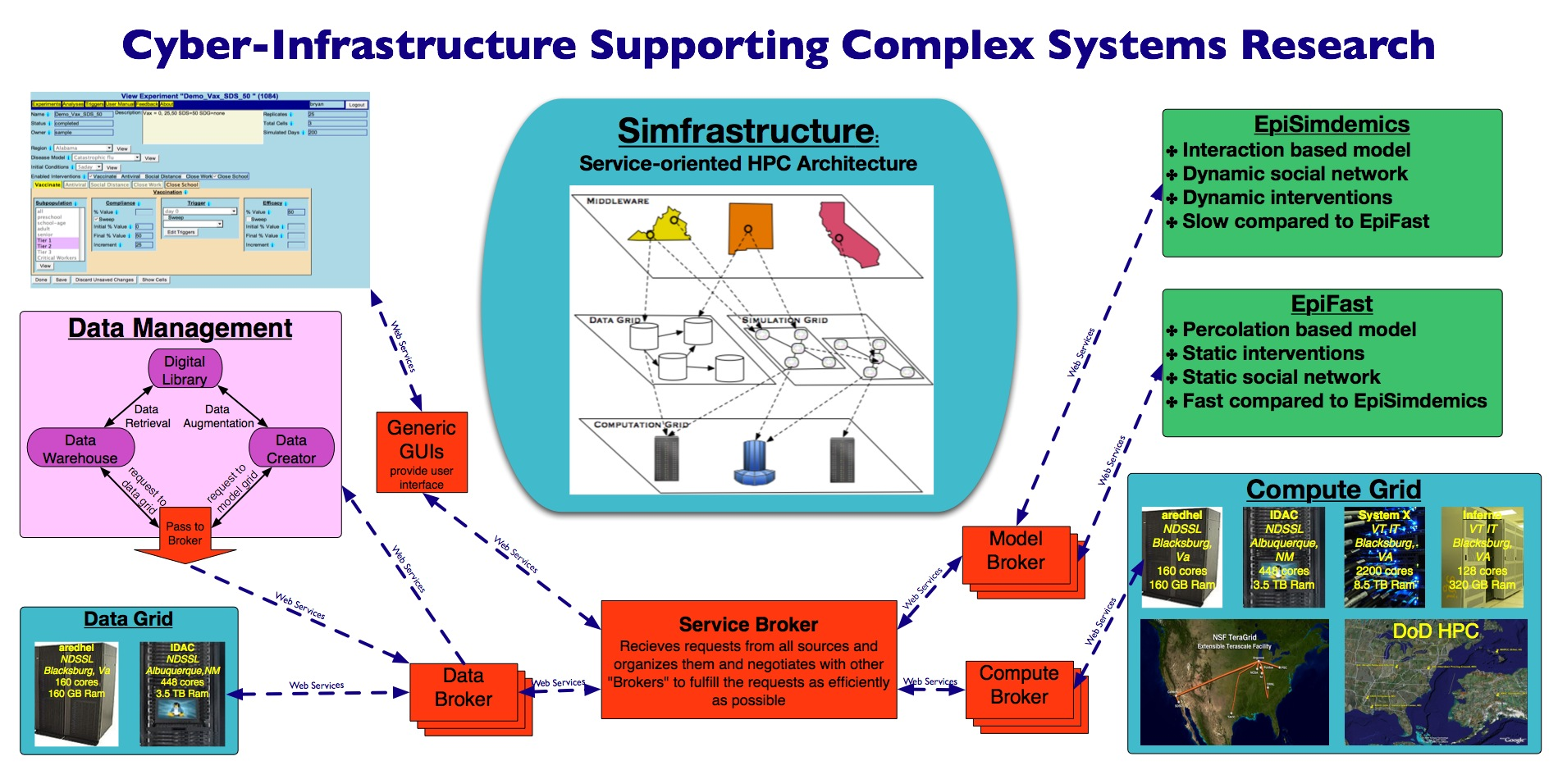
Modeling Grid: Simfrastructure
Compute
Cloud
Notes:
Grid Based, Service Oriented Distributed Modeling Framework
Mediates interaction between decision makers and models
Manages HPC hardware resources
Manages distributed data sources
Ensures data consistency
Handles selection of appropriate resources
Pre-computes where appropriate
Allows transparent access to other models (e.g., Population Mobility)
Accessible via web services to client applications
Promotes information sharing and access
Facilitates scenario definition and execution

Slide 12
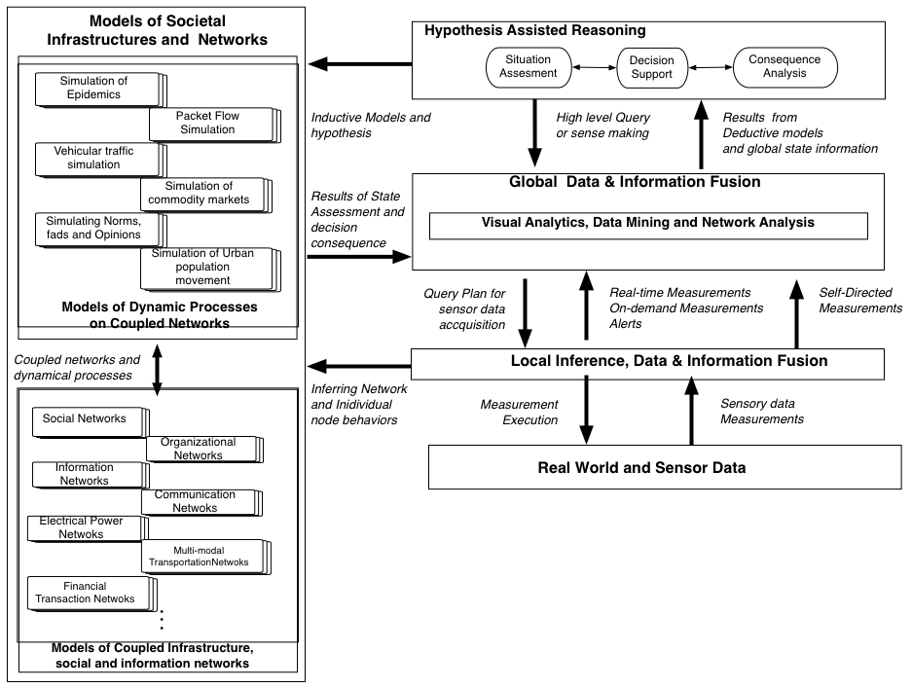
Integrating the Modeling Grid within the CI

Slide 13
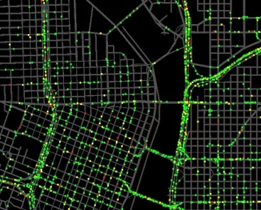
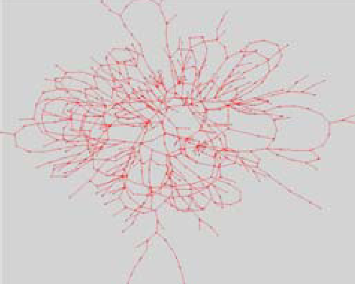
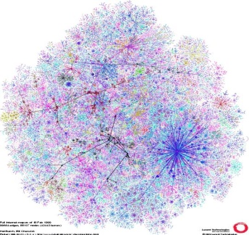
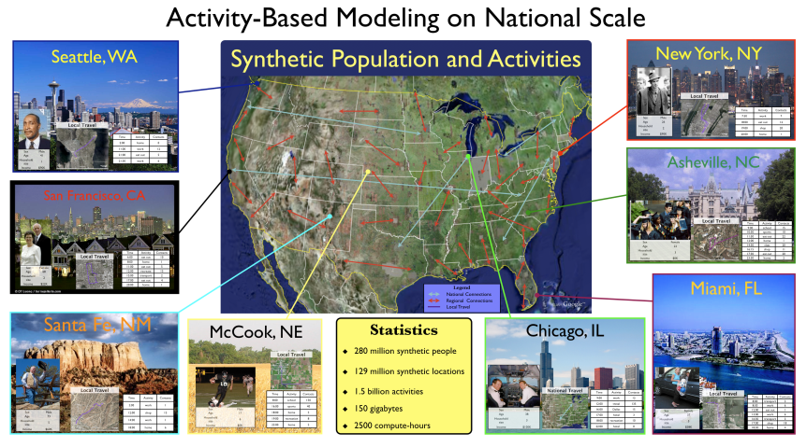
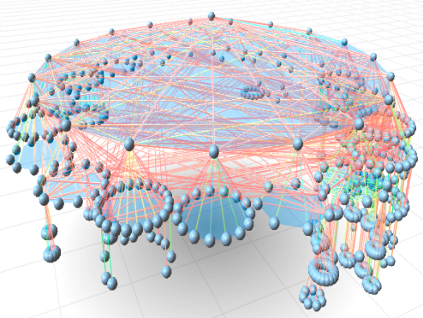
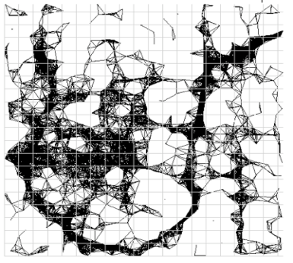
Modeling and Simulations of Interdependent Infrastructure Networks
Interaction based HPC-models
A collection of interoperable simulations of societal infrastructures
Coupled with individual-based social networks
Individual based realistic behavioral models
  Who, What, Where, When, and How
Unprecedented Scale and Resolution: 300 million individuals, 6 billion interactions, 100 million locations, temporal scale of minutes and spatial scale of few meters
Notes:
Supports study of cascading failures and human-mediated interactions
Support a range of problems including such as urban evacuation, epidemiological events, biomonitoring systems, population risk-exposure estimation, logistical planning and management of isolated populations, site evacuations, and interdependent infrastructure failures, and others.

Slide 14
Challenges within DHS context
Incorporating real-time data for crisis response
  Integrating modeling grid with Sensor grid
Extending the modeling efforts to other sectors beyond the currently covered ones
Enabling Collaborative analysis
  Integrating data from different stake holders
  Providing context specific shared information
  NaradaBrokering supports Collaborative Grid by multicast messages

Slide 15
IU Data Grid Components
The streaming infrastructure (NaradaBrokering) will ensure that data disseminations are fast, resilient to failures, and secure.
  Extensively tested in academic (QuakeSim, Clemson) and commercial (Anabas) sensor and collaboration
The runtime infrastructure (Granules) will orchestrate computations concurrently over a cloud of machines.

Slide 16

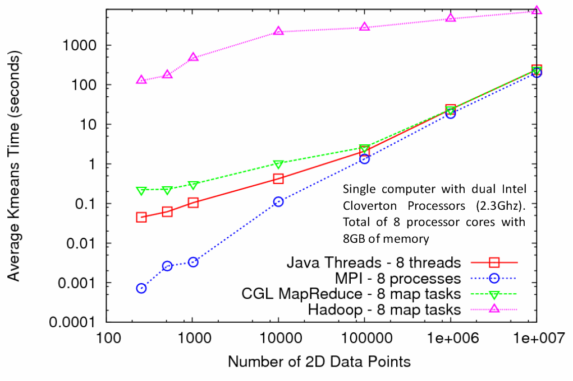
Kmeans Clustering
MapReduce for Kmeans Clustering
Kmeans Clustering, execution time vs. the number of 2D data points (Both axes are in log scale)
All three implementations perform the same Kmeans clustering algorithm
Each test is performed using 5 compute nodes (Total of 40 processor cores)
CGL-MapReduce shows a performance close to the MPI and Threads implementation , Granules extends CGL-MapReduce Prototype
Hadoop’s high execution time is due to:
  Lack of support for iterative MapReduce computation
  Overhead associated with the file system based communication

Slide 17
NaradaBrokering: Summary of Capabilities
Routing
  Overlay networks, efficient long-tail disseminations
Security
  Provenance, secure disseminations, denial of service attacks
Failure-resiliency and autonomic systems
  Failure recovery, reliable delivery, redundancy and scalable tracking
Discovery
  Load-balancing, resource assimilation, proximate conduits
Mitigating network induced effects
  Unpredictable links, buffering, active replays
Support for Service Oriented Architectures

Slide 18
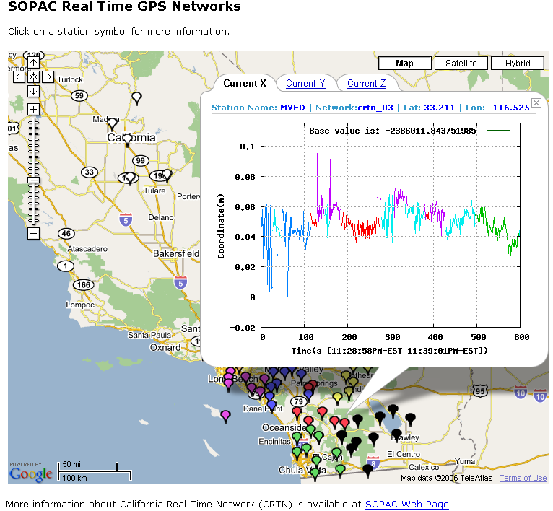
Projects utilizing NaradaBrokering: QuakeSim

Slide 19
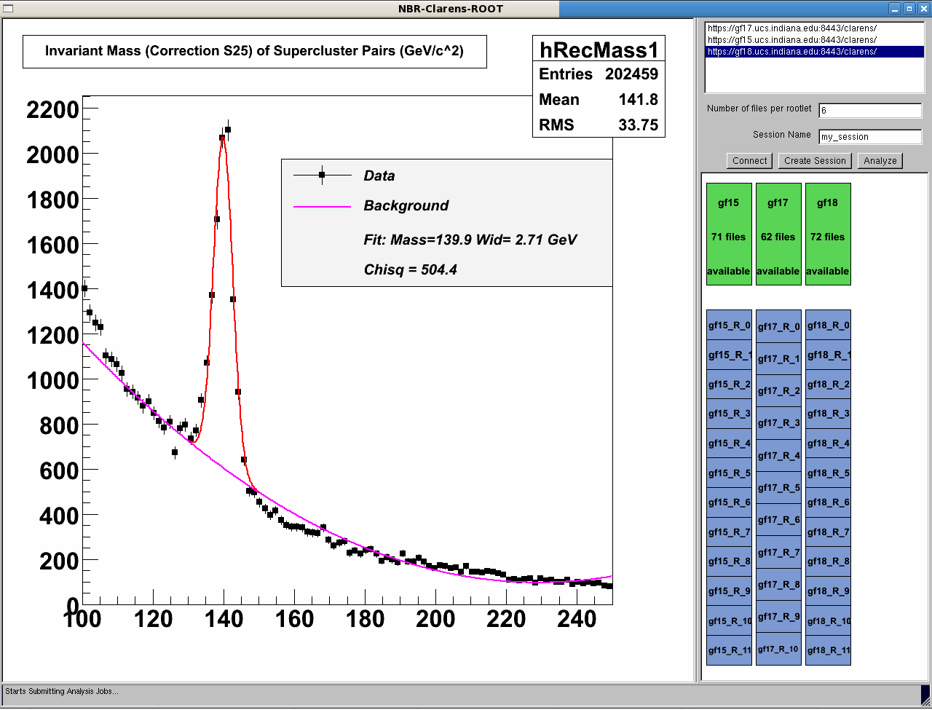
Projects utilizing NaradaBrokering:Clarens

Slide 20
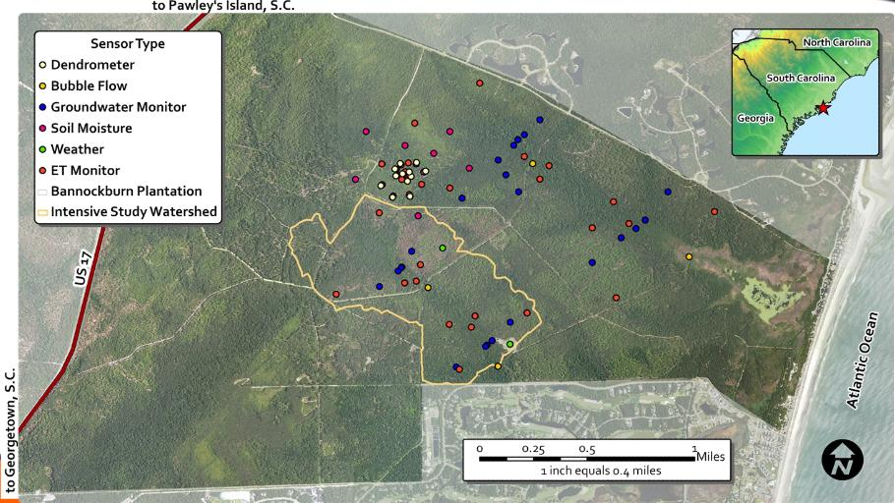
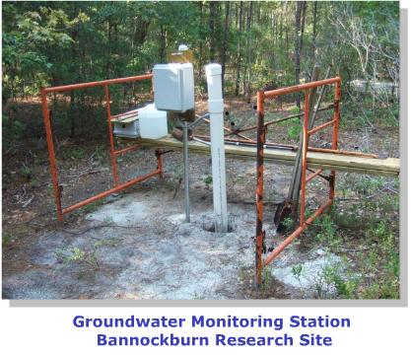
Projects utilizing NaradaBrokering:: PISCES

Slide 21
Stream dissemination
Routing sustains and eschews failed nodes
  Selective deployment of links
Long-tail distribution: Selectivity within streams
  Strings, tuples, Regular Expressions, SQL/XPath & XQuery queries
Stream jitter reduction
Time-ordering of streams
Support for multiple transports
  TCP, UDP, Multicast, IPSec, SSL, HTTP/S, Parallel-TCP

Slide 22
Secure Streaming
Enforce authorizations for different stream slices based on role and time
Streams can have different cryptographic profiles
Confidentiality and tamper evidence
Cope with Denial of Service attacks
  Person-in-the-middle, brute force, replay attacks
Performance and Scale

Slide 23
Reliable delivery
Reliable delivery ONLY for authorized entities
  Coexists with entities not interested in reliable delivery
Easy to instrument the protocol
Easy to track usage patterns
  Track client loss rates, NAKs, disconnects & recoveries
Sustain repository failures and downtimes

Slide 24
Granules
Lightweight runtime for cloud computing
Orchestrates execution of computations on a compute cloud
Interleaves execution of thousands of computations on a given resource.

Slide 25
Granules: High-level View

Slide 26
Granules: Components

Slide 27
Granules: Scheduling computations
Exactly-once
When data is available
At regular intervals
Till a termination condition is reached
And valid permutations of the above

Slide 28
Map-Reduce Framework
Data Driven Grids or Clouds
Enables concurrent processing of large datasets
Large datasets are broken up into smaller ones, and processed by distributed Maps (filters, services).
The results from these Maps are reduced (or combined) to reconstitute the final result

Slide 29
Granules: Map-Reduce [Basic]

Slide 30
Granules: Map-Reduce Redundancies
Supports redundancies of both Map & Reduce instances.

Slide 31
Supports complex orchestration strategies

