Slide 1
Digital Science Center
October 15, 2009, Bloomington
Geoffrey Fox
gcf@indiana.edu www.infomall.org
School of Informatics and Computing
and Community Grids Laboratory,
Digital Science Center
Pervasive Technology Institute
Indiana University

Slide 2
PTI Activities in Digital Science Center
Community Grids Laboratory led by Fox
  Gregor von Lazewski: FutureGrid architect
  Marlon Pierce: Grids, Services, Portals including Chemistry and Polar Science applications
  Judy Qiu: Multicore and Data Intensive Computing including Biology and Cheminformatics applications
Open Software Laboratory led by Andrew Lumsdaine
  Software like MPI, Scientific Computing Environments
  Parallel Graph Algorithms
Complex Networks and Systems led by Alex Vespignani
  Very successful H1N1 spread simulations run on Big Red
  Can be extended to other epidemics and to “critical infrastructure” simulations such as transportation

Slide 3
FutureGrid
September 10, 2009 Press Release
BLOOMINGTON, Ind. -- The future of scientific computing will be developed with the leadership of Indiana University and nine national and international partners as part of a $15 million project largely supported by a $10.1 million grant from the National Science Foundation (NSF). The award will be used to establish FutureGrid—one of only two experimental systems (other one is GPU enhanced cluster) in the NSF Track 2 program that funds the most powerful, next-generation scientific supercomputers in the nation.
http://uitspress.iu.edu/news/page/normal/11841.html

Slide 4
FutureGrid
FutureGrid is part of TeraGrid – NSF’s national network of supercomputers – and is aimed at providing a distributed testbed of ~9 clusters for both application and computer scientists exploring
  Clouds
  Grids
  Multicore and architecture diversity
Testbed enabled by virtual machine technology including virtual network
  Dedicated network connects allowing experiments to be isolated
Modest number of cores (5000) but will be relatively large as a Science Cloud

Slide 5
Add 768 core Windows Server at IU and Network Fault Generator

Slide 6
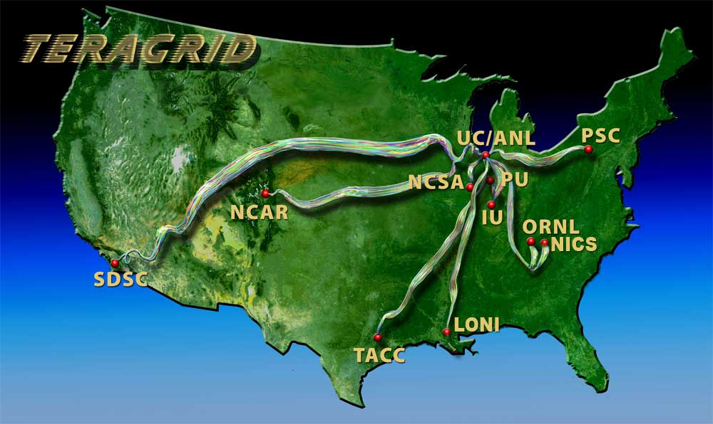
Indiana University is already part of base TeraGrid through Big Red and services

Slide 8
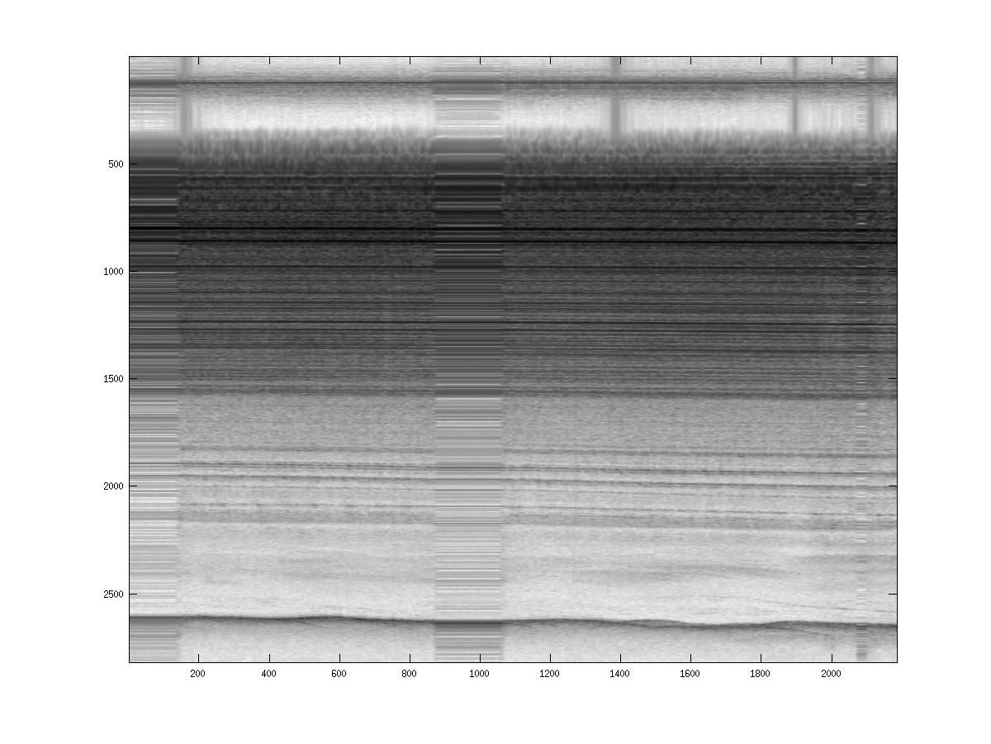
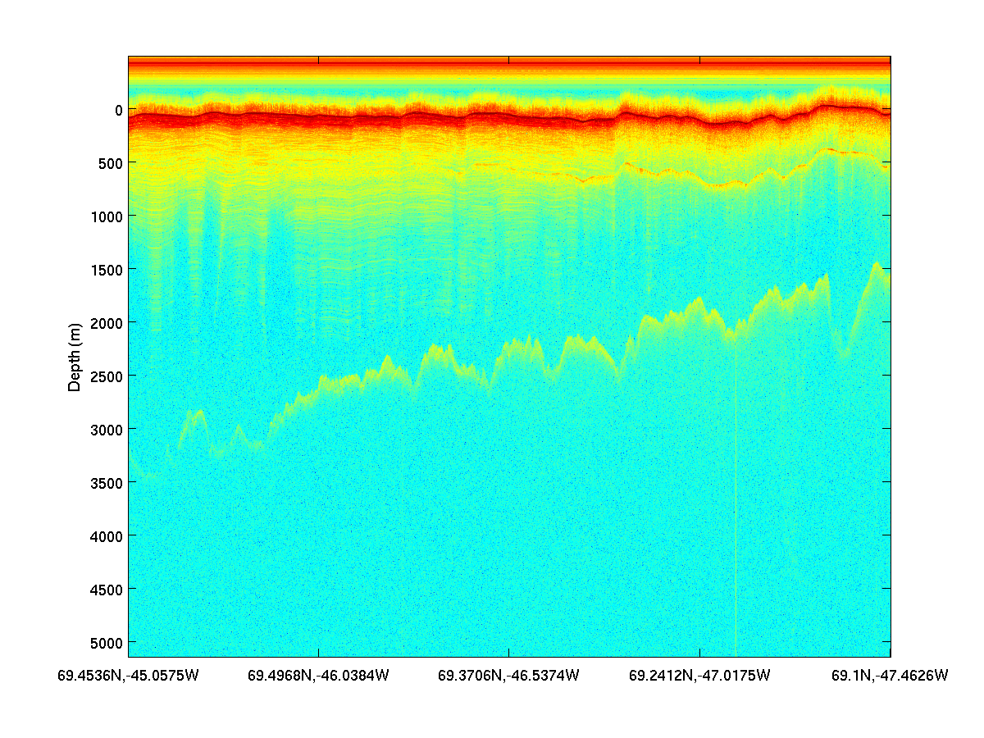
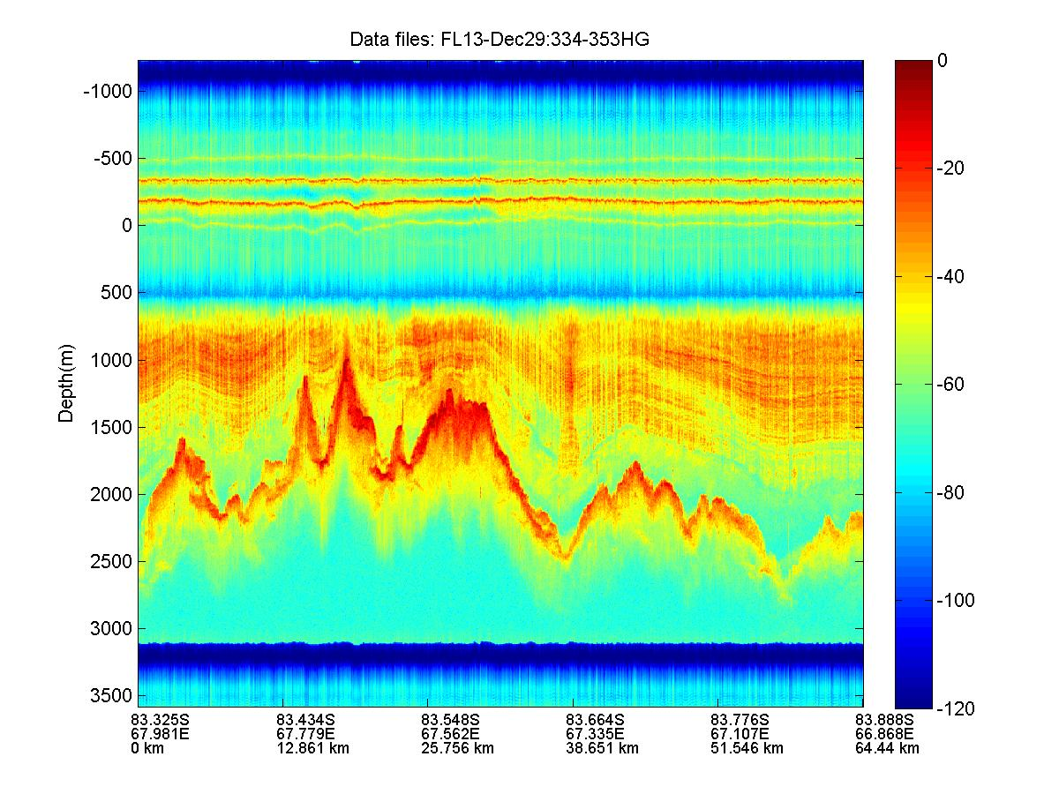
Field Results – 2008/09
“Without on-site processing enabled by POLARGRID, we would not have identified aircraft inverter-generated RFI. This capability allowed us to replace these “noisy” components with better quality inverters, incorporating CReSIS-developed shielding, to solve the problem mid-way through the field experiment.”
Jakobshavn 2008
NEEM 2008
GAMBIT 2008/09

Slide 9
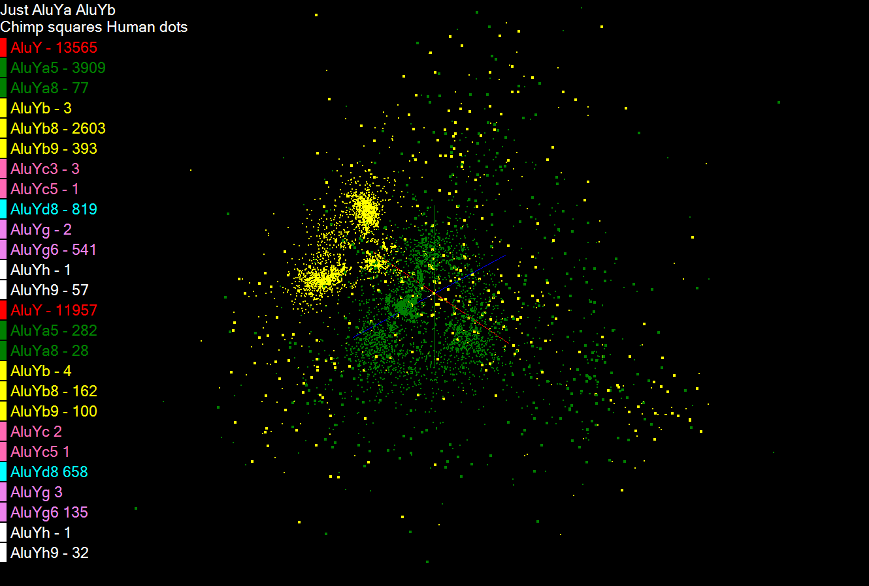

Slide 10
