Slide 1
Theme 4: High-performance computing for Precision Health Initiative
PHI Internal Presentation Indianapolis
June 15, 2017
Geoffrey Fox
gcf@indiana.edu
http://www.dsc.soic.indiana.edu/, http://spidal.org/ http://hpc-abds.org/kaleidoscope/
Digital Science Center
Department of Intelligent Systems Engineering
School of Informatics and Computing, Digital Science Center
Indiana University Bloomington

Slide 2
Intelligence Systems Engineering
13 faculty expecting to add 5 this year
High Performance and Computer Engineering
Bioengineering
  Computational approaches: cancer and virtual tissues (Glazier, Macklin)
  Maria Bondesson; toxicity experiments on zebrafish
  Feng Guo: 2016- Postdoc Stanford; 2015 Ph.D. in Engineering Science and Mechanics PSU; B.S. in Physics, Wuhan 2007.Acoustic tweezers. biomedical devices, and instruments for a wide variety of applications ranging from Single Cell Analysis and Prenatal Diagnostics to Virology and Neuroscience
  Gary Lewis; PhD University of Illinois Chicago, Bioengineering (Currently faculty at UNC); wearable data analysis with Kinsey Institute
Other areas: Robotics/Internet of Things, Nanoengineering, Intelligent Systems, Neuroengineering, Environmental Engineering

Slide 3
Digital Science Center
Faculty (Fox, Crandall, Qiu) Postdocs/Research staff, students (Ph.D. and Undergraduate), Systems, Software Engineering and Business staff
Run computer infrastructure for Cloud and HPC research
  64 node system Tango with high performance disks (SSD, NVRam = 5x SSD and 25xHDD) and Intel KNL (Knights Landing) manycore (68-72) chips. Omnipath interconnect
  128 node system Juliet with two 12-18 core Haswell chips, SSD and conventional HDD disks. Infiniband Interconnect
  16 GPU, 4 Haswell node deep learning system Romeo
  All can run HDFS and store data on nodes
  200 older nodes
Big Data Engineering (Data Science) research with applied collaborators
  System architecture, performance
Teach basic and advanced Cloud Computing and bigdata courses
Work with NIST on Big Data Standards and non-proprietary Frameworks

Slide 4
PHI Relevant Activities
Big Data Application analysis developed with NIST
  52 use cases (including 1 from Regenstrief)
  New survey starting to gather more data
  Patterns of execution and classification features
IoTCloud: technology to control robots and IoT systems from the cloud
Held 2 Streaming data analysis workshops with NSF, DoE, Industry
Major NSF SPIDAL scalable data science project including pathology image analysis with SUNY-SB developing HPC-ABDS High Performance Computing Enhanced Apache Big Data Stack
  Work on Heron, Storm, Hadoop, Spark, Flink, Hbase with communication, API’s and scheduling addressed
  Many performance analyses for machine learning applications on different platforms
Cloudmesh technology supports software automation with same scripts deployable on HPC, OpenStack, Amazon, Azure, Docker etc.

Slide 5
Components of Big Data Stack
Google likes to show a timeline
2002 Google File System GFS ~HDFS
2004 MapReduce Apache Hadoop
2006 Big Table Apache Hbase
2008 Dremel Apache Drill
2009 Pregel Apache Giraph
2010 FlumeJava Apache Crunch
2010 Colossus better GFS
2012 Spanner horizontally scalable NewSQL database ~CockroachDB
2013 F1 horizontally scalable SQL database
2013 MillWheel ~Apache Storm, Twitter Heron (Google not first!)
2015 Cloud Dataflow Apache Beam with Spark or Flink (dataflow) engine
Functionalities not identified: Security, Data Transfer, Scheduling, serverless computing

Slide 6
HPC-ABDS

Slide 7
Big Data ABDS HPCCloud 3.0 HPC, Cluster
17. Orchestration Beam, Crunch, Tez, Cloud Dataflow Kepler, Pegasus, Taverna
16. Libraries MLlib/Mahout, TensorFlow, CNTK, R, Python ScaLAPACK, PETSc, Matlab
15A. High Level Programming Pig, Hive, Drill Domain-specific Languages
15B. Platform as a Service App Engine, BlueMix, Elastic Beanstalk XSEDE Software Stack
Languages Java, Erlang, Scala, Clojure, SQL, SPARQL, Python Fortran, C/C++, Python
14B. Streaming Storm, Kafka, Kinesis
13,14A. Parallel Runtime Hadoop, MapReduce MPI/OpenMP/OpenCL
2. Coordination Zookeeper
12. Caching Memcached
11. Data Management Hbase, Accumulo, Neo4J, MySQL iRODS
10. Data Transfer Sqoop GridFTP
9. Scheduling Yarn, Mesos Slurm
8. File Systems HDFS, Object Stores Lustre
1, 11A Formats Thrift, Protobuf FITS, HDF
5. IaaS OpenStack , Docker Linux, Bare-metal, SR-IOV
Infrastructure CLOUDS Clouds and/or HPC SUPERCOMPUTERS
HPC-ABDS Integrated
Software
CUDA, Exascale Runtime

Slide 8
HPCCloud Convergence Architecture
Running same HPC-ABDS software across all platforms but data management machine has different balance in I/O, Network and Compute from “model” machine
  Note data storage approach: HDFS v. Object Store v. Lustre style file systems is still rather unclear
The Model behaves similarly whether from Big Data or Big Simulation.
Data Management Model for Big Data
and Big Simulation
HPCCloud Capacity-style Operational Model matches hardware features with application requirements

Slide 9


Multidimensional Scaling MDS Results with Flink, Spark and MPI
MDS execution time on 16 nodes with 20 processes in each node with varying number of points
MDS execution time with 32000 points on varying number of nodes. Each node runs 20 parallel tasks
MDS performed poorly on Flink due to its lack of support for nested iterations. Need to have data locality (alignment) sensitivity

Slide 10
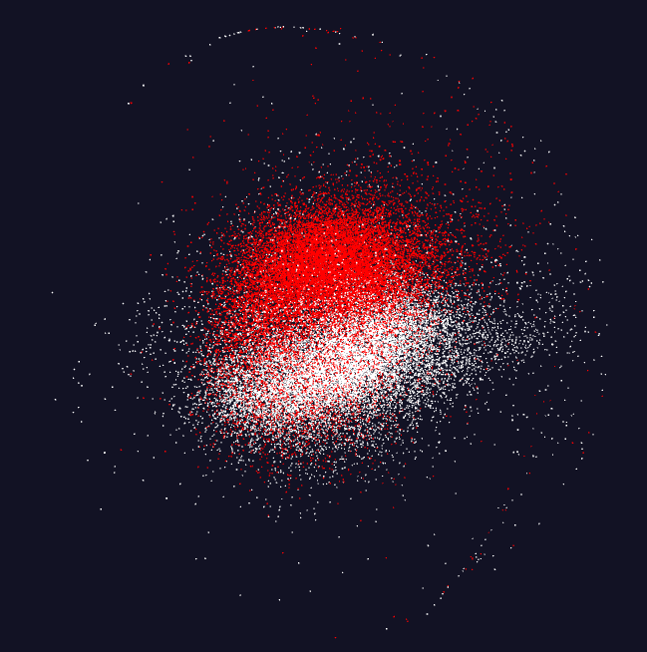
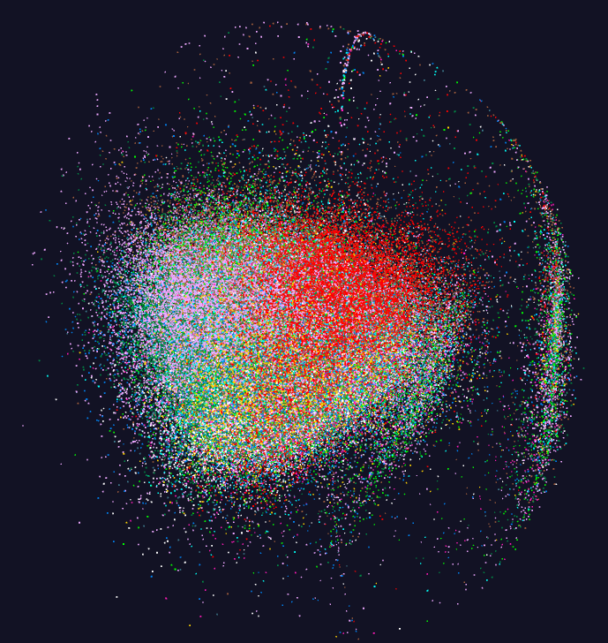
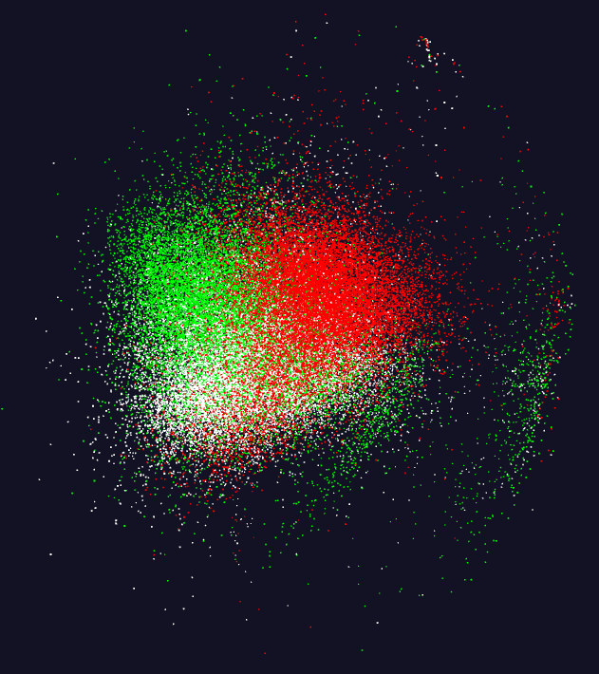
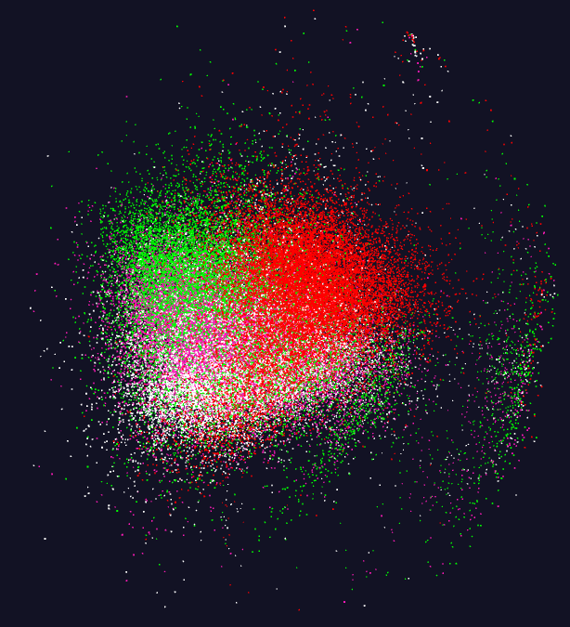
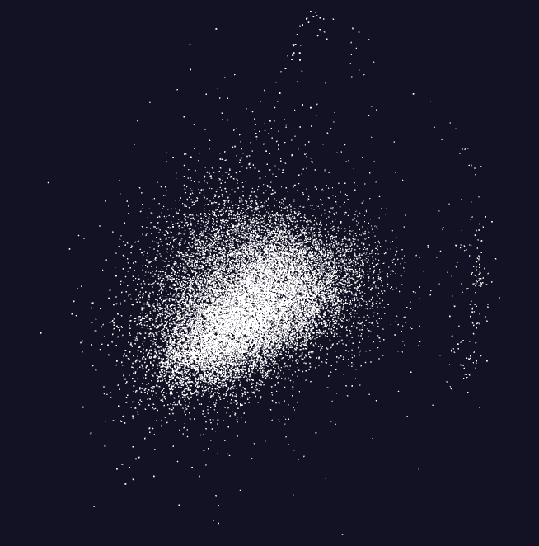
Pathology Image Features (cells)
11 Images
20,000 features per image.
96 properties per feature but projected to 3D for visualization – colored by image
Parallel MPI job
https://spidal-gw.dsc.soic.indiana.edu/public/resultsets/1678860580

Slide 11
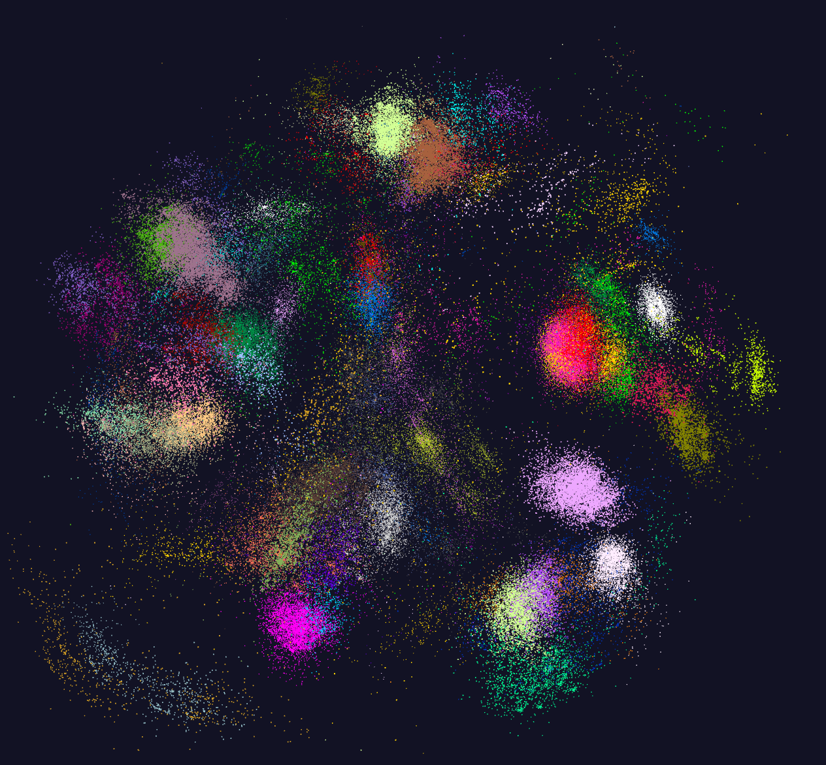
https://spidal-gw.dsc.soic.indiana.edu/public/resultsets/1273112137
170,000 distinct Fungi sequences.
64 clusters
Projected to 3D and visualized. Colored by cluster
Pipeline of 2 MPI jobs

Slide 12
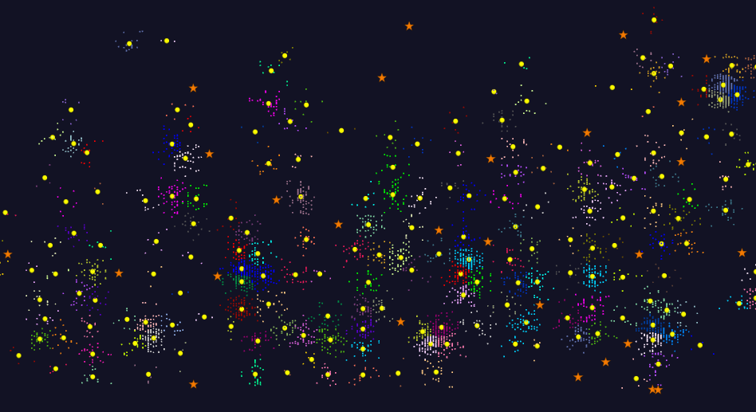
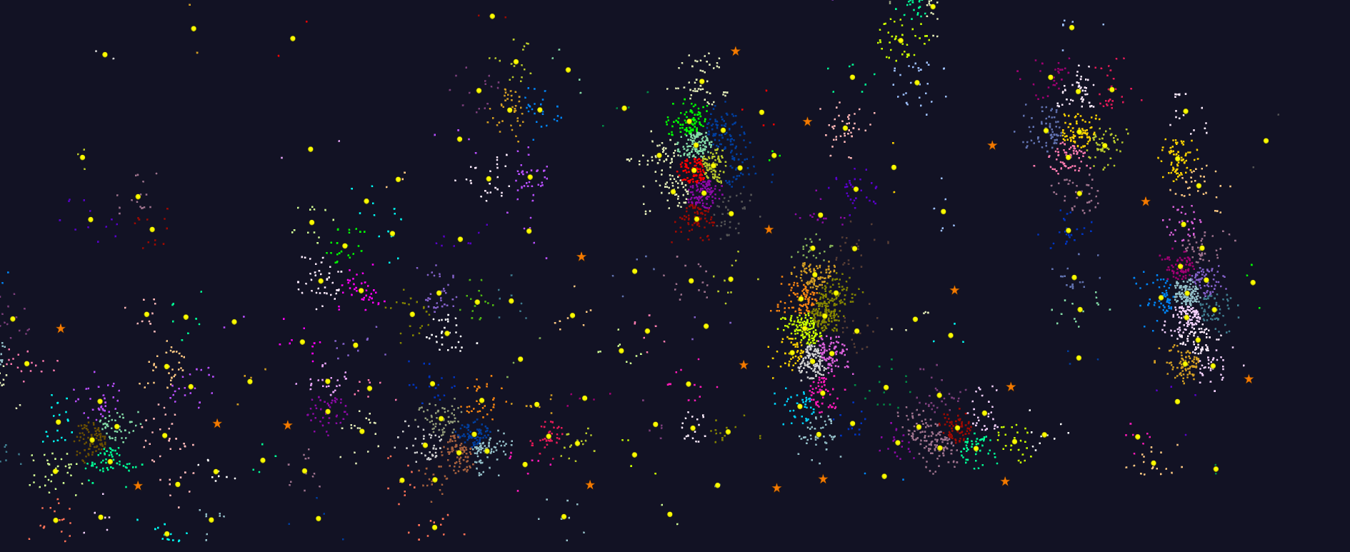
2D Vector Clustering with cutoff at 3 σ
Orange Star – outside all clusters; yellow circle cluster centers
LCMS Mass Spectrometer Peak Clustering with MPI. Charge 2 Sample with 10.9 million points and 420,000 clusters visualized in WebPlotViz. Nature Article "Proteogenomics connects somatic mutations to signalling in breast cancer".
https://spidal-gw.dsc.soic.indiana.edu/public/resultsets/1657429765

Slide 13
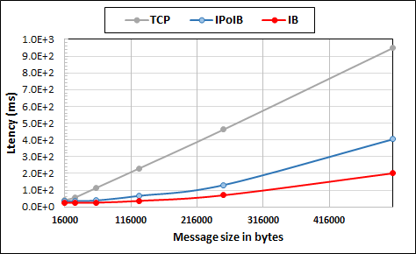
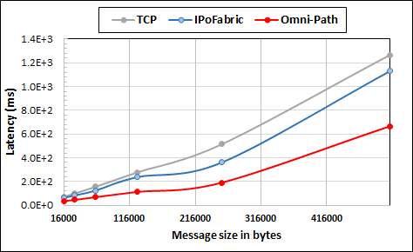
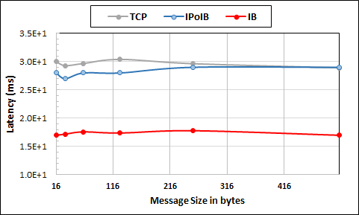
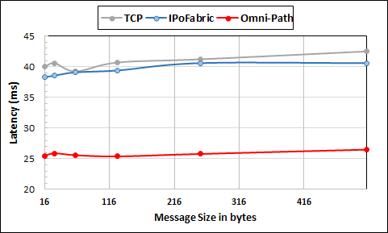
Intel Haswell Cluster with 2.4GHz Processors and 56Gbps Infiniband and 1Gbps Ethernet
Intel KNL Cluster with 1.4GHz Processors and 100Gbps Omni-Path and 1Gbps Ethernet
Large messages
Small messages
Parallelism of 2 and using 8 Nodes
Parallelism of 2 and using 4 Nodes
Twitter Heron Streaming Software using HPC Hardware

Slide 14
Knights Landing KNL Data Analytics: Harp, Spark, NOMAD
Single Node and Cluster performance: 1.4GHz 68 core nodes
Kmeans SGD ALS
Strong Scaling Multi Node Parallelism Scaling - Omnipath Interconnect
Strong Scaling Single Node Core Parallelism Scaling

Slide 15
HPCCloud Software Defined Systems
Significant advantages in specifying job software with scripts such as Chef, Puppet, Ansible – “Software Defined Systems” (SDS)
  Choose Ansible as Python based
Less voluminous than machine images; easier to ensure latest version; easy to recreate image on demand after crashes
In work with NIST, we looked at 87 applications from two of our “big data on cloud” classes and from NIST itself (6)
The 6 NIST use cases need 27 Ansible roles (distinct software subsystems) and full set of 87 needed 62 separate roles (average 4.75 roles per use case)
With NIST Public Big Data group, looking at mapping SDS to system architecture
Preparing Ansible specifications of many subsystems and use cases

Slide 16
27 Ansible Roles and Re-use in 6 NIST use cases
ID | 6 NIST Use Cass | Hadoop | Mesos | Spark | Storm | Pig | Hive | Drill | HDFS | HBase | Mysql | MongoDB | RethinkDB | Mahout | D3, Tableau | nltk | MLlib | Lucene/Solr | OpenCV | Python | Java | maven | Ganglia | Nagios | spark supervisord | zookeeper | AlchemyAPI | R
1 | NIST Fingerprint Matching | x |  | x |  |  | x | x |  | x | x |  |  |  |  |  |  |  |  |  | x | x | x | x | x | x
2 | Human and Face Detection |  | x | x |  |  |  |  |  |  |  |  |  |  |  |  |  |  | x | x |  |  |  |  |  | x
3 | Twitter Analysis |  |  |  | x |  |  |  |  | x |  | x |  |  | x | x |  |  |  | x | x |  |  |  |  | x | x | x
4 | Analytics for Healthcare Data/Health Informatics | x |  | x |  |  |  |  |  | x |  |  |  | x | x |  | x | x |  |  | x |  |  |  |  | x
5 | Spatial Big Data/Spatial Statistics/Geographic Information Systems | x |  | x |  |  |  |  |  |  |  |  |  | x | x |  | x |  |  |  | x | x
6 | Data Warehousing and Data Mining | x |  | x |  | x | x |  |  | x |  | x |  | x | x |  | x | x |  |  | x |  |  |  |  | x
count |  | 4 | 1 | 5 | 1 | 1 | 2 | 1 | 0 | 4 | 1 | 2 | 0 | 3 | 4 | 1 | 3 | 2 | 1 | 2 | 5 | 2 | 3 | 1 | 1 | 5 | 1 | 1

Slide 17
All Presentations Available

Slide 18
Typical Big Data Pattern 2. Perform real time analytics on data source streams and notify users when specified events occur
Specify filter
Filter Identifying Events
Fetch streamed Data
Post Selected Events
Streaming Data
Posted Data
Identified Events
Streaming Data
Streaming Data
Archive
Repository
Storm (Heron), Kafka, Hbase, Zookeeper

Slide 20
6 Forms of MapReduce
Describes Architecture of
- Problem (Model reflecting data)
- Machine
- Software
Problem Architecture Classifiers such as Pleasingly Parallel, Map-Collective,Map- Streaming, and Graph feature in Processing view

