Slide 1
Data Science and Clouds
August 23 2013
MURPA/QURPA Melbourne/Queensland/Brisbane Virtual Presentation
Geoffrey Fox
gcf@indiana.edu
http://www.infomall.org http://www.futuregrid.org
School of Informatics and Computing
Community Grids Laboratory
Indiana University Bloomington

Slide 2
Abstract
There is an endlessly growing amount of data as we record every transaction between people and the environment (whether shopping or on a social networking site) while smart phones, smart homes, ubiquitous cities, smart power grids, and intelligent vehicles deploy sensors recording even more.
Science with satellites and accelerators is giving data on transactions of particles and photons at the microscopic scale while low cost gene sequencers can soon give us petabytes of data each day.
This data are and will be stored in immense clouds with co-located storage and computing that perform "analytics" that transform data into information and then to wisdom and decisions; data mining finds the proverbial knowledge diamonds in the data rough.
This disruptive transformation is driving the economy and creating millions of jobs in the emerging area of "data science". We discuss this revolution and its implications for research and education in universities.

Slide 3
Issues of Importance
Economic Imperative: There are a lot of data and a lot of jobs
Computing Model: Industry adopted clouds which are attractive for data analytics
Research Model: 4th Paradigm; From Theory to Data driven science?
Confusion in data science: lack of consensus academically in several aspects of data intensive computing from storage to algorithms, to processing and education
Progress in Data Intensive Programming Models
( Progress in Academic (open source) clouds )
( Progress in scalable robust Algorithms: new data need better algorithms? )
Progress in Data Science Education: opportunities at universities

Slide 4
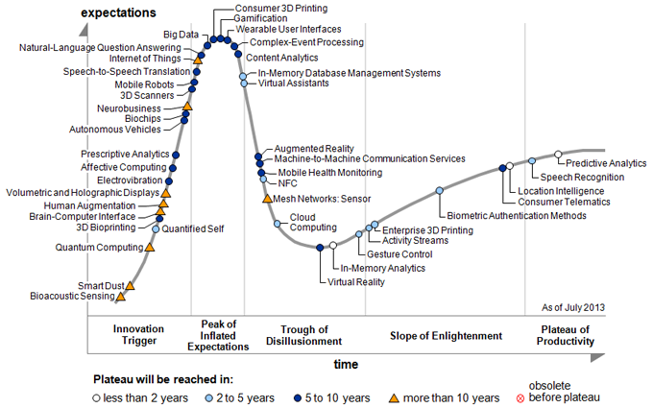
Gartner Emerging Technology Hype Cycle 2013

Slide 5
Economic Imperative
There are a lot of data and a lot of jobs

Slide 6
Data Deluge

Slide 7
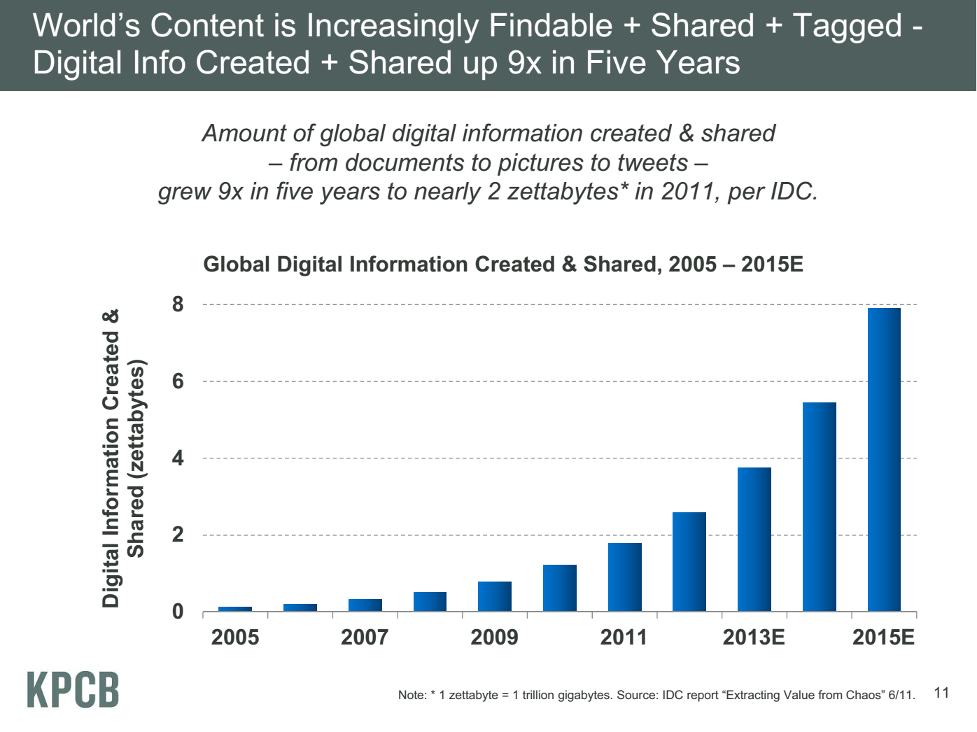
Meeker/Wu May 29 2013 Internet Trends D11 Conference

Slide 8
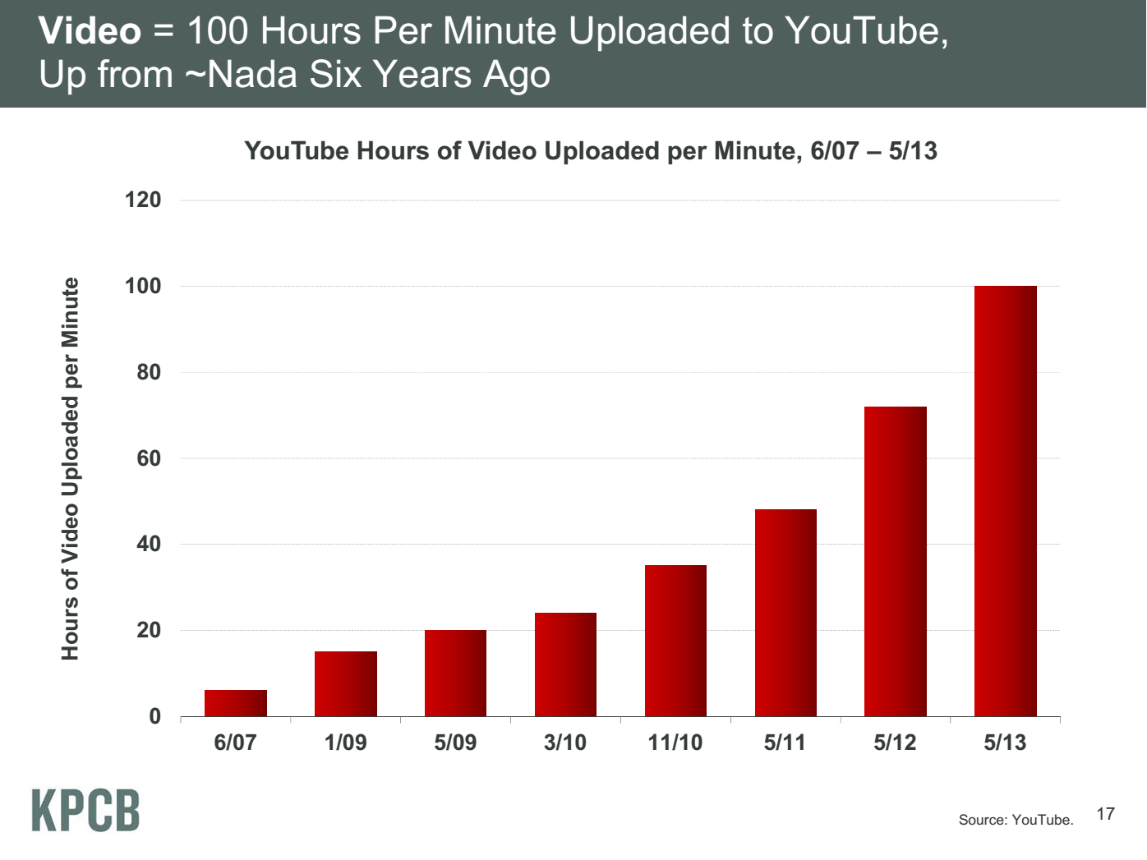
20 hours
Meeker/Wu May 29 2013 Internet Trends D11 Conference

Slide 9
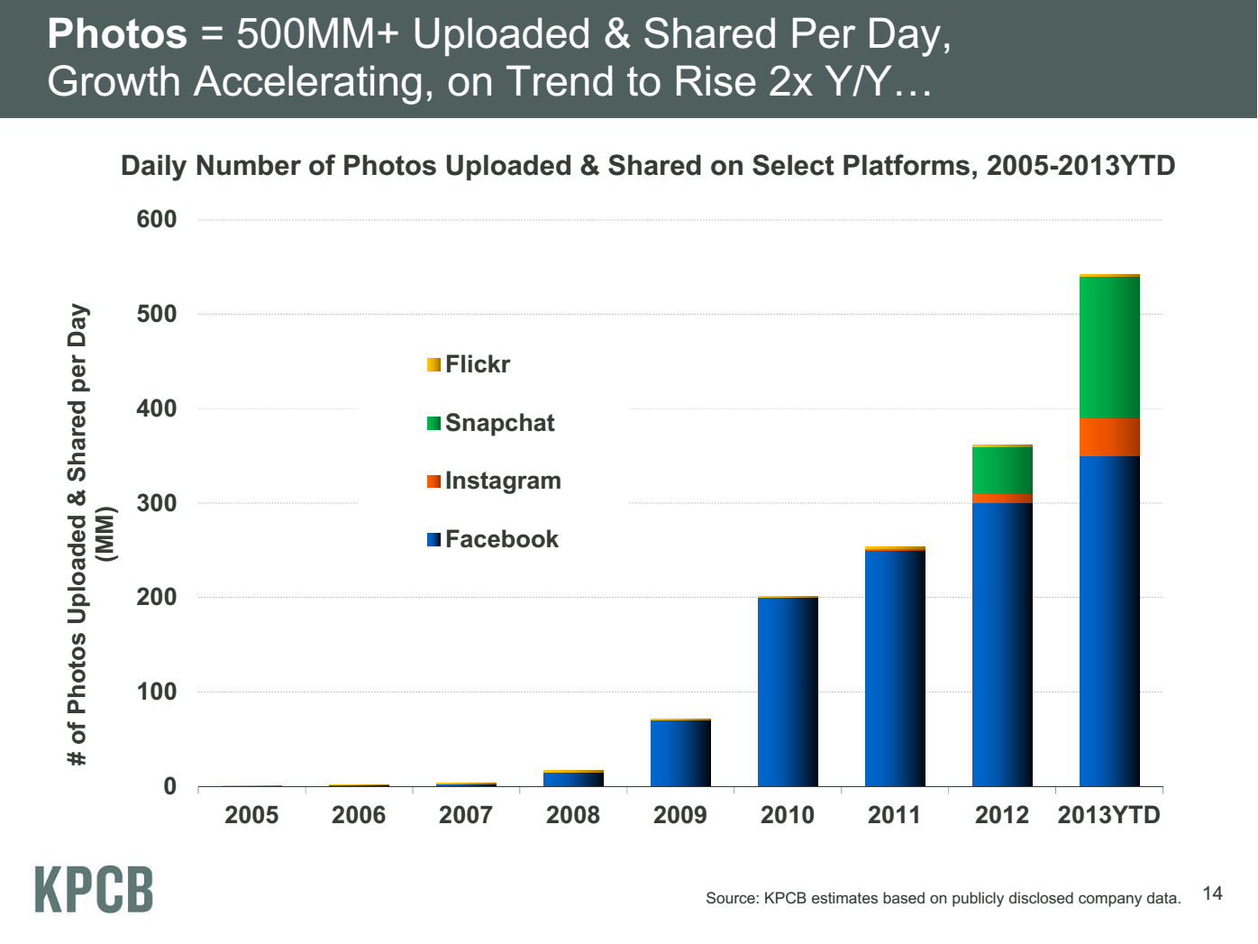
Meeker/Wu May 29 2013 Internet Trends D11 Conference

Slide 10

Some Data sizes
  ~40 10⁹ Web pages at ~300 kilobytes each = 10 Petabytes
  LHC 15 petabytes per year
  Radiology 69 petabytes per year
  Square Kilometer Array Telescope will be 100 terabits/second
  Earth Observation becoming ~4 petabytes per year
  Earthquake Science – few terabytes total today
  PolarGrid – 100’s terabytes/year becoming petabytes
  Exascale simulation data dumps – terabytes/second
  Deep Learning to train self driving car; 100 million megapixel images ~ 100 terabytes

Slide 11
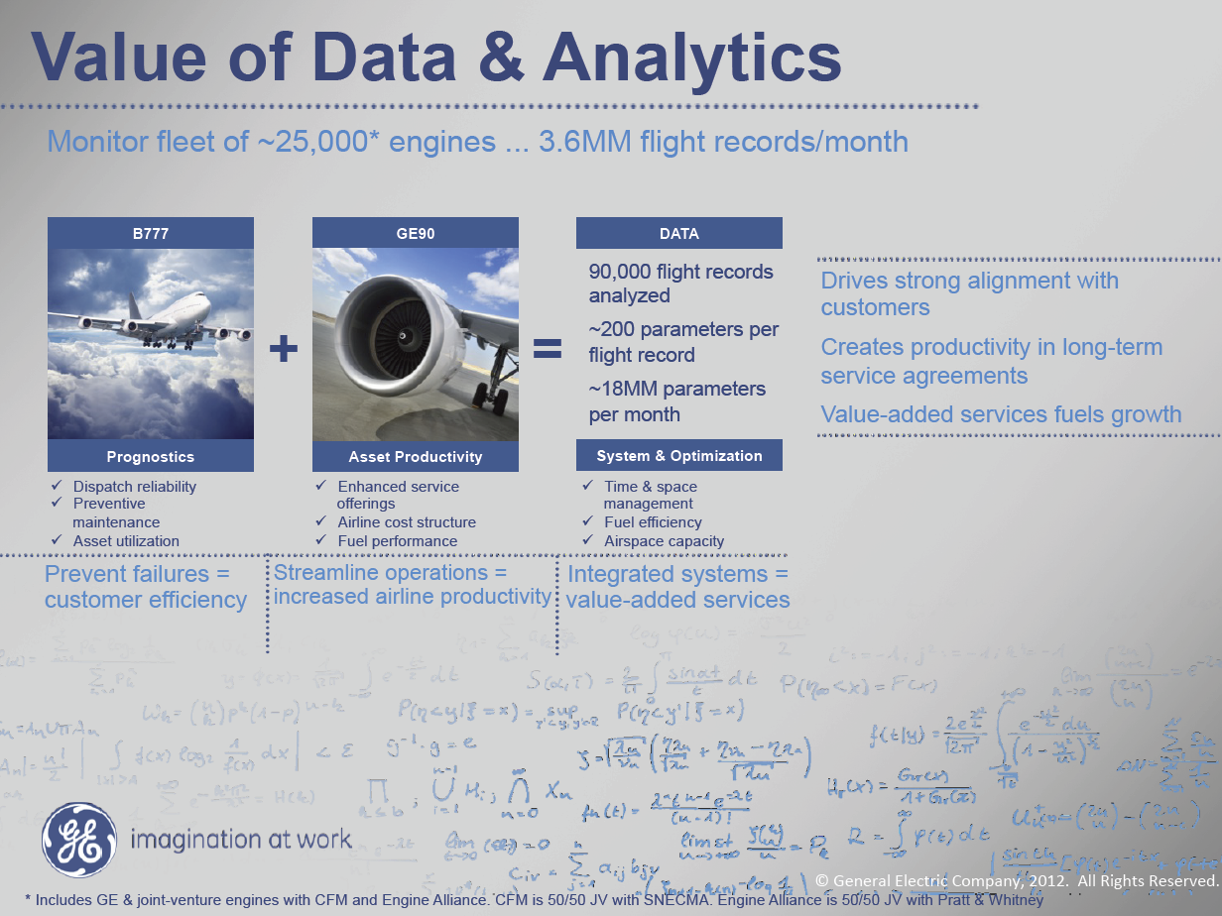
MM = Million
Ruh VP Software GE http://fisheritcenter.haas.berkeley.edu/Big_Data/index.html

Slide 12
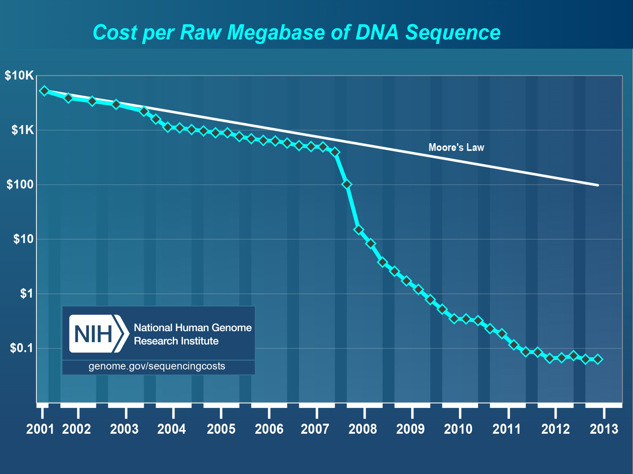
Why need cost effective
Computing!
Full Personal Genomics: 3 petabytes per day
Faster than Moore’s Law
Slower?
http://www.genome.gov/sequencingcosts/

Slide 13
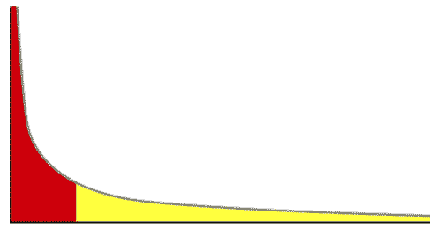
The Long Tail of Science
High energy physics, astronomy
genomics
The long tail: economics, social science, ….
Collectively “long tail” science is generating a lot of data
  Estimated at over 1PB per year and it is growing fast.
80-20 rule: 20% users generate 80% data but not necessarily 80% knowledge
From Dennis Gannon Talk

Slide 14
Jobs

Slide 15
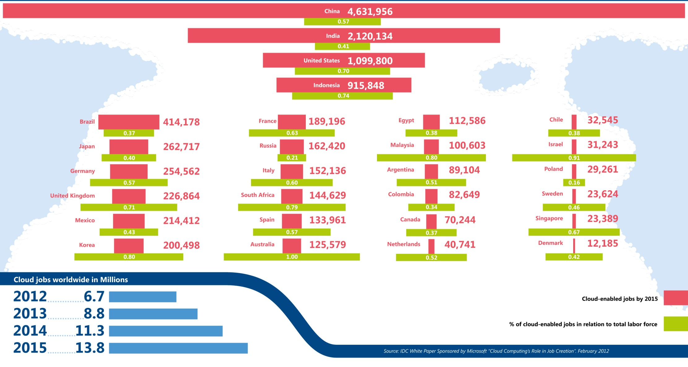
Jobs v. Countries
http://www.microsoft.com/en-us/news/features/2012/mar12/03-05CloudComputingJobs.aspx

Slide 16
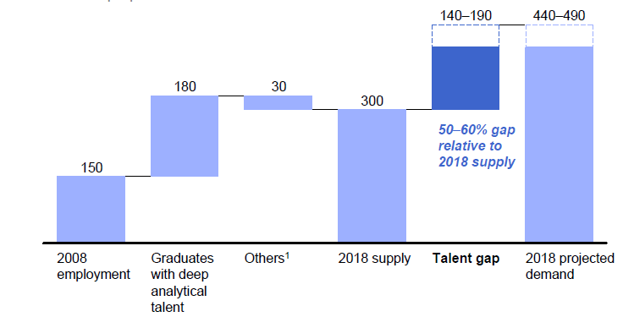
McKinsey Institute on Big Data Jobs
There will be a shortage of talent necessary for organizations to take advantage of big data. By 2018, the United States alone could face a shortage of 140,000 to 190,000 people with deep analytical skills as well as 1.5 million managers and analysts with the know-how to use the analysis of big data to make effective decisions.
At IU, Informatics aimed at 1.5 million jobs. Computer Science covers the 140,000 to 190,000
http://www.mckinsey.com/mgi/publications/big_data/index.asp.

Slide 17
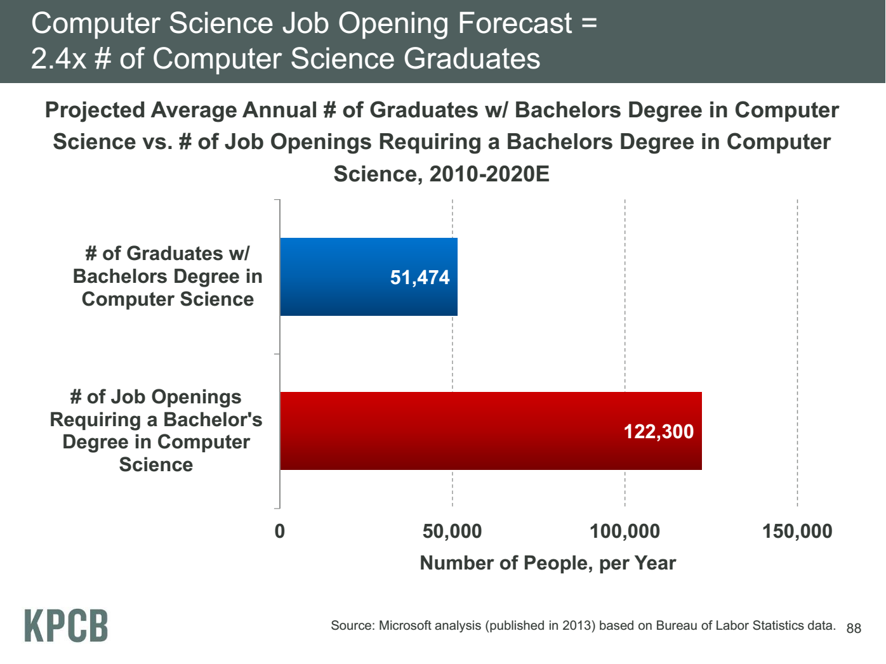
Meeker/Wu May 29 2013 Internet Trends D11 Conference

Slide 18
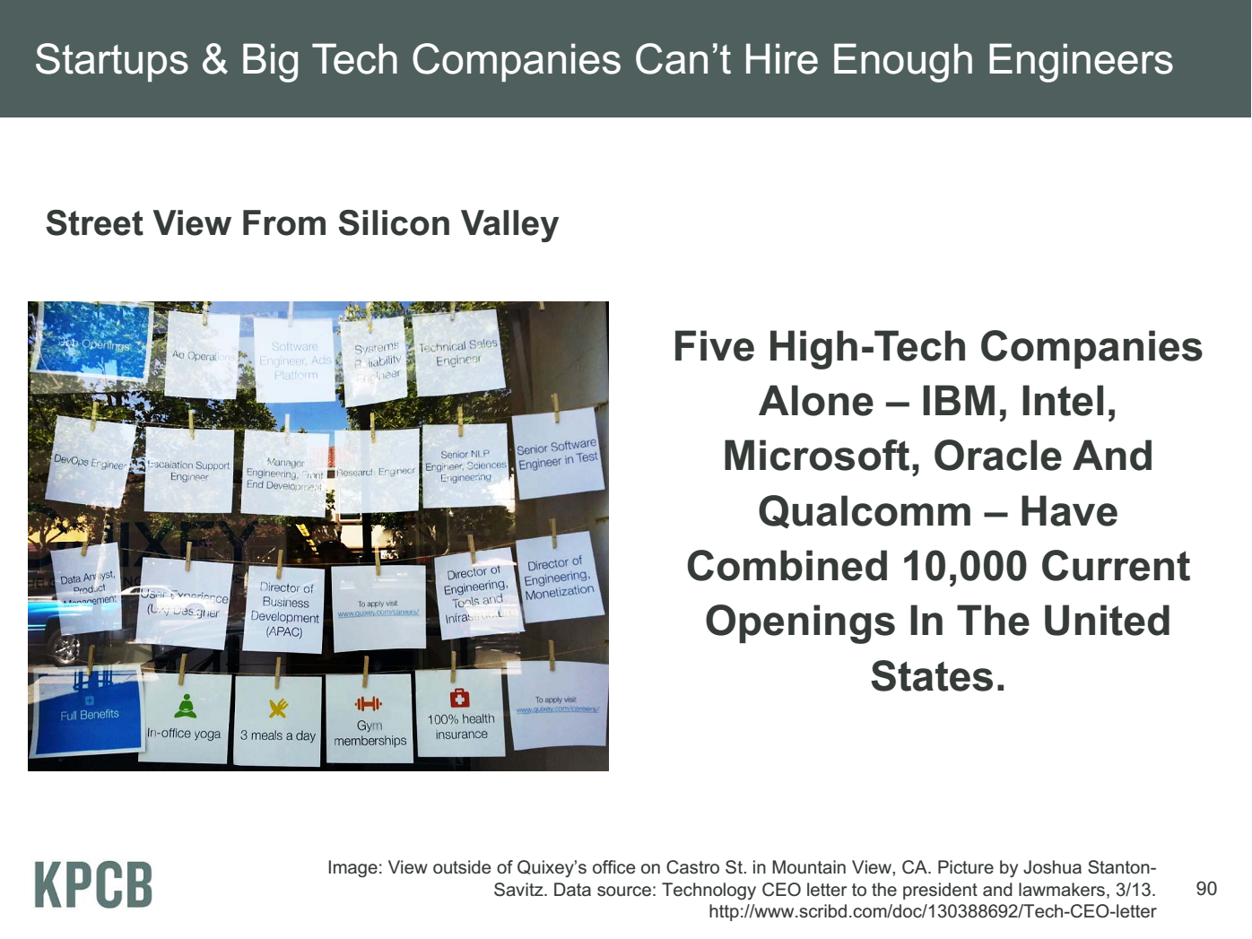
Meeker/Wu May 29 2013 Internet Trends D11 Conference

Slide 19
Computing Model
Industry adopted clouds which are attractive for data analytics

Slide 20
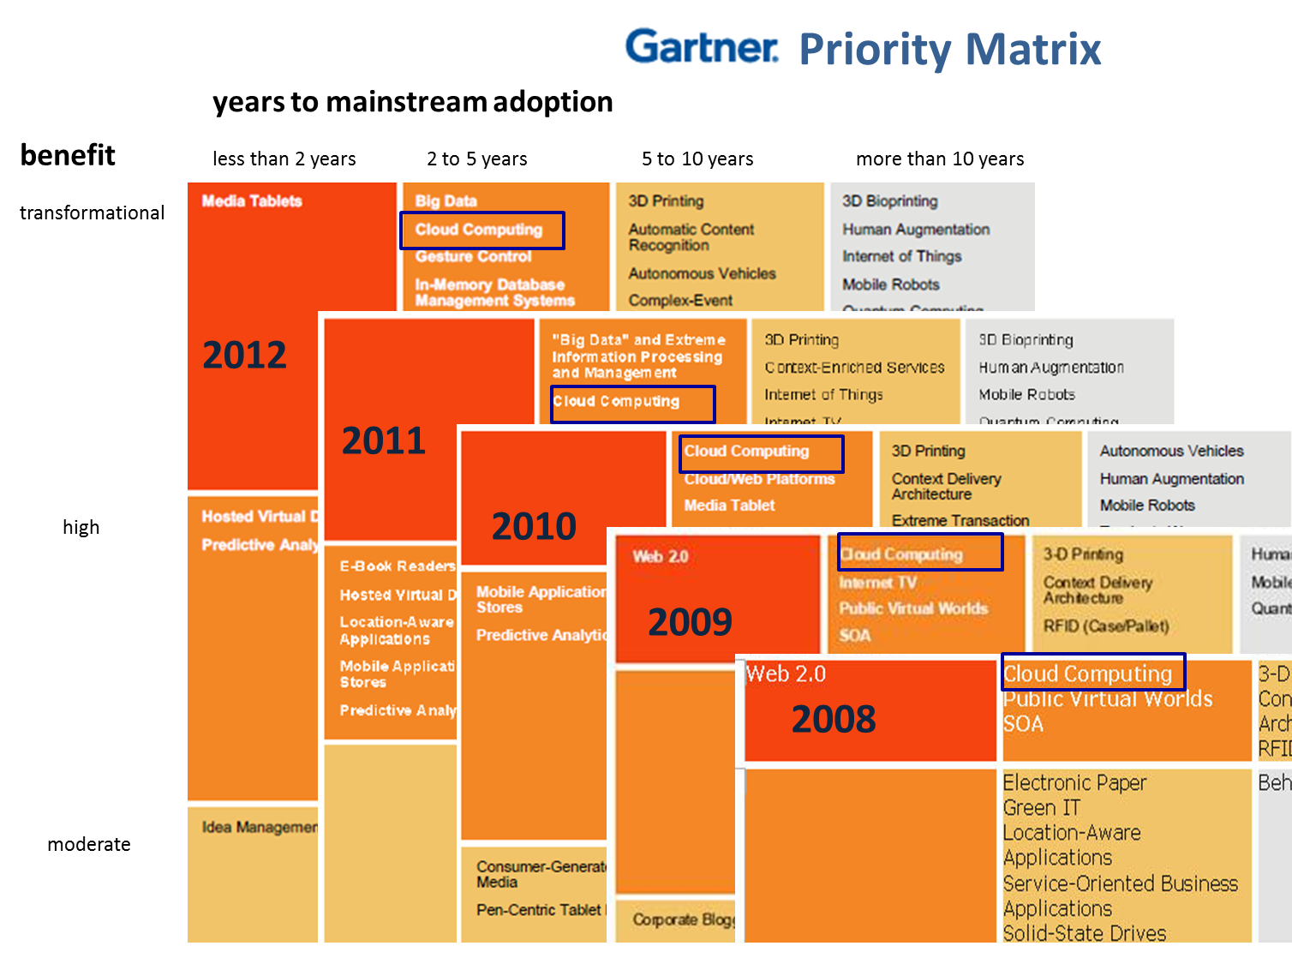
5 years Cloud Computing
2 years Big Data Transformational

Slide 21
Amazon making money
It took Amazon Web Services (AWS) eight years to hit $650 million in revenue, according to Citigroup in 2010.
Just three years later, Macquarie Capital analyst Ben Schachter estimates that AWS will top $3.8 billion in 2013 revenue, up from $2.1 billion in 2012 (estimated), valuing the AWS business at $19 billion.

Slide 22
Physically Clouds are Clear
A bunch of computers in an efficient data center with an excellent Internet connection
They were produced to meet need of public-facing Web 2.0 e-Commerce/Social Networking sites
They can be considered as “optimal giant data center” plus internet connection
Note enterprises use private clouds that are giant data centers but not optimized for Internet access
Exascale build-out of commercial cloud infrastructure: for 2014-15 expect 10,000,000 new servers and 10 Exabytes of storage in major commercial cloud data centers worldwide.

Slide 23
Virtualization made several things more convenient
Virtualization = abstraction; run a job – you know not where
Virtualization = use hypervisor to support “images”
  Allows you to define complete job as an “image” – OS + application
Efficient packing of multiple applications into one server as they don’t interfere (much) with each other if in different virtual machines;
They interfere if put as two jobs in same machine as for example must have same OS and same OS services
Also security model between VM’s more robust than between processes

Slide 24
Clouds Offer From different points of view
Features from NIST:
  On-demand service (elastic);
  Broad network access;
  Resource pooling;
  Flexible resource allocation;
  Measured service
Economies of scale in performance and electrical power (Green IT)
Powerful new software models
  Platform as a Service is not an alternative to Infrastructure as a Service – it is instead an incredible valued added
  Amazon offers PaaS as Azure, Google started
  Azure, Google offer IaaS as Amazon started
They are cheaper than classic clusters unless latter 100% utilized

Slide 25
Research Model
4th Paradigm; From Theory to Data driven science?

Slide 26
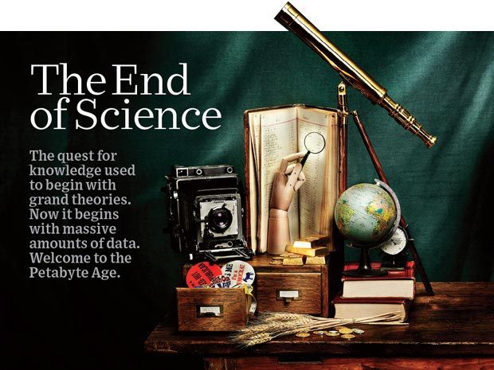
http://www.wired.com/wired/issue/16-07 September 2008

Slide 27
The 4 paradigms of Scientific Research
Theory
Experiment or Observation
  E.g. Newton observed apples falling to design his theory of mechanics
Simulation of theory or model
Data-driven (Big Data) or The Fourth Paradigm: Data-Intensive Scientific Discovery (aka Data Science)
  http://research.microsoft.com/en-us/collaboration/fourthparadigm/ A free book
  More data; less models

Slide 28

More data usually beats better algorithms
Here's how the competition works. Netflix has provided a large data set that tells you how nearly half a million people have rated about 18,000 movies. Based on these ratings, you are asked to predict the ratings of these users for movies in the set that they have not rated. The first team to beat the accuracy of Netflix's proprietary algorithm by a certain margin wins a prize of $1 million!
Different student teams in my class adopted different approaches to the problem, using both published algorithms and novel ideas. Of these, the results from two of the teams illustrate a broader point. Team A came up with a very sophisticated algorithm using the Netflix data. Team B used a very simple algorithm, but they added in additional data beyond the Netflix set: information about movie genres from the Internet Movie Database(IMDB). Guess which team did better?
Anand Rajaraman is Senior Vice President at Walmart Global eCommerce, where he heads up the newly created @WalmartLabs,
http://anand.typepad.com/datawocky/2008/03/more-data-usual.html
20120117berkeley1.pdf Jeff Hammerbacher

Slide 29
Confusion in the new-old data field
lack of consensus academically in several aspects from storage to algorithms, to processing and education

Slide 30
Data Communities Confused I?
Industry seems to know what it is doing although it’s secretive – Amazon’s last paper on their recommender system was 2003
  Industry runs the largest data analytics on clouds
  But industry algorithms are rather different from science
  NIST Big Data Initiative mainly industry
Academia confused on repository model: traditionally one stores data but one needs to support “running Data Analytics” and one is taught to bring computing to data as in Google/Hadoop file system
  Either store data in compute cloud OR enable high performance networking between distributed data repositories and “analytics engines”
Academia confused on data storage model: Files (traditional) v. Database (old industry) v. NOSQL (new cloud industry)
  Hbase MongoDB Riak Cassandra are typical NOSQL systems
Academia confused on curation of data: University Libraries, Projects, National repositories, Amazon/Google?

Slide 31
Data Communities Confused II?
Academia agrees on principles of Simulation Exascale Architecture: HPC Cluster with accelerator plus parallel wide area file system
  Industry doesn’t make extensive use of high end simulation
Academia confused on architecture for data analysis: Grid (as in LHC), Public Cloud, Private Cloud, re-use simulation architecture with database, object store, parallel file system, HDFS style data
Academia has not agreed on Programming/Execution model: “Data Grid Software”, MPI, MapReduce ..
Academia has not agreed on need for new algorithms: Use natural extension of old algorithms, R or Matlab. Simulation successes built on great algorithm libraries;
Academia has not agreed on what algorithms are important?
Academia could attract more students: with data-oriented curricula that prepare for industry or research careers

Slide 32
Clouds in Research

Slide 33
2 Aspects of Cloud Computing:
Infrastructure and Runtimes
Cloud infrastructure: outsourcing of servers, computing, data, file space, utility computing, etc..
Cloud runtimes or Platform: tools to do data-parallel (and other) computations. Valid on Clouds and traditional clusters
  Apache Hadoop, Google MapReduce, Microsoft Dryad, Bigtable, Chubby and others
  MapReduce designed for information retrieval but is excellent for a wide range of science data analysis applications
  Can also do much traditional parallel computing for data-mining if extended to support iterative operations
  Data Parallel File system as in HDFS and Bigtable

Slide 34
Clouds have highlighted SaaS PaaS IaaS
But equally valid for classic clusters
Software
(Application
Or Usage) SaaS
Education
Applications
CS Research Use e.g. test new compiler or storage model
Software Services are building blocks of applications
The middleware or computing environment including HPC, Grids …
Nimbus, Eucalyptus, OpenStack, OpenNebula
CloudStack plus Bare-metal
OpenFlow – likely to grow in importance
Cloud e.g. MapReduce
HPC e.g. PETSc, SAGA
Computer Science e.g. Compiler tools, Sensor nets, Monitors
Platform
PaaS
Infra
structure
IaaS
Software Defined Computing (virtual Clusters)
Hypervisor, Bare Metal
Operating System
Network
NaaS
Software Defined Networks
OpenFlow GENI

Slide 35
Science Computing Environments
Large Scale Supercomputers – Multicore nodes linked by high performance low latency network
  Increasingly with GPU enhancement
  Suitable for highly parallel simulations
High Throughput Systems such as European Grid Initiative EGI or Open Science Grid OSG typically aimed at pleasingly parallel jobs
  Can use “cycle stealing”
  Classic example is LHC data analysis
Grids federate resources as in EGI/OSG or enable convenient access to multiple backend systems including supercomputers
Use Services (SaaS)
  Portals make access convenient and
  Workflow integrates multiple processes into a single job

Slide 36
Clouds HPC and Grids
Synchronization/communication Performance
Grids > Clouds > Classic HPC Systems
Clouds naturally execute effectively Grid workloads but are less clear for closely coupled HPC applications
Classic HPC machines as MPI engines offer highest possible performance on closely coupled problems
The 4 forms of MapReduce/MPI
  Map Only – pleasingly parallel
  Classic MapReduce as in Hadoop; single Map followed by reduction with fault tolerant use of disk
  Iterative MapReduce use for data mining such as Expectation Maximization in clustering etc.; Cache data in memory between iterations and support the large collective communication (Reduce, Scatter, Gather, Multicast) use in data mining
  Classic MPI! Support small point to point messaging efficiently as used in partial differential equation solvers

Slide 37
4 Forms of MapReduce
(a) Map Only
(b) Classic MapReduce
(c) Iterative MapReduce
(d) Loosely Synchronous
Input
Input
Iterations
Input
map
map
map
P_{ij}
reduce
reduce
Output
BLAST Analysis
Parametric sweep
Pleasingly Parallel
High Energy Physics (HEP) Histograms
Distributed search
Expectation maximization Clustering e.g. Kmeans
Linear Algebra, Page Rank
Classic MPI
PDE Solvers and particle dynamics
Domain of MapReduce and Iterative Extensions
Science Clouds
MPI
Exascale
MPI is Map followed by Point to Point Communication – as in style d)

Slide 38
Classic Parallel Computing
HPC: Typically SPMD (Single Program Multiple Data) “maps” typically processing particles or mesh points interspersed with multitude of low latency messages supported by specialized networks such as Infiniband and technologies like MPI
  Often run large capability jobs with 100K (going to 1.5M) cores on same job
  National DoE/NSF/NASA facilities run 100% utilization
  Fault fragile and cannot tolerate “outlier maps” taking longer than others
Clouds: MapReduce has asynchronous maps typically processing data points with results saved to disk. Final reduce phase integrates results from different maps
  Fault tolerant and does not require map synchronization
  Map only useful special case
HPC + Clouds: Iterative MapReduce caches results between “MapReduce” steps and supports SPMD parallel computing with large messages as seen in parallel kernels (linear algebra) in clustering and other data mining

Slide 39
Cloud Applications

Slide 40
What Applications work in Clouds
Pleasingly (moving to modestly) parallel applications of all sorts with roughly independent data or spawning independent simulations
  Long tail of science and integration of distributed sensors
Commercial and Science Data analytics that can use MapReduce (some of such apps) or its iterative variants (most other data analytics apps)
Which science applications are using clouds?
  Venus-C (Azure in Europe): 27 applications not using Scheduler, Workflow or MapReduce (except roll your own)
  50% of applications on FutureGrid are from Life Science
  Locally Lilly corporation is commercial cloud user (for drug discovery) but not IU Biology
But overall very little science use of clouds

Slide 41
Parallelism over Users and Usages
“Long tail of science” can be an important usage mode of clouds.
In some areas like particle physics and astronomy, i.e. “big science”, there are just a few major instruments generating now petascale data driving discovery in a coordinated fashion.
In other areas such as genomics and environmental science, there are many “individual” researchers with distributed collection and analysis of data whose total data and processing needs can match the size of big science.
Clouds can provide scaling convenient resources for this important aspect of science.
Can be map only use of MapReduce if different usages naturally linked e.g. exploring docking of multiple chemicals or alignment of multiple DNA sequences
  Collecting together or summarizing multiple “maps” is a simple Reduction

Slide 42
Internet of Things and the Cloud
Cisco projects that there will be 50 billion devices on the Internet by 2020. Most will be small sensors that send streams of information into the cloud where it will be processed and integrated with other streams and turned into knowledge that will help our lives in a multitude of small and big ways.
The cloud will become increasing important as a controller of and resource provider for the Internet of Things.
As well as today’s use for smart phone and gaming console support, “Intelligent River” “smart homes and grid” and “ubiquitous cities” build on this vision and we could expect a growth in cloud supported/controlled robotics.
Some of these “things” will be supporting science
Natural parallelism over “things”
“Things” are distributed and so form a Grid

Slide 43
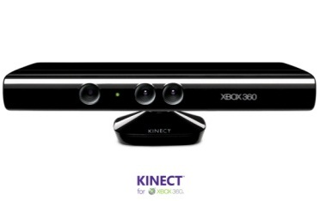

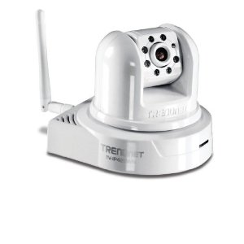
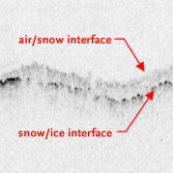
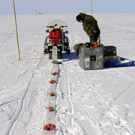

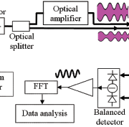

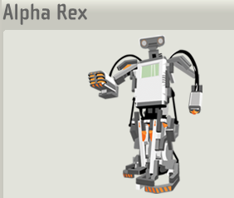
Sensors (Things) as a Service
Output Sensor
Sensors as a Service
Sensor Processing as a Service (could use
MapReduce)
A larger sensor ………
https://sites.google.com/site/opensourceiotcloud/ Open Source Sensor (IoT) Cloud

Slide 44
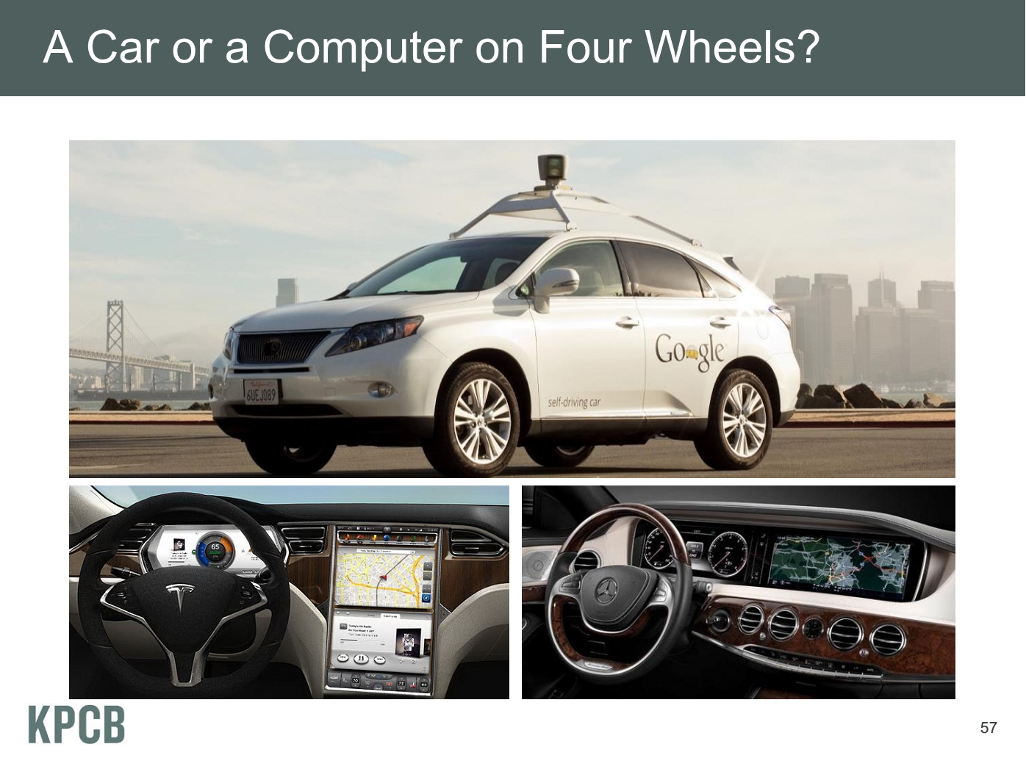
Meeker/Wu May 29 2013 Internet Trends D11 Conference

Slide 45
Clouds & Data Intensive Applications
Applications tend to be new and so can consider emerging technologies such as clouds
Do not have lots of small messages but rather large reduction (aka Collective) operations
  New optimizations e.g. for huge messages
Machine Learning has FULL Matrix kernels
EM (expectation maximization) tends to be good for clouds and Iterative MapReduce
  Quite complicated computations (so compute largish compared to communicate)
  Communication is Reduction operations (global sums or linear)
We looked at Clustering and Multidimensional Scaling using deterministic annealing which are both EM

Slide 46
Data Intensive Programming Models

Slide 47
Map Collective Model (Judy Qiu)
Combine MPI and MapReduce ideas
Implement collectives optimally on Infiniband, Azure, Amazon ……
Iterate
Input
map
Initial Collective Step
Generalized Reduce
Final Collective Step

Slide 48
Twister for Data Intensive
Iterative Applications
Generalize to arbitrary Collective
Broadcast
Compute
Communication
Reduce/ barrier
New Iteration
Smaller Loop-Variant Data
Larger Loop-Invariant Data
(Iterative) MapReduce structure with Map-Collective is framework
Twister runs on Linux or Azure
Twister4Azure is built on top of Azure tables, queues, storage
Qiu, Gunarathne
Notes:
Most of these applications consists of iterative computation and communication steps where single iterations can easily be specified as MapReduce computations.
Large input data sizes which are loop-invariant and can be reused across iterations.
Loop-variant results.. Orders of magnitude smaller…
While these can be performed using traditional MapReduce frameworks, Traditional is not efficient for these types of computations. MR leaves lot of room for improvements in terms of iterative applications.

Slide 49
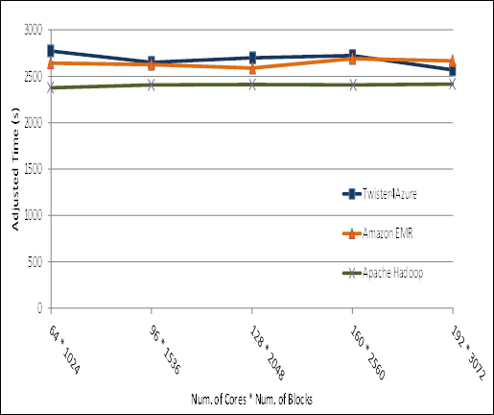
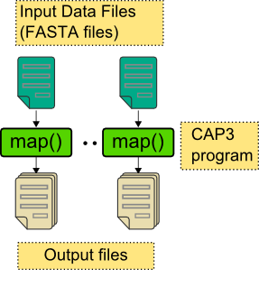
Pleasingly Parallel
Performance Comparisons
Smith Waterman
Sequence Alignment
BLAST Sequence Search
Cap3 Sequence Assembly

Slide 50
Kmeans Clustering
This shows that the communication and synchronization overheads between iterations are very small (less than one second, which is the lowest measured unit for this graph).
128 Million data points(19GB), 500 centroids (78KB), 20 dimensions
10 iterations, 256 cores, 256 map tasks per iteration

Slide 51
Kmeans Clustering
128 Million data points(19GB), 500 centroids (78KB), 20 dimensions
10 iterations, 256 cores, 256 map tasks per iteration

Slide 52
Kmeans and (Iterative) MapReduce
Shaded areas are computing only where Hadoop on HPC cluster fastest
Areas above shading are overheads where T4A smallest and T4A with AllReduce collective has lowest overhead
Note even on Azure Java (Orange) faster than T4A C#

Slide 53
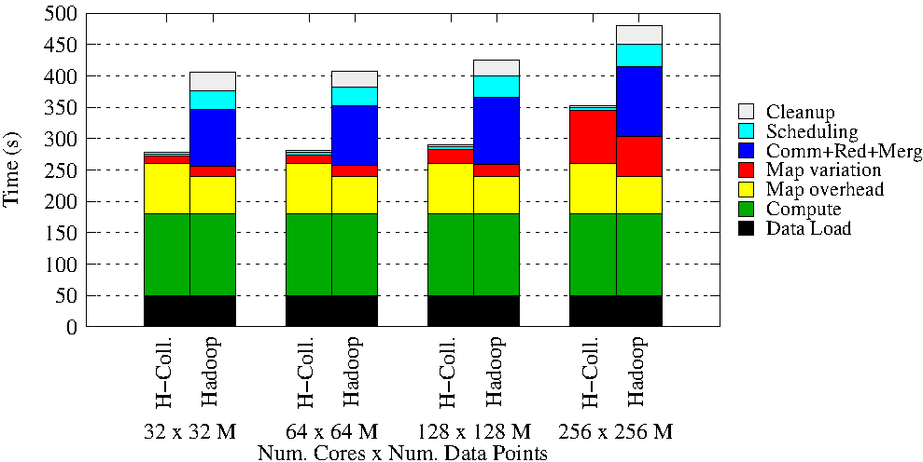
Details of K-means Linux Hadoop and Hadoop with AllReduce Collective

Slide 54
Data Science Education
Opportunities at universities
see recent New York Times articles
http://datascience101.wordpress.com/2013/04/13/new-york-times-data-science-articles/

Slide 55
Data Science Education
Broad Range of Topics from Policy to curation to applications and algorithms, programming models, data systems, statistics, and broad range of CS subjects such as Clouds, Programming, HCI,
Plenty of Jobs and broader range of possibilities than computational science but similar cosmic issues
  What type of degree (Certificate, minor, track, “real” degree)
  What implementation (department, interdisciplinary group supporting education and research program)

Slide 56
Computational Science
Interdisciplinary field between computer science and applications with primary focus on simulation areas
Very successful as a research area
  XSEDE and Exascale systems enable
Several academic programs but these have been less successful than computational science research as
  No consensus as to curricula and jobs (don’t appoint faculty in computational science; do appoint to DoE labs)
  Field relatively small
Started around 1990

Slide 57
MOOC’s

Slide 58
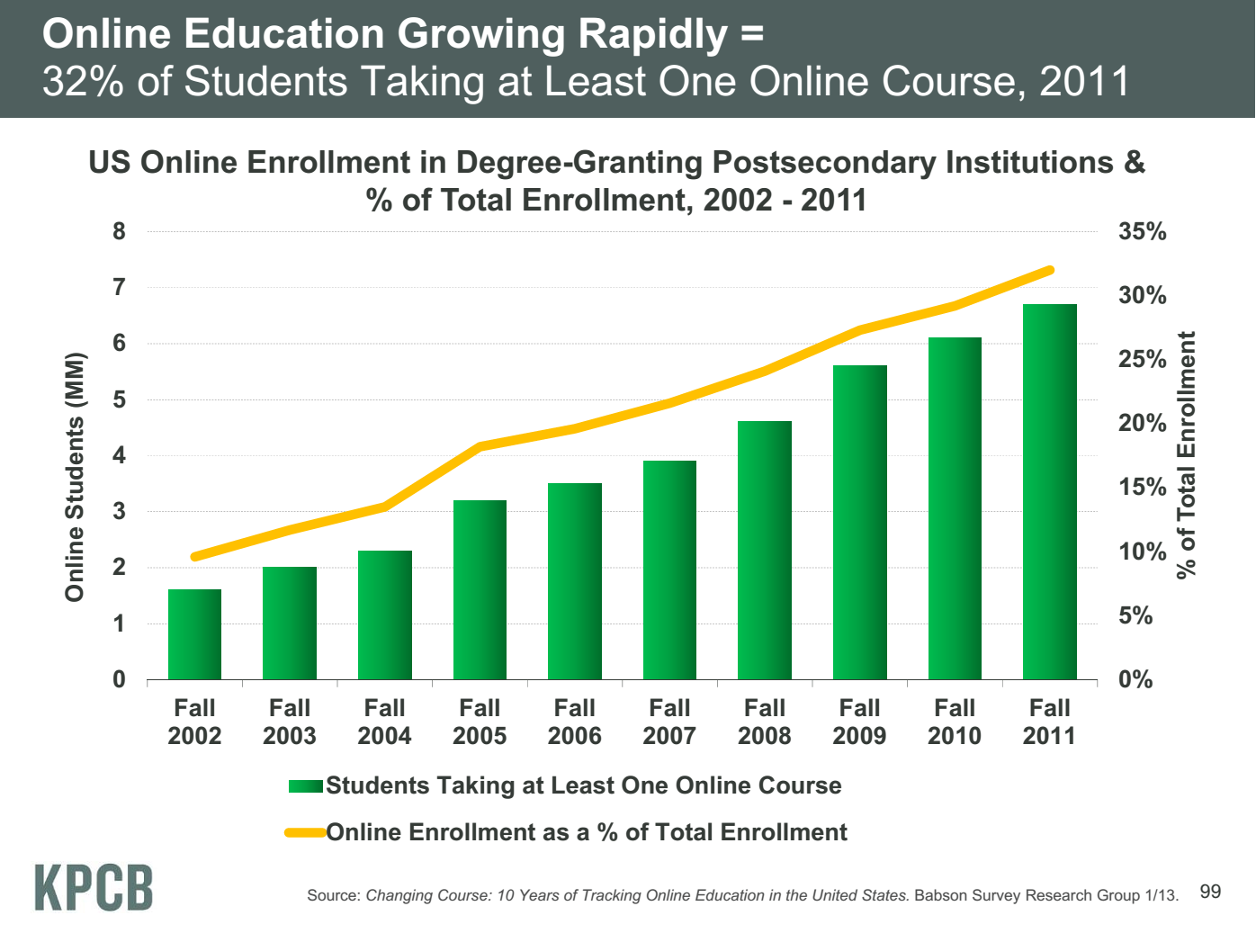
Meeker/Wu May 29 2013 Internet Trends D11 Conference

Slide 59
Massive Open Online Courses (MOOC)
MOOC’s are very “hot” these days with Udacity and Coursera as start-ups; perhaps over 100,000 participants
Relevant to Data Science (where IU is preparing a MOOC) as this is a new field with few courses at most universities
Typical model is collection of short prerecorded segments (talking head over PowerPoint) of length 3-15 minutes
These “lesson objects” can be viewed as “songs”
Google Course Builder (python open source) builds customizable MOOC’s as “playlists” of “songs”
Tells you to capture all material as “lesson objects”
We are aiming to build a repository of many “songs”; used in many ways – tutorials, classes …

Slide 60
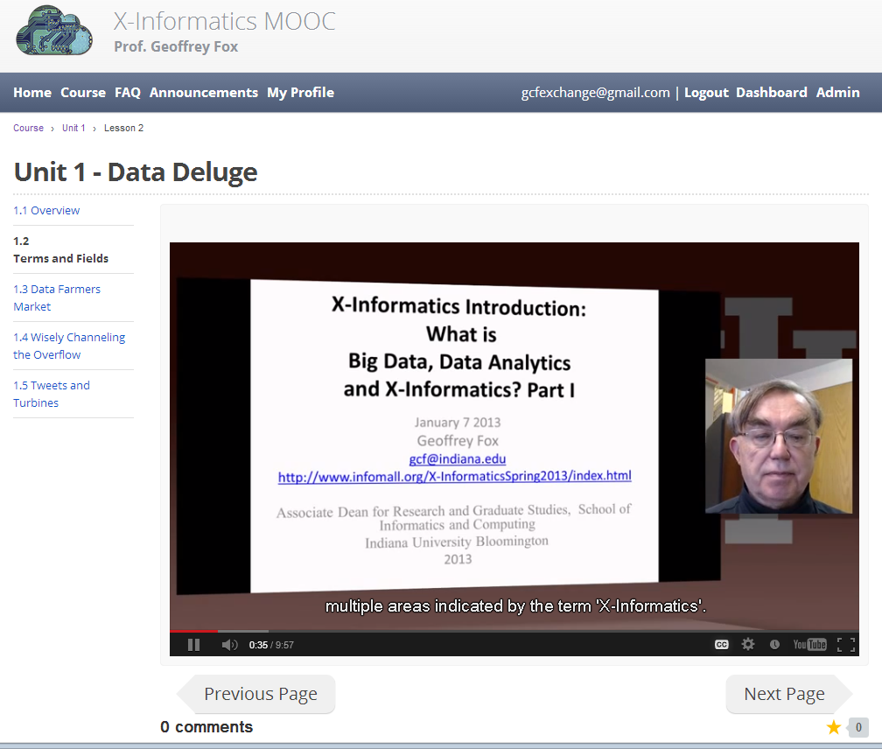
MOOC’s for Traditional Lectures
We can take MOOC lessons and view them as a “learning object” that we can share between different teachers
i.e. as a way of teaching typical sized classes but with less effort as shared material
Start with what’s in repository;
pick and choose;
Add custom material of individual teachers
The ~15 minute Video over PowerPoint of MOOC’s much easier to re-use than PowerPoint
Do not need special mentoring support
Defining how to support computing labs with FutureGrid or appliances + Virtual Box

Slide 61
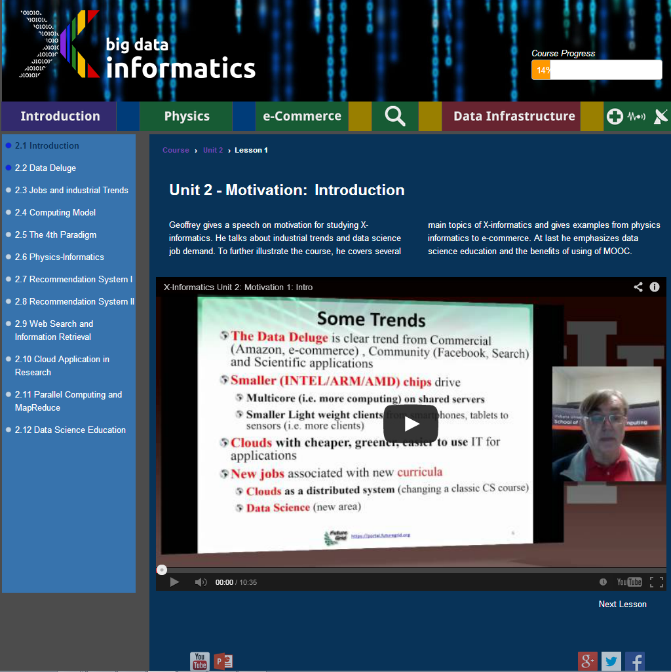
Twelve ~10 minutes lesson objects in this lecture
IU wants us to close caption if use in real course

Slide 62
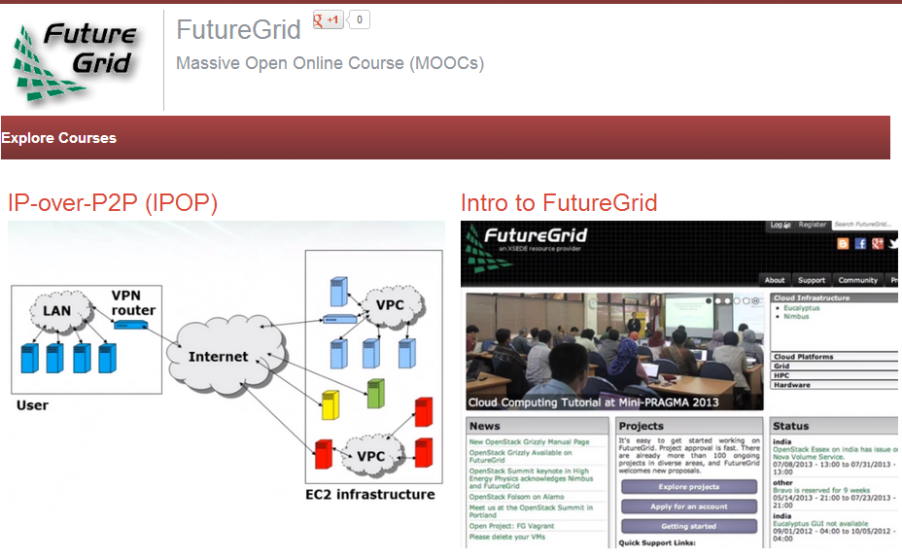

Slide 63
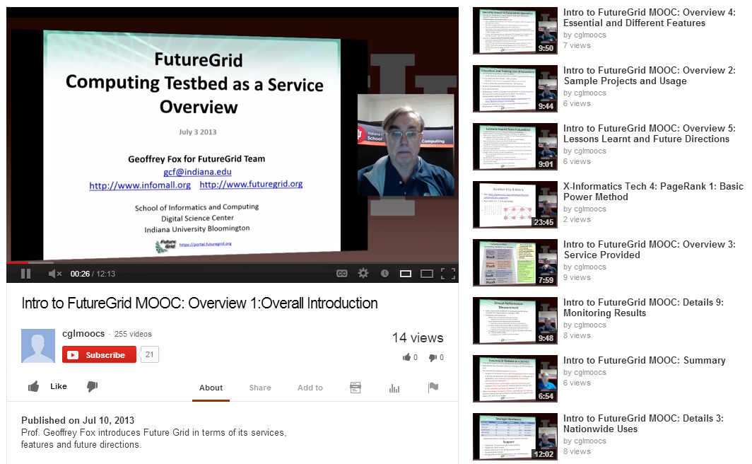

Slide 64
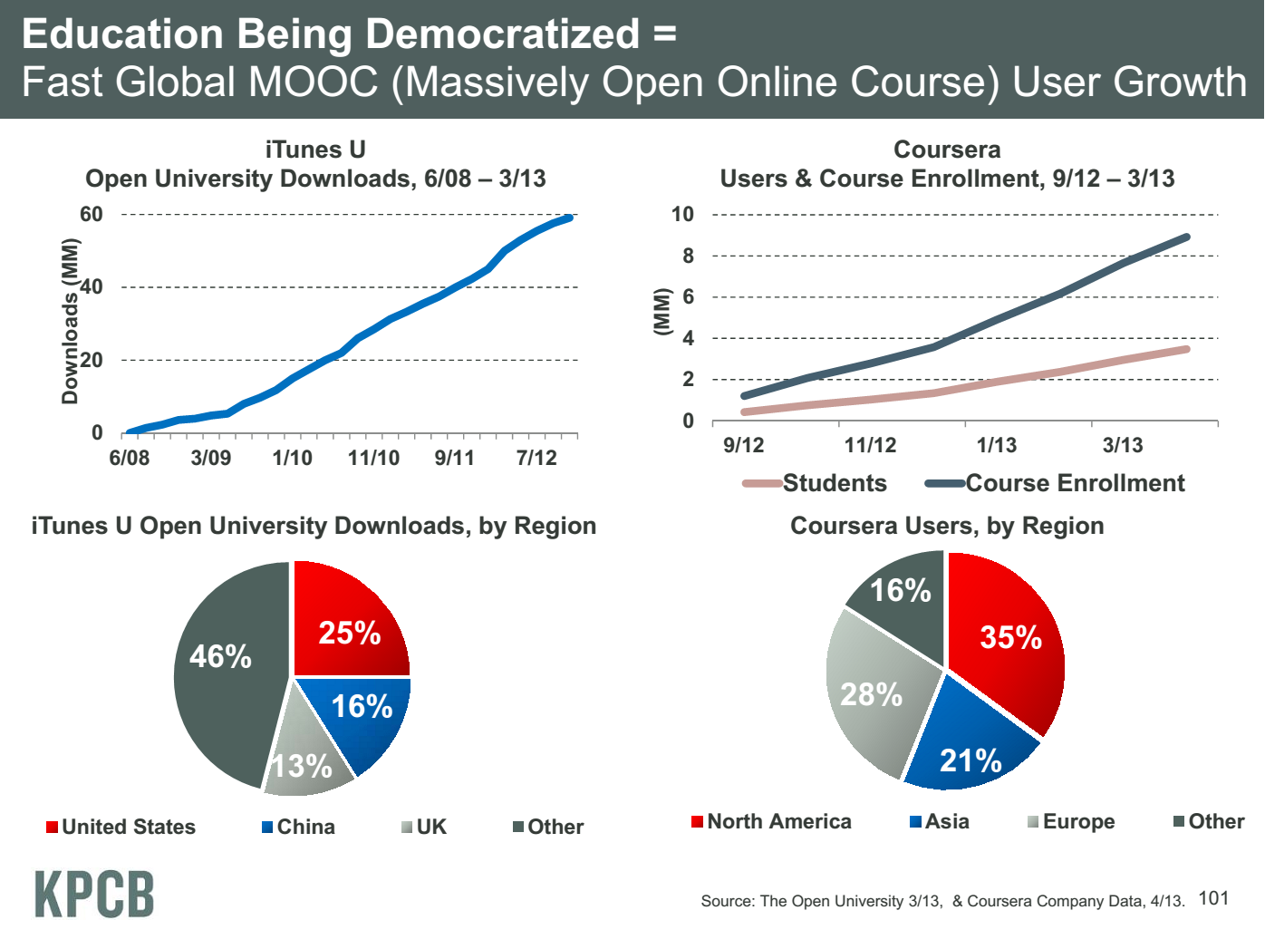
Meeker/Wu May 29 2013 Internet Trends D11 Conference

Slide 65
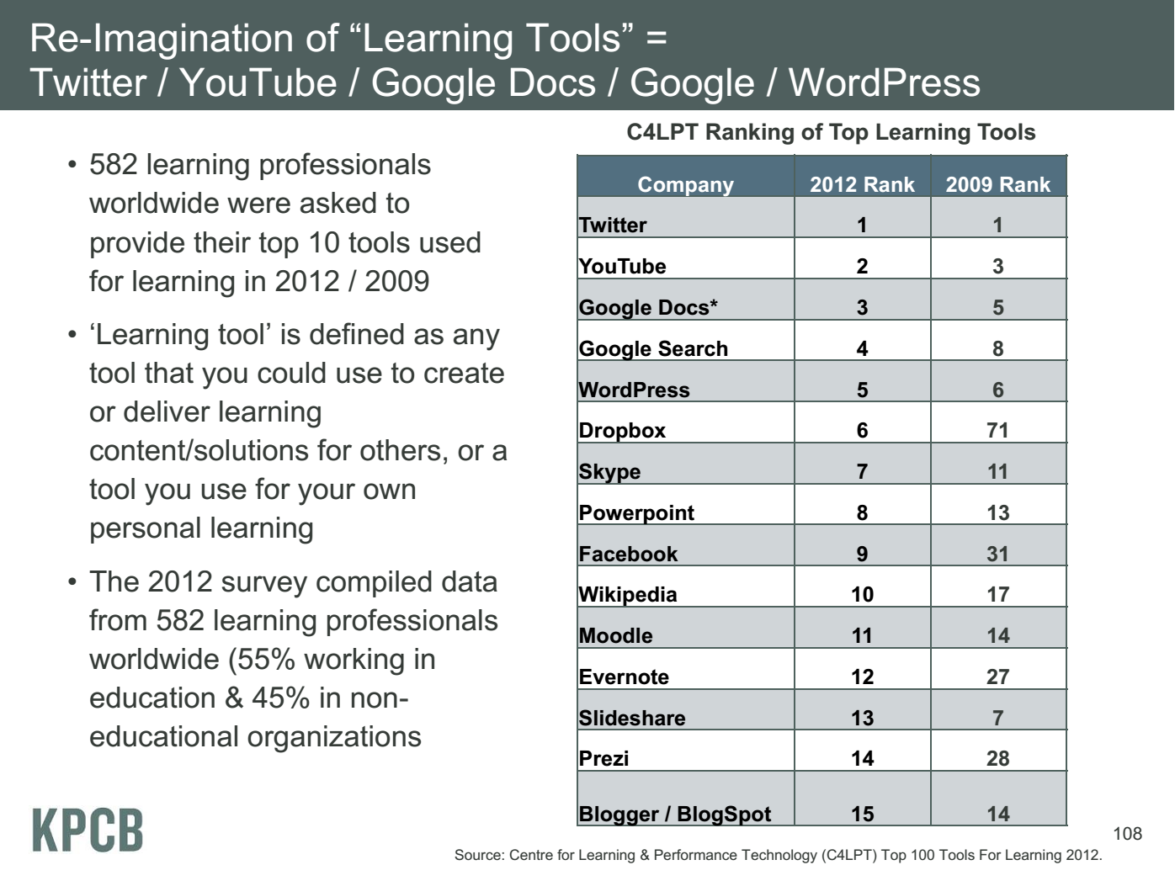
Meeker/Wu May 29 2013 Internet
Trends D11 Conference

Slide 66
Customizable MOOC’s I
We could teach one class to 100,000 students or 2,000 classes to 50 students
The 2,000 class choice has 2 useful features
  One can use the usual (electronic) mentoring/grading technology
  One can customize each of 2,000 classes for a particular audience given their level and interests
  One can even allow student to customize – that’s what one does in making play lists in iTunes
Both models can be supported by a repository of lesson objects (3-15 minute video segments) in the cloud
The teacher can choose from existing lesson objects and add their own to produce a new customized course with new lessons contributed back to repository

Slide 67
Customizable MOOC’s II
The 3-15 minute Video over PowerPoint of MOOC lesson object’s is easy to re-use
Qiu (IU)and Hayden (ECSU Elizabeth City State University) will customize a module
  Starting with Qiu’s cloud computing course at IU
  Adding material on use of Cloud Computing in Remote Sensing (area covered by ECSU course)
This is a model for adding cloud curricula material to diverse set of universities
Defining how to support computing labs associated with MOOC’s with FutureGrid or appliances + Virtual Box
  Appliances scale as download to student’s client
  Virtual machines essential

Slide 68
Conclusions

Slide 69
Big Data Ecosystem in One Sentence
Use Clouds running Data Analytics Collaboratively processing Big Data to solve problems in X-Informatics ( or e-X)
X = Astronomy, Biology, Biomedicine, Business, Chemistry, Climate, Crisis, Earth Science, Energy, Environment, Finance, Health, Intelligence, Lifestyle, Marketing, Medicine, Pathology, Policy, Radar, Security, Sensor, Social, Sustainability, Wealth and Wellness with more fields (physics) defined implicitly
Spans Industry and Science (research)
Education: Data Science see recent New York Times articles
http://datascience101.wordpress.com/2013/04/13/new-york-times-data-science-articles/
X-Informatics Class http://www.infomall.org/X-InformaticsSpring2013/
Big data MOOC http://x-informatics.appspot.com/preview

Slide 70
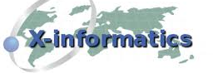


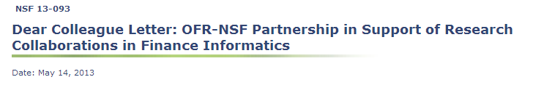
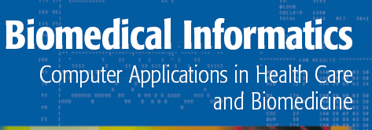




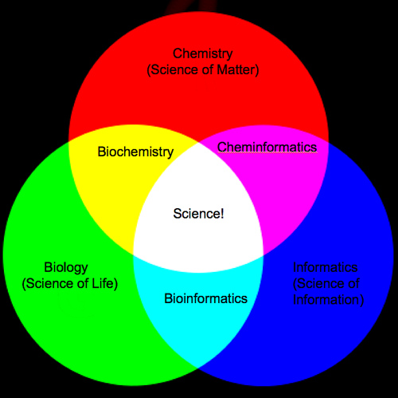


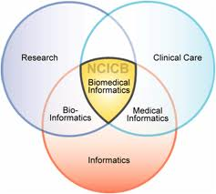
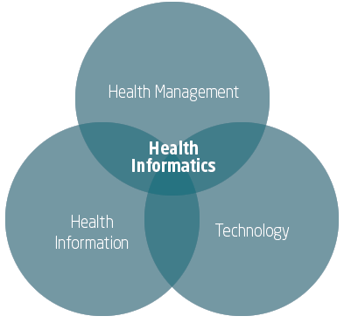
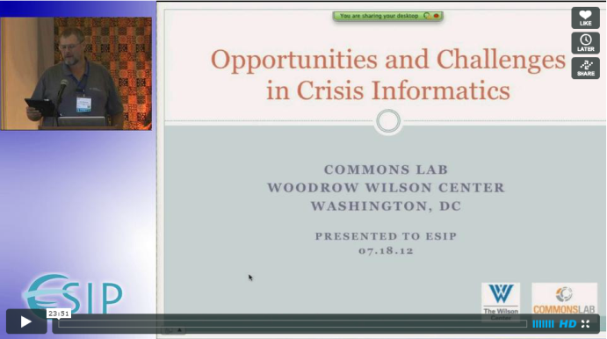

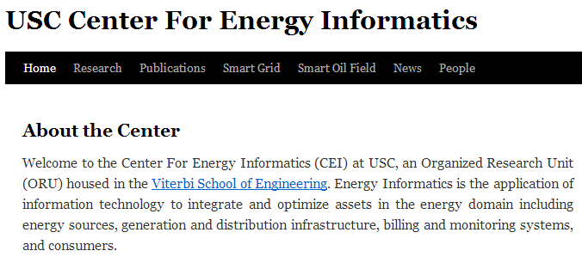
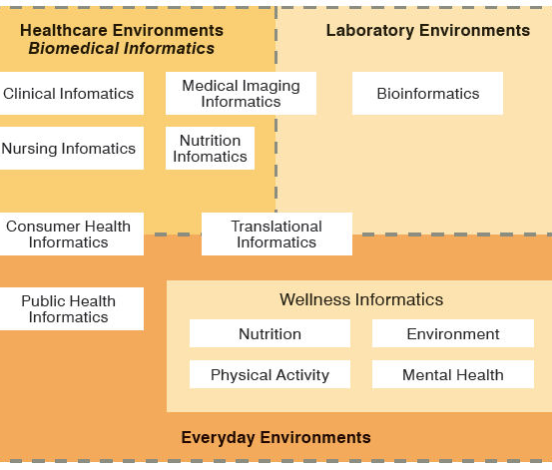
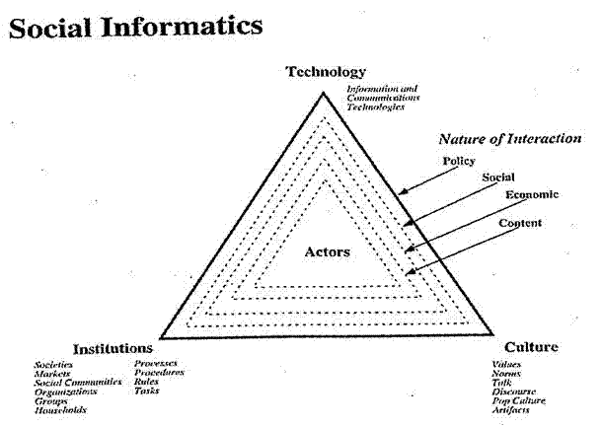

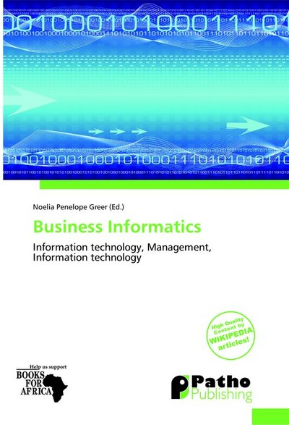
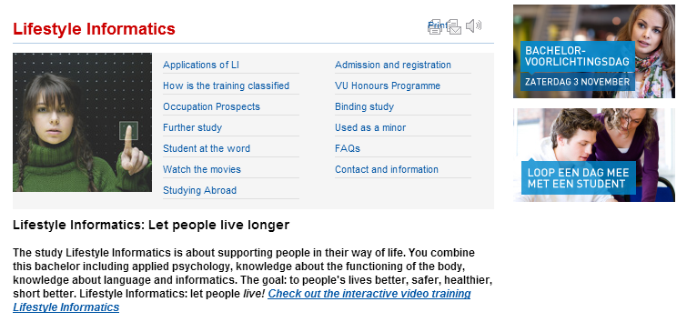
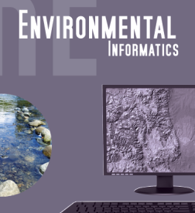

Social Informatics

Slide 71
Conclusions
Clouds and HPC are here to stay and one should plan on using both
Data Intensive programs are not like simulations as they have large “reductions” (“collectives”) and do not have many small messages
  Clouds suitable
Iterative MapReduce an interesting approach; need to optimize collectives for new applications (Data analytics) and resources (clouds, GPU’s …)
Need an initiative to build scalable high performance data analytics library on top of interoperable cloud-HPC platform
Many promising data analytics algorithms such as deterministic annealing not used as implementations not available in R/Matlab etc.
  More sophisticated software and runs longer but can be efficiently parallelized so runtime not a big issue

Slide 72
Conclusions II
Software defined computing systems linking NaaS, IaaS, PaaS, SaaS (Network, Infrastructure, Platform, Software) likely to be important
More employment opportunities in clouds than HPC and Grids and in data than simulation; so cloud and data related activities popular with students
Community activity to discuss data science education
  Agree on curricula; is such a degree attractive?
Role of MOOC’s as either
  Disseminating new curricula
  Managing course fragments that can be assembled into custom courses for particular interdisciplinary students

