Slide 1

MPI, Dataflow, Streaming: Messaging for Diverse Requirements
25 years of MPI Symposium
Argonne National Lab, Chicago, Illinois,
Geoffrey Fox, September 25, 2017
Indiana University, Department of Intelligent Systems Engineering
gcf@indiana.edu, http://www.dsc.soic.indiana.edu/, http://spidal.org/
`
Work with Judy Qiu, Shantenu Jha, Supun Kamburugamuve, Kannan Govindarajan, Pulasthi Wickramasinghe

Slide 2
Abstract: MPI, Dataflow, Streaming: Messaging for Diverse Requirements
We look at messaging needed in a variety of parallel, distributed, cloud and edge computing applications.
We compare technology approaches in MPI, Asynchronous Many-Task systems, Apache NiFi, Heron, Kafka, OpenWhisk, Pregel, Spark and Flink, event-driven simulations (HLA) and Microsoft Naiad.
We suggest an event-triggered dataflow polymorphic runtime with implementations that trade-off performance, fault tolerance, and usability.
Integrate Parallel Computing, Big Data, Grids

Slide 3
Motivating Remarks
MPI is wonderful (and impossible to beat?) for closely coupled parallel computing but
  There are many other regimes where either parallel computing and/or message passing essential
  Application domains where other/higher-level concepts successful/necessary
Internet of Things and Edge Computing growing in importance
Use of public clouds increasing rapidly
  Clouds becoming diverse with subsystems containing GPU’s, FPGA’s, high performance networks, storage, memory …
Rich software stacks:
  HPC (High Performance Computing) for Parallel Computing less used than(?)
  Apache for Big Data Software Stack ABDS including some edge computing (streaming data)
A lot of confusion coming from different communities (database, distributed, parallel computing, machine learning, computational/data science) investigating similar ideas with little knowledge exchange and mixed up requirements
Notes:
Barga Edge and Serverless driving AWS

Slide 4
Requirements
On general principles parallel and distributed computing have different requirements even if sometimes similar functionalities
  Apache stack ABDS typically uses distributed computing concepts
  For example, Reduce operation is different in MPI (Harp) and Spark
Large scale simulation requirements are well understood
Big Data requirements are not clear but there are a few key use types
  Pleasingly parallel processing (including local machine learning LML) as of different tweets from different users with perhaps MapReduce style of statistics and visualizations; possibly Streaming
  Database model with queries again supported by MapReduce for horizontal scaling
  Global Machine Learning GML with single job using multiple nodes as classic parallel computing
  Deep Learning certainly needs HPC – possibly only multiple small systems
Current workloads stress 1) and 2) and are suited to current clouds and to ABDS (with no HPC)
  This explains why Spark with poor GML performance is so successful and why it can ignore MPI

Slide 5

HPC Runtime versus ABDS distributed Computing Model on Data Analytics
Hadoop writes to disk and is slowest; Spark and Flink spawn many processes and do not support AllReduce directly;
MPI does in-place combined reduce/broadcast and is fastest
Need Polymorphic Reduction capability choosing best implementation
Use HPC architecture with
  Mutable model
  Immutable data

Slide 6



Multidimensional Scaling: 3 Nested Parallel Sections
Flink
Spark
MPI
MPI Factor of 20-200 Faster than Spark/Flink
MDS execution time on 16 nodes with 20 processes in each node with varying number of points
MDS execution time with 32000 points on varying number of nodes. Each node runs 20 parallel tasks

Slide 7



Implementing Twister2 to support a Grid linked to an HPC Cloud
Cloud
HPC
Cloud
HPC
Fog
Cloud
HPC
HPC Cloud can
be federated
Centralized HPC Cloud + IoT Devices
Centralized HPC Cloud + Edge = Fog + IoT Devices

Slide 8
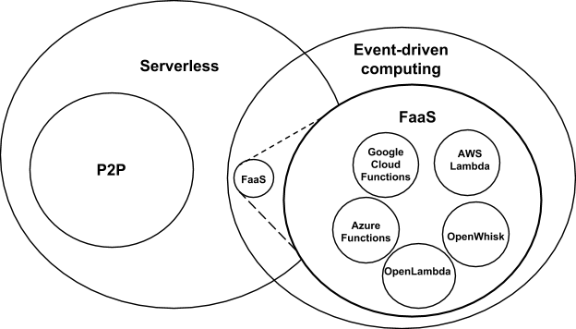
Serverless (server hidden) computing attractive to user:
“No server is easier to manage than no server”
Cloud-owner Provided Cloud-native platform for
Event-driven applications which
Scale up and down instantly and automatically Charges for actual usage at a millisecond granularity
GridSolve, Neos were FaaS
See review http://dx.doi.org/10.13140/RG.2.2.15007.87206
Notes:
Short-running, Stateless computation may go away

Slide 9
Twister2: “Next Generation Grid - Edge – HPC Cloud”
Original 2010 Twister paper was a particular approach to Map-Collective iterative processing for machine learning
Re-engineer current Apache Big Data software systems as a toolkit with MPI as an option
  Base on Apache Heron as most modern and “neutral” on controversial issues
Support a serverless (cloud-native) dataflow event-driven HPC-FaaS (microservice) framework running across application and geographic domains.
  Support all types of Data analysis from GML to Edge computing
Build on Cloud best practice but use HPC wherever possible to get high performance
Smoothly support current paradigms Naiad, Hadoop, Spark, Flink, Storm, Heron, MPI …
Use interoperable common abstractions but multiple polymorphic implementations.
  i.e. do not require a single runtime
Focus on Runtime but this implies HPC-FaaS programming and execution model
This describes a next generation Grid based on data and edge devices – not computing as in original Grid
See long paper http://dsc.soic.indiana.edu/publications/Twister2.pdf

Slide 10
Communication (Messaging) Models
MPI Gold Standard: Tightly synchronized applications
  Efficient communications (µs latency) with use of advanced hardware
  In place communications and computations (Process scope for state)
Basic (coarse-grain) dataflow: Model a computation as a graph
  Nodes do computations with Task as computations and
  edges are asynchronous communications
  A computation is activated when its input data dependencies
  are satisfied
Streaming dataflow: Pub-Sub with data partitioned into streams
  Streams are unbounded, ordered data tuples
  Order of events important and group data into time windows
Machine Learning dataflow: Iterative computations
  There is both Model and Data, but only communicate the model
  Collective communication operations such as AllReduce AllGather (no differential operators in Big Data problems)
  Can use in-place MPI style communication
W
S
W
G
S
Dataflow
W

Slide 11
Core SPIDAL Parallel HPC Library with Collective Used
DA-MDS Rotate, AllReduce, Broadcast
Directed Force Dimension Reduction AllGather, Allreduce
Irregular DAVS Clustering Partial Rotate, AllReduce, Broadcast
DA Semimetric Clustering Rotate, AllReduce, Broadcast
K-means AllReduce, Broadcast, AllGather DAAL
SVM AllReduce, AllGather
SubGraph Mining AllGather, AllReduce
Latent Dirichlet Allocation Rotate, AllReduce
Matrix Factorization (SGD) Rotate DAAL
Recommender System (ALS) Rotate DAAL
Singular Value Decomposition (SVD) AllGather DAAL
QR Decomposition (QR) Reduce, Broadcast DAAL
Neural Network AllReduce DAAL
Covariance AllReduce DAAL
Low Order Moments Reduce DAAL
Naive Bayes Reduce DAAL
Linear Regression Reduce DAAL
Ridge Regression Reduce DAAL
Multi-class Logistic Regression Regroup, Rotate, AllGather
Random Forest AllReduce
Principal Component Analysis (PCA) AllReduce DAAL
DAAL implies integrated with Intel DAAL Optimized Data Analytics Library (Runs on KNL!)

Slide 12
Coordination Points
There are in many approaches, “coordination points” that can be implicit or explicit
Twister2 makes coordination points an important (first class) concept
  Dataflow nodes in Heron, Flink, Spark, Naiad; we call these fine-grain data flow
  Issuance of a Collective communication command in MPI
  Start and End of a Parallel section in OpenMP
  End of a job; we call these coarse-grain data flow nodes and these are seen in workflow systems such as Pegasus, Taverna, Kepler and NiFi (from Apache)
Twister2 will allow users to specify the existence of a named coordination point and allow actions to be initiated
  Produce an RDD style dataset from user specified
  Launch new tasks as in Heron, Flink, Spark, Naiad
  Change execution model as in OpenMP Parallel section

Slide 13
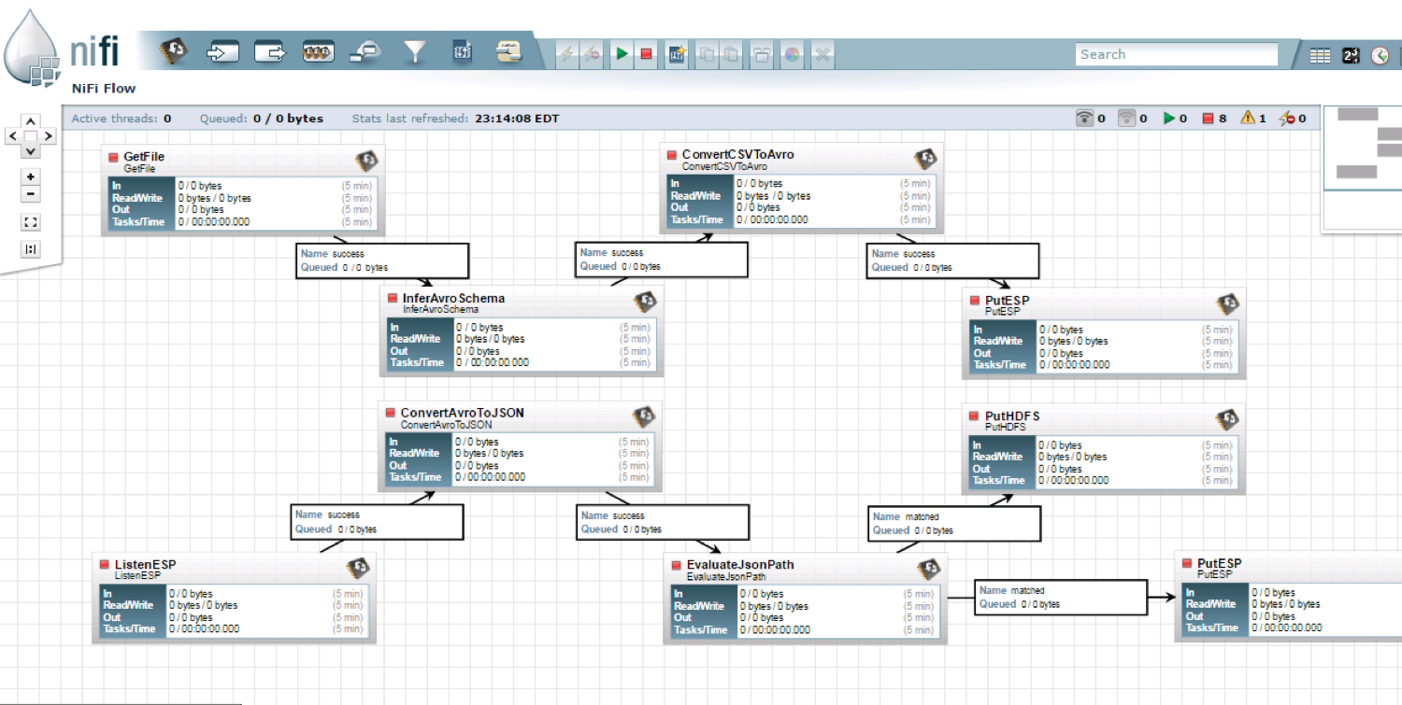
NiFi Workflow with Coarse Grain Coordination

Slide 14
K-means and Dataflow
Data Set <Points>
Dataflow for K-means
Data Set <Initial Centroids>
Map (nearest centroid calculation)
Reduce (update centroids)
Data Set <Updated Centroids>
Internal Execution (Iteration) Nodes
Fine-Grain Coordination
Broadcast
Corse Grain
Workflow Nodes
Coarse Grain
Workflow Nodes
Full Job
Another Job
Reduce
Dataflow
Communication
HPC
Communication
Maps
“Coordination Points”
Iterate

Slide 15
Handling of State
State is a key issue and handled differently in systems
MPI Naiad, Storm, Heron have long running tasks that preserve state
  MPI tasks stop at end of job
  Naiad Storm Heron tasks change at (fine-grain) dataflow nodes but all tasks run forever
  Spark and Flink tasks stop and refresh at dataflow nodes but preserve some state as RDD/datasets using in-memory databases
All systems agree on actions at a coarse grain dataflow (at job level); only keep state by exchanging data.

Slide 16
Fault Tolerance and State
Similar form of check-pointing mechanism is used already in HPC and Big Data
  although HPC informal as doesn’t typically specify as a dataflow graph
  Flink and Spark do better than MPI due to use of database technologies; MPI is a bit harder due to richer state but there is an obvious integrated model using RDD type snapshots of MPI style jobs
Checkpoint after each stage of the dataflow graph
  Natural synchronization point
  Let’s allows user to choose when to checkpoint (not every stage)
  Save state as user specifies; Spark just saves Model state which is insufficient for complex algorithms

Slide 17
Twister2 Components I
Area | Component | Implementation | Comments
Distributed Data API | Relaxed Distributed data set | Similar to Spark RDD | ETL type data applications; Streaming Backup for Fault Tolerance
 | Streaming | Pub-Sub and Spouts as in Heron | API to pub-sub messages
 | Data access | Access common data sources including file, connecting to message brokers etc. | All the above applications can use this base functionality
 | Distributed Shared Memory | Similar to PGAS | Machine learning such as graph algorithms
Task API FaaS API (Function as a Service) | Dynamic Task Scheduling | Dynamic scheduling as in AMT | Some machine learning FaaS
 | Static Task Scheduling | Static scheduling as in Flink & Heron | Streaming ETL data pipelines
 | Task Execution | Thread based execution as seen in Spark, Flink, Naiad, OpenMP | Look at hybrid MPI/thread support available
 | Task Graph | Twister2 Tasks similar to Naiad and Heron
 | Streaming and FaaS Events | Heron, OpenWhisk, Kafka/RabbitMQ | Classic Streaming Scaling of FaaS needs Research
 | Elasticity | OpenWhisk | Needs experimentation
 | Task migration | Monitoring of tasks and migrating tasks for better resource utilization

Slide 18
Twister2 Components II
Area | Component | Implementation | Comments
Communication API | Messages | Heron | This is user level and could map to multiple communication
 | Dataflow Communication | Fine-Grain Twister2 Dataflow communications: MPI,TCP and RMA Coarse grain Dataflow from NiFi, Kepler? | Streaming Machine learning ETL data pipelines
 | BSP Communication Map-Collective | MPI Style communication Harp | Machine learning
Execution Model | Architecture | Spark, Flink | Container/Processes/Tasks=Threads
 | Job Submit API Resource Scheduler | Pluggable architecture for any resource scheduler (Yarn, Mesos, Slurm) | All the above applications need this base functionality
 | Dataflow graph analyzer & optimizer | Flink | Spark is dynamic and implicit
 | Coordination Points Specification and Actions | Research based on MPI, Spark, Flink, NiFi (Kepler) | Synchronization Point. Backup to datasets Refresh Tasks
Security | Storage, Messaging, execution | Research | Crosses all Components

Slide 19
Summary of MPI in a
HPC Cloud + Edge + Grid Environment
We suggest value of an event driven computing model built around Cloud and HPC and spanning batch, streaming, and edge applications
  Highly parallel on cloud; possibly sequential at the edge
We have done a preliminary analysis of the different runtimes of MPI, Hadoop, Spark, Flink, Storm, Heron, Naiad, HPC Asynchronous Many Task(AMT)
There are different technologies for different circumstances but can be unified by high level abstractions such as communication collectives
  Obviously MPI best for parallel computing (by definition)
Apache systems use dataflow communication which is natural for distributed systems but inevitably slow for classic parallel computing
  No standard dataflow library (why?). Add Dataflow primitives in MPI-4?
MPI could adopt some of tools of Big Data as in Coordination Points (dataflow nodes), State management with RDD (datasets)

