Slide 1
FutureGrid
Computing Testbed as a Service
EGI Technical Forum 2013
Madrid Spain September 17 2013
Geoffrey Fox and Gregor von Laszewski
for FutureGrid Team
gcf@indiana.edu
http://www.infomall.org http://www.futuregrid.org
School of Informatics and Computing
Digital Science Center
Indiana University Bloomington

Slide 2
FutureGrid Testbed as a Service
FutureGrid is part of XSEDE set up as a testbed with cloud focus
Operational since Summer 2010 (i.e. has had three years of use)
The FutureGrid testbed provides to its users:
  Support of Computer Science and Computational Science research
  A flexible development and testing platform for middleware and application users looking at interoperability, functionality, performance or evaluation
  FutureGrid is user-customizable, accessed interactively and supports Grid, Cloud and HPC software with and without VM’s
  A rich education and teaching platform for classes
Offers OpenStack, Eucalyptus, Nimbus, OpenNebula, HPC (MPI) on same hardware moving to software defined systems; supports both classic HPC and Cloud storage
Mainly support staff limited

Slide 3
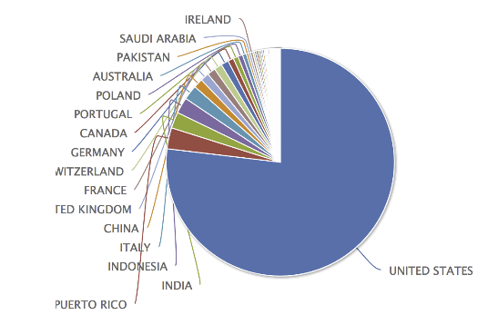
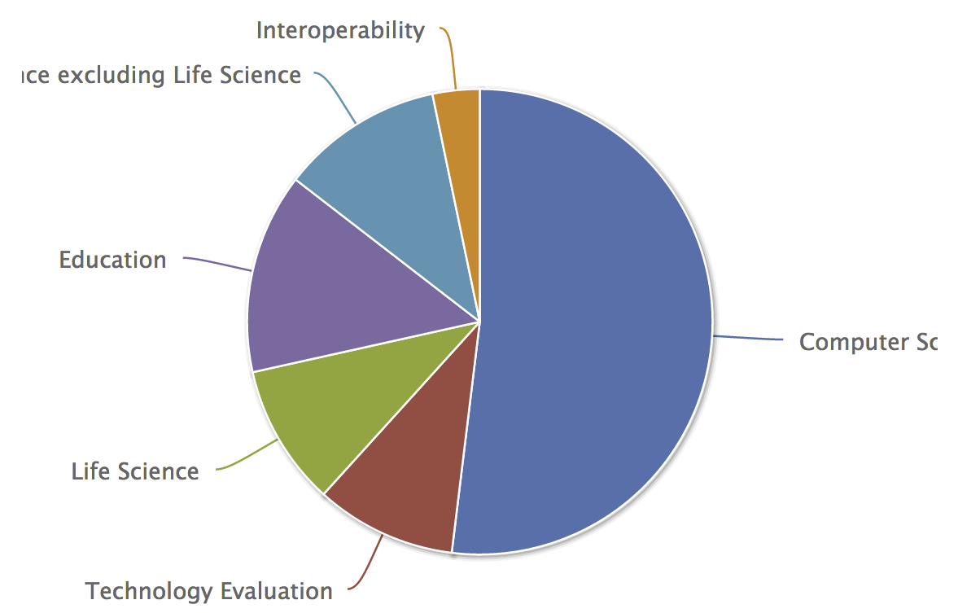
Use Types for FutureGrid TestbedaaS
339 approved projects (2009 users) Sept 16 2013
  Users from 53 Countries
  USA (77.3%), Puerto Rico (2.9%), Indonesia (2.2%) Italy (2%) (last 3 large from classes) India (2.2%)
Computer Science and Middleware (55.4%)
  Core CS and Cyberinfrastructure (52.2%); Interoperability (3.2%) for Grids and Clouds such as Open Grid Forum OGF Standards
Domain Science applications (21.1%)
  Life science high fraction (9.7%), All non Life Science (11.2%)
Training Education and Outreach (13.9%)
  Semester and short events; interesting outreach to HBCU; 48.6% users
Computer Systems Evaluation (9.7%)
  XSEDE (TIS, TAS), OSG, EGI; Campuses

Slide 4

FutureGrid Operating Model
Rather than loading images onto VM’s, FutureGrid supports Cloud, Grid and Parallel computing environments by provisioning software as needed onto “bare-metal” or VM’s/Hypervisors using (changing) open source tools
  Image library for MPI, OpenMP, MapReduce (Hadoop, (Dryad), Twister), gLite, Unicore, Globus, Xen, ScaleMP (distributed Shared Memory), Nimbus, Eucalyptus, OpenNebula, KVM, Windows …..
  Either statically or dynamically
Growth comes from users depositing novel images in library
FutureGrid is quite small with ~4700 distributed cores and a dedicated network
Image1
Image2
…
ImageN
Choose
Load
Run

Slide 5
FutureGrid Operating Model
Rather than loading images onto VM’s, FutureGrid supports Cloud, Grid and Parallel computing environments by provisioning software as needed onto “bare-metal” or VM’s/Hypervisors using (changing) open source tools
  Image library for MPI, OpenMP, MapReduce (Hadoop, Twister), gLite, Unicore, Globus, Xen, ScaleMP (distributed Shared Memory), Nimbus, Eucalyptus, OpenNebula, KVM, Windows …..
  Either statically or dynamically
Growth comes from users depositing novel images in library
FutureGrid is quite small with ~4700 distributed cores and a dedicated network
Image1
Image2
…
ImageN
Choose
Load
Run

Slide 6
Heterogeneous Systems Hardware
Name | System type | # CPUs | # Cores | TFLOPS | Total RAM (GB) | Secondary Storage (TB) | Site | Status
India | IBM iDataPlex | 256 | 1024 | 11 | 3072 | 512 | IU | Operational
Alamo | Dell PowerEdge | 192 | 768 | 8 | 1152 | 30 | TACC | Operational
Hotel | IBM iDataPlex | 168 | 672 | 7 | 2016 | 120 | UC | Operational
Sierra | IBM iDataPlex | 168 | 672 | 7 | 2688 | 96 | SDSC | Operational
Xray | Cray XT5m | 168 | 672 | 6 | 1344 | 180 | IU | Operational
Foxtrot | IBM iDataPlex | 64 | 256 | 2 | 768 | 24 | UF | Operational
Bravo | Large Disk & memory | 32 | 128 | 1.5 | 3072 (192GB per node) | 192 (12 TB per Server) | IU | Operational
Delta | Large Disk & memory With Tesla GPU’s | 32 CPU 32 GPU’s | 192 | 9 | 3072 (192GB per node) | 192 (12 TB per Server) | IU | Operational
Lima | SSD Test System | 16 | 128 | 1.3 | 512 | 3.8(SSD) 8(SATA) | SDSC | Operational
Echo | Large memory ScaleMP | 32 | 192 | 2 | 6144 | 192 | IU | Beta
TOTAL |  | 1128 + 32 GPU | 4704 +14336 GPU | 54.8 | 23840 | 1550

Slide 7
FutureGrid Partners
Indiana University (Architecture, core software, Support)
San Diego Supercomputer Center at University of California San Diego (INCA, Monitoring)
University of Chicago/Argonne National Labs (Nimbus)
University of Florida (ViNE, Education and Outreach)
University of Southern California Information Sciences (Pegasus to manage experiments)
University of Tennessee Knoxville (Benchmarking)
University of Texas at Austin/Texas Advanced Computing Center (Portal, XSEDE Integration)
University of Virginia (OGF, XSEDE Software stack)
Red institutions have FutureGrid hardware

Slide 8
Sample FutureGrid Projects I
FG18 Privacy preserving gene read mapping developed hybrid MapReduce. Small private secure + large public with safe data. Won 2011 PET Award for Outstanding Research in Privacy Enhancing Technologies
FG132, Power Grid Sensor analytics on the cloud with distributed Hadoop. Won the IEEE Scaling challenge at CCGrid2012.
FG156 Integrated System for End-to-end High Performance Networking showed that the RDMA over Converged Ethernet (InfiniBand made to work over Ethernet network frames) protocol could be used over wide-area networks, making it viable in cloud computing environments.
FG172 Cloud-TM on distributed concurrency control (software transactional memory): "When Scalability Meets Consistency: Genuine Multiversion Update Serializable Partial Data Replication,“ 32nd International Conference on Distributed Computing Systems (ICDCS'12) (good conference) used 40 nodes of FutureGrid

Slide 9
Sample FutureGrid Projects II
FG42,45 SAGA Pilot Job P* abstraction and applications. XSEDE Cyberinfrastructure used on clouds
FG130 Optimizing Scientific Workflows on Clouds. Scheduling Pegasus on distributed systems with overhead measured and reduced. Used Eucalyptus on FutureGrid
FG133 Supply Chain Network Simulator Using Cloud Computing with dynamic virtual machines supporting Monte Carlo simulation with Grid Appliance and Nimbus
FG257 Particle Physics Data analysis for ATLAS LHC experiment used FutureGrid + Canadian Cloud resources to study data analysis on Nimbus + OpenStack with up to 600 simultaneous jobs
FG254 Information Diffusion in Online Social Networks is evaluating NoSQL databases (Hbase, MongoDB, Riak) to support analysis of Twitter feeds
FG323 SSD performance benchmarking for HDFS on Lima

Slide 10
FG-226 Virtualized GPUs and Network Devices in a Cloud (ISI/IU)
Need for GPUs and Infiniband Networking on Clouds
  Goal: provide the same hardware at a minimal overhead to build a clean HPC Cloud
Different competing methods for virtualizing GPUs
  Remote API for CUDA calls ← rCUDA, vCUDA, gVirtus
  Direct GPU usage within VM ← our method
GPU uses Xen 4.2 Hypervisor with hardware directed I/O virt (VT-d or IOMMU)
  Kernel overheads <~2% except for Kepler FFT at 15%
Implement Infiniband via SR-IOV
Work integrated into OpenStack “Havana” release
  Xen support for full virtualization with libvirt
  Custom Libvirt driver for PCI-Passthrough

Slide 11
Performance of GPU enabled VMs
Notes:
Used two Nvidia GPUs – Nvidia “Fermi” C2075 and Nvidia “Kepler” K20m for testing. Both perform well. Kepler is newest and obviously much faster, but overhead of virtualization for both is still low!

Slide 12
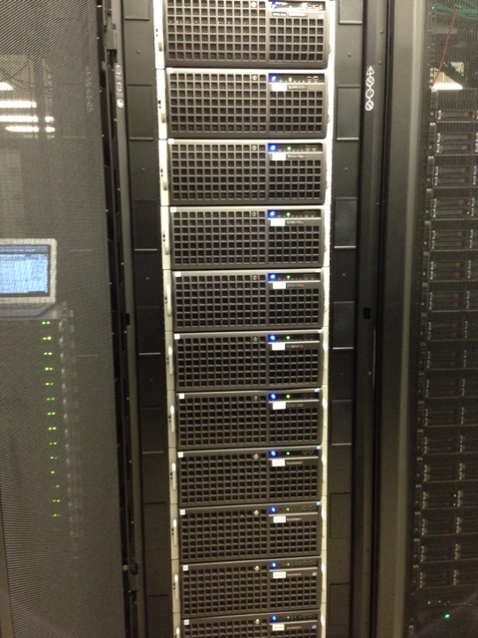
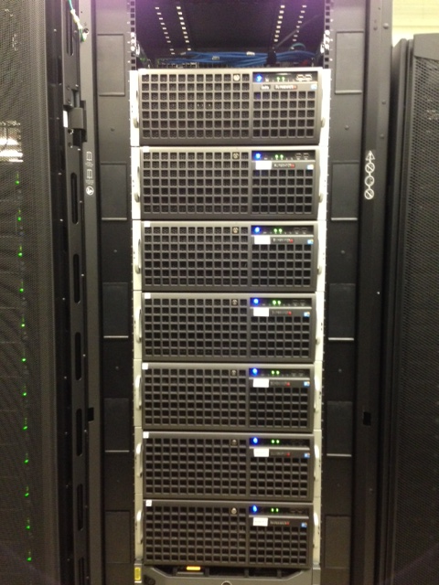
Experimental Deployment:
FutureGrid Delta
Mid October 2013
16x 4U nodes in 2 Racks
  2x Intel Xeon X5660
  192GB Ram
  Nvidia Tesla C2075 Fermi
  QDR InfiniBand - CX-2
Management Node
  OpenStack Keystone, Glance, API, Cinder, Nova-network
Compute Nodes
  Nova-compute, Xen, libvirt
Submit your project requests now!

Slide 13
Education and Training Use of FutureGrid
FutureGrid supports many educational uses
  36 Semester long classes (9 this semester): over 650 students from over 20 institutions
  Cloud Computing, Distributed Systems, Scientific Computing and Data Analytics
  3 one week summer schools: 390+ students
  Big Data, Cloudy View of Computing (for HBCU’s), Science Clouds
  7 one to three day workshop/tutorials: 238 students
  We are building MOOC (Massive Open Online Courses) lessons to describe core FutureGrid Capabilities so they can be re-used as classes by all courses https://fgmoocs.appspot.com/explorer
  Science Cloud Summer School available in MOOC format
  First high level MOOC is Software IP-over-P2P (IPOP)
  Overview and Details of FutureGrid
  How to get project, use HPC and use OpenStack

Slide 14
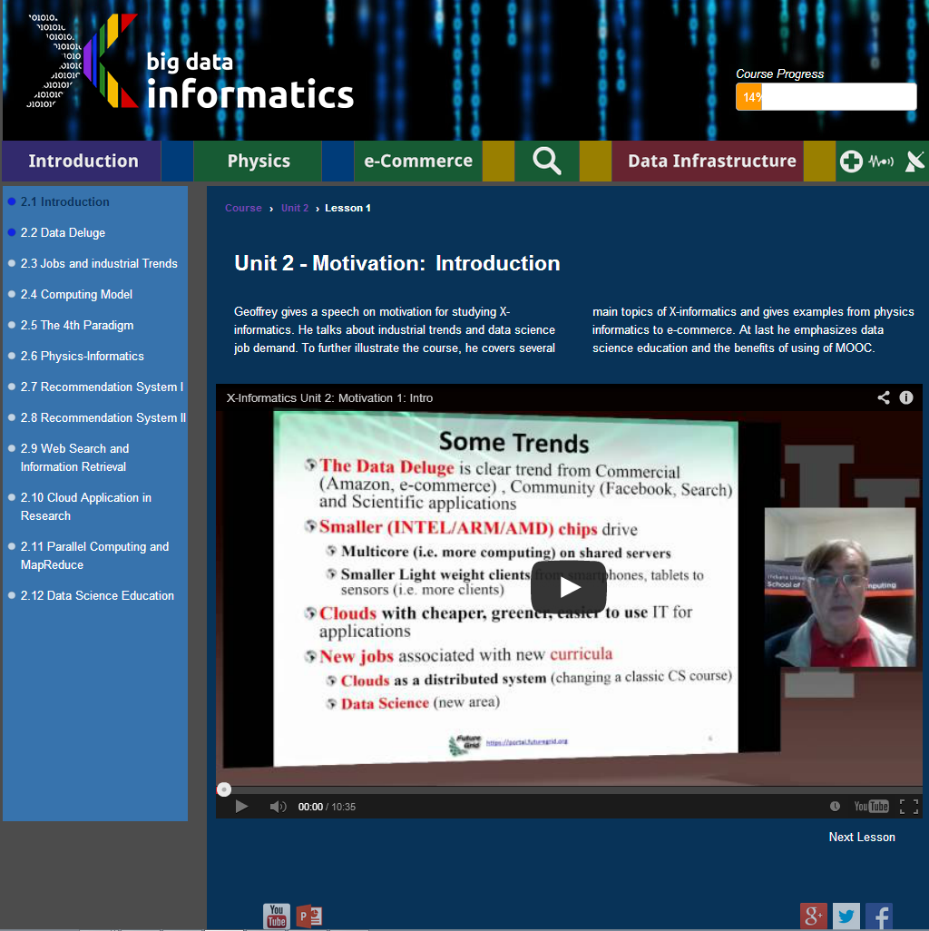
MOOC is short prerecorded segments (talking head over PowerPoint) of length 3-15 minutes
MOOC software dynamically assembles lessons to courses
Twelve such lesson objects in this lecture

Slide 15
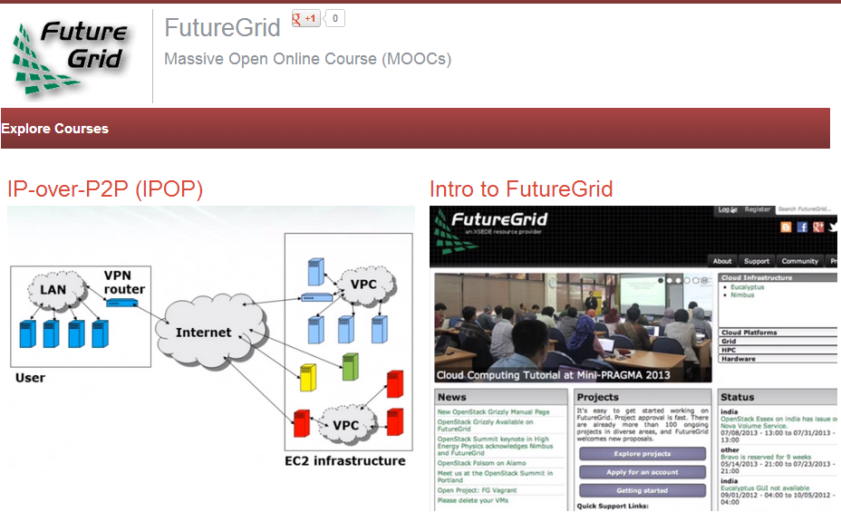
FutureGrid hosts many classes per semester
How to use FutureGrid is shared MOOC

Slide 16
Support for classes on FutureGrid
Classes are setup and managed using the FutureGrid portal
Project proposal: can be a class, workshop, short course, tutorial
  Needs to be approved as FutureGrid project to become active
Users can be added to a project
  Users create accounts using the portal
  Project leaders can authorize them to gain access to resources
  Students can then interactively use FG resources (e.g. to start VMs)
Note that it is getting easier to use “open source clouds” like OpenStack with convenient web interfaces like Nimbus-Phantom and OpenStack-Horizon replacing command line Euca2ools

Slide 17
FutureGrid offers
Computing Testbed as a Service
FutureGrid Uses
Testbed-aaS Tools
Provisioning
Image Management
IaaS Interoperability
NaaS, IaaS tools
Monitoring
Expt management
Dynamic IaaS NaaS
Devops
CS Research Use e.g. test new compiler or storage model
Class Usages e.g. run GPU & multicore
Applications
Software
(Application
Or Usage) SaaS
Cloud e.g. MapReduce
HPC e.g. PETSc, SAGA
Computer Science e.g. Compiler tools, Sensor nets, Monitors
FutureGrid Cloudmesh (includes RAIN) uses Dynamic Provisioning and Image Management to provide custom environments for general target systems
Involves (1) creating,
(2) deploying, and
(3) provisioning
of one or more images in a set of machines on demand
Platform
PaaS
Infra
structure
IaaS
Software Defined Computing (virtual Clusters)
Hypervisor, Bare Metal
Operating System
Network
NaaS
Software Defined Networks
OpenFlow GENI

Slide 18
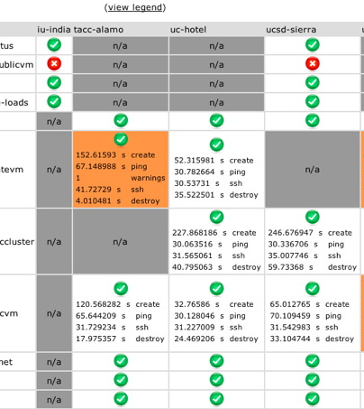
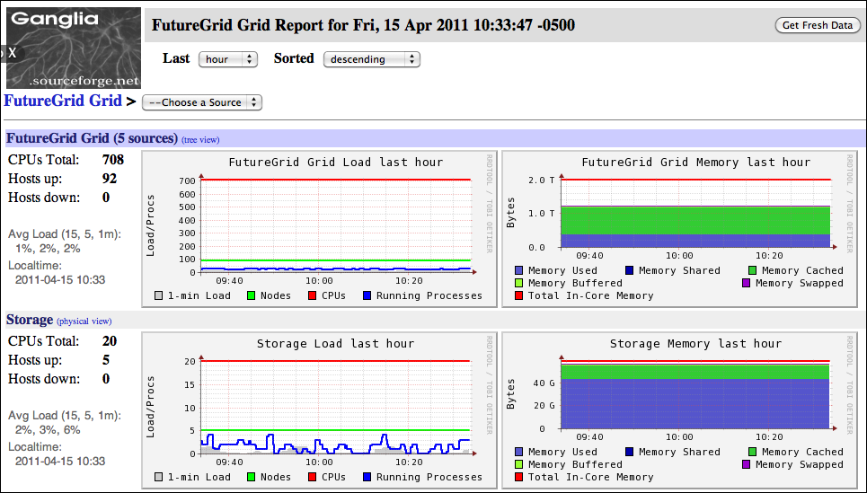
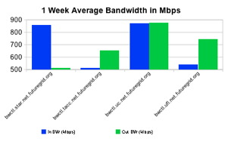
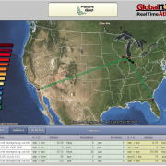
Inca
Software functionality and performance
Ganglia
Cluster monitoring
perfSONAR
Network monitoring - Iperf measurements
SNAPP
Network monitoring – SNMP measurements
Monitoring on FutureGrid
Important and even more needs to be done
Notes:
Listing of the monitoring tools currently deployed on FutureGrid

Slide 19
Selected List of Services Offered
FutureGrid
IaaS
Nimbus
Cloud PaaS
Hadoop
Iterative MapReduce
HDFS
Hbase
Swift Object Store
MPI
TestbedaaS
FG RAIN, CloudMesh
Portal
Inca
Eucalyptus
OpenStack
ViNE
HPCaaS
Ganglia
Devops (Chef, Puppet, Salt)
Experiment Management e.g. Pegasus
OpenMP
CUDA
GridaaS
Unicore
SAGA
Globus
Genesis II

Slide 20
Technology Requests per Quarter
Poly is a polynomial fit

Slide 21
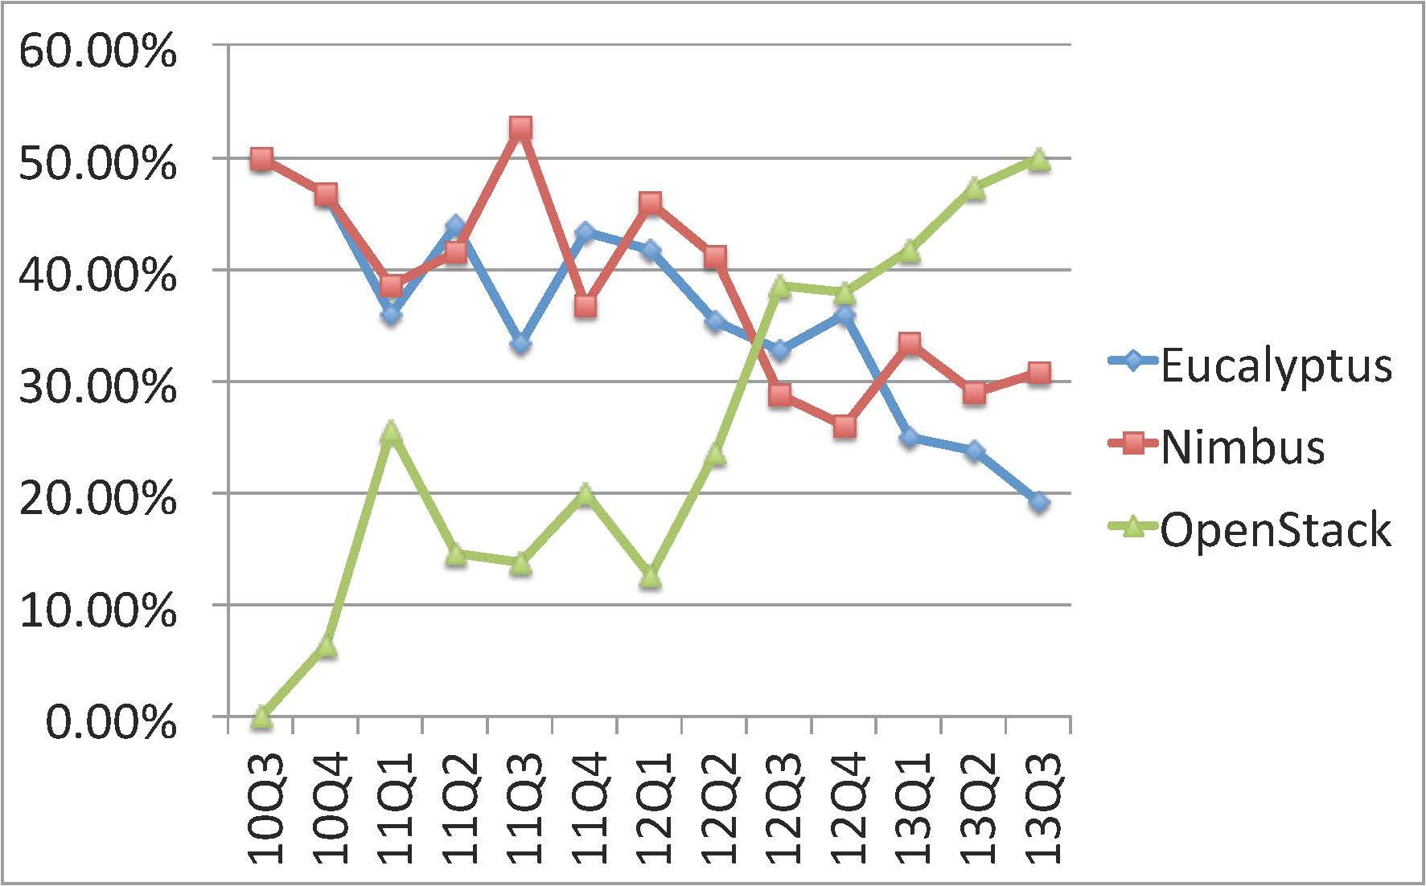
Education Technology Requests

Slide 22
Essential and Different features of FutureGrid in Cloud area
Unlike many clouds such as Amazon and Azure, FutureGrid allows robust reproducible (in performance and functionality) research (you can request same node with and without VM)
  Open Transparent Technology Environment
FutureGrid is more than a Cloud; it is a general distributed Sandbox; a cloud grid HPC testbed
Supports 3 different IaaS environments (Nimbus, Eucalyptus, OpenStack) and projects involve 5 (also CloudStack, OpenNebula)
Supports research on cloud tools, cloud middleware and cloud-based systems
FutureGrid has itself developed middleware and interfaces to support FutureGrid’s mission e.g. Phantom (cloud user interface) Vine (virtual network) RAIN (deploy systems) and security/metric integration
FutureGrid has experience in running cloud systems

Slide 23
FutureGrid is an onramp to other systems
FG supports Education & Training for all systems
User can do all work on FutureGrid OR
User can download Appliances on local machines (Virtual Box) OR
User soon can use CloudMesh to jump to chosen production system
CloudMesh is similar to OpenStack Horizon, but aimed at multiple federated systems.
  Built on RAIN and tools like libcloud, boto with protocol (EC2) or programmatic API (python)
  Uses general templated image that can be retargeted
  One-click template & image install on various IaaS & bare metal including Amazon, Azure, Eucalyptus, Openstack, OpenNebula, Nimbus, HPC
  Provisions the complete system needed by user and not just a single image; copes with resource limitations and deploys full range of software
  Integrates our VM metrics package (TAS collaboration) that links to XSEDE (VM's are different from traditional Linux in metrics supported and needed)

Slide 24
Cloudmesh Functionality View
Virtual Machine
Management
  IaaS Abstraction
Provisioning Management
  Rain
  Cloud Shifting
  Cloud Bursting
Experiment
Management
  Shell
  IPython
Information Services
  CloudMetrics
Accounting
  FG Portal
  XSEDE Portal
Future Grid
TaaS
User On-Ramp
Amazon, Azure, FutureGrid, XSEDE,
OpenCirrus, ExoGeni, Other Science Clouds
Initial Open Source Release Mid October 2013

Slide 25
Cloudmesh Layered Architecture View
Notes:
Multiple components are part of cloudmesh. Cloudmesh is an umbrella for it. We are still debating about its name as we aslo could have used RAIN. But rain was initially just a small component and deals predominantly so far with templated image management

Slide 26
Performance of Dynamic Provisioning
4 Phases a) Design and create image (security vet) b) Store in repository as template with components c) Register Image to VM Manager (cached ahead of time) d) Instantiate (Provision) image
Phase d)
Phase a) b)
Phase a) b)

Slide 27
Security issues in FutureGrid Operation
Security for TestBedaaS is a good research area (and Cybersecurity research supported on FutureGrid)!
Authentication and Authorization model
  This is different from those in use in XSEDE and changes in different releases of VM Management systems
  We need to largely isolate users from these changes for obvious reasons
  Non secure deployment defaults (in case of OpenStack)
  OpenStack Grizzly and Havana have reworked the role based access control mechanisms and introduced a better token format based on standard PKI (as used in AWS, Google, Azure); added groups
  Custom: We integrate with our distributed LDAP between the FutureGrid portal and VM managers. LDAP server will soon synchronize via AMIE to XSEDE
Security of Dynamically Provisioned Images
  Templated image generation process automatically puts security restrictions into the image; This includes the removal of root access
  Images include service allowing designated users (project members) to log in
  Images vetted before allowing role-dependent bare metal deployment
  No SSH keys stored in images (just call to identity service) so only certified users can use

Slide 28
Related Projects
Grid5000 (Europe) and OpenCirrus with managed flexible environments are closest to FutureGrid and are collaborators
PlanetLab has a networking focus with less managed system
Several GENI related activities including network centric EmuLab, PRObE (Parallel Reconfigurable Observational Environment), ProtoGENI, ExoGENI, InstaGENI and GENICloud
BonFire (Europe) European cloud Testbed supporting OCCI
EGI Federated Cloud with OpenStack and OpenNebula aimed at EU Grid/Cloud federation
Private Clouds: Red Cloud (XSEDE), Wispy (XSEDE), Open Science Data Cloud and the Open Cloud Consortium are typically aimed at computational science
Public Clouds such as AWS do not allow reproducible experiments and bare-metal/VM comparison; do not support experiments on low level cloud technology

Slide 29
Lessons learnt from FutureGrid
Unexpected major use from Computer Science and Middleware
Rapid evolution of Technology Eucalyptus → Nimbus → OpenStack
Open source IaaS maturing as in “Paypal To Drop VMware From 80,000 Servers and Replace It With OpenStack” (Forbes)
  “VMWare loses $2B in market cap”; eBay expects to switch broadly?
Need interactive not batch use; nearly all jobs short but can need lots of nodes
Substantial TestbedaaS technology needed and FutureGrid developed (RAIN, CloudMesh, Operational model) some
Lessons more positive than DoE Magellan report (aimed as an early science cloud) but goals different
Still serious performance problems in clouds for networking and device (GPU) linkage; many activities in and outside FG addressing
We identified characteristics of “optimal hardware”
Run system with integrated software (computer science) and systems administration team
Build Computer Testbed as a Service Community

Slide 30
EGI Cloud Activities v. FutureGrid
https://wiki.egi.eu/wiki/Fedcloud-tf:FederatedCloudsTaskForce
EGI Phase 1. Setup: Sept 2011 - March 2012 |  |  | FutureGrid
# | Workbenches | Capabilities
1 | Running a pre-defined VM Image | VM Management | Cloudmesh. Templated image management
2 | Managing users' data and VMs | Data management | Not addressed due to multiple FG environments/lack of manpower
3 | Integrating information from multiple resource providers | Information discovery | Cloudmesh, FG Metrics, Inca, FG Glue2, Ubmod, Ganglia
4 | Accounting across Resource Providers | Accounting | FG Metrics
5 | Reliability/Availability of Resource Providers | Monitoring | Not addressed (as Testbed not production)
6 | VM/Resource state change notification | Notification | Provided by IaaS for our systems
7 | AA across Resource Providers | Authentication and Authorisation | LDAP, Role-based AA
8 | VM images across Resource Providers | VM sharing | Templated image Repository

Slide 31
Future Directions for FutureGrid
Poised to support more users as technology like OpenStack matures
  Please encourage new users and new challenges
More focus on academic Platform as a Service (PaaS) - high-level middleware (e.g. Hadoop, Hbase, MongoDB) – as IaaS gets easier to deploy with increased Big Data challenges but we lack staff!
    Need Large Cluster for Scaling tests of Data mining environments (also missing in production systems)
Improve Education and Training with model for MOOC laboratories
Finish Cloudmesh (and integrate with Nimbus Phantom) to make FutureGrid as hub to jump to multiple different “production” clouds commercially, nationally and on campuses; allow cloud bursting
Build underlying software defined system model with integration with GENI and high performance virtualized devices (MIC, GPU)
Improved ubiquitous monitoring at PaaS IaaS and NaaS levels
Improve “Reproducible Experiment Management” environment
Expand and renew hardware via federation

Slide 32
Summary Differences between FutureGrid I (current) and FutureGrid II
Usage | FutureGrid I | FutureGrid II
Target environments | Grid, Cloud, and HPC | Cloud, Big-data, HPC, some Grids
Computer Science | Per-project experiments | Repeatable, reusable experiments
Education | Fixed Resource | Scalable use of Commercial to FutureGrid II to Appliance per-tool and audience type
Domain Science | Software develop/test | Software develop/test across resources using templated appliances
Cyberinfrastructure | FutureGrid I | FutureGrid II
Provisioning model | IaaS+PaaS+SaaS | CTaaS including NaaS+IaaS+PaaS+SaaS
Configuration | Static | Software-defined
Extensibility | Fixed size | Federation
User support | Help desk | Help Desk + Community based
Flexibility | Fixed resource types | Software-defined + federation
Deployed Software Service Model | Proprietary, Closed Source, Open Source | Open Source
IaaS Hosting Model | Private Distributed Cloud | Public and Private Distributed Cloud with multiple administrative domains

Slide 33
Federated Hardware Model in FutureGrid I
FutureGrid internally federates heterogeneous cloud and HPC systems
  Want to expand with federated hardware partners
HPC services: Federation of HPC hardware is possible via Grid technologies (However we do not focus on this as this done well at XSEDE and EGI)
Homogeneous cloud federation (one IaaS framework).
  Integrate multiple clouds as zones.
  Publish the zones so we can find them in a service repository.
  introduce trust through uniform project vetting
  allow authorized projects by zone (zone can determine is a project is allowed on their cloud)
  integrate trusted identity providers => trusted identity providers & trusted project management & local autonomy

Slide 34
Federated Hardware Model in FutureGrid II
Heterogeneous Cloud Federation (multiple IaaS)
  Just as homogeneous case but in addition to zones we also have different IaaS frameworks including commercial
  Such as Azure + Amazon + FutureGrid federation
Federation through Cloudmesh
  HPC+Cloud extended outside FutureGrid
  Develop "drivers license model" (online user test) for RAIN.
  Introduce service access policies. CloudMesh is just one of such possible services e.g. enhance previous models with role based system allowing restriction of access to services
  Development of policies on how users gain access to such services, including consequences if they are broken.
  Automated security vetting of images before deployment

Slide 35
Link FutureGrid and GENI
Identify how to use the ORCA federation framework to integrate FutureGrid (and more of XSEDE?) into ExoGENI
Allow FG(XSEDE) users to access the GENI resources and vice versa
Enable PaaS level services (such as a distributed Hbase or Hadoop) to be deployed across FG and GENI resources
Leverage the Image generation capabilities of FG and the bare metal deployment strategies of FG within the GENI context.
  Software defined networks plus cloud/bare metal dynamic provisioning gives software defined systems
Not funded yet!

Slide 36
Typical FutureGrid/GENI Project
Bringing computing to data is often unrealistic as repositories distinct from computing resource and/or data is distributed
So one can build and measure performance of virtual distributed data stores where software defined networks bring the computing to distributed data repositories.
Example applications already on FutureGrid include Network Science (analysis of Twitter data), “Deep Learning” (large scale clustering of social images), Earthquake and Polar Science, Sensor nets as seen in Smart Power Grids, Pathology images, and Genomics
Compare different data models HDFS, Hbase, Object Stores, Lustre, Databases

