Slide 1
Panel on Merge or Split: Mutual Influence between Big Data and HPC Techniques
IEEE International Workshop on High-Performance Big Data Computing In conjunction with The 30th IEEE International Parallel and Distributed Processing Symposium (IPDPS 2016)
In Chicago Hyatt Regency, Chicago, Illinois USA, Friday, May 27th, 2016
http://web.cse.ohio-state.edu/~luxi/hpbdc2016
Geoffrey Fox
May 27, 2016
gcf@indiana.edu
http://www.dsc.soic.indiana.edu/, http://spidal.org/ http://hpc-abds.org/kaleidoscope

Slide 2
Panel Topics
What is the impact of Big Data techniques on HPC?
Software sustainability model from Apache community
Functionality in data area from streaming to repository to NOSQL to Graph
Parallel computing paradigm useful in simulations as well as big data
DevOps gives sustainability and interoperability
What is the impact of HPC techniques on Big Data?
Performance of mature hardware, algorithms and software
Future mutual influence between HPC and Big Data techniques?
HPC-ABDS(Apache Big Data Stack) Software Stack; take best of each world
Integrated environments that approach data and model components of Big data and simulations; use HPC-ABDS for Exascale and Big Data
Work with Apache and Industry
Specifying stacks and benchmarks with DevOps

Slide 3
HPC-ABDS

Slide 4
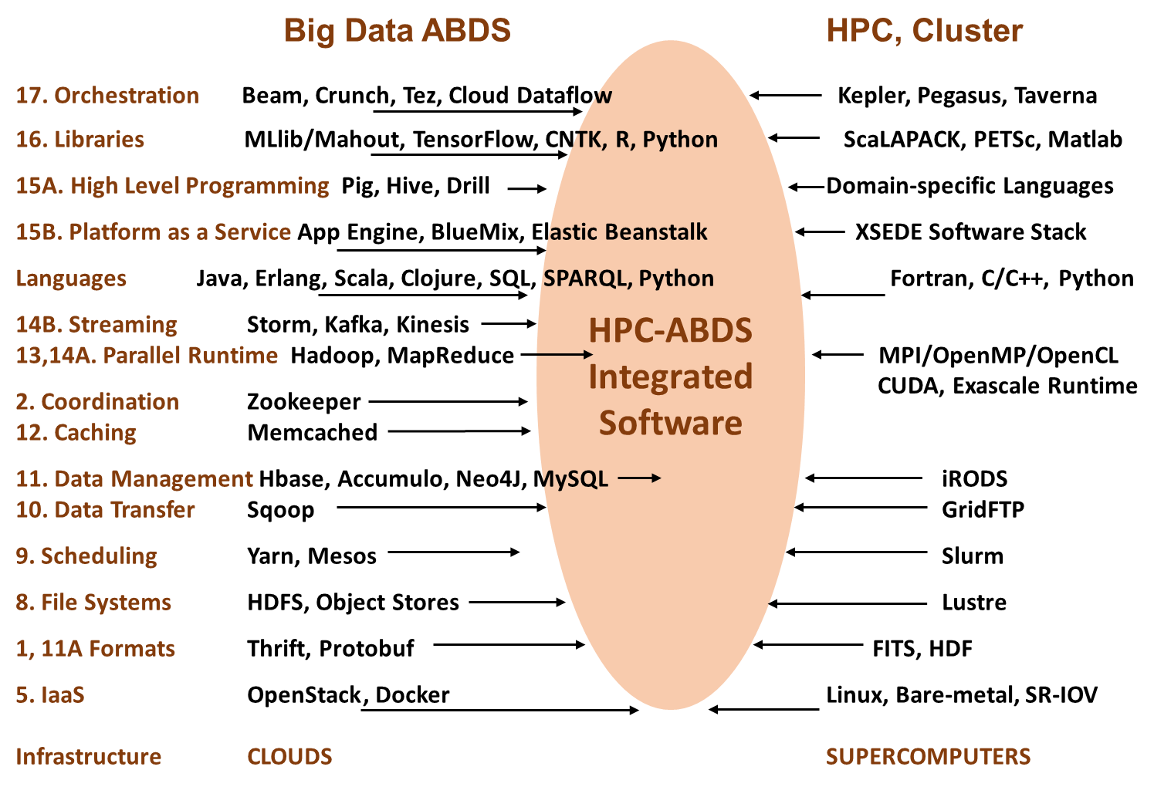

Slide 5
Implementing HPC-ABDS
Build HPC data analytics library – NSF14-43054 Dibbs SPIDAL building blocks
Define Java Grande as approach and runtime
Software Philosophy – enhance existing ABDS rather than building standalone software
Heron, Storm, Hadoop, Spark, Hbase, Yarn, Mesos
Working with Apache; how should one do this?
Establish a standalone HPC project
Join existing Apache projects and contribute HPC enhancements
Experimenting first with Twitter (Apache) Heron to build HPC Heron that supports science use cases (big images)

Slide 6
HPC-ABDS Mapping of Dibbs NSF14-43054 project
Level 17: Orchestration: Apache Beam (Google Cloud Dataflow) integrated with Cloudmesh on HPC cluster
Level 16: Applications: Datamining for molecular dynamics, Image processing for remote sensing and pathology, graphs, streaming, bioinformatics, social media, financial informatics, text mining
Level 16: Algorithms: Generic and custom for applications SPIDAL
Level 14: Programming: Storm, Heron (Twitter replaces Storm), Hadoop, Spark, Flink. Improve Inter- and Intra-node performance
Level 13: Communication: Enhanced Storm and Hadoop using HPC runtime technologies, Harp
Level 11: Data management: Hbase and MongoDB integrated via use of Beam and other Apache tools; enhance Hbase
Level 9: Cluster Management: Integrate Pilot Jobs with Yarn, Mesos, Spark, Hadoop; integrate Storm and Heron with Slurm
Level 6: DevOps: Python Cloudmesh virtual Cluster Interoperability

Slide 7
Constructing HPC-ABDS Exemplars
This is one of next steps in NIST Big Data Working Group
Philosophy: jobs will run on virtual clusters defined on variety of infrastructures: HPC, SDSC Comet, OpenStack, Docker, AWS, Virtualbox
Jobs are defined hierarchically as a combination of Ansible (preferred over Chef as Python) scripts
Scripts are invoked on Infrastructure (Cloudmesh Tool)
INFO 524 “Big Data Open Source Software Projects” IU Data Science class required final project to be defined in Ansible and decent grade required that script worked (On NSF Chameleon and FutureSystems)
80 students gave 37 projects with ~20 pretty good such as
“Machine Learning benchmarks on Hadoop with HiBench” Hadoop/YARN, Spark, Mahout, Hbase
“Human and Face Detection from Video” Hadoop, Spark, OpenCV, Mahout, MLLib
Build up curated collection of Ansible scripts defining use cases for benchmarking, standards, education

Slide 8
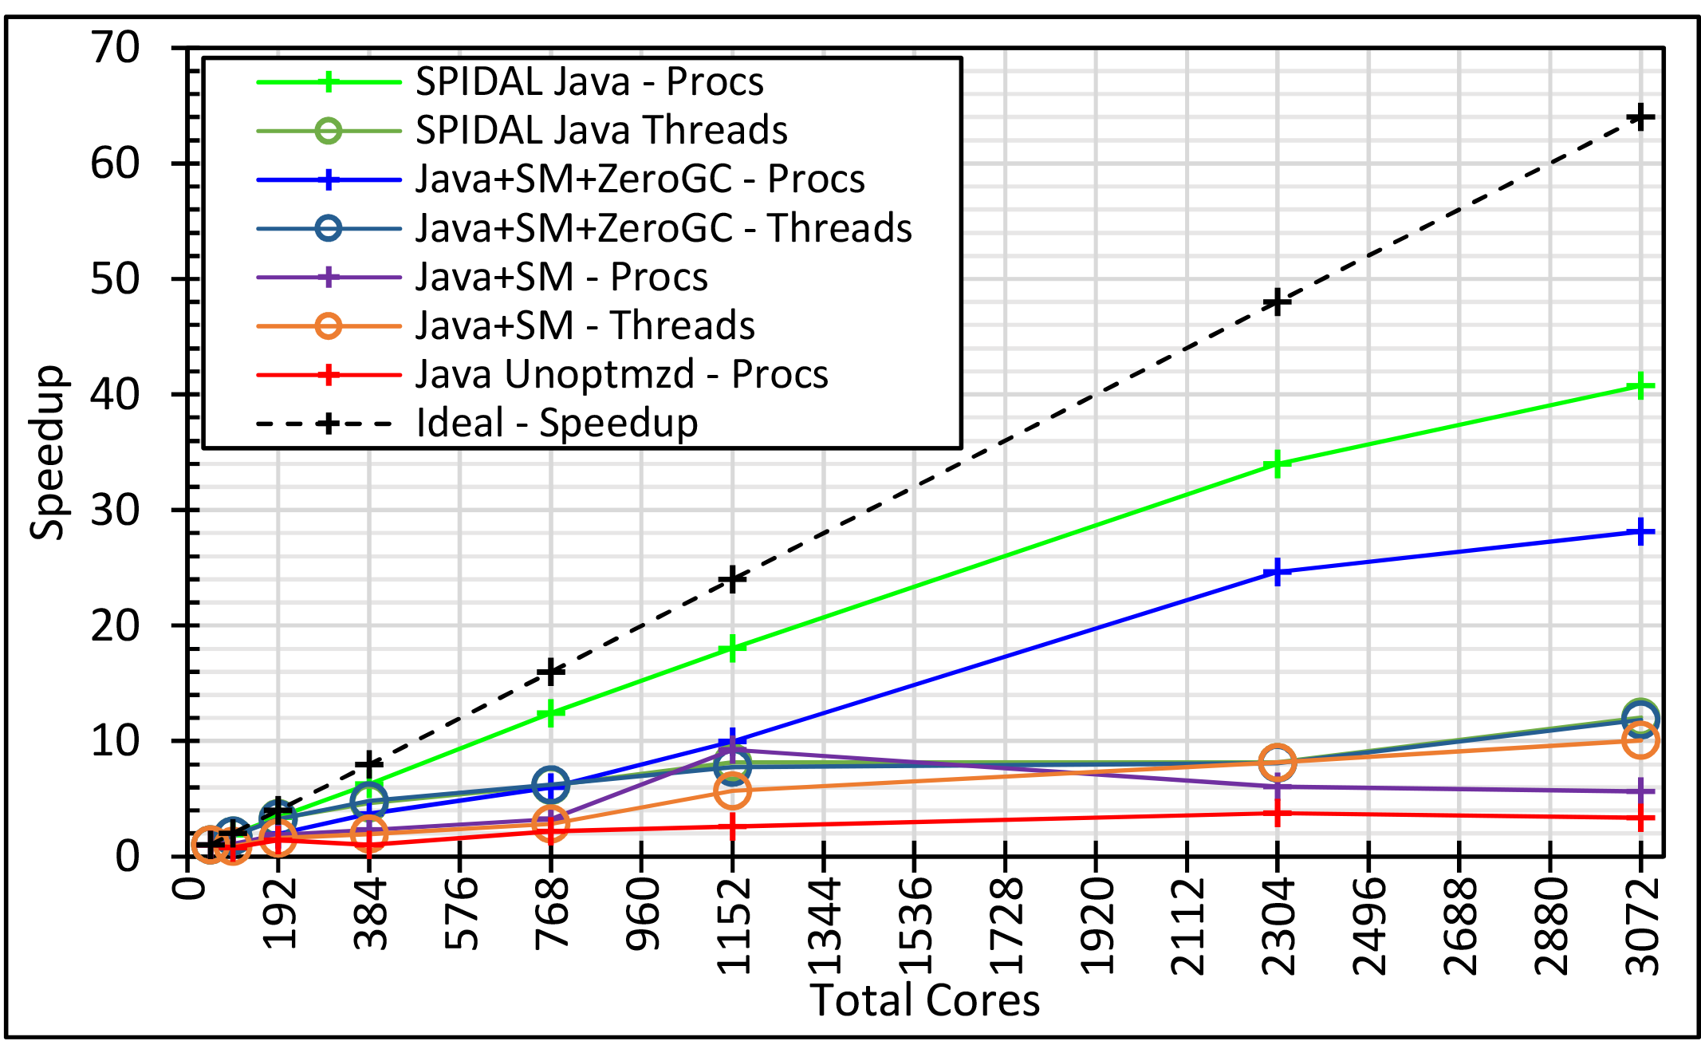
Java MPI performs better than Threads 128 24 core Haswell nodes on SPIDAL DA-MDS Code
SM = Optimized Shared memory for intra-node MPI
Best MPI; inter and intra node
Best Threads intra node
And MPI inter node
HPC into Java Runtime and Programming Model

Slide 9
Big Data - Big Simulation (Exascale) Convergence
Discuss Data and Model together as built around problems which combine them, but we can get insight by separating which allows better understanding of Big Data - Big Simulation “convergence”
Big Data implies Data is large but Model varies
e.g. LDA with many topics or deep learning has large model
Clustering or Dimension reduction can be quite small
Simulations can also be considered as Data and Model
Model is solving particle dynamics or partial differential equations
Data could be small when just boundary conditions
Data large with data assimilation (weather forecasting) or when data visualizations are produced by simulation
Data often static between iterations (unless streaming); Model varies between iterations
Take 51 NIST and other use cases → derive multiple specific features
Generalize and systematize with features termed “facets”
50 Facets (Big Data) or 64 Facets (Big Simulation and Data) divided into 4 sets or views where each view has “similar” facets
Allows one to study coverage of benchmark sets and architectures

Slide 10
64 Features in 4 views for Unified Classification of Big Data and Simulation Applications
Both
Simulations
Analytics
(Model for Data)
(Nearly all Data)
(All Model)
(Mix of Data and Model)
(Nearly all Data+Model)

