Slide 1
Big Data, Simulations and HPC Convergence
BDEC: Big Data and Extreme-scale Computing
June 15-17 2016 Frankfurt
http://www.exascale.org/bdec/meeting/frankfurt
Geoffrey Fox, Judy Qiu, Shantenu Jha, Saliya Ekanayake, Supun Kamburugamuve
June 16, 2016
gcf@indiana.edu
http://www.dsc.soic.indiana.edu/, http://spidal.org/ http://hpc-abds.org/kaleidoscope/
Department of Intelligent Systems Engineering
School of Informatics and Computing, Digital Science Center
Indiana University Bloomington

Slide 2
Components in Big Data HPC Convergence
Applications, Benchmarks and Libraries
  51 NIST Big Data Use Cases, 7 Computational Giants of the NRC Massive Data Analysis, 13 Berkeley dwarfs, 7 NAS parallel benchmarks
  Unified discussion by separately discussing data & model for each application;
  64 facets– Convergence Diamonds -- characterize applications
    Pleasingly parallel or Streaming used for data & model;
    O(N²) Algorithm relevant to model for big data or big simulation
    “Lustre v. HDFS” just describes data
    “Volume” large or small separately for data and model
  Characterization identifies hardware and software features for each application across big data, simulation; “complete” set of benchmarks (NIST)
Software Architecture and its implementation
  HPC-ABDS: Cloud-HPC interoperable software: performance of HPC (High Performance Computing) and the rich functionality of the Apache Big Data Stack.
  Added HPC to Hadoop, Storm, Heron, Spark; will add to Beam and Flink
  Work in Apache model contributing code
Run same HPC-ABDS across all platforms but “data management” nodes have different balance in I/O, Network and Compute from “model” nodes
  Optimize to data and model functions as specified by convergence diamonds
  Do not optimize for simulation and big data

Slide 3
64 Features in 4 views for Unified Classification of Big Data and Simulation Applications
Both
Simulations
Analytics
(Model for Data)
(Not surprising! Nearly all Data)
(All Model for simulations & Data Analytics)
(The details :
Mix of Data and Model)
(Nearly all combination of Data+Model)

Slide 4
HPC-ABDS

Slide 5
HPC-ABDS Activities of NSF14-43054
Level 17: Orchestration: Apache Beam (Google Cloud Dataflow)
Level 16: Applications: Datamining for molecular dynamics, Image processing for remote sensing and pathology, graphs, streaming, bioinformatics, social media, financial informatics, text mining
Level 16: Algorithms: Generic and application specific; SPIDAL Library
Level 14: Programming: Storm, Heron (Twitter replaces Storm), Hadoop, Spark, Flink. Improve Inter- and Intra-node performance; science data structures
Level 13: Runtime Communication: Enhanced Storm and Hadoop (Spark, Flink, Giraph) using HPC runtime technologies, Harp
Level 11: Data management: Hbase and MongoDB integrated via use of Beam and other Apache tools; enhance Hbase
Level 9: Cluster Management: Integrate Pilot Jobs with Yarn, Mesos, Spark, Hadoop; integrate Storm and Heron with Slurm
Level 6: DevOps: Python Cloudmesh virtual Cluster Interoperability

Slide 6

Convergence Language: Recreating Java Grande
128 24 core Haswell nodes on SPIDAL Data Analytics
Best Java factor of 10 faster than “out of the box”; comparable to C++
Speedup compared to 1 process per node on 48 nodes
Best MPI; inter and intra node
MPI; inter/intra node; Java not optimized
Best Threads intra node; MPI inter node

Slide 7
Some Confusing Issues; Missing Requirements; Missing Consensus I
Different Problem Types
  Data Management v. Data Analytics
  Every problem has Data & Model; which is Big/Important?
  Streaming v Batch; Interactive v Batch
  Science Requirements v. Commercial Requirements; are they similar?; what are important problems ; how big are they and are they global or locally parallel?
Broad Execution Issues
  Pleasingly Parallel (Local Machine Learning) v. Global Machine Learning
  Fine grain v. Coarse Grain parallelism; workflow (dataflow with directed graph) v. parallel computing (tight synchronization and ~BSP))
  Threads v Processes
  Objects v files; HDFS v Lustre

Slide 8
Local and Global Machine Learning
Many applications use LML or Local machine Learning where machine learning (often from R or Python or Matlab) is run separately on every data item such as on every image
But others are GML Global Machine Learning where machine learning is a basic algorithm run over all data items (over all nodes in computer)
  maximum likelihood or χ² with a sum over the N data items – documents, sequences, items to be sold, images etc. and often links (point-pairs).
  GML includes Graph analytics, clustering/community detection, mixture models, topic determination, Multidimensional scaling, (Deep) Learning Networks
Note Facebook may need lots of small graphs (one per person and ~LML) rather than one giant graph of connected people (GML)

Slide 9
Some confusing issues; Missing Requirements; Missing Consensus II
Qualitative Aspects of Approach
  Need for Interdisciplinary Collaboration
  Trade-off between Performance and Productivity
  What about software sustainability? Should we do all with Apache?
  Academic v. Industry; who is leading?
Many choices in all parts of System
  Virtualization: HPC v Docker v OpenStack (OpenNebula)
  Apache Beam v. Kepler for orchestration and lots of other HPC v “Apache” or “Apache v Apache” choices e.g. Beam v. Crunch v. NiFi
  What Language should be used: Python/R/Matlab, C++, Java …
  350 Software systems in HPC-ABDS collection with lots of choice
  HPC simulation stack well defined and highly optimized; user makes few choices

Slide 10
Some confusing issues; Missing Requirements; Missing Consensus III
What is the appropriate hardware?
  Depends on answers to “what are requirements” and software choices
  What is flexible cost effective hardware; at universities? In public clouds?
  HPC v. HTC (high throughput) v. Cloud
  Value of GPU’s and other innovative node hardware
Miscellaneous Issues
  Big Data Performance analysis often rudimentary (compared to HPC)
  What is the Big Data Stack?
  Trade-off between “integrated systems” versus using a collection of independent components
  What are parallelization challenges? Library of “hand optimized” code versus automatic parallelization and domain specific libraries
  Can DevOps be used more systematically to promote interoperability
  Orchestration v. Management; TOSCA v. BPEL (Heat v. Beam)

Slide 11
Some confusing issues; Missing Requirements; Missing Consensus IV
Status of field
  What problems need to be solved?
  What is pretty universally agreed?
  What is understood (by some) but not broadly agreed?
  What is not understood and needs substantial more work?
  Is there an interesting Big Data Exascale Convergence?
  Role of Data Science? Curriculum of Data Science?
  Role of Benchmarks

Slide 12
51 Detailed Use Cases: Contributed July-September 2013
Covers goals, data features such as 3 V’s, software, hardware
26 Features for each use case
Biased to science
http://bigdatawg.nist.gov/usecases.php
https://bigdatacoursespring2014.appspot.com/course (Section 5)
Government Operation(4): National Archives and Records Administration, Census Bureau
Commercial(8): Finance in Cloud, Cloud Backup, Mendeley (Citations), Netflix, Web Search, Digital Materials, Cargo shipping (as in UPS)
Defense(3): Sensors, Image surveillance, Situation Assessment
Healthcare and Life Sciences(10): Medical records, Graph and Probabilistic analysis, Pathology, Bioimaging, Genomics, Epidemiology, People Activity models, Biodiversity
Deep Learning and Social Media(6): Driving Car, Geolocate images/cameras, Twitter, Crowd Sourcing, Network Science, NIST benchmark datasets
The Ecosystem for Research(4): Metadata, Collaboration, Language Translation, Light source experiments
Astronomy and Physics(5): Sky Surveys including comparison to simulation, Large Hadron Collider at CERN, Belle Accelerator II in Japan
Earth, Environmental and Polar Science(10): Radar Scattering in Atmosphere, Earthquake, Ocean, Earth Observation, Ice sheet Radar scattering, Earth radar mapping, Climate simulation datasets, Atmospheric turbulence identification, Subsurface Biogeochemistry (microbes to watersheds), AmeriFlux and FLUXNET gas sensors
Energy(1): Smart grid

Slide 13
7 Computational Giants of
NRC Massive Data Analysis Report
http://www.nap.edu/catalog.php?record_id=18374 Big Data Models?
G1: Basic Statistics e.g. MRStat
G2: Generalized N-Body Problems
G3: Graph-Theoretic Computations
G4: Linear Algebraic Computations
G5: Optimizations e.g. Linear Programming
G6: Integration e.g. LDA and other GML
G7: Alignment Problems e.g. BLAST

Slide 14
HPC (Simulation) Benchmark Classics
Linpack or HPL: Parallel LU factorization
for solution of linear equations
NPB version 1: Mainly classic HPC solver kernels
  MG: Multigrid
  CG: Conjugate Gradient
  FT: Fast Fourier Transform
  IS: Integer sort
  EP: Embarrassingly Parallel
  BT: Block Tridiagonal
  SP: Scalar Pentadiagonal
  LU: Lower-Upper symmetric Gauss Seidel
Simulation Models

Slide 15
13 Berkeley Dwarfs
Dense Linear Algebra
Sparse Linear Algebra
Spectral Methods
N-Body Methods
Structured Grids
Unstructured Grids
MapReduce
Combinational Logic
Graph Traversal
Dynamic Programming
Backtrack and
Branch-and-Bound
Graphical Models
Finite State Machines
Largely Models for Data or Simulation
First 6 of these correspond to Colella’s original. (Classic simulations)
Monte Carlo dropped.
N-body methods are a subset of Particle in Colella.
Note a little inconsistent in that MapReduce is a programming model and spectral method is a numerical method.
Need multiple facets to classify use cases!

Slide 16
Data and Model in Big Data and Simulations
Need to discuss Data and Model as problems combine them, but we can get insight by separating which allows better understanding of Big Data - Big Simulation “convergence” (or differences!)
Big Data implies Data is large but Model varies
  e.g. LDA with many topics or deep learning has large model
  Clustering or Dimension reduction can be quite small for model
Simulations can also be considered as Data and Model
  Model is solving particle dynamics or partial differential equations
  Data could be small when just boundary conditions
  Data large with data assimilation (weather forecasting) or when data visualizations are produced by simulation
Data often static between iterations (unless streaming); Model varies between iterations

Slide 17
Functionality of 21 HPC-ABDS Layers
Message Protocols:
Distributed Coordination:
Security & Privacy:
Monitoring:
IaaS Management from HPC to hypervisors:
DevOps:
Interoperability:
File systems:
Cluster Resource Management:
Data Transport:
A) File management
B) NoSQL
C) SQL
In-memory databases&caches / Object-relational mapping / Extraction Tools
Inter process communication Collectives, point-to-point, publish-subscribe, MPI:
A) Basic Programming model and runtime, SPMD, MapReduce:
B) Streaming:
A) High level Programming:
B) Frameworks
Application and Analytics:
Workflow-Orchestration:
Here are 21 functionalities. (including 11, 14, 15 subparts)
4 Cross cutting at top
17 in order of layered diagram starting at bottom

Slide 18
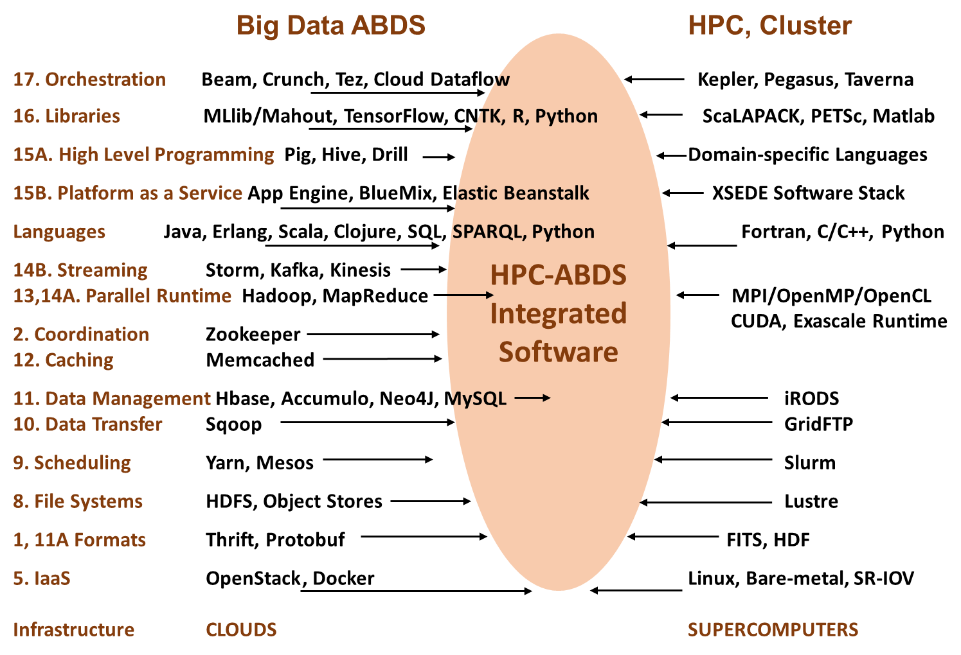

Slide 19
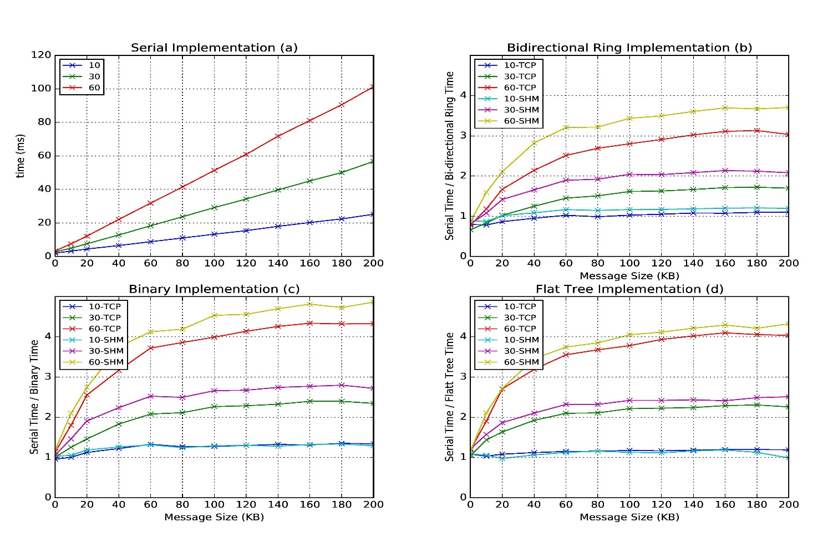
Improvement of Storm (Heron) using HPC communication algorithms

Slide 20
Dual Convergence Architecture
Running same HPC-ABDS across all platforms but data management machine has different balance in I/O, Network and Compute from “model” machine
Data Management Model for Big Data
and Big Simulation

