Slide 1
FutureGrid Connection to Comet
CS Research Use e.g. test new compiler or storage model
Class Usages e.g. run GPU & multicore
Applications
Testbed and On Ramp as a Service
Geoffrey Fox
Indiana University
gcf@Indiana.edu
http://www.futuregrid.org
Software
(Application
Or Usage) SaaS
Cloud e.g. MapReduce
HPC e.g. PETSc, SAGA
Computer Science e.g. Compiler tools, Sensor nets, Monitors
Platform
PaaS
Infra
structure
IaaS
Software Defined Computing (virtual Clusters)
Hypervisor, Bare Metal
Operating System
Network
NaaS
Software Defined Networks
OpenFlow GENI

Slide 2
Deployment Automation
Support deployment of a given program on multiple platforms – interoperability
Test on small interactive isolatable platforms and deploy on comet
Support virtual clusters – a job that involves multiple nodes possibly on different distributed platforms -- federation
Support clouds and bare metal
Support adding (cloud bursting) and moving nodes
Use templated machine images – “Software defined computing or systems” – jobs defined abstractly
Obvious security issues
Keep up with continued dramatic change

Slide 3
CloudMesh Architecture
Notes:
Multiple components are part of cloudmesh. Cloudmesh is an umbrella for it. We are still debating about its name as we aslo could have used RAIN. But rain was initially just a small component and deals predominantly so far with templated image management

Slide 4
Evolution of Bare metal/Hypervisor provisioning
Many changing approaches and many gotchas
  E.g. Approaches only work on some linux’s and some network adapter software releases
FutureGrid (early)
  Uses XCAT as part of FG Rain. It allows us to provision images on virtual machines, but also bare metal. We use templated images that can easily be transformed to run on different IaaS as well as bare metal
FutureGrid Cloudmesh bare metal abstraction
  Abstract the bare metal provisioners to a very simple set of functionality so they are easier to integrate in higher level tools
  Provide different backends
  Currently uses Cloudmesh teefaa
  Planned: OpenStack bare metal, cobbler, XCAT, …

Slide 5
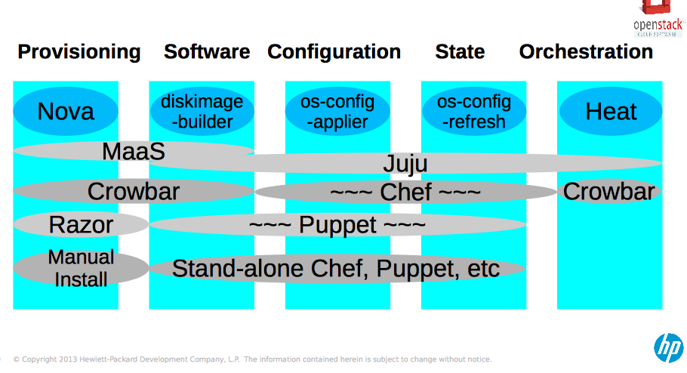
Technologies classified by TrippleO
OpenStack on openstack
Orchestration ~ virtual cluster
http://events.linuxfoundation.org/sites/events/files/slides/TripleO%20Overview.pdf

Slide 6
Some Integrated Resources
Core FutureGrid machines including Sierra at SDSC with Bare Metal, OpenStack and Eucalyptus
Azure and Amazon
OpenStack based HPCloud
Working on OpenCirrus cloud (Tashi)
FutureGrid metrics project links metrics to XSEDE
Cloudmesh Python based and supporting Libcloud, OpenStack, Azure and AWS API’s
Extend to comet and others over next year

