Slide 1
Distributed and Parallel Programming Environments and their performance
GCC2008
(Global Clouds and Cores 2008)
October 24 2008
Geoffrey Fox
Community Grids Laboratory, School of informatics
Indiana University
gcf@indiana.edu, http://www.infomall.org
1
Notes:
1

Slide 2
Consider a Collection of Computers
We can have various hardware
  Multicore – Shared memory, low latency
  High quality Cluster – Distributed Memory, Low latency
  Standard distributed system – Distributed Memory, High latency
We can program the coordination of these units by
  Threads on cores
  MPI on cores and/or between nodes
  MapReduce/Hadoop/Dryad../AVS for dataflow
  Workflow linking services
  These can all be considered as some sort of execution unit exchanging messages with some other unit
And higher level programming models such as OpenMP, PGAS, HPCS Languages

Slide 3
Grids become Clouds
Grids solve problem of too little computing: We need to harness all the world’s computers to do Science
Clouds solve the problem of too much computing: with multicore we have so much power that we need to solve user’s problems and buy the needed computers
One new technology: Virtual Machines (dynamic deployment) enable more dynamic flexible environments
  Is Virtual Cluster or Virtual Machine right way to think?
Virtualization a bit inconsistent with parallel computing as virtualization makes it hard to use correct algorithms and correct runtime
  2 cores in a chip very different algorithm/software than 2 cores in separate chips

Slide 4
Old Issues
Essentially all “vastly” parallel applications are data parallel including algorithms in Intel’s RMS analysis of future multicore “killer apps”
  Gaming (Physics) and Data mining (“iterated linear algebra”)
So MPI works (Map is normal SPMD; Reduce is MPI_Reduce) but may not be highest performance or easiest to use
Some new issues
What is the impact of clouds?
There is overhead of using virtual machines (if your cloud like Amazon uses them)
There are dynamic, fault tolerance features favoring MapReduce Hadoop and Dryad
No new ideas but several new powerful systems
Developing scientifically interesting codes in C#, C++, Java and using to compare cores, nodes, VM, not VM, Programming models

Slide 5
Intel’s Application Stack

Slide 6
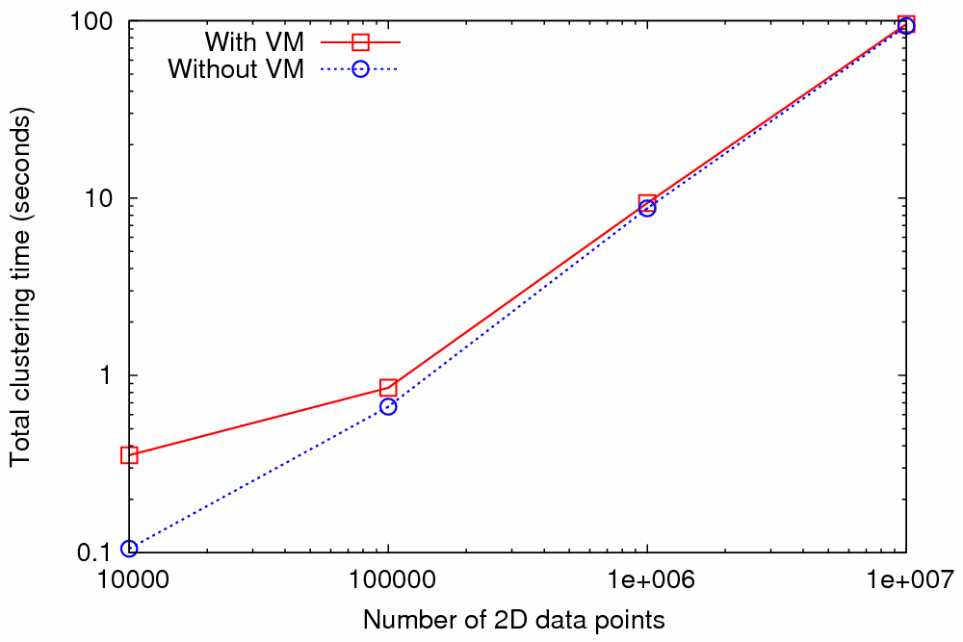
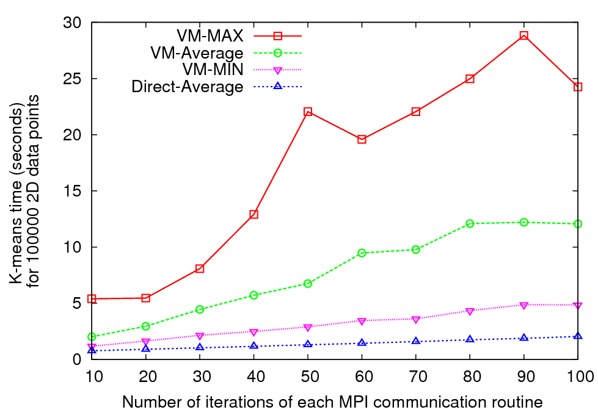
Nimbus Cloud – MPI Performance
Kmeans clustering time vs. the number of 2D data points.
(Both axes are in log scale)
Kmeans clustering time (for 100000 data points) vs. the number of iterations of each MPI communication routine
Graph 1 (Left) - MPI implementation of Kmeans clustering algorithm
Graph 2 (right) - MPI implementation of Kmeans algorithm modified to perform
each MPI communication up to 100 times
Performed using 8 MPI processes running on 8 compute nodes each with AMD Opteron™ processors (2.2 GHz and 3 GB of memory)
Note large fluctuations in VM-based runtime – implies terrible scaling

Slide 7
Nimbus Kmeans Time in secs for 100 MPI calls
Setup 1
Setup 1
VM_MIN | 4.857
VM_Average | 12.070
VM_MAX | 24.255
Setup 3
VM_MIN | 7.736
VM_Average | 17.744
VM_MAX | 32.922
Setup 2
VM_MIN | 5.067
VM_Average | 9.262
VM_MAX | 24.142
Direct
MIN | 2.058
Average | 2.069
MAX | 2.112
Setup 2
Direct
Setup 3
Test Setup | # of cores to the VM OS (domU) | # of cores to the host OS (dom0)
1 | 2 | 2
2 | 1 | 2
3 | 1 | 1

Slide 8
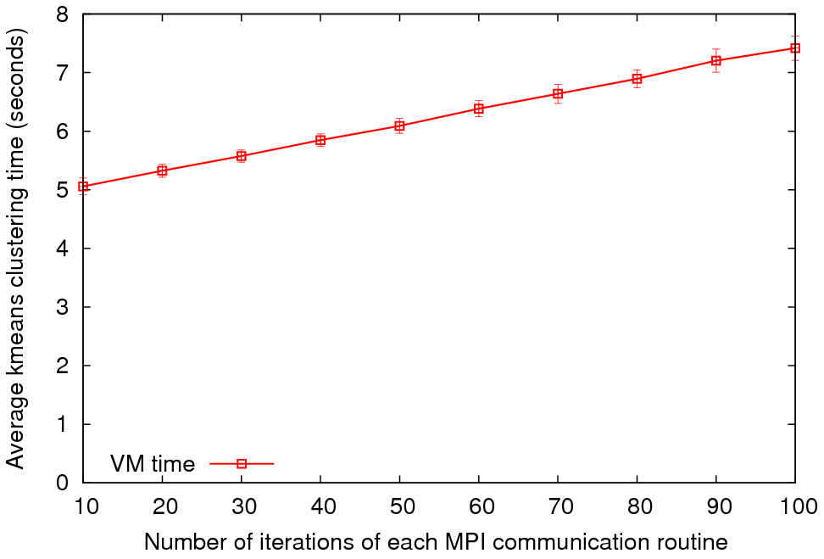
MPI on Eucalyptus Public Cloud
Kmeans Time for 100 iterations
Average Kmeans clustering time vs. the number of iterations of each MPI communication routine
4 MPI processes on 4 VM instances were used
Variable | MPI Time
VM_MIN | 7.056
VM_Average | 7.417
VM_MAX | 8.152
Configuration | VM
CPU and Memory | Intel(R) Xeon(TM) CPU 3.20GHz, 128MB Memory
Virtual Machine | Xen virtual machine (VMs)
Operating System | Debian Etch
gcc | gcc version 4.1.1
MPI | LAM 7.1.4/MPI 2
Network | -
We will redo on larger dedicated hardware
Used for direct (no VM), Eucalyptus and Nimbus

Slide 9
Data Parallel Run Time Architectures
CCR Ports
Trackers
CCR Ports
Pipes
MPI
Disk HTTP
CCR Ports
Trackers
CCR Ports
Pipes
MPI
Disk HTTP
CCR Ports
Trackers
CCR Ports
Pipes
MPI
Disk HTTP
CCR Ports
Trackers
CCR Ports
Pipes
MPI
Disk HTTP
CGL MapReduce is long running processing with asynchronous distributed
Rendezvous
synchronization
CCR (Multi Threading) uses short or long
running threads communicating via shared memory and
Ports (messages)
Microsoft DRYAD
uses short running processes communicating via pipes, disk or shared memory between cores
CCR (Multi Threading) uses short or long
running threads communicating via shared memory and
Ports (messages)
MPI is long running processes with Rendezvous for message exchange/
synchronization
Yahoo Hadoop uses short running processes communicating via disk and tracking processes

Slide 10
Is Dataflow the answer?
For functional parallelism, dataflow natural as one moves from one step to another
For much data parallel one needs “deltaflow” – send change messages to long running processes/threads as in MPI or any rendezvous model
  Potentially huge reduction in communication cost
For threads no difference but for processes big difference
Overhead is Communication/Computation
Dataflow overhead proportional to problem size N per process
For solution of PDE’s
  Deltaflow overhead is N^{1/3} and computation like N
  So dataflow not popular in scientific computing
For matrix multiplication, deltaflow and dataflow both O(N) and computation N^{1.5}
MapReduce noted that several data analysis algorithms can use dataflow (especially in Information Retrieval)

Slide 11
Dryad
H
MapReduce implemented by Hadoop
Y
n
Y
map(key, value)
U
U
reduce(key, list<value>)
S
4n
S
E.g. Word Count
M
4n
M
map(String key, String value):
// key: document name
// value: document contents
D
n
D
reduce(String key, Iterator values):
// key: a word
// values: a list of counts
X
n
X
U
N
U
N

Slide 12
CGL-MapReduce
Content Dissemination Network
M
Map Worker
Worker Nodes
R
Reduce Worker
D
D
MR
Driver
User
Program
M
M
M
M
D
MRDeamon
R
R
R
R
Data Read/Write
File System
Communication
Data Split
Architecture of CGL-MapReduce
A streaming based MapReduce runtime implemented in Java
All the communications(control/intermediate results) are routed via a content dissemination network
Intermediate results are directly transferred from the map tasks to the reduce tasks – eliminates local files
MRDriver
  Maintains the state of the system
  Controls the execution of map/reduce tasks
User Program is the composer of MapReduce computations
Support both stepped (dataflow) and iterative (deltsflow) MapReduce computations
All communication uses publish-subscribe “queues in the cloud” not MPI

Slide 13
CGL-MapReduce – The Flow of Execution
Initialization
Start the map/reduce workers
Configure both map/reduce tasks (for configurations/fixed data)
Fixed Data
1
Initialize
Variable Data
map
reduce
Iterative MapReduce
2
Map
Execute map tasks passing <key, value> pairs
combine
Terminate
3
Reduce
Execute reduce tasks passing <key, List<values>>
Content Dissemination Network
4
Combine
Combine the outputs of all the reduce tasks
Worker Nodes
D
D
MR
Driver
User
Program
M
M
M
M
5
Termination
Terminate the map/reduce workers
R
R
R
R
Data Split
File System
CGL-MapReduce, the flow of execution

Slide 14
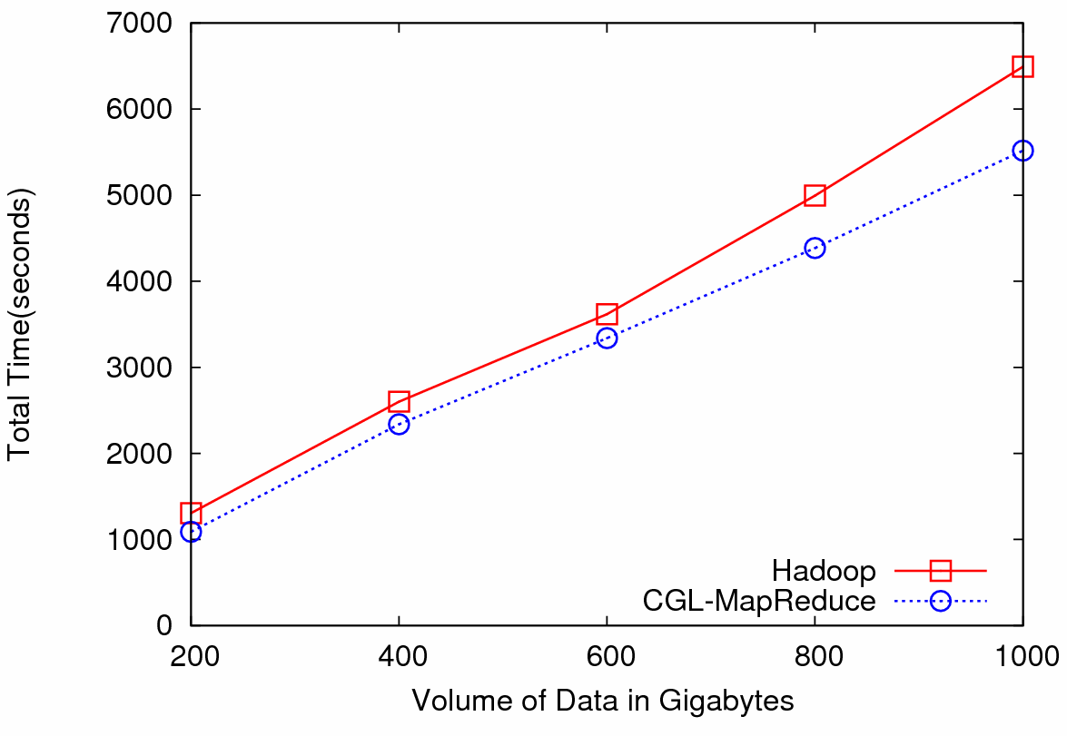

Particle Physics (LHC) Data Analysis
Data: Up to 1 terabytes of data, placed in IU Data Capacitor
Processing:12 dedicated computing nodes from Quarry (total of 96 processing cores)
MapReduce for LHC data analysis
LHC data analysis, execution time vs. the volume of data (fixed compute resources)
Hadoop and CGL-MapReduce both show similar performance
The amount of data accessed in each analysis is extremely large
Performance is limited by the I/O bandwidth
The overhead induced by the MapReduce implementations has negligible effect on the overall computation

Slide 15
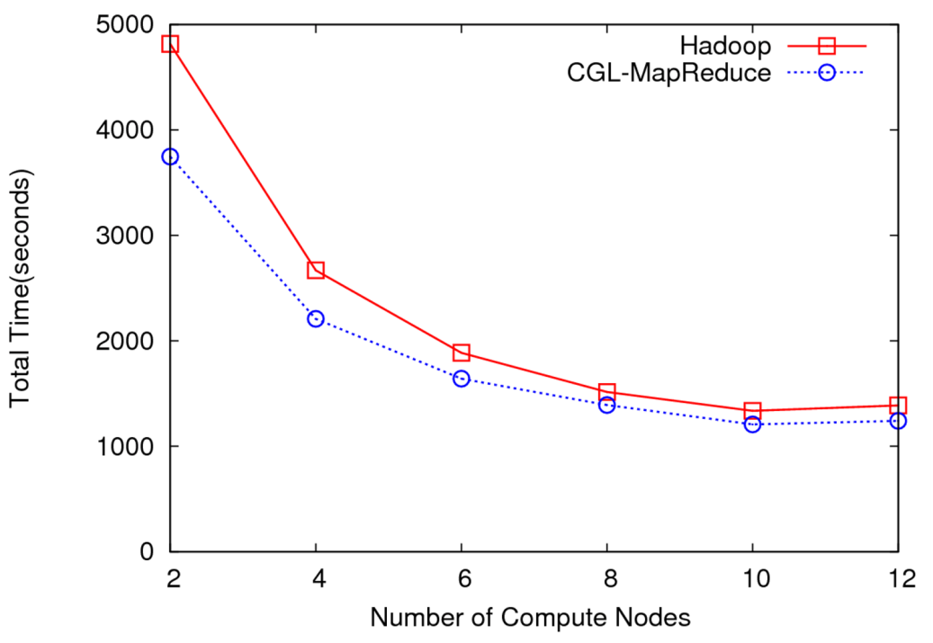
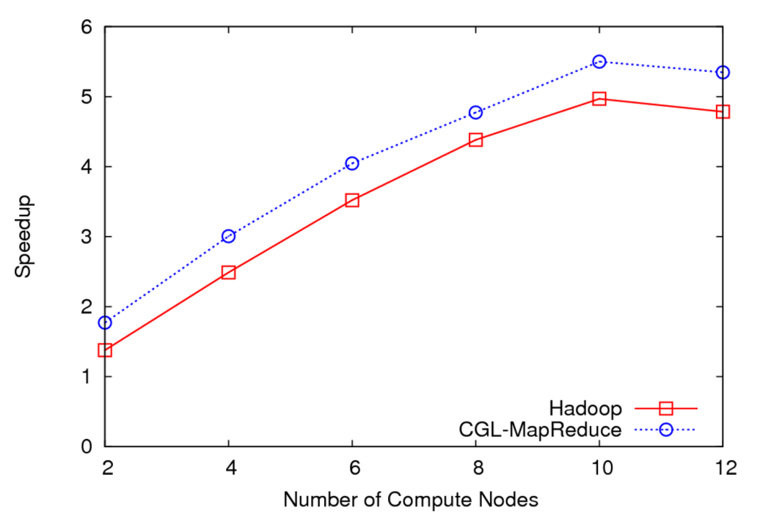
LHC Data Analysis Scalability and Speedup
Execution time vs. the number of compute nodes (fixed data)
Speedup for 100GB of HEP data
100 GB of data
One core of each node is used (Performance is limited by the I/O bandwidth)
Speedup = MapReduce Time / Sequential Time
Speed gain diminish after a certain number of parallel processing units (after around 10 units)

Slide 16
Deterministic Annealing for Pairwise Clustering
Clustering is a well known data mining algorithm with K-means best known approach
Two ideas that lead to new supercomputer data mining algorithms
Use deterministic annealing to avoid local minima
Do not use vectors are often not known – use distances δ(i,j) between points i, j in collection – N=millions of points are available in Biology; algorithms go like N² . Number of clusters
Developed (partially) by Hofmann and Buhmann in 1997 but little or no application
Minimize H_{PC} = 0.5 ∑_{i=1}^{N} ∑_{j=1}^{N} δ(i, j) ∑_{k=1}^{K} M_{i}(k) M_{j}(k) / C(k)
M_{i}(k) is probability that point i belongs to cluster k
C(k) = ∑_{i=1}^{N} M_{i}(k) is number of points in k’th cluster
M_{i}(k) ∝ exp( -ε_{i}(k)/T ) with Hamiltonian ∑_{i=1}^{N} ∑_{k=1}^{K} M_{i}(k) ε_{i}(k)
Reduce T from large to small values to anneal
PCA
2D MDS

Slide 17
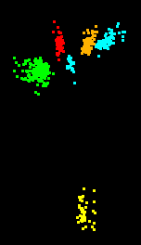
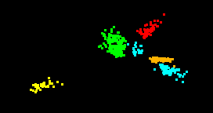
Multidimensional Scaling MDS
Map points in high dimension to lower dimensions
Many such dimension reduction algorithm (PCA Principal component analysis easiest); simplest but perhaps best is MDS
Minimize Stress
σ(X) = Σ_{i<j=1}^{n} weight(i,j) (δ_{ij} - d(X_{i} , X_{j}))²
δ_{ij} are input dissimilarities and d(X_{i} , X_{j}) the Euclidean distance squared in embedding space (3D usually)
SMACOF or Scaling by minimizing a complicated function is clever steepest descent algorithm
Computational complexity goes like
N². Reduced Dimension
Gene families – clustered and visualized with pairwise algorithms
Naïve original dimension 4000
Complexity dimension 50
Mapped to 3D. Projected to 2D

Slide 18
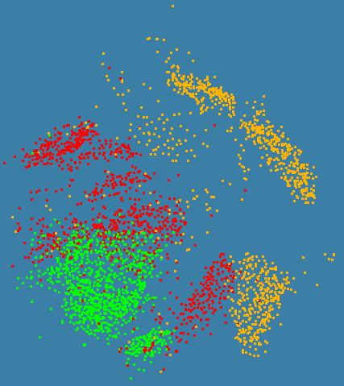
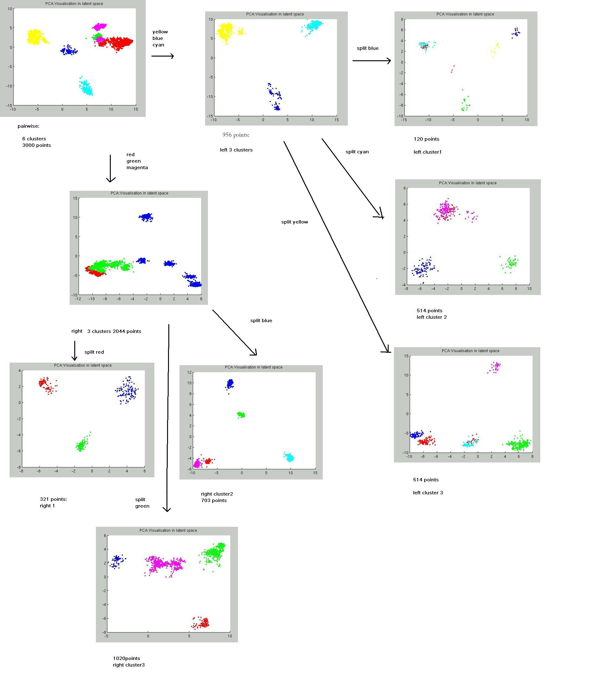
N=3000 sequences each length ~1000 features
Only use pairwise distances will repeat with 0.1 to 0.5 million sequences with a larger machine
C# with CCR and MPI

Slide 19
Windows Thread Runtime System
We implement thread parallelism using Microsoft CCR
(Concurrency and Coordination Runtime) as it supports both MPI rendezvous and dynamic (spawned) threading style of parallelism http://msdn.microsoft.com/robotics/
CCR Supports exchange of messages between threads using named ports and has primitives like:
FromHandler: Spawn threads without reading ports
Receive: Each handler reads one item from a single port
MultipleItemReceive: Each handler reads a prescribed number of items of a given type from a given port. Note items in a port can be general structures but all must have same type.
MultiplePortReceive: Each handler reads a one item of a given type from multiple ports.
CCR has fewer primitives than MPI but can implement MPI collectives efficiently
Can use DSS (Decentralized System Services) built in terms of CCR for service model
DSS has ~35 µs and CCR a few µs overhead

Slide 20
MPI Exchange Latency in µs (20-30 µs computation between messaging)
Machine | OS | Runtime | Grains | Parallelism | MPI Latency
Intel8c:gf12 (8 core 2.33 Ghz) (in 2 chips) | Redhat | MPJE(Java) | Process | 8 | 181
 |  | MPICH2 (C) | Process | 8 | 40.0
 |  | MPICH2:Fast | Process | 8 | 39.3
 |  | Nemesis | Process | 8 | 4.21
Intel8c:gf20 (8 core 2.33 Ghz) | Fedora | MPJE | Process | 8 | 157
 |  | mpiJava | Process | 8 | 111
 |  | MPICH2 | Process | 8 | 64.2
Intel8b (8 core 2.66 Ghz) | Vista | MPJE | Process | 8 | 170
 | Fedora | MPJE | Process | 8 | 142
 | Fedora | mpiJava | Process | 8 | 100
 | Vista | CCR (C#) | Thread | 8 | 20.2
AMD4 (4 core 2.19 Ghz) | XP | MPJE | Process | 4 | 185
 | Redhat | MPJE | Process | 4 | 152
 |  | mpiJava | Process | 4 | 99.4
 |  | MPICH2 | Process | 4 | 39.3
 | XP | CCR | Thread | 4 | 16.3
Intel(4 core) | XP | CCR | Thread | 4 | 25.8
Messaging CCR versus MPI C# v. C v. Java
SALSA
Notes:
20

Slide 21
MPI outside the mainstream
Multicore best practice and large scale distributed processing not scientific computing will drive
Party Line Parallel Programming Model: Workflow (parallel--distributed) controlling optimized library calls
  Core parallel implementations no easier than before; deployment is easier
MPI is wonderful but it will be ignored in real world unless simplified; competition from thread and distributed system technology
CCR from Microsoft – only ~7 primitives – is one possible commodity multicore driver
  It is roughly active messages
  Runs MPI style codes fine on multicore
Hadoop and Multicore and their relations are likely to replace current workflow (BPEL ..)

Slide 22
Deterministic Annealing Clustering
Scaled Speedup Tests on 4 8-core Systems
1,600,000 points per C# thread
1, 2, 4. 8, 16, 32-way parallelism
On Windows
Parallel
Overhead
≈ 1-efficiency
= (PT(P)/T(1)-1)
On P processors
= (1/efficiency)-1
32-way
16-way
2-way
8-way
4-way
Nodes
1 2 1 1 4 2 1 2 1 1 4 2 1 4 2 1 2 1 1 4 2 4 2 4 2 2 4 4 4 4
MPI Processes per Node
1 1 2 1 1 2 4 1 2 1 2 4 8 1 2 4 1 2 1 4 8 2 4 1 2 1 8 4 2 1
CCR Threads per Process
1 1 1 2 1 1 1 2 2 4 1 1 1 2 2 2 4 4 8 1 1 2 2 4 4 8 1 2 4 8

Slide 23
Run Time Fluctuations for Clustering Kernel
This is average of standard deviation of run time of the 8 threads between messaging synchronization points

Slide 24
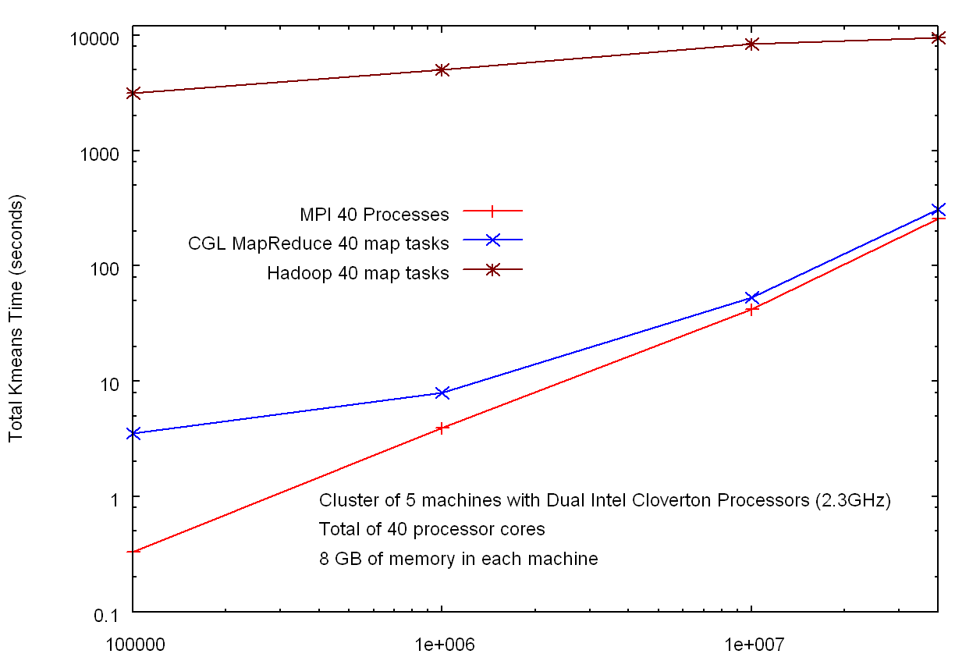
Hadoop v MPI and CGL-MapReduce for Clustering
HADOOP
Factor of 30
Factor of 10³
In memory MapReduce
MPI
Number of Data Points

Slide 25

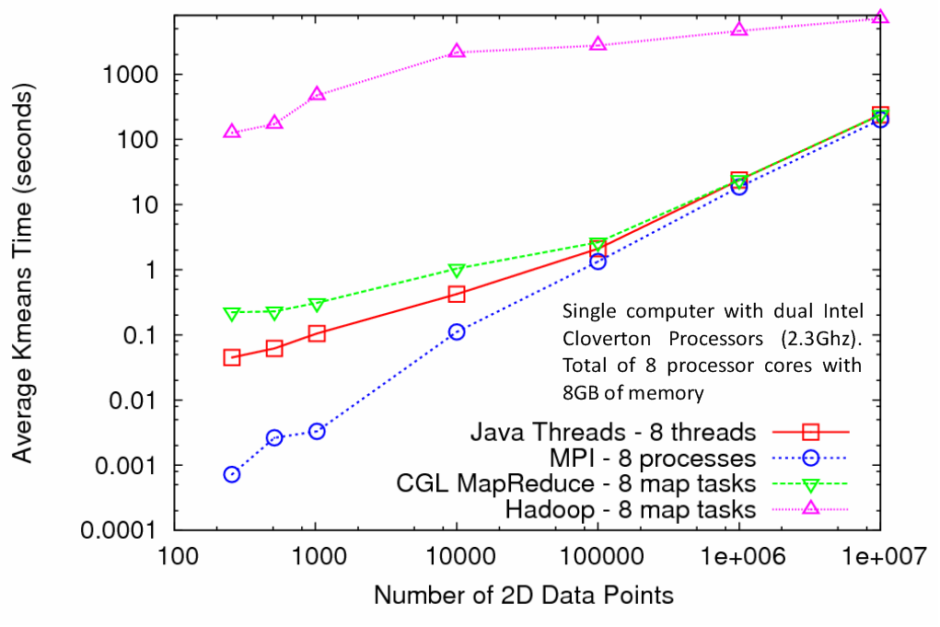
Kmeans Clustering
MapReduce for Kmeans Clustering
Kmeans Clustering, execution time vs. the number of 2D data points (Both axes are in log scale)
All three implementations perform the same Kmeans clustering algorithm
Each test is performed using 5 compute nodes (Total of 40 processor cores)
CGL-MapReduce shows a performance close to the MPI and Threads implementation
Hadoop’s high execution time is due to:
  Lack of support for iterative MapReduce computation
  Overhead associated with the file system based communication

Slide 26

http://escience2008.iu.edu/

