Slide 1
A Global System Architecture
Next Generation HPC-ABDS
Indiana University Internal Presentation
SPIDAL
Geoffrey Fox, Supun Kamburugamuve, Judy Qiu, Shantenu Jha
June 9, 2017
gcf@indiana.edu
http://www.dsc.soic.indiana.edu/, http://spidal.org/ http://hpc-abds.org/kaleidoscope/
Department of Intelligent Systems Engineering
School of Informatics and Computing, Digital Science Center
Indiana University Bloomington

Slide 2
Problem

Slide 3
Big Data Software and Applications
The big data software systems are numerous and powerful
  One can get good (and bad) performance in an understandable reproducible fashion
  Surely need better documentation and packaging
The problems (and users) are definitely not mature (i.e. not understood, and key issues not agreed)
  Many academic fields are just starting to use big data and some are still restricted to small data
  e.g. Deep Learning is not understood in many cases outside the well publicized commercial cases (voice, translation, images)
In many areas, applications are pleasingly parallel or involve MapReduce; performance issues are different from HPC
  Common is lots of independent Python or R jobs

Slide 4
More on Academic (Research) Applications
Applications ought to drive new-generation big data software stacks but (at many universities) academic applications lag commercial use in big data area and needs are quite modest
  This will change and we can expect big data software stacks to become more important
Note University compute systems historically offer HPC and not Big Data Expertise.
  We could anticipate users moving to public clouds (away from university systems) but
  Users will still want support
Need a Requirements Analysis that builds in application changes that might occur as users get more sophisticated
Need to help (train) users to explore big data opportunities

Slide 5
Why use Spark Hadoop Flink rather than HPC?
Yes if you value ease of programming over performance.
  This could be the case for most companies where they can find people who can program in Spark/Hadoop much more easily than people who can program in MPI.
  Most of the complications including data, communications are abstracted away to hide the parallelism so that average programmer can use Spark/Flink easily and doesn't need to manage state, deal with file systems etc.
  RDD data support very helpful
For large data problems involving heterogeneous data sources such as HDFS with unstructured data, databases such as HBase etc
Yes if one needs fault tolerance for our programs.
  Our 13-node Moe “big data” (Hadoop twitter analysis) cluster at IU faces such problems around once per month. One can always restart the job, but automatic fault tolerance is convenient.

Slide 6
Why use HPC and not Spark, Flink, Hadoop?
The performance of Spark, Flink, Hadoop on classic parallel data analytics is poor/dreadful whereas HPC (MPI) is good
One way to understand this is to note most Apache systems deliberately support a dataflow programming model
e.g. for Reduce, Apache will launch a bunch of tasks and eventually bring results back
  MPI runs a clever AllReduce interleaved “in-place” tree
Maybe can preserve Spark, Flink programming model but change implementation “under the hood” where optimization important.
Note explicit dataflow is efficient and preferred at coarse scale as used in workflow systems
  Need to change implementations for different problems

Slide 7

HPC Runtime versus ABDS distributed Computing Model on Data Analytics
Hadoop writes to disk and is slowest; Spark and Flink spawn many processes and do not support AllReduce directly;
MPI does in-place combined reduce/broadcast and is fastest
Need Polymorphic Reduction capability choosing best implementation
Use New HPC communication mechanisms
Mutable model
Immutable data

Slide 8


Multidimensional Scaling MDS Results with Flink, Spark and MPI
MDS execution time on 16 nodes with 20 processes in each node with varying number of points
MDS execution time with 32000 points on varying number of nodes. Each node runs 20 parallel tasks
MDS performed poorly on Flink due to its lack of support for nested iterations. Need to have data locality (alignment) sensitivity

Slide 9
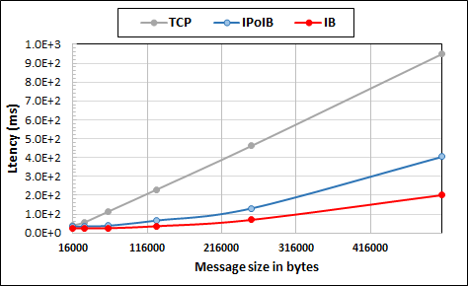
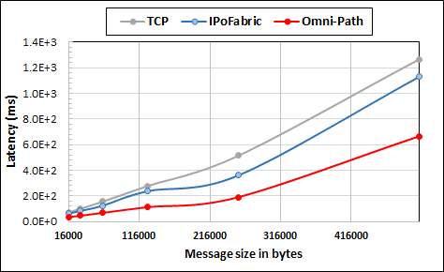
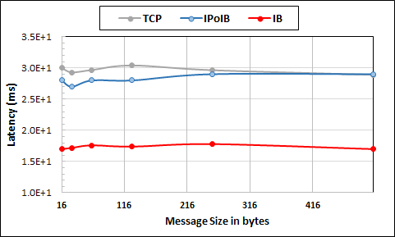
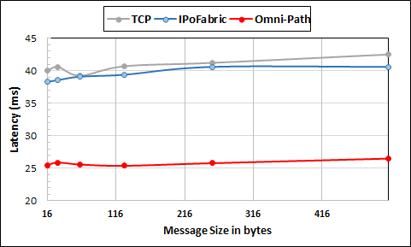
Intel Haswell Cluster with 2.4GHz Processors and 56Gbps Infiniband and 1Gbps Ethernet
Intel KNL Cluster with 1.4GHz Processors and 100Gbps Omni-Path and 1Gbps Ethernet
Large messages
Small messages
Parallelism of 2 and using 8 Nodes
Parallelism of 2 and using 4 Nodes
Twitter Heron Streaming Software using HPC Hardware

Slide 10
Knights Landing KNL Data Analytics: Harp, Spark, NOMAD
Single Node and Cluster performance: 1.4GHz 68 core nodes
Kmeans SGD ALS
Strong Scaling Multi Node Parallelism Scaling - Omnipath Interconnect
Strong Scaling Single Node Core Parallelism Scaling

Slide 11
Components of Big Data Stack
Google likes to show a timeline
2002 Google File System GFS ~HDFS
2004 MapReduce Apache Hadoop
2006 Big Table Apache Hbase
2008 Dremel Apache Drill
2009 Pregel Apache Giraph
2010 FlumeJava Apache Crunch
2010 Colossus better GFS
2012 Spanner horizontally scalable NewSQL database ~CockroachDB
2013 F1 horizontally scalable SQL database
2013 MillWheel ~Apache Storm, Twitter Heron (Google not first!)
2015 Cloud Dataflow Apache Beam with Spark or Flink (dataflow) engine
Functionalities not identified: Security, Data Transfer, Scheduling, serverless computing

Slide 12
Solution

Slide 13
What is the challenge?
Integrate systems that offer full capabilities
  Scheduling
  Storage
  “Database”
  Programming Model (dataflow and/or “in-place” control-flow) and corresponding runtime
  Analytics
  Workflow
  Function as a Service and Event-based Programming
With a broad scope
  For both Batch and Streaming
  Distributed and Centralized (Grid versus Cluster)
  Pleasingly parallel (Local machine learning) and Global machine learning (large scale parallel codes)
How do we do this?

Slide 14
Important Trends I
Data gaining in importance compared to simulations
  Data analysis techniques changing with old and new applications
All forms of IT increasing in importance; both data and simulations increasing
Internet of Things and Edge Computing growing in importance
Exascale initiative driving large supercomputers
Use of public clouds increasing rapidly
  Clouds becoming diverse with subsystems containing GPU’s, FPGA’s, high performance networks, storage, memory …
  They have economies of scale; hard to compete with
Serverless computing attractive to user:
“No server is easier to manage than no server”

Slide 15
Important Trends II
Rich software stacks:
  HPC for Parallel Computing
  Apache for Big Data including some edge computing (streaming data)
On general principles parallel and distributed computing has different requirements even if sometimes similar functionalities
  Apache stack typically uses distributed computing concepts
  Reduce different in MPI (Harp) and Spark
Important to put grain size into analysis
  Its easier to make dataflow efficient if grain size large
Streaming Data ubiquitous including data from edge
Edge computing has some time-sensitive applications
  Choosing a good restaurant can wait seconds
  Avoiding collisions is milliseconds

Slide 16
Important Trends III
HPC needed for some Big Data processing
  Deep Learning needs small HPC systems
Big Data requirements are not clear but current workloads have substantial pleasingly parallel or modestly synchronized applications that are well suited to current clouds
  Maybe will change as users get more sophisticated
  Such as change happened in simulation as increased computer power led to ability to do much larger and different problems (2D in 1980 became fully realistic 3D)
Data should not be moved unless essential
  Supported by Fog computing
Fog is a well establish idea but no agreement on architecture
Need Security and Fault Tolerance!!

Slide 17
Predictions/Assumptions
Supercomputers will continue for large simulations and may run other applications but these will be developed on
Next-Generation Commodity Systems are dominant force
  Merge Cloud HPC and Edge computing
  Clouds running in multiple giant datacenters offering all types of computing
  Distributed data sources associated with device and Fog processing resources
  Server-hidden computing for user pleasure
  Support a distributed event driven dataflow computing model covering batch and streaming data
  Needing parallel and distributed (Grid) computing ideas

Slide 18
Proposed Approach I
Unit of Processing is an Event driven Function
  Can have state that may need to be preserved in place (Iterative MapReduce)
  Can be hierarchical as in invoking a parallel job
Processing units run in clouds, fogs or devices but these all have similar architecture
  Fog (e.g. car) looks like a cloud to a device (radar sensor) while public cloud looks like a cloud to the fog (car)
Use polymorphic runtime that uses different implementations depending on environment e.g. on fault-tolerance – latency (performance) tradeoffs
Data locality (minimize explicit dataflow) properly supported as in HPF alignment commands (specify which data and computing needs to be kept together)

Slide 19
Proposed Approach II
Analyze the runtime of existing systems
  Spark, Flink
  Storm, Heron Dataflow
  Kepler, Pegasus, NiFi workflow
  Harp Map-Collective, MPI and HPC runtime like HPX
  And approaches such as GridFTP for data transfer
Propose polymorphic unification (given function can have different implementations)
Choose powerful scheduler (Mesos?)
Support processing locality/alignment including MPI’s never move model with grain size consideration
This should integrate HPC and Clouds

