Slide 1
Experimenting Lucene Index on HBase in an HPC Environment
Xiaoming Gao
Vaibhav Nachankar
Judy Qiu

Slide 2
Outline
Introduction
System design and implementation
Preliminary index data analysis
Comparison with related work
Future work

Slide 3
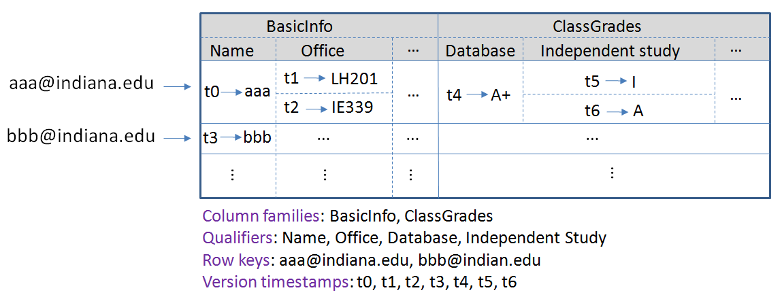
Introduction
Background: data intensive computing requires storage solutions for huge amounts of data
One proposed solution: HBase, Hadoop implementation of Google’s BigTable

Slide 4
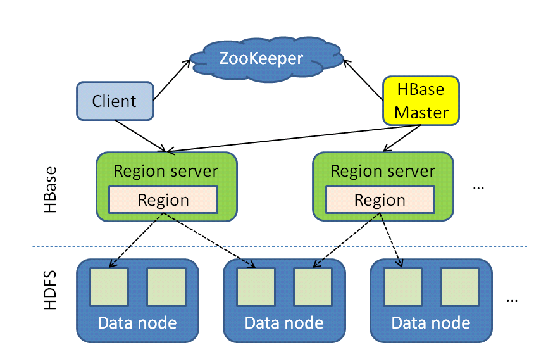
Introduction
HBase architecture:
Tables split into regions and served by region servers
Reliable data storage and efficient access to TBs or PBs of data, successful application in Facebook and Twitter
Problem: no inherent mechanism for field value searching, especially for full-text values

Slide 5
Introduction
Inverted index:
- <term value> -> <doc id>, <doc id>, …
- “computing” -> doc1, doc3, …
Apache Lucene:
- Inverted index library for full-text search
- Incremental indexing, document scoring, and multi-index search with merged results, etc.
- Existing Lucene-based indexing systems use files to store index data – not a natural integration with HBase
Solution: integrate and maintain inverted indices directly in HBase

Slide 6
System design
Data from a real digital library application
- Bibliography data, page image data, texts data
- Requirements: answer users’ queries for books, and fetch book pages for users
Query format:
- {<field1>: term1, term2, ...; <field2>: term1, term2, ...; ...}
- {title: "computer"; authors: "Radiohead"; text: "Let down"}

Slide 7
System design
①
④
⑤
Client
②
③
⑥
⑥
HBase
Lucene index tables
Book bibliography table
Book text data table
Book image data table

Slide 8
System design
Table schemas:
Table | Schema
Book bibliography table | <book id> --> {md:[title, category, authors, createdYear, publishers, location, startPage, currentPage, ISBN, additional, dirPath, keywords]}
Book text data table | <book id> --> {pages:[1, 2, ...]}
Book image data table | <book id>-<page number> --> {image:[image]}
Lucene index tables | <term value> --> {frequencies:[<book id>, <book id>, ...]} <term value> --> {positions:[<book id>, <book id>, ...]}

Slide 9
System design
Index table schema for storing term frequencies:
frequencies
283
1349
… (other book ids)
“database”
3
4
…
Index table schema for storing term position vectors:
positions
283
1349
… (other book ids)
“database”
1, 24, 33
1, 34, 77, 221
…

Slide 10
System design
Benefits of the system architecture:
- Natural integration with HBase
- Reliable and scalable index data storage
- Distributed workload for index data access
- Real-time document addition and deletion
- MapReduce programs for building index and index data analysis

Slide 11
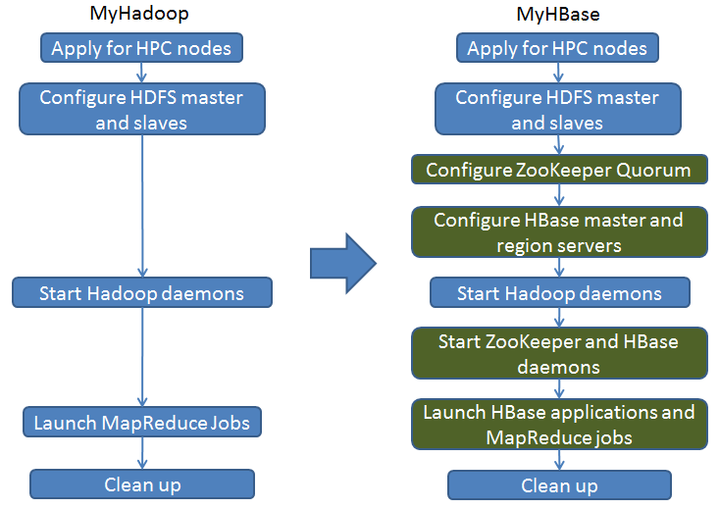
System implementation
Experiments completed in the Alamo HPC cluster of FutureGrid
MyHadoop -> MyHBase

Slide 12
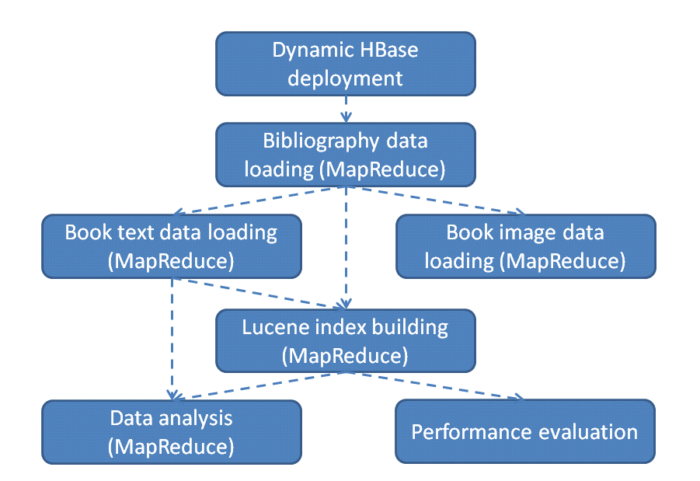
System implementation
Workflow:

Slide 13
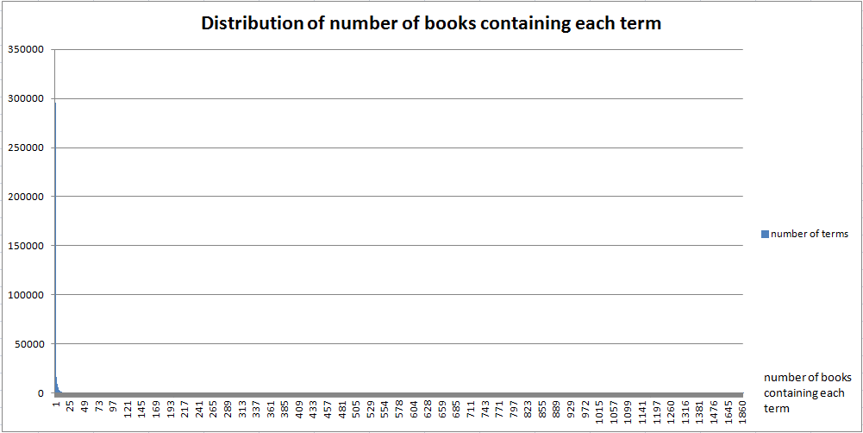
Preliminary index data analysis
Number of books indexed: 2294
Number of distinct terms: 406689
295662 terms (73%) appear only in 1 book.
“1” appears in 1904 books.

Slide 14
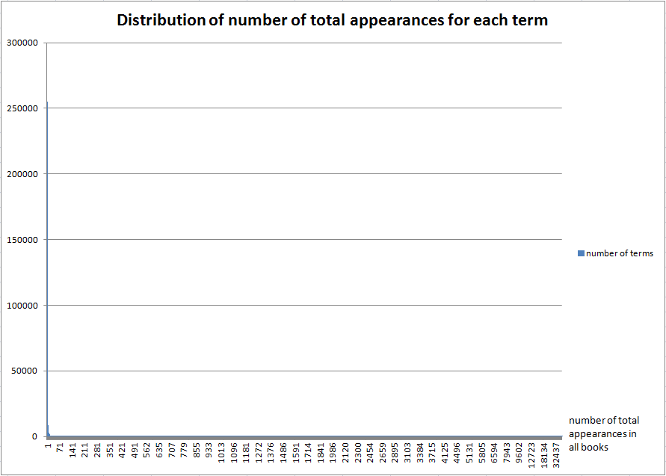
Preliminary index data analysis
254934 terms (63%) appear only once in all books.
“we” appears 103174 times in the whole data set.

Slide 15
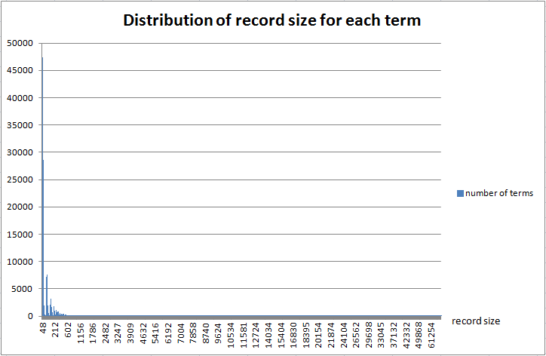
Preliminary index data analysis
94% of all terms have a record size of <= 500 bytes in the frequency index table.
Largest record size: 85KB for “from”. Smallest record size: 48 bytes for “w9”.

Slide 16
Comparison with related work
Pig and Hive:
- Pig Latin and HiveQL have operators for search, but not based on indices
- Suitable for batch analysis to large data sets
SolrCloud, ElasticSearch, Katta:
- Distributed search systems based on Lucene indices
- Indices organized as files; not a natural integration with HBase
- Each has its own system management mechanisms
Solandra:
- Inverted index implemented as tables in Cassandra
- Different index table designs; no MapReduce support

Slide 17
Future work
Distributed performance evaluation
Distributed search engine integrated with HBase region servers
More data analysis or text mining based on the index support

Slide 18
Thanks!
Questions?

