Slide 1
Remarks on Cyberinfrastructure and Climate Change from a Polar Science Point of View
April 27 2013
Earlham College Hackathon
Geoffrey Fox
gcf@indiana.edu
http://www.infomall.org http://www.futuregrid.org
School of Informatics and Computing
Digital Science Center
Indiana University Bloomington

Slide 2
Big Data Ecosystem in One Sentence
Use Clouds running Data Analytics processing Big Data to solve problems in X-Informatics ( or e-X)
X = Astronomy, Biology, Biomedicine, Business, Chemistry, Crisis, Earth Science, Energy, Environment, Finance, Health, Intelligence, Lifestyle, Marketing, Medicine, Pathology, Policy, Radar, Security, Sensor, Social, Sustainability, Wealth and Wellness with more fields (physics) defined implicitly
Spans Industry and Science (research)
X = Climate, Polar Science, Radar
Education: Data Science see recent New York Times articles
http://datascience101.wordpress.com/2013/04/13/new-york-times-data-science-articles/

Slide 3








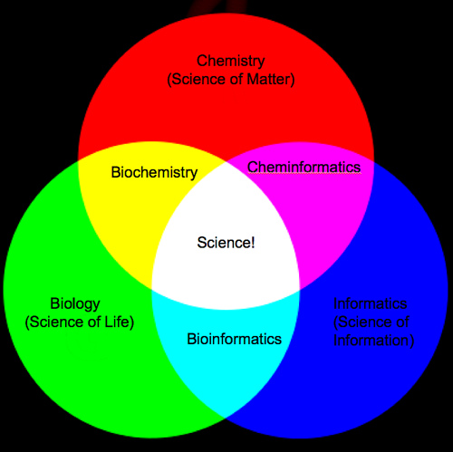

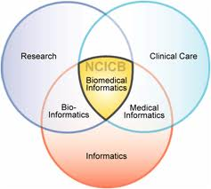
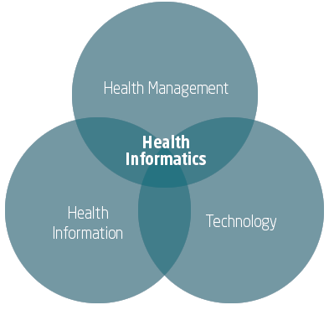
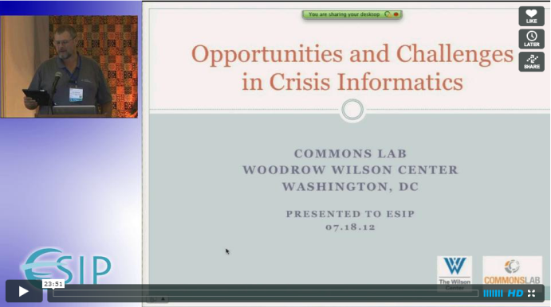

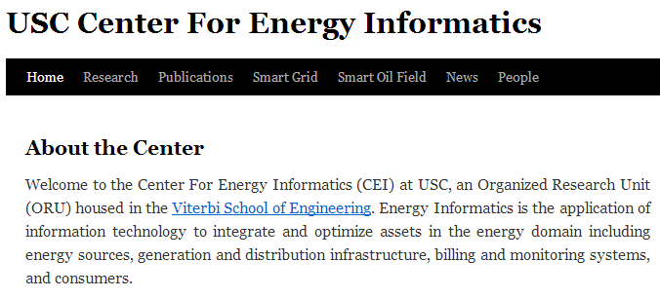
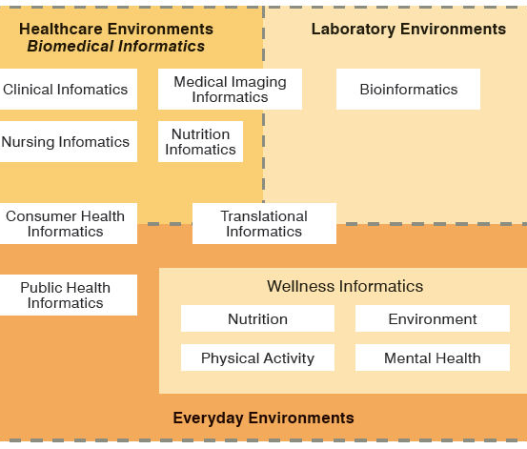
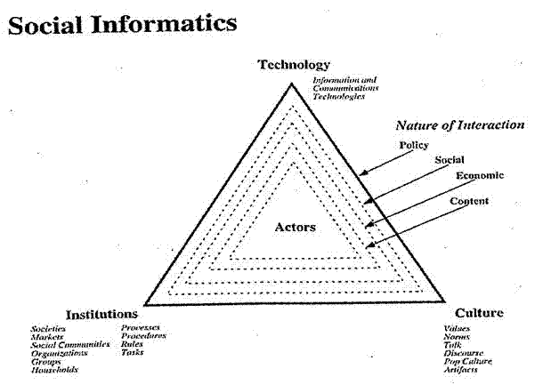
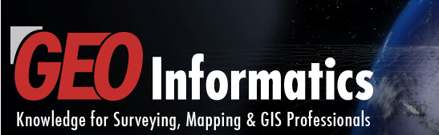

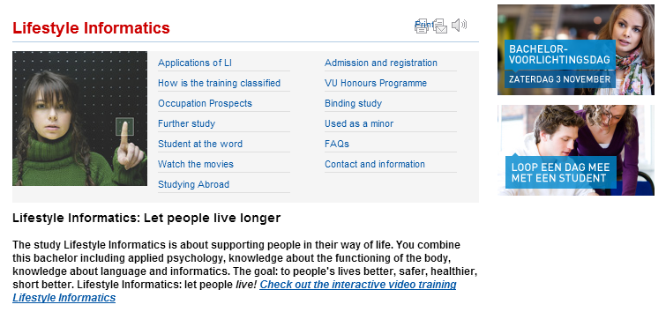


Social Informatics

Slide 4

Some Trends
  The Data Deluge is clear trend from Commercial (Amazon, e-commerce) , Community (Facebook, Search) and Scientific applications
  Light weight clients from smartphones, tablets to sensors
  Multicore reawakening parallel computing
  Exascale initiatives will continue drive to high end with a simulation orientation
  Clouds with cheaper, greener, easier to use IT for (some) applications
  New jobs associated with new curricula
    Clouds as a distributed system (classic CS courses)
    Data Analytics (Important theme in academia and industry)
    Network/Web Science

Slide 5
Data Deluge is also Information/Knowledge/Wisdom/Decision Deluge?
Data-1
Source
Layered GIS View
Read
Data-1
Prepare
View
Filter
Data
Fuse
Data
Read
Data-2
Data-2
Source

Slide 6
Use Services + Mashup + GIS/Portal
All (coarse grain = big) Software written as a Service
  Chunk of code that receives input as messages and gives results as a message sent to another service (or client)
  Generalizes Web Server-client interaction
Important set of API’s (application program interfaces defining syntax of message)
  See programmableweb.com
The linking of several services together is called a mashup or a workflow
The final step is a server (called a portal) that prepares data for transmission to client
  For Earth/Polar science data use “Geographical Information System” (e.g. Google maps) as client model

Slide 7
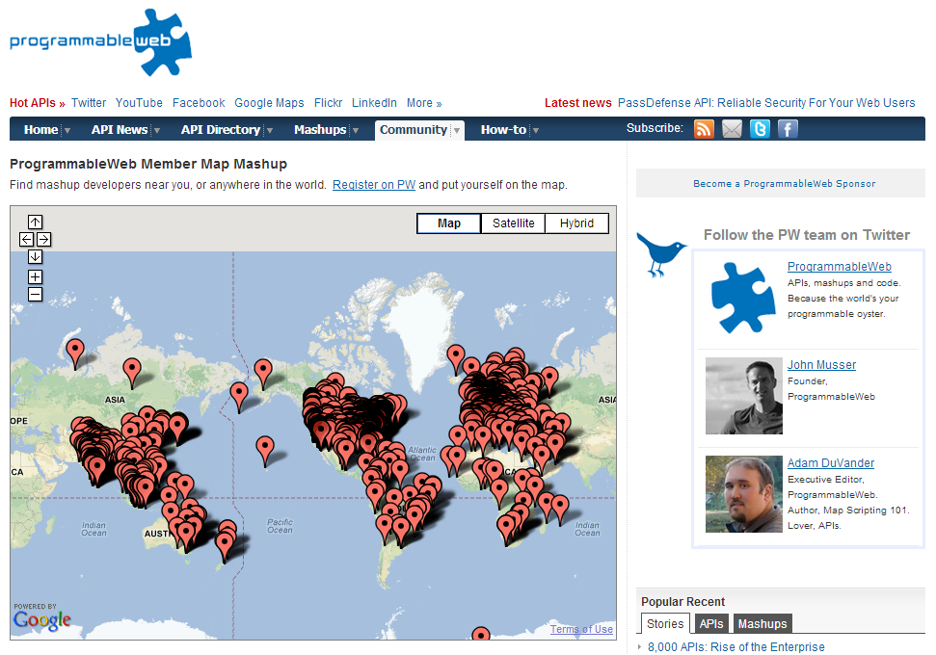
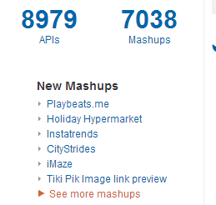
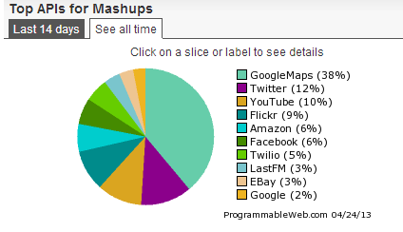
http://www.programmableweb.com/

Slide 8
Notes:
PolarGrid acts as a contractor to CReSIS to support the storage and processing needs of the field

Slide 9
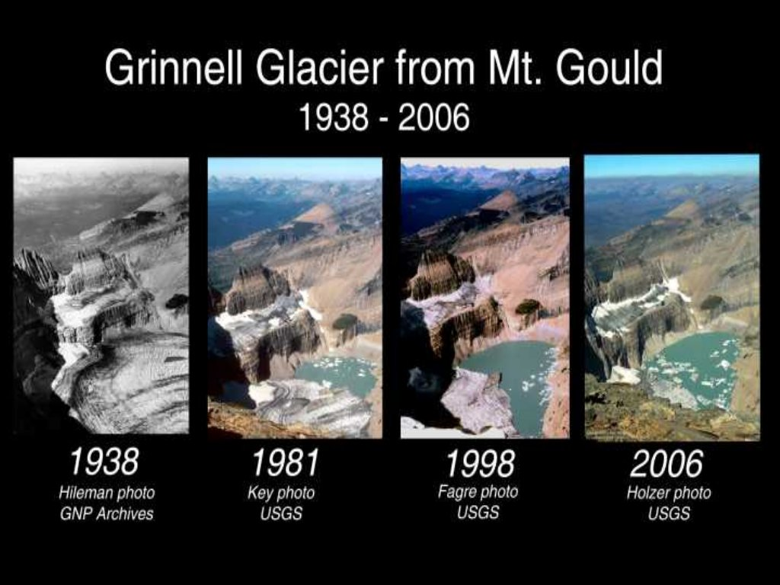
Glacier National Park Montana

Slide 10
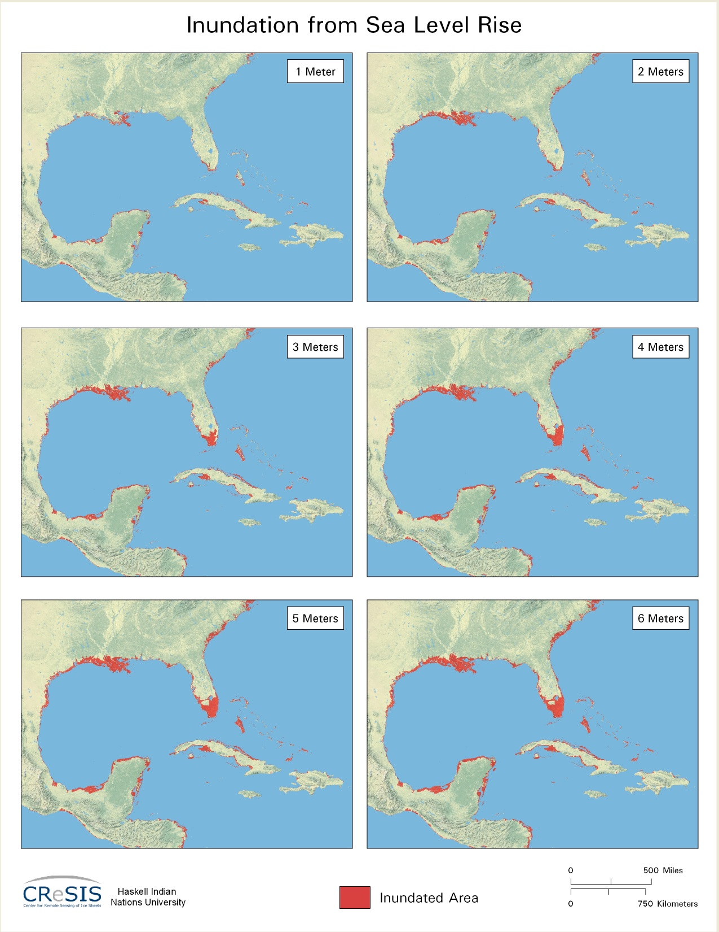
Sea Level Rise
CReSIS data says sea level rise likely to 30-50 cm not many meters. West Antarctica (Thwaites) worrisome

Slide 11
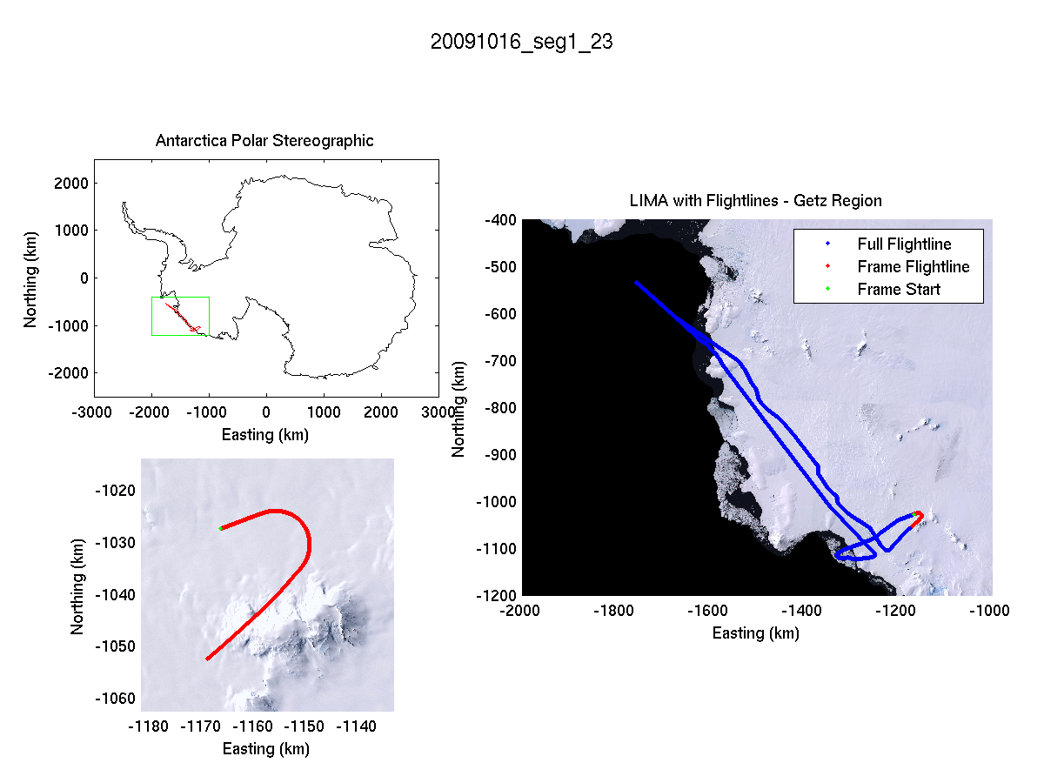
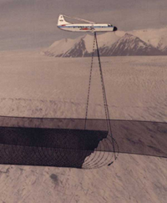
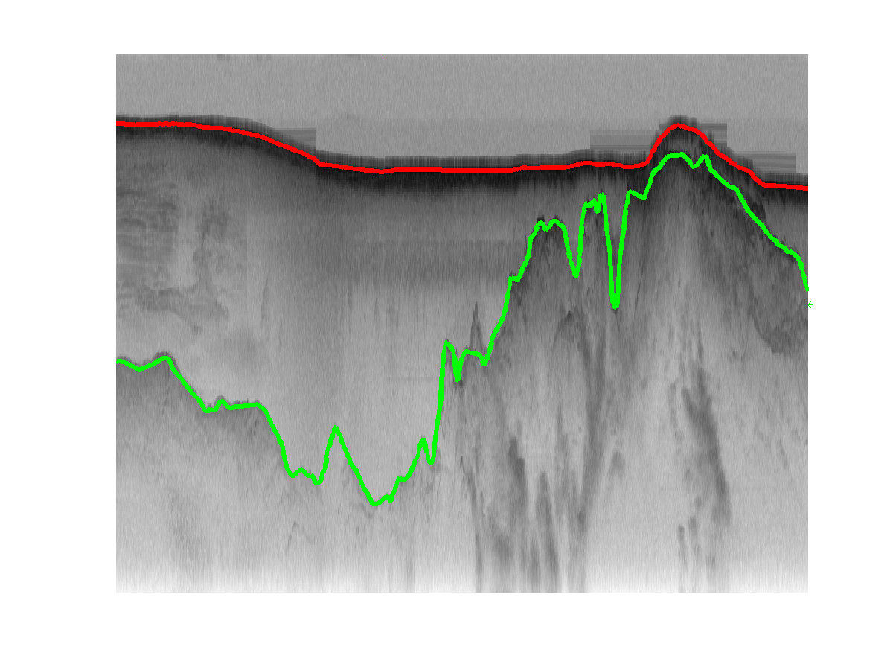
Ice sheet radar echograms
Distance along flight line
Air
Depth resolution data
CReSIS 1-5cm (snow)
50cm (bed)
Distance below aircraft
Ice
First large scale high resolution data
Previous 10km horizontal
CReSIS 0.05 km
Bedrock

Slide 12
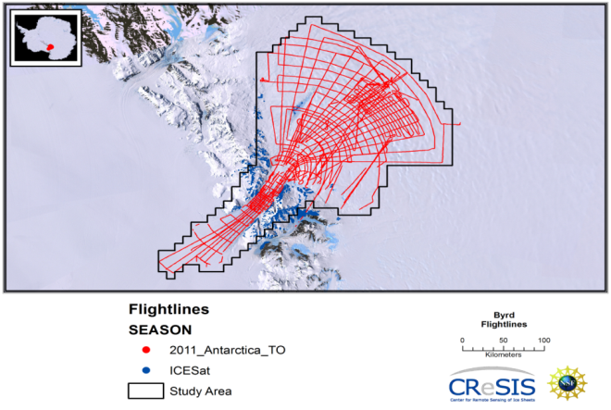
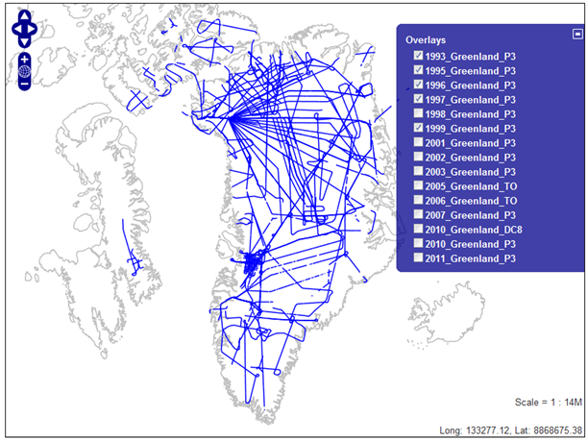
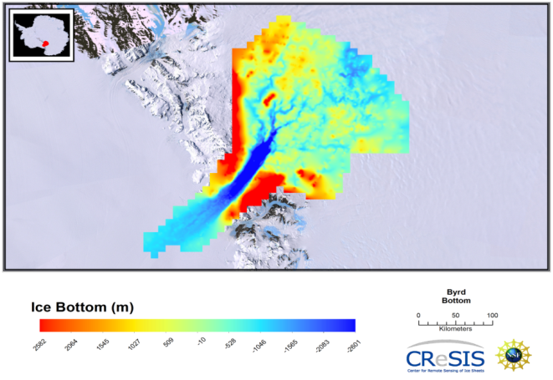
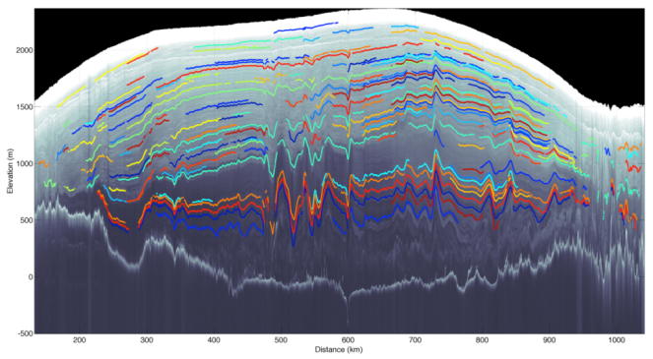
Analyze Data with GIS
Flight Paths
Byrd Glacier
Ice Depth
(annual) Snow Layers

Slide 13
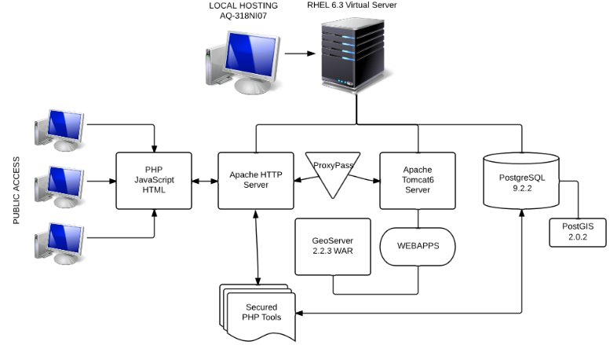
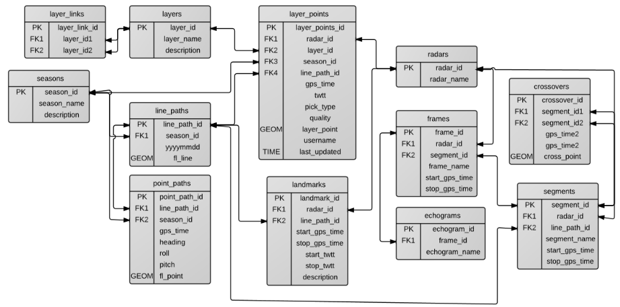
Geospatial Database and WMS
Kyle Purdon, 2013
Purpose: Access all radar datasets and campaigns simultaneously with powerful search and geographic browsing capability
Key Features:
  Portable VM
  Unlimited layers and layer relationships

Slide 14
CReSIS Instruments
Instrument | Measurement | Freq./ Wavelength | BW/ Res. | Depth | Power | Altitude | Antenna | Installs
HF Sounder Under development | Ice Thickness | 14 MHz 35 MHz | 1 MHz 5 MHz | 3 km | 100 W | TBD | Dual-Freq Dipole | Yak Small UAV
UWB Radar Under development | Ice Thickness Int. Layering Bed Properties | Adjustable 350 MHz | Up to 450 MHz | 4 km | 800 W | TBD | Array | Basler
MCoRDS/I Radar Depth Sounder | Ice Thickness Int. Layering Bed Properties | 195 MHz 1.5 m | 30 MHz 4 m | 4 km | 800 W | 30000 ft | Dipole Array Wing Mount Fuslage | Twin-Otter P-3 DC-8
Accum. Radar | Internal Layering Ice Thickness | 750 MHz 40 cm | 300 MHz 40 cm | 300 m | 10 W | 20000 ft | Patch Array Vivaldi Array | Twin-Otter P-3
Snow Radar | Snow Cover Topography Layering | 5 GHz 7.5 cm | 6 GHz 4 cm | 80 m | 200 mW | 30000 ft | Horn | P-3 DC-8
Ku-Band | Topography Layering | 15 GHz 2 cm | 6 GHz 4 cm | 15 m | 200 mW | 20000 ft | Horn | Twin-Otter DC-8

Slide 15

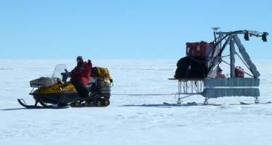
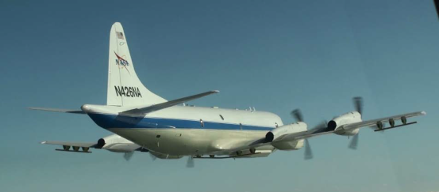
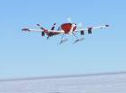
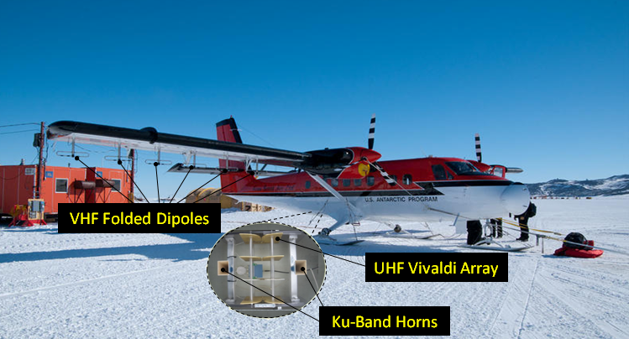
Deployments & Installations
NASA Operation Ice Bridge
  P-3B: MCoRDS, Accum, Ku-Band & Snow
  DC-8: MCoRDS, Ku-Band & Snow
    DC-8 operations could move to P-3 for fall deployments
CReSIS Field Work
  Twin-Otter: MCoRDS, Accum, Ku-Band
    Wings Expired: CReSIS operations are moving to the Basler (DC-3)
  Basler: New UWB radar, Ku-Band & Snow, Google Camera
  Meridian: UAV Radar (Single Channel MCoRDS)
  Scale Model Yak: Compact HF Sounder.
In-Situ (Sleds)
  Multi-Channel Accum, Ku-Band & Snow

Slide 16
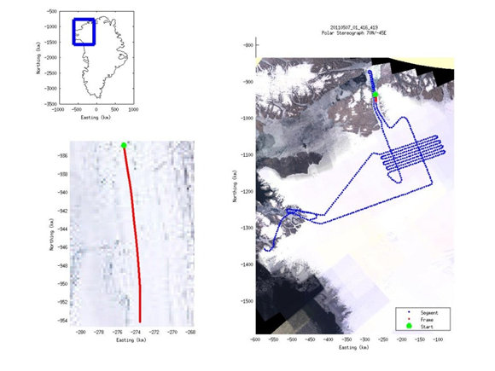
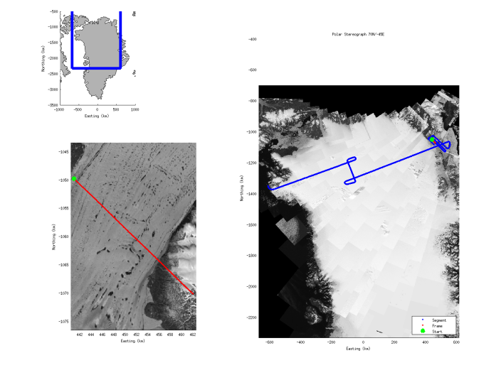
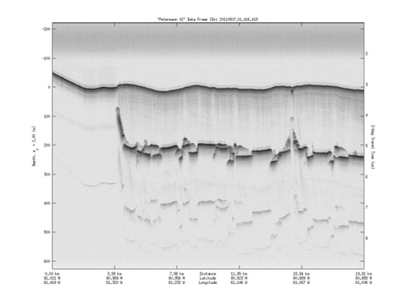
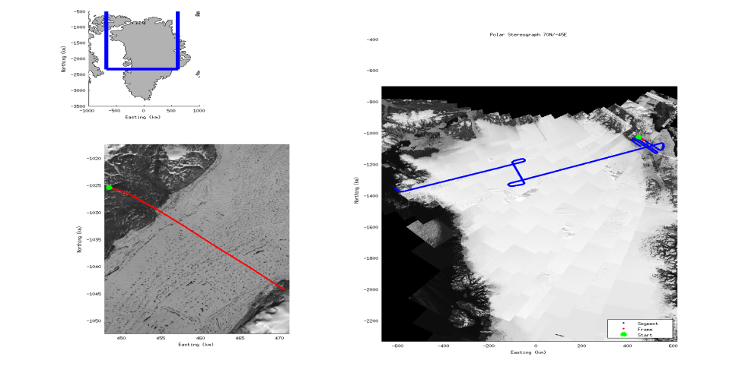
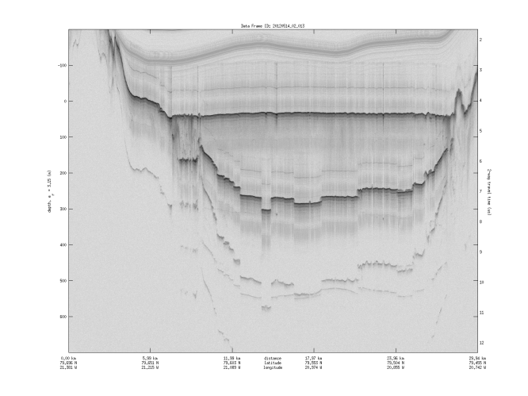
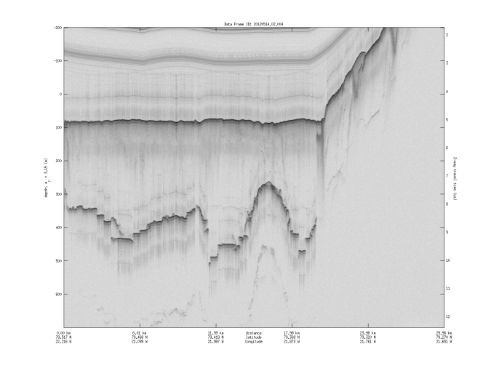
Accumulation Radar

Slide 17
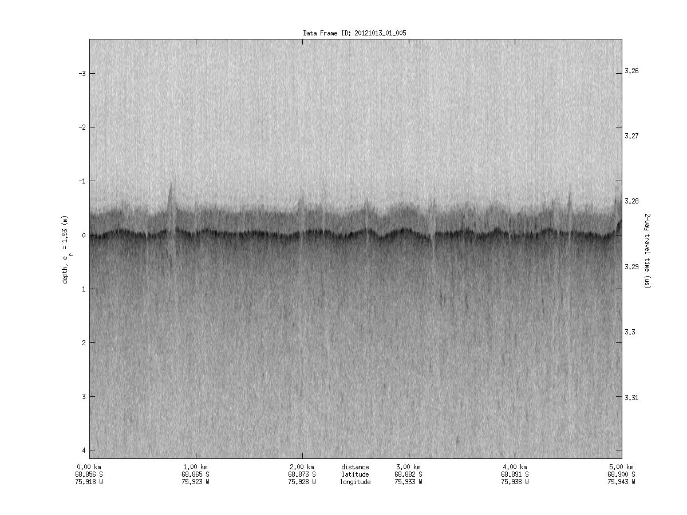
Bellingshausen Sea (West Antarctica)
Snow Radar
Air
Snow
Ice

Slide 18
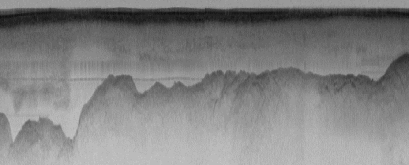
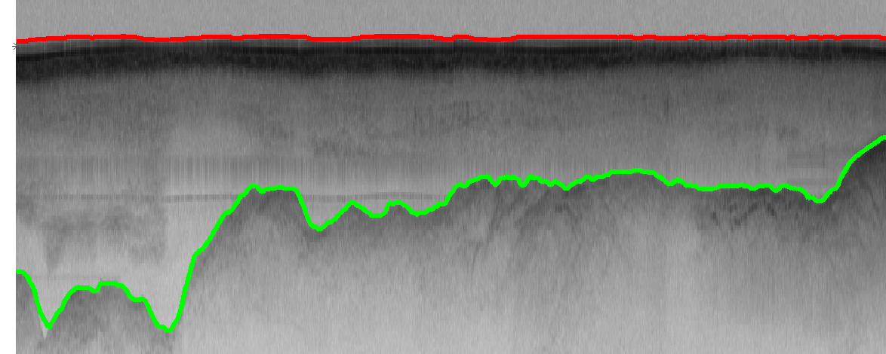
(Raw) Data Deluge →Information → Knowledge → Wisdom → Decision
The (airborne) radars take raw data and do substantial processing to convert to
Information
This information is analyzed to find the height/depth of layers (surface, bed, snow layers)
Knowledge
This data is placed into models of individual ice-sheets or coupled ocean-atmosphere-environment-ice climate simulations
Wisdom Sea level rise, climate change
Decisions: Steps to ameliorate causes and consequences of climate change

Slide 19
Uses of Data
Engineers in field taking data: quickly analyze data(information) in real time to detect and correct instrument errors
Polar Scientists using “Knowledge” planning expeditions (month long field trips) and corresponding flights
  Trade off resolution versus coverage
Data scientists using “Knowledge analysis” to find layers – possibly combining data from overlapping flights
Polar modelers combining datasets to get region wide “knowledge” used to build ice flow models
IPCC (Intergovernmental Panel on Climate Change) preparing next report
“Virtual Earth Scientist” integrating different data modalities (ice sheet, snow, atmosphere, environment, ocean, shipping …)
All exploit geo-encoded data

Slide 20
A few References
a) Cyberinfrastructure and Geographical Information Systems
http://www.cigi.illinois.edu/dokuwiki/doku.php/home
http://www.tandfonline.com/doi/full/10.1080/13658816.2013.776049 (and http://josis.org/index.php/josis/article/viewFile/83/67)
http://csiss.gmu.edu/
http://www.geosquare.org/ (big project from LIESMARS Wuhan China)
b) GIS in general http://en.wikipedia.org/wiki/Geographic_information_system
c) Climate Change in general
http://en.wikipedia.org/wiki/IPCC_Fourth_Assessment_Report
d) Work on Polar Ice Sheets
https://www.cresis.ku.edu/
http://www.infomall.org/X-InformaticsSpring2013/slides/mitchell-radarinformatics-0415.pptx
e) Lots of Data e.g.
http://geobrain.laits.gmu.edu/GeoDataDownload/
https://data.cresis.ku.edu/
e.g. ftp://data.cresis.ku.edu/data/rds/2012_Greenland_P3/kml_good/

