Slide 1
Data Intensive Cyberinfrastructure
Geoffrey Fox
I400
March 8 2011

Slide 2
Big Data in Many Domains
According to one estimate, mankind created 150 exabytes (billion gigabytes) of data in 2005. This year, it will create 1,200 exabytes
PC’s have ~100 Gigabytes disk and 4 Gigabytes of memory
Size of the web ~ 3 billion web pages: MapReduce at Google was on average processing 20PB per day in January 2008
During 2009, American drone aircraft flying over Iraq and Afghanistan sent back around 24 years’ worth of video footage
  http://www.economist.com/node/15579717
  New models being deployed this year will produce ten times as many data streams as their predecessors, and those in 2011 will produce 30 times as many
~108 million sequence records in GenBank in 2009, doubling in every 18 months
~20 million purchases at Wal-Mart a day
90 million Tweets a day
Astronomy, Particle Physics, Medical Records …
Most scientific task shows CPU:IO ratio of 10000:1 – Dr. Jim Gray
The Fourth Paradigm: Data-Intensive Scientific Discovery
Large Hadron Collider at CERN; 100 Petabytes to find Higgs Boson
Notes:
For each category, give examples, e.g. Astronomy solon 20 TB night,
http://www.datacenterknowledge.com/archives/2009/12/22/the-data-crunching-powerhouse-behind-avatar/

Slide 3
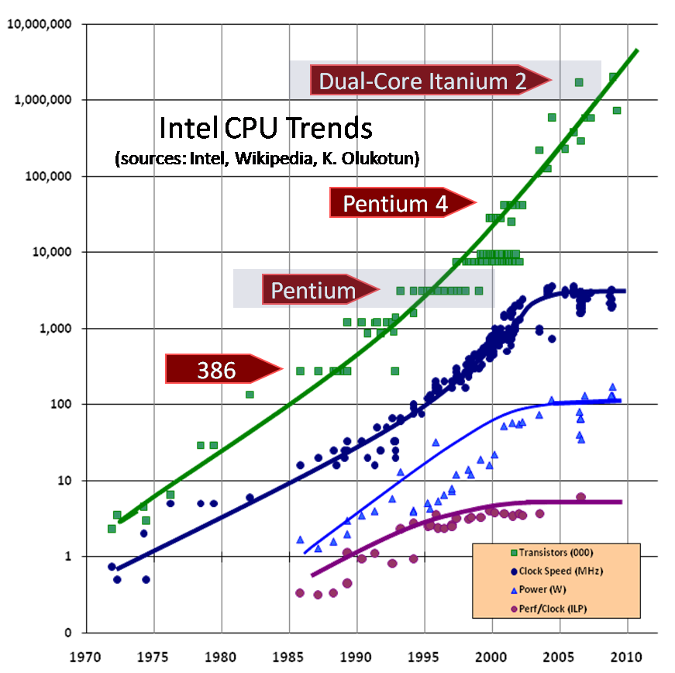

Data Deluge => Large Processing Capabilities
Converting raw data to knowledge
Requires large
processing capabilities
> O (n)
CPUs stop getting faster
Multi /Many core architectures
  Thousand cores in clusters and millions in data centers
Parallelism is a must to process data in a meaningful time
Image Source: The Economist

Slide 4
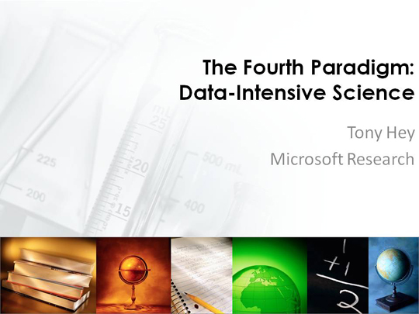
http://research.microsoft.com/en-us/um/redmond/events/TonyHey/21216/player.htm

Slide 5
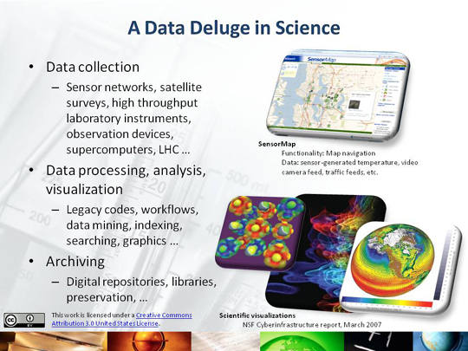

Slide 6
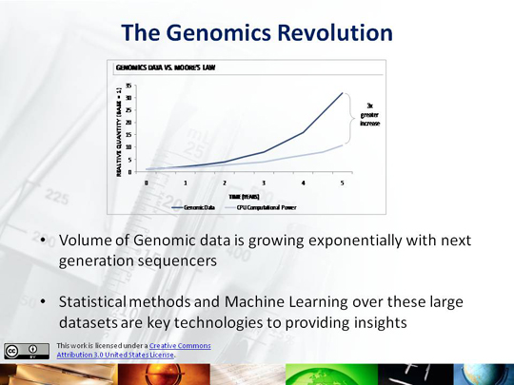

Slide 7
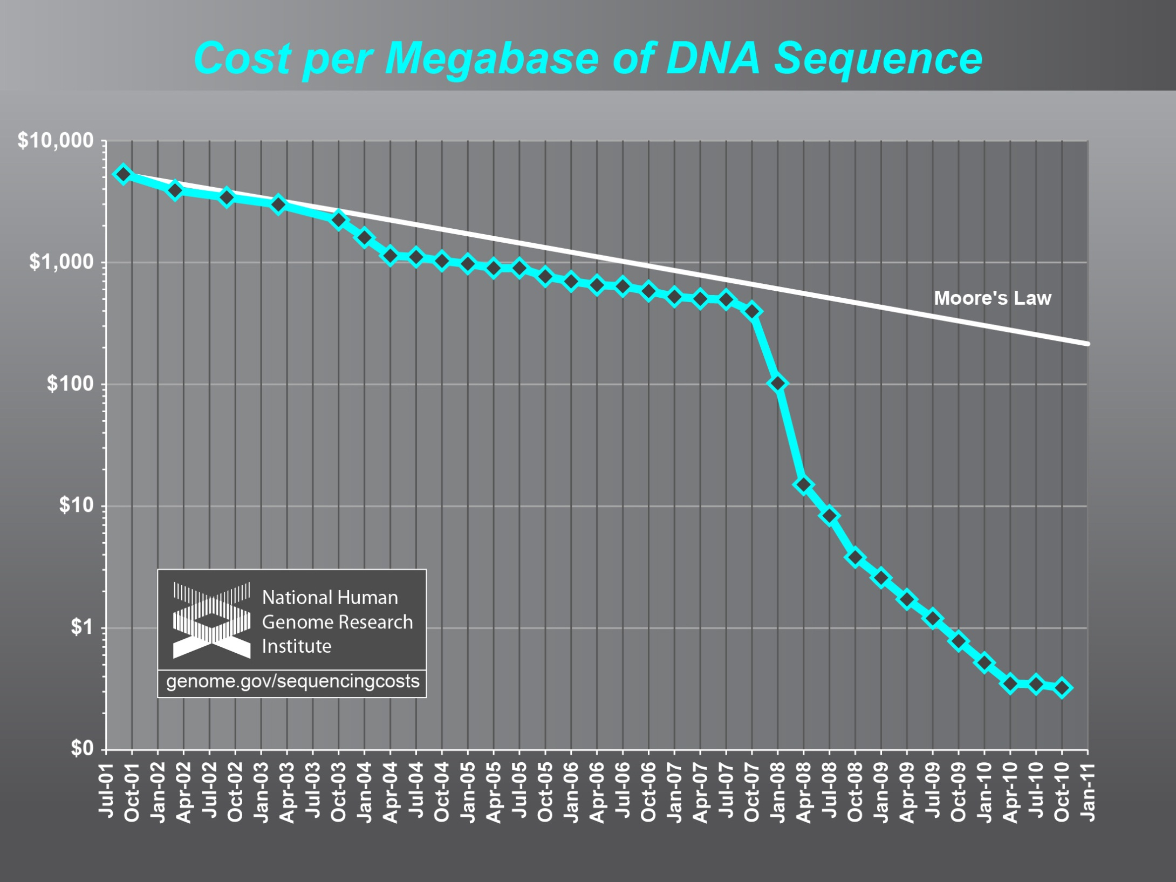

Slide 8
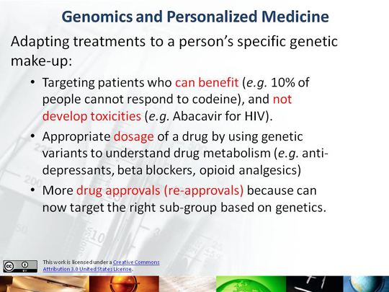

Slide 9
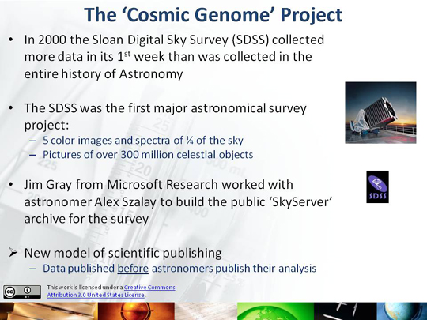

Slide 10
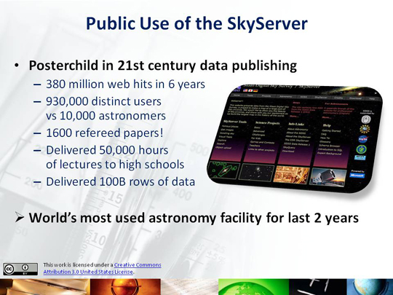

Slide 11
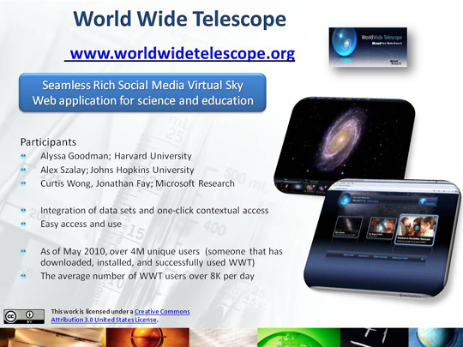

Slide 12
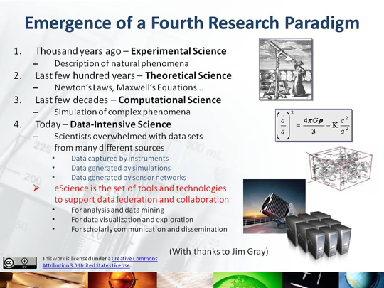

Slide 13
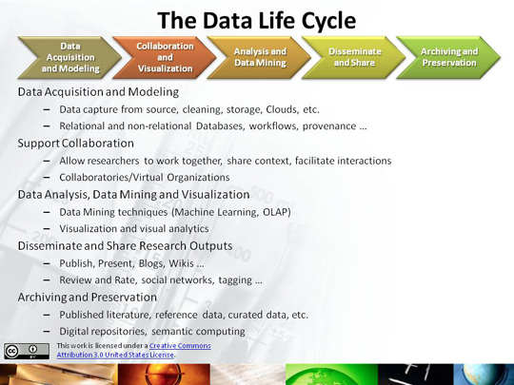

Slide 14
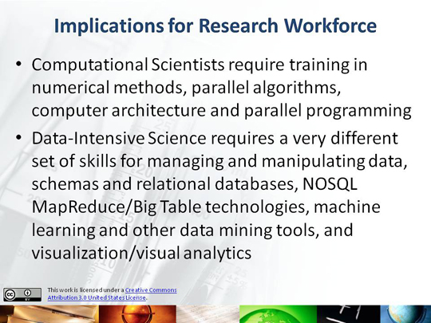

Slide 15
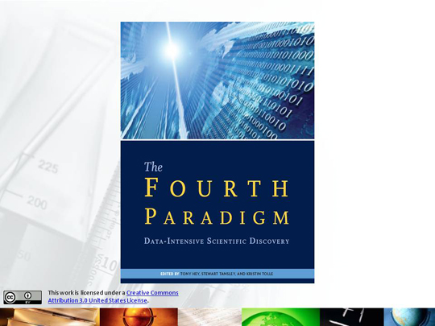

Slide 16
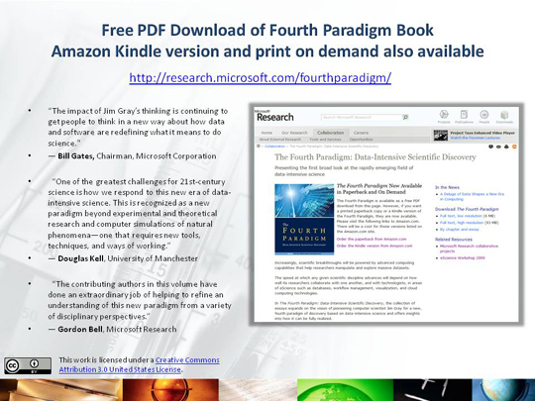

Slide 17
What is Cyberinfrastructure
Cyberinfrastructure is (from NSF) infrastructure that supports distributed research and learning (e-Science, e-Research, e-Education)
  Links data, people, computers
Exploits Internet technology (Web2.0 and Clouds) adding (via Grid technology) management, security, supercomputers etc.
It has two aspects: parallel – low latency (microseconds) between nodes and distributed – highish latency (milliseconds) between nodes
Parallel needed to get high performance on individual large simulations, data analysis etc.; must decompose problem
Distributed aspect integrates already distinct components – especially natural for data (as in biology databases etc.)
17
Notes:
17

Slide 18
e-moreorlessanything
‘e-Science is about global collaboration in key areas of science, and the next generation of infrastructure that will enable it.’ from inventor of term John Taylor Director General of Research Councils UK, Office of Science and Technology
e-Science is about developing tools and technologies that allow scientists to do ‘faster, better or different’ research
Similarly e-Business captures the emerging view of corporations as dynamic virtual organizations linking employees, customers and stakeholders across the world.
This generalizes to e-moreorlessanything including e-DigitalLibrary, e-SocialScience, e-HavingFun and e-Education
A deluge of data of unprecedented and inevitable size must be managed and understood.
People (virtual organizations), computers, data (including sensors and instruments) must be linked via hardware and software networks
18
Notes:
18

Slide 19
Important Trends
Data Deluge in all fields of science
Multicore implies parallel computing important again
  Performance from extra cores – not extra clock speed
  GPU enhanced systems can give big power boost
Clouds – new commercially supported data center model replacing compute grids (and your general purpose computer center)
Light weight clients: Sensors, Smartphones and tablets accessing and supported by backend services in cloud
Commercial efforts moving much faster than academia in both innovation and deployment

Slide 20
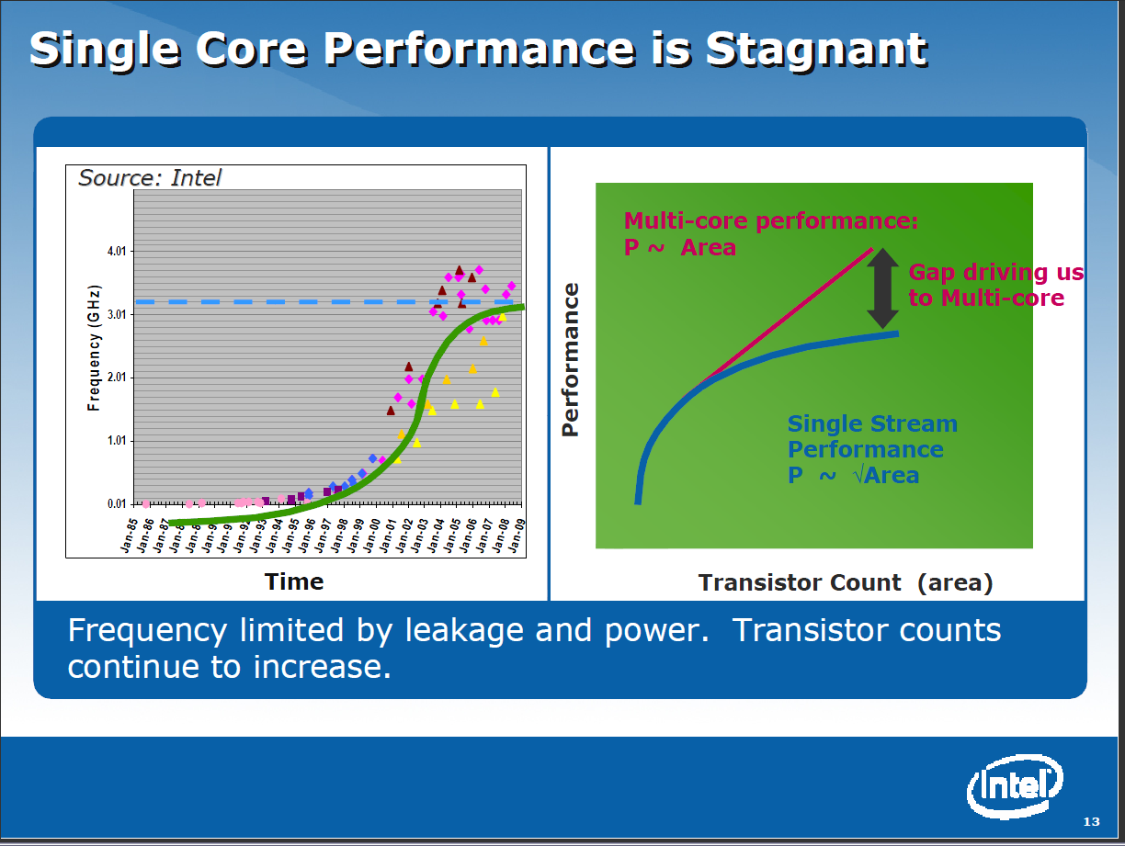

Slide 21
Lightweight Cyberinfrastructure to support mobile Data gathering expeditions plus classic central resources (as a cloud)

Slide 22
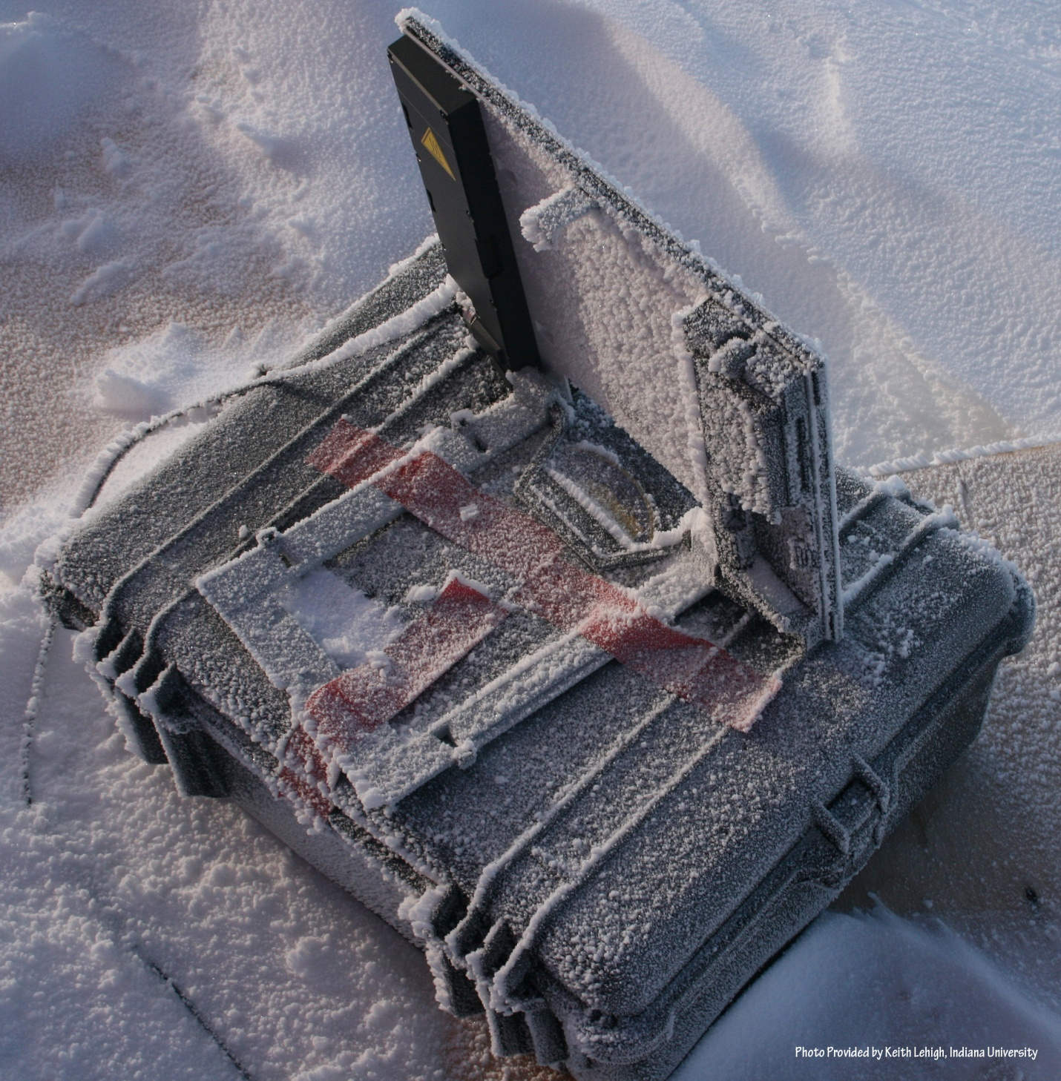
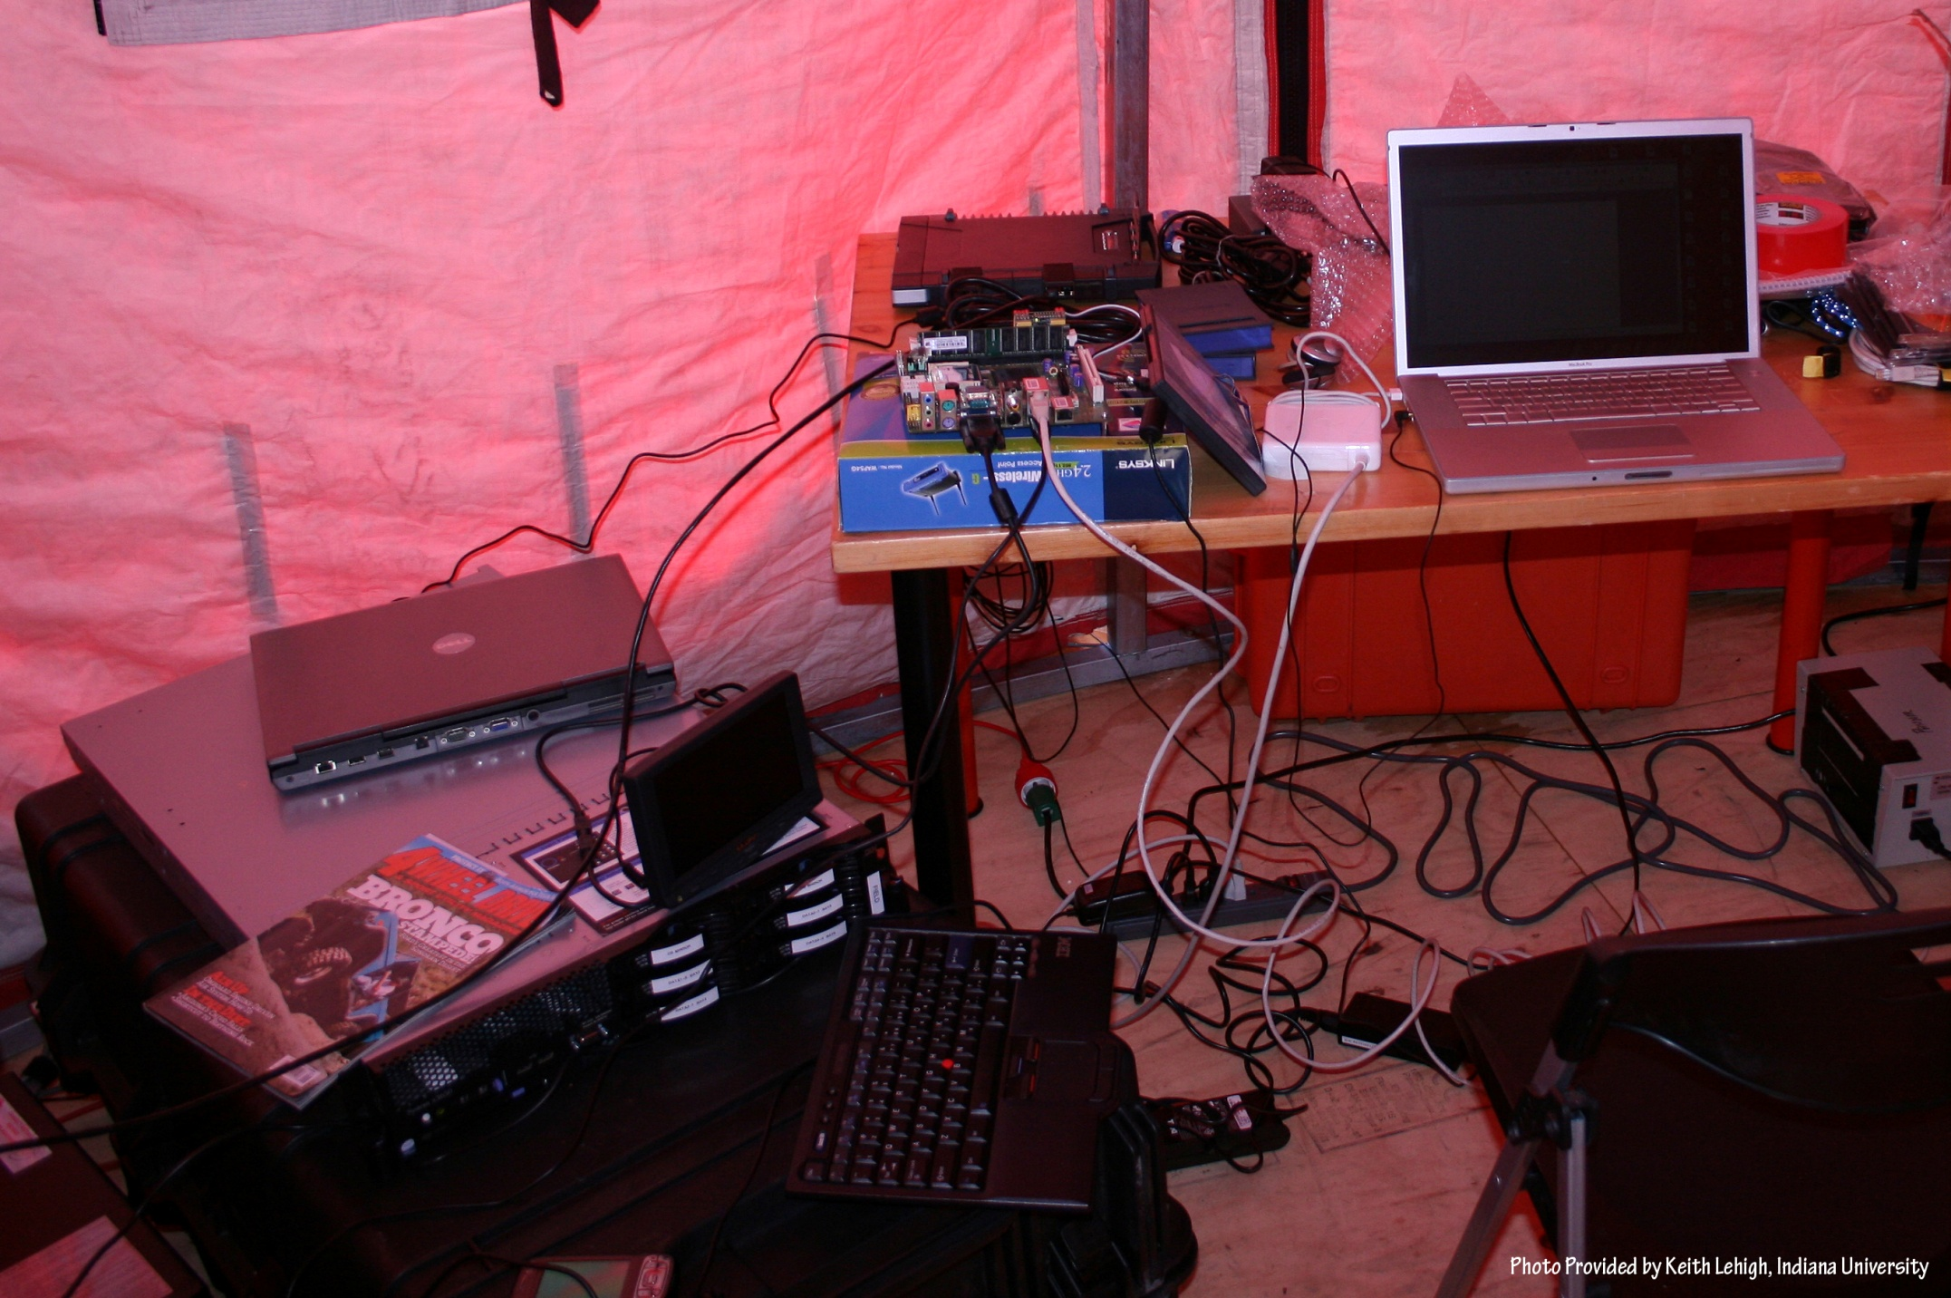
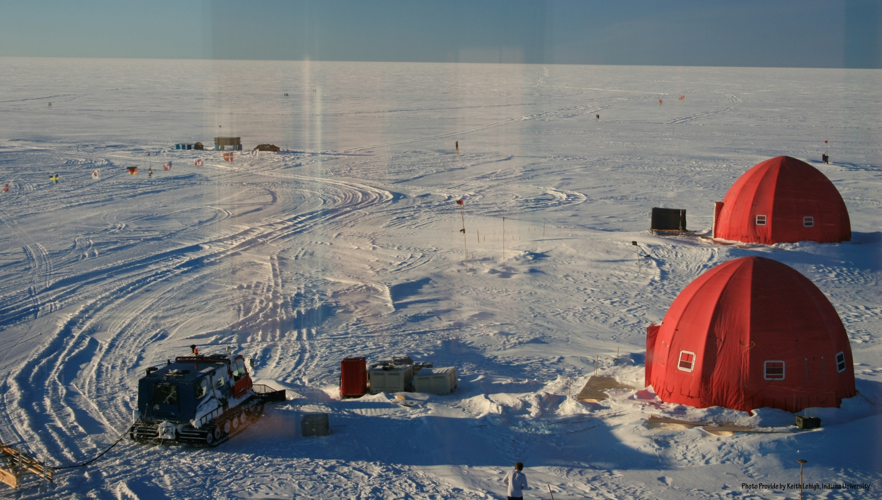
NEEM 2008 Base Station

Slide 23
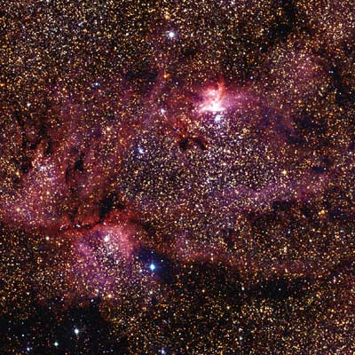
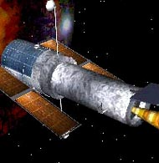
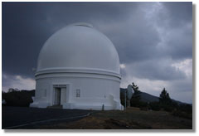
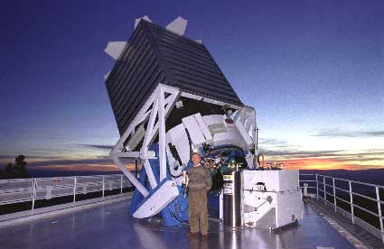
Tracking the Heavens
“The Universe is now being explored systematically, in a panchromatic way, over a range of spatial and temporal scales that lead to a more complete, and less biased understanding of its constituents, their evolution, their origins, and the physical processes governing them.”
Towards a National Virtual Observatory
Hubble Telescope
Palomar Telescope
Sloan Telescope

Slide 24
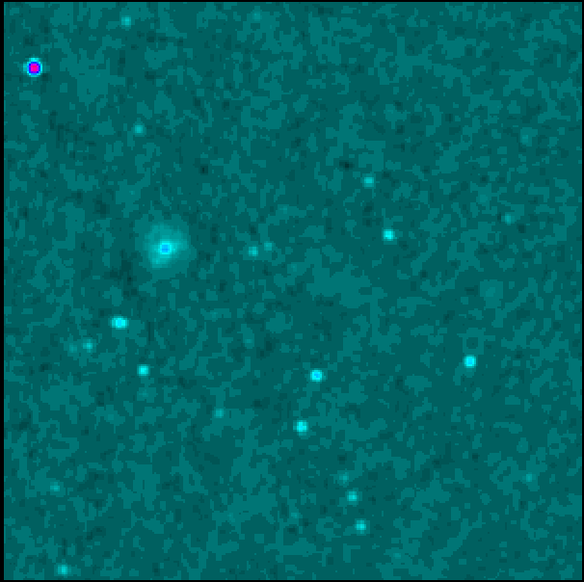
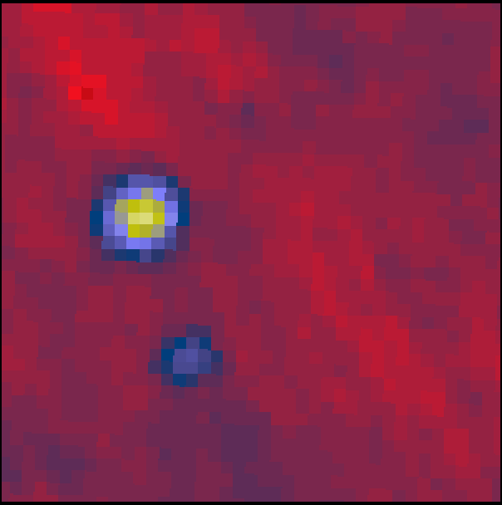
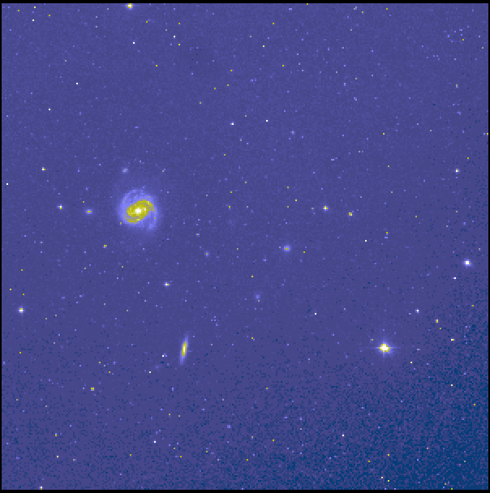
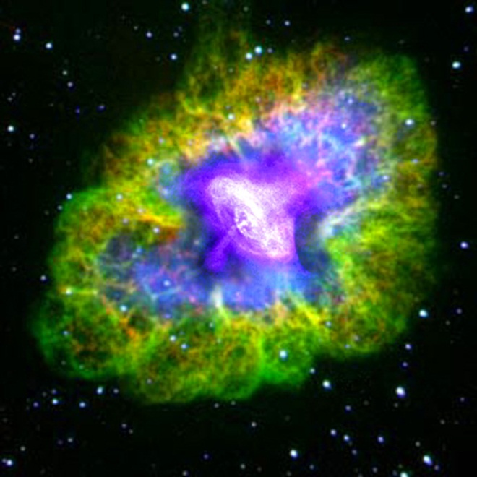
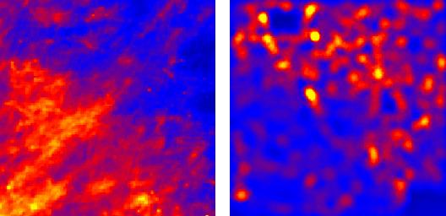
Virtual Observatory Astronomy Grid
Integrate Experiments
Radio
Far-Infrared
Visible
Dust Map
Visible + X-ray
Galaxy Density Map

Slide 25
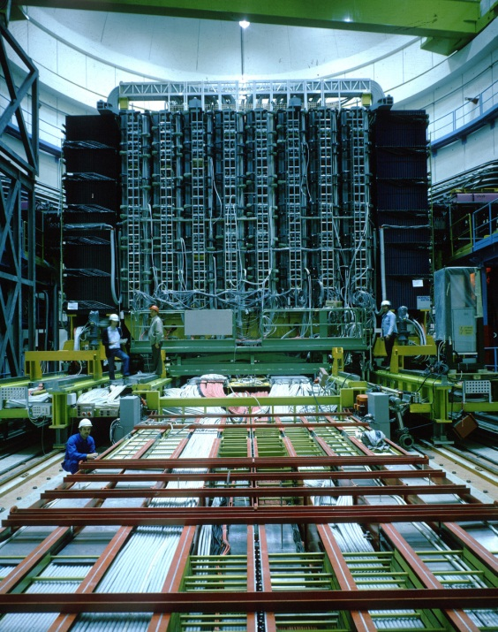
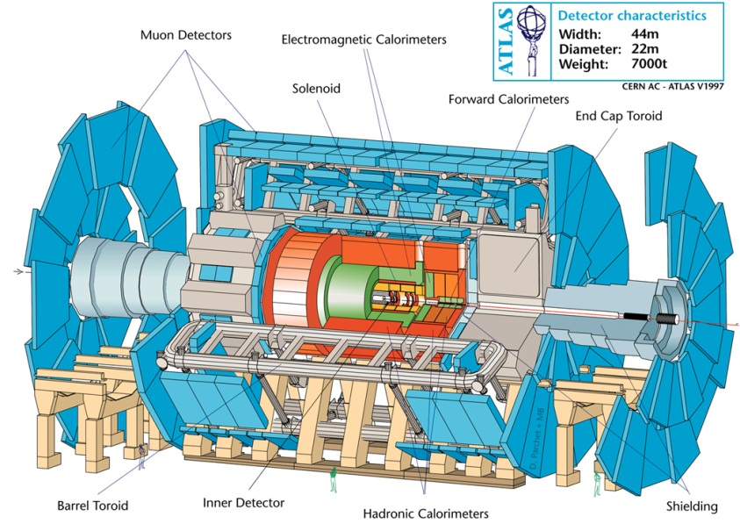
Particle Physics at the CERN LHC
ATLAS at LHC, 2006-2020
150*10⁶ sensors
UA1 at CERN 1981-1989
"hermetic detector"
LHC experimental collaborations (e.g. ATLAS) typically involve over 100 institutes and over 1000 physicists world wide

Slide 26
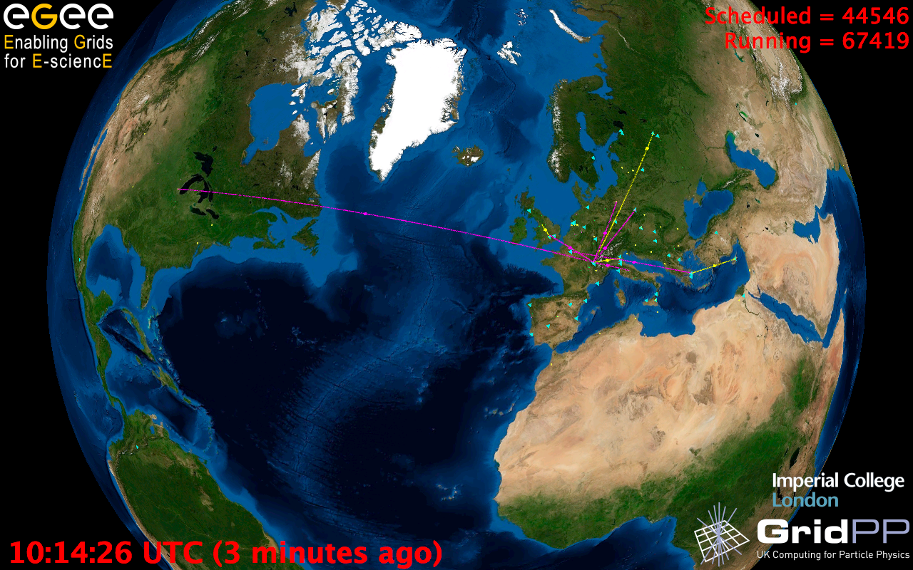
European Grid Infrastructure
Status April 2010 (yearly increase)
10000 users: +5%
243020 LCPUs (cores): +75%
40PB disk: +60%
61PB tape: +56%
15 million jobs/month: +10%
317 sites: +18%
52 countries: +8%
175 VOs: +8%
29 active VOs: +32%

Slide 27
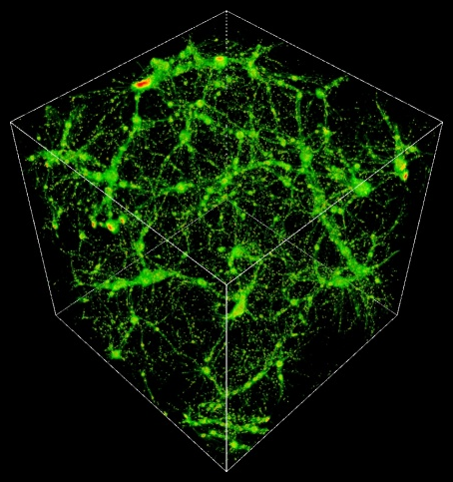
TeraGrid Example: Astrophysics
Science: MHD and star formation; cosmology at galactic scales (6-1500 Mpc) with various components: star formation, radiation diffusion, dark matter
Application: Enzo (loosely similar to: GASOLINE, etc.)
Science Users: Norman, Kritsuk (UCSD), Cen, Ostriker, Wise (Princeton), Abel (Stanford), Burns (Colorado), Bryan (Columbia), O’Shea (Michigan State), Kentucky, Germany, UK, Denmark, etc.
Notes:
The StarGate demo at SC09 combined steps 5 and 6, using 10 Gbps ESnet connection and 10 Gbps Dynamic Circuit Network (DCN) – 150 TB was moved from NICS to ANL for rendering on GPU cluster, results were streamed to OptiPortal at SC – our network tradeoffs include similar options.
The full simulation takes 3 months real time at NICS, moving data to ANL takes 3 nights – moving the data is practical, if it can be made simple and reliable.
http://www.lbl.gov/cs/Archive/news112009.html

Slide 28
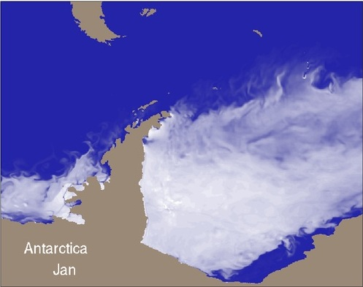
TeraGrid Example:
Petascale Climate Simulations
Science: Climate change decision support requires high-resolution, regional climate simulation capabilities, basic model improvements, larger ensemble sizes, longer runs, and new data assimilation capabilities. Opening petascale data services to a widening community of end users presents a significant infrastructural challenge.
  2008 WMS: We need faster higher resolution models to resolve important features, and better software, data management, analysis, viz, and a global VO that can develop models and evaluate outputs
Realistic Antarctic sea-ice coverage generated from century-scale high resolution coupled climate simulation performed on Kraken (John Dennis, NCAR)
Applications: many, including: CCSM (climate system, deep), NRCM (regional climate, deep), WRF (meteorology, deep), NCL/NCO (analysis tools, wide), ESG (data, wide)
Science Users: many, including both large (e.g., IPCC, WCRP) and small groups;
  ESG federation includes >17k users, 230 TB data, 500 journal papers (2 years)
Notes:
TeraGrid has had a modest impact on the advancement of climate science thus far -- XROADS plans for XD to have a much larger impact on the advancement of climate science. The XROADS team we've assembled includes individuals (Apps, tools, viz, data, AUSS including Gateways, TEOS) working at the forefront of petascale climate simulation, climate science gateways, climate workflows, analysis and visualization of climate, and global data and knowledge sharing. A solid Deep & Wide foundation for advancing climate science.
WMS – 2008 World Modeling Summit
WCRP – World Climate Research Program
WMS and community says models need to be 1 km or less resolution
Lots of users for each tool, hundreds for CCSM, WRF, tens of thousands for NCL/NCO, ESG

Slide 29

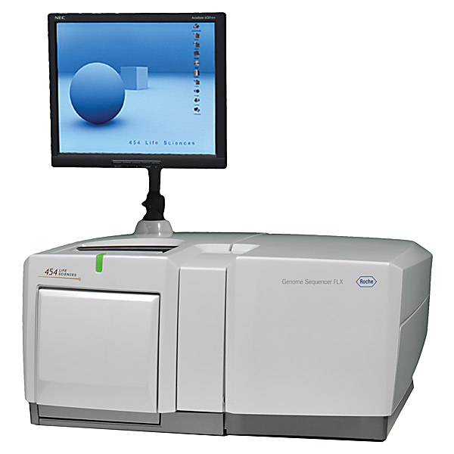
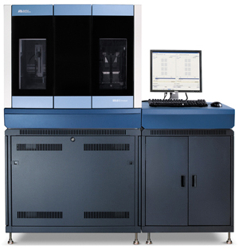
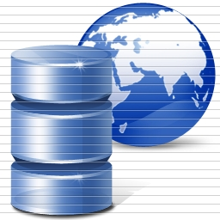
DNA Sequencing Pipeline
Illumina/Solexa Roche/454 Life Sciences Applied Biosystems/SOLiD
Internet
~300 million base pairs per day leading to
~3000 sequences per day per instrument
? 500 instruments at ~0.5M$ each
Read Alignment
Pairwise
clustering
Form block
Pairings
Sequence
alignment
Dissimilarity
Matrix
N(N-1)/2 values
Visualization
Plotviz
FASTA File
N Sequences
Blocking
MPI
MDS
MapReduce

Slide 30


TeraGrid Example: Genomic Sciences
Science: many, ranging from de novo sequence analysis to resequencing, including: genome sequencing of a single organism; metagenomic studies of entire populations of microbes; study of single base-pair mutations in DNA
Applications: e.g. ANL’s Metagenomics RAST server catering to hundreds of groups, Indiana’s SWIFT aiming to replace BLASTX searches for many bio groups, Maryland’s CLOUDburst, BioLinux
PIs: thousands of users and developers, e.g. Meyer (ANL), White (U. Maryland), Dong (U. North Texas), Schork (Scripps), Nelson, Ye, Tang, Kim (Indiana)
Results of Smith-Waterman distance computation, deterministic annealing clustering, and Sammon’s mapping visualization pipeline for 30,000 metagenomics sequences: (a) 17 clusters for full sample; (b) 10 sub-clusters found from purple and green clusters in (a). (Nelson and Ye, Indiana)
Map sequence
clusters to 3D
Notes:
Simon Twigger (UMD) example: CloVR, a tool that can be used to build pipelines that use cloud resources: http://clovr.igs.umaryland.edu/
Porting/developing pipelines can make use of clouds; on XD, will use XROADS services, e.g., job execution, metascheduling
Sharing digital products includes supporting standard data formats: e.g., Metagenome Transport Format from Genomics Standards Consortium’s M5 working group, coming in other fields following the MTF model according to Eugene Kolker, Seattle Children’s Hospital – see “‘Omics Data Sharing,” Science 9 Oct 2009
XROADS Wide follows successful TG gateways model – build general tools that communities can use to build specific tools for their members

Slide 31
Steps in Data Analysis Again
Gather data – patient records or Gene Sequencer
Store Data – Database or “collection of files”
  SQL does not have a good reputation as best way to query scientific data
  Partly as need to do substantial processing on data
Note there is raw data and data about data aka. Metadata
  Metadata can be stored in databases as not analyzed
Process data – e.g. BLAST compares new gene sequences with database of existing sequences
Analyze results and write papers etc.

Slide 32
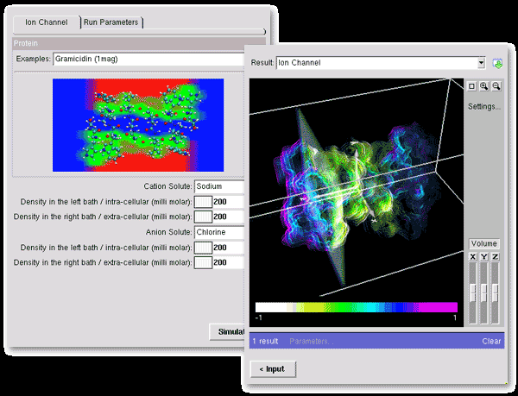
Highlight: NanoHub Harnesses TeraGrid for Education
Nanotechnology education
Used in dozens of courses at many universities
Teaching materials
Collaboration space
Research seminars
Modeling tools
Access to cutting edge research software
Notes:
While addressing challenges in nanotechnology, NCN researchers produce new algorithms, approaches, and software with capabilities not yet available commercially. As part of the NSF's infrastructure for the National Nanotechnology Initiative (NNI), the NCN engages the community through workshops, seminars and novel educational resources. The nanoHUB is a source of on-line resources including a unique web-based computational user facility that puts research-grade software in the hands of users across the globe.
was created in 2000 and relies on middleware developed at Purdue called PUNCH (Purdue University Network Computing Hub). In the year 2003, the nanoHUB has served 1000 users and ran 86,000 jobs
The applications already available on the nanoHUB range from single cpu jobs to parallel jobs. Some are well suited to run on a Condor pool, whereas more compute intensive application will run on the TeraGrid.

Slide 33
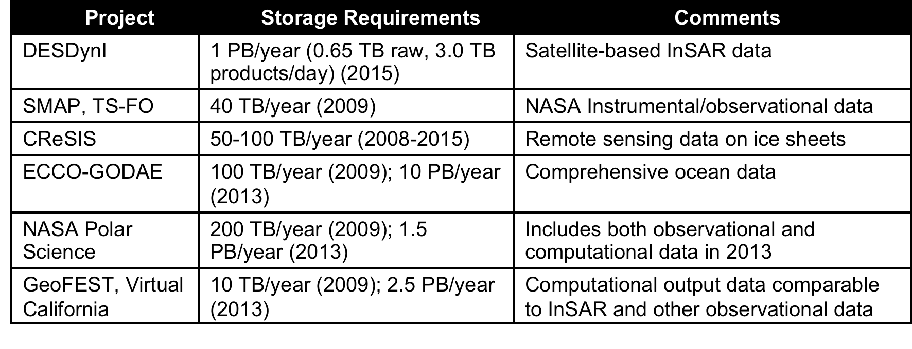
Data Sources
Common Themes of Data Sources
Focus on geospatial, environmental data sets
  Data from computation and observation.
Rapidly increasing data sizes
Data and data processing pipelines are inseparable.

Slide 34
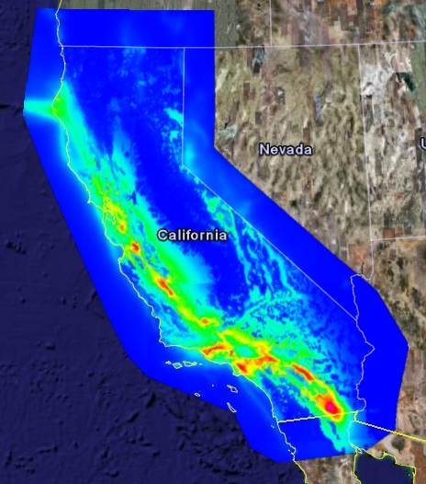
Highlight: SCEC using gateway to produce hazard map
PSHA hazard map for California using newly released Earthquake Rupture Forecast (UCERF2.0) calculated using SCEC Science Gateway
Warm colors indicate regions with a high probability of experiencing strong ground motion in the next 50 years.
High resolution map, significant CPU use
Notes:
NVO's objective is to enable new science by greatly enhancing access to data and computing resources. NVO makes it easy to locate, retrieve, and analyze data from archives and catalogs worldwide.
The development of the National Virtual Observatory (NVO; http//www.us-vo.org), an NSF sponsored
Information Technology Research project, together with related efforts ongoing world-wide (through the
International Virtual Observatory Alliance) has the potential to revolutionize scientific research in
astrophysics. The NVO is designed to support the federation of astronomical sky surveys; seamlessly
interlacing data across the full electromagnetic spectrum. It provides tools to explore within and extract
data from these massive, multi-frequency surveys. Such unprecedented access provides an astronomer
with the ability to determine the detailed correlations within these data, to understand the physical
processes that give rise to these correlations and to potentially identify new classes of astrophysical
phenomena.

Slide 35

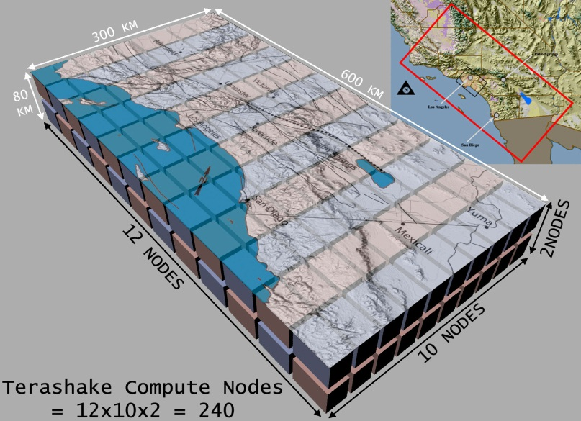
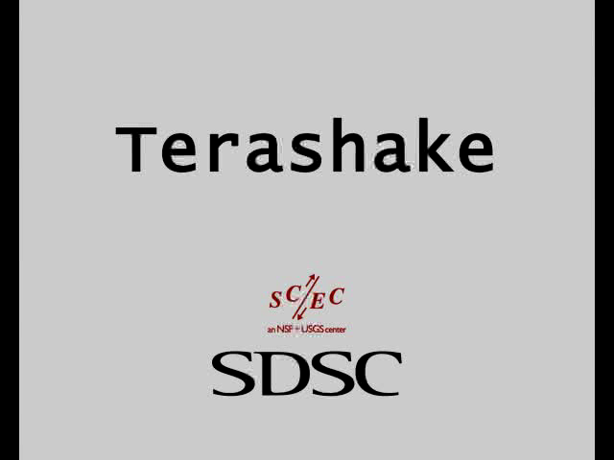
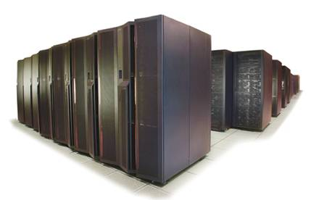
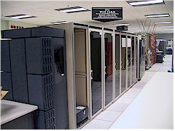
HowTerashake Works
Map the blocks on to processors of the supercomputer
Run the simulation using current information on fault activity and the physics of earthquakes
SDSC Machine Room
SDSC’s DataStar –
one of the 50 fastest computers in the world

Slide 36

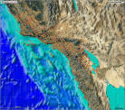
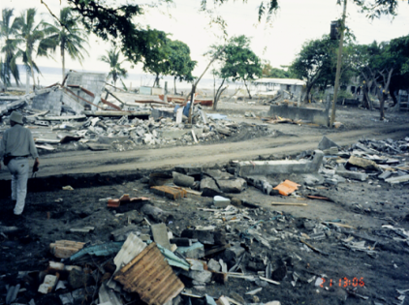
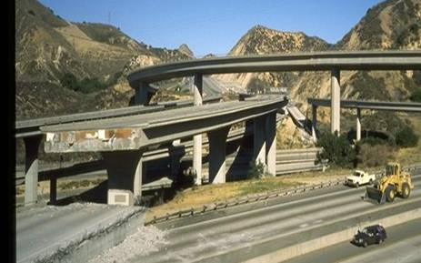
SCEC Data Requirements
Resources must support a complicated orchestration of computation and data movement
Data parking of 100s of TBs for many months
“Fat Nodes” with 256 GB of DS for pre-processing and post visualization
10-20 TB data archived a day
240 procs on
SDSC Datastar,
5 days, 1 TB
of main memory
47 TB output data for 1.8 billion grid points
Continuous I/O 2GB/sec
Parallel
file system
Data
parking
The next generation simulation will require even more resources: Researchers plan to double the temporal/spatial resolution of TeraShake
“I have desired to see a large earthquake simulation for over a decade. This dream has been accomplished.”
Bernard Minster, Scripps Institute of Oceanography

Slide 37
USArray
Seismic
Sensors

Slide 38
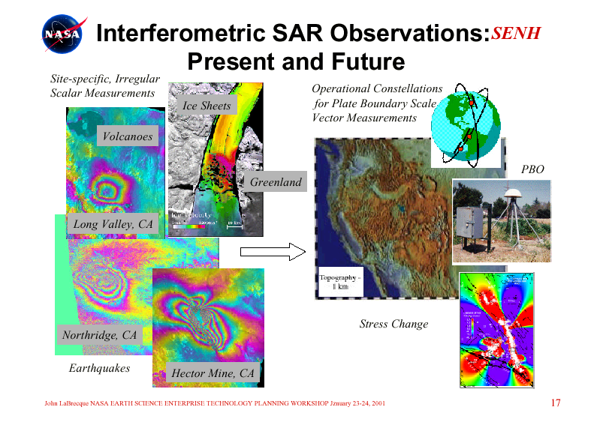
a
Site-specific Irregular
Scalar Measurements
a
Constellations for Plate Boundary-Scale Vector Measurements
Ice Sheets
a
Volcanoes
PBO
Greenland
Long Valley, CA
Topography
1 km
Stress Change
Northridge, CA
Earthquakes
Hector Mine, CA

Slide 39
US Cyberinfrastructure Context
There are a rich set of facilities
  Production TeraGrid facilities with distributed and shared memory
  Experimental “Track 2D” Awards
    FutureGrid: Distributed Systems experiments cf. Grid5000
    Keeneland: Powerful GPU Cluster
    Gordon: Large (distributed) Shared memory system with SSD aimed at data analysis/visualization
  Open Science Grid aimed at High Throughput computing and strong campus bridging

Slide 40
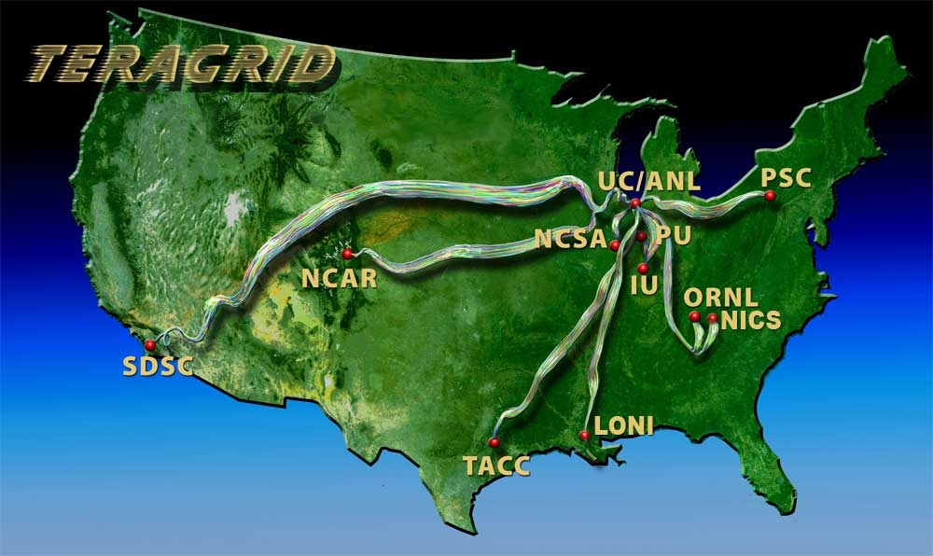
TeraGrid
~2 Petaflops; over 20 PetaBytes of storage (disk and tape), over 100 scientific data collections
UW
Grid Infrastructure Group (UChicago)
UC/ANL
PSC
NCAR
PU
NCSA
Caltech
IU
UNC/RENCI
ORNL
USC/ISI
NICS
SDSC
LONI
TACC
Resource Provider (RP)
Software Integration Partner
Network Hub

Slide 41
TeraGrid Resources and Services
Computing: ~2 PFlops aggregate
  more than two PFlops of computing power today and growing
    Ranger: 579 Tflop Sun Constellation resource at TACC
    Kraken: 1.03 Pflop Cray XT5 NICS/UTK
Remote visualization servers and software
  Spur: 128 core, 32 GPU cluster connected to Ranger’s interconnect
  Longhorn: 2048 core, 512 GPU cluster directly connected to Ranger’s parallel file system
  Nautilus: 1024 core, 16 GPU, 4 TB SMP directly connected to parallel file system shared with Kraken
Data
  allocation of data storage facilities
  over 100 Scientific Data Collections
Central allocations process
  single process to request access to (nearly) all TG resources/services
Core/Central services
  documentation
  User Portal
  EOT program
Coordinated technical support
  central point of contact for support of all systems
  Advanced Support for TeraGrid Applications (ASTA)
  education and training events and resources
  over 30 Science Gateways

Slide 42
Resources Evolving
Recent and anticipated resources
  Track 2D awards
    Dash/Gordon (SDSC), Keeneland (GaTech), FutureGrid (Indiana)
  XD Visualization and Data Analysis Resources
    Spur (TACC), Nautilus (UTK)
  “NSF DCL”-funded resources
    PSC, NICS/UTK, TACC, SDSC
  Other
    Ember (NCSA)
Continuing resources
  Ranger, Kraken
Retiring resources
  most other resources in TeraGrid today will retire in 2011
Attend BoFs for more on this:
  New Compute Systems in the TeraGrid Pipeline(Part 1)
    Tuesday, 5:30-:700pm in Woodlawn I
  New Compute Systems in the TeraGrid Pipeline(Part 2)
    Wednesday, 5:15-6:45pm in Stoops Ferry

Slide 43
Impacting Many Agencies
(CY2008 data)
Supported Research
Funding by Agency
Resource Usage
by Agency
University
Industry
University
Industry
International
2%
Other
1%
1%
1%
0%
2%
International
3%
Other
DOD
DOD
1%
5%
6%
NASA
10%
NSF
NASA
NSF
DOE
9%
49%
NIH
NIH
NASA
19%
NSF
NIH
DOD
52%
15%
International
University
DOE
DOE
Other
13%
11%
Industry
$91.5M Direct Support of Funded Research
10B NUs Delivered

Slide 44
Across a Range of Disciplines
Advanced
Earth Sciences
19 Others
Scientific
5%
4%
Computing
6%
Physics
Materials
26%
Research
6%
Chemical,
Thermal
Systems
6%
Chemistry
7%
Molecular
Biosciences
Atmospheric
18%
Sciences
8%
Astronomical
Sciences
14%
>27B NUs Delivered in 2009

Slide 45
Ongoing Impact
More the 1,200 projects supported
  54 examples highlighted in most recent TG Annual Report
    atmospheric sciences, biochemistry and molecular structure/function, biology, biophysics, chemistry, computational epidemiology, environmental biology, earth sciences, materials research, advanced scientific computing, astronomical sciences, computational mathematics, computer and computation research, global atmospheric research, molecular and cellular biosciences, nanoelectronics, neurosciences and pathology, oceanography, physical chemistry
2009 TeraGrid Science and Engineering Highlights
  16 focused stories
  http://tinyurl.com/TeraGridSciHi2009-pdf
2009 EOT Highlights
  12 focused stories
  http://tinyurl.com/TeraGridEOT2009-pdf

Slide 46
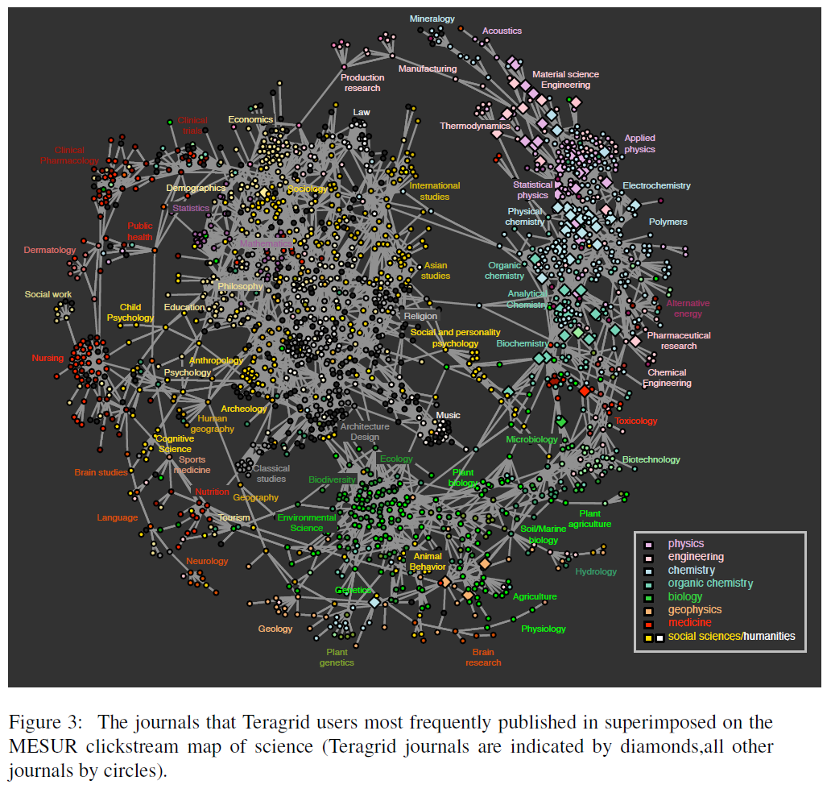
TeraGrid
User Areas

