Slide 1
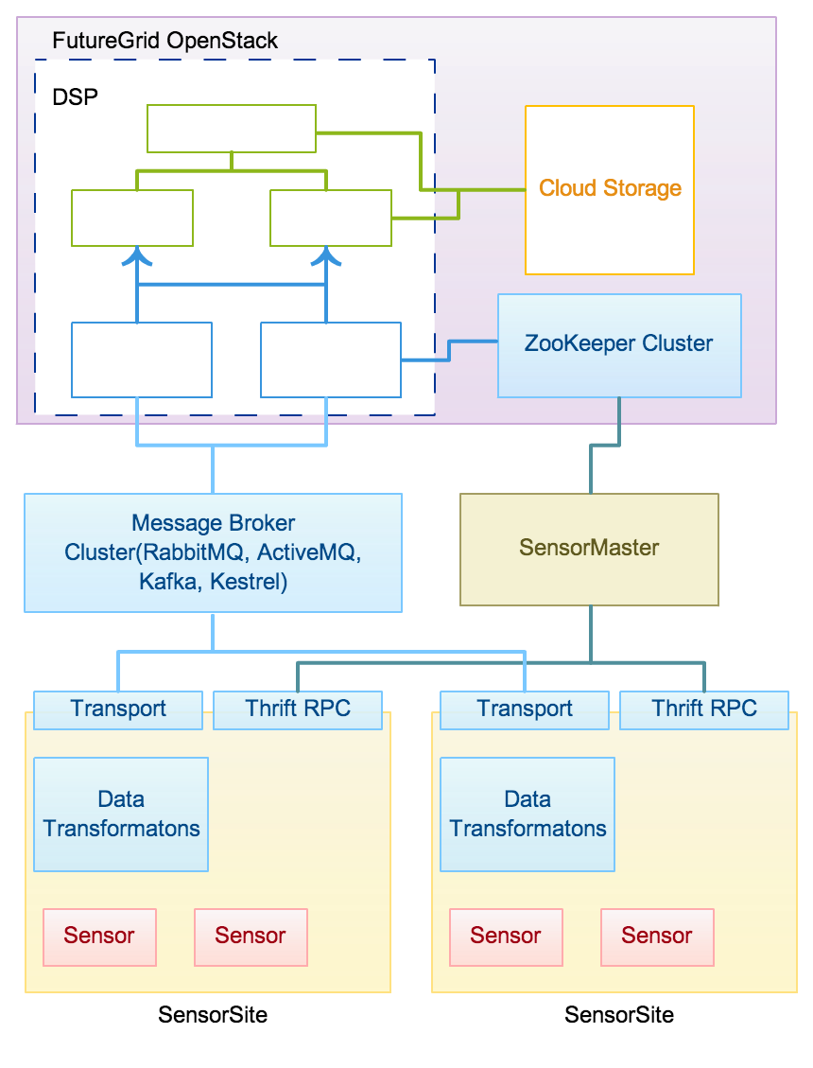
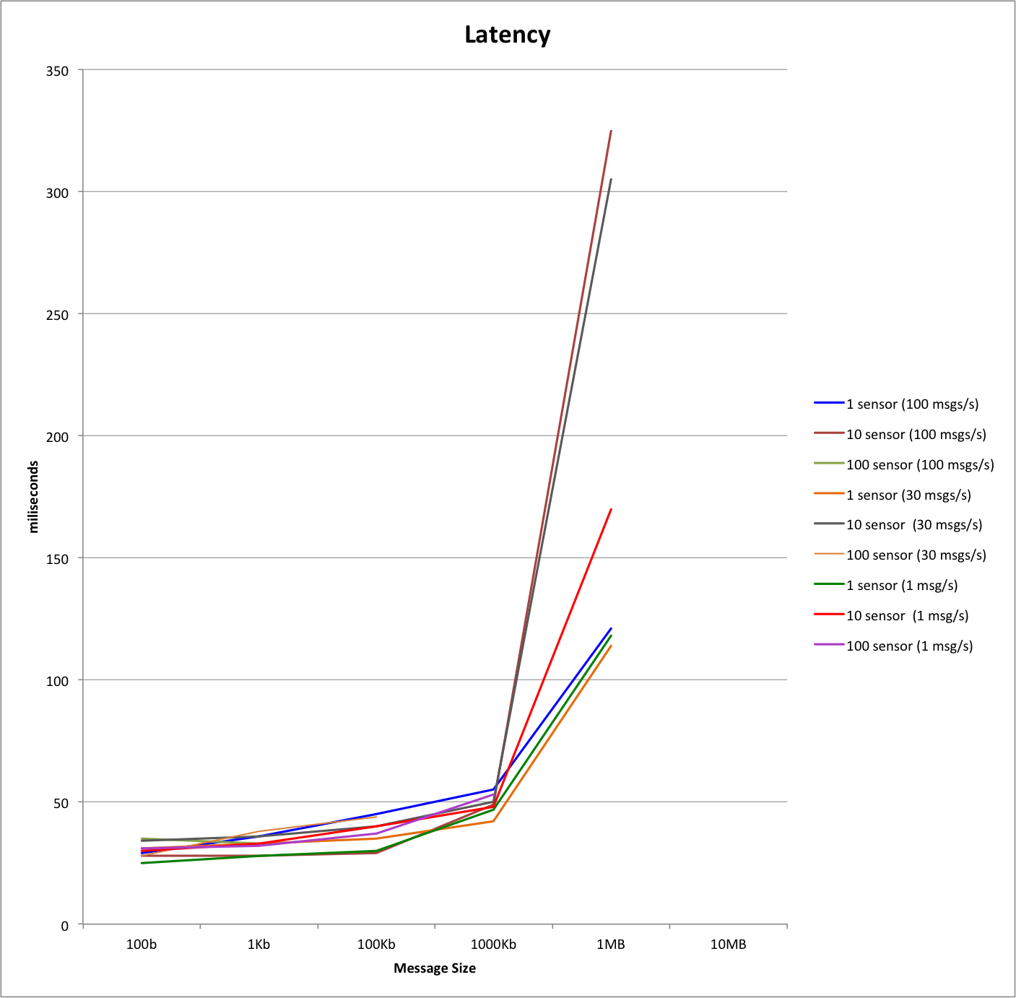
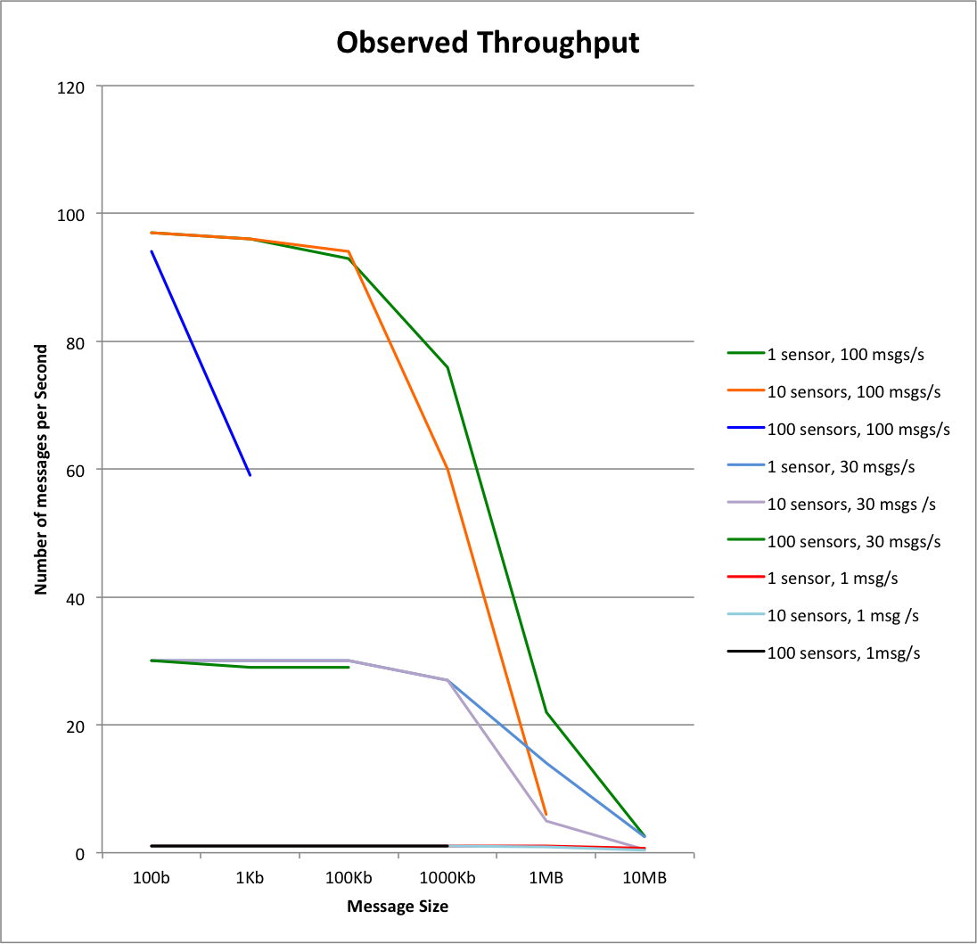
IoTCloud Platform – Connecting Sensors to Cloud Services
Supun Kamburugamuve, Geoffrey C. Fox {skamburu, gcf}@indiana.edu
School of Informatics and Computing and Community Grids Laboratory
Indiana University, Bloomington
Introduction
Architecture
Experiment
Results
Internet of things is the broad area of placing objects in an Internet like structure enabling applications to take informed decisions [1]. Large numbers of such objects are connected to the Internet and this number is expected to increase exponentially in the coming years.
Internet of Things middleware is used as a bridge between the objects and the applications. The middleware provides the framework to manage the objects, retrieve the data and make the data available to applications in a suitable form. These objects produces huge amount of data and processing this data to make intelligent decisions in a timely fashion is a challenge in terms of computational resources required and the processing frameworks.
The cloud has emerged as the platform for processing such large amount of data in an efficient manner. Also there are distributed software platforms developed to process such large amount of data in cloud environments. In this poster we present the architecture of a platform called IoTCloud capable of connecting the devices to the cloud applications and process them in a distributed manner using cloud services
The experiment is conducted in the Futuregrid OpenStack Cloud Environment with 6 m1.large instances (4 VCPUs, 8GG).
Storm - ZooKeeper and Nimbus in one node, 2 Supervisor nodes
ActiveMQ Message Broker 1 Node
Sensor Master & Sensor Site 1 Node
The results are obtained with sensors trying to send data at 1, 30 and 100 messages per second.
Then message size is varied from 1, 100, 1000, 10000, 100000, 1000000 and 10000000 bytes.
The latency is the time for a message to leave the sensor site and arrive at the cloud layer. The observed throughput is the amount of messages actually sent by the sensor for 1 second.
At 100 Msg/sec system cannot handle 100 KB messages and keep the expected throughput
At 30 Msg/sec system cannot handle the 1 Mb messages
At 1 Msg/sec system cannot handle 10 MB messages.
The graphs only include the values the system can handle with an steady latency and throughput
Conclusion
The preliminary results indicate the limits of the system. The results are obtained using 1 Broker and 1 Sensor Site. The system saturation can be avoided by including multiple brokers and multiple sensor sites. The overhead introduced by the system can be unacceptable for some applications and different brokers have to be explored for minimizing the latency.
Results
Sensor Site
Hosts and runs the sensor code to communicate with the devices.
Each sensor site can have multiple communication mechanisms defined to be used by the deployed sensors.
There can be hundreds of sensor sites in a deployment. Each site has a RPC style service to receive the control information from the master.
Message Broker
Pub-sub messaging for sending the data to the cloud services.
Architecture is not limited to pub- sub messaging.
Transports for popular open source pub-sub brokers such as ActiveMQ [3], Kafka [4] and RabbitMQ [5] are supported
Cloud Processing layer
Sensor data is considered as streams of data and processed in the cloud using the distributed stream-processing engine Apache Storm [6]
Future Directions
Do a comprehensive performance analysis with the other open source brokers
Handling fault tolerance for sensor sites and sensors
Handling fault tolerance at the broker level
Cloud storage for sensor data
Objective
Introduce the architecture of the IoTCloud
Evaluate the architecture’s scalability and overhead by measuring the performance.
References
Architecture
1. Postscapes. Internet of Things Definition. [accessed 2012 February 6]; Available from: http://postscapes.com/internet-of-things-definition
2. Geoffrey Fox. FutureGrid Platform FGPlatform: Rationale and Possible Directions (White Paper). 2010 [2012 February 6]; Available from:http://grids.ucs.indiana.edu/ptliupages/publications/FGPlatform.docx.
3. Snyder, Bruce, Dejan Bosnanac, and Rob Davies. ActiveMQ in action. Manning, 2011.
4. Kreps, Jay, Neha Narkhede, and Jun Rao. "Kafka: A distributed messaging system for log processing." In Proceedings of the NetDB. 2011.
5. Boschi, Sigismondo, and Gabriele Santomaggio. RabbitMQ Cookbook. Packt Publishing Ltd, 2013.
6. Apache Storm, ASF, http://storm.incubator.apache.org/
Sensor Master
Keeps track of the sensor sites and the sensors deployed in the sites.
The applications get the information about the sensors from the sensor master.
The master is designed keeping in mind to handle the sensor site failures and sensor failures (not implemented at this moment).

