Slide 1
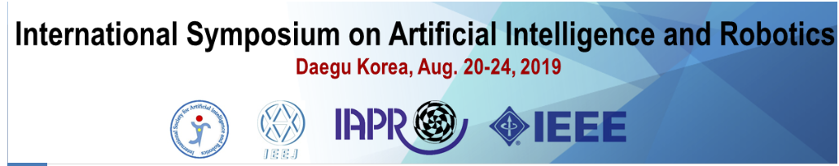
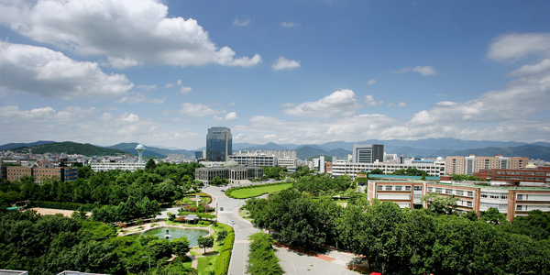
Machine Learning and High
Performance Computing
The 4th International Symposium on Artificial Intelligence and Robotics (ISAIR2019)
Kyungpook National University on August 20-24, 2019, Daegu, Korea
Geoffrey Fox | August 20, 2019
Supported by US National Science Foundation through Awards
1443054 CIF21 DIBBs: Middleware and High Performance Analytics Libraries for Scalable Data Science
1720625 Network for Computational Nanotechnology - Engineered nanoBIO Node
1849625 BDEC2 Community activities
gcf@indiana.edu,
http://www.dsc.soic.indiana.edu/,
http://spidal.org/

Slide 2
Overall Environment
Cloud Computing domination; it is all data center computing
  Including HPC offered by Public Clouds
MLPerf
Apache Big Data Stack
5 Computation Paradigms
Global AI Supercomputer
Intelligent Cloud and Intelligent Edge
Clouds & Deep Learning Lead
Follow and make use of technologies and architectures developed in Industry

Slide 3
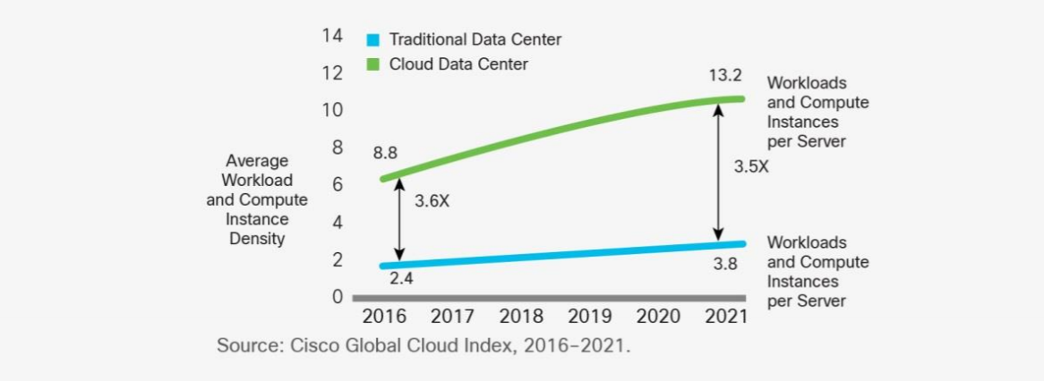
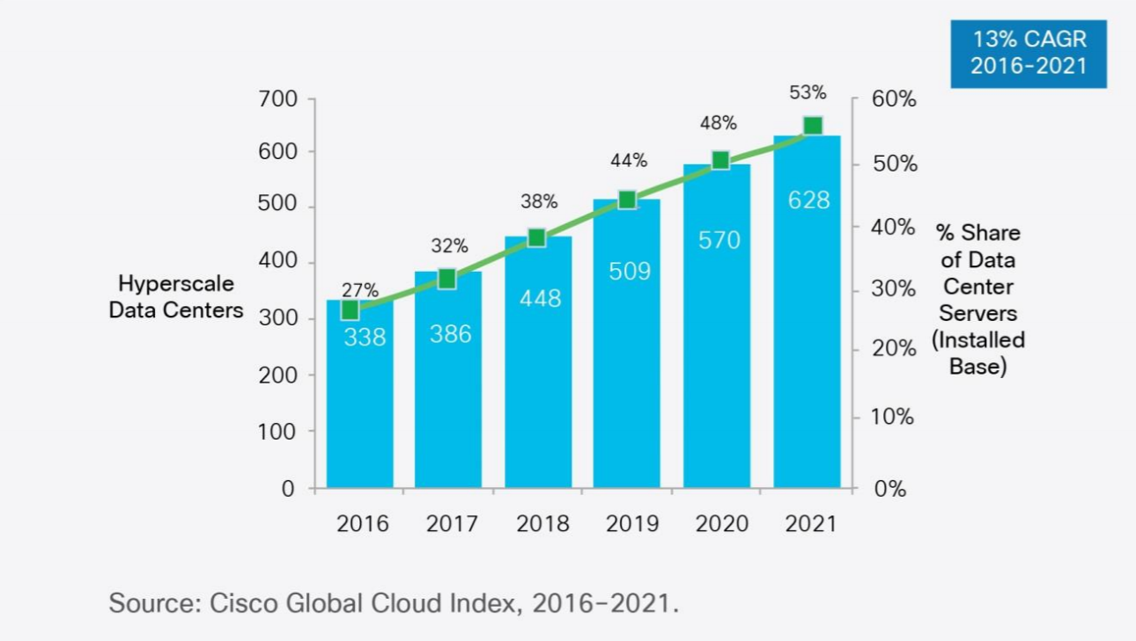
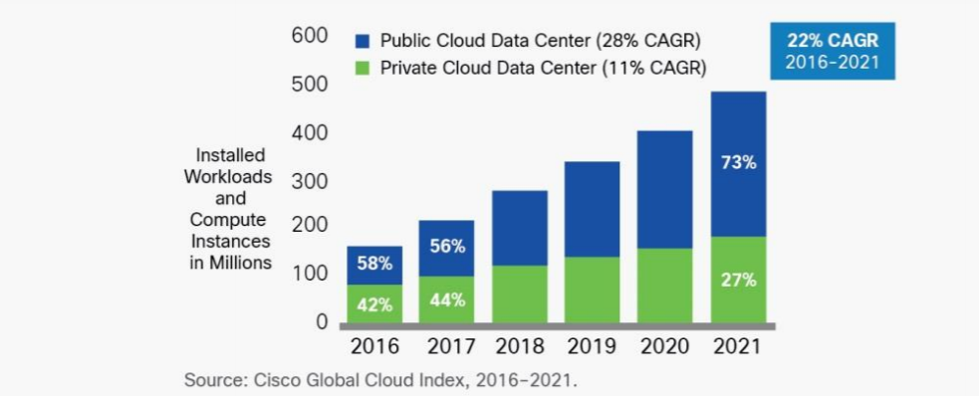
Dominance of Cloud Computing
Number of instances per server
94 percent of workloads and compute instances will be processed by cloud data centers (22% CAGR) by 2021-- only six percent will be processed by traditional data centers (-5% CAGR).
Hyperscale data centers will grow from 338 in number at the end of 2016 to 628 by 2021. They will represent 53 percent of all installed data center servers by 2021. They form a distributed Compute (on data) grid with some 50 million servers
Analysis from CISCO https://www.cisco.com/c/en/us/solutions/collateral/service-provider/global-cloud-index-gci/white-paper-c11-738085.html updated November 2018
Number of Cloud Data Centers
Number of Public or Private Cloud Data Center Instances

Slide 4
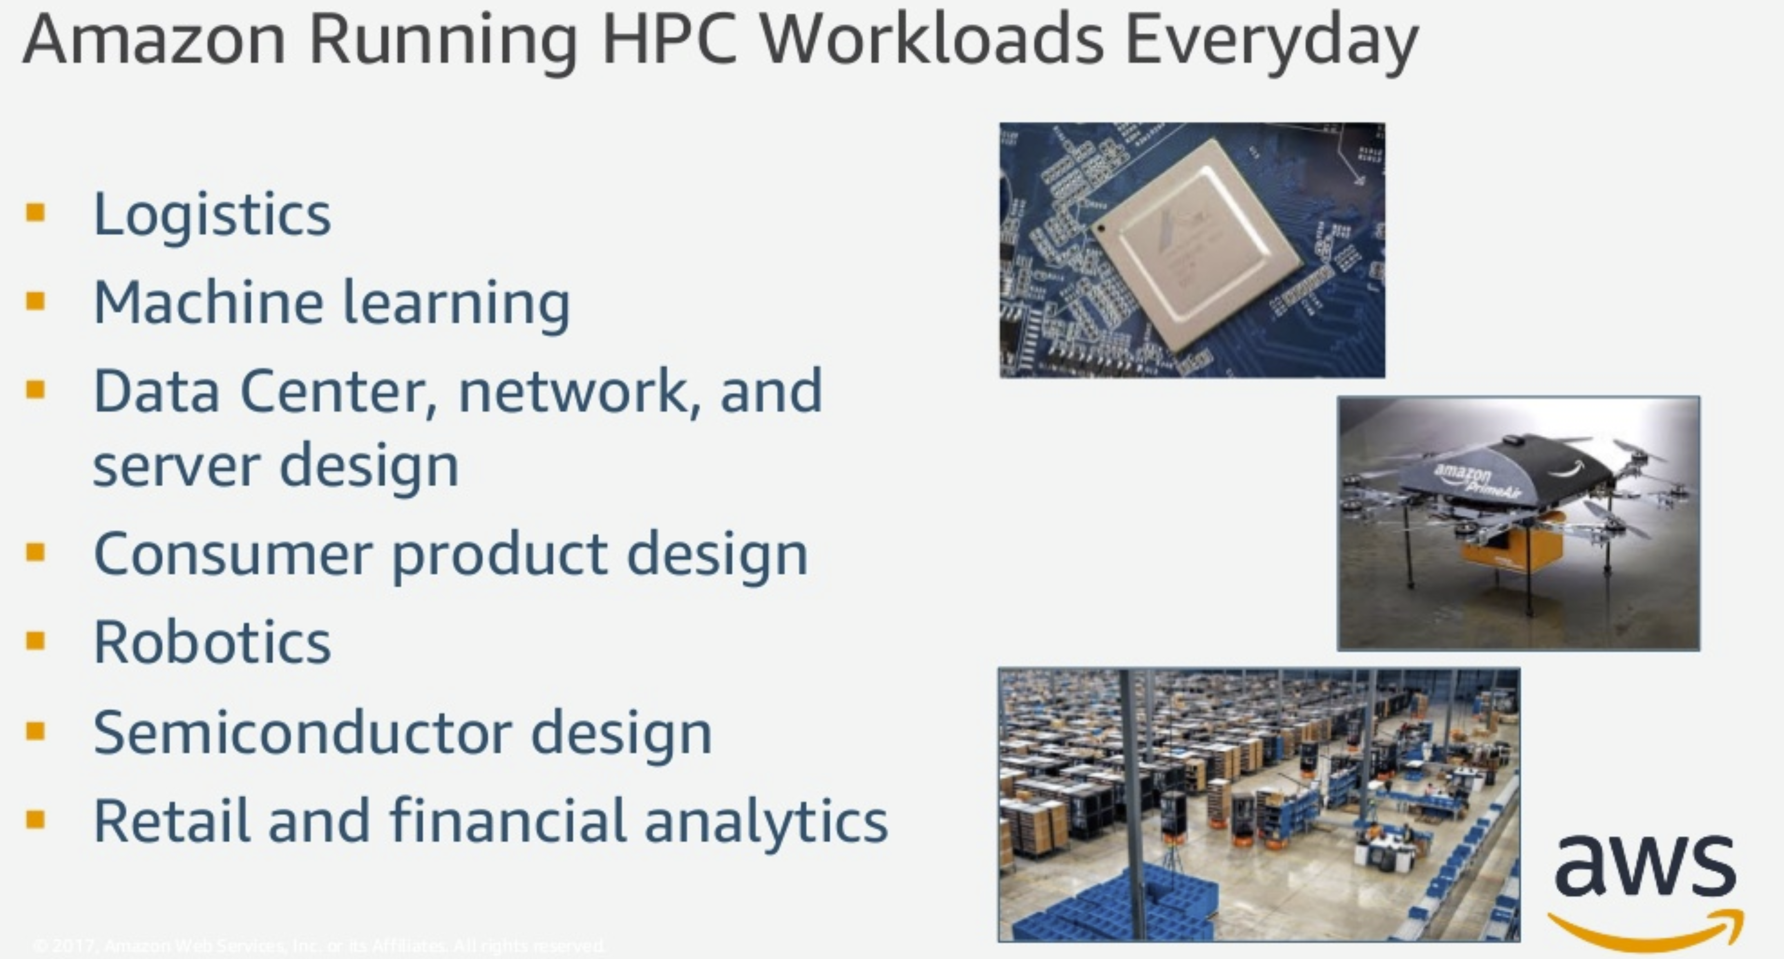
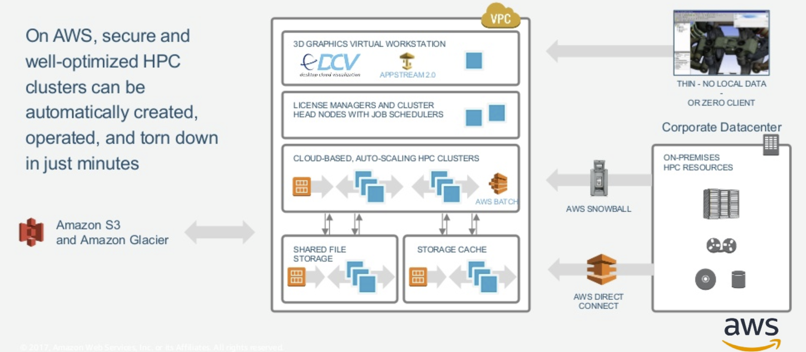
HPC is available on Public Clouds
AWS runs everyday HPC for logistics, ML, Data Center, Consumer Product design, Robotics, Semiconductor design, Retail and Financial analytics

Slide 5
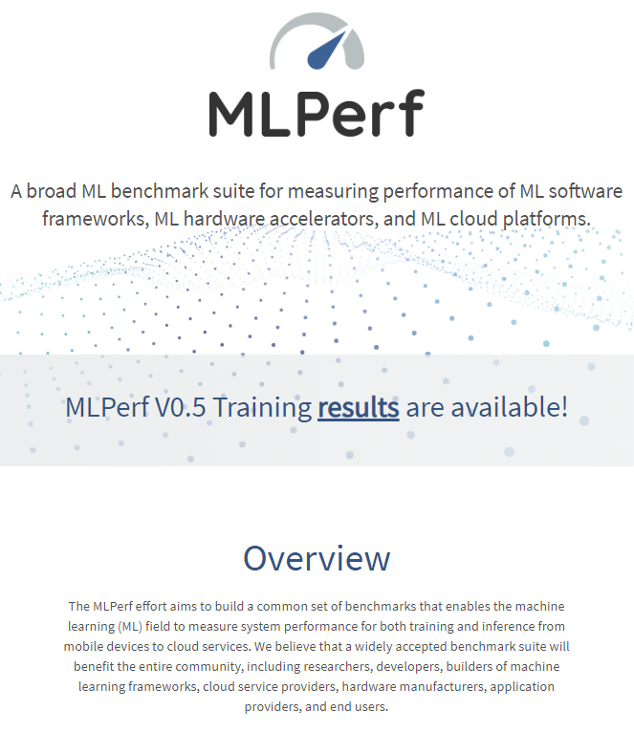
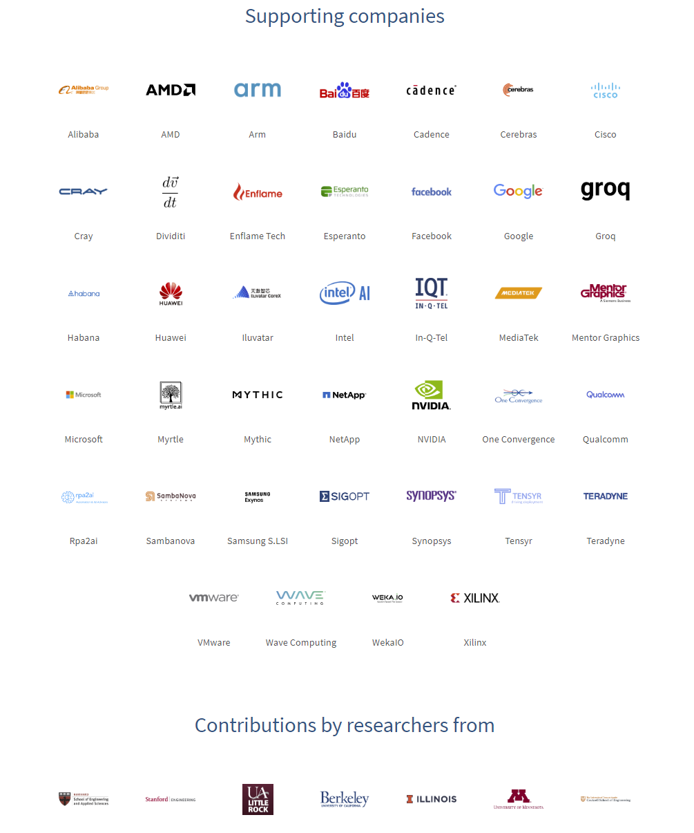
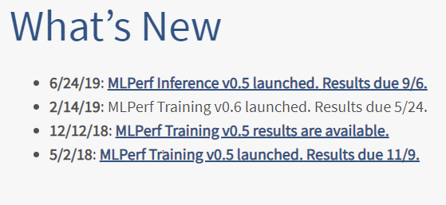
MLPerf's mission is to build fair and useful benchmarks for measuring training and inference performance of ML hardware, software, and services. MLPerf was founded in February, 2018 as a collaboration of companies and researchers from educational institutions. MLPerf is presently led by volunteer working group chairs. MLPerf could not exist without open source code and publically available datasets others have generously contributed to the community.
Get Involved
Join the forum
Join working groups
Attend community meetings
Make your organization an official supporter of MLPerf
Ask questions, or raise issues
Note Industry Dominance

Slide 6
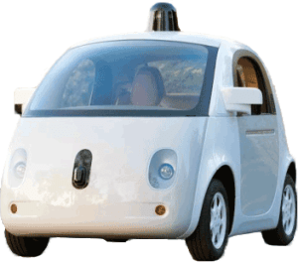
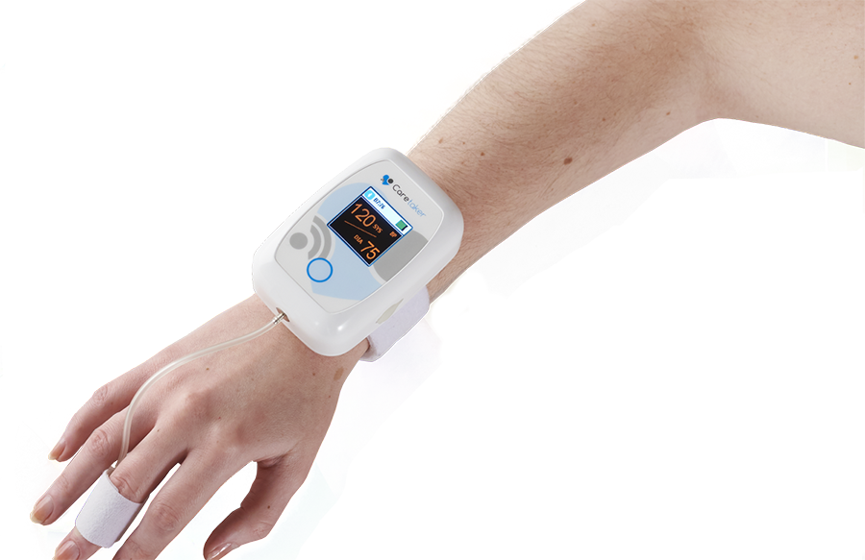
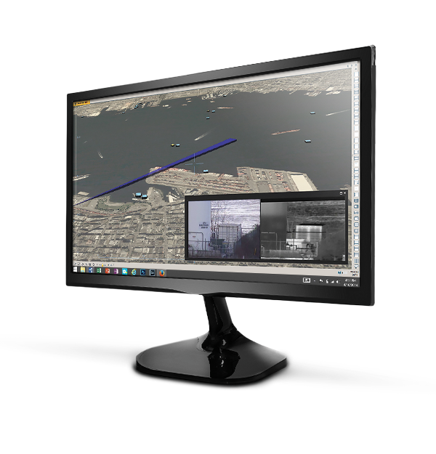
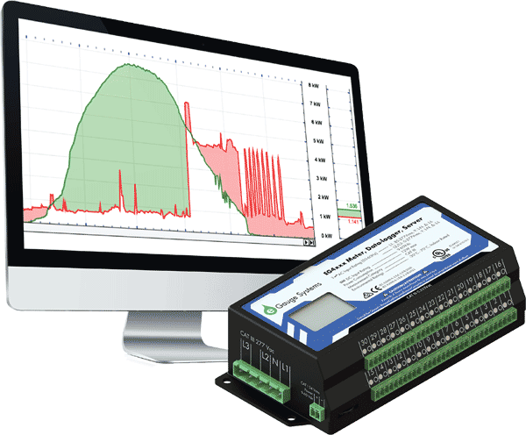
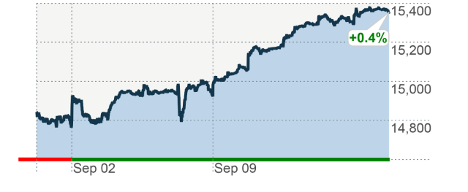
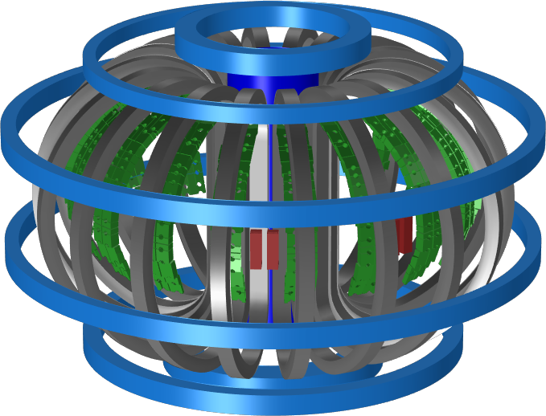
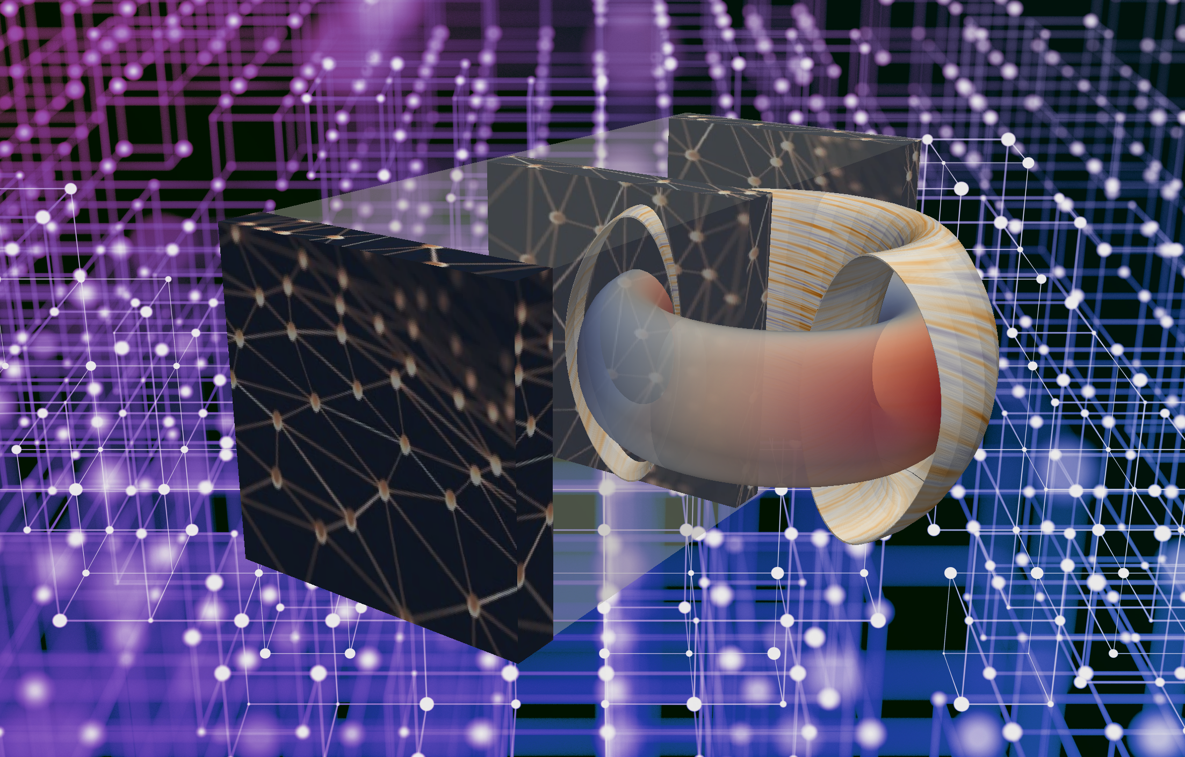
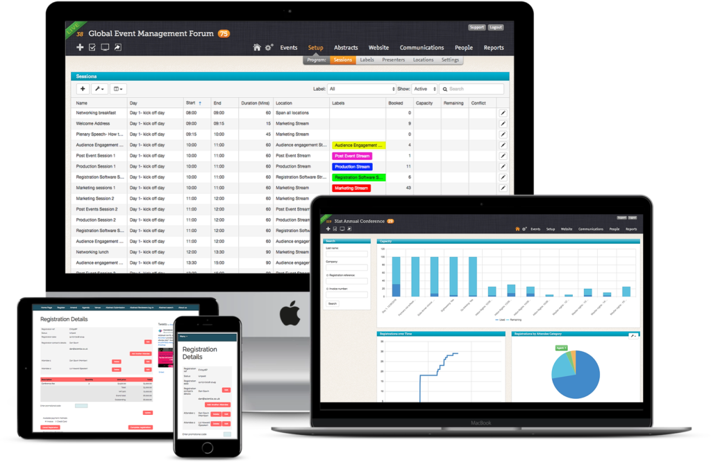
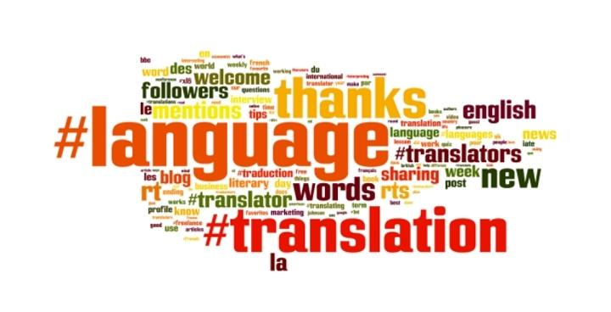
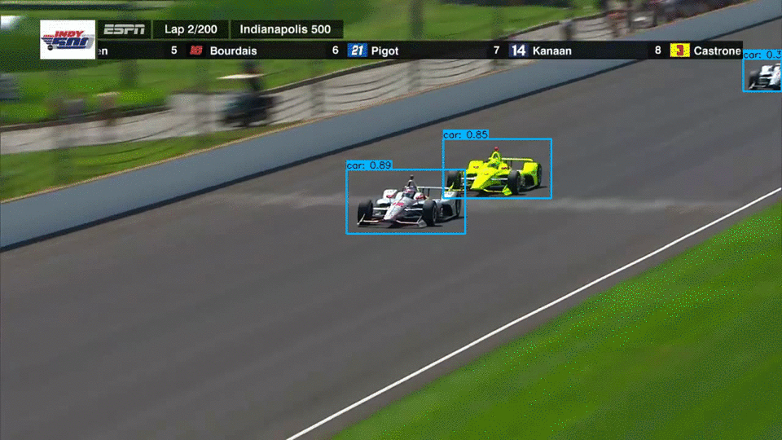
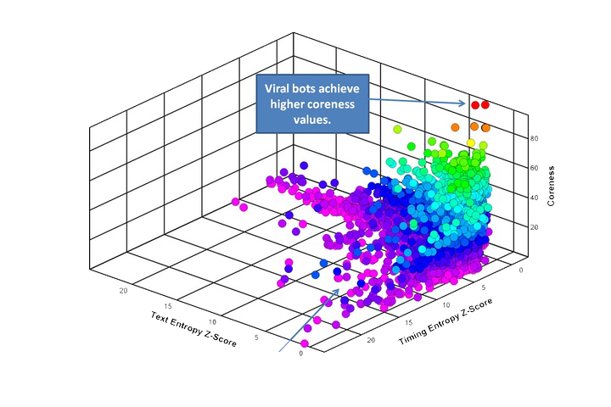

Performance of Time Series Machine Learning Algorithms (MLPerf)
Areas | Applications | Model | Data sets | Papers
Transportation | Cars, Taxis, Freeway Detectors | TT-RNN , BNN, LSTM | Caltrans highway traffic [1], Taxi/Uber trips [2-5] | [6-8]
Medical | Wearables, Medical instruments: EEG, ECG, ERP, Patient Data | LSTM, RNN | OPPORTUNITY [9-10], EEG [11-14], MIMIC [15] | [16-20]
Cybersecurity | Intrusion, classify traffic, anomaly detection | LSTM | GPL loop dataset [21], SherLock [22] | [21, 23-25]
General Social Statistics | Household electric use, Economic, Finance, Demographics, Industry | CNN, RNN | Household electric [26], M4Competition [27], | [28-29]
Finance | Stock Prices versus time | CNN, RNN | Available academically from Wharton [30] | [31]
Science | Climate, Tokamak | Markov, RNN | USHCN climate [32] | [33-35]
Software Systems | Events | LSTM | Enterprise SW system [36] | [36-37]
Language and Translation | Pre-trained Data | Transformer [38] | [39-40] | [41-42]Mesh Tensorflow
Google Speech | All-Neural On-Device Speech Recognizer | RNN-T |  | [43]
IndyCar Racing | Real-time car and track detectors | HTM |  | [44]
Social media | Twitter | Online Clustering | Available from Twitter | [45-46]
Notes:
http://jeffnolan.com/wp/2015/11/23/the-fascinating-implications-for-autonomous-vehicles/
https://www.comsol.com/blogs/analyzing-a-component-of-the-iter-tokamak-with-simulation/
https://www.oreilly.com/ideas/identifying-viral-bots-and-cyborgs-in-social-media
https://www.caretakermedical.net/
https://www.eventsforce.com/
https://money.cnn.com/2013/09/13/investing/stocks-markets/index.html
https://www.stickpng.com/img/icons-logos-emojis/tech-companies/twitter-logo
https://www.flir.com/products/cameleon-tactical/
https://www.androidpolice.com/2019/03/12/google-bringing-faster-on-device-speech-recognition-to-gboard-starting-with-pixel-phones/

Slide 7
ABDS
Apache Big Data Stack
HPC-ABDS is an integrated wide range of HPC and Big Data technologies.
I gave up updating list in January 2016!
21 layers

Slide 8
Architecture of five Big Data and Big Simulation Computation Paradigms
Dataflow and “in-place”
Classic Cloud Workload
These 3 are focus of Twister2 but we need to preserve capability on first 2 paradigms
Note Problem, Software and System all have an Architecture and efficient execution says they must match

Slide 9
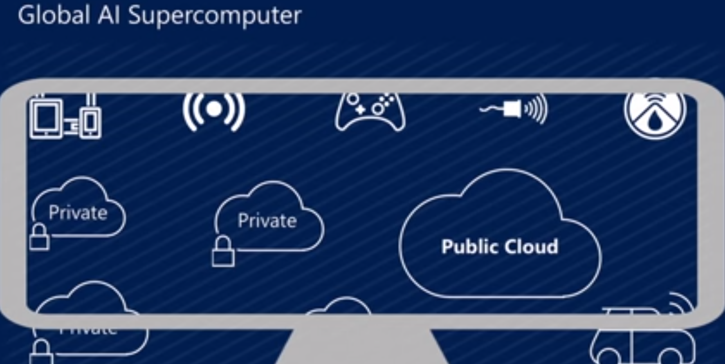
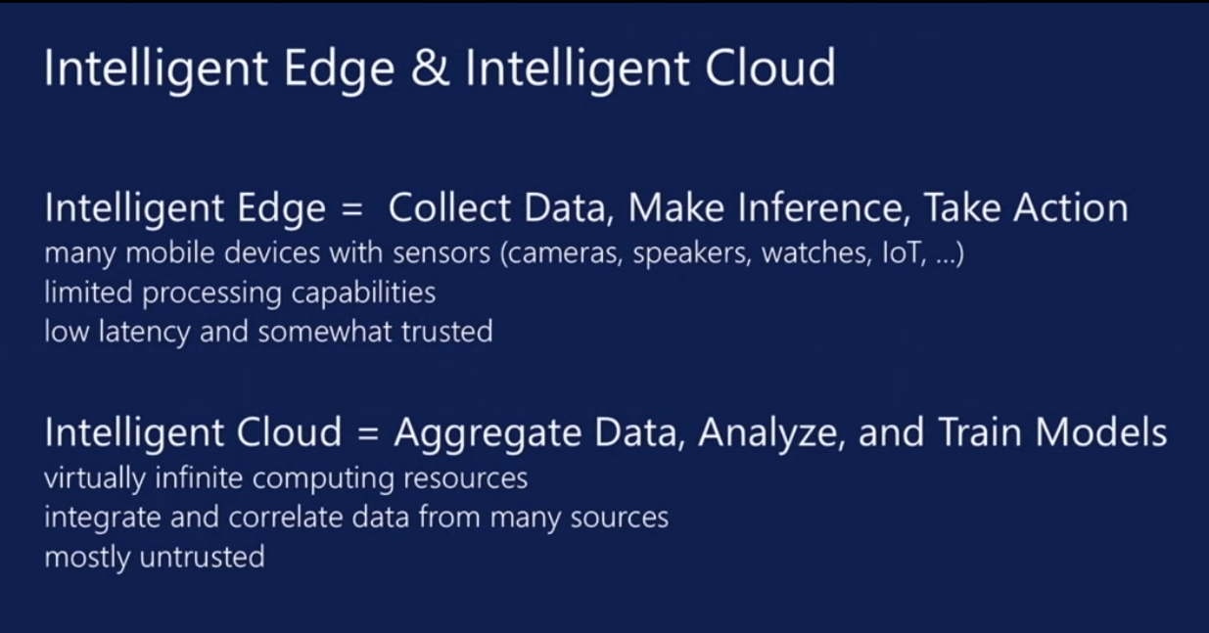
Microsoft Summer 2018: Global AI Supercomputer
By Donald Kossmann

Slide 10
Overall Global AI and Modeling Supercomputer GAIMSC Architecture
Global says we are all involved - it is an HPDC system
I added “Modeling” to get the Global AI and Modeling Supercomputer GAIMSC
There is only a cloud at the logical center but it’s physically distributed and domated by a few major players
Modeling was meant to include classic simulation oriented supercomputers
Even in Big Data, one needs to build a model for the machine learning to use
GAIMSC will use classic HPC for data analytics which has similarities to big simulations (HPCforML)
GAIMSC must also support I/O centric data management with Hadoop etc.
Nature of I/O subsystem controversial for such HPC clouds
  Lustre v. HDFS; importance of SSD and NVMe;
HPC Clouds would suggest that MPI runs well on Mesos and Kubernetes and with Java and Python

Slide 11
HPCforML and
MLforHPC
Technical aspects of converging HPC and Machine Learning
HPCforML
  Parallel high performance ML algorithms
  High Performance Spark, Hadoop, Storm
9 scenarios for MLforHPC
  Illustrate 3 scenarios
  Transform Computational Biology
  Research Issues

Slide 12
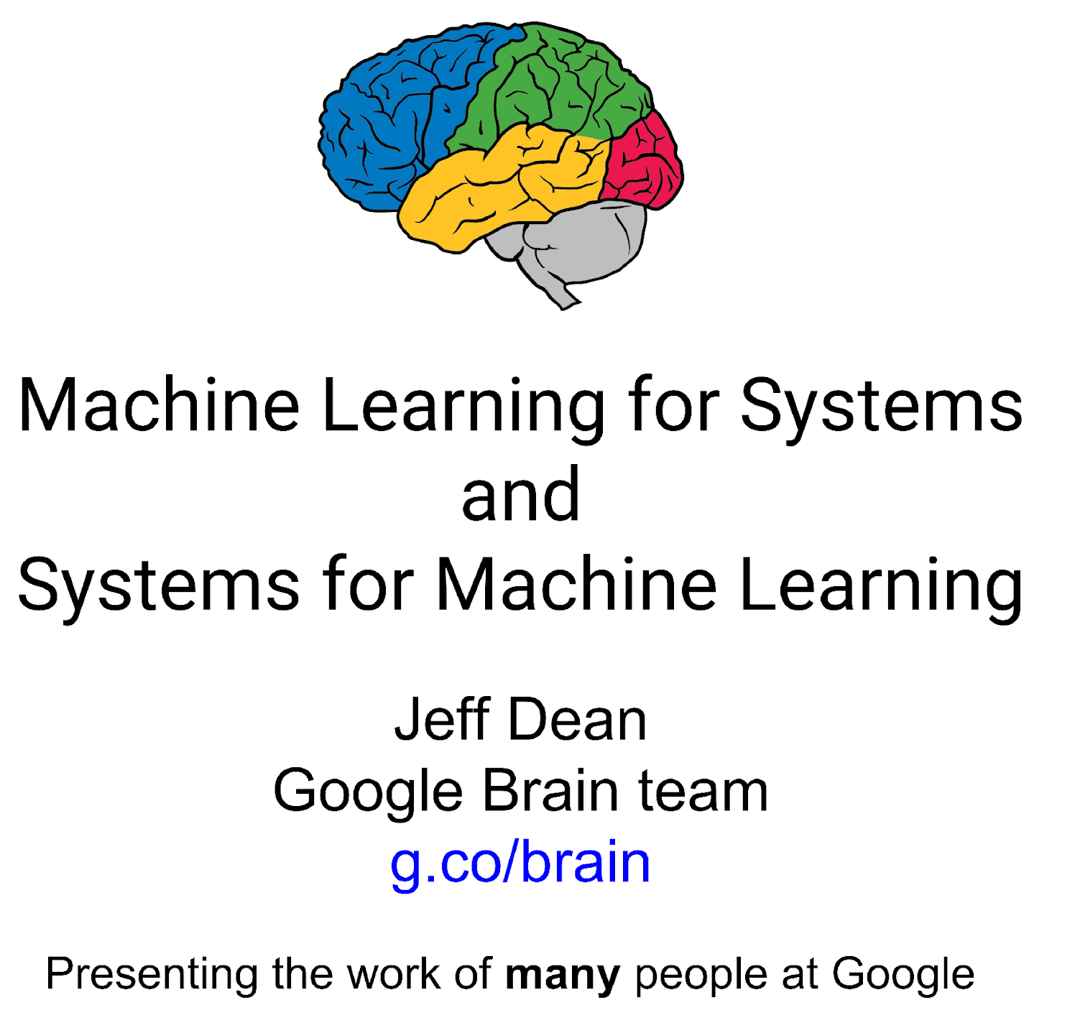
Dean at NeurIPS
DECEMBER 2017
ML for optimizing parallel computing (load balancing)
Learned Index Structure
ML for Data-center Efficiency
ML to replace heuristics and user choices (Autotuning)

Slide 13
Implications of Machine Learning for Systems and Systems for Machine Learning
We could replace “Systems” by “Cyberinfrastructure” or by “HPC”
I use HPC as we are aiming at systems that support big data or big simulations and almost by (my) definition could naturally involve HPC.
So we get ML for HPC and HPC for ML
HPC for ML is very important but has been quite well studied and understood
  It makes data analytics run much faster
ML for HPC is transformative both as a technology and for application progress enabled
  If it is ML for HPC running ML, then we have the creepy situation of the AI supercomputer improving itself
  Microsoft 2018 faculty summit discussed ML to improve Big Data systems e.g. configure database system.

Slide 14
HPCforML
Parallel Big Data Analytics in some ways like parallel Big Simulation
Twister2 Implements HPCforML as HPC-ABDS and supports MLforHPC

Slide 15
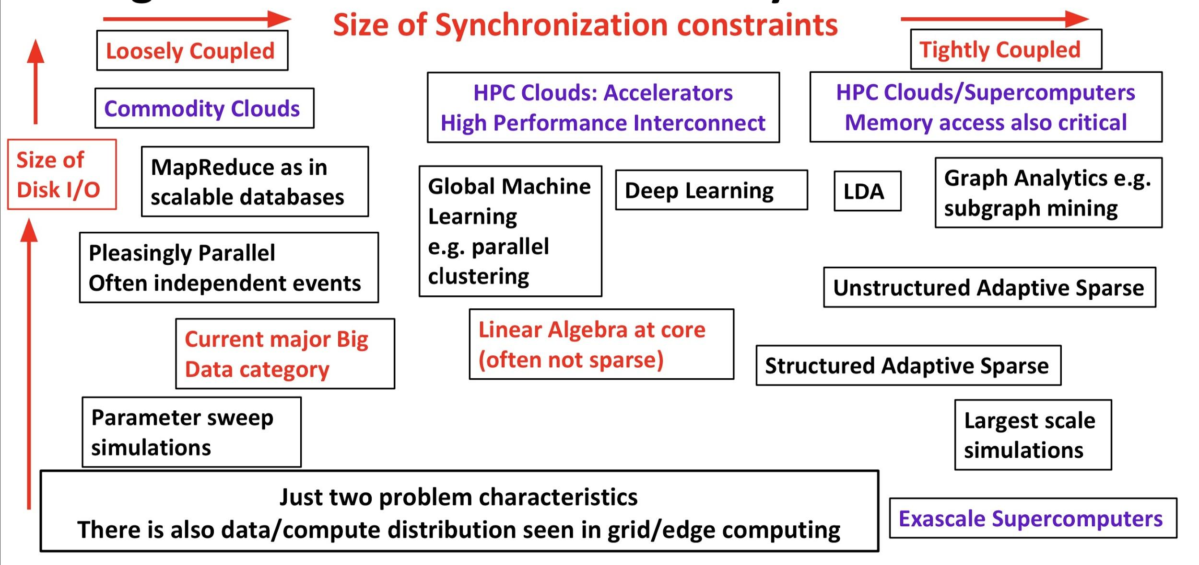
Big Data and Simulation Comparison of Difficulty in Parallelism
Parallel Big Data Algorithms many issues in common with Parallel Simulations

Slide 16
Requirements for a Global AI Supercomputer
Support HPC simulation stack – MPI, Kepler (workflow), Slurm
  Fast network and nodes
  Modest I/O constrains – shared backend Lustre
  Uses Shifter, Singularity but probably can change
Support Apache Big Data stack – such as Spark, Storm, Hadoop, Flink, Docker, Kubernetes, Mesos or equivalent
  Runs on hypervisors on shared systems; can support bare metal and use when machines but not individual nodes shared
  Does workflow as dataflow in Spark
  Several non optimized implementations
  Large I/O; data from Computer, Repositories, Edge (streaming), Local disks
Support Machine Learning – Tensorflow, PyTorch
  GPU, TPU, Fast Networks
  Python front ends
All 3 must be integrated

Slide 17
Twister2 Highlights I
“Big Data Programming Environment” such as Hadoop, Spark, Flink, Storm, Heron but uses HPC wherever appropriate and outperforms Apache systems – often by large factors
Runs preferably under Kubernetes Mesos Nomad but Slurm supported
Highlight is high performance dataflow supporting iteration, fine-grain, coarse grain, dynamic, synchronized, asynchronous, batch and streaming
Three distinct communication environments
  DFW Dataflow with distinct source and target tasks; data not message level; Data-level Communications spilling to disks as needed
  BSP for parallel programming; MPI is default. Inappropriate for dataflow
  Storm API for streaming events with pub-sub such as Kafka
Rich state model (API) for objects supporting in-place, distributed, cached, RDD (Spark) style persistence with Tsets (see Pcollections in Beam, Datasets in Flink, Streamlets in Storm, Heron)

Slide 18
Twister2 Highlights II
Can be a pure batch engine
  Not built on top of a streaming engine
Can be a pure streaming engine supporting Storm/Heron API
  Not built on on top of a batch engine
Fault tolerance (June 2019) as in Spark or MPI today; dataflow nodes define natural synchronization points
Many API’s: Data, Communication, Task
  High level hiding communication and decomposition (as in Spark) and low level (as in MPI)
DFW supports MPI and MapReduce primitives: (All)Reduce, Broadcast, (All)Gather, Partition, Join with and without keys
Component based architecture -- it is a toolkit
  Defines the important layers of a distributed processing engine
  Implements these layers cleanly aiming at high performance data analytics

Slide 19
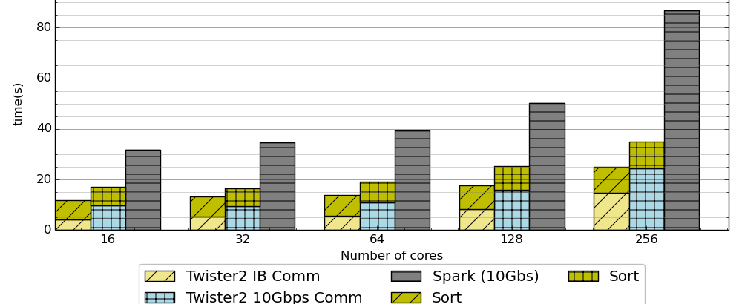
Terasort in Spark and Twister2
Times
Spark 10 Gbs > Twister2 10 Gbs > Twister2 IB
1 Gigabyte per core; all jobs run on 16 nodes; varying core count
Running on 16 nodes of Intel with 2 24-core Intel(R) Xeon(R) Platinum 8160 Skylake 2.10GHz processors, 256GB of memory, 8TB of local disk storage, 400GB of NVMe storage, and a Mellanox ConnectX-3 InfiniBand (IB) FDR 56GT/s adapter

Slide 20
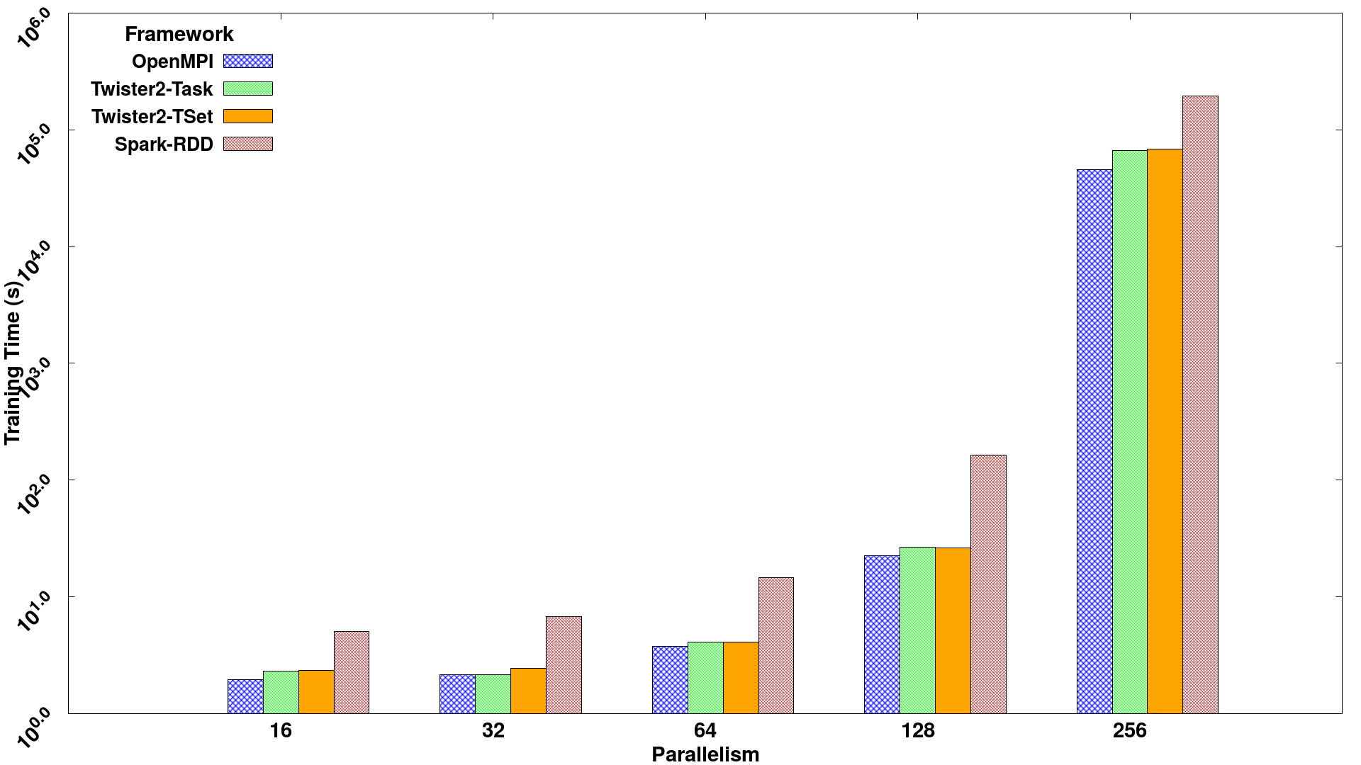
Parallel SVM using SGD execution time for 320K data points with 2000 features and 500 iterations, on 16 nodes with varying parallelism
Times
Spark RDD > Twister2 Tset > Twister2 Task > MPI

Slide 21
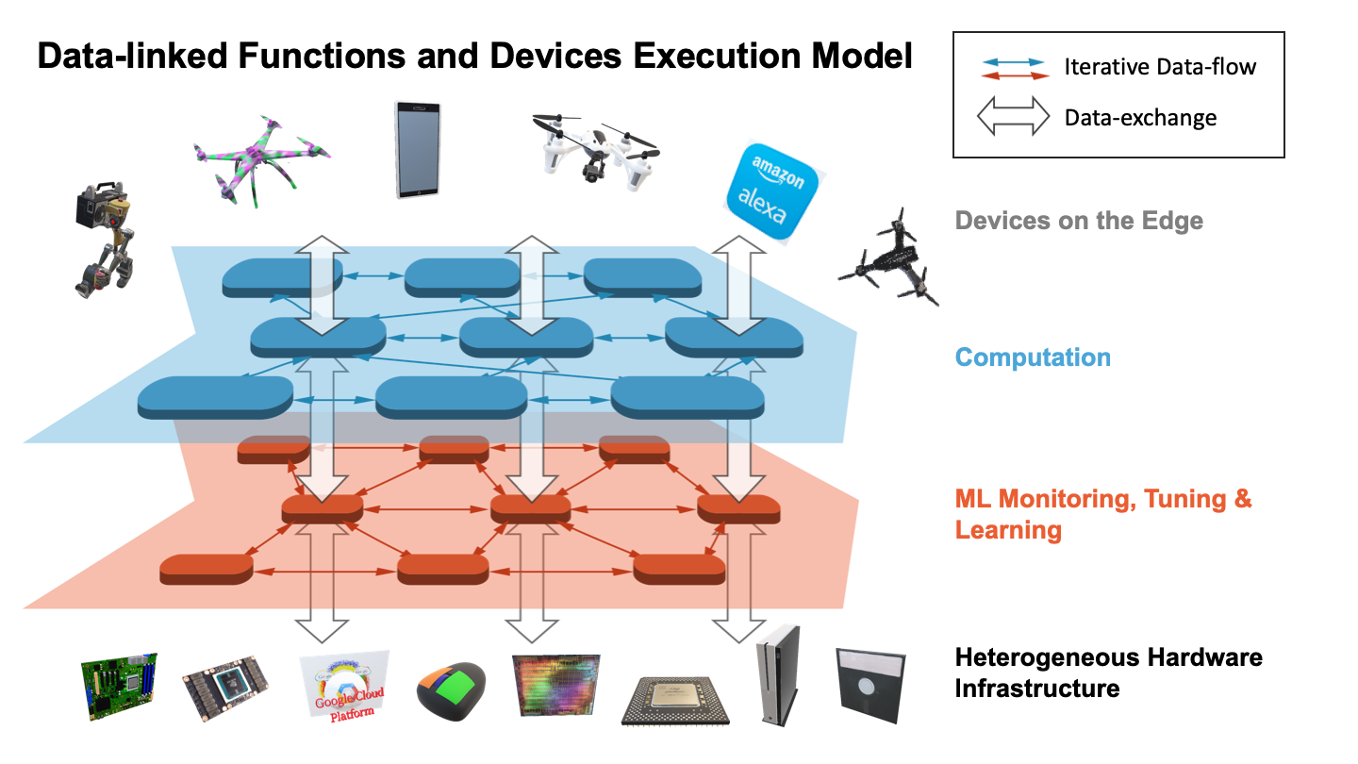
Suitable for MLforHPC?
Continually interacting in the Intelligent Aether with
Software model supported by Twister2

Slide 22
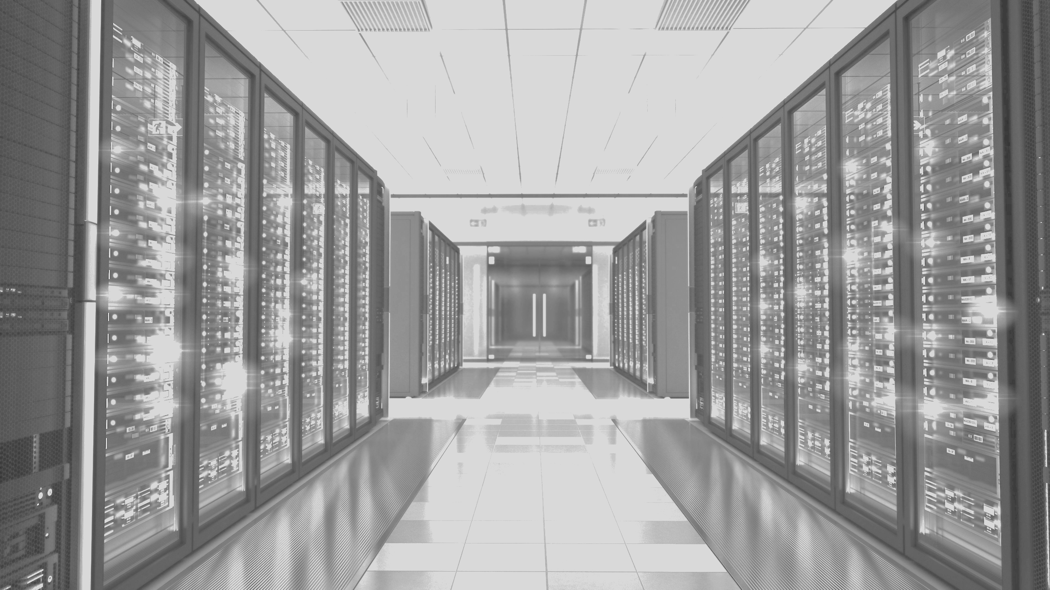
MLaroundHPC
MLAutotuning

Slide 23
MLforHPC (ML for Systems) in detail
MLforHPC can be further subdivided into several categories:
  MLafterHPC: ML analyzing results of HPC as in trajectory analysis and structure identification in biomolecular simulations. Well established and successful
  MLControl: Using simulations (with HPC) and ML in control of experiments and in objective driven computational campaigns. Here simulation surrogates are very valuable to allow real-time predictions.
  MLAutotuning: Using ML to configure (autotune) ML or HPC simulations.
  MLaroundHPC: Using ML to learn from simulations and produce learned surrogates for the simulations or parts of simulations. The same ML wrapper can also learn configurations as well as results. Most Important.

Slide 24
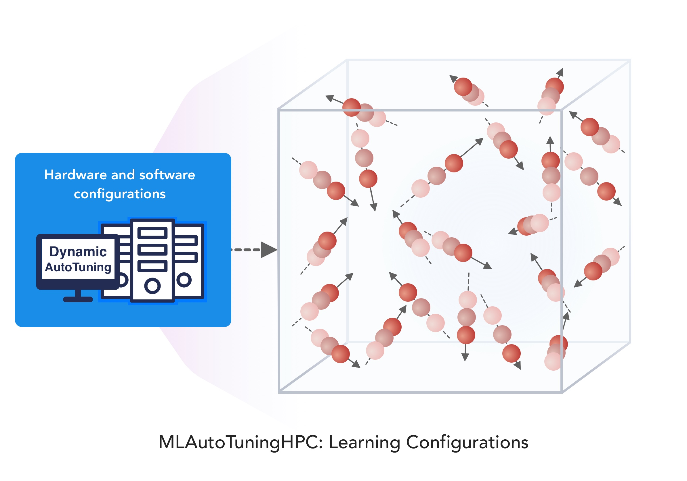
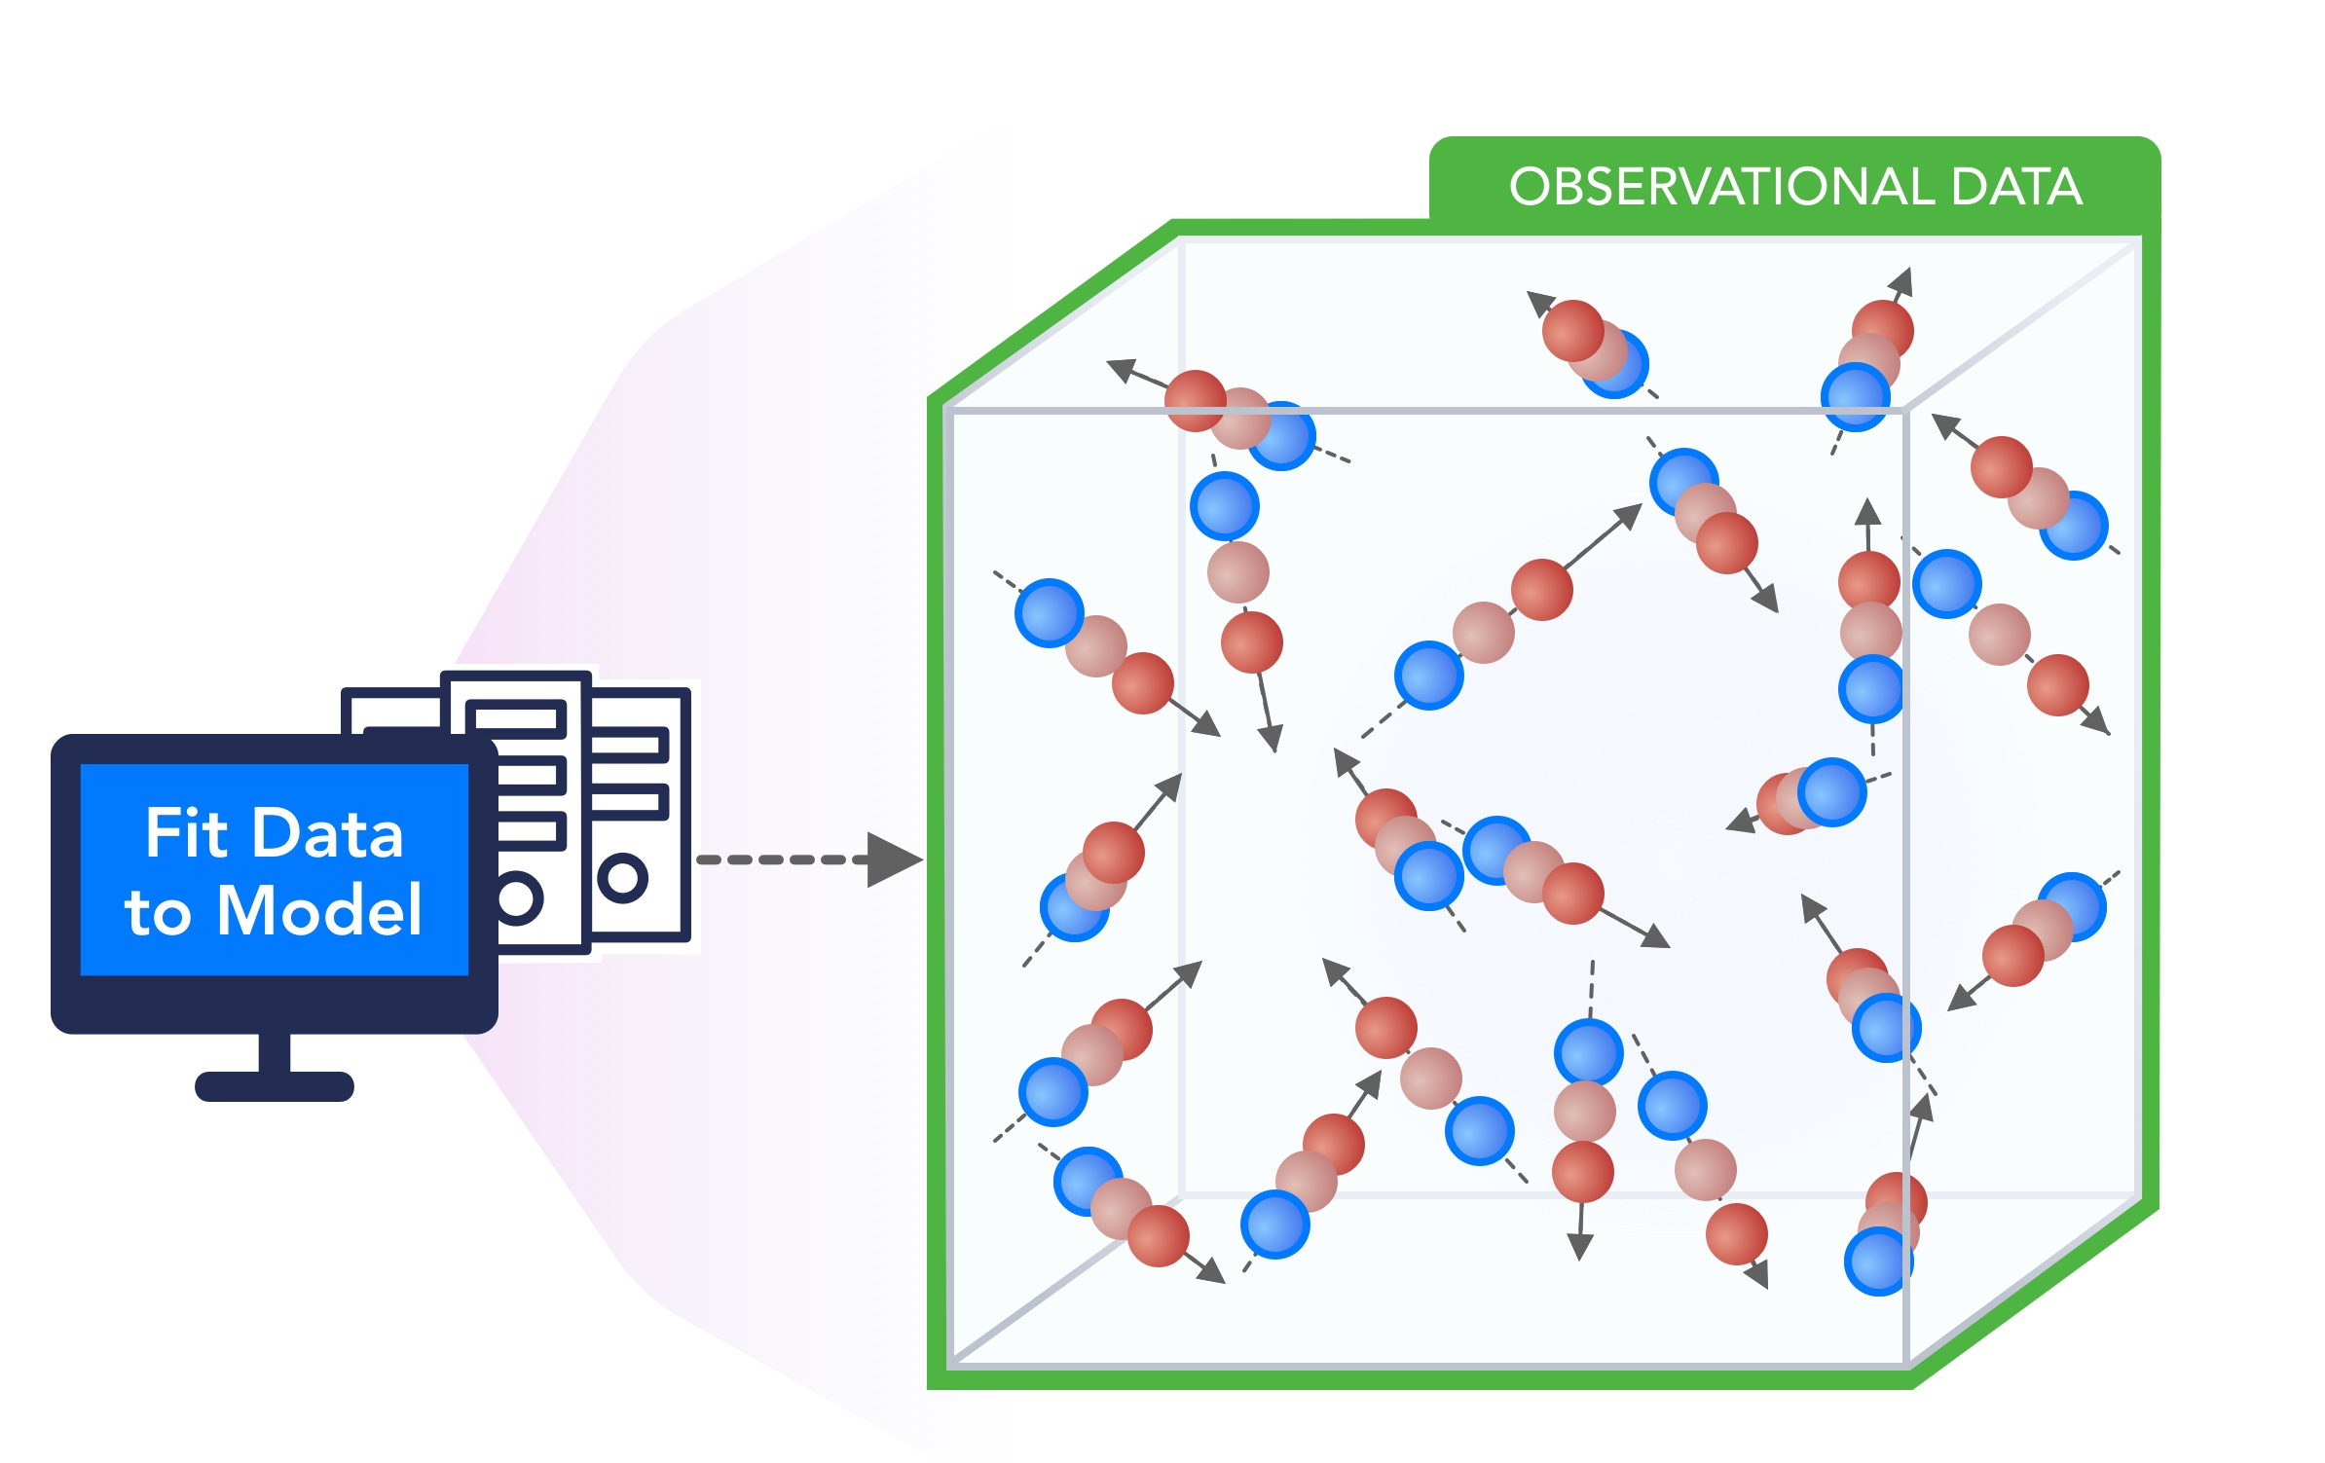
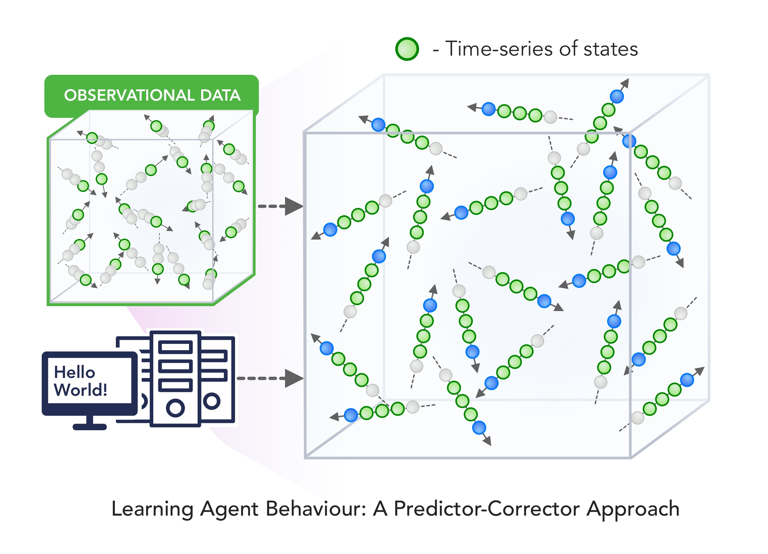
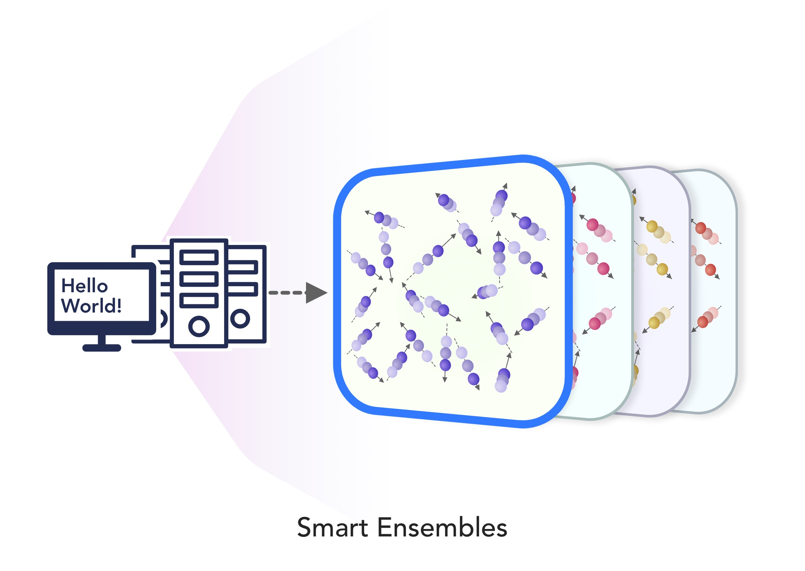
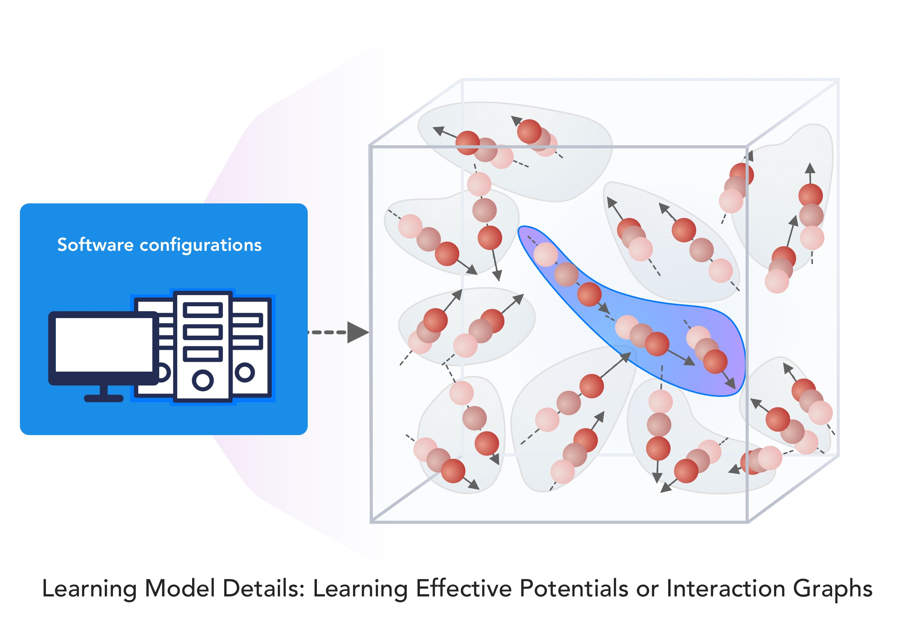
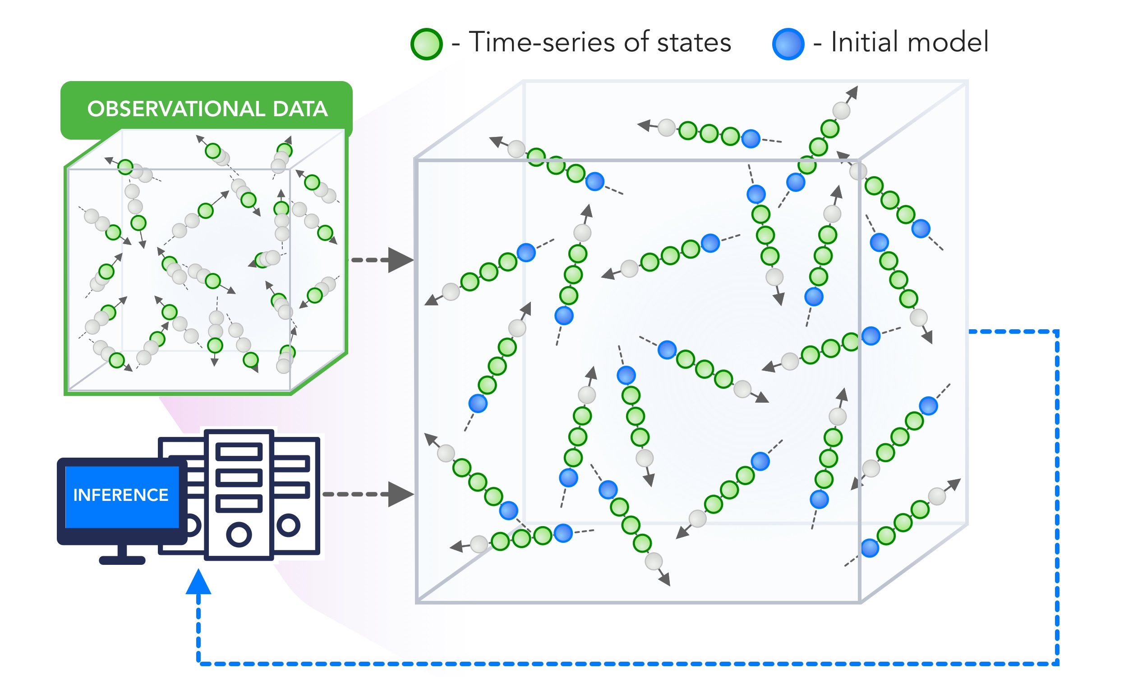
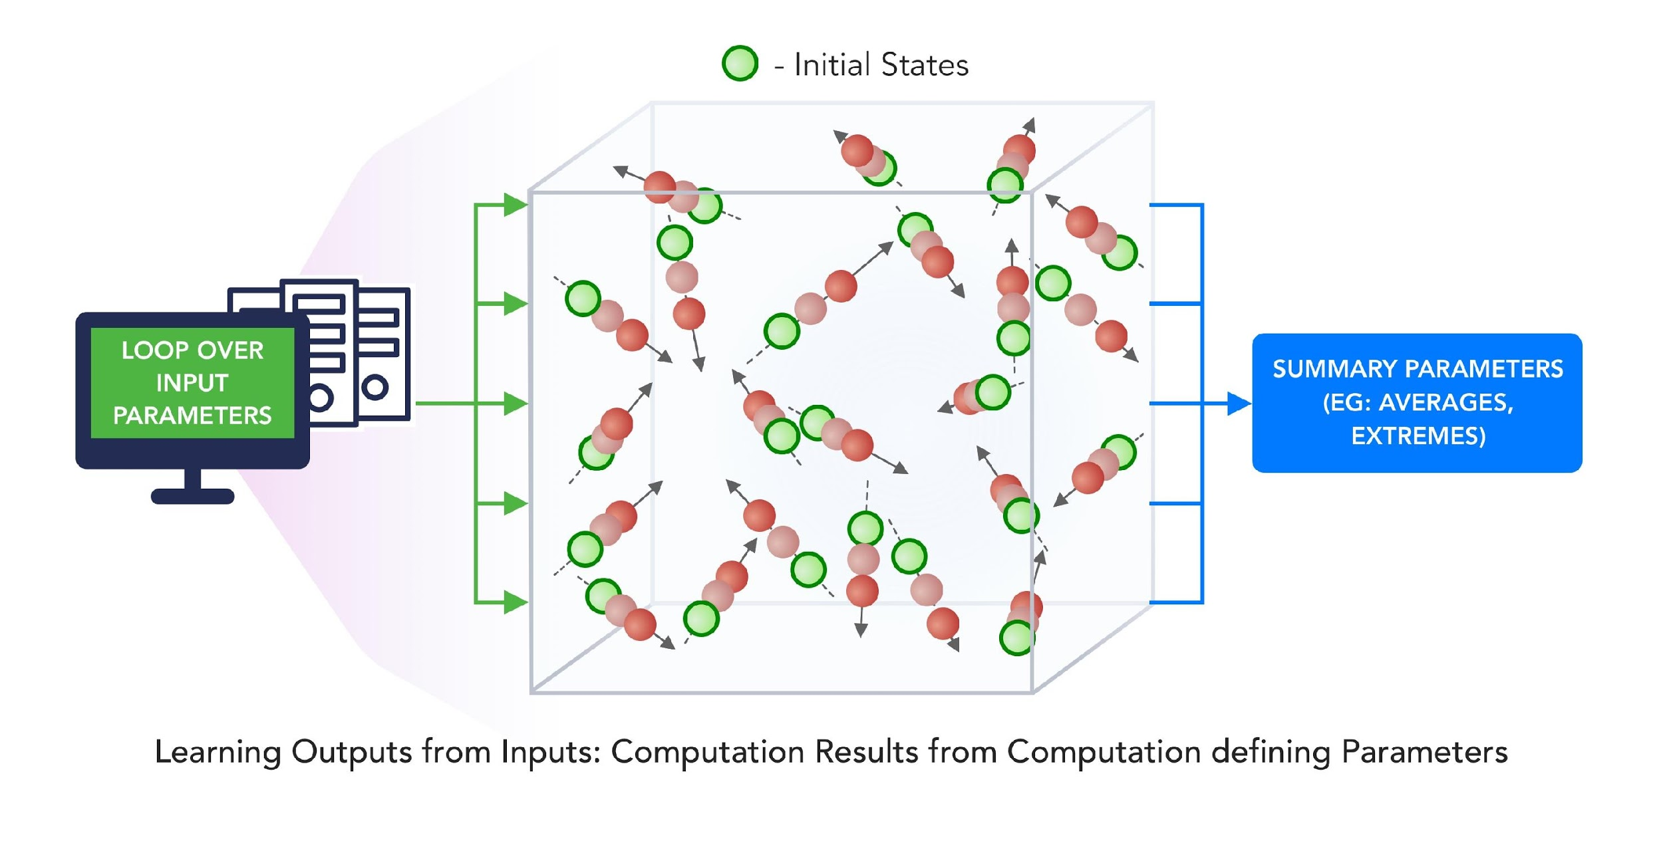
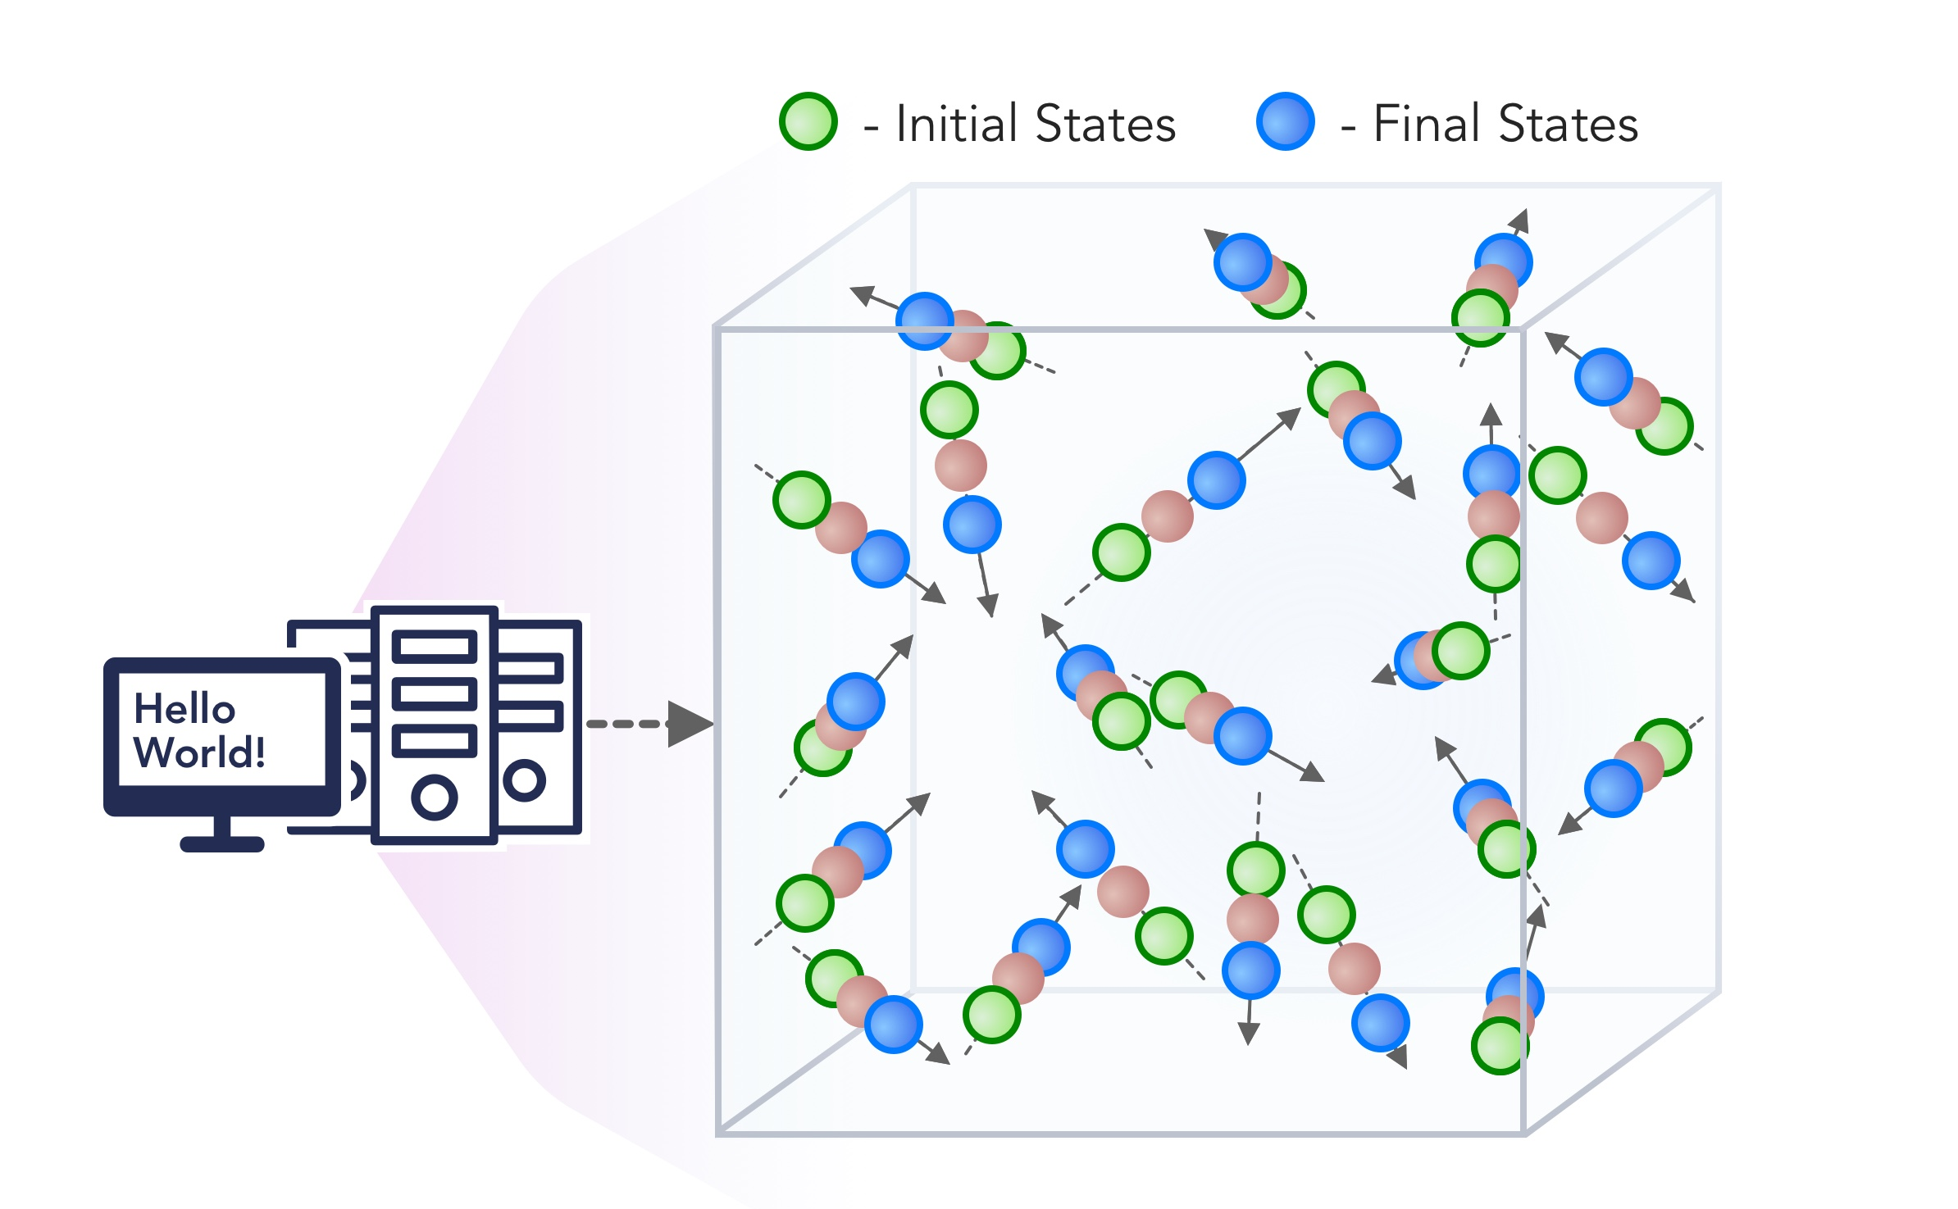
1. Improving Simulation with Configurations and Integration of Data
1.1 MLAutotuningHPC – Learn configurations
1.2 MLAutotuningHPC – Learn models from data
1.3 MLaroundHPC: Learning Model Details (ML based data assimilation)
2. Learn Structure, Theory and Model for Simulation
2.1 MLAutotuningHPC – Smart ensembles
2.2 MLaroundHPC: Learning Model Details (coarse graining, effective potentials)
2.3 MLaroundHPC: Improve Model or Theory
3. Learn Surrogates for Simulation
3.1 MLaroundHPC: Learning Outputs from Inputs (parameters)
3.2 MLaroundHPC: Learning Outputs from Inputs (fields)
INPUT
OUTPUT

Slide 25
MLforHPC Learn Surrogates for Simulation
MLaroundHPC: Learning Outputs from Inputs:
Computation Results from Computation defining Parameters
Here one just feeds in a modest number of meta-parameters that the define the problem and learn a modest number of calculated answers.
This presumably requires fewer training samples than “fields from fields” and is main use so far
Operationally same as SimulationTrainedML but with a different goal: In SimulationTrainedML the simulations are performed to directly train an AI system rather than the AI system being added to learn a simulation.

Slide 26
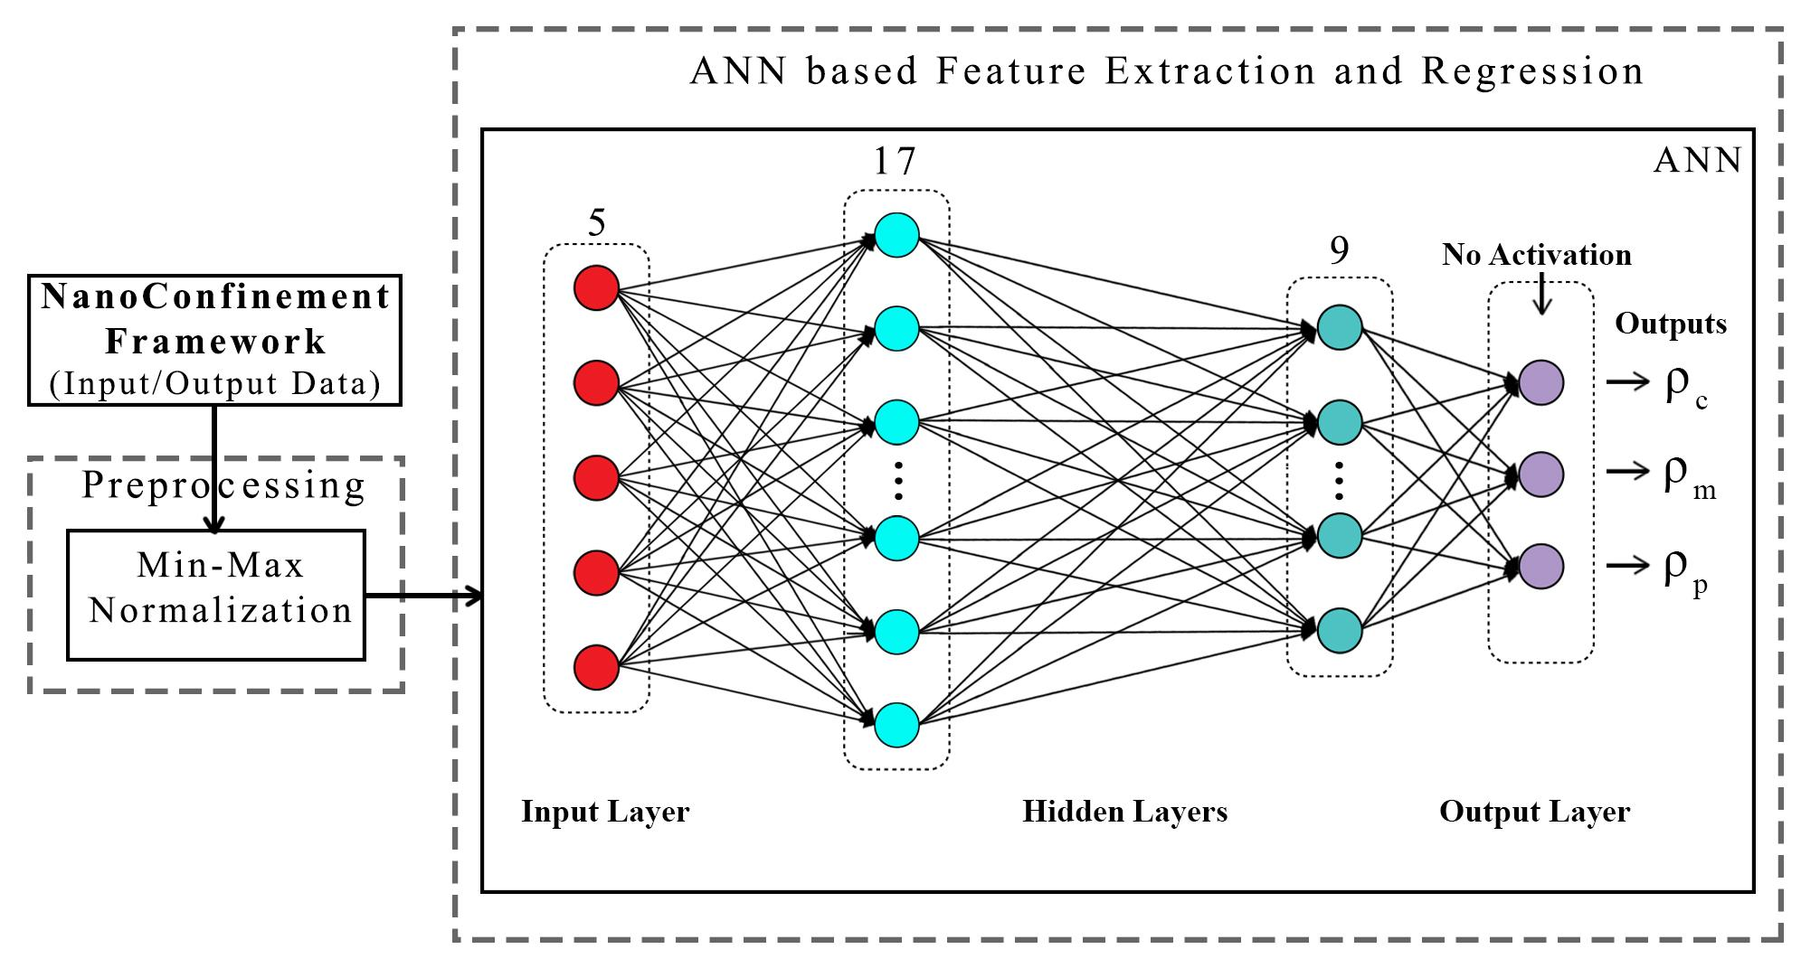
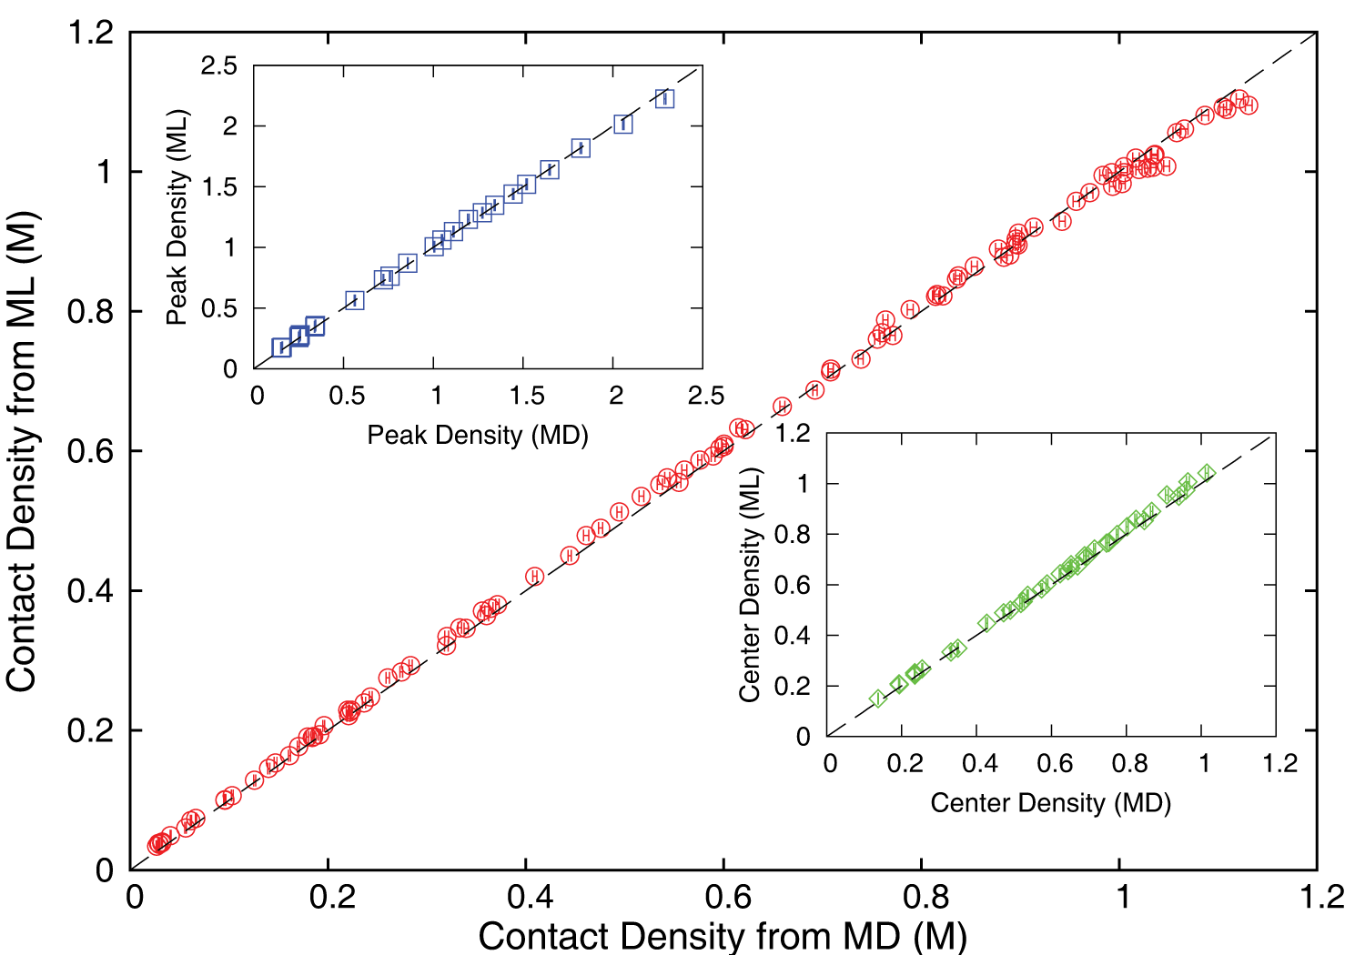
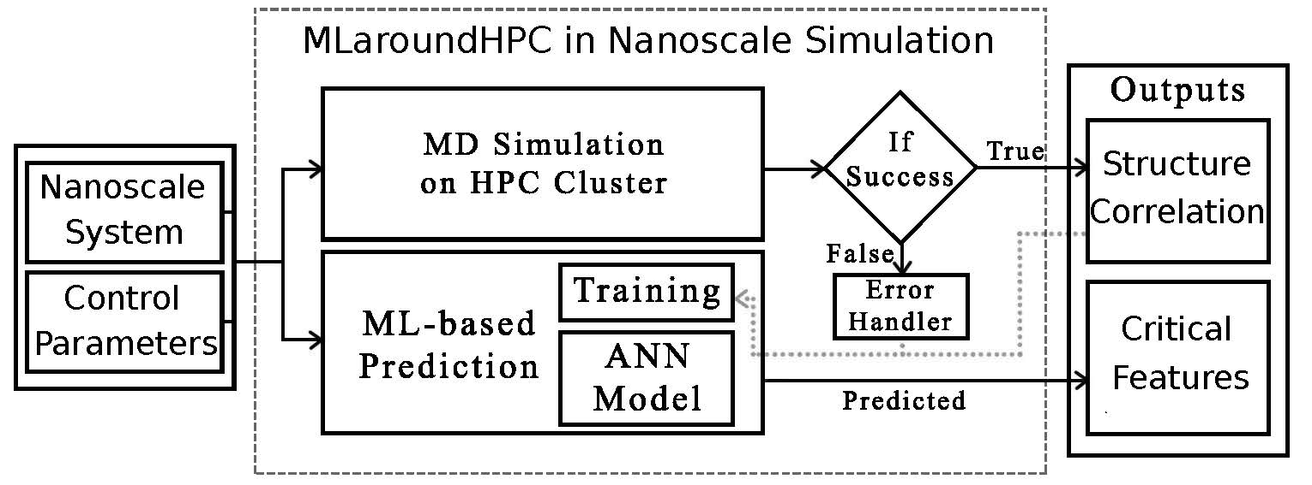
MLaroundHPC: Machine learning for performance enhancement with Surrogates of molecular dynamics simulations
Employed to extract the ionic structure in electrolyte solutions confined by planar and spherical surfaces.
Written with C++ and accelerated with hybrid MPI-OpenMP.
MLaroundHPC successfully learns desired features associated with the output ionic density that are in excellent agreement with the results from explicit molecular dynamics simulations.
Speed up 10⁵
ML-Based Simulation Prediction
ANN Model
Training
Inference

Slide 27
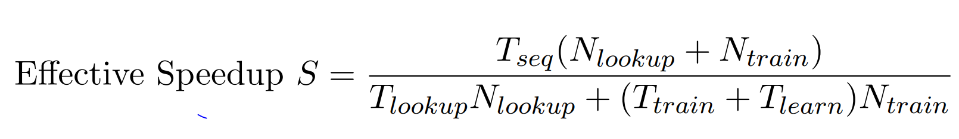
Speedup of MLaroundHPC
T_{seq} is sequential time
T_{train} time for a (parallel) simulation used in training ML
T_{learn} is time per point to run machine learning
T_{lookup} is time to run inference per instance
N_{train} number of training samples
N_{lookup} number of results looked up
Becomes T_{seq}/T_{train} if ML not used
Becomes T_{seq}/T_{lookup} (10⁵ faster in our case) if inference dominates (will overcome end of Moore’s law and win the race to zettascale)
Another factor as inferences uses one core; parallel simulation 128 cores
Strong scaling as no need to parallelize on more than effective number of nodes
N_{train} is 7K to 16K in our work

Slide 28
Improving Simulation with Configurations and Integration of Data
MLAutoTuningHPC: Learning Configurations
This is classic Autotuning and one optimizes some mix of performance and quality of results with the learning network inputting the configuration parameters of the computation.
This includes initial values and also dynamic choices such as block sizes for cache use, variable step sizes in space and time.
It can also include discrete choices as to the type of solver to be used.

Slide 29
Improving Simulation with Configurations and Integration of Data MLaroundHPC: Learning Model Details (ML for Data Assimilation)
a) Learning Agent Behavior One has a a set of cells as agents modeling a virtual tissue and use ML to learn both parameters and dynamics of cells replacing detailed computations by ML surrogates. As there can be millions to billions of such agents the performance gain can be huge as each agent uses same learned model.
b) Predictor-Corrector approach Take the case where data is a video or high dimensional (spatial extent) time series. Now one time steps models and at each step optimize the parameters to minimize divergence between simulation and ground truth data. E.g. produce a generic model organism such as an embryo. Take this generic model as a template and learn the different adjustments for particular individual organisms.
Current state of the art expresses spatial structure as a convolutional neural net and time dependence as recurrent neural net (LSTM)

Slide 30
Learn Structure, Theory and Model for Simulation
MLAutoTuningHPC: Smart Ensembles
Here we choose the best set of collective coordinates to achieve some computation goal
Such as exploring special states – proteins are folding
Or providing the most efficient training set with defining parameters spread well over the relevant phase space.
Closely related to use of machine learning to find effective potentials and interaction graphs

Slide 31
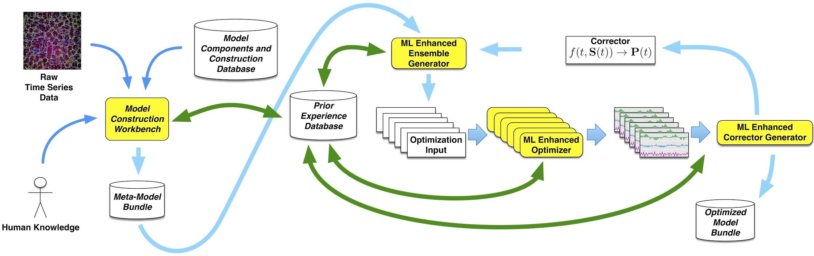
Putting it all Together
Simulating Biological Organisms (with James Glazier @IU)
Learning Model (Agent) Behavior
Replace components by learned surrogates
(Reaction Kinetics Coupled ODE’s)
All steps use MLAutotuning
Smart Ensembles
Predictor-Corrector

Slide 32
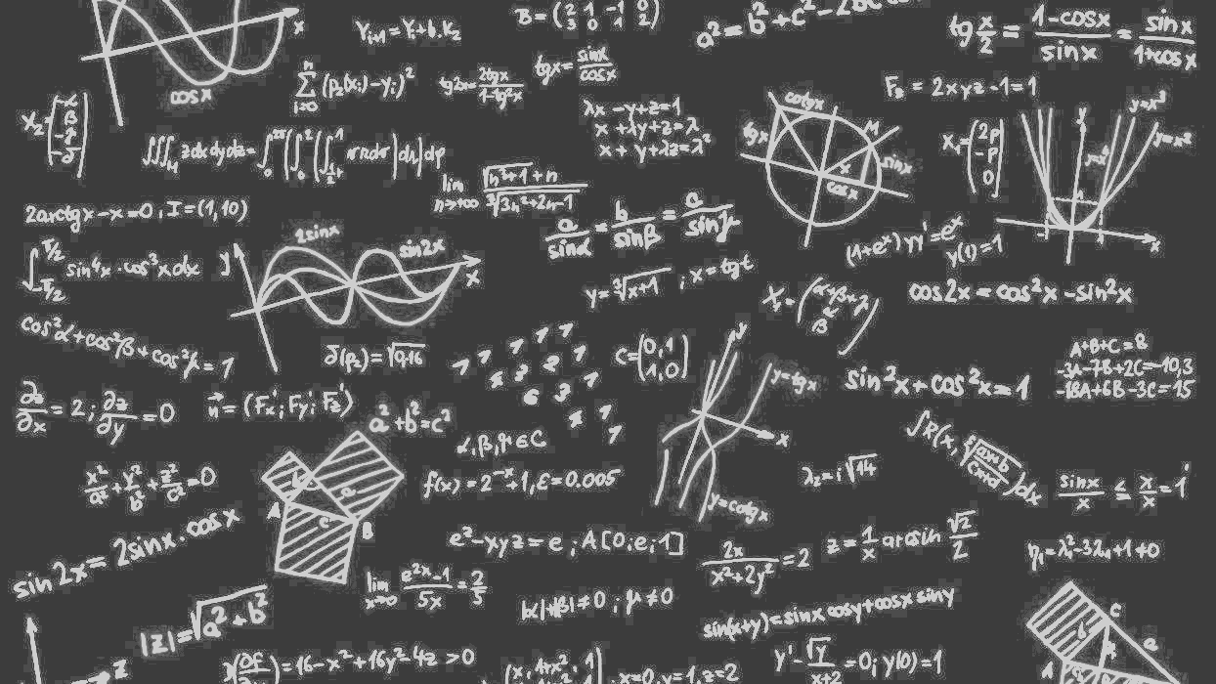
Challenges and Opportunities
Computer Science Issues

Slide 33
Computer Science Issues I
Hundreds of Ph. D. theses!
What computations can be assisted by what ML in which of 9 scenarios
  What is performance of different DL (ML) choices in compute time and capability
  What can we do with zettascale computing?
Redesign all algorithms so they can be ML-assisted
Dynamic interplay (of data and control) between simulations and ML seems likely but not clear at present
There ought to be important analogies between time series and this area (as simulations are 4D time series?)
  Exploit MLPerf examples?

Slide 34
Computer Science Issues II
Little study of best ANN structure especially for hardest cases such as “predict fields from fields” and ML assisted data assimilation
  Not known how large training set needs to be.
  Most published data has quite small training sets
I am surprised that there is not a rush to get effective performances on simulations of exascale and zettascale on current machines
Interesting load balancing issues if in parallel case some points learnt using surrogates and some points calculated from scratch
Little or no study of either predicting errors or in fact of getting floating point numbers from deep learning.

Slide 35

Conclusions

Slide 36
Conclusions
HPC is essential (HPCforML) although innovation in classic areas limited
Everybody needs systems
Need to align communities to ensure HPC importance recognized
1
HPC is essential for the future of the world
  Everybody needs systems
  Need to align communities
2
Good to work closely with industry
Student Internships, Collaborations such as Contributions to MLPerf
Global AI and Modeling Supercomputer GAIMSC good framework with HPC Cloud linked to HPC Edge
Training on cloud; Inference and some training on the edge
3
HPCforML well established but MLforHPC even more promising where we could aim at
First Zettascale effective performance in next 2 years
Hardware/Software aimed at general ML assisted speedup of computation
Your health can be engineered with ML-assisted personalized nanodevices designed based on the ML-assisted digital twin of disease in your tissues
4

