Slide 1
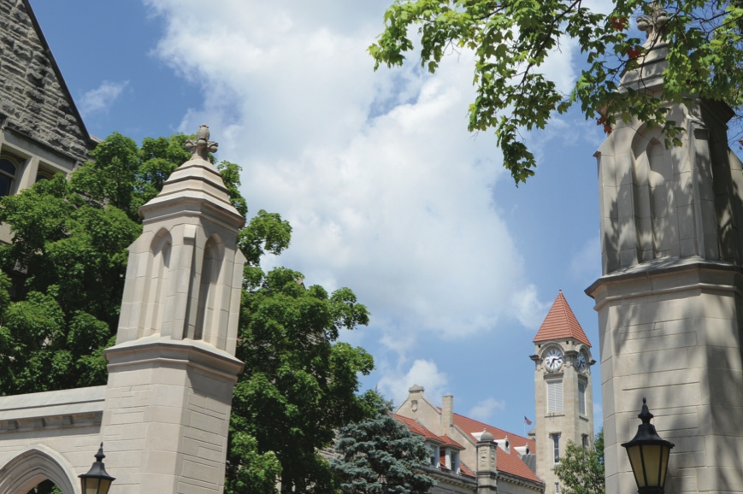
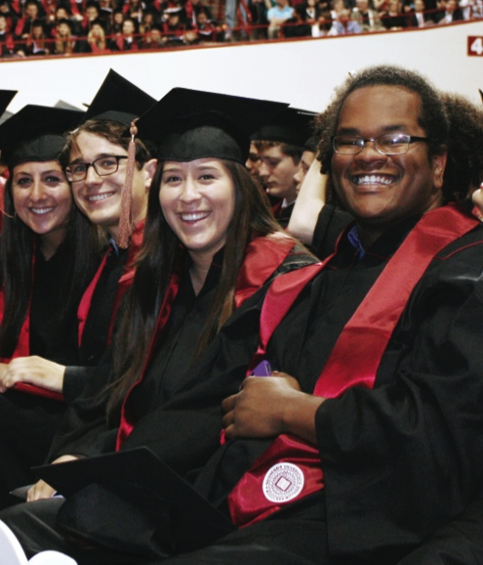
Indiana University School of Informatics, Computing and Engineering ISE: Intelligent Systems Engineering

Slide 2
What is Intelligent Systems Engineering?
The practice of system design and build with computing and artificial intelligence as key components
We can parse name in two ways ……
Intelligent Systems Engineering – sense their environment and act accordingly – and use machine learning, artificial intelligence with edge (small devices) and cloud computing
Intelligent Systems Engineering – design of systems that are the complex interrelation of many elements

Slide 3
What is Intelligent Systems Engineering?
We define “Intelligent Systems” as purpose-engineered systems
from the raw hardware and embedded systems,
through data acquisition and signal processing
to the transformation of data into decisions and/or knowledge.
Creating a new program ab initio offers us the opportunity to focus on a modern set of engineering topics:
those that involve intelligent systems
as realized with embedded, customizable computing components
combined with sophisticated data interpretation
This program will train students in the practical engineering of systems with an emphasis on hands-on designing, simulating (“digital twin”) and building systems. Graduates prepared with this core set of workforce-aligned skills will be in high demand for careers.

Slide 4
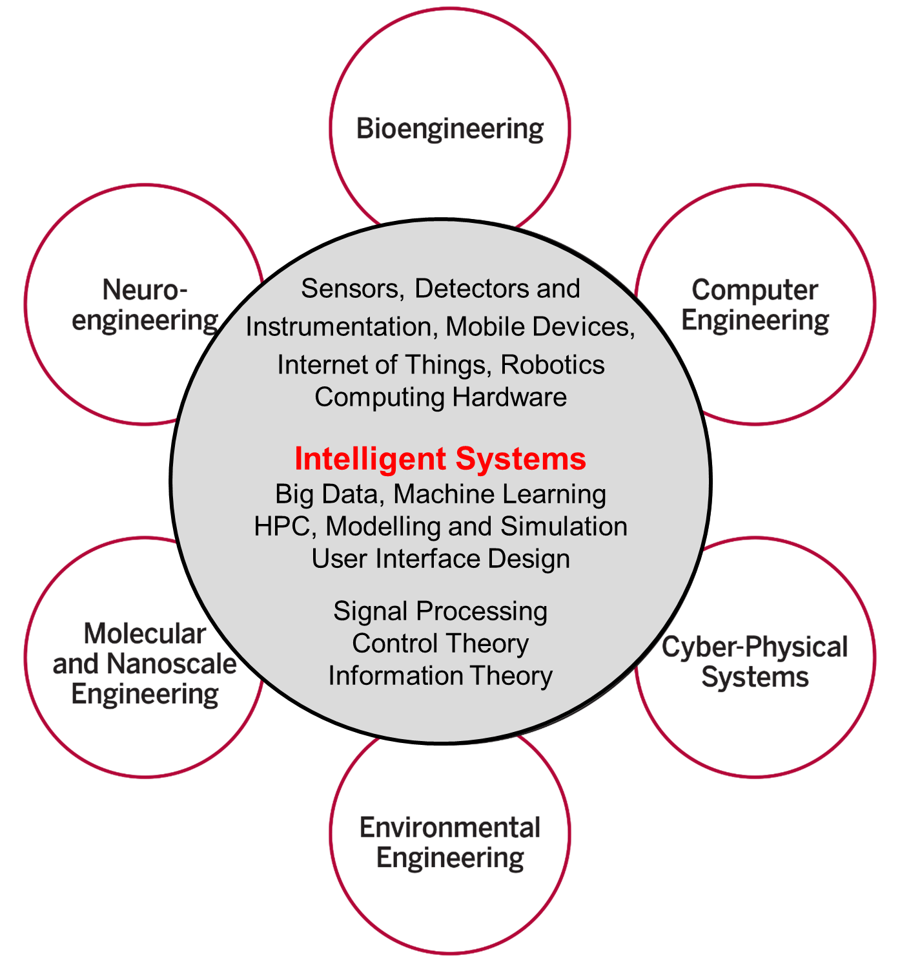
Intelligent Systems Engineering Structure

Slide 5
What is Intelligent Systems Engineering?
From the small to the large
Edge Computing: Embedded Systems and Nanoscale Sensors – computing and sensing will be ubiquitous as we move toward smart homes, smart cities and smart transportation, with computing and intelligent systems helping us lead healthier lives
Cloud and High-Performance computing – behind all of these edge devices are massive systems that analyze and manage the floods of data that are being produced
They also allow modeling and simulation of the engineered systems
All students have courses on edge, cloud, HPC systems, machine learning and modelling and simulation

Slide 6
Computing-based Systems Engineering
Integration of customized systems rather than traditional software and servers
FPGAs
Customizable hardware logic
Significant interest in the financial sector, large scale data centers
Microcontrollers
Industrial automation
Smart devices
Accelerators
GPGPUs
Intel Xeon Phi

Slide 7
Intelligent Systems ~ Artificial Intelligence ~ Machine Learning
2017 Headlines
The Race For AI: Google, Twitter, Intel, Apple In A Rush To Grab Artificial Intelligence Startups
Google, Facebook, And Microsoft Are Remaking Themselves Around AI
Google: The Full Stack AI Company
Bezos Says Artificial Intelligence to Fuel Amazon's Success
Microsoft CEO says artificial intelligence is the 'ultimate breakthrough'
Tesla’s New AI Guru Could Help Its Cars Teach Themselves
Netflix Is Using AI to Conquer the World... and Bandwidth Issues
How Google Is Remaking Itself As A “Machine Learning First” Company
If You Love Machine Learning, You Should Check Out General Electric
The trouble for all of these companies is that finding the talent needed to drive all this AI work can be difficult. (That is where ISE comes in!)
Notes:
until ISE came along

Slide 8
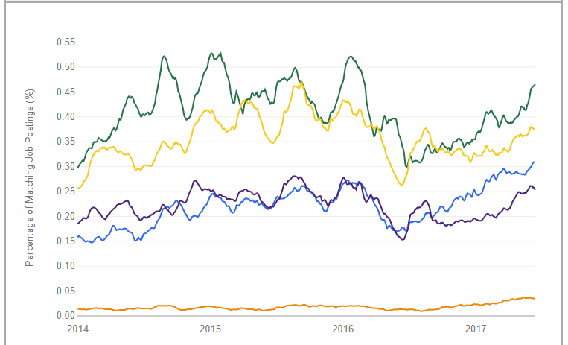
And from indeed.com the jobs are for
Big Data Engineer
Data Scientist
Machine Learning Engineer
Computer Scientist
Artificial Intelligence Engineer

Slide 9
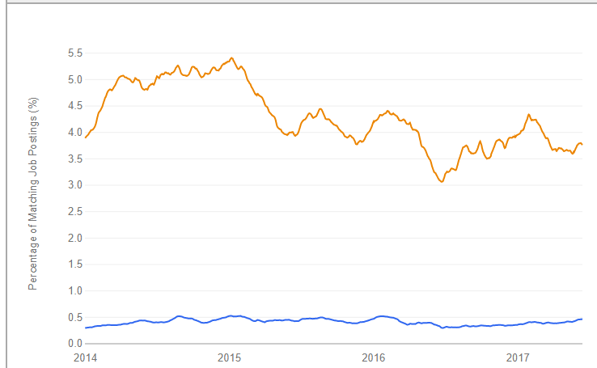
And Computer Engineering is in great demand (scale changed by a factor of 10)
https://www.indeed.com/jobtrends/q-big-data-engineer-q-computer-engineer.html
Computer Engineer
Big Data Engineer

Slide 10
Intelligent Systems Engineering Areas of Study
Undergraduate and Graduate
Computer engineering
Cyber-physical systems
Bioengineering
Nano-engineering
Graduate (Masters, PhD) Only
Environmental engineering
Neuro-engineering
Intelligent systems (base ISE degree)

Slide 11
B.S. in Intelligent Systems Engineering
Computer Engineering CE is about building computing systems of various scales or building an internet-of-things device. It relates to hardware and low-level software, e.g., drivers. Within CE, students can mix and match courses to tailor the program toward building Big Data or Deep Learning analysis systems (and go to work for Google) or High-performance computing systems (and go to work for an oil company modeling oil fields or a car company simulating aerodynamics). Students could also focus on the engineering of specialized computing devices for use in manufacturing or finance.
Cyber-physical Systems CPS focuses on systems that interact with the physical work directly in some way. CPS is about the entire system including high-level software. Since it is cyber physical, it usually emphasizes small devices. This includes Robotics as well as sensor-rich environments like Smart Homes, Smart Cars and Smart Cities. In all of these cases, the Intelligence comes from computing devices. This track could also focus on bio-sensors.

Slide 12
B.S. in Intelligent Systems Engineering
Bioengineering builds on existing IU Bloomington strengths combining life sciences, computing, and engineering practices to solve problems spanning biology, medicine, environmental remediation, and more. Graduates will be well-equipped for careers in medical devices, wearables, drug development, tissue engineering, environmental engineering, toxicology and related policy work, or advanced academic degrees.
Nano-engineering integrates electrical and materials engineering to prepare students to work with cyber-physical systems or other responsive intelligent systems that include nanoscale building blocks. Modeling and simulation of nanosystems is an integral part of curriculum. Students will take courses that train them in both experimental and computational aspects of nanoengineering. Students can pursue their interest in sensing technologies, energy devices, nanomedicine, materials discovery through Research and/or electives.

Slide 13
Our Curriculum and Approach
Our core philosophy is that students should learn, apply and contextualize
Hands-on building from the beginning; building facilitates contextualization
Science observes the world and derives principles; engineering applies those principles to create
All of our specializations require a fundamental understanding of computing
Whether designing nano-sensors or high-performance image processing pipelines, a solid understanding of how computers work is essential
Thus, we begin with computing early in the program

Slide 14
Structure of ISE Undergraduate Degree
Total 120 credits of which 69 are Engineering
University General Education: 21 credits
University Math and Science: 30 credits
Intelligent Systems Engineering core taken by all tracks: 30 credits
CE/CPS core taken in CE and CPS: 15 credits
CE Track: 18 Credits
CPS Track: 18 Credits
Engineering Electives: 6 Credits
Bio/Nano differ first in semester 4 with advanced Chemistry course
There are separate ISE Nano and ISE Bio cores of 15 credits in third year
There are separate Nano and Bio tracks of 18 credits in third and fourth year

Slide 15
Typical Degree Map - CE
Eng Innovation and Design (E101)
Eng Computer Architectures (E110)
Computer Systems Engineering (E201)
Eng Cyber-Physical Systems (E210)
English Comp
Software Systems Engineering (E111)
Intelligent Systems Engineering I (211)
Intelligent Systems Engineering II (E222)
Calculus I
Calculus II
Professionalization and Ethics (E299 & E395)
Signal Processing (E250)
Physics I
Physics II
Statistics
Differential Eqn
Science Elective
Arts&Humanities
Digital Design with FPGA’s (E315)
Intro to Modeling and Simuation(E332)
Eng Capstone Design (E490)
Eng Capstone Design (E491)
Advanced Eng Mathematics (E331)
Circuits and Digital Systems (E311)
Operating Systems (E316)
Cloud Computing Eng (E416)
Modern Computer Arch (E312)
High Performance Computing (E317)
Network Eng (E318)
Deep Learning (E433)
Math/Sci Elective
Engr Elective
Engr Elective
Sci&Humanities
Language/Culture
Language/Culture
Sci&Humanities
Arts&Humanities

Slide 16
Typical Degree Map - CPS
Eng Innovation and Design (E101)
Eng Computer Architectures (E110)
Computer Systems Engineering (E201)
Eng Cyber-Physical Systems (E210)
English Comp
Software Systems Engineering (E111)
Intelligent Systems Engineering I (E211)
Intelligent Systems Engineering II (E222)
Calculus I
Calculus II
Professionalization and Ethics (E299 & E395)
Signal Processing (E250)
Physics I
Physics II
Statistics
Differential Eqn
Science Elective
Arts&Humanities
Digital Design with FPGA’s (E315)
Intro to Modeling and Simuation(E332)
Eng Capstone Design (490)
Eng Capstone Design (491)
Advanced Eng Mathematics (E331)
Circuits and Digital Systems (E311)
Robotics 2 (E326)
Automatic Fab Mach (E327)
Advanced Cyber-Physical Sys (E312)
Robotics 1 (E325)
Internet of Things (E323)
Smart Envments (E324)
Math/Sci Elective
Engr Elective
Engr Elective
Sci&Humanities
Language/Culture
Language/Culture
Sci&Humanities
Arts&Humanities

Slide 17
Typical Degree Map - Bioengineering
Eng Innovation and Design (101)
Eng Computer Architectures (110)
Computer Systems Engineering (201)
Eng Cyber-Physical Systems (210)
English Comp
Software Systems Engineering (111)
Intelligent Systems Engineering I (211)
Signal Processing (250)
Calculus I
Calculus II
Professionalization and Ethics (299 & 395)
Chem I (C117) without lab
Physics I
Physics II
Statistics
Differential Eqn (M343)
Bio I (BIOL-L 112)
Arts&Humanities
Advanced Engy Mathematics (E331)
Intro to Modeling and Simuation(E332)
Eng Capstone Design (490)
Eng Capstone Design (491)
Organic Chemistry (C341)
Cell Biology (BIOL-L 312)
Comp Biomaterials (E443)
Comp Tissue Engineering (E444)
Intro Computational Bioengy E341
Biotech Lab (BIOT-T 315)
Biotech Lecture (BIOT-T 310)
Wearable Devices (E424)
Molecular Bio (BIOL-L211)
Engr Elective
Engr Elective
Sci&Humanities
Language/Culture
Language/Culture
Sci&Humanities
Arts&Humanities

Slide 18
Typical Degree Map - Nanoengineering
Eng Innovation and Design (101)
Eng Computer Architectures (110)
Computer Systems Engineering (201)
Eng Cyber-Physical Systems (210)
English Comp
Software Systems Engineering (111)
Intelligent Systems Engineering I (211)
Signal Processing (250)
Calculus I
Calculus II
Professionalization and Ethics (299 & 395)
Chem I (C117) without lab
Physics I
Physics II
Statistics
Differential Eqn (M343)
Bio I (BIOL-L 112)
Arts&Humanities
Advanced Engy Mathematics (E331)
Intro to Modeling and Simuation(E332)
Eng Capstone Design (490)
Eng Capstone Design (491)
Physics III (Phys P301)
Electricity and Mag (Phys P)
Surface Chemistry (CHEM C416)
Advanced Cyber-Physical Sys (E321)
Physical Chemistry (CHEM C361)
Nanoscale Simulation (Exxx)
Engineering Nano Sensors (Exxx)
Soft Nanodevices (Exxx)
Nanoscale Materials (CHEM 420)
Engr Elective
Engr Elective
Sci&Humanities
Language/Culture
Language/Culture
Sci&Humanities
Arts&Humanities

Slide 19
Accreditation and Funding Opportunities
Accreditation Information
The curriculum has been designed to meet the ABET requirements.
SICE can apply for accreditation after the first graduating class, which means that the first cohort of graduates’ degrees will be accredited.
SICE will seek retroactive accreditation
The B.S. in Intelligent Systems Engineering is a degree from Indiana University; it is an accredited degree
IU holds North Central Association accreditation
Scholarship Information
IU/SICE/ISE
Other Funding Opportunities
Summer Camps
Summer and Academic Year Research

Slide 20
ISE PhD Program
7 Tracks
43 students Fall 2017
22 CE; 8 CPS; 3 ISE (Intelligent Systems); 5 Bio; 1 Nano; 3 Neuro; 1 Environmental
Degree requires a total of 90 Credits
9 credits minor inside or outside ISE
24 credits major in Engineering
3 credit E500 Introduction to ISE
3 credits introduction to track E501-507
9 credits major
9 other engineering credits
Qualifying exam customized by committee and could involve writing a quality professional paper and an oral exam

Slide 21
ISE Masters of Science Program
Just fully approved. Will have a small Spring 2018 cohort and full launch Fall 2018.
30 Credits in Traditional or Accelerated mode
Accelerated Masters (4+1) shares 12 credits of graduate courses between both Bachelor’s and Master’s plans of study
4 Paradigms: one of coursework, internship, project and research (typically for students aiming at PhD) chosen by students.
The last 3 involving 6-9 credits of internship, Project work or Research
All students must take 15 credits of graduate level ISE courses
There is general core (E500-507), computing core, math methods core (can place out) and a core for each track. Track core is 2 courses (6 credits)
Remaining credits are electives

Slide 22
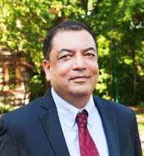
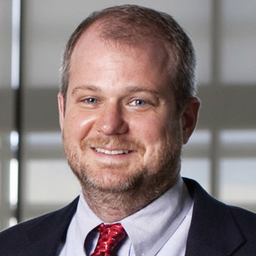
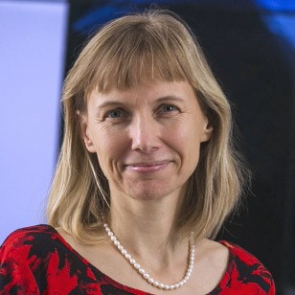
ISE Senior Faculty
Raj Acharya, CE, Intelligent Systems: Dean of the School of Informatics, Computing and Engineering, Rudy Professor of Engineering, Computer Science and Informatics
Geoffrey Fox; Chair, CPS, Intelligent Systems: IU distinguished professor, Data Analytics, Parallel computing, Physics.
Martin Swany; Associate Chair, CE, CPS: Network Systems, Embedded Systems, High-Performance Computing, Data Management
Katy Borner, Intelligent Systems: IU distinguished professor, data analysis and visualization, particularly in the areas of science and technology studies.

Slide 23
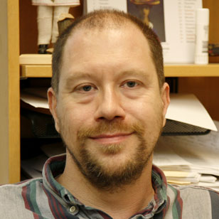
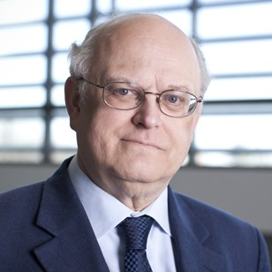
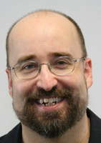
ISE Senior Faculty
James Glazier; Bio-engineering: Biocomplexity, Virtual Tissue, toxicity.
Judy Qiu; CE, Intelligent Systems: Big Data, Cloud and Parallel Computing.
Thomas Sterling; CE, CPS: Electrical Engineering, Extreme Scale high performance hardware/software
Clint Whaley CE; HPC Software systems, Performance Engy; Assoc Tenured LSU, Asst. Prof UTSA, PhD CS FSU 2004; MS and Researcher CS UTK, BS Math Oklahoma.

Slide 24
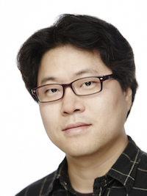
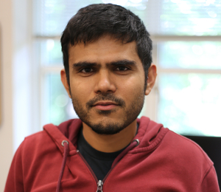
ISE Faculty joining Fall 2016
Lei Jiang, CE: HPC hardware studies: undergraduate Computer science, masters and PhD (Pittsburgh) in Computer Engineering; industry work with AMD as Senior Design Engineer.
Minje Kim, Intelligent Systems: signal processing & machine learning in multimedia area; Undergraduate and Masters in computer engineering; PhD (UIUC) in Computer Science.
Vikram Jadhao, Nanoengineering: using HPC simulation; Physics degrees (UIUC PhD); Postdocs in Department of Materials Science and Engineering at Northwestern, Physics at JHU
Alexander Gumennik, Nanoengineering; Intelligent fibers and 3D printing; Physics and Math Undergraduate, Applied Physics Masters and PhD (Hebrew University), Postdoc in MIT's Department of Materials Science and Engineering, Industry Process Engineer in 3D printing startup

Slide 25
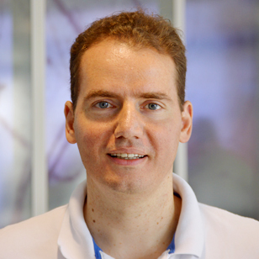
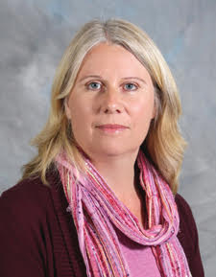
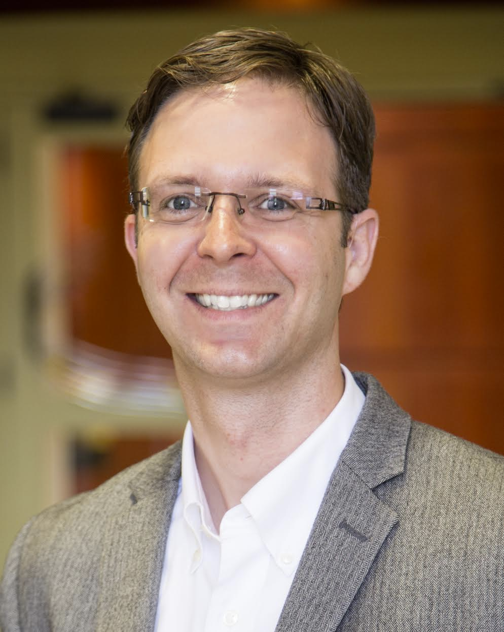
ISE Faculty joining 2016-2017
Eleftherios Garyfallidis, Neuroengineering: with software lab for MRI imaging; Undergraduate degree in Computer Science; Masters in Brain & Mind Sciences, PhD in Cognition and Brain Sciences (Neuroscience Cambridge)
Maria Bondesson-Bolin, Bioengineering: Systems biology and computational toxicology and experimental imaging analysis; Undergraduate degree in biology, PhD and research position in Department of Cell and Molecular Biology Karolinska Institutet, Sweden
Paul Macklin, Bioengineering: Modeling and data analysis for medical applications including cancer; Undergraduate degree in Mathematics, Graduate degrees in Industrial, Computational and Applied Mathematics (PhD, UC Irvine)

Slide 26
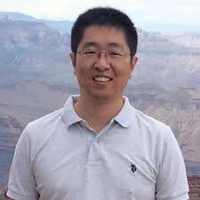
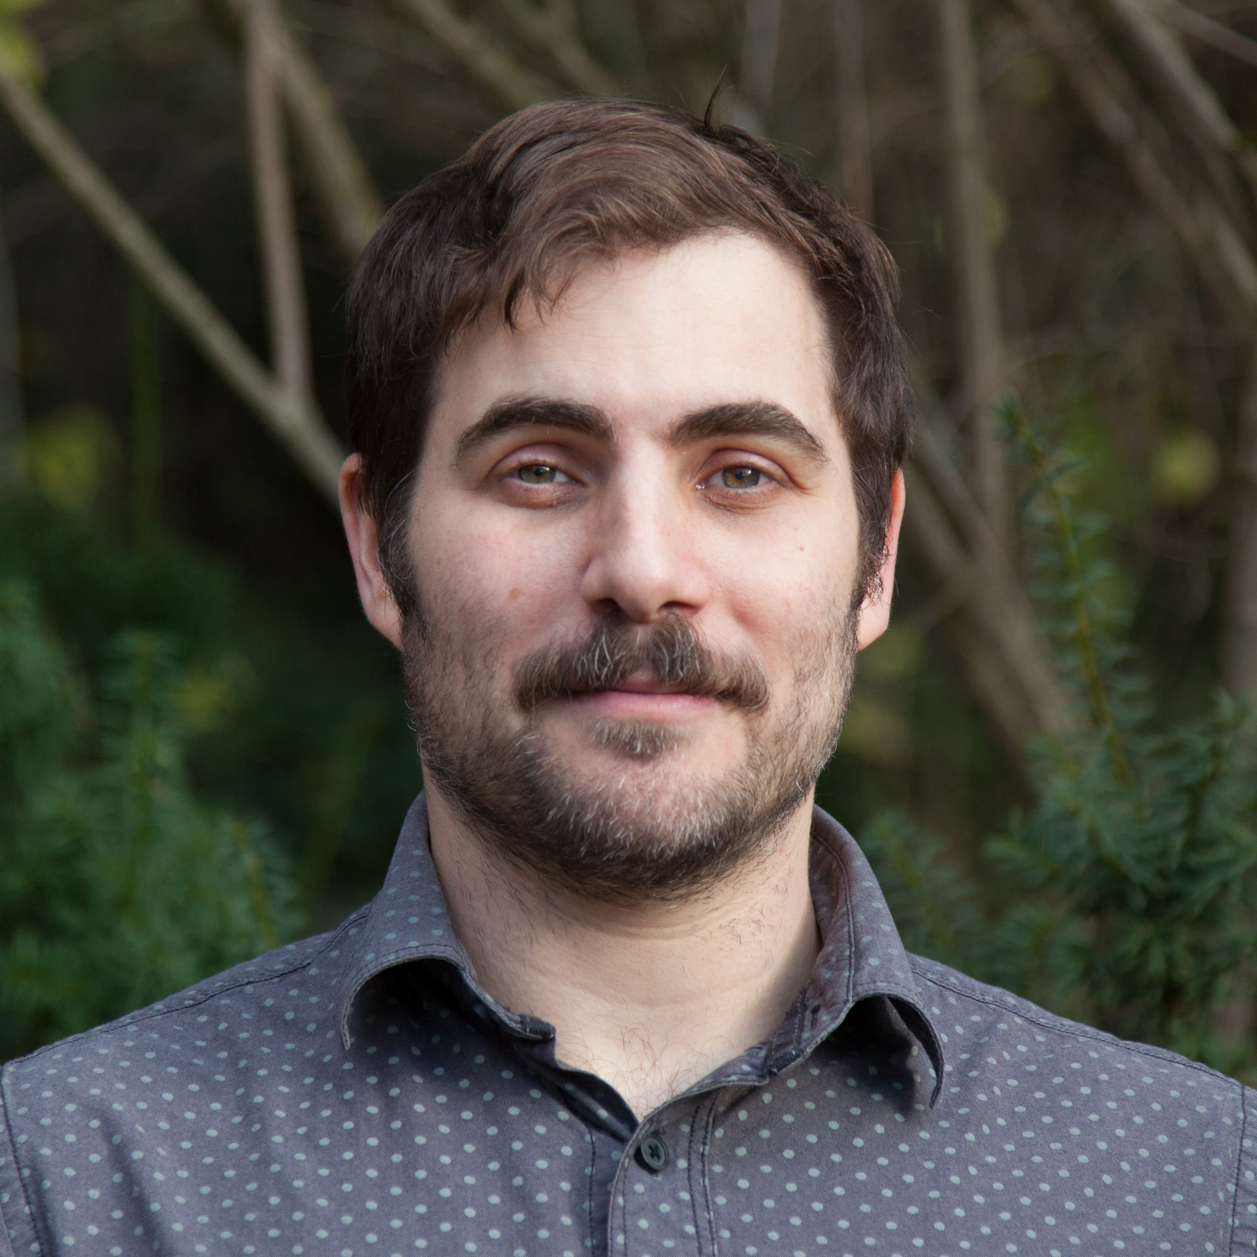
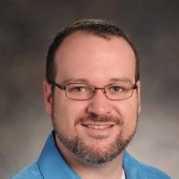
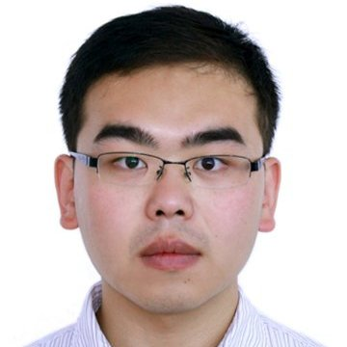
ISE Faculty joining 2017-2018
Lantao Liu; CPS, Env: Planning, decision-making, and machine learning methods for autonomous robots; Postdoc USC and CMU Robotics. PhD CS&Eng Texas A&M. BS Control China.
Eatai Roth; Neuro, CPS: Animal-robot flight analogies. reverse engineers intelligent (living) systems with a focus on cyber-physical interactions; Postdoc Seattle, PhD Mech Engy, BS Mech Engy Pitt, BS Fine Arts Wash U St. Louis 2001.
Greg Lewis; Bio, CPS: Wearables, work with Kinsey Institute; Asst. Prof. Psychiatry UNC-Chapel Hill, PhD University of Illinois Chicago, B.A., Psychology UNC-Chapel Hill.
Feng Guo; Bio, Nano: Acoustic tweezers. biomedical devices, and instruments for apps ranging from Single Cell Analysis and Prenatal Diagnostics to Virology and Neuroscience; Postdoc Stanford, Engineering Science and Mechanics Ph.D. PSU; B.S. Physics, Wuhan 2007. hindex 20.

Slide 27
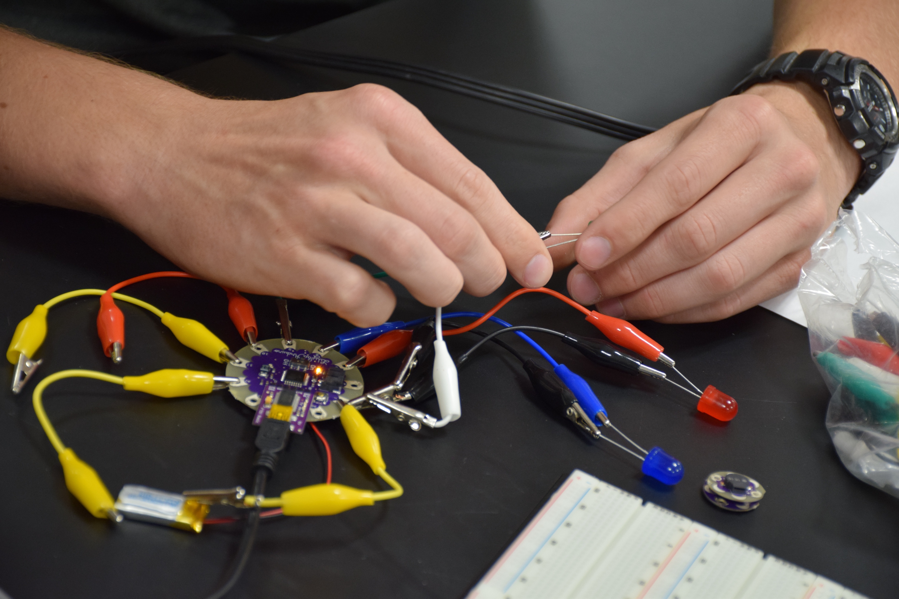
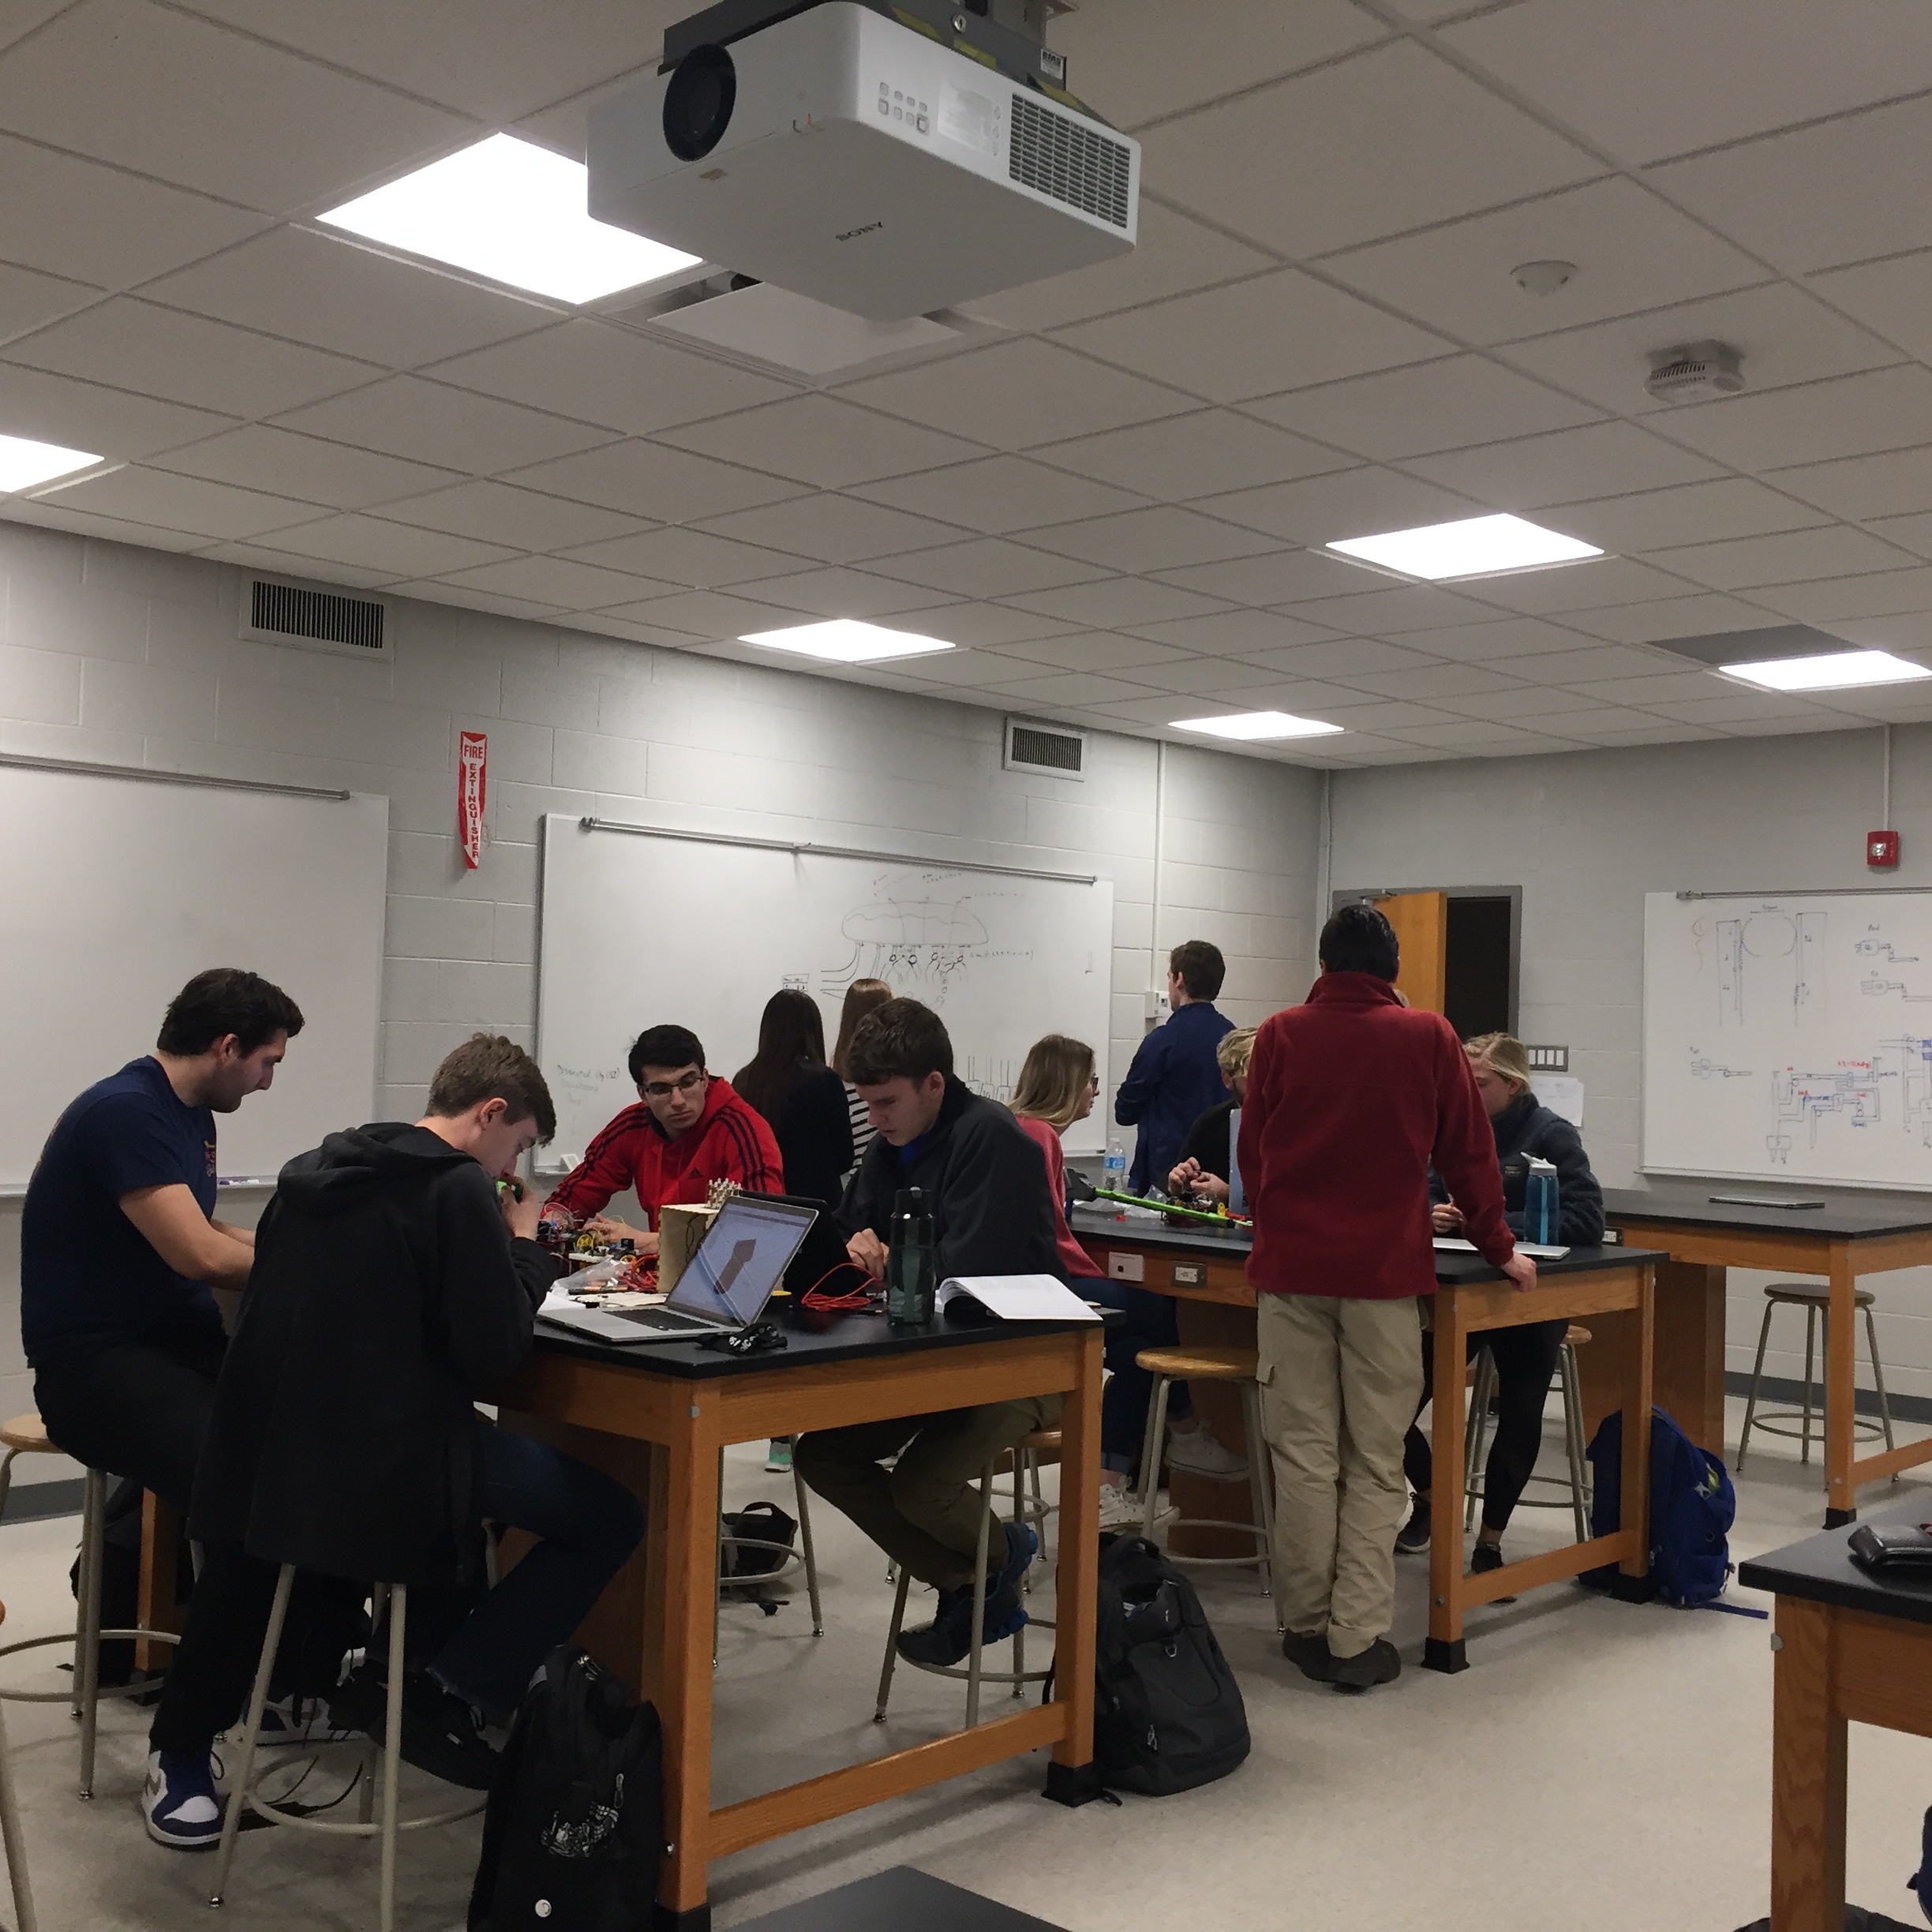
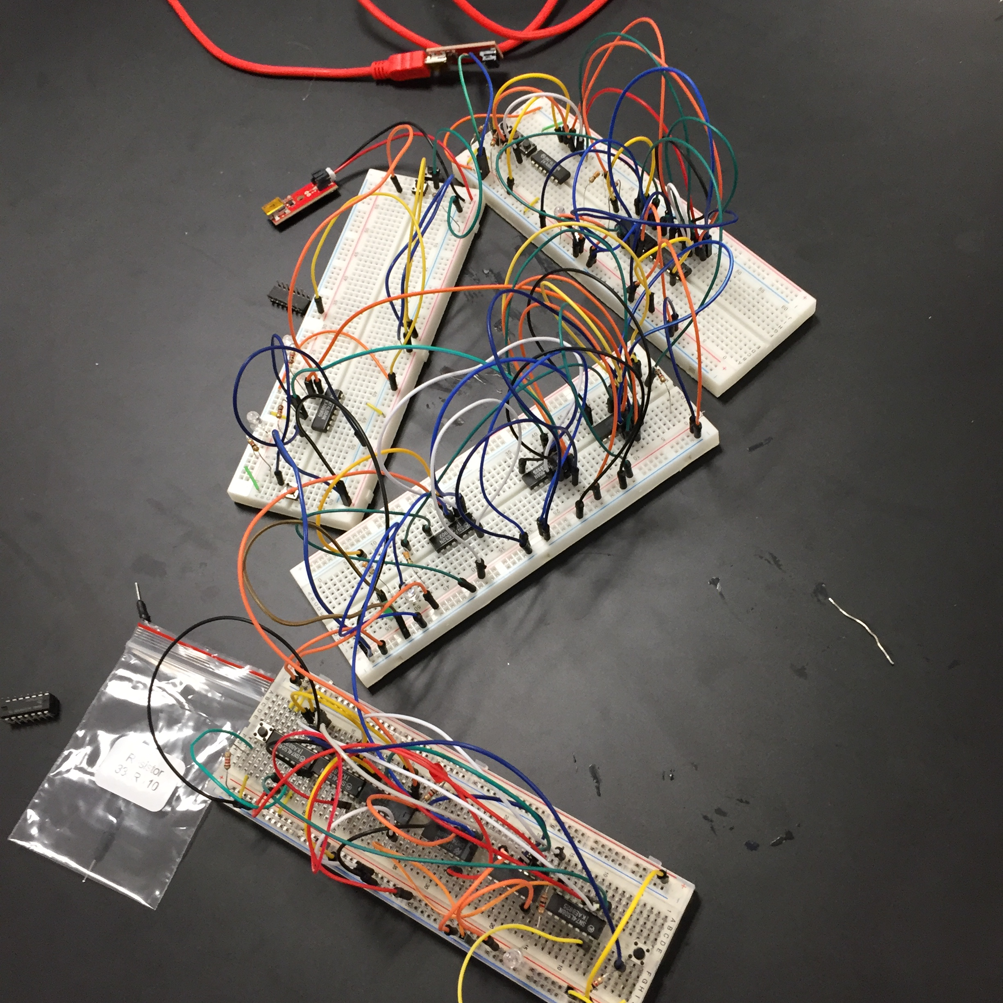
Questions?

