Slide 1
Cloud Technologies and
GeoScience Applications including FutureGrid
International Symposium on Geo-Computation and Analysis
ISGA 2009
Wuhan December 10 2009
Geoffrey Fox
gcf@indiana.edu
http://www.infomall.org http://www.futuregrid.org
Director, Digital Science Center, Pervasive Technology Institute
Associate Dean for Research and Graduate Studies, School of Informatics and Computing
Indiana University Bloomington
Notes:
SALSA is
Service Aggregated Linked Sequential Activities

Slide 2
Important Trends
Data Deluge in all fields of science
  Also throughout life e.g. web!
Multicore implies parallel computing important again
  Performance from extra cores – not extra clock speed
Clouds – new commercially supported data center model replacing compute grids

Slide 3
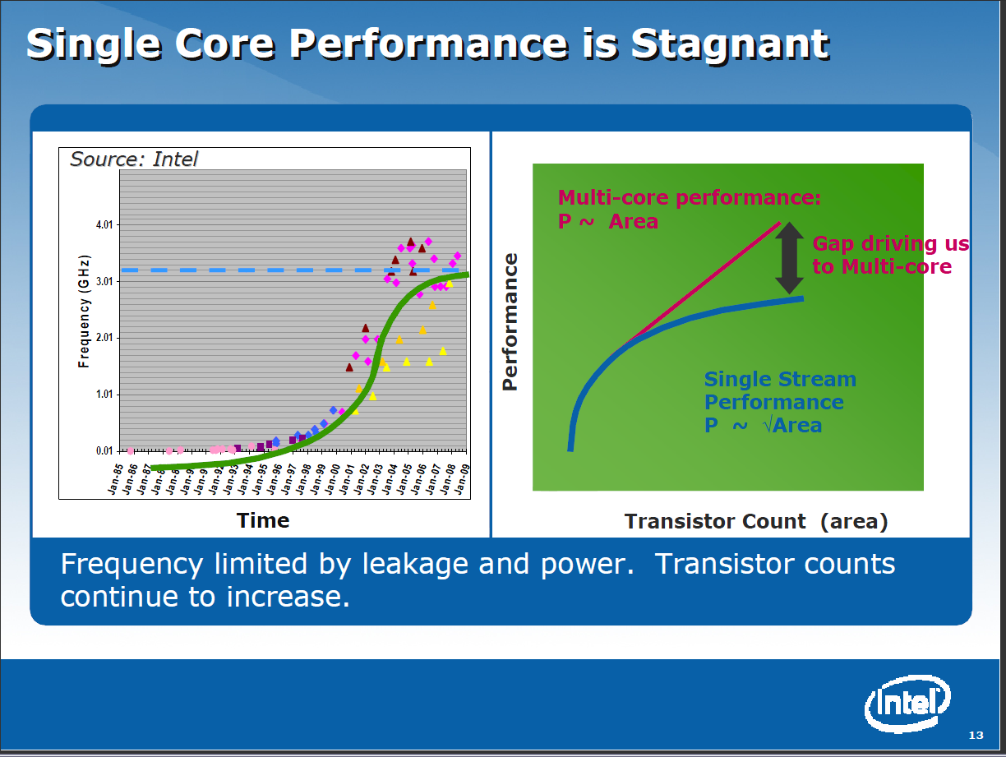

Slide 4


Clouds as Cost Effective Data Centers
Builds giant data centers with 100,000’s of computers; ~ 200
-1000 to a shipping container with Internet access
“Microsoft will cram between 150 and 220 shipping containers filled with data center gear into a new 500,000 square foot Chicago facility. This move marks the most significant, public use of the shipping container systems popularized by the likes of Sun Microsystems and Rackable Systems to date.”

Slide 5

Clouds hide Complexity
SaaS: Software as a Service
IaaS: Infrastructure as a Service or HaaS: Hardware as a Service – get your computer time with a credit card and with a Web interaface
PaaS: Platform as a Service is IaaS plus core software capabilities on which you build SaaS
Cyberinfrastructure is “Research as a Service”
SensaaS is Sensors as a Service
2 Google warehouses of computers on the banks of the Columbia River, in The Dalles, Oregon
Such centers use 20MW-200MW
(Future) each
150 watts per core
Save money from large size, positioning with cheap power and access with Internet

Slide 6
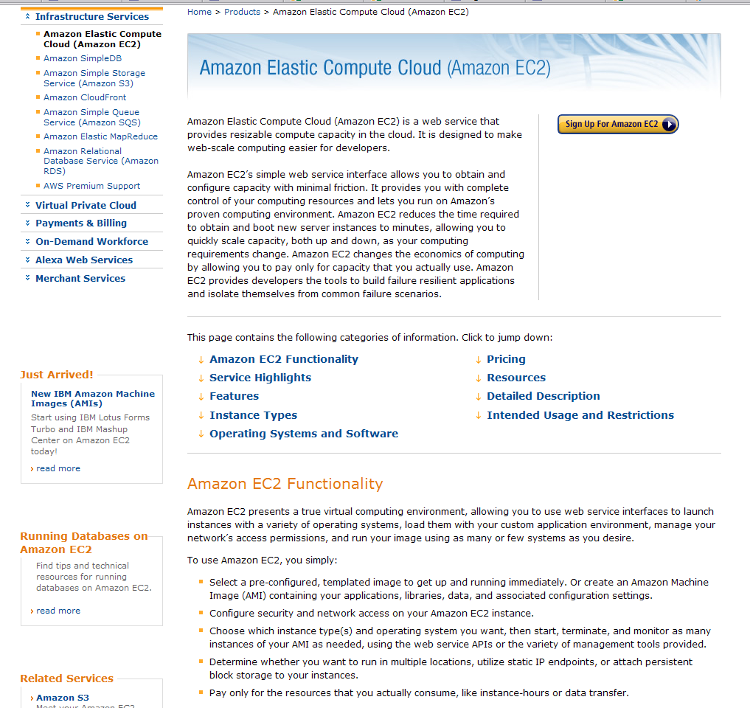

Slide 7
Philosophy of Clouds and Grids
Clouds are (by definition) commercially supported approach to large scale computing
  So we should expect Clouds to replace Compute Grids
  Current Grid technology involves “non-commercial” software solutions which are hard to evolve/sustain
  Maybe Clouds ~4% IT expenditure 2008 growing to 14% in 2012 (IDC Estimate)
Public Clouds are broadly accessible resources like Amazon and Microsoft Azure – powerful but not easy to optimize and perhaps data trust/privacy issues
Private Clouds run similar software and mechanisms but on “your own computers”
Services still are correct architecture with either REST (Web 2.0) or Web Services

Slide 8






MapReduce “File/Data Repository” Parallelism
Map = (data parallel) computation reading and writing data
Reduce = Collective/Consolidation phase e.g. forming multiple global sums as in histogram
Instruments
Iterative MapReduce
Map Map Map Map
Reduce Reduce Reduce
Communication
Reduce
Portals
/Users
Disks
Map₁
Map₂
Map₃

Slide 9
Cloud Computing: Infrastructure and Runtimes
Cloud infrastructure: outsourcing of servers, computing, data, file space, utility computing, etc.
  Handled through Web services that control virtual machine lifecycles.
Cloud runtimes: tools (for using clouds) to do data-parallel computations.
  Apache Hadoop, Google MapReduce, Microsoft Dryad, and others
  Designed for information retrieval but are excellent for a wide range of science data analysis applications
  Can also do much traditional parallel computing for data-mining if extended to support iterative operations
  Not usually on Virtual Machines

Slide 10
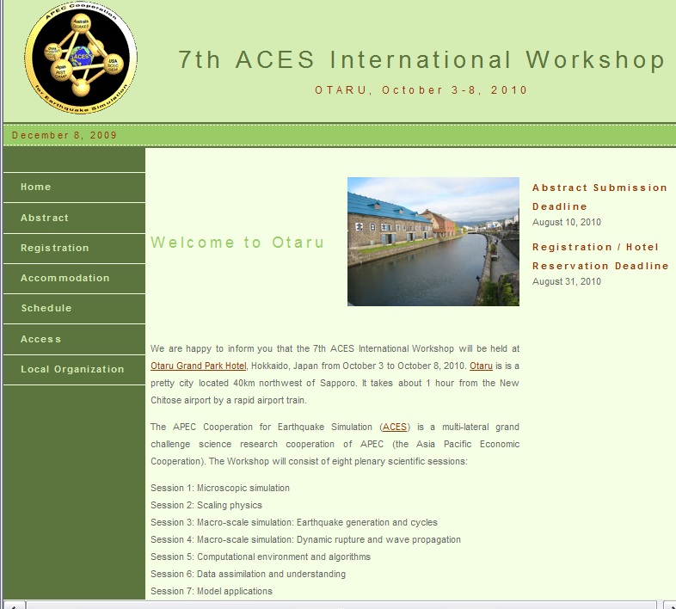
ACES: APEC Cooperation for Earthquake Simulation
ACES is a ten year-old collaboration among scientists interested in earthquake and tsunami predication
  Quakesim is (completed) US Grid that is a prototype of international system thatcan be applied to other Geoscience areas
http://www.quakesim.org
Chartered under APEC –
the Asia Pacific Economic
Cooperation of 21 economies
Collaboration between Australia, China, Japan and USA
Next ACES meeting October 2010

Slide 11
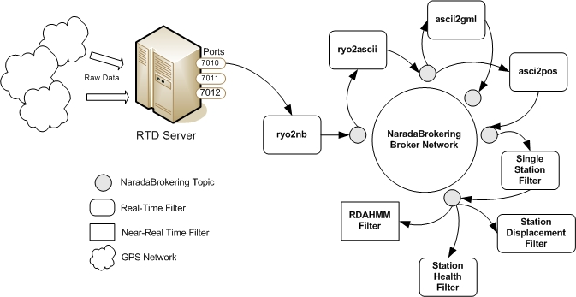
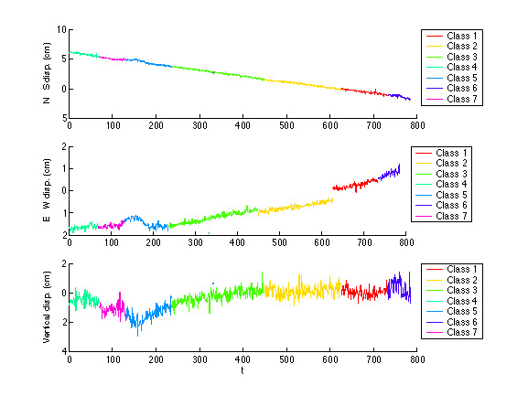
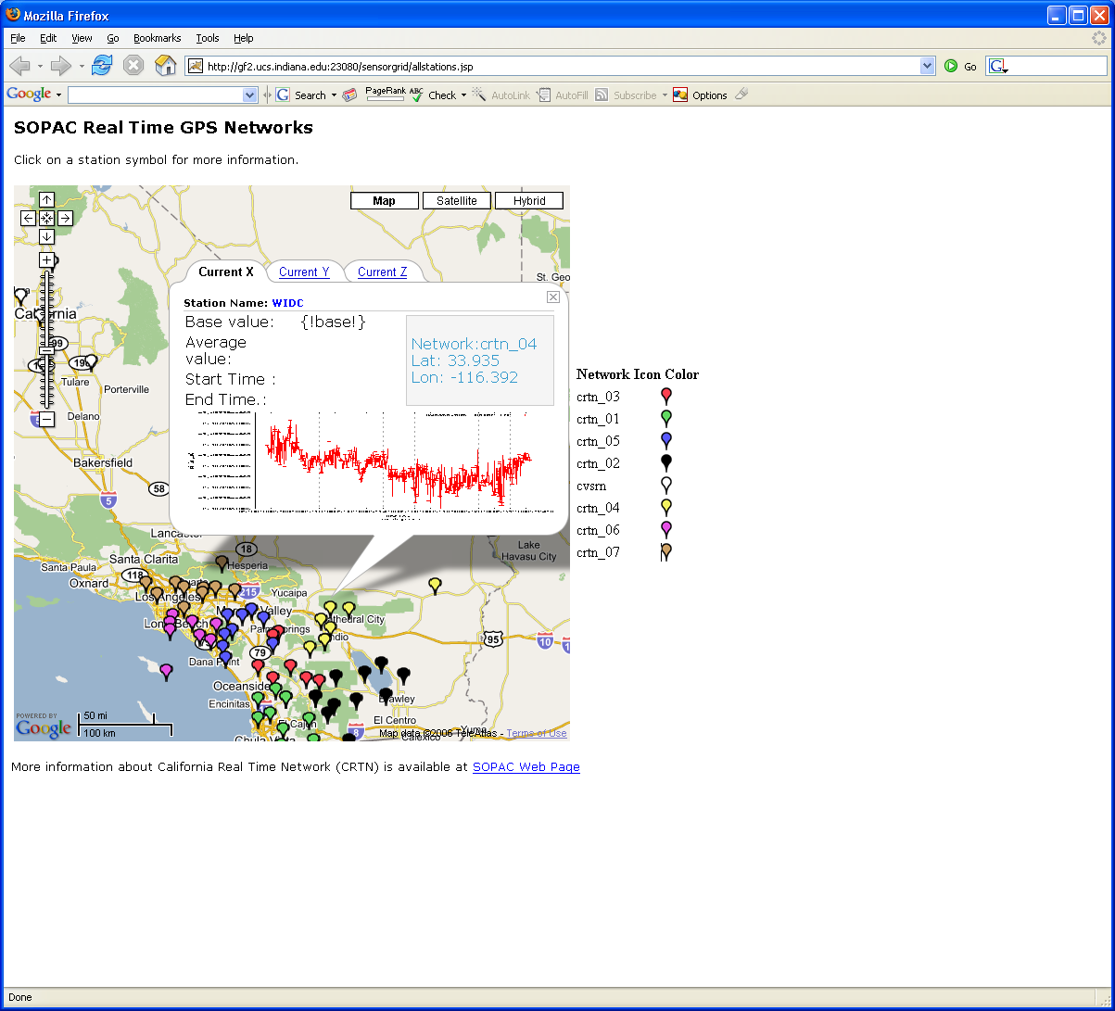
Real-Time GPS Sensor Data-Mining
Services process real time data from ~70 GPS Sensors in Southern California
Brokers and Services on Clouds – no major performance issues
CRTN GPS
Earthquake
Streaming Data
Support
Transformations
Data Checking
Archival
Hidden Markov
Datamining (JPL)
Display (GIS)
Real Time
11
Notes:
11

Slide 12
Processing Real-Time GPS Streams
ascii2gml
ryo2ascii
RYO
Ports
ascii2pos
7010
NB Server
Raw Data
Scripps
RTD
Server
ryo2nb
Single Station
7011
7012
GPS Networks
Displacement Filter
RDAHMM Filter
Station Health
Filter
/SOPAC/GPS/CRTN01/RYO
Raw Data
ryo2nb
ryo2ascii
/SOPAC/GPS/CRTN01/ASCII
ascii2pos
Single Station
RDAHMM Filter
/SOPAC/GPS/CRTN01/POS
Broker and
services in
the cloud
/SOPAC/GPS/CRTN01/DSME
A Complete Sensor Message Processing Path, including a data analysis application.

Slide 13
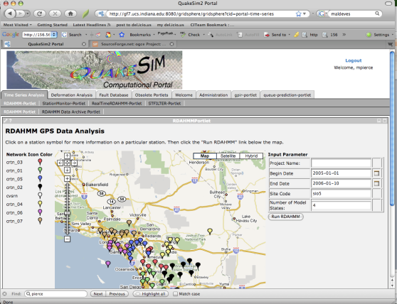
HTTP(S)
Traditional
Web Service
Architecture
Portlets + Client Stubs
SOAP/HTTP
WSDL
WSDL
WSDL
WSDL
WSDL
WSDL
WSDL
WSDL
DB Service
Job Sub/Mon
And File
Services
Visualization
Or Map
Service
JDBC
DB
Operating and
Queuing
Systems
DB,
etc
Host 1 (QT or GRWS)
Host 2 (Comp Grid)
Host 3 (GIS)

Slide 14
Web 2.0
Version
Browser Interface
HTTP(S)
Social Gadgets+AJAX
RSS,JSON/HTTP
REST
REST
REST
REST
REST
REST
WSDL
REST
REST
DB Service
Job Sub/Mon
And File
Services
Visualization
Service
JDBC
DB
Operating and
Queuing
Systems
DB
Host 1
Host 2
Host 3

Slide 15
Lightweight Cyberinfrastructure to support mobile Data gathering expeditions plus classic central resources (as a cloud)

Slide 16
PolarGrid Greenland 2008
Base System (Ilulissat Airborne Radar)
8U, 64 core cluster, 48TB external fibre-channel array
Laptops (one off processing and image manipulation)
2TB MyBook tertiary storage
Total data acquisition 12TB (plus 2 back up copies)
Satellite transceiver available if needed, but used wired network at airport used for sending data back to IU
Base System (NEEM Surface Radar, Remote Deployment)
2U, 8 core system utilizing internal hard drives hot swap for data back up
4.5TB total data acquisition (plus 2 backup copies)
Satellite transceiver used for sending data back to IU
Laptops (one off processing and image manipulation)

Slide 17
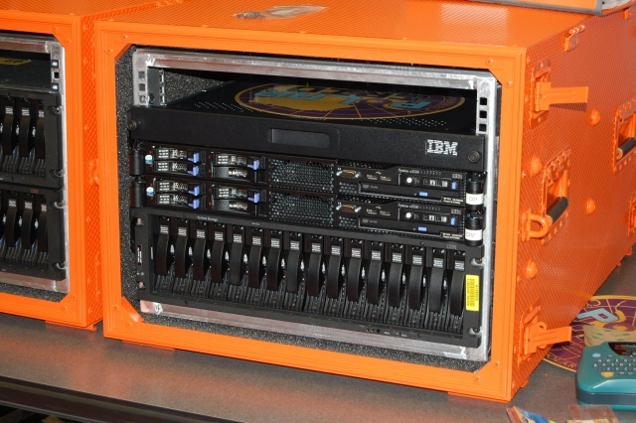
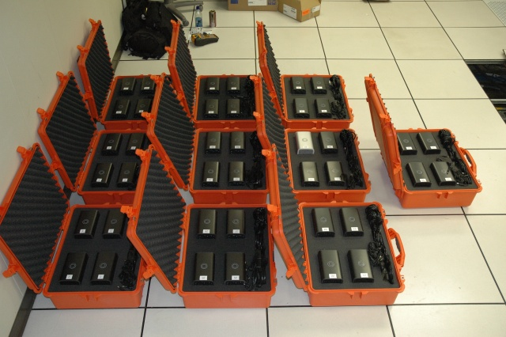
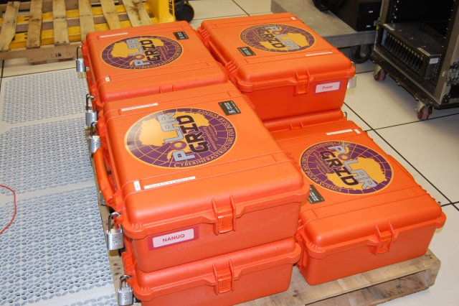
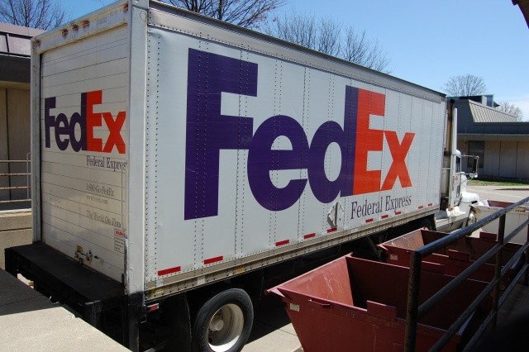
PolarGrid goes to Greenland

Slide 18
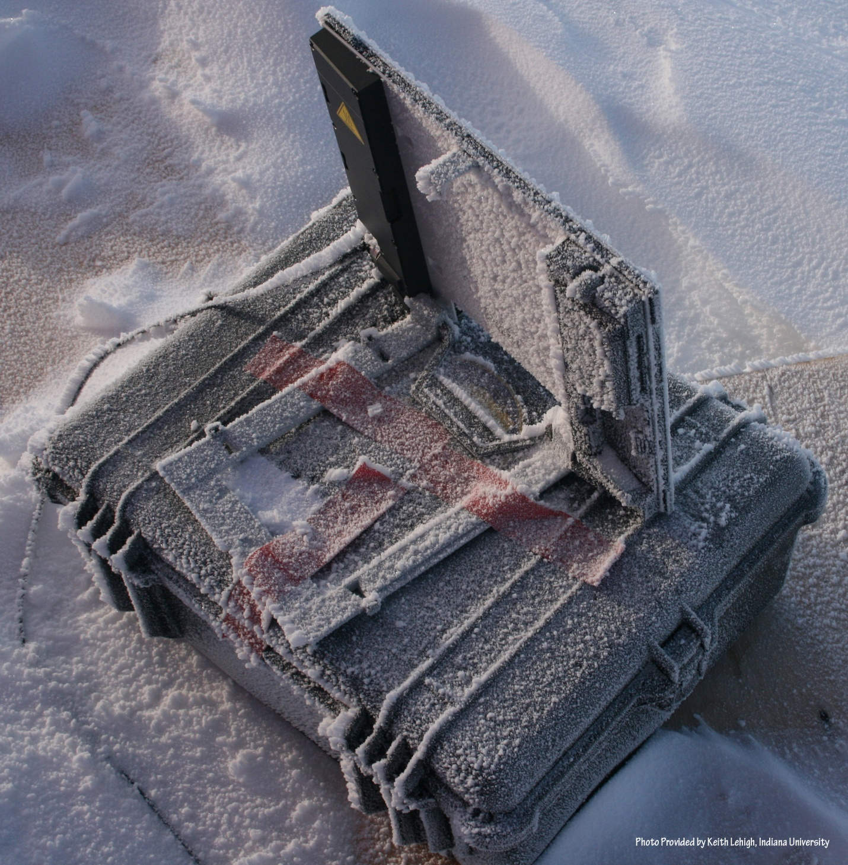
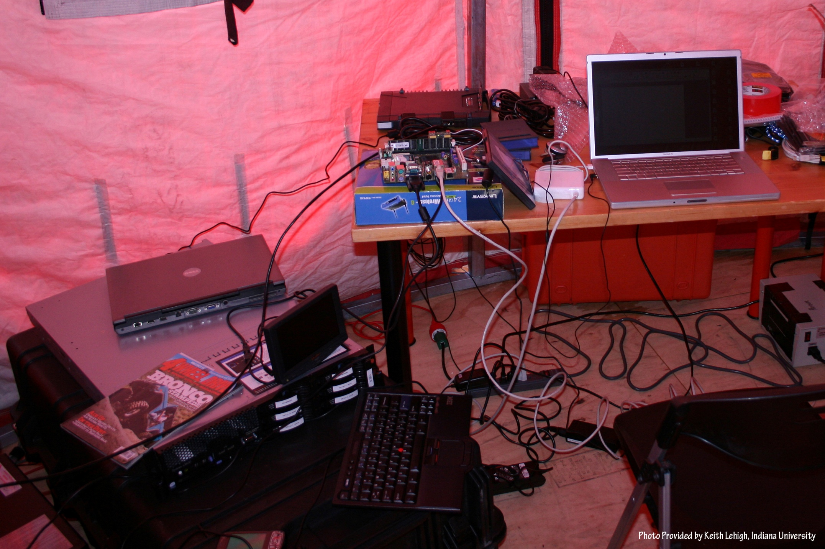
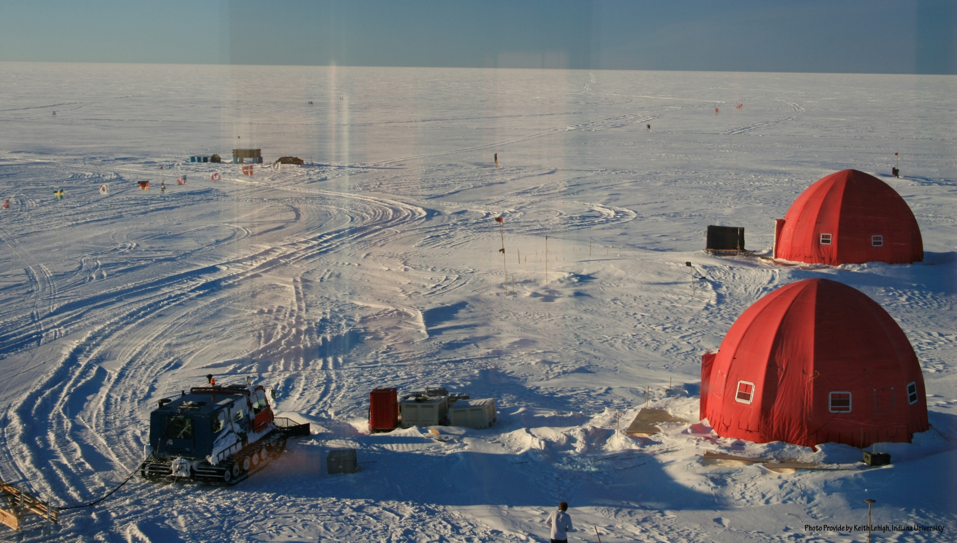
NEEM 2008 Base Station

Slide 19
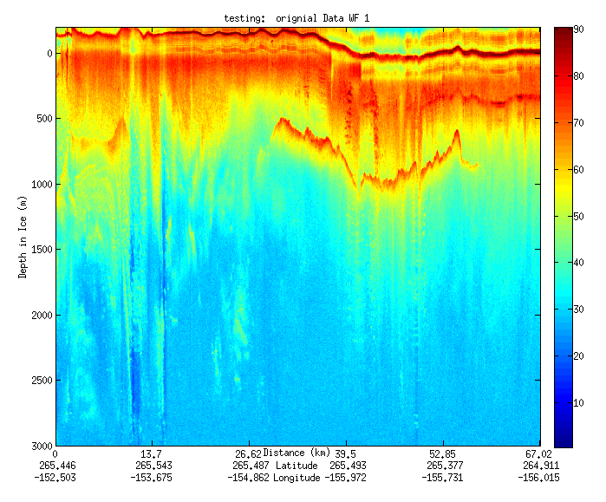
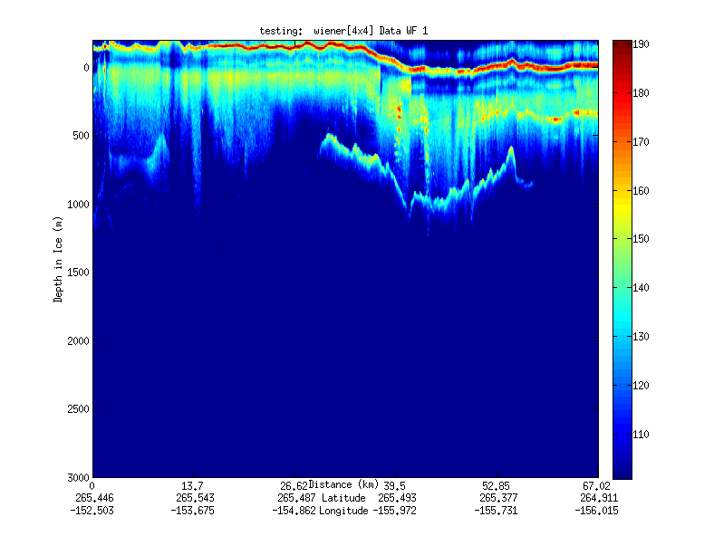
Geospatial Examples on Cloud Infrastructure
Image processing and mining
  SAR Images from Polar Grid (Matlab)
  Apply to 20 TB of data
  Could use MapReduce
Flood modeling
  Chaining flood models over a geographic area.
  Parameter fits and inversion problems.
  Deploy Services on Clouds – current models do not need parallelism
Real time GPS processing (QuakeSim)
  Services and Brokers (publish subscribe Sensor Aggregators) on clouds
  Performance issues not critical
Filter

Slide 20

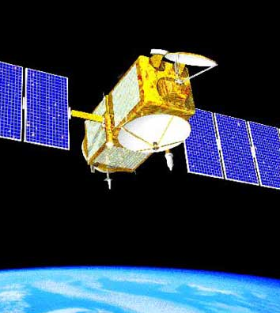
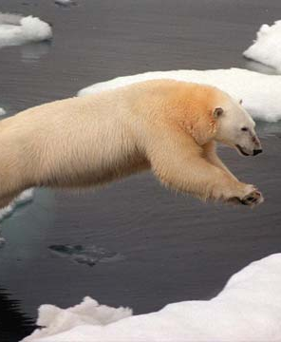
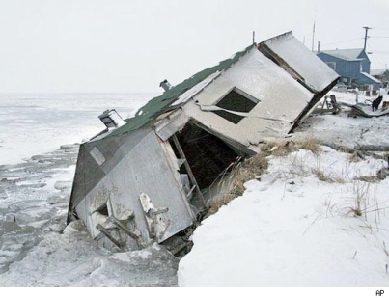

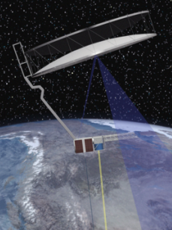
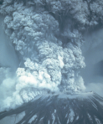
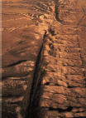
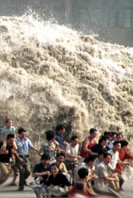
Generalizing GeoCloud/Grid Technologies
The Earth, its resources and inhabitants face challenges related to changing climate and natural disasters
Climate Change
How does our changing climate influence the oceans and ice sheets and how are they interacting?
Guided by: Intergovernmental Panel on Climate Change
Ocean temperature
atmospheric exchange
Changing sea ice
Rising sea level
Natural Disasters
How do the tectonic plates and fault systems interact to produce earthquakes?
Provide disaster information and understand potential for future events
Guided by: OSTP CENR Subcommittee for Disaster Reduction
Volcanoes
Earthquakes
Earthquakes

Slide 21
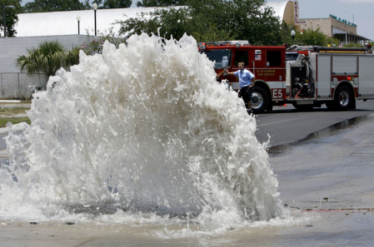
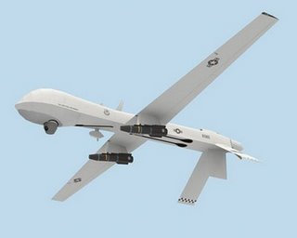
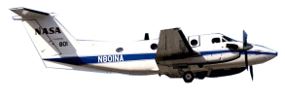
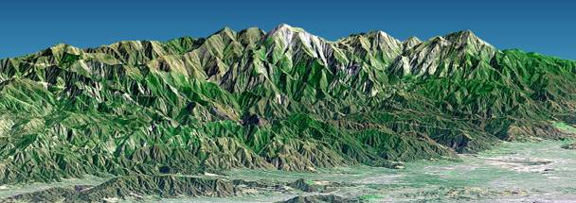
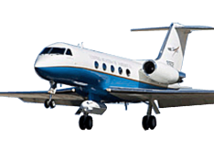
Enabling Repurposing of Data:
Applications to Civil Infrastructure and Crisis Management
Civil Infrastructure
Provide access to clean water
Restore and improve urban infrastructure
Develop carbon sequestration methods
Guided by: Grand Challenges for Engineering
Water pipe breaks
Crisis Management
Provide disaster information and understand potential for future events
Guided by: OSTP CENR Subcommittee for Disaster Reduction

Slide 22
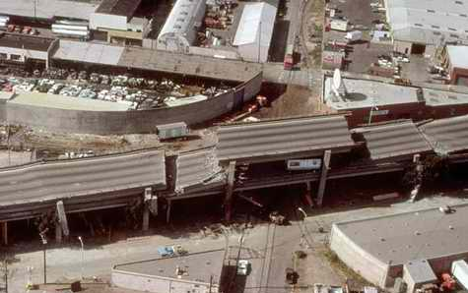
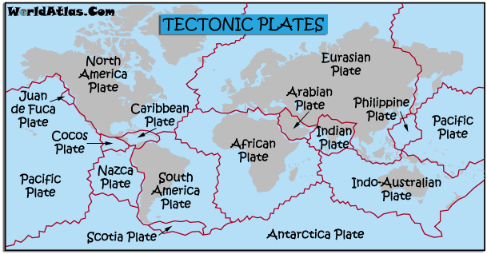
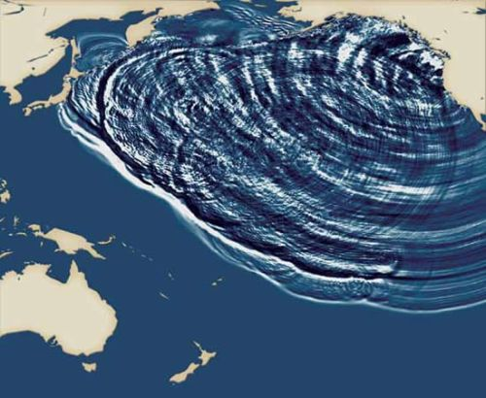
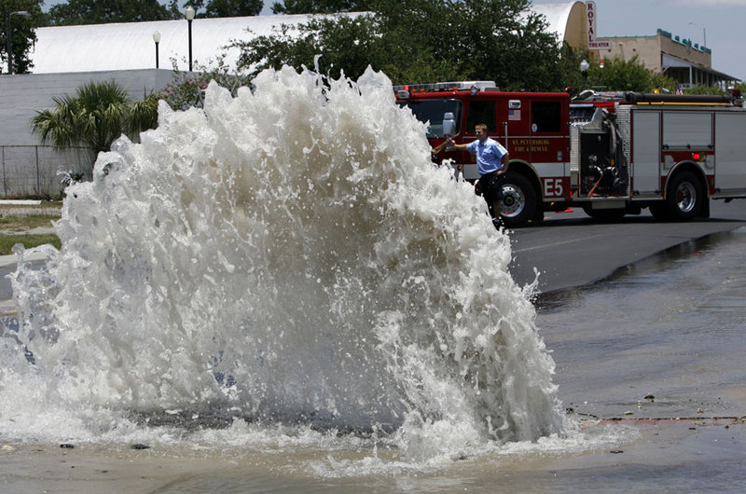
Natural Disasters
Earthquakes
Tectonics, Plate
Movement
Tsunamis
Broken Water Pipes (?)
Indicators of Changing Earth

Slide 23
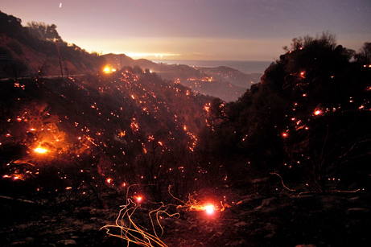
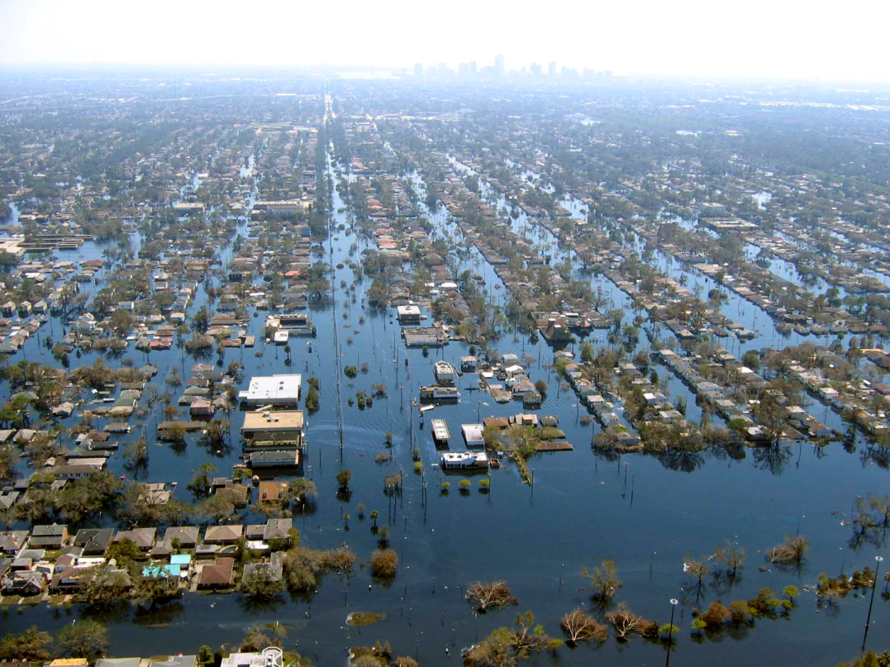
Crisis Management
Fires
Floods
Potential for future occurrences

Slide 24
Data Sources
Common Themes of Data Sources
Focus on geospatial, environmental data sets
  Data from computation and observation.
Rapidly increasing data sizes
Data and data processing pipelines are inseparable.

Slide 25
Example InSAR Data Processing Pipeline

Slide 26
GeoCloud (Proposed) Concept
Capture both data and data processing pipelines using sustainable hardware.
  Virtual machines for legacy systems
Data will be accessible from resources via Cloud-style interfaces.
  Amazon S3, MS Azure REST interfaces are the core.
  We believe these APIs are the best chance for sustainable access.
  Higher level GIS, search, metadata, ontology services built on these services.
Data processing pipelines/workflows/dataflows will also be stored on virtual machines, virtual clusters.
  Data products produced by processing chains.
  Users can recreate processing infrastructure (clusters) on demand with EC2-style interfaces.
  Many processing pipelines themselves can be implemented using Apache Hadoop, Microsoft Dryad (MapReduce)

Slide 27
Ontologies
Metadata
Curation
GIS Services
Documentation Services
Data mining/assimilation
Workflow
Web 2.0, Gadgets, Atom Feeds, Social Networks
Access, Portals
Gateways
GeoCloud Application Middleware
Existing and other non-GeoCloud Middleware
Core Commercial Cloud Platform PaaS
Production Clouds
Amazon, Microsoft,
Government, Campus
Legacy Hardware
VM based IaaS
Infrastructure
FutureGrid
Design/Test
Core Commercial Cloud Platform PaaS
Existing non-GeoCloud Data Provider Middleware/Interfaces
GeoCloud Cloud Data Provider Middleware/Interfaces
Computational Model Output
Other NASA/NSF/.. GeoData
DESDynl InSAR Data
Comprehensive Ocean Data
Remote Ice Sensing

Slide 28

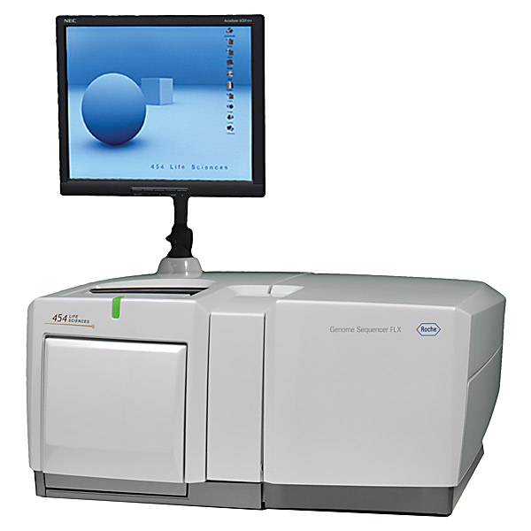
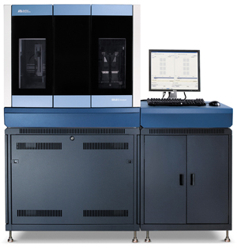
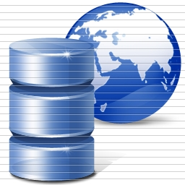
DNA Sequencing Pipeline
Illumina/Solexa Roche/454 Life Sciences Applied Biosystems/SOLiD
Internet
~300 million base pairs per day leading to
~3000 sequences per day per instrument
? 500 instruments at ~0.5M$ each
Read Alignment
Pairwise
clustering
Form block
Pairings
Sequence
alignment
Dissimilarity
Matrix
N(N-1)/2 values
Visualization
Plotviz
FASTA File
N Sequences
Blocking
MPI
MDS
MapReduce

Slide 29
Alu and Sequencing Workflow
Data is a collection of N sequences – 100’s of characters long
  These cannot be thought of as vectors because there are missing characters
  “Multiple Sequence Alignment” (creating vectors of characters) doesn’t seem to work if N larger than O(100)
Can calculate N² dissimilarities (distances) between sequences (all pairs)
Find families by clustering (much better methods than Kmeans). As no vectors, use vector free O(N²) methods
Map to 3D for visualization using Multidimensional Scaling MDS – also O(N²)
N = 50,000 runs in 10 hours (all above) on 768 cores
Our collaborators just gave us 170,000 sequences and want to look at 1.5 million – will develop new algorithms!
MapReduce++ will do all steps as MDS, Clustering just need MPI Broadcast/Reduce

Slide 30
Science Cloud (Dynamic Virtual Cluster)
Data Analysis Architecture
Bioinformatics
Geoscience
Information Retrieval
Applications
Runtimes
Apache Hadoop / MapReduce++ / MPI
Microsoft DryadLINQ / MPI
Linux Bare-system
Linux Virtual Machines
Windows Server 2008 HPC
Bare-system
Windows Server 2008 HPC
Infrastructure software
Xen Virtualization
Xen Virtualization
xCAT Infrastructure
Hardware
iDataplex Bare-metal Nodes
Dynamic Virtual Cluster provisioning via xCAT
Supports both stateful and stateless OS images

Slide 31
MapReduce implemented
by Hadoop
H
map(key, value)
reduce(key, list<value>)
Y
n
Y
U
U
S
4n
S
Example: Word Histogram
Start with a set of words
Each map task counts number of occurrences in each data partition
Reduce phase adds these counts
M
4n
M
D
n
D
X
n
X
Dryad supports general dataflow
U
N
U
N

Slide 32
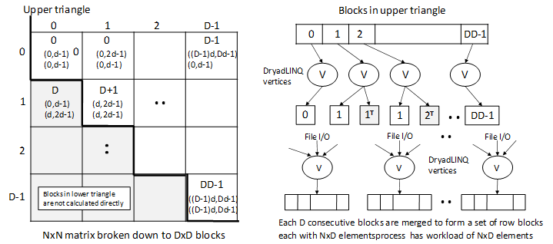
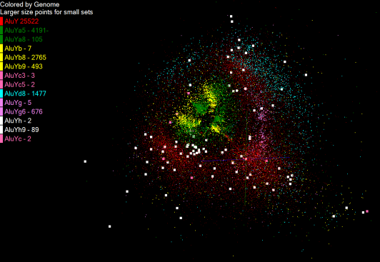
Pairwise Distances – ALU Sequences
125 million distances
4 hours & 46 minutes
Calculate pairwise distances for a collection of genes (used for clustering, MDS)
O(N^2) problem
“Doubly Data Parallel” at Dryad Stage
Performance close to MPI
Performed on 768 cores (Tempest Cluster)
Processes work better than threads when used inside vertices
100% utilization vs. 70%
Notes:
1~180 lines without threading in DryadLINQ, with threading, it is about 400 lines
MPI ~500 lines
The Alu clustering problem [27] is one of the most challenging problems for sequencing clustering because Alus represent the largest repeat families in human genome. There are about 1 million copies of Alu sequences in human genome, in which most insertions can be found in other primates and only a small fraction (~ 7000) are human-specific. This indicates that the classification of Alu repeats can be deduced solely from the 1 million human Alu elements. Notable, Alu clustering can be viewed as a classical case study for the capacity of computational infrastructures because it is not only of great intrinsic biological interests, but also a problem of a scale that will remain as the upper limit of many other clustering problem in bioinformatics for the next few years, e.g. the automated protein family classification for a few millions of proteins predicted from large metagenomics projects. In our work here we examine Alu samples of 35339 and 50,000 sequences.

Slide 33


Slide 34


Slide 35
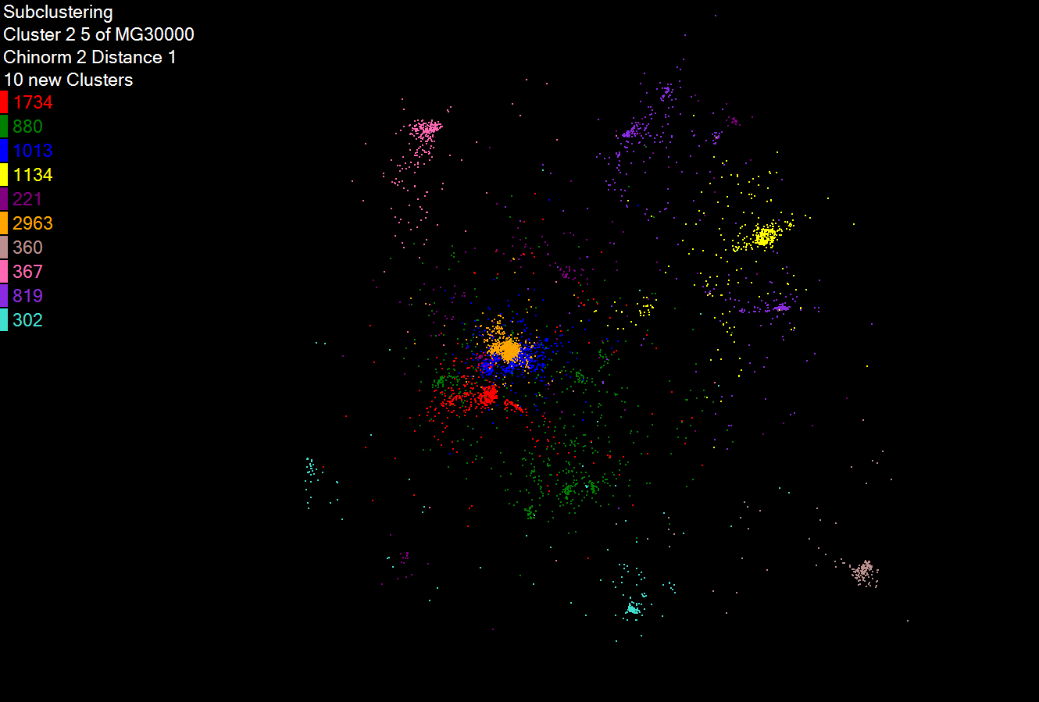
Hierarchical Subclustering

Slide 36
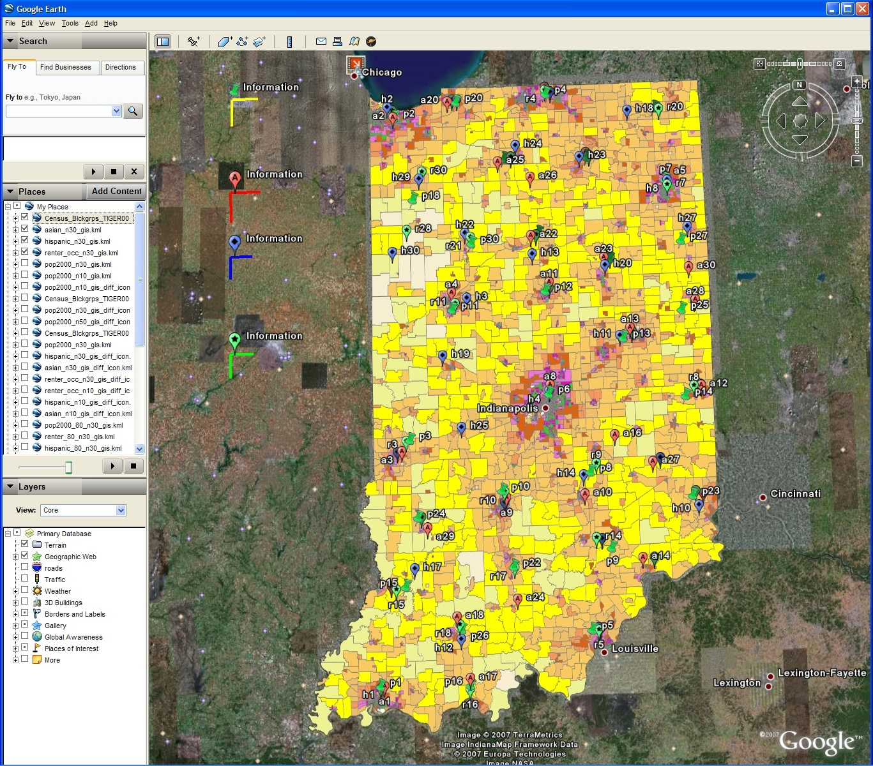
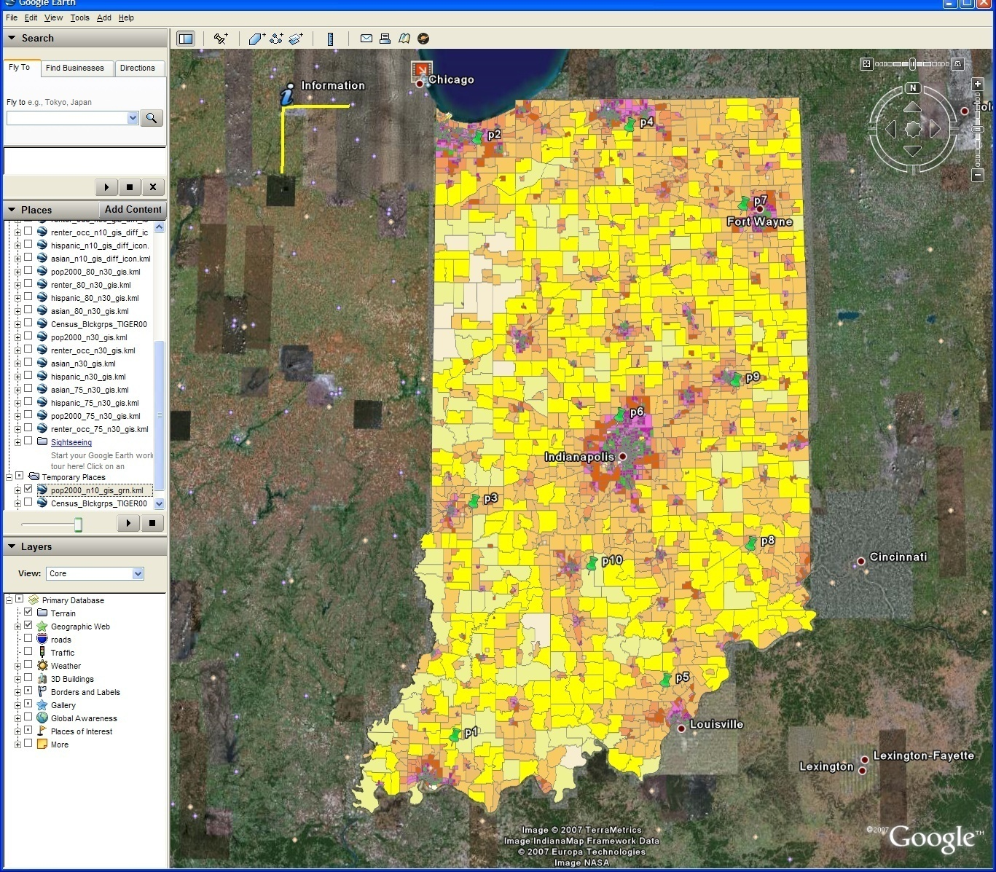
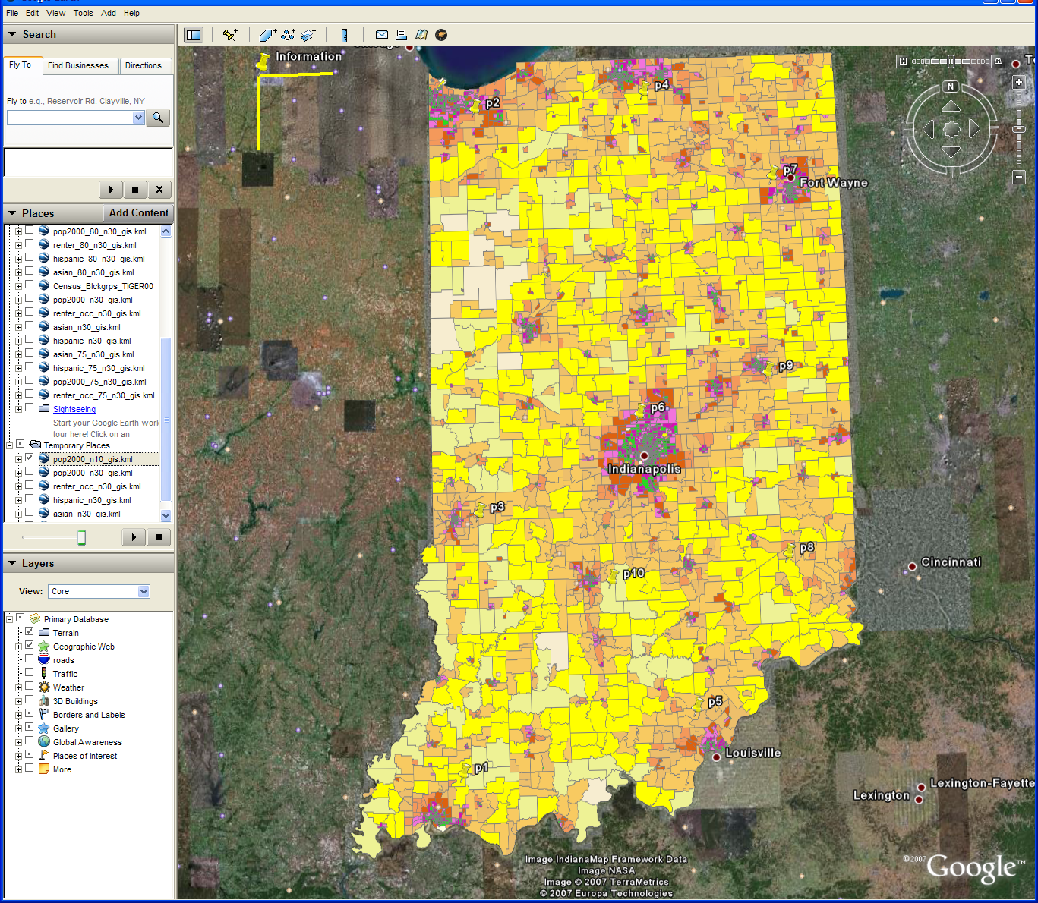
Changing resolution of GIS Clustering
Total
Asian
Hispanic
Renters
GIS Clustering
30 Clusters
30 Clusters
10 Clusters
Notes:
Same display as last slide but using Google Earth
This shows the clusters for 4 population types available in raw census data
Total
Asian
Hispanic
Renters
It has on right 10 clusters shown as black dots for total. Scale is bottom right
Left is 30 clusters with scale on left edge
These maps overlay a density map of census data converting Shape files from US Census to Google KML
This used Shape2Earth program

Slide 37
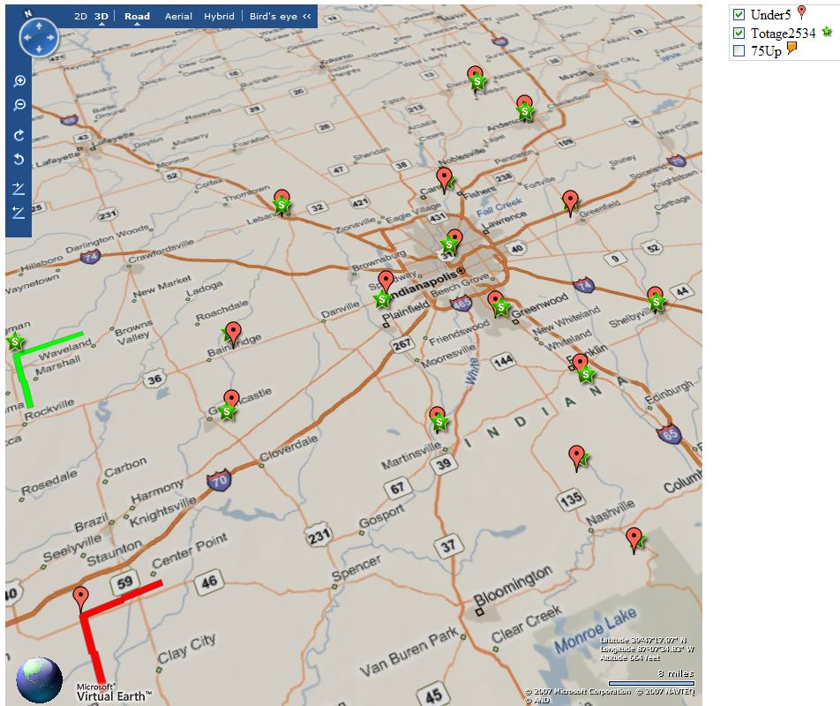


Slide 38
Child Obesity Study
Discover environmental factors related with child obesity
About 137,000 Patient records with 8 health-related and 97 environmental factors has been analyzed
Health data
Environment data
Genetic Algorithm
BMI
Blood Pressure
Weight
Height
…
Greenness
Neighborhood
Population
Income
…
Canonical Correlation Analysis
Visualization

Slide 39
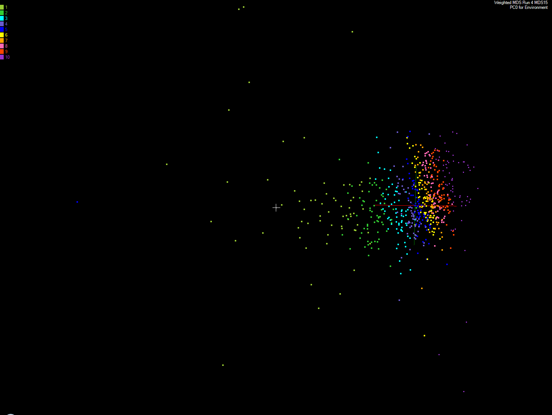
Apply MDS to Patient Record Data
and correlation to GIS properties
MDS and Primary PCA Vector
MDS of 635 Census Blocks with 97 Environmental Properties
Shows expected Correlation with Principal Component – color varies from greenish to reddish as projection of leading eigenvector changes value
Ten color bins used

Slide 40
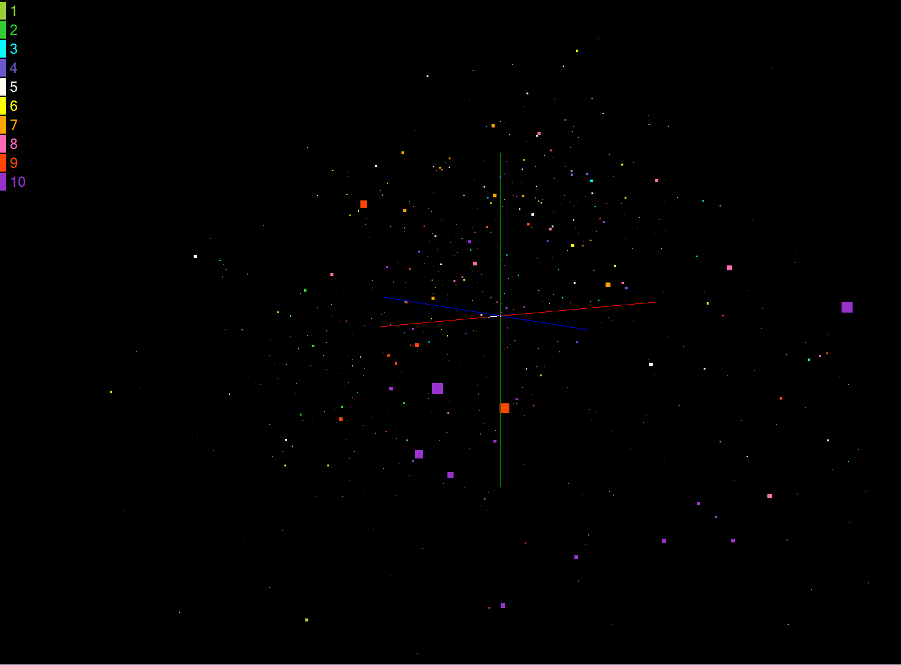
Apply MDS to Patient Record Data
and correlation of GIS properties
MDS and Patient Data
MDS of 635 Census Blocks with 97 Environmental Properties
Color varies from greenish to reddish as projection on Patient vector varies
Ten color bins used

Slide 41
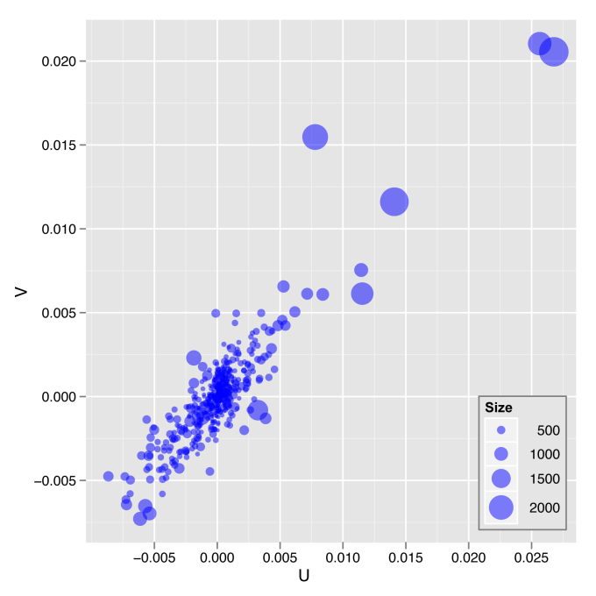
Canonical Correlation Analysis
and Multidimensional Scaling
The plot of the first pair of canonical variables for 635 Census Blocks compared to patient records

Slide 42
“Chemical Information System CIS”
26 million PubChem compounds with 166 features
  Drug discovery
  Bioassay
3D visualization for data exploration/mining
  Mapping by MDS(Multi-dimensional Scaling) and
  GTM(Generative Topographic Mapping)
  Interactive visualization tool PlotViz
  Browse related chemicals in same way GIS expresses locality
Note that here we can use GTM (better version of SOM) or PCA
Bioinformatics has no vectors so MDS attractive there

Slide 43
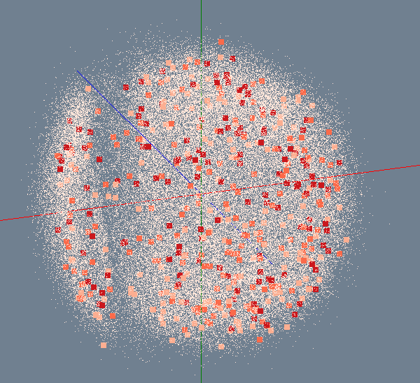
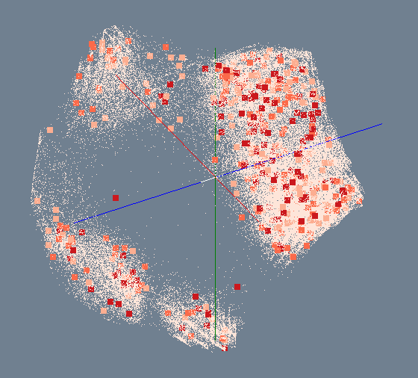
MDS/GTM for 100K PubChem
Number of Activity Results
> 300
200 ~ 300
100 ~ 200
< 100
MDS
GTM

Slide 44
Dryad versus MPI for Smith Waterman
Flat is perfect scaling

Slide 45
Hadoop/Dryad Comparison
Inhomogeneous Data I
Inhomogeneity of data does not have a significant effect when the sequence lengths are randomly distributed
Dryad with Windows HPCS compared to Hadoop with Linux RHEL on Idataplex (32 nodes)
Notes:
10k data size

Slide 46
Hadoop VM Performance Degradation
Perf. Degradation = (T_{vm} – T_{baremetal})/T_{baremetal}
15.3% Degradation at largest data set size

Slide 47
FutureGrid
The goal of FutureGrid is to support the research on the future of distributed, grid, and cloud computing.
FutureGrid will build a robustly managed simulation environment or testbed to support the development and early use in science of new technologies at all levels of the software stack: from networking to middleware to scientific applications.
The environment will mimic TeraGrid and/or general parallel and distributed systems – FutureGrid is part of TeraGrid and one of two experimental TeraGrid systems (other is GPU)
This test-bed will succeed if it enables major advances in science and engineering through collaborative development of science applications and related software.
FutureGrid is a (small >5000 core) Science/Computer Science Cloud but it is more accurately a virtual machine based simulation environment

Slide 48
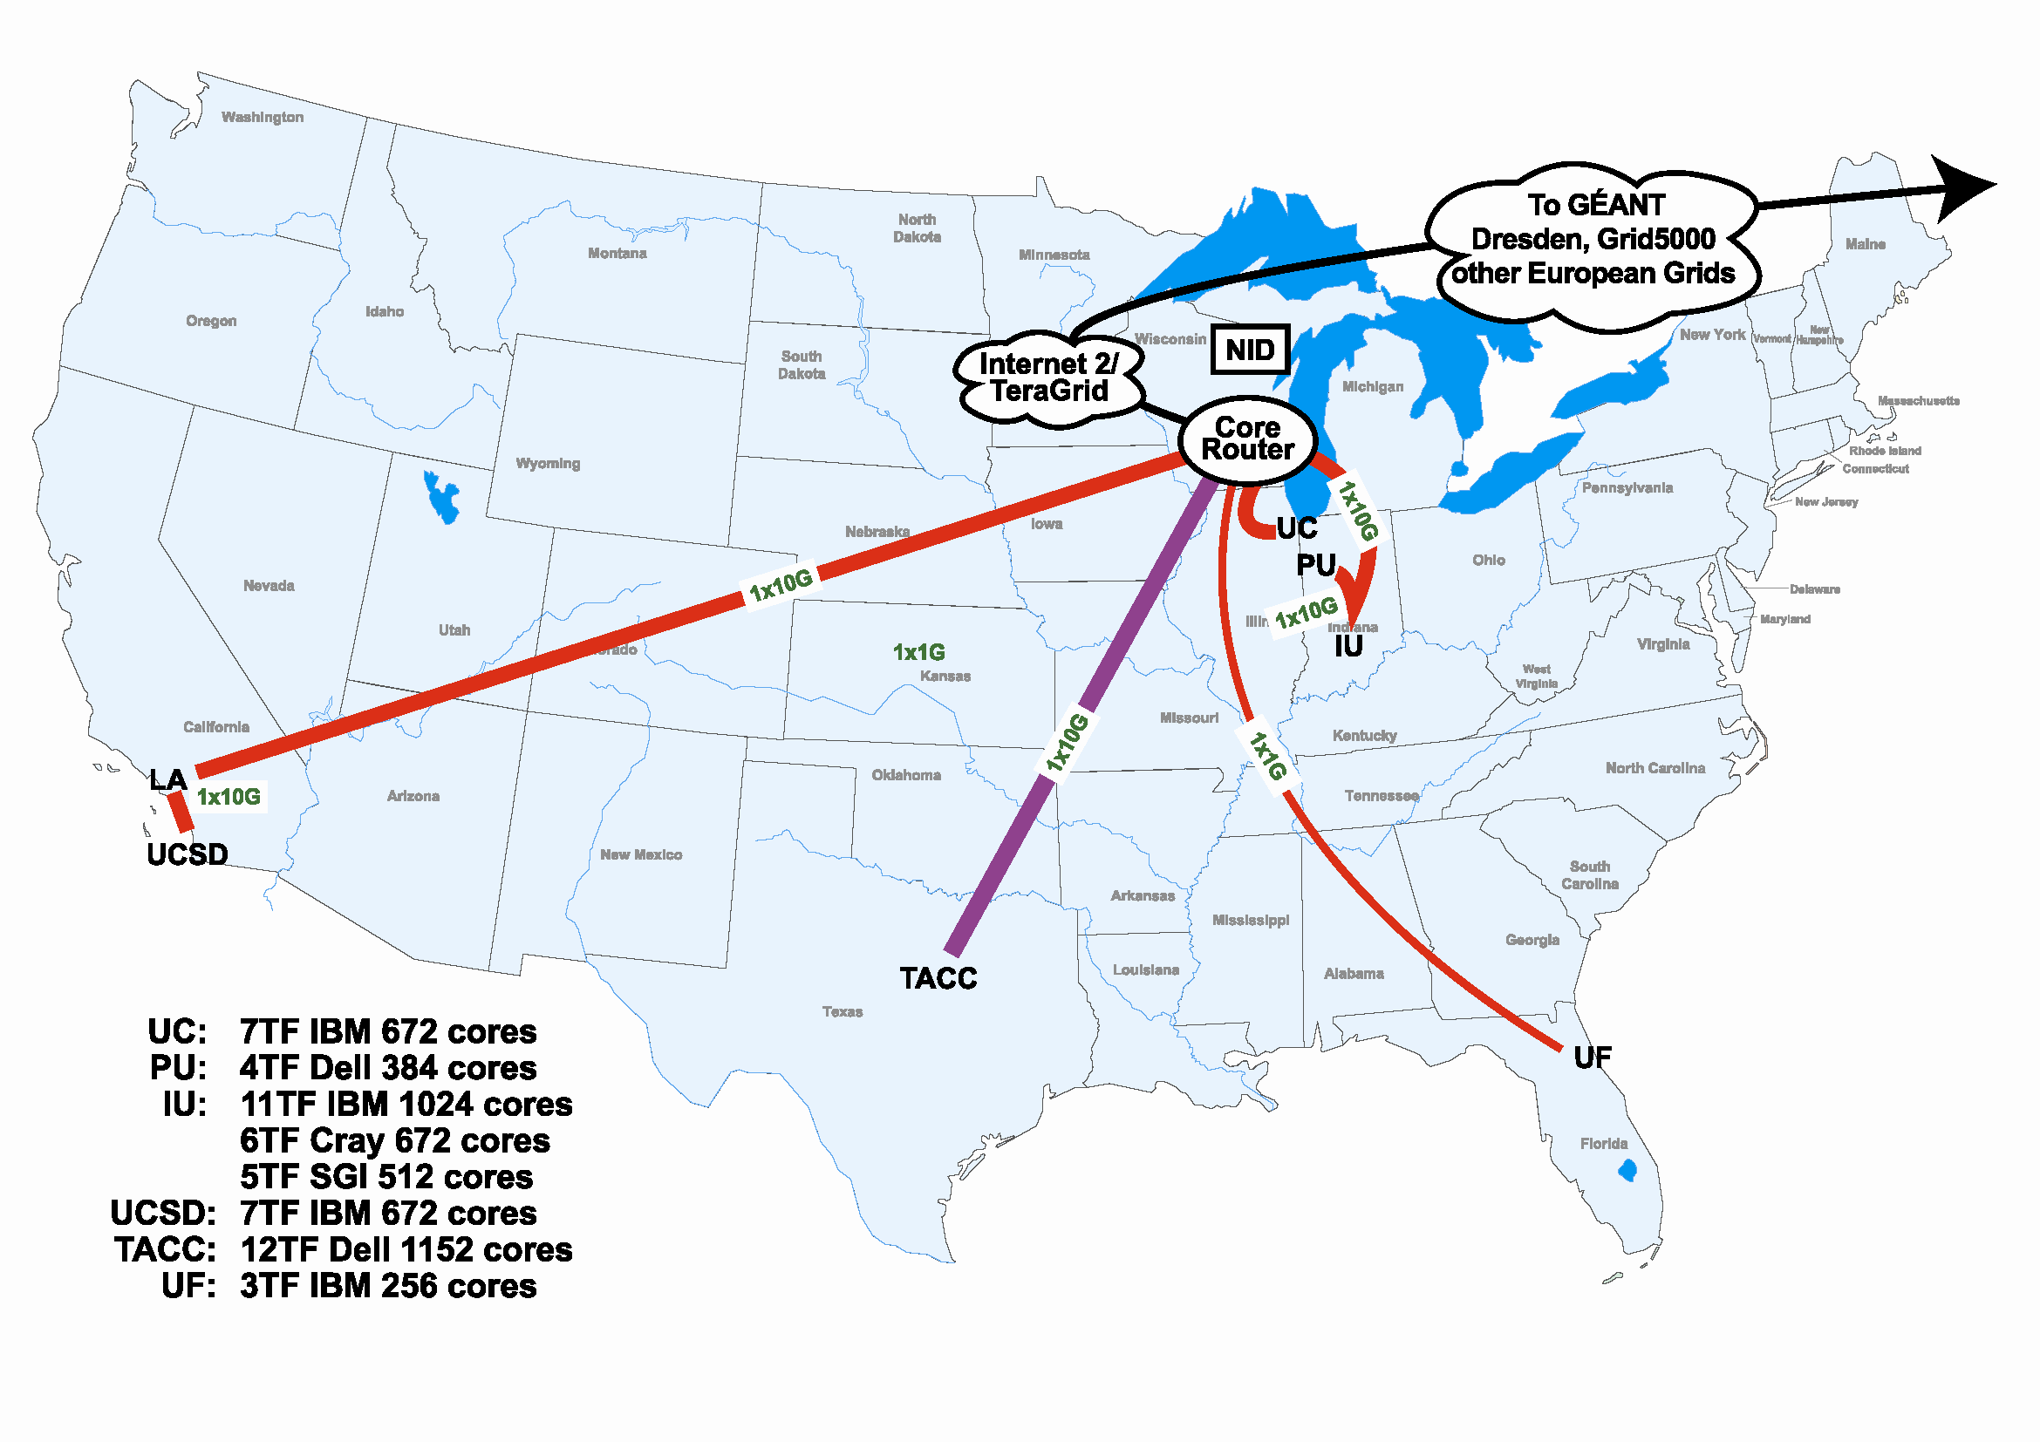
FutureGrid Hardware

Slide 49
FutureGrid Partners
Indiana University (Architecture, core software, Support)
Purdue University (HTC Hardware)
San Diego Supercomputer Center at University of California San Diego (INCA, Monitoring)
University of Chicago/Argonne National Labs (Nimbus)
University of Florida (ViNE, Education and Outreach)
University of Southern California Information Sciences Institute (Pegasus to manage experiments)
University of Tennessee Knoxville (Benchmarking)
University of Texas at Austin/Texas Advanced Computing Center (Portal)
University of Virginia (OGF, Advisory Board and allocation)
Center for Information Services and GWT-TUD from Technische Universtität Dresden Germany. (VAMPIR)
Blue institutions have FutureGrid hardware

Slide 50
Other Important Collaborators
NSF
Early users from an application and computer science perspective and from both research and education
Grid5000/Aladdin and D-Grid in Europe
Commercial partners such as
  Eucalyptus ….
  Microsoft (Dryad + Azure) – Note current Azure external to FutureGrid as are GPU systems
  Application partners
TeraGrid
Open Grid Forum
Possibly Open Nebula, Open Cirrus Testbed, Open Cloud Consortium, Cloud Computing Interoperability Forum. IBM-Google-NSF Cloud, and other DoE/NSF/… clouds
China, Japan, Korea, Australia, other Europe … ?

Slide 51
FutureGrid Usage Scenarios
Developers of end-user applications who want to develop new applications in cloud or grid environments, including analogs of commercial cloud environments such as Amazon or Google.
  Is a Science Cloud for me? Is my application secure?
Developers of end-user applications who want to experiment with multiple hardware environments.
Grid/Cloud middleware developers who want to evaluate new versions of middleware or new systems.
Networking researchers who want to test and compare different networking solutions in support of grid and cloud applications and middleware. (Some types of networking research will likely best be done via through the GENI program.)
Education as well as research
Interest in performance requires that bare metal important

Slide 52
Selected FutureGrid Timeline
October 1 2009 Project Starts
November 16-19 SC09 Demo/F2F Committee Meetings/Chat up collaborators
February 2010 – Significant Hardware available
March 2010 FutureGrid network complete
March 2010 FutureGrid Annual Meeting
April 2010 Many early users
September 2010 All hardware (except Track IIC lookalike) accepted
October 1 2011 FutureGrid allocatable via TeraGrid process – first two years by user/science board led by Andrew Grimshaw

Slide 53
FutureGrid Architecture
Open Architecture allows to configure resources based on images
Managed images allows to create similar experiment environments
Experiment management allows reproducible activities
Through our modular design we allow different clouds and images to be “rained” upon hardware.
Note will be supported 24x7 at “TeraGrid Production Quality”
Will support deployment of “important” middleware including TeraGrid stack, Condor, BOINC, gLite, Unicore, Genesis II

Slide 54

FutureGrid is a new part of TeraGrid
Several Postdoc and
Software Engineer Positions open
Please apply

Slide 55


Slide 56

With CCGrid

Slide 57
Spares

Slide 58

We can also analyze real-time GPS data from the California Real Time Network

Slide 59

Daily RDAHMM Updates
Daily analysis and
event classification
of GPS data from
REASoN’s GRWS.

Slide 60
Requires Team Approach
Geophysics
Computing and Information
Management Technologists
Earth Science
Cloud Computing
Oceanography
Virtualization
Data Preservation
Cryospheric Science
Service-based Interfaces
End-User Interfaces
Civil and Environmental
Engineering
Data Access
Information Fusion
Data Discovery
Data Semantics
Geo-spatial
Information
Management
Data Curation
Users, Providers
Data Mining

Slide 61
Inter-Disciplinary Complex Systems Science
Example Scientific Question/Study:
How are ocean temperature and level changing due
to ice sheet loss and undersea volcanic eruptions?
Discipline:
Geophysics
Oceanography
Cryospheric
Science
Fault and Tectonic
Data
Ocean
Temperature and Trend Data
Remotely-
Sensed
Ice Sheet
Data
Fused Data
Visualize Data
Together
(Geospatial, Temporal)
Utilize Modeling and
Simulation Tools

Slide 62
SALSA
Dynamic Virtual Cluster Hosting
Monitoring Infrastructure
SW-G Using Hadoop
SW-G Using Hadoop
SW-G Using DryadLINQ
SW-G Using Hadoop
SW-G Using Hadoop
SW-G Using DryadLINQ
Linux
Bare-system
Linux on Xen
Windows Server 2008 Bare-system
Cluster Switching from Linux Bare-system to Xen VMs to Windows 2008 HPC
xCAT Infrastructure
iDataplex Bare-metal Nodes (32 nodes)
SW-G : Smith Waterman Gotoh Dissimilarity Computation
– A typical MapReduce style application

Slide 63

Monitoring Infrastructure
Monitoring Interface
Pub/Sub Broker Network
Virtual/Physical Clusters
Summarizer
xCAT Infrastructure
Switcher
iDataplex Bare-metal Nodes
(32 nodes)

Slide 64

SALSA HPC Dynamic Virtual Clusters

