Slide 1

Next Generation Grid: Integrating Parallel and Distributed Computing Runtimes from Cloud to Edge Applications
The 15th IEEE International Symposium on Parallel and Distributed Processing with Applications (IEEE ISPA 2017) Guangzhou, China, December 12-15, 2017
http://trust.gzhu.edu.cn/conference/ISPA2017/
Geoffrey Fox, December 13, 2017
Department of Intelligent Systems Engineering
gcf@indiana.edu, http://www.dsc.soic.indiana.edu/, http://spidal.org/
Work with Judy Qiu, Shantenu Jha, Supun Kamburugamuve, Kannan Govindarajan, Pulasthi Wickramasinghe
`

Slide 2
Abstract
We look again at Big Data Programming environments such as Hadoop, Spark, Flink, Heron, Pregel; HPC concepts such as MPI and Asynchronous Many-Task runtimes and Cloud/Grid/Edge ideas such as event-driven computing, serverless computing, workflow and Services.
These cross many research communities including distributed systems, databases, cyberphysical systems and parallel computing which sometimes have inconsistent worldviews.
There are many common capabilities across these systems which are often implemented differently in each packaged environment. For example, communication can be bulk synchronous processing or data flow; scheduling can be dynamic or static; state and fault-tolerance can have different models; execution and data can be streaming or batch, distributed or local.
We suggest that one can usefully build a toolkit (called Twister2 by us) that supports these different choices and allows fruitful customization for each application area. We illustrate the design of Twister2 by several point studies.

Slide 3
Predictions/Assumptions
Supercomputers will be essential for large simulations and will run other applications
HPC Clouds or Next-Generation Commodity Systems will be a dominant force
  Merge Cloud HPC and (support of) Edge computing
  Federated Clouds running in multiple giant datacenters offering all types of computing
  Distributed data sources associated with device and Fog processing resources
  Server-hidden computing and Function as a Service FaaS for user pleasure
  “No server is easier to manage than no server”
  Support a distributed event-driven serverless dataflow computing model covering batch and streaming data as HPC-FaaS
  Needing parallel and distributed (Grid) computing ideas
  Span Pleasingly Parallel to Data management to Global Machine Learning

Slide 4
Background Remarks
Use of public clouds increasing rapidly
  Clouds becoming diverse with subsystems containing GPU’s, FPGA’s, high performance networks, storage, memory …
Rich software stacks:
  HPC (High Performance Computing) for Parallel Computing less used than(?)
  Apache for Big Data Software Stack ABDS including center and edge computing (streaming)
Surely Big Data requires High Performance Computing?
Service-oriented Systems, Internet of Things and Edge Computing growing in importance
A lot of confusion coming from different communities (database, distributed, parallel computing, machine learning, computational/data science) investigating similar ideas with little knowledge exchange and mixed up (unclear) requirements
Notes:
Barga Edge and Serverless driving AWS

Slide 5
Requirements
On general principles parallel and distributed computing have different requirements even if sometimes similar functionalities
  Apache stack ABDS typically uses distributed computing concepts
  For example, Reduce operation is different in MPI (Harp) and Spark
Large scale simulation requirements are well understood
Big Data requirements are not agreed but there are a few key use types
  Pleasingly parallel processing (including local machine learning LML) as of different tweets from different users with perhaps MapReduce style of statistics and visualizations; possibly Streaming
  Database model with queries again supported by MapReduce for horizontal scaling
  Global Machine Learning GML with single job using multiple nodes as classic parallel computing
  Deep Learning certainly needs HPC – possibly only multiple small systems
Current workloads stress 1) and 2) and are suited to current clouds and to ABDS (with no HPC)
  This explains why Spark with poor GML performance is so successful and why it can ignore MPI even though MPI uses best technology for parallel computing

Slide 6

HPC Runtime versus ABDS distributed Computing Model on Data Analytics
Hadoop writes to disk and is slowest; Spark and Flink spawn many processes and do not support AllReduce directly;
MPI does in-place combined reduce/broadcast and is fastest
Need Polymorphic Reduction capability choosing best implementation
Use HPC architecture with
  Mutable model
  Immutable data

Slide 7
Use Case Analysis
Very short as described in previous talks and papers
Started with NIST collection of 51 use cases
“Version 2” https://bigdatawg.nist.gov/V2_output_docs.php just released August 2017
64 Features of Data and Model for large scale big data or simulation use cases

Slide 8
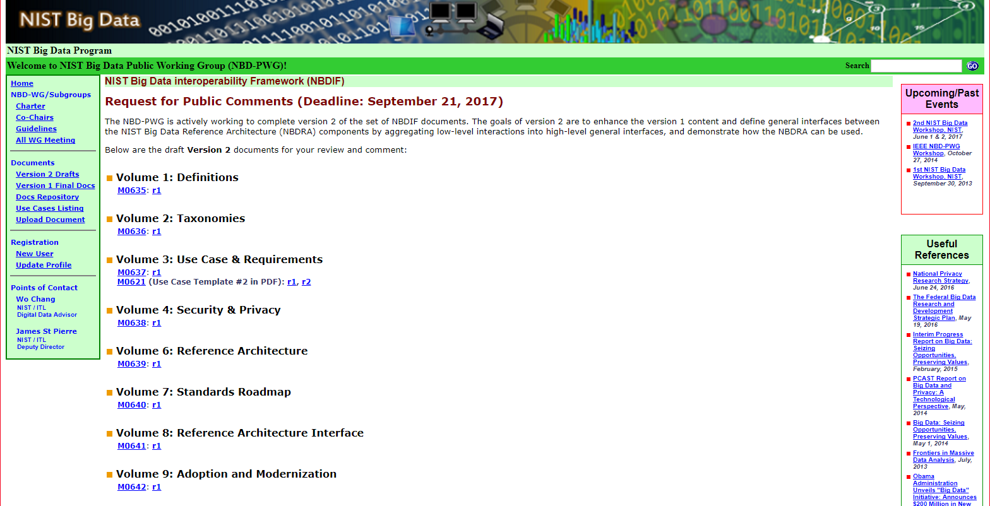
NIST Big Data Public Working Group
Standards
Best Practice
https://bigdatawg.nist.gov/V2_output_docs.php
Indiana
Indiana Cloudmesh launching Twister2

Slide 9
64 Features in 4 views for Unified Classification of Big Data and Simulation Applications
41/51 Streaming
26/51 Pleasingly Parallel
25/51 Mapreduce

Slide 10
Problem Architecture View (Meta or MacroPatterns)
Pleasingly Parallel – as in BLAST, Protein docking, some (bio-)imagery including Local Analytics or Machine Learning – ML or filtering pleasingly parallel, as in bio-imagery, radar images (pleasingly parallel but sophisticated local analytics)
Classic MapReduce: Search, Index and Query and Classification algorithms like collaborative filtering (G1 for MRStat in Features, G7)
Map-Collective: Iterative maps + communication dominated by “collective” operations as in reduction, broadcast, gather, scatter. Common datamining pattern
Map-Point to Point: Iterative maps + communication dominated by many small point to point messages as in graph algorithms
Map-Streaming: Describes streaming, steering and assimilation problems
Shared Memory: Some problems are asynchronous and are easier to parallelize on shared rather than distributed memory – see some graph algorithms
SPMD: Single Program Multiple Data, common parallel programming feature
BSP or Bulk Synchronous Processing: well-defined compute-communication phases
Fusion: Knowledge discovery often involves fusion of multiple methods.
Dataflow: Important application features often occurring in composite Ogres
Use Agents: as in epidemiology (swarm approaches) This is Model only
Workflow: All applications often involve orchestration (workflow) of multiple components
Most (11 of total 12) are properties of Data+Model
Notes:
Big dwarfs are Ogres
Implement Ogres in ABDS+

Slide 11
Note Problem and System Architecture as efficient execution says they must match
Global Machine Learning
Classic Cloud Workload
These 3 are focus of Twister2 but we need to preserve capability on first 2 paradigms

Slide 12
Data and Model in Big Data and Simulations I
Need to discuss Data and Model as problems have both intermingled, but we can get insight by separating which allows better understanding of Big Data - Big Simulation “convergence” (or differences!)
The Model is a user construction and it has a “concept”, parameters and gives results determined by the computation. We use term “model” in a general fashion to cover all of these.
Big Data problems can be broken up into Data and Model
  For clustering, the model parameters are cluster centers while the data is set of points to be clustered
  For queries, the model is structure of database and results of this query while the data is whole database queried and SQL query
  For deep learning with ImageNet, the model is chosen network with model parameters as the network link weights. The data is set of images used for training or classification

Slide 13
Data and Model in Big Data and Simulations II
Simulations can also be considered as Data plus Model
  Model can be formulation with particle dynamics or partial differential equations defined by parameters such as particle positions and discretized velocity, pressure, density values
  Data could be small when just boundary conditions
  Data large with data assimilation (weather forecasting) or when data visualizations are produced by simulation
Big Data implies Data is large but Model varies in size
  e.g. LDA (Latent Dirichlet Allocation) with many topics or deep learning has a large model
  Clustering or Dimension reduction can be quite small in model size
Data often static between iterations (unless streaming); Model parameters vary between iterations
Data and Model Parameters are often confused in papers as term data used to describe the parameters of models.
Models in Big Data and Simulations have many similarities and allow convergence

Slide 14
Convergence/Divergence Points for HPC-Cloud-Edge- Big Data-Simulation
Applications – Divide use cases into Data and Model and compare characteristics separately in these two components with 64 Convergence Diamonds (features).
  Identify importance of streaming data, pleasingly parallel, global/local machine-learning
Software – Single model of High Performance Computing (HPC) Enhanced Big Data Stack HPC-ABDS. 21 Layers adding high performance runtime to Apache systems HPC-FaaS Programming Model
  Serverless Infrastructure as a Service IaaS
Hardware system designed for functionality and performance of application type e.g. disks, interconnect, memory, CPU acceleration different for machine learning, pleasingly parallel, data management, streaming, simulations
  Use DevOps to automate deployment of event-driven software defined systems on hardware: HPCCloud 2.0
Total System Solutions (wisdom) as a Service: HPCCloud 3.0
Uses DevOps not discussed in this talk

Slide 15
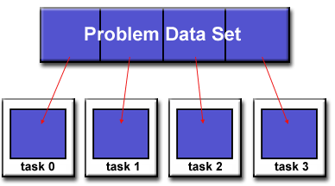
Parallel Computing: Big Data and Simulations
All the different programming models (Spark, Flink, Storm, Naiad, MPI/OpenMP) have the same high level approach but application requirements and system architecture can give different appearance
First: Break Problem Data and/or Model-parameters into parts assigned to separate nodes, processes, threads
Then: In parallel, do computations typically leaving data untouched but changing model-parameters. Called Maps in MapReduce parlance; typically owner computes rule.
If Pleasingly parallel, that’s all it is except for management
If Globally parallel, need to communicate results of computations between nodes during job
Communication mechanism (TCP, RDMA, Native Infiniband) can vary
Communication Style (Point to Point, Collective, Pub-Sub) can vary
Possible need for sophisticated dynamic changes in
partioning (load balancing)
Computation either on fixed tasks or flow between tasks
Choices: “Automatic Parallelism or Not”
Choices: “Complicated Parallel Algorithm or Not”
Fault-Tolerance model can vary
Output model can vary: RDD or Files or Pipes

Slide 16
Difficulty in Parallelism
Size of Synchronization constraints
Loosely Coupled
HPC Clouds/Supercomputers
Memory access also critical
HPC Clouds
High Performance Interconnect
MapReduce as in scalable databases
Disk I/O
Unstructured Adaptive Sparsity
Medium size Jobs
Global Machine Learning
e.g. parallel clustering
Deep Learning
Pleasingly Parallel
Often independent events
LDA
Graph Analytics e.g. subgraph mining
Linear Algebra at core (typically not sparse)
Large scale simulations
Current major Big Data category
Structured Adaptive Sparsity
Huge Jobs
Commodity Clouds
Spectrum of Applications and Algorithms
Exascale Supercomputers

Slide 17
Software
HPC-ABDS
HPC-FaaS

Slide 18





NSF 1443054: CIF21 DIBBs: Middleware and High Performance Analytics Libraries for Scalable Data Science
Ogres Application Analysis
HPC-ABDS and HPC-FaaS Software
Harp and Twister2 Building Blocks
SPIDAL Data Analytics Library
Software: MIDAS
HPC-ABDS

Slide 19
HPC-ABDS
Integrated wide range of HPC and Big Data technologies.
I gave up updating list in January 2016!

Slide 20
Components of Big Data Stack
Google likes to show a timeline; we can build on (Apache version of) this
2002 Google File System GFS ~HDFS (Level 8)
2004 MapReduce Apache Hadoop (Level 14A)
2006 Big Table Apache Hbase (Level 11B)
2008 Dremel Apache Drill (Level 15A)
2009 Pregel Apache Giraph (Level 14A)
2010 FlumeJava Apache Crunch (Level 17)
2010 Colossus better GFS (Level 18)
2012 Spanner horizontally scalable NewSQL database ~CockroachDB (Level 11C)
2013 F1 horizontally scalable SQL database (Level 11C)
2013 MillWheel ~Apache Storm, Twitter Heron (Google not first!) (Level 14B)
2015 Cloud Dataflow Apache Beam with Spark or Flink (dataflow) engine (Level 17)
Functionalities not identified: Security(3), Data Transfer(10), Scheduling(9), DevOps(6), serverless computing (where Apache has OpenWhisk) (5)
HPC-ABDS Levels in ()

Slide 21
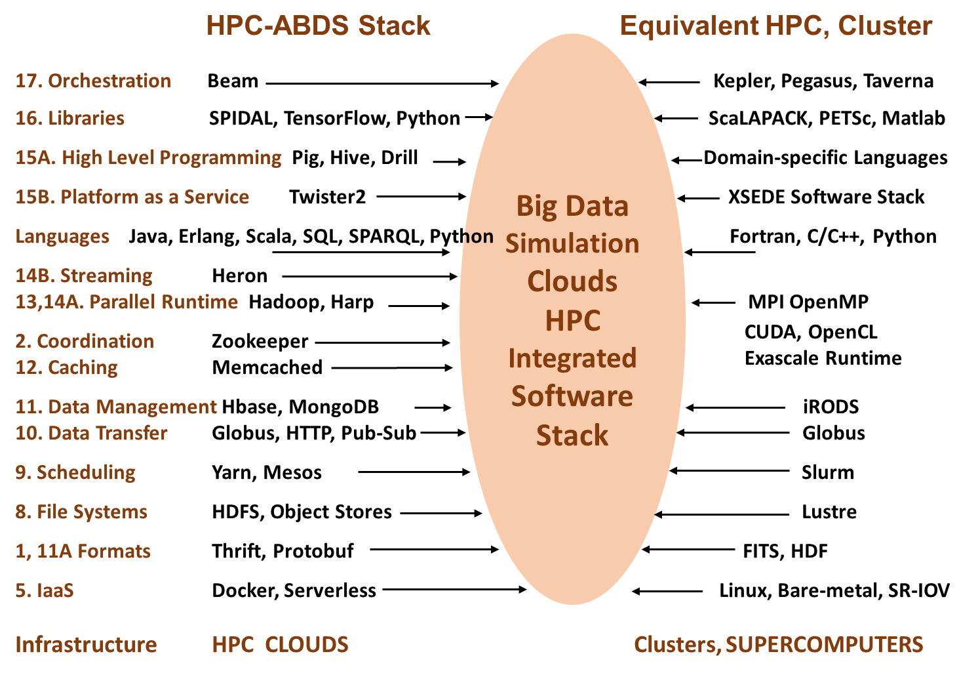
Different choices in software systems in Clouds and HPC. HPC-ABDS takes cloud software augmented by HPC when needed to improve performance
16 of 21 layers plus languages

Slide 22



Implementing Twister2 to support a Grid linked to an HPC Cloud
Cloud
HPC
Cloud
HPC
Fog
Cloud
HPC
HPC Cloud can
be federated
Centralized HPC Cloud + IoT Devices
Centralized HPC Cloud + Edge = Fog + IoT Devices

Slide 23
Twister2: “Next Generation Grid - Edge – HPC Cloud”
Original 2010 Twister paper has 914 citations; it was a particular approach to MapCollective iterative processing for machine learning
Re-engineer current Apache Big Data and HPC software systems as a toolkit
Support a serverless (cloud-native) dataflow event-driven HPC-FaaS (microservice) framework running across application and geographic domains.
  Support all types of Data analysis from GML to Edge computing
Build on Cloud best practice but use HPC wherever possible to get high performance
Smoothly support current paradigms Hadoop, Spark, Flink, Heron, MPI, DARMA …
Use interoperable common abstractions but multiple polymorphic implementations.
  i.e. do not require a single runtime
Focus on Runtime but this implies HPC-FaaS programming and execution model
This defines a next generation Grid based on data and edge devices – not computing as in old Grid
See paper http://dsc.soic.indiana.edu/publications/twister2_design_big_data_toolkit.pdf

Slide 24
Proposed Twister2 Approach
Unit of Processing is an Event driven Function (a microservice) replaces libraries
  Can have state that may need to be preserved in place (Iterative MapReduce)
  Functions can be single or 1 of 100,000 maps in large parallel code
Processing units run in HPC clouds, fogs or devices but these all have similar software architecture (see AWS Greengrass and Lambda)
  Universal Programming model so Fog (e.g. car) looks like a cloud to a device (radar sensor) while public cloud looks like a cloud to the fog (car)
Analyze the runtime of existing systems (More study needed)
  Hadoop, Spark, Flink, Pregel Big Data Processing
  Storm, Heron Streaming Dataflow
  Kepler, Pegasus, NiFi workflow systems
  Harp Map-Collective, MPI and HPC AMT runtime like DARMA
  And approaches such as GridFTP and CORBA/HLA (!) for wide area data links

Slide 25
Comparing Spark Flink Heron and MPI
On Global Machine Learning GML.
Note I said Spark and Flink are successful on LML not GML and currently LML is more common than GML

Slide 26
Machine Learning with MPI, Spark and Flink
Three algorithms implemented in three runtimes
  Multidimensional Scaling (MDS)
  Terasort
  K-Means (drop as no time)
Implementation in Java
  MDS is the most complex algorithm - three nested parallel loops
  K-Means - one parallel loop
  Terasort - no iterations
With care, Java performance ~ C performance
Without care, Java performance << C performance (details omitted)

Slide 27



Multidimensional Scaling: 3 Nested Parallel Sections
Flink
Spark
MPI
MPI Factor of 20-200 Faster than Spark/Flink
MDS execution time on 16 nodes with 20 processes in each node with varying number of points
MDS execution time with 32000 points on varying number of nodes. Each node runs 20 parallel tasks

Slide 28
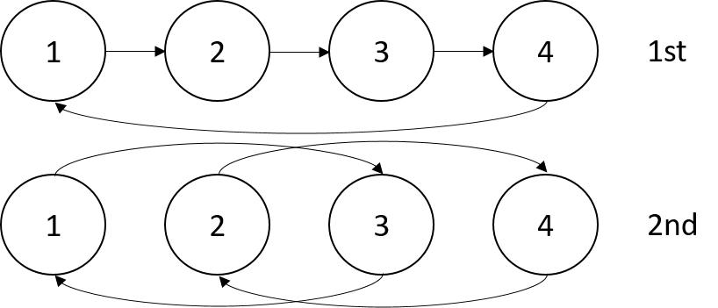


Terasort
Transfer data using MPI
Sorting 1TB of data records
Terasort execution time in 64 and 32 nodes. Only MPI shows the sorting time and communication time as other two frameworks doesn't provide a viable method to accurately measure them. Sorting time includes data save time. MPI-IB - MPI with Infiniband
Partition the data using a sample and regroup

Slide 29

Dataflow at Different Grain sizes
Coarse Grain Dataflows links jobs in such a pipeline
Visualization
Dimension
Reduction
Data preparation
Clustering
But internally to each job you can also elegantly express algorithm as dataflow but with more stringent performance constraints
Corresponding to classic Spark K-means Dataflow
P = loadPoints()
C = loadInitCenters()
for (int i = 0; i < 10; i++) {
T = P.map().withBroadcast(C)
C = T.reduce() }
Internal Execution
Dataflow Nodes
Reduce
Iterate
HPC
Communication
Maps
Iterate

Slide 30
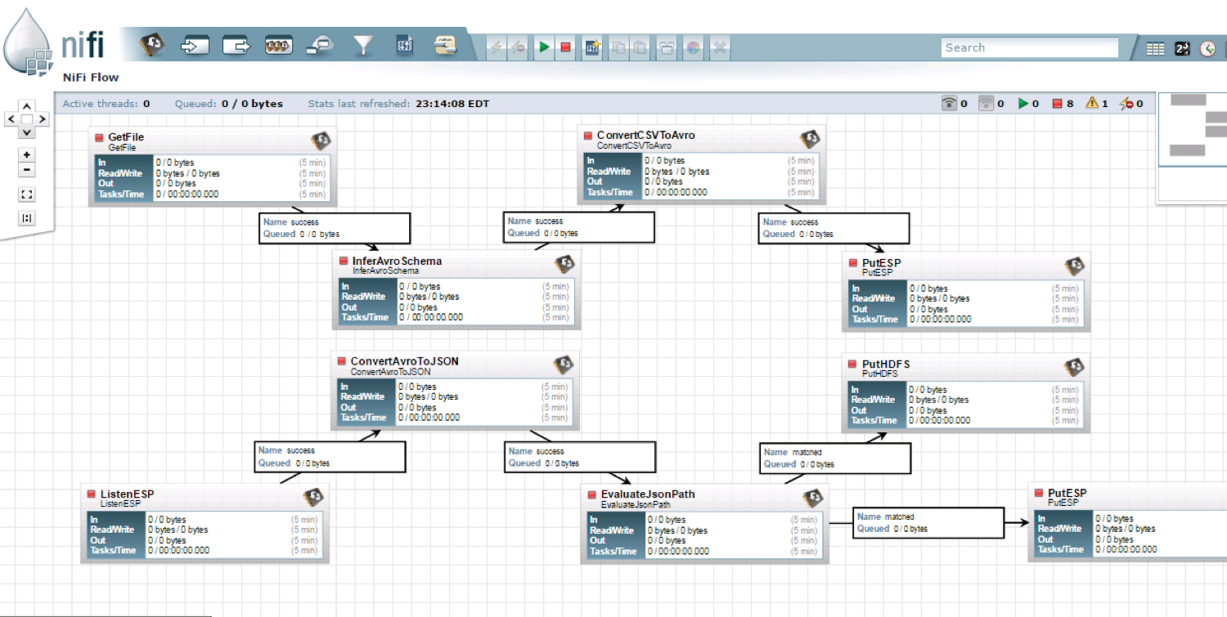
NiFi Workflow

Slide 31

Flink MDS Dataflow Graph

Slide 32
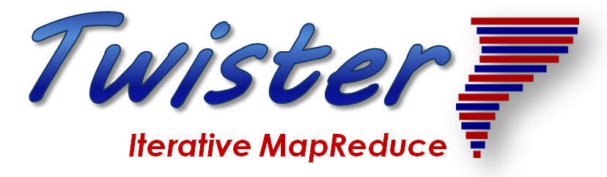
Implementing Twister2 in detail I
http://www.iterativemapreduce.org/
This breaks rule from 2012-2017 of not “competing” with but rather “enhancing” Apache
Look at Communication in detail

Slide 33
Twister2 Components I
Area | Component | Implementation | Comments: User API
Architecture Specification | Coordination Points | State and Configuration Management; Program, Data and Message Level | Change execution mode; save and reset state
 | Execution Semantics | Mapping of Resources to Bolts/Maps in Containers, Processes, Threads | Different systems make different choices - why?
 | Parallel Computing | Spark Flink Hadoop Pregel MPI modes | Owner Computes Rule
Job Submission | (Dynamic/Static) Resource Allocation | Plugins for Slurm, Yarn, Mesos, Marathon, Aurora | Client API (e.g. Python) for Job Management
Task System | Task migration | Monitoring of tasks and migrating tasks for better resource utilization | Task-based programming with Dynamic or Static Graph API; FaaS API; Support accelerators (CUDA,KNL)
 | Elasticity | OpenWhisk
 | Streaming and FaaS Events | Heron, OpenWhisk, Kafka/RabbitMQ
 | Task Execution | Process, Threads, Queues
 | Task Scheduling | Dynamic Scheduling, Static Scheduling, Pluggable Scheduling Algorithms
 | Task Graph | Static Graph, Dynamic Graph Generation

Slide 34
Twister2 Components II
Area | Component | Implementation | Comments
Communication API | Messages | Heron | This is user level and could map to multiple communication systems
 | Dataflow Communication | Fine-Grain Twister2 Dataflow communications: MPI,TCP and RMA Coarse grain Dataflow from NiFi, Kepler? | Streaming, ETL data pipelines; Define new Dataflow communication API and library
 | BSP Communication Map-Collective | Conventional MPI, Harp | MPI Point to Point and Collective API
Data Access | Static (Batch) Data | File Systems, NoSQL, SQL | Data API
 | Streaming Data | Message Brokers, Spouts
Data Management | Distributed Data Set | Relaxed Distributed Shared Memory(immutable data), Mutable Distributed Data | Data Transformation API; Spark RDD, Heron Streamlet
Fault Tolerance | Check Pointing | Upstream (streaming) backup; Lightweight; Coordination Points; Spark/Flink, MPI and Heron models | Streaming and batch cases distinct; Crosses all components
Security | Storage, Messaging, execution | Research needed | Crosses all Components

Slide 35
Scheduling Choices
Scheduling is one key area where dataflow systems differ
  Dynamic Scheduling (Spark)
    Fine grain control of dataflow graph
    Graph cannot be optimized
  Static Scheduling (Flink)
    Less control of the dataflow graph
    Graph can be optimized
Twister2 will allow either

Slide 36
Communication Models
MPI Characteristics: Tightly synchronized applications
  Efficient communications (µs latency) with use of advanced hardware
  In place communications and computations (Process scope for state)
Basic dataflow: Model a computation as a graph
  Nodes do computations with Task as computations and
  edges are asynchronous communications
  A computation is activated when its input data dependencies
  are satisfied
Streaming dataflow: Pub-Sub with data partitioned into streams
  Streams are unbounded, ordered data tuples
  Order of events important and group data into time windows
Machine Learning dataflow: Iterative computations and keep track of state
  There is both Model and Data, but only communicate the model
  Collective communication operations such as AllReduce AllGather (no differential operators in Big Data problems)
  Can use in-place MPI style communication
W
S
W
G
S
Dataflow
W

Slide 37
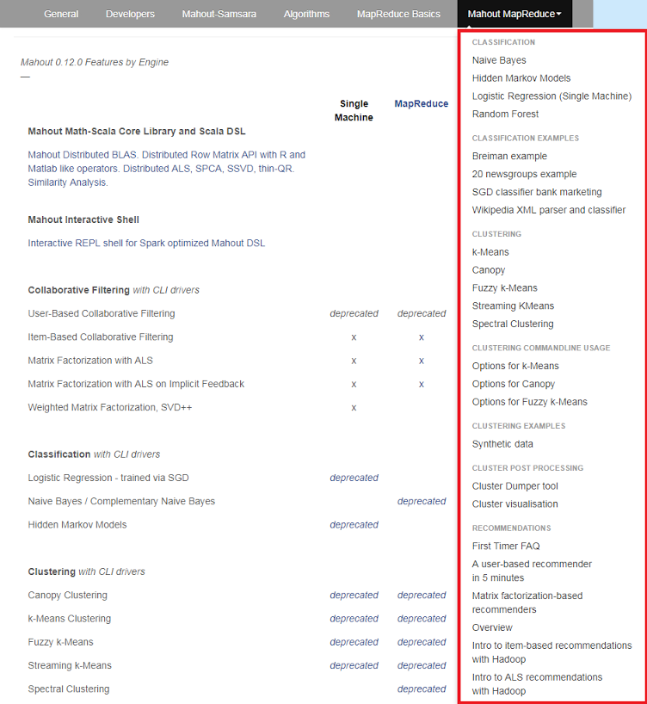
Mahout and SPIDAL
Mahout was Hadoop machine learning library but largely abandoned as Spark outperformed Hadoop
SPIDAL outperforms Spark Mllib and Flink due to better communication and in-place dataflow.
SPIDAL also has community algorithms
  Biomolecular Simulation
  Graphs for Network Science
  Image processing for pathology and polar science

Slide 38
Qiu/Fox Core SPIDAL Parallel HPC Library with Collective Used
DA-MDS Rotate, AllReduce, Broadcast
Directed Force Dimension Reduction AllGather, Allreduce
Irregular DAVS Clustering Partial Rotate, AllReduce, Broadcast
DA Semimetric Clustering (Deterministic Annealing) Rotate, AllReduce, Broadcast
K-means AllReduce, Broadcast, AllGather DAAL
SVM AllReduce, AllGather
SubGraph Mining AllGather, AllReduce
Latent Dirichlet Allocation Rotate, AllReduce
Matrix Factorization (SGD) Rotate DAAL
Recommender System (ALS) Rotate DAAL
Singular Value Decomposition (SVD) AllGather DAAL
QR Decomposition (QR) Reduce, Broadcast DAAL
Neural Network AllReduce DAAL
Covariance AllReduce DAAL
Low Order Moments Reduce DAAL
Naive Bayes Reduce DAAL
Linear Regression Reduce DAAL
Ridge Regression Reduce DAAL
Multi-class Logistic Regression Regroup, Rotate, AllGather
Random Forest AllReduce
Principal Component Analysis (PCA) AllReduce DAAL
DAAL implies integrated on node with Intel DAAL Optimized Data Analytics Library (Runs on KNL!)

Slide 39
Harp Plugin for Hadoop: Important part of Twister2
Work of Judy Qiu

Slide 40
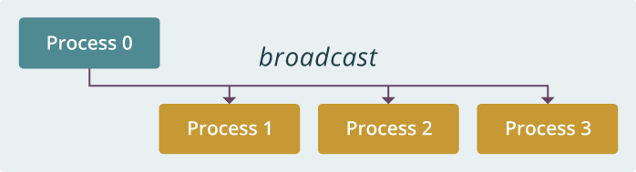
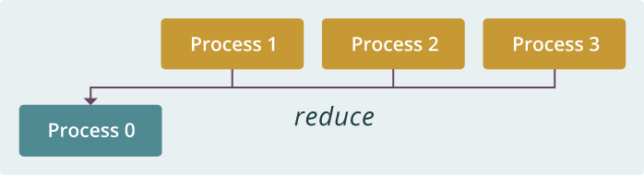
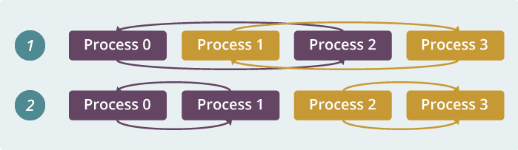
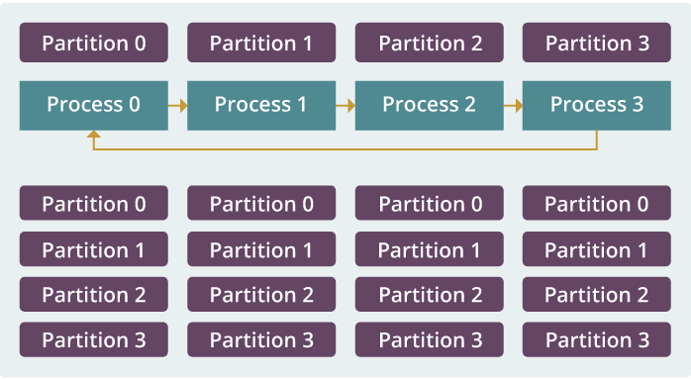
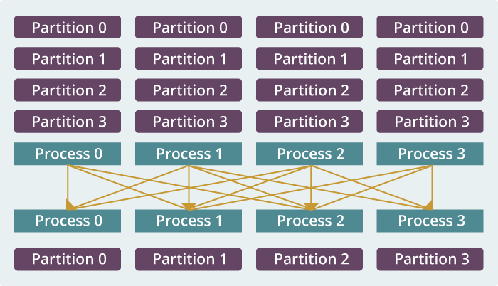
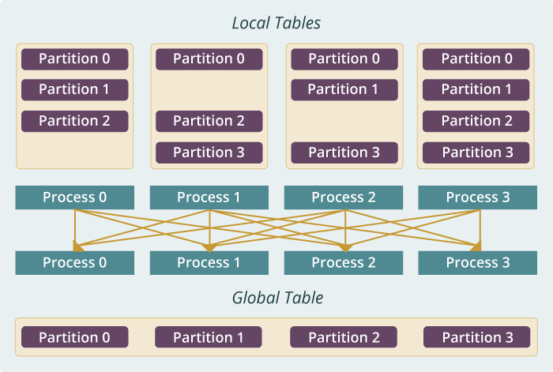
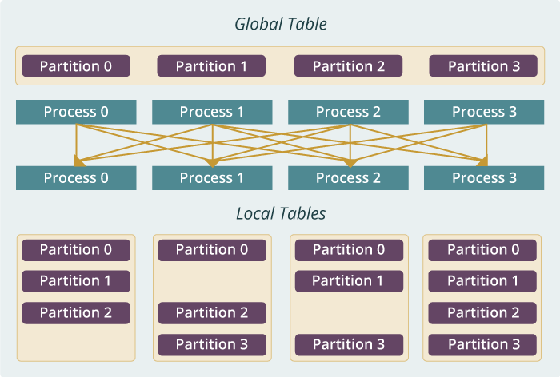
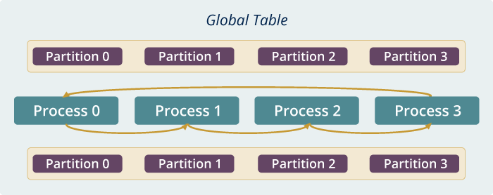
Qiu MIDAS run time software for Harp
broadcast
reduce
allreduce
allgather
regroup
push & pull
rotate
Map Collective Run time merges MapReduce and HPC

Slide 41
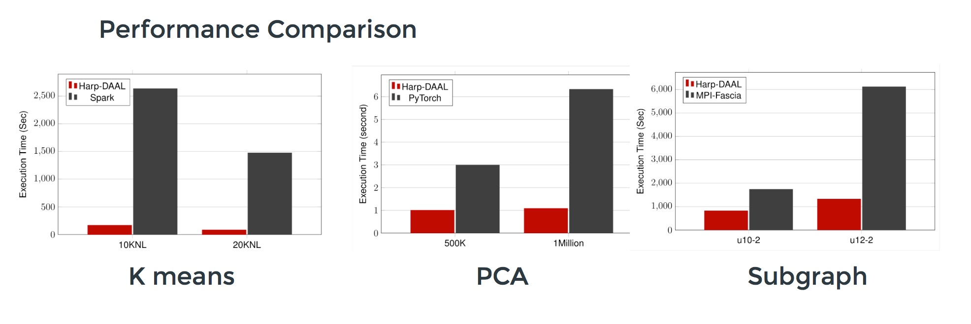
Harp v. Spark Harp v. Torch Harp v. MPI
Datasets: 5 million points, 10 thousand centroids, 10 feature dimensions
10 to 20 nodes of Intel KNL7250 processors
Harp-DAAL has 15x speedups over Spark MLlib
Datasets: 500K or 1 million data points of feature dimension 300
Running on single KNL 7250 (Harp-DAAL) vs. single K80 GPU (PyTorch)
Harp-DAAL achieves 3x to 6x speedups
Datasets: Twitter with 44 million vertices, 2 billion edges, subgraph templates of 10 to 12 vertices
25 nodes of Intel Xeon E5 2670
Harp-DAAL has 2x to 5x speedups over state-of-the-art MPI-Fascia solution

Slide 42
Implementing Twister2 in detail II
State

Slide 43
Systems State Spark Kmeans Dataflow
State is handled differently in systems
  CORBA, AMT, MPI and Storm/Heron have long running tasks that preserve state
  Spark and Flink preserve datasets across dataflow node using in-memory databases
  All systems agree on coarse grain dataflow; only keep state by exchanging data
P = loadPoints()
C = loadInitCenters()
for (int i = 0; i < 10; i++) {
T = P.map().withBroadcast(C)
C = T.reduce() }
Iterate
Save State at Coordination Point
Store C in RDD

Slide 44
Fault Tolerance and State
Similar form of check-pointing mechanism is used already in HPC and Big Data
  although HPC informal as doesn’t typically specify as a dataflow graph
  Flink and Spark do better than MPI due to use of database technologies; MPI is a bit harder due to richer state but there is an obvious integrated model using RDD type snapshots of MPI style jobs
Checkpoint after each stage of the dataflow graph (at location of intelligent dataflow nodes)
  Natural synchronization point
  Let’s allows user to choose when to checkpoint (not every stage)
  Save state as user specifies; Spark just saves Model state which is insufficient for complex algorithms

Slide 45
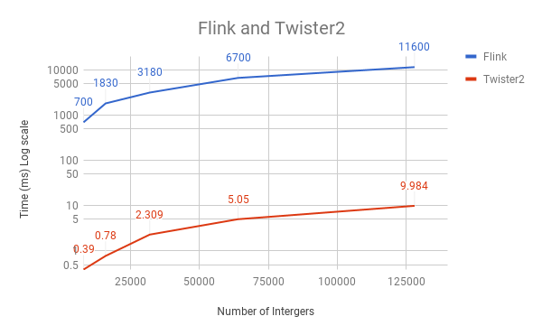
Initial Twister2 Performance
Eventually test lots of choices of task managers and communication models; threads versus processes; languages etc.
Here 16 Haswell nodes each with 1 process running 20 tasks as threads; Java
Reduce microbenchmark for Apache Flink and Twister2; Flink poor performance due to nonoptimized reduce operation
Twister2 has a new dataflow communication library based on MPI – in this case a 1000 times faster than Flnk

Slide 46
Summary of Twister2: Next Generation HPC Cloud + Edge + Grid
We suggest an event driven computing model built around Cloud and HPC and spanning batch, streaming, and edge applications
  Highly parallel on cloud; possibly sequential at the edge
Integrate current technology of FaaS (Function as a Service) and server-hidden (serverless) computing with HPC and Apache batch/streaming systems
We have built a high performance data analysis library SPIDAL
We have integrated HPC into many Apache systems with HPC-ABDS
We have done a very preliminary analysis of the different runtimes of Hadoop, Spark, Flink, Storm, Heron, Naiad, DARMA (HPC Asynchronous Many Task)
There are different technologies for different circumstances but can be unified by high level abstractions such as communication collectives
  Obviously MPI best for parallel computing (by definition)
Apache systems use dataflow communication which is natural for distributed systems but inevitably slow for classic parallel computing
  No standard dataflow library (why?). Add Dataflow primitives in MPI-4?
MPI could adopt some of tools of Big Data as in Coordination Points (dataflow nodes), State management with RDD (datasets)

