Slide 1
IU QuakeSim Annual Report Slides

Slide 2
IU People
Geoffrey Fox and Marlon Pierce are Co-PIs at IU.
Xiaoming Gao: graduate student, developer of the RDAHMM-related Web interfaces and services.
Jun Ji: hourly staff, developer of deformation analysis (Disloc, Simplex, Geofest) Web interfaces and support.
  Ji completed his M.S. in May 2010 and worked on the project through OPT until December 1, 2010
Jun Wang: full time staff, working on visualization services, GIS, and E-DECIDER related deliverables.
Yu Ma: full time staff, developing deformation and time-series user interfaces and providing infrastructure support
Josh Rosen: full time staff, developed the RDAHMM GPS flash viewer.
  Josh worked part time to upgrade the viewer.

Slide 3
Publications and Presentations
Publications
  Marlon E. Pierce, Xiaoming Gao, Sangmi Lee Pallickara, Zhenhua Guo, Geoffrey Fox: The Quakesim portal and services: new approaches to science gateway development techniques. Concurrency and Computation: Practice and Experience 22(12): 1732-1749 (2010)
  Xiaoming Gao, Yu Ma, Marlon Pierce, Mike Lowe, Geoffrey Fox, “Building a Distributed Block Storage System for Cloud Infrastructure” Proceedings of CloudCom 2010 Conference IUPUI Conference Center Indianapolis November 30-December 3 2010.
  Marlon E. Pierce, Geoffrey C. Fox, Yu Ma, Jun Wang, “Cloud Computing and Spatial Cyberinfrastructure” Technical Report submitted to PNAS special issue on spatial cyberinfrastructure.
  Andrea Donnellan, Marlon Pierce, Dennis McLeod, Jay Parker, John Rundle, Lisa Grant, Rami Al-Ghanmi, Gepffrey Fox, Robert Granat, “Integrating GPS, InSAR, and UAVSAR data into the QuakeSim Computational Environment” 2011 IEEE Aerospace Conference March 5-12, 2011, Big Sky, Montana
Presentations
  Geoffrey Fox, “Cloud Architecture for Earthquake Science” Abstract for 7th ACES International Workshop OTARU, October 3-8, 2010
  Donnellan, A., Parker, J., Granat, R., Lyzenga, G., Glasscoe, M., Rundle, J., McLeod, D., Al-Ghanmi, R., Pierce, M., Fox, G. and Ludwig, L. G., “QuakeSim Earthquake Modeling, Forecasting, and Data Access Tools” Abstract for 7th ACES International Workshop OTARU, October 3-8, 2010
  Gao, X., Granat, R., Pierce, M. and Wang, J., “Building Services and Web Portal for GPS Time Series Data Analysis” Abstract for 7th ACES International Workshop OTARU, October 3-8, 2010
  Pierce, M, Fox, G, Gao, X, Ji, J, Ma, Y, Wang, J, Donnellan, A, Parker, J, Glasscoe, M, Granat, R, Al-Ghanmi, R and McLeod, D, “QuakeSim Science Gateway Updates” Abstract for 7th ACES International Workshop OTARU, October 3-8, 2010
[Does not include AGU abstracts. Others should have these]

Slide 4
Outreach
[Major outreach activity was the “eye in the sky”(?) demo and tutorial. Maggi will have more information on this.

Slide 5
QuakeSim Portal Overview
QuakeSim is a science gateway that provides Web user and Web service interfaces to earthquake modeling tools:
  Fault deformation analysis: Disloc, Simplex, GeoFEST
  GPS time series analysis: RDAHMM
Data sources include
  QuakeTables Fault Database: fault models
  Scripps GRWS: GPS data products
  UNAVCO: GPS data products
All tools are exposed as online services. Inputs and outputs are URLs. We export results as KML for use outside the portal.
All user interface Web components work as both portlets and Google gadgets.

Slide 6
Available Gateway Applications
Application | Purpose | Data Source | Compared To
GeoFEST | Finite element deformation model | Faults | GPS and InSAR surface deformation
Disloc | Surface displacements from fault motion | Faults | GPS and InSAR surface deformation
Simplex | Inversion for fault motion from deformation data | InSAR and GPS surface deformation | Fault data constrain model
RIPI (results only) | Seismic pattern analysis | Seismicity | Earthquake faults
RDAHMM | Time series analysis | GPS | Earthquake, aquifer sources

Slide 7
GPS Data Analysis with RDAHMM
Xiaoming Gao, Josh Rosen, and Yu Ma

Slide 8
Accomplishments
Now providing RDAHMM analysis and classification for both JPL and SOPAC solutions.
  Will be adding UNAVCO
Redesigned processing pipeline as independent services.
  Pipeline now composible, executable as a workflow.
  Will give power users more control over the processing pipeline (can add, replace components)
Several user interface improvements resulting from IU visit by Robert Granat.
  Improved GPS viewer, bug fixes, etc

Slide 9
Daily RDAHMM – user configurable workflow
Prototype Web services – RDAHMM processing:
Web service name | Functionality
ModelBuilder | Build RDAHMM model
Evaluator | Complete RDAHMM evaluation
User-defined filter Web services:
DetrendFilter | De-trend the input data
DenoiseFilter | De-noise the input data
DenoiseOutputPatcher | Patch the de-noised data with duplicated data
General auxiliary filter Web services:
MissingDataNaNFiller | Fill missing data in GPS time series raw file with “NaN”
InputExtracter | Extract input data columns from GPS time series raw file
FilteredRawComposer | Compose GPS time series raw file with filtered input data
MissingDataDupFiller | Fill missing data in GPS time series raw file with duplicates
FileConcatenater | Concatenate the modeling input and evaluation input files

Slide 10
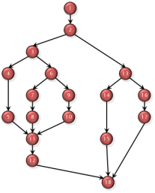
Daily RDAHMM – user configurable workflow
Ideal working mode:
Workflow composer such as XBaya
User/Researcher
Workflow configuration file
Daily RDAHMM portal
Daily RDAHMM workflow runner
results
GPS time series data

Slide 11
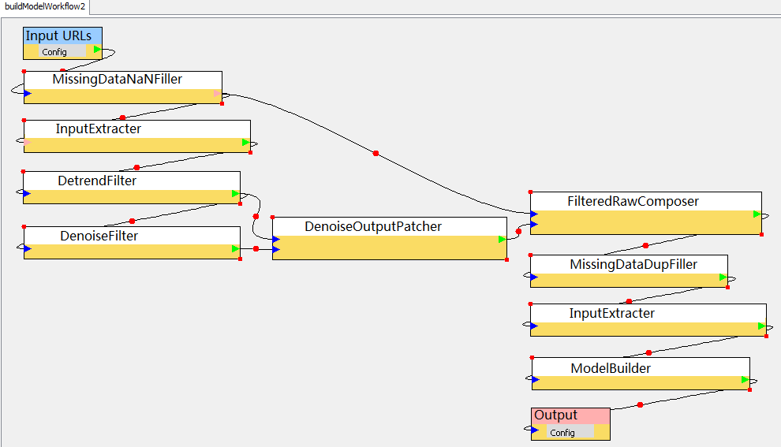
Daily RDAHMM – user configurable workflow
Prototype RDAHMM modeling workflow in XBaya:
Pre-defined filtering component template

Slide 12
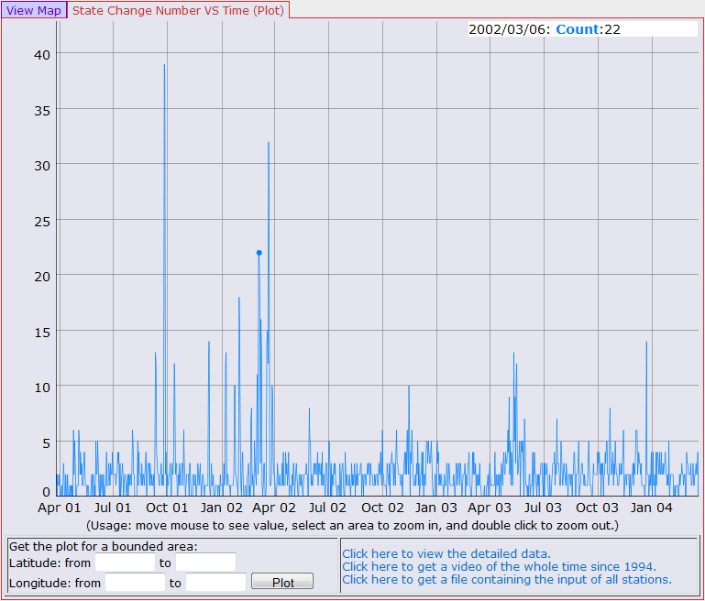
Daily RDAHMM – new state change number vs. time plot component
Use the "DyGraph" Javascript component to draw the plot
Select data points by moving mouse through the plot
Zoom in to a specific time section by selecting an area in the plot

Slide 13
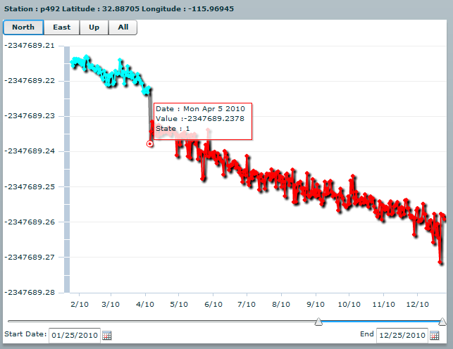
Daily RDAHMM – updates to portlet user interface
Support for multiple date formats in user input, including 'yyyy-mm-dd', 'yyyy/MM/dd', 'MM/dd/yyyy', 'MMMM dd, yyyy', and 'MMM dd, yyyy'.
Corrected a bug in the GPS plotting component about date display
Used to be “Wed May 5 2010”

Slide 14
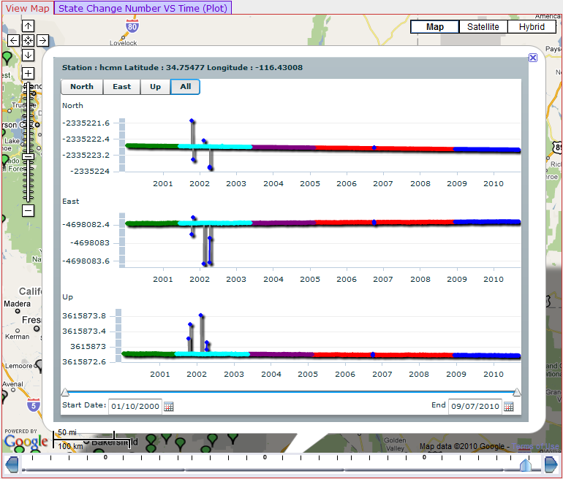
RDAHMM GPS Viewer Updates
RDAHMM and GPS user interfaces are described in more detail in a companion talk.
We highlight here some improvements to the GPS results viewer.
This is an Adobe Flash application embedded into Google maps in the “Daily RDAHMM” gadget.

Slide 15
New Interactive Plotting Component (More Later)
- better point and line connections
- zoom-in and zoom-out in time scale
- slide-though along time axis

Slide 16
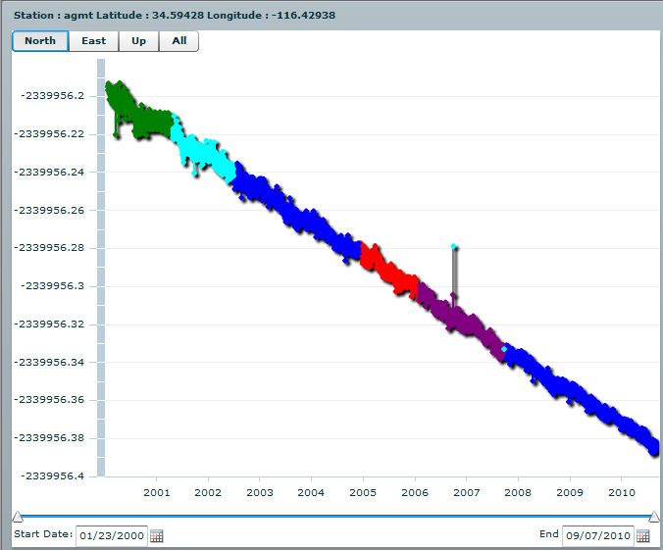
We made several updates to our interactive GPS viewer.

Slide 17
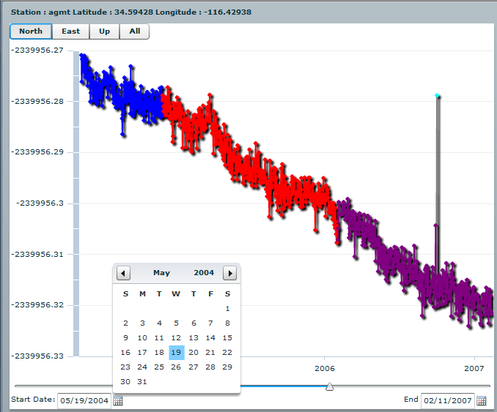
Specific Date Chooser

Slide 18
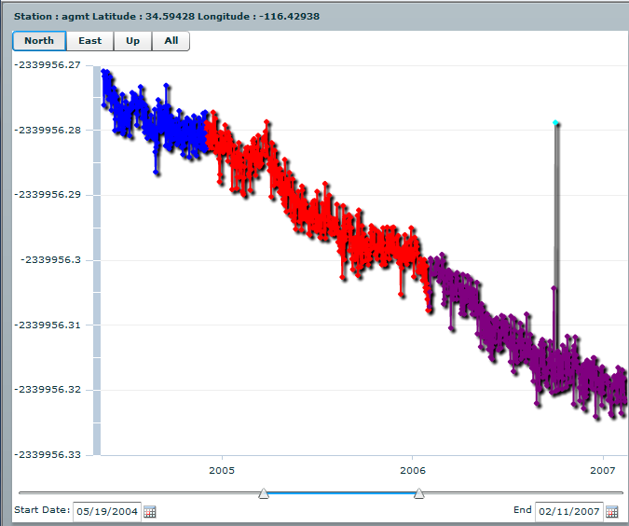
A dual slider allows you to navigate by hand. The slider also moves as a whole to keep the
Interval static.

Slide 19
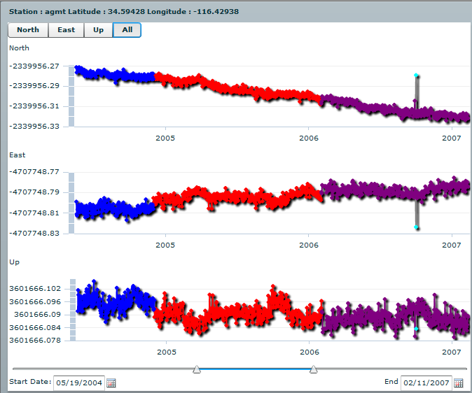
All three axes can be displayed simultaneously to see the whole picture. The
date filtering applies to each graph so the data lines up properly.

Slide 20
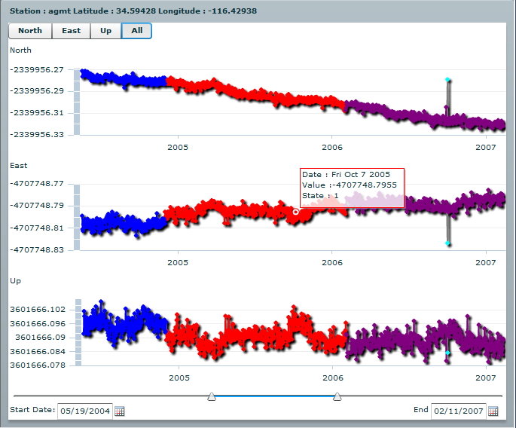
Pop-ups with detailed. point specific data can be found by moving the
mouse over the graphs.

Slide 21
Data Cloud Updates
Xiaoming Gao, Yu Ma

Slide 22
Accomplishments
Redesigned Virtual Block Store (VBS) research system to build on top of Lustre file system.
  Substantial benchmarking and comparison with previous design
Paper presented at CloudCom2010.
Example applications support workflows tested, documented for submission to PNAS

Slide 23
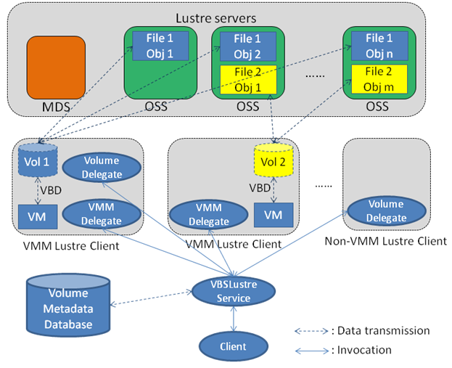
VBS – extended architecture based on Lustre
Better scalability and reliability
Public key user authentication and access control
Read-only volume sharing
Publication: “Building a Distributed Block Storage System for Cloud Infrastructure”, CloudCom 2010, Indianapolis, November 30-December 3, 2010.

Slide 24
VBS – application in FloodGrid
shared volume
private volume
private volume
private volume
private volume
Model files, programs
results
results
results
results
Simulation service
Simulation service
Simulation service
Simulation service
VM 1
VM 2
VM 3
VM 4
Simulation for 10 flood scenarios takes 205 minutes on 4 VMs.
In comparison, it takes 739 minutes if only 1 VM is used.

Slide 25
Deformation Tools Updates
Jun Wang, Jun Ji, Yu Ma

Slide 26
Accomplishments
Added “RSS Disloc” service: automatically runs deformation simulation for all earthquakes in the world with M>=5.0
  As they are published on USGS’s RSS feed.
Improved plotting and visualization services
  Substantial feedback resulting from Baja earthquake, UAVSAR
Added UNAVCO GPS station velocities to Simplex.
Various user interface improvements
Prototype earthquake animation service (harvested from ANSS, QuakeTables)

Slide 27
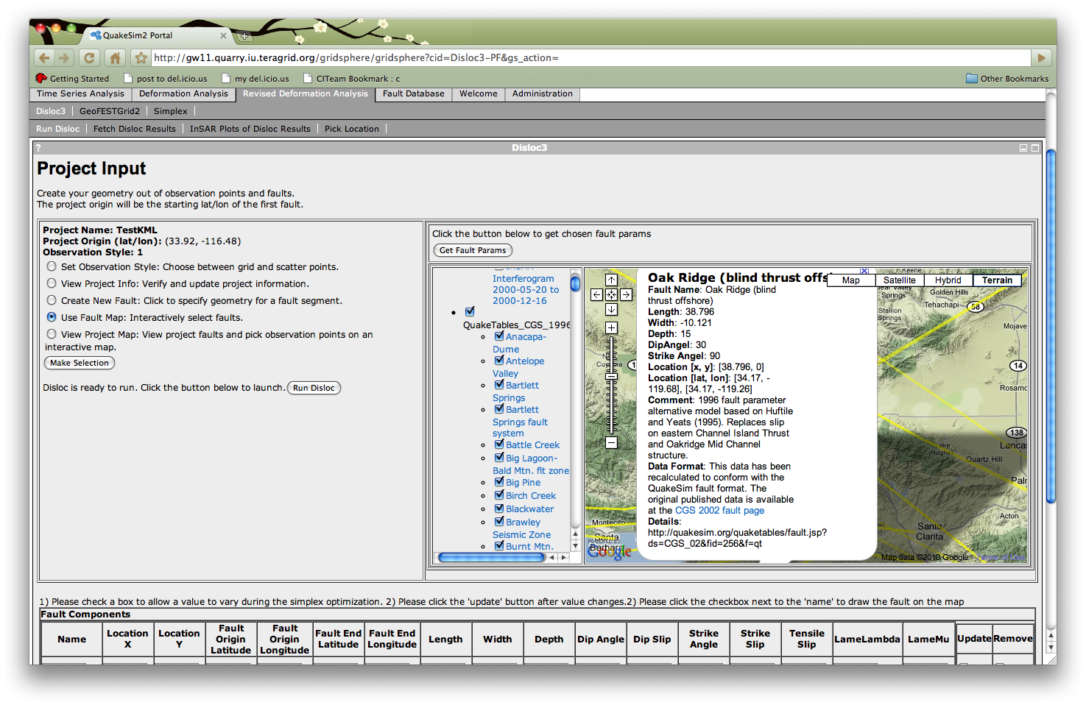
Deformation Tool Enhancements
Deformation tools updated to to interact with the upgraded Fault Database.
Faults now organized into appropriate CGS catalogs and accessible by KML-emitting REST services for each catalog.
Upgraded map interfaces to display the new KML and integrate its data into the Disloc, Simplex, and GeoFEST application submission tools.
Disloc portlet showing upgraded map interface. Faults in the map come from the revised QuakeTables fault database’s KML service. Parameter values for the fault model in the dialog box are extracted and used to set up deformation jobs.

Slide 28
RSS-Driven Disloc and InSAR Plotting Service
We developed a version of the Disloc tool that is driven by the USGS M>5.0 Earthquake RSS feed.
You can view results anonymously.
You also can log in with Google ID and copy results to your personal workspace.
  Can edit parameters submission parameters.

Slide 29
Disloc-RSS Service and User Interface
KMLGenerator
3. Generate displacement arrows per earthquake case
AutomatedRssDisloc
Webservice
1. Request
Disloc
RssDisloc3
4. Send
InsarGenerator
3. Read pre-calculated results for the earthquake or run Disloc, InsarGenerator and store the results if the earthquake case isn’t pre-calculated.
2. Update if it has been an hour since the last update
Pre-calculated results
USGS earthquake RSS feed
http://earthquake.usgs.gov/
earthquakes/catalogs/
7day-M5.xml

Slide 30
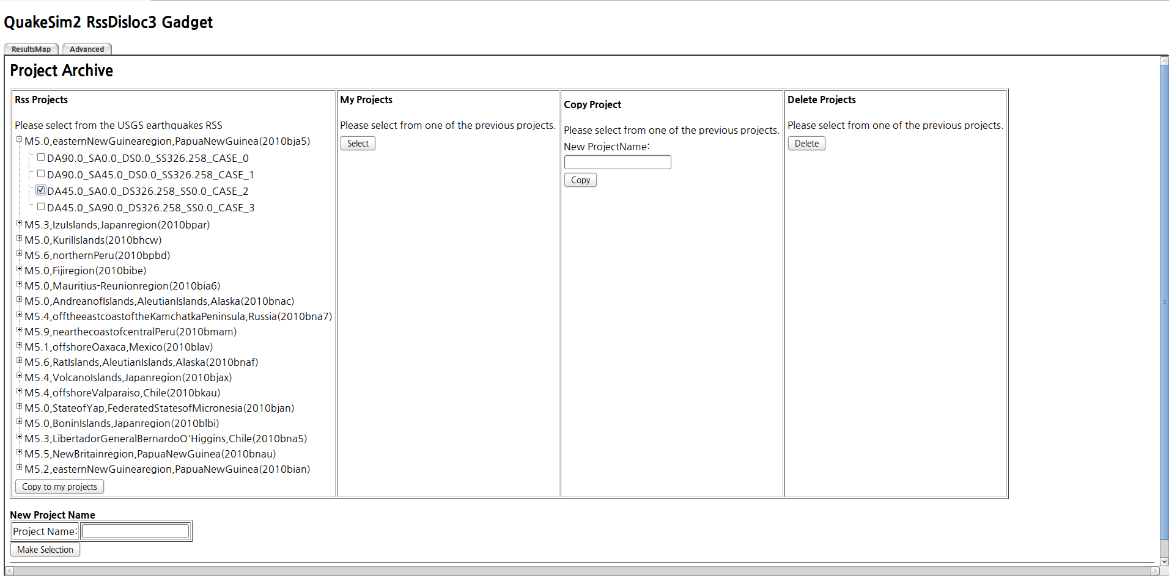
Users can copy the earthquakes into their personal workspace to modify the default Disloc settings.

Slide 31
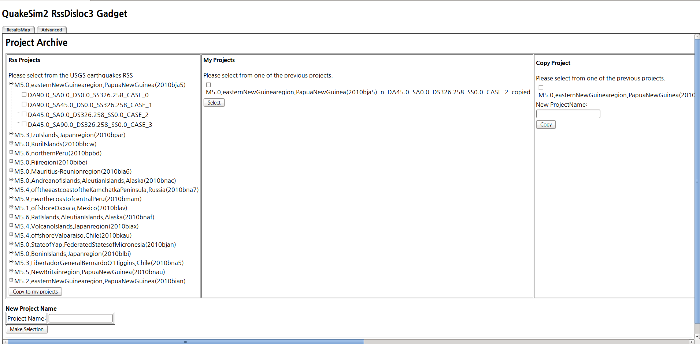
The copied project already has pre-calculated disloc result, displacement arrows kml, insar image kml.

Slide 32
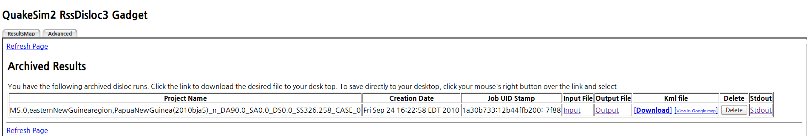
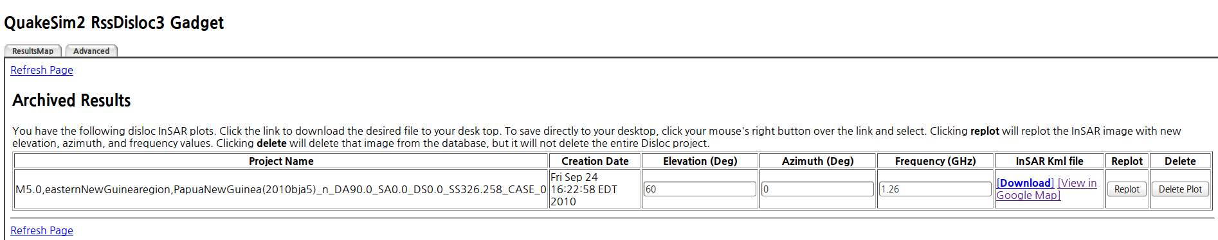
User can see the results at ‘FetchResults’, ‘InSarPlots’.

Slide 33
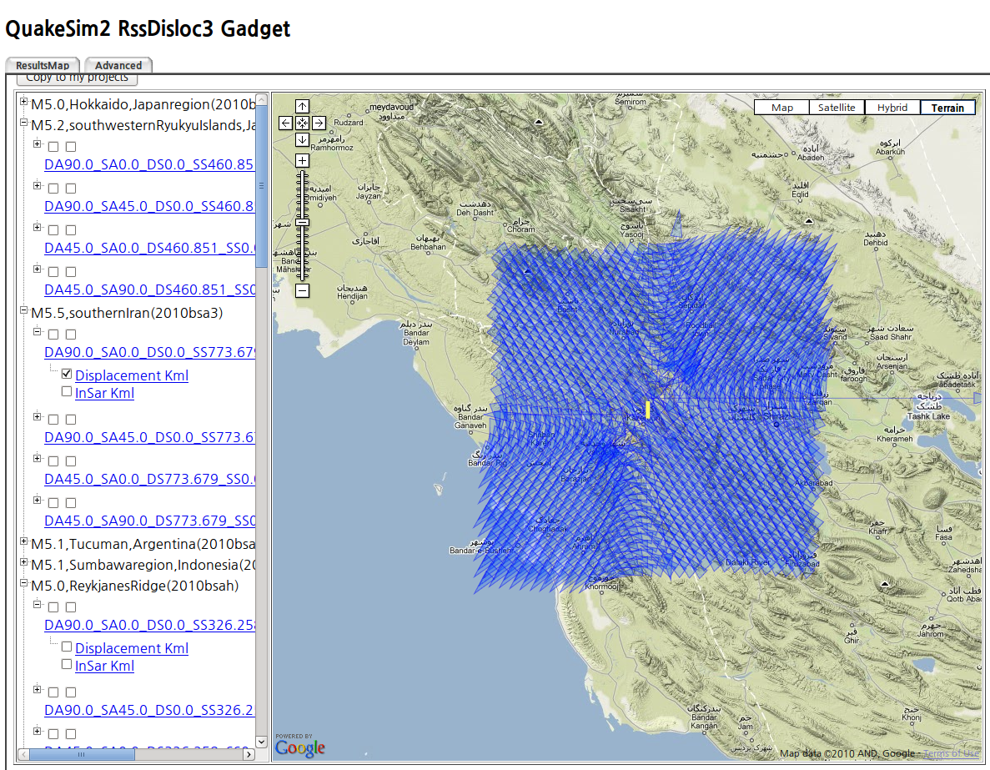
Subscribes to USGS earthquake RSS feed, calculates Disloc deformations and InSAR interferograms for every earthquake in the world with M>5. Uses previously developed Disloc services and since the same case number makes same results, it reuses the pre-calculated data from the second run. Plot is M 5.5 earthquake in southern Iran. Arrows are displacements. Detailed information in clickable popup.

Slide 34
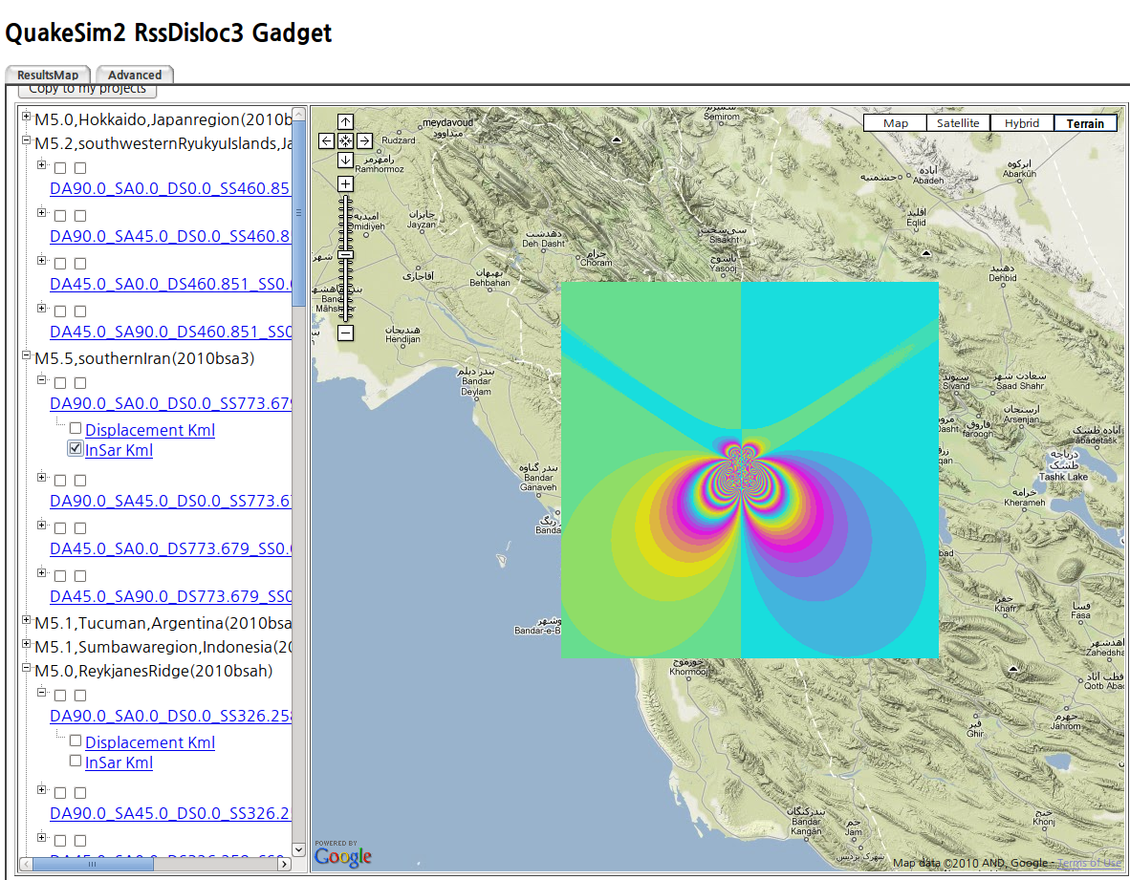
Interferogram plot of the same earthquake in previous slide.

Slide 35
Simplex Updates
Simplex is an inversion code that determines best-fit fault models for a particular set of observed displacements or velocities.
We have added UNAVCO GPS station velocities to Simplex’s user interface.
  Using a Web service provided by UNAVCO.
  Supplements JPL GIPSY and Scripps GLOBK values from Yehuda Bock’s team’s GRWS service.
This is introduces a problem, since the services give different values.
  Need an easy interface for selecting the ones you want.

Slide 36
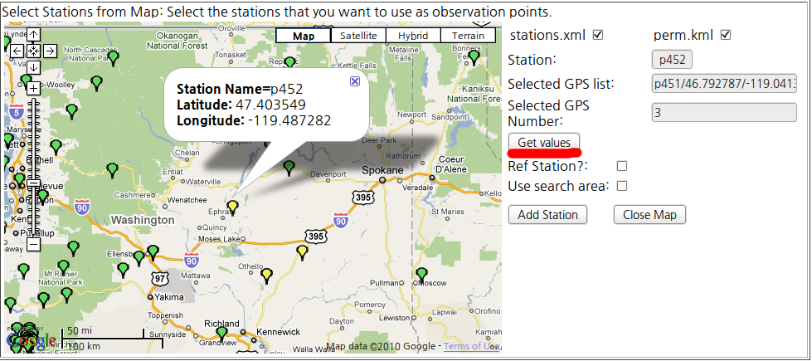
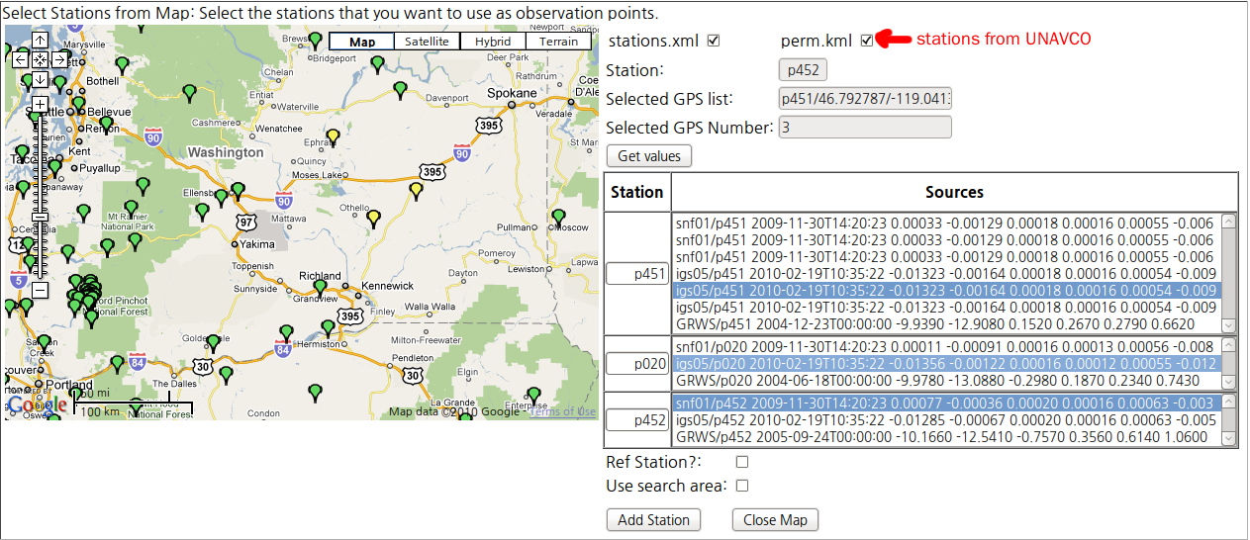
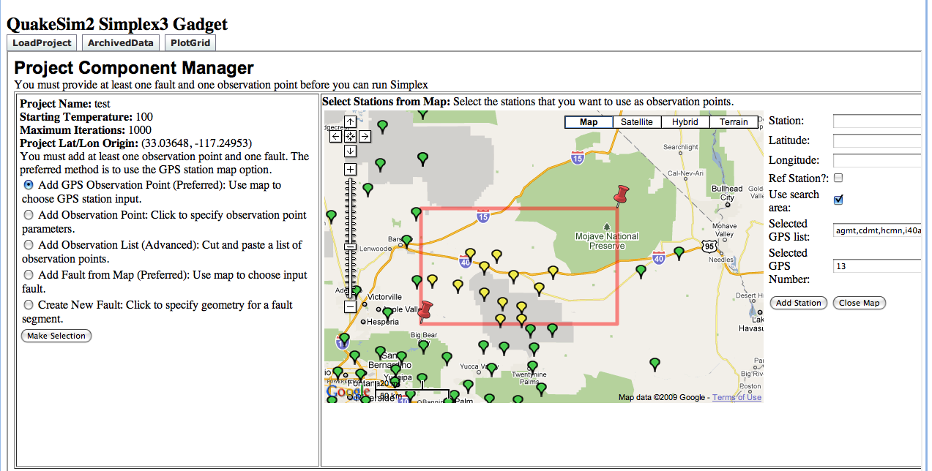
Select GPS stations with map interface. This may have multiple values.
View multiple values, select the data source that you want.
Optionally, select multiple GPS stations with draggable box.

Slide 37
Plotting Service Update
Color matching between UAVSAR and Disloc interferogram
Publication-ready plotting products for daily RDAHMM GPS data analysis
3D earthquake visualization

Slide 38
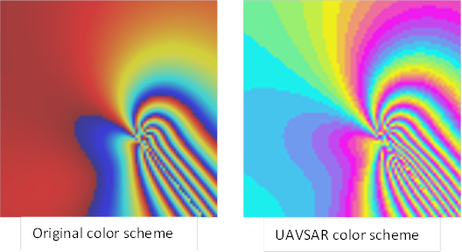
Color Matching
Color matching between UAVSAR and Disloc interferogram

Slide 39
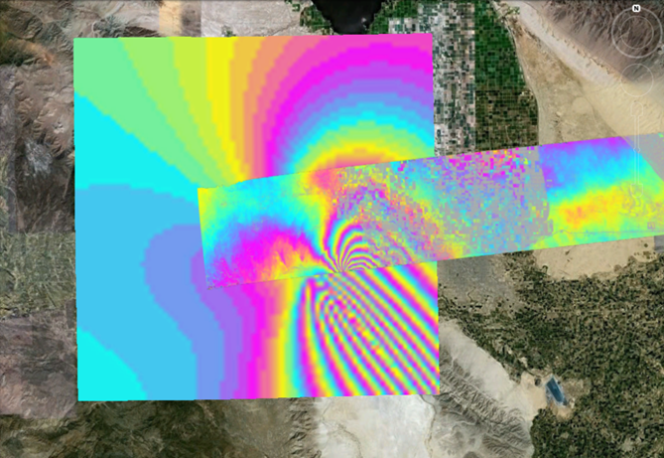
Color Matching
The example of displaying disloc interferogram and UAVSAR interferogram on Google Earth.

Slide 40
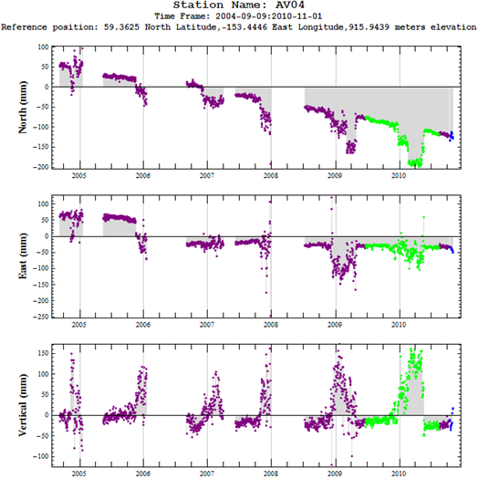
Publication-Ready Plotting Products
Support high quality output formats: eps and pdf.

Slide 41
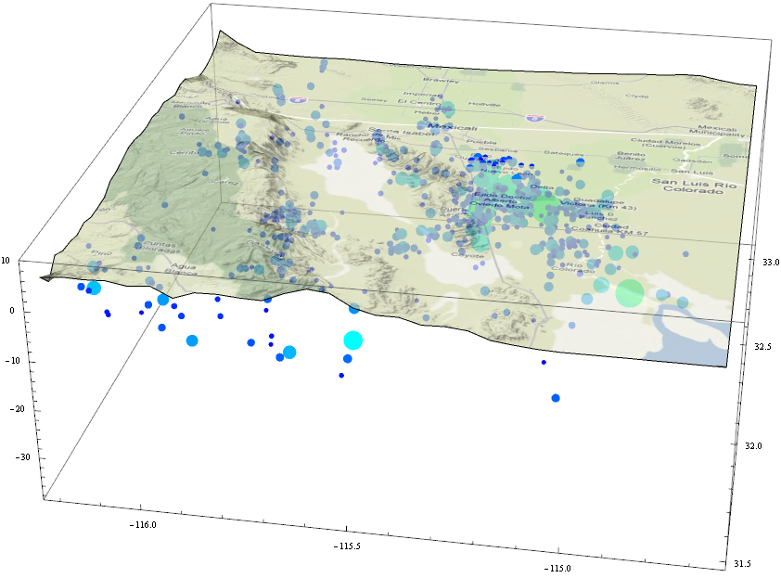
3D Earthquake Visualization
Visualize earthquakes in 3D for a given region (prototype development)

Slide 42
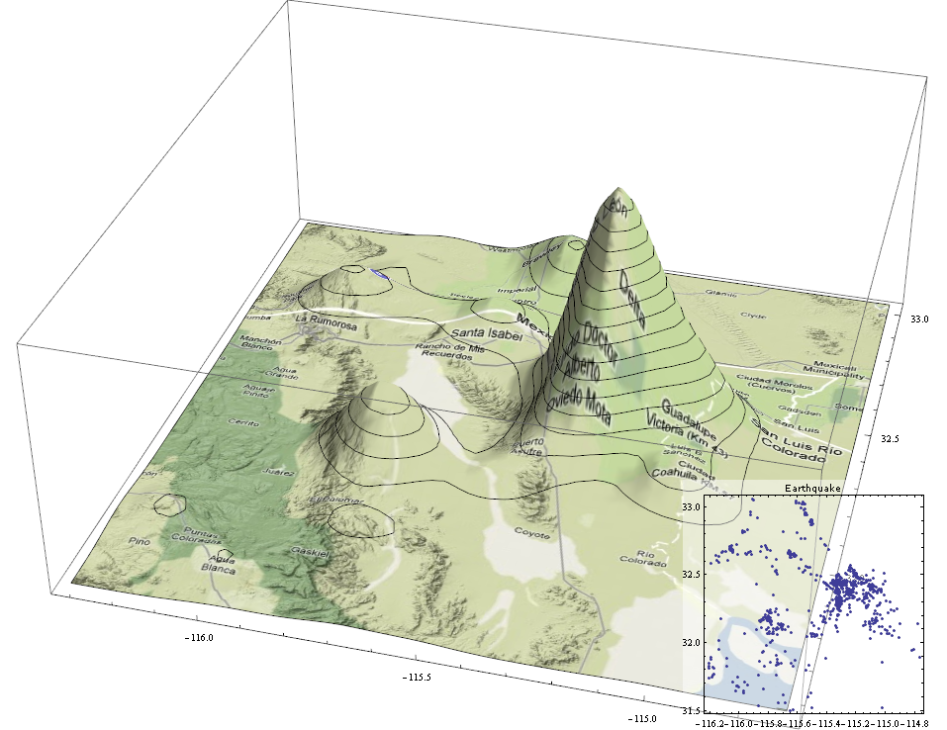
3D Visualization: Spatial Distribution
Visualize 2D earthquake spatial distribution in 3D with Google Map overlay

Slide 43
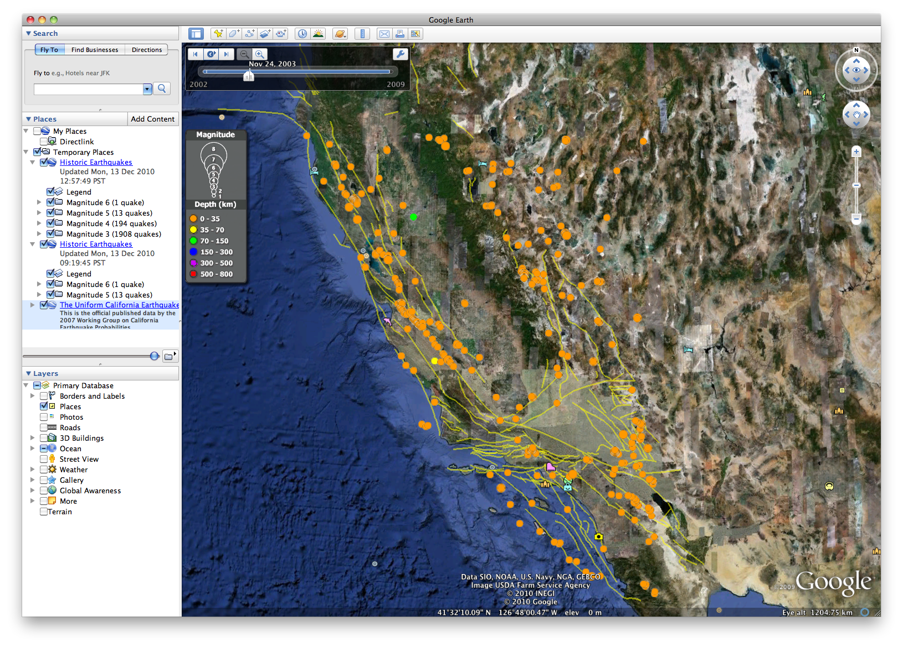
Animated KML of all earthquakes M>=3 from ANSS catalog and UCERF faults from QuakeTables database. KML generated by prototype plotting service developed with Jersey REST libraries.

