Slide 1
Introduction To Windows Azure Cloud
Thilina Gunarathne, Indiana University
Notes:
I’m going to give you an overview and an introduction to Windows Azure cloud. This will be followed up by a presentation on Twister4Azure, iterative MapREduce framework.

Slide 2
What is a “Cloud”?
Cloud: on-demand, scalable, multi-tenant, self-service compute and storage resources
Server Provisioning
Cloud Provisioning
Demand
Demand
Time
Overprovisioned
Time
Underprovisioned
Notes:
I’m sure you all have heard enough of wat is cloud and wat is not.
Left side graph shows typical data center envrionment. Where you provision a certain number of compute resources and the demand often times is not predictable. Sometime you may have over provisioned wasting your money, while in other times you may be under provisioned, affecting your application performance.

Slide 3
Cloud Computing Patterns
On and Off
Inactivity
Period
On & off workloads (e.g. batch job)
Over provisioned capacity is wasted
Time to market can be cumbersome
Compute
t
Growing Fast
Compute
Successful services needs to grow/scale
Keeping up w/ growth is big IT challenge
Cannot provision hardware fast enough
t
Unpredictable Bursting
Compute
Unexpected/unplanned peak in demand
Sudden spike impacts performance
Can’t over provision for extreme cases
t
Predictable Bursting
Compute
Services with micro seasonality trends
Peaks due to periodic increased demand
IT complexity and wasted capacity
t
Notes:
Batch job..
Viral facebook or android application
You just got slashdotted..
Shopping web site during holidays… NBC olympics..

Slide 4
Cloud Terminology
Infrastructure as a Service (IaaS): basic compute and storage resources
On-demand servers
Amazon EC2, VMWare vCloud
Platform as a Service (PaaS): cloud application infrastructure
On-demand application-hosting environment
E.g. Google AppEngine, Salesforce.com, Windows Azure
Software as a Service (SaaS): cloud applications
On-demand applications
E.g. Office 365, GMail, Microsoft Office Web Companions
Notes:
IAAS Provide the on demand virtual servers. You have to take care of all the thing in your VM. OS, updates, firewall’s etc.. You don’t have to worry about the physical node or hardware level details.
PAAS: Provides a managed environment to host your application. This environment provides resources and services for your application and you don’t need to worry about it. Worry only about our application..
SaaS: provides the application it self. You just go ahead and use it. Now the only thing you have to worry about is the billing and payments☺..

Slide 5
Cloud: Efficiency Versus Control
Packaged Software
Infrastructure
(as a Service)
Platform
(as a Service)
Software
(as a Service)
Applications
Applications
You manage
Applications
Applications
Data
You manage
Data
Data
Data
Runtime
Runtime
Runtime
Runtime
Managed by vendor
You manage
Middleware
Middleware
Middleware
Middleware
Managed by vendor
O/S
O/S
O/S
O/S
Virtualization
Virtualization
Managed by vendor
Virtualization
Virtualization
Servers
Servers
Servers
Servers
Storage
Storage
Storage
Storage
Networking
Networking
Networking
Networking
Efficiency
Control+Cost
Notes:
When go to the right side torwards the SaaS your efficiency increases.. But so do the cost.
When you go the left side towards IaaS, you get lot more work take care of.. But it costs less and you have all the control and flexibility.
Lately, we’ve been noticing a convergence of the landscape , where traditional IaaS vendors are starting to offer PaaS services as well..While PaaS offer IaaS as well..

Slide 6
IaaS
Developer
5) Configure load
balancer
1) Choose image, then create VM for DBMS and configure DBMS
2) Choose image, then create and configure VM(s) for application
3) Provision database, then create tables and add data
4) Install application
6) Manage VMs and DBMS (e.g., deploying new OS images in VMs)
Library
VM Images
Data
Application
Web
Server
Load Balancer
DBMS
Operating
System
Operating
System
Operating
System
VM
VM
Notes:
6) Managing the DBMS,, checking whether it has enough space.. Updating the OS’s..

Slide 7
PaaS
Developer
1) Provision database, then create tables and add data
2) Deploy application
Data
Application
Web
Server
Load Balancer
DBMS
Operating
System
Operating
System
Operating
System
VM
VM
Notes:
You just provision a database, then deploy your application. And everything else is more or less taken care of the platform.

Slide 8
Windows Azure
Windows Azure is an OS for the data center
Handles resource management, provisioning, and monitoring
Manages application lifecycle
Allows developers to concentrate on business logic
Provides common building blocks for distributed applications
Reliable queuing, simple structured storage, SQL storage
Application services like access control, caching, and connectivity

Slide 9
The Windows Azure Service Model

Slide 10
The Windows Azure Service Model
A Windows Azure application is called a “service”
Definition information
Configuration information
At least one “role”
Roles are like DLLs in the service “process”
Collection of code with an entry point that runs in its own virtual machine
Windows Azure compute SLA requires two instances of each role
99.95% for connectivity to two instances
Achieved with update and fault domains
Notes:
Do we need this,

Slide 11
Role Types
There are currently three role types:
Web Role: IIS7 and ASP.NET in Windows Azure-supplied OS
Worker Role: arbitrary code in Windows Azure-supplied OS
VM Role: uploaded VHD with customer-supplied OS
VM Role: is it a VM?
No, because it is stateless
Good for:
Long install (5+ minutes)
Manual install/config
Fragile install/config
Linux instances as well
Notes:
Web role : provides IIS as a service and supports ASP.NET in a managed environment. (firewall, load balance?)
Worker Role : .Net platform as a service in a managed environment

Slide 12
Role Contents
Cloud Service
Definition:
Role name
Role type
VM size (e.g. small, medium, etc.)
Network endpoints
Code:
Web/Worker Role: Hosted DLL and other executables
VM Role: VHD
Configuration:
Number of instances
Number of update and fault domains
Role: Front-End
Definition
Type: Web
VM Size: Small
Endpoints: External-1
Configuration
Instances: 2
Update Domains: 2
Fault Domains: 2
Role: Middle-Tier
Definition
Type: Worker
VM Size: Large
Endpoints: Internal-1
Configuration
Instances: 3
Update Domains: 2
Fault Domains: 2

Slide 13
Windows Azure Instance Sizes
Variable instance sizes to handle complex workloads of any size
Extra Small
Small
Medium
Large
X-Large
$0.02
$0.12
$0.24
$0.48
$0.96
Per service hour
Per service hour
Per service hour
Per service hour
Per service hour
Unit of Compute Defined
Extra Small
Small
Medium
Large
X-Large
1 x 1.0Ghz
1 x 1.6Ghz
2 x 1.6Ghz
4 x 1.6Ghz
8 x 1.6Ghz
(low IO)
(moderate IO)
(high IO)
(high IO)
(high IO)
1.75 GB memory
3.5 GB memory
7.0 GB memory
14 GB memory
768 MB memory
20 GB storage
(instance storage)
225 GB storage
(instance storage)
490 GB storage
(instance storage)
1000 GB storage
(instance storage)
2040 GB
(instance storage)

Slide 14
Application building blocks
Big data
Database
Storage
Traffic
Caching
Messaging
Identity
Media
CDN
Networking

Slide 15
Windows Azure Storage

Slide 16
Windows Azure Storage Fundamentals
Storage characteristics
Durable – replicated three times
Scalable (capacity and throughput)
Highly available
Simple and familiar programming interfaces
REST (HTTP and HTTPS)
.NET accessible
Notes:
Eventual consitency.. If one of your roles perfrom an update to an entity, other roles will see the update eventually, but it’s not guaranteed that they’ll see it nimmediately.

Slide 17
Storage Objects
Blobs
Provide a simple interface for storing named files along with metadata for the file
Tables
Provide lightly structured storage with a set of entities that contain a set of properties
Queues
Provide reliable storage and delivery of messages

Slide 18
Storage Account and Blob Containers
Storage account
An account can have many blob containers
Container
A container is a set of blobs
Sharing policies are set at the container level
Public READ or Private
List the blobs in a container
Content Delivery Network (CDN)
Azure Drives
Notes:
The value of caching blobs in the Windows Azure CDN is realized only when the content is delivered from the CDN edge cache, so content requested only once during the blob’s TTL period will not get performance improvements from edge caching.

Slide 19
Blob Storage Concepts
Account
Container
Blob
IMG001.JPG
pictures
IMG002.JPG
sally
movies
MOV1.AVI

Slide 20
Table Data Model
Table
A storage account can create many tables
A table is a set of entities (rows)
An entity is a set of properties (columns)
Billions of entities and TBs of data
Two “key” properties that together are the unique ID of the entity in the table
PartitionKey – enables scalability
RowKey – uniquely identifies the entity within the partition
Notes:
Partitions distributedly stored.
Querying using ParititionKey and RowKey are faster. You can encode data in to the PartitionKey and RowKey..
Eventual consistency
Atomic update operations only inside a partition.

Slide 21
Table Storage Concepts
Account
Table
Entity
Name =…
Email = …
users
Name =…
Email = …
sally
Photo ID =…
Date =…
photo index
Photo ID =…
Date =…

Slide 22
Windows Azure Queues
Provide reliable message delivery
Simple, asynchronous work dispatch
Programming semantics ensure that a message can be processed at least once
Queues are highly available, durable and performance efficient
Maximum size is 64K
FIFO in general, but not guaranteed
Pulling an item from the queue doesn’t delete it
It becomes invisible for a visibility timeout
Item must be deleted before timeout or else it becomes visible
Notes:
Not exactly once..

Slide 23
Queue Storage Concepts
Account
Queue
Message
128x128, http://…
thumbnail jobs
256x256, http://…
sally
http://…
photo processing jobs
http://…

Slide 24
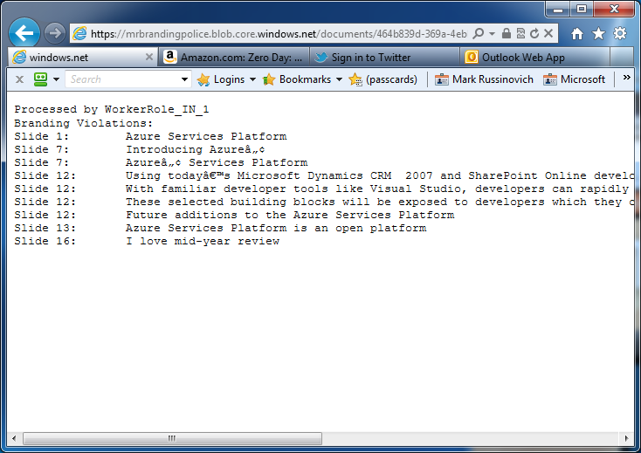
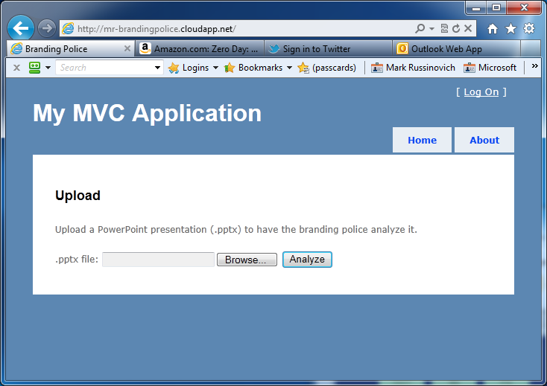
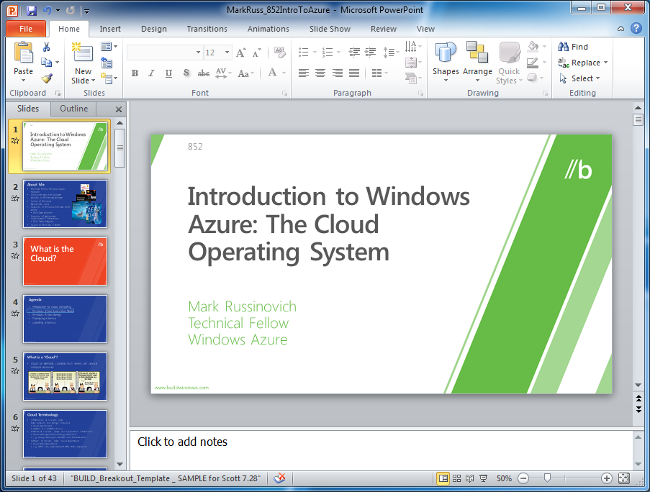
Branding Police
Web
Role
Worker
Role
brandingpolice.cloudapp.net
Web
Role
{…-…-...-…}
Worker
Role
Working on…
Violations:…
{…-…-...-…}-report.txt
{…-…-...-…}

Slide 25
Application building blocks
Big data
Database
Storage
Traffic
Caching
Messaging
Identity
Media
CDN
Networking

Slide 26
DB
SQL database
Relational SQL Server Engine in the Cloud
Clustered for high availability
Fully Managed Service
SQL Reporting support

Slide 27
Cache
Low latency, in-memory distributed cache
Dynamically grow and shrink cache size
High availability support
Memcached protocol support

Slide 28
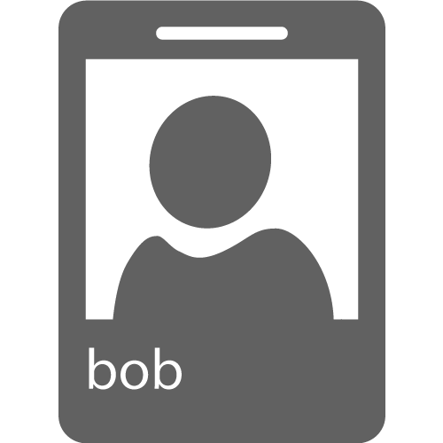
Identity
Integrate with enterprise identity
Enable single sign-on within your apps
Enterprise Graph REST API

Slide 29
Service bus
Secure messaging and relay capabilities
Easily build hybrid apps
Enable loosely coupled solutions

Slide 30
Window Azure HPC Scheduler
Compute intensive, parallel computations on cloud
Parametric sweeps
MPI
SOA
LINQ to HPC
Cloud bursting
Dynamically adjust how much runs on-premise and in the cloud
“Burst” into cloud on-demand

Slide 31
Windows Azure SDK
Local development emulator
Compute
Storage
In several languages

Slide 32
Next Up…
Twister4Azure – Iterative MapReduce for Windows Azure Cloud
Demo : KMeansClustering on Azure using Twister4Azure
Windows Azure Training course
http://msdn.microsoft.com/en-us/wazplatformtrainingcourse.aspx
Hands-on labs, Samples, Presentations

Slide 33
Acknowledgements
Roger Barga – Microsoft
Windows Azure Platform Training Kit
Salsa Group

