Slide 1
High Performance Dimension Reduction and Visualization for Large High-dimensional Data Analysis
Jong Youl Choi, Seung-Hee Bae, Judy Qiu, and Geoffrey Fox
School of Informatics and Computing
Pervasive Technology Institute
Indiana University
SALSA project
http://salsahpc.indiana.edu

Slide 2
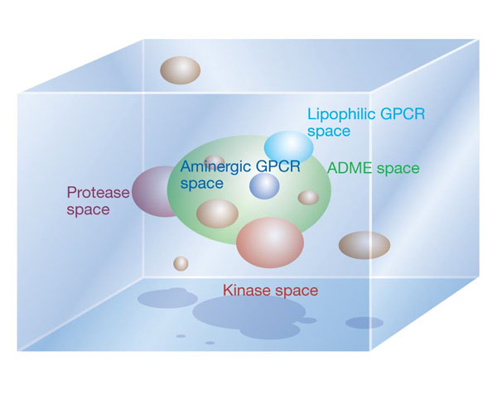
Navigating Chemical Space
Christopher Lipinski, “Navigating chemical space for biology and medicine”, Nature, 2004

Slide 3
Data Visualization
Visualize high-dimensional data as points in 2D or 3D by dimension reduction
Distances in target dimension represent similarities in original data
Interactively browse data
Easy to recognize clusters or groups
An example of chemical data (PubChem)
Visualization to display disease-gene relationship, aiming at finding cause-effect relationships between disease and genes.

Slide 4
Motivation
Data is getting larger and high-dimensional
PubChem : database of 60M chemical compounds
Each compound is represented by multiple features or fingerprint (166, 320, or 880 bit long)
Fast and efficient visualization is needed
Chemical space visualization is used for early stage of drug-discovery research (e.g., pre-screening, …)
Dimension reduction algorithms are computation- and memory-intensive algorithm
Parallelization to utilize a distributed memory
Reduce memory requirement per process
Increase computational speed

Slide 5
Generative Topographic Mapping
K latent points
N data points
An algorithm for dimension reduction
Latent Variable Model (LVM)
Define K latent variables (z_{k})
Map K latent points to the data space by using a non-linear function f
Construct maps of data points in the latent space

Slide 6
EM optimization
Find K centers for N data
K-clustering problem, known as NP-hard
Use Expectation-Maximization (EM) method
EM algorithm
Find local optimal solution iteratively until converge
E-step:
M-step:

Slide 7
Parallel GTM
Finding K clusters for N data points
Relationship is a bipartite graph (bi-graph)
Represented by K-by-N matrix (K << N)
Decomposition for P-by-Q compute grid
Reduce memory requirement by 1/PQ
Example:
A 8-byte double precision matrix for N=100K and K=8K requires 6.4GB
A
A
B
C
1
B
1
2
C
2
K latent points
N data points

Slide 8
Multi-Dimensional Scaling
Pairwise dissimilarity matrix
N-by-N matrix
Each element can be a distance, rank, etc., …
Given Δ, find a map in a target dimension
Criteria (or objective function)
STRESS
SSTRESS
SMACOF is one of algorithms to solve MDS problem
Notes:
Microarray data

Slide 9
Parallel MDS
Example:
A 8-byte double precision matrix for N=100K requires 80GB
Decomposition for P-by-Q compute grid
Reduce memory requirement by 1/PQ
A
B
C
A
B
C

Slide 10
GTM vs. MDS
GTM
MDS (SMACOF)
Purpose
Non-linear dimension reduction
Find an optimal configuration in a lower-dimension
Iterative optimization method
Objective Function
Maximize Log-Likelihood
Minimize STRESS or SSTRESS
Complexity
O(KN) (K << N)
O(N²)
Optimization
Method
EM
Iterative Majorization (EM-like)

Slide 11
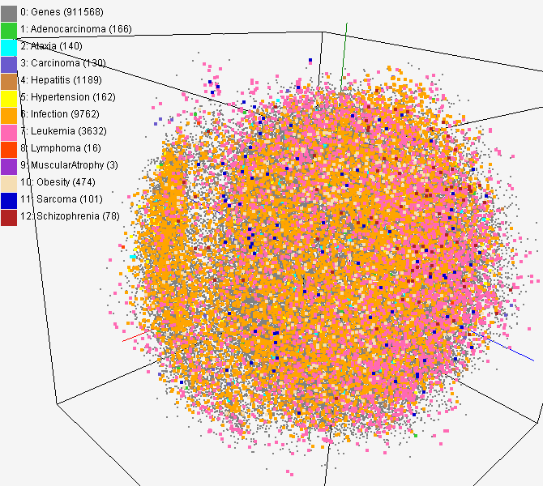
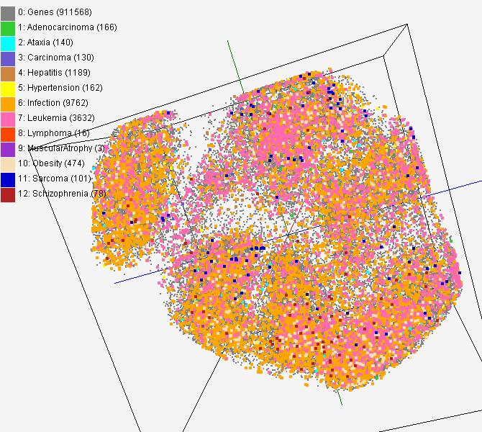
MDS and GTM Map (1)
PubChem data with CTD visualization by using MDS (left) and GTM (right)
About 930,000 chemical compounds are visualized as a point in 3D space, annotated by the related genes in Comparative Toxicogenomics Database (CTD)

Slide 12
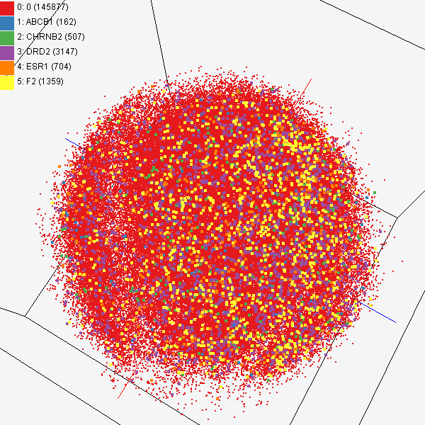
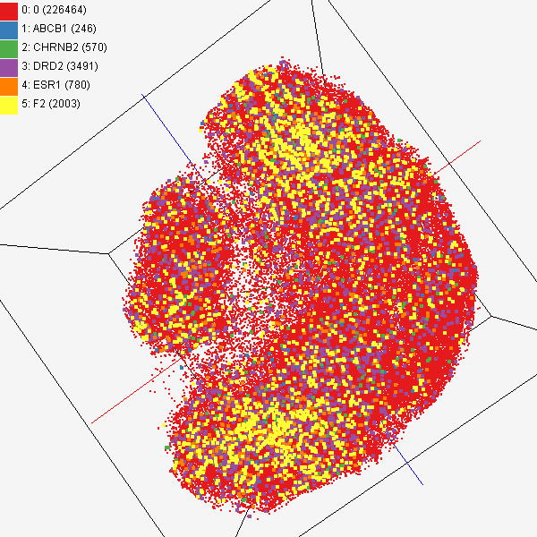
MDS and GTM Map (2)
Chemical compounds shown in literatures, visualized by MDS (left) and GTM (right)
Visualized 234,000 chemical compounds which may be related with a set of 5 genes of interest (ABCB1, CHRNB2, DRD2, ESR1, and F2) based on the dataset collected from major journal literatures which is also stored in Chem2Bio2RDF system.

Slide 13
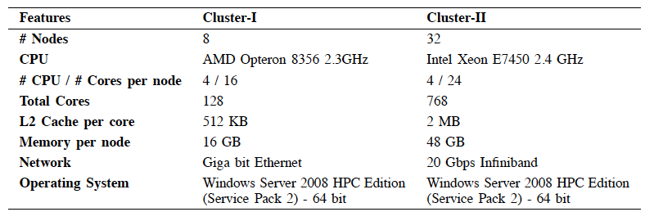
Experiment Environments

Slide 14
Parallel GTM using 128 cores
10,000 PubChem dataset
20,000 PubChem dataset

Slide 15
Parallel MDS using 128 cores
10,000 PubChem dataset
20,000 PubChem dataset

Slide 16
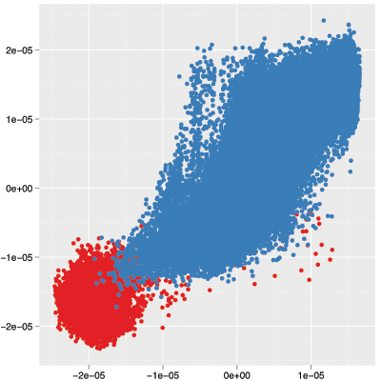
Canonical Correlation Analysis
GTM
MDS
Maximum correlation = 0.90

Slide 17
Conclusion
Developed parallel GTM and MDS to process large- and high-dimensional dataset
100,000 chemical compounds in PubChem database have been processed
Compared MDS and GTM map

Slide 18
Thank you
Question?
Email me at jychoi@cs.indiana.edu

Slide 19
>1 aliphatic oxygen joined to a ring
multiple ring system

