Slide 1

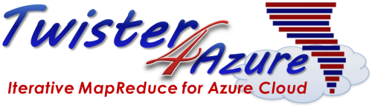

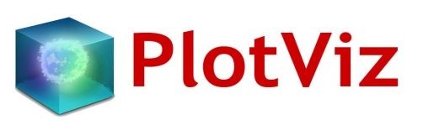
Iterative MapReduce Enabling HPC-Cloud Interoperability
Workshop on Petascale Data Analytics: Challenges, and Opportunities, SC11
SALSA HPC Group
http://salsahpc.indiana.edu
School of Informatics and Computing
Indiana University

Slide 2




SALSA HPC Group
Twister Bingjing Zhang, Richard Teng
 | Twister4Azure Thilina Gunarathne
High-Performance Visualization Algorithms For Data-Intensive Analysis Seung-Hee Bae and Jong Youl Choi

Slide 3







 | DryadLINQ CTP Evaluation Hui Li, Yang Ruan, and Yuduo Zhou
Cloud Storage, FutureGrid Xiaoming Gao, Stephen Wu
Million Sequence Challenge Saliya Ekanayake, Adam Hughs, Yang Ruan
 | Cyberinfrastructure for Remote Sensing of Ice Sheets Jerome Mitchell

Slide 4
Intel’s Application Stack

Slide 5
(Iterative) MapReduce in Context
Support Scientific Simulations (Data Mining and Data Analysis)
Kernels, Genomics, Proteomics, Information Retrieval, Polar Science, Scientific Simulation Data Analysis and Management, Dissimilarity Computation, Clustering, Multidimensional Scaling, Generative Topological Mapping
Applications
Security, Provenance, Portal
Programming Model
Services and Workflow
High Level Language
Runtime
Cross Platform Iterative MapReduce (Collectives, Fault Tolerance, Scheduling)
Storage
Distributed File Systems
Object Store
Data Parallel File System
Linux HPC
Bare-system
Amazon Cloud
Windows Server HPC
Bare-system
Azure Cloud
Grid Appliance
Infrastructure
Virtualization
Virtualization
Hardware
CPU Nodes
GPU Nodes

Slide 6
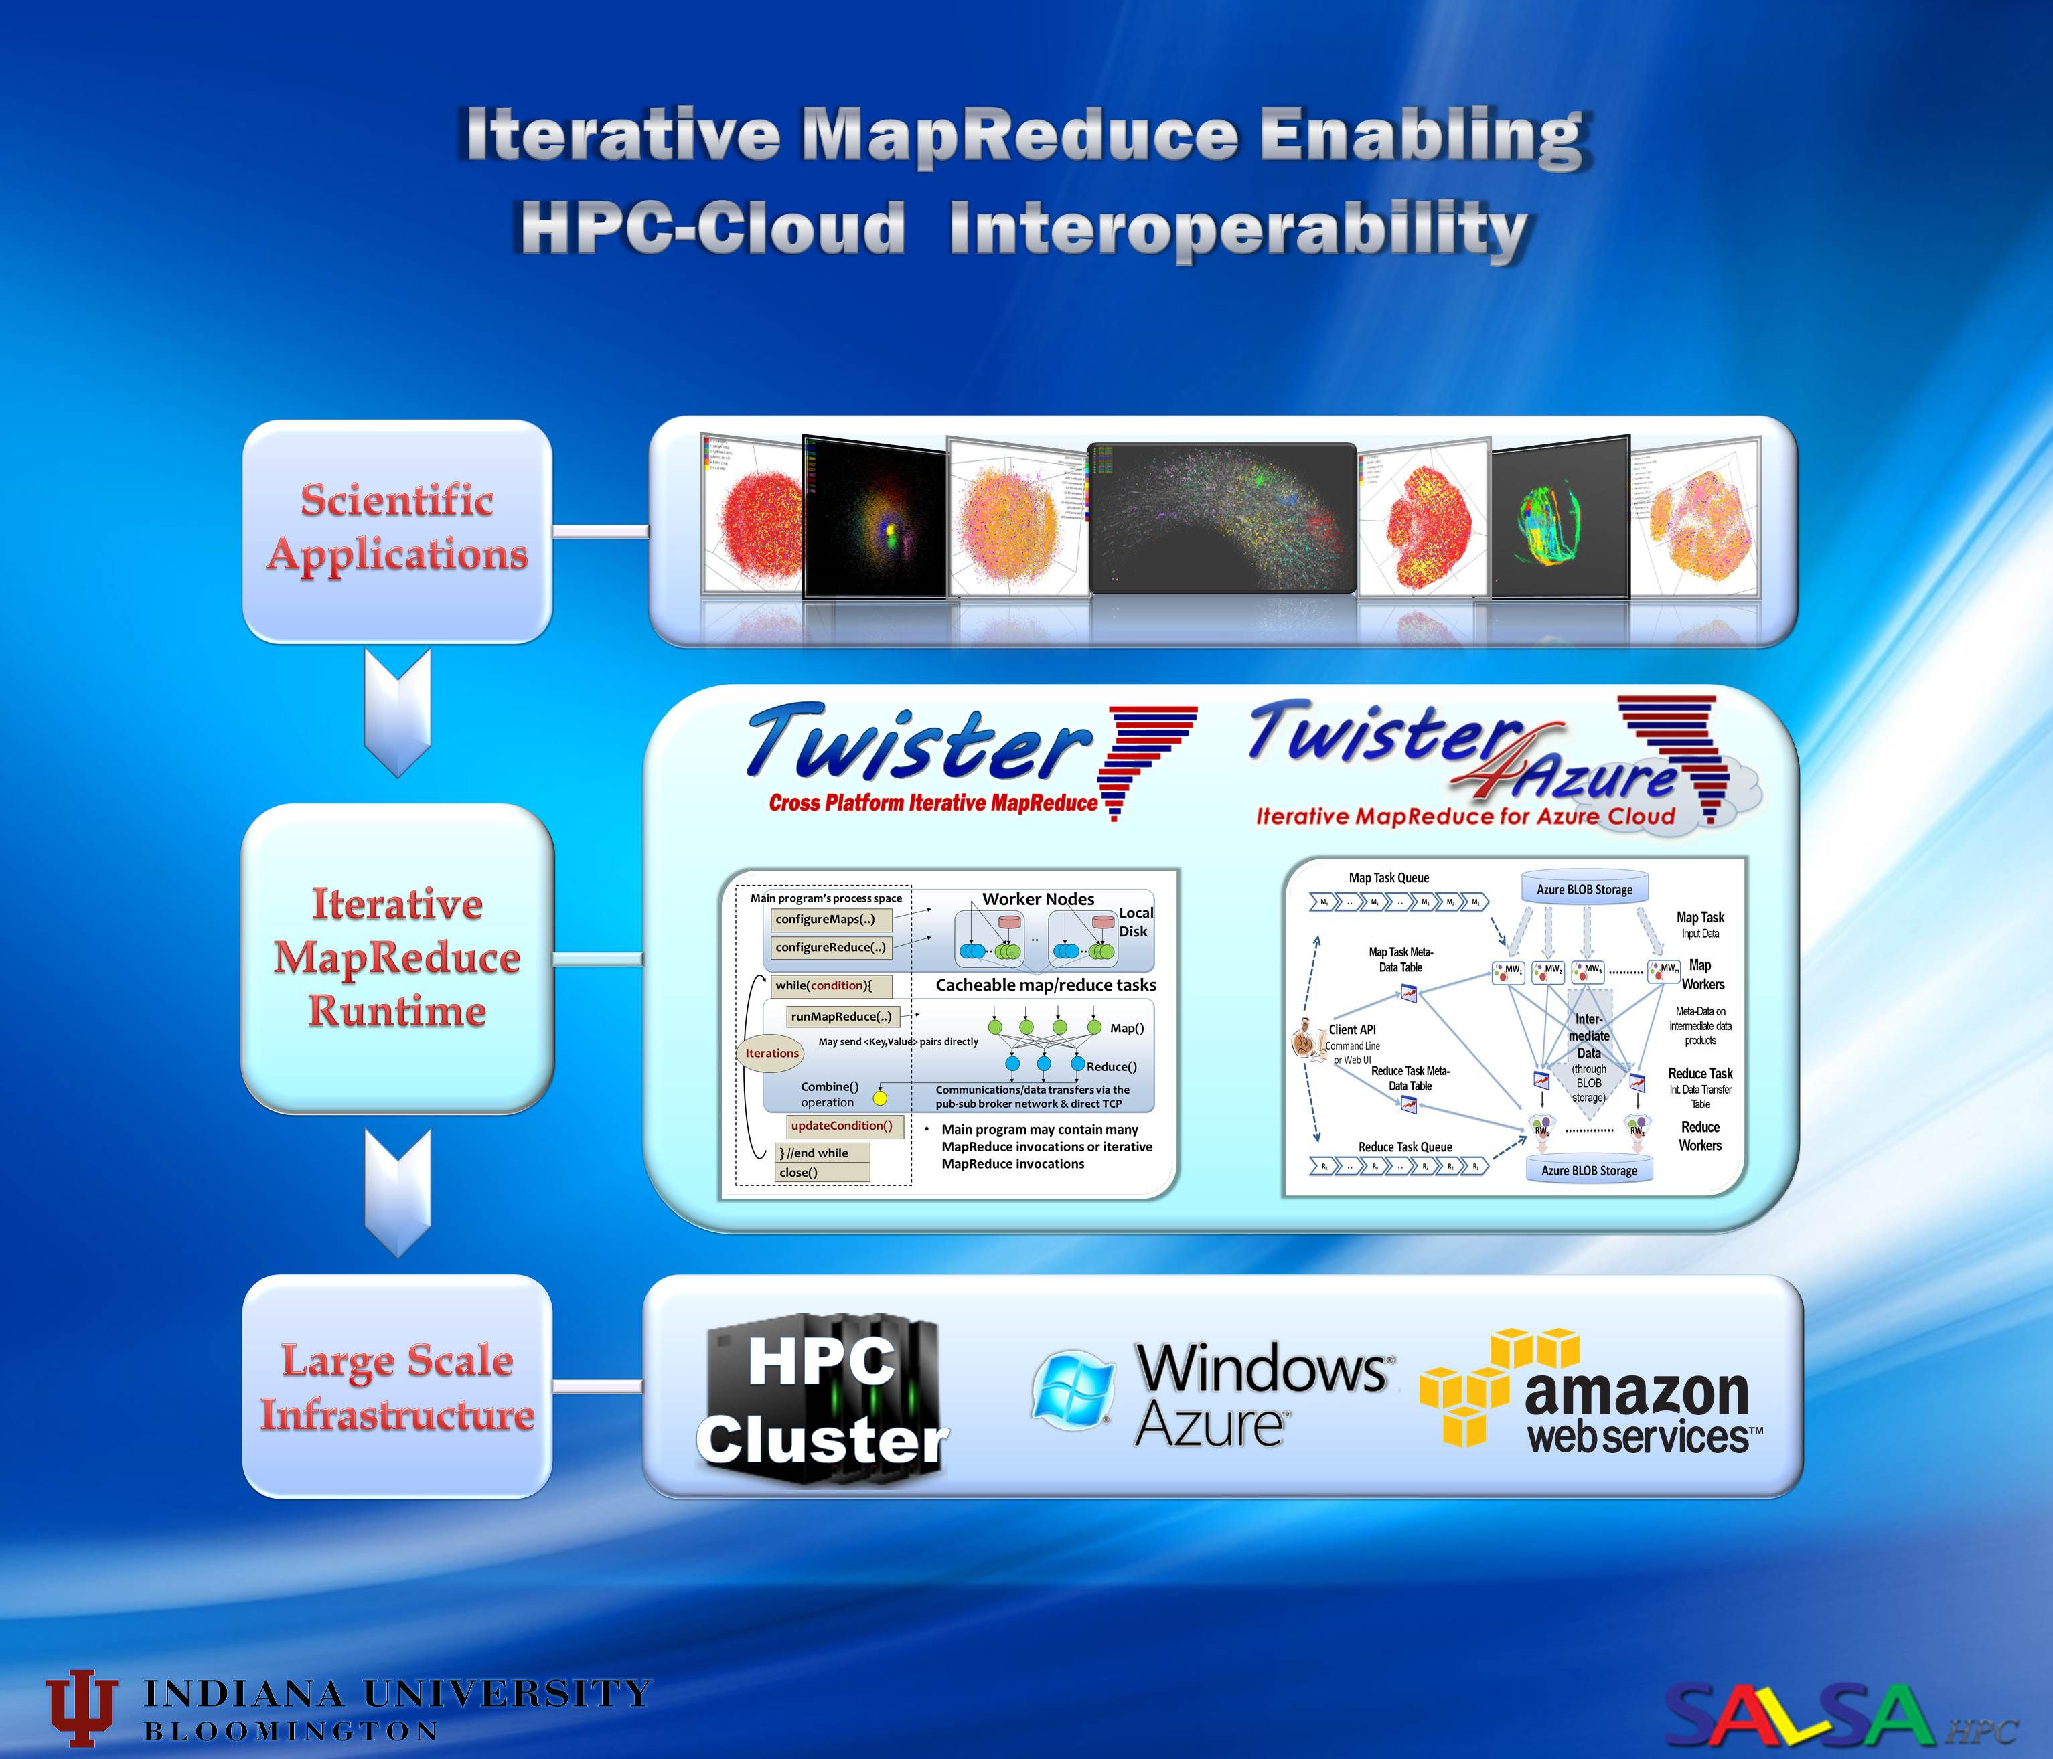

Slide 7
What are the challenges?
Providing both cost effectiveness and powerful parallel programming paradigms that is capable of handling the incredible increases in dataset sizes.
(large-scale data analysis for Data Intensive applications )
Research issues
portability between HPC and Cloud systems
scaling performance
fault tolerance
These challenges must be met for both computation and storage. If computation and storage are separated, it’s not possible to bring computing to data.
Data locality
its impact on performance;
the factors that affect data locality;
the maximum degree of data locality that can be achieved.
Factors beyond data locality to improve performance
To achieve the best data locality is not always the optimal scheduling decision. For instance, if the node where input data of a task are stored is overloaded, to run the task on it will result in performance degradation.
Task granularity and load balance
In MapReduce , task granularity is fixed.
This mechanism has two drawbacks
limited degree of concurrency
load unbalancing resulting from the variation of task execution time.

Slide 8
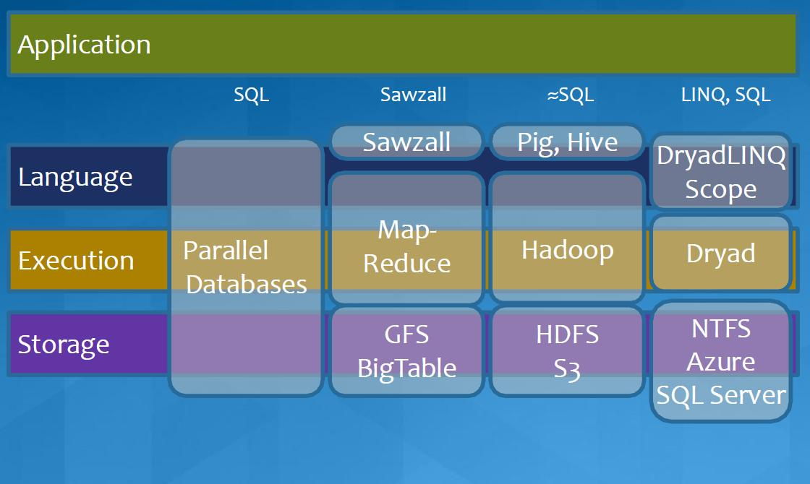
Programming Models and Tools
MapReduce in Heterogeneous Environment
MICROSOFT
8
Notes:
http://dss-vm.ncsa.illinois.edu/summerschool2010/bigdata/DistributedData.mov
http://groups.google.com/group/vscse-big-data-for-science-2010/web/course-presentations?hl=en

Slide 9
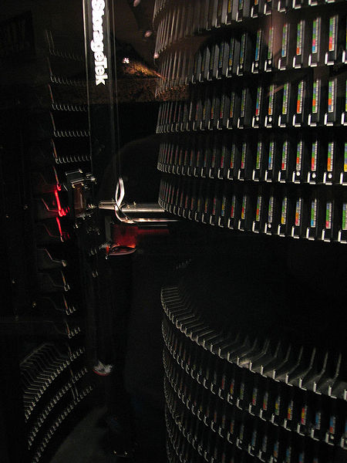
Motivation
Data Deluge
MapReduce
Classic Parallel Runtimes (MPI)
Data Centered, QoS
Efficient and Proven techniques
Experiencing in many domains
Expand the Applicability of MapReduce to more classes of Applications
Iterative MapReduce
Map-Only
MapReduce
More Extensions
iterations
Input
Input
Input
map
map
map
Pij
reduce
reduce
Output

Slide 10
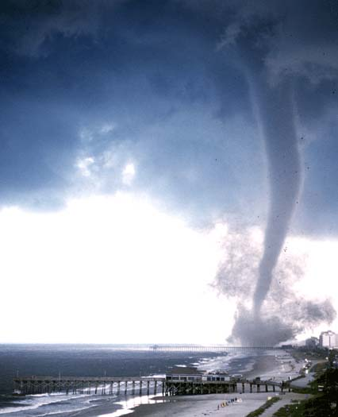

Twister v0.9
  New Infrastructure for Iterative MapReduce Programming
  Distinction on static and variable data
  Configurable long running (cacheable) map/reduce tasks
  Pub/sub messaging based communication/data transfers
  Broker Network for facilitating communication

Slide 11
Main program’s process space
Worker Nodes
configureMaps(..)
Local Disk
configureReduce(..)
Cacheable map/reduce tasks
while(condition){
runMapReduce(..)
May send <Key,Value> pairs directly
Map()
Iterations
Reduce()
Combine() operation
Communications/data transfers via the pub-sub broker network & direct TCP
updateCondition()
Main program may contain many MapReduce invocations or iterative MapReduce invocations
} //end while
close()

Slide 12
Master Node
B
Pub/sub
Broker Network
Twister
Driver
B
B
B
Main Program
One broker serves several Twister daemons
Twister Daemon
Twister Daemon
map
reduce
Cacheable tasks
Worker Pool
Worker Pool
Scripts perform:
Data distribution, data collection, and partition file creation
Local Disk
Local Disk
Worker Node
Worker Node

Slide 13
Components of Twister

Slide 14
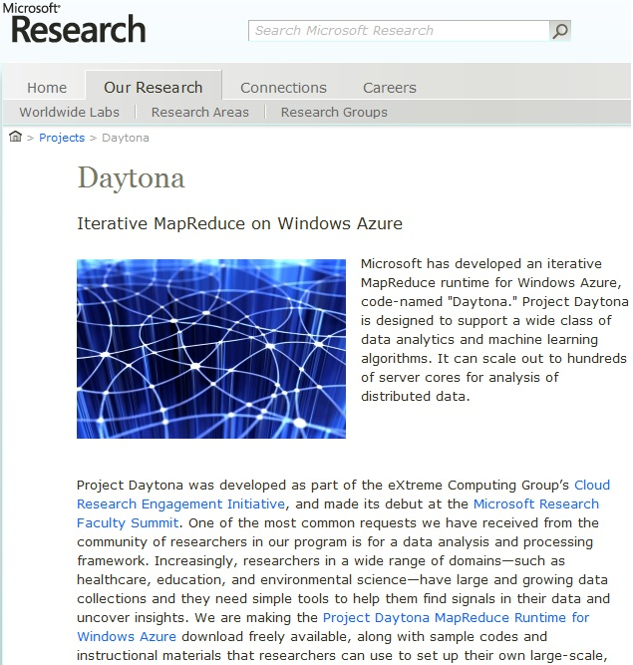

Slide 15
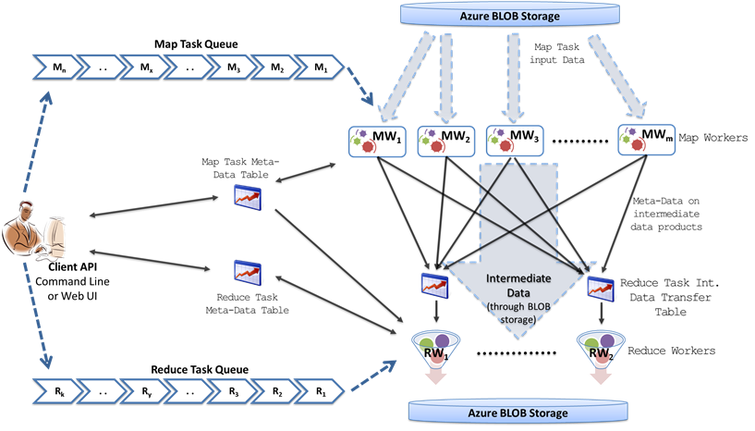
TwisterR4Azure
Azure Queues for scheduling, Tables to store meta-data and monitoring data, Blobs for input/output/intermediate data storage.

Slide 16
Iterative MapReduce for Azure
Programming model extensions to support broadcast data
Merge Step
In-Memory Caching of static data
Cache aware hybrid scheduling using Queues, bulletin board (special table) and execution histories
Hybrid intermediate data transfer

Slide 17
Twister4Azure
Distributed, highly scalable and highly available cloud services as the building blocks.
Utilize eventually-consistent , high-latency cloud services effectively to deliver performance comparable to traditional MapReduce runtimes.
Decentralized architecture with global queue based dynamic task scheduling
Minimal management and maintenance overhead
Supports dynamically scaling up and down of the compute resources.
MapReduce fault tolerance

Slide 18
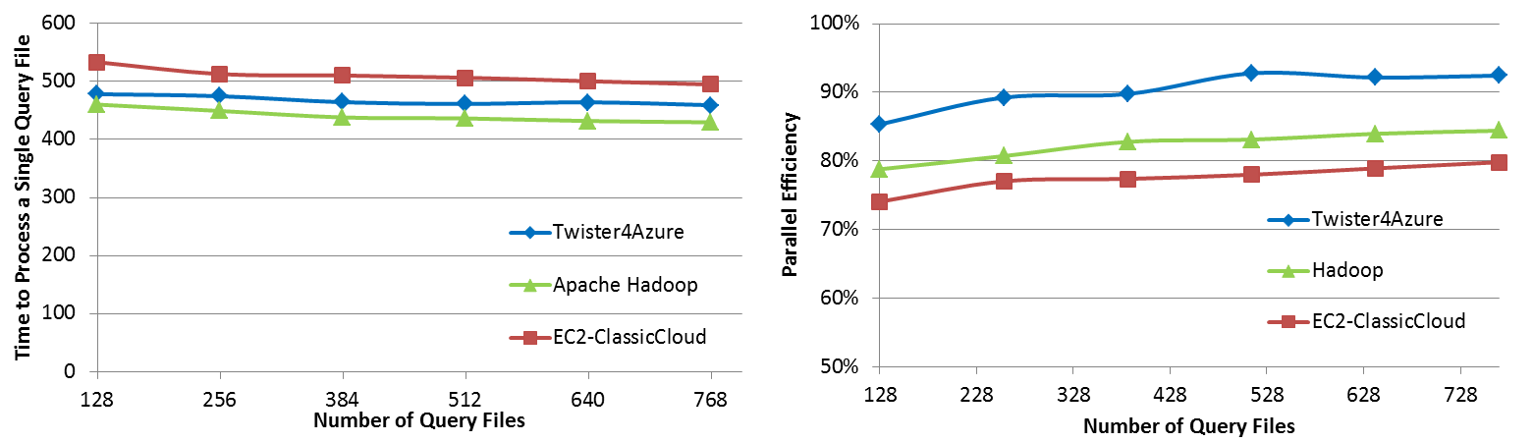

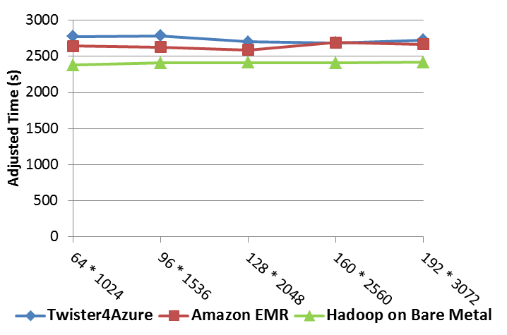
Performance Comparisons
BLAST Sequence Search
Smith Waterman Sequence Alignment
Cap3 Sequence Assembly

Slide 19

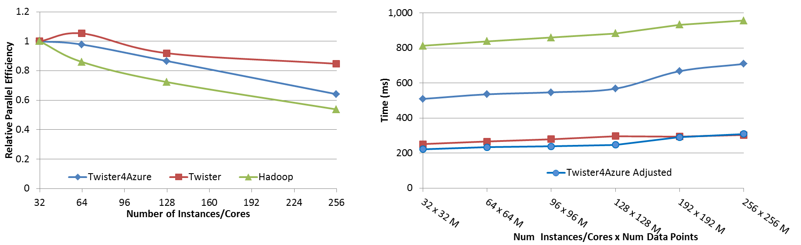




Performance – Kmeans Clustering
Task Execution Time Histogram
Number of Executing Map Task Histogram
Strong Scaling with 128M Data Points
Weak Scaling
Performance with/without
data caching
Speedup gained using data cache
Scaling speedup
Increasing number of iterations
Notes:
Right(c): Twister4Azure executing Map Task histogram for 128 million data points in 128 Azure small instances
Figure 5. KMeansClustering Scalability. Left(a): Relative parallel efficiency of strong scaling using 128 million data points.
Center(b): Weak scaling. Workload per core is kept constant (ideal is a straight horizontal line).

Slide 20
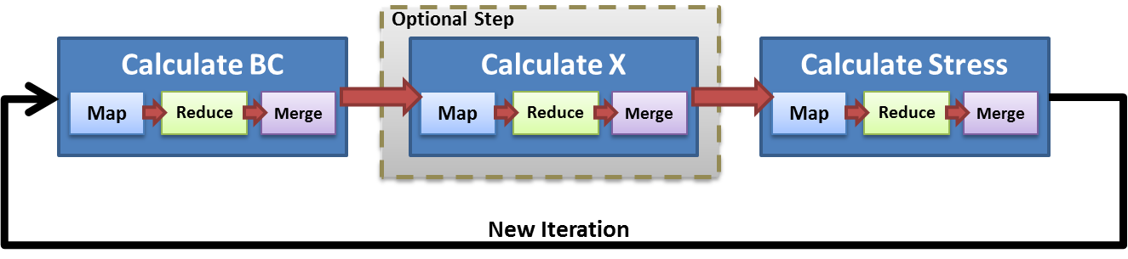
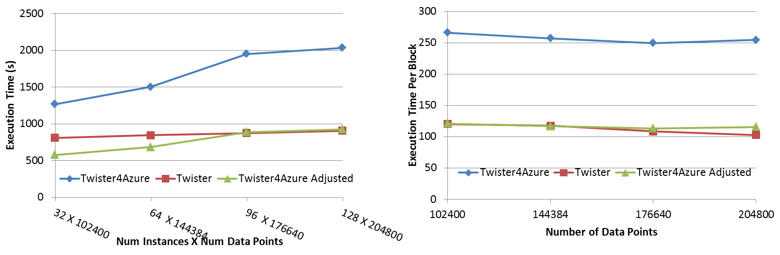
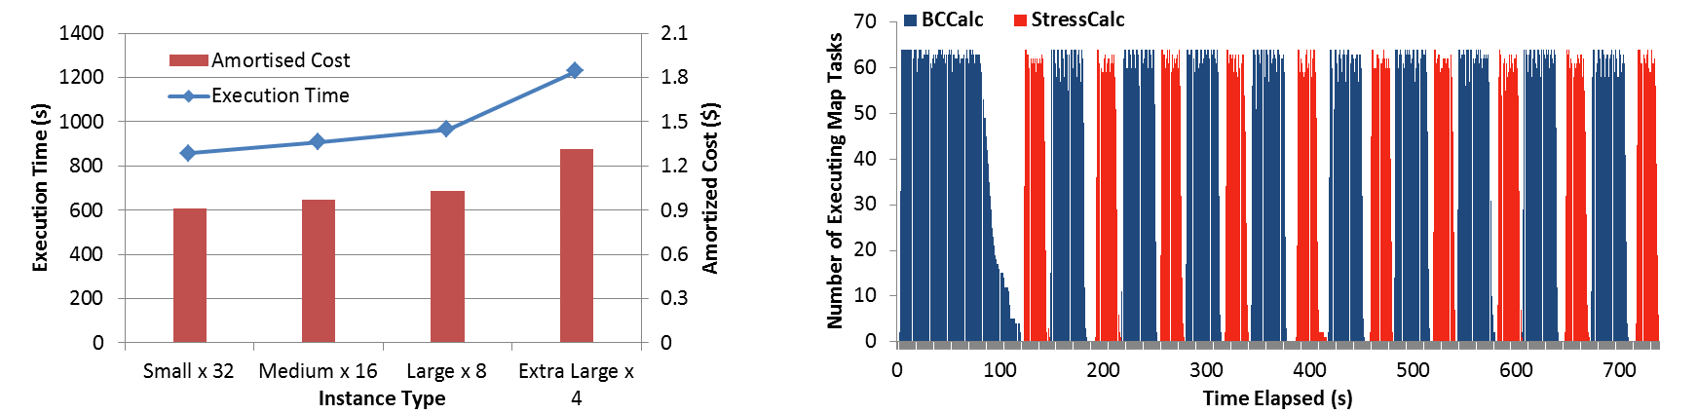
Performance – Multi Dimensional Scaling
Weak Scaling
Data Size Scaling
Task Execution Time Histogram
Azure Instance Type Study
Number of Executing Map Task Histogram
Performance with/without
data caching
Speedup gained using data cache
Scaling speedup
Increasing number of iterations
Notes:
Weak scaling where workload per core is ~constant. Ideal is a straight horizontal line. Center : Data size scaling with 128 Azure small instances/cores, 20 iterations.
Instance type study using 76800 data points, 32 instances, 20 iterations. Right: Twister4Azure executing Map Task histogram for 144384 x144384 distance matrix in 64 Azure small instances, 10 iterations

Slide 21

Twister-MDS Demo
This demo is for real time visualization of the process of multidimensional scaling(MDS) calculation.
We use Twister to do parallel calculation inside the cluster, and use PlotViz to show the intermediate results at the user client computer.
The process of computation and monitoring is automated by the program.

Slide 22
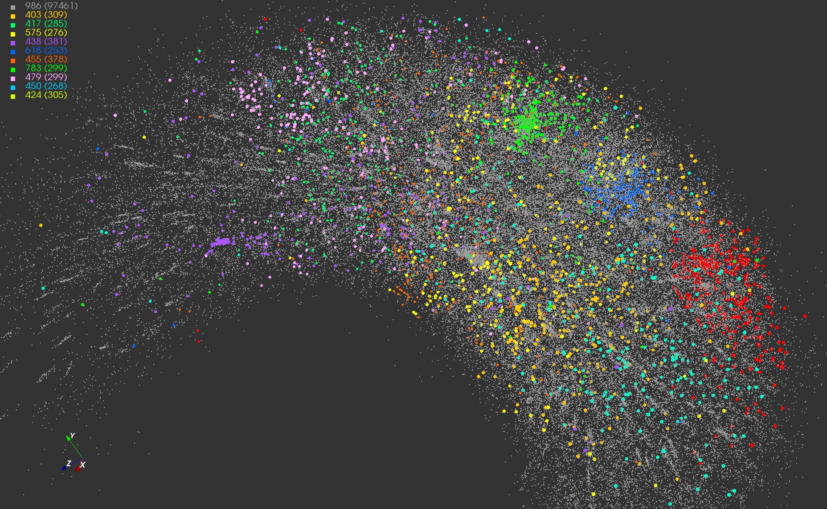
Twister-MDS Output
MDS projection of 100,000 protein sequences showing a few experimentally
identified clusters in preliminary work with Seattle Children’s Research Institute

Slide 23
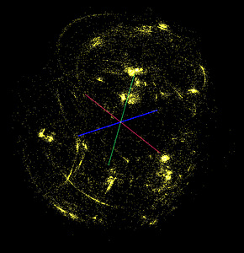
Twister-MDS Work Flow
Client Node
II. Send intermediate results
Master Node
ActiveMQ
Broker
Twister
Driver
MDS Monitor
Twister-MDS
PlotViz
I. Send message to start the job

Slide 24
Twister-MDS Structure
Master Node
Twister
Driver
Pub/Sub Broker Network
MDS Output Monitoring Interface
Twister-MDS
Twister Daemon
Twister Daemon
map
reduce
calculateBC
map
reduce
calculateStress
Worker Pool
Worker Pool
Worker Node
Worker Node

Slide 25
Map-Collective Model
Input
Iterations
User Program
map
Initial Collective Step
Network of Brokers
reduce
Final Collective Step
Network of Brokers

Slide 26
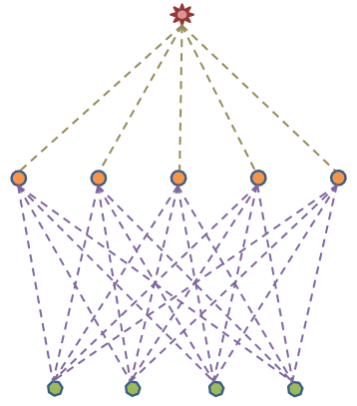
New Network of Brokers
Twister Daemon Node
ActiveMQ Broker Node
B. Hierarchical Sending
Twister Driver
Node
7 Brokers and 32 Computing Nodes in total
A. Full Mesh Network
5 Brokers and 4 Computing Nodes in total
Broker-Driver Connection
Broker-Daemon Connection
Broker-Broker Connection
C. Streaming

Slide 27
Performance Improvement

Slide 28
Broadcasting on 40 Nodes
(In Method C, centroids are split to 160 blocks, sent through 40 brokers in 4 rounds)

Slide 29
Twister New Architecture
Master Node
Worker Node
Worker Node
Broker
Broker
Broker
Configure Mapper
map broadcasting chain
Add to MemCache
map
Map
Cacheable tasks
merge
reduce
Reduce
reduce collection chain
Twister Driver
Twister Daemon
Twister Daemon

Slide 30
Chain/Ring Broadcasting
Twister Daemon Node
Twister Driver Node
Driver sender:
  send broadcasting data
  get acknowledgement
  send next broadcasting data
  …
Daemon sender:
  receive data from the last daemon (or driver)
  cache data to daemon
  Send data to next daemon (waits for ACK)
  send acknowledgement to the last daemon

Slide 31
Chain Broadcasting Protocol
Driver
Daemon 0
Daemon 1
Daemon 2
send
receive
I know this is the end of Daemon Chain
handle data
send
receive
get ack
ack
handle data
send
receive
send
receive
ack
handle data
handle data
ack
get ack
send
receive
get ack
ack
handle data
get ack
send
receive
ack
handle data
ack
get ack
get ack
ack
I know this is the end of Cache Block
get ack
ack

Slide 32
Broadcasting Time Comparison

Slide 33
Applications & Different Interconnection Patterns
Map Only | Classic MapReduce | Iterative Reductions Twister | Loosely Synchronous
CAP3 Analysis Document conversion (PDF -> HTML) Brute force searches in cryptography Parametric sweeps | High Energy Physics (HEP) Histograms SWG gene alignment Distributed search Distributed sorting Information retrieval | Expectation maximization algorithms Clustering Linear Algebra | Many MPI scientific applications utilizing wide variety of communication constructs including local interactions
- CAP3 Gene Assembly - PolarGrid Matlab data analysis | - Information Retrieval - HEP Data Analysis - Calculation of Pairwise Distances for ALU Sequences | Kmeans Deterministic Annealing Clustering - Multidimensional Scaling MDS | - Solving Differential Equations and - particle dynamics with short range forces
Input
iterations
Input
Input
map
map
map
Pij
reduce
Output
reduce
Domain of MapReduce and Iterative Extensions
MPI

Slide 34
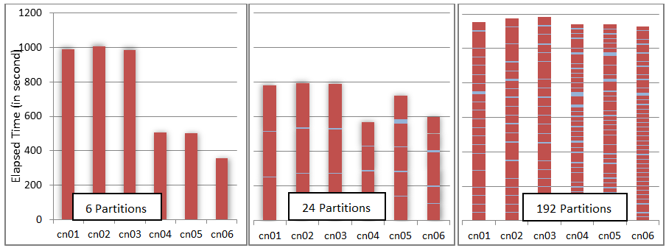
Scheduling vs. Computation of Dryad in a Heterogeneous Environment

Slide 35
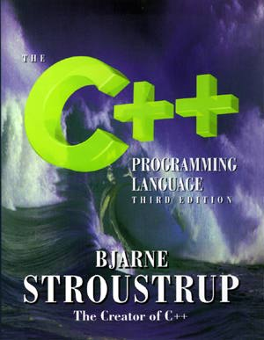
Runtime Issues

Slide 36

Twister Futures
Development of library of Collectives to use at Reduce phase
  Broadcast and Gather needed by current applications
  Discover other important ones
  Implement efficiently on each platform – especially Azure
Better software message routing with broker networks using asynchronous I/O with communication fault tolerance
Support nearby location of data and computing using data parallel file systems
Clearer application fault tolerance model based on implicit synchronizations points at iteration end points
Later: Investigate GPU support
Later: run time for data parallel languages like Sawzall, Pig Latin, LINQ

Slide 37
Convergence is Happening
Multicore
Clouds
Data intensive application (three basic activities):
capture, curation, and analysis (visualization)
Data Intensive
Paradigms
Cloud infrastructure and runtime
Parallel threading and processes

Slide 38

FutureGrid: a Grid Testbed
IU Cray operational, IU IBM (iDataPlex) completed stability test May 6
UCSD IBM operational, UF IBM stability test completes ~ May 12
Network, NID and PU HTC system operational
UC IBM stability test completes ~ May 27; TACC Dell awaiting delivery of components
NID: Network Impairment Device
Private
Public
FG Network

Slide 39

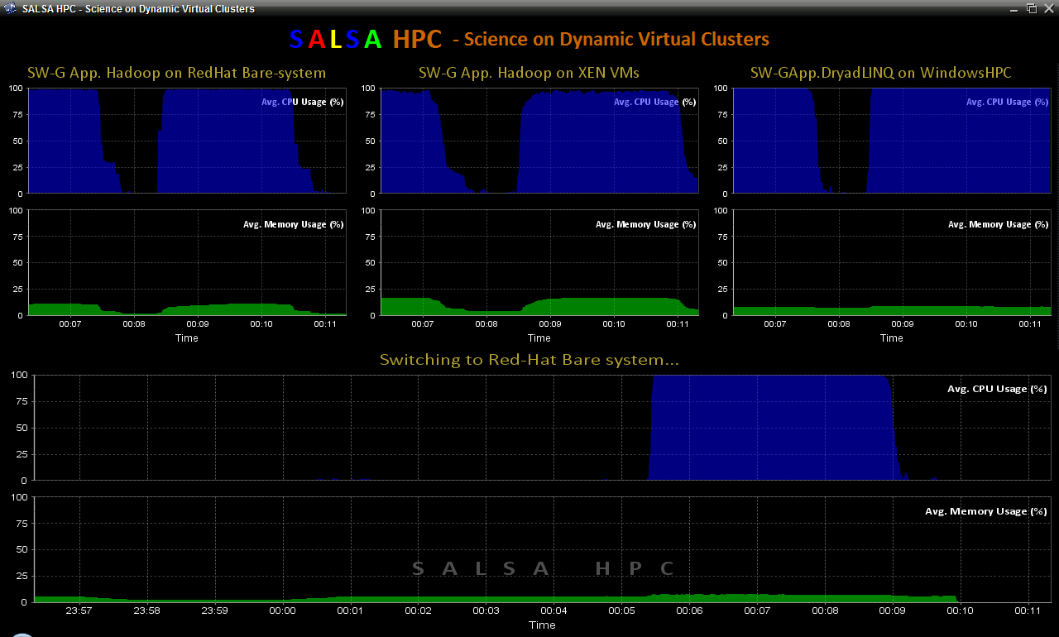
SALSAHPC Dynamic Virtual Cluster on FutureGrid -- Demo at SC09
Demonstrate the concept of Science on Clouds on FutureGrid
Dynamic Cluster Architecture
Monitoring & Control Infrastructure
Monitoring Infrastructure
Monitoring Interface
Pub/Sub Broker Network
SW-G Using Hadoop
SW-G Using Hadoop
SW-G Using DryadLINQ
Linux
Bare-system
Linux on Xen
Windows Server 2008 Bare-system
Virtual/Physical Clusters
Summarizer
XCAT Infrastructure
XCAT Infrastructure
Switcher
iDataplex Bare-metal Nodes
(32 nodes)
iDataplex Bare-metal Nodes
Switchable clusters on the same hardware (~5 minutes between different OS such as Linux+Xen to Windows+HPCS)
Support for virtual clusters
SW-G : Smith Waterman Gotoh Dissimilarity Computation as an pleasingly parallel problem suitable for MapReduce style applications

Slide 40
SALSAHPC Dynamic Virtual Cluster on FutureGrid -- Demo at SC09
Demonstrate the concept of Science on Clouds using a FutureGrid cluster
Top: 3 clusters are switching applications on fixed environment. Takes approximately 30 seconds.
Bottom: Cluster is switching between environments: Linux; Linux +Xen; Windows + HPCS.
Takes approxomately 7 minutes
SALSAHPC Demo at SC09. This demonstrates the concept of Science on Clouds using a FutureGrid iDataPlex.

Slide 41


Education and Broader Impact
We devote a lot to guide students
who are interested in computing

Slide 42

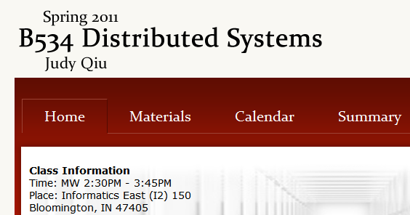
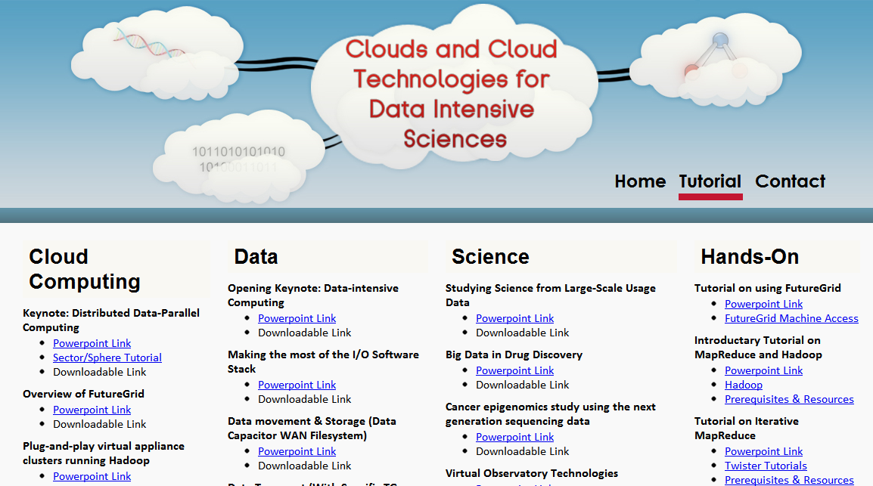
Education
We offer classes with emerging new topics
Together with tutorials on the most popular cloud computing tools

Slide 43
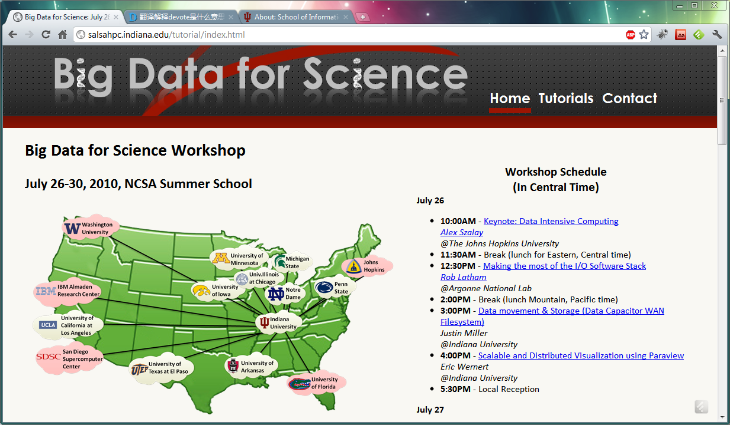
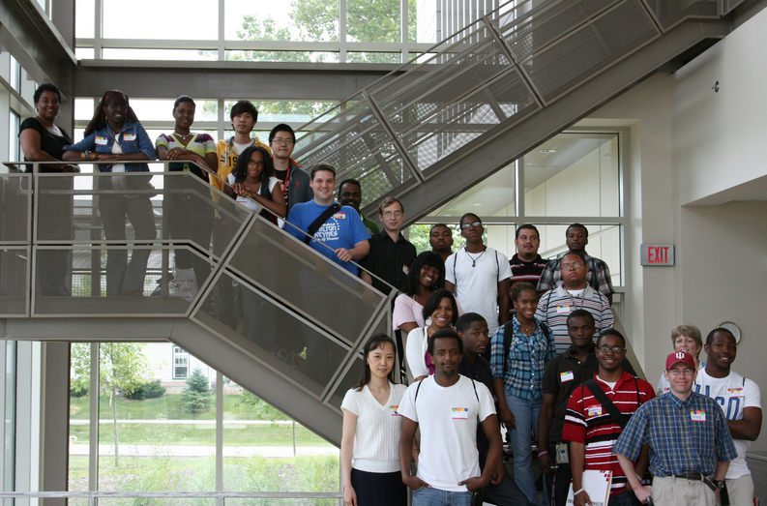

Broader Impact
Hosting workshops and spreading our technology across the nation
Giving students unforgettable research experience

Slide 44






Acknowledgement
SALSA HPC Group
Indiana University
http://salsahpc.indiana.edu

