Slide 1
Cloud Technologies and
Their Applications
May 17, 2010 Melbourne, Australia
Judy Qiu
xqiu@indiana.edu
http://salsahpc.indiana.edu
Pervasive Technology Institute
Indiana University
Notes:
SALSA is
Service Aggregated Linked Sequential Activities

Slide 2
The term SALSA or Service Aggregated Linked Sequential Activities, is derived from Hoare’s Concurrent Sequential Processes (CSP)
SALSA Group
http://salsahpc.indiana.edu
Group Leader: Judy Qiu
Staff : Adam Huges
CS PhD: Jaliya Ekanayake, Thilina Gunarathne, Jong Youl Choi, Seung-Hee Bae,
Yang Ruan, Hui Li, Bingjing Zhang, Saliya Ekanayake,
CS Masters: Stephen Wu
Undergraduates: Zachary Adda, Jeremy Kasting, William Bowman
Notes:
describes our approach to multicore computing where we used services as modules to capture key functionalities implemented with multicore threading.
This will be expanded as a proposed approach to parallel computing where one produces libraries of parallelized components and combines them with a generalized service integration (workflow) model

Slide 3
Important Trends
  In all fields of science and throughout life (e.g. web!)
  Impacts preservation, access/use, programming model
    new commercially supported data center model building on compute grids
Data Deluge
Cloud Technologies
Multicore/
Parallel Computing
eScience
  Implies parallel computing important again
    Performance from extra cores – not extra clock speed
  A spectrum of eScience or eResearch applications (biology, chemistry, physics social science and
  humanities …)
  Data Analysis
  Machine learning
Notes:
Within past 5 year, Data -> Hardware -> Software -> Application
Data coming from everywhere 24/7.
Science faces a data deluge.
How to manage and analyze information?
Data are too large to fit into memory and take impractical time to run and get results
e.g. 50K all pairs SWG (O(N2)) takes ~5 hours on 768 cores. A sequential run takes 160 days.
MPI OpenMP RPC RMI

Slide 4
Challenges for CS Research
Science faces a data deluge. How to manage and analyze information?
Recommend CSTB foster tools for data capture, data curation, data analysis
―Jim Gray’s
Talk to Computer Science and Telecommunication Board (CSTB), Jan 11, 2007
There’re several challenges to realizing the vision on data intensive systems and building generic tools (Workflow, Databases, Algorithms, Visualization ).
Cluster-management software
Distributed-execution engine
Language constructs
Parallel compilers
Program Development tools
. . .
Notes:
Jim Gray’s talk to the Computer Science and Telecommunications Board in 2007
His vision of the fourth paradigm of scientific research is to focus on Data-intensive Systems and Scientific communications
New scientific research is highlighted by “data science”

Slide 5
Data Explosion and Challenges
Data Deluge
Cloud Technologies
Multicore/
Parallel Computing
eScience
Notes:
Within past 5 year
Data -> Hardware -> Software -> Application
Data coming from everywhere 24/7.
Data are too large to fit into memory and take impractical time to run and get results
e.g. 50K all pairs SWG (O(N2)) takes ~5 hours on 768 cores. A sequential run takes 160 days.
MPI OpenMP RPC RMI

Slide 6
Data We’re Looking at
  Public Health Data (IU Medical School & IUPUI Polis Center)
  (65535 Patient/GIS records / 54 dimensions each)
  Biology DNA sequence alignments (IU Medical School & CGB)
  (several million Sequences / at least 300 to 400 base pair each)
  NIH PubChem (David Wild)
  (60 million chemical compounds/166 fingerprints each)
  Particle physics LHC (Caltech)
  (1 Terabyte data placed in IU Data Capacitor)
High volume and high dimension require new efficient computing approaches!
Notes:
If people need to understand the information, first computer program needs to “understand” the volume information
,

Slide 7
Data Explosion and Challenges
Data is too big and gets bigger to fit into memory
For “All pairs” problem O(N²),
PubChem data points 100,000 => 480 GB of main memory
(Tempest Cluster of 768 cores has 1.536TB)
We need to use distributed memory and new algorithms to solve the problem
Communication overhead is large as main operations include matrix multiplication (O(N²)), moving data between nodes and within one node adds extra overheads
We use hybrid mode of MPI between nodes and concurrent threading internal to node on multicore clusters
Concurrent threading has side effects (for shared memory model like CCR and OpenMP) that impact performance
sub-block size to fit data into cache
cache line padding to avoid false sharing

Slide 8
Cloud Services and MapReduce
Data Deluge
Cloud Technologies
Multicore/
Parallel Computing
eScience
Notes:
Within past 5 year
Data -> Hardware -> Software -> Application
Data coming from everywhere 24/7.
Data are too large to fit into memory and take impractical time to run and get results
e.g. 50K all pairs SWG (O(N2)) takes ~5 hours on 768 cores. A sequential run takes 160 days.
MPI OpenMP RPC RMI

Slide 9
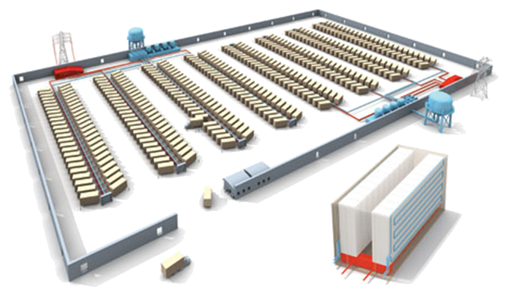
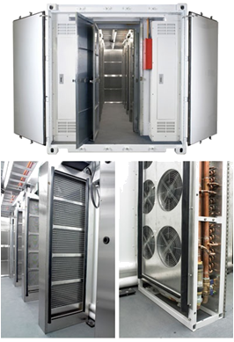
Clouds as Cost Effective Data Centers
Builds giant data centers with 100,000’s of computers; ~ 200-1000 to a shipping container with Internet access
“Microsoft will cram between 150 and 220 shipping containers filled with data center gear into a new 500,000 square foot Chicago facility. This move marks the most significant, public use of the shipping container systems popularized by the likes of Sun Microsystems and Rackable Systems to date.”
―News Release from Web

Slide 10
Clouds hide Complexity
Cyberinfrastructure
Is “Research as a Service”
SaaS: Software as a Service
(e.g. Clustering is a service)
PaaS: Platform as a Service
IaaS plus core software capabilities on which you build SaaS
(e.g. Azure is a PaaS; MapReduce is a Platform)
IaaS (HaaS): Infrasturcture as a Service
(get computer time with a credit card and with a Web interface like EC2)

Slide 11

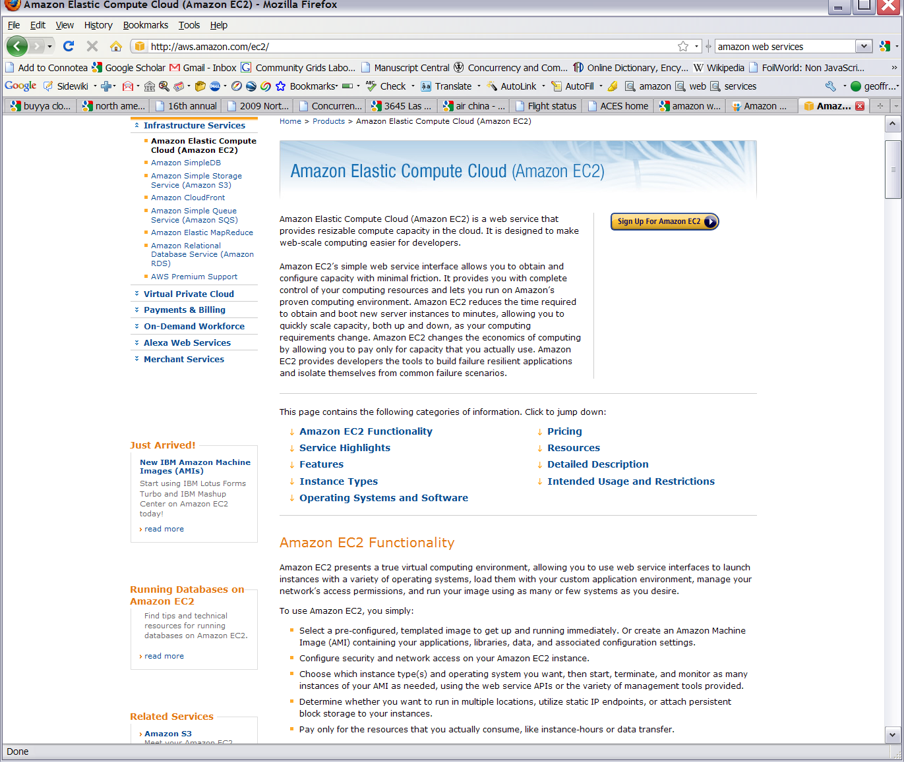






Commercial Cloud
Software

Slide 12
MapReduce
A parallel Runtime coming from Information Retrieval
Data Partitions
Map(Key, Value)
A hash function maps the results of the map tasks to r reduce tasks
Reduce(Key, List<Value>)
Reduce Outputs
Implementations support:
  Splitting of data
  Passing the output of map functions to reduce functions
  Sorting the inputs to the reduce function based on the intermediate keys
  Quality of services

Slide 13

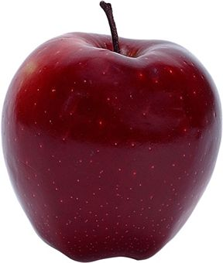
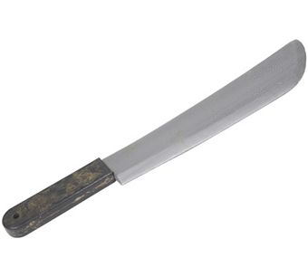
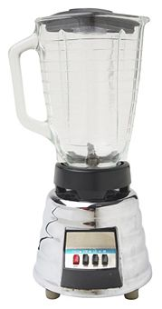

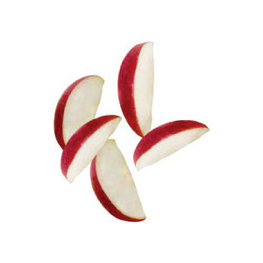
Sam’s Problem
Sam thought of “drinking” the apple
He used a to cut the and a to make juice.

Slide 14
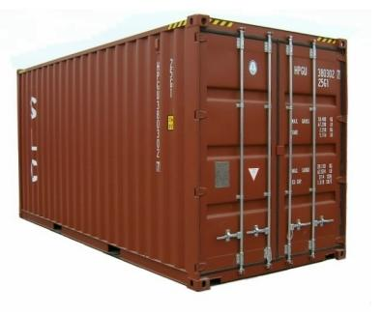
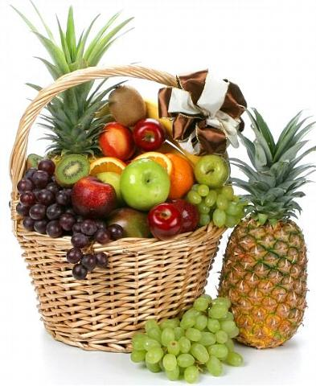

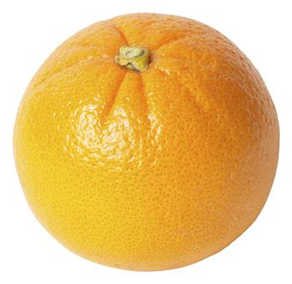
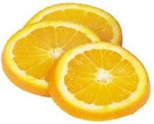

Creative Sam
Implemented a parallel version of his innovation
Fruits
Each input to a map is a list of <key, value> pairs
A list of <key, value> pairs mapped into another list of <key, value> pairs which gets grouped by the key and reduced into a list of values
(<a, > , <o, > , <p, > , …)
Each output of slice is a list of <key, value> pairs
(<a’, > , <o’, > , <p’, > )
Grouped by key
The idea of Map Reduce in Data Intensive Computing
Each input to a reduce is a <key, value-list> (possibly a list of these, depending on the grouping/hashing mechanism)
e.g. <ao, ( …)>
Reduced into a list of values
Notes:
To create his favorite mix fruit juice he can use a combiner after the reducers
If several <key, value-list> fall into the same group (based on the grouping/hashing algorithm) then use the blender (reducer) separately on each of them
The knife (mapper) and blender (reducer) should not contain residue after use – Side Effect Free
In general reducer should be associative and commutative

Slide 15
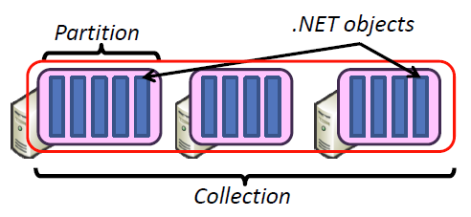
Hadoop & DryadLINQ
Apache Hadoop
Microsoft DryadLINQ
Master Node
Data/Compute Nodes
Standard LINQ operations
Job
Tracker
M
M
M
M
DryadLINQ operations
R
R
R
R
DryadLINQ Compiler
Name
Node
HDFS
Data
blocks
Directed Acyclic Graph (DAG) based execution flows
1
2
Vertex :
execution task
2
3
3
4
Edge :
communication path
Dryad Execution Engine
Apache Implementation of Google’s MapReduce
Hadoop Distributed File System (HDFS) manage data
Map/Reduce tasks are scheduled based on data locality in HDFS (replicated data blocks)
Dryad process the DAG executing vertices on compute clusters
LINQ provides a query interface for structured data
Provide Hash, Range, and Round-Robin partition patterns
  Job creation; Resource management; Fault tolerance& re-execution of failed taskes/vertices

Slide 16

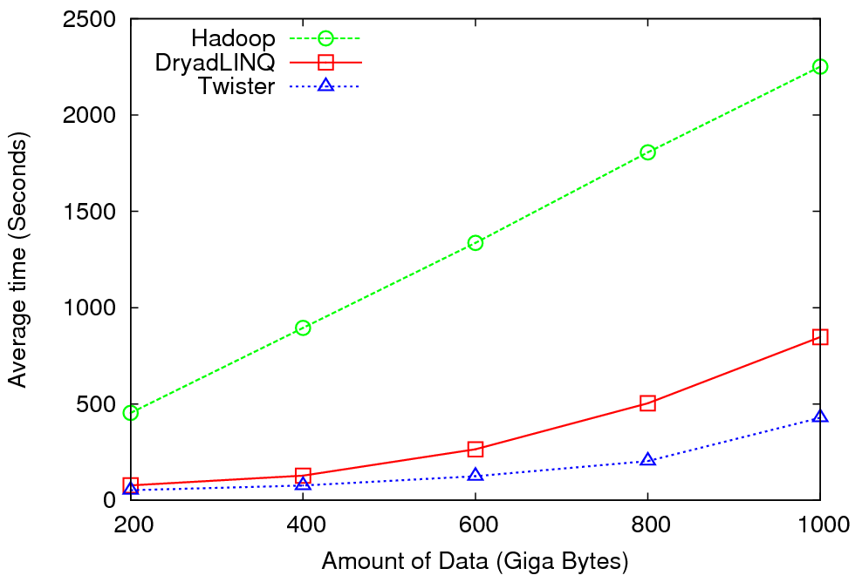
High Energy Physics Data Analysis
An application analyzing data from Large Hadron Collider (1TB but 100 Petabytes eventually)
Input to a map task: <key, value>
key = Some Id value = HEP file Name
Output of a map task: <key, value>
key = random # (0<= num<= max reduce tasks)
value = Histogram as binary data
Input to a reduce task: <key, List<value>>
key = random # (0<= num<= max reduce tasks)
value = List of histogram as binary data
Output from a reduce task: value
value = Histogram file
Combine outputs from reduce tasks to form the final histogram
Notes:
A simple MapReduce model and Performance depends on disk access speeds
Hadoop implementation uses a shared parallel file system (Lustre)
ROOT scripts cannot access data from HDFS
On demand data movement has significant overhead
Dryad and Twister both store data in local disks and have better performance
Data analysis requires ROOT framework (ROOT Interpreted Scripts)

Slide 17

Reduce Phase of Particle Physics
“Find the Higgs” using Dryad
Higgs in Monte Carlo
Combine Histograms produced by separate Root “Maps” (of event data to partial histograms) into a single Histogram delivered to Client
This is an example using MapReduce to do distributed histogramming.

Slide 18


Applications using Dryad & DryadLINQ
CAP3 - Expressed Sequence Tag assembly to re-construct full-length mRNA
Input files (FASTA)
DryadLINQ
CAP3
CAP3
CAP3
Output files
Perform using DryadLINQ and Apache Hadoop implementations
Single “Select” operation in DryadLINQ
“Map only” operation in Hadoop
X. Huang, A. Madan, “CAP3: A DNA Sequence Assembly Program,” Genome Research, vol. 9, no. 9, pp. 868-877, 1999.

Slide 19
Architecture of EC2 and Azure Cloud for Cap3
HDFS
Input Data Set
Data File
exe
exe
Map()
Map()
Executable
Optional
Reduce
Phase
Reduce
HDFS
Results

Slide 20
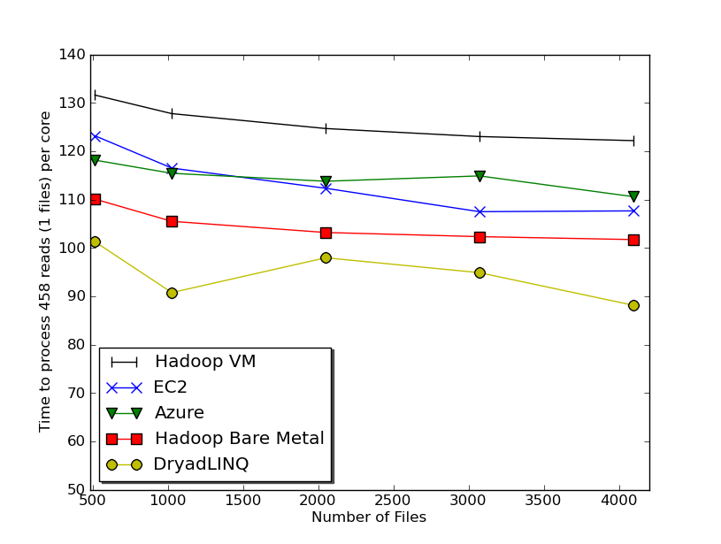

Usability and Performance of Different Cloud Approaches
Cap3 Performance
Cap3 Efficiency
Ease of Use – Dryad/Hadoop are easier than EC2/Azure as higher level models
Lines of code including file copy
  Azure : ~300 Hadoop: ~400 Dyrad: ~450 EC2 : ~700
Efficiency = absolute sequential run time / (number of cores * parallel run time)
Hadoop, DryadLINQ - 32 nodes (256 cores IDataPlex)
EC2 - 16 High CPU extra large instances (128 cores)
Azure- 128 small instances (128 cores)
Notes:
Emerging technologies we cannot draw too much conclusion yet but all look promising at the moment
Ease of development. Dryad and Hadoop >> EC2 and Azure
Why Azure is worse than EC2 although less code lines?
Simplest model

Slide 21
Table 1 : Selected EC2 Instance Types
Instance Type | Memory | EC2 compute units | Actual CPU cores | Cost per hour | Cost per Core per hour
Large (L) | 7.5 GB | 4 | 2 X (~2Ghz) | 0.34$ | 0.17$
Extra Large (XL) | 15 GB | 8 | 4 X (~2Ghz) | 0.68$ | 0.17$
High CPU Extra Large (HCXL) | 7 GB | 20 | 8 X (~2.5Ghz) | 0.68$ | 0.09$
High Memory 4XL (HM4XL) | 68.4 GB | 26 | 8X (~3.25Ghz) | 2.40$ | 0.3$
Tempest@IU | 48GB | n/a | 24 | 1.62$ | 0.07$
Notes:
#core x 1Ghz

Slide 22
4096 Cap3 data files : 1.06 GB / 1875968 reads (458 readsX4096)..
Following is the cost to process 4096 CAP3 files..
Cost to process 4096 FASTA files (~1GB) on EC2 (58 minutes)
Amortized compute cost = 10.41 $ (0.68$ per high CPU extra large instance per hour) 10000 SQS messages = 0.01 $ Storage per 1GB per month = 0.15 $ Data transfer out per 1 GB = 0.15 $ Total = 10.72 $
Cost to process 4096 FASTA files (~1GB) on Azure (59 minutes)
Amortized compute cost = 15.10 $ (0.12$ per small instance per hour) 10000 queue messages = 0.01 $ Storage per 1GB per month = 0.15 $ Data transfer in/out per 1 GB =0.10 $ + 0.15 $ Total = 15.51 $
Amortized cost in Tempest (24 core X 32 nodes, 48 GB per node) = 9.43$
(Assume 70% utilization, write off over 3 years, include support)

Slide 23
Data Intensive Applications
Data Deluge
Cloud Technologies
Multicore
eScience
Notes:
Within past 5 year
Data -> Hardware -> Software -> Application
Data coming from everywhere 24/7.
Data are too large to fit into memory and take impractical time to run and get results
e.g. 50K all pairs SWG (O(N2)) takes ~5 hours on 768 cores. A sequential run takes 160 days.
MPI OpenMP RPC RMI

Slide 24
Some Life Sciences Applications
EST (Expressed Sequence Tag) sequence assembly program using DNA sequence assembly program software CAP3.
Metagenomics and Alu repetition alignment using Smith Waterman dissimilarity computations followed by MPI applications for Clustering and MDS (Multi Dimensional Scaling) for dimension reduction before visualization
Mapping the 60 million entries in PubChem into two or three dimensions to aid selection of related chemicals with convenient Google Earth like Browser. This uses either hierarchical MDS (which cannot be applied directly as O(N²)) or GTM (Generative Topographic Mapping).
Correlating Childhood obesity with environmental factors by combining medical records with Geographical Information data with over 100 attributes using correlation computation, MDS and genetic algorithms for choosing optimal environmental factors.

Slide 25



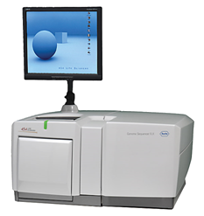
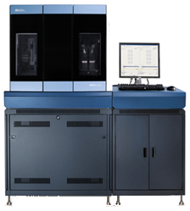
DNA Sequencing Pipeline
MapReduce
Pairwise
clustering
Sequence
alignment
Dissimilarity
Matrix
N(N-1)/2 values
Visualization
Plotviz
FASTA File
N Sequences
Blocking
block
Pairings
MPI
MDS
Read Alignment
This chart illustrate our research of a pipeline mode to provide services on demand (Software as a Service SaaS)
User submit their jobs to the pipeline. The components are services and so is the whole pipeline.
Illumina/Solexa Roche/454 Life Sciences Applied Biosystems/SOLiD
Internet
Modern Commerical Gene Sequences

Slide 26
Alu and Metagenomics Workflow
“All pairs” problem
Data is a collection of N sequences. Need to calcuate N² dissimilarities (distances) between sequnces (all pairs).
  These cannot be thought of as vectors because there are missing characters
  “Multiple Sequence Alignment” (creating vectors of characters) doesn’t seem to work if N larger than O(100), where 100’s of characters long.
Step 1: Can calculate N² dissimilarities (distances) between sequences
Step 2: Find families by clustering (using much better methods than Kmeans). As no vectors, use vector free O(N²) methods
Step 3: Map to 3D for visualization using Multidimensional Scaling (MDS) – also O(N²)
Results:
N = 50,000 runs in 10 hours (the complete pipeline above) on 768 cores
Discussions:
Need to address millions of sequences …..
Currently using a mix of MapReduce and MPI
Twister will do all steps as MDS, Clustering just need MPI Broadcast/Reduce

Slide 27


Biology MDS and Clustering Results
Alu Families
This visualizes results of Alu repeats from Chimpanzee and Human Genomes. Young families (green, yellow) are seen as tight clusters. This is projection of MDS dimension reduction to 3D of 35399 repeats – each with about 400 base pairs
Metagenomics
This visualizes results of dimension reduction to 3D of 30000 gene sequences from an environmental sample. The many different genes are classified by clustering algorithm and visualized by MDS dimension reduction

Slide 28

All-Pairs Using DryadLINQ
125 million distances
4 hours & 46 minutes
Calculate Pairwise Distances (Smith Waterman Gotoh)
Calculate pairwise distances for a collection of genes (used for clustering, MDS)
Fine grained tasks in MPI
Coarse grained tasks in DryadLINQ
Performed on 768 cores (Tempest Cluster)
Moretti, C., Bui, H., Hollingsworth, K., Rich, B., Flynn, P., & Thain, D. (2009). All-Pairs: An Abstraction for Data Intensive Computing on Campus Grids. IEEE Transactions on Parallel and Distributed Systems , 21, 21-36.

Slide 29
Hadoop/Dryad Comparison
Inhomogeneous Data I
Inhomogeneity of data does not have a significant effect when the sequence lengths are randomly distributed
Dryad with Windows HPCS compared to Hadoop with Linux RHEL on Idataplex (32 nodes)
Notes:
10k data size

Slide 30
Hadoop/Dryad Comparison
Inhomogeneous Data II
This shows the natural load balancing of Hadoop MR dynamic task assignment using a global pipe line in contrast to the DryadLinq static assignment
Dryad with Windows HPCS compared to Hadoop with Linux RHEL on Idataplex (32 nodes)
Notes:
10k data size

Slide 31
Hadoop VM Performance Degradation
Perf. Degradation = (T_{vm} – T_{baremetal})/T_{baremetal}
15.3% Degradation at largest data set size
Notes:
Overhead is independent of computation time. With the size of data go up, overall overhead is reduced.

Slide 32
Parallel Computing and Software
Data Deluge
Cloud Technologies
Parallel Computing
eScience
Notes:
Within past 5 year
Data -> Hardware -> Software -> Application
Data coming from everywhere 24/7.
Data are too large to fit into memory and take impractical time to run and get results
e.g. 50K all pairs SWG (O(N2)) takes ~5 hours on 768 cores. A sequential run takes 160 days.
MPI OpenMP RPC RMI

Slide 33


Twister(MapReduce++)
Pub/Sub Broker Network
Map Worker
M
Streaming based communication
Intermediate results are directly transferred from the map tasks to the reduce tasks – eliminates local files
Cacheable map/reduce tasks
  Static data remains in memory
Combine phase to combine reductions
User Program is the composer of MapReduce computations
Extends the MapReduce model to iterative computations
Worker Nodes
R
Reduce Worker
D
D
MR
Driver
User
Program
M
M
M
M
D
MRDeamon
R
R
R
R
Data Read/Write
Communication
Data Split
File System
Iterate
Static
data
Configure()
User Program
Map(Key, Value)
δ flow
Reduce (Key, List<Value>)
Combine (Key, List<Value>)
Different synchronization and intercommunication mechanisms used by the parallel runtimes
Close()
Notes:
MapReduce did some things very well but we needed MPI for MDS and Clustering.
BUT we realize not all MPI – just map and reduce iterate
Thus we designed Twister
Add new release

Slide 34
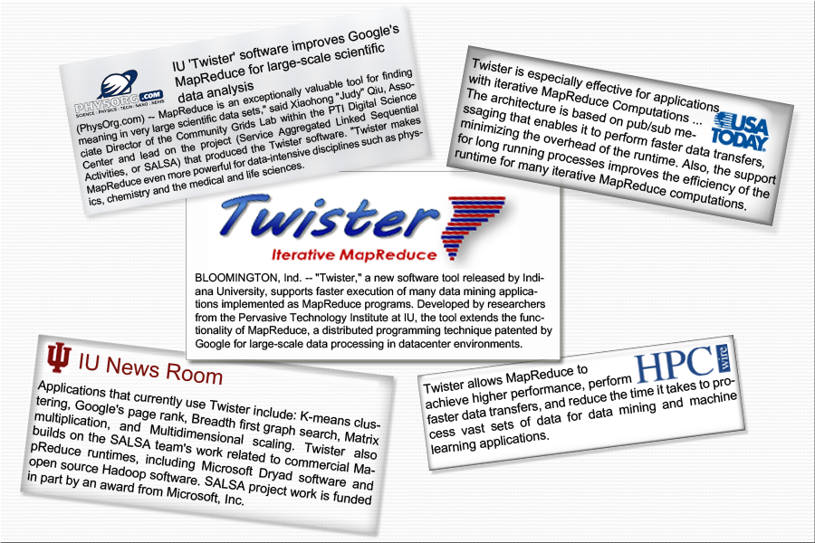
Twister New Release

Slide 35


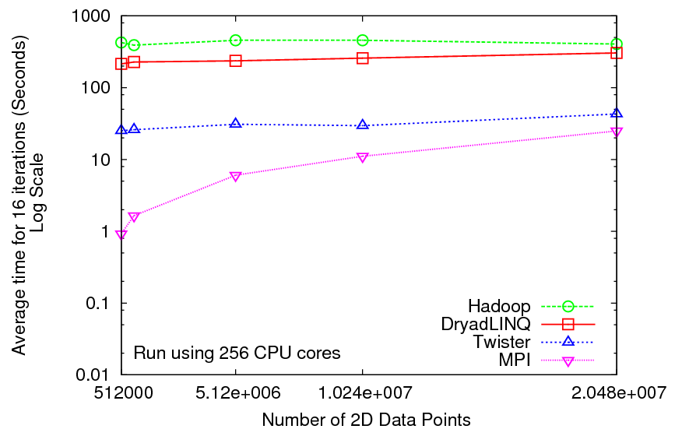
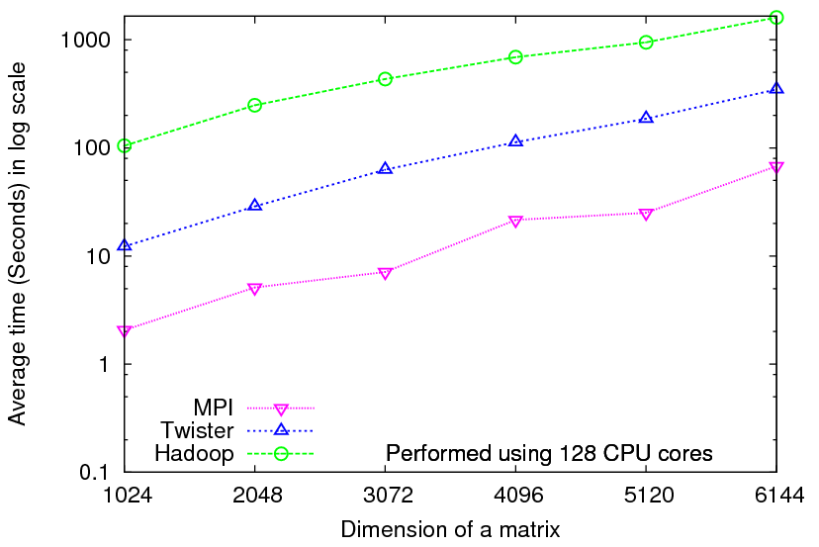
Iterative Computations
K-means
Matrix Multiplication
Performance of K-Means
Parallel Overhead Matrix Multiplication
Notes:
As a lot of data analysis algorithms are built on linear algebra, by using Twister, we can support many data analysis algorithms.

Slide 36
Parallel Computing and Algorithms
Data Deluge
Cloud Technologies
Parallel Computing
eScience
Notes:
Within past 5 year
Data -> Hardware -> Software -> Application
Data coming from everywhere 24/7.
Data are too large to fit into memory and take impractical time to run and get results
e.g. 50K all pairs SWG (O(N2)) takes ~5 hours on 768 cores. A sequential run takes 160 days.
MPI OpenMP RPC RMI

Slide 37
Parallel Data Analysis Algorithms on Multicore
Developing a suite of parallel data-analysis capabilities
  Clustering with deterministic annealing (DA)
  Dimension Reduction for visualization and analysis (MDS, GTM)
  Matrix algebra as needed
    Matrix Multiplication
    Equation Solving
    Eigenvector/value Calculation
Notes:
Results
Microsoft CCR supports MPI, dynamic threading
Detailed performance measurements with Speedups of 7.5 or above on 8-core systems for “large problems” using deterministic annealed (avoid local minima) algorithms for clustering, Gaussian Mixtures, GTM (dimensional reduction) etc.

Slide 38
High Performance
Dimension Reduction and Visualization
Need is pervasive
  Large and high dimensional data are everywhere: biology, physics, Internet, …
  Visualization can help data analysis
Visualization of large datasets with high performance
  Map high-dimensional data into low dimensions (2D or 3D).
  Need Parallel programming for processing large data sets
  Developing high performance dimension reduction algorithms:
    MDS(Multi-dimensional Scaling), used earlier in DNA sequencing application
    GTM(Generative Topographic Mapping)
    DA-MDS(Deterministic Annealing MDS)
    DA-GTM(Deterministic Annealing GTM)
  Interactive visualization tool PlotViz
We are supporting drug discovery by browsing 60 million compounds in PubChem database with 166 features each
Notes:
With David Wild

Slide 39
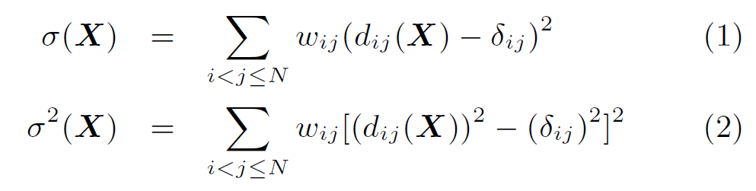

Dimension Reduction Algorithms
Multidimensional Scaling (MDS) [1]
  Given the proximity information among points.
  Optimization problem to find mapping in target dimension of the given data based on pairwise proximity information while minimize the objective function.
  Objective functions: STRESS (1) or SSTRESS (2)
  Only needs pairwise distances δ_{ij} between original points (typically not Euclidean)
  d_{ij}(X) is Euclidean distance between mapped (3D) points
Generative Topographic Mapping
(GTM) [2]
  Find optimal K-representations for the given data (in 3D), known as
  K-cluster problem (NP-hard)
  Original algorithm use EM method for optimization
  Deterministic Annealing algorithm can be used for finding a global solution
  Objective functions is to maximize log-likelihood:
[1] I. Borg and P. J. Groenen. Modern Multidimensional Scaling: Theory and Applications. Springer, New York, NY, U.S.A., 2005.
[2] C. Bishop, M. Svens´en, and C. Williams. GTM: The generative topographic mapping. Neural computation, 10(1):215–234, 1998.
Notes:
MDS implemented in C#; GTM in R and C/C++

Slide 40
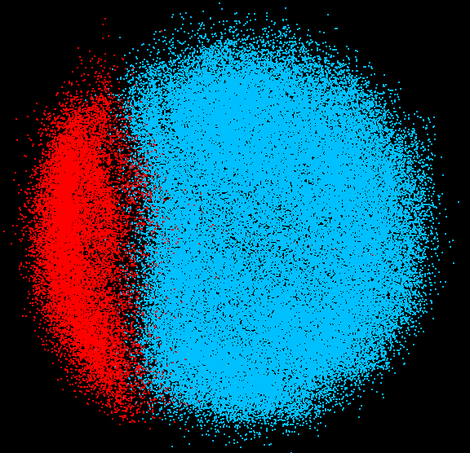
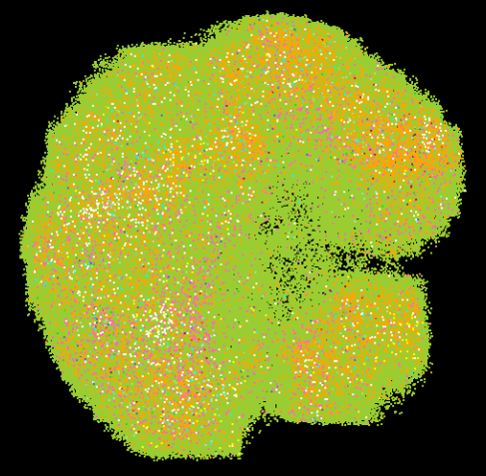
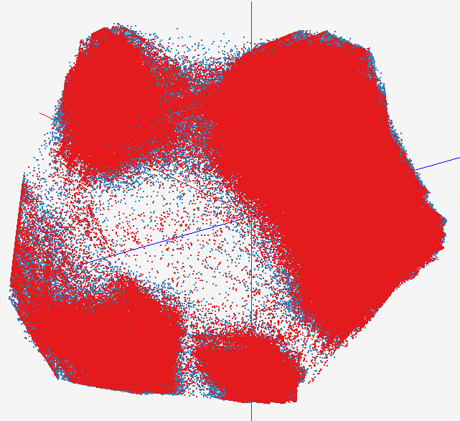
High Performance Data Visualization..
First time using Deterministic Annealing for parallel MDS and GTM algorithms to visualize large and high-dimensional data
Processed 0.1 million PubChem data having 166 dimensions
Parallel interpolation can process 60 million PubChem points
GTM with interpolation for
2M PubChem data
2M PubChem data is plotted in 3D with GTM interpolation approach. Blue points are 100k sampled data and red points are 2M interpolated points.
MDS for 100k PubChem data
100k PubChem data having 166 dimensions are visualized in 3D space. Colors represent 2 clusters separated by their structural proximity.
GTM for 930k genes and diseases
Genes (green color) and diseases (others) are plotted in 3D space, aiming at finding cause-and-effect relationships.
PubChem project, http://pubchem.ncbi.nlm.nih.gov/

Slide 41
Interpolation Method
MDS and GTM are highly memory and time consuming process for large dataset such as millions of data points
MDS requires O(N²) and GTM does O(KN) (N is the number of data points and K is the number of latent variables)
Training only for sampled data and interpolating for out-of-sample set can improve performance
Interpolation is a pleasingly parallel application
n
in-sample
Training
Trained data
N-n
out-of-sample
Interpolated
MDS/GTM map
Interpolation
Total N data

Slide 42
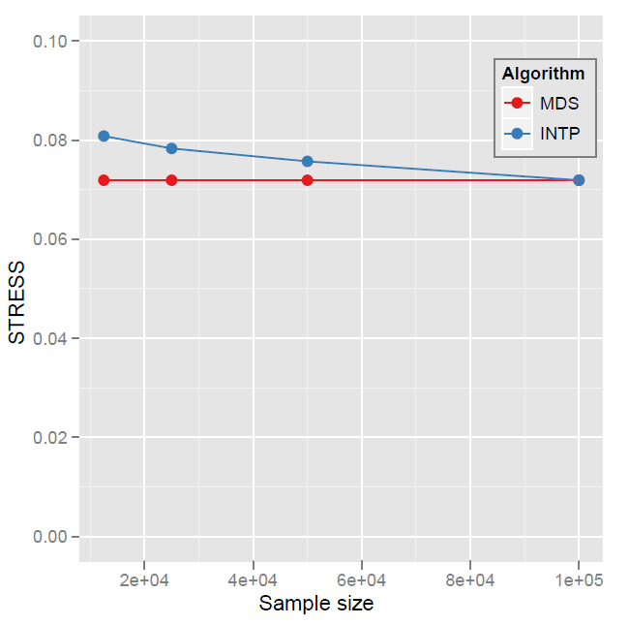
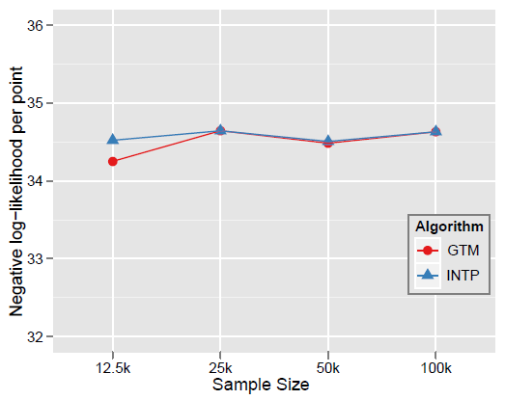

Quality Comparison
(Original vs. Interpolation)
MDS
GTM
Quality comparison between Interpolated result upto 100k based on the sample data (12.5k, 25k, and 50k) and original MDS result w/ 100k.
STRESS:
w_{ij} = 1 / ∑δ_{ij}²
Interpolation result (blue) is getting close to the original (read) result as sample size is increasing.
12.5K 25K 50K 100K Run on 16 nodes of Tempest
Note that we gain performance of over a factor of 100 for this data size. It would be more for larger data set.
Notes:
12.5K 25K 50K 100K Run on 16 nodes of Tempest
Note that we gain performance of over a factor of 100 for this data size. It would be more for larger data set.

Slide 43
Convergence is Happening
Multicore
Clouds
Data intensive application with basic activities:
capture, curation, preservation, and analysis (visualization)
Data Intensive
Paradigms
Cloud infrastructure and runtime
Parallel threading and processes
Notes:
Jim Gray’s talk to the Computer Science and Telecommunications Board in 2007
His vision of the fourth paradigm of scientific research. Focus on Data-intensive Systems and Scientific communications
New scientific research is highlighted by “data science”

Slide 44
Science Cloud (Dynamic Virtual Cluster) Architecture
Smith Waterman Dissimilarities, CAP-3 Gene Assembly, PhyloD Using DryadLINQ, High Energy Physics, Clustering, Multidimensional Scaling, Generative Topological Mapping
Applications
Services and Workflow
Runtimes
Apache Hadoop / Twister/ MPI
Microsoft DryadLINQ / MPI
Linux Bare-system
Linux Virtual Machines
Windows Server 2008 HPC
Bare-system
Windows Server 2008 HPC
Infrastructure software
Xen Virtualization
Xen Virtualization
XCAT Infrastructure
Hardware
iDataplex Bare-metal Nodes
Dynamic Virtual Cluster provisioning via XCAT
Supports both stateful and stateless OS images

Slide 45
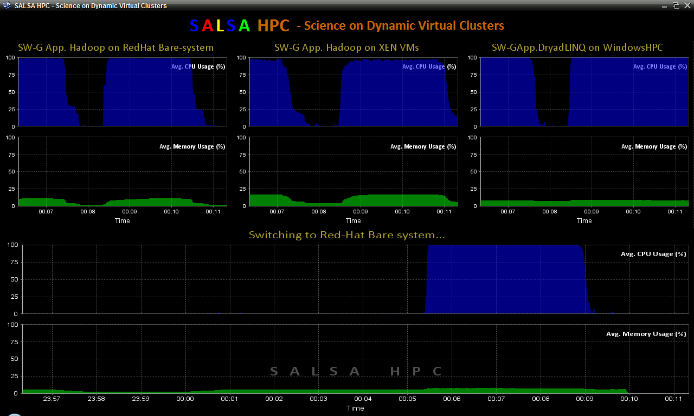
Dynamic Virtual Clusters
Dynamic Cluster Architecture
Monitoring & Control Infrastructure
Monitoring Infrastructure
Monitoring Interface
Pub/Sub Broker Network
SW-G Using Hadoop
SW-G Using Hadoop
SW-G Using DryadLINQ
Linux
Bare-system
Linux on Xen
Windows Server 2008 Bare-system
Virtual/Physical Clusters
Summarizer
XCAT Infrastructure
XCAT Infrastructure
Switcher
iDataplex Bare-metal Nodes
(32 nodes)
iDataplex Bare-metal Nodes
Switchable clusters on the same hardware (~5 minutes between different OS such as Linux+Xen to Windows+HPCS)
Support for virtual clusters
SW-G : Smith Waterman Gotoh Dissimilarity Computation as an pleasingly parallel problem suitable for MapReduce style applications

Slide 46
SALSA HPC Dynamic Virtual Clusters Demo
At top, these 3 clusters are switching applications on fixed environment. Takes ~30 Seconds.
At bottom, this cluster is switching between Environments – Linux; Linux +Xen; Windows + HPCS. Takes about ~7 minutes.
It demonstrates the concept of Science on Clouds using a FutureGrid cluster.

Slide 47
Summary of Initial Results
Cloud technologies (Dryad/Hadoop/Azure/EC2) promising for Biology computations
Dynamic Virtual Clusters allow one to switch between different modes
Overhead of VM’s on Hadoop (15%) acceptable
Inhomogeneous problems currently favors Hadoop over Dryad
Twister allows iterative problems (classic linear algebra/datamining) to use MapReduce model efficiently
  Prototype Twister released

Slide 48

FutureGrid: a Grid Testbed
IU Cray operational, IU IBM (iDataPlex) completed stability test May 6
UCSD IBM operational, UF IBM stability test completes ~ May 12
Network, NID and PU HTC system operational
UC IBM stability test completes ~ May 27; TACC Dell awaiting delivery of components
NID: Network Impairment Device
Private
Public
FG Network

Slide 49
FutureGrid Partners
Indiana University (Architecture, core software, Support)
Purdue University (HTC Hardware)
San Diego Supercomputer Center at University of California San Diego (INCA, Monitoring)
University of Chicago/Argonne National Labs (Nimbus)
University of Florida (ViNE, Education and Outreach)
University of Southern California Information Sciences (Pegasus to manage experiments)
University of Tennessee Knoxville (Benchmarking)
University of Texas at Austin/Texas Advanced Computing Center (Portal)
University of Virginia (OGF, Advisory Board and allocation)
Center for Information Services and GWT-TUD from Technische Universtität Dresden. (VAMPIR)
Blue institutions have FutureGrid hardware

Slide 50
FutureGrid Concepts
Support development of new applications and new middleware using Cloud, Grid and Parallel computing (Nimbus, Eucalyptus, Hadoop, Globus, Unicore, MPI, OpenMP. Linux, Windows …) looking at functionality, interoperability, performance
Put the “science” back in the computer science of grid computing by enabling replicable experiments
Open source software built around Moab/xCAT to support dynamic provisioning from Cloud to HPC environment, Linux to Windows ….. with monitoring, benchmarks and support of important existing middleware
June 2010 Initial users; September 2010 All hardware (except IU shared memory system) accepted and major use starts; October 2011 FutureGrid allocatable via TeraGrid process

Slide 51
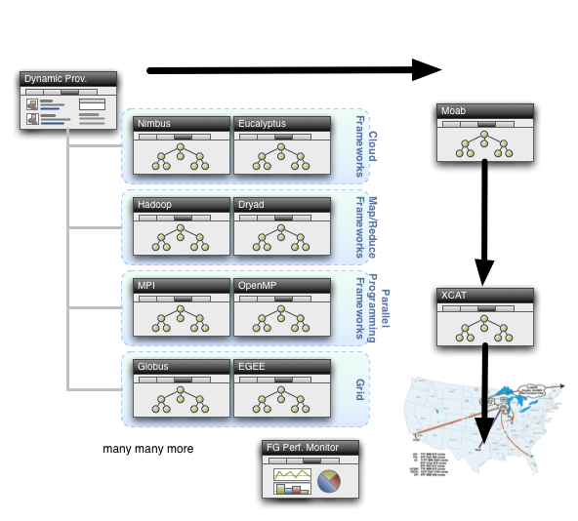
Dynamic Provisioning

Slide 52
Summary
Intend to implement range of biology applications with Dryad/Hadoop/Twister
FutureGrid allows easy Windows v Linux with and without VM comparison
Initially we will make key capabilities available as services that we eventually implement on virtual clusters (clouds) to address very large problems
  Basic Pairwise dissimilarity calculations
  Capabilities already in R (done already by us and others)
  MDS in various forms
  GTM Generative Topographic Mapping
  Vector and Pairwise Deterministic annealing clustering
Point viewer (Plotviz) either as download (to Windows!) or as a Web service gives Browsing
Should enable much larger problems than existing systems
  Will look at Twister as a “universal” solution

Slide 53
Future Work
The support for handling large data sets, the concept of moving computation to data, and the better quality of services provided by cloud technologies, make data analysis feasible on an unprecedented scale for assisting new scientific discovery.
Combine "computational thinking“ with the “fourth paradigm” (Jim Gray on data intensive computing)
Research from advance in Computer Science and Applications (scientific discovery)
Notes:
A glimpse of the future and motivation

Slide 54


Slide 55
Thank you!
Collaborators
Yves Brun, Peter Cherbas, Dennis Fortenberry, Roger Innes, David Nelson, Homer Twigg,
Craig Stewart, Haixu Tang, Mina Rho, David Wild, Bin Cao, Qian Zhu, Gilbert Liu, Neil Devadasan
Sponsors
Microsoft Research, NIH, NSF, PTI

Slide 56
Important Trends
Data Deluge
Cloud Technologies
Multicore
eScience
Notes:
Within past 5 year
Data -> Hardware -> Software -> Application
Data coming from everywhere 24/7.
Data are too large to fit into memory and take impractical time to run and get results
e.g. 50K all pairs SWG (O(N2)) takes ~5 hours on 768 cores. A sequential run takes 160 days.
MPI OpenMP RPC RMI

Slide 57
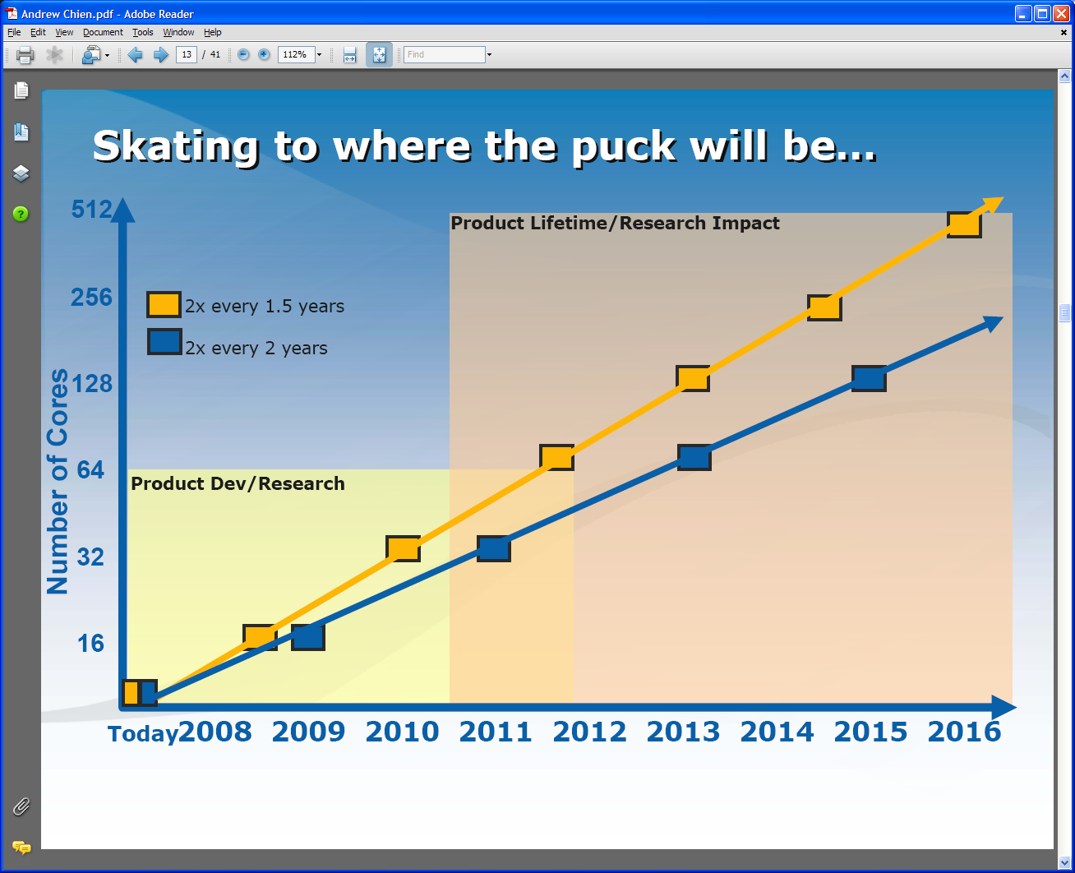
Intel’s Projection

Slide 58
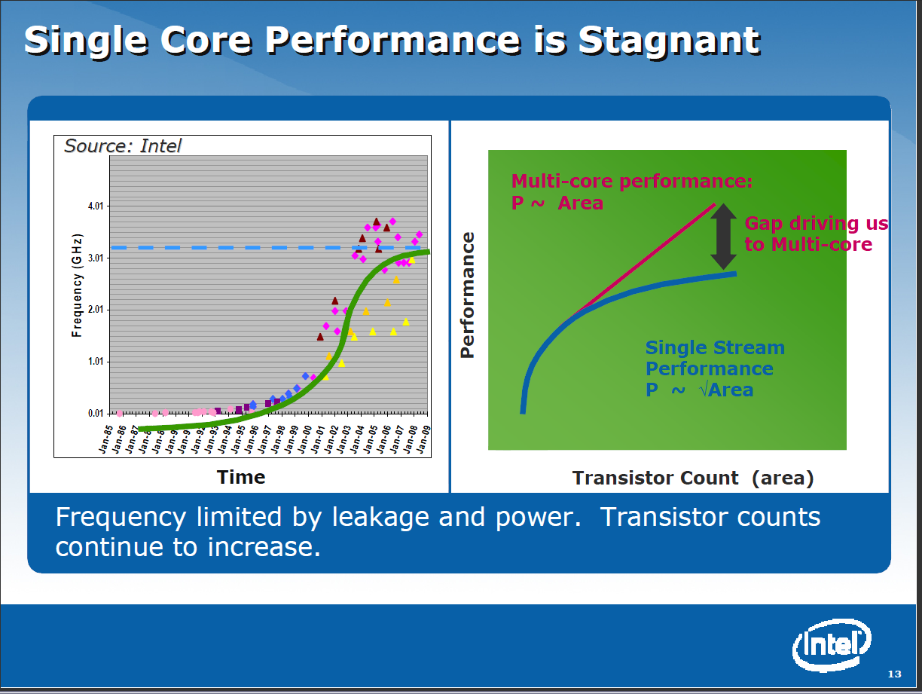

Slide 59
Intel’s Multicore Application Stack

Slide 60
Runtime System Used
We implement micro-parallelism using Microsoft CCR
(Concurrency and Coordination Runtime) as it supports both MPI rendezvous and dynamic (spawned) threading style of parallelism http://msdn.microsoft.com/robotics/
CCR Supports exchange of messages between threads using named ports and has primitives like:
  FromHandler: Spawn threads without reading ports
  Receive: Each handler reads one item from a single port
  MultipleItemReceive: Each handler reads a prescribed number of items of a given type from a given port. Note items in a port can be general structures but all must have same type.
  MultiplePortReceive: Each handler reads a one item of a given type from multiple ports.
CCR has fewer primitives than MPI but can implement MPI collectives efficiently
Use DSS (Decentralized System Services) built in terms of CCR for service model
DSS has ~35 µs and CCR a few µs overhead (latency, details later)

Slide 61
Typical CCR Performance Measurement
Performance of CCR vs MPI for MPI Exchange Communication
Machine | OS | Runtime | Grains | Parallelism | MPI Latency
Intel8 (8 core, Intel Xeon CPU, E5345, 2.33 Ghz, 8MB cache, 8GB memory) (in 2 chips) | Redhat | MPJE(Java) | Process | 8 | 181
 |  | MPICH2 (C) | Process | 8 | 40.0
 |  | MPICH2:Fast | Process | 8 | 39.3
 |  | Nemesis | Process | 8 | 4.21
Intel8 (8 core, Intel Xeon CPU, E5345, 2.33 Ghz, 8MB cache, 8GB memory) | Fedora | MPJE | Process | 8 | 157
 |  | mpiJava | Process | 8 | 111
 |  | MPICH2 | Process | 8 | 64.2
Intel8 (8 core, Intel Xeon CPU, x5355, 2.66 Ghz, 8 MB cache, 4GB memory) | Vista | MPJE | Process | 8 | 170
 | Fedora | MPJE | Process | 8 | 142
 | Fedora | mpiJava | Process | 8 | 100
 | Vista | CCR (C#) | Thread | 8 | 20.2
AMD4 (4 core, AMD Opteron CPU, 2.19 Ghz, processor 275, 4MB cache, 4GB memory) | XP | MPJE | Process | 4 | 185
 | Redhat | MPJE | Process | 4 | 152
 |  | mpiJava | Process | 4 | 99.4
 |  | MPICH2 | Process | 4 | 39.3
 | XP | CCR | Thread | 4 | 16.3
Intel4 (4 core, Intel Xeon CPU, 2.80GHz, 4MB cache, 4GB memory) | XP | CCR | Thread | 4 | 25.8
MPI Exchange Latency in µs (20-30 µs computation between messaging)
CCR outperforms Java always and even standard C except for optimized Nemesis

Slide 62
Notes on Performance
Speed up = T(1)/T(P) = ε (efficiency ) P
  with P processors
Overhead f = (PT(P)/T(1)-1) = (1/ε -1)
is linear in overheads and usually best way to record results if overhead small
For communication f ∝ ratio of data communicated to calculation complexity = n^{-0.5} for matrix multiplication where n (grain size) matrix elements per node
Overheads decrease in size as problem sizes n increase (edge over area rule)
Scaled Speed up: keep grain size n fixed as P increases
Conventional Speed up: keep Problem size fixed n ∝ 1/P

Slide 63
Threading versus MPI on node
Always MPI between nodes
Clustering by Deterministic Annealing
(Parallel Overhead = [PT(P) – T(1)]/T(1), where T time and P number of parallel units)
MPI
MPI
Parallel Overhead
MPI
Thread
Thread
Thread
Thread
Thread
MPI
MPI
MPI
MPI
Thread
Thread
Parallel Patterns (ThreadsxProcessesxNodes)
Note MPI best at low levels of parallelism
Threading best at Highest levels of parallelism (64 way breakeven)
Uses MPI.Net as an interface to MS-MPI

Slide 64
Typical CCR Comparison with TPL
Efficiency = 1 / (1 + Overhead)
Hybrid internal threading/MPI as intra-node model works well on Windows HPC cluster
Within a single node TPL or CCR outperforms MPI for computation intensive applications like clustering of Alu sequences (“all pairs” problem)
TPL outperforms CCR in major applications

Slide 65
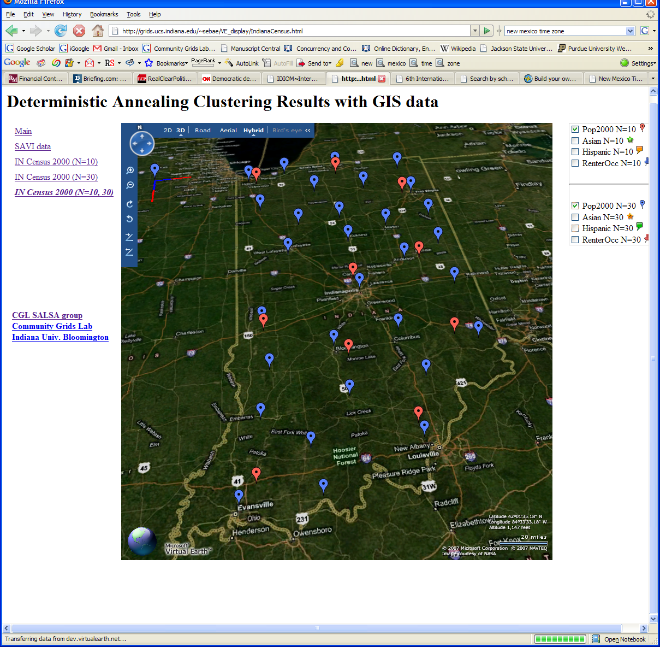
Deterministic Annealing Clustering of Indiana Census Data
Decrease temperature (distance scale) to discover more clusters
Notes:
Blue and Red baloon shows different resolutions.
Notice that the Coarse resolution (in red) doesn’t show Purdue.
Census data are provided by Polis Center at IUPUI with GIS work as main area

Slide 66
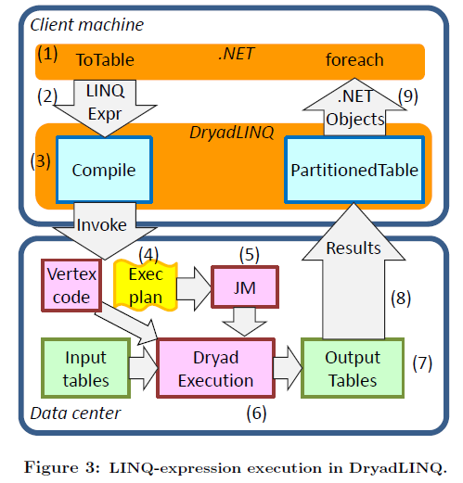
Dryad & DryadLINQ Evaluation
Programming Model for Dryad
Illusion of a Single Computer
Distributed Implementation of LINQ Collections
Input/Output is DryadTable<T>
  Subtype of IQueryable<T>
Higher Jumpstart cost
    User needs to be familiar with LINQ constructs
Higher continuing development efficiency
    Minimal parallel thinking
    Easy querying on structured data (e.g. Select, Join etc..)
Many scientific applications using DryadLINQ including a High Energy Physics data analysis
Comparable performance with Apache Hadoop
    Smith Waterman Gotoh 250 million sequence alignments, performed comparatively or better than Hadoop & MPI
Applications with complex communication topologies are harder to implement
Notes:
As SALSA project is partially funded by Microsoft Research, we produced the evaluation of Dryad for Microsoft as a report so study it’s applicability for support of large scale scientific applications. These are highlights of some of our conclusions.
Partitioning Strategies
Hash-Partitioning, Range Partitioning, Round-Robin Partitioning
Operations
Apply
Performance Penalty
Annotations
Fork
Annotations
Semantic Preserving Optimization Hints
Correctness is Not Enforced

Slide 67
Application Classes
Classification of Parallel software/hardware use in terms of “Application architecture” Structures
1 | Synchronous | Lockstep Operation as in SIMD architectures | SIMD
2 | Loosely Synchronous | Iterative Compute-Communication stages with independent compute (map) operations for each CPU. Heart of most MPI jobs | MPP
3 | Asynchronous | Compute Chess; Combinatorial Search often supported by dynamic threads | MPP
4 | Pleasingly Parallel | Each component independent | Grids
5 | Metaproblems | Coarse grain (asynchronous) combinations of classes 1)-4). The preserve of workflow. | Grids
6 | MapReduce++ | It describes file(database) to file(database) operations which has subcategories including. Pleasingly Parallel Map Only (e.g. Cap3) Map followed by reductions (e.g. HEP) Iterative “Map followed by reductions” – Extension of Current Technologies that supports much linear algebra and datamining | Clouds Hadoop/ Dryad Twister
Notes:
Twister is an example of MapReduce++ -- supports MapReduce model with iteration (data stays in memory and communication via streams not files)
Synchronous and loosely Synchronous classes are classic simulations – Particle dynamics and solve Partial Differential Equations
Asynchronous class is uncommon in Science
Pleasingly Parallel Metaproblems and MapReduce++ important classes for data analysis

Slide 68
MapReduce Code Segment
String execCommand =cap3Dir+File.separator+execName+ " "+inputFileName+" "+ cmdArgs;
JavaProcess p = Runtime.getRuntime().exec(execCommand);
...p.waitFor();
//HEP
String command = dirPath + File.separator+execScript;
C#Process p = new Process();
p.StartInfo.FileName = rootExecutable;
...p.Start()
//CAP3 using Hadoop
public void map(Object key, Text value, Context context) throws IOException, InterruptedException {
Configuration conf=context.getConfiguration();
String cap3Dir=conf.get(Cap3Analysis.prop_cap3_dir);
String execName=conf.get(Cap3Analysis.prop_exec_name);
String inputFileName = value.toString();
String execCommand =cap3Dir+File.separator+execName+ " "+inputFileName;
Process p = Runtime.getRuntime().exec(execCommand);
...
}

