Slide 1
CCR Multicore Performance
ECMS Multiconference HPCS 2008
Nicosia Cyprus June 5 2008
Geoffrey Fox, Seung-Hee Bae, Neil Devadasan, Rajarshi Guha, Marlon Pierce, Xiaohong Qiu, David Wild, Huapeng Yuan
Community Grids Laboratory, Research Computing UITS, School of informatics and POLIS Center Indiana University
George Chrysanthakopoulos, Henrik Frystyk Nielsen
Microsoft Research, Redmond WA
gcf@indiana.edu
http://grids.ucs.indiana.edu/ptliupages/presentations/

Slide 2
Motivation
Exploring possible applications for tomorrow’s multicore chips (especially clients) with 64 or more cores (about 5 years)
One plausible set of applications is data-mining of Internet and local sensors
Developing Library of efficient data-mining algorithms
  Clustering (GIS, Cheminformatics, Bioinformatics) and Hidden Markov Methods (Speech Recognition)
Choose algorithms that can be parallelized well
2
Notes:
2

Slide 3
Approach
Need 3 forms of parallelism
  MPI Style
  Dynamic threads as in pruned search
  Coarse Grain functional parallelism
Do not use an integrated language approach as in Darpa HPCS
Rather use “mash-ups” or “workflow” to link together modules in optimized parallel libraries
Use Microsoft CCR/DSS where DSS is mash-up/workflow model built from CCR and CCR supports MPI or Dynamic threads
3
Notes:
3

Slide 4
Parallel Programming Model
If multicore technology is to succeed, mere mortals must be able to build effective parallel programs on commodity machines
There are interesting new developments – especially the new Darpa HPCS Languages X10, Chapel and Fortress
However if mortals are to program the 64-256 core chips expected in 5-7 years, then we must use near term technology and we must make it easy
  This rules out radical new approaches such as new languages
Remember that the important applications are not scientific computing but most of the algorithms needed are similar to those explored in scientific parallel computing
We can divide problem into two parts:
  “Micro-parallelism”: High Performance scalable (in number of cores) parallel kernels or libraries
  Macro-parallelism: Composition of kernels into complete applications
We currently assume that the kernels of the scalable parallel algorithms/applications/libraries will be built by experts with a
Broader group of programmers (mere mortals) composing library members into complete applications.

Slide 5

Multicore SALSA at CGL
Service Aggregated Linked Sequential Activities
Aims to link parallel and distributed (Grid) computing by developing parallel applications as services and not as programs or libraries
  Improve traditionally poor parallel programming development environments
Developing set of services (library) of multicore parallel data mining algorithms
Looking at Intel list of algorithms (and all previous experience), we find there are two styles of “micro-parallelism”
  Dynamic search as in integer programming, Hidden Markov Methods (and computer chess); irregular synchronization with dynamic threads
  “MPI Style” i.e. several threads running typically in SPMD (Single Program Multiple Data); collective synchronization of all threads together
Most Intel RMS are “MPI Style” and very close to scientific algorithms even if applications are not science

Slide 6
Scalable Parallel Components
How do we implement micro-parallelism?
There are no agreed high-level programming environments for building library members that are broadly applicable.
However lower level approaches where experts define parallelism explicitly are available and have clear performance models.
These include MPI for messaging or just locks within a single shared memory.
There are several patterns to support here including the collective synchronization of MPI, dynamic irregular thread parallelism needed in search algorithms, and more specialized cases like discrete event simulation.
We use Microsoft CCR
http://msdn.microsoft.com/robotics/ as it supports both MPI and dynamic threading style of parallelism

Slide 7
There is MPI style messaging and ..
OpenMP annotation or Automatic Parallelism of existing software is practical way to use those pesky cores with existing code
  As parallelism is typically not expressed precisely, one needs luck to get good performance
  Remember writing in Fortran, C, C#, Java … throws away information about parallelism
HPCS Languages should be able to properly express parallelism but we do not know how efficient and reliable compilers will be
  High Performance Fortran failed as language expressed a subset of parallelism and compilers did not give predictable performance
PGAS (Partitioned Global Address Space) like UPC, Co-array Fortran, Titanium, HPJava
  One decomposes application into parts and writes the code for each component but use some form of global index
  Compiler generates synchronization and messaging
  PGAS approach should work but has never been widely used – presumably because compilers not mature

Slide 8
Summary of micro-parallelism
On new applications, use MPI/locks with explicit user decomposition
A subset of applications can use “data parallel” compilers which follow in HPF footsteps
  Graphics Chips and Cell processor motivate such special compilers but not clear how many applications can be done this way
OpenMP and/or Compiler-based Automatic Parallelism for existing codes in conventional languages

Slide 9
Composition of Parallel Components
The composition (macro-parallelism) step has many excellent solutions as this does not have the same drastic synchronization and correctness constraints as one has for scalable kernels
  Unlike micro-parallelism step which has no very good solutions
Task parallelism in languages such as C++, C#, Java and Fortran90;
General scripting languages like PHP Perl Python
Domain specific environments like Matlab and Mathematica
Functional Languages like MapReduce, F#
HeNCE, AVS and Khoros from the past and CCA from DoE
Web Service/Grid Workflow like Taverna, Kepler, InforSense KDE, Pipeline Pilot (from SciTegic) and the LEAD environment built at Indiana University.
Web solutions like Mash-ups and DSS
Many scientific applications use MPI for the coarse grain composition as well as fine grain parallelism but this doesn’t seem elegant
The new languages from Darpa’s HPCS program support task parallelism (composition of parallel components) decoupling composition and scalable parallelism will remain popular and must be supported.

Slide 10
Integration of Services and “MPI”/Threads
Kernels and Composition must be supported both inside chips (the multicore problem) and between machines in clusters (the traditional parallel computing problem) or Grids.
The scalable parallelism (kernel) problem is typically only interesting on true parallel computers (rather than grids) as the algorithms require low communication latency.
However composition is similar in both parallel and distributed scenarios and it seems useful to allow the use of Grid and Web composition tools for the parallel problem.
  This should allow parallel computing to exploit large investment in service programming environments
Thus in SALSA we express parallel kernels not as traditional libraries but as (some variant of) services so they can be used by non expert programmers
Bottom Line: We need a runtime that supports inter-service linkage and micro-parallelism linkage
CCR and DSS have this property
  Does it work and what are performance costs of the universality of runtime?
  Messaging need not be explicit for large data sets inside multicore node. However still use small messages to synchronize

Slide 11
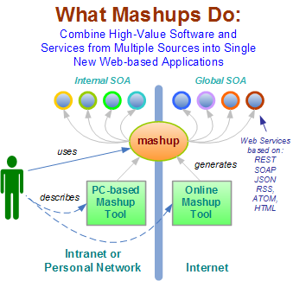
Mashups v Workflow?
Mashup Tools are reviewed at http://blogs.zdnet.com/Hinchcliffe/?p=63
Workflow Tools are reviewed by Gannon and Fox http://grids.ucs.indiana.edu/ptliupages/publications/Workflow-overview.pdf
Both include scripting in PHP, Python, sh etc. as both implement distributed programming at level of services
Mashups use all types of service interfaces and perhaps do not have the potential robustness (security) of Grid service approach
Mashups typically “pure” HTTP (REST)
11
Notes:
11

Slide 12
“Service Aggregation” in SALSA
Kernels and Composition must be supported both inside chips (the multicore problem) and between machines in clusters (the traditional parallel computing problem) or Grids.
The scalable parallelism (kernel) problem is typically only interesting on true parallel computers as the algorithms require low communication latency.
However composition is similar in both parallel and distributed scenarios and it seems useful to allow the use of Grid and Web composition tools for the parallel problem.
  This should allow parallel computing to exploit large investment in service programming environments
Thus in SALSA we express parallel kernels not as traditional libraries but as (some variant of) services so they can be used by non expert programmers
For parallelism expressed in CCR, DSS represents the natural service (composition) model.

Slide 13

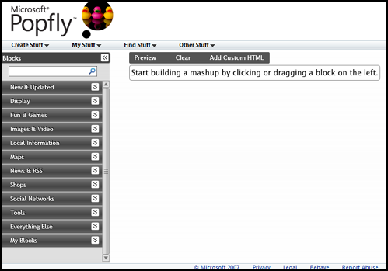
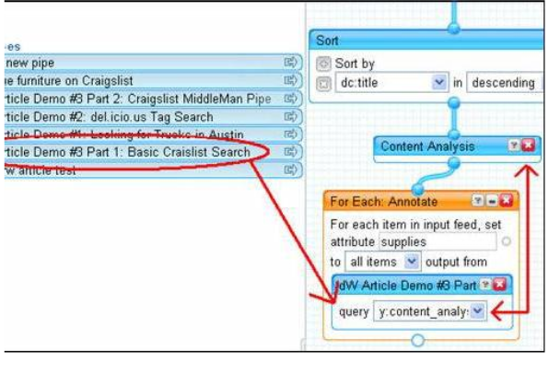
Parallel Programming 2.0
Web 2.0 Mashups will (by definition the largest market) drive composition tools for Grid, web and parallel programming
Parallel Programming 2.0 will build on Mashup tools like Yahoo Pipes and Microsoft Popfly
Yahoo Pipes

Slide 14
Inter-Service Communication
Note that we are not assuming a uniform implementation of service composition even if user sees same interface for multicore and a Grid
  Good service composition inside a multicore chip can require highly optimized communication mechanisms between the services that minimize memory bandwidth use.
  Between systems interoperability could motivate very different mechanisms to integrate services.
  Need both MPI/CCR level and Service/DSS level communication optimization
Note bandwidth and latency requirements reduce as one increases the grain size of services
  Suggests the smaller services inside closely coupled cores and machines will have stringent communication requirements.

Slide 15
Inside the SALSA Services
We generalize the well known CSP (Communicating Sequential Processes) of Hoare to describe the low level approaches to fine grain parallelism as “Linked Sequential Activities” in SALSA.
We use term “activities” in SALSA to allow one to build services from either threads, processes (usual MPI choice) or even just other services.
We choose term “linkage” in SALSA to denote the different ways of synchronizing the parallel activities that may involve shared memory rather than some form of messaging or communication.
There are several engineering and research issues for SALSA
  There is the critical communication optimization problem area for communication inside chips, clusters and Grids.
  We need to discuss what we mean by services
  The requirements of multi-language support
Further it seems useful to re-examine MPI and define a simpler model that naturally supports threads or processes and the full set of communication patterns needed in SALSA (including dynamic threads).
  Should start a new standards effort in OGF perhaps?

Slide 16
General Problem Classes
N data points X(x) in D dimensional space OR points with dissimilarity δ_{ij} defined between them
  Unsupervised Modeling
Find clusters without prejudice
Model distribution as clusters formed from Gaussian distributions with general shape
Both can use multi-resolution annealing
  Dimensional Reduction/Embedding
Given vectors, map into lower dimension space “preserving topology” for visualization: SOM and GTM
Given δ_{ij} associate data points with vectors in a Euclidean space with Euclidean distance approximately δ_{ij} : MDS (can anneal) and Random Projection
Data Parallel over N data points X(x)
SALSA
Notes:
16

Slide 17
Machines Used
AMD4: HPxw9300 workstation, 2 AMD Opteron CPUs Processor 275 at 2.19GHz, 4 cores L2 Cache 4x1MB (summing both chips), Memory 4GB, XP Pro 64bit , Windows Server, Red Hat C# Benchmark Computational unit: 1.388 µs
Intel4: Dell Precision PWS670, 2 Intel Xeon Paxville CPUs at 2.80GHz, 4 cores L2 Cache 4x2MB, Memory 4GB, XP Pro 64bit C# Benchmark Computational unit: 1.475 µs
Intel8a: Dell Precision PWS690, 2 Intel Xeon CPUs E5320 at 1.86GHz, 8 cores L2 Cache 4x4M, Memory 8GB, XP Pro 64bit C# Benchmark Computational unit: 1.696 µs
Intel8b: Dell Precision PWS690, 2 Intel Xeon CPUs E5355 at 2.66GHz, 8 cores L2 Cache 4x4M, Memory 4GB, Vista Ultimate 64bit, Fedora 7 C# Benchmark Computational unit: 1.188 µs
Intel8c: Dell Precision PWS690, 2 Intel Xeon CPUs E5345 at 2.33GHz, 8 cores L2 Cache 4x4M, Memory 8GB, Red Hat 5.0, Fedora 7

Slide 18
Runtime System Used
We implement micro-parallelism using Microsoft CCR
(Concurrency and Coordination Runtime) as it supports both MPI rendezvous and dynamic (spawned) threading style of parallelism http://msdn.microsoft.com/robotics/
CCR Supports exchange of messages between threads using named ports and has primitives like:
FromHandler: Spawn threads without reading ports
Receive: Each handler reads one item from a single port
MultipleItemReceive: Each handler reads a prescribed number of items of a given type from a given port. Note items in a port can be general structures but all must have same type.
MultiplePortReceive: Each handler reads a one item of a given type from multiple ports.
CCR has fewer primitives than MPI but can implement MPI collectives efficiently
Use DSS (Decentralized System Services) built in terms of CCR for service model
DSS has ~35 µs and CCR a few µs overhead

Slide 19
Parallel Multicore
Deterministic Annealing Clustering
Parallel Overhead
on 8 Threads Intel 8b
Speedup = 8/(1+Overhead)
10 Clusters
Overhead = Constant1 + Constant2/n
Constant1 = 0.05 to 0.1 (Client Windows) due to thread
runtime fluctuations
20 Clusters
10000/(Grain Size n = points per core)

Slide 20
Parallel Multicore
Deterministic Annealing Clustering
Parallel Overhead for large (2M points) Indiana Census clustering
on 8 Threads Intel 8b
This fluctuating overhead due to 5-10% runtime fluctuations between threads
“Constant1”
Increasing number of clusters decreases
communication/memory bandwidth overheads

Slide 21
Parallel Multicore
Deterministic Annealing Clustering
Parallel Overhead for subset of PubChem clustering on 8 Threads (Intel 8b)
The fluctuating overhead is reduced to 2% (as bits not doubles)
40,000 points with 1052 binary properties
(Census is 2 real valued properties)
“Constant1”
Increasing number of clusters decreases
communication/memory bandwidth overheads

Slide 22
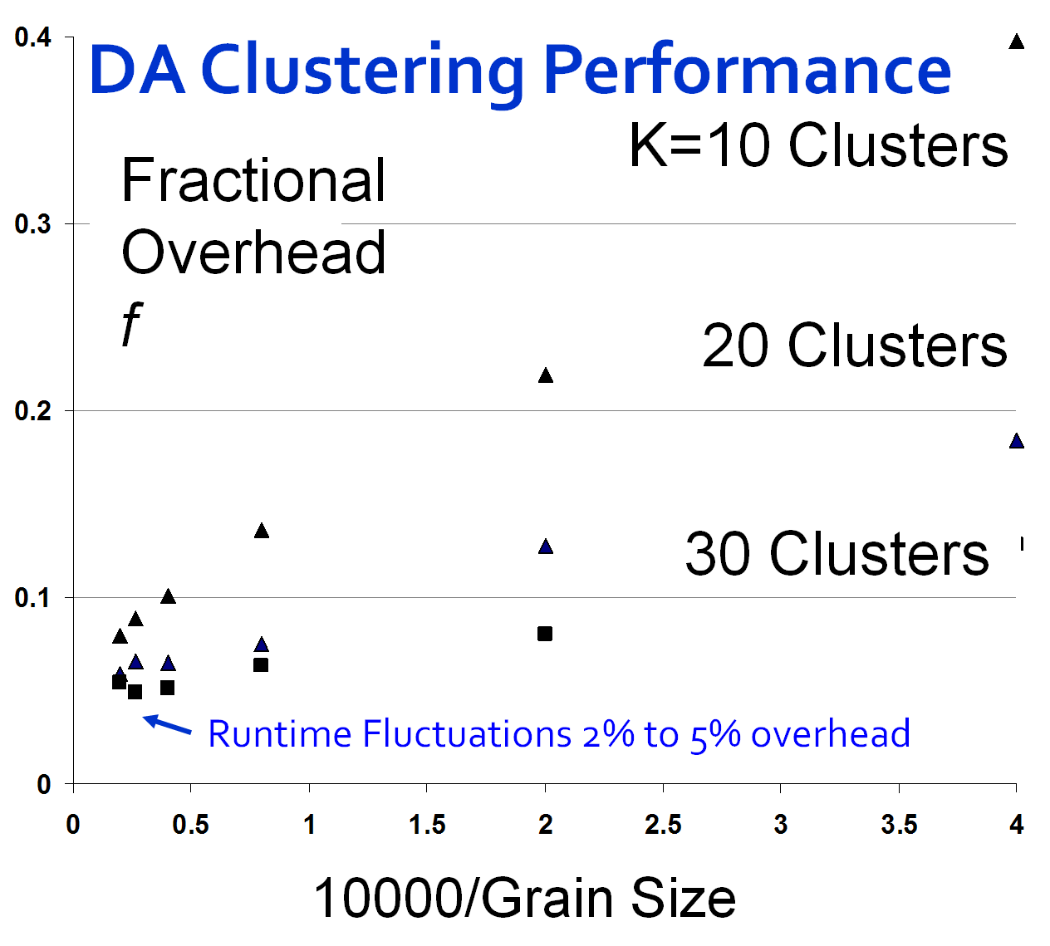
Speedup = Number of cores/(1+f)
f = (Sum of Overheads)/(Computation per core)
Computation ∝ Grain Size n . # Clusters K
Overheads are
Synchronization: small with CCR
Load Balance: good
Memory Bandwidth Limit: → 0 as K → ∞
Cache Use/Interference: Important
Runtime Fluctuations: Dominant large n, K
All our “real” problems have f ≤ 0.05 and
speedups on 8 core systems greater than 7.6
SALSA
Notes:
22

Slide 23
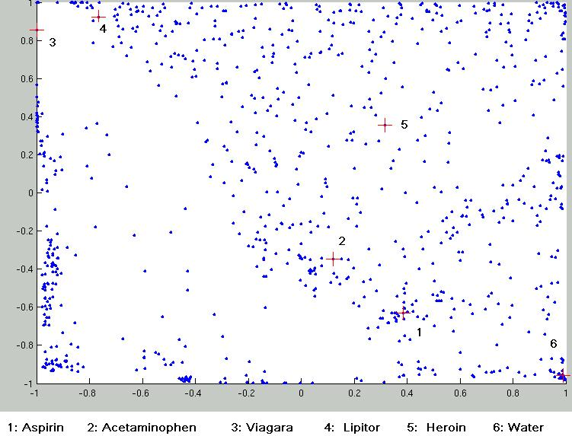
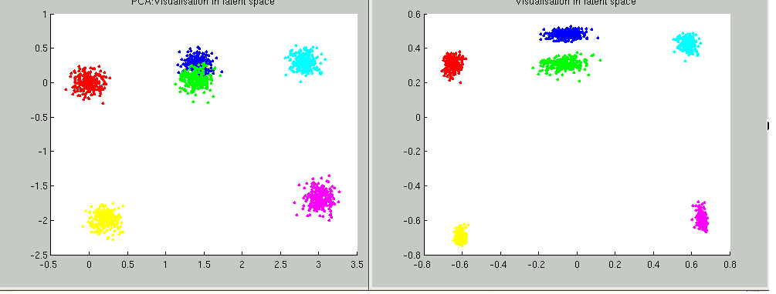
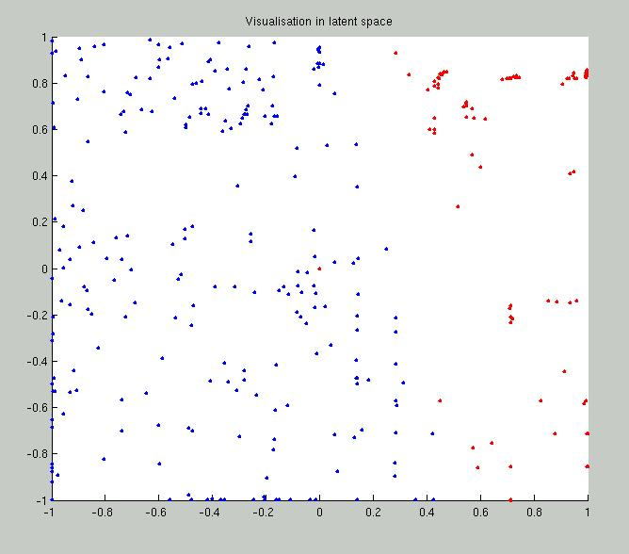
Parallel Generative Topographic Mapping GTM
Reduce dimensionality preserving topology and perhaps distances
Here project to 2D
GTM Projection of PubChem: 10,926,94 compounds in 166 dimension binary property space takes 4 days on 8 cores. 64X64 mesh of GTM clusters interpolates PubChem. Could usefully use 1024 cores! David Wild will use for GIS style 2D browsing interface to chemistry
PCA
GTM
Linear PCA v. nonlinear GTM on 6 Gaussians in 3D
PCA is Principal Component Analysis
GTM Projection of 2 clusters of 335 compounds in 155 dimensions
SALSA
Notes:
23

Slide 24
Parallel Programming Strategy
“Main Thread” and Memory M
MPI/CCR/DSS
From other nodes
MPI/CCR/DSS
From other nodes
0
m₀
1
m₁
2
m₂
3
m₃
4
m₄
5
m₅
6
m₆
7
m₇
Subsidiary threads t with memory m_{t}
Use Data Decomposition as in classic distributed memory but use shared memory for read variables. Each thread uses a “local” array for written variables to get good cache performance
Multicore and Cluster use same parallel algorithms but different runtime implementations; algorithms are
        Accumulate matrix and vector elements in each process/thread
        At iteration barrier, combine contributions (MPI_Reduce)
        Linear Algebra (multiplication, equation solving, SVD)

Slide 25
MPI Exchange Latency in µs (20-30 µs computation between messaging)
Machine | OS | Runtime | Grains | Parallelism | MPI Latency
Intel8c:gf12 (8 core 2.33 Ghz) (in 2 chips) | Redhat | MPJE(Java) | Process | 8 | 181
 |  | MPICH2 (C) | Process | 8 | 40.0
 |  | MPICH2:Fast | Process | 8 | 39.3
 |  | Nemesis | Process | 8 | 4.21
Intel8c:gf20 (8 core 2.33 Ghz) | Fedora | MPJE | Process | 8 | 157
 |  | mpiJava | Process | 8 | 111
 |  | MPICH2 | Process | 8 | 64.2
Intel8b (8 core 2.66 Ghz) | Vista | MPJE | Process | 8 | 170
 | Fedora | MPJE | Process | 8 | 142
 | Fedora | mpiJava | Process | 8 | 100
 | Vista | CCR (C#) | Thread | 8 | 20.2
AMD4 (4 core 2.19 Ghz) | XP | MPJE | Process | 4 | 185
 | Redhat | MPJE | Process | 4 | 152
 |  | mpiJava | Process | 4 | 99.4
 |  | MPICH2 | Process | 4 | 39.3
 | XP | CCR | Thread | 4 | 16.3
Intel(4 core) | XP | CCR | Thread | 4 | 25.8
Messaging CCR versus MPI C# v. C v. Java
SALSA
Notes:
25

Slide 26
MPICH mpiJava MPJE
MPI Shift Latency on AMD4
Stages (millions)
0
2
4
6
8
10

Slide 27
MPICH mpiJava MPJE
MPI Exchange Latency on AMD4
Stages (millions)
0
2
4
6
8
10

Slide 28
MPICH Nemesis MPJE
MPI Exchange Latency on Intel8c RedHat
Stages (millions)
0
2
4
6
8
10

Slide 29
One Stage
Next Stage
Port0
Port0
Port0
Port0
Port0
Thread0
Port0
Thread0
Thread0
Thread0
Thread0
Thread0
Message
Message
Message
Message
Message
Message
Message
Message
Message
Message
Message
Message
Message
Message
Message
Message
Message
Message
Port1
Port1
Port1
Port1
Port1
Thread1
Port1
Thread1
Thread1
Thread1
Thread1
Thread1
Message
Message
Message
Message
Message
Message
Message
Message
Message
Message
Message
Message
Message
Message
Message
Message
Message
Message
Thread2
Port2
Thread2
Port2
Thread2
Port2
Message
Message
Message
Message
Message
Message
Message
Message
Message
Message
Message
Message
Thread3
Port3
Thread3
Port3
Thread3
Port3
Message
Message
Message
Message
Message
Message
Message
Message
Message
Message
Message
Message
Pipeline which is Simplest loosely synchronous execution in CCR
Note CCR supports thread spawning model
MPI usually uses fixed threads with message rendezvous

Slide 30
Thread0
Port0
Thread0
Message
Message
Message
Message
Thread1
Port1
Thread1
Message
Message
EndPort
Message
Message
Thread2
Port2
Thread2
Message
Message
Message
Message
Thread3
Port3
Message
Thread3
Message
Message
Message
Idealized loosely synchronous endpoint (broadcast) in CCR
An example of MPI Collective in CCR

Slide 31
Write
Exchanged
Messages
Read
Messages
Write
Exchanged
Messages
Thread0
Port0
Thread0
Port0
Thread0
Thread1
Port1
Thread1
Port1
Thread1
Thread2
Port2
Thread2
Port2
Thread2
Thread3
Port3
Thread3
Port3
Thread3
Exchanging Messages with 1D Torus Exchange
topology for loosely synchronous execution in CCR

Slide 32
(a) Pipeline
(b) Shift
Thread0
Port0
Thread0
Port0
Thread1
Port1
Thread1
Port1
Thread2
Port2
Thread2
Port2
Thread3
Port3
Thread3
Port3
(c) Two Shifts
(d) Exchange
Thread0
Port0
Thread0
Port0
Thread1
Port1
Thread1
Port1
Thread2
Port2
Thread2
Port2
Thread3
Port3
Thread3
Port3
Four Communication Patterns used in CCR Tests. (a) and (b) use CCR Receive while (c) and (d) use CCR Multiple Item Receive

Slide 33
CCR Overhead for a computation of 27.76 µs between messaging
AMD4: 4 Core |  | Number of Parallel Computations
(μs) |  | 1 | 2 | 3 | 4 | 7 | 8
Spawned | Pipeline | 1.76 | 4.52 | 4.4 | 4.84 | 1.42 | 8.54
 | Shift |  | 4.48 | 4.62 | 4.8 | 0.84 | 8.94
 | Two Shifts |  | 7.44 | 8.9 | 10.18 | 12.74 | 23.92
(MPI) | Pipeline | 3.7 | 5.88 | 6.52 | 6.74 | 8.54 | 14.98
 | Shift |  | 6.8 | 8.42 | 9.36 | 2.74 | 11.16
 | Exchange As Two Shifts |  | 14.1 | 15.9 | 19.14 | 11.78 | 22.6
 | Exchange |  | 10.32 | 15.5 | 16.3 | 11.3 | 21.38
Rendez
vous

Slide 34
CCR Overhead for a computation of
29.5 µs between messaging
Intel4: 4 Core |  | Number of Parallel Computations
(μs) |  | 1 | 2 | 3 | 4 | 7 | 8
Spawned | Pipeline | 3.32 | 8.3 | 9.38 | 10.18 | 3.02 | 12.12
 | Shift |  | 8.3 | 9.34 | 10.08 | 4.38 | 13.52
 | Two Shifts |  | 17.64 | 19.32 | 21 | 28.74 | 44.02
MPI | Pipeline | 9.36 | 12.08 | 13.02 | 13.58 | 16.68 | 25.68
 | Shift |  | 12.56 | 13.7 | 14.4 | 4.72 | 15.94
 | Exchange As Two Shifts |  | 23.76 | 27.48 | 30.64 | 22.14 | 36.16
 | Exchange |  | 18.48 | 24.02 | 25.76 | 20 | 34.56
Rendez
vous

Slide 35
CCR Overhead for a computation of
23.76 µs between messaging
Intel8b: 8 Core |  | Number of Parallel Computations
(μs) |  | 1 | 2 | 3 | 4 | 7 | 8
DynamicSpawned Threads | Pipeline | 1.58 | 2.44 | 3 | 2.94 | 4.5 | 5.06
 | Shift |  | 2.42 | 3.2 | 3.38 | 5.26 | 5.14
 | Two Shifts |  | 4.94 | 5.9 | 6.84 | 14.32 | 19.44
Rendezvous MPI style | Pipeline | 2.48 | 3.96 | 4.52 | 5.78 | 6.82 | 7.18
 | Shift |  | 4.46 | 6.42 | 5.86 | 10.86 | 11.74
 | Exchange As Two Shifts |  | 7.4 | 11.64 | 14.16 | 31.86 | 35.62
 | CCR Custom Exchange |  | 6.94 | 11.22 | 13.3 | 18.78 | 20.16

Slide 36
Time Microseconds
Stages (millions)
Overhead (latency) of AMD4 PC with 4 execution threads on MPI style Rendezvous Messaging for Shift and Exchange implemented either as two shifts or as custom CCR pattern

Slide 37
Time Microseconds
Stages (millions)
Overhead (latency) of Intel8b PC with 8 execution threads on MPI style Rendezvous Messaging for Shift and Exchange implemented either as two shifts or as custom CCR pattern

Slide 38
Scaled Speed up Tests
The full clustering algorithm involves different values of the number of clusters N_{C} as computation progresses
The amount of computation per data point is proportional to N_{C} and so overhead due to memory bandwidth (cache misses) declines as N_{C} increases
We did a set of tests on the clustering kernel with fixed N_{C}
Further we adopted the scaled speed-up approach looking at the performance as a function of number of parallel threads with constant number of data points assigned to each thread
  This contrasts with fixed problem size scenario where the number of data points per thread is inversely proportional to number of threads
We plot Run time for same workload per thread divided by number of data points multiplied by number of clusters multiped by time at smallest data set (10,000 data points per thread)
Expect this normalized run time to be independent of number of threads if not for parallel and memory bandwidth overheads
  It will decrease as N_{C} increases as number of computations per points fetched from memory increases proportional to N_{C}

Slide 39
Scaled Runtime
Divide runtime
by
Grain Size n
. # Clusters K
8 cores (threads) and 1 cluster show memory bandwidth effect
80 clusters show cache/memory bandwidth effect

Slide 40
Intel 8b C with 1 Cluster: Vista Scaled Run Time for Clustering Kernel
Note the smallest dataset has highest overheads as we increase the number of threads
  Not clear why this is
Scaled Run Time
Number of Threads

Slide 41
Intel 8b C with 80 Clusters: Vista Scaled Run Time for Clustering Kernel
As we increase number of clusters, the effects at 10,000 data points decrease
Number of Threads
Scaled Run Time

Slide 42
Intel 8c C with 1 Cluster: Red Hat Scaled Run Time for Clustering Kernel
Deviations from “perfect” scaled speed-up are much less for Red Hat than for Windows
Scaled Run Time
Number of Threads

Slide 43
Intel 8c C with 80 Clusters: Red Hat Scaled Run Time for Clustering Kernel
Deviations from “perfect” scaled speed-up are much less for Red Hat
Scaled Run Time
Number of Threads

Slide 44
AMD4 C with 1 Cluster: XP Scaled Run Time for Clustering Kernel
This is significantly more stable than Intel runs and shows little or no memory bandwidth effect
Scaled Run Time
Number of Threads

Slide 45
AMD4 C# with 1 Cluster: XP Scaled Run Time for Clustering Kernel
This is significantly more stable than Intel C# 1 Cluster runs
Scaled Run Time
Number of Threads

Slide 46
AMD4 C# with 80 Clusters: XP Scaled Run Time for Clustering Kernel
This is broadly similar to 80 Cluster Intel C# runs unlike one cluster case that was very different
Scaled Run Time
Number of Threads

Slide 47
AMD4 C# with 1 Cluster: Windows Server Scaled Run Time for Clustering Kernel
This is significantly more stable than Intel C# runs
Scaled Run Time
Number of Threads

Slide 48
Run Time Fluctuations

Slide 49
Intel 8b C# with 1 Cluster: Vista Run Time Fluctuations for Clustering Kernel
This is average of standard deviation of run time of the 8 threads between messaging synchronization points
Standard Deviation/Run Time
Number of Threads

Slide 50
Intel 8-core C# with 80 Clusters: Vista Run Time Fluctuations for Clustering Kernel
2 Quadcore Processors
This is average of standard deviation of run time of the 8 threads between messaging synchronization points
Standard Deviation/Run Time
Number of Threads

Slide 51
Run Time Fluctuations for Clustering Kernel
This is average of standard deviation of run time of the 8 threads between messaging synchronization points

Slide 52
AMD4 with 1 Cluster: Windows Server Run Time Fluctuations for Clustering Kernel
This is average of standard deviation of run time of the 8 threads between messaging synchronization points
XP (not shown) is similar
Standard Deviation/Run Time
Number of Threads

Slide 53
Cache Line Interference
Early implementations of our clustering algorithm showed large fluctuations due to the cache line interference effect (false sharing)
We have one thread on each core each calculating a sum of same complexity storing result in a common array A with different cores using different array locations
Thread i stores sum in A(i) is separation 1 – no memory access interference but cache line interference
Thread i stores sum in A(X*i) is separation X
Serious degradation if X < 8 (64 bytes) with Windows
  Note A is a double (8 bytes)
  Less interference effect with Linux – especially Red Hat

Slide 54
Cache Line Interference
Note measurements at a separation X of 8 and X=1024 (and values between 8 and 1024 not shown) are essentially identical
Measurements at 7 (not shown) are higher than that at 8 (except for Red Hat which shows essentially no enhancement at X<8)
As effects due to co-location of thread variables in a 64 byte cache line, align the array with cache boundaries

Slide 55
Services v. micro-parallelism
Micro-parallelism uses low latency CCR threads or MPI processes
Services can be used where loose coupling natural
  Input data
  Algorithms
    PCA
    DAC GTM GM DAGM DAGTM – both for complete algorithm and for each iteration
    Linear Algebra used inside or outside above
    Metric embedding MDS, Bourgain, Quadratic Programming ….
    HMM, SVM ….
  User interface: GIS (Web map Service) or equivalent
SALSA

Slide 56
Timing of HP Opteron Multicore as a function of number of simultaneous two-way service messages processed (November 2006 DSS Release)
DSS Service Measurements
Measurements of Axis 2 shows about 500 microseconds – DSS is 10 times better
56
Notes:
56

Slide 57
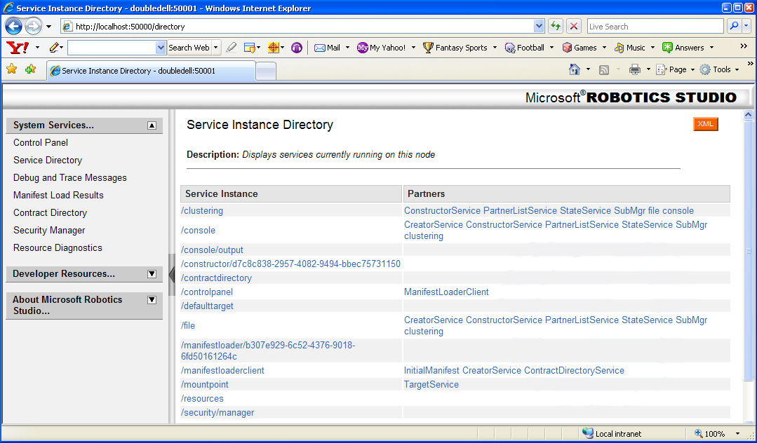

Slide 58
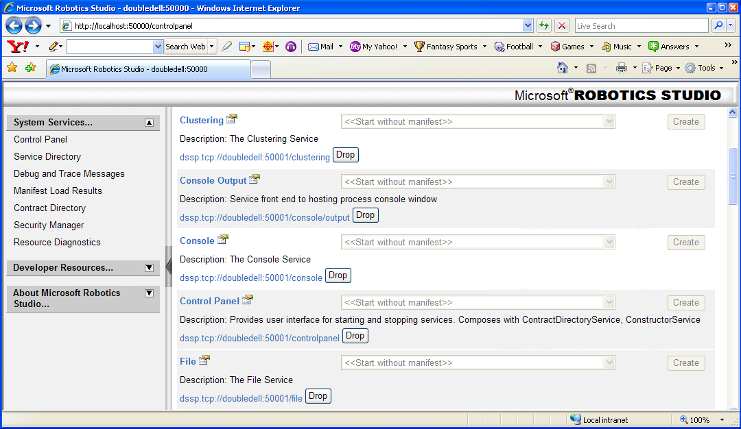

Slide 59
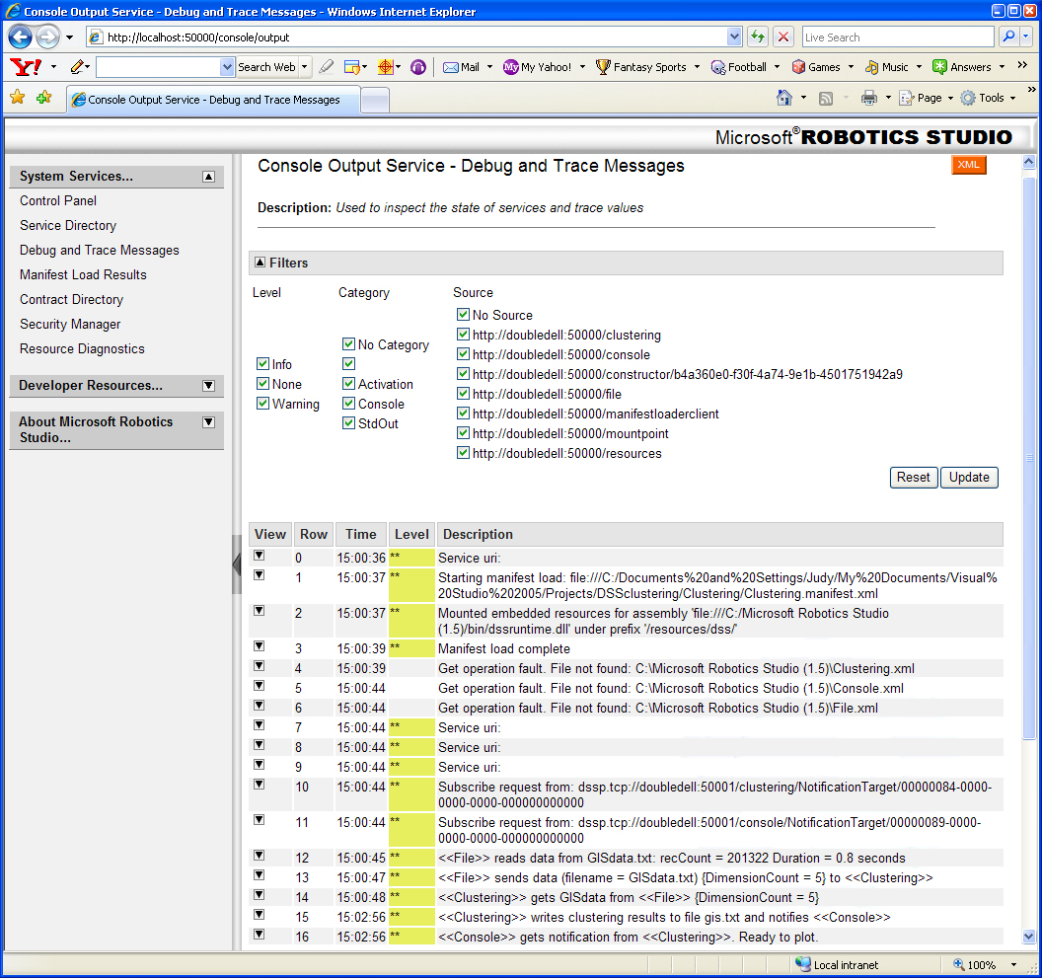

Slide 60
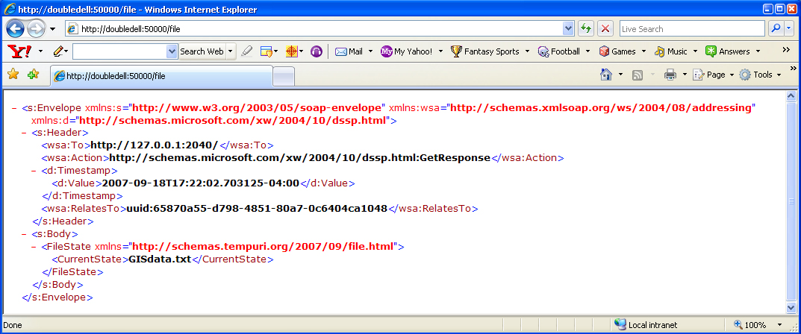

Slide 61
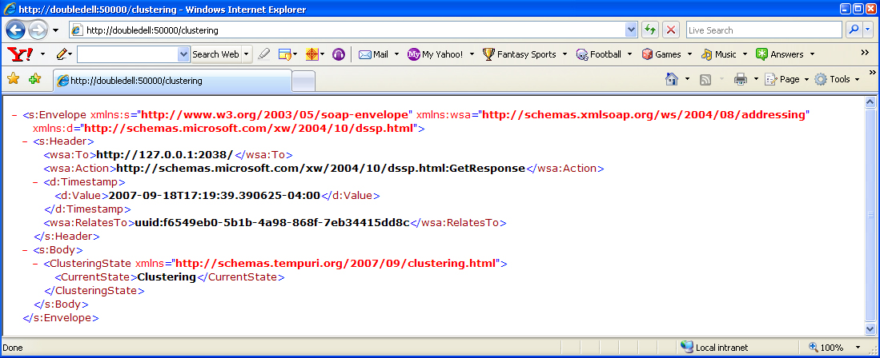

Slide 62
