Slide 1

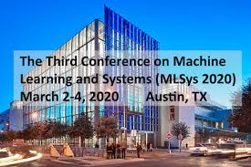
Benchmarking Science: Datasets and Exascale Infrastructure
MLSys Austin Texas
Geoffrey Fox 4 March 2020
Digital Science Center, Indiana University
gcf@indiana.edu, http://www.dsc.soic.indiana.edu/, http://spidal.org/
Collaborators: Tony Hey, Shantenu Jha, JCS Kadupitiya and Vikram Jadhao
MLPerf DeepTS and HPC working groups

Slide 2
Some Simple Sugggestions
Consider Science Research Benchmarks in MLPerf
Enhance collaboration between HPC and MLPerf MLSys communities
Support common environments from Cloud to HPC systems that lead to exascale MLPerf submissions and improved science use of HPC and clouds
Emphasize simulation-based and theory-based learning

Slide 3
Science Data and MLPerf I
Suggest that MLPerf should address Science Research Data
There is no existing scientific data benchmarking activity with a similar flavor to MLPerf -- namely addressing important realistic problems aiming at modern data analytics including deep learning on modern high-performance analysis systems.
Further, the challenges of science data benchmarking both benefit from the approach of MLPerf and will be synergistic with existing working groups.
Science like industry involves edge and data-center issues, inference, and training, There are some similarities in the datasets and analytics as both industry and science involve image data but also differences; science data associated with simulations and particle physics experiments are quite different from most industry exemplars.
Science datasets are often large and growing in size, while the multitude of active areas gives diverse challenges. The best practice science algorithms are shifting to deep learning approaches as in industry today.
Benchmarks will help more science fields take advantage of modern ML
  Limits on research funding does not make it easy to shift approaches in some areas quickly

Slide 4
Science Data and MLPerf II
Our benchmark collection can offer the following:
  Possibility to do end-to-end benchmarking: most of the scientific tasks often encompass a number of stages, where machine learning is often a component among storage access, data wrangling, and decision making.
  Offer enhanced insights into architectures, application design, and even on scientific aspects. (Such as insights from new algorithms)
  Extended understanding of inferencing: Outcomes from these scientific benchmarks often demand detailed inferencing, differing from conventional machine learning benchmarks.
  Ability to benchmark complex models: As scientific solutions can include more than one type of machine learning solution, it will be a perfect testing ground for complex machine learning models.
  Comparisons and collaborations between scientific fields and industry
  Requirements for future cyberinfrastructure to support scientific data analysis
Bring simulation-based and theory-based learning to forefront
Unify and compare Industry and Research best practices

Slide 5
Science Data and MLPerf III
We foresee that scientific machine learning benchmarks for MLPerf will include a number of datasets, from each of the scientific domains, along with a representative problem from those domains. Some example benchmarks where we already have contacted scientists are:
  Classifying cloud types from satellite imagery (environmental sciences)
  Photometric redshift estimation based on observational data (astronomy), and
  Removing noise from microscopic datasets (life and material sciences)
  Real-time monitoring and archival analysis of data from light sources at DIAMOND (UK) and DoE Laboratories (US) (Biological and Material sciences)
  Simulations covering near term recurrent neural networks and long term studies with fully connected and convolutional networks. This would initially be taken from biomolecular and material science areas but these examples will lead to work across many fields
  Time series of geographically distributed disease occurrences with simulated and observed data
  Monitoring of plasma instabilities in fusion Tokamaks with observation and simulation
When fully contributed, the benchmark suite will cover the following domains: material sciences, environmental sciences, life sciences, fusion, particle physics, astronomy, earthquake and earth sciences, with more than one representative problem from each of these domains

Slide 6
Science Data and MLPerf IV
We would have a special relationship with the HPC MLPerf working group as much scientific data is analyzed by HPC systems.
We would have synergy with the Deep Learning for Time Series DeepTS MLPerf working group as many scientific datasets correspond to time series; this includes, for example, astronomy, earthquake science, light source data, and results from simulations.
The TinyML MLPerf working group is addressing small edge devices; these are very common in science.
Broadly science data has issues in common with all other MLPerf working groups e.g. involve Training and Inference.
Initial Organization
The initial group would be led by Tony Hey (Chief Data Scientist, Rutherford Appleton Laboratory UK) and Geoffrey Fox (Indiana University).
We will evolve leadership as working group meetings are held. We will coordinate with activities such as the DoE “AI for Science” initiative.
Happy to have others interested!
.

Slide 7
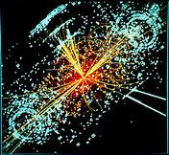
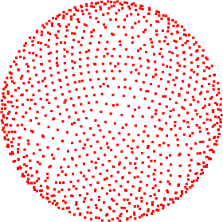
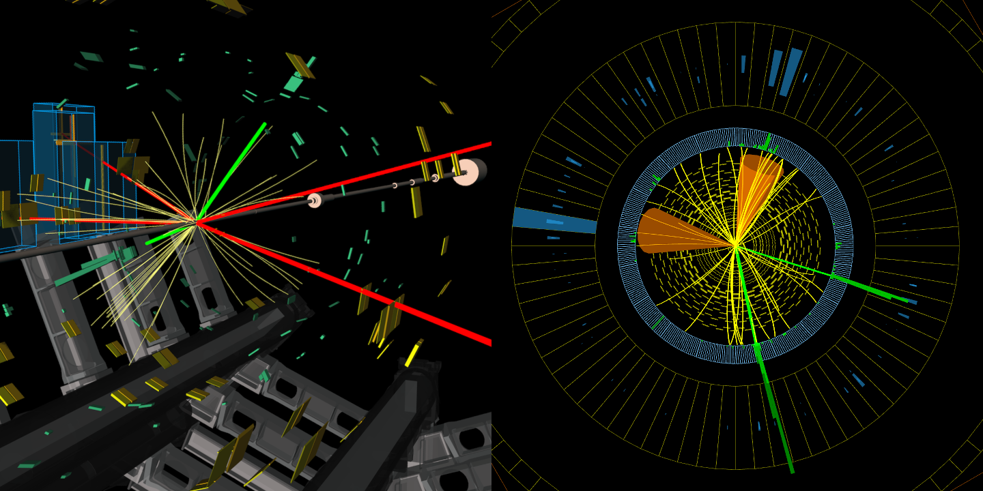
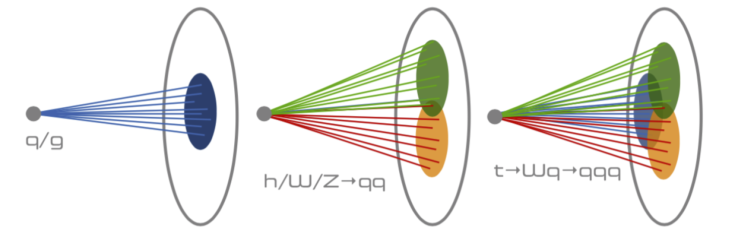
Deep Learning in Particle Physics Data Analysis
Train on LHC and simulation events with input as angular distribution of momentum in a 4π steradian detector i.e. you have total energy transmitted in each direction on sphere surrounding interaction point
Different physics gives different patterns of particles
Energy flowing in each direction
LHC Events

Slide 8
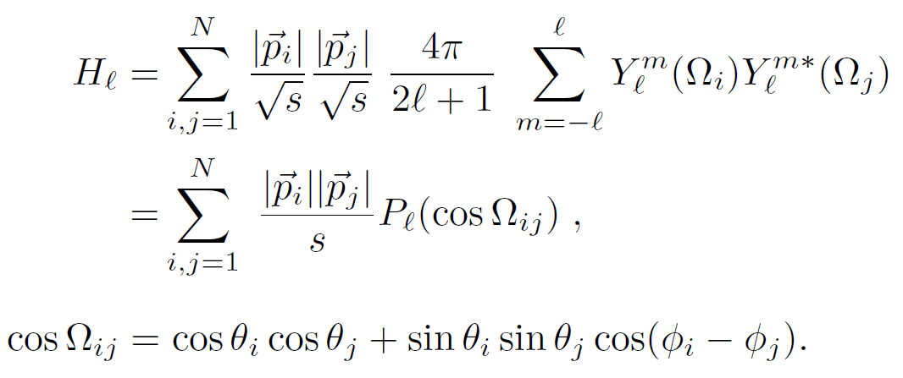
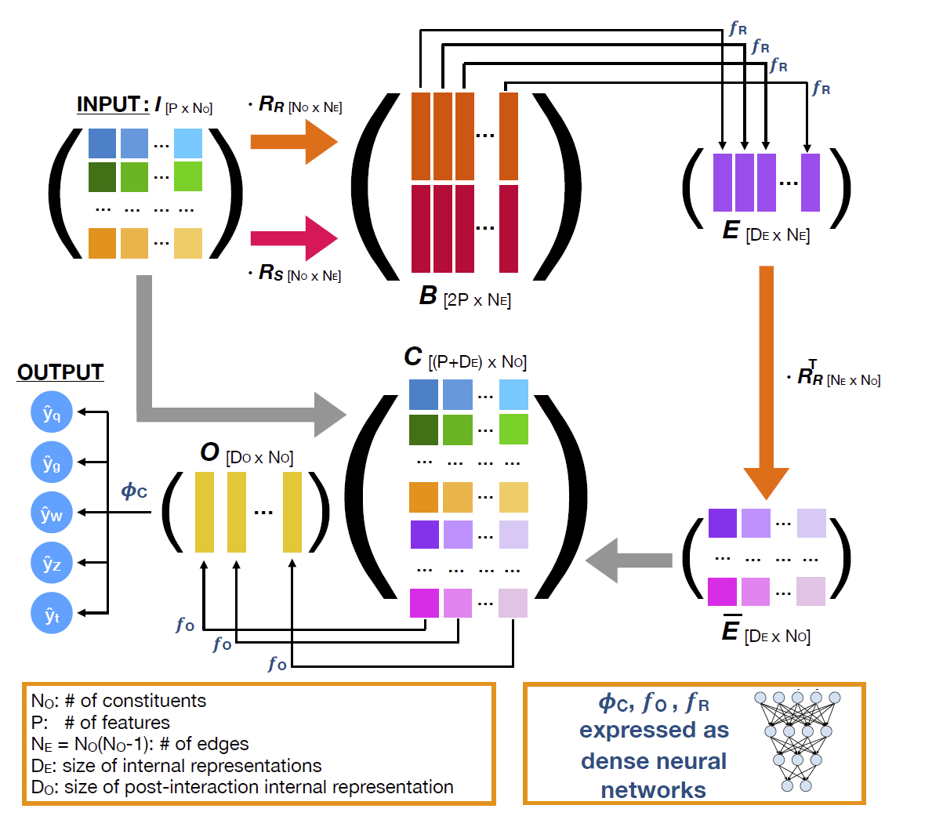
Deep Learning in Particle Physics Data Analysis
(Caltech) Observables for the analysis of event shapes in e+ e− annihilation and other processes, GC Fox, S Wolfram, Physical Review Letters 1978, 1648 citations (50 in 2019) introduced quantities to characterize shapes of collections of particles. They were invariant exactly to rotations and approximately to unknown details of decays of hidden particles (quarks, gluons, Higgs, W/Z bosons) as involved sums over momenta preserved in decays
  Need tiny computing!
(Caltech, Fermilab, CERN) arXiv:1908.05318 from CMS introduces JEDI-NET with 3 DNN’s for this
This just one of many classic ideas replaced by deep learning.
Fox Wolfram Moments
JEDI-NET

Slide 9
Linkage of Deep Learning (AI) and High Performance Computing
On general principles, Big data stresses capabilities of compute/data platforms and needs best possible performance and naturally uses HPC
  Don’t think of HPC as just Supercomputers
The use of HPC (GPUs, FPGA, …) for deep learning is pervasive in MLSys and MLPerf
Much scientific data is analyzed in collaboration with HPC community and has been for last 20 years with initiatives like eScience (High Performance Big Data Computing)
  E.g. Astronomy and Particle Physics run on NSF and DoE supercomuters
  Supercomputers run giant simulation jobs but individual data science jobs smaller
Department of Energy (DoE) has a really strong program in HPC and itself generates several large datasets as in particle physics and light sources
  DoE is a mission-driven agency with progress in Science as a major mission
DoE is very likely to have major new program on “AI for Science” following on and building on the Exascale Program
As well as HPC for AI (GPU’s for deep learning), dramatic progress on AI for HPC enhancing simulations with 100’s of papers in last 3 years
  See Systems for ML and ML for Systems in Dean’s talk at NeurIPS 2017
  Performance boosts of up to 2.10⁹ reported in https://arxiv.org/pdf/2001.08055.pdf giving Zettascale and Yottascale performance. See Ramanathan’s talk this morning
  Can these ideas also work in data analytics with surrogates for ML

Slide 10
HPCforML: Integrated HPC and Cloud Deep Learning Environment
Suggest a collaboration between HPC and MLPerf/MLSys community to produce good deep learning implementations that cross from clouds to HPC clusters to exascale supercomputers including accelerators
  MLSys conference showed systems work on issues reducing cloud performance – not present in classic HPC systems
  Don’t think network and GPU interference addressed in MLPerf
Need a Pytorch/Tensorflow/MXNet based environment addressing
  Data-parallelism: Decompose tensor index corresponding to data into blocks i.e. divide the mini-batch into micro-batches on parallel nodes
  Intra-layer model parallelism: Decompose one or more other tensor indices
  Inter-layer model (pipeline) parallelism: Decompose model by groups of layers in the model
  Hyper-parameter search parallelism often with genetic algorithm or ASHA Monday MLSys
All need to be efficiently integrated into system which needs to do more than deep learning

Slide 11
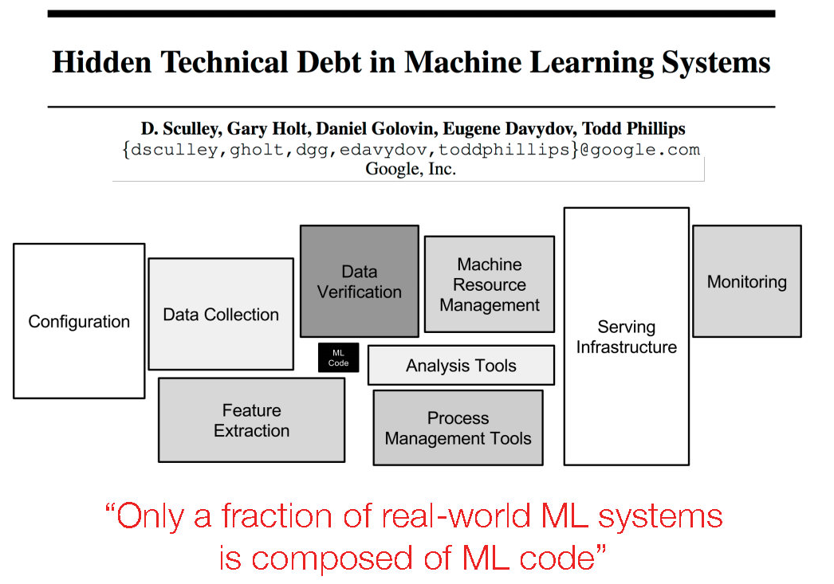
HPCforML: Integration Challenges
This well-known paper points out that parallel high-performance machine learning is perhaps most fun but just a part of system. We need to integrate in the other data and orchestration components.
This integration is not very good or easy partly because data management systems like Spark are JVM-based which doesn’t cleanly link to C++, Python world of high-performance ML
My project Twister2 at IU addresses this problem
Not much addressed at MLSys
ML Code
NIPS 2015 http://papers.nips.cc/paper/5656-hidden-technical-debt-in-machine-learning-systems.pdf

Slide 12
Let’s look at ML for HPC
Currently in science the ML is used to enhance simulations and dominantly the ML used is Deep Learning
Introduced 3 major categories and 8 subcategories
  Improving Simulation with ML-controlled Configurations and Integration of Data
  Use ML to Learn Structure, Theory and Model for Simulation
  Use ML to Learn Surrogates for Simulation
Work with Shantenu Jha
  https://arxiv.org/abs/1909.13340
  https://arxiv.org/abs/1909.02363
  100 refs classified

Slide 13
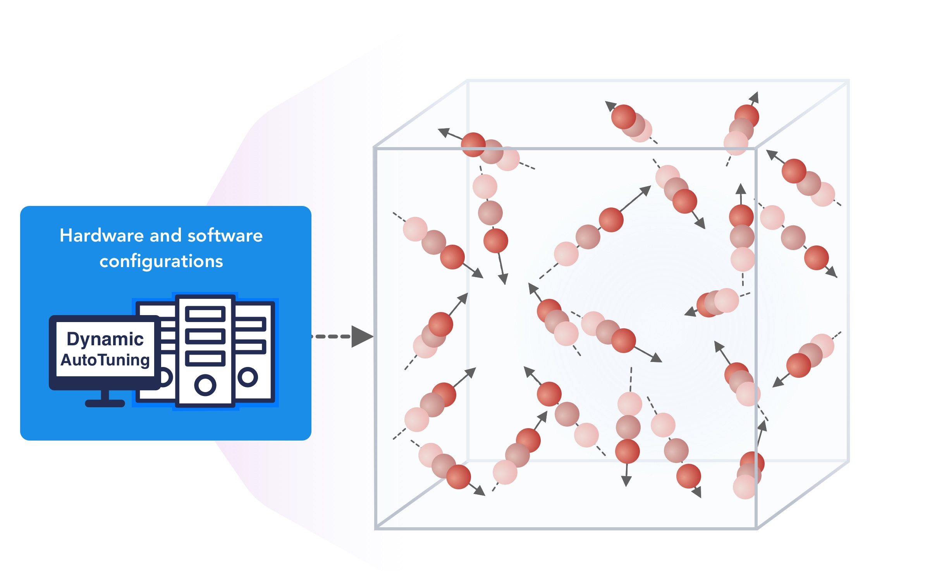
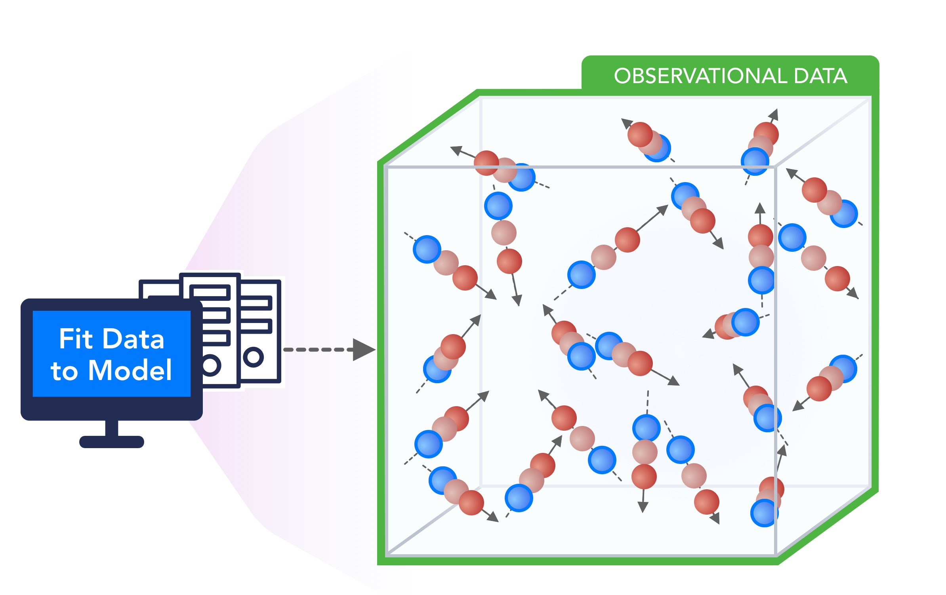
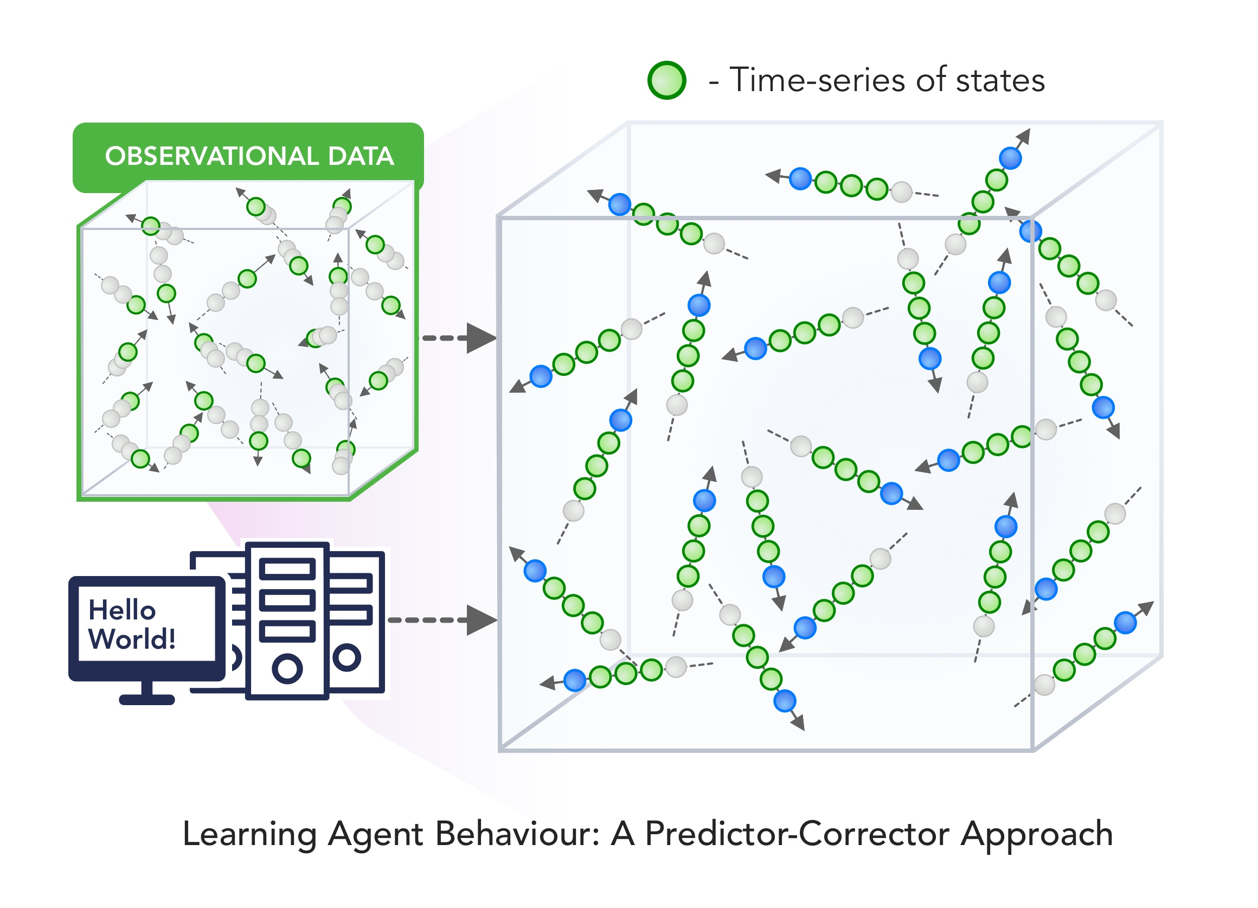
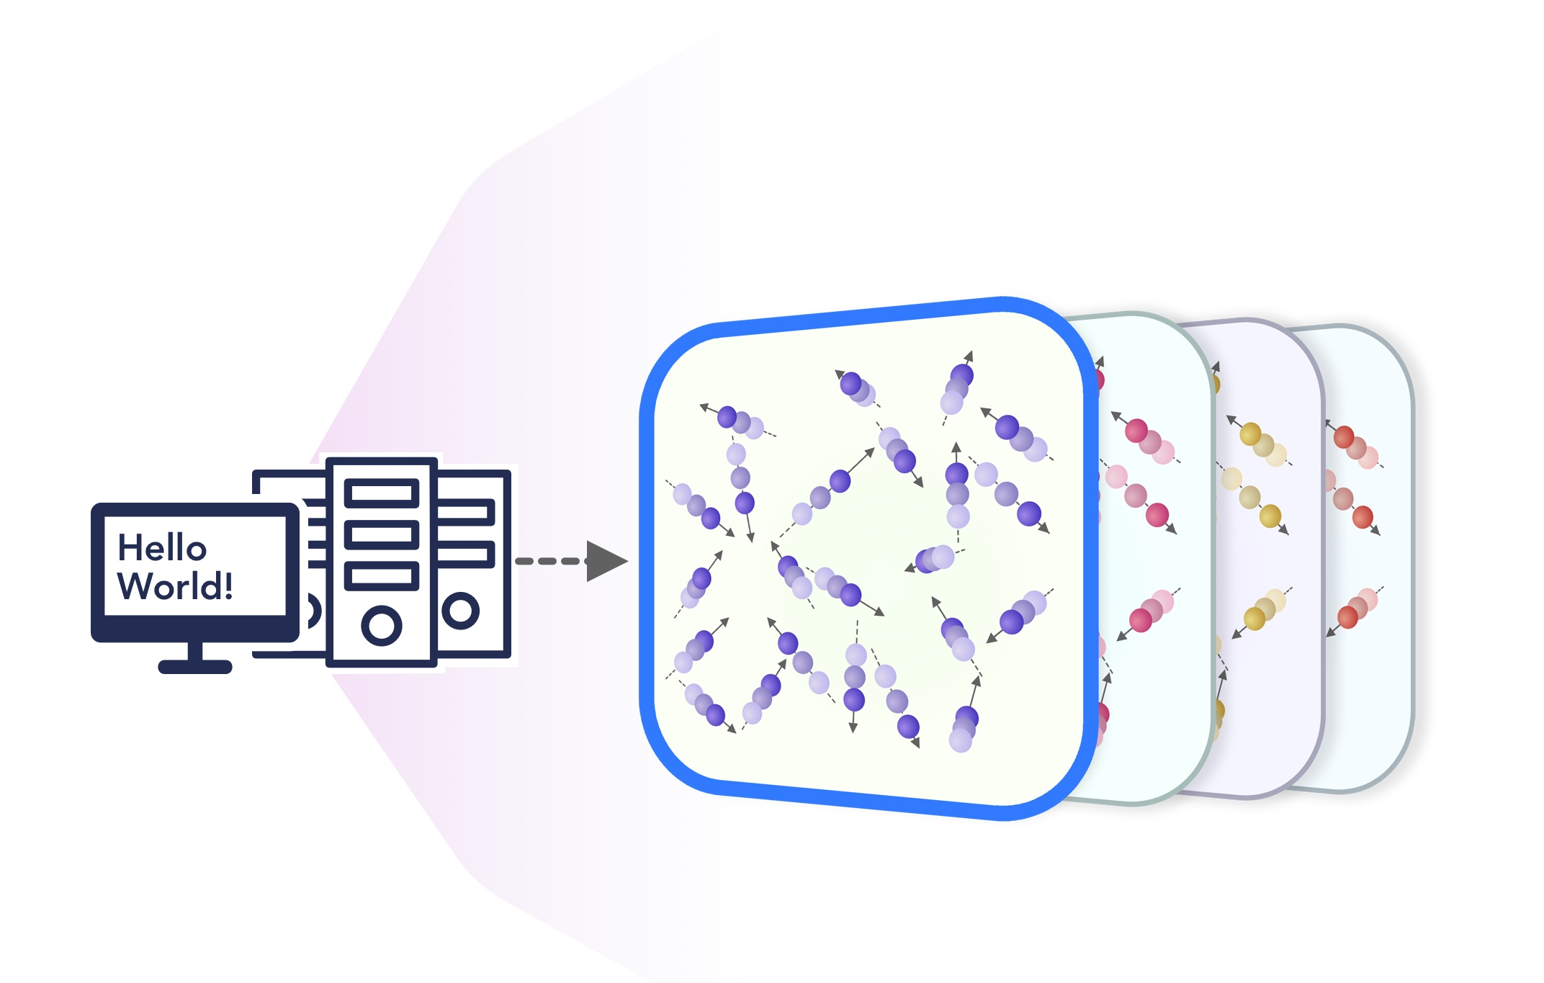
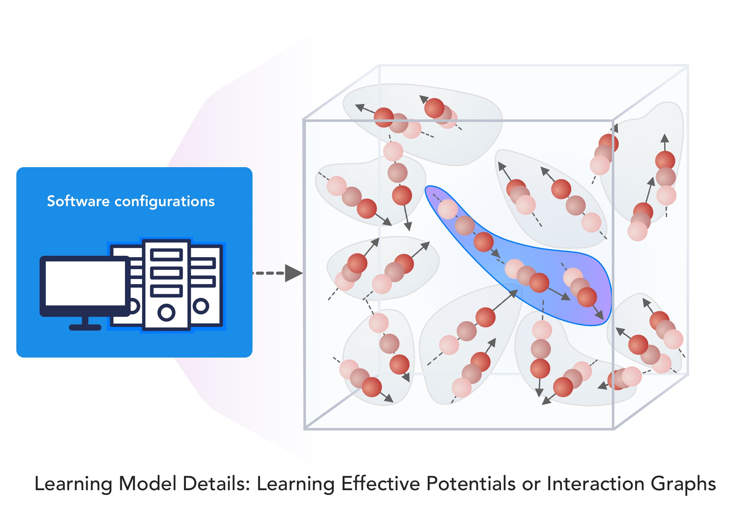
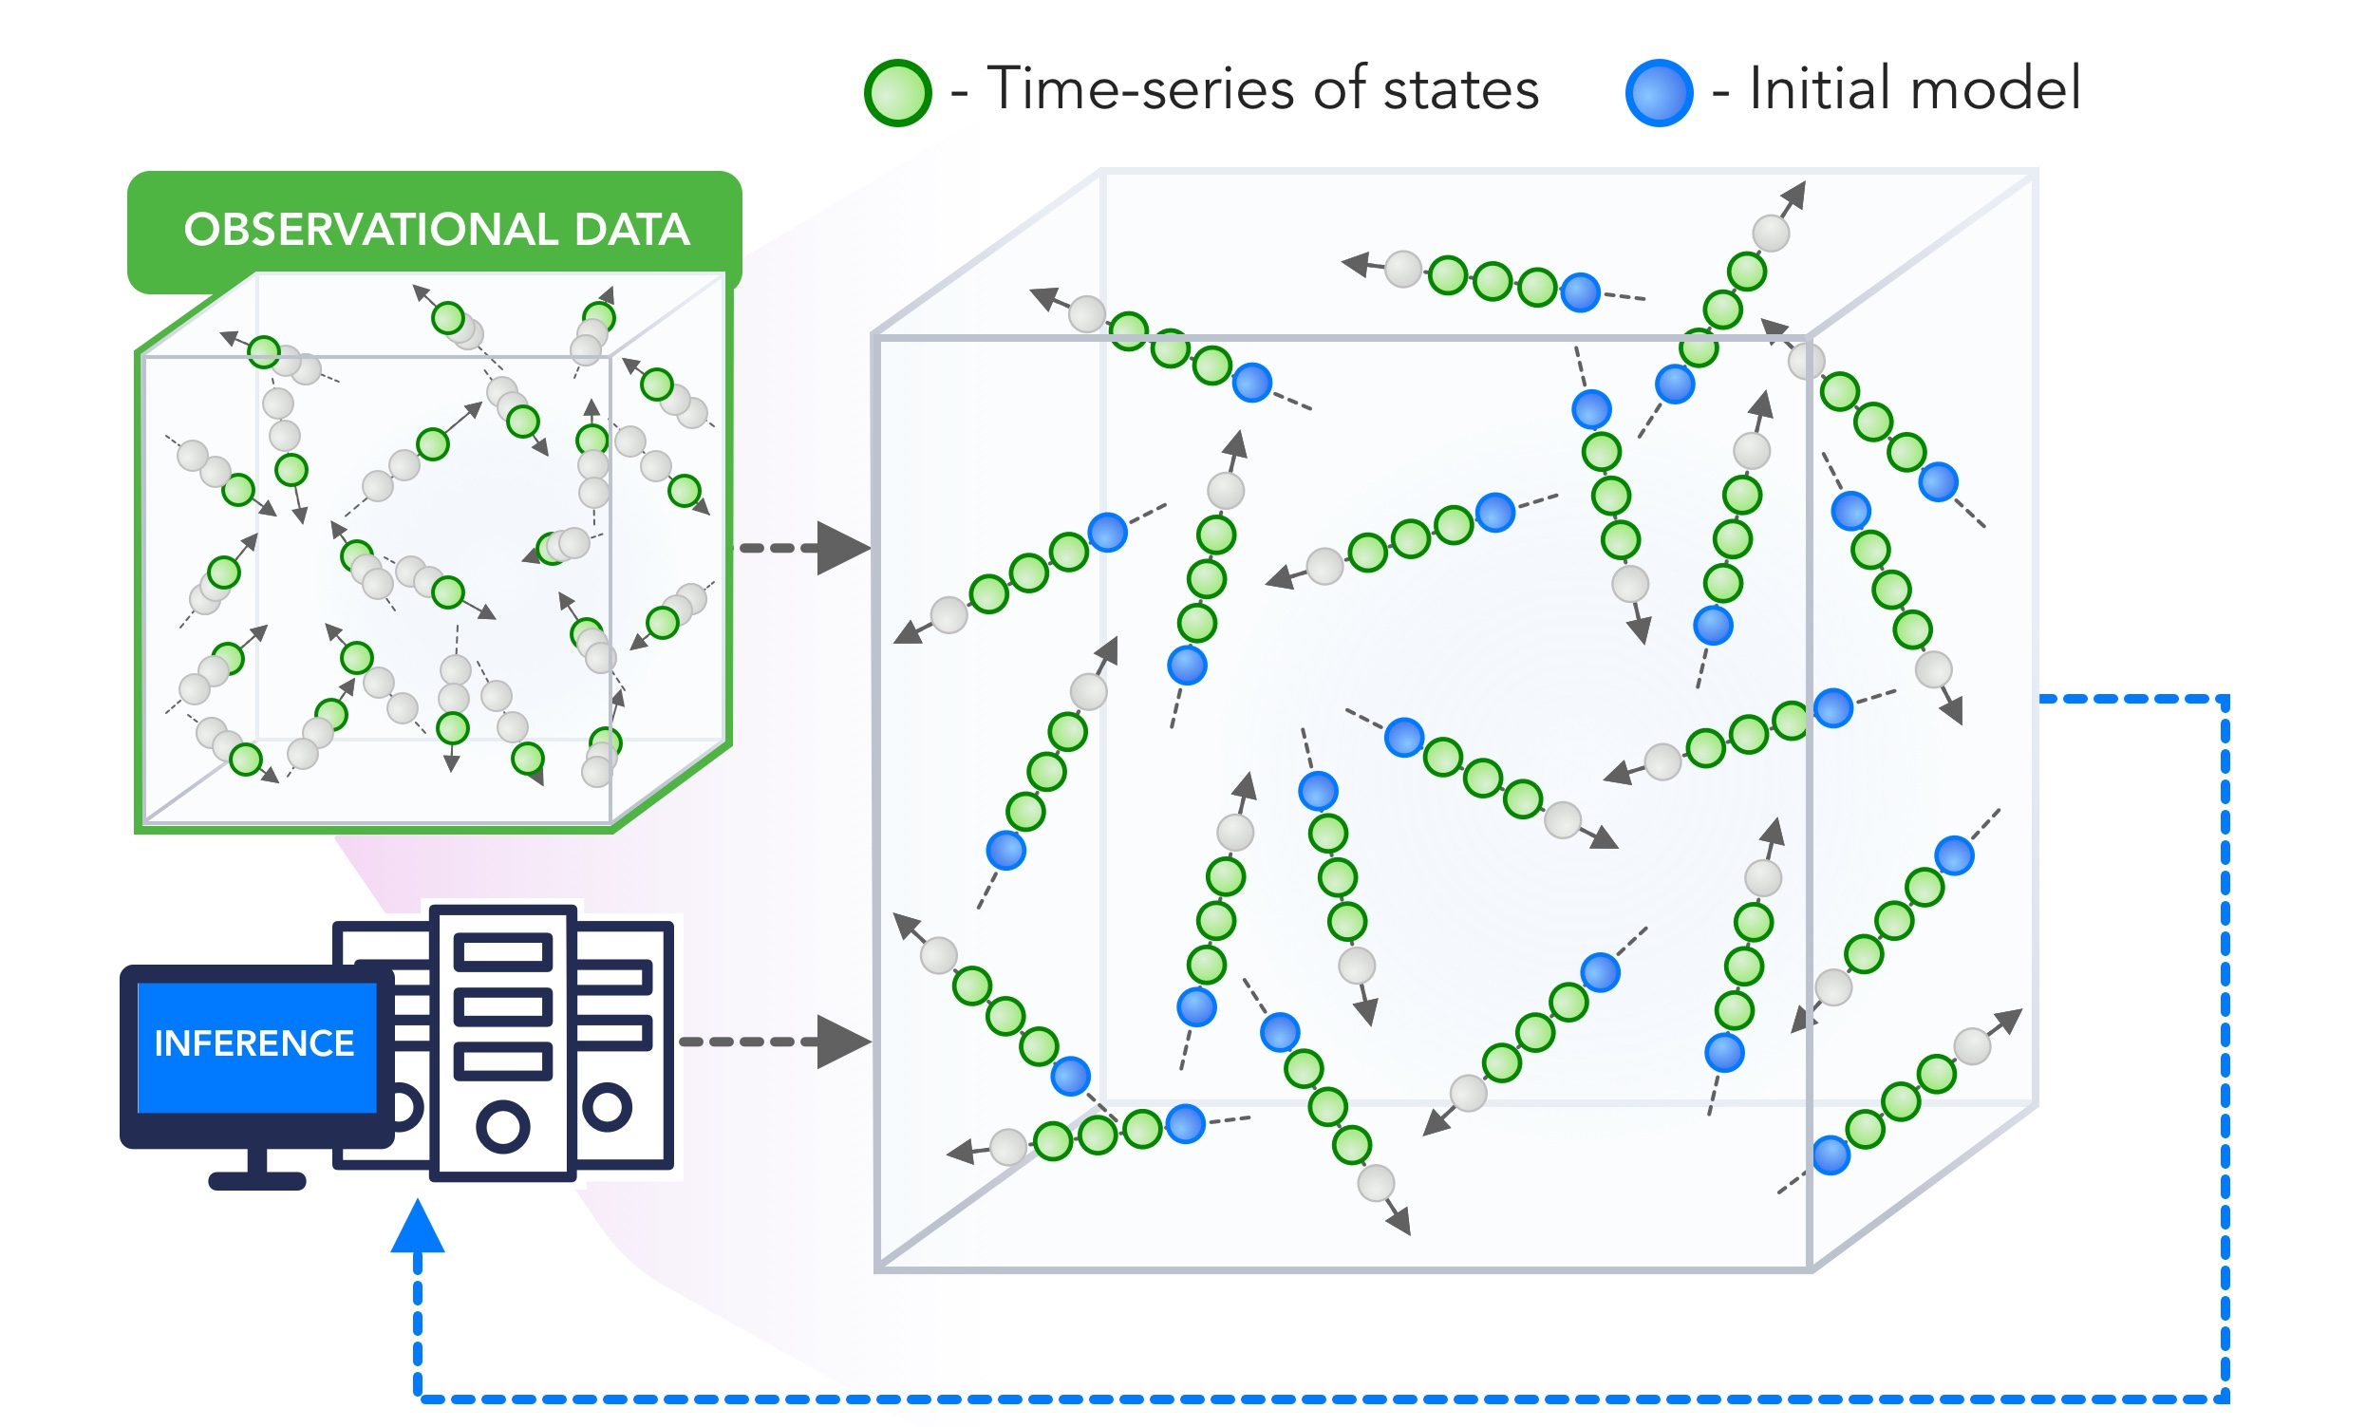
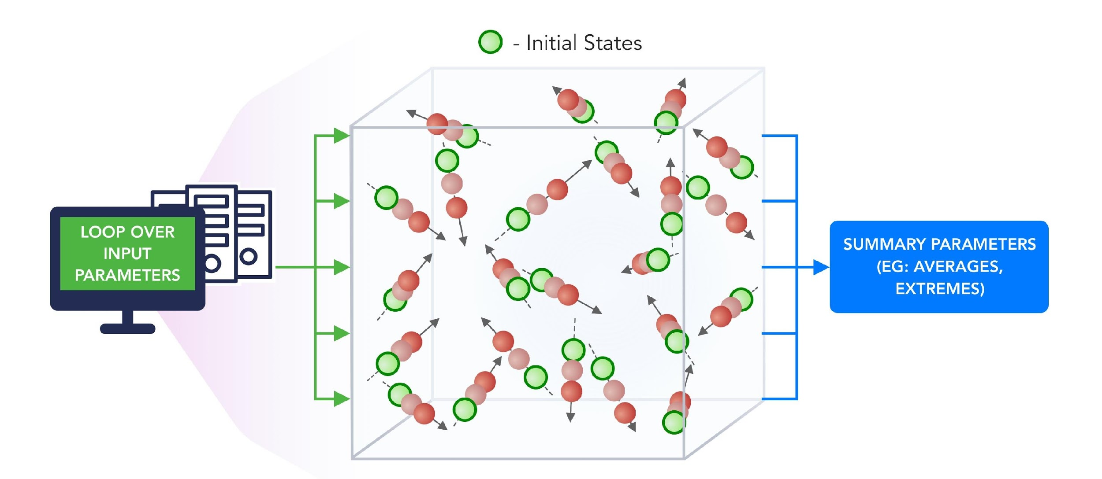
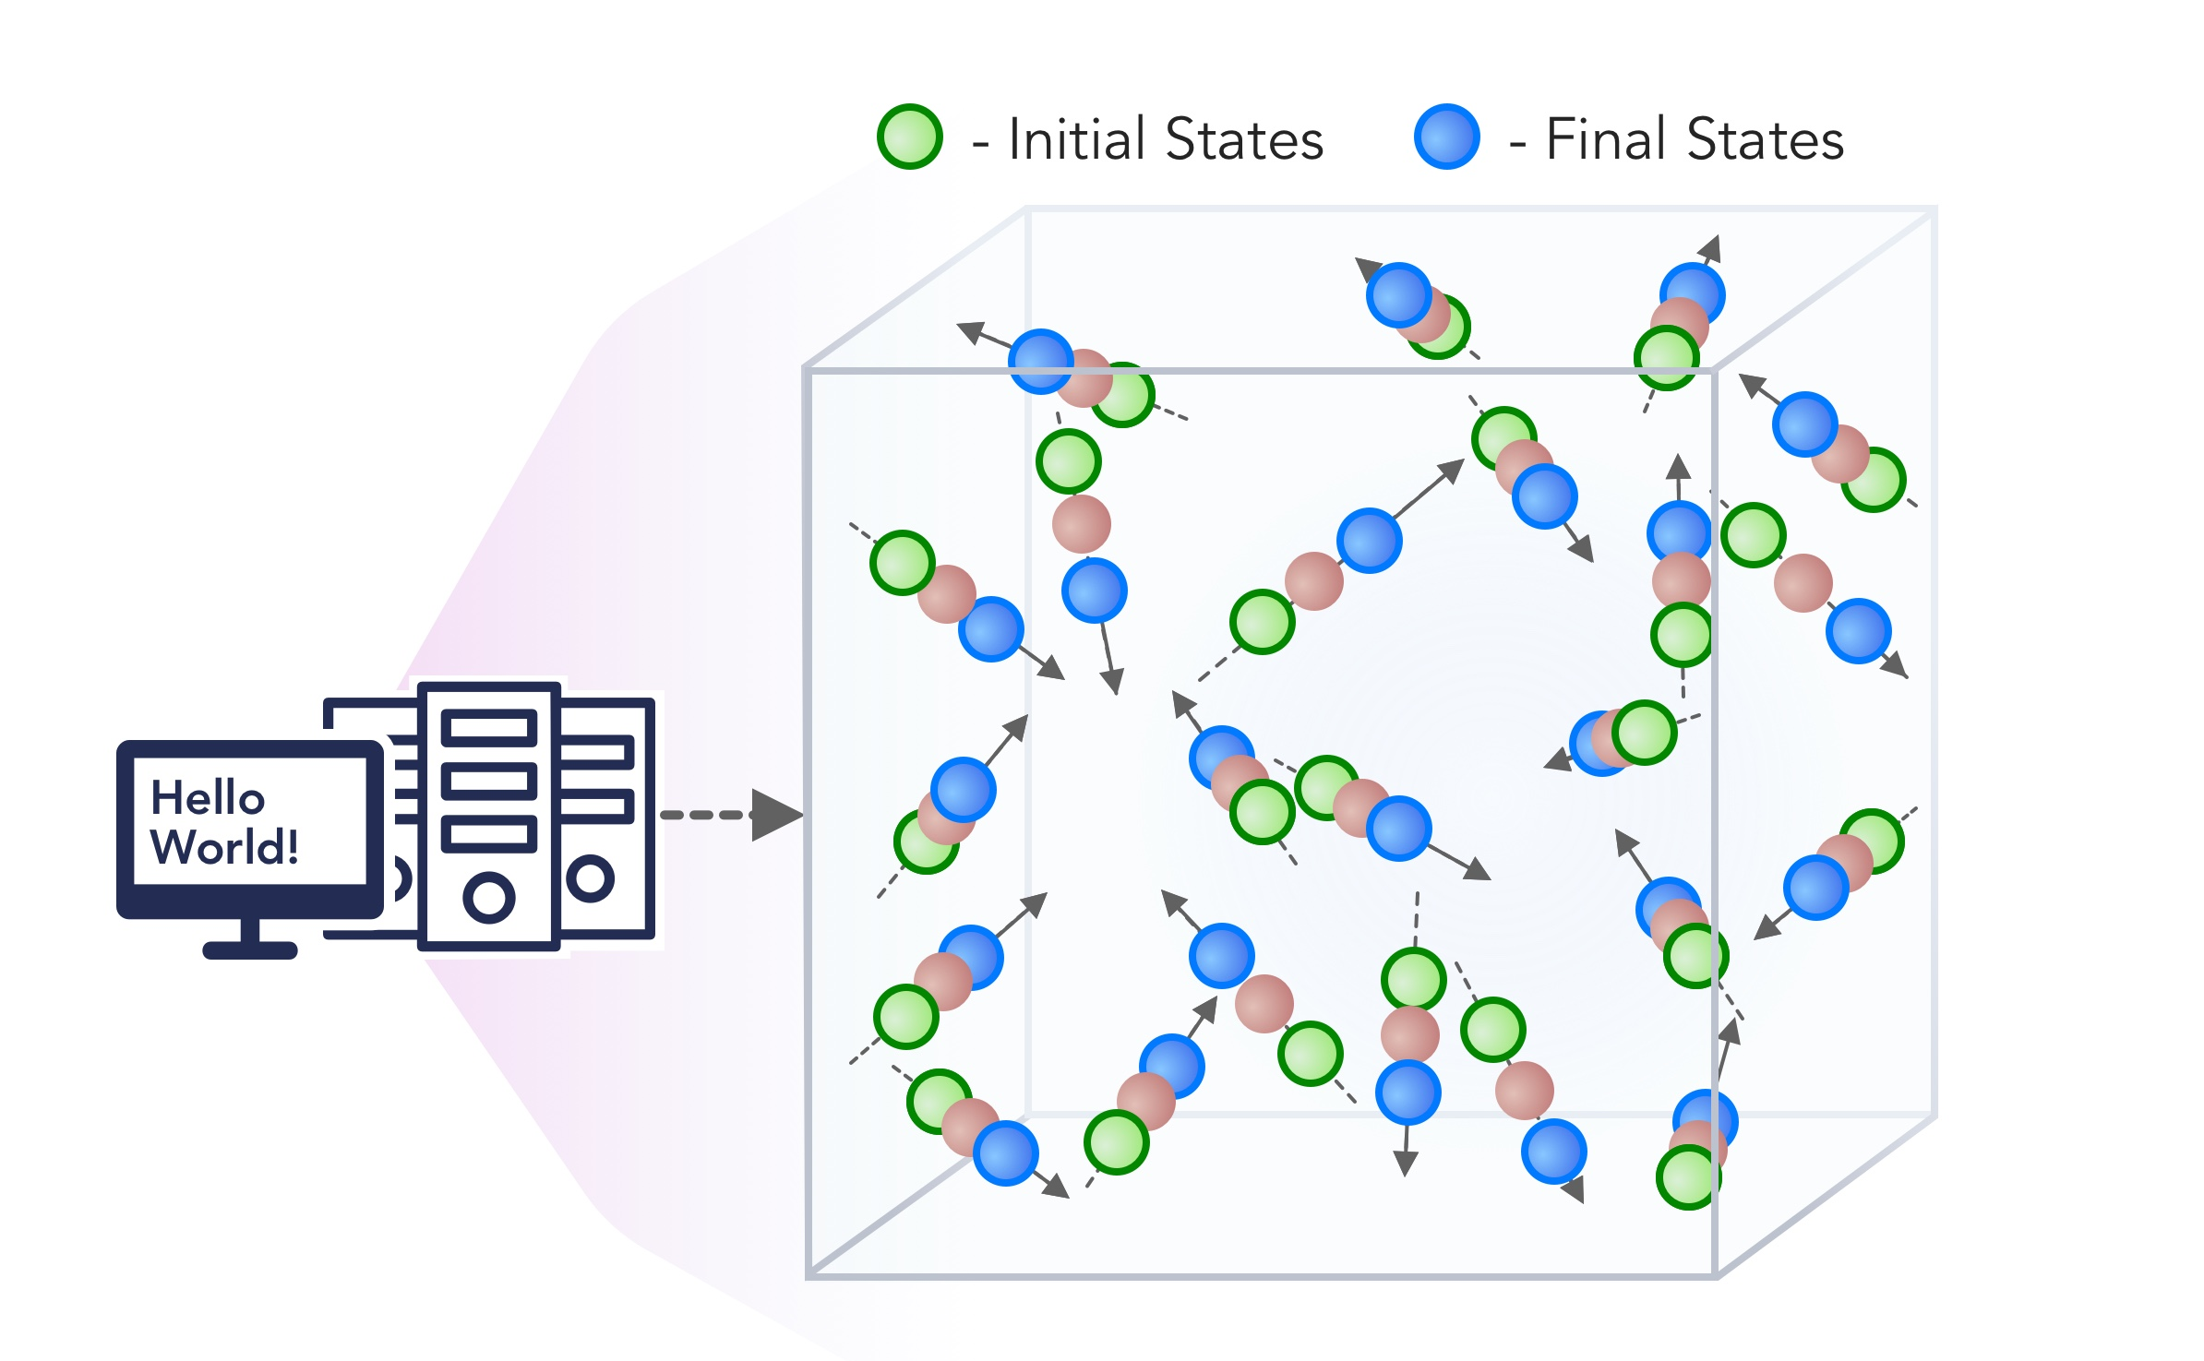
1. Improving Simulation with Configurations and Integration of Data
1.1 MLAutotuningHPC – Learn configurations
1.2 MLAutotuningHPC – Learn models from data
1.3 MLaroundHPC: Learning Model Details (ML based data assimilation)
2. Learn Structure, Theory and Model for Simulation
2.1 MLAutotuningHPC – Smart ensembles
2.2 MLaroundHPC: Learning Model Details (coarse graining, effective potentials)
2.3 MLaroundHPC: Improve Model or Theory
3. Learn Surrogates for Simulation
3.1 MLaroundHPC: Learning Outputs from Inputs (parameters)
3.2 MLaroundHPC: Learning Outputs from Inputs (fields)
INPUT
OUTPUT

Slide 14
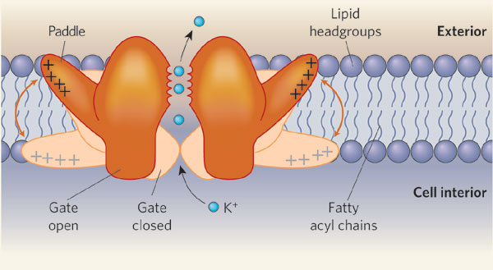
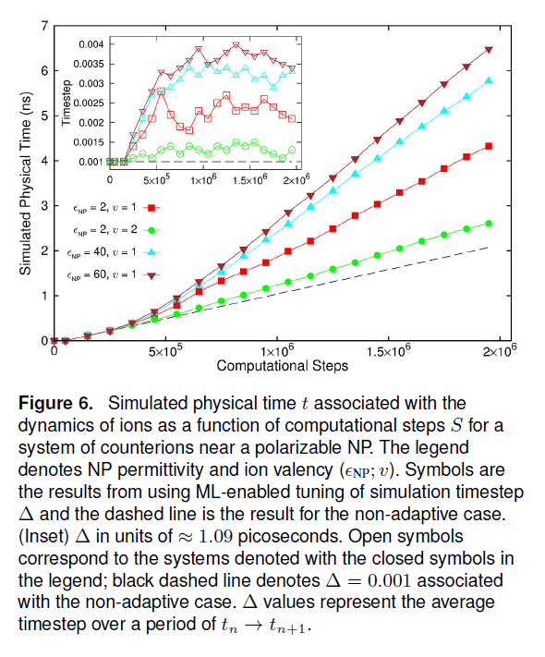
Dynamics of Ions near Polarizable Nanoparticles
Choose time step dynamically using ML
Choose consistency parameter (94.3% success) with ML
Speedup of 3 from MLAutoTuning and a maximum speedup of 600 from the combination of ML and parallel computing.
Quality of simulation measured by time simulated per step with increasing use of ML enhancements. (Larger is better).
Inset is timestep used

Slide 15
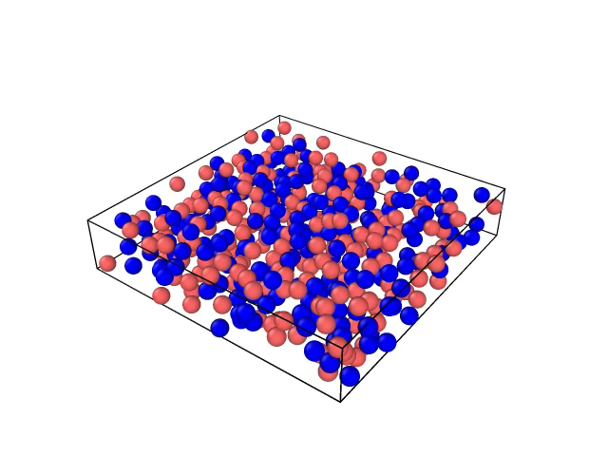
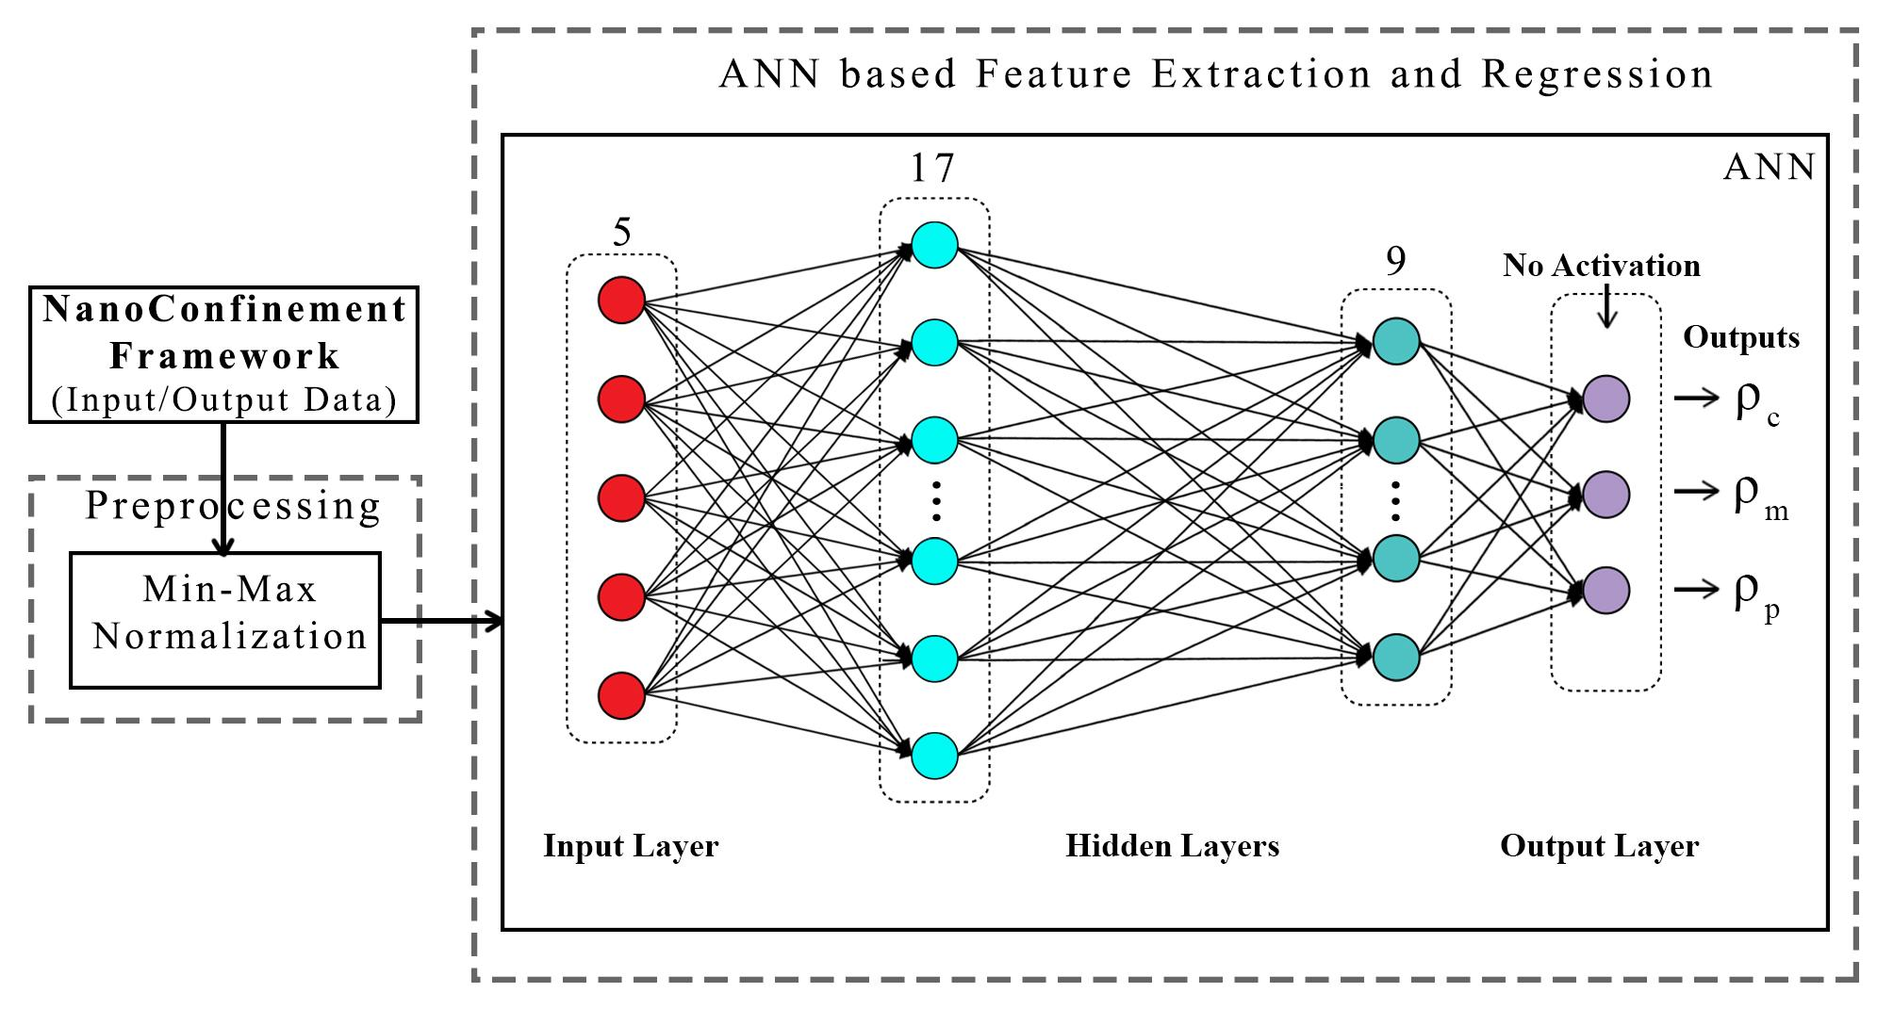
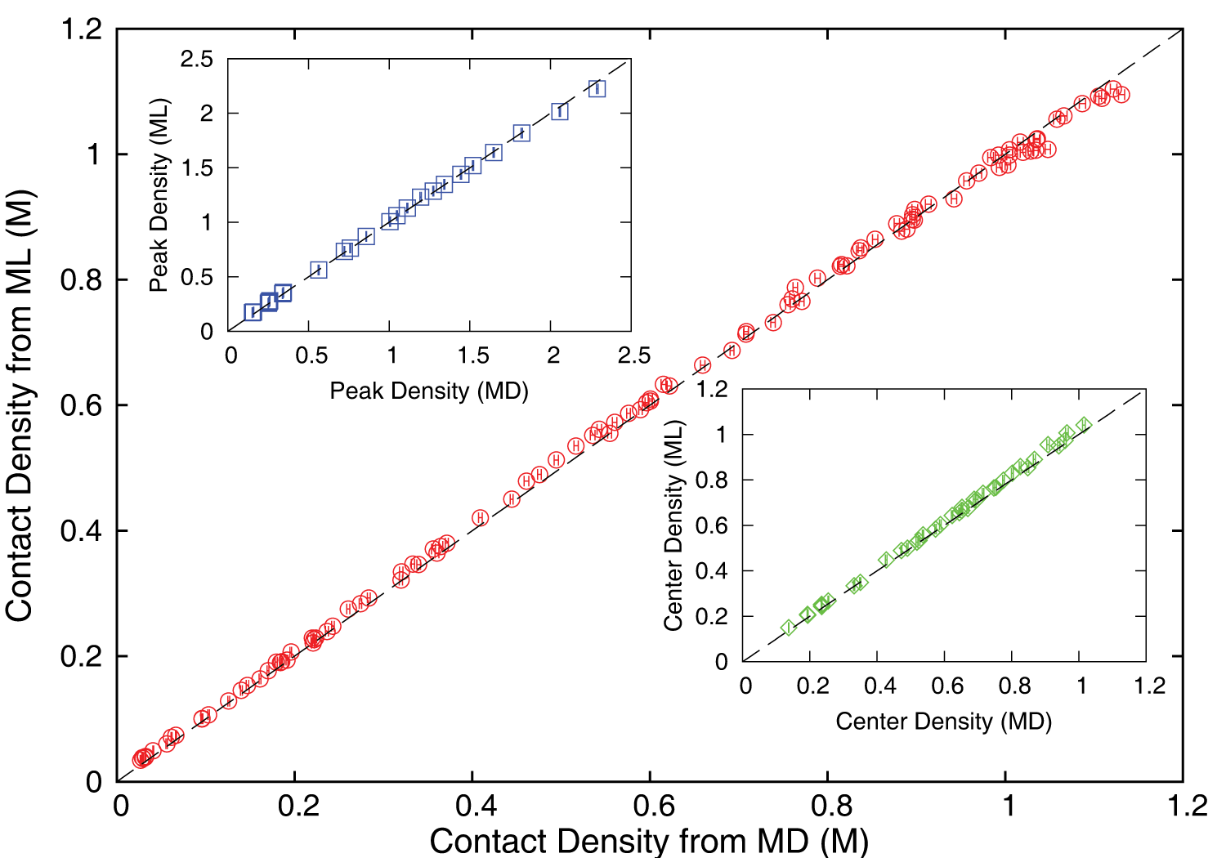
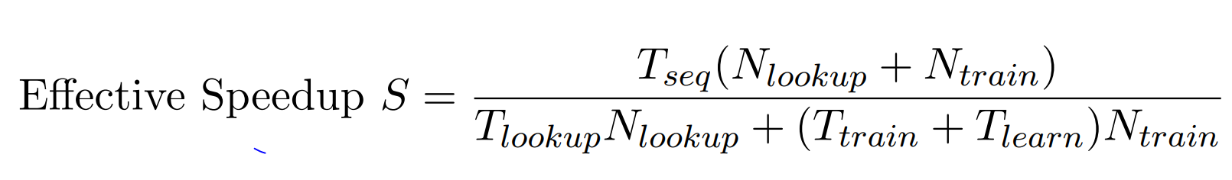
Examples of ML for HPC (work with JCS Kadupitiya, Vikram Jadhao)
The Learning Net
Extraction of ionic structure in electrolyte solutions confined by planar and spherical surfaces.
Classic HPC code written with C++ and accelerated with hybrid MPI-OpenMP.
Uses quite small Multi-layer perceptron MLP to predict 3 observables from 5 input parameters (~5000 in training set)
MLP outperforms other ML choices
Deployed on nanoHUB for education (an attractive use of surrogates so students get answers fast)
General Electric uses similar approach to give interactive Engine design options (200 in training set)
Direct simulation compared to Surrogates
→ 10⁵ as N_{lookup} → ∞

Slide 16
Up to two billion times acceleration of scientiﬁc simulations with deep neural architecture search
January 23 2020 https://arxiv.org/pdf/2001.08055.pdf
10 scientiﬁc cases including astrophysics, climate science, biogeochemistry, high energy density physics, fusion energy, and seismology, using the same super-architecture, algorithm, and hyperparameters.
Approach also inherently provides emulator (=surrogate) uncertainty estimation, adding further conﬁdence in their use.

Slide 17
Sample Results

Slide 18
The 10 examples in the “two billion times paper”
X-ray Thomson scattering (XRTS)
Optical Thomson scattering (OTS)
X-ray emission spectroscopy (XES)
Edge-Localized Modes (ELMs) diagnostics
Galaxy halo occupation distribution modelling (Halo)
JAG model for Inertial Conﬁnement Fusion (ICF JAG)
Shatsky Rise seismic tomography (SeisTomo)
The Model of Oceanic Pelagic Stoichiometry (MOPS)
Global aerosol-climate modelling (GCM)

Slide 19
INSILICO MEDICINE USED CREATIVE AI TO DESIGN POTENTIAL DRUGS IN JUST 21 DAYS
September 4 2019 News Item
Map Drug (Material) Structure to Drug (Material) Properties
Hong Kong-based Insilico Medicine sent shockwaves through the pharma industry after publishing research in Nature Biotechnology that proves its AI-powered drug discovery system was capable of producing at least one potential treatment for fibrosis in less than a month's time.
The system uses a Deep Reinforcement Learning algorithm that can imagine potential protein structures based on existing research and certain preprogrammed design criteria.
Insilico's system initially produced 30,000 possible designs, which the research team whittled down to six that were synthesized in the lab, with one design eventually tested on mice to promising results.
Insilico's AI-powered research process could offer a massive push forward for the pharmaceutical industry, which faces increasingly high drug development costs. In just a handful of weeks and for approximately $150,000, Insilico delivered what typically takes pharmaceutical companies $2.6 billion over seven years.

Slide 20
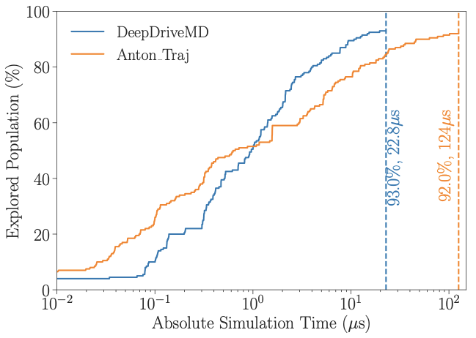
DeepDriveMD Smart Ensemble
O(10) improvement in sampling efficiency with DL model over previous ML model
O(1000) concurrent simulations on Summit supercomputer
Jha (BNL/Rutgers) and Ramanathan (ANL)
Notes:
Not a lucky

Slide 21
Operator Formulation of Deep Learning Inference
Suppose we are solving PDE’s or sets of coupled ODE’s
Typically we solve iteratively New Values = (Differential Operator) Previous Values
Classic applied math tells you nifty difference equations and spectral methods to represent Operator numerically
Deep Learning learns the operator from classic numerics or observational data or their combination
Inference is New Values = (DL Operator) Previous Values
This new nonlinear trained DL operator can allow much larger time steps, incorporate variations in parameters, learn potentials etc.
DL Operator is the new theory (Newton’s laws) of science
High order approximations are traditionally very sensitive to noise and one was taught to avoid but Deep NNs are the opposite – both verbose and robust
  See DL operator and multiple LSTM layers with 100s-100,000 parameters
  Newton’s laws for this have 2-4 parameters

Slide 22
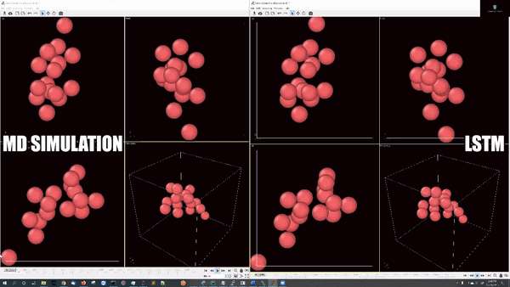
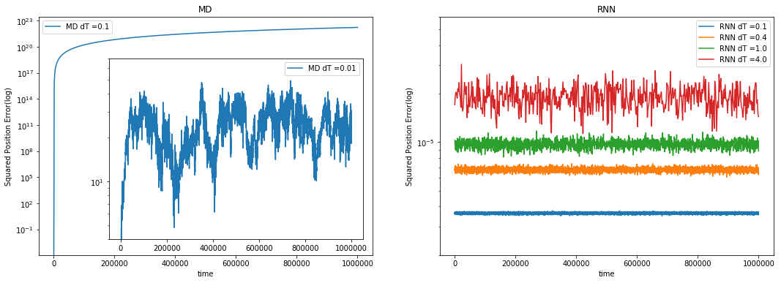
Learn Newton’s laws with Recurrent Neural Networks
Deep Learning is revolutionizing (spatial) Time series Analysis
Good example is integrating sets of differential equations
Train the network on traditional 5 time step series from (Verlet) difference equations
Verlet needs time step .001 for reliable integration but
Learnt LSTM network is reliable for time steps which
are 4000 times longer
and also learn potential.
Speedup is 30000 on 16 particles interacting with Lennard-Jones potentials
2 layer-64 units per layer LSTM network: 65,072 trainable parameters
5000 training simulations
10²³
RNN Error² up to step size dT=4 and total time 10⁶
10⁻⁵
10¹
Verlet error²
dT = 0.01, 0.1

Slide 23
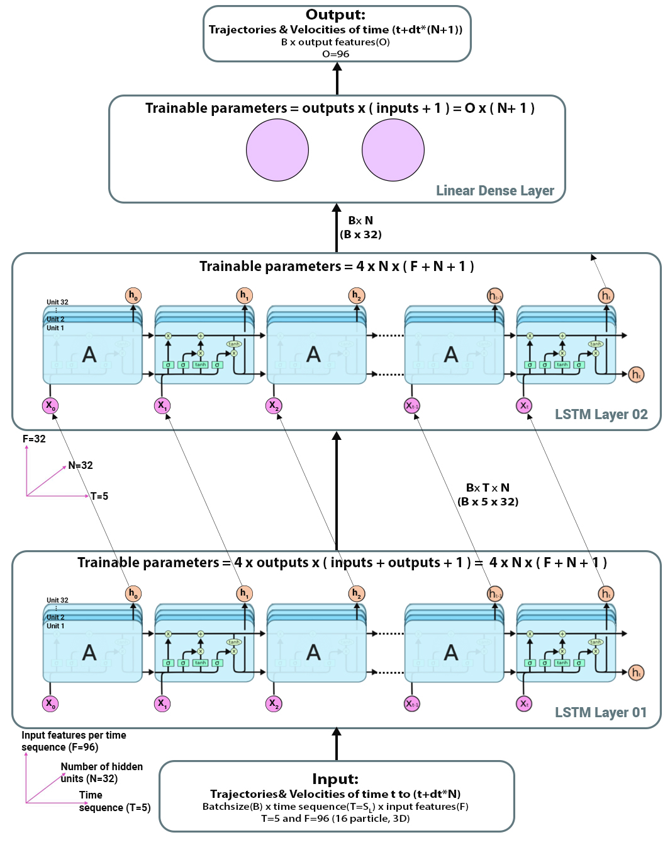
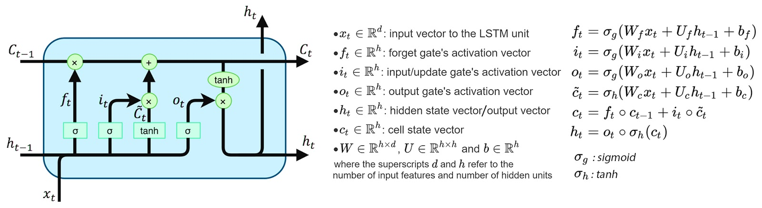
RNN (LSTM) model
Input dimensions:
  Batch size(B) * Time sequence(T) * Input features (F)
  F = # of particles * 3D * [positions, velocity, force, etc.]
Output dimensions:
  Batch size(B) * Output features (O)
  O = # of particles * 3D * [positions, velocity, force, etc.]

Slide 24
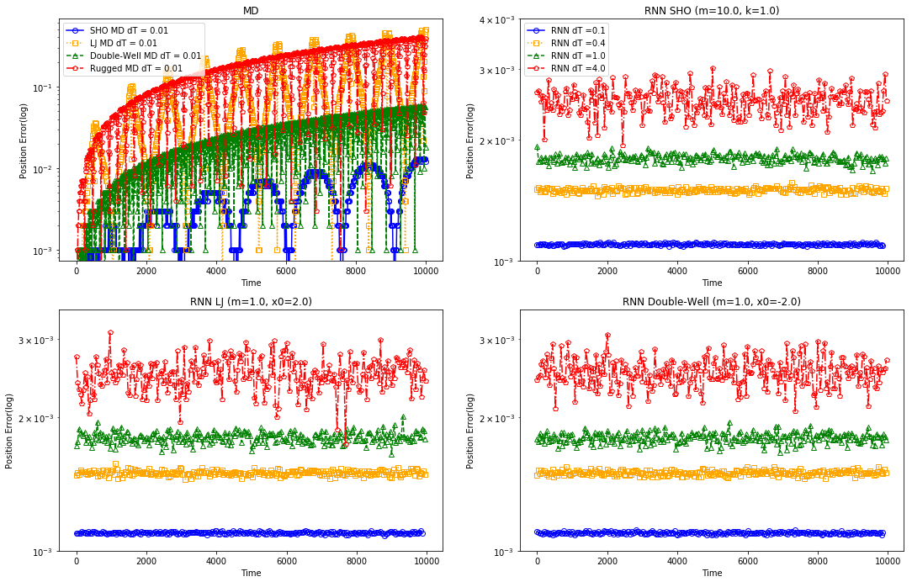
Results on different potentials
Simple harmonic Oscillator:
  Hooke's law in VV
  T=100, ∆T_{MD} = 0.001
  RuntimeMD = 1.8 sec
  Mass(m) and spring constant(k) varied: 500 initial configs
Lennard-Jones:
  Lennard-Jones (LJ) in VV
  T=100, ∆T_{MD} = 0.001
  RuntimeMD = 2.7 sec
  Mass(m) and initial position (x₀) varied: 500 initial configs
Double Well:
  [U(X)=X⁴/4 - X²/2] in VV
  T=100, ∆T_{MD} = 0.001
  RuntimeMD = 1.9 sec
  Mass(m) and initial position (x₀) varied: 500 initial configs

Slide 25
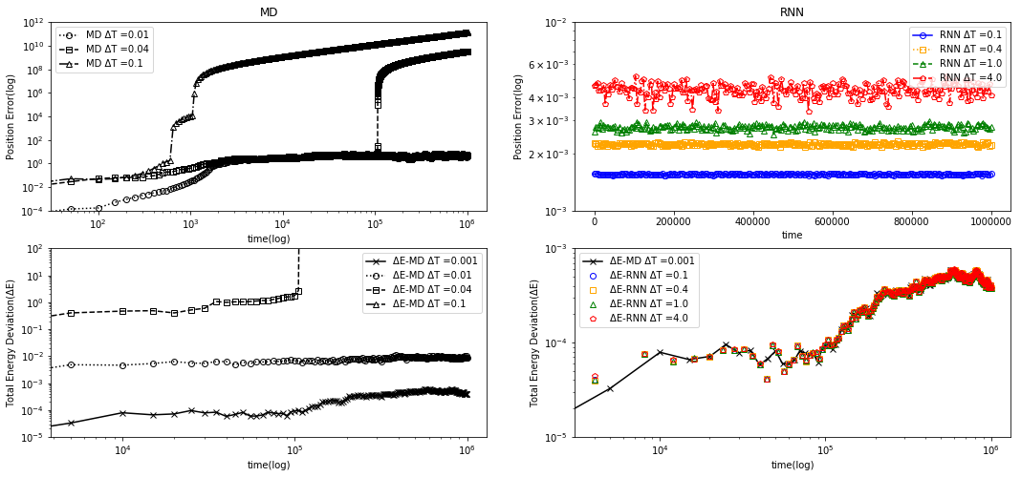
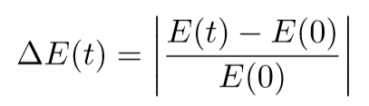
Many Particle results with 16 particles and PB
The ground truth (black line) ) is computed with velocity verlet (dt=0.001)
3D Lennard-Jones (LJ) potential (eps=1.0, m=1.0) with 16 particle and PB
T=10⁶, ∆T_{MD} = [0.001(ground truth), 0.01, 0.05, 0.1] and different ∆T_{RNN} = [0.1, 0.4, 1.0, 4.0]
Note that black triangles (∆t_{MD}= 0.1) is outside the range as the ∆E ≈ 10¹⁵ in the (bottom-left) plot
Notes:
Extension to many particle essentially has the same story here we compare average positional deviation and energy deviation of MD different delta T vs RNN different dT compared to ground truth result of MD with velocity verlet dt=0.001

Slide 26
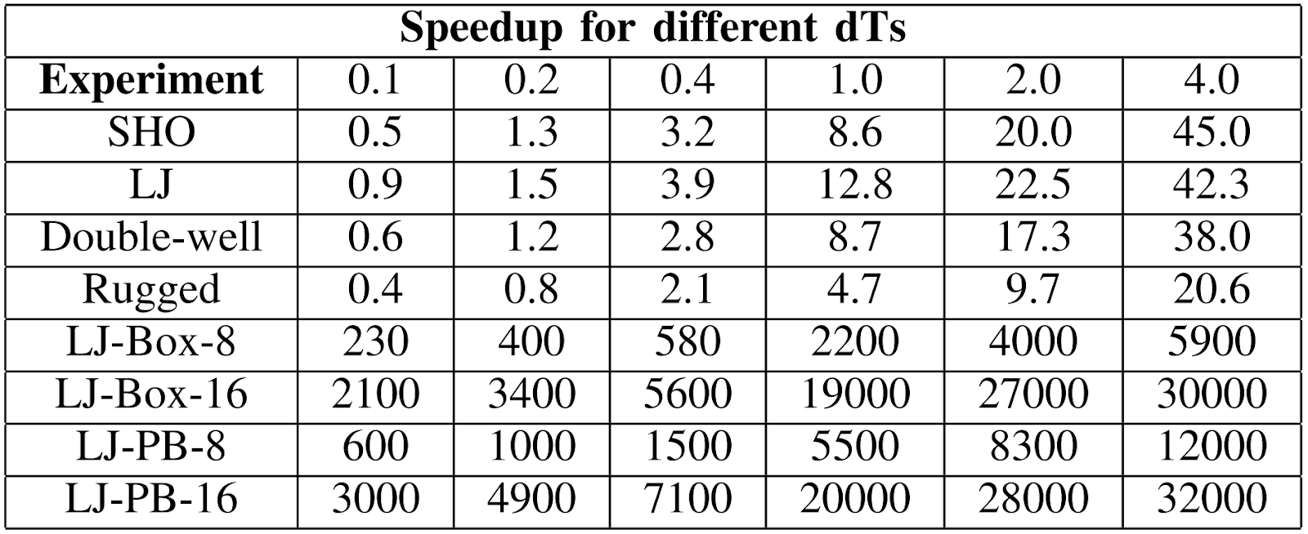

Asymptotic Speedup of LSTM approch
$$\text{Speedup}\text{ (}\text{S}\text{) =}\frac{\text{Total} \text{time} \text{for} \text{MD}}{\text{( }\text{RNN} \text{init} \text{time}\text{ + }\text{RNN} \text{run} \text{time} \text{)}}$$
MD velocity verlet required dt of 0.001 to get an accurate result and all the simulations ran with dt=0.001 and up to 1million in time
Many particle PB 16:
  Runtime MD =146.42 min
  Runtime MD(OMP=16) =733.9518sec
  Speedup (LSTM(dt=4.0))(Compared to sequential MD)=32000X
  Speedup(LSTM(dt=4.0))(Compared to OMP)=5100X

Slide 27
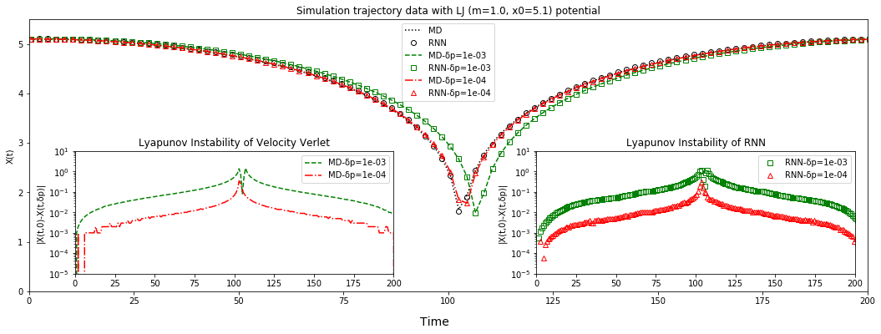
Lyapunov Instability of LSTM and Verlet simulation methods?
Compare 2 simulations 1) with Δt=0.001 m=1, x₀= 5.1, v_{o}=0.0, and 2) v_{o}(𝛿𝑝) = 10⁻³,10⁻⁴
LSTM initial 5 time frames are set with initial data from simulations with small v_{o}(𝛿𝑝) values.
Following plots show results diverge exponentially in same way for MD and LSTM
Difference v_{o}(𝛿𝑝) = 0 and v_{o}(𝛿𝑝) = 10⁻³,10⁻⁴
Difference v_{o}(𝛿𝑝) = 0 and v_{o}(𝛿𝑝) = 10⁻³,10⁻⁴

Slide 28
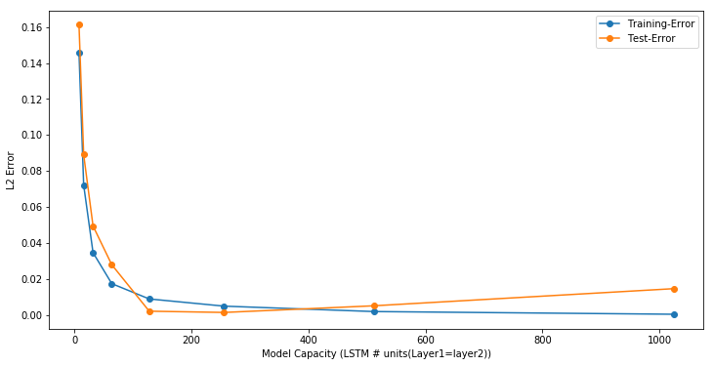
Does too many parameters in Rugged potential model causes overfitting?
The following study is done keeping all the hyperparameters constant other than the unit size of the LSTM layers.
learningRate = 0.0005, batchSize = 512, dropout_rate=0.2, epochs=100, time_frames=5

Slide 29
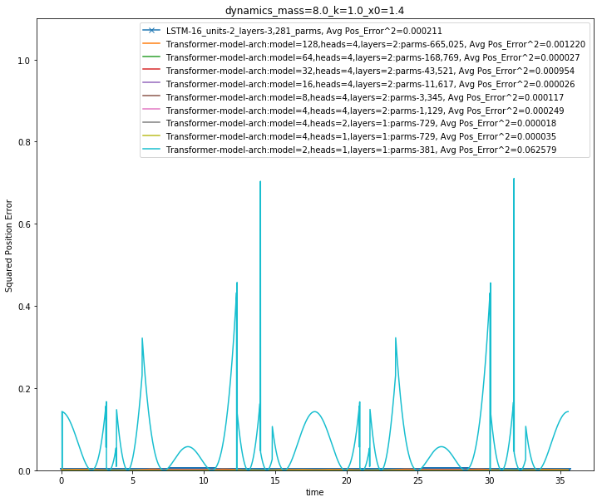
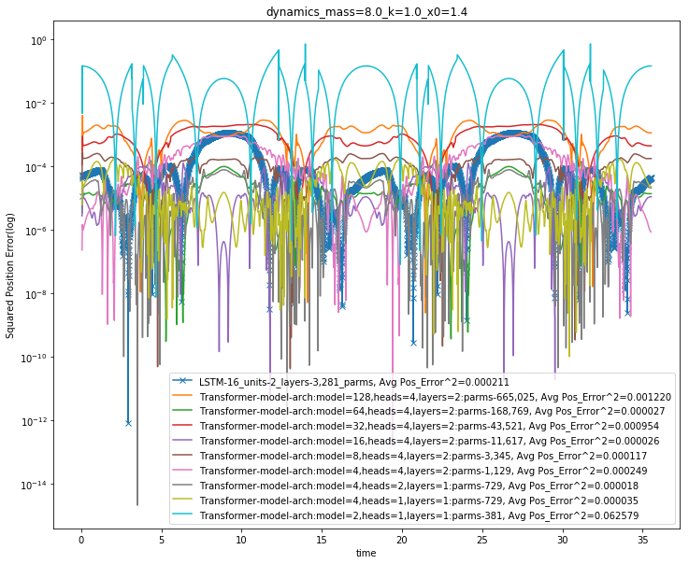
LSTM vs Regression Transformer for Simple Harmonic Oscillator
Training data:
  mass(m): 1-10,
  spring constant(k): 1-10 and
  starting point (x0) : 1.0 to 2.0 with a step size of 0.2.
Randomly selected 10 simulations from those 600 for training and validation.
Transformer has from 381 (too small) to 665025 (overfits) parameters; values in between good but needs more study

Slide 30
Sizes of datasets
Simulation Name | # of Simulations/(datasize) | Optimized LSTM configs
Simple harmonic oscillator | 500 (~5GB -> 500MB) Full -> Subsample size | 873 parms, 2 layers, 8 units in each layer, timeframes=4 (MSE)~0.005
Double well | 640 (~6GB -> 600MB) | 3281 parms, 2 layers, 16 units in each layer, timeframes=4 (MSE)~0.005
LJ potential | 520 (~5GB -> 500MB) | 12705 parms, 2 layers, 32 units in each layer, timeframes=4 (MSE)~0.01
Rugged potential | 2460 (~25GB -> 2.5GB) | 198273 parms, 2 layers, 128 units in each layer, timeframes=5 (MSE)~0.005
Many particle (3) | 520 (~5GB -> 500MB) | 13993 parms, 2 layers, 32 units in each layer, timeframes=5 (MSE)~0.005
Many particle (8) | 5200 (~100GB->1GB) | 57368 parms, 2 layers, 64 units in each layer, timeframes=5 (MSE)~0.005
Many particle (16) | 5200 (~200GB->2GB) | 65702 parms, 2 layers, 64 units in each layer, timeframes=5 (MSE)~0.005
.

Slide 31
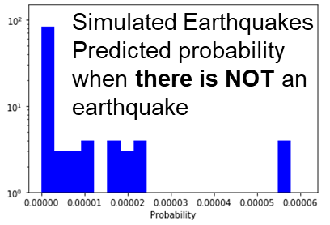
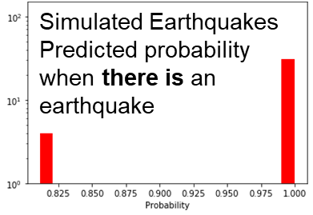
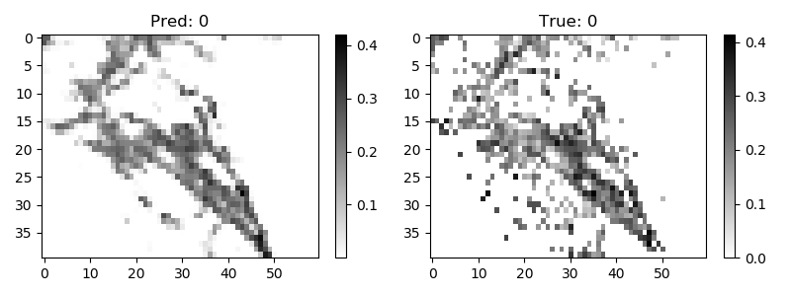
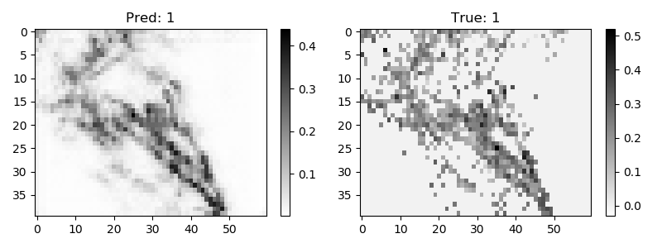
Hidden Theories and Hidden Instances
The LSTM description of particle dynamics suggests that the DNN has learnt “Newton’s laws” and then you look at different instances in the inference
This approach of a general theory given in simulations refined by observed data could be a powerful model in Earthquake Science, Virtual Tissues, Epidemics and other socio-technical studies
Below are two predictions compared to observation for annual earthquake activity in Southern California (each pixel is about 11 km square)
Uses Convolutional LSTM with 5 time steps and data is log of aggregated energy released (can’t use energy as too large a dynamic range)
DNN learns theories

Slide 32
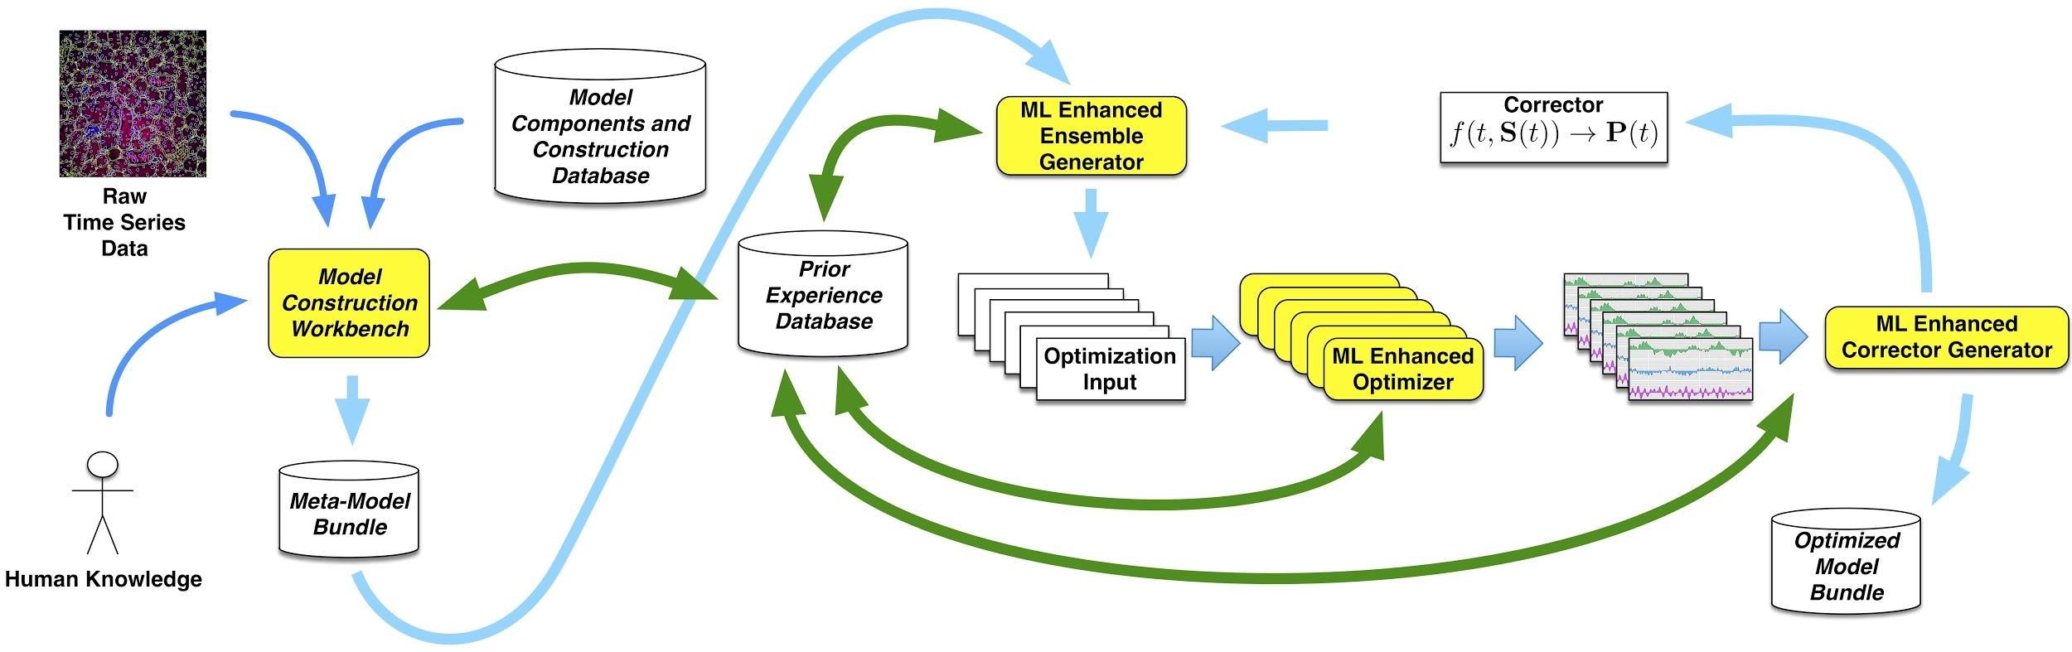
Multiple versions of MLforHPC used in
Simulating Biological Organisms (with James Glazier @IU)
Learning Model (Agent) Behavior
Replace components by learned surrogates
(Reaction Kinetics Coupled ODE’s)
All steps use MLAutotuning
Smart Ensembles
Dynamic Data Assimilation
Theory to Instance

Slide 33
Futures of Ml for HPC I
ML for HPC broadly but current use is nonuniform across domains
  We need to improve Cyberinfrastructure support to make MLforHPC more effective for more users
Use of modest DL network to map material/potential drug structure to properties (generalized QSAR) with simulation and observation: Advanced Progress
Learn surrogates for large scale simulations: initial small scale results
Use of MLforHPC in agent-based systems (learn agents replaing by surrogates): Very promising but few results
  Use in Sociotechnical simulations and in virtual tissues (agents are people or cells)
Macroscopic Structure as in learn complex multi-particle potentials scaling to N⁷: many great successes
Learn Collective coordinates and guide ensemble computations: dramatic progress with speedups up to 10⁸
Microscale; learn dynamics of small scale such as clouds, turbulence: Interesting results but much more to do
Use of Recurrent NN’s to represent dynamics (learn numerical differential operators): Promising but only studied in small problems

Slide 34
Futures of ML for HPC II
Learn errors as well as values in differential equation solutions
Look at advanced solver methods such as fast multipole or ML learnt potentials
Quantify Deep Learning for (geospatial) Time Series for different applications and different methods: Looking at
  Virtual biological tissues – apply surrogates to virtual cell-based simulations
  Snow layers from polar science radar data
  Earthquake Forecasting (are there actually hidden variables as phase transition?)
  Epidemic Forecasting with mix of simulation and observation
  Industry is Ride Hailing and Transportation as well as audio
  MLPerf has a Deep Learning for Time Series working group
Investigate different methods: RNN (LSTM, GRU), RNN-T, non-recurrent with attention: Transformer
Build Software systems to support AI dynamically mixed with simulation
Investigate optimized hardware – CPU, Accelerator, Storage, Network for AI dynamically mixed with simulation
How does this hardware and software compare to that for
  Edge to Cloud data-center use case
  Simulation supercomputer
  Classic data-center big data problem

Slide 35
Conclusions
Science has many exciting big data problems with both similarities and differences from those in industry
  Science data analysis can learn from and illuminate methods pioneered in Industry
  Image based science deep learning such as pathology also made good progress with natural MLPerf links
  I expect other areas of science data analytics to adopt deep learning quite quickly
  Geospatial time series very promising (DeepTS MLPerf WG)
The role of simulation is distinctive and the intersection of deep learning DL and simulation MLforHPC has made remarkable progress in last 3 years
The existence of hidden theories that DL can learn could be important
I suggest increased collaboration HPC/Science research-Cloud/MLSys/MLPerf communities in benchmarking and software and hardware environments spanning Clouds to HPC; CPUs to GPUs to accelerators.

Slide 36
Status of ML for HPC and HPC for ML
What are the challenges for ML for HPC and HPCfor ML?
  Increasing importance of deep learning and dominance of Industry in deep learning algorithms and systems needs to be understood
  Implications of new AI accelerators
  Need middleware integrating simulations and ML for HPC
What are the challenges and opportunities to form cross-disciplinary collaborations for ML for HPC and HPC for ML?
  Speedups of up to 2. 10⁹ reported in ML for HPC but only in some fields and need significant changes in application code while nature and requirements of cyberinfrastructure (HPC system) unclear.
  Thus must have interdisciplinary teams to both develop new approaches to applications and give requirements to Cyberinfrastructure
  HPC for ML: Deep Learning broadly used in industry; many science areas need to examine it.
How do you see the future of ML for HPC and HPC for ML?
  Both will have transformative impact on computational and data science with effective performance of zetta and yottascale expected from ML for HPC.
  Need to enhance interactions between science and industry; MLPerf, MLSys and common software stacks in workflow, deep learning

Slide 37
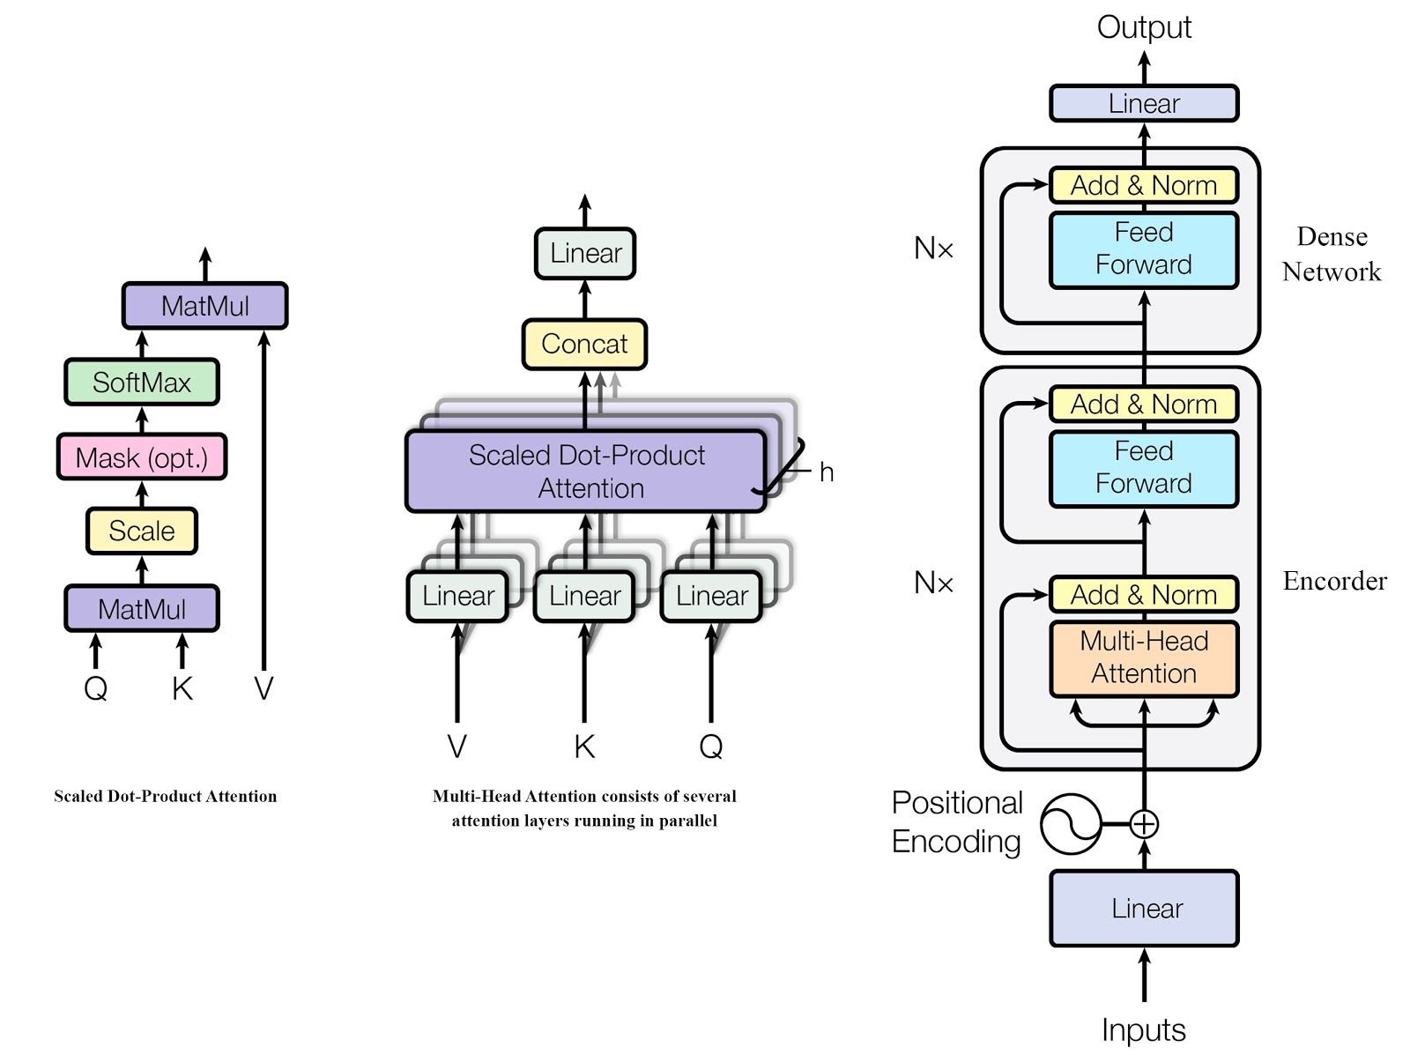
Transformer Architecture for ODE Integration
Regression Transformer is traditional encoder followed by a dense network for regression.
Input dimensions:
  Batch size(B) * Time sequence(T) * Input features (F)
  F= # of particles * 3D * [positions, velocity, force, etc.]
Output dimensions:
  Batch size(B) * Output features (O)
  O= # of particles * 3D * [positions, velocity, force, etc.]
Architecture details:
  Model size=8
  Heads(h)=4
  Number of layers(N_{x})=2
  Dense network units/layer=32
  Activations= Relu
  Implemented in tf v 2.x

