Slide 1
A PROGRESSIVE STUDY FOR THE AUTOMATIC ANALYSIS OF INTERNAL LAYERS FROM POLAR RADAR IMAGERY
Jerome E. Mitchell
2013 NASA Earth and Space Science Fellow
Ph.D Dissertation Defense
Advisor: Geoffrey C. Fox
Committee: David J. Crandall, Judy Qiu, Minje Kim, and John D. Paden*

Slide 2
Overview
Introduction: Motivation and Background
Related Literature
Semi-Automated Approach (using active contours for near surface layers)
Automated Approach (improved probabilistic graphical model with MCMC sampling for bedrock and surface layers)
Automated Approach (probabilistic graphical model with advanced MCMC sampling)
Conclusion and Future Directions

Slide 3
Introduction
The Problem
Understanding Layers in the radar images:
the ice thickness and accumulation rate maps
help studies relating to the ice sheets, their volume, and how they contribute to climate change
Need for an automated approach (to include the detection of a varying number of layers)

Slide 4
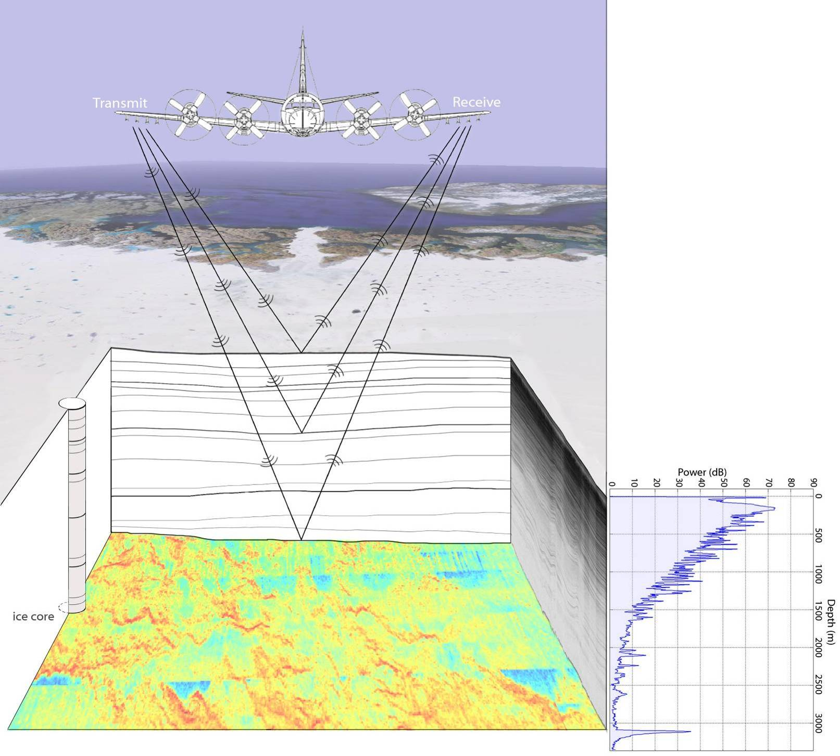
Illustration of the airborne depth-sounding radar

Slide 5
Column
Pixel
100

Slide 6
The Layers
Information from Layers are incorporated into climate models for determining ice thickness, internal stratigraphy, subglacial topography, and basal conditions
Layer:
continuity across an ice sheet links cores and time scales, shows correlations
discontinuity suggest problems (crevasses, etc)
diving into bed show basal melting
shape contributes to climate record

Slide 7
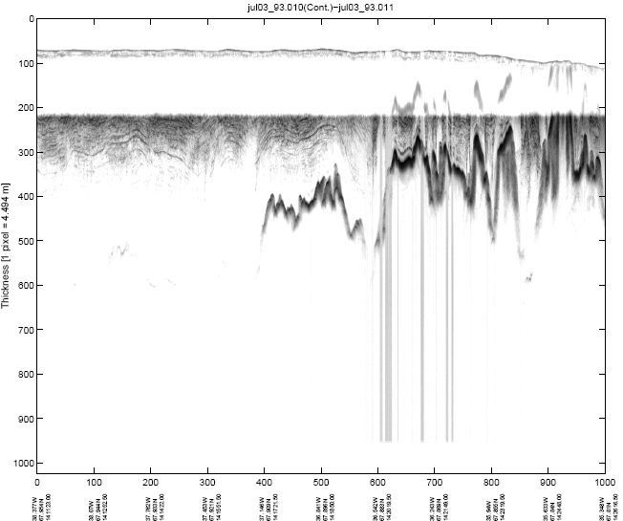
Example Echogram
Ice sheet Surface
Bed Topography
Snow Layers

Slide 8
Depth Sounder
Accumulation
ice surface
internal layers (millennial +)
ice surface
Internal layers (annual/decadal)
bedrock
Ku-Band Altimeter
Snow Radar
Ice surface
ice surface
internal layers (annual)
internal layers (annual)

Slide 9
Challenges in Processing RADAR Imagery
Bedrock/Surface Layers
Two Layers (but, false positives)
Low magnitude, faint, or non-existent bedrock reflections
Strong surface reflections can be repeated in an image causing surface multiples
Internal Layers
Multiple Layers (a couple dozen)
Fuse into existing Layers
Disappear and Reappear

Slide 10
Internal Layer Approaches…
Cross-correlation and a Peak following routine
Internal Layer Tracing and Age Depth Accumulation Relationships for the Northern Greenland Ice Sheet
M. Fahnestock, W. Abdalati, S. Luo, and S. Gogineni
Ramp based function
Tracing the Depth of the Holocene Ice in North Greenland from Radio-Echo Sounding Data
N. Karlsson, D. Dahl-Jensen, S. Gogineni, and J. Paden
Radon Transform
Automated MultiLayer Picking Algorithm for Ice Sheet Radar Echograms Applied to Ground-Based Near Surface Data
V. de Paul Onana, L. Koenig, J. Ruth, M. Studinger, and J. Harbeck

Slide 11
Internal Layer Approaches…
Several Semi-Automated Methods
Radiostratigraphy and Age Structure of the Greenland Ice Sheet
J. MacGregor, M. Fahnestock, G. Catania, J. Paden, S. Gogineni, S. Young, S. Rybarski, A. Mabrey, B. Wagman, and M. Morlighem
ARESP 6 Phases
Automated Processing to Derive Dip Angles of Englacial Radar Reflectors in Ice Sheets
L. Sime, R. Hindmarsh, and H. Corr
Active Contours (‘Snakes’) [Layer Position: Dynamic Time Warping ]
Detection of layer slopes and mapping of discrete reflectors in radio echograms
C. Panton

Slide 12
Data Disclaimer
Used data only collected by the Center for Remote Sensing of Ice Sheets (CReSIS)
Approaches tested on:
Multichannel Coherent Depth Sounder (MCORDS) (ground-truth),
Snow and Accumulation Radar Imageries (no to little ground-truth)
CReSIS data is publicly accessible and documented

Slide 13
Estimating Near Surface Internal Layers

Slide 14
Snakes
A snake is defined in the (x,y) plane of an image as a parametric curve
A contour has an energy (E_{snake}), which is defined as the sum of the three energy terms.
Detecting Layers reduces to an energy minimization problem.

Slide 15
Algorithm for Estimating Near Surface Internal Layers
Identify Ice Surface
Classify Curve Points
Active Contours (Snakes)

Slide 16
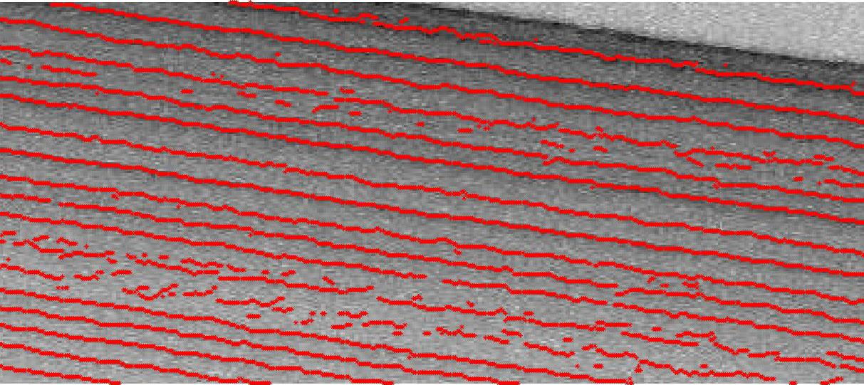
Algorithm for Estimating Near Surface Internal Layers
Identify Ice Surface
Classify Curve Points
Active Contours (Snakes)

Slide 17
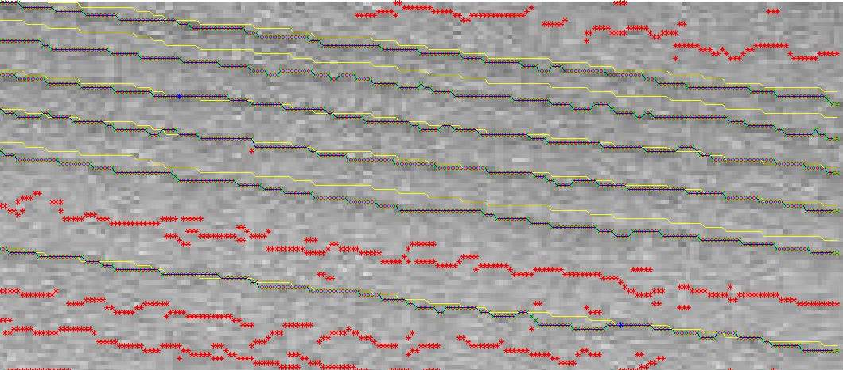
Algorithm for Estimating Near Surface Internal Layers
Identify Ice Surface
Classify Curve Points
Active Contours (Snakes)

Slide 18
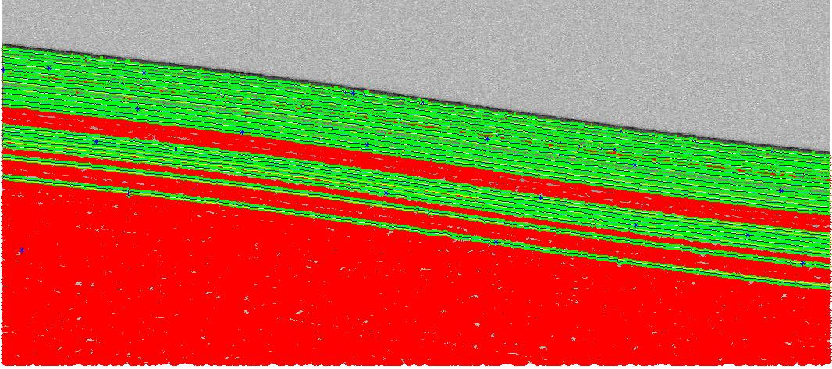
Algorithm for Estimating Near Surface Internal Layers
Identify Ice Surface
Classify Curve Points
Active Contours (Snakes)

Slide 19
Algorithm for Estimating Near Surface Internal Layers
Identify Ice Surface
Classify Curve Points
Active Contours (Snakes)

Slide 20
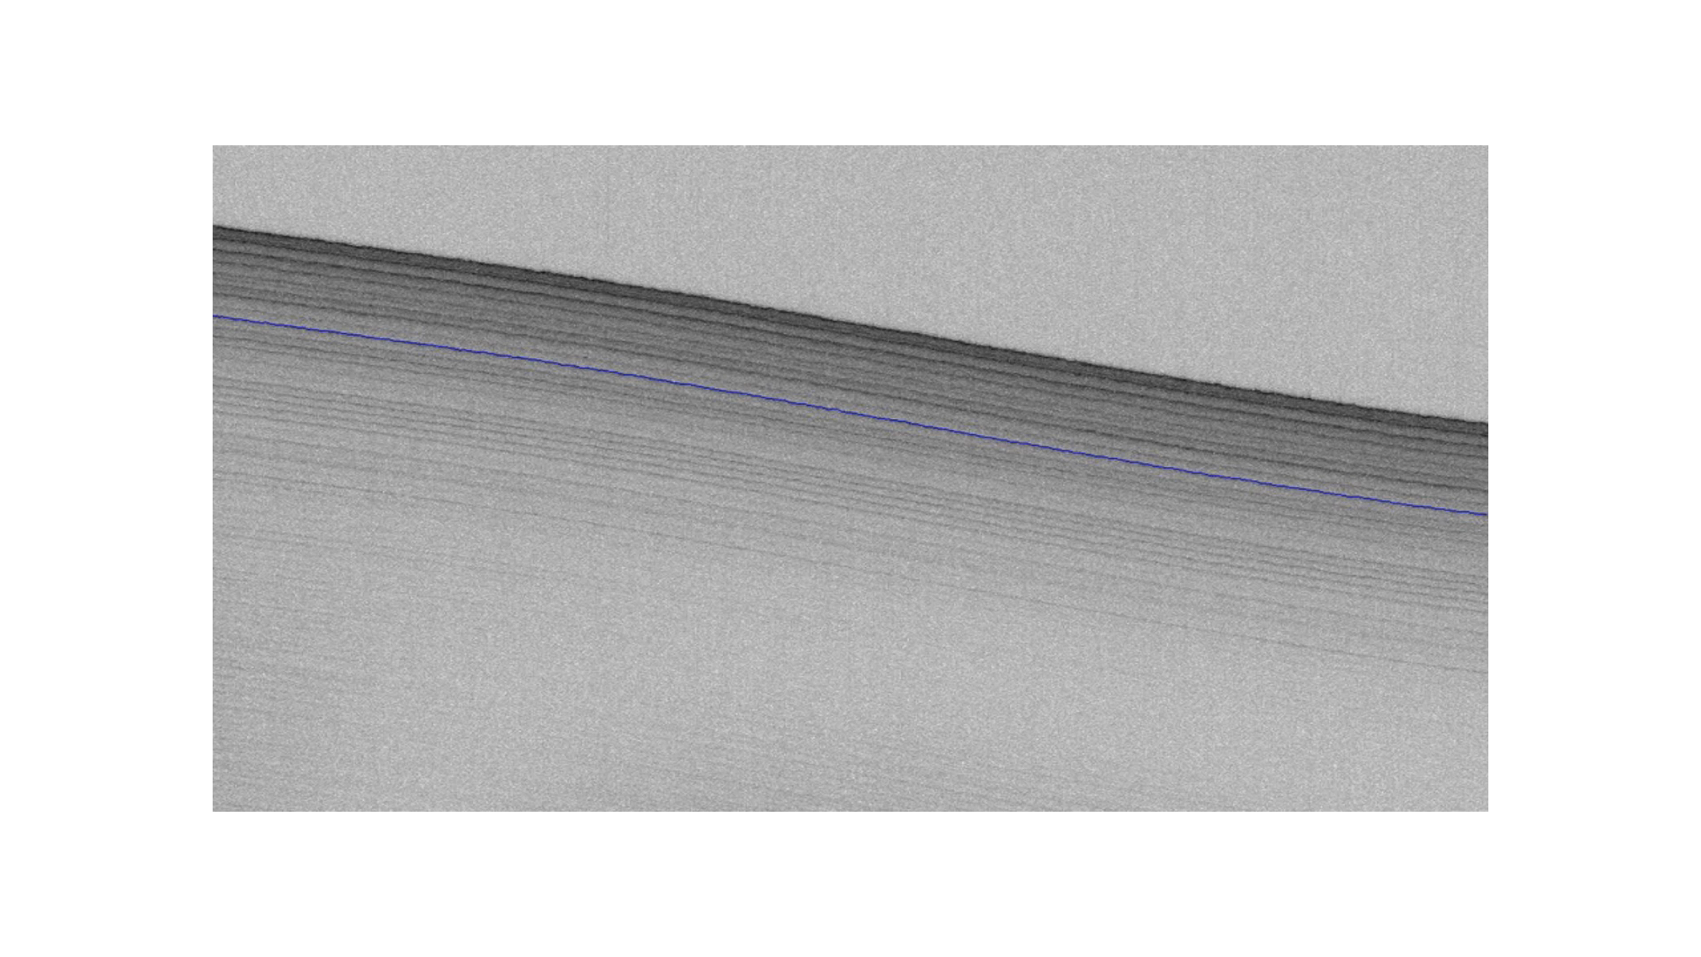

Slide 21
Near Surface Internal Layers
Mitchell, Crandall, Fox, and Paden, “A Semi-Automated Approach to Estimating Near Surface Internal Layers from Snow Radar Imagery”, International Geoscience and Remote Sensing (IGARSS), 2013.

Slide 22
Conclusion
2011 Antarctica Near Surface Internal Layers
Specialized approach, which uses an active contours in addition to “off-the-shelf” image processing techniques to identify near surface internal layers
Limitations:
(Semi) automated approach requires specifying a global parameter for determining number of visible layers
Each layer requires tuning active contour model parameters

Slide 23
Probabilistic Graphical Models
A graph comprises nodes (or vertices) and links (or edges),
where each node represents a random variable and the link probabilistic relationship between these variables
Models
Bayesian Network
Markov Random Field encode contextual constraints visual information
Inference
process of computing posterior probabilities of one or more nodes

Slide 24
Crandall et al, “Layer-finding in Radar Echograms using Probabilistic Graphical Models”, International Conference on Pattern Recognition (ICPR), 2012
Developed an automated layer detection method, which used an probabilistic graphical model for integrating local and global features.
Technique developed from simplistic model and solved for layer
boundaries incrementally, producing a single answer

Slide 25
Surface and Bedrock (Hidden Markov Model)
Approach Ground-Truth
Crandall, Fox, Paden, “Layer-finding in Radar Echograms using Probabilistic Graphical Models”, International Conference on Pattern Recognition (ICPR), 2012.

Slide 26
Crandall et al, “Layer-finding in Radar Echograms using Probabilistic Graphical Models”, International Conference on Pattern Recognition (ICPR), 2012
Developed an automated layer detection method, which used an probabilistic graphical model for integrating local and global features.
Technique developed from simplistic model and solved for layer
boundaries incrementally, producing a single answer
Improved the model by solving for layer boundaries simultaneously and providing confidence intervals, which can aid glaciologists in determining correct layer boundaries

Slide 27
Estimating Bedrock and Surface Boundaries with Confidence Intervals in Ice Sheet Radar Imagery using MCMC
Improved the model by solving for layer boundaries simultaneously and providing confidence intervals, which can aid in glaciologists in determining correct layer boundaries
using Gibbs sampling for performing inference instead of the dynamic programming
Gibbs sampler produces explicit confidence intervals, thus giving bands of uncertainty in the layer boundary locations

Slide 28
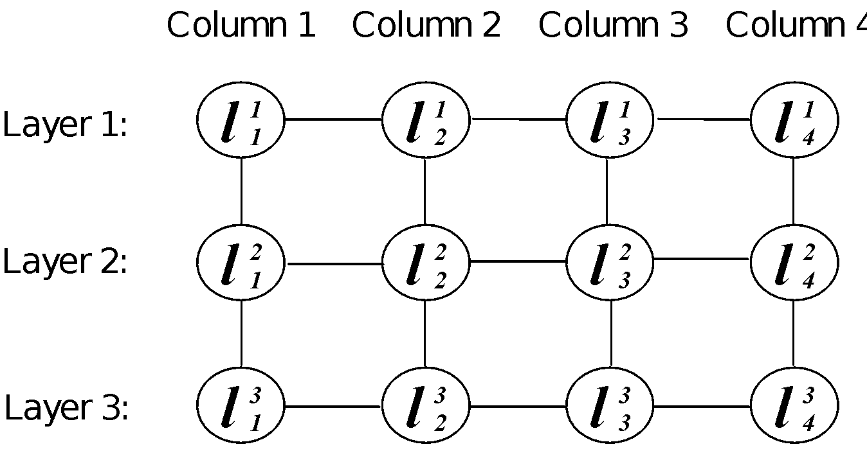
The Model
Goal: Find a labeling for entire image, 𝐿 = (𝐿₁, … , 𝐿_{𝑘})

Slide 29
Probabilistic Formula
The problem of layer detection is posed as a probabilistic graphical model based on the following assumptions:
Image characteristics determined by local layer boundaries
Variables in L exhibit a Markov property with respect to their local neighbors

Slide 30
Probabilistic Formulation
The problem of layer detection is posed as a probabilistic graphical model based on the following assumptions:
Prior term models how well labeling agrees with typical ice layer properties
Likelihood term models how well labeling agrees with image

Slide 31
Probabilistic Formulation

Slide 32
Probabilistic Formulation
Zero-mean Gaussian penalizes discontinuities in layer boundaries across columns
Repulsive term prevents boundary crossing

Slide 33
Introduction to Markov Chain Markov Random Fields (MCMC)
Markov Chain Monte Carlo
characterizes a distribution without knowing all the distribution’s mathematical properties
Solution: Estimates properties of distribution by examining random samples from it
Techniques:
Metropolis Hastings
Gibbs Sampling

Slide 34
Statistical Inference
Finding L, which maximizes P(L | I) involves inference on a Markov Random Field
estimate full joint distribution using Gibbs sampling
Gibbs Sampling (MCMC)
approximates the joint distribution by iteratively sampling from the conditional distribution
Layer location determined by the mean of posterior samples, which approximates the expectation of the joint distribution

Slide 35
Confidence Intervals
Confidence intervals provide quality control for label accuracy in distinguishing between bedrock and surface boundaries
94.7% of surface boundaries and 78.1% of bedrock boundaries are within confidence intervals

Slide 36
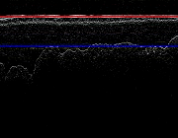
Gibbs Sampling

Slide 37
Results
Dataset contained 826 images acquired from an airborne multichannel coherent radar depth sounder
Labeled images (ground-truth) are often noisy
automatically removed images with either incomplete or partially
defined layers, leaving 560 images

Slide 38
Quantitative Results
Approach | Mean Error Surface Bedrock |  | Median Mean Error Surface Bedrock
Crandall et. al | 22.3 | 43.1 | 10.6 | 14.4
Our | 9.3 | 37.4 | 5.9 | 9.1
Error measured in terms of absolute column-wise difference compared to ground-truth, summarized with average mean deviation and median mean deviation across echograms, in pixels.

Slide 39
Surface and Bedrock
Approach Ground-Truth
Lee, Mitchell, Crandall, and Fox “Estimating Bedrock and Surface Boundaries with Confidence Intervals in Ice Sheet Radar Imagery using MCMC”, International Conference on Image Processing (ICIP), 2014.

Slide 40
Conclusion
Improved Detection of Surface and Bedrock Layer Boundaries
Used MCMC to sample from the joint distribution over all possible layers
Reduced labeling error by 50% with respect to Crandall et al.
Estimated confidence intervals to improve climate models based upon a belief of correct layer boundary
Limitations:
Fixed K for specifying the number of layers (i.e K = 2) focused on ice thickness estimates

Slide 41
An Sampling-based Approach to the Automatic Analysis of Layers from Polar Radar Imagery
Reversible Jumps Markov Chain Monte Carlo (RJMCMC) based Sampling procedure
Extension of Metropolis Hastings, which explores configurations of different dimensionality, in this case, the number of layer boundaries
Informative, Data Driven Proposals
Birth and Death, Update
A Layer is proposed by choosing a move from all candidates based on move probability distribution

Slide 42
An Sampling-based Approach to the Automatic Analysis of Layers from Polar Radar Imagery
Reversible Jumps Markov Chain Monte Carlo (RJMCMC) based Sampling procedure
Birth
a layer is added to the configuration
Update
a layer is adjusted
Death
a layer is deleted from configuration

Slide 43
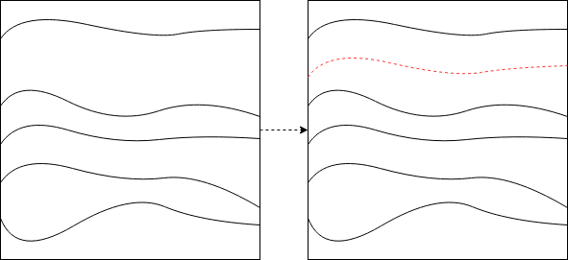
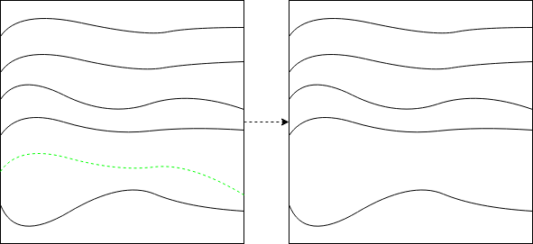
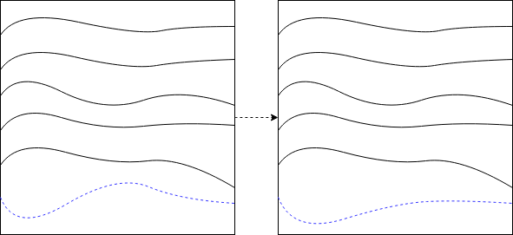
Birth
Death
Update

Slide 44
Experimental Results
Comparison of over – and under – seeding initialization
The RJMCMC sampler coupled with simulated annealing to ensure convergence
achieved from birth and death moves
2014 Greenland Accumulation Radar Imagery and 2014 Antarctica Snow Radar Imagery

Slide 46
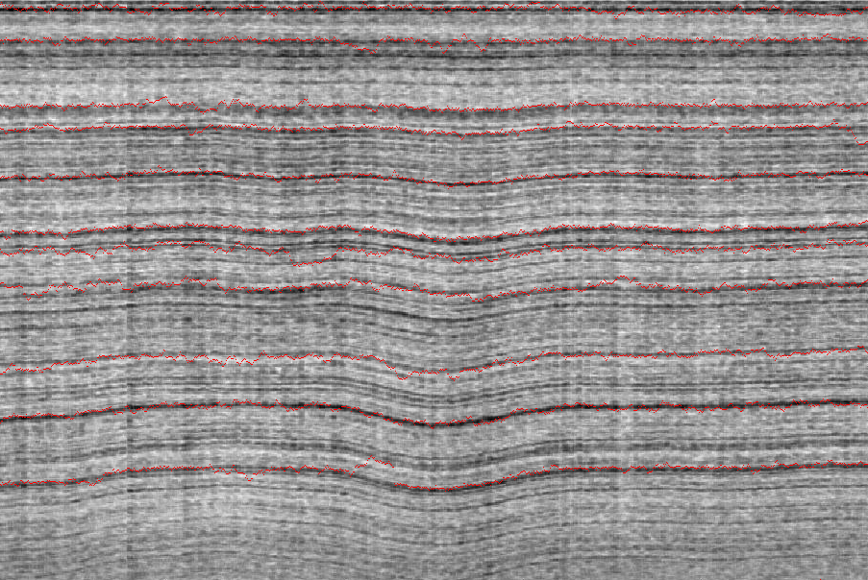
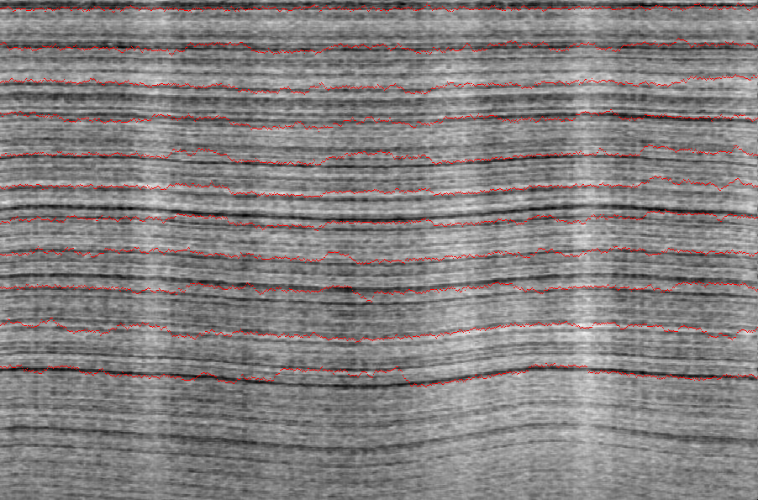
Accumulation Radar Imagery
Original Echogram
Layer Detected Echogram

Slide 47
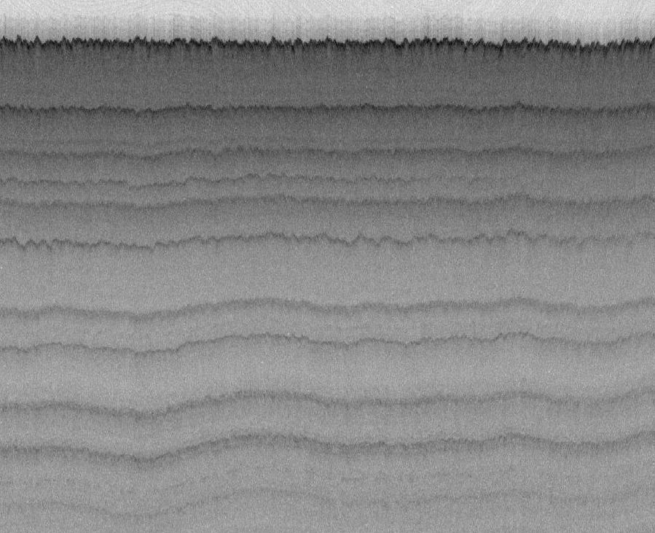
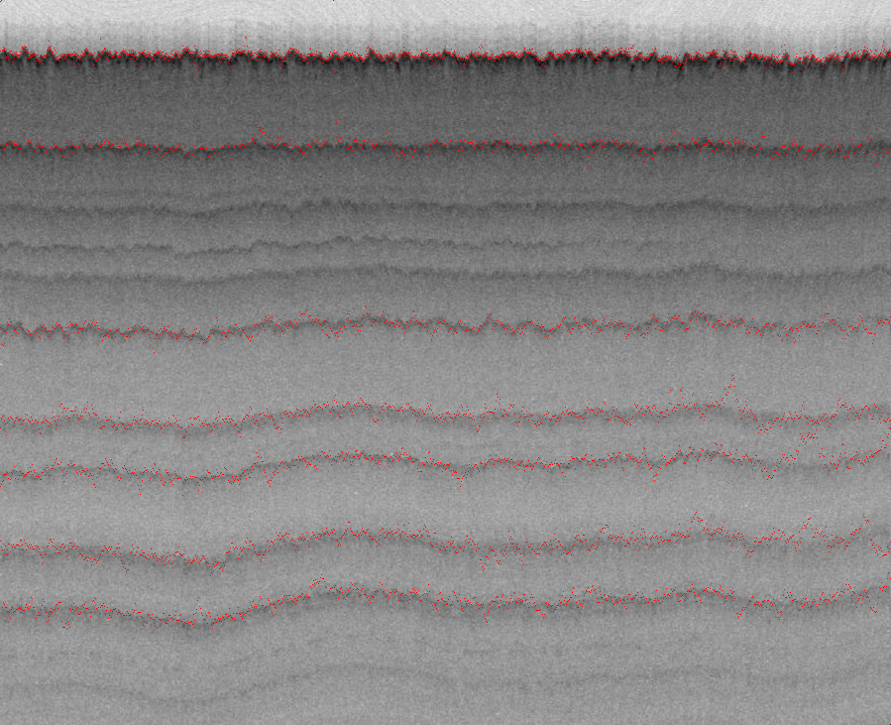
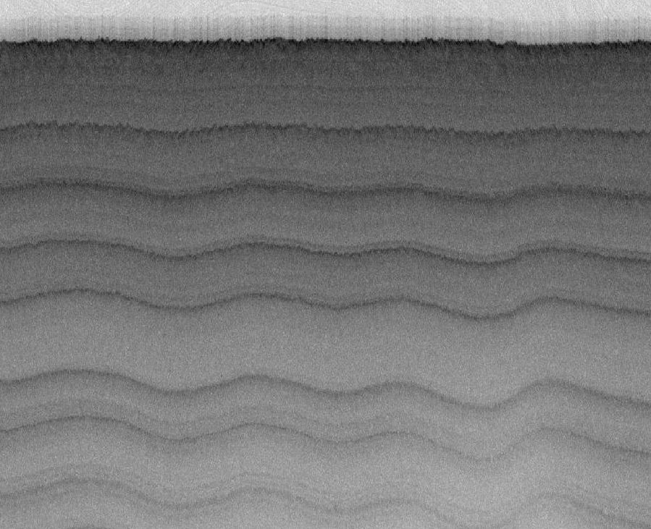
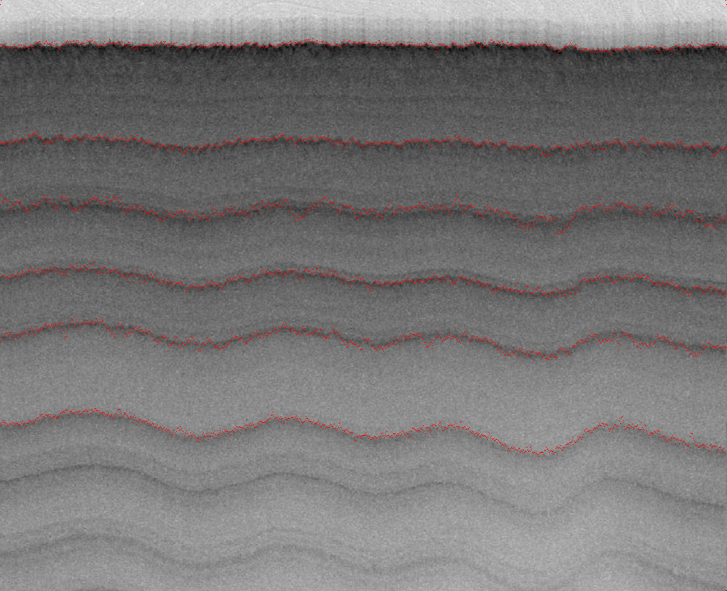
Snow Radar Imagery
Original Echogram
Layer Detected Echogram
Mitchell, Lee, Crandall, and Fox “A Sampling-based Approach to the Automatic Analysis of Layers from Polar Radar Imagery ”, 2018.

Slide 48
Conclusion
Accumulation and Snow Radar Imageries
RJMCMC
Automated approach to detect an unknown number of layer irrespective of radar and layer resolution
Fast convergence for any number of layers

Slide 49
Conclusion: Comparative Model Analysis
Active Contour Models
Advantages: fast convergence
Disadvantages: sensitivity to initialization, either trial and error or heuristic for tuning model parameters, single boundary of interest
Probabilistic Graphical Models
Advantages: encode complex relationships between graph attributes
Disadvantages: domain knowledge, a lot of training data, inference is computationally challenging, NP-hard inference

Slide 50
Conclusion and Future Directions: Conclusion
Understanding internal layers can aid in forecasting global change
Progressive Approach: From approach to an automated approach a semi-automated, which detects an unknown number of layers
Active Contour
Probabilistic Graphical Model

Slide 51
Conclusion and Future Directions: Future Directions
Validation of proposed techniques to datasets with different characteristics (e.g layer slopes) acquired from Antarctica and Greenland
Improve layer accuracy by incorporating a ‘cross-sectional’ prior to discriminate the selection of layer boundaries

Slide 52
Acknowledgments
Advisor: Geoffrey C. Fox
Committee: David J. Crandall (and IU Computer Vision), Judy Qiu, Minje Kim, and John D. Paden
Linda Hayden and Prasad Gogineni
Center for Remote Sensing of Ice Sheets (CReSIS)
NASA Earth and Space Science Fellowship

Slide 53
Questions?

