Slide 1
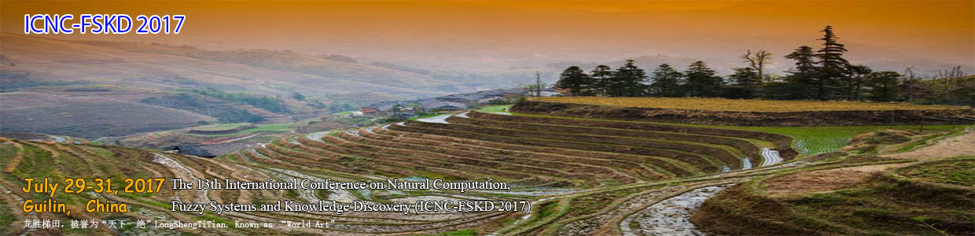
Big Data and High-Performance Technologies for Natural Computation
`
Geoffrey Fox July 29, 2017
gcf@indiana.edu, http://www.dsc.soic.indiana.edu/, http://spidal.org/
Digital Science Center
Department of Intelligent Systems Engineering

Slide 2
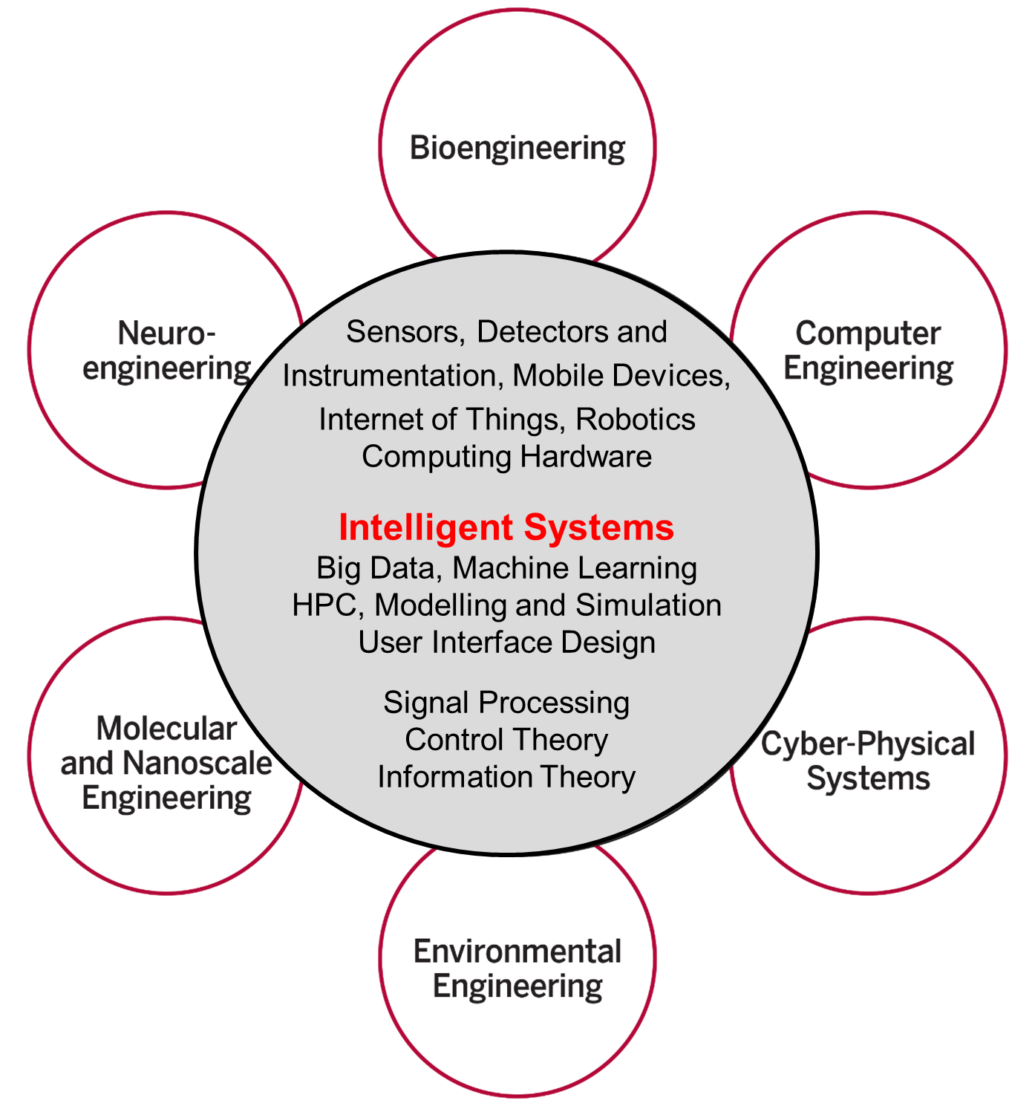
Intelligent Systems Engineering at Indiana University
All students do basic engineering plus machine learning (AI), Modelling& Simulation, Internet of Things
Also courses on HPC, cloud computing, edge computing, deep learning and physical optimization (this conference)
Fits recent headlines:
Google, Facebook, And Microsoft Are Remaking Themselves Around AI
How Google Is Remaking Itself As A “Machine Learning First” Company
If You Love Machine Learning, You Should Check Out General Electric

Slide 3
Abstract
We examine the current state of Big Data and High-Performance Computing (HPC) and its significance for large-scale machine learning.
We cover hardware and software systems with applications including deep learning and the deterministic annealing approach to both clustering and dimension reduction.
We analyze results on machines with up to 1,000-10,000 cores and extrapolate to larger systems.
The software model is built around the Apache Big Data Stack with HPC enhancements.
The tension between HPC and cloud systems is explored stressing need for interoperable approaches.

Slide 4
Important Trends I
Data gaining in importance compared to simulations
  Data analysis techniques changing with old and new applications
All forms of IT increasing in importance; both data and simulations increasing
Internet of Things and Edge Computing growing in importance
Exascale initiative driving large supercomputers
Use of public clouds increasing rapidly
  Clouds becoming diverse with subsystems containing GPU’s, FPGA’s, high performance networks, storage, memory …
  They have economies of scale; hard to compete with
Serverless (server hidden) computing attractive to user:
“No server is easier to manage than no server”

Slide 5
Important Trends II
Rich software stacks:
  HPC for Parallel Computing
  Apache for Big Data Software Stack ABDS including some edge computing (streaming data)
On general principles parallel and distributed computing has different requirements even if sometimes similar functionalities
  Apache stack ABDS typically uses distributed computing concepts
  For example, Reduce operation is different in MPI (Harp) and Spark
Important to put problem size per task (grain size) into analysis
  Its easier to make dataflow efficient if grain size large
Streaming Data ubiquitous including data from edge
Edge computing has some time-sensitive applications
  Choosing a good restaurant can wait seconds
  Avoiding collisions must be finished in milliseconds

Slide 6
Important Trends III
HPC needed for some Big Data processing
  Deep Learning needs small HPC systems
Big Data requirements are not clear but there are a few key use types
  Pleasingly parallel processing (including local machine learning) as of different tweets from different users with perhaps MapReduce style of statistics and visualizations
  Database model with queries again supported by MapReduce for horizontal scaling
  Global Machine Learning with single job using multiple nodes as classic parallel computing
Current workloads stress 1) and 2) and are suited to current clouds and to ABDS (no HPC)
  Expect to change as users get more sophisticated
  Such as change happened in simulation as increased computer power led to ability to do much larger and different problems (2D in 1980 became fully realistic 3D)
Data should not be moved unless essential
  Supported by Fog computing -- a well establish idea but no agreement on architecture

Slide 7
Global Machine Learning
Classic Cloud Workload
These 3 are focus of our improvement but we need to preserve capability on first 2 paradigms

Slide 8
Predictions/Assumptions
Supercomputers will continue for large simulations and may run other applications but these codes will be developed on HPC Clouds or
Next-Generation Commodity Systems which are dominant force
  Merge Cloud HPC and Edge computing
  Clouds running in multiple giant datacenters offering all types of computing
  Distributed data sources associated with device and Fog processing resources
  Server-hidden computing for user pleasure
  Support a distributed event driven dataflow computing model covering batch and streaming data
  Needing parallel and distributed (Grid) computing ideas
  Span Pleasingly Parallel to Data management to Global Machine Learning

Slide 9
Twister2: “Next Generation Grid - Edge – HPC Cloud”
Original 2010 Twister paper has 875 citations; it was a particular approach to MapCollective iterative processing for machine learning
Re-engineer current Apache Big Data and HPC software systems as a toolkit
Support a dataflow event-driven FaaS (microservice) framework running across application and geographic domains.
  Support all types of Data analysis assuming global machine learning will increase in importance
Build on Cloud best practice but use HPC wherever possible to get high performance
Smoothly support current paradigms Hadoop, Spark, Flink, Heron, MPI, DARMA …
Use interoperable common abstractions but multiple polymorphic implementations.
  i.e. do not require a single runtime
Focus on Runtime but this implicitly suggests programming and execution model
This is a next generation Grid based on data and edge devices – not computing as in old Grid

Slide 10





NSF 1443054: CIF21 DIBBs: Middleware and High Performance Analytics Libraries for Scalable Data Science
HPC-ABDS Software
Harp and Twister2 Building Blocks
SPIDAL Data Analytics Library
Software: MIDAS
HPC-ABDS

Slide 11



Implementing these ideas at a high level
Cloud
HPC
Cloud
HPC
Cloud
HPC
Centralized HPC Cloud + IoT Devices
Centralized HPC Cloud + Edge = Fog + IoT Devices

Slide 12
What is the challenge?
Integrate systems that offer full capabilities
  Scheduling
  Storage
  “Database”
  Programming Model (dataflow and/or “in-place” control-flow) and corresponding runtime
  High Performance Analytics
  Workflow
  Function as a Service and Event-based Programming
With a broad scope
  For both Batch and Streaming
  Distributed and Centralized (Grid versus Cluster)
  Pleasingly parallel (Local machine learning) and Global machine learning (large scale parallel codes)
How do we do this?

Slide 13
Proposed Approach I
Unit of Processing is an Event driven Function (a service)
  Can have state that may need to be preserved in place (Iterative MapReduce)
  Can be hierarchical as in invoking a parallel job
  Functions can be single or 1 of 100,000 maps in large parallel code
Processing units run in clouds, fogs or devices but these all have similar architecture
  Fog (e.g. car) looks like a cloud to a device (radar sensor) while public cloud looks like a cloud to the fog (car)
Use polymorphic runtime that uses different implementations depending on environment e.g. on fault-tolerance – latency (performance) tradeoffs
Data locality (minimize explicit dataflow) properly supported as in HPF alignment commands (specify which data and computing needs to be kept together)
Support the federation of the heterogeneous (in function – not just interface that characterized old Grid) resources that form the new Grid

Slide 14
Proposed Approach II
Analyze the runtime of existing systems
  Hadoop, Spark, Flink, Naiad Big Data Processing
  Storm, Heron Streaming Dataflow
  Kepler, Pegasus, NiFi workflow systems
  Harp Map-Collective, MPI and HPC AMT runtime like DARMA
  And approaches such as GridFTP and CORBA/HLA (!) for wide area data links
  Include High Performance Data Analysis Library
Propose polymorphic unification (given function can have different implementations)
Choose powerful scheduler (Mesos?)
Support processing locality/alignment including MPI’s never move model with grain size consideration
This should integrate HPC and Clouds

Slide 15

Motivation of Deterministic Annealing
Big Data requires high performance – achieve with parallel computing
Big Data sometimes requires robust algorithms as more opportunity to make mistakes
Deterministic annealing (DA) is one of better approaches
to robust optimization and broadly applicable
  Started as “Elastic Net” by Durbin for
  Travelling Salesman Problem TSP
  Tends to remove local optima
  Addresses overfitting
  Much Faster than simulated annealing
Physics systems find true lowest energy state if you anneal i.e. you equilibrate at each temperature as you cool
Uses mean field approximation, which is also used in “Variational Bayes” and “Variational inference”

Slide 16
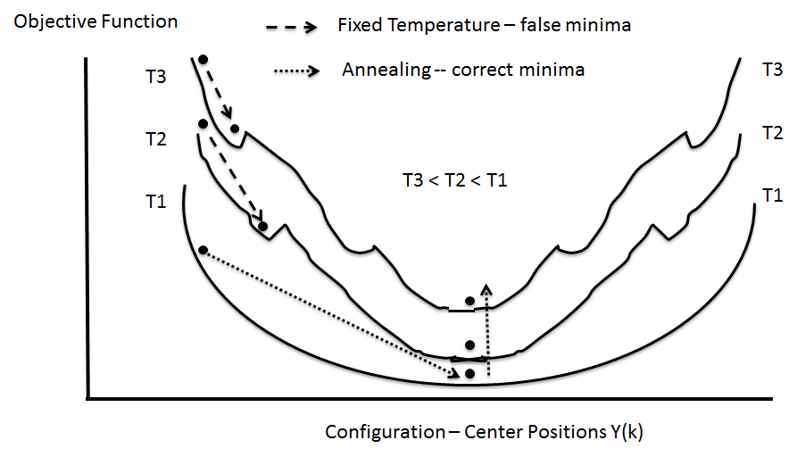
(Deterministic) Annealing follows Nature (Physics)
Find minimum at high temperature when trivial
Small change avoiding local minima as lower temperature
Typically gets better answers than standard libraries- R and Mahout
And can be parallelized and put on GPU’s etc.

Slide 17
General Features of Deterministic Annealing DA
In many problems, decreasing temperature is classic multiscale – finer resolution (√T is “just” distance scale)
In clustering √T is distance in space of points (and centroids), for MDS scale in mapped Euclidean space
T = ∞, all points are in same place – the center of universe
For MDS all Euclidean points are at center and distances are zero. For clustering, there is one cluster
As Temperature lowered there are phase transitions in clustering cases where clusters split
  Algorithm determines whether split needed as second derivative matrix singular
Note DA has similar features to hierarchical methods and you do not have to specify a number of clusters; you need to specify a final distance scale

Slide 18
Math of Deterministic Annealing
H(χ) is objective function to be minimized as a function of parameters χ (as in Stress formula given earlier for MDS)
Gibbs Distribution at Temperature T
P(χ) = exp( - H(χ)/T) / ∫ dχ exp( - H(χ)/T)
Or P(χ) = exp( - H(χ)/T + F/T )
Minimize the Free Energy combining Objective Function and Entropy
F = < H - T S(P) > = ∫ dχ {P(χ)H + T P(χ) lnP(χ)}
Simulated annealing performs these integrals by Monte Carlo
Deterministic annealing corresponds to doing integrals analytically (by mean field approximation) and is much much faster
Need to introduce a modified Hamiltonian for some cases so that integrals are tractable. Introduce extra parameters to be varied so that modified Hamiltonian matches original
Temperature is lowered slowly – say by a factor 0.95 to 0.9999 at each iteration

Slide 19
Some Uses of Deterministic Annealing DA
Clustering improved K-means
    Vectors: Rose (Gurewitz and Fox 1990 – 486 citations encouraged me to revisit)
    Clusters with fixed sizes and no tails (Proteomics team at Broad)
    No Vectors: Hofmann and Buhmann (Just use pairwise distances)
    Many clustering methods – not clear what is best although DA pretty good and improves K-means at increased computing cost which is not always useful
Dimension Reduction for visualization and analysis
    Vectors: GTM Generative Topographic Mapping
    No vectors SMACOF: Multidimensional Scaling) MDS (Just use pairwise distances)
    DA clearly improves MDS which is most reliable dimension reduction method?
Can apply to HMM & general mixture models (less study)
  Gaussian Mixture Models
  Probabilistic Latent Semantic Analysis with Deterministic Annealing DA-PLSA as alternative to Latent Dirichlet Allocation for finding “hidden factors”
Have scalable parallel versions of most of these– mainly Java

Slide 20
Metagenomics -- Sequence clustering
Non-metric Spaces
O(N²) Algorithms – Illustrate Phase Transitions

Slide 21
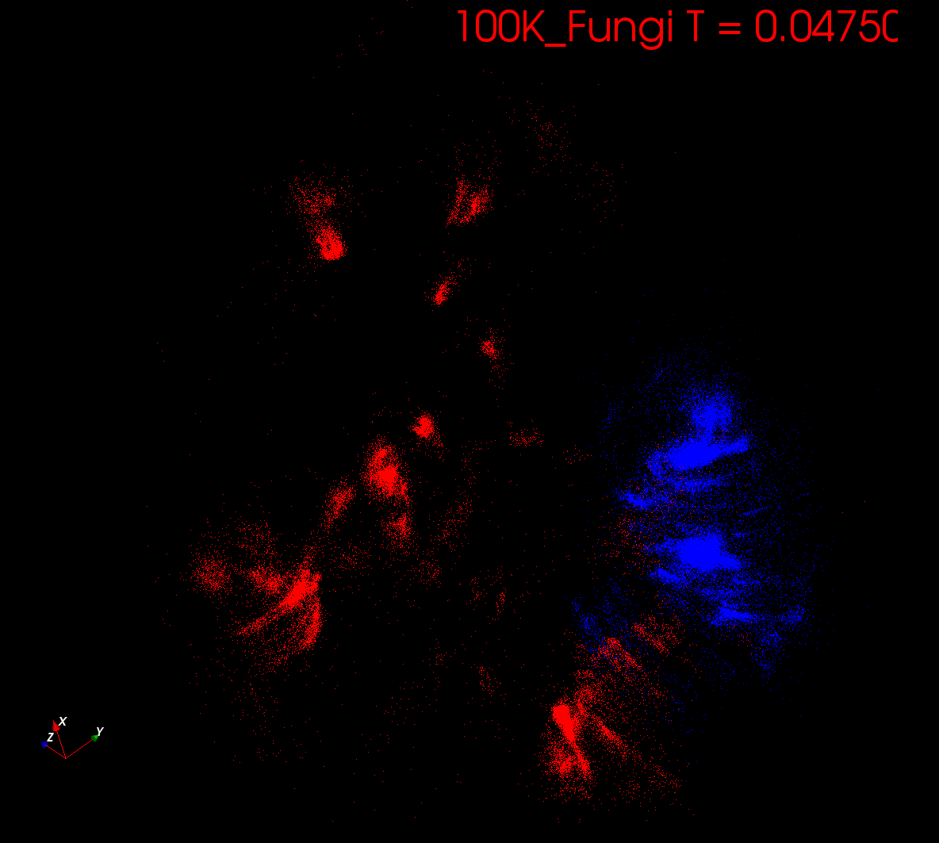
Start at T= “∞” with 1 Cluster
Decrease T, Clusters emerge at instabilities
2 in this visualization

Slide 22
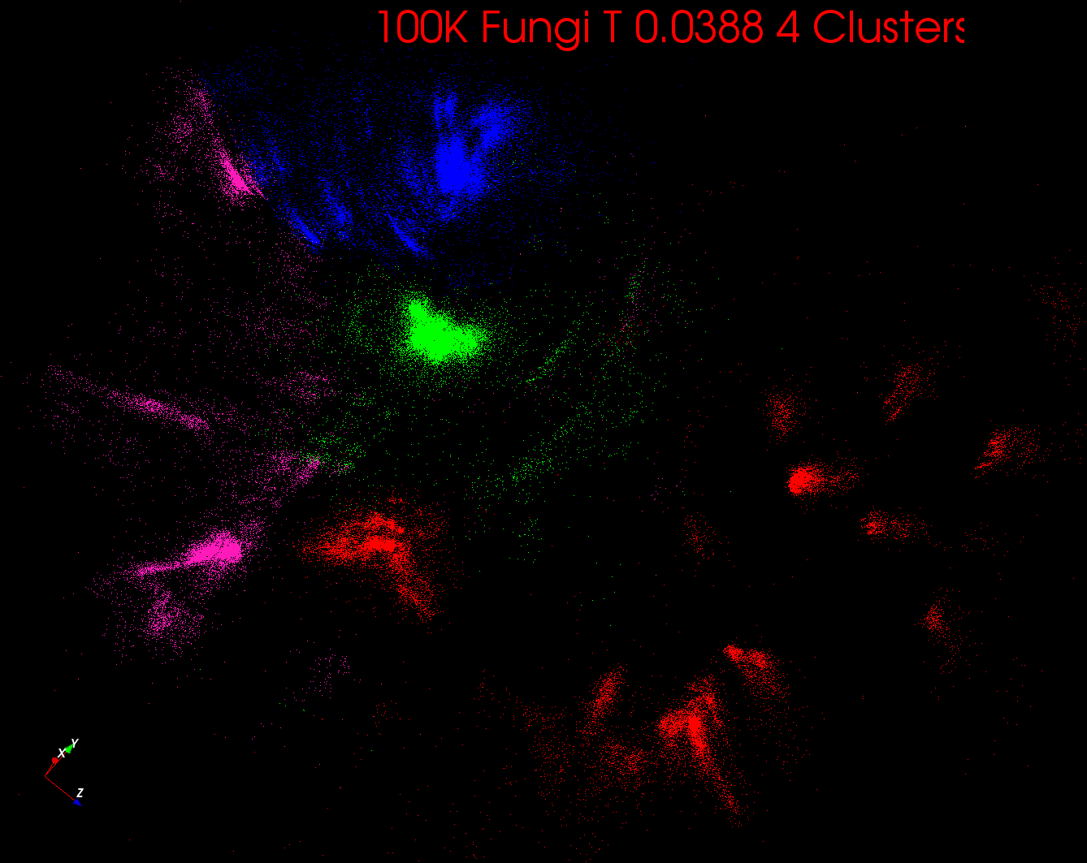
Start at T= “∞” with 1 Cluster
Decrease T, Clusters emerge at instabilities
4 in this visualization

Slide 23
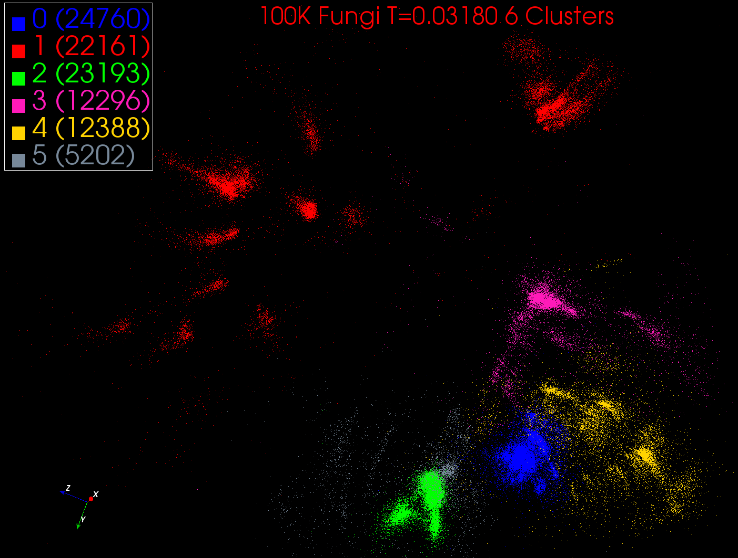
Start at T= “∞” with 1 Cluster
Decrease T, Clusters emerge at instabilities
6 clusters in this visualization

Slide 24
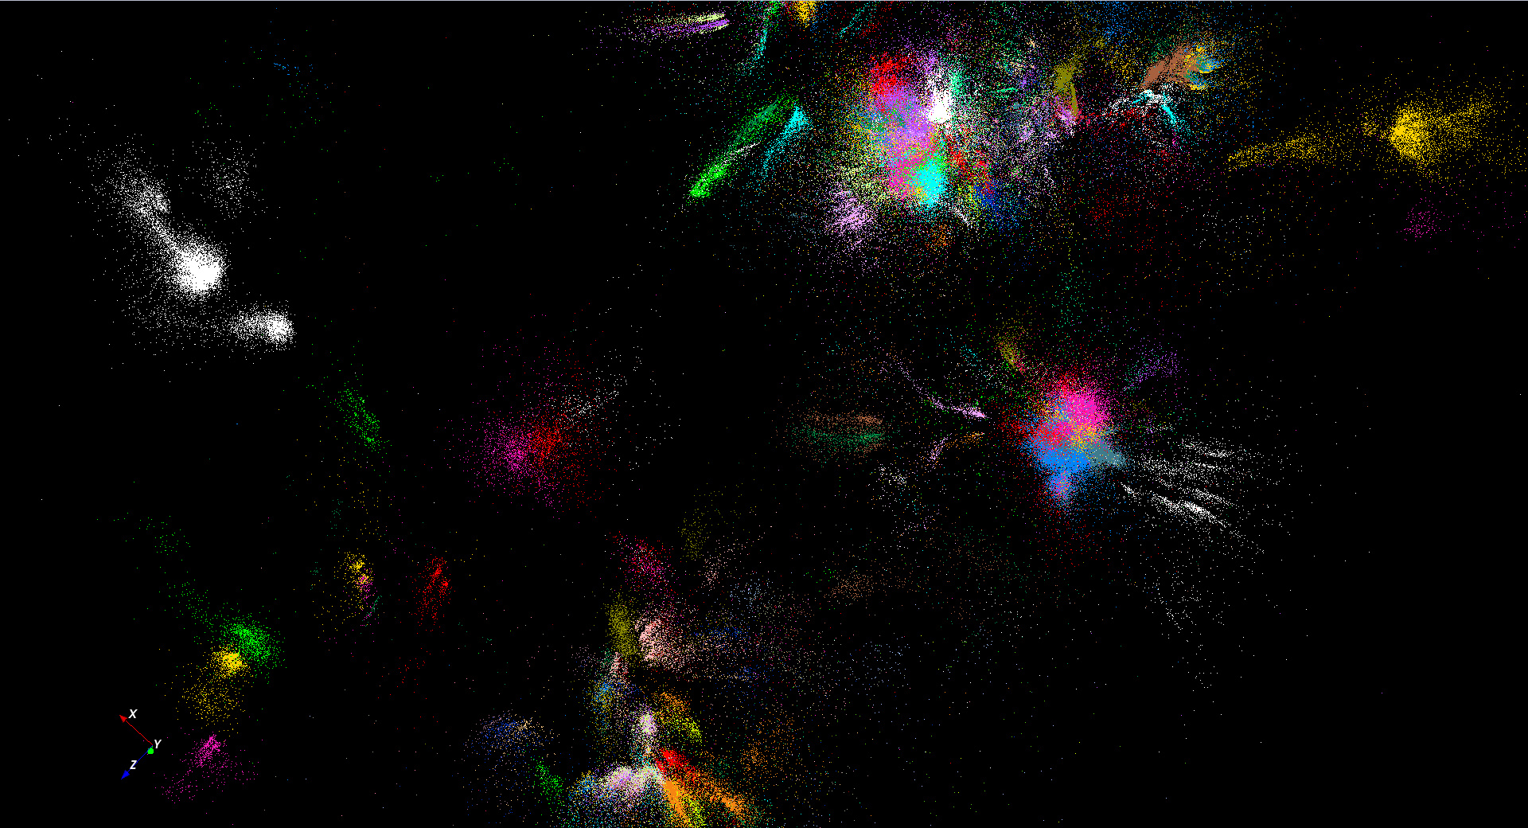
446K sequences
~100 clusters

Slide 25
Proteomics
No clear clusters

Slide 26

Protein Universe Browser for COG Sequences
with a few illustrative biologically identified clusters

Slide 27
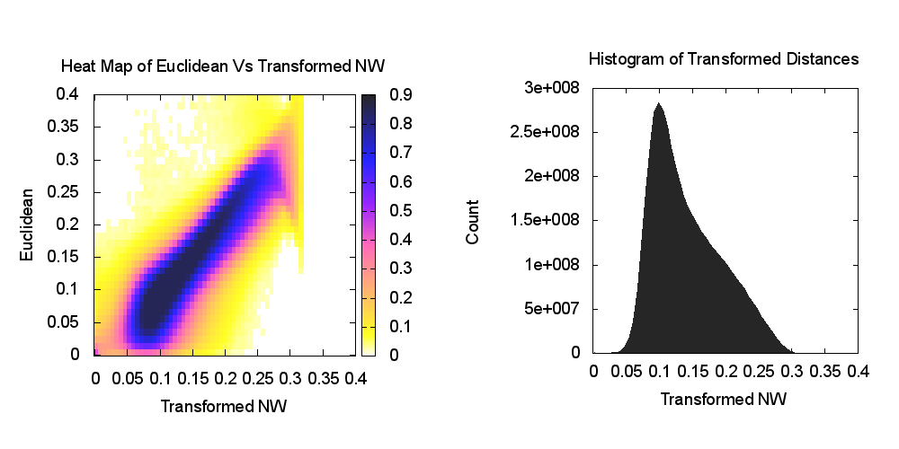
Heatmap of biology distance (Needleman-Wunsch) vs 3D Euclidean Distances
If d a distance, so is f(d) for any monotonic f. Optimize choice of f

Slide 28

https://spidal-gw.dsc.soic.indiana.edu/public/resultsets/668018718
Global Machine Learning for O(N²) Clustering and Dimension Reduction MDS to 3D for 170,000 Fungi sequences – Performance analysis follows
211 Clusters
MDS allows user (visual) control of clustering process

Slide 29
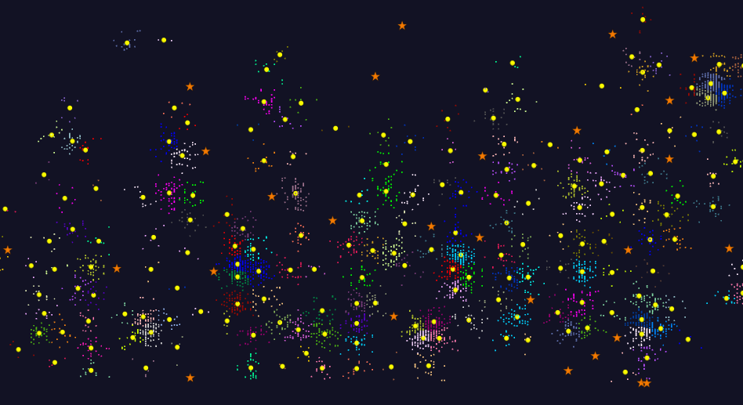
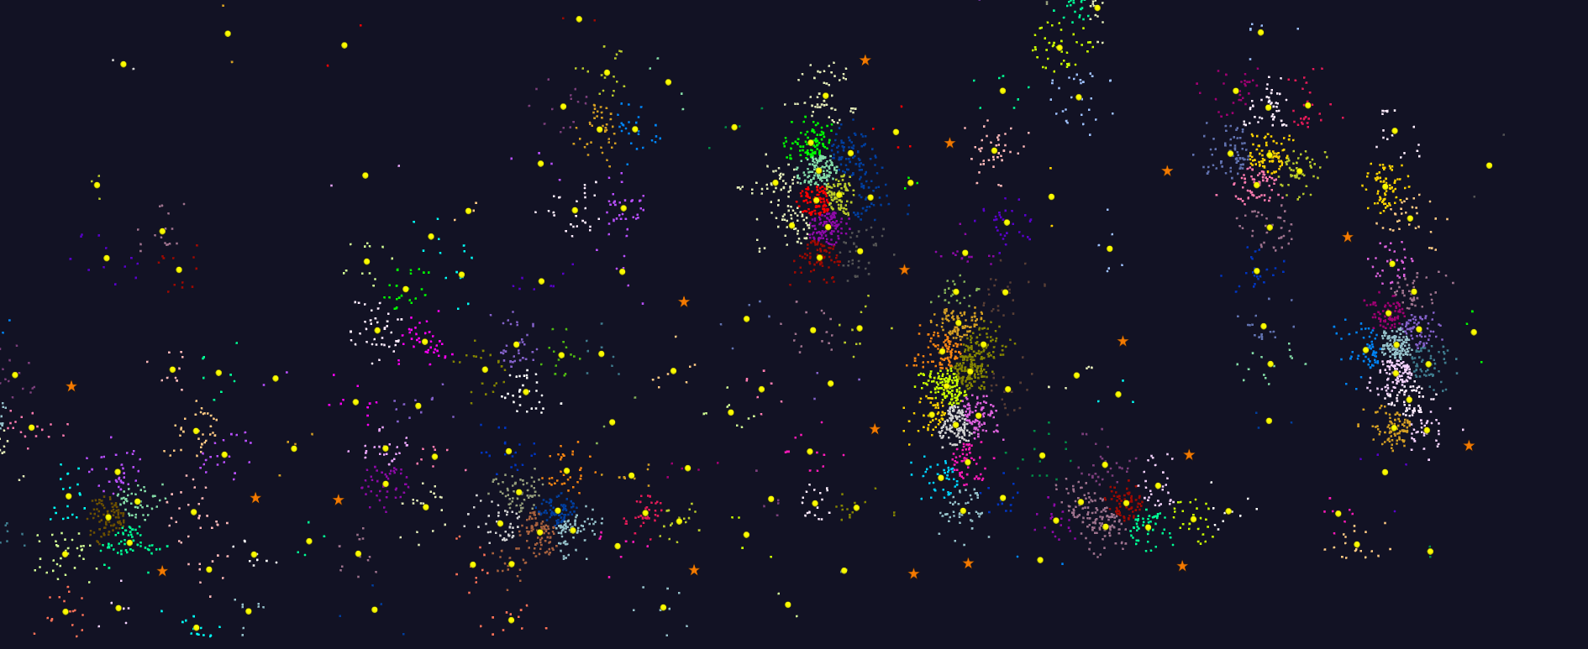
2D Vector Clustering with cutoff at 3 σ
Orange Star – outside all clusters; yellow circle cluster centers
LCMS Mass Spectrometer Peak Clustering. Charge 2 Sample with 10.9 million points and 420,000 clusters visualized in WebPlotViz

Slide 30
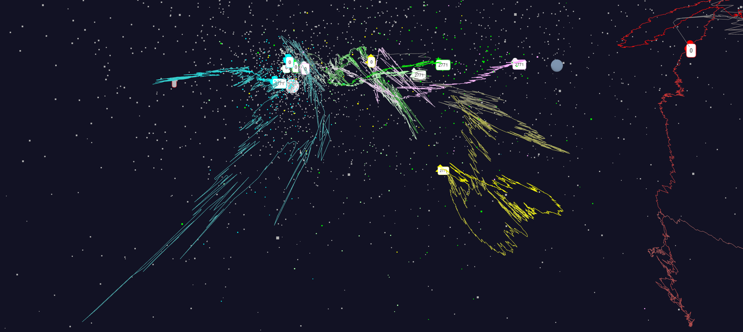
Relative Changes in Stock Values using one day values
S&P
Mid Cap
S&P
Mid Cap
Dow Jones
Dow Jones
+10%
Finance
Finance
Origin
0% change
Energy
Energy
8/17/2017
30

Slide 31
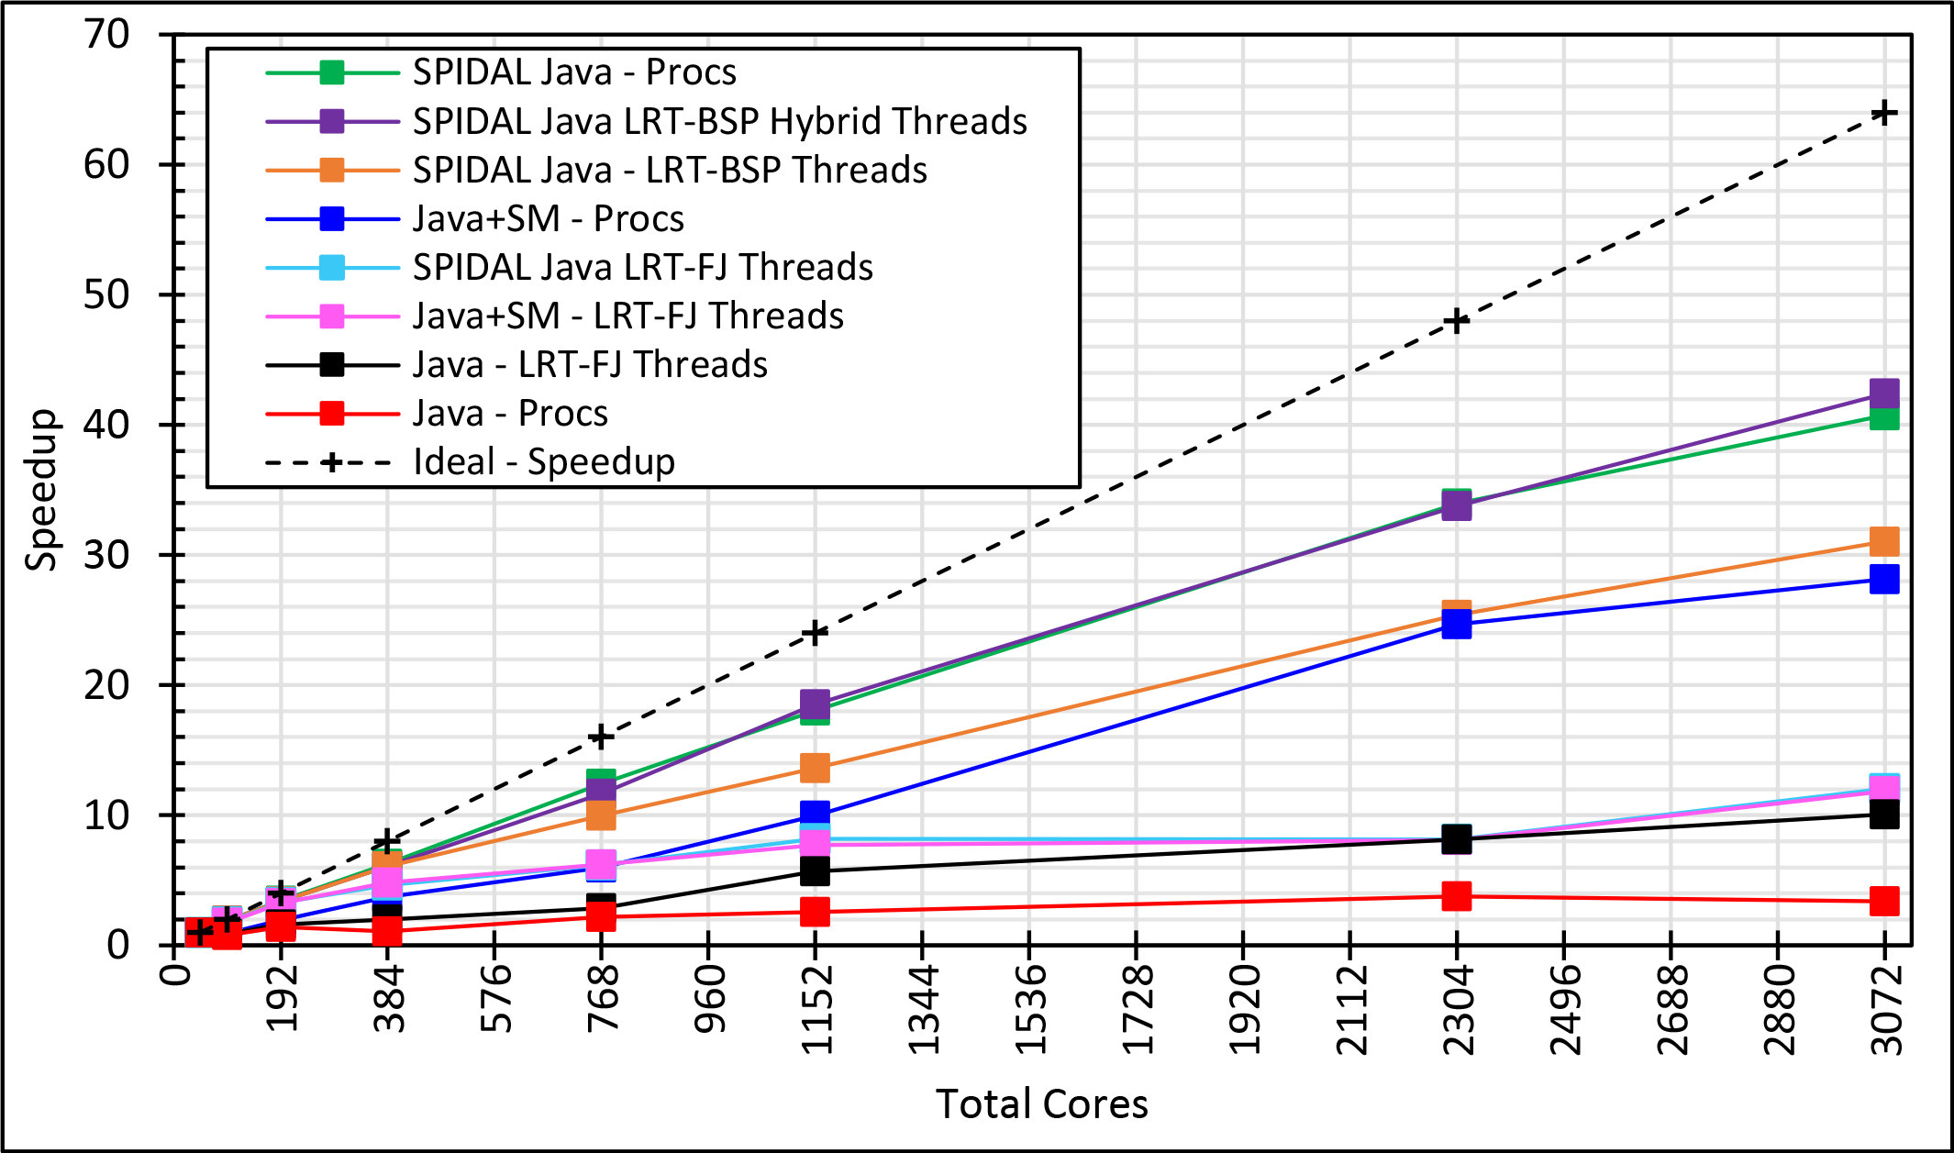
Java MPI performs better than FJ Threads
Speedup compared to 1 process per node on 48 nodes
BSP Threads are better than FJ and at best match Java MPI
128 24 core Haswell nodes on SPIDAL 200K DA-MDS Code
Best MPI; inter and intra node
MPI; inter/intra node; Java not optimized
Best FJ Threads intra node; MPI inter node

Slide 32
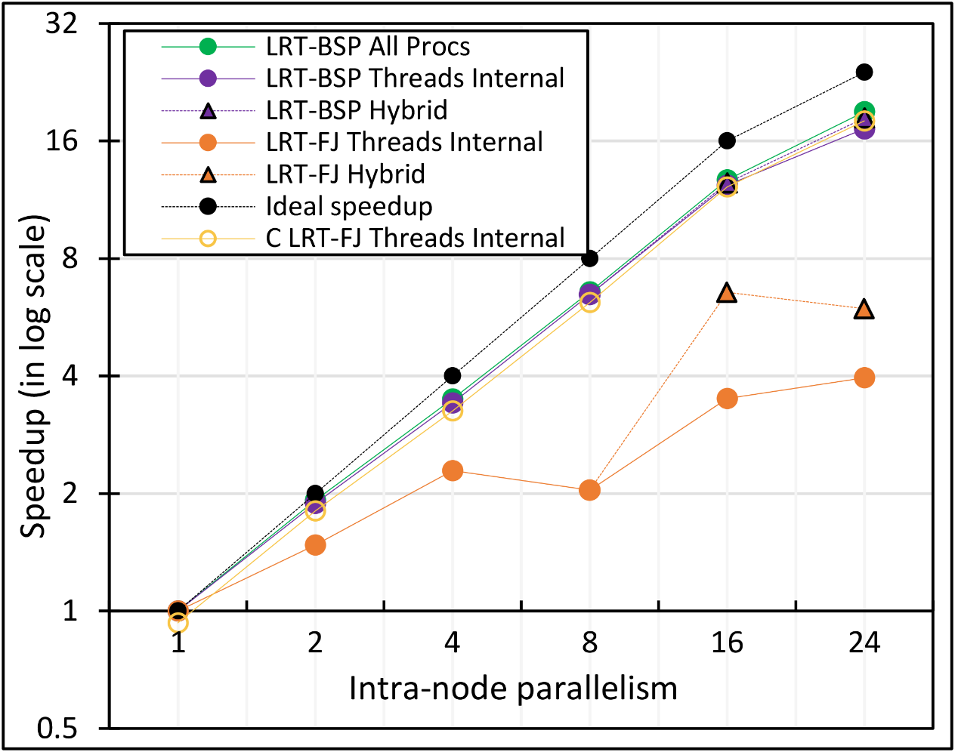
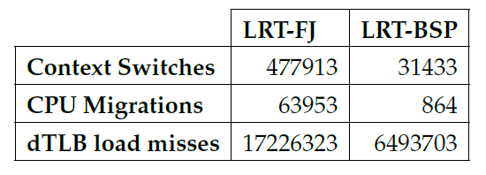
Performance Dependence on Number of Cores
All MPI internode
  All Processes
LRT BSP Java
  All Threads internal to node
  Hybrid – Use one process per chip
LRT Fork Join Java
  All Threads
  Hybrid – Use one process per chip
Fork Join C
All Threads
24-core node (16 nodes total)
15x
74x
2.6x

Slide 33
Java versus C Performance
C and Java Comparable with Java doing better on larger problem sizes
All data from one million point dataset with varying number of centers on 16 nodes 24 core Haswell

Slide 34
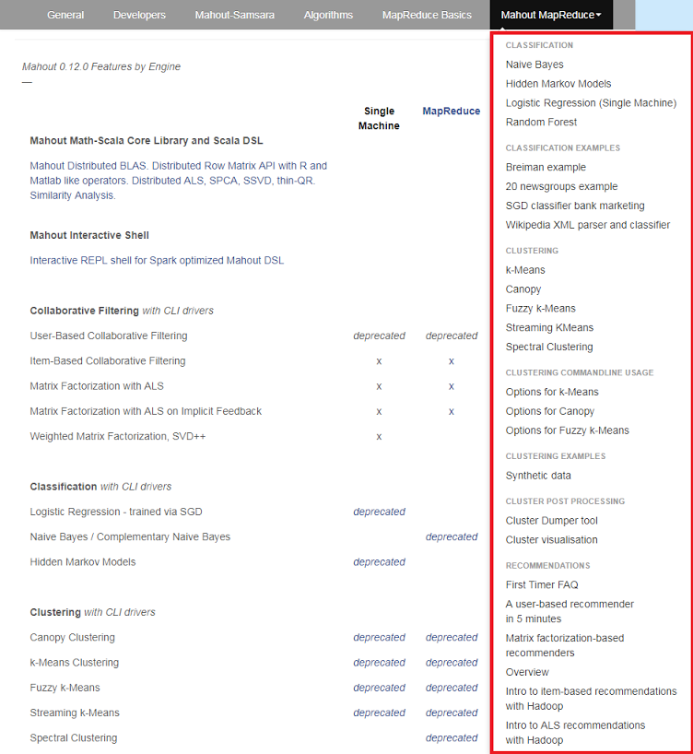
Mahout and SPIDAL
Mahout was Hadoop machine learning library but largely abandoned as Spark outperformed Hadoop
SPIDAL outperforms Spark Mllib and Flink due to better communication and in-place dataflow.
SPIDAL will also have community algorithms
  Biomolecular Simulation
  Graphs for Network Science
  Image processing for pathology and polar science

Slide 35
Implementing these ideas in detail

Slide 36
Components of Big Data Stack
Google likes to show a timeline; we can build on (Apache version of) this
2002 Google File System GFS ~HDFS
2004 MapReduce Apache Hadoop
2006 Big Table Apache Hbase
2008 Dremel Apache Drill
2009 Pregel Apache Giraph
2010 FlumeJava Apache Crunch
2010 Colossus better GFS
2012 Spanner horizontally scalable NewSQL database ~CockroachDB
2013 F1 horizontally scalable SQL database
2013 MillWheel ~Apache Storm, Twitter Heron (Google not first!)
2015 Cloud Dataflow Apache Beam with Spark or Flink (dataflow) engine
Functionalities not identified: Security, Data Transfer, Scheduling, DevOps, serverless computing (assume OpenWhisk will improve to handle robustly lots of large functions)

Slide 37
HPC-ABDS
Integrated wide range of HPC and Big Data technologies.
I gave up updating!

Slide 38
Why use Spark Hadoop Flink rather than HPC?
Yes if you value ease of programming over performance.
  This could be the case for most companies where they can find people who can program in Spark/Hadoop much more easily than people who can program in MPI.
  Most of the complications including data, communications are abstracted away to hide the parallelism so that average programmer can use Spark/Flink easily and doesn't need to manage state, deal with file systems etc.
  RDD data support very helpful
For large data problems involving heterogeneous data sources such as HDFS with unstructured data, databases such as HBase etc
Yes if one needs fault tolerance for our programs.
  Our 13-node Moe “big data” (Hadoop twitter analysis) cluster at IU faces such problems around once per month. One can always restart the job, but automatic fault tolerance is convenient.

Slide 39
Why use HPC and not Spark, Flink, Hadoop?
The performance of Spark, Flink, Hadoop on classic parallel data analytics is poor/dreadful whereas HPC (MPI) is good
One way to understand this is to note most Apache systems deliberately support a dataflow programming model
e.g. for Reduce, Apache will launch a bunch of tasks and eventually bring results back
  MPI runs a clever AllReduce interleaved “in-place” (dataflow) tree
Goal is to preserve Spark, Flink programming model but change implementation “under the hood” where optimization important.
Note explicit dataflow is efficient and preferred at coarse scale as used in workflow systems
  Need to change implementations for different problems

Slide 40
What do we need in runtime for distributed HPC FaaS
Finish examination of all the current tools
Handle Events
Handle State
Handle Scheduling and Invocation of Function
Define and build infrastructure for data-flow graph that needs to be analyzed including data access API for different applications
Handle data flow execution graph with internal event-driven model
Handle geographic distribution of Functions and Events
Design and build dataflow collective and P2P communication model (build on Harp)
Decide which streaming approach to adopt and integrate
Design and build in-memory dataset model for backup and exchange of data in data flow (fault tolerance)
Support DevOps and server-hidden cloud models
Support elasticity for FaaS (connected to server-hidden)
Green is initial (current) work

Slide 41
Communication Support
MPI Characteristics: Tightly synchronized applications
  Efficient communications (µs latency) with use of advanced hardware
  In place communications and computations (Process scope state)
Basic dataflow: Model a computation as a graph
  Nodes do computations with Task as computations and
  edges are asynchronous communications
  A computation is activated when its input data dependencies
  are satisfied
Streaming dataflow: with data partitioned into streams
  Streams are unbounded, ordered data tuples
  Order of events important and group data into time windows
Machine Learning dataflow: Iterative computations and keep track of state
  There is both Model and Data, but only communicate model
  Complex communication operations such as AllReduce
  Can use in-place MPI style communication
W
S
W
G
S
Dataflow
W

Slide 42
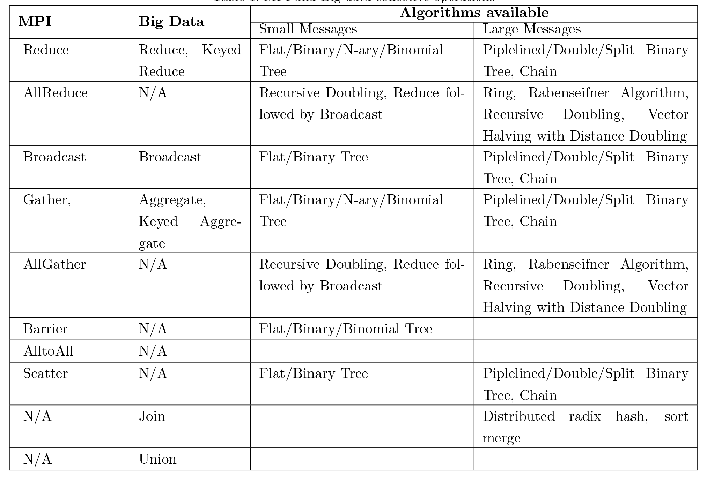
Communication Primitives
Need Collectives and Point to point
Real Dataflow and in-place
Big data systems do not implement optimized communications
It is interesting to see no Big data AllReduce implementations
  AllReduce has to be done with Reduce + Broadcast
Should consider RDMA

Slide 44
Dataflow Graph State and Scheduling
State is a key issue and handled differently in systems
  CORBA, AMT, MPI and Storm/Heron have long running tasks that preserve state
  Spark and Flink preserve datasets across dataflow node using in-memory databases
  All systems agree on coarse grain dataflow; only keep state in exchanged data.
Scheduling is one key area where dataflow systems differ
  Dynamic Scheduling
    Fine grain control of dataflow graph
    Graph cannot be optimized
  Static Scheduling
    Less control of the dataflow graph
    Graph can be optimized

Slide 45
Fault Tolerance
Similar form of check-pointing mechanism is used in HPC and Big Data
  MPI, Flink, Spark
  Flink and Spark do better than MPI due to use of database technologies; MPI is a bit harder due to richer state but there is an obvious integrated model using RDD type snapshots of MPI style jobs
Checkpoint after each stage of the dataflow graph
  Natural synchronization point
  Generally allows user to choose when to checkpoint (not every stage)
Executors (processes) don’t have external state, so can be considered as coarse grained operations

Slide 46
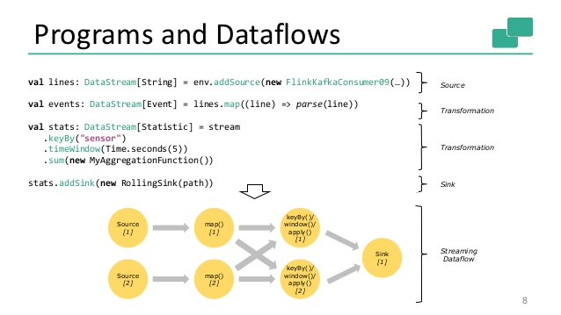
Spark Kmeans Flink Streaming Dataflow
P = loadPoints()
C = loadInitCenters()
for (int i = 0; i < 10; i++) {
T = P.map().withBroadcast(C)
C = T.reduce() }

Slide 47
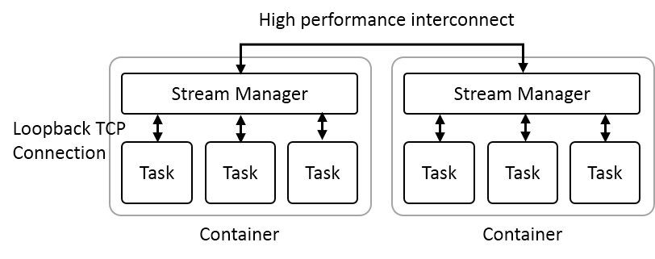
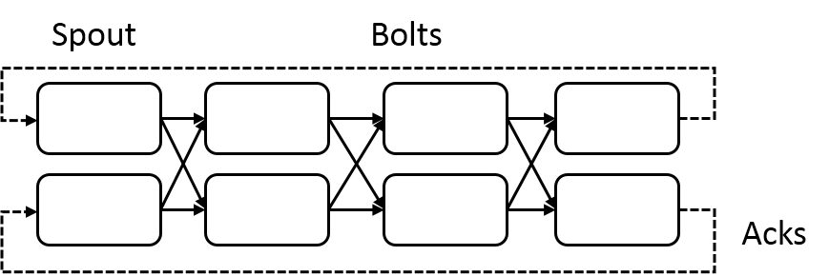
Heron Streaming Architecture
System Management
Add HPC
Infiniband
Omnipath
Inter node
Intranode
Typical Dataflow Processing Topology
User Specified Dataflow
All Tasks Long running
No context shared apart from dataflow
Parallelism 2; 4 stages

Slide 48
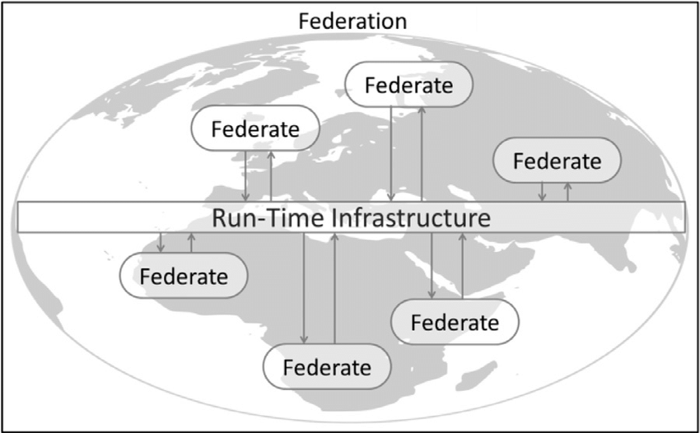
Naiad Timely Dataflow HLA Distributed Simulation

Slide 49
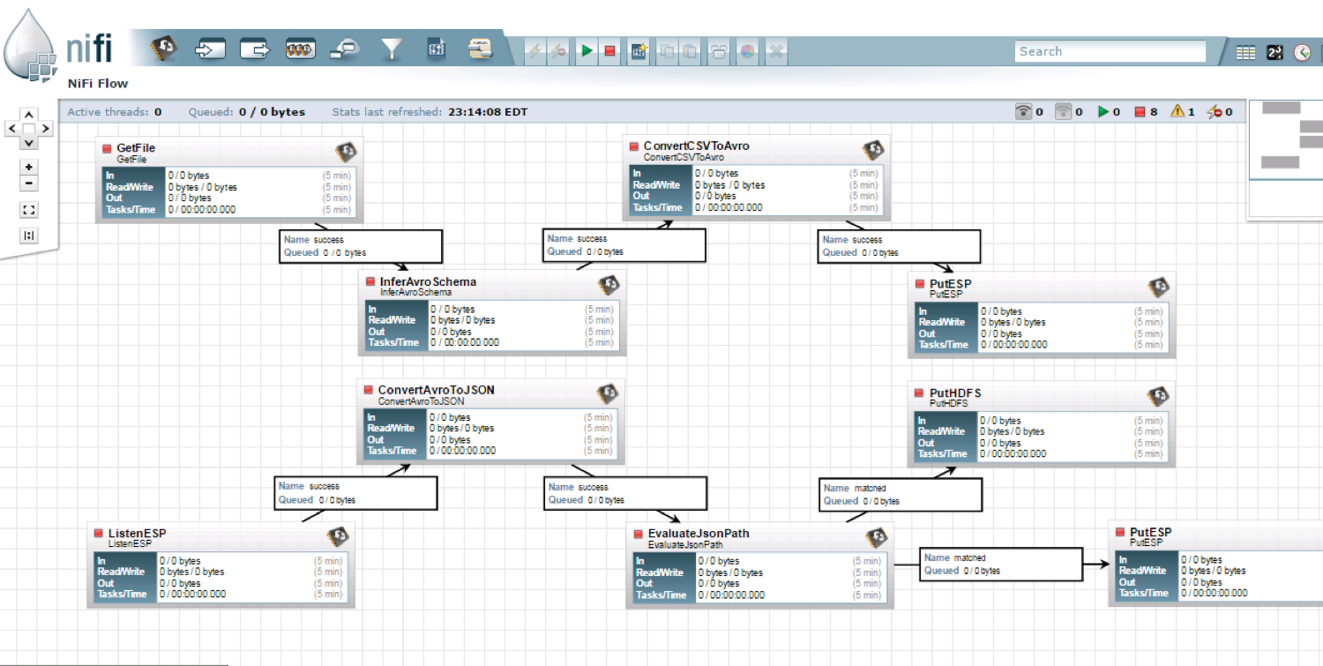
NiFi Workflow

Slide 50
Dataflow for a linear algebra kernel
Typical target of HPC AMT System
Danalis 2016

Slide 51
Machine Learning with MPI, Spark and Flink
Three algorithms implemented in three runtimes
  Multidimensional Scaling (MDS)
  Terasort
  K-Means
Implementation in Java
  MDS is the most complex algorithm - three nested parallel loops
  K-Means - one parallel loop
  Terasort - no iterations

Slide 52

HPC Runtime versus ABDS distributed Computing Model on Data Analytics
Hadoop writes to disk and is slowest; Spark and Flink spawn many processes and do not support AllReduce directly;
MPI does in-place combined reduce/broadcast and is fastest
Need Polymorphic Reduction capability choosing best implementation
Use HPC architecture with
  Mutable model
  Immutable data

Slide 53



Multidimensional Scaling
MDS execution time on 16 nodes with 20 processes in each node with varying number of points
MDS execution time with 32000 points on varying number of nodes. Each node runs 20 parallel tasks

Slide 54

Flink MDS Dataflow Graph

Slide 55
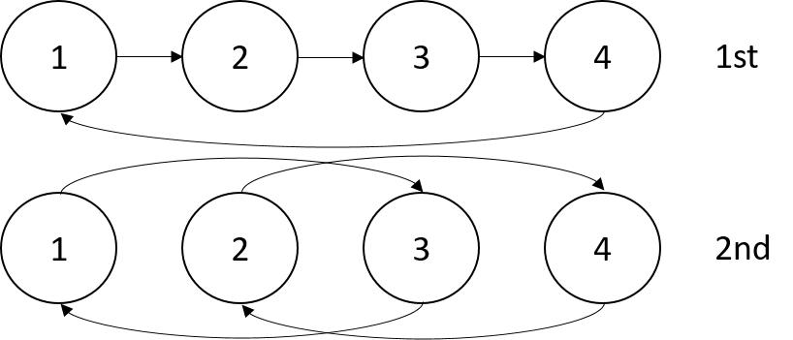


Terasort
Transfer data using MPI
Sorting 1TB of data records
Terasort execution time in 64 and 32 nodes. Only MPI shows the sorting time and communication time as other two frameworks doesn't provide a viable method to accurately measure them. Sorting time includes data save time. MPI-IB - MPI with Infiniband
Partition the data using a sample and regroup

Slide 56
K-Means
Point data set is partitioned and loaded to multiple map tasks
  Custom input format for loading the data as block of points
Full centroid data set is loaded at each map task
Iterate over the centroids
  Calculate the local point average at each map task
  Reduce (sum) the centroid averages to get a global centroids
  Broadcast the new centroids back to the map tasks
Data Set <Points>
Data Set <Initial Centroids>
Map (nearest centroid calculation)
Reduce (update centroids)
Data Set <Updated Centroids>
Broadcast

Slide 57
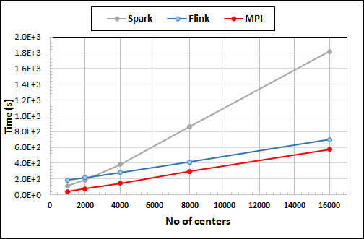
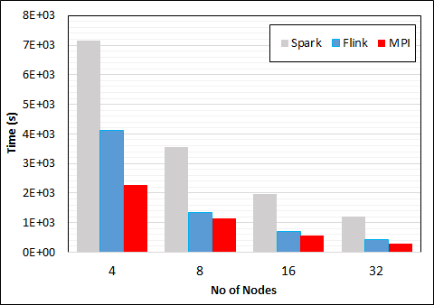
K-Means Clustering in Spark, Flink, MPI
Data Set <Points>
Dataflow for K-means
Data Set <Initial Centroids>
Map (nearest centroid calculation)
Reduce (update centroids)
Data Set <Updated Centroids>
Broadcast
K-Means execution time on 16 nodes with 20 parallel tasks in each node with 10 million points and varying number of centroids. Each point has 100 attributes.
K-Means execution time on varying number of nodes with 20 processes in each node with 10 million points and 16000 centroids. Each point has 100 attributes.
Notes:
Note the differences in communication architectures
Note times are in log scale
Bars indicate compute only times, which is similar across these frameworks
Overhead is dominated by communications in Flink and Spark

Slide 58
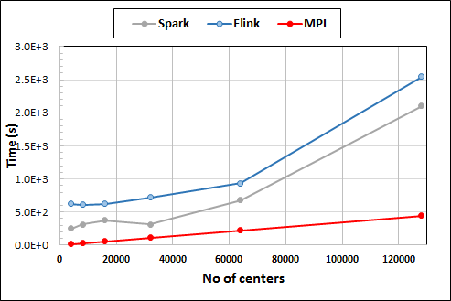
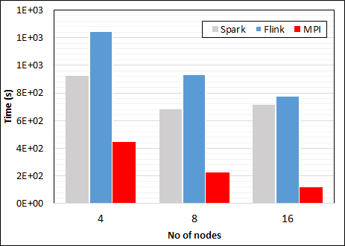
K-Means Clustering in Spark, Flink, MPI
K-Means execution time on 8 nodes with 20 processes in each node with 1 million points and varying number of centroids. Each point has 2 attributes.
K-Means execution time on varying number of nodes with 20 processes in each node with 1 million points and 64000 centroids. Each point has 2 attributes.
K-Means performed well on all three platforms when the computation time is high and communication time is low as illustrated in 10 million points and 10 iterations case. After lowering the computation and increasing the communication by setting the points to1 million and iterations to 100, the performance gap between MPI and the other two platforms increased.
Notes:
Note the differences in communication architectures
Note times are in log scale
Bars indicate compute only times, which is similar across these frameworks
Overhead is dominated by communications in Flink and Spark

Slide 59
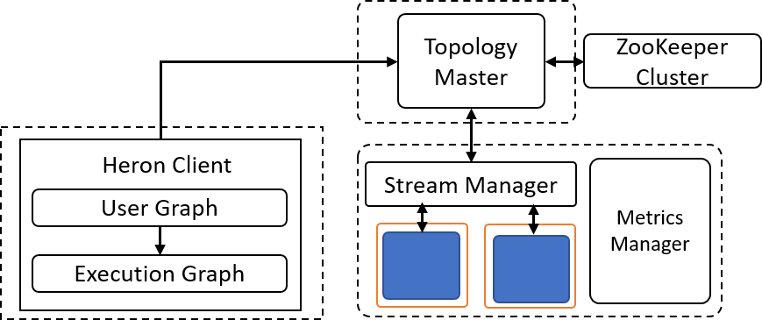
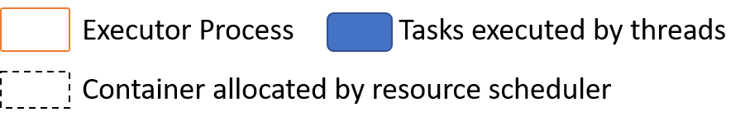
Heron Architecture
Each topology runs as a single standalone Job
Topology Master handles the Job
Can run on any resource scheduler (Mesos, Yarn, Slurm)
Each task run as a separate Java Process (Instance)
Stream manager acts as a network router/bridge between tasks in different containers
Every task in a container connects to a stream manager running in that container

Slide 60
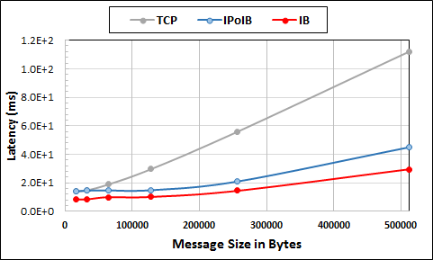
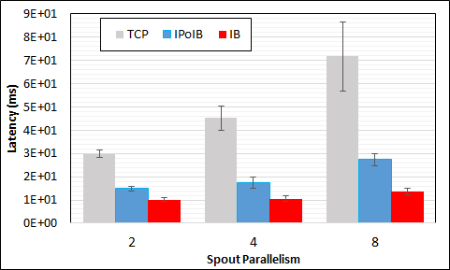
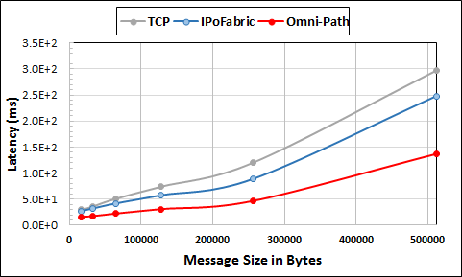
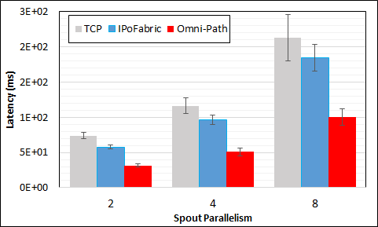
Heron High Performance Interconnects
Infiniband & Intel Omni-Path integrations
Using Libfabric as a library
Natively integrated to Heron through Stream Manager without needing to go through JNI

Slide 61
Summary of Twister2:
Next Generation HPC Cloud + Edge + Grid
We suggest an event driven computing model built around Cloud and HPC and spanning batch, streaming, batch and edge applications
  Highly parallel on cloud; possibly sequential at the edge
Expand current technology of FaaS (Function as a Service) and server-hidden computing
We have built a high performance data analysis library SPIDAL
We have integrated HPC into many Apache systems with HPC-ABDS
We have analyzed the different runtimes of Hadoop, Spark, Flink, Storm, Heron, Naiad, DARMA (HPC Asynchronous Many Task)
  There are different technologies for different circumstances but can be unified by high level abstractions such as communication collectives
  Need to be careful about treatment of state – more research needed

