Slide 1
Open Grid Computing Environments
Marlon Pierce, Suresh Marru, Gregor von Laszewski, Mary Thomas, Maytal Dahan, Gopi Kandaswamy, and Wenjun Wu

Slide 2
GPIR Gadgets
GPIR: GridPort Information Repository, stores dynamic and static resource information for Vos
Facebook
Mini TeraGrid system monitor and full size system monitor
Mini: http://apps.facebook.com/mini_tgsysmon/
Full Size: http://apps.facebook.com/tgsysmon/
Google
Mini System monitor for iGoogle page
To add visit:
http://www.google.com/ig/adde?moduleurl=http://iola.tacc.utexas.edu:22080/gpir-app/minigpir.xml&nocache=1&source=imag
Facebook, Gadget GPIR Clients

Slide 3
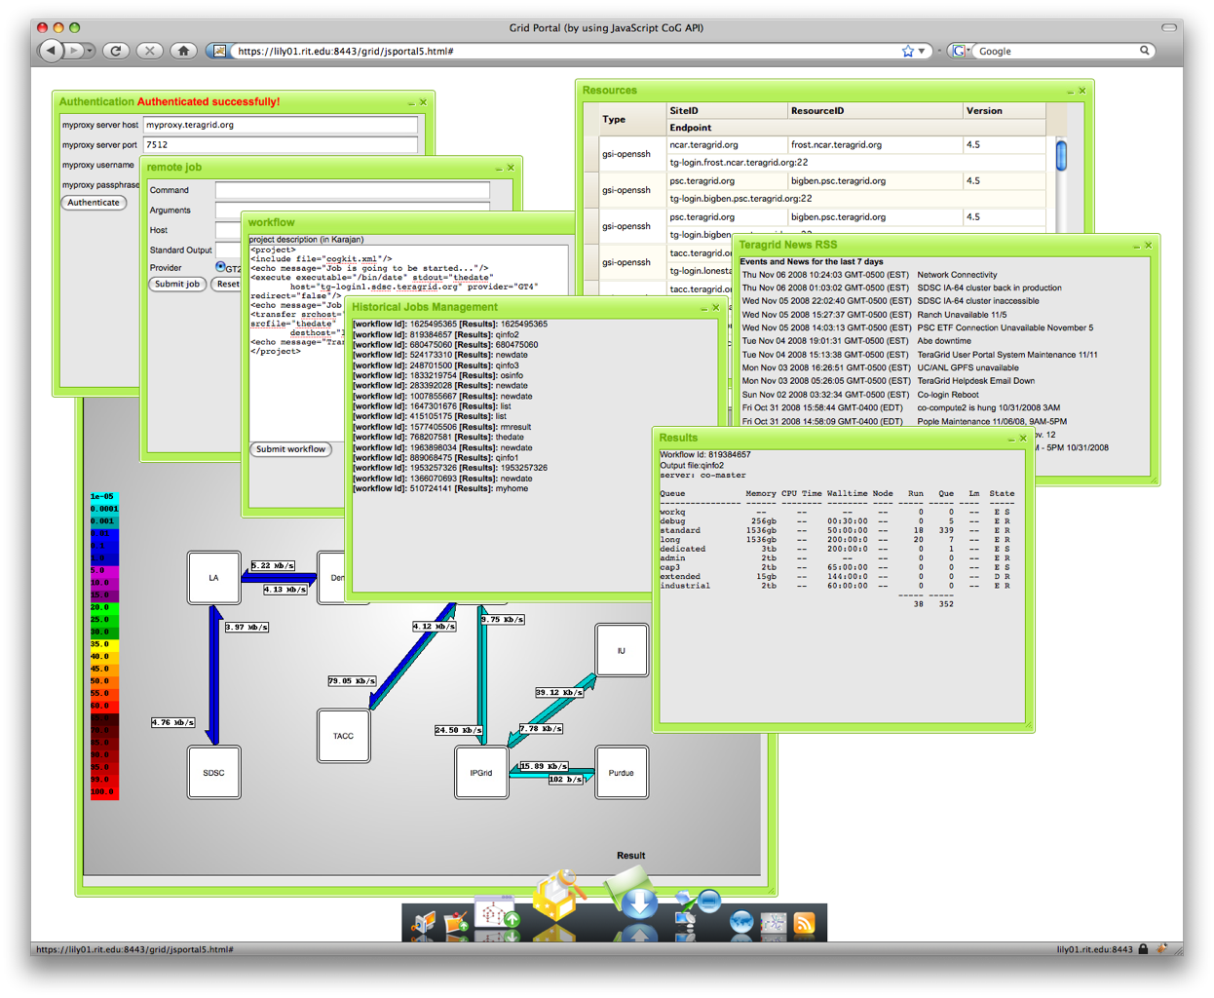
Cyberaide JavaScript Framework
A multi-tier SOA based framework to enable access through web interface.
A reusable JavaScript library provided.
A web 2.0 portal by using the JavaScript library provides functionalities to access cyberinfrastructure through a web browser.
For more information please visit http://grid.rit.edu/lab/doku.php/grid:javascript
System Architecture
Portal
Gregor von Laszewski*, Fugang Wang, Zhenhua Guo, Marlon Pierce
laszewski@gmail.com

Slide 4
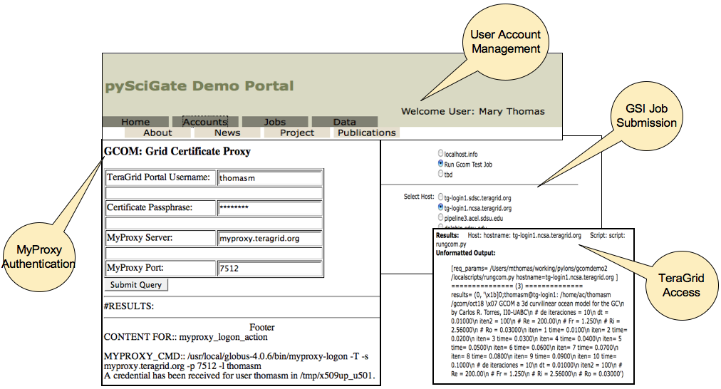
SDSU Python Gateway Project
Portal and Web Services based on Pylons Web Framework
WSGI (WS-Gateway Interface)
AJAX (asynchronous JavaScript and XML)
Use any Python tools/libraries
GSI: MyProxy, GT4, Globus Core Python Toolkit, pyWSRF pyGlobus, gsissh, etc.
Features:
dynamic hosting - codebase changes sensed and reloaded
URL routing to hide hosting details, “pretty URLS”
Paste deployment (like Mako) so easy to package and distribute
Uses templates for layout of HTML
Hosting of portals and web services in same system
Status:
Demo portal in operation with access to TeraGrid resources, job submission.
Successfully ported components to run GSI commands within Google Gadgets Google App Engine, and Facebook.
Applications: CyberCHEQS (NSF CI-TEAM), and General Coastal Ocean Model (GCOM).
Future Plans:
OGCE release of demo portal as PyGate Software download
incorporate data management/file browser, simple visualization.
Integrate Javascript COG
See http://acel.sdsu.edu

Slide 5
Open Life Sciences Gateway Bio-gadgets for iGoogle
ClustalW gadget
Job Submission History gadget
Blast gadget

Slide 6
Resource Prediction Service (RPS)
Predicts an optimal set of resources for running scientific applications
Predicts a set of resources on which the sum of data transfer time, queue wait time and compute time for the application will be minimum
Data transfer time: Uses input data size and NWS info
Queue wait time: Uses BQP info
Compute time: Uses application performance info
Axis2 web service with a MySQL backend
RPS is a subset of the Fault Tolerance and Recovery service used in LEAD and VGrADS

Slide 7
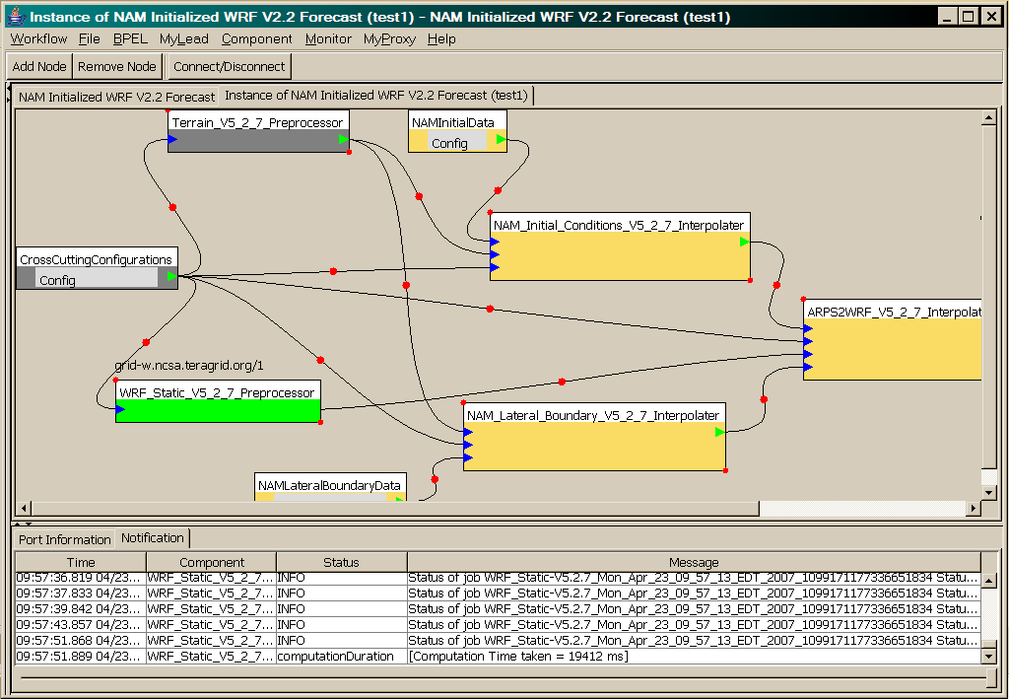
OGCE Workflow Tools
WRF-Static running on Tungsten

Slide 8
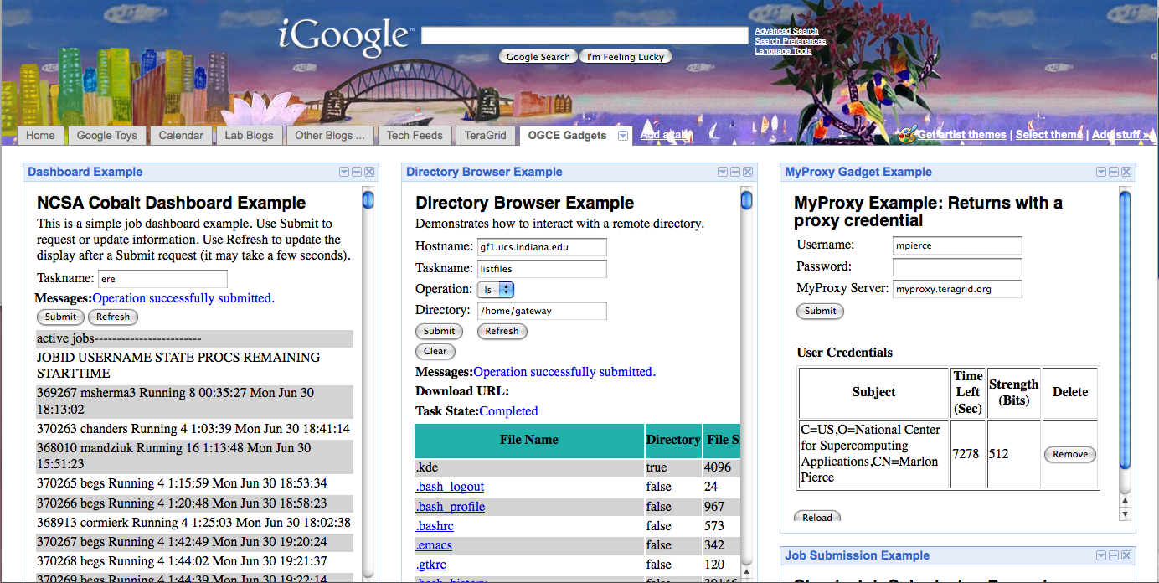
GTLAB Applications as Google Gadgets: MOAB dashboard, remote directory browser, and proxy management.

