Slide 1
HPC, Big Data, and Machine Learning Convergence
PDCAT Conference, Gold Coast, Australia Geoffrey Fox, December 7, 2019
Digital Science Center, Indiana University gcf@indiana.edu, http://www.dsc.soic.indiana.edu/, http://spidal.org/

Slide 2
Overall Architecture
Global AI and Modeling Supercomputer GAIMSC

Slide 3
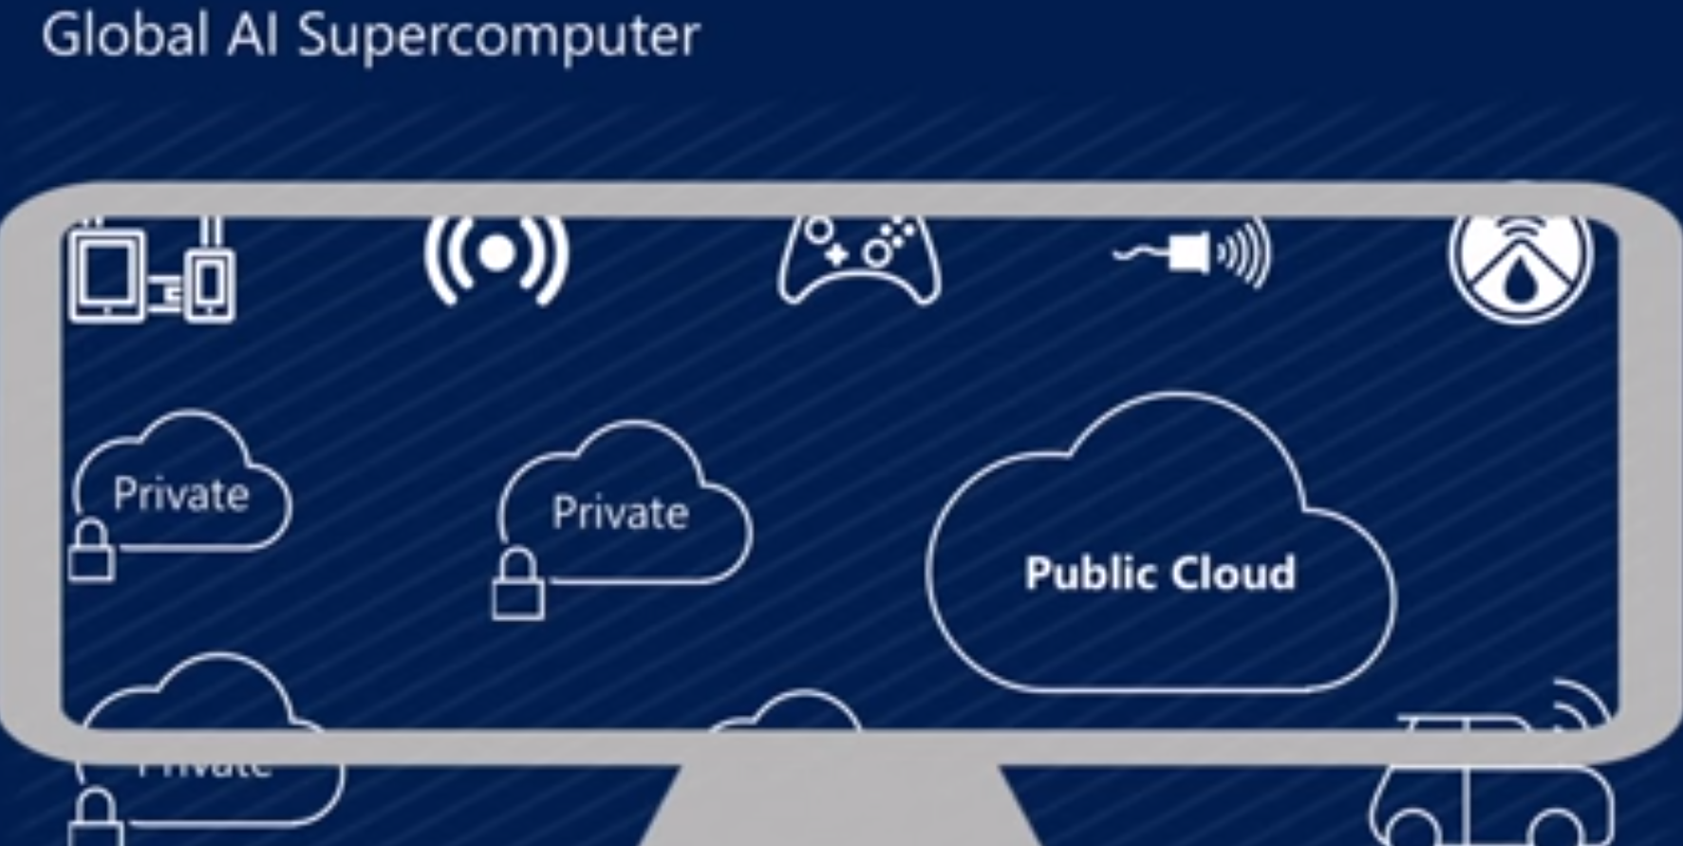
Microsoft Summer 2018: Global AI Supercomputer
By Donald Kossmann

Slide 4
Overall Global AI and Modeling Supercomputer GAIMSC Architecture
Global says we are all involved –
I added “Modeling” to get the Global AI and Modeling Supercomputer GAIMSC
There is only a cloud at the logical center but it’s physically distributed and domated by a few major players
Modeling includes classic simulation oriented supercomputers
Even in Big Data, one needs to build a model for the machine learning to use
GAIMSC will use classic HPC for data analytics which has similarities to big simulations (HPCforML)
GAIMSC must also support I/O centric data management with Hadoop, Spark, Flink etc.
Twister2 supports GAIMSC
Nature of I/O subsystem controversial for such HPC clouds
Lustre v. HDFS; importance of SSD and NVMe;
HPC Clouds would suggest that MPI runs well on Mesos and Kubernetes and with Java and Python

Slide 5
HPCforML in detail
HPCforML can be further subdivided
HPCrunsML: Using HPC to execute ML with high performance
SimulationTrainedML: Using HPC simulations to train ML algorithms, which are then used to understand experimental data or simulations.
Twister2 supports HPCrunsML by using high performance technology everywhere and this has been my major emphasis over last 5 years
HPC is a well understood technology to improve performance
ML develops many new innovative algorithms

Slide 6
Motivating Twister2
Initial Spark Flink MPI studies
HPCrunsML

Slide 7
Machine Learning with MPI, Spark and Flink
Three algorithms implemented in three runtimes
Multidimensional Scaling (MDS)
Terasort
K-Means (drop as no time and looked at later)
Implementation in Java
MDS is the most complex algorithm - three nested parallel loops
K-Means - one parallel loop
Terasort - no iterations (see later)
With care, Java performance ~ C performance
Without care, Java performance << C performance (details omitted)

Slide 8
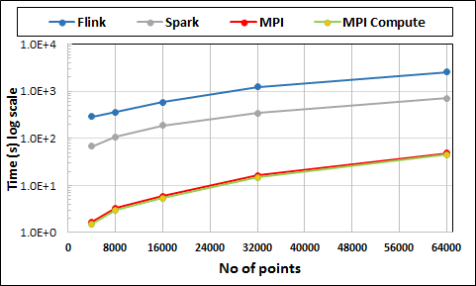
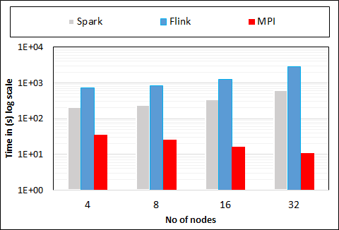
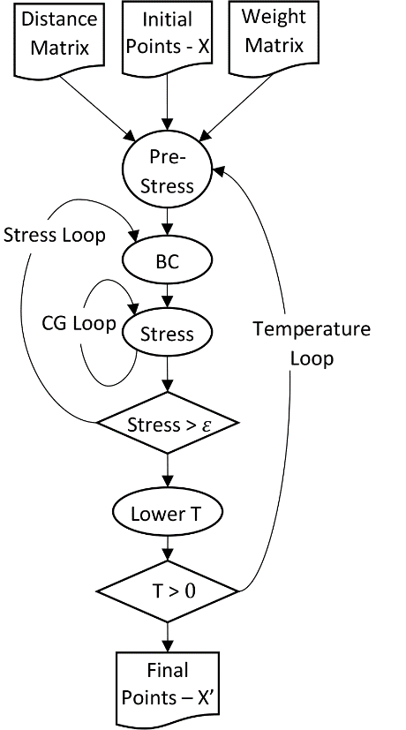
Multidimensional Scaling: 3 Nested Parallel Sections
Flink
Spark
MPI
MPI Factor of 20-200 Faster than Spark/Flink
MDS execution time with 32000 points on varying number of nodes. Each node runs 20 parallel tasks
Spark, Flink No Speedup
MDS execution time on 16 nodes with 20 processes in each node with varying number of points
Flink especially loses touch with relationship of computing and data location

Slide 9
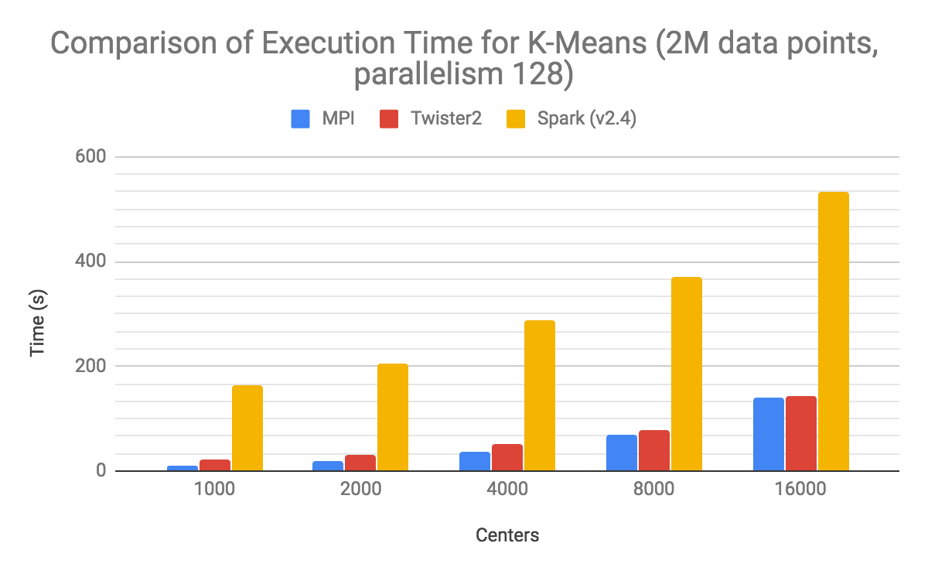

Slide 10
Programming Environment for Global AI and Modeling Supercomputer GAIMSC
2
Uses HPCforML(HPC for Big Data) and supports MLforHPC

Slide 11
Ways of adding High Performance to Global AI (and Modeling) Supercomputer
Fix performance issues in Spark, Heron, Hadoop, Flink etc.
Messy as some features of these big data systems intrinsically slow in some (not all) cases
All these systems are “monolithic” and difficult to deal with individual components
Execute HPBDC High Performance Big Data Computing from classic big data system with custom communication environment – approach of Harp for the relatively simple Hadoop environment
Provide a native Mesos/Yarn/Kubernetes/HDFS high performance execution environment with all capabilities of Spark, Hadoop and Heron – goal of Twister2
Execute with MPI in classic (Slurm, Lustre) HPC environment
In all cases, assume deep learning obtained from Tensorflow, PyTorch and/or MXNET

Slide 12
Twister2 Highlights I
“Big Data Programming Environment” such as Hadoop, Spark, Flink, Storm, Heron but uses HPC wherever appropriate and outperforms Apache systems – often by large factors
Runs preferably under Kubernetes (Mesos) Nomad but Slurm supported
Highlight is high performance dataflow supporting iteration, fine-grain, coarse grain, dynamic, synchronized, asynchronous, batch and streaming
Three distinct communication environments
DFW Dataflow with distinct source and target tasks; data not message level; Data-level Communications spilling to disks as needed
BSP for parallel programming; MPI is default. Inappropriate for dataflow
Storm API for streaming events with pub-sub such as Kafka
Rich state model (API) for objects supporting in-place, distributed, cached, RDD (Spark) style persistence with Tsets (see Pcollections in Beam, Datasets in Flink, Streamlets in Storm, Heron)

Slide 13
Twister2 Highlights II
Can be a pure batch engine
Not built on top of a streaming engine
Can be a pure streaming engine supporting Storm/Heron API
Not built on on top of a batch engine
Fault tolerance as in Spark or MPI today; dataflow nodes define natural synchronization points
Many API’s: Data, Communication, Task
High level hiding communication and decomposition (as in Spark) and low level (as in MPI)
DFW supports MPI and MapReduce primitives: (All)Reduce, Broadcast, (All)Gather, Partition, Join with and without keys
Component based architecture -- it is a toolkit
Defines the important layers of a distributed processing engine
Implements these layers cleanly aiming at high performance data analytics

Slide 14
Twister2 Highlights III
Key features of Twister2 are associated with its dataflow model
Fast and functional inter-node linkage; distributed from edge to cloud or in-place between identical source and target tasks
Streaming or Batch nodes (Storm persisent or Spark emphemeral model)
Supports both Orchestration (as in Pegasus, Kepler, NiFi) or high performance streaming flow (as in Naiad) model
Tset Twister2 datasets like RDD define a full object state model supported across links of dataflow

Slide 15
Comparison of Twister2 Task System Vs Big Data Systems
Big Data Platforms | Task Graph |  | Scheduling Types |  | Scheduling Job Types |  |  |  | Dataflow Programming Model | Task Executor
 | Static | Dynamic | Static | Dynamic | Batch | Streaming | MPI | FaaS/ Microservices |  | Streaming | Batch
Spark | Yes | Yes |  | Yes | Yes | Yes | Add-on |  | Yes | Yes | Yes
Flink | Yes |  | Yes |  | Yes | Yes |  |  | Yes | Yes | Yes
Heron | Yes |  | Yes |  |  | Yes |  |  | Yes | Yes
Storm | Yes |  | Yes |  |  | Yes |  |  | Yes | Yes
Hadoop MapReduce |  |  | Yes |  | Yes |  |  |  |  |  | Yes
Twister2 | Yes | Yes | Yes | Yes | Yes | Yes | Yes | No (Future Work) | Yes | Yes | Yes

Slide 16
TSets, RDDs and Streamlets
Similar abstractions with small differences
Twister2 Tset | Spark RDD | Heron Streamlet
Higher Level API | Lowest Level API | Heron has a Task Abstraction. So not the lowest.
Clear separation of data and operations | Data and operation separation not clear | Data and operations are not clearly separated
Streaming and Batch natively | Batch and Mini-Batch streaming | Only Streaming
More basic operations such as AllReduce and AllGather | More user focused operations
Clearly defined component of Twister2 | Capability intertwined with complete system. Hard to disentangle

Slide 17
Twister2 Logistics
Open Source - Apache Licence Version 2.0
Github - https://github.com/DSC-SPIDAL/twister2
Documentation - https://twister2.org/ with tutorial
Developer Group - twister2@googlegroups.com – India(1) Sri Lanka(9) and Turkey(2)
Started in the 4th Quarter of 2017; reversing previous philosophy which was to modify Hadoop, Spark, Heron;
Bootstrapped using Heron code but that code now changed
About 100000 Lines of Code (plus 50,000 for SPIDAL+Harp HPCforML)
Languages - Primarily Java with some Python

Slide 18
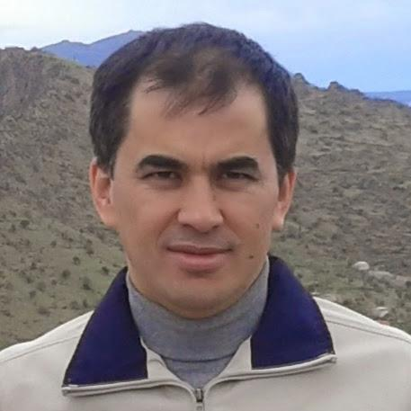
Twister2 Team

Slide 19
GAIMSC Programming Environment Components I
Area | Component | Implementation | Comments: User API
Architecture Specification | Coordination Points | State and Configuration Management; Program, Data and Message Level | Change execution mode; save and reset state
 | Execution Semantics | Mapping of Resources to Bolts/Maps in Containers, Processes, Threads | Different systems make different choices - why?
 | Parallel Computing | Spark Flink Hadoop Pregel MPI modes | Owner Computes Rule
Job Submission | (Dynamic/Static) Resource Allocation | Plugins for Slurm, Yarn, Mesos, Marathon, Aurora | Client API (e.g. Python) for Job Management
Task System | Task migration | Monitoring of tasks and migrating tasks for better resource utilization | Task-based programming with Dynamic or Static Graph API; FaaS API; Support accelerators (CUDA,FPGA, KNL)
 | Elasticity | OpenWhisk
 | Streaming and FaaS Events | Heron, OpenWhisk, Kafka/RabbitMQ
 | Task Execution | Process, Threads, Queues
 | Task Scheduling | Dynamic Scheduling, Static Scheduling, Pluggable Scheduling Algorithms
 | Task Graph | Static Graph, Dynamic Graph Generation

Slide 20
GAIMSC Programming Environment Components II
Area | Component | Implementation | Comments
Communication API | Messages | Heron | This is user level and could map to multiple communication systems
 | Dataflow Communication | Fine-Grain Twister2 Dataflow communications: MPI,TCP and RMA Coarse grain Dataflow from NiFi, Kepler? | Streaming, ETL data pipelines; Define new Dataflow communication API and library
 | BSP Communication Map-Collective | Conventional MPI, Harp | MPI Point to Point and Collective API
Data Access | Static (Batch) Data | File Systems, NoSQL, SQL | Data API
 | Streaming Data | Message Brokers, Spouts
Data Management | Tset Distributed Data Set | Relaxed Distributed Shared Memory(immutable data), Mutable Distributed Data | Data Transformation API; Spark RDD, Heron Streamlet
Fault Tolerance | Check Pointing | Upstream (streaming) backup; Lightweight; Coordination Points; Spark/Flink, MPI and Heron models | Streaming and batch cases distinct; Crosses all components
Security | Execution, Storage, Messaging, | Research needed | Crosses all Components

Slide 21
Runtime Components
Atomic Job Submission
Connected or External DataFlow
Orchestration API
Streaming, Batch and ML Applications
Python API
SQL API
Java APIs
Scala APIs
Language APIs
Runtime
TSet
Tset API
Task Graph System
Task API
BSP Operations
Internal (fine grain) DataFlow Operations
Resource API
Mesos
Kubernetes
Standalone
Slurm
HDFS
NoSQL
Message Brokers
Local
Data Access APIs
Future Features

Slide 22
Twister2 APIs I
Operator Level APIs
APIs built on top of Task Graph
Java API
Python API
Java API
Java API
Java API
TSet
SQL
DataFlow Operations
BSP Operations
Task Graph
Task Graph
Task Graph
Worker
Worker
DataFlow Operations
DataFlow Operations
DataFlow Operations
Worker
Worker
Worker
Low level APIs with the most flexibility. Harder to program
Higher Level APIs based on Task Graph
Future
APIs are built combining different components of the System

Slide 23
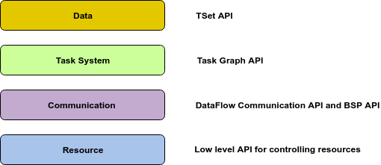
Twister2 APIs II

Slide 24
Components of System relevant to Fault Tolerance
Cluster resource managers (ex: Mesos/ Kubernetes) provide fault-tolerance. They provide failure detection and restarting.
Shared file systems (ex: NFS, HDFS) provide persistent storage with highly availability.
Key-value storing services (ex: ZooKeeper/ etcd) are fault-tolerant and highly available. They provide persistent data storage.
Twister2 Client described later
Twister2 Job Master
Twister2 Workers
Twister2 Dashboard
Twister2 ZooKeeper Service
MPI. We only discuss Twister2 running under Kubernetes; we need to add Fault Tolerant OpenMPI for usage under Slurm

Slide 25
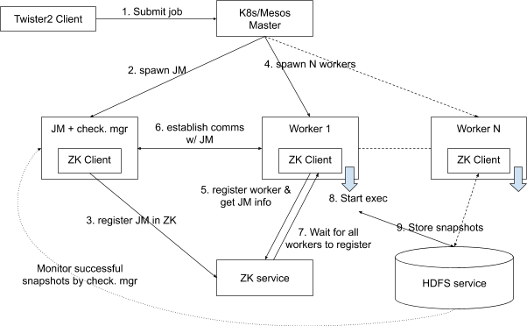
Fault Tolerance in Twister2
Twister2 uses Zookeeper (ZK)
JM is Job Master

Slide 26
Twister2 Client
Twister2 Client is used to submit jobs. It communicates with cluster resource managers (K8s/Mesos/Nomad) to allocate resources.
If N nodes are requested for the job, N+1 nodes will be allocated (extra node for Job Master)
Twister2 Client uploads the job package to workers/web server/distributed storage.
Twister2 Client finishes execution after it complete job submission. No I/O from client to the workers during job execution.
In Kubernetes, submitting client may upload the job package directly to workers/job master. In that case, it needs to be running during job execution to upload the job package in case of a restart of workers/job master.

Slide 27
Twister2 Workers and Dashboard
Workers:
Register with Job master.
Register with the membership service. Get the list of other workers in the job and the job master.
Get the job package from Twister2 Client/webserver/distributed storage.
Execute IWorker after all workers initialized. Membership service will be used for this.
Upon completion, let the membership service know that it has completed.
Twister2 Dashboard displays data about twister2 jobs. It will be fed real-time status data by the job master.

Slide 28
Twister2 Job Master
Job Master performs following activities:
Provides membership service to workers in non-fault tolerant jobs. Lets workers to discover each other, sends worker lists.
Monitoring worker status changes. Workers push their status changes to job master.
Runs IDriver - mainly for connected dataflow jobs; scaling up/down workers.
Handles IDriver to worker communications.
Runs Checkpoint manager.
Cleans up job resources after the job completes.
Acts as a bridge between workers and Dashboard.

Slide 29
Twister Fault Tolerance II
Tset provides user-controlled snapshots of system state
Batch: nodes where you are
Streaming all nodes as active throughout graph
ZooKeeper: ZooKeeper is a key-value store. We developed a membership service based on ZooKeeper. It provides:
Registering workers and the job master. Informing all entities about it.
Detecting failed entities and informing all workers and the job master.
Keeping latest status of workers and the job master. Getting status changes from workers and the job master.
Keeping initial states of workers, discovering initial state of a worker when it starts.
ZooKeeper detects failed workers and the job master.
In a fault-tolerant job, ZooKeeper informs all live entities and recovers failed entities

Slide 30
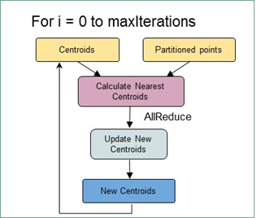
Some Choices in Dataflow Systems
NiFi
Classic coarse-grain workflow
Computations (maps) happen at nodes
Generalized Communication happens on links
Direct, Keyed, Collective (broadcast, reduce), Join
In coarse-grain workflow, communication can be by disk
In fine-grain dataflow (as in K-means), communication needs to be fast
Caching and/or use in-place tasks
In-place not natural for streaming as persistent nodes/tasks
K-means in Spark, Flink, Twister2

Slide 31
Execution as a Graph for Data Analytics
The graph created by the user API can be executed using an event model
The events flow through the edges of the graph as messages
The compute units are executed upon arrival of events
Supports Function as a Service
Execution state can be checkpointed automatically with natural synchronization at node boundaries
T
T
Task Schedule
Events flow through edges
Graph
Execution Graph (Plan)
R

Slide 32
as a service
Continually interacting in the Intelligent Aether with
Software model supported by Twister2
(Omni)

Slide 33
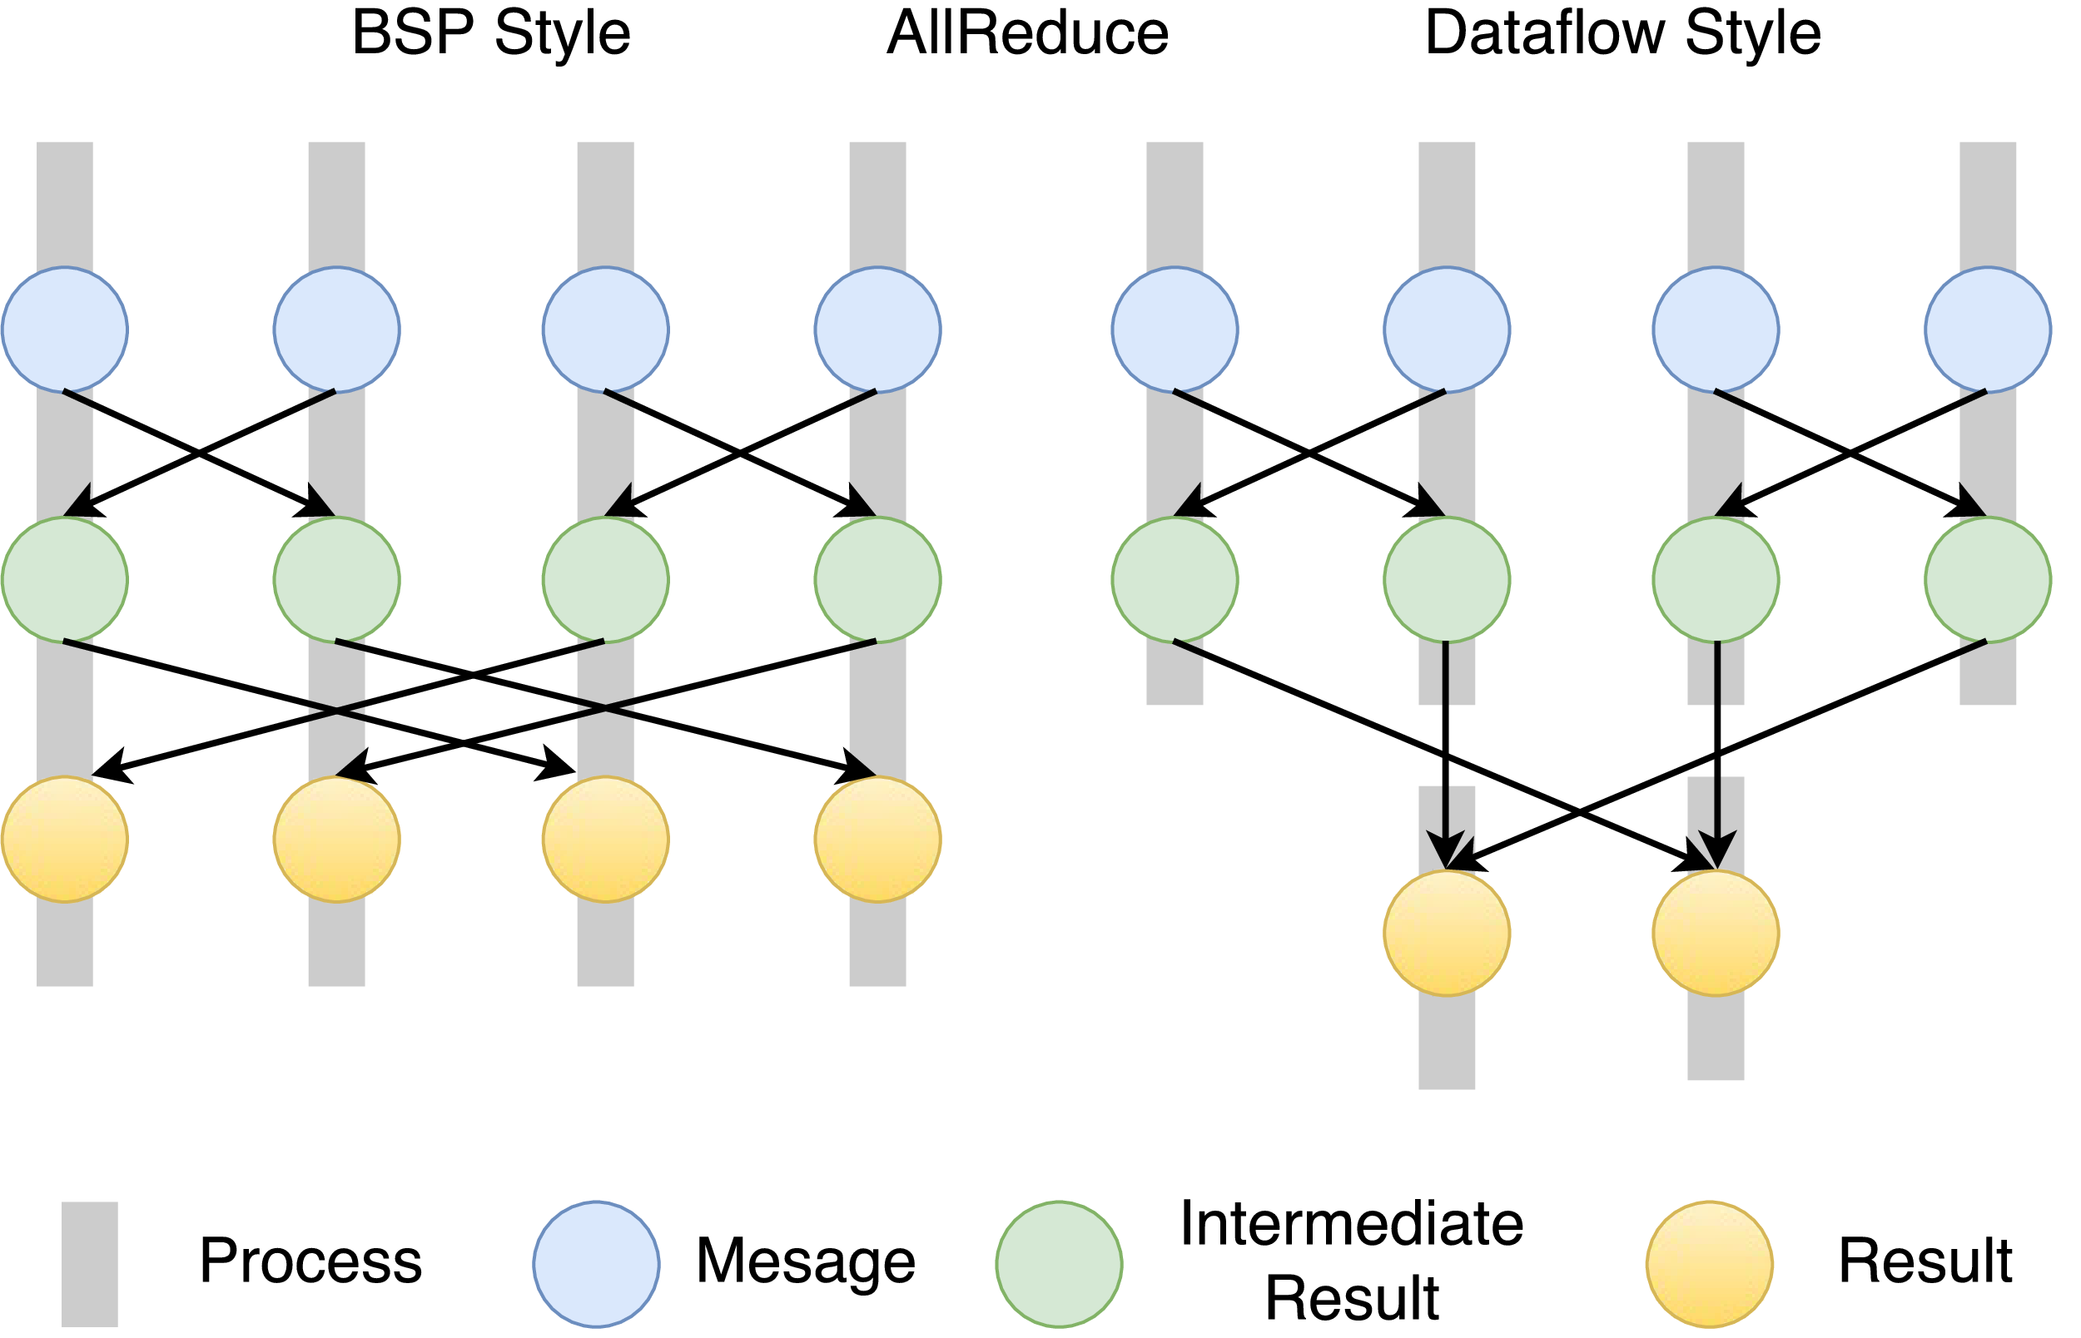
Twister2 Dataflow Communications
Twister:Net offers two communication models
BSP (Bulk Synchronous Processing) message-level communication using TCP or MPI separated from its task management plus extra Harp collectives
DFW a new Dataflow library built using MPI software but at data movement not message level
Non-blocking
Dynamic data sizes
Streaming model
Batch case is represented as a finite stream
The communications are between a set of tasks in an arbitrary task graph
Key based communications: all the MapReduce movement functions
Data-level Communications spilling to disks
Target tasks can be different from source tasks
BSP and DFW for Reduce Operation

Slide 34
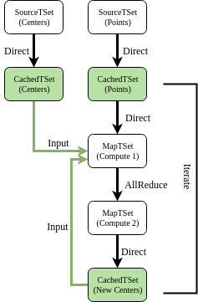
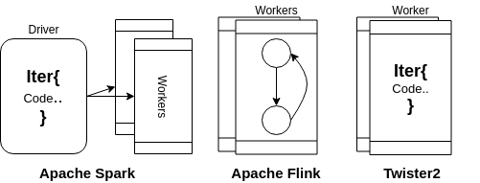
Structure of Iterations and Dataflow nodes in Spark, Flink and Twister2
K-Means TSet API dataflow graph

Slide 35
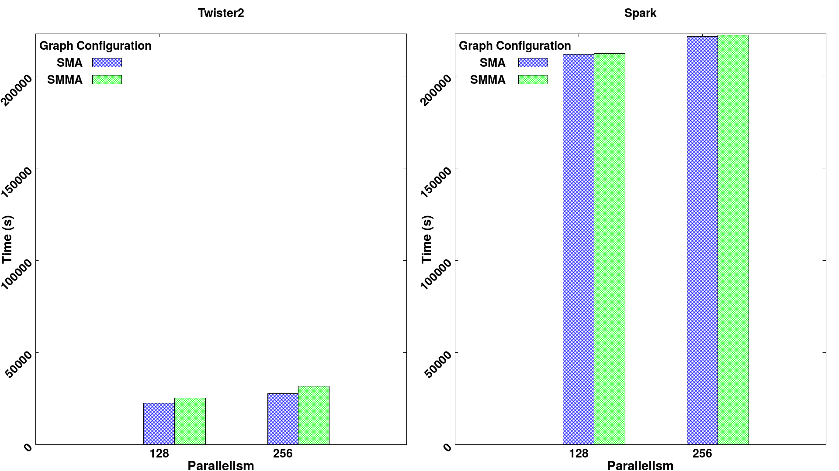
Effect of processing an extra dataflow node
Twister2 spawns a new context by “direct” dataflow node1 to node 2 which could be edge to cloud Spark always compiles 2 nodes into one. Twister2 doesn’t do this but Twister2’s transfer communication is very fast

Slide 36
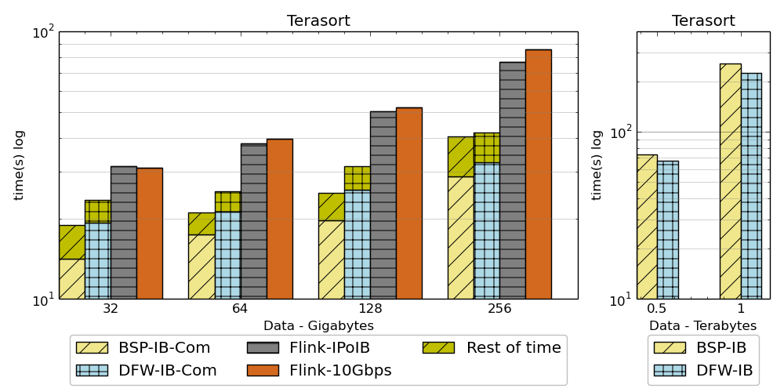
Results on Terasort
Twister2 performance against Apache Flink and MPI for Terasort.
Notation : DFW refers to Twister2 BSP refers to MPI (OpenMPI)

Slide 37
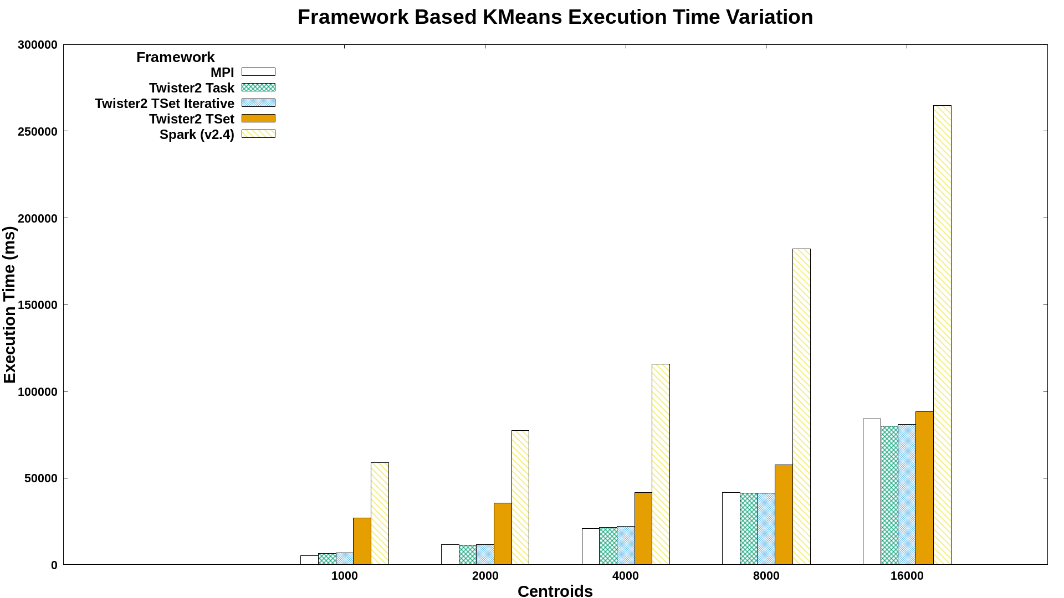
Batch Benchmark - Kmeans
K-Means job execution time on 16 nodes with varying centers, 2 million data points with 128-way parallelism for 100 iterations
Notes:
TSet iterative refers to the option in which the iterative execution mode is used, which removes the need to build the execution graph for each iteration.

Slide 38
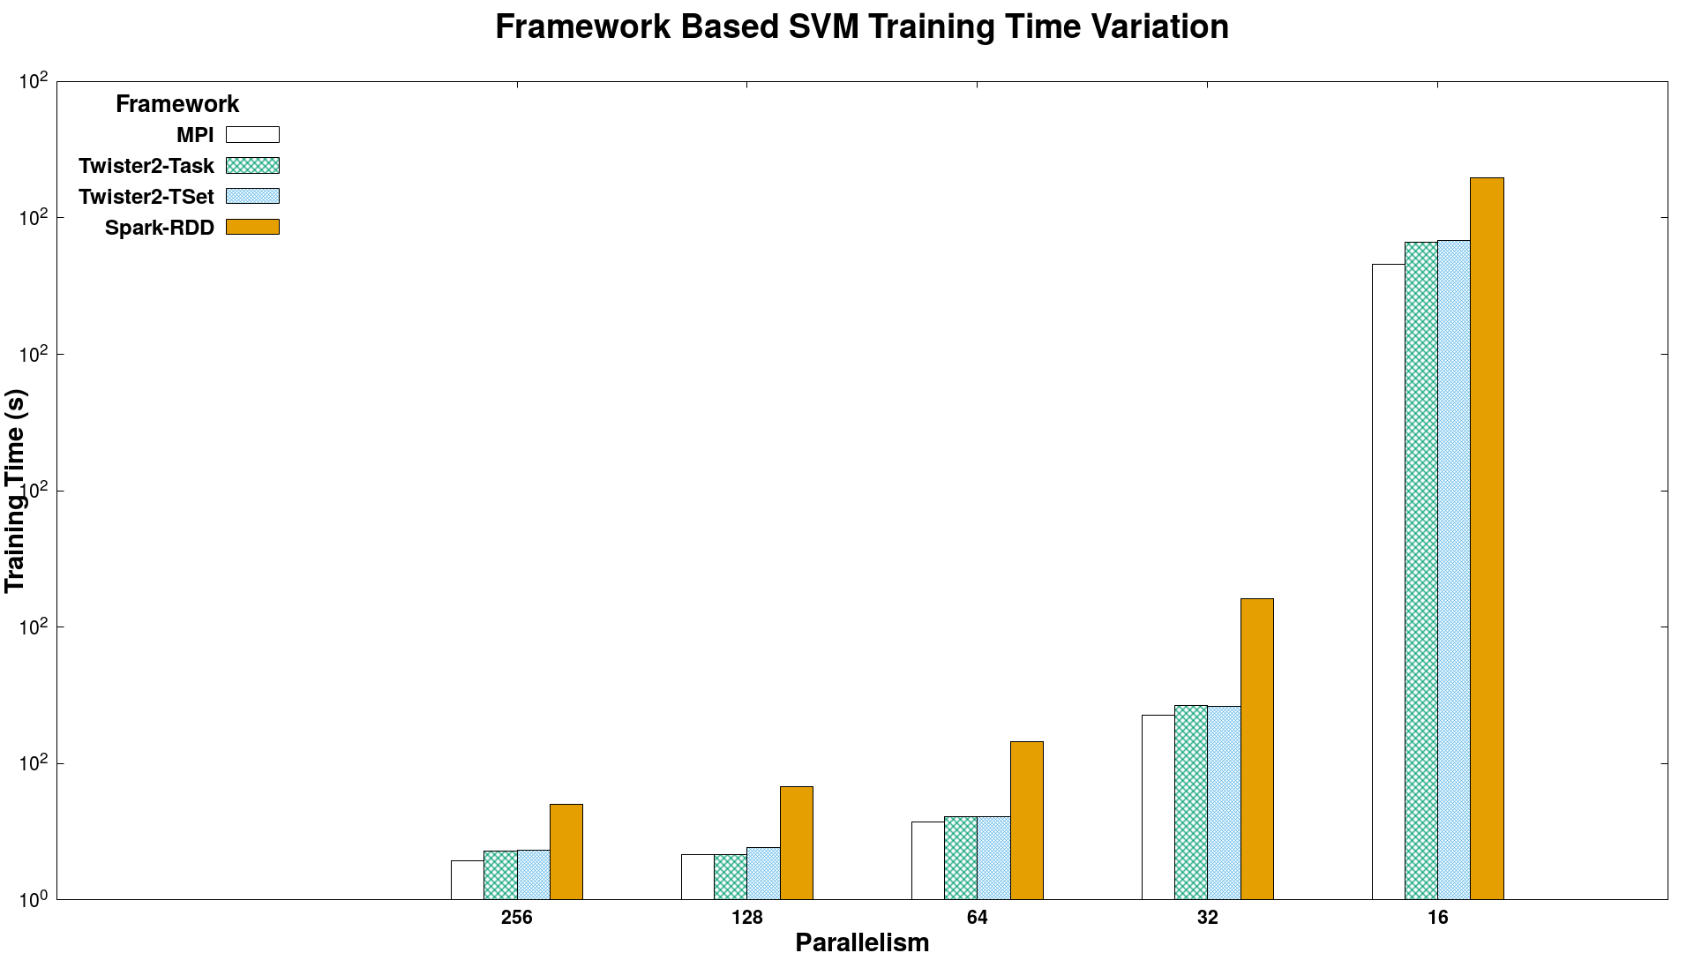
Batch Benchmark - SVM
Times
Spark RDD > Twister2 Tset > Twister2 Task > MPI
SVM job execution time for 320K data points with 2000 features and 500 iterations, on 16 nodes with varying parallelism

Slide 39
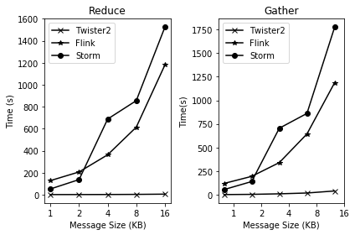
Streaming Benchmark
Test being conducted with 8 nodes, 16 cores per node. Each core runs a task of each framework and produces 20,000 records with 1KB, 2KB, 4KB, 8KB, 16 KB messages.
Warm up of 10,000 messages per each framework.
Spark doesn’t work for this case

Slide 40
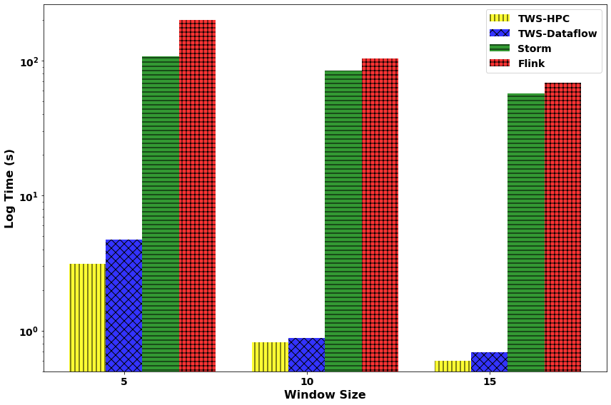
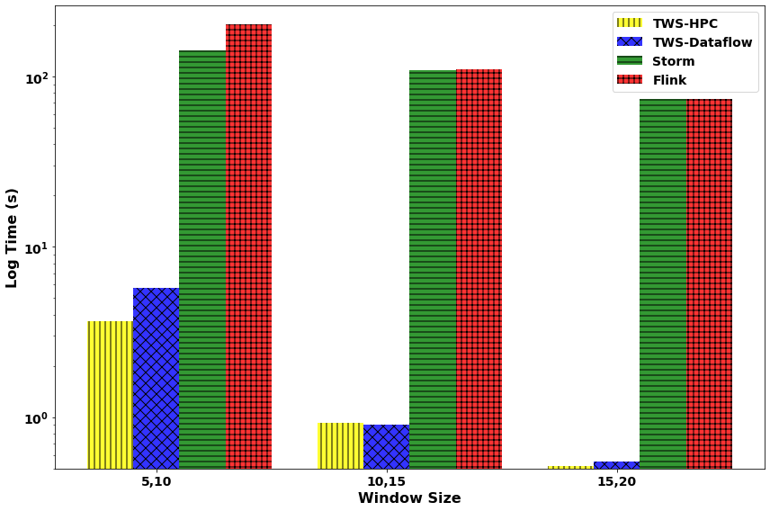
Streaming Machine Learning with Tumbling Window
Streaming KMeans
Streaming SVM
KMeans: 49,000 data points with 23 features streamed. Model accuracy tested once a windowed computation is done. Testing data set size is 91,000 samples (1000 clusters). (non-iterative)
SVM: 49,000 data points with 22 features streamed. Model accuracy tested once a windowed computation is done. Testing data set size is 91,000 samples. 5 Iterations per window.

Slide 41
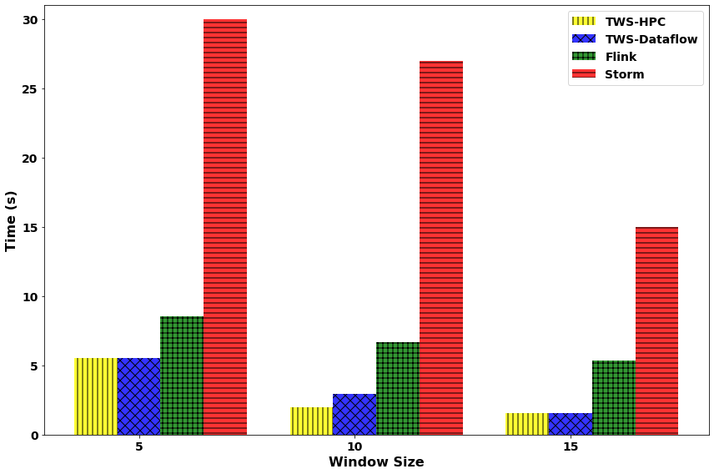
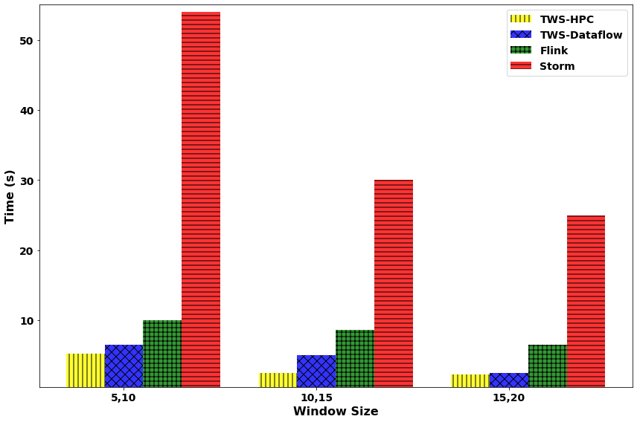
Streaming Machine Learning with Sliding Window
Streaming KMeans
Streaming SVM
KMeans: 49,000 data points with 23 features streamed. Model accuracy tested once a windowed computation is done. Testing data set size is 91,000 samples (1000 clusters). (non iterative)
SVM: 49,000 data points with 22 features streamed. Model accuracy tested once a windowed computation is done. Testing data set size is 91,000 samples. 5 Iterations per window.

Slide 42
Conclusions
Twister2 ready to go
Big Data Systems
Parallel Computing
MLforHPC

Slide 43
Twister2 Status
100,000 lines of new open source Code: mainly Java but significant Python
Github https://github.com/DSC-SPIDAL/twister2
Documentation https://twister2.org/
Operational with documentation and examples
December 2019 release 0.4.0: Fault tolerance, Apache BEAM Linkage, UCX unified communication Python API https://github.com/DSC-SPIDAL/twister2/releases
Near term: TensorFlow/PyTorch Integration, Certify Beam compliance, SQL interface using Apache Calcite
Medium term: Apache Arrow (cross language) Integration, MPI Fault tolerance integration (OpenMPI ULFT) for Slurm
Ongoing: C++ version of modules to improve performance

Slide 44
Summary of Big Data Systems
HPC/Computation and Machine Learning Link becoming clearer
HPCforML focus being extended to MLforHPC
Designing, building and using the Global AI and Modeling Supercomputer
Cloudmesh build interoperable Cloud systems (von Laszewski)
Harp is parallel high performance machine learning (Qiu)
Twister2 can offer the major Spark Hadoop Heron capabilities with clean high performance
Implements dataflow model for MLforHPC
Tset high performance RDD
DFW is distributed (dataflow) communication with data not message interface
Apache Beam Integration and Python API

