Slide 1
Childhood Obesity Studies with Multicore Robust Data Mining
Proposal Review Meeting with CTSI Translating Research Into Practice Project Development Team,
July 8, 2009, IUPUI
Gil Liu, Judy Qiu, Craig Stewart
Contact xqiu@indiana.edu www.infomall.org/salsa
Research Technology, UITS
Community Grids Laboratory, PTI
Children’s Health Service
Indiana University

Slide 2
Obesogenic Environment
Environmental factors that increase caloric intake and decrease energy expenditure “…so manifold and so basic as to be inseparable from the way we live.”
Margaret Talbot (New America Foundation)
“The current U.S. environment is characterized by an essentially unlimited supply of convenient, inexpensive, palatable, energy-dense foods coupled with a lifestyle requiring negligible amounts of physical activity for subsistence.”
Hill & Peters 2001
“Genes load the gun, and environment pulls the trigger.”
        G Bray 1998

Slide 3
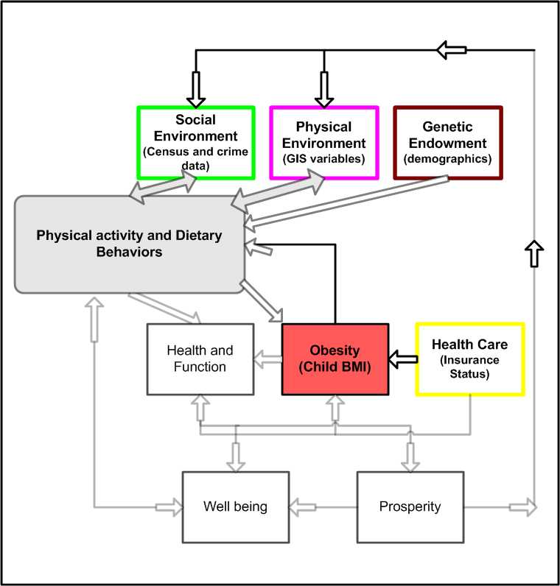

Slide 4
Distribution of Visits by Year and Frequency
Year # of visits
2004 43005
2005 45271
2006 45300
2007 54707
# of Visits
Per patient Percent
1 only 44%
2 or more 46%
3 or more 22%
4 or more 11%
5 or more 6%

Slide 5
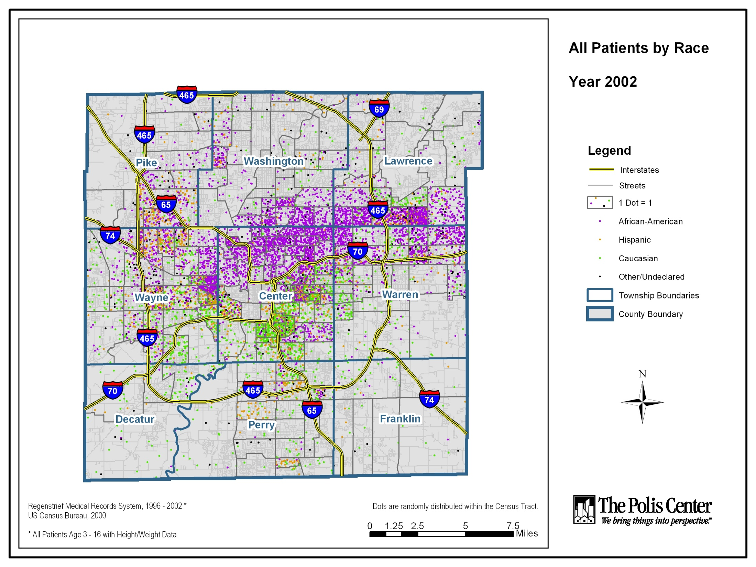

Slide 6
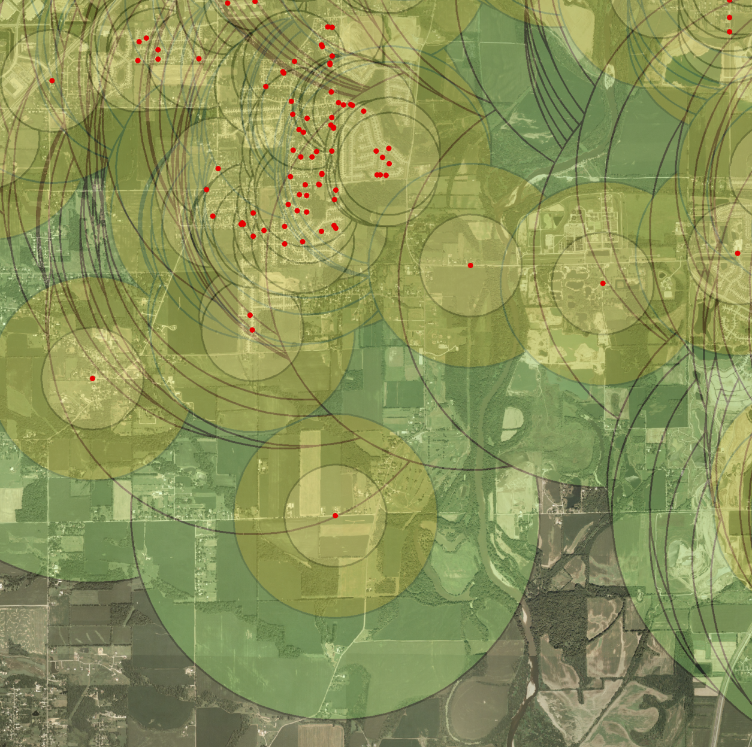
Zones of Analysis
Centered on Subject’s Residence

Slide 7
Generalized Land
Use Categories
units/acre
very low density 0-2
low density 2-5
medium density 5-15
high density > 15
commercial light
commercial office
commercial heavy
industrial light
Industrial heavy
special use
parks
vacant / agricultural
roads
interstates
water
0
1
2
Miles

Slide 8
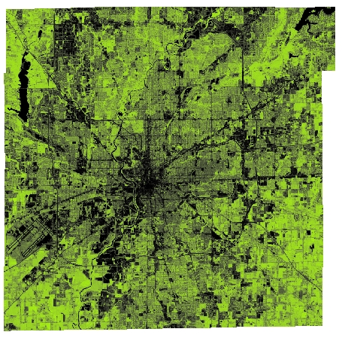

The Environment
Variables of the Built Environment Selected for Study:
GREENNESS
  Normalized Difference Vegetation Index (NDVI)
  Healthy green biomass

Slide 9
Variables
Dependent
  2-year change in BMI z-Score (t₂-t₁)
Covariates
  Age, race/ethnicity, sex
  Baseline z-BMI (linear, quadratic, cubic)
  Health insurance status
  Census tract median family income (log)
  Index year

Slide 10
Linear Regression Models of 2-year change in z-BMI

Slide 11
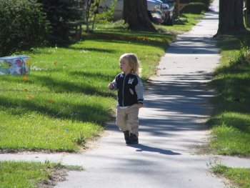
Potential Pathways and Mechanisms
Places that promote outside play and physical activity
“Territorial personalization”
Improved mental health, self-esteem, reduced stress

Slide 12
Collaboration of SALSA Project
Microsoft Research
Industry Technology Collaboration
Dryad
Roger Barga
CCR
George Chrysanthakopoulos
DSS
Henrik Frystyk Nielsen
Indiana University IT
SALSA Team
Geoffrey Fox
Xiaohong Qiu
Scott Beason
Seung-Hee Bae
Jaliya Ekanayake
Jong Youl Choi
Yang Ruan
Application Collaborators
Bioinformatics, CGB
Haiku Tang, Mina Rho, Qufeng Dong
IU Medical School
Gilbert Liu
IUPUI Polis Center (GIS)
Neil Devadasan
Cheminformatics
Rajarshi Guha, David Wild
PTI/UITS RT
Craig Stewart
William Bernnet
Scott Mcaulay

Slide 13
Components of Data Intensive
Computing System
Hardware
Developing and applying parallel and distributed Cyberinfrastructure to support large scale data analysis.
Childhood Obesity Studies (314,932 patient records/188 dimensions)
Indiana census 2000 (65535 GIS records / 54 dimensions)
Biology gene sequence alignments (640 million / 300 to 400 base pair)
Particle physics LHC (1 terabytes data that placed in IU Data Capacitor)
Data
Application
Software

Slide 14


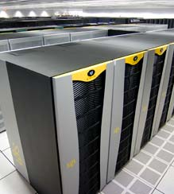
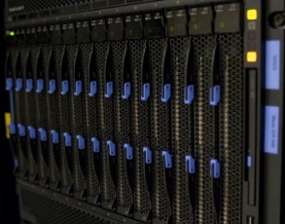

Components of Data Intensive
Computing System
HPC clusters
Laptops
Data
Hardware
Network Connection
Desktops
Workstations
Supercomputers
Application
Software

Slide 15
Components of Data Intensive
Computing System
Hardware
Data
The exponentially growing volumes of data requires robust high performance tools.
Parallelization frameworks
  MPI for High performance clusters of multicore systems
  MapReduce for Cloud/Grid systems (Hadoop , Dryad)
Data mining algorithms and tools
  Deterministic Annealing Clustering (VDAC)
  Pairwise Clustering
  Multi Dimensional Scaling (Dimension Reduction)
  Visualization (Plotviz)
Application
Software

Slide 16
Components of Data Intensive
Computing System
Hardware
Data
Data Intensive (Science) Applications
Heath
Biology
Chemistry
Particle Physics LHC
GIS
Software
Application

Slide 17
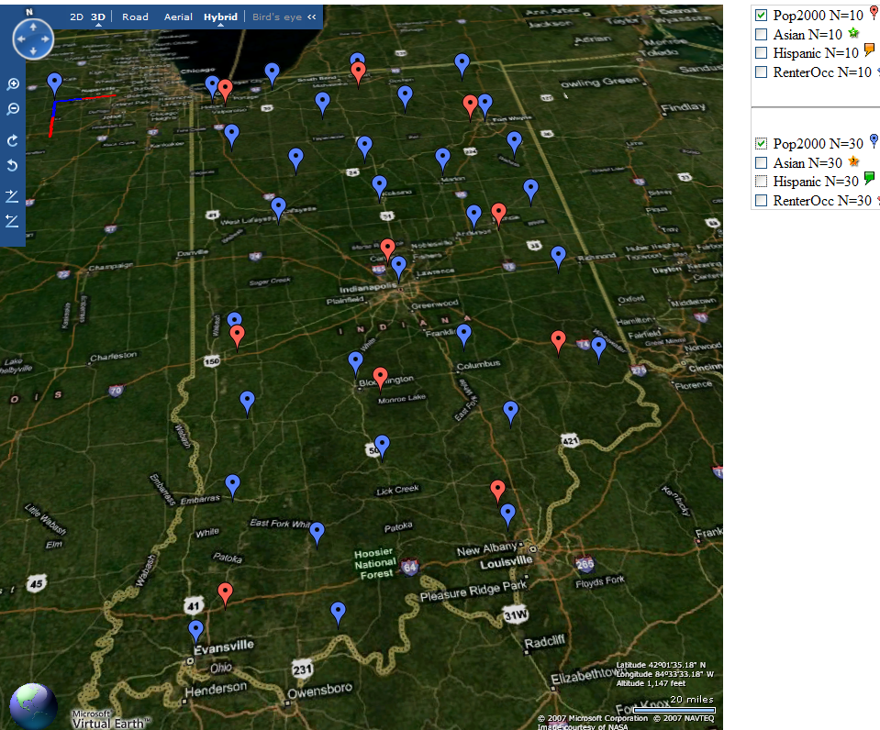
Deterministic Annealing Clustering of Indiana Census Data
Decrease temperature (distance scale) to discover more clusters
Distance Scale
Temperature^{0.5}
Red is coarse resolution with 10 clusters
Blue is finer resolution with 30 clusters
Clusters find cities in Indiana
Distance Scale is √Temperature

Slide 18
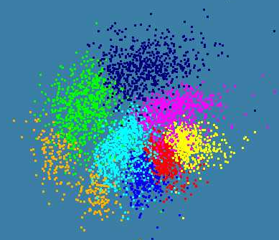
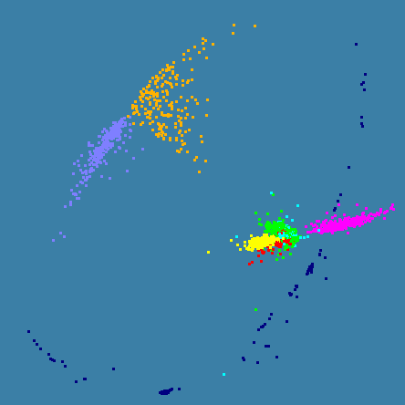
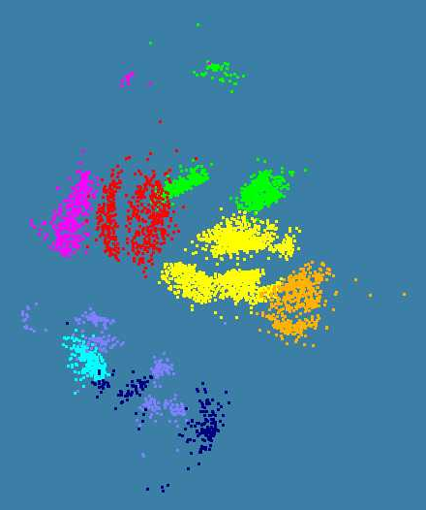
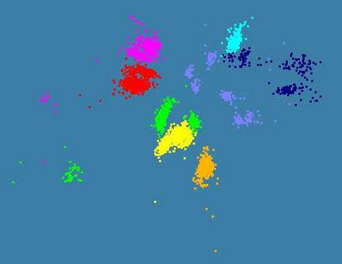
Various Sequence Clustering Results
4500 Points : Pairwise Aligned
3000 Points : Clustal MSA
Kimura2 Distance
4500 Points : Clustal MSA
Map distances to 4D Sphere before MDS

Slide 19
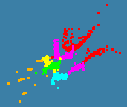

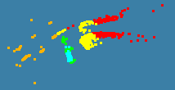
Initial Obesity Patient Data Analysis
2000 records 6 Clusters
Refinement of 3 of
clusters to left into 5
4000 records 8 Clusters

Slide 20
PWDA Parallel Pairwise data clustering
by Deterministic Annealing run on 24 core computer
Parallel
Overhead
Intra-node
MPI
Inter-node
MPI
Threading
Parallel Pattern (Thread X Process X Node)
June 11 2009

Slide 21
June 11 2009
Parallel Pairwise Clustering PWDA
Speedup Tests on eight 16-core Systems (6 Clusters, 10,000 Patient Records)
Threading with Short Lived CCR Threads
Parallel Overhead
Parallel Patterns (# Thread /process) x (# MPI process /node) x (# node)

Slide 22
Pairwise Sequence Distance Calculation
Pattern | Parallelism | Total Pairwise Alignments | Actual Time (ms) | Overhead | Nodes | Process | Threads | milliseconds/alignment | days/640million alignments
1x1x1 | 1 | 499500 | 7496846 | 0 | 1 | 1 | 1 | 15.0087 | 111.1756
1x8x1 | 8 | 499500 | 925544 | -0.012337722 | 1 | 8 | 1 | 1.852941 | 13.72549
1x4x2 | 8 | 499500 | 983639 | 0.049656349 | 1 | 4 | 2 | 1.969247 | 14.58702
1x2x4 | 8 | 499500 | 1048946 | 0.119346456 | 1 | 2 | 4 | 2.099992 | 15.5555
1x1x8 | 8 | 499500 | 1332675 | 0.422118048 | 1 | 1 | 8 | 2.668018 | 19.7631
1x16x1 | 16 | 499500 | 499500 | 0.066048309 | 1 | 16 | 1 | 1 | 7.407407
1x8x2 | 16 | 499500 | 515269 | 0.099702995 | 1 | 8 | 2 | 1.03157 | 7.641256
1x4x4 | 16 | 499500 | 556739 | 0.188209548 | 1 | 4 | 4 | 1.114593 | 8.256241
1x2x8 | 16 | 499500 | 772563 | 0.648827787 | 1 | 2 | 8 | 1.546673 | 11.45683
1x1x16 | 16 | 499500 | 1266255 | 1.702480483 | 1 | 1 | 16 | 2.535045 | 18.77811
1x24x1 | 24 | 499500 | 436759 | 0.398216797 | 1 | 24 | 1 | 0.874392 | 6.476981
1x1x24 | 24 | 499500 | 1242180 | 2.976648313 | 1 | 1 | 24 | 2.486847 | 18.42109
32x1x24 | 768 | 499500 | 50155 | 4.138032714 | 32 | 1 | 24 | 0.10041 | 0.743781
32x24x1 | 768 | 499500 | 22359 | 1.290524842 | 32 | 24 | 1 | 0.044763 | 0.331576
Perform all possible pairwise sequence alignment given a set of genomic sequences.
Alignments performed using Smith-Waterman (local) sequence alignment algorithm.
Currently we are able to perform ~640 million alignments (300 to 400 base pairs) in ~4 hours using tempest cluster.
Represents one of the largest datasets we have analyzed.

Slide 23
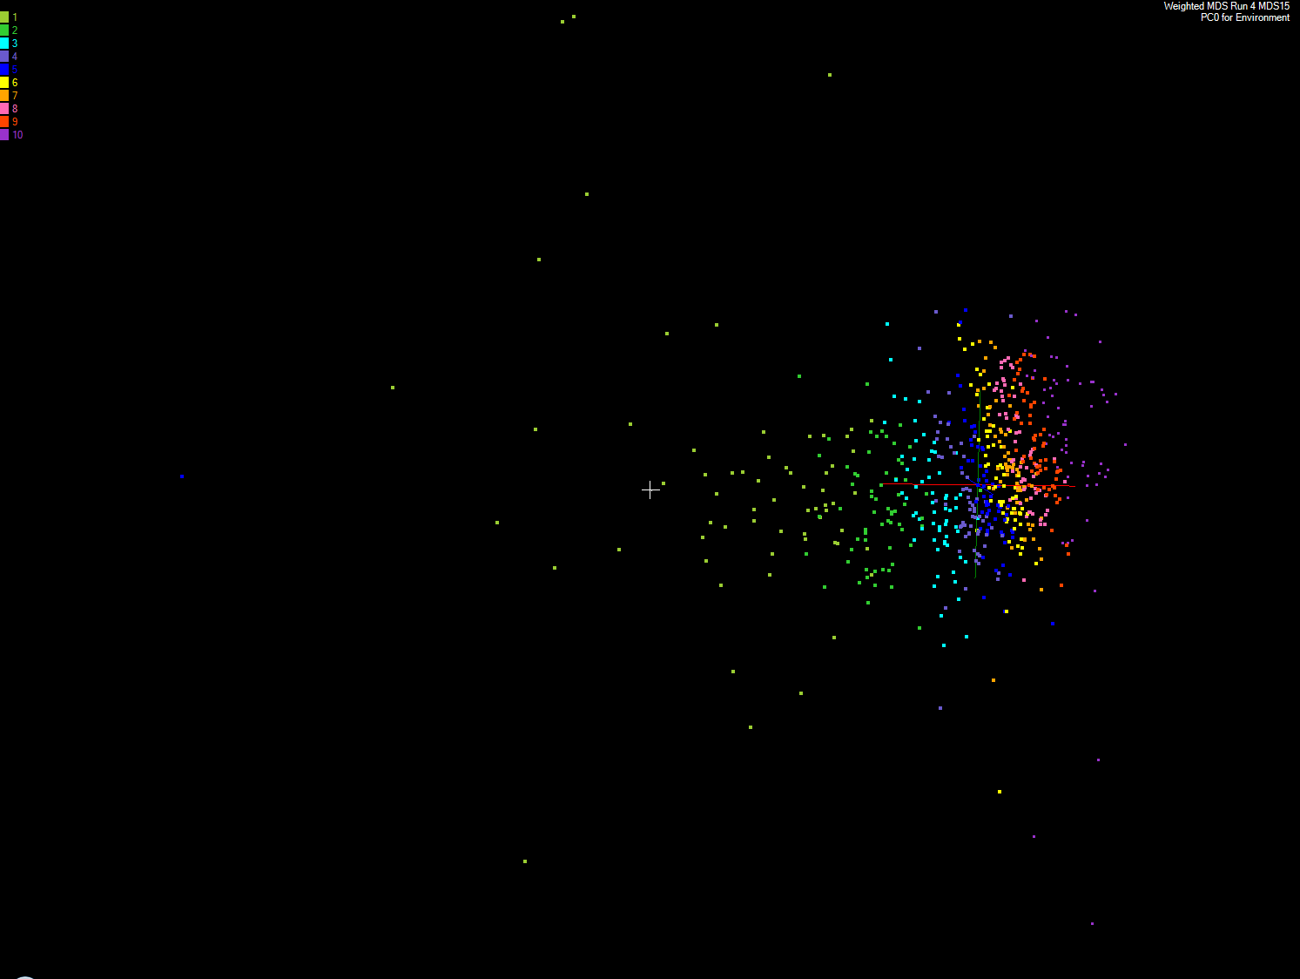
MDS of 635 Census Blocks with 97 Environmental Properties
Shows expected Correlation with Principal Component – color varies from greenish to reddish as projection of leading eigenvector changes value
Ten color bins used

Slide 24
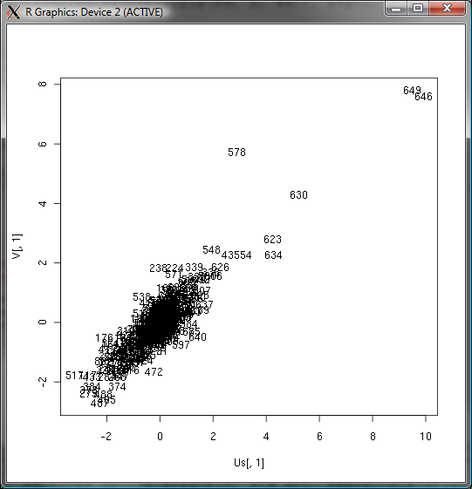
Canonical Correlation
Choose vectors a and b such that the random variables U = a^{T}.X and V = b^{T}.Y maximize the correlation
ρ= cor(a^{T}.X, b^{T}.Y).
X Environmental Data
Y Patient Data
Use R to calculate ρ = 0.76

Slide 25
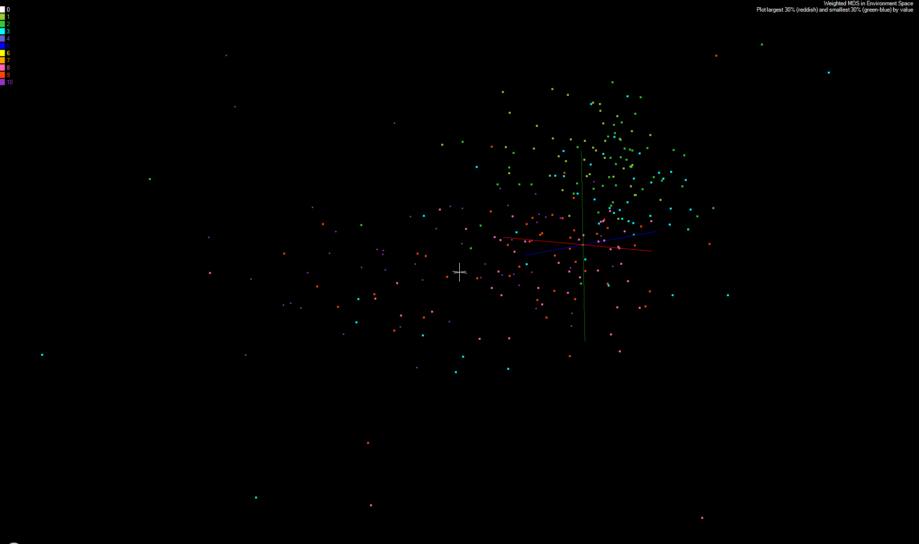
MDS and Canonical Correlation
Projection of First Canonical Coefficient between Environment and Patient Data onto Environmental MDS
Keep smallest 30% (green-blue) and top 30% (red-orchid) in numerical value
Remove small values < 5% mean in absolute value

Slide 26
References
See K. Rose, "Deterministic Annealing for Clustering, Compression, Classification, Regression, and Related Optimization Problems," Proceedings of the IEEE, vol. 80, pp. 2210-2239, November 1998
T Hofmann, JM Buhmann Pairwise data clustering by deterministic annealing, IEEE Transactions on Pattern Analysis and Machine Intelligence 19, pp1-13 1997
Hansjörg Klock and Joachim M. Buhmann Data visualization by multidimensional scaling: a deterministic annealing approach Pattern Recognition Volume 33, Issue 4, April 2000, Pages 651-669
Granat, R. A., Regularized Deterministic Annealing EM for Hidden Markov Models, Ph.D. Thesis, University of California, Los Angeles, 2004. We use for Earthquake prediction
Geoffrey Fox, Seung-Hee Bae, Jaliya Ekanayake, Xiaohong Qiu, and Huapeng Yuan, Parallel Data Mining from Multicore to Cloudy Grids, Proceedings of HPC 2008 High Performance Computing and Grids Workshop, Cetraro Italy, July 3 2008
Project website: www.infomall.org/salsa

