Slide 1
FutureGrid and
Data Intensive Applications on Clouds
Peking University, Beijing, China
December 23 2011
Geoffrey Fox
gcf@indiana.edu
http://www.infomall.org http://www.salsahpc.org
Director, Digital Science Center, Pervasive Technology Institute
Associate Dean for Research and Graduate Studies, School of Informatics and Computing
Indiana University Bloomington
Work with Judy Qiu and several students

Slide 2
Topics Covered
Broad Overview: Data Deluge to Clouds
Clouds Grids and Supercomputers: Infrastructure and Applications
Internet of Things: Sensor Grids supported as pleasingly parallel applications on clouds
MapReduce and Iterative MapReduce for non trivial parallel applications on Clouds
MapReduce and Twister on Azure
Summary of Applications Suitable for Clouds
Architecture of Data-Intensive Clouds
Summary of Data-Intensive Applications on Clouds
FutureGrid

Slide 3

Some Trends
  The Data Deluge is clear trend from Commercial (Amazon, e-commerce) , Community (Facebook, Search) and Scientific applications
  Light weight clients from smartphones, tablets to sensors
  Multicore reawakening parallel computing
  Exascale initiatives will continue drive to high end with a simulation orientation
  Clouds with cheaper, greener, easier to use IT for (some) applications
  New jobs associated with new curricula
    Clouds as a distributed system (classic CS courses)
    Data Analytics (Important theme at SC11)
    Network/Web Science

Slide 4
Some Data sizes
  ~40 10⁹ Web pages at ~300 kilobytes each = 10 Petabytes
  Youtube 48 hours video uploaded per minute;
    in 2 months in 2010, uploaded more than total NBC ABC CBS
    ~2.5 petabytes per year uploaded?
  LHC 15 petabytes per year
  Radiology 69 petabytes per year
  Square Kilometer Array Telescope will be 100 terabits/second
  Earth Observation becoming ~4 petabytes per year
  Earthquake Science – few terabytes total today
  PolarGrid – 100’s terabytes/year
  Exascale simulation data dumps – terabytes/second

Slide 5
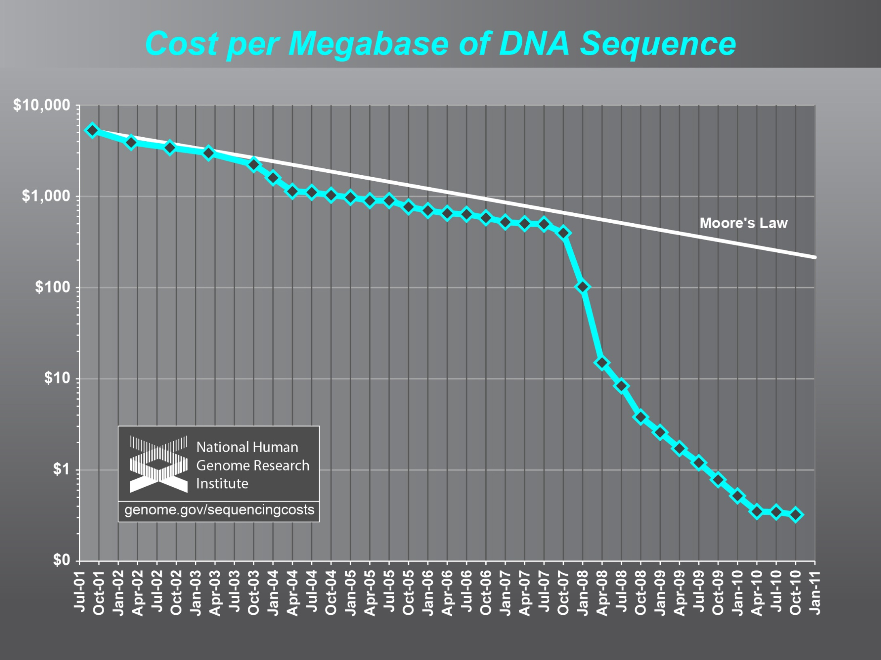
Why need cost effective
Computing!
(Note Public Clouds not allowed for human genomes)

Slide 6
Genomics in Personal Health
  Suppose you measured everybody’s genome every 2 years
    30 petabits of new gene data per day
    factor of 100 more for raw reads with coverage
  Data surely distributed
  1.5*10⁸ to 1.5*10¹⁰ continuously running present day cores to perform a simple Blast analysis on this data
    Amount depends on clever hashing and maybe Blast not good enough as field gets more sophisticated

Slide 7
Clouds Offer From different points of view
Features from NIST:
  On-demand service (elastic);
  Broad network access;
  Resource pooling;
  Flexible resource allocation;
  Measured service
Economies of scale in performance and electrical power (Green IT)
Powerful new software models
  Platform as a Service is not an alternative to Infrastructure as a Service – it is instead an incredible valued added
  Amazon is as much PaaS as Azure

Slide 8
2 Aspects of Cloud Computing:
Infrastructure and Runtimes
Cloud infrastructure: outsourcing of servers, computing, data, file space, utility computing, etc..
Cloud runtimes or Platform: tools to do data-parallel (and other) computations. Valid on Clouds and traditional clusters
  Apache Hadoop, Google MapReduce, Microsoft Dryad, Bigtable, Chubby and others
  MapReduce designed for information retrieval but is excellent for a wide range of science data analysis applications
  Can also do much traditional parallel computing for data-mining if extended to support iterative operations
  Data Parallel File system as in HDFS and Bigtable

Slide 9
Clouds and Jobs
Clouds are a major industry thrust with a growing fraction of IT expenditure that IDC estimates will grow to $44.2 billion direct investment in 2013 while 15% of IT investment in 2011 will be related to cloud systems with a 30% growth in public sector.
Gartner also rates cloud computing high on list of critical emerging technologies with for example “Cloud Computing” and “Cloud Web Platforms” rated as transformational (their highest rating for impact) in the next 2-5 years.
Correspondingly there is and will continue to be major opportunities for new jobs in cloud computing with a recent European study estimating there will be 2.4 million new cloud computing jobs in Europe alone by 2015.
Cloud computing spans research and economy and so attractive component of curriculum for students that mix “going on to PhD” or “graduating and working in industry” (as at Indiana University where most CS Masters students go to industry)

Slide 10
The Google gmail example
http://www.google.com/green/pdfs/google-green-computing.pdf
Clouds win by efficient resource use and efficient data centers
Business Type | Number of users | # servers | IT Power per user | PUE (Power Usage effectiveness) | Total Power per user | Annual Energy per user
Small | 50 | 2 | 8W | 2.5 | 20W | 175 kWh
Medium | 500 | 2 | 1.8W | 1.8 | 3.2W | 28.4 kWh
Large | 10000 | 12 | 0.54W | 1.6 | 0.9W | 7.6 kWh
Gmail (Cloud) | ∞ | ∞ | < 0.22W | 1.16 | < 0.25W | < 2.2 kWh

Slide 11

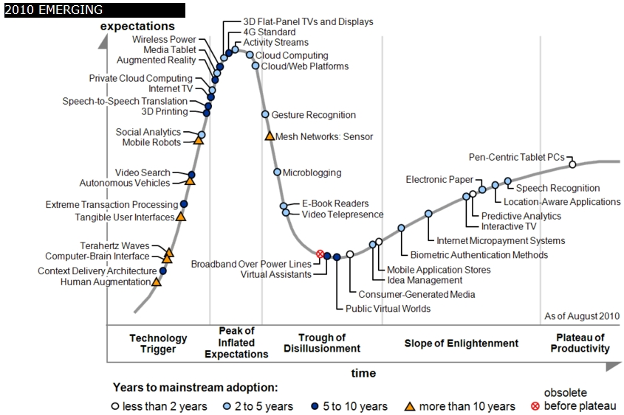
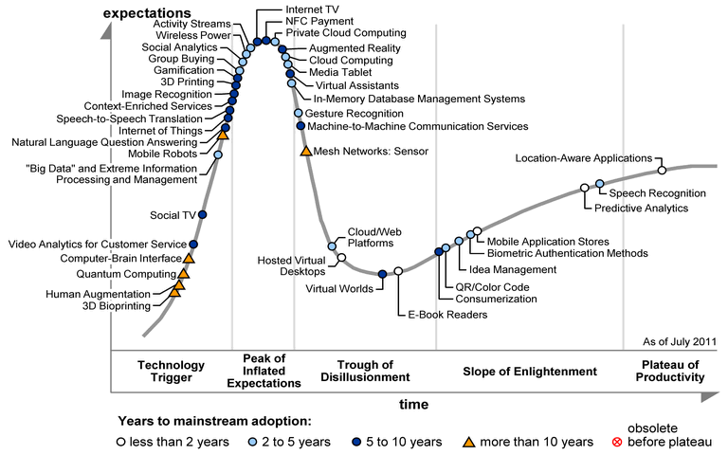
Gartner 2009 Hype Curve
Clouds, Web2.0, Green IT
Service Oriented Architectures

Slide 12
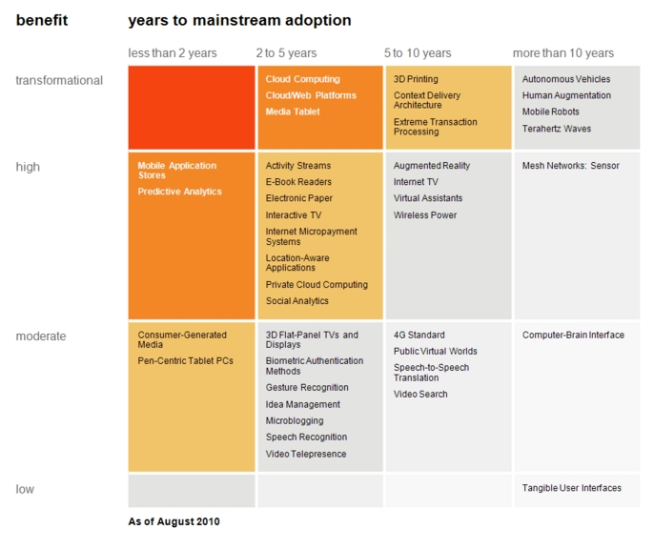
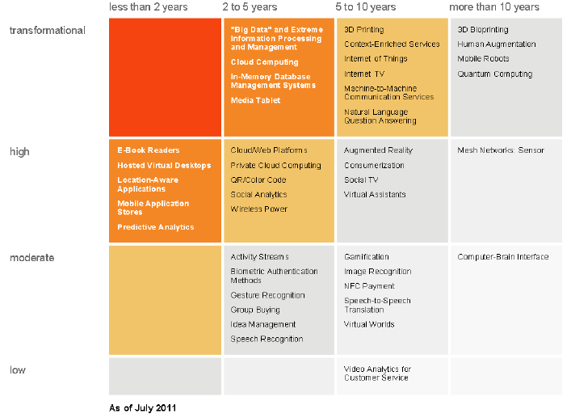
“Big Data” and Extreme
Information Processing and Management
Cloud Computing
In-memory Database Management Systems
Media Tablet
Transformational
High
Moderate
Low
Cloud Computing
Cloud Web Platforms
Media Tablet
Cloud/Web Platforms
Private Cloud Computing
QR/Color Bar Code
Social Analytics
Wireless Power

Slide 13
Clouds Grids and Supercomputers: Infrastructure and Applications

Slide 14
What Applications work in Clouds
Workflow and Services
Pleasingly parallel applications of all sorts analyzing roughly independent data or spawning independent simulations including
  Long tail of science
  Integration of distributed sensor data
Science Gateways and portals
Commercial and Science Data analytics that can use MapReduce (some of such apps) or its iterative variants (most analytic apps)
Note Data Analysis requirements not well articulated in many fields – See http://www.delsall.org for life sciences

Slide 15
Clouds and Grids/HPC
Synchronization/communication Performance
Grids > Clouds > HPC Systems
Clouds appear to execute effectively Grid workloads but are not easily used for closely coupled HPC applications
Service Oriented Architectures and workflow appear to work similarly in both grids and clouds
Assume for immediate future, science supported by a mixture of
  Clouds – data analysis (and pleasingly parallel)
  Grids/High Throughput Systems (moving to clouds as convenient)
  Supercomputers (“MPI Engines”) going to exascale

Slide 16
Internet of Things: Sensor Grids supported as pleasingly parallel applications on clouds

Slide 17
  Internet of Things: Sensor Grids
  A pleasingly parallel example on Clouds
  A sensor (“Thing”) is any source or sink of time series
    In the thin client era, smart phones, Kindles, tablets, Kinects, web-cams are sensors
    Robots, distributed instruments such as environmental measures are sensors
    Web pages, Googledocs, Office 365, WebEx are sensors
    Ubiquitous Cities/Homes are full of sensors
    They have IP address on Internet
  Sensors – being intrinsically distributed are Grids
  However natural implementation uses clouds to consolidate and control and collaborate with sensors
  Sensors are typically “small” and have pleasingly parallel cloud implementations

Slide 18








Sensors as a Service
Output Sensor
Sensors as a Service
A larger sensor ………
Sensor Processing as a Service (MapReduce)

Slide 19
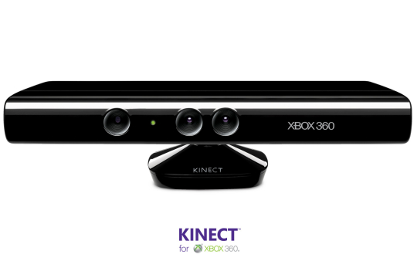
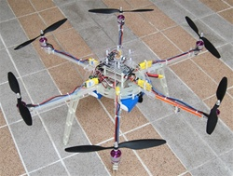



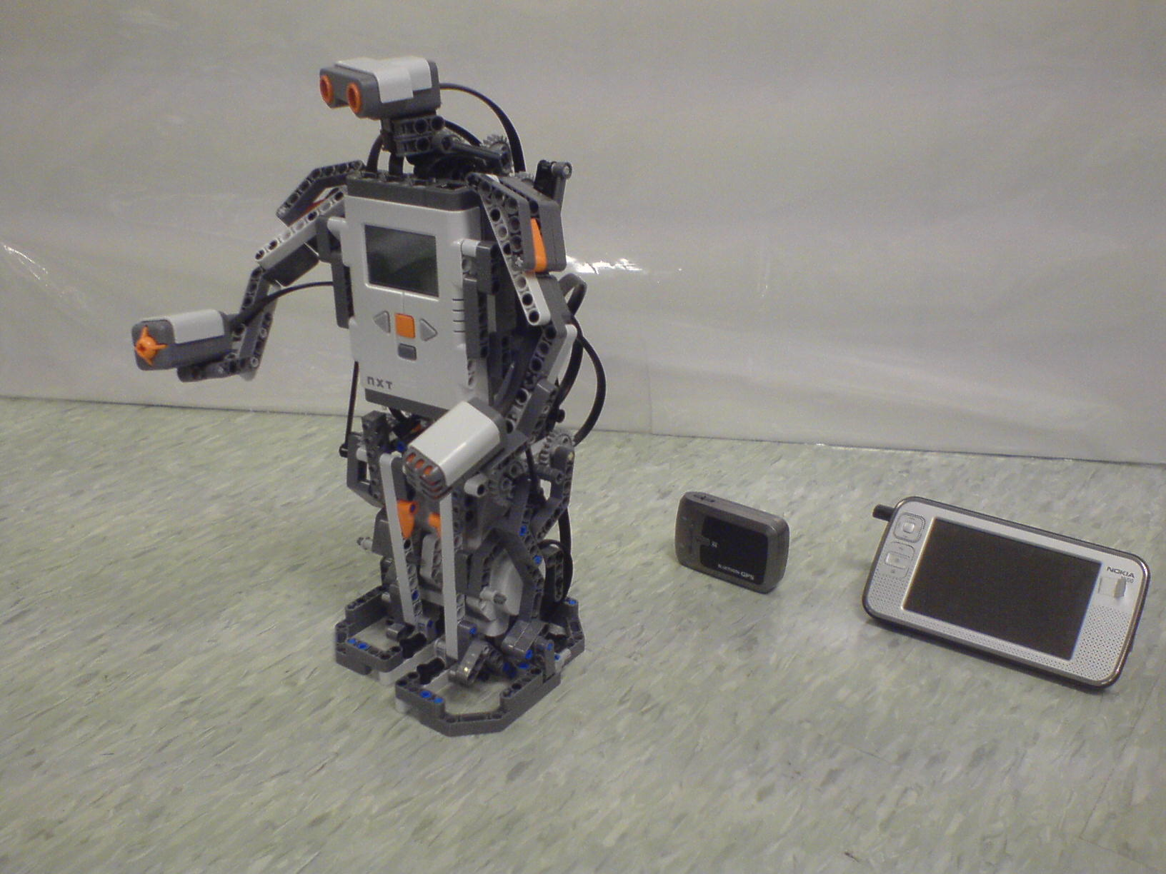
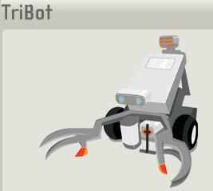

Some Sensors
Hexacopter
Laptop for PowerPoint
Surveillance Camera
RFID Reader
RFID Tag
Lego Robot GPS Nokia N800

Slide 20
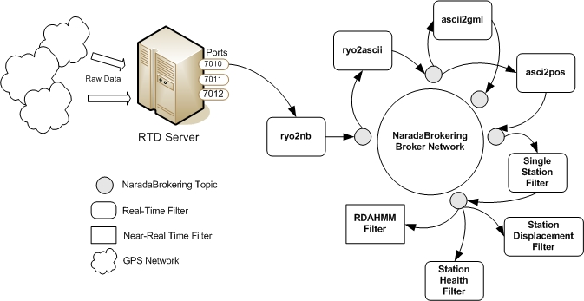
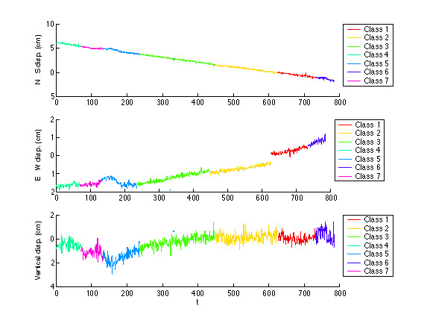
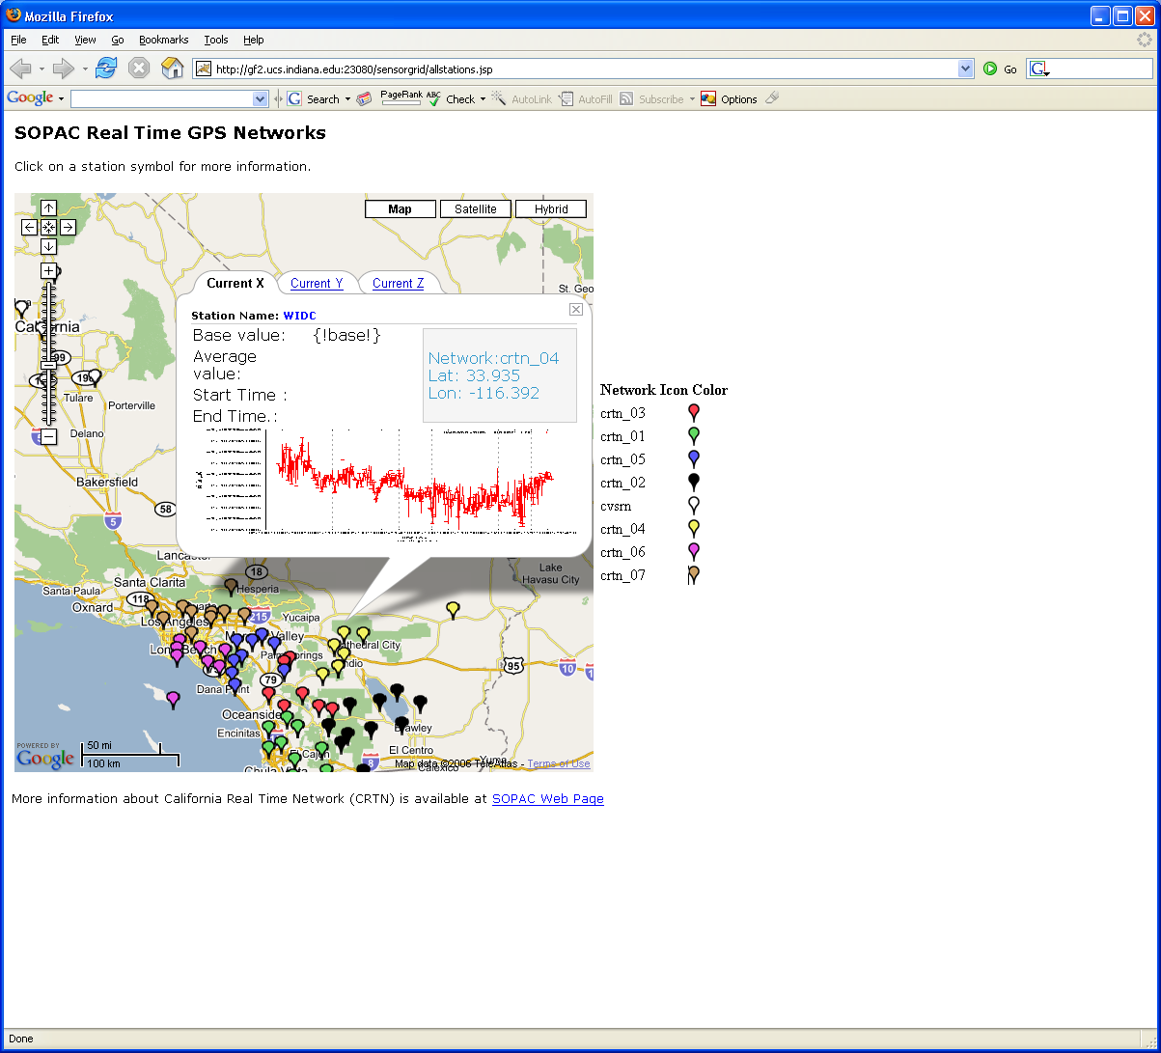
Real-Time GPS Sensor Data-Mining
Services process real time data from ~70 GPS Sensors in Southern California
Brokers and Services on Clouds – no major performance issues
CRTN GPS
Earthquake
Streaming Data
Support
Transformations
Data Checking
Archival
Hidden Markov
Datamining (JPL)
Display (GIS)
Real Time
20
Notes:
20

Slide 21
Performance of Pub-Sub Cloud Brokers
High end sensors equivalent to Kinect or MPEG4 TRENDnet TV-IP422WN camera at about 1.8Mbps per sensor instance
OpenStack hosted sensors and middleware

Slide 22
MapReduce and Iterative MapReduce for non trivial parallel applications on Clouds

Slide 23






MapReduce “File/Data Repository” Parallelism
Map = (data parallel) computation reading and writing data
Reduce = Collective/Consolidation phase e.g. forming multiple global sums as in histogram
Instruments
MPI or Iterative MapReduce
Map Reduce Map Reduce Map
Communication
Reduce
Portals
/Users
Disks
Map₁
Map₂
Map₃

Slide 24
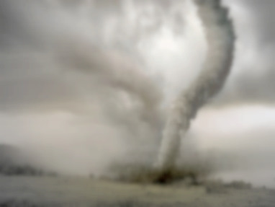
Twister v0.9
March 15, 2011
  New Interfaces for Iterative MapReduce Programming
  http://www.iterativemapreduce.org/
SALSA Group
Bingjing Zhang, Yang Ruan, Tak-Lon Wu, Judy Qiu, Adam Hughes, Geoffrey Fox, Applying Twister to Scientific Applications, Proceedings of IEEE CloudCom 2010 Conference, Indianapolis, November 30-December 3, 2010
Twister4Azure released May 2011
http://salsahpc.indiana.edu/twister4azure/
MapReduceRoles4Azure available for some time at
http://salsahpc.indiana.edu/mapreduceroles4azure/
Microsoft Daytona project July 2011 is Azure version

Slide 25

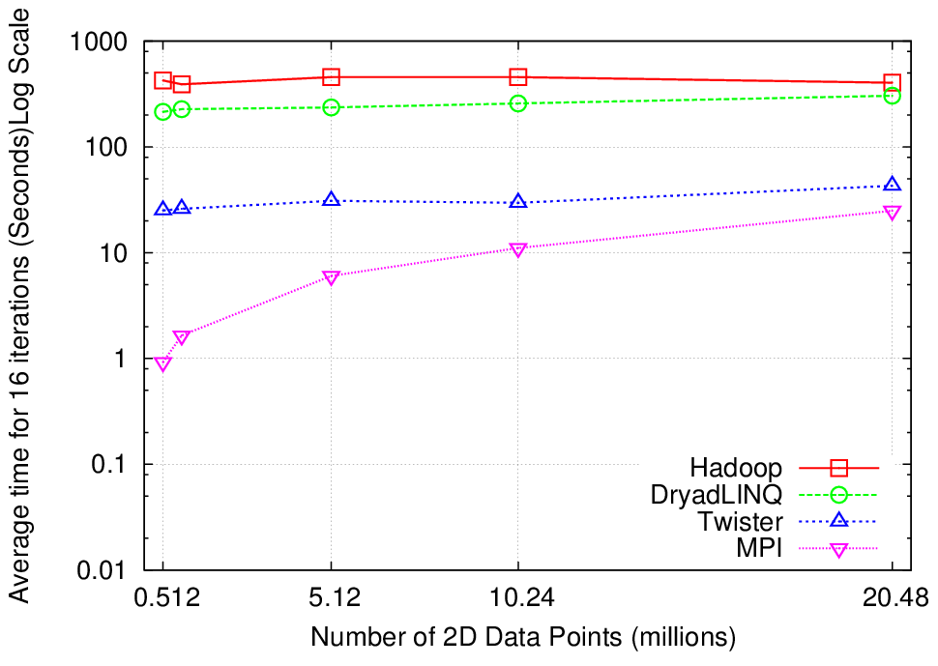
K-Means Clustering
Compute the distance to each data point from each cluster center and assign points to cluster centers
map
map
Time for 20 iterations
reduce
Compute new cluster
centers
User program
Compute new cluster centers
Iteratively refining operation
Typical MapReduce runtimes incur extremely high overheads
  New maps/reducers/vertices in every iteration
  File system based communication
Long running tasks and faster communication in Twister enables it to perform close to MPI

Slide 26


Twister
Pub/Sub Broker Network
Map Worker
M
Worker Nodes
R
Reduce Worker
Streaming based communication
Intermediate results are directly transferred from the map tasks to the reduce tasks – eliminates local files
Cacheable map/reduce tasks
  Static data remains in memory
Combine phase to combine reductions
User Program is the composer of MapReduce computations
Extends the MapReduce model to iterative computations
D
D
MR
Driver
User
Program
M
M
M
M
D
MRDeamon
R
R
R
R
Data Read/Write
Communication
Data Split
File System
Iterate
Static
data
Configure()
User Program
Map(Key, Value)
δ flow
Reduce (Key, List<Value>)
Combine (Key, List<Value>)
Different synchronization and intercommunication mechanisms used by the parallel runtimes
Close()

Slide 27
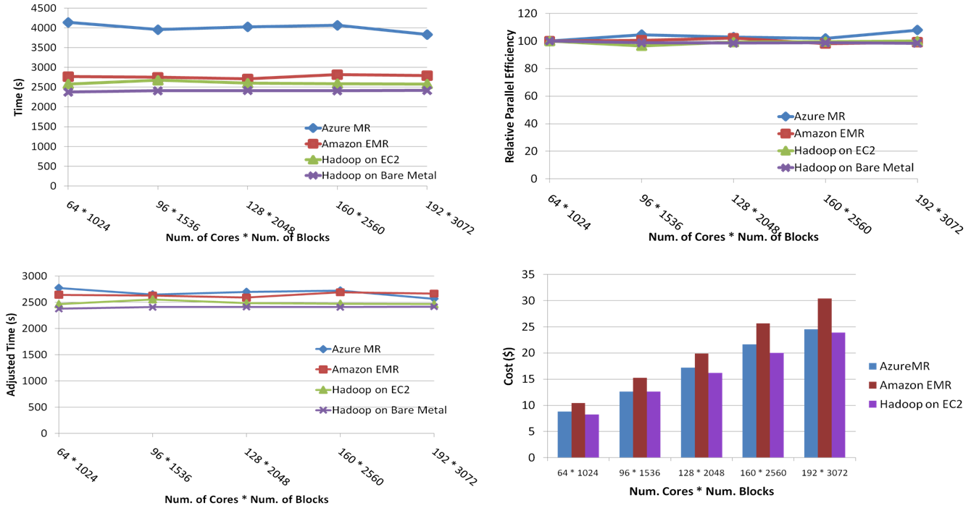
SWG Sequence Alignment Performance
Smith-Waterman-GOTOH to calculate all-pairs dissimilarity
Notes:
~123 million sequence alignments, for under 30$ with zero up front hardware cost,

Slide 28

Performance of Pagerank using
ClueWeb Data (Time for 20 iterations)
using 32 nodes (256 CPU cores) of Crevasse

Slide 29
Map Collective Model (Judy Qiu)
Combine MPI and MapReduce ideas
Implement collectives optimally on Infiniband, Azure, Amazon ……
Iterate
Input
map
Initial Collective Step
Network of Brokers
Generalized Reduce
Final Collective Step
Network of Brokers

Slide 30
MapReduce and Twister on Azure

Slide 31
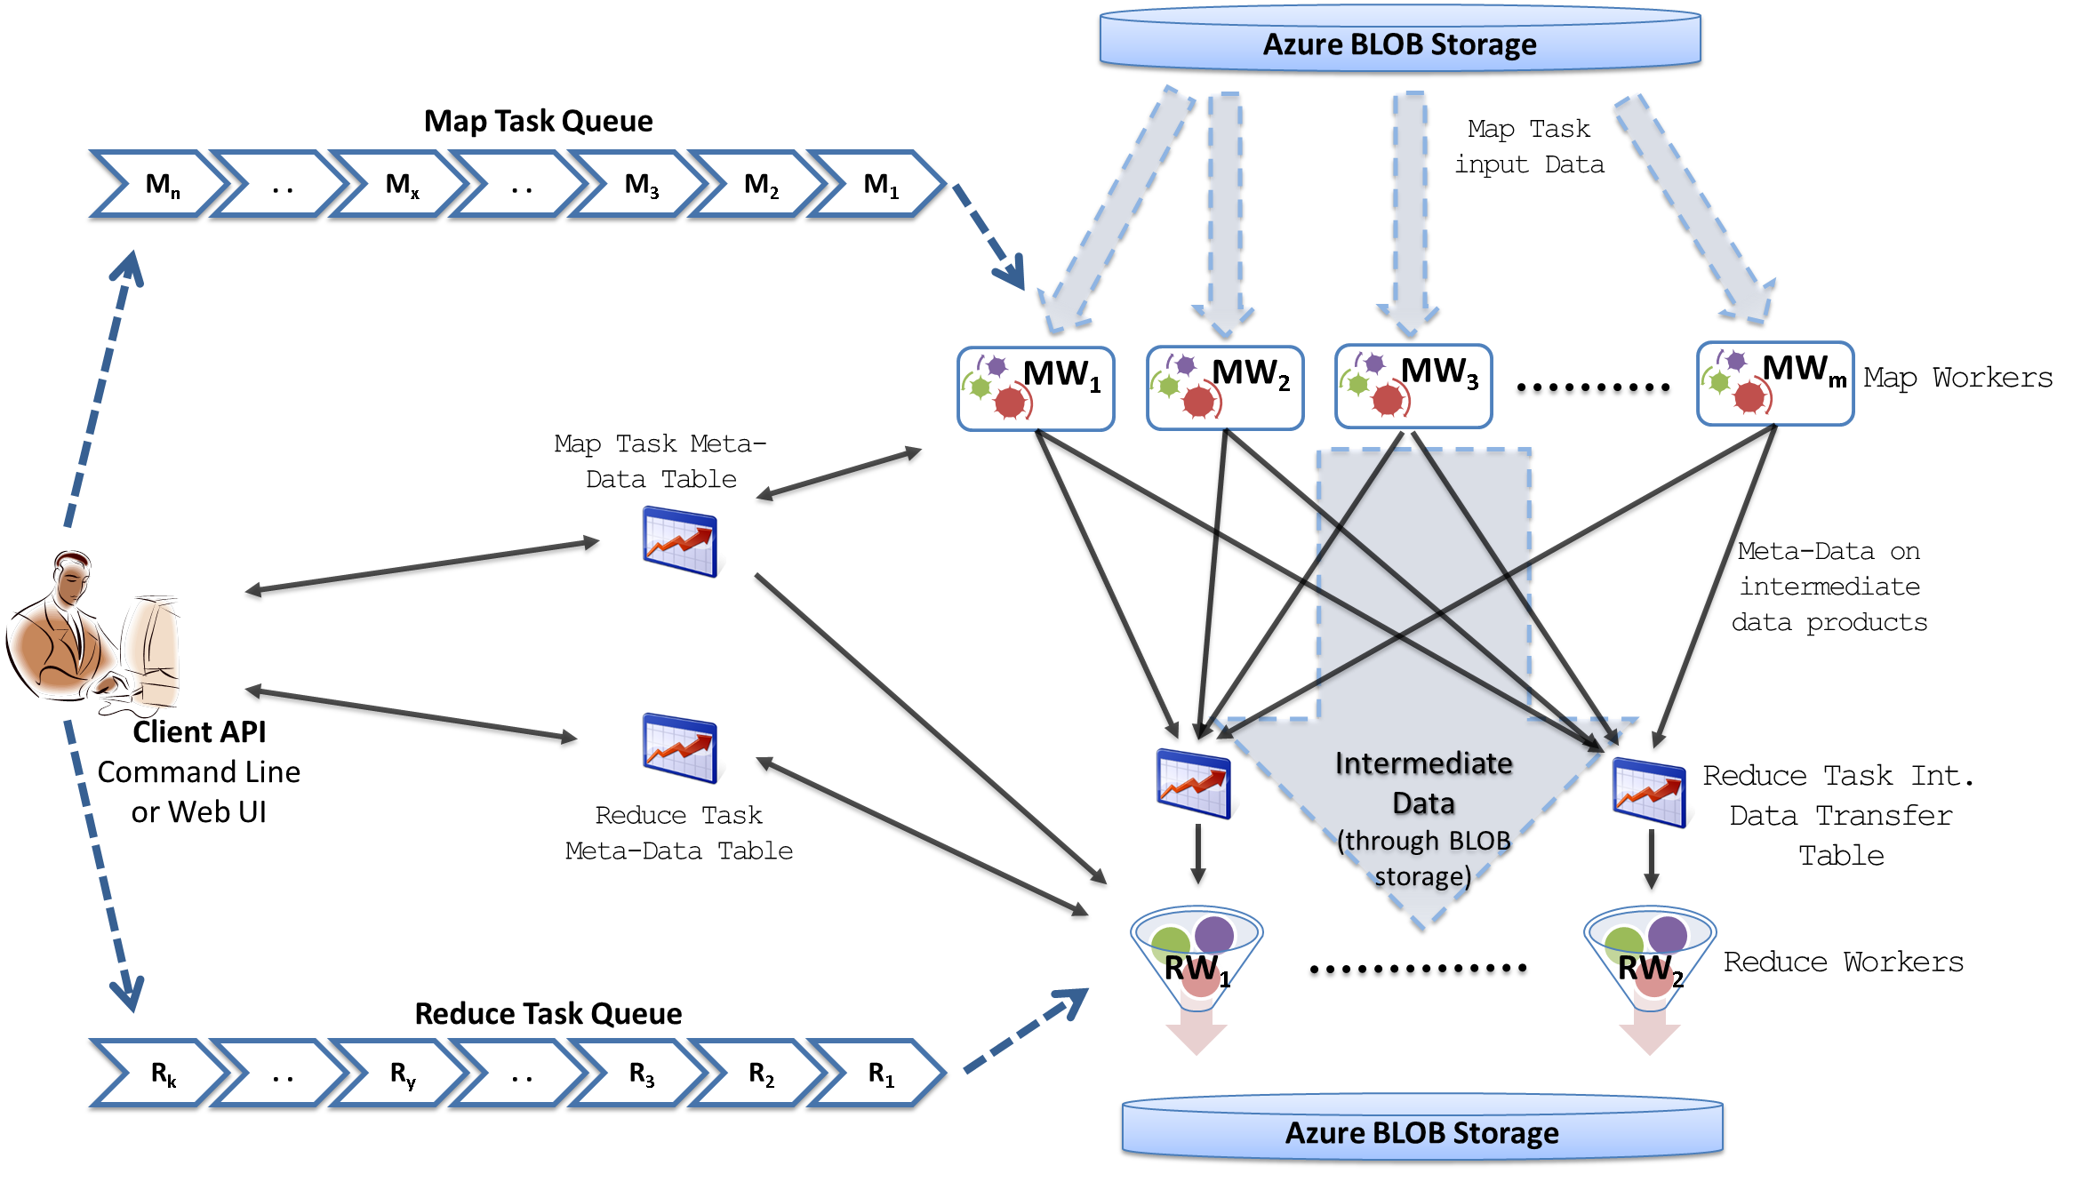
MapReduceRoles4Azure Architecture
Azure Queues for scheduling, Tables to store meta-data and monitoring data, Blobs for input/output/intermediate data storage.
Notes:
We use Azure Queues for scheduling, Tables to store meta-data and monitoring data, Blobs for input/output/intermediate data storage.

Slide 32
MapReduceRoles4Azure
Use distributed, highly scalable and highly available cloud services as the building blocks.
  Azure Queues for task scheduling.
  Azure Blob storage for input, output and intermediate data storage.
  Azure Tables for meta-data storage and monitoring
Utilize eventually-consistent , high-latency cloud services effectively to deliver performance comparable to traditional MapReduce runtimes.
Minimal management and maintenance overhead
Supports dynamically scaling up and down of the compute resources.
MapReduce fault tolerance
http://salsahpc.indiana.edu/mapreduceroles4azure/

Slide 33
High Level Flow Twister4Azure
Map
Combine
Job Start
Map
Reduce
Combine
Merge
Add Iteration?
Job Finish
Reduce
No
Map
Combine
Yes
Data Cache
Hybrid scheduling of the new iteration
Merge Step
In-Memory Caching of static data
Cache aware hybrid scheduling using Queues as well as using a bulletin board (special table)
Notes:
In our current work, we extend MR4Azure to support iterative mapreduce computations. We added an additional merge step to the programming model, where the computations decides whether to go for a new iteration or not. We also support in-memory caching of static data between iterations and we developed a hybrid scheduling strategy to perform cache aware scheduling.

Slide 34
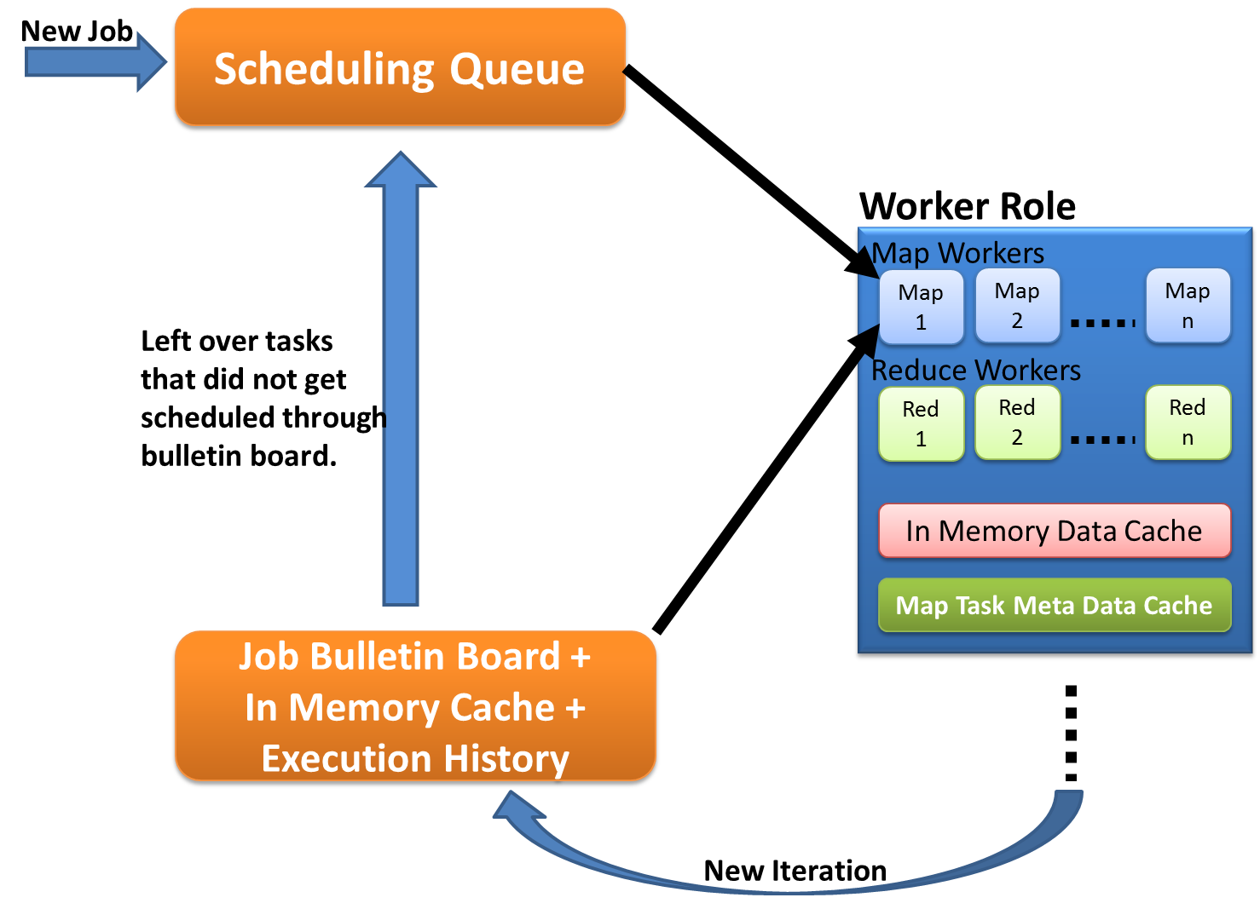
Cache aware scheduling
New Job (1st iteration)
  Through queues
New iteration
  Publish entry to Job Bulletin Board
  Workers pick tasks based on in-memory data cache and execution history (MapTask Meta-Data cache)
  Any tasks that do not get scheduled through the bulletin board will be added to the queue.

Slide 35
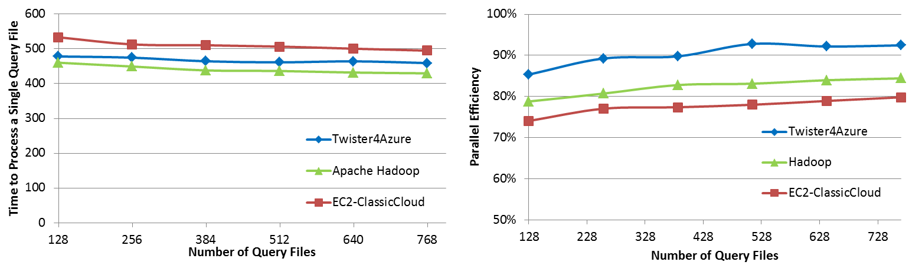

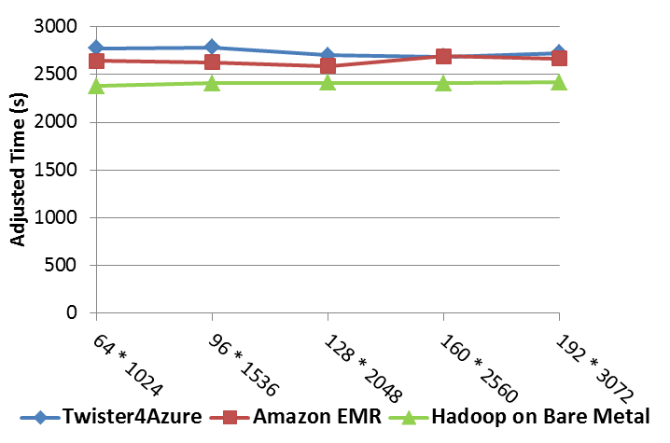
Performance Comparisons
BLAST Sequence Search
Smith Waterman Sequence Alignment
Cap3 Sequence Assembly

Slide 36

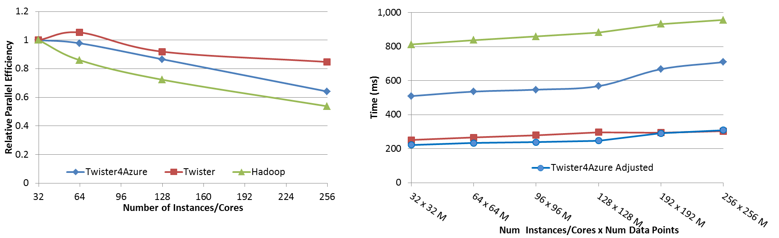
Performance – Kmeans Clustering
Task Execution Time Histogram
Number of Executing Map Task Histogram
Strong Scaling with 128M Data Points
Weak Scaling
Notes:
Right(c): Twister4Azure executing Map Task histogram for 128 million data points in 128 Azure small instances
Figure 5. KMeansClustering Scalability. Left(a): Relative parallel efficiency of strong scaling using 128 million data points.
Center(b): Weak scaling. Workload per core is kept constant (ideal is a straight horizontal line).

Slide 37
Kmeans Speedup from 32 cores

Slide 38
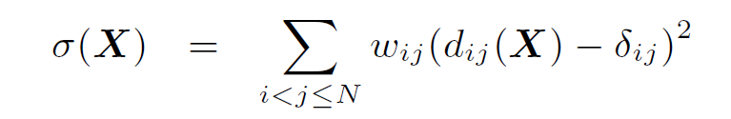
Look at one problem in detail
Visualizing Metagenomics where sequences are ~1000 dimensions
Map sequences to 3D so you can visualize
Minimize Stress
Improve with deterministic annealing (gives lower stress with less variation between random starts)
Need to iterate Expectation Maximization
N² dissimilarities (Smith Waterman, Needleman-Wunsch, Blast) δ_{i j}
Communicate N positions X between steps

Slide 39
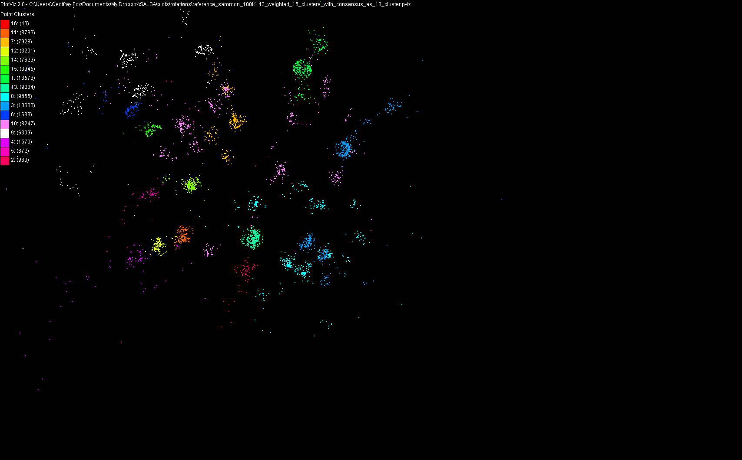
100,043 Metagenomics Sequences mapped to 3D

Slide 40
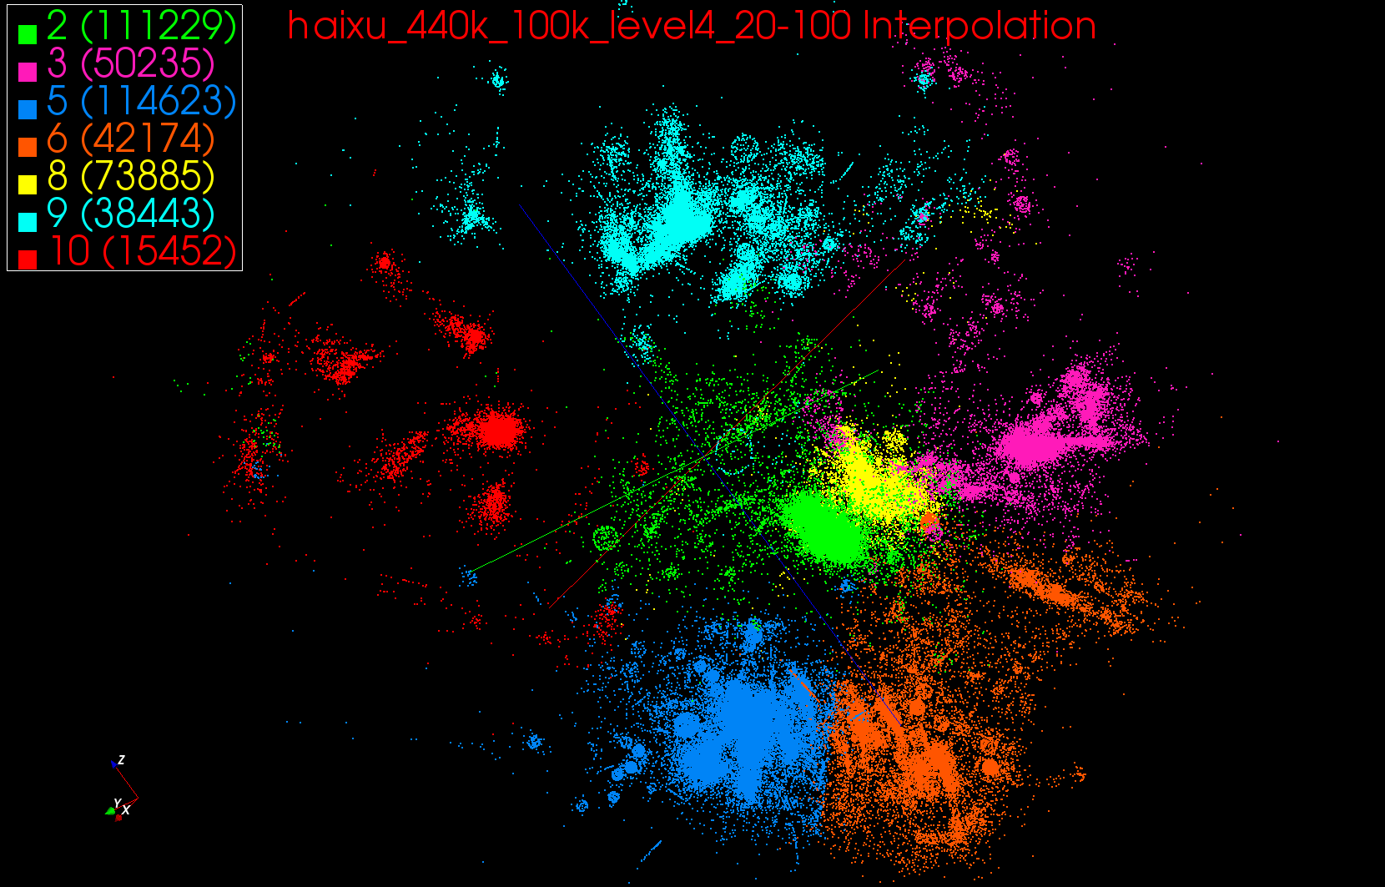
440K Interpolated

Slide 41
Multi-Dimensional-Scaling
Many iterations
Memory & Data intensive
3 Map Reduce jobs per iteration
X_{k} = invV * B(X_{(k-1)}) * X_{(k-1)}
2 matrix vector multiplications termed BC and X
BC: Calculate BX
X: Calculate invV (BX)
Calculate Stress
Map
Reduce
Merge
Map
Reduce
Merge
Map
Reduce
Merge
New Iteration

Slide 42
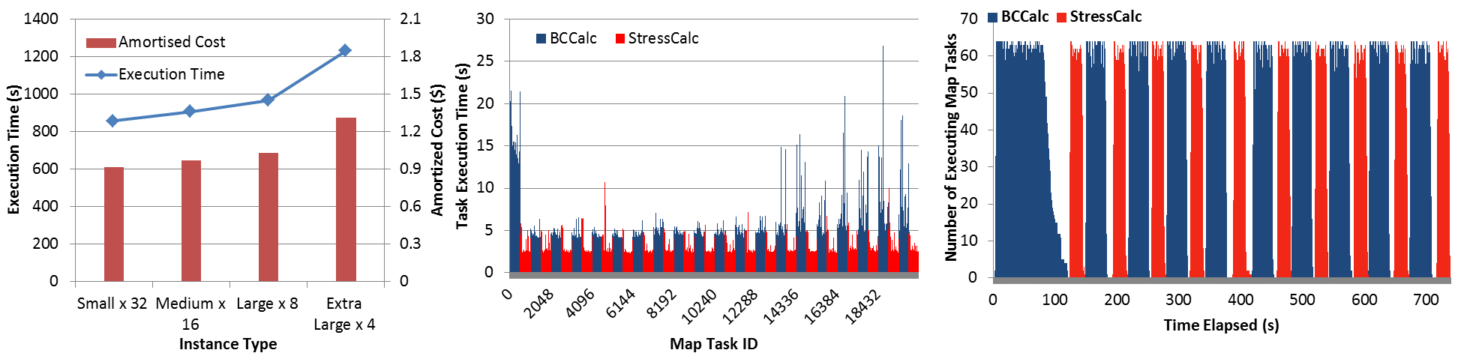
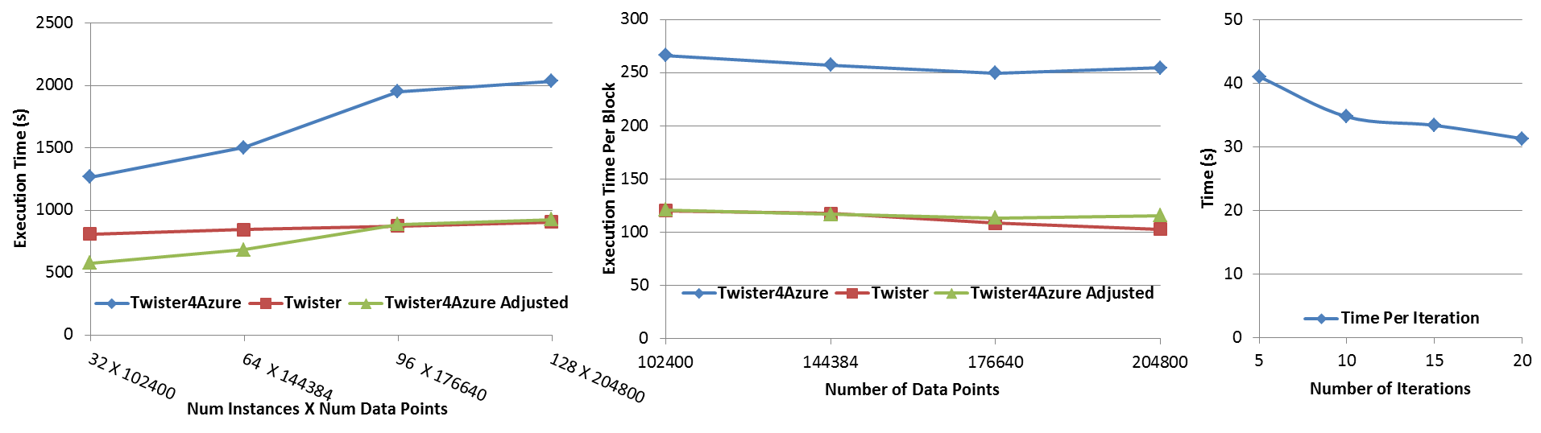




Performance – Multi Dimensional Scaling
Azure Instance Type Study
Task Execution Time Histogram
Number of Executing Map Task Histogram
Weak Scaling
Data Size Scaling
Increasing Number of Iterations
Performance with/without
data caching
Speedup gained using data cache
Scaling speedup
Increasing number of iterations
Notes:
Figure 6. Twister4Azure MDS performance Left: Instance type study using 76800 data points, 32 instances, 20 iterations. Center: Twister4Azure MDS individual task execution time histogram for 144384 x144384 distance matrix in 64 Azure small instances, 10 iterations Right: Twister4Azure executing Map Task histogram for 144384 x144384 distance matrix in 64 Azure small instances, 10 iterations
Figure 7. Left: Weak scaling where workload per core is ~constant. Ideal is a straight horizontal line. Center : Data size scaling with 128 Azure small instances/cores, 20 iterations. Right: Time per iteration with increasing number of iterations 30k x 30k distance matrix, 15 instances.

Slide 43
Twister4Azure Conclusions
Twister4Azure enables users to easily and efficiently perform large scale iterative data analysis and scientific computations on Azure cloud.
  Supports classic and iterative MapReduce
  Non pleasingly parallel use of Azure
Utilizes a hybrid scheduling mechanism to provide the caching of static data across iterations.
Should integrate with workflow systems
Plenty of testing and improvements needed!
Open source: Please use http://salsahpc.indiana.edu/twister4azure

Slide 44
Summary of
Applications Suitable for Clouds

Slide 45
Application Classification
(a) Map Only
(b) Classic MapReduce
(c) Iterative MapReduce
(d) Loosely Synchronous
Input
Input
Iterations
Input
map
map
map
P_{ij}
reduce
reduce
Output
BLAST Analysis
Smith-Waterman Distances
Parametric sweeps
PolarGrid Matlab data analysis
High Energy Physics (HEP) Histograms
Distributed search
Distributed sorting
Information retrieval
Expectation maximization clustering e.g. Kmeans
Linear Algebra
Multimensional Scaling
Page Rank
Many MPI scientific applications such as solving differential equations and particle dynamics
Domain of MapReduce and Iterative Extensions
MPI

Slide 46
Expectation Maximization and Iterative MapReduce
Clustering and Multidimensional Scaling are both EM (expectation maximization) using deterministic annealing for improved performance
EM tends to be good for clouds and Iterative MapReduce
  Quite complicated computations (so compute largish compared to communicate)
  Communication is Reduction operations (global sums in our case)
  See also Latent Dirichlet Allocation and related Information Retrieval algorithms similar structure

Slide 47
DA-PWC EM Steps (E is red, M Black) k runs over clusters; i,j, α points
A(k) = - 0.5 ∑_{i=1}^{N} ∑_{j=1}^{N} δ(i, j) <M_{i}(k)> <M_{j}(k)> / <C(k)>²
B_{α}(k) = ∑_{i=1}^{N} δ(i, α) <M_{i}(k)> / <C(k)>
ε_{α}(k) = (B_{α}(k) + A(k))
<M_{i}(k)> = p(k) exp( -ε_{i}(k)/T )/
∑_{k’=1}^{K} p(k’) exp(-ε_{i}(k’)/T)
C(k) = ∑_{i=1}^{N} <M_{i}(k)>
p(k) = C(k) / N
Loop to converge variables; decrease T from ∞; split centers by halving p(k)
Steps 1 global sum (reduction)
Step 1, 2, 5 local sum if <M_{i}(k)> broadcast

Slide 48
What can we learn?
There are many pleasingly parallel data analysis algorithms which are super for clouds
  Remember SWG computation longer than other parts of analysis
There are interesting data mining algorithms needing iterative parallel run times
There are linear algebra algorithms with flaky compute/communication ratios
Expectation Maximization good for Iterative MapReduce

Slide 49
Research Issues for (Iterative) MapReduce
Quantify and Extend that Data analysis for Science seems to work well on Iterative MapReduce and clouds so far.
  Iterative MapReduce (Map Collective) spans all architectures as unifying idea
Performance and Fault Tolerance Trade-offs;
  Writing to disk each iteration (as in Hadoop) naturally lowers performance but increases fault-tolerance
  Integration of GPU’s
Security and Privacy technology and policy essential for use in many biomedical applications
Storage: multi-user data parallel file systems have scheduling and management
  NOSQL and SciDB on virtualized and HPC systems
Data parallel Data analysis languages: Sawzall and Pig Latin more successful than HPF?
Scheduling: How does research here fit into scheduling built into clouds and Iterative MapReduce (Hadoop)
  important load balancing issues for MapReduce for heterogeneous workloads

Slide 50
Architecture of Data-Intensive Clouds

Slide 51
Authentication and Authorization: Provide single sign in to All system architectures
Workflow: Support workflows that link job components between Grids and Clouds.
Provenance: Continues to be critical to record all processing and data sources
Data Transport: Transport data between job components on Grids and Commercial Clouds respecting custom storage patterns like Lustre v HDFS
Program Library: Store Images and other Program material
Blob: Basic storage concept similar to Azure Blob or Amazon S3
DPFS Data Parallel File System: Support of file systems like Google (MapReduce), HDFS (Hadoop) or Cosmos (dryad) with compute-data affinity optimized for data processing
Table: Support of Table Data structures modeled on Apache Hbase/CouchDB or Amazon SimpleDB/Azure Table. There is “Big” and “Little” tables – generally NOSQL
SQL: Relational Database
Queues: Publish Subscribe based queuing system
Worker Role: This concept is implicitly used in both Amazon and TeraGrid but was (first) introduced as a high level construct by Azure. Naturally support Elastic Utility Computing
MapReduce: Support MapReduce Programming model including Hadoop on Linux, Dryad on Windows HPCS and Twister on Windows and Linux. Need Iteration for Datamining
Software as a Service: This concept is shared between Clouds and Grids
Web Role: This is used in Azure to describe user interface and can be supported by portals in Grid or HPC systems
Components of a Scientific Computing Platform

Slide 52
Architecture of Data Repositories?
Traditionally governments set up repositories for data associated with particular missions
  For example EOSDIS, GenBank, NSIDC, IPAC for Earth Observation , Gene, Polar Science and Infrared astronomy
  LHC/OSG computing grids for particle physics
This is complicated by volume of data deluge, distributed instruments as in gene sequencers (maybe centralize?) and need for complicated intense computing

Slide 53
Clouds as Support for Data Repositories?
The data deluge needs cost effective computing
  Clouds are by definition cheapest
Shared resources essential (to be cost effective and large)
  Can’t have every scientists downloading petabytes to personal cluster
Need to reconcile distributed (initial source of ) data with shared computing
  Can move data to (disciple specific) clouds
  How do you deal with multi-disciplinary studies

Slide 54
Traditional File System?
S
Data
C
C
C
C
S
C
C
C
C
Archive
Data
S
C
C
C
C
Data
C
C
C
C
S
Data
Compute Cluster
Storage Nodes
Typically a shared file system (Lustre, NFS …) used to support high performance computing
Big advantages in flexible computing on shared data but doesn’t “bring computing to data”
Object stores similar to this?

Slide 55
Data Parallel File System?
Block1
Replicate each block
File1
Block2
……
Breakup
BlockN
C
C
C
C
Data
Data
Data
Data
C
C
C
C
Data
Data
Data
Data
C
C
C
C
Data
Data
Data
Data
C
C
C
C
Data
Data
Data
Data
Block1
File1
Block2
……
Breakup
Replicate each block
BlockN
No archival storage and computing brought to data

Slide 56
Summary of
Data-Intensive Applications on Clouds

Slide 57
Summarizing Guiding Principles
Clouds may not be suitable for everything but they are suitable for majority of data intensive applications
  Solving partial differential equations on 100,000 cores probably needs classic MPI engines
Cost effectiveness, elasticity and quality programming model will drive use of clouds in many areas such as genomics
Need to solve issues of
  Security-privacy-trust for sensitive data
  How to store data – “data parallel file systems” (HDFS), Object Stores, or classic HPC approach with shared file systems with Lustre etc.
Programming model which is likely to be MapReduce based
  Look at high level languages
  Compare with databases (SciDB?)
  Must support iteration to do “real parallel computing”
  Need Cloud-HPC Cluster Interoperability

Slide 58
FutureGrid in a Nutshell

Slide 59
What is FutureGrid?
The FutureGrid project mission is to enable experimental work that advances:
  Innovation and scientific understanding of distributed computing and parallel computing paradigms,
  The engineering science of middleware that enables these paradigms,
  The use and drivers of these paradigms by important applications, and,
  The education of a new generation of students and workforce on the use of these paradigms and their applications.
The implementation of mission includes
  Distributed flexible hardware with supported use
  Identified IaaS and PaaS “core” software with supported use
    Expect growing list of software from FG partners and users
  Outreach

Slide 60
FutureGrid key Concepts I
FutureGrid is an international testbed modeled on Grid5000
Supporting international Computer Science and Computational Science research in cloud, grid and parallel computing (HPC)
  Industry and Academia
  Note much of current use Education, Computer Science Systems and Biology/Bioinformatics
The FutureGrid testbed provides to its users:
  A flexible development and testing platform for middleware and application users looking at interoperability, functionality, performance or evaluation
  Each use of FutureGrid is an experiment that is reproducible
  A rich education and teaching platform for advanced cyberinfrastructure (computer science) classes

Slide 61

FutureGrid key Concepts II
Rather than loading images onto VM’s, FutureGrid supports Cloud, Grid and Parallel computing environments by dynamically provisioning software as needed onto “bare-metal” using Moab/xCAT
  Image library for MPI, OpenMP, Hadoop, Dryad, gLite, Unicore, Globus, Xen, ScaleMP (distributed Shared Memory), Nimbus, Eucalyptus, OpenStack, KVM, Windows …..
Growth comes from users depositing novel images in library
FutureGrid has ~4000 (will grow to ~5000) distributed cores with a dedicated network and a Spirent XGEM network fault and delay generator
Image1
Image2
…
ImageN
Choose
Load
Run

Slide 62

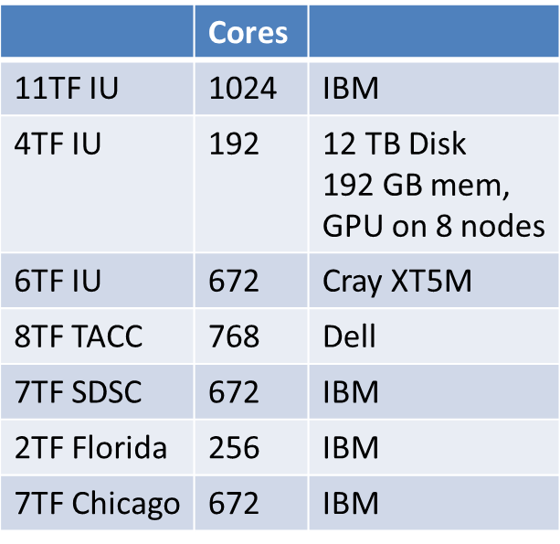
FutureGrid: a Grid/Cloud/HPC Testbed
 | Cores
11TF IU | 1024 | IBM
4TF IU | 192 | 12 TB Disk 192 GB mem, GPU on 8 nodes
6TF IU | 672 | Cray XT5M
8TF TACC | 768 | Dell
7TF SDSC | 672 | IBM
2TF Florida | 256 | IBM
7TF Chicago | 672 | IBM
NID: Network Impairment Device
Private
Public
FG Network

Slide 63
FutureGrid Partners
Indiana University (Architecture, core software, Support)
Purdue University (HTC Hardware)
San Diego Supercomputer Center at University of California San Diego (INCA, Monitoring)
University of Chicago/Argonne National Labs (Nimbus)
University of Florida (ViNE, Education and Outreach)
University of Southern California Information Sciences (Pegasus to manage experiments)
University of Tennessee Knoxville (Benchmarking)
University of Texas at Austin/Texas Advanced Computing Center (Portal)
University of Virginia (OGF, Advisory Board and allocation)
Center for Information Services and GWT-TUD from Technische Universtität Dresden. (VAMPIR)
Red institutions have FutureGrid hardware

Slide 64
5 Use Types for FutureGrid
~122 approved projects over last 10 months
Training Education and Outreach (11%)
  Semester and short events; promising for non research intensive universities
Interoperability test-beds (3%)
  Grids and Clouds; Standards; Open Grid Forum OGF really needs
Domain Science applications (34%)
  Life sciences highlighted (17%)
  Computer science (41%)
  Largest current category
Computer Systems Evaluation (29%)
  TeraGrid (TIS, TAS, XSEDE), OSG, EGI, Campuses
Clouds are meant to need less support than other models; FutureGrid needs more user support …….

Slide 65
Software Components
Portals including “Support” “use FutureGrid” “Outreach”
Monitoring – INCA, Power (GreenIT)
Experiment Manager: specify/workflow
Image Generation and Repository
Intercloud Networking ViNE
Virtual Clusters built with virtual networks
Performance library
Rain or Runtime Adaptable InsertioN Service for images
Security Authentication, Authorization,
“Research”
Above and below
Nimbus OpenStack Eucalyptus

Slide 66
Motivation: Image Management and Rain on FutureGrid
Allow users to take control of installing the OS on a system on bare metal (without the administrator)
By providing users with the ability to create their own environments to run their projects (OS, packages, software)
Users can deploy their environments in both bare-metal and virtualized infrastructures
Security is obviously important
RAIN manages tools to dynamically provide custom HPC environment, Cloud environment, or virtual networks on-demand

Slide 67
Architecture
Notes:
IM provides a unified environment to create and maintain VM and bare-metal images
Integrate images through a repository to instantiate services on demand with RAIN
Essentially enables the rapid development and deployment of Platform services on FutureGrid infrastructure

Slide 68
Image Generation
  Creates and customizes images according to user requirements
  Images are not aimed to any specific infrastructure

Slide 69
Image Deployment
Customizes and deploys images for specific infrastructures
Two main infrastructures types:
HPC Deployment
Cloud Deployment
https://portal.futuregrid.org

Slide 70
Dynamic Provisioning Scalability Test
HPC including reboot

Slide 71
Test Setup
Environments: Provision in HPC, Eucalyptus, OpenStack, OpenNebula
Image: Create CentOS5 images
  We use FG image generator
    Adapts image to kernel/ramdisk so we can deploy in various environments
    HPC: ramdisk modified by XCAT
    Eucalyptus: XEN kernel
    OpenStack/OpenNebula: General Linux kernel
  Imagesize 1.5 GB, 300MB compressed via netboot

Slide 72
Compute Infrastructure
Xeons with 8 cores, 24GB of RAM
Network 1GBps Ethernet

Slide 73
Summary – HPC
HPC
  111 machines available, we could use all of them
  linear scaling
  Due to reboot each reprovisioning takes some time

Slide 74
Summary - OpenStack
Cactus release of OpenStack (not the newest one)
Provisioning is done in batches of 10.
  E.g. 30 machines is done through 3 x provisioning of 10 images, and so forth.
  If we do not do it this way experiments failed (50%)
Caching of the images in the nodes is needed or scalability is effected significantly.
Network sometimes gets not properly created (a known problem in OpenStack)
Diabolo has additional features that are a must in scalability experiments.
Scalability was not possible beyond 64 ndes
We conclude(e.g. Gregor): Cactus out of the box is not suitable for our purposes. However, we have been able to make it work through workarounds.

Slide 75
Eucalyptus
Latest open source version 2.03
We created VMS similar to OpenStack due to the same problems noted as in OpenStack
Problematic is that Eucalyptus (in FG?) does not allow us to execute commands in quick succession (e.g. we had to wait at least 6 seconds to issue consecutive staging requests of images)
Scalability was not possible beyond 16 nodes

Slide 76
OpenNebula
We used version 3.0.0
OpenNebula does not cache images by default (we used the default setup)
We used ssh distribution of images as NFS had terrible performance problems
We were able to instantiate 148 instances with little problems.
In our experiments we observed only one fault.
Open Nebula without cache works well and is suitable for scalability experiments, however it is slow due to that. A community contribution reports that the ssh staging could be improved through caching.

Slide 77
Need for fg-rain -move
Within FG we are in need of a tool that simply moves nodes from one cloud infrastructure to another to conduct scalability experiments
  E.g. Node x at time a could be assigned to Eucalyptus, while at time b it could be assigned to OpenStack, …

Slide 78
Nimbus
Nimbus has in FG been reported to be very reliable.
We need to expand our environment towards Nimbus and conduct a similar experiment
Manpower prevented us to do this so far

Slide 79
FutureGrid in a nutshell
The FutureGrid project mission is to enable experimental work that advances:
  Innovation and scientific understanding of distributed computing and parallel computing paradigms,
  The engineering science of middleware that enables these paradigms,
  The use and drivers of these paradigms by important applications, and,
  The education of a new generation of students and workforce on the use of these paradigms and their applications.
The implementation of mission includes
  Distributed flexible hardware with supported use
  Identified IaaS and PaaS “core” software with supported use
    Growing list of software from FG partners and users
  Outreach

