Slide 1
The Past and the Future: This talk will give a broad overview, incl. role of hadrons, hadron reaction phenomenology, past achievements and future goals
2015 International Summer Workshop on Reaction Theory
Indiana University Bloomington
June 8 2015
http://www.indiana.edu/~ssrt/
Geoffrey Fox
Informatics and Computing, Physics
Indiana University Bloomington

Slide 2
(One) Purpose of Summer School
Capture what is known (and not known) about low transverse momentum scattering so it can be applied/improved in Partial Waved Analysis and Resonance searches in recent and future such as at Jefferson Laboratory
Often interesting resonances only can be produced peripherally and need an amplitude analysis to disentangle
Or
Reggeon

Slide 3
Low Transverse Momentum Scattering

Slide 4
PictureBook 1975
Interesting that my classification ignored the dominant experiments in following 30 years that focused on “hard” not “soft” low transverse momentum physics
At this time I was working on three Fermilab experiments E110, E260, E350 where I wrote most of analysis and Monte Carlo software
Around 1981 I switched to “computer science” although data analysis continued till 1984
My dream “E110” essentially failed as not enough data

Slide 5
Scattering Processes
The original Picturebook was third part of a series produced by Caltech particle physics group
  I don’t have others
I started as a theorist or phenomenologist but decided to join experiments “for real” as I though best to analyze raw events rather than let experimentalists make a model which was often different from what I would expect and then present “experimental” results based on (wrong) model

Slide 6
Amplitudes for Spinless Scattering
At this time QCD calculations were only just starting and we had no realistic expectation of calculating amplitudes from first principles
We could hope to derive some features (constraints) from first principles
S-matrix theory hoped that constraints would be enough to define a “unique” answer

Slide 7
SPIN, the Essential Complication
Spin is always present and we discussed role of polarization
Fox, G. C. and Berger, E. L., ``High Energy Physics with Polarized Proton Beams,''
Fox, G. C., ``The Importance of Being an Amplitude,”
Density matrices ρ(i,j) of especially rho mesons were used effectively

Slide 8
Quasi Two Body Reactions
I claim there are 400 such reactions in 1975 and they some disadvantages
Need to be identified from background
Complex Spin
Advantages
Some large Regge couplings e.g. Δ++ → πp which does not vanish at t=0 for π trajectory
p → π n does vanish
Resonances as bumps inspired me to do PhD in this area

Slide 9
Multiparticle Final States
I thought there were 2000 of these in 1975.
The slide references Feynman’s parton model as in
“Quantum-chromodynamic approach for the large-transverse-momentum production of particles and jets”, RP Feynman, RD Field, GC Fox, Physical Review D 18 (9), 3320 (1978)

Slide 10
Regge Theory
Observed particles lie on Regge trajectories and these control scattering in “crossed channels”
Lost papers 1969-1971
Fox, G.C., “Veni, Vidi, Vici Regge theory”,
Fox, G. C. ``Skeletons in the Regge Cupboard,''
Fox, G. C., ``π-exchange,'' in Planning for the Future, ANL/HEP-7208

Slide 11
For every World, there are two more twisted ones
π⁺ p → π⁺ p has two reactions related by “crossing”
A key feature of relativistic field theories not present in potential theories
t channel
π⁺ π⁻ → p p
u channel
π⁻ p → π⁻ p
Next slide will show in s, t, u plane with
s + t + u = 2m² + 2μ²
-

Slide 12
Let There be Regge Poles and There were and it was Good
The physical regions of the 3 related reactions described by same analytic function.
9(b) show the Regge Poles
9(a) shows key parts of scattering regions.
In bottom right of 9(a), we see s-(direct-) channel resonances for π⁺ p → π⁺ p
As s increases, the scattering is concentrated on forward and backward peaks with s behavior
dσ/d(t,u) ∝ s^{2α(t,u)-2}

Slide 13
Progression in πN Scattering
πN scattering starting at threshold
Moving to resonance region
And then settling down to a dominant forward peak and some backward peak
Nature has a range ~s in t but only uses a fraction of a (Gev/c)²

Slide 14
Regge Theory

Slide 15
Regge Theory for π⁻p → π⁰n
Regge Theory has (at least) three distinctive predictions
Shrinkage – power of s in s^{2α(t)-2} decreases as –t decreases so peaks get sharper as energy increases
WSNZ Wrong Signature Nonsense zeroes. Trajectory and amplitude vanishes at α = 0.
Factorization. Total coupling constant product of those at “top” and “bottom” vertex
Corrections due to “cuts”

Slide 16
Picture 13
The first universal success for Regge theory. Excellent data. Simple theory
Confirmed with later data
How α(t) determined at each t

Slide 17
E111 π⁻ p → π⁰ n
Best data and best success of Regge Theory?

Slide 18
E111 π⁻p → η n
No dip near t=-0.6 (GeV/c)² as predicted by theory

Slide 19
Total Cross Section Differences
Irving & Worden fig. 2.5
Δσ ∝ p_{lab}^{(α(0)-1)} as no Pomeron exchange
ρ or ω exchange term
1- α(0)

Slide 20
π⁺p π⁻p Polarizations
Irving and Worden Fig. 4A1
The π⁺p π⁻p polarizations are mirror-symmetric showing the dominance of p exchange over f exchange in the helicity-flip amplitude, and have a double zero at t = —0.5, as expected from a p pole amplitude (with WSNZ)

Slide 21
Irving & Worden fig. 2.7
Pomeron etc.
ρ
π⁻p →π⁰n
K*
np →pn
(23-63 GeV/c
π Exchange + ρ, A₂
B
Triple Regge, proton

Slide 22
Irving & Worden fig 4A2
ρ exchange
A₂ exchange

Slide 23
γ p → π⁰ p
The α_{eff} for dσ/dt
(γ p → π⁰ p)
Also shown is the trajectory of the Regge pole which is expected to dominate this process (in a helicity-flip amplitude).
The α_{eff}(t) is much more reminiscent of a pole + strong cut than of a simple Regge pole.
The feature, α_{eff}(t) ≈ 0 for -t ≥ 0.6, is common to most photo-production cross-sections.
Irving & Worden fig. 4A2

Slide 24
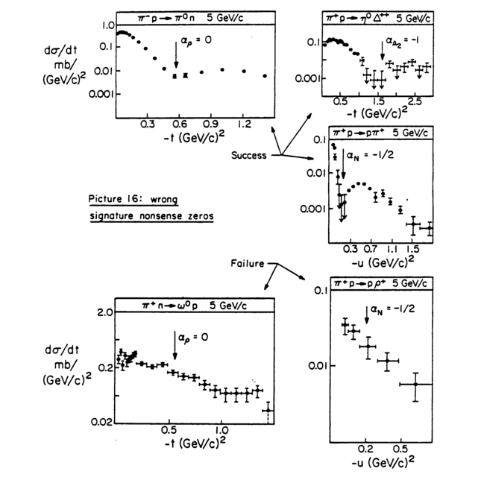

Slide 25
πN Backward Scattering
Old data πN Backward Scattering
Irving & Worden fig, 4.I4

Slide 26
2010 ReggE Fits
π⁺ p backward scattering
Nucleon Exchange with WSNZ
π⁻ p backward scattering
Δ⁺⁺ Exchange without WSNZ
√s

Slide 27
π Exchange
Regge Cuts and Problems

Slide 28
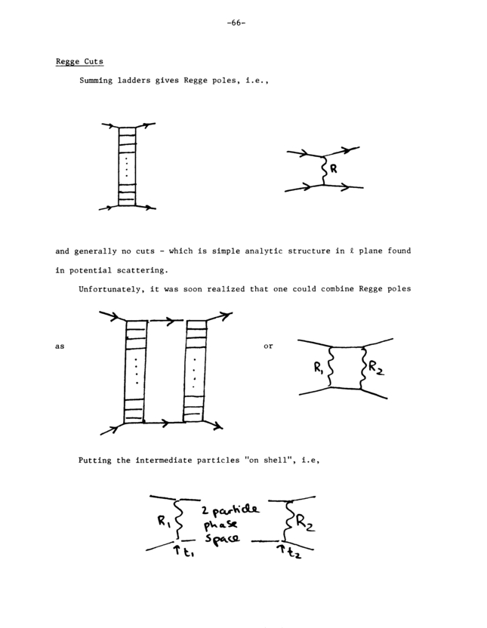
Regge Cuts
Regge Pole Cross Section s^{2α(t) – 2}
Regge Cut
α_{cut}(t) <= α₁(t₁) + α₂(t₂) – 1
α₂(t) = 1 gives simplest result α_{cut}(t) <= α₁(0)
Plenty of deviations from Regge theory but no striking successes or failures for cuts?
1
ρ Pomeron Cut
0
α_{ρ}(t)
These box diagrams may be included in dynamically generated pole. The ρ trajectory is not a Born term

Slide 29

Fermilab E110 Multiparticle SpectrOmeter
Highlights of the reaction π⁻p→π⁻π⁺n at 100 and 175 GeV/c
Nuclear Physics B232 (1984) 189-235 Cited by (only) 5

Slide 30
E260 and E110
17.2 Gev CERN

Slide 31
π Trajectory
Pretty scruffy slide standards in those days
ρ_{(0,0)} dσ/dt π⁻ p → ρ⁰ (→π⁺ π⁻) n
ρ_{(0,0)} projects out helicity nonflip (must be unnatural parity) at π⁻ → ρ⁰ vertex and always spinflip at p → n vertex
This is total Spin flip π exchange with no conspiracy issues (see later)
Special as π pole so near physical region that cross-section large
One can project out natural and unnatural parity in “helicity flip” at π⁻ → ρ⁰ vertex
Helicity flip has π and A₂ exchange and Regge cuts
Written 1980

Slide 32
E110
Natural parity
Total
Excluding special alignment and calibration runs, the first run recorded 1.058 million events from all triggers at 100 GeV/c with 280 000 events in the ππn_{T} trigger.
The second run had 1.680 million events at 175 GeV/c of which 481000 were from ππn_{T}. Final samples used for decay distributions are 10577 events at 100 GeV/c and 9895 events at 175 GeV/c
Unnatural
Parity
s Helicity 0
Unnatural
Parity
t Helicity 0
Unnatural
Parity
t Helicity 1
Unnatural
Parity
s Helicity 1

Slide 33
Irving & Worden
Fig. 4E1

Slide 34
π Conspiracy I
Problems with double spin flip amplitudes
Factorization requires full amplitude to vanish at t = 0 whereas general principles only require amplitude where there is a double spin flip to vanish e.g. (½ , ½ → -½ , -½) helicity states
π exchange data like this looks as double spin flip amplitude is just like (*) but non flip amplitudes like (½ , ½ → ½ , ½) are just what you would get from smooth AMPLITUDE approximation
Coupling Constant . (m_{π}²/m_{π}²)/(m_{π}² – t) (**)
In np → p n, π exchange is large due to nearby pole and as spin flip at BOTH vertices the Regge formula is proportional to
π p n vertex vanishes at t=0 as spin flip=0
So amplitude is
Coupling Constant . (t/m_{π}²)/(m_{π}² – t) (*)
with α_{π}(0) ~ 0
t
n
p
π
p
n

Slide 35
Fermilab np Charge Exchange
Agrees better with ρ, A₂ exchange at highest energies
See paper by Farmelo and Irving 1977

Slide 36
π Conspiracy II
You can explore these issues more clearly with π⁻ p → ρ⁰ n as you can project out rigorously unnatural parity part where π is leading trajectory
Interesting to compare with Δ production at target vertex as π p Δ does not vanish at t=0
π⁺ p → ρ⁰ Δ⁺⁺ and p p → n Δ⁺⁺
t
ρ
OK with helicity 0 ρ but naïve factorizable π exchange vanishes when ρ helicity 1 – not seen experimentally in any π exchange reaction
See E110 data
π
π
p
n

Slide 37
Irving and Worden fig 4E.2
Broken SU(3) from π exchange in π⁺p → ρ⁰Δ⁺⁺. Unknown Energy
Note unnatural parity part extracted

Slide 38
Triple Regge Theory

Slide 39
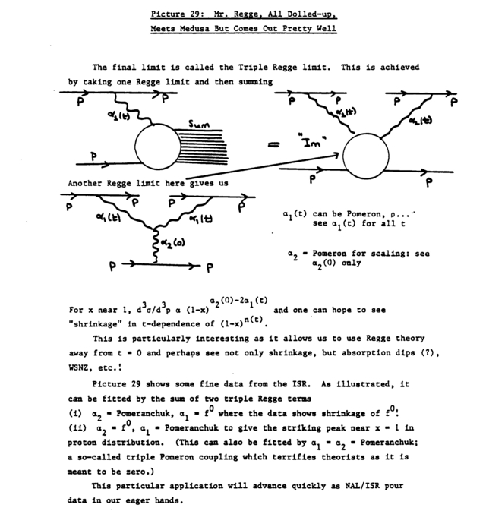
Triple Regge
Theory

Slide 40
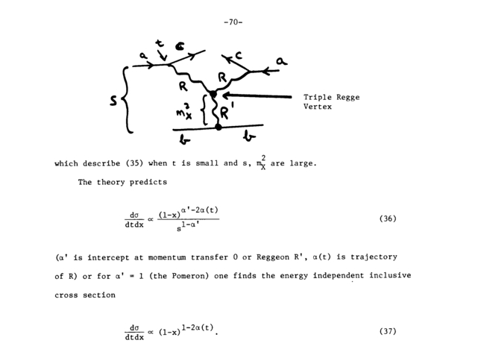

Slide 41
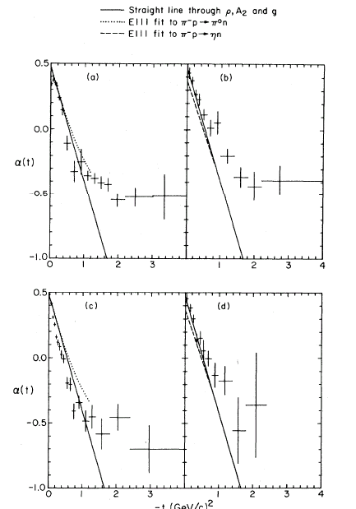
4 Triple Regge Reactions
E350
Triple Regge Theory
The cut “all” or “all neutrals” both sum ladder diagrams and one expects “all neutral Regge pole” controlling all neutral total cross section
α_{All Neutral}(0) = -0.08
π⁰X
η⁰X
π⁻
π⁻
A₂
ρ
-t
η⁰X⁰
π⁰X⁰
p
ρ
A₂
p

Slide 42
All that remains from that work are papers and a good fitting program!
aa

Slide 43
s^{-1.08} dependence in G due to all neutral pseudopole

Slide 44
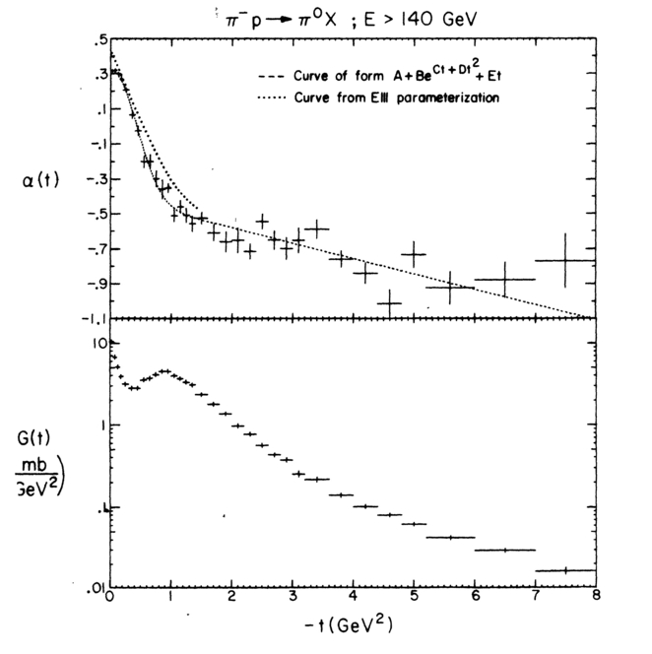
E350: Triple Regge Data
Note get good agreement with ρ trajectory from E111 π⁻ p → π⁰ n
WSNZ very clear
Extend trajectory measurement to t = - 8 (GeV/c)²
Agreement between π⁰ and η inclusive
Full and all neutral final states

Slide 45
Peripheral Partial Wave Analysis

Slide 46
Issues in Partial Wave Analysis
Goal: Extract clear evidence for resonances; determine masses, widths and their decay modes; compare with theoretical models; especially in areas that extend understanding of quark model (exotics, glueballs)
Peripheral Production should be cleanest; Goal of E110 at Fermilab but never ran for long enough!
Beam
1
s₁₂
s₁₂₃
2
s₁₃
s₂₃
3
Production
Exchange
Target

Slide 47
Some Lessons from the past I
s
t
Amplitudes exhibit many features for which there is no clear formalism that expresses in an integrated “additive” fashion
  We found a lot of “true” results but little that was quantitative
Analytic Structure as in S matrix with poles and cuts
  Poles correspond to particles and resonances
  Cuts to multiple exchanges (box and more complex diagrams)
  Need to look at all channels to get full analytic structure
Unitarity as a well understood (but difficult in multi-particle case to implement) constraint in every direct sub-channel
  Constraint only strong at low channel energy when one or a few possible intermediate states and not clearly useful in production processes
Spin formalism (Lorenz invariance) is of course well understood and uncontroversial
Field Theory (Quark Model) can suggest quantum numbers, coupling constants, symmetries, chiral limits etc.
Calculable field theories may not embody all known constraints

Slide 48
Some Lessons from the past II
Spin Formalism well understood both for full, decay, and Regge exchange amplitudes
  Extremely complex
Analytic structure of amplitudes well understood for t-channel (Jackson-Gottfried), s-channel frame helicity and transversity amplitudes
  Transversity amplitudes have nice selection rules and invariance under rotations
  But poor analyticity structure
s-channel frame has particularly good analyticity and well understood “zero” structure at t=0

Slide 49
Density Matrix or Amplitude?
Density Matrices will find dominant high spin resonances
Amplitudes are more or less essential to find anything “not immediately obvious”
  enforces rank and positivity conditions on density matrix
  have well defined analyticity properties
  But must be parameterized to reflect both unknowns and “what we know” – this bound to be wrong at some level?
  Minimize and more realistically find ways to estimate error in amplitude approximations
1
Beam
2
Reggeon
Exchange
3

Slide 50
Break Amplitude Model into 2 pieces
1) Model for Exchange
  In nearly all interesting cases exchanged particle should be a well known Reggeon (possibly the Pomeron) as these have highest intercept and will dominate in high energy region and this is only place reaction clean and distinguishable from background
  Exchange is Pomeron, ρ ω π and exchange degenerate A₂ f₂ B₁
2) Model for
Beam plus Exchange → “top vertex” final state
  This is similar (how accurate is this?) to that for case where Exchange (Reggeon) replaced by “real particle” as critical symmetry, analyticity, duality, relevant unitarity constraints are qualitatively unchanged

Slide 51
Prototypical Reaction
We are studying the sub-Reaction,
Beam + “Production Exchange” gives 1 + 2 or 1 + 2 + 3
1
Beam
s₁₂
Fast Particles
“Beam Fragments”
s₁₂₃
2
s₁₃
s₂₃
3
Production
Exchange
“Clear”
(rapidity) gap
Slow Particles
“Target Fragments”
Target

Slide 52
What do we know about Production?
Exchanged Reggeons are pretty phenomenological – mixtures of multiple poles and cuts – so exact status of a say Pomeron is not important – can use α_{Pomeron}(0) ≈ 1.0 style fits agreeing naturally with flat pp total cross section at intermediate energies
There are well understood difficulties with π exchange as a simple factorizable Regge pole (in case of helicity flip at top vertex)
  More study useful here
So we know how to do exchanges and this will be more or less accurate for overall beam momentum dependence, quark model structure of exchange, production t dependence and aspects of the exchanged Reggeon helicity structure

Slide 53
Factorization Useful?
As in Triple Regge experiments with full or all neutral, we got essentially identical dynamics from π⁻ p → π⁰ n ; π⁻ p → π⁰ inclusive ; π⁻ p → π⁰ plus any neutral
So at least in cases where clear Reggeon exchange involved, doesn’t really matter if “target vertex” reaction clean
1
2
3
Production
Exchange
Add anything you like at
bottom vertex

Slide 54
What’s the Problem Again?
The understanding of exchange part is roughly right and we will use a roughly right model in PWA
But in trying to find new resonances, we are looking at non dominant effects in
Beam Reggeon → 2 or 3 (or more) particles
How can we sure that approximations do not affect our partial wave analysis
Answer:
Beam
Need to include all important
effects and evaluate uncertainties
they cause?
Exchange
Target
Lets examine other approximations
In the
Beam Reggeon → 2 or 3 (or more) particles reaction

Slide 55
Lessons from Duality I
t(u)-channel exchanges are “classically” the forces that create the s-channel particles
Thus it is not trivially “wrong” that same effect (e.g. diffractively produced a₁) can be “explained from direct or cross channel point of view
Veneziano model illustrates this
1
3
1
3
s
is same as
t
4
2
4
2
plus
1
4
u
2
3

Slide 56
Lessons from Duality II
It appears that ρ ω A₂ f g N Δ … particles form Regge trajectories having party line characteristics
  Exchange degeneracy of mesons reflecting exotic channels
  Daughters
Presumably this extends to π B a₁ but study here could be improved
Exchange Degenerate α_{ρ} = α_{f} = α(0) + α' t
Veneziano formula for π⁻ π⁺ → π⁻ π⁺ is
A(s,t) = Г(1-α_{ρ}(s)) Г (1-α_{ρ}(t)) /Г (1-α_{ρ}(s)-α_{ρ}(t))
This has Regge poles in s and t channels, no poles in u channel and residue proportional to α(0) + α' t at α_{ρ}(s)=1
  α(0) + α' t is a mixture of spin 0 and spin 1 i.e. requires ρ + ε

Slide 57
Lessons from Duality III
Partial Wave Analyses of π N elastic scattering suggested an important additive model of two component duality
  A_{π N→ π N}(s,t,u) = A_{Particle Regge}(s,t,u) + A_{Pomeron}(s,t,u)
The classic nucleon resonances in the s channel sum to an amplitude A_{Particle Regge}(s,t,u) corresponding to the classic meson Reggeons in t channel plus classic nucleon Reggeons in u channel
The background in the s channel corresponds to an amplitude A_{Pomeron}(s,t,u) corresponding to the Pomeron in the t channel
  Pomeron component in meson scattering can be estimated from
  π⁺ π⁺ → π⁺ π⁺ ?
Regge Pole for high partial waves plus “s-channel” (resonances) guided by 2-component duality is natural model

Slide 58
Finite Energy Sum Rules
In π N elastic scattering, duality worked well to low energies as shown by for example
  Persistence of Regge zeros (such as ρ exchange zero at t = -0.6 Gev²) to low energies
  Suppression of backward peaks corresponding to nucleon and not meson exchange)
We need to convert sloppy S-matrix arguments into more precise constraints wherever possible
Finite energy sum rules FESR of form
were successful in π N scattering and should be also be applicable in Beam (Reggeon) scattering (see Indiana University work on
π⁻ p → η π⁻ p with Pomeron at p→p vertex)
A is the low energy amplitude from the partial wave analysis
Cutoff
∫
ν^{n} Im A(ν,t) dν = Regge Contribution [ ν = s-u ]
Threshold

Slide 59
Source of Error in Peripheral Partial Wave Analysis

Slide 60
Sources of Errors in PWA
We will need to study final state interactions although these are partly included as
Duality says direct (resonances) and exchange effects (forces) are the same not different dynamics
  An effect being “final state interactions” does not mean it is or is not a resonance ….
One will be looking at 2 3 and higher particle final states at the top vertex and realistically one will need the “Quasi 2-body” approximation to do a practical amplitude based partial wave analysis.
  This sometimes can be done reliably and independently in different sub-channels

Slide 61
Quasi 2-body Approximation I
The “Quasi 2-body” approximation says that π₁⁻ π₂⁻ π⁺ final state can be thought of as π₁⁻ ρ plus π₂⁻ ρ and has proven to be reliable at least when resonances are well established like the ρ which appears to have similar dynamics to “real particles” like the π
However there are subtle amplitude interference effects required by duality
Note the spin 0+ f0(600) or σ must exist by duality as daughter of ρ. It can be arbitrarily distorted by threshold effects and mixing
Examine in simpler π π scattering case
π₁⁻
}
Beam
ρ
π₃⁺
}
ρ
Reggeon
Exchange
π₂⁻

Slide 62
Quasi 2-body Approximation II
The ρ and σ must interfere coherently to suppress double charge exchange x⁻ to π⁺
ρ + σ
Dalitz Plot
π₁⁻ π₂⁻ π₃⁺
ρ + σ
π₁⁻
Depleted
m²₁₃
x₄⁻
m²₁₂
π₃⁺
ρ + σ
π₂⁻
x₄⁻ π₂⁺ → π₁⁻ π₃⁺
m²₂₃
ρ
pure ρ
ρ
t₂₃= 0
ρ + σ
u₁₂= 0
s₁₃= 0
t₂₃= 0
u₁₂= 0

Slide 63
Plan going Forward

Slide 64
Some lessons I
All confusing effects exist and no fundamental (correct) way to remove. So one should:
  Minimize effect of the hard (insoluble) problems such as “particles from wrong vertex”, “impossible to estimate exchange effects” sensitive to slope of unclear Regge trajectories, absorption etc.
Note many of effects (exchanges) are intrinsically more important in multiparticle case than in relatively well studied π N ⇨ π N
Try to estimate impact of uncertainties from each effect on results
Need systematic very high statistic studies of relatively clean cases where spectroscopy may not be most interesting issue but one can examine uncertainties

Slide 65
Some lessons II
Theory failed to provide convincing parameterizable amplitudes one could use to fit/explain data
Theory provided some quantitative constraints (π pole, unitarity, kinematics, …), many qualitative truths (two-component duality) which overlap and whose effect can be estimated with errors from 10 to 100%
Now we must take a factor of 100 or so more data to tackle problem phenomenologically
First step is to clarify and test technique
Next step is to use technique to do new physics
Put everything on the web! http://www.indiana.edu/~jpac/index.html

Slide 66
Effects to Include I
We need to develop reasonable Regge phenomenology for production amplitudes
  Update Irving, A. C.; Worden, R. P. (1977). "Regge phenomenology". Phys. Rep. 34 (3): 117–231 (Worden was my student)
Identifying reliably quantum
numbers (including naturality)
of exchanged particles
will be essential if we want to
make reliable PWA models
We do not expect previous fits
to give quantitative predictions
in many cases but good start
Beam
Exchange
Target

Slide 67
Effects to Include II
Include Regge cuts as phenomenological poles?
Spin Formalism: Must use
  Amplitude Parameterization – polarization needed with photon beams to determine the different amplitudes with different photon helicities
  With some checks using a Density Matrix Formalism – but this can’t cope with explicit contributions, analyticity etc. Only likely to show clearly “blatant” effects.
  Transversity versus helicity formalism is trade-off of analyticity versus selection rules; I always preferred helicity amplitudes

Slide 68
Effects to Include III
Regge exchange contributions within top vertex (Production Reggeon Beam Scattering) : Identify all allowed (by normal Regge phenomenology) exchanges and catalog where expected to be large due to coupling constants and/or values of α(t,u)
Use usual duality type arguments to identify related crossed channel exchanges i.e. where you might expect the direct and crossed descriptions to be related
Develop models for exchange contributions using simple phenomenological Regge theory
  Determine parameter either by fitting higher mass data or iteratively through finite energy sum rules
  Identify all π exchange contributions and expect these to be reliable (with “conspirator) near t=0 but unreliable away from there -- π as a Regge pole problematic
Use Regge exchange for high partial waves

Slide 69
Effects to Include IV
Dispersion Relations and other Analyticity
  Check FESR’s and look for zeros
  Present data and fits in a way to display effect (e.g. fixed u cross sections for reactions with no u channel exchanges) – check qualitatively reasonable
Coupled Multichannel analysis (at top vertex) is useful and could reduce parameters and check results
  but will not be as powerful as in π N case as unitarity will rarely be applicable in same fashion (as don’t have any elastic amplitudes except for case of π exchange in production case)

Slide 70
Investigate Uncertainties
There are several possible sources of error
  Unitarity (final state interactions)
  Errors in the two-component duality picture
  Exotic particles are produced and are just different
  Photon beams, π exchange or some other “classic effect” not present in original πN analyses behaves unexpectedly
  Failure of quasi two body approximation
  Regge cuts cannot be ignored
  Background from other channels
Develop tests for these in “easy” cases such as π π Scattering
  Investigate all effects on any interesting result from PWA

